Slide 1
Wide-Field Imaging I:
Full-Beam Imaging & Surveys
Steven T. Myers (NRAO-Socorro)

Slide 2
What is Wide-Field Imaging?
“Narrow-Field” Imaging:
  imaging of a single field well within Primary Beam (PB)
  able to ignore (orientation dependent) PB effects
  able to ignore non-coplanar array (w-term) effects
  this will get you far, but sometimes you need…
“Wide-Field” Imaging:
  includes non-coplanar array (w-term) effects
  includes orientation-dependent (polarized) PB effects
  includes mosaciking outside PB
  all these more complicated for wide-bandwidth imaging!
  these effects limit dynamic range & fidelity even within PB

Slide 3
Outline of this Lecture
The Imaging Equation revisited
The W-Term
The (Polarized) Primary Beam
Mosaicking 101
Imaging Techniques for Linear Mosaics
Mosaic Sampling – Hex Grids & On-The-Fly
Practical Mosaicking – Observing Preparation
Setting up your Survey

Slide 4
Interferometer Equation
Relates what we measure in a visibility k to what is on the sky and what our antennas and array are doing (no noise):
  the visibility index k encapsulates the time, antenna pair, parallactic angle, pointing direction, phase center of the observation for A
To do 2D Fourier transforms between the (l,m) and (u,v)
Write with linear operators: (includes noise term)
  v = F⁻¹ W A s + n
Data Sky Primary Beam Geometry Fourier kernel
Linear operator notation: can represent integrals or discrete matrix equations!

Slide 5
From sky to uv plane
Visibility vector v is over distinct integrations and channels.
Sky image vector s is over pixels on sky.
A is not square and is non-invertible!
Visibility equation (subsume W inside A for now):
  v = F⁻¹ A s + n
Fourier transformation of vector and matrix operators:
s = F⁻¹ s A = F⁻¹ A F
Equivalent Fourier (uv) domain equation (insert FF⁻¹):
  v = A s + n
(this is just stating the Fourier convolution theorem)
This is saying that the Fourier transform of the sky (F⁻¹s) is convolved in the uv-plane with the transform of the Primary Beam (including any geometric w-term)

Slide 6
Image Reconstruction
Visibilities and the Sky
  v = A s + n
  A known instrumental response, but is not invertible
    true uv-plane convolved by aperture cross correlation A
    has finite support (2x dish dia.) in uv-plane (not including w-term)
  A has support only where there is data in v
    incomplete sampling of uv-plane by visibilities
  instrumental noise n is a random variable with covariance N = <nn^{T}>
Maximum Likelihood Estimate (MLE) of sky:
  s_{MLE} = ( A^{T} N⁻¹ A)⁻¹ A^{T} N⁻¹ v = R⁻¹ d d = H v
  R = A^{T} N⁻¹ A H = A^{T} N⁻¹
  R singular (at best ill-conditioned) so no inversion practical

Slide 7
The Dirty Map
Grid onto sampled uv-plane
  d = H v = H s + n_{d}
  H should be close to H_{MLE}, e.g.
  H = A^{T} N⁻¹ : A ~ A N ~ N
  A^{T} should sample onto suitable grid in uv-plane
  reminder: need only be approximate for gridding = “A-projection”
    include w-term geometry A → AG = “AW-projection” (later)
Invert onto sky ➔ “dirty image”
  d = F d = R s + n_{d} R = F R F⁻¹
  image is “dirty” as it contains artifacts
    convolution by “point spread function” (columns of R) = PSF dirty beam
    multiplication by response function (diagonal of R) = Primary Beam
    noise (& calibration errors, etc.)
Use of N⁻¹ here in gridding is “natural weighting”. Other choices give uniform or robust weighting!

Slide 8
Imaging Equation Summary
Our best estimation (MLE) of the sky is
s_{MLE} = R⁻¹ A^{T} N⁻¹ v
An intermediate estimate is the dirty image
d = F H v = F H ( F⁻¹ A s + n ) = R s + n_{d}
  all the data, regardless of where the antennas and array were pointed or phase, goes into this image through H
    There is a single uv-plane
  can choose the gridding kernel H to optimize image
    e.g. H = A^{T} N⁻¹
  R is the known relation between d and s (PSF & PB)
    iterative methods (e.g. Cotton-Schwab Clean) perform well
You can store R and H for later use!

Slide 9
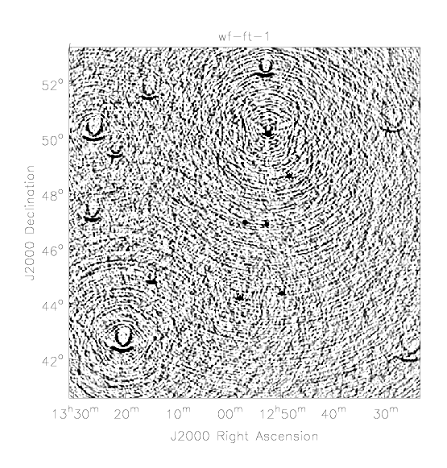
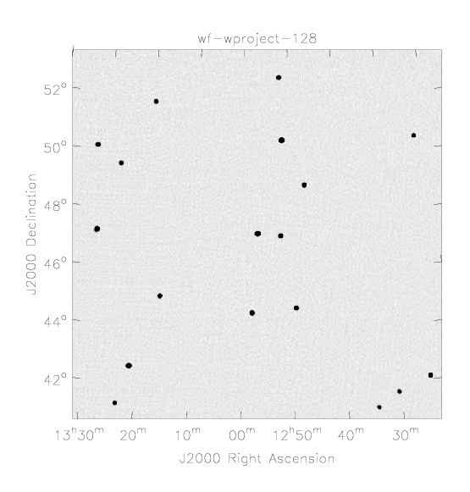
Wide-field Imaging: W-term
2D Fourier transform approximation of the imaging equation breaks down due to geometric term (“The W-term problem”)
Imaging dynamic range throughout the image is limited by deconvolution errors due to the sources away from the (phase) center.
Without w-term correction
With w-term correction (w-projection)
For the Student: Hey, these look like diffraction patterns! Is there some sort of diffraction at work here?

Slide 10
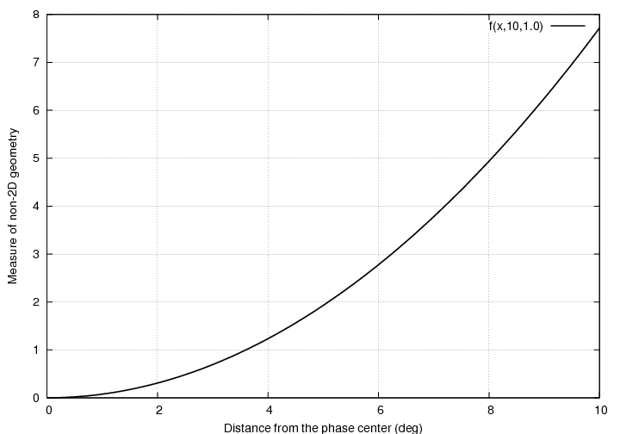
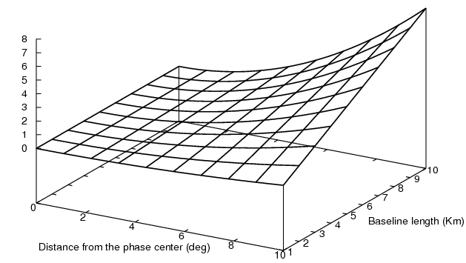
Wide-field Imaging: W-term
Deviation from 2D geometry increases with FoV and baseline length.
W-Term: convolution in the imaging equation (IE) by
For the Student:
Can W be treated as an extra Fourier transform (3D)? If so, is this a practical implementation?
Measure of non-2D geometry

Slide 11
W-term: when does it matter?
The geometric term in the IE is:
This is negligible when:
  the Field-of-View (FoV) is small:
  the array is nearly coplanar:
  duration of observations is short
    “snapshot”
Rule of thumb: ok when
Remember: Earth rotation will cause non-coplanarity of baselines in 2D array!
Ref: Chapter 19
D = Dish diameter
B_{max} = maximum baseline
Example: VLA A-config λ_{max} < 2cm (15GHz) !
VLA: D=25m
VLA configurations:
(A) 36km (C) 3.4km
(B) 11km (D) 1.0km

Slide 12



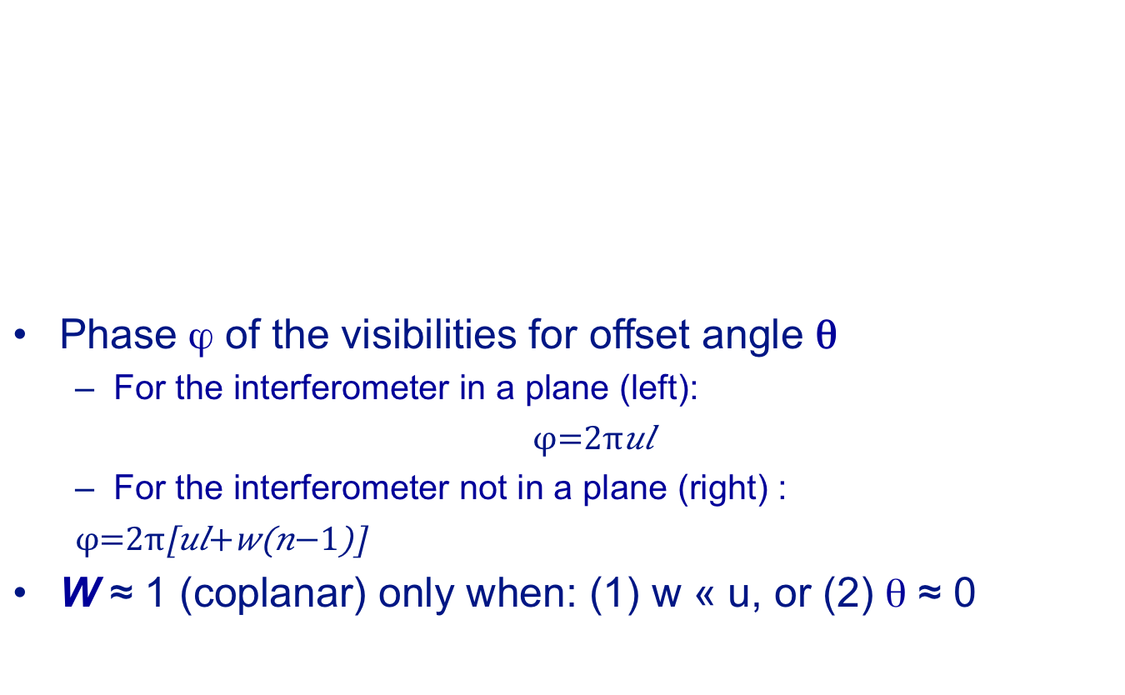
W-term: geometric picture
Phase ϕ of the visibilities for offset angle θ
  For the interferometer in a plane (left):
  $$φ=2πul$$
  For the interferometer not in a plane (right) :
  $$φ=2π\left[ul+w\left(n−1\right)\right]$$
W ≈ 1 (coplanar) only when: (1) w « u, or (2) θ ≈ 0
$$θ$$
$$θ$$
$$l=sin\left(θ\right)$$
$$n=cos\left(θ\right)$$
w
u
u
X
X

Slide 13
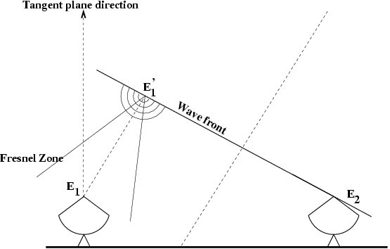
W-term: optics picture
We want to measure:
  (in wavefront tangent plane)
We actually measure:
  (in imaging tangent plane)
Propagate using Fresnel diffraction:
so
For the Student:
What is the functional form of transform W?

Slide 14
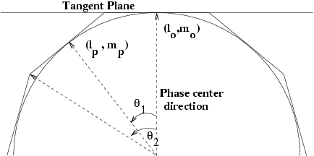
W-term: image-plane faceting
Interpret S(l,m) as emission on the surface of the Celestial Sphere of unit radius: l²+m²+n²=1
  Approximate the celestial sphere by a set of tangent planes – a.k.a. “facets” – such that 2D geometry is valid per facet
  Use 2D imaging on each facet
  Re-project and stitch the facet-images to a single 2D plane
Number of facets required:
Ref: Chapter 19
Example:
VLA A-config 1.0GHz
N>34
f=1 for critical sampling. f<1 for high dynamic range

Slide 15
W-term: uv-plane faceting
Since shifting (rotating axes on sky) and summing image facets is a linear operation, and our Imaging Equation is linear, there must be an equivalent in the uv-plane to faceting:
  C = image-plane coordinate transformation
  θ and u are the image and uv plane coordinates respectively
uv-plane faceting vs. image plane faceting
  errors same as in image plane faceting
  produces a single image (no edge effects)
  global (single plane) deconvolution straightforward
  use of advanced algorithms for extended emission possible
  can be faster in some implementations
  Note: uv-plane faceting used in CASA

Slide 16
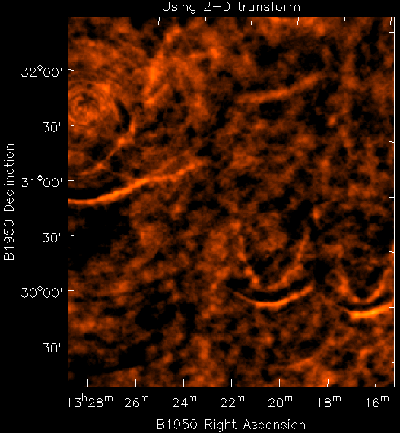
W-term: example
No correction
  W-term introduces a phase error
  dependent on distance from center of image
  dependent on baseline length and frequency (uv radius)
  characteristic arc shapes

Slide 17
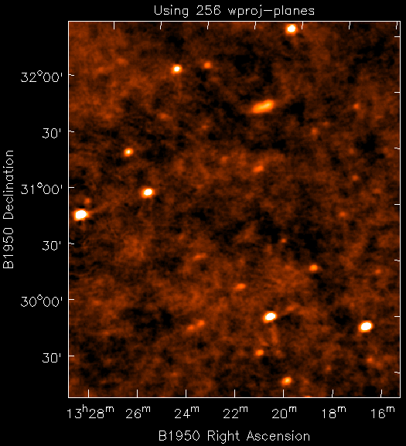
W-term: corrected!
Correction applied
  using CASA w-projection
  256 w planes

Slide 18
W-term: W-projection
Go back to our Imaging Equation (including W):
  v = F⁻¹ W A s + n
or in the uv domain:
  v = W A s + n
which implies that we image using:
  d = H v H = A^{T} W^{T} N⁻¹
(W ≈ W using Hermitian transpose, W^{T} W=1 unitary)
Gridding using the W-kernel (in the uv-plane) is called “W-projection” (see Cornwell, Golap, Bhatnagar EVLA Memo 67). This is an efficient alternative / augmentation to faceting.
Ref: Cornwell et al. IEEE Special topics in SP, Vol. 2, No5, 2008 [arXiv:0807.4161]

Slide 19
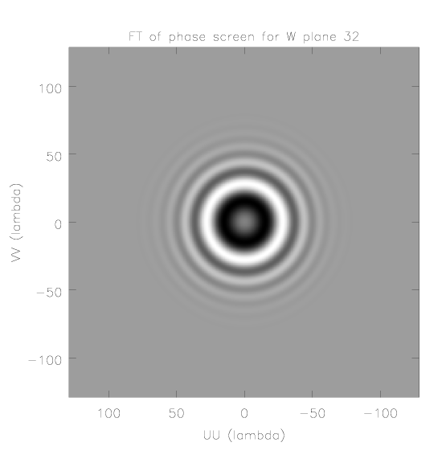
W-term: W-projection
As W is unitary and W^{T}W≈1 W^{T} and W can be used in the forward and inverse transforms to produce minimally distorted residual images as part of Cotton-Schwab (CS) clean
Vº(u,v,w) = V(u,v,0) * W(u,v,w)
Model prediction during major cycle:
  compute 2D FFT of model image → V(u,v,0)
  evaluate above convolution to get Vº(u,v,w)
  subtract from visibilites to get residual
Compute dirty residual image for minor cycle:
  use W^{T}(u,v,w) on each Vº(u,v,w) on a grid in w, sum to get V^{proj}(u,v)
  this is just a modification of normal gridding CF!
  make dirty image with 2D FFT-1 of V(u,v)
Radius of Fresnel zone:

Slide 20
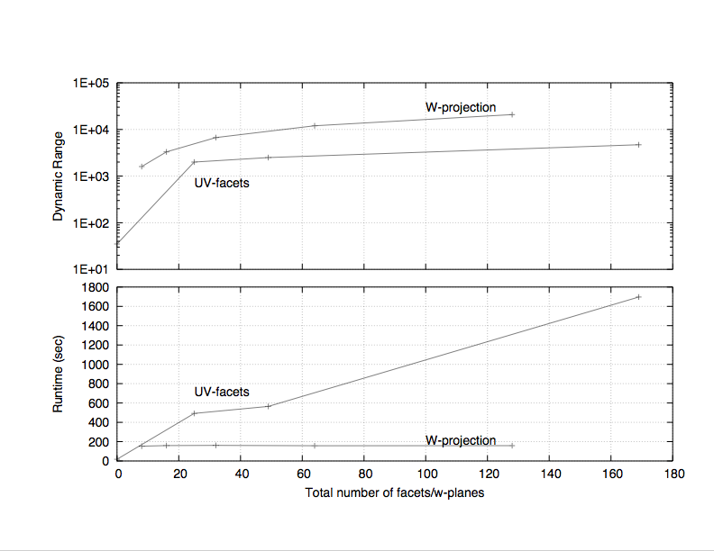
W-term: Performance
Scaling
  Faceted imaging: (N²_{fac} + N²_{GCF}) N_{vis}
  W-projection: (N²_{Wplanes} + N²_{GCF}) N_{vis}
  Ratio:
In practice W-projection works well for modest (128 or 256) number of w-planes. Best to combine with faceting for larger problems!
In practice W-Projection algorithm is about 10x faster
Size of G(u,v,w) increases with W
Ref: Cornwell et al. IEEE Special topics in SP, Vol. 2, No5, 2008 [arXiv:0807.4161]

Slide 21
Example: 2D imaging uncorrected

Slide 22
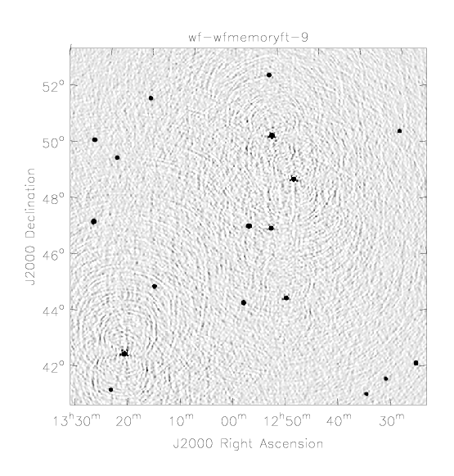
Example: 2D imaging uncorrected

Slide 23
Example: 2D imaging uncorrected

Slide 24
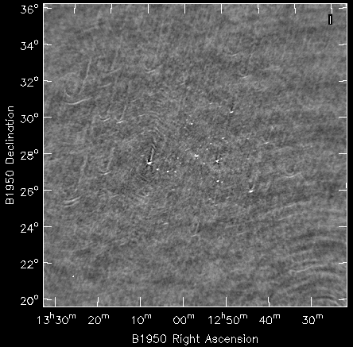
Example: VLA 74MHz before correction
Courtesy Kumar Golap

Slide 25
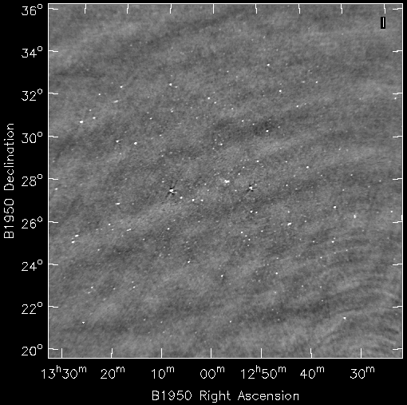
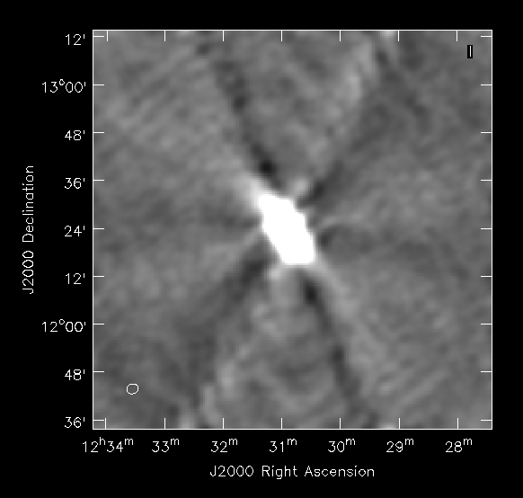
Example: VLA 74MHz after correction
Courtesy Kumar Golap
Sub-image of
an “outlier” field. This bright source should be peeled out!

Slide 26
W-term: Practical Considerations
Faceted imaging:
  number of facets in l and m
  θ = FOV (radians) σ_{w} = rms w δA = max tolerable amp loss
  N_{facets} = n_{facets} x n_{facets} , θ ~ λ/D σ_{w} ~ √w_{max} ~ √B_{max}/λ
W-projection:
  N_{Wplanes}~ N_{facets} ?? Choose 256? We are working on formula
  space w-planes uniformly in √w
Ref: Cornwell et al. IEEE Special topics in SP, Vol. 2, No5, 2008 [arXiv:0807.4161]

Slide 27
Wide-field imaging: Primary Beam
The “Primary Beam” pattern for an interferometric array (visibility from the correlation of a pair of antennas) contains effects from:
  amplitude fall-off (with characteristic FWHM or Gaussian dispersion) due to geometric mean of diffraction patterns from the antenna elements (including optics, blockage)
  phase pattern due to diffraction and optics (focus, etc.)
  polarization pattern due to optics (reflection from dish surface, feed legs, location of feed (off-axis) in focal plane, any secondary or tertiary mirrors)
  large (angle) scale sidelobes and scattered power due to surface errors (e.g. misaligned panels) [T.Hunter talk]

Slide 28
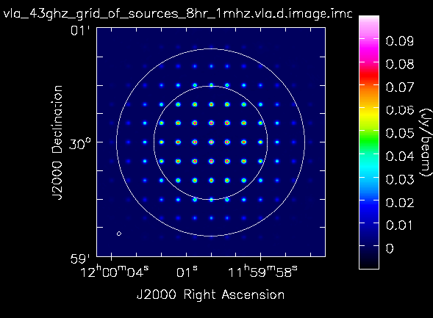
Primary Beam – responses
Example: response to a grid of point sources within the primary beam (courtesy T. Hunter):

Slide 29
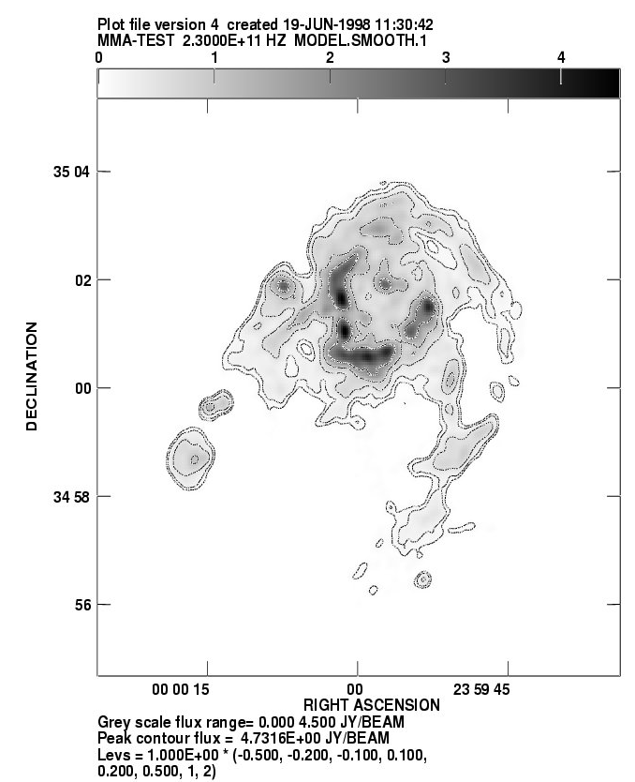
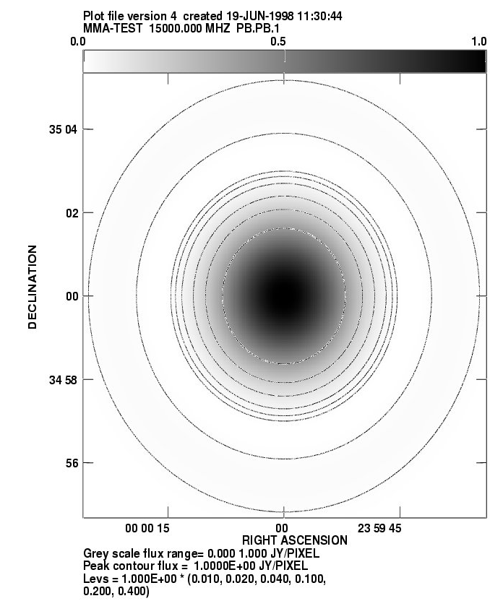
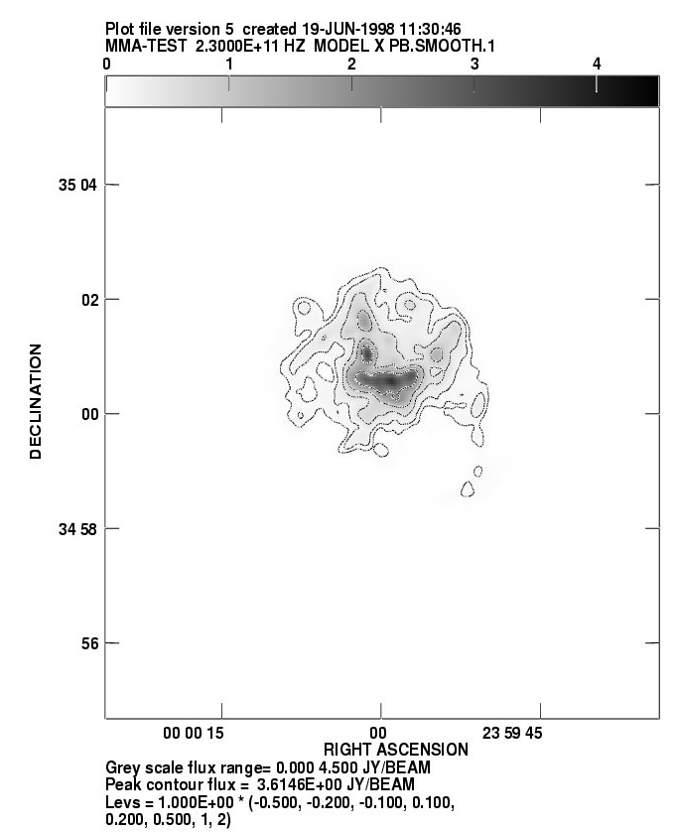
Primary Beam – example 1
CASA tip: pbcor=True during clean or divide by .flux image. Uses Airy or Gaussian beam model ☹
Primary effect – apodization of image by PB amplitude pattern
  suppression of emission far from pointing center
Emission structure larger than PB
PB sensitivity pattern on sky (circular symmetry assumed)
PB applied: sensitive to center emission only

Slide 30
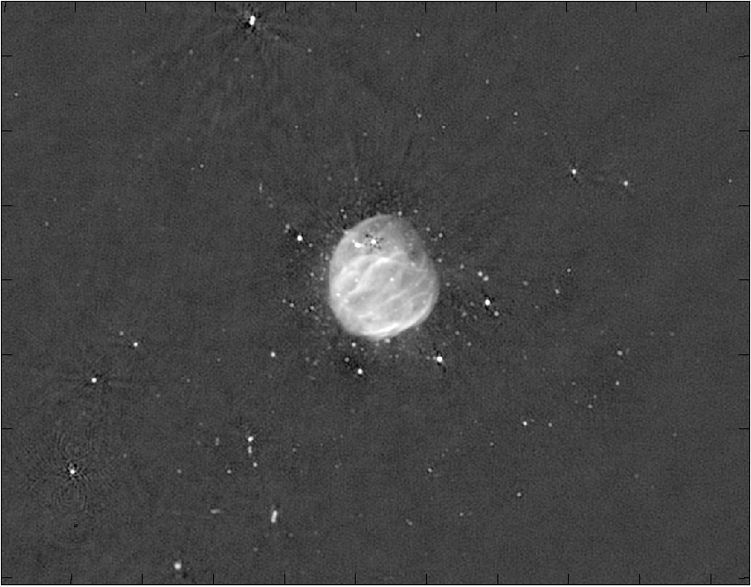
Primary Beam – example 2
another example…
EVLA Special Issue, ApJ, 739, L20, 2011

Slide 31
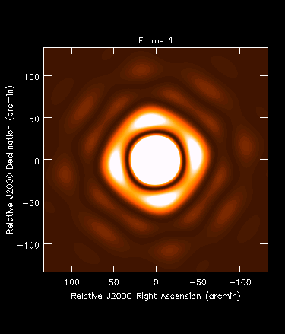
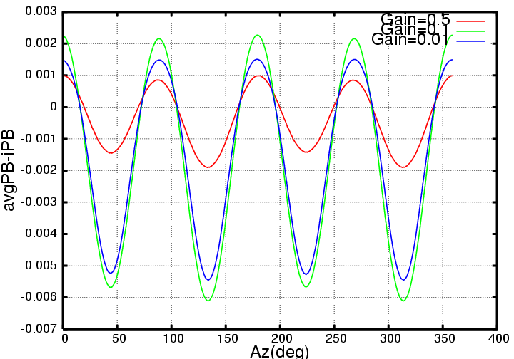
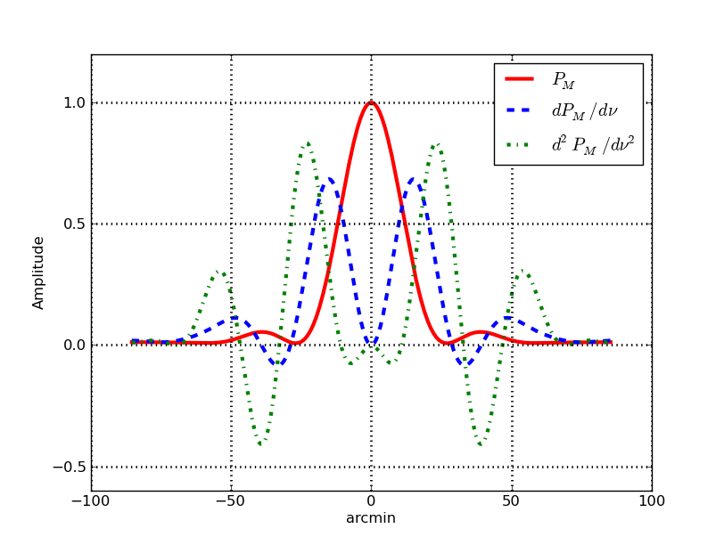
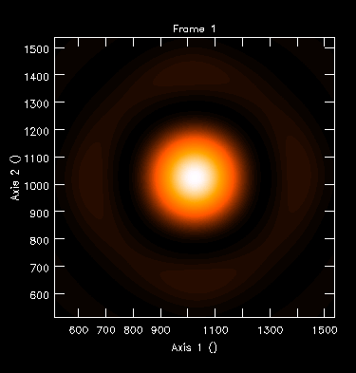
Primary Beam Time-dependence
Full-beam imaging: Antenna Primary Beam (PB) asymmetry cannot be ignored. “Sidelobe” pattern very sensitive to orientation.
For the Student:
What happens if there is a time-variable antenna-dependent pointing error?
Antenna PB = autocorrelation of voltage patterns E_{i}*E_{i}*
Visibility “vPB” = cross-correlation E_{i}*E_{j}* of voltage patterns. If not identical vPB will be complex

Slide 32
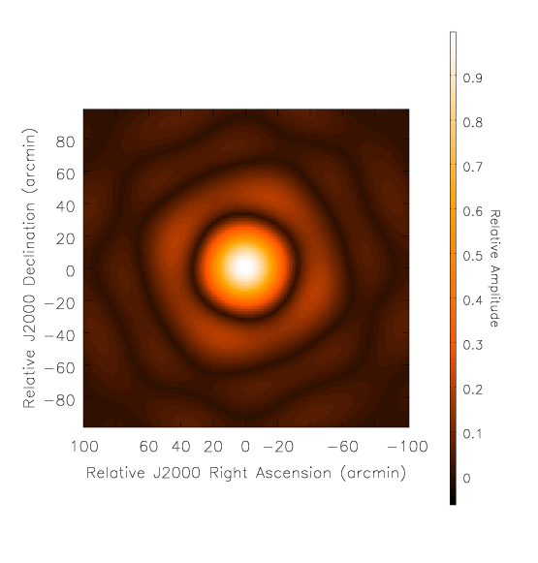
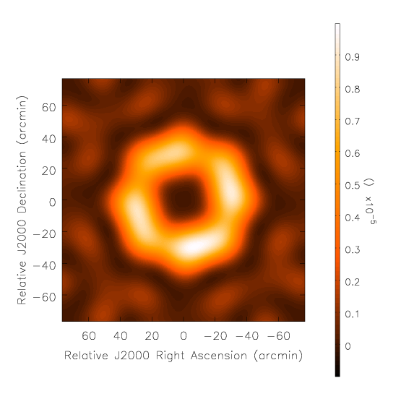
Primary Beam: Polarized
The aperture response functions have polarization dependence
  cross-correlation of complex antenna voltage patterns (R,L or X,Y)
Parallel Hand Pattern: A^{RR}
Cross Hand Pattern: A^{RL}
Imperative – you MUST correct (at some level) for (polarized) primary beam effects during imaging if you want accurate wide-field images!

Slide 33
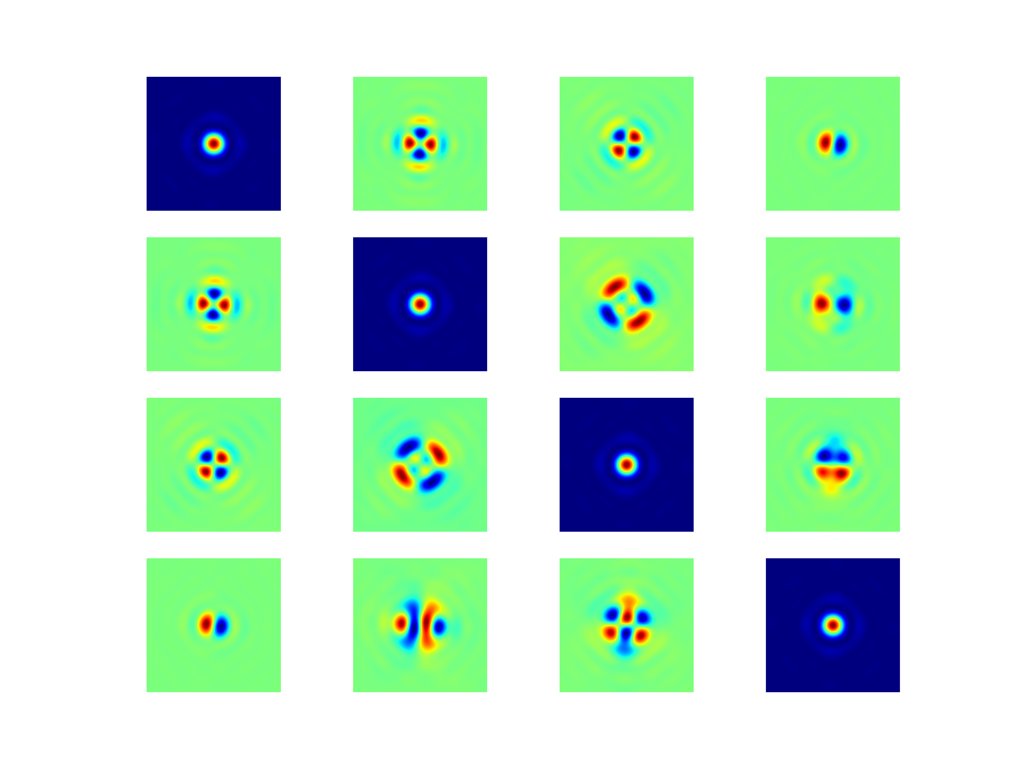
Primary Beam Mapping
For the Student:
What do the leakages QI UI VI imply?
Now underway for JVLA (Perley, Cotton, Jagannathan)
I
Q
U
V
IV leakage showing R/L squint.
This row: II IQ IU IV
Q and U get quadrupolar patterns of induced cross-polarization. Note purity is good on-axis (after calibration).
“Squint”: Due to VLA feeds off-axis on feed ring, R and L are displaced (phase gradients in X and Y). This causes apparent V signature in unpolarized sources!
Direction-dependent. Must correct during imaging.
Mueller matrix (IQUV) showing leakages in L-band. Data taken this past weekend!

Slide 34
Primary Beam Summary
The primary beam response of the antennas in the array must be corrected for during imaging to get accurate intensities (and polarizations) for source outside the core of the beam.
Due to various optics effects, the primary beam is asymmetric and rotates with respect to the source as the sky rotates (in parallactic angle).
During imaging can be corrected approximately in gridding (A-projection) and accurately in de-gridding (major cycles).
Accurate time-dependent beam correction is expensive!
The primary beam structure depends on frequency, so wideband imaging is harder (see Wide Bandwidth Imaging lecture by Urvashi on Monday!)

Slide 35
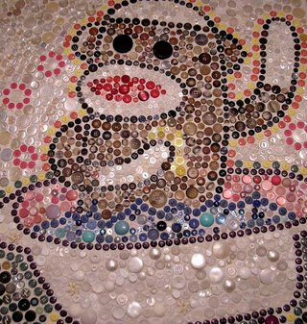
Mosaicking
Accurate imaging of emission covering areas larger than the primary beam requires the combination of multiple pointings. Example: Large area sky surveys
This is called “Mosaicking”
Simple mosaicking captures the distribution of compact structures (each << primary beam in size) = panorama
If you have good measurements on the shortest baselines (which probe the center of the uv-plane) then mosaicking can reconstruct spacing on sub-aperture scales!

Slide 36
Mosaicking Options
Classic – Linear Image-plane Mosaicking
  Form separate images from each pointing (using normal clean), then form weighted sum with PB correction to form larger image. Example: NVSS and FIRST
Modern – Joint Deconvolution
  Linear: At minor cycles form linear mosaic of residual images.
  Gridded: Use Fourier shift theorem to combine pointings in the uv-plane during gridding (A-projection) with application of the phase gradient from phase center offsets of each pointing. Example: CBI (Myers et al. 2003)
of course there is a third path…
Post-modern – use Joint Mosaicking for subsets of nearby pointings, and Image plane Mosaicking to combine sub-mosaics.
  Combine with “peeling” of sources outside of beams.

Slide 37
Linear Mosaicking
Form a linear combination of the individual pointings p of the individual deconvolved images I_{p} on a pixel by pixel basis
Here σ⁻²_{p} (diagonals of N⁻¹) is the inverse noise variance of an individual pointing and A(m) is the primary response function of an antenna (primary beam)
W(m) is a weighting function that suppresses noise amplification at the edge of mosaic
This linear weighted mosaic can also be computed for the residual dirty image at minor cycles to carry out a joint linear mosaic deconvolution.

Slide 38
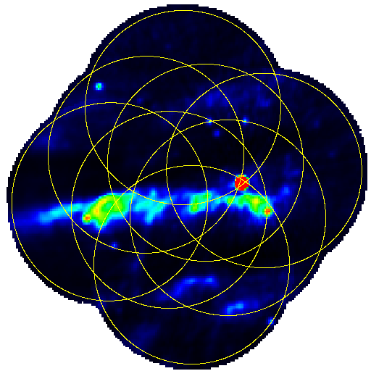
Linear Mosaic – observe pointings

Slide 39
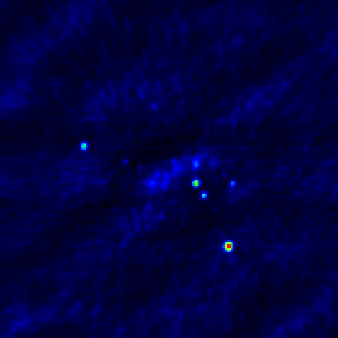
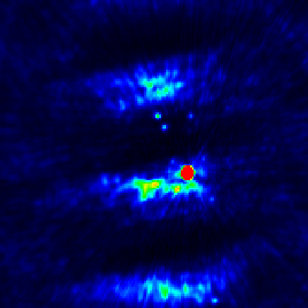
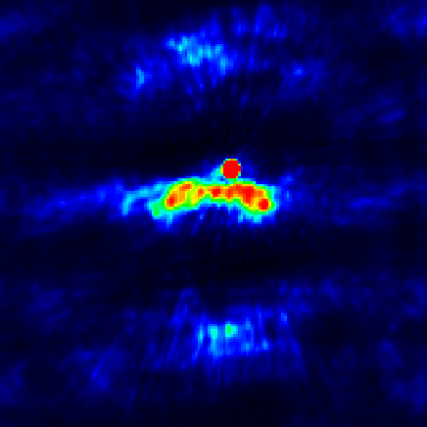
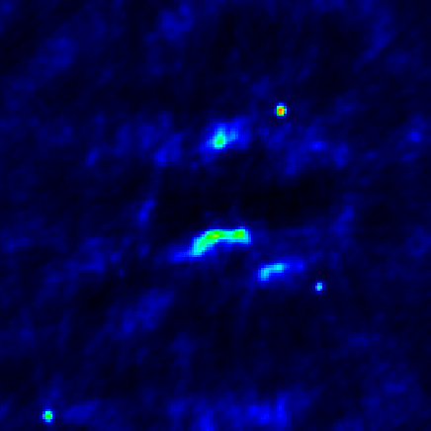
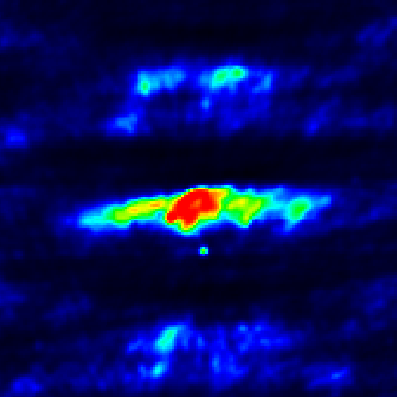
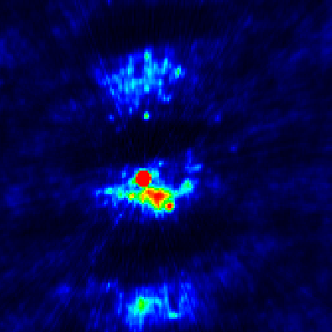
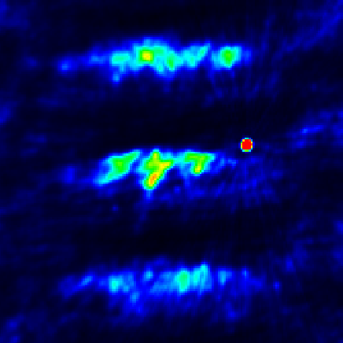
Linear Mosaic – individual images
Treat each pointing separately
Image & deconvolve each pointing
Stitch together linearly with optimal pointing weights from noise and primary beam

Slide 40
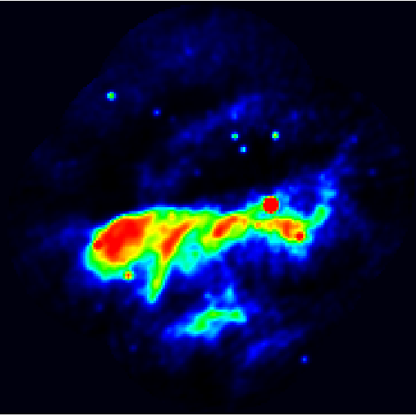
Linear Mosaic – combine pointings

Slide 41
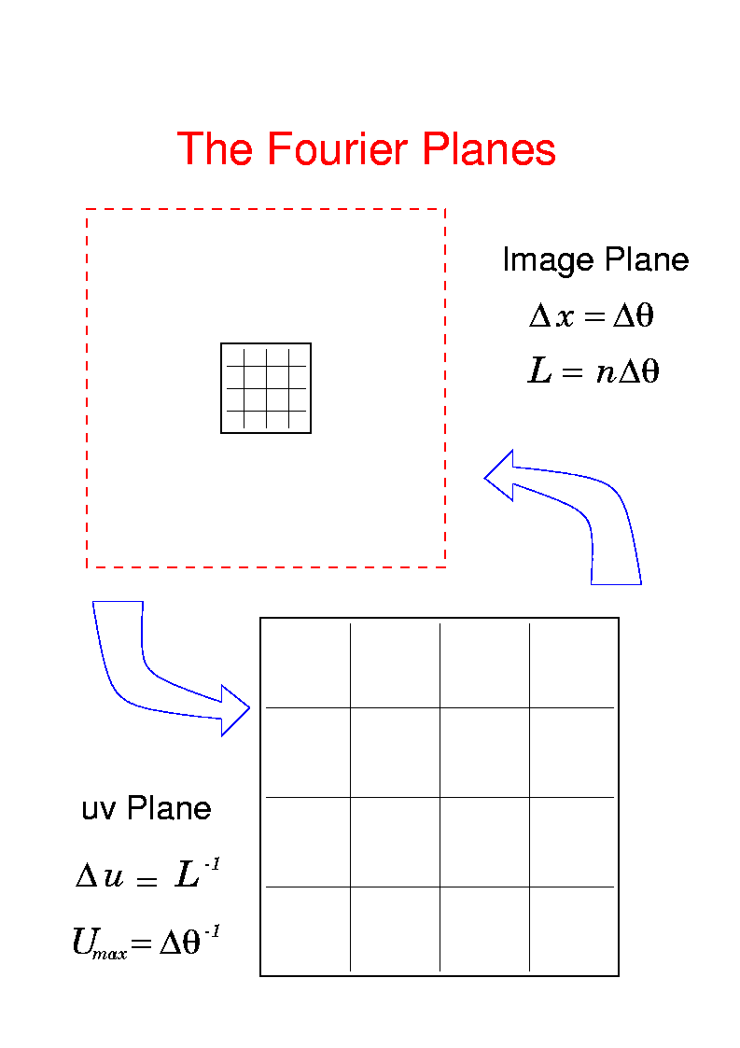
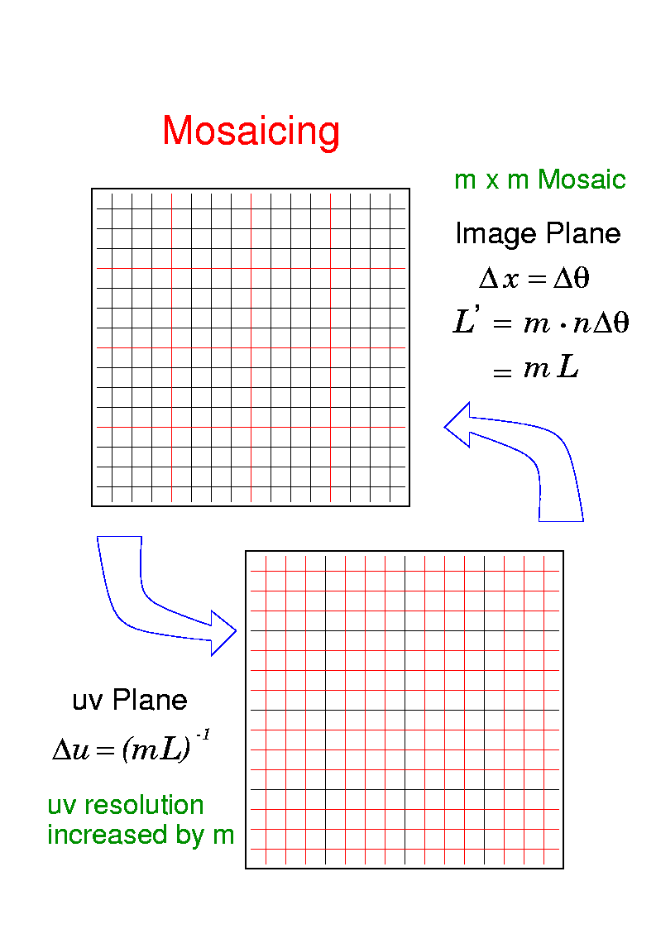
Mosaicking 101
Ekers & Rots (1979) – mosaicking can synthesize short spacings. Effectively is a FT of the mosaic grid.
Mosaicking in the image and uv domains:
offset & add
phase
gradients
Mosaicking increases resolution in ALL parts of the uv-plane!

Slide 42
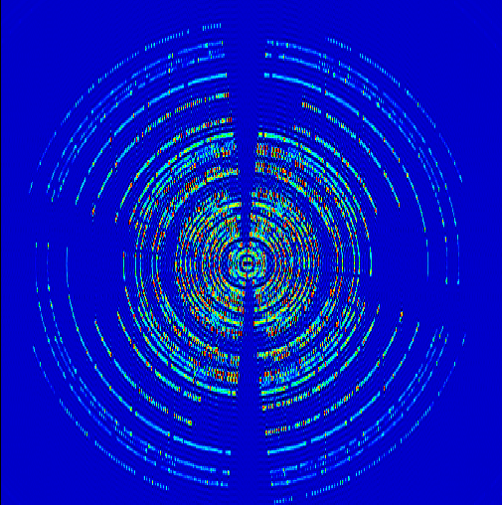
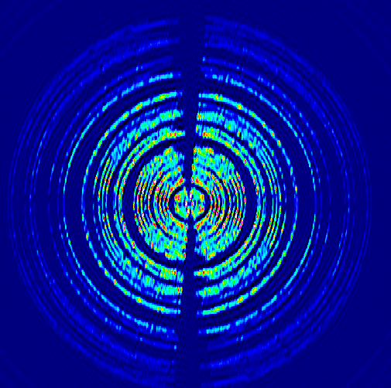
Mosaicking and the uv-plane
No Ekers-Rots
Ekers-Rots

Slide 43
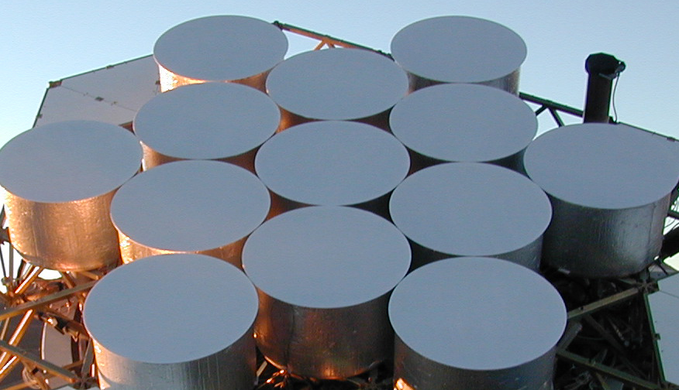
The Aperture Plane
See “Widefield Imaging II” tomorrow (Brian Mason) for more on recovery of short spacing information.
CBI
visibility contains range of baselines from
closest to furthest parts of apertures
each point on aperture
gets correlated with each
point on other aperture
autocorrelations
measure uv spacings inside D/λ
interferometer cannot measure “zero-spacing” w/o autocorrelations

Slide 44
Mosaicking Options – comparison
Individual Deconvolution, Linear Mosaic:
  Disadvantages:
    Deconvolution only possible to depth of individual pointing
    Overlap regions rather noisy when not drastically oversampled
  Advantage:
    Each pointing can be treated and calibrated separately for best results. Can be an advantage for high-dynamic range imaging where calibration effects need to be treated with great care. Easy to integrate with “peeling”.
Joint (Gridded) Approach:
  Advantages:
    Uses all uv info per overlap → better sensitivity & beam
    More large-scale structure due to PB convolution in uv-plane
  Disadvantages:
    Requires a good model for the primary beam response
    WA-projection can be expensive

Slide 45
Mosaicking - equations
Use our Imaging Equation
  Visibility k for the phase center φ and pointing center p where A is the primary beam pattern (ignoring w)
  express convolution integral in uv-plane (shift theorem)
This tells you how to apply the phase offsets and gradients from the pointing and phase centers – these centers are not necessarily the same in a mosaic!

Slide 46
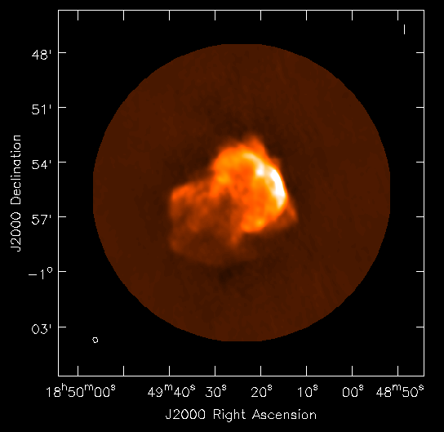
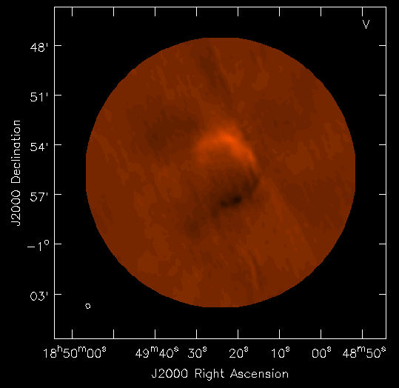
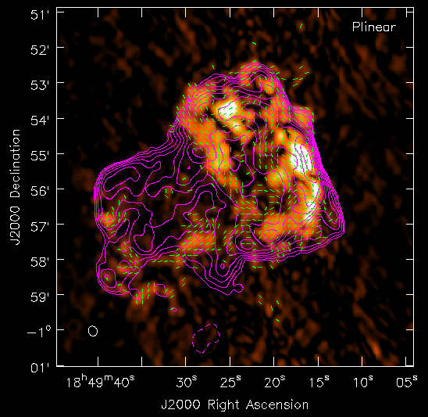
Mosaicing – joint imaging example
From JVLA casaguide for Supernova Remnant 3C391 at 4.6GHz:
Stokes I image showing
extended SNR emission.
Stokes V image showing
artifacts from R/L squint.
Linear polarization vectors, on-axis leakage corrected.
Hexagonal mosaic, 7 pointings. FWHM is 9.8’ at 4.6GHz.

Slide 47
Mosaicking Limitations
Your ability to combine observations from different pointings is limited by your knowledge of the primary beam pattern(s)
Denser field sampling gives more uniform coverage, but requires more processing for imaging.
If you use fields taken with different uv-coverages (e.g. observed at different hour angles) then the PSF will vary over the mosaic (it will be a weighted sum of field PSFs).
Flagging can cause unanticipated gaps and variations across the mosaic.
Bright sources can cause problems for “nearby” fields, self-calibration can help, and possibly “peeling”
Pointing errors will induce errors into mosaic (via PB).

Slide 48
Mosaicking in CASA
Calibrate as you would do for a single pointing (e.g. pipeline)
Use the clean task with your favorite parameters
In imagermode use ‘mosaic’
  Use ftmachine=‘ft’ for joint linear deconvolution, ‘mosaic’ for the joint gridded imaging (preferred, faster)
  will always use Cotton-Schwab (major/minor cycle) algorithm
  Use psfmode=‘clark’ (default) or ‘hogbom’ (for poor psf)
  Fill in ‘multiscale’ parameters (scales) for MS Clean
Linear mosaicking of cleaned images only available from the CASA toolkit (im.linearmosaic) currently. [AIPS FLATN]
Contributed tasks for mosaicking field setup (makeschedule)
  also check ALMA OT and JVLA OPT (e.g. for OTF)

Slide 49
Practical Mosaicking
So you want to mosaic over a large area?
What field center pattern to use?
How often to come back to a individual pointing
Slew time of Antennas
Change of atmospheric conditions
For more information, see the Guide to VLA Observing section on mosaicking:
https://science.nrao.edu/facilities/vla/docs/manuals/obsguide/modes/mosaicking

Slide 50
Practical Mosaicking – pattern
Different ways to lay out the field centers on the sky:
“Nyquist” sampling:
lower sensitivity at interstices
Rectangular grid
Hexagonal grid
Minimum “Nyquist” for structure information recovery
Most efficient coverage with minimal non-uniformity (centers on equilateral triangles). Preferred!

Slide 51
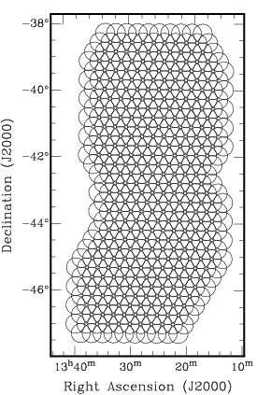
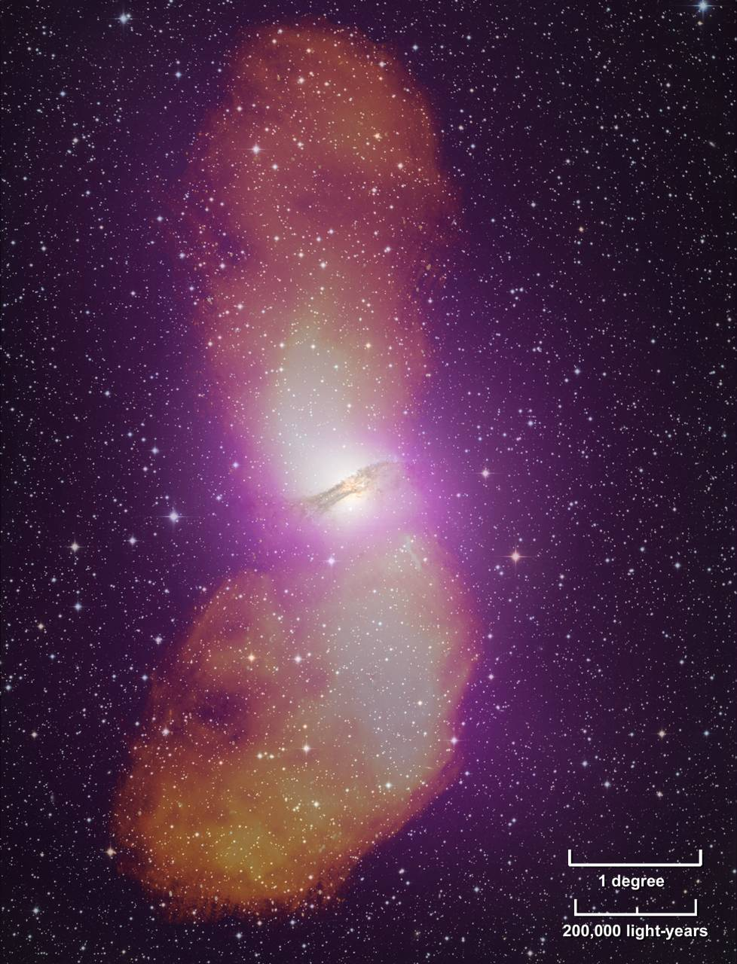
Example: Centaurus A – 406 pointings
Feain et al. 2011

Slide 52
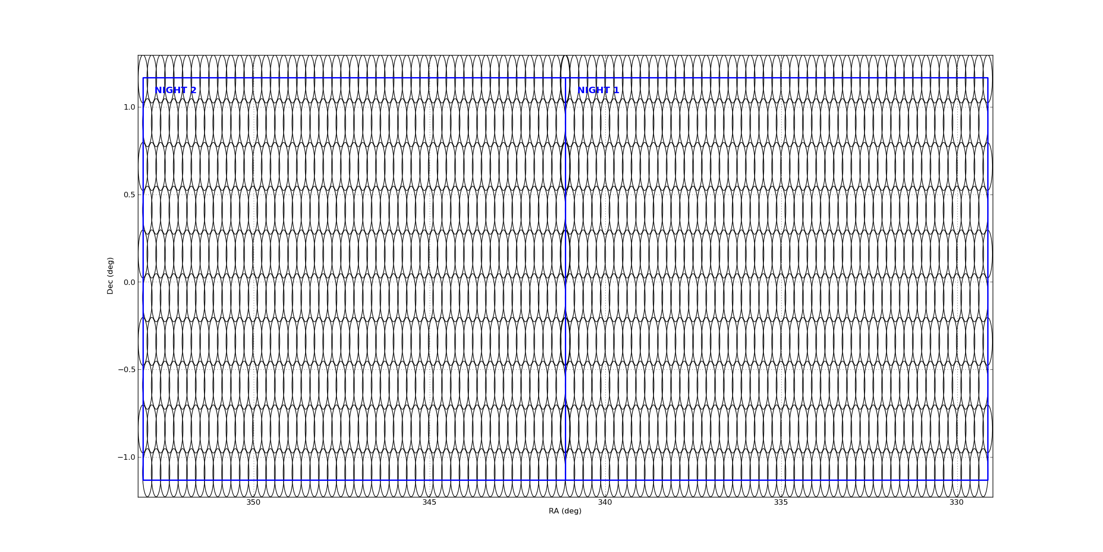
Example – JVLA 2-4GHz Stripe82
Mooley, Hallinan, et al. (Caltech) – 50 sq.deg. pilot, B-config
Hexagonal mosaic with 970 pointings (makeschedule)
Observed in 3 epochs. Coadded rms 50 μJy

Slide 53
Practical Mosaicking: Antenna Slew
Telescope slew times are calculated by:
  Acceleration
  Constant Slew velocity
  Deceleration
  Settling time
Some telescopes may have variations in Az and El
JVLA: acceleration: 2.2 deg s⁻², slew rate: 20 deg min⁻¹ in El, 40 in Az
  Settling time: around 6-7s min, ~1-3s shorter in El, longer in Az
ALMA: acceleration: 24 deg s⁻², slew rate 180 deg min⁻¹ in El, 360 in Az = super fast!
Good news! An Antenna Control Unit (ACU) upgrade has started on the JVLA . This will give us better control and greatly reduce settling times!
accel
slew
decel
settle

Slide 54
Practical Mosaicking: Time is your Enemy
The water vapor content of the atmosphere can change on small timescales
In particular there can be large variations in individual cells
  Changing sky brightness
  Changing opacity
  Increased phase noise
Delay variations due to ionosphere are possible at low frequencies
→ Try to cover the full mosaic fast but more frequently
This will make the map (and uv-coverage) more uniform, but it can increase your overhead

Slide 55
Other Patterns
On-The-Fly (OTF) Interferometry – continual scanning
Sub-Nyquist sampling
OTF
Non-Nyquist
Antenna scan does not stop, fast dumping of data, influences the primary beam shape, produces lots of data but reduces overhead
Fast sky coverage, non-uniform

Slide 56
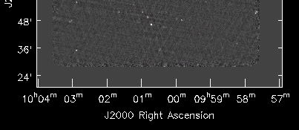
On-the-fly (OTF) scanning
Available for JVLA (currently shared risk) and ALMA
JVLA Atomic element: “OTF Scan” of length Duration in time
  StartPosition (RA,Dec) → EndPosition (RA,Dec)
    COSMOS Field example: 2 square degrees = 85’x85’
    COSMOS 6GHz : 85’ in 150sec = 34”/sec (2x sidereal)
  Usually scan at fixed Dec, weave in RA alternate stripes
    Step phase center every N_{int} integrations (or fix at stripe center)
    Scan stripes FWHM/√2 separation (at ν_{max}) for uniformity
Efficiency: taking data while scanning, no overhead.
Go to calibrator when needed (between stripes).

Slide 57

OTF Now – VLA COSMOS 6GHz C-config
C-config C-band OTF
  3200x3200 2” cells
  8bit 2GHz, 84μJy rms
  <30m on-src
  Now: simple linear mosaic after clean of each 4s “field” (CASA)
  Striping/defects: RFI, missing data, unboxed cleaning, spectral index
COSMOS field
13A-362 (Myers)
C-band 1hr SB
4.2-5.2 + 6.5-7.5GHz
2 square degrees
OTF scans in RA
432 phase centers
Repeat bi-monthly.

Slide 58
OTF Surveys
We are crazy enough to do this! The VLA Sky Survey (VLASS) is being planned. See
https://science.nrao.edu/science/surveys/vlass
Goal: Cover a fixed area Ω to a rms image sensitivity σ
  how long does it take? how many pointings? what scan rate?
  effective beam area (area under square of beam) Ω_{B}=0.5665θ²_{FWHM}
  example: JVLA 3GHz (15’ FWHM) Ω_{B} = 0.0354 deg²
    34000 deg² (full sky from VLA) will have 960282 beam areas!
  use JVLA exposure calculator for integration time t_{int} to reach σ
    2-4GHz (1500MHz bandwidth) σ=100μJy gives t_{int} = 7.7sec
    survey speed SS = Ω_{B}/t_{int} = 16.5 deg²/hour (or arcmin²/sec)
    our full-sky survey will need 7.4Msec = 2054 hours integration
  stripe (row) spacing FWHM/√2 (at 4GHz) θ_{row} = 7.96’
    scan speed SS/θ_{row} = 2.1 arcmin/sec (0.19 FWHM/sec at 4GHz!)
    need 0.5sec integrations to minimize PB smearing in integration
  change phase center every ~7sec = 1 million phase centers!
https://science.nrao.edu/facilities/vla/docs/manuals/obsguide/modes/mosaicking

Slide 59
Summary
Imaging of fields larger than the central area of the primary beam requires attention to special issues
  determined by imaging equation
  non-coplanar array geometry (W-term)
  (polarized) primary beam pattern (optics)
Carrying out sky surveys or accurate observations of fields and structures larger than the main beam of the array requires multiple pointings of the array, which are combined in imaging using Mosaicking
  linear and/or joint mosaic deconvolution algorithms
Carrying out mosaicking requires control of antenna motion and correct calculation of fields and integration times.

Slide 60




The End?
1025 pointings

Slide 61
References for W-term & PB
Interferometry and Synthesis in Radio Astronomy, 2nd Ed.: Thompson, Moran and Swenson
Synthesis Imaging in Radio Astronomy: II – The “White Book”
W-Projection: IEEE Journal of Selected Topics in Signal Processing, Vol. 2, No. 5, 2008
A-Projection: A&A, 487, 419, 2008 (arXiv:0808.0834)
Scale sensitive deconvolution of astronomical images: A&A, 426, 747, 2004 (astro-ph/0407225)
MS-Clean: IEEE Journal of Selected Topics in Signal Processing, Vol.2, No.5,2008
Advances in Calibration and Imaging in Radio Interferometry: Proc. IEEE, Vol. 97, No. 8, 2008
Calibration and Imaging challenges at low frequencies: ASP Conf. Series, Vol. 407, 2009
High Fidelity Imaging of Moderately Resolved Source; PhD Thesis, Briggs, NMT, 1995
Parametrized Deconvolution for Wide-band Radio Synthesis Imaging; PhD Thesis, Rao Venkata; NMT, 2010
http://www.aoc.nrao.edu/~sbhatnag
NRAO Algo. R&D Page: https://safe.nrao.edu/wiki/bin/view/Software/Algorithms/WebHome
Home pages of SKA Calibration and Imaging Workshops (CALIM), 2005, 2006, 2008, 2009
Home Pages of: EVLA, ALMA, ATA, LOFAR, ASKAP, SKA, MeerKat

Slide 62
References for Mosaicking & Surveys
Interferometry and Synthesis in Radio Astronomy, 2nd Ed.: Thompson, Moran and Swenson
Synthesis Imaging in Radio Astronomy: II – The “White Book”
A-Projection: A&A, 487, 419, 2008 (arXiv:0808.0834)
A Fast Gridded Method for Mosaicking of Interferometer Data: ApJ, 591, 575-598 (2003); astro-ph/0205385
Ekers & Rots 1979 : http://adsabs.harvard.edu/abs/1979ASSL...76...61E [arXiv:1212.3311]
https://science.nrao.edu/facilities/vla/docs/manuals/obsguide/modes/mosaicking
NVSS: Condon, J. J. et al. 1998, AJ, 115, 1693.
  http://www.cv.nrao.edu/nvss/
FIRST: Becker, R. H., White, R. L., & Helfand, D. J. 1995, ApJ, 450, 559
  http://sundog.stsci.edu/top.html
VLASS: https://science.nrao.edu/science/surveys/vlass

