Slide 1

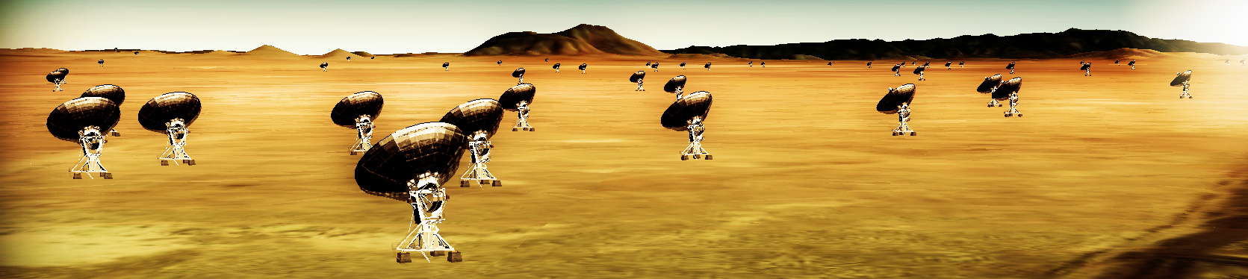
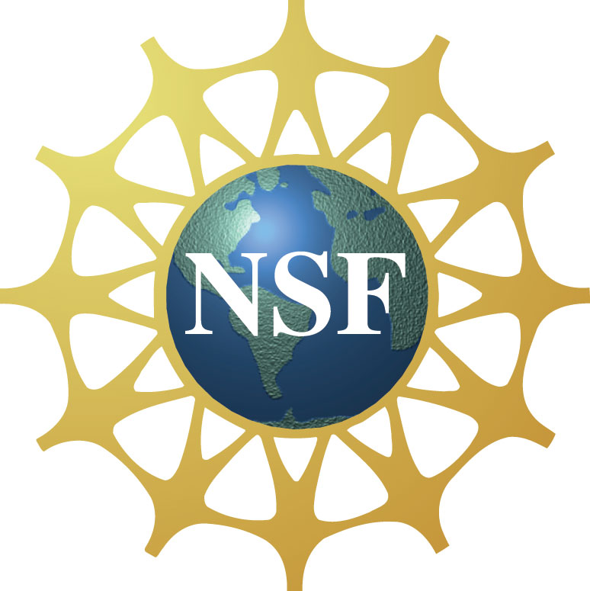

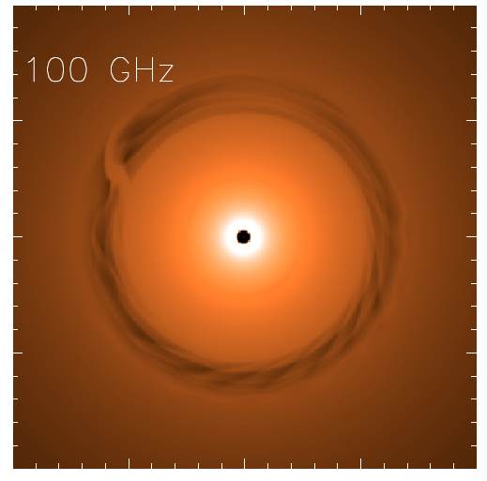
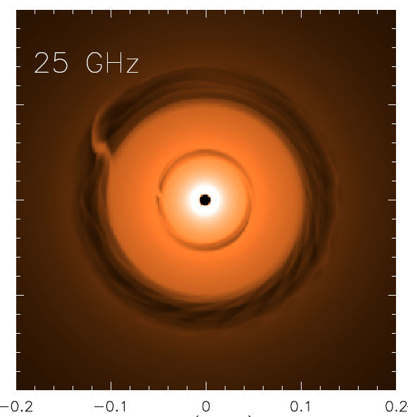
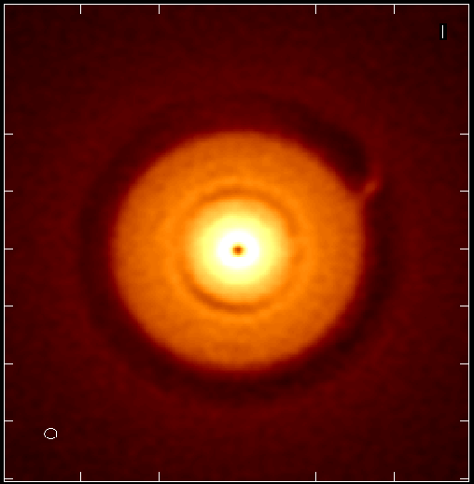
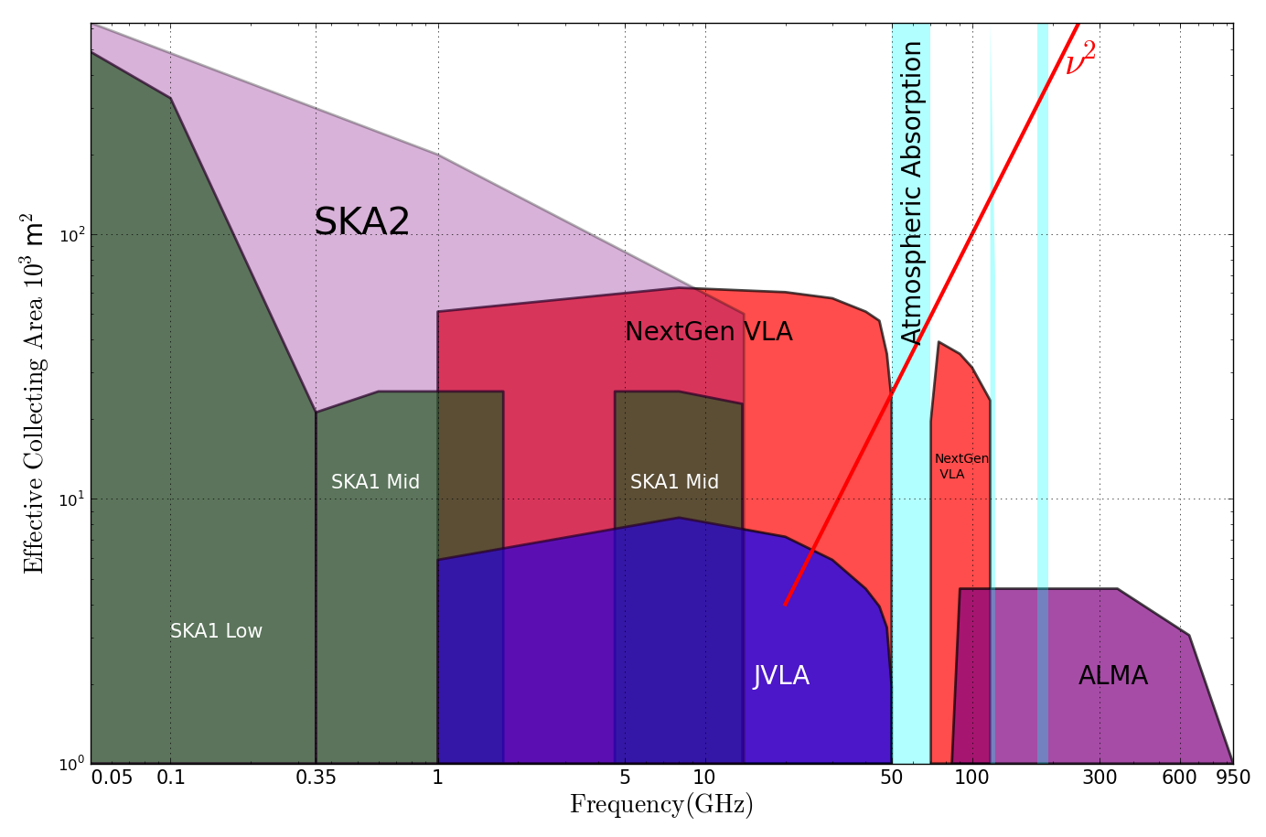
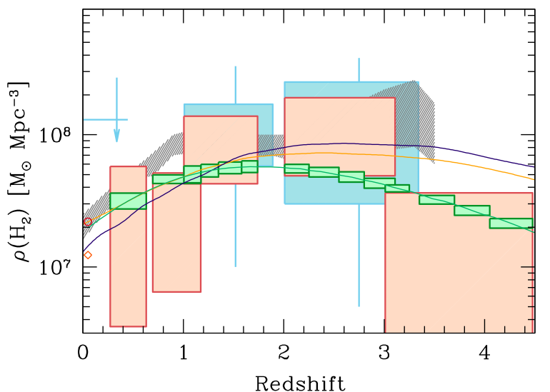
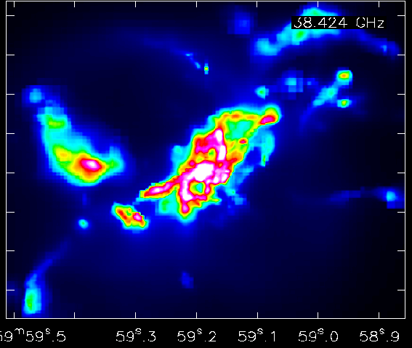
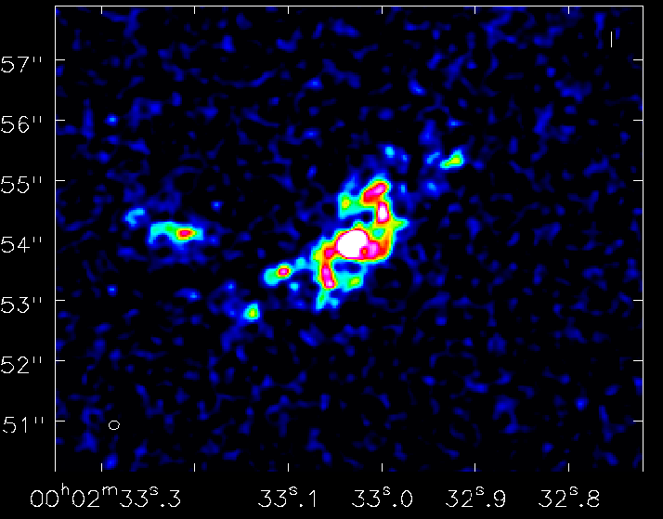
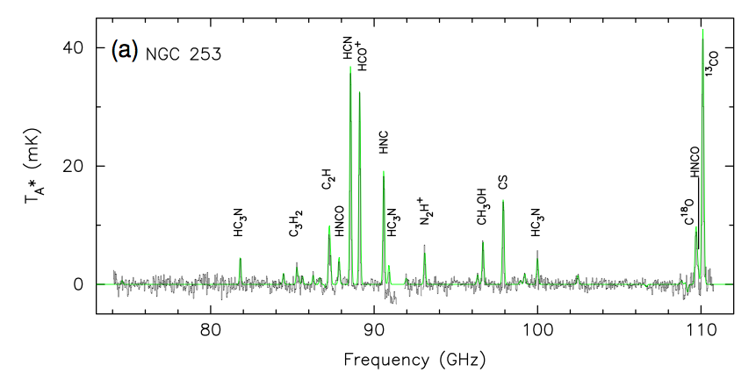
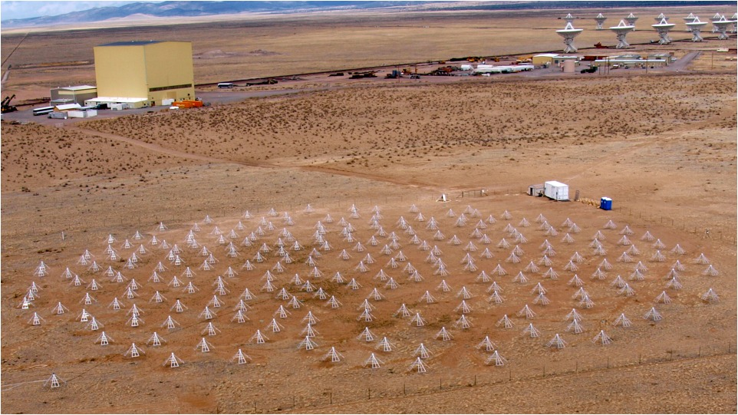
Science with a Next-Generation Very Large Array
Effective area ~ 10x JVLA, ALMA
Resolution ~ 10x JVLA, ALMA
Frequency range ~ 1 – 115 GHz
Eric J. Murphy, C.L. Carilli (NRAO) and the ngVLA Science Working Groups
Background
Terrestrial Zone Planet Formation
AU-scale imaging of a 1Myr protoplanetary disk at a distance of 140pc
Inspired by dramatic discoveries from the Jansky VLA and ALMA, the radio astronomy community is considering a future large area radio interferometer that will open new discovery space from proto-planetary disks to distant galaxies. Building on the superb cm observing conditions and existing infrastructure of the VLA site, the current vision of ngVLA is an interferometric array with more than 10 times the effective collecting area and 10 times higher spatial resolution than the current VLA and ALMA. The array will operate at frequencies spanning ~1.2 to 116GHz. The ngVLA is optimized for observations at wavelengths between the exquisite performance of ALMA at submm wavelengths, and the future SKA-1 at decimeter to meter wavelengths. The ngVLA will open a new window on the universe through ultra-sensitive imaging of thermal line and continuum emission down to milliarcecond resolution, as well as deliver unprecedented broad band continuum polarimetric imaging of non-thermal processes
Jupiter at 13AU Saturn at 6AU
0.1” = 13AU
ngVLA 100hr 25GHz 10mas
Dust Model
model
rms = 90nJy/bm = 1K
(From Isella et al. 2015) Models of the dust continuum emission from a 1Myr old protoplanetary disk around a 1M_{o} protostar. The disk hosts forming Jupiter and Saturn mass planets at 12 AU and 6 AU from the central star, respectively. Because of the high optical depth within a radius of 10 AU, the emission at frequencies > 50 GHz reveals only the outermost planet. The emission at frequencies <50 GHz reveals both planets in formation. The right panel shows the simulated ngVLA observation of the 25 GHz disk emission, assuming a distance of 140pc, with a resolution of 10 mas (~1AU), and a noise level of 1 K.
The Cool Gas History of the Universe
Bure
1” = 7kpc
38GHz
z=2, CO1-0
ngVLA
Narayanan Model
ngVLA
Expected radio-submm facilities into the mid-21st century. The ngVLA is positioned to uniquely address a number of key science goals including:
Direct imaging of planet formation in the terrestrial-zone
Mapping dust-obscured star formation and the cosmic baryon cycle down to pc-scales out to the Virgo cluster.
Taking a census of the molecular gas which fuels star formation back to first light and cosmic reionization.
Carrying out novel techniques for exploring temporal phenomena from milliseconds to years.
ALMA
Simulation of ngVLA capabilities to image the CO(1-0) emission from a model forming disk galaxy at z = 2. In 10 hours of integration at 0.15′′ resolution (1kpc), the ngVLA will be able to resolve structural detail in the molecular gas reservoir of high-z systems at a level an order of magnitude better than ALMA and the VLA. The ngVLA reaches an rms of 12μJy per 100 km/s channel, which implies a gas mass sensitivity of ~2x10⁸ (α_{CO}/0.8) M⊙ at 1 kpc resolution.
Decarli et al. 2016
Mean cosmic mass density of molecular gas as a function of redshift, from surveys carried out with ALMA (pink), and projected for the ngVLA (green). The vertical boxes indicate the uncertainties. By delivering 1000’s of galaxies in blind CO surveys vs. 10’s from existing observations, the ngVLA will obtain galaxy number counts comparable to the deepest optical surveys, hence providing precision constraints on the evolution of the gas content of galaxies. These measurements reveal the fuel driving the star formation history of the Universe, thereby completing our view of the cosmic baryon cycle.
Physics of the ISM
The ngVLA will have the sensitivity and bandwidth to quickly image the rich molecular spectrum in the range 20 – 116 GHz at 1” resolution across entire galaxies and Galactic star-forming regions. These ground-state transition lines trace shocks, gas density, excitation, ionization and the UV field, and offer the chance to harness the growing field of astrochemistry as a main tool to understand the physics of the ISM, star formation, and galaxy evolution. The ngVLA also spans a frequency range that includes multiple thermal and non-thermal continuum emission processes, from synchrotron, through free-free, to cold dust.
Snell ea
Coordinate with Low Frequency Arrays
Synergies With Telescopes in the 2030’s
See ngLOBO poster by N. Kassim
Share site development: location, land access
Share infrastructure: communications, power, fiber
Coordinate electronics development: correlator
Coordinate archive
Coordinate operations, maintenance, security

