Slide 1
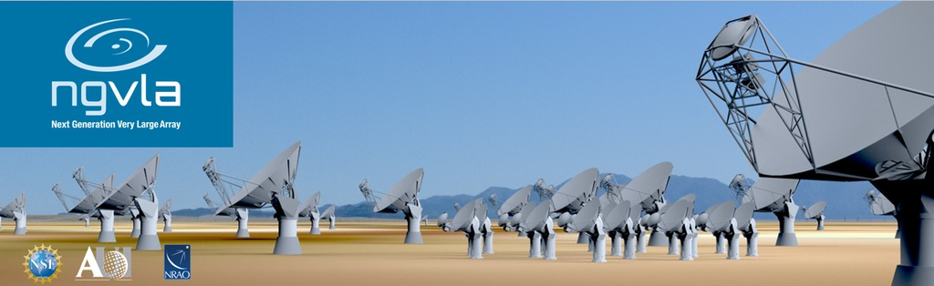
Configuration
Carilli, Rosero, Erickson, Mason

Slide 2
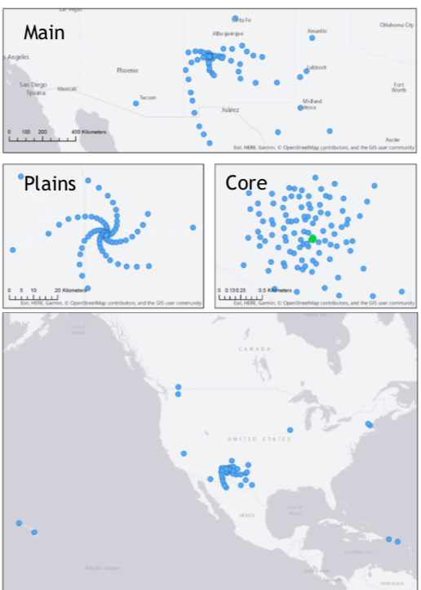
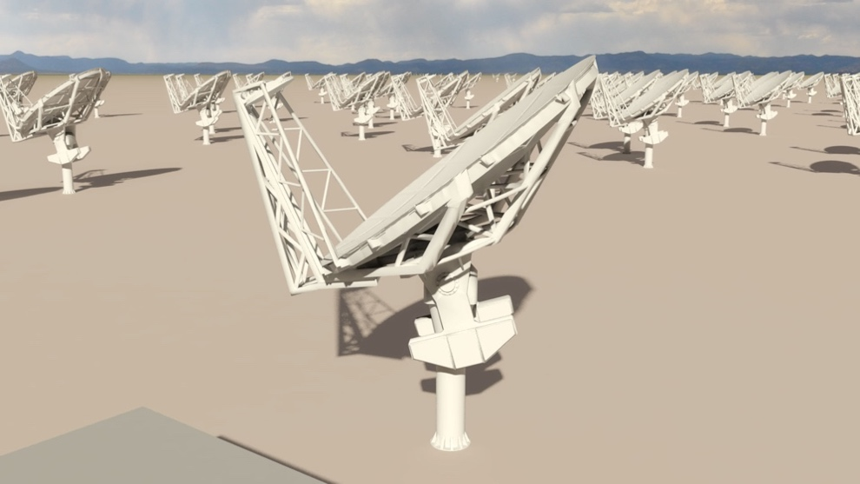
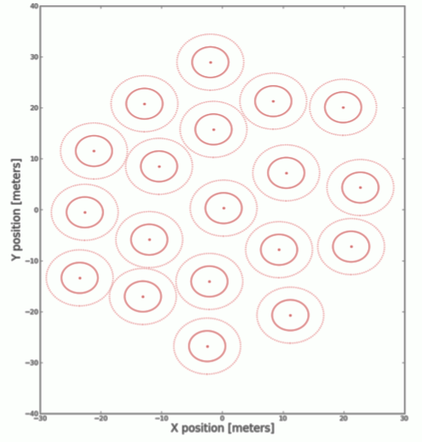
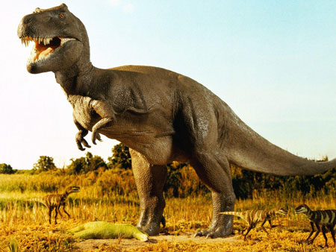
Reference Design Configuration (Rev C)
Subarray | Min B km | Max B km | # Ants. | Res. 30GHz arcsec | Science
Main (18m) | 0.027 | 1005 | 214 | 0.005 | PP Disks
Plains | 0.027 | 36.5 | 168 | 0.1 | High z CO
Core | 0.027 | 1.3 | 94 | 2 | Nearby Gal.
LBA | 32.6 | 8856 | 30 | 0.0004 | High Energy
SBA (6m) | 0.01 | 0.045 | 19 | 60 | Galactic
Total Power | -- | -- | 4 (18m) | 120
400 km
20 km
0.5 km
LBA
SBA
20 m

Slide 3
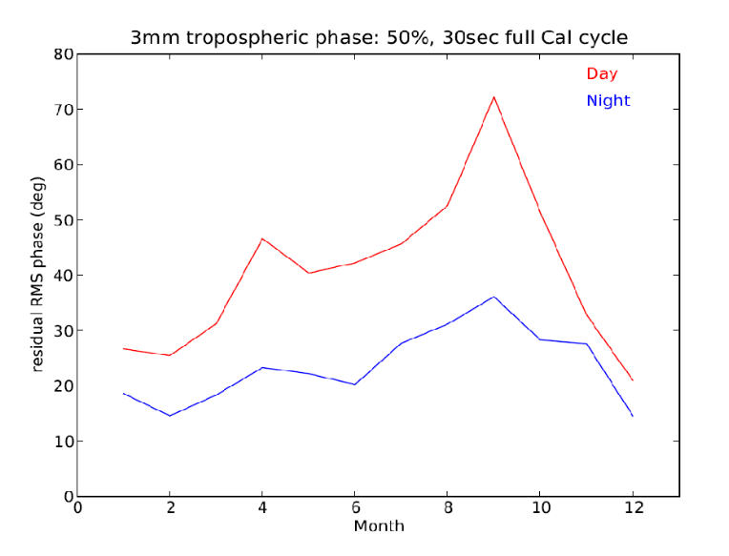
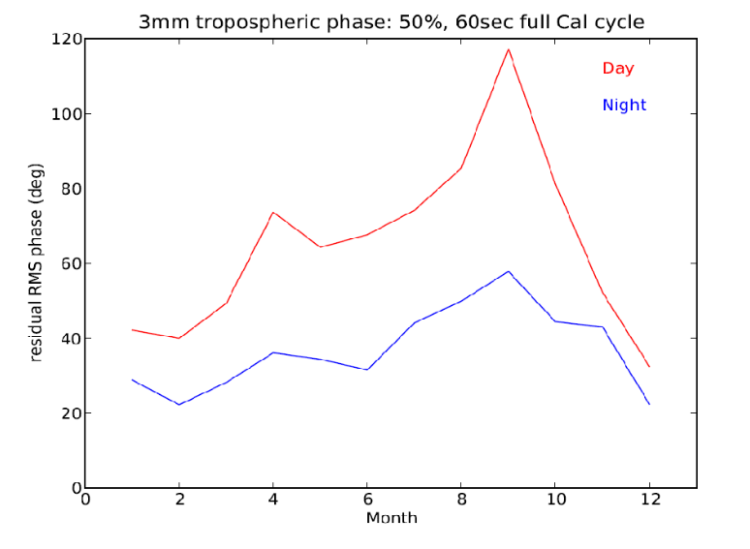
Good 3mm site
Plains of San Augustin altitude = 2200 m
ALMA Test Facility: good 3mm testing conditions
Fast switching phase calibration: Site testing interferometer data over years
  30sec cycle at 3mm => reasonable coherence on longest baselines over most of the year (median rms phase < 40º), except summer day time
  Calibrator density: Typical distance to calibrator of 25mJy at 3mm ~ 2º => adequate to ensure that phase noise due to SNR is not a limiting factor for a 3sec integration
Real-world constraints
S/W tools employed to optimize location wrt Roads, Power, Fiber, RFI, land ownership…
rms residual at 3mm
w. 30s calibration cycle
<20% coherence loss on longest baselines
rms residual at 3mm
w. 60s calibration cycle

Slide 4
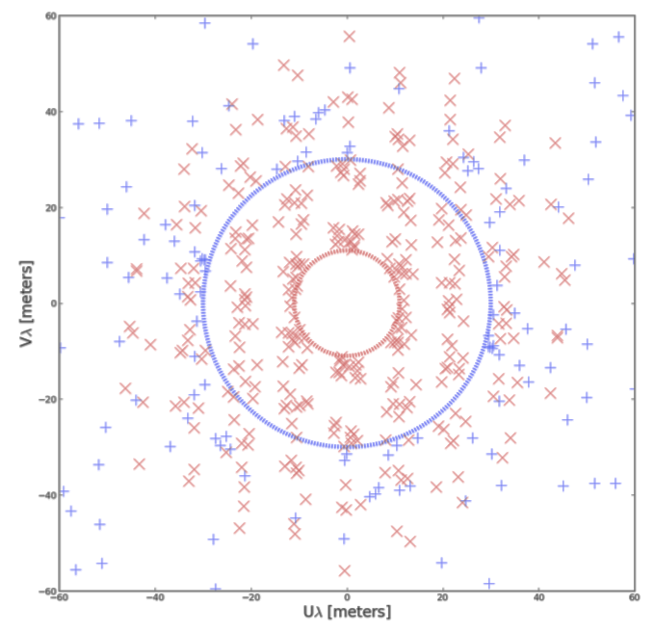
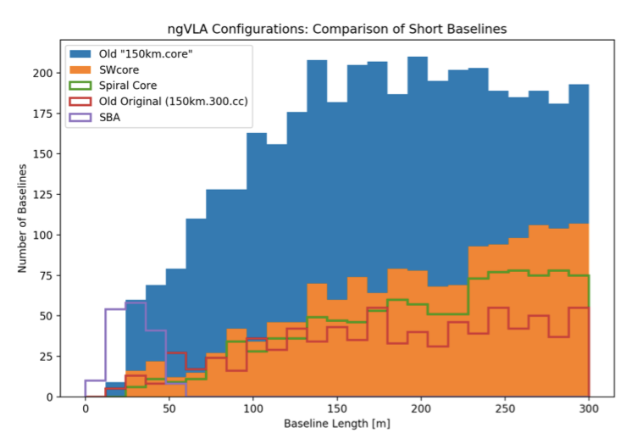
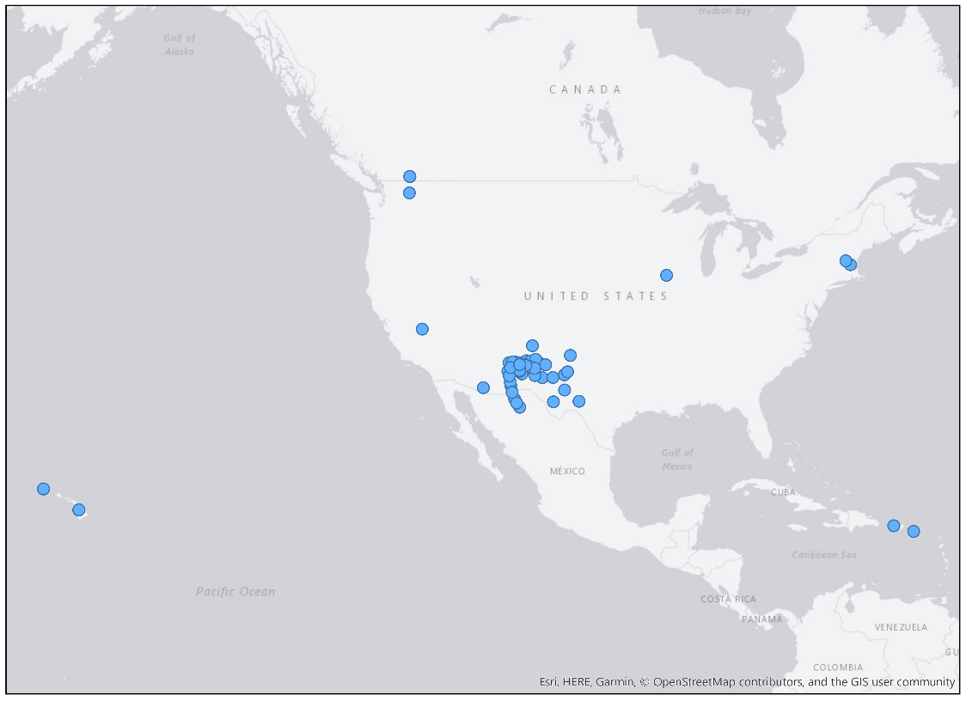
20m
SBA + Total Power: Wide field, low T_{B}, imaging.
Designed to obtain uniform surface brightness sensitivity on ‘all’ scales
TP
50m
LBA: sub-mas resolution imaging.
Designed for good calibration and good uv-coverage for stand-alone operation
Stations: 2 to 3 x 18m antennas at each site
  short baselines
  paired-antenna calibration
Outer Sites: ‘Neighbors’, typically within ~ 50 km => no ‘uv-orphan’ antennas

Slide 5
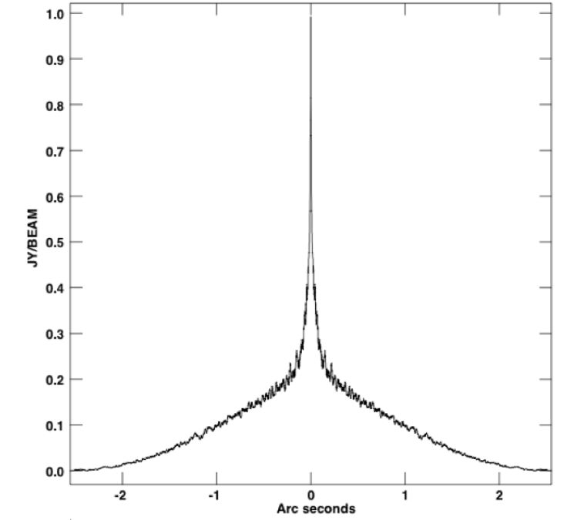
Multi-scale array => multi-scale beam
Main array
NA beam at 30GHz
0.005”
Not Reconfigurable => challenge becomes adjusting uv-weighting, cell size, taper to get reasonable beam with desired resolution, while maintaining reasonable sensitivity
0.1” to 0.2”
1” to 2”

Slide 6
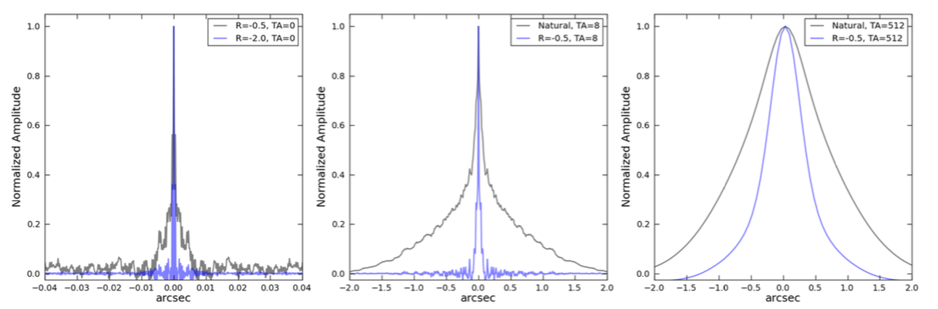
Beam Sculpting (Rosero ea. 2019)
PSF Metrics (Imaging Performance Report)
NOT peak sidelobe (there is no peak sidelobe of NA beam)
PSF Width at Half Maximum
Near-field RMS of the PSF (SKA)
PSF Main Beam Efficiency vs. Gaussian
PSF level at HWHM and FWHM (wings < 10% at radius = FWHM)

Slide 7
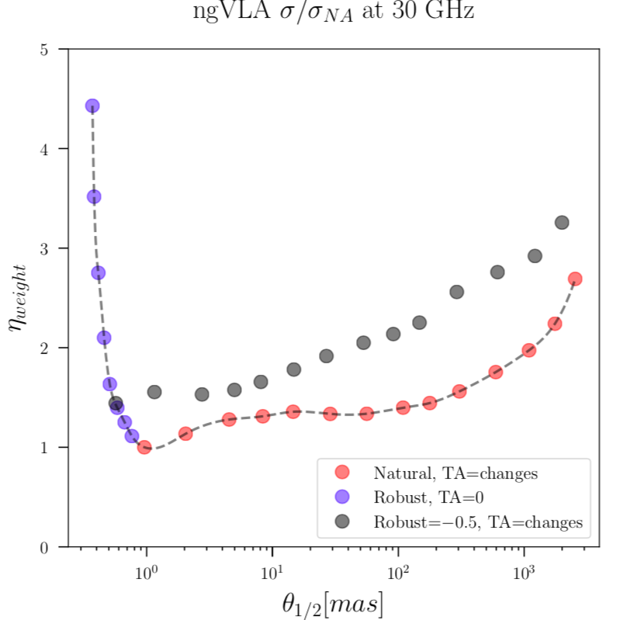
‘Taperability Curve’: rms relative to ‘NA best’, to achieve given resolution and meet PSF metrics
Shallow sensitivity curve ~ factor 2 loss wrt NA from 1 mas to 1” at 30GHz
  Short Baselines: using only core stations ~ 40%
  Main array: Core offset north => Cross-correrlation to core with many long baselines
Config. Working-Group Efforts: ‘stress test’ performance in KSGs
Rosero 2019
1 mas
1 arcsec

Slide 8
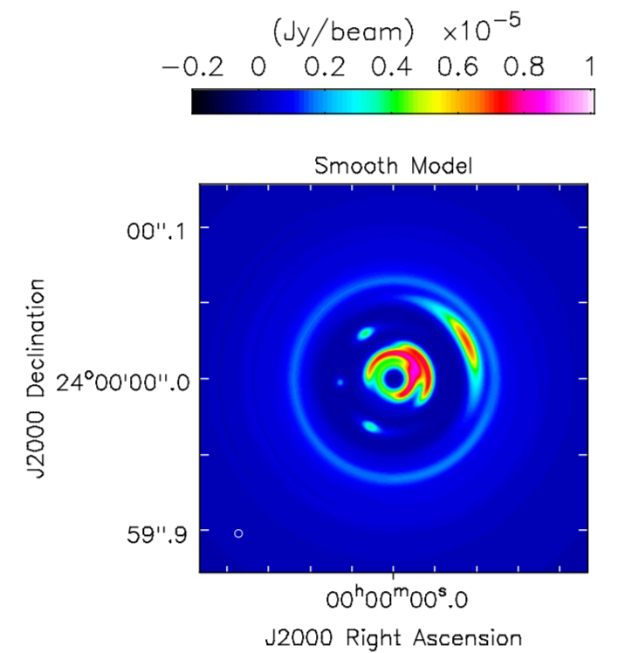
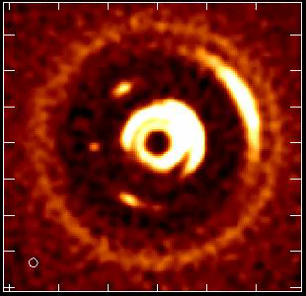
Main Array Stress test @ 100GHz Movies of Planet Formation
Protoplanetary disk at 140pc, 1 Myr
Resolve ‘dust traps’ and L4,5 points at 0.7 AU resolution
Circumplanetary disks: imaging accretion on to planets
Ricci 19
R = -1.4, TA = 5 mas
rms T_{B} ~ 4 K

Slide 9
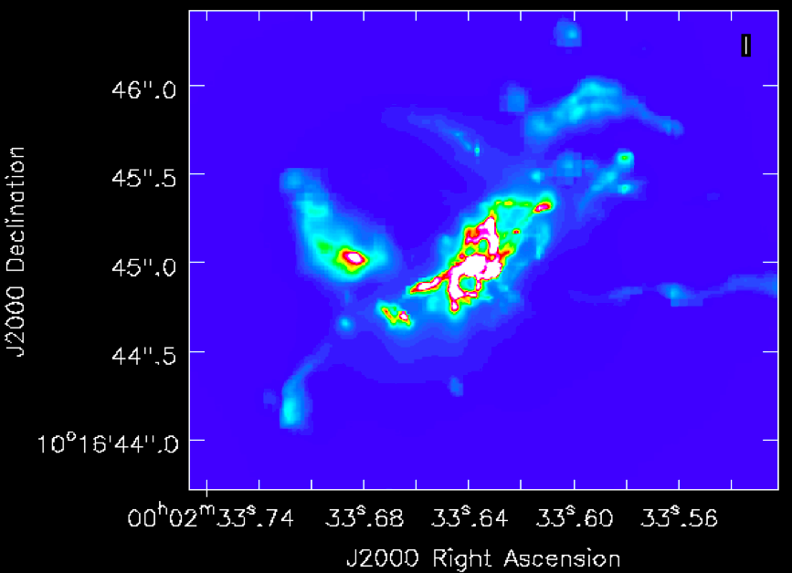
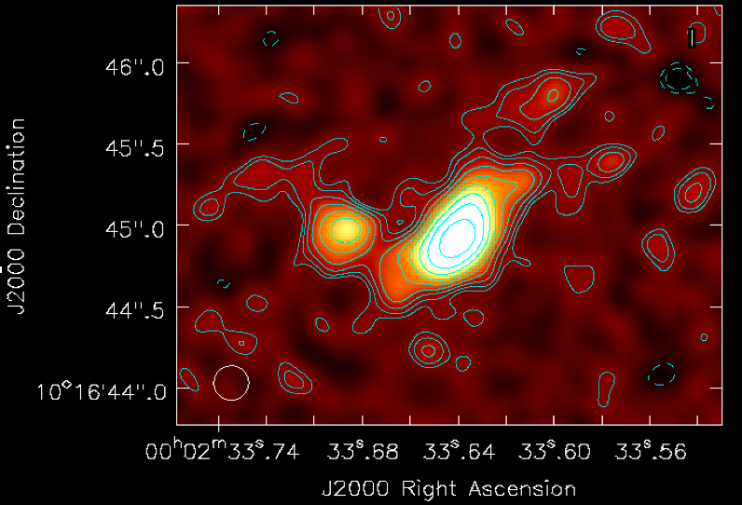
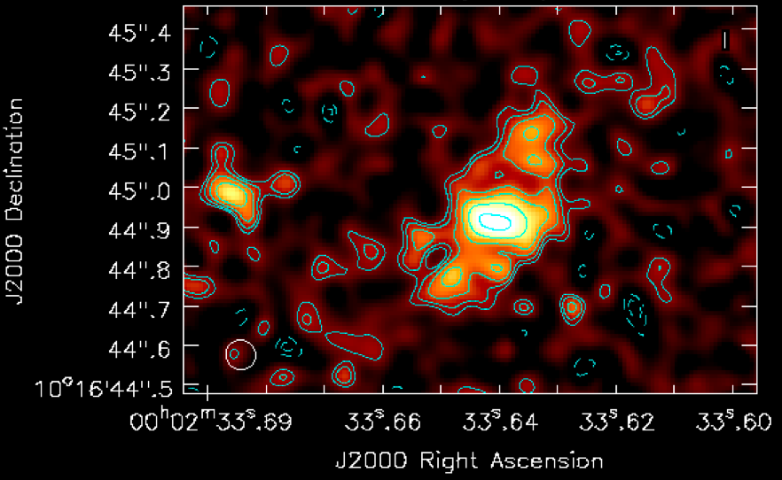
Plains Array Stress Test @ 30 GHz: Imaging CO 1-0 at z = 2
Main Sequence Galaxy at z = 2: SFR = 250 M_{o}/yr, M_{gas} = 1e11 M_{o}, D_{disk} = 10 kpc
𝜈_{obs} = 38 GHz, 𝚫v = 500 km/s, t_{obs} = 12 hr
R = 0, TA = 0.18” => FWHM = 0.21”, rms = 2uJy/beam (2e8 M_{o})
R = -0.5, TA = 0.05 => FWHM = 0.075”, rms = 2uJy/beam
4kpc
Narayanan 18

Slide 10
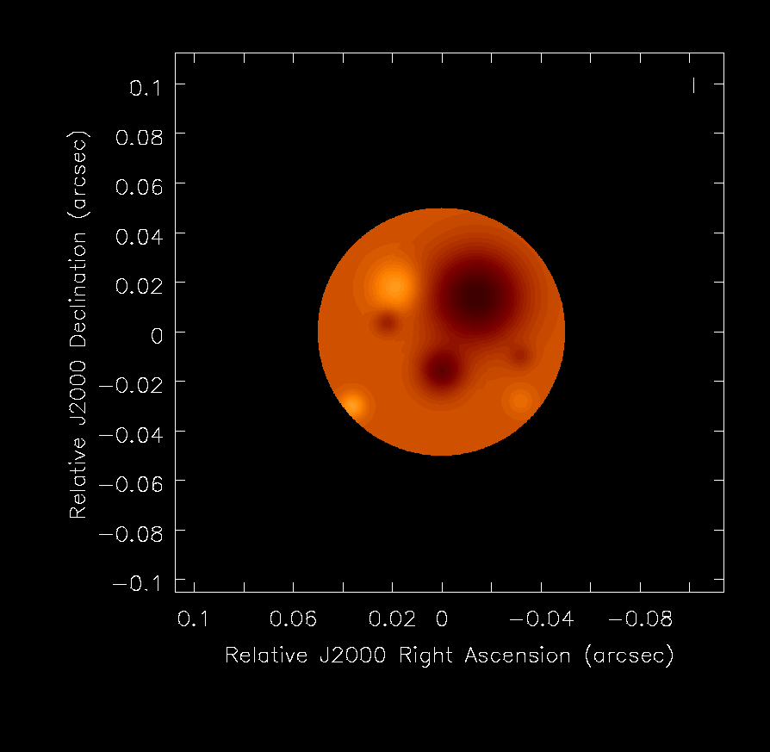
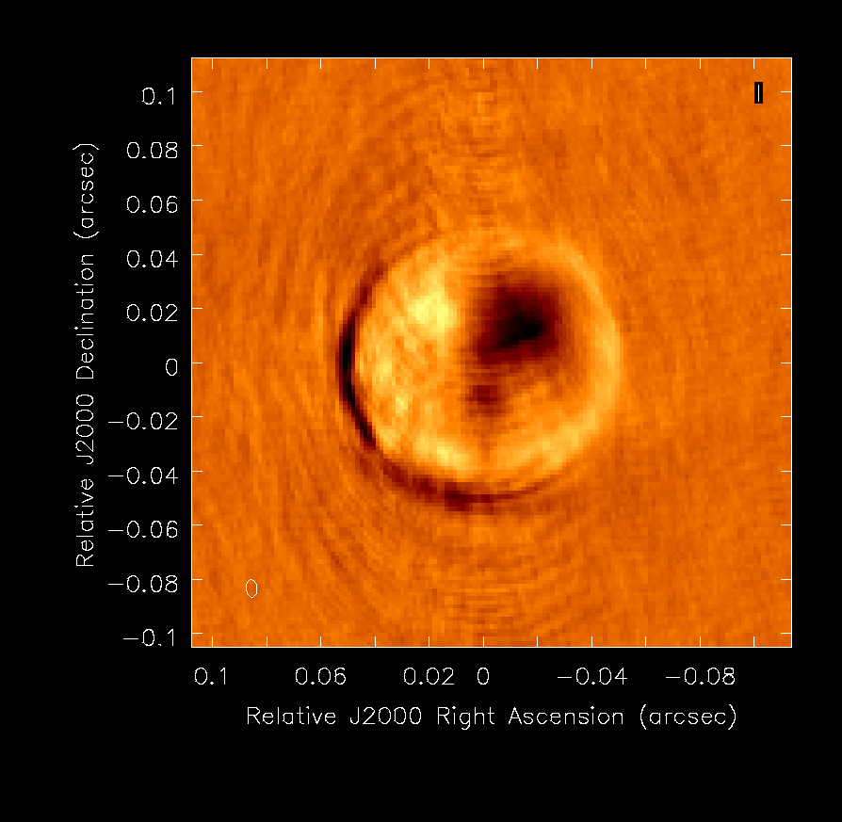
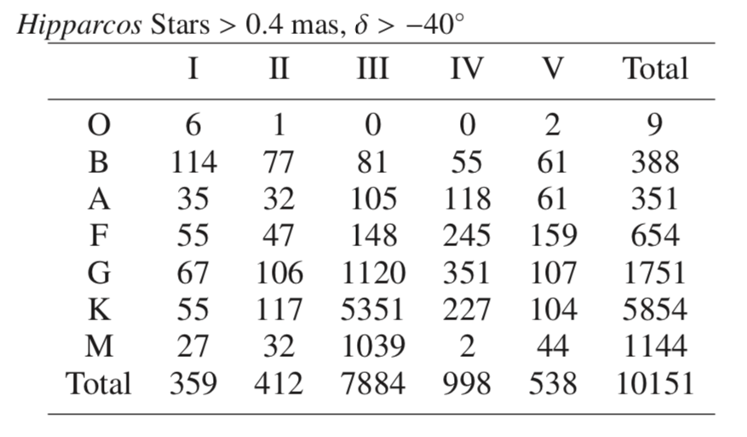
LBA Stress test: Imaging stellar photospheres
40mas
𝛂-Orionis at 38GHz, M1 Ia, 11 M_{o}, D = 100mas at 222pc, +/-10% hot/cold spots, <T_{b}> = 3000 K
t_{obs} = 4hr, R = -0.5 => FWHM = 5mas, rms = 0.5 uJy/bm
𝛉-Leonis at 85 GHz, A2 V, 2.5 M_{o}, D = 0.72 mas at 51pc, <T_{b}> = 9000 K
uv-fitting: Sizes and <T_{b}> for thousands of stars, including hundreds of main sequence stars
Sensitivity drops at b > 5000 km (core drops-out)
Main
Main + LBA
Measure D, T_{b} to few %
1000 km
5000 km

Slide 11
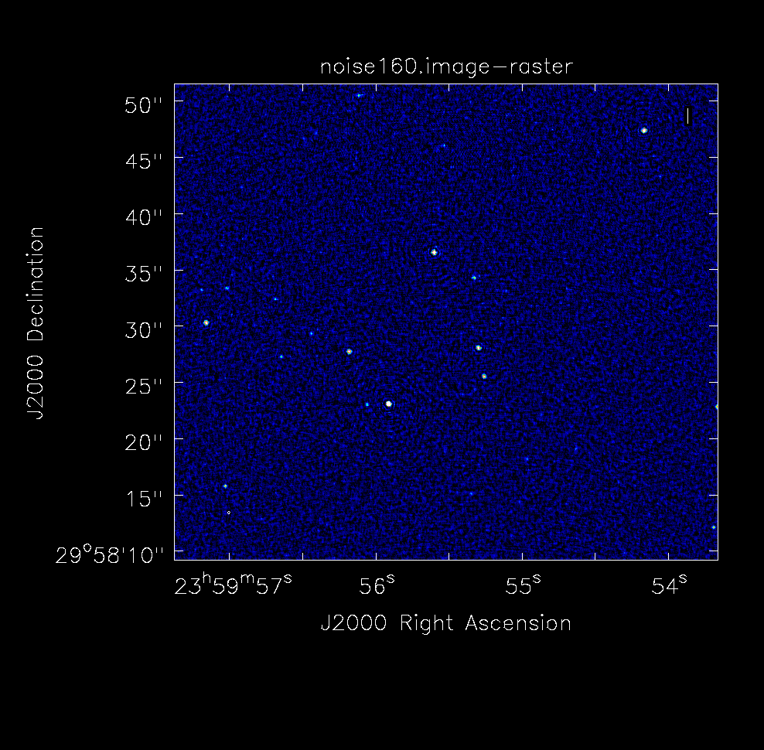
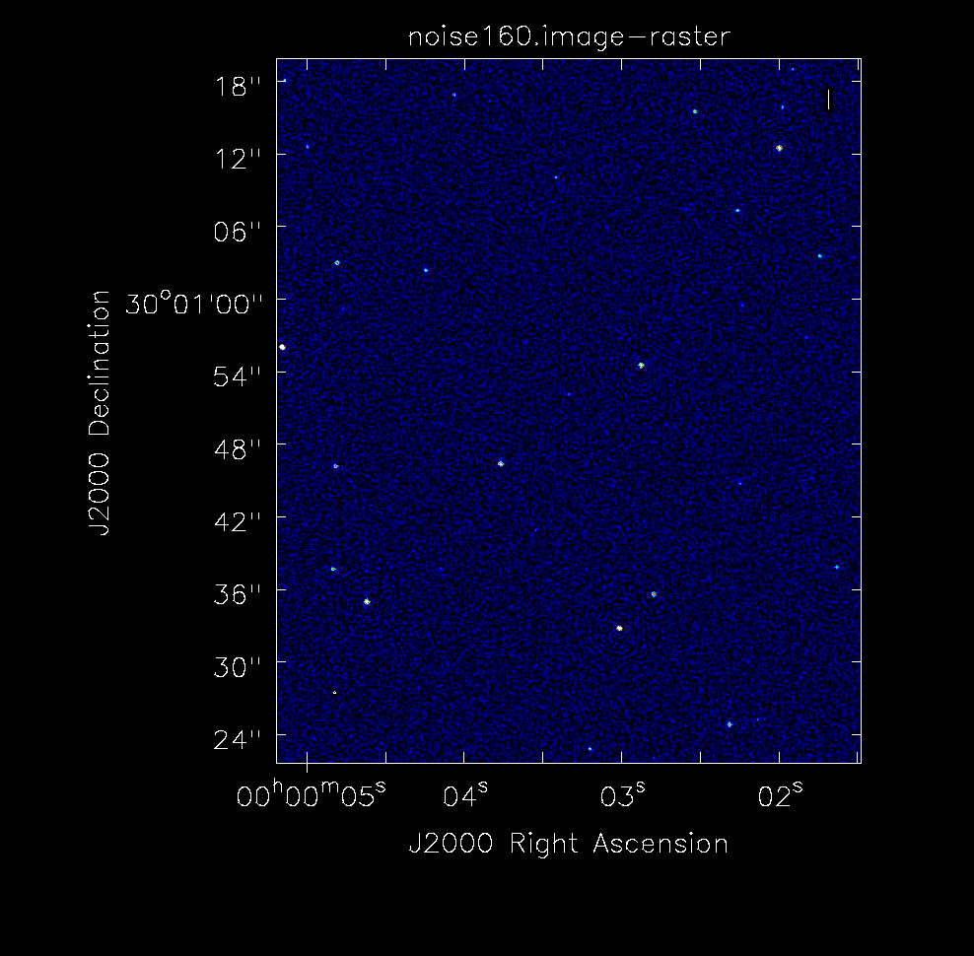
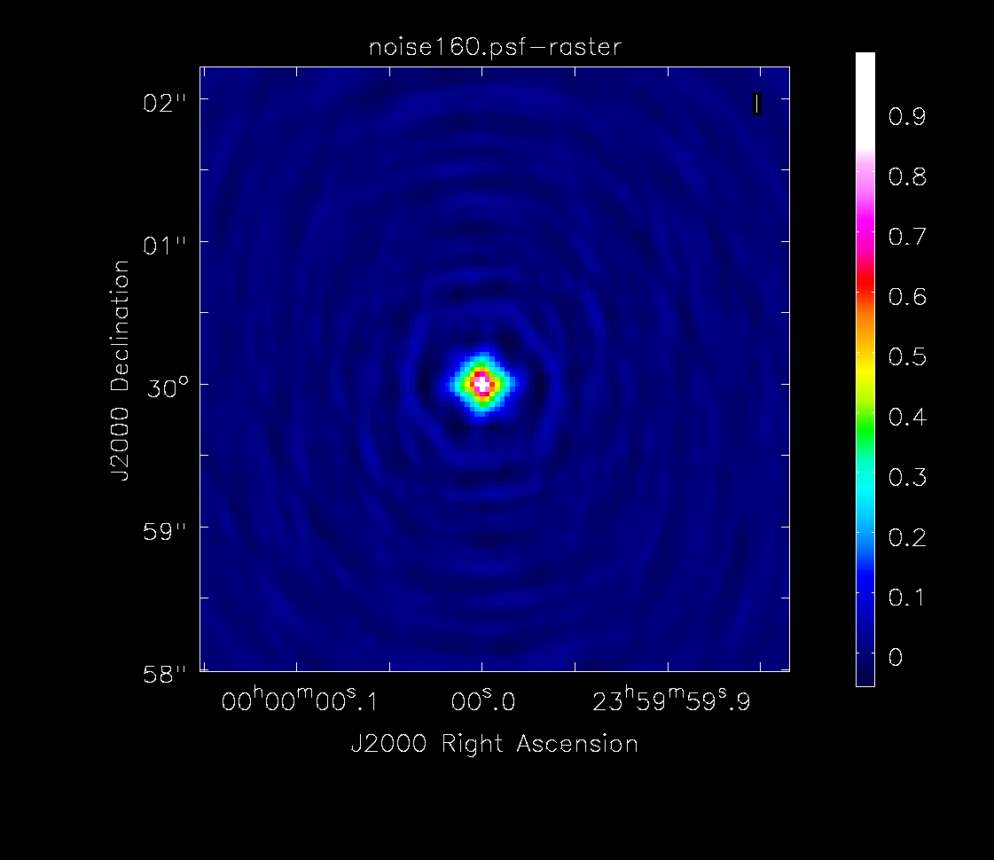
Main Array Stress Test: Deep Field Dynamic Range
Cosmological Continuum Deep Field at 8 GHz
6000 sources from 0.1 uJy to 4 mJy over PB (‘S-cubed’ sky simulator)
t_{obs} = 160hr, R = -0.75, TA = 0.1” => FWHM = 0.19”, rms = 40 nJy/bm (2x NA)
DNR ~ 1e5 (note: W/O MFS)

Slide 12
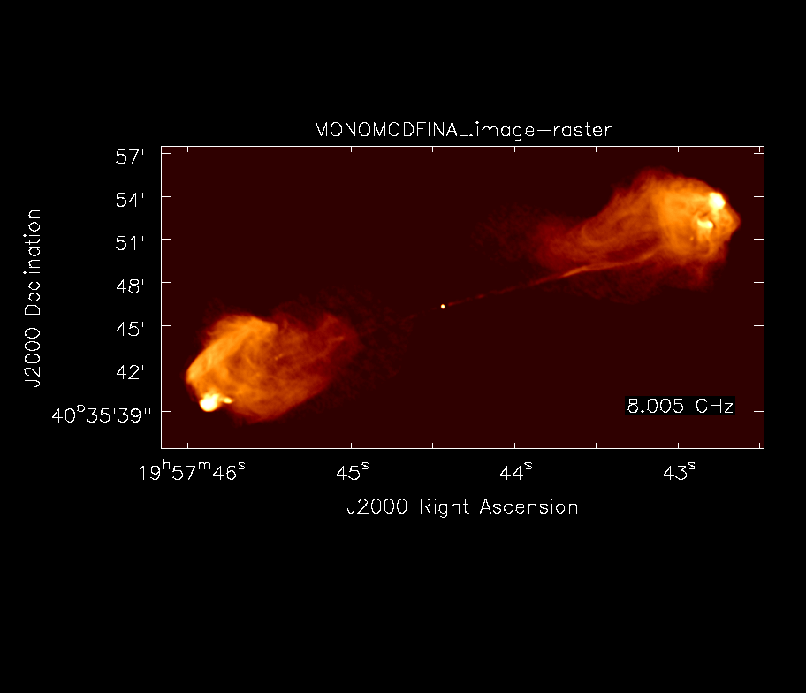
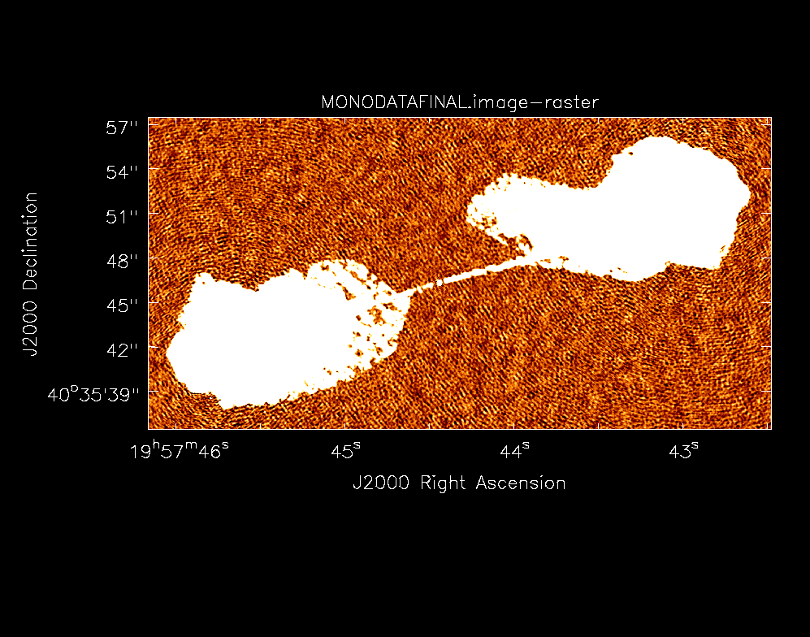
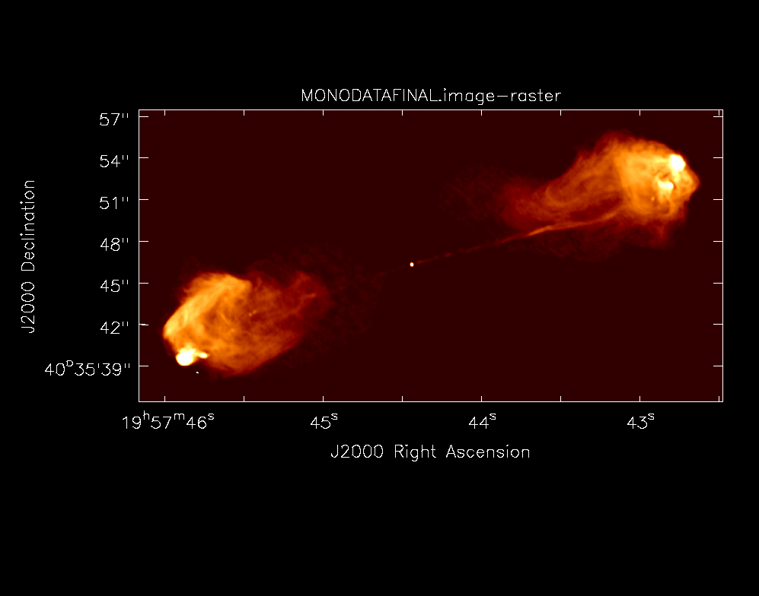
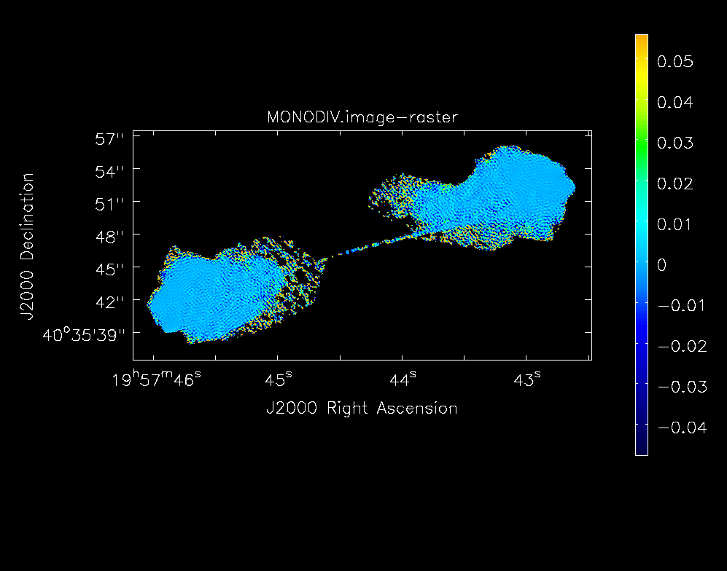
High Fidelity Stress Test: Cygnus A at 8 GHz
Cygnus A at 8 GHz, scaled and blanked
t_{obs} = 6hr, UN weight, TA = 0.12”, MSC => FWHM = 0.12”, rms = 26 uJy/bm, DNR ~ 1e5
<Fidelity> = (Mod - Obs)/Mod = 0.0036 +/- 0.038 (spec = 10%)

Slide 13
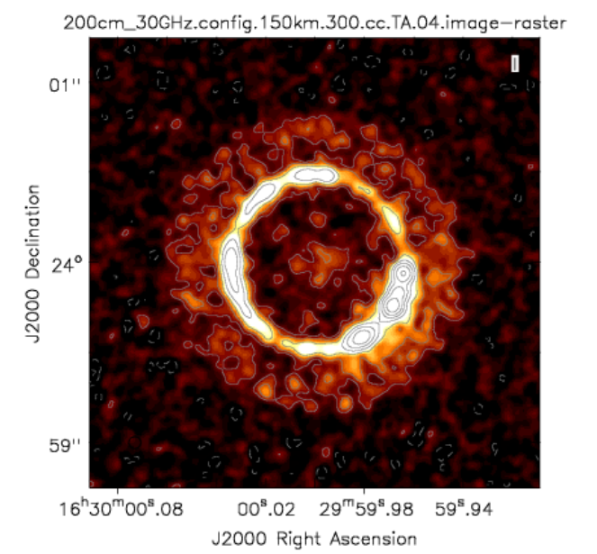
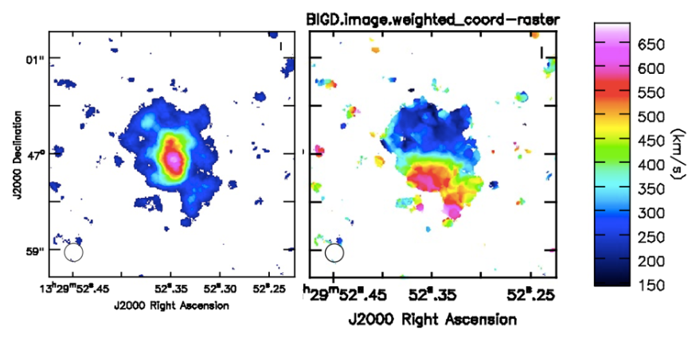
Array Simulation Tools: working and improving
Debris disk 1cm, 10mas
Configurations
  Main Configuration (214 x 18m)
  Subcomponents: Core, Pains
  Long Baseline Array
  Short Baseline Array
CASA simulator
  Simobserve: generate mock.ms from FITS image cubes
  Add thermal noise
  Explore imaging capabilities (uv weights, subarrays..)
  Explore wide field mosaic
CO dynamics z = 4.2
https://ngvla.nrao.edu/page/tools
https://casaguides.nrao.edu/index.php/Simulating_ngVLA_Data-CASA5.4.1

Slide 14
On-going Work: Configuration Working Group
Move Core to northern edge of Plains
Walker Configuration
Roads, Fiber, Power, RFI
SBA/TP/CORE: simulations
Algorithms: multiscale reconstruction to maximize information return

Slide 16
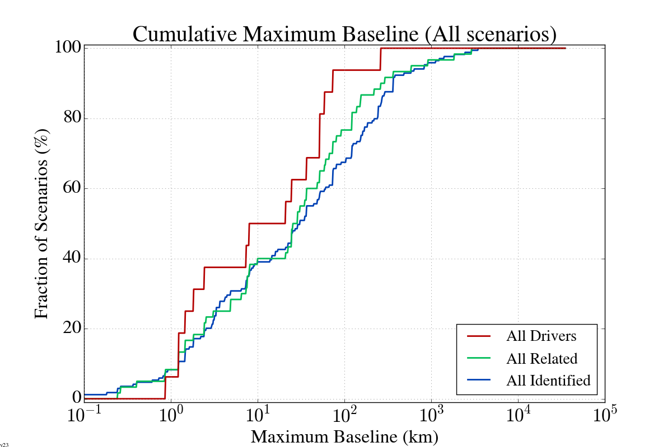
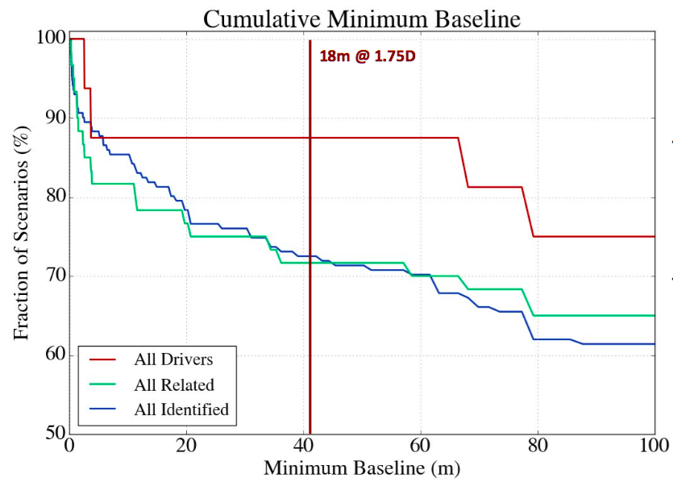
Science Use Case analysis (170 programs)
80% to 90% science can be done with 18m homogeneous array with
  Shortest spacing = 1.75 x 18m (off-set geometry limit)
  Maximum spacing ~ few hundred km
1.75x18m
30 km
300 km

