Slide 1
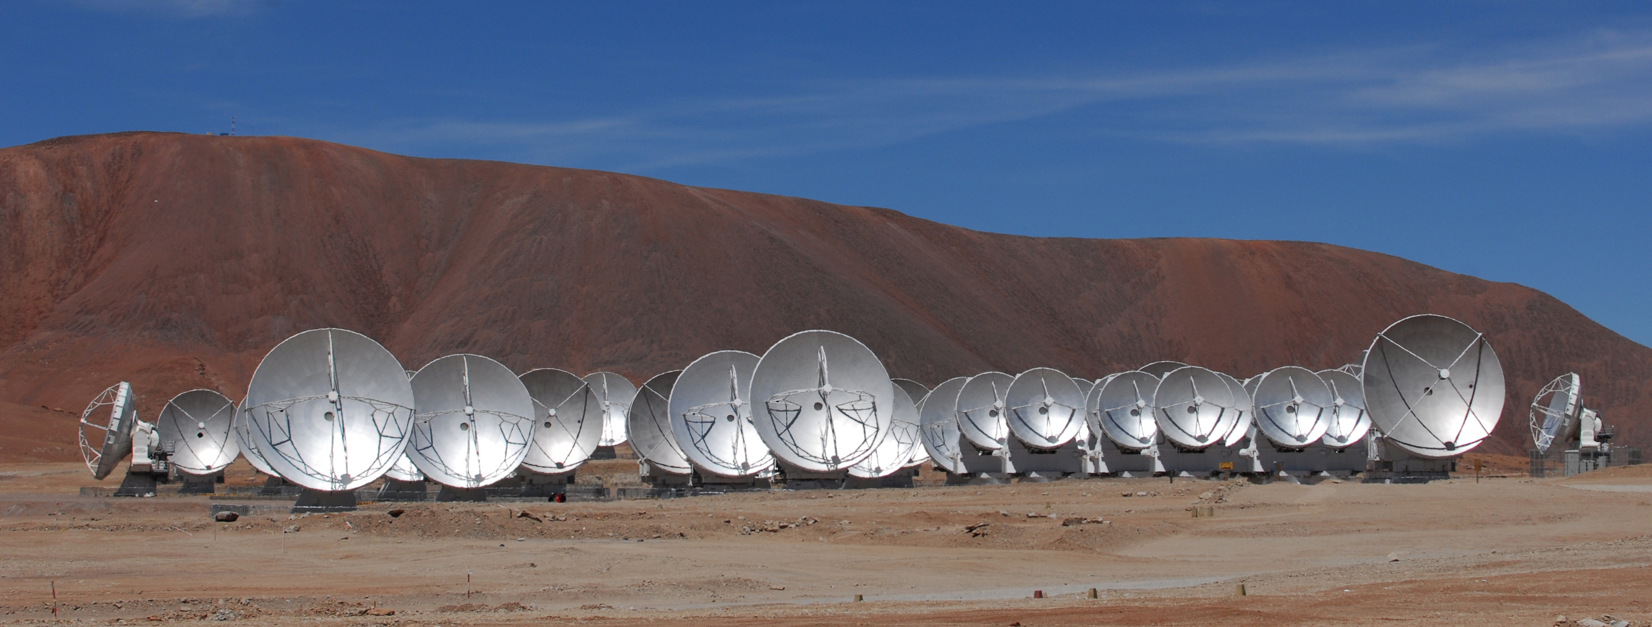
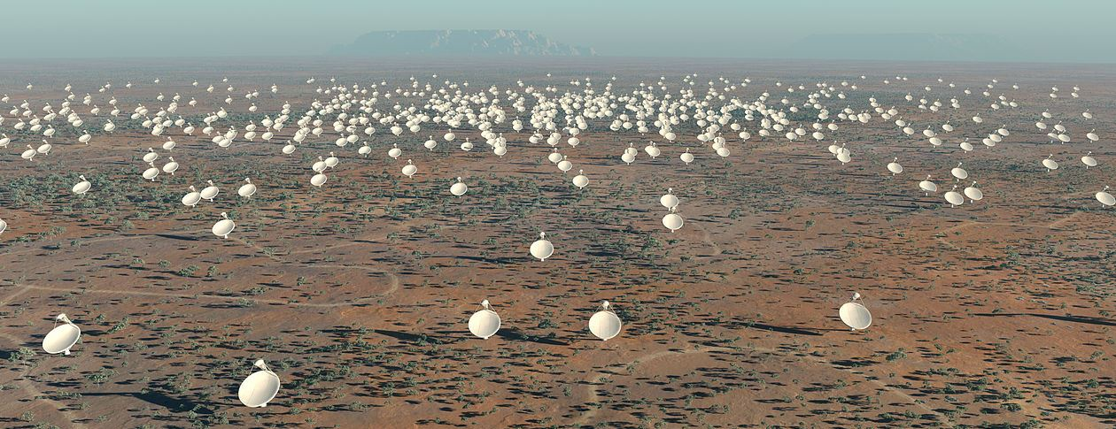
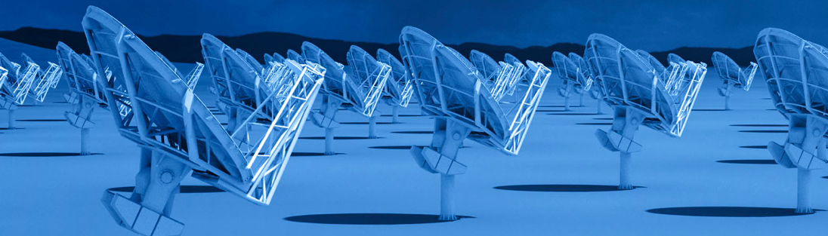
Radio Astronomy 2025+ Major Facilities (Arrays)
ALMA
30 to 900 GHz: Similar collecting area and frequency coverage as today
Longer baselines (15 antennas to 30km)
Factor two increase in bandwidth (8GHz to 16GHz)
SKA Phase I (2022+)
SKA1-low: 50 to 350 MHz; 512 dipole-stations of 38m diameter; Bmax = 50km.
SKA1-MID: 350MHz to 15GHz; 64x18m + 133x15m dishes; Bmax = 120km
Next Generation Very Large Array: (2025+)
1.2 to 115 GHz, with up to 20GHz bandwidth
214x 18m antennas
Bmax = 600km

Slide 2
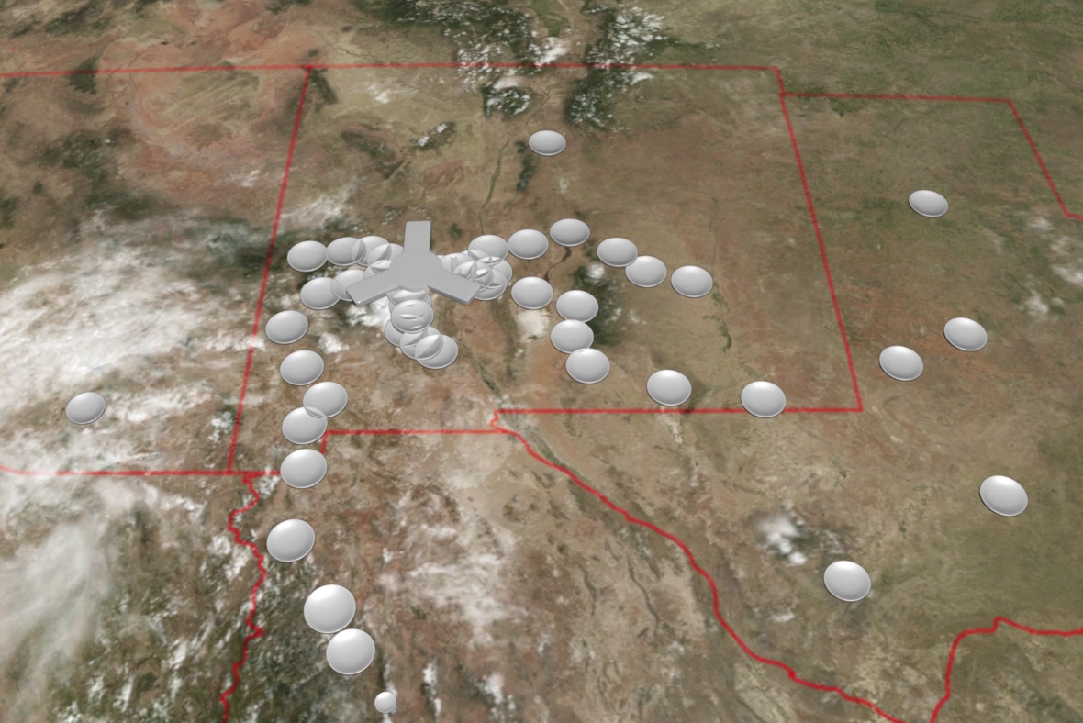
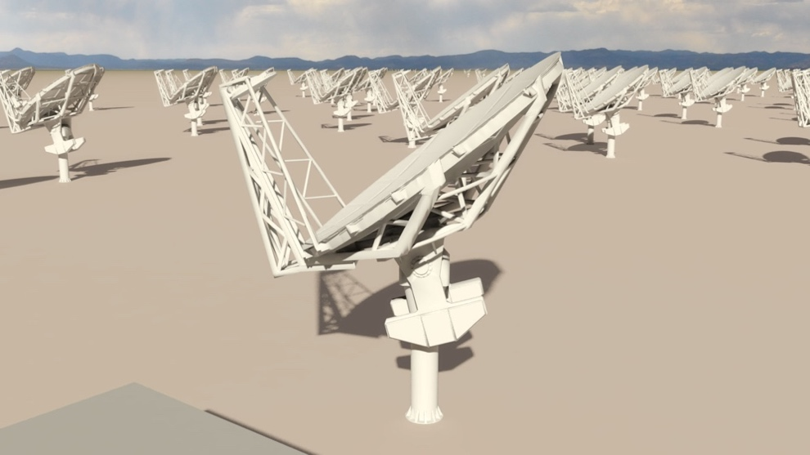
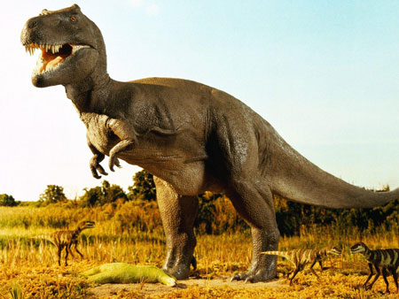
A next generation VLA
Built on the legacy of the VLA and ALMA
Thermal imaging on milliarcsec scales
550km
Reference Design Requirements
10x effective collecting area of JVLA and ALMA at 30GHz
10x resolution of JVLA and ALMA
Frequency range: 1.2 –116 GHz (single-mode feeds)
214 18m offset Gregorian (feed-low) antennas
Fixed antenna locations in Southwest USA and Mexico: good 3mm site (40% core – 1km; 40% Plains = 30km; 20% outer 600km)
Continuum sensitivity (10hr) = 0.1uJy/bm @ 1cm, 0.01” (T_{B} = 2K)
Line sensitivity = 21.5uJy/bm @ 1cm, 10 km/s, 1” (T_{B} = 35mK)
350 miles

Slide 3
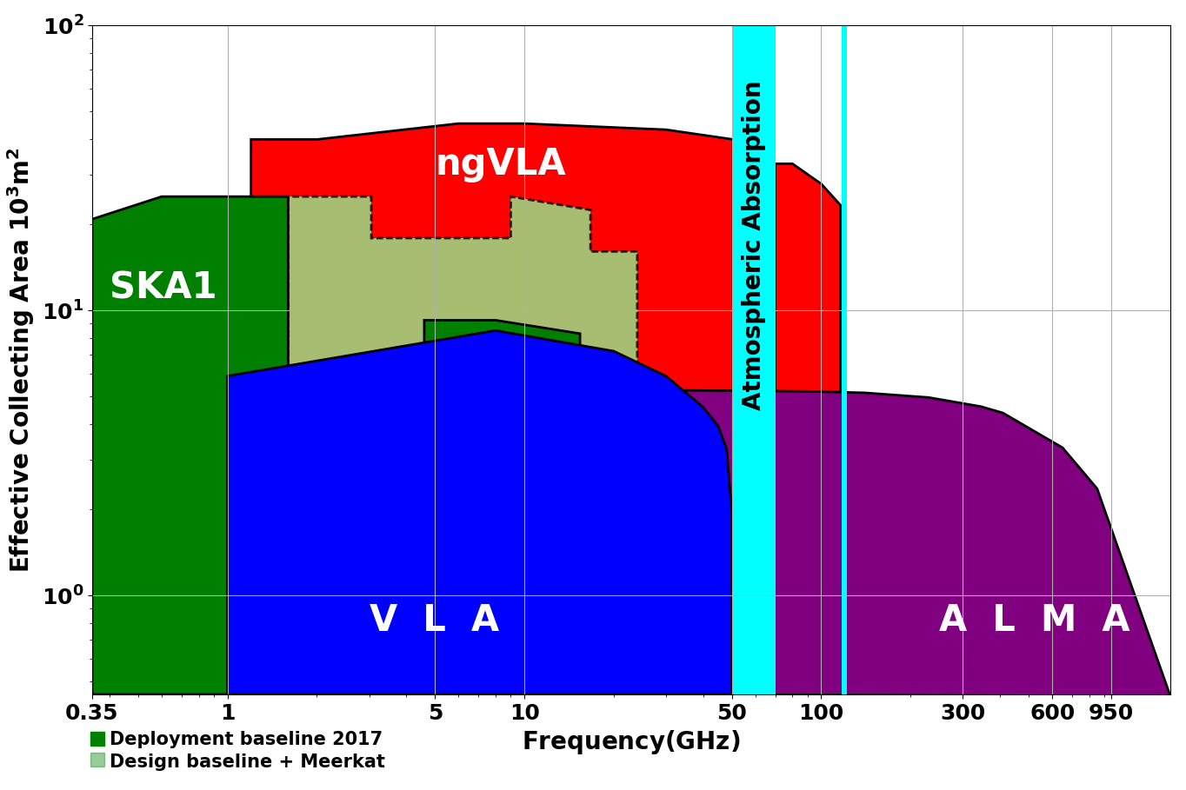
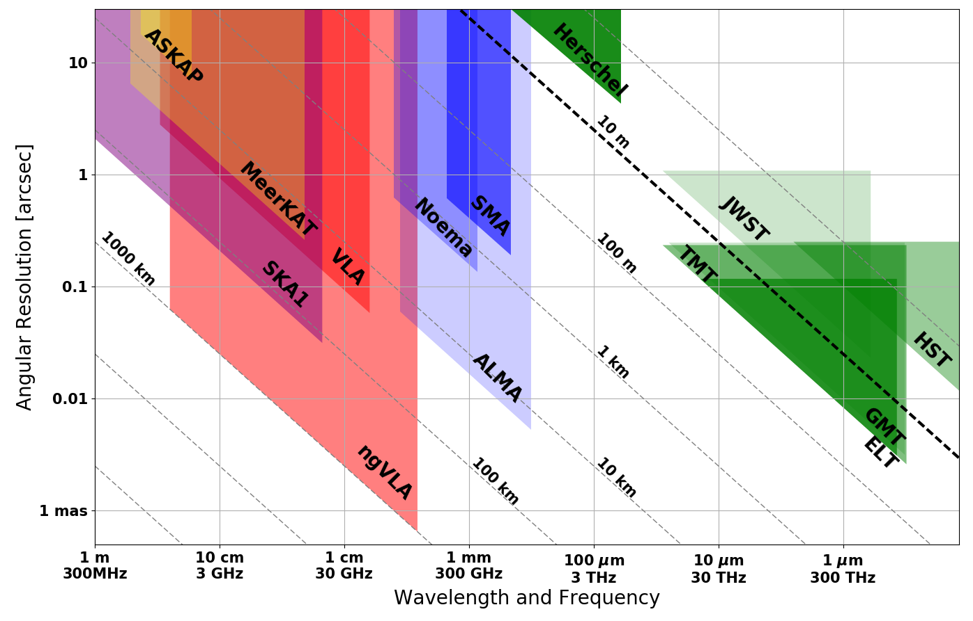
Global Radio Astronomy into mid-Century
mid
Terrestrial zone planet formation: 1AU @ 140pc
Complementary suite from cm to submm arrays for the mid-21st century
< 0.3cm: ALMA 2030 superb for warm chemistry, dust, fine structure lines
0.3 to 3cm: ngVLA ngVLA superb for terrestrial planet formation, dense gas history, baryon cycling
> 3cm: SKA superb for pulsars, reionization, HI + continuum surveys
Notes:
Snapshot comparison of effective collecting area for dish-arrays expected in the 2030’s.
Assumes SKA deployment baseline (July 2017)
SKA 1
- 130 antennas, SKA bands 1, 2
- 67 antennas, SKA Band 5 a/b
MeerKAT:
- 64 antennas, bands 1, 2, 3
MeerKAT has receiver indexer with 4 slots

Slide 4
WFIRST GOAL | RADIO | TELESCOPE
EXOPLANETS: direct imaging, debris disks | Imaging of terrestrial planet formation, pre-biotic chemistry | ngVLA, ALMA
Dark Energy: SNe | N/A
Dark Energy: BAO | Intensity mapping: HI, CO | SKA, CHIME, HIRAX, DAKOTA, COMAP…
Dark Energy: weak lensing | sub-arcsec imaging (challenge: narrow FoV) | ngVLA, SKA-1
Galaxy Formation: cosmic reionization & 1st galaxies | HI 21cm, CII-IM | SKA, HERA, CCAT’, Time-Pilot…
Galaxy Formation: baryon evolution stars/SF | Gas: molecular, FSL, Dust | ngVLA, ALMA

Slide 5
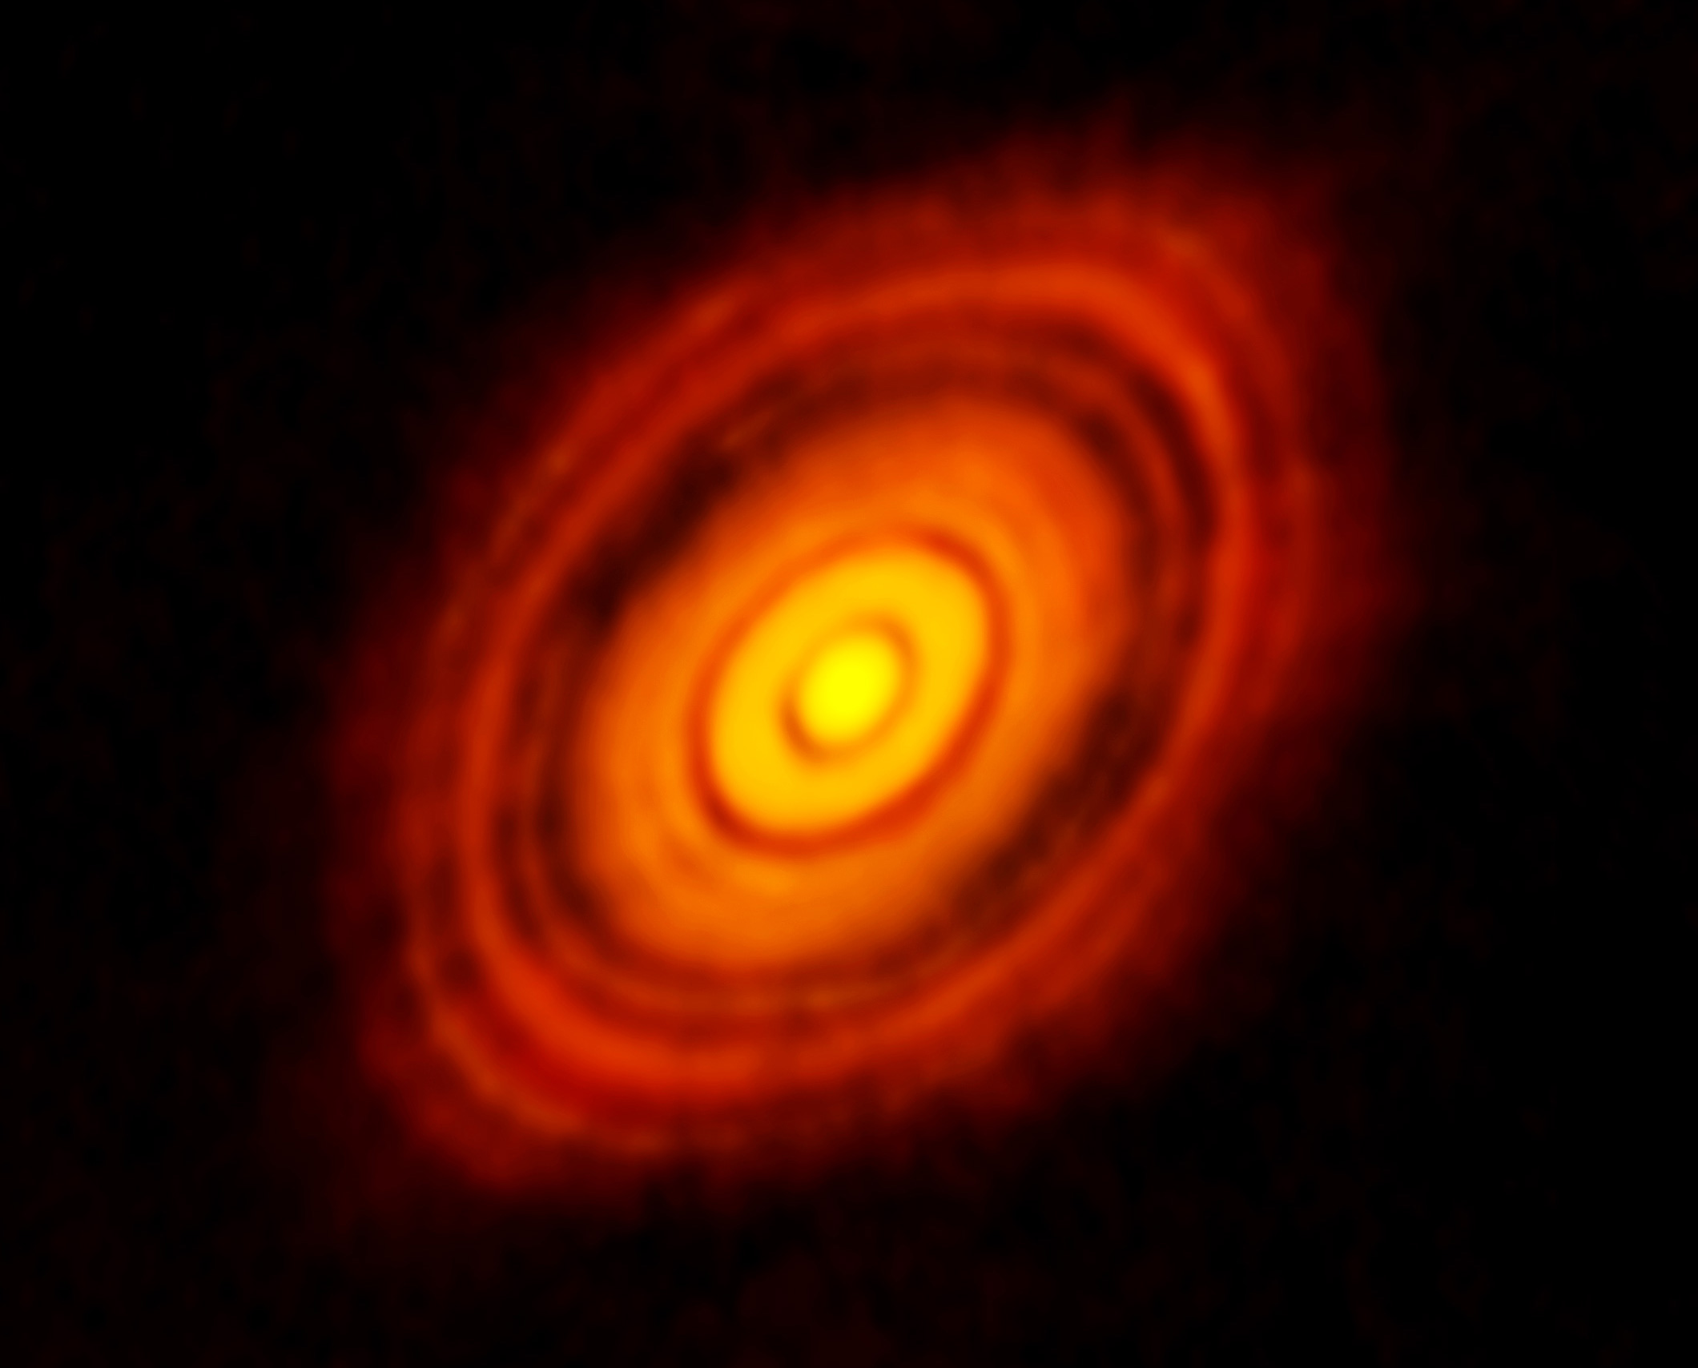
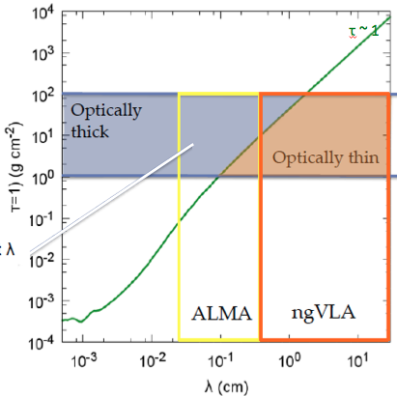
Terrestrial zone planet formation
ALMA 250GHz (Brogan ea.)
HL Tau: Rosetta Stone of planet formation around Solar-mass protostar
Distance = 140pc
1Myr protostar ~ 1 M_{o} w. 0.1 M_{o} dusty disk
100AU = 0.7”
Inner ~ 10AU optically thick at mm wavelengths = ‘ngVLA zone’
Isella ea.

Slide 6
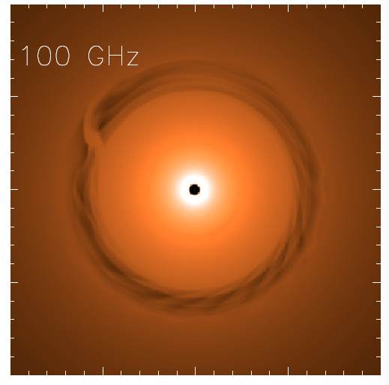
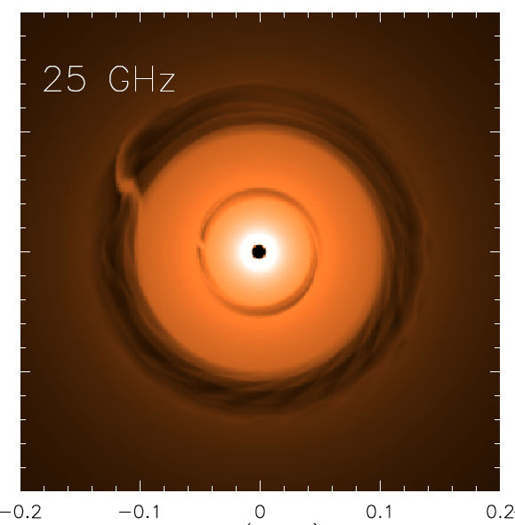
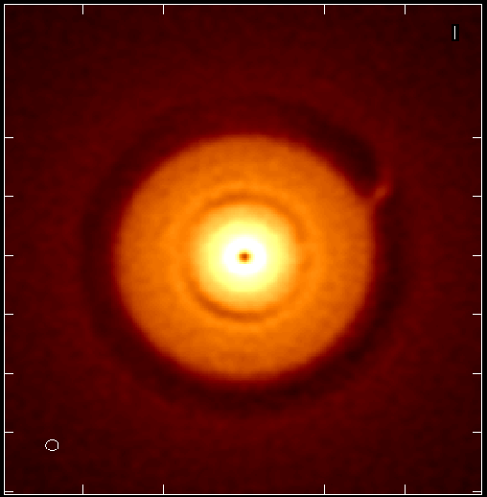
NGVLA: 1Myr Protoplanetary disk at 140pc distance
Saturn at 13AU
Jupiter at 6AU
ngVLA 100hr 25GHz
res = 10mas ~ 1AU
0.1” = 13AU
Isella Dust Model
Model
rms = 90nJy/bm = 1K
Next generation VLA and Planet formation
Probe inner few AU-scales (‘Solar-system scales’)
Measures the planet initial mass function down to 5-10 Earth masses and unveil the formation of planetary systems similar to our own
Reveal circumplanetary disks and sub-structures in the distribution of mm-size particles created by close-in planets, and measure the orbital motion of these features on monthly timescales.

Slide 7
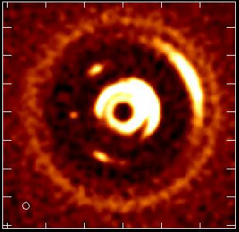
ngVLA Movies of planet formation: Solar System Analogues and the Initial Conditions for the Development of Life
Large Molecule Astrochemistry: Observe complex pre-biotic molecules and determine the chemical initial conditions in forming solar systems and individual planets
Luca Ricci et al.
10yr observations of 100 GHz ngVLA observations of a newborn planetary system w. a Jupiter analogue orbiting at 5 AU from a Solar type star
Notes:
Turning planet formation science into a time-domain science!
Of the 3 blobs you see at 5 au, the one associated to the Jupiter-mass planet is the one in the middle.
The other two blobs in the movie (leading and trailing) are dust particles concentrated in the L4 and L5 Lagrangian points of the star - Jupiter-mass planet system.
Dust emission comes from the circum-planetary disk orbiting the planet, so the planet is mostly formed in that movie (I say "mostly" cause material in the circumplanetary disk will accrete onto the planet, therefore increasing its mass by some amount).

Slide 8
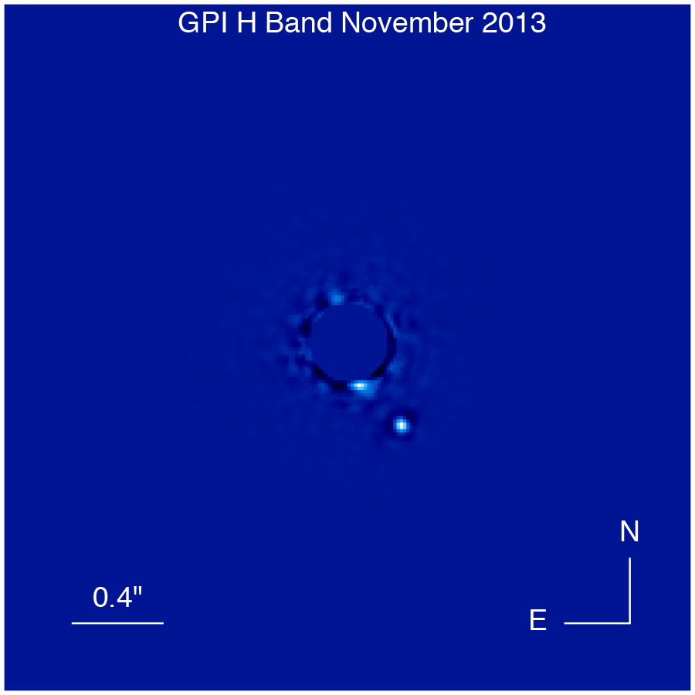
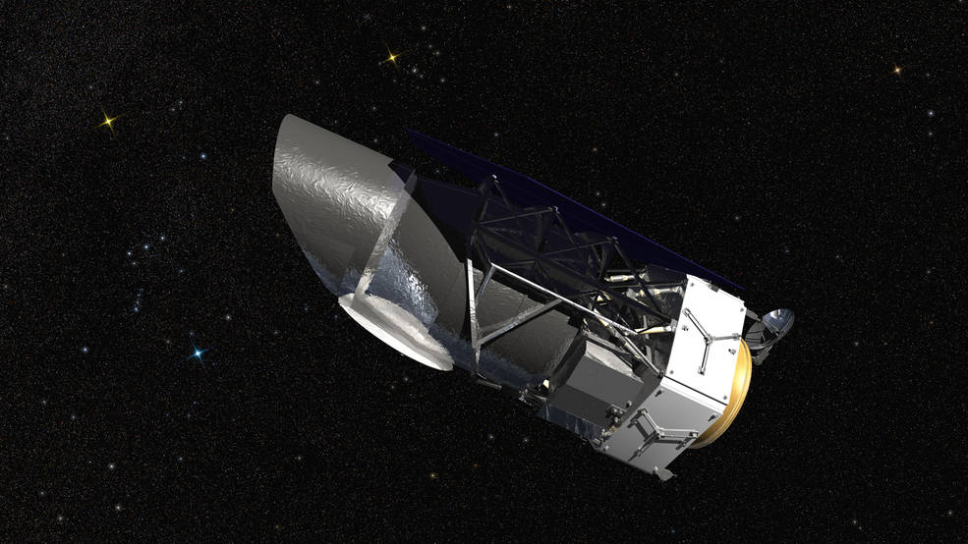
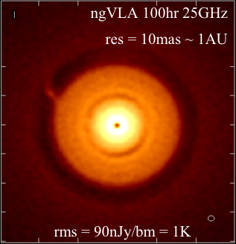
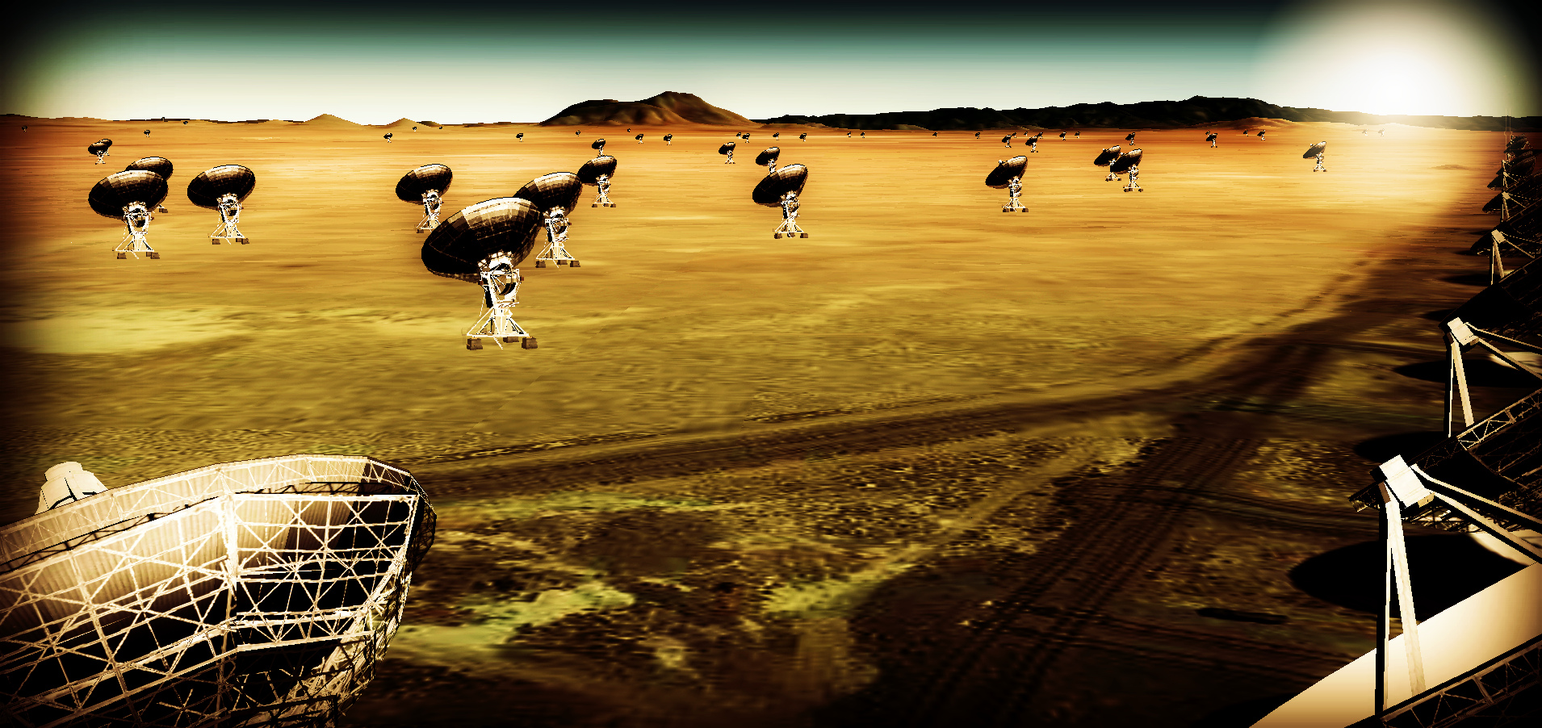
ng-Synergy: Terrestrial zone exoplanets and life
WFIRST to HabEx
Direct detection of earth-like planets
Search for atmospheric bio-signatures
Origins Space Telescope
Prevalence of water
ngVLA
Imaging the formation of terrestrial planets
Pre-biotic chemistry

Slide 9
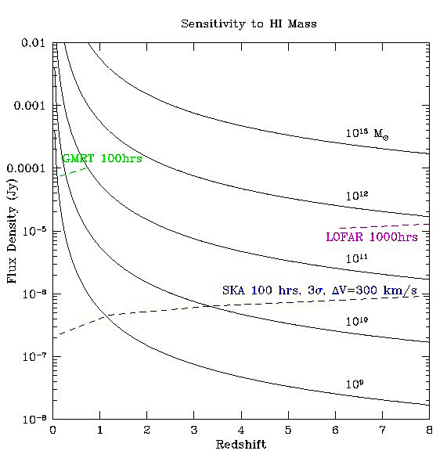
HI 21cm Cosmology: Detection of individual galaxies in HI
1sigma, 100hs, 300 km/s
Current large arrays: z < 0.5
SKA1: push to z ~ 1
SKA2: push to z ~ 2
Bottom line: HI 21cm cosmology using individual galaxies requires SKA-2
JVLA
SKA1-Mid
+
SKA2
MW at z=1

Slide 10
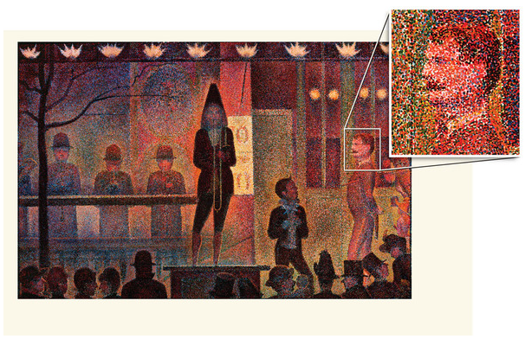
Large scale galaxy surveys
Classical method: one galaxy at time, eg. SDSS 2e7 galaxies
Intensity mapping: low spatial and spectral resolution imaging of summed signal from aggregates of thousands of galaxies on Mpc scales
Classic galaxy surveys (eg. SDSS)
Intensity mapping

Slide 11
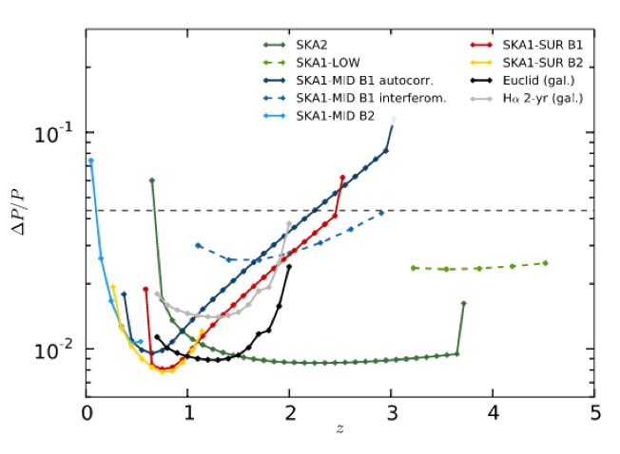
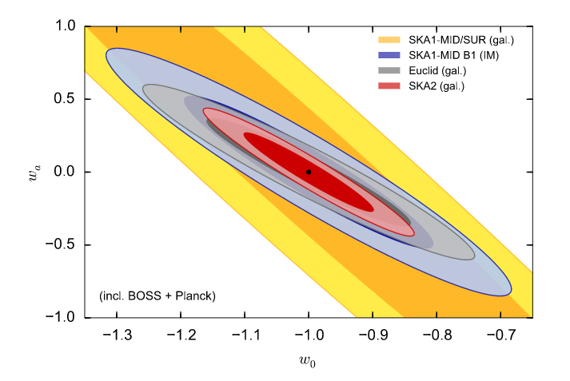
SKA1 Solution: Intensity Mapping HI 21m BAOs
SKA wide field surveys with total power!?
10,000 hours observation, 25,000 deg²
k = 0.074 h/Mpc
Santos ea. 2015
BAO level
SKA1-IM
Euclid-gal
Bull et al. 2015
SKA2-gal
Power spectrum N/S from SKA surveys on BAO scales as a function of redshift
Constraints on dynamical dark energy EoS: w(z) = w_{o} + (z/(1+z))w_{a}, for SKA and Euclid
Competitive but not unique

Slide 12
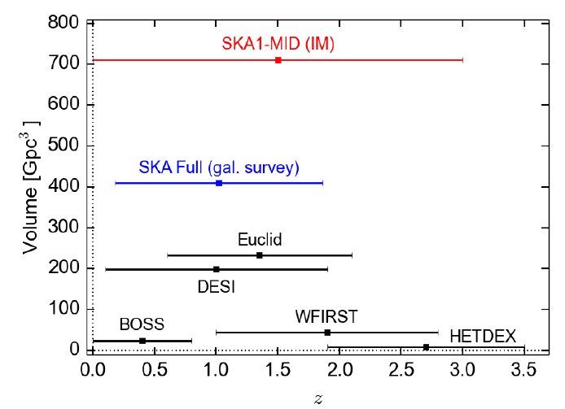
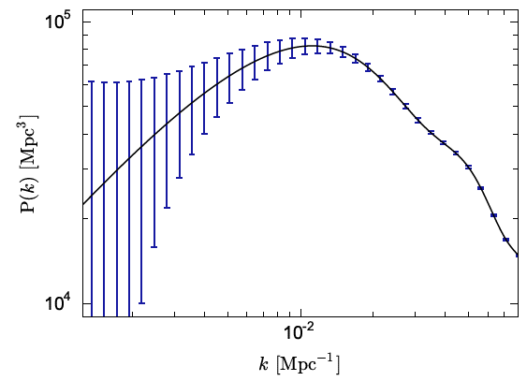
Where does SKA1 Intensity Mapping win? Huge volume
Unique parameter space for tests of physics on very large (‘horizon’) scales
k = 0.01 h/Mpc
Bull ea 2015
Santos ea. 2015
Euclid
SKA1 IM
Boss k_{min} Anderson ea.
Two year survey covering: 0.5 < z < 3 and 20,000 deg²
Low k cut-off at matter-radiation ‘equality scale’ (horizon at z~3600)
Test cosmological principle on largest scales
Primordial non-Gaussianity: manifest on largest scales?
Test gravity on largest scales

Slide 13
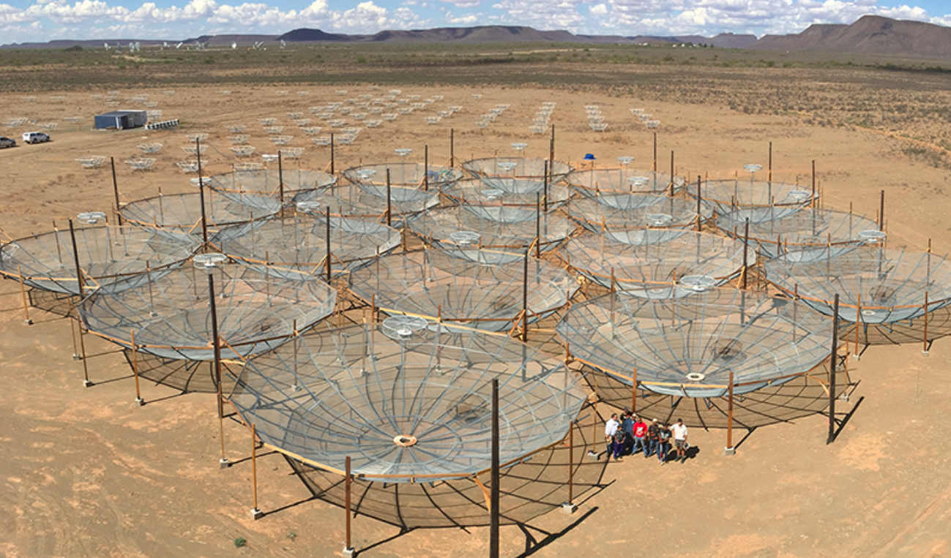
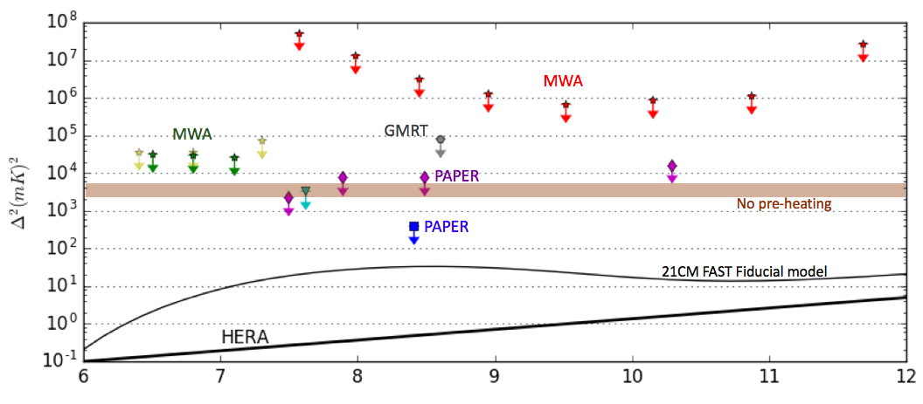
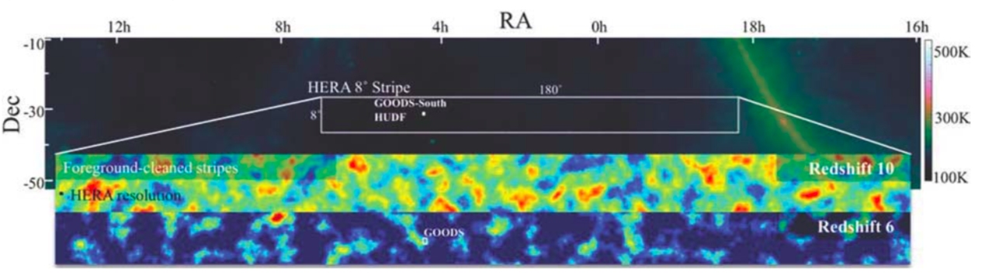
Cosmic reionization: HI 21cm image with HERA to SKA1
HERA: 100-200MHz; 80x14m ants. March 2018; 350 by end 2019
k ~ 0.1 to 0.5 h/Mpc
LOFAR
HERA350 at Dec = -30º; FoV = 10º; Res ~ 20’

Slide 14
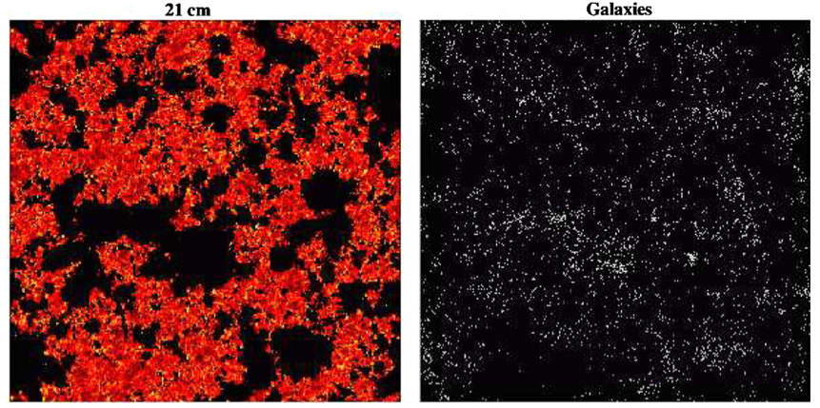
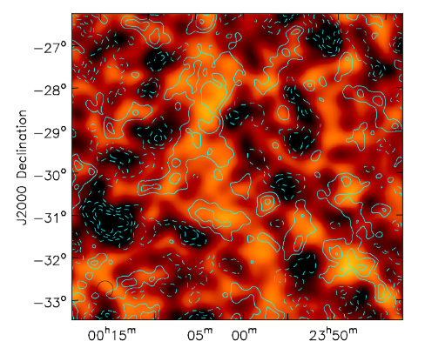
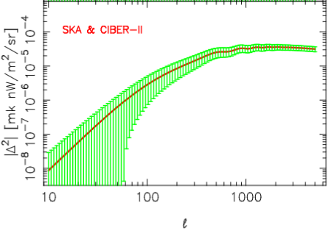
Cross Correlation w. LSS via HLS (or CII-IM…)
‘Inverse’ views of evolution of large scale structure during reionization – robust to systematics!
HERA350 can image ~ 0.5º to few deg structures at reasonable significance (few to 10 sigma)
WFIRST HLS: prospects at z = 6 ~ 10?
Neutral IGM (21cm)
130 cMpc ~ 1º
20mK
Galaxies; z = 7.3; Lidz ea
HERA z=8 100hrs
21cm x IRBG z=9
Mao 2011

Slide 15
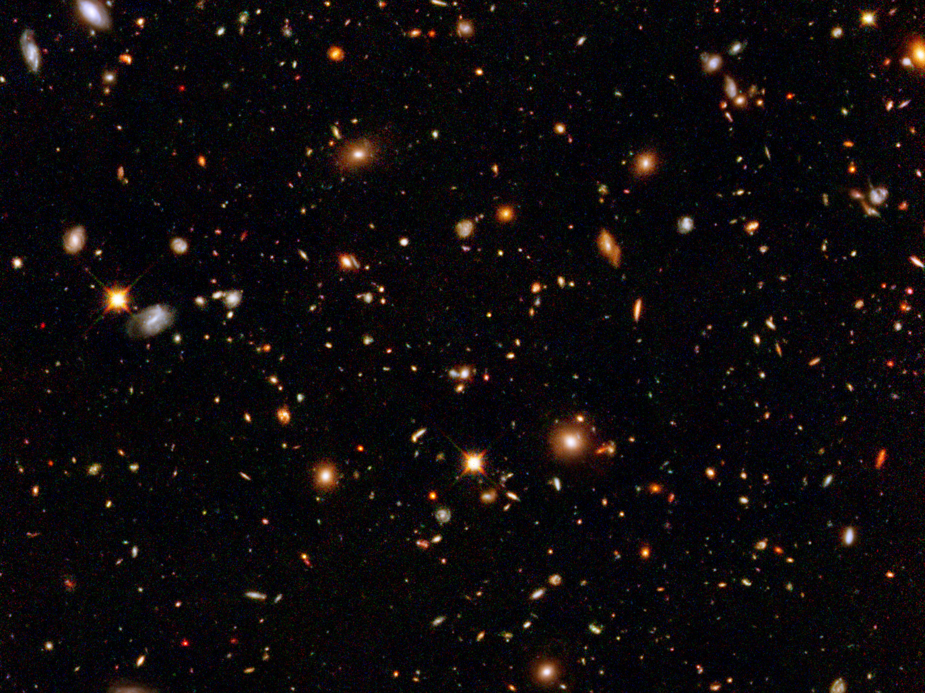
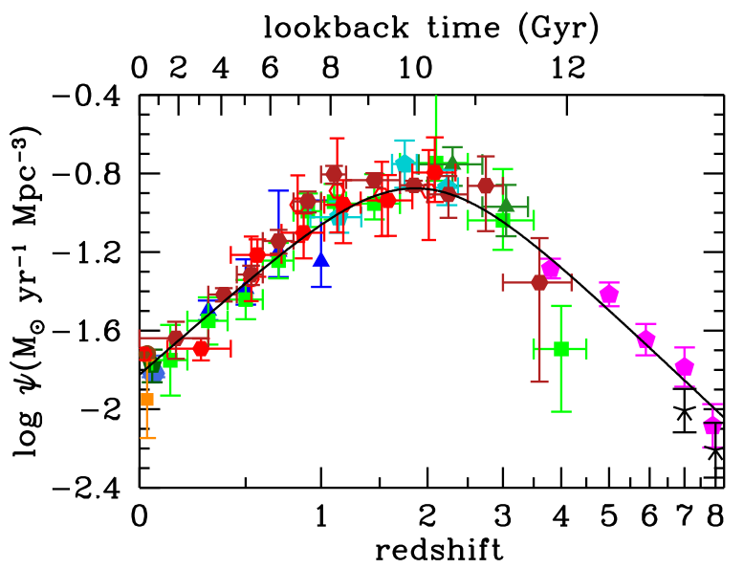
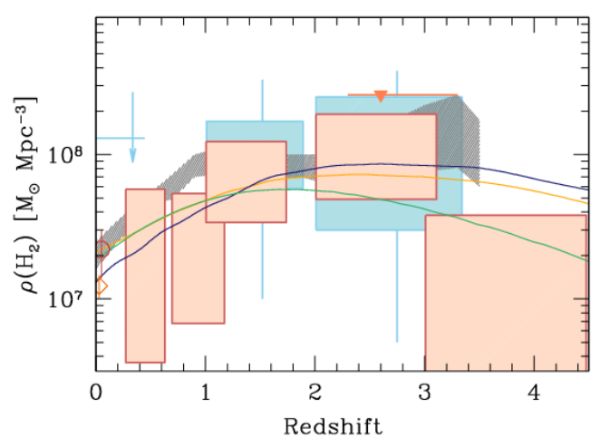
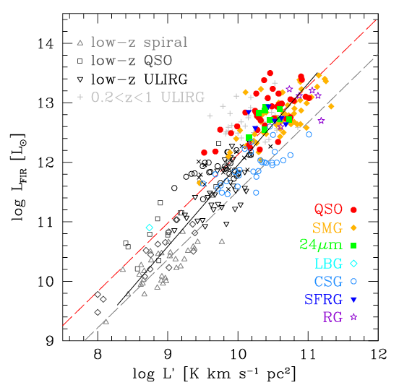
Baryon Cycle: Dense Gas History of the Universe
‘Missing half of galaxy formation’
Madua & Dickenson
‘SF Law’
FIR ~ SFR
Decarli ea 2017
FIR ~ SFR
L_{CO} ~ M_{gas}
SFHU has been delineated in remarkable detail back to reionization
SF laws => SFHU must result from evolution of dense gas in galaxies
ALMA, JVLA, Noema: first attempts at the DGHU w. 100’s hours

Slide 16
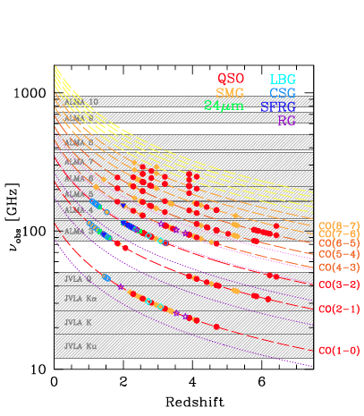
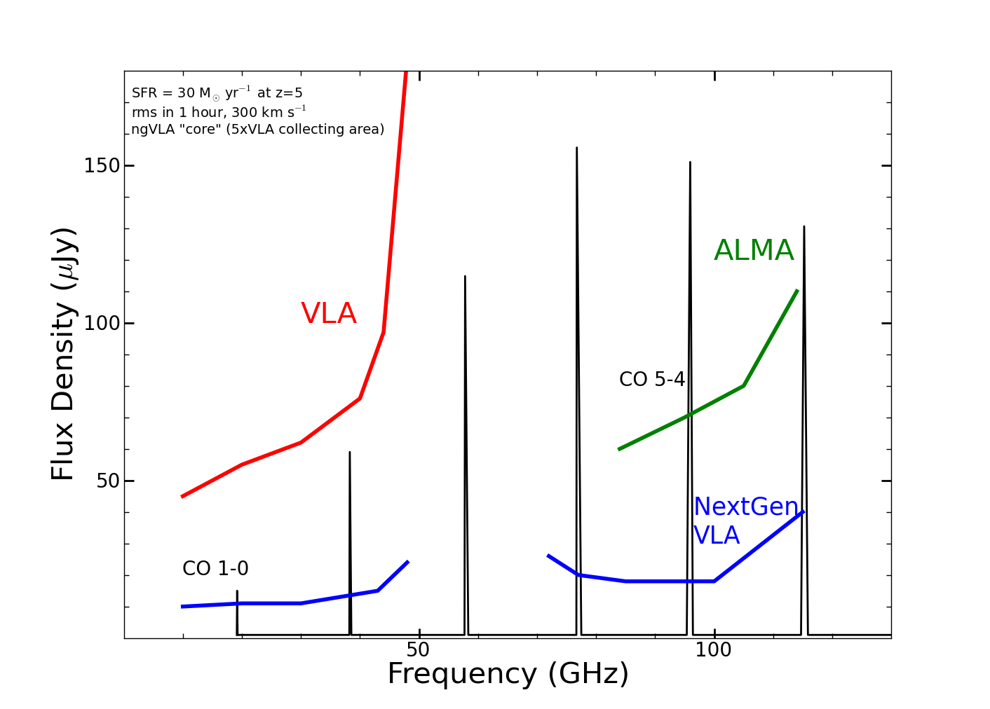
z=5, 30 M_{o}/yr, 1hr, 300 km/s
ALMA/Noema
ngVLA ‘sweet spot’
VLA
Frequency range: ideal to study dominant molecular gas tracers
10x Sensitivity: detect star forming disk (‘main sequence’) galaxies in ~ 1hr
SKA 1

Slide 17
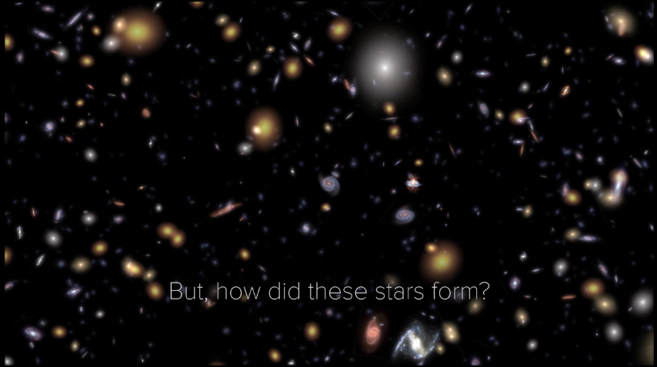
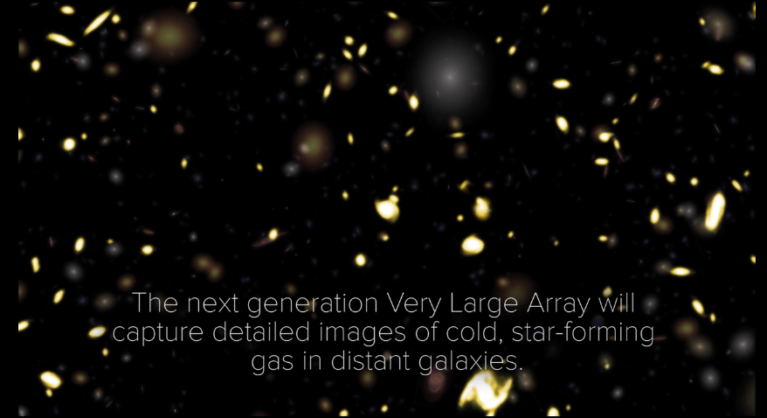
ngVLA revolution!
10x sensitivity + 2:1 band ratio => 50 to 100-fold increase in CO-discovered galaxies per hour in blind surveys
JVLA ~ 1/hr, M_{gas} > 10¹⁰ M_{o}
ngVLA ~ 100/hr, M_{gas} > 2x10⁹ M_{o}
Galaxy counts in CO ~ deepest optical fields, with redshifts (3D)!
HST stars
ngVLA CO

Slide 18
Imaging the fuel for star formation during epoch of galaxy assembly: massive disk galaxy
z=4.2, 100M_{o}/yr, CO2-1
44GHz ngVLA 30hr
VLA/ALMA
Resolution = 0.15” => 1kpc
Sensitivity 30hrs ~ few 10⁸ M_{o} at z ~ 2 to 4
Imaging gas dynamics
18

Slide 19
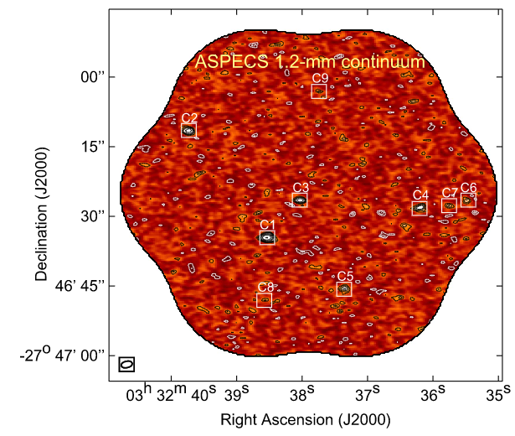
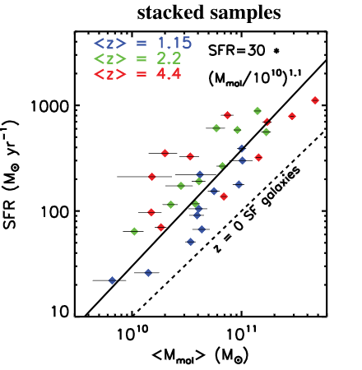
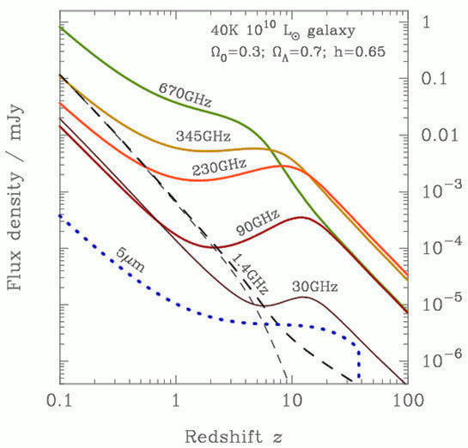
ALMA and Dust
Cold Dust + dust-to-gas ratio: Dense Gas History of the Universe
Warm Dust: (obscured) Star Formation History of the Universe
Downside: no redshifts, no dynamics, ‘coupled parameters’
Aravena ea. 2016
State of Art
12uJy/bm at 250GHz => 10 M_{o}/yr to z = 6
9 detections per arcmin²
Blain
Scoville ea. 2016

Slide 20
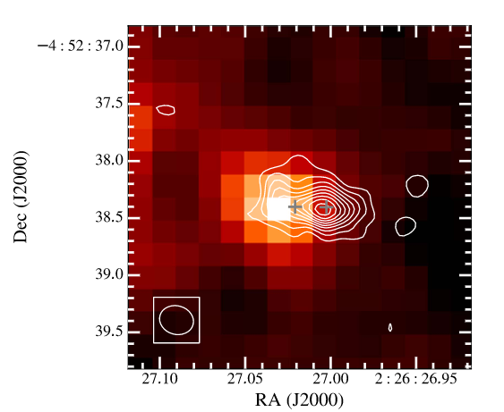
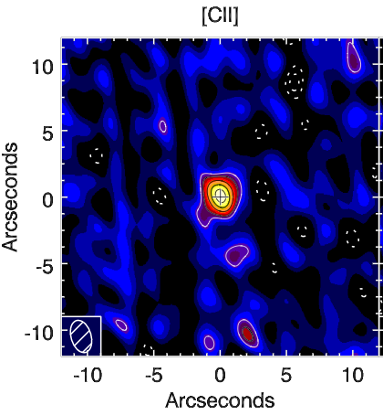
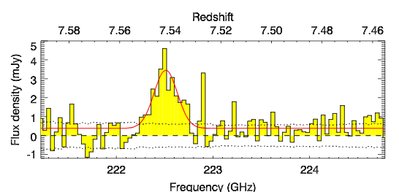
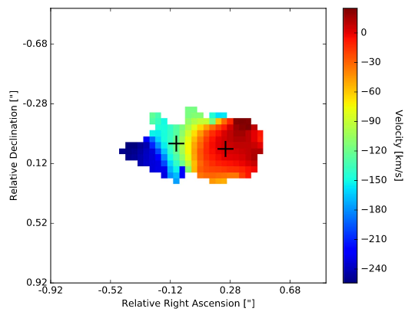
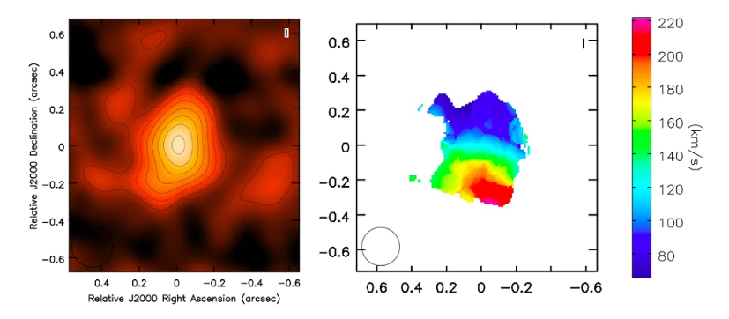
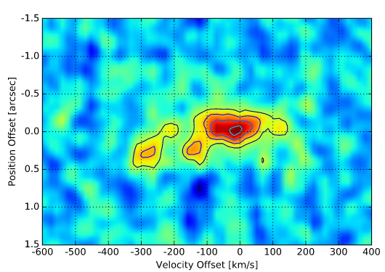
ALMA (and ngVLA) Fine Structure Lines: [CII] 158um
Z=6.1 LBG
SFR ~ 50
z = 1.2 to 15; SFR ~ 10 M_{o}/yr out z ~ 7
Spectroscopic Redshifts and Galaxy dynamics
Z = 7.5 QSO SFR ~ 200
Venemans ea.
Jones ea
ngVLA imaging at z=16 for SFR = 5 M_{o}/yr

Slide 21
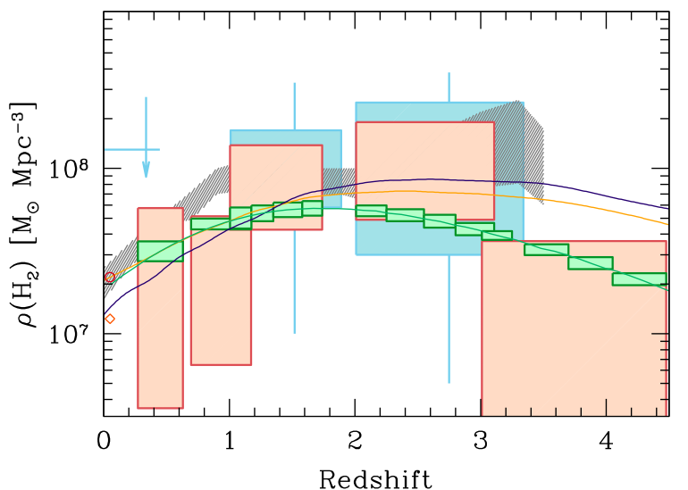
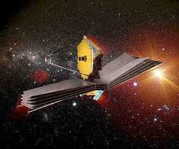
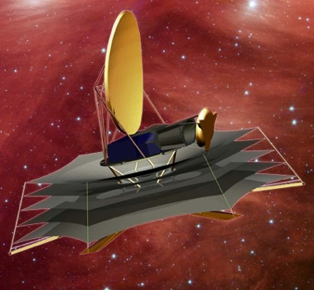
Next-Gen Synergy: Cosmic Conversion of Gas to Stars
‘Precision galaxy formation’
Gas
NGVLA
ALMA
Decarli
WFIRST/JWST: stars, star formation, dust
ngVLA and ALMA: cold gas fueling cosmic star formation

Slide 22
ngVLA: The Road to Astro 2020, and beyond
CoDR-level reference design: Project Office + TAC (Chairs : Soriano, Lamb)
Science Book: (SAC Chairs: Bolatto, Isella)
Cradle of Life: Terrestrial-zone planet formation, Massive Stars, etc.
Galaxy Ecosystems: wide field, high resolution/sensitive imaging
Galaxy Formation: Dense gas history of the Universe
Time domain, Cosmology, and Physics: Black Hole Physics, Exo-space weather, EM-GW/FRB/GRB…
$11M development funding 2017-2019: Science Cases, Antennas, Rx, LO/IF, Correlator, Config., Ops..
Partnerships
U.S. Multiagencies (ICRF; Spacecraft tracking;`burst-telemetry’; Space situational awareness)
International Partnership critical for success
Current Industrial Involvement through Community Studies
Initial costing baseline construction budget ~ $1.5B
Target operations budget of < $75M ~ 3x current VLA. Optimize operations costs during design

Slide 23





Astrophysical Frontiers in the Next Decade: Planets, Galaxies, Black Holes, & the Transient Universe Portland, OR USA June 26-29, 2018
Registration open: http://go.nrao.edu/ngVLA18
SOC co-Chairs
Brenda Matthews (NRC – Cradle of Life)
Caitlin Casey (UT – Galaxy Evolution)
Laura Chomiuk (MSU – BHs and Transients)
New research facilities and the scientific vision outlined by New Worlds, New Horizons have motivated the exploration of vast new discovery space, and astrophysics has seen extraordinary progress in the past decade, opening new frontiers across many fields. Sponsored by the National Radio Astronomy Observatory, this conference will bring together a substantial cross-section of the astronomical community to discuss how to effectively address the highest priority astrophysical questions of our time. Plenary sessions will feature invited speakers, and three parallel sessions of contributed presentations will address (1) Exoplanet and Protoplanetary Disk Origins, (2) Galaxy Evolution Mechanisms, and (3) Black Holes & Transient Phenomena. Each session will canvas recent observational and theoretical progress, address key unanswered questions, and motivate future research directions in the context of next-generation facilities that would span the electromagnetic spectrum, including a Next Generation Very Large Array, the Large Synoptic Survey Telescope, 30m-class optical-infrared telescopes, the Advanced Laser Interferometer Gravitational-Wave Observatory, and the Square Kilometre Array.

Slide 25






Versatility: Remarkable breadth of Science Enabled by the ngVLA
Time Domain
Galactic Center pulsars: testing GR
Gravitational Wave EM Follow-up
Extrasolar Space Weather: impact on formation of life!
Bursting universe (FRB, GRB, TDE…)
Black Holes
Obscured Black Hole Growth and AGN Physics
Quasar-Mode Feedback and the SZ Effect
Black hole masses and H_{o} with Mega-Masers
Solar System and non-RA applications
μas Astrometry: ICRF, Galactic structure…
Solar system remote sensing: passive and active radar
Spacecraft telemetry, tracking: movies from Pluto!

Slide 26



ngVLA Key Science Mission
Unveiling the Formation of Solar System Analogues
Probing the Initial Conditions for Planetary Systems and Life with Astrochemistry
Charting the Assembly, Structure, and Evolution of Galaxies Over Cosmic Time
Using Pulsars in the Galactic Center as Fundamental Tests of Gravity
Black Hole formation and physics and time domain astronomy (GW, FRBs, GRBs…)
Saturn @13AU
Jupiter @6AU
ngVLA 100hr 25GHz 10mas
Gas
NGVLA
ALMA
Decarli+2016
0.1” = 13AU
rms = 90nJy/bm = 1K
HI + CO(1-0)
CO(2-1)

Slide 27

Weak lensing with radio continuum surveys
Advantages
Stable and deterministic PSF of an interferometer,
Polarization: unique measure of intrinsic orientation of galaxies (B along major axis)
Higher mean redshift for sources vs. optical
Cross correlation with optical: robust to systematic errors
Disadvantage: Areal density of sources
SKA1 ~ 10 arcmin⁻²
SKA2 ~ 75 arcmin⁻²
z_{bins} = 0.5 to 3
Brown ea 2015
Power spectrum constraints on a 5-bin tomographic shear power spectrum analysis, vs. z

Slide 28


ngVLA: The Road to Astro 2020, and beyond
Project Office w. TAC: CoDR-level reference design (Chairs: Soriano, Lamb)
SAC w. Community: Science Book (Chairs: Bolatto, Isella)
Target construction baseline budget ~ $1.5B
Target operations budget of < $75M ~ 3x current VLA. Optimize operations costs during design
2017
2018
2019
Start Wed 9/14/16
Nov '16
Jan '17
Mar '17
May '17
Jul '17
Sep '17
Nov '17
Jan '18
Mar '18
May '18
Jul '18
Sep '18
Nov '18
Jan '19
Mar '19
May '19
Finish Mon 7/1/19
Sci Case Capture Mon 10/31/16 - Wed 5/30/17
Sci Book First Draft Thu 6/1/17 - Fri 12/1/17
Sci Book Second Draft Mon 12/4/17 - Fri 6/15/18
Sci Book Final Draft Mon 6/18/18 - Fri 12/14/18
ngVLA Astro2020 Proposal Sat 12/15/18 - Mon 7/1/19
Ref. Design First Draft Mon 10/31/16 - Fri 4/28/17
Rev 1 Design Docs Published (TRL1) Fri 5/12/17
Ref. Design 1.5 Draft Mon 5/15/17 - Fri 11/24/17
Reference Design Second Draft Mon 11/27/17 - Tue 7/31/18
Final Draft
Tue 10/23/18
Community Study Development Mon 10/31/16 - Tue 8/15/17
2020
Rev 1.5 Design Docs Published (TRL1)
Release 2nd Draft of Sci Book Fri 6/15/18
2023
Publish Final Draft of Sci Book Fri 12/14/18
Submit RFIR1 Mon 4/1/19
Design Docs Rev2 Released for Review (TRL2) Tue 7/31/18
Submit RFIR2 Mon 7/1/19
Release 1st Draft of Sci Book Fri 12/1/17
Submit NOI Fri 1/11/19
Final Design Docs Published Tue 10/23/18
Submit SWPs Fri 2/15/19
Pre-Proposal Review #1 Complete
US Radio Futures Conference #3
Community Study Final Reports Due Tue 8/15/17
Pre-Proposal Review #2 Complete Fri 9/28/18
2025
2034

