Slide 1
Intro and Science Program
Chris Carilli
https://ngvla.nrao.edu

Slide 2
Next Generation Very Large Array: URSI 2018 Talks
J1-1 THE SCIENCE PROGRAM FOR THE NEXT GENERATION VERY LARGE ARRAY, Chris Carilli
J1 -2 ANTENNA CONCEPT FOR THE NEXT GENERATION VERY LARGE ARRAY, James M. Jackson
J1-4 BASELINE RECEIVER CONCEPT FOR A NEXT GENERATION VERY LARGE ARRAY, Wes Grammer
J2-2 ADVANCES IN AN 8 TO 50 GHZ CRYOGENIC LOW NOISE AMPLIFIER FOR THE NEXT GENERATION VERY LARGE ARRAY, Andrew Janzen
J4-2 THE NEXT GENERATION VERY LARGE ARRAY LONG BASELINE OPTION, Robert J. Selina
J5-2 PERFORMANCE ESTIMATES FOR THE NEXT- GENERATION VERY LARGE ARRAY, Robert J. Selina
J5-3 A STUDY OF THE COMPACT WATER VAPOR RADIOMETER FOR THE KARL G. JANSKY VERY LARGE ARRAY, Ajay Gill

Slide 3
A next generation VLA A New Array for the mid-21st Century: thermal imaging on milliarcsec scales
Core Design Requirements
10x effective collecting area of JVLA and ALMA at 30GHz
10x resolution of JVLA and ALMA
Frequency range: 1.2 –116 GHz
Reference design established; DS2020 Baseline design under development
Numerous Science and Technical meetings, starting Jan 2015 AAS
Initial Science Working Group reports Nov 2015
Community Studies Program: 38 studies approved over 2 Rounds
Community-Led Science Use Cases: 80 submitted for ‘Reqs to Specs’ process
SAC and TAC established
Socorro June 2017 Sci/Tech meeting: Consensus Reference Design and Key Science Goals
Notes:
Where we started… goals for the array.
Really was EVLA phase 2 (New Mexico Array) then North America Array

Slide 4
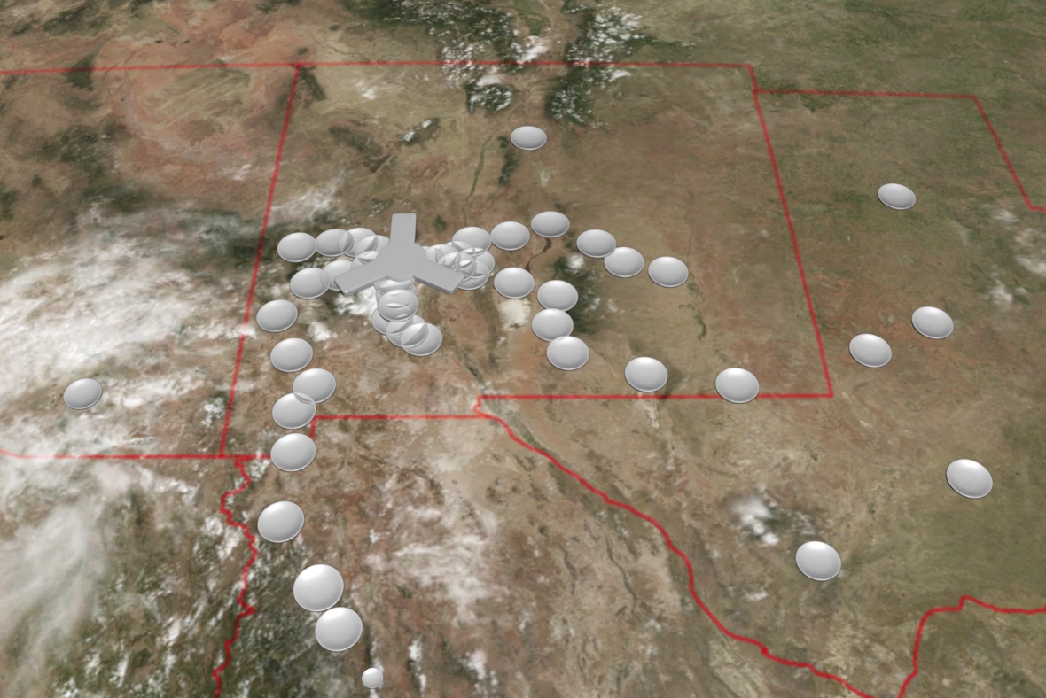
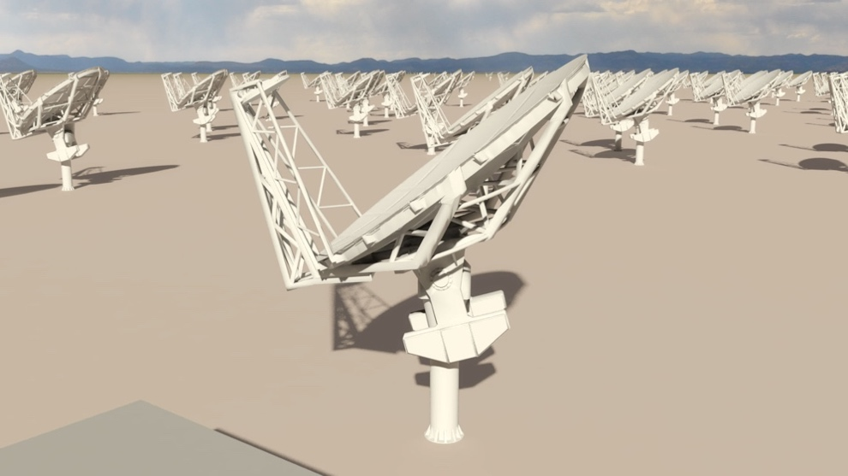

Reference Design: ‘Southwest Array’ (memo 17)
550km
214 18m offset Gregorian (feed-low) antennas
Fixed antenna locations in Southwest USA and Mexico: good 3mm site (elev ~ 2000m)
50% to core: b < 3km => 1” at 30GHz
80% to mid: b < 30km => 0.1”
100% to long: b < 800km => 0.003”
1.2 – 50.5 GHz; 70 – 116 GHz
Single-pixel feeds
6 feeds / 2 dewar package
Continuum sens (10hr) = 0.1uJy/bm @ 1cm, 0.01” (T_{B} = 2K)
Line sens = 21.5uJy/bm @ 1cm, 10 km/s, 1” (T_{B} = 35mK)
Main options under consideration
VLBI: dedicated and/or networked?
Short-spacing/total power array
350 miles

Slide 5
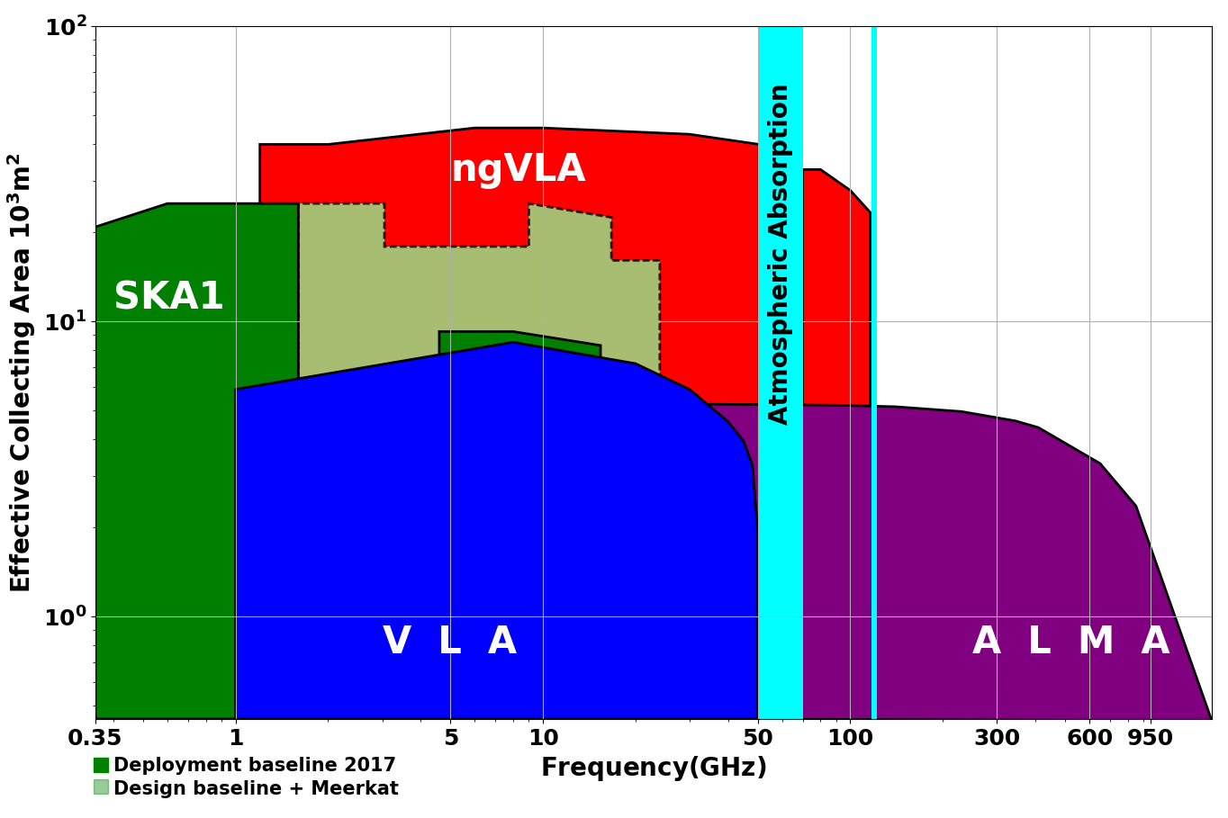
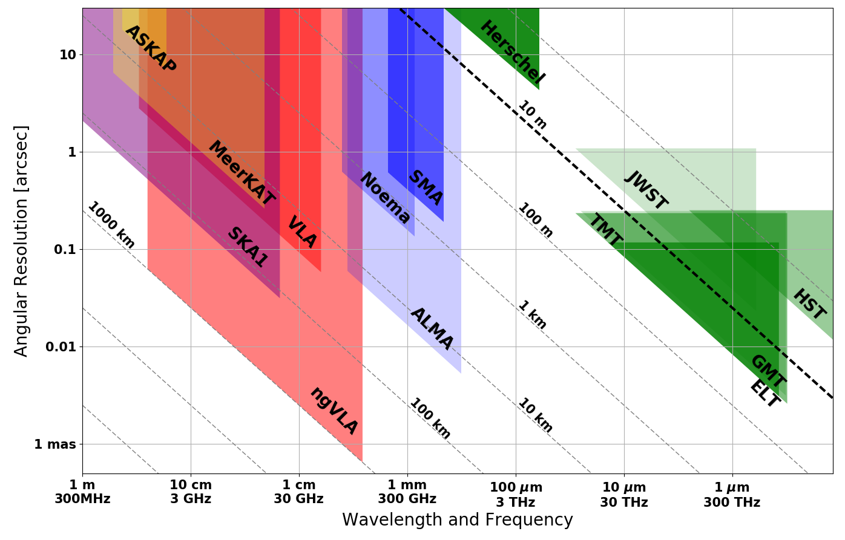
Bridging SKA & ALMA Scientifically
Thermal Imaging on mas scales at λ ~ 0.3cm to 3cm
Terrestrial zone planet formation: 1AU @ 140pc
Complementary suite from cm to submm arrays for the mid-21st century
< 0.3cm: ALMA 2030 superb for warm chemistry, dust, fine structure lines
0.3 to 3cm: ngVLA ngVLA superb for terrestrial planet formation, dense gas history, baryon cycling
> 3cm: SKA superb for pulsars, reionization, HI + continuum surveys
Notes:
Snapshot comparison of effective collecting area for dish-arrays expected in the 2030’s.
Assumes SKA deployment baseline (July 2017)
SKA 1
- 130 antennas, SKA bands 1, 2
- 67 antennas, SKA Band 5 a/b
MeerKAT:
- 64 antennas, bands 1, 2, 3
MeerKAT has receiver indexer with 4 slots

Slide 6
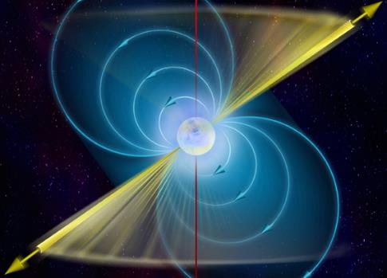
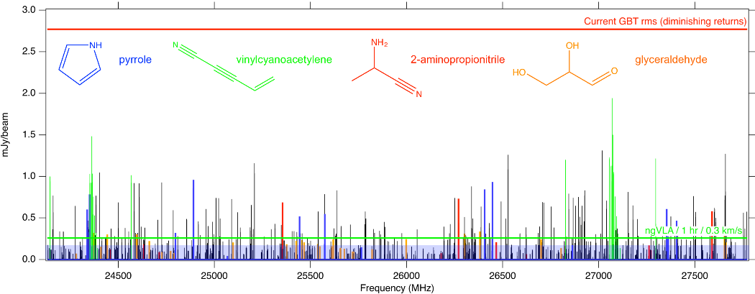
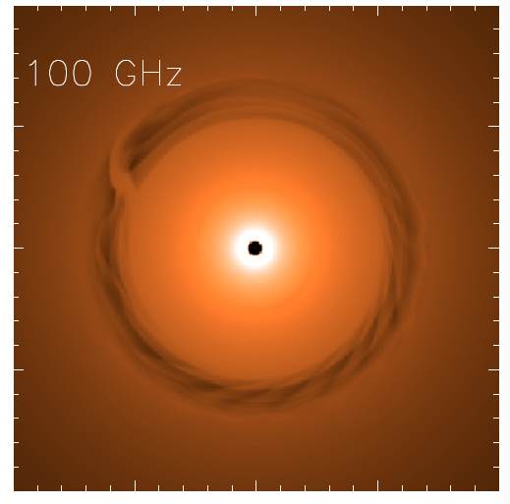
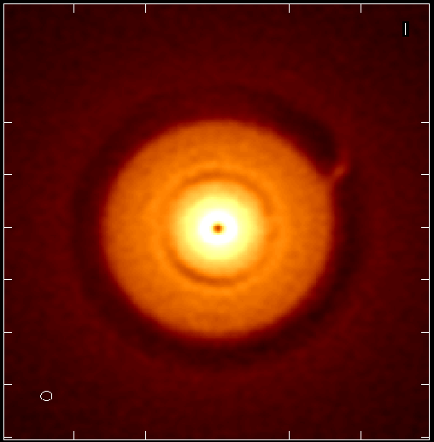
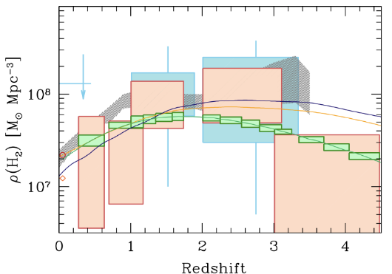
ngVLA Key Science Mission (ngVLA memo #19)
Unveiling the Formation of Solar System Analogues
Probing the Initial Conditions for Planetary Systems and Life with Astrochemistry
Charting the Assembly, Structure, and Evolution of Galaxies Over Cosmic Time
Using Pulsars in the Galactic Center as Fundamental Tests of Gravity
Black Hole formation and physics and time domain astronomy (GW, FRBs, GRBs…)
Saturn @13AU
Jupiter @6AU
ngVLA 100hr 25GHz 10mas
Gas
NGVLA
ALMA
Decarli+2016
0.1” = 13AU
rms = 90nJy/bm = 1K
HI + CO(1-0)
CO(2-1)

Slide 7
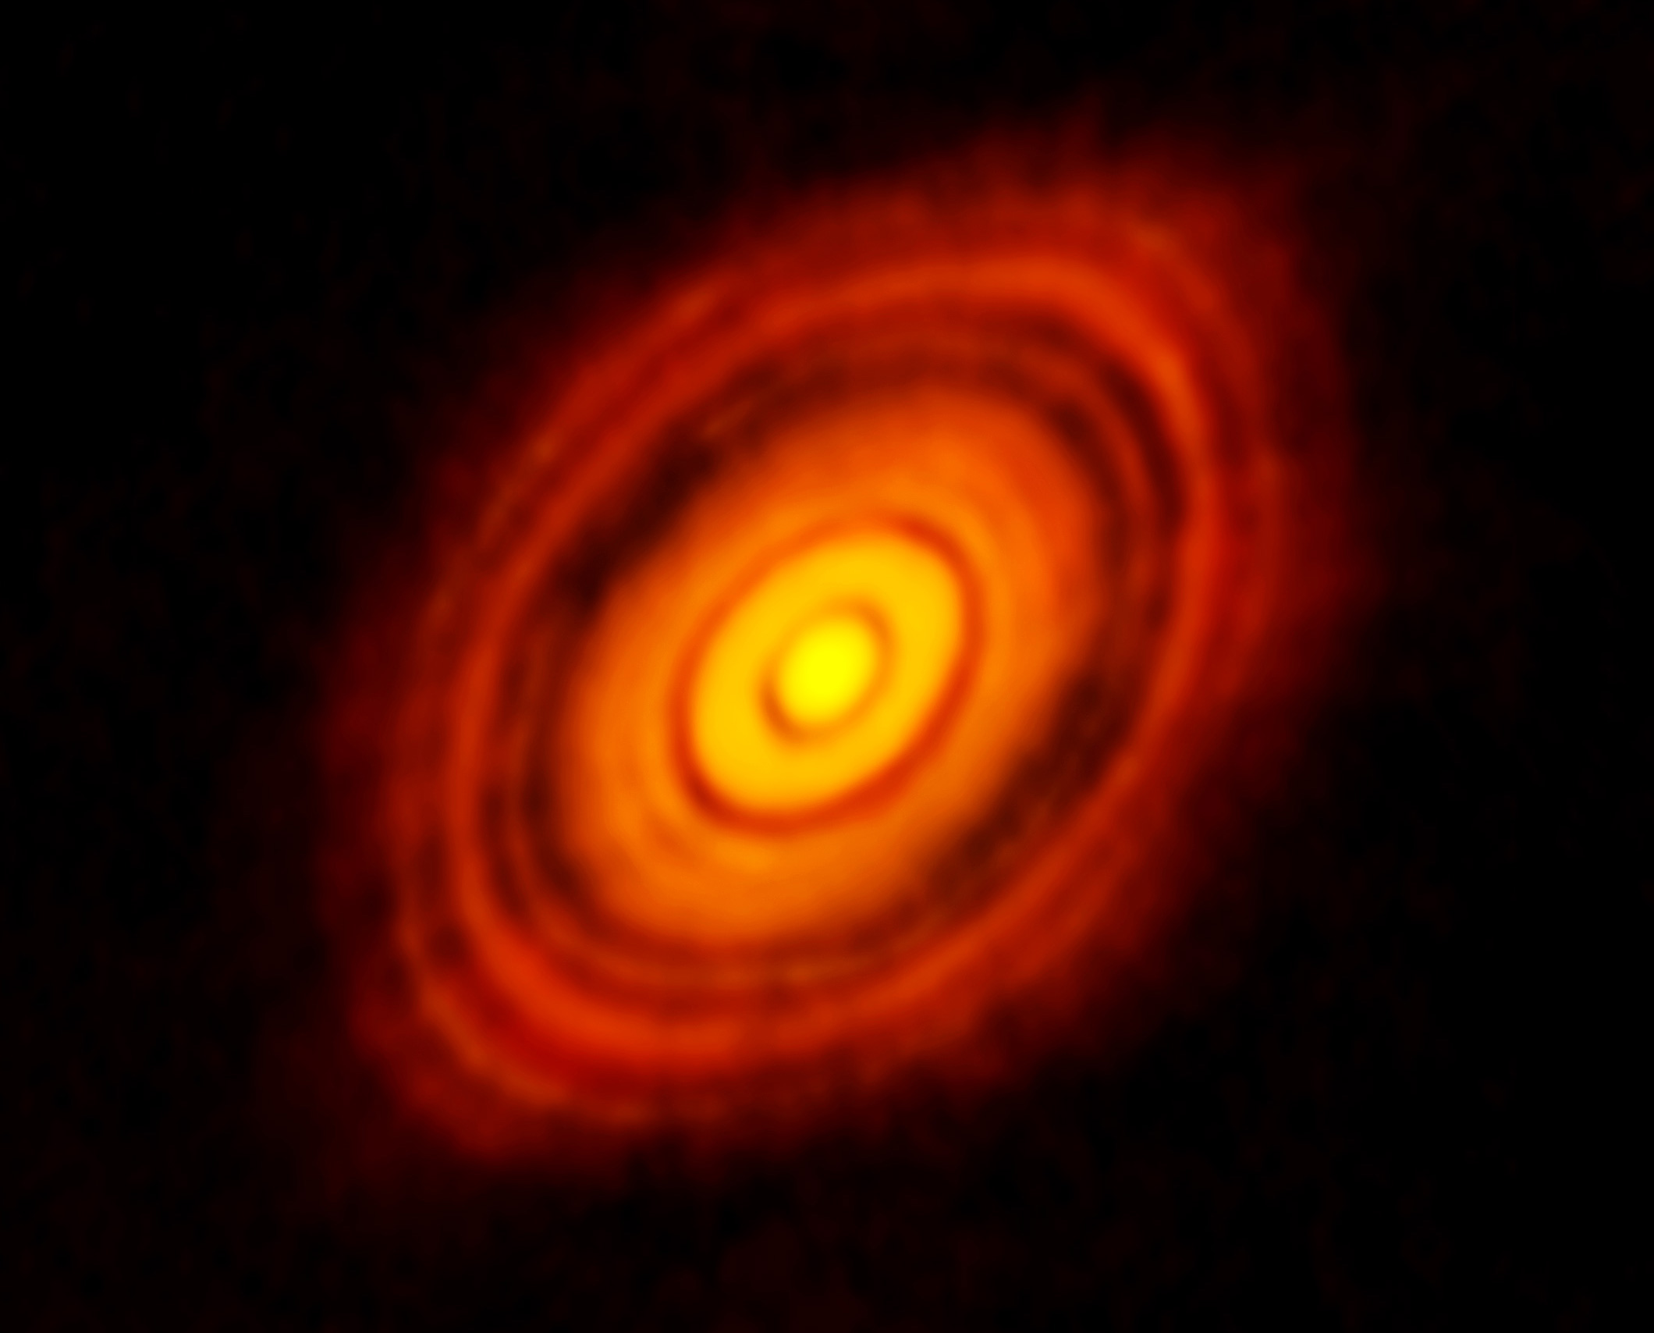
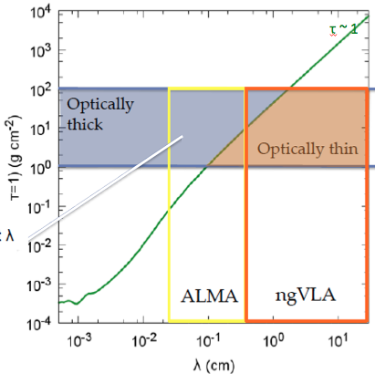
Terrestrial zone planet formation
ALMA 250GHz (Brogan ea.)
HL Tau: Rosetta Stone of planet formation around Solar-mass protostar
Distance = 140pc
1Myr protostar ~ 1 M_{o} w. 0.1 M_{o} dusty disk
100AU = 0.7”
Inner ~ 10AU optically thick at mm wavelengths = ‘ngVLA zone’
Isella ea.

Slide 8
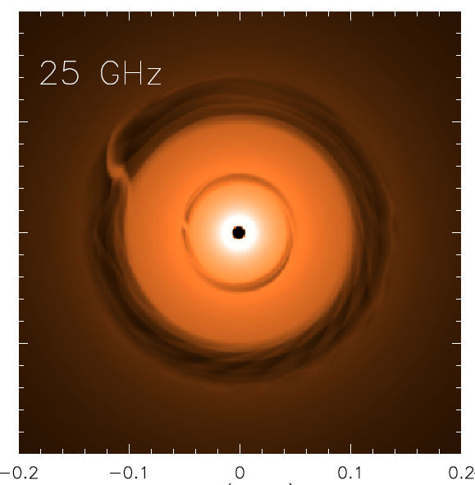
NGVLA: 1Myr Protoplanetary disk at 140pc distance
Saturn at 13AU
Jupiter at 6AU
ngVLA 100hr 25GHz
res = 10mas ~ 1AU
0.1” = 13AU
Isella Dust Model
Model
rms = 90nJy/bm = 1K
Next generation VLA and Planet formation
Probe inner few AU-scales (‘Solar-system scales’)
Measures the planet initial mass function down to 5-10 Earth masses and unveil the formation of planetary systems similar to our own
Reveal circumplanetary disks and sub-structures in the distribution of mm-size particles created by close-in planets, and measure the orbital motion of these features on monthly timescales.

Slide 9
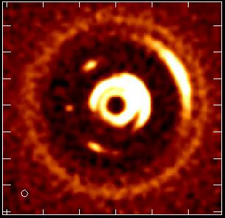
Movies of planet formation: Solar System Analogues and the Initial Conditions for the Develoment of Life
Large Molecule Astrochemistry: Observe complex pre-biotic molecules and determine the chemical initial conditions in forming solar systems and individual planets
Luca Ricci et al.
Simulated 100 GHz ngVLA observations of a newborn planetary system comprising a Jupiter analogue orbiting at 5 AU from a Solar type star, over ~ 10 years.
Notes:
Turning planet formation science into a time-domain science!
Of the 3 blobs you see at 5 au, the one associated to the Jupiter-mass planet is the one in the middle.
The other two blobs in the movie (leading and trailing) are dust particles concentrated in the L4 and L5 Lagrangian points of the star - Jupiter-mass planet system.
Dust emission comes from the circum-planetary disk orbiting the planet, so the planet is mostly formed in that movie (I say "mostly" cause material in the circumplanetary disk will accrete onto the planet, therefore increasing its mass by some amount).

Slide 10
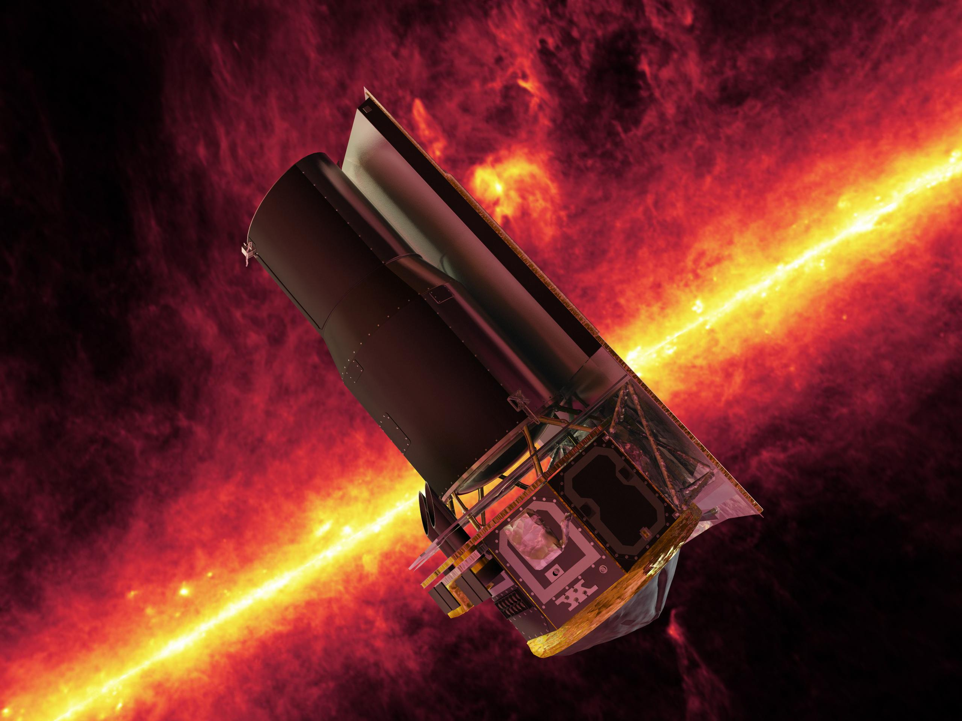
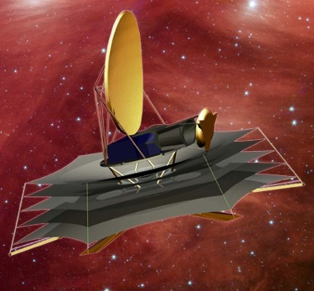
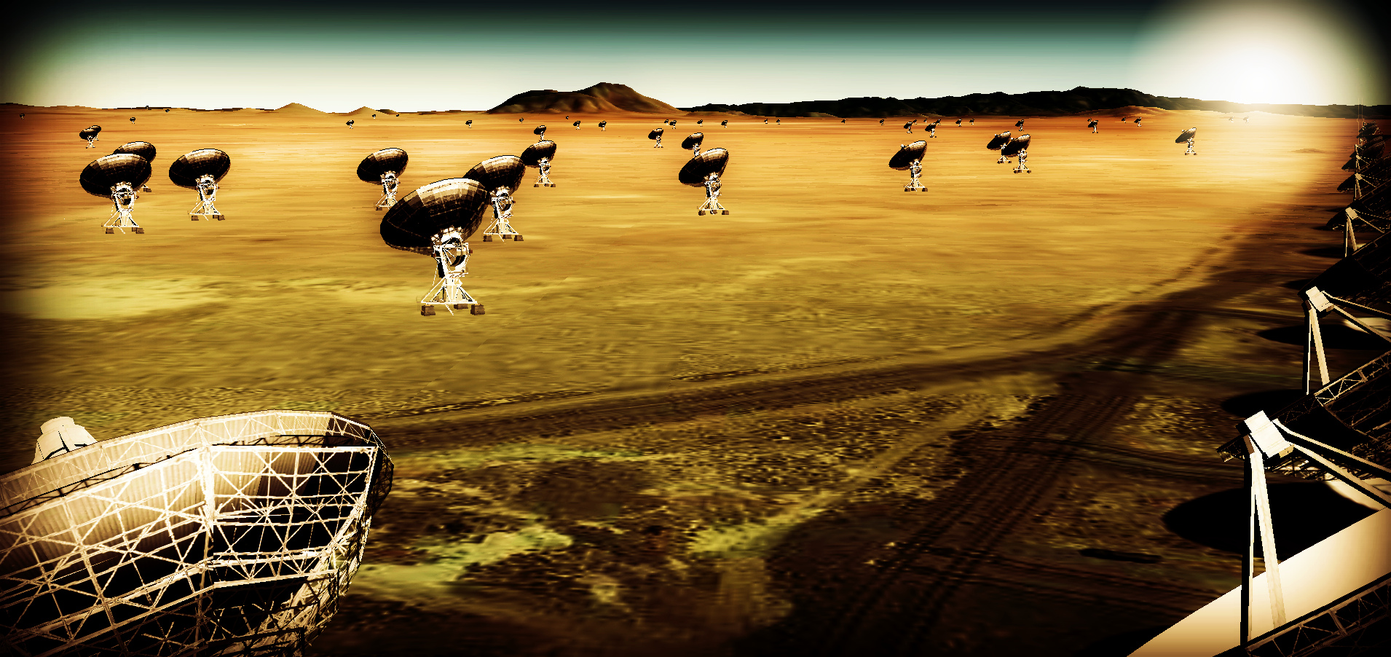
ng-Synergy: Terrestrial zone exoplanets and life
Habitable Exoplanet imaging mission
Direct detection of earth-like planets
Search for atmospheric bio-signatures
Origins Space Telescope
Prevalence of water
ngVLA
Imaging formation of terrestrial planets
Pre-biotic chemistry

Slide 11
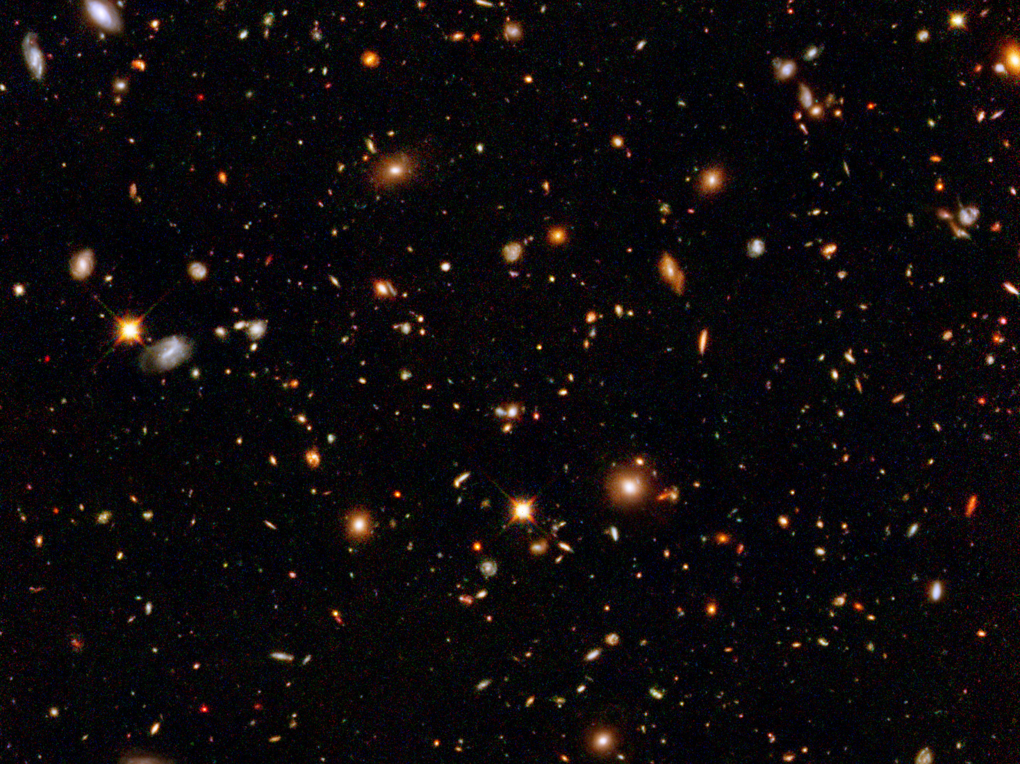
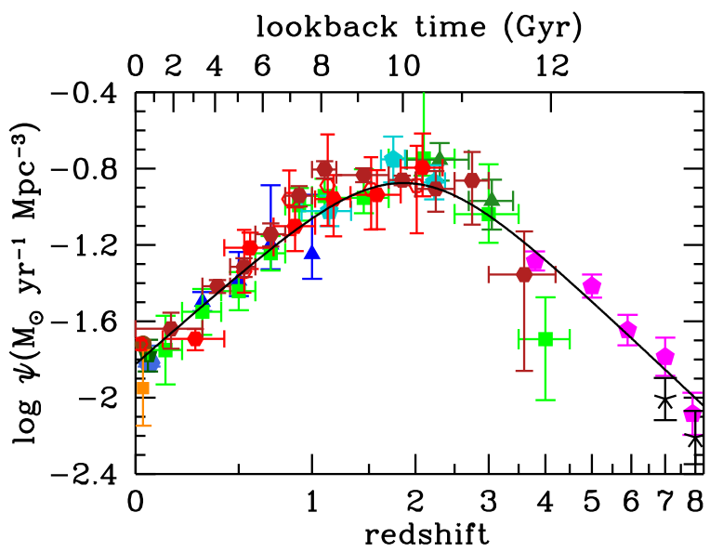
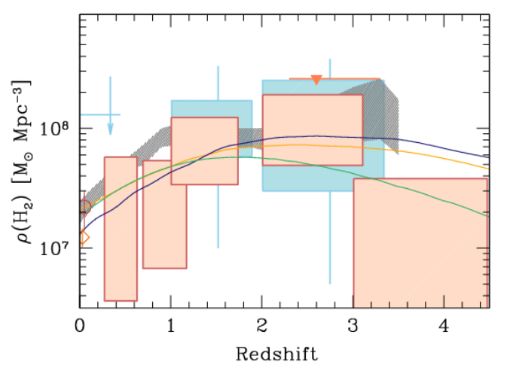
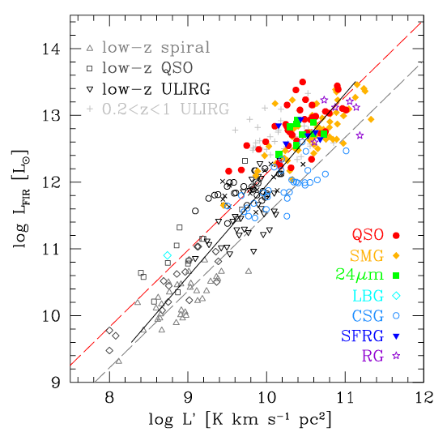
SWG3: Dense Gas History of the Universe
‘Missing half of galaxy formation’
Madua & Dickenson
‘SF Law’
FIR ~ SFR
Decarli ea 2017
FIR ~ SFR
L_{CO} ~ M_{gas}
SFHU has been delineated in remarkable detail back to reionization
SF laws => SFHU must result from evolution of dense gas in galaxies
ALMA, JVLA, Noema: first attempts at the DGHU w. 100’s hours

Slide 12
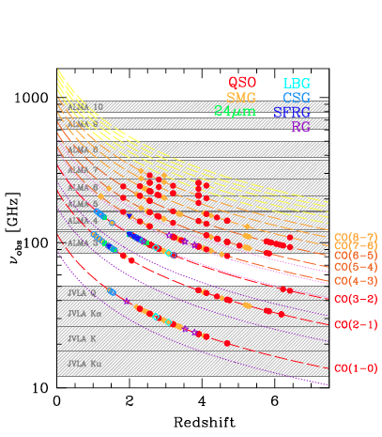
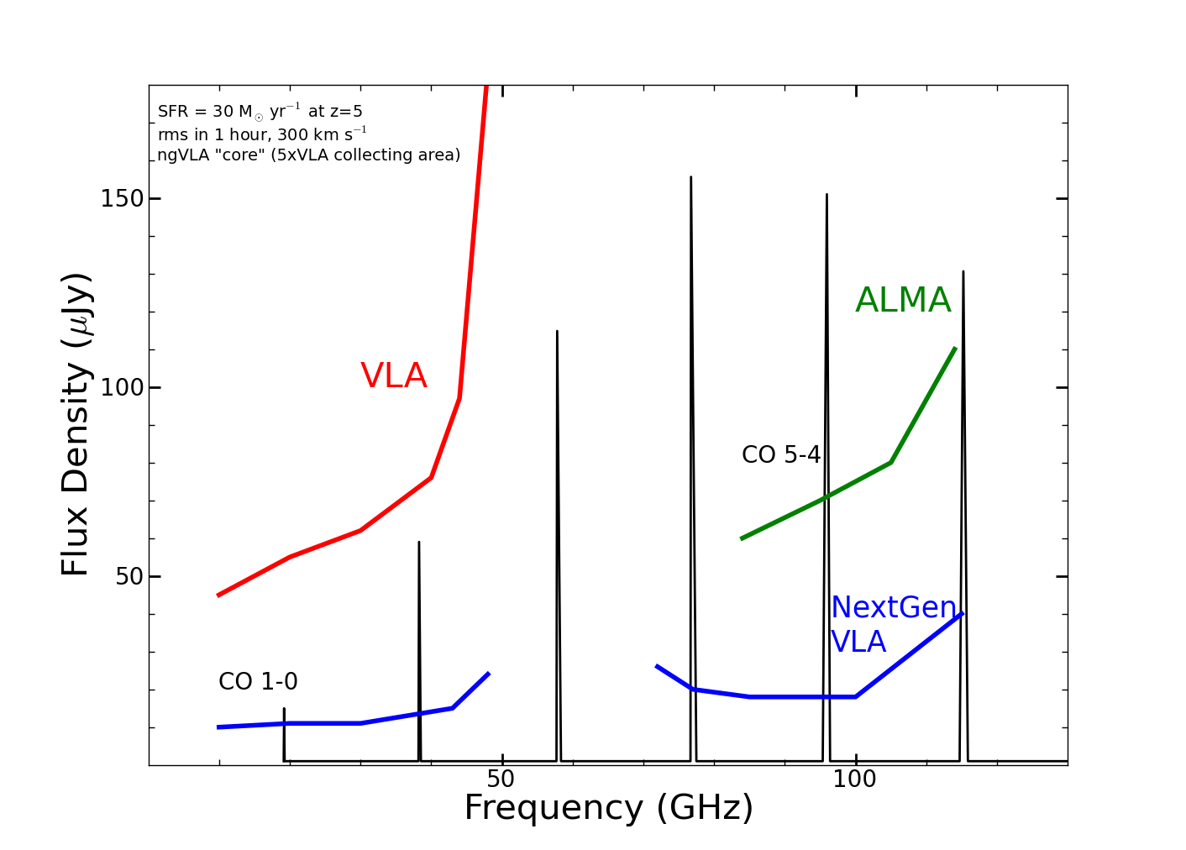
z=5, 30 M_{o}/yr, 1hr, 300 km/s
ALMA/Noema
ngVLA ‘sweet spot’
VLA
Frequency range: ideal to study dominant molecular gas tracers
10x Sensitivity: detect star forming disk (‘main sequence’) galaxies in ~ 1hr
SKA 1

Slide 13
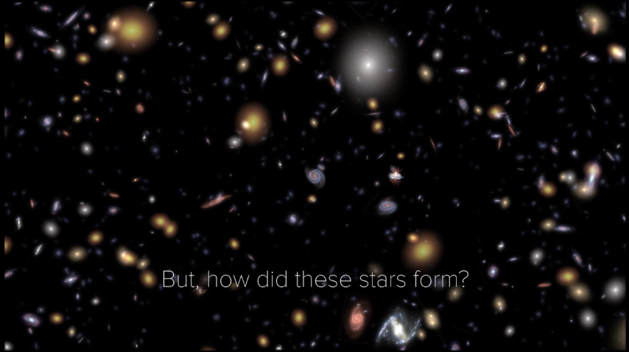
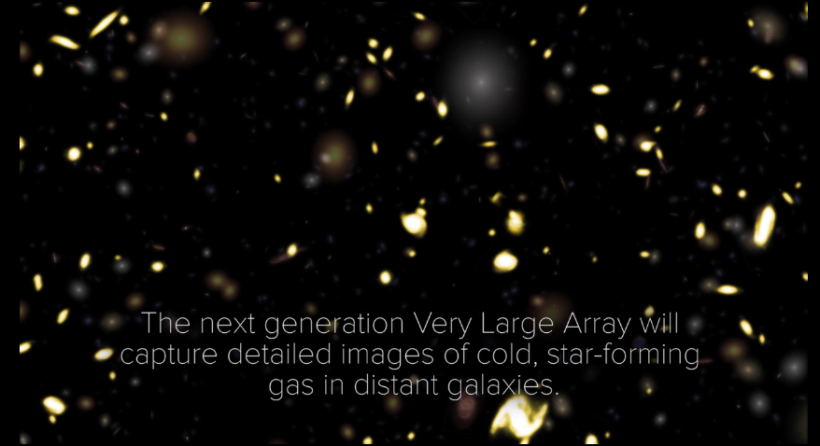
ngVLA revolution!
10x sensitivity + 2:1 band ratio => 50 to 100-fold increase in CO-discovered galaxies per hour:
JVLA ~ 1/hr, M_{gas} > 10¹⁰ M_{o}
ngVLA ~ 100/hr, M_{gas} > 2x10⁹ M_{o}
Galaxy counts in CO ~ deepest optical fields, with redshifts (3D)!
HST stars
ngVLA CO

Slide 14
Imaging the fuel for star formation during epoch of galaxy assembly: massive disk galaxy
z=4.2, 100M_{o}/yr, CO2-1
44GHz ngVLA 30hr
VLA/ALMA
Resolution = 0.15” => 1kpc
Sensitivity 30hrs ~ few 10⁸ M_{o} at z ~ 2 to 4
Imaging gas dynamics
14

Slide 15

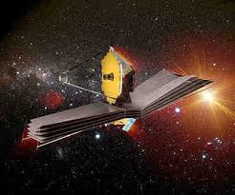
Next-Gen Synergy: Cosmic Conversion of Gas to Stars
‘Precision galaxy formation’
Gas
NGVLA
ALMA
Decarli
JWST/ELT/OST: stars, star formation, dust
ngVLA: cold gas fueling cosmic star formation

Slide 16
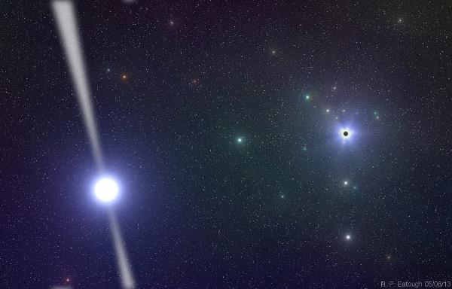

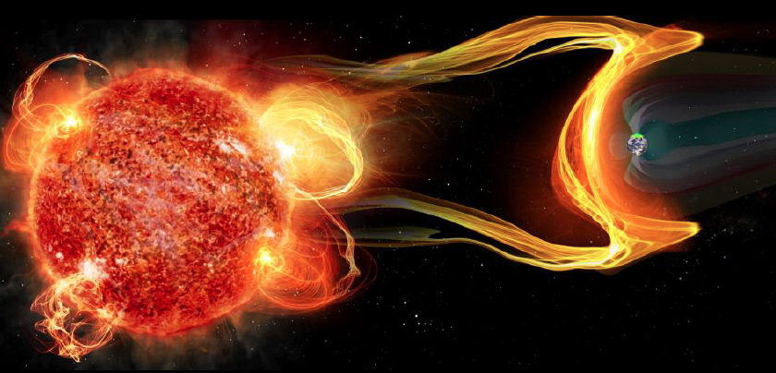
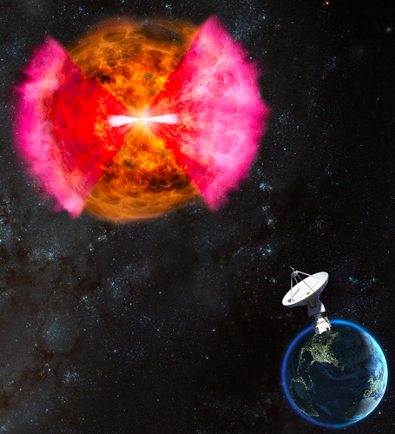
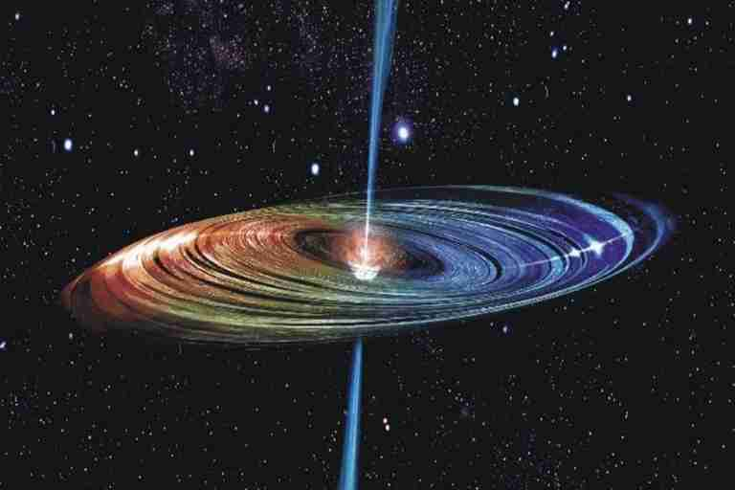
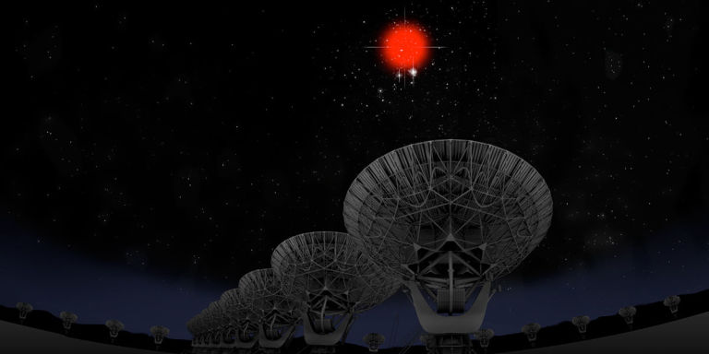
Versatility: Remarkable breadth of Science Enabled by the ngVLA
Time Domain
Galactic Center pulsars: testing GR
Gravitational Wave EM Follow-up
Extrasolar Space Weather: impact on formation of life!
Bursting universe (FRB, GRB, TDE…)
Black Holes
Obscured Black Hole Growth and AGN Physics
Quasar-Mode Feedback and the SZ Effect
Black hole masses and H_{o} with Mega-Masers
Solar System and non-RA applications
μas Astrometry: ICRF, Galactic structure…
Solar system remote sensing: passive and active radar
Spacecraft telemetry, tracking: movies from Pluto!

Slide 17

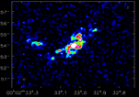
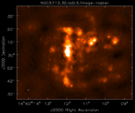
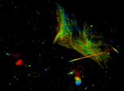

Next step: Fine-tune Science Requirements and Map to Telescope Specifications (80 use-cases to date)
Goal | Science Requirement | Array Specification
Terrestrial-Zone Planet Formation | Optically thin | Freq ~ 15 to 50GHz
 | 1AU at 130pc @ 30GHz | B < 300-500km
 | 1K in 10hrs @ 10mas, 30GHz | A_{full} ~ 300 x 18m; BW ~ 20GHz
Dense gas History of the Universe | CO 1-0 to z=8 | Freq = 15 to 115GHz
 | M_{gas} = 10⁹ M_{o} at z = 3 in 1hr | A_{mid} ~ 70% to B ~ 30km
 | 500pc resolution at z = 3 (60mas) | 30km
 | Large volume surveys | Octave Band Ratio
Baryon Cycling | T_{B} < 0.2K (1hr, 10 km/s, 80GHz, 1”) | A_{core} >30% to B ~ 2km
 | Continuum science | Octave BR; Linear pol to 0.1%
Time Domain, Cosmology, Physics | Explosive follow-up (GRBs, GW/EM…) | Minute trigger response time
 | Blind discoveries (e.g.. FRBs) | millisecond searches
 | Exo-space weather: 1uJy in 1min | Freq ~ 1 to 20GHz A_{full} ~ 10x JVLA Circular pol to few %

Slide 18
Estimated Price Tag (Internal Preliminary Costing Exercise)
Target construction baseline budget ~ (2016) $1.5B
Target operations budget of < (2016) $75M (< 3x current VLA)
Operations, maintenance, computing, archiving, etc.: optimize as part of design
Partnerships:
Possible U.S. Multiagency Interest [including VLBI option]
ICRF – DOD/Navy, Air Force
Spacecraft tracking/imaging, `burst-telemetry’ (mission-critical events) – NASA, DOD
Space situational awareness – DOD
Strong International Partnership critical for success:
Current International Involvement in SAC/TAC/Community Studies:
Canada, Mexico, Japan, Germany, Netherlands, Taiwan
Current Industrial Involvement through Community Studies:
REhnu Inc., Minex Engineering Corp, LaserLaB, Quantum Design
Notes:
Anticipating “Open Skies” policy
Is this SKA-High? Scientifically, the same direction.

Slide 19
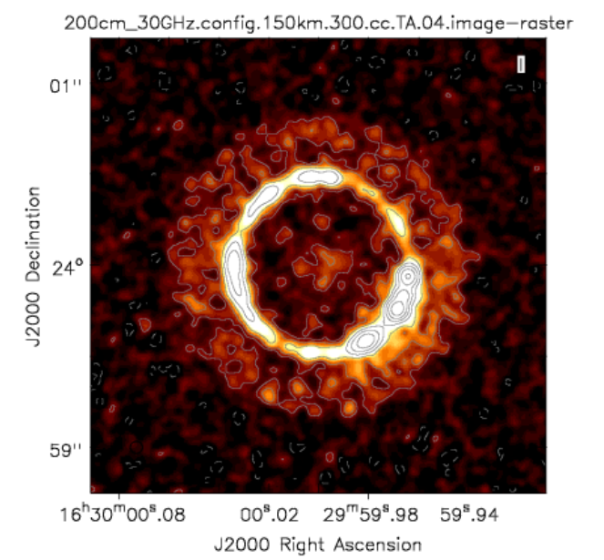
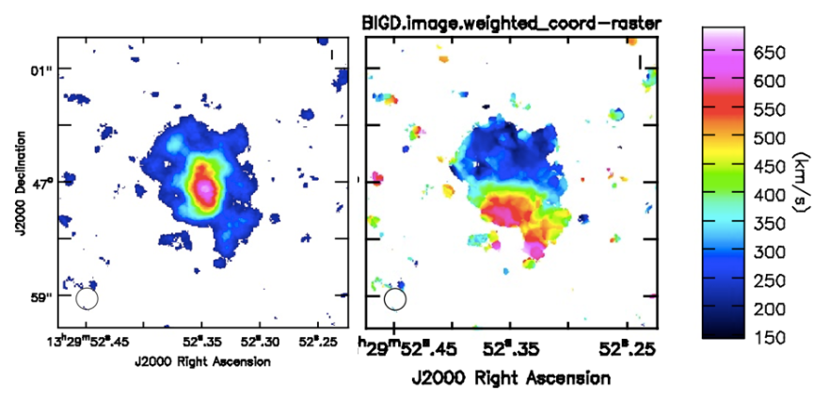
Array Simulation Tools: working and improving
Debris disk 1cm, 10mas
Configurations
Southwest Configuration (214 x 18m; 1000km)
Add VLBA (4000km)
To come: short baseline array
CASA simulator
Simobserve: generate mock.ms from FITS image cubes
Add thermal noise
Explore imaging capabilities (uv weights, subarrays..)
Explore wide field mosaic
CO dynamics z = 4.2
http://ngvla.nrao.edu/page/tools

Slide 20
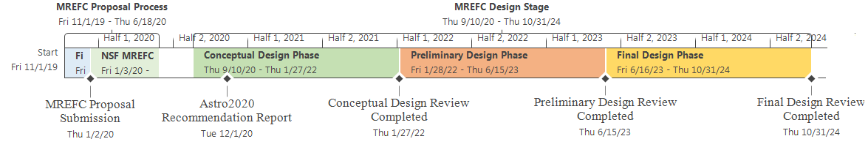
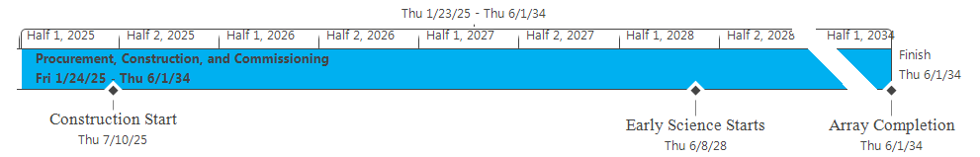
The Road to Astro 2020
Near-term Goal: CoDR-level ‘proposal’ to 2020 Decade Survey
Science Book and Reference Design by 2019
2017
2018
2019
Start Wed 9/14/16
Nov '16
Jan '17
Mar '17
May '17
Jul '17
Sep '17
Nov '17
Jan '18
Mar '18
May '18
Jul '18
Sep '18
Nov '18
Jan '19
Mar '19
May '19
Finish Mon 7/1/19
Sci Case Capture Mon 10/31/16 - Wed 5/30/17
Sci Book First Draft Thu 6/1/17 - Fri 12/1/17
Sci Book Second Draft Mon 12/4/17 - Fri 6/15/18
Sci Book Final Draft Mon 6/18/18 - Fri 12/14/18
ngVLA Astro2020 Proposal Sat 12/15/18 - Mon 7/1/19
Ref. Design First Draft Mon 10/31/16 - Fri 4/28/17
Rev 1 Design Docs Published (TRL1) Fri 5/12/17
Ref. Design 1.5 Draft Mon 5/15/17 - Fri 11/24/17
Reference Design Second Draft Mon 11/27/17 - Tue 7/31/18
Final Draft
Tue 10/23/18
Community Study Development Mon 10/31/16 - Tue 8/15/17
Rev 1.5 Design Docs Published (TRL1)
Release 2nd Draft of Sci Book Fri 6/15/18
Publish Final Draft of Sci Book Fri 12/14/18
Submit RFIR1 Mon 4/1/19
2020
2023
Design Docs Rev2 Released for Review (TRL2) Tue 7/31/18
Submit RFIR2 Mon 7/1/19
Release 1st Draft of Sci Book Fri 12/1/17
Submit NOI Fri 1/11/19
Final Design Docs Published Tue 10/23/18
Submit SWPs Fri 2/15/19
Pre-Proposal Review #1 Complete
US Radio Futures Conference #3
Community Study Final Reports Due Tue 8/15/17
Pre-Proposal Review #2 Complete Fri 9/28/18
2025
2034

Slide 21

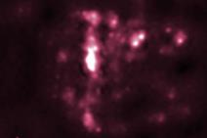
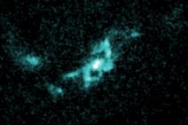
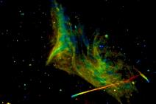
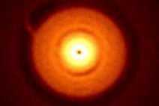
Astrophysical Frontiers in the Next Decade: Planets, Galaxies, Black Holes, & the Transient Universe Portland, OR USA June 26-29, 2018
Registration open: http://go.nrao.edu/ngVLA18
SOC co-Chairs
Brenda Matthews (NRC – Cradle of Life)
Caitlin Casey (UT – Galaxy Evolution)
Laura Chomiuk (MSU – BHs and Transients)
New research facilities and the scientific vision outlined by New Worlds, New Horizons have motivated the exploration of vast new discovery space, and astrophysics has seen extraordinary progress in the past decade, opening new frontiers across many fields. Sponsored by the National Radio Astronomy Observatory, this conference will bring together a substantial cross-section of the astronomical community to discuss how to effectively address the highest priority astrophysical questions of our time. Plenary sessions will feature invited speakers, and three parallel sessions of contributed presentations will address (1) Exoplanet and Protoplanetary Disk Origins, (2) Galaxy Evolution Mechanisms, and (3) Black Holes & Transient Phenomena. Each session will canvas recent observational and theoretical progress, address key unanswered questions, and motivate future research directions in the context of next-generation facilities that would span the electromagnetic spectrum, including a Next Generation Very Large Array, the Large Synoptic Survey Telescope, 30m-class optical-infrared telescopes, the Advanced Laser Interferometer Gravitational-Wave Observatory, and the Square Kilometre Array.

Slide 22
Many Thanks to
The ngVLA Science and Technical Advisory committees
All ngVLA Science Working Group Participants
Initial ngVLA Science White Paper Authors
ngVLA Community Studies Participants

