Slide 1
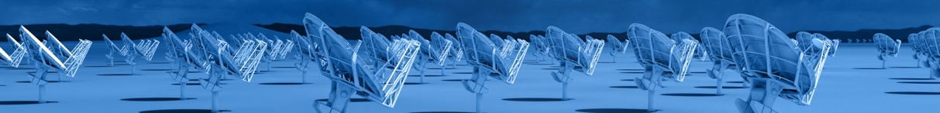
A Next-generation Very Large Array
Core Design Requirements: build on legacy ALMA and JVLA
10x sensitivity of JVLA and ALMA
10x resolution of JVLA and ALMA
Frequency range: 1.2 –116 GHz
Scientific Frontier: Thermal imaging at milliarcsecond resolution
Reference design and science case submitted to Decade Survey 2020
Active community engagement
Low technical risk: measured step beyond current state of the art
Known costing as basis of a Decadal submission
Life-cycle costing: design choices to minimize operations costs

Slide 2
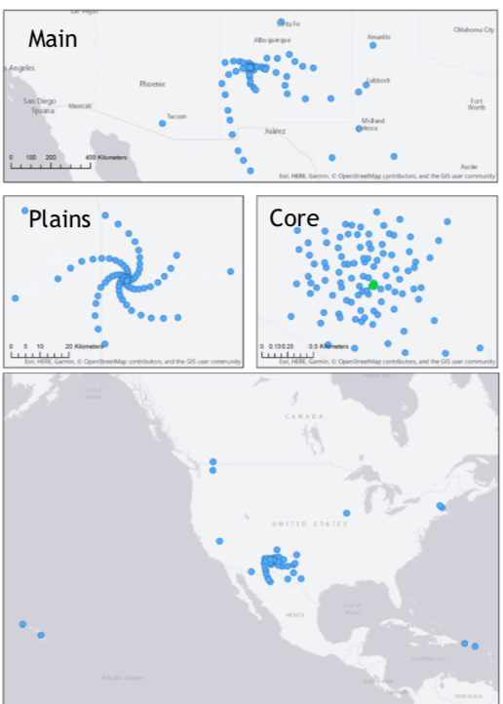
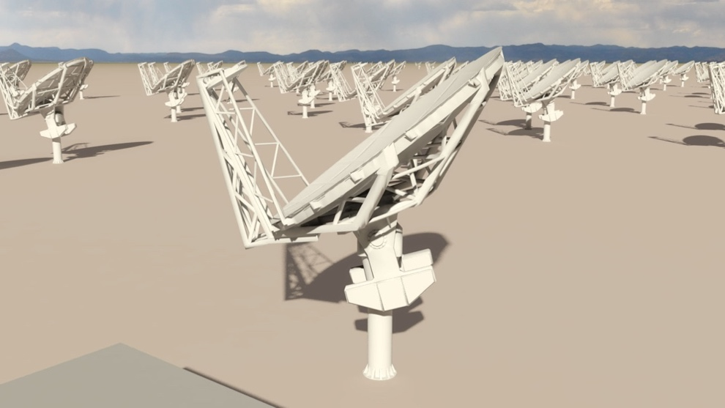
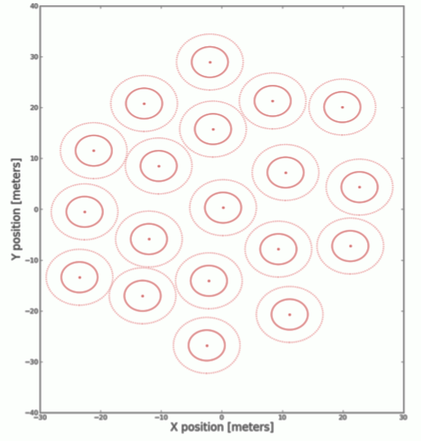

Reference Design Configuration (Rev C)
Subarray | Min B km | Max B km | # Ants. | Res. 30GHz arcsec | Science
Main (18m) | 0.027 | 1005 | 214 | 0.005 | PP Disks
Plains | 0.027 | 36.5 | 168 | 0.1 | High z CO
Core | 0.027 | 1.3 | 94 | 2 | Nearby Gal.
LBA | 32.6 | 8856 | 30 | 0.0004 | High Energy
SBA (6m) | 0.01 | 0.045 | 19 | 60 | Galactic
TP (18m) | -- | -- | 4 | 120
400 km
20 km
0.5 km
Spatial Dyn. Range ~ 10⁴ => subarray observing is critical
LBA
SBA
Off-axis feed-low
20 m

Slide 3
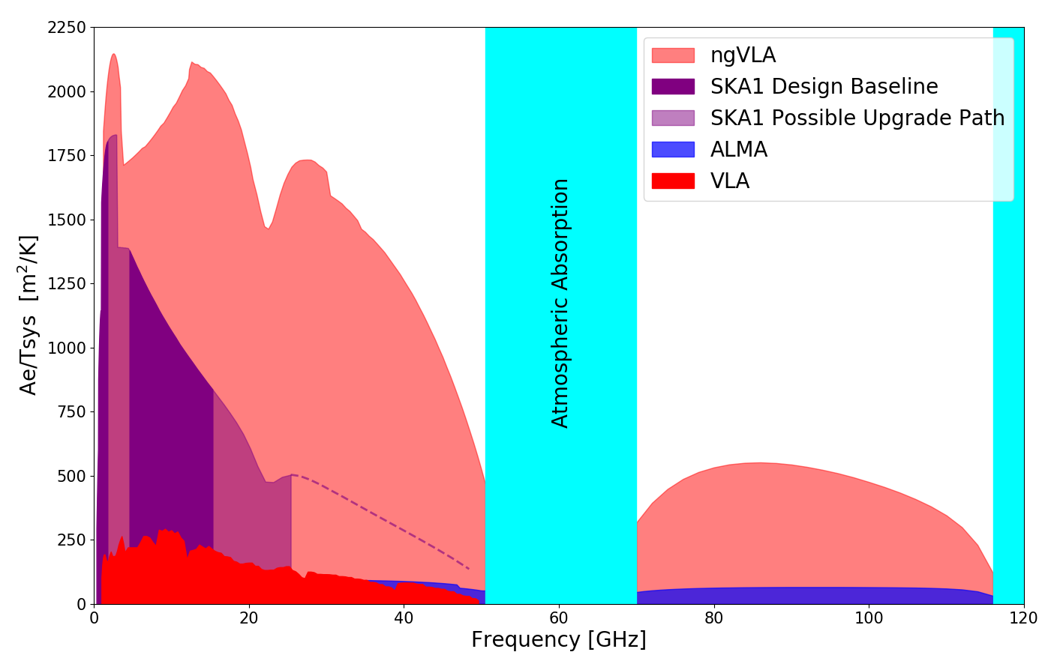
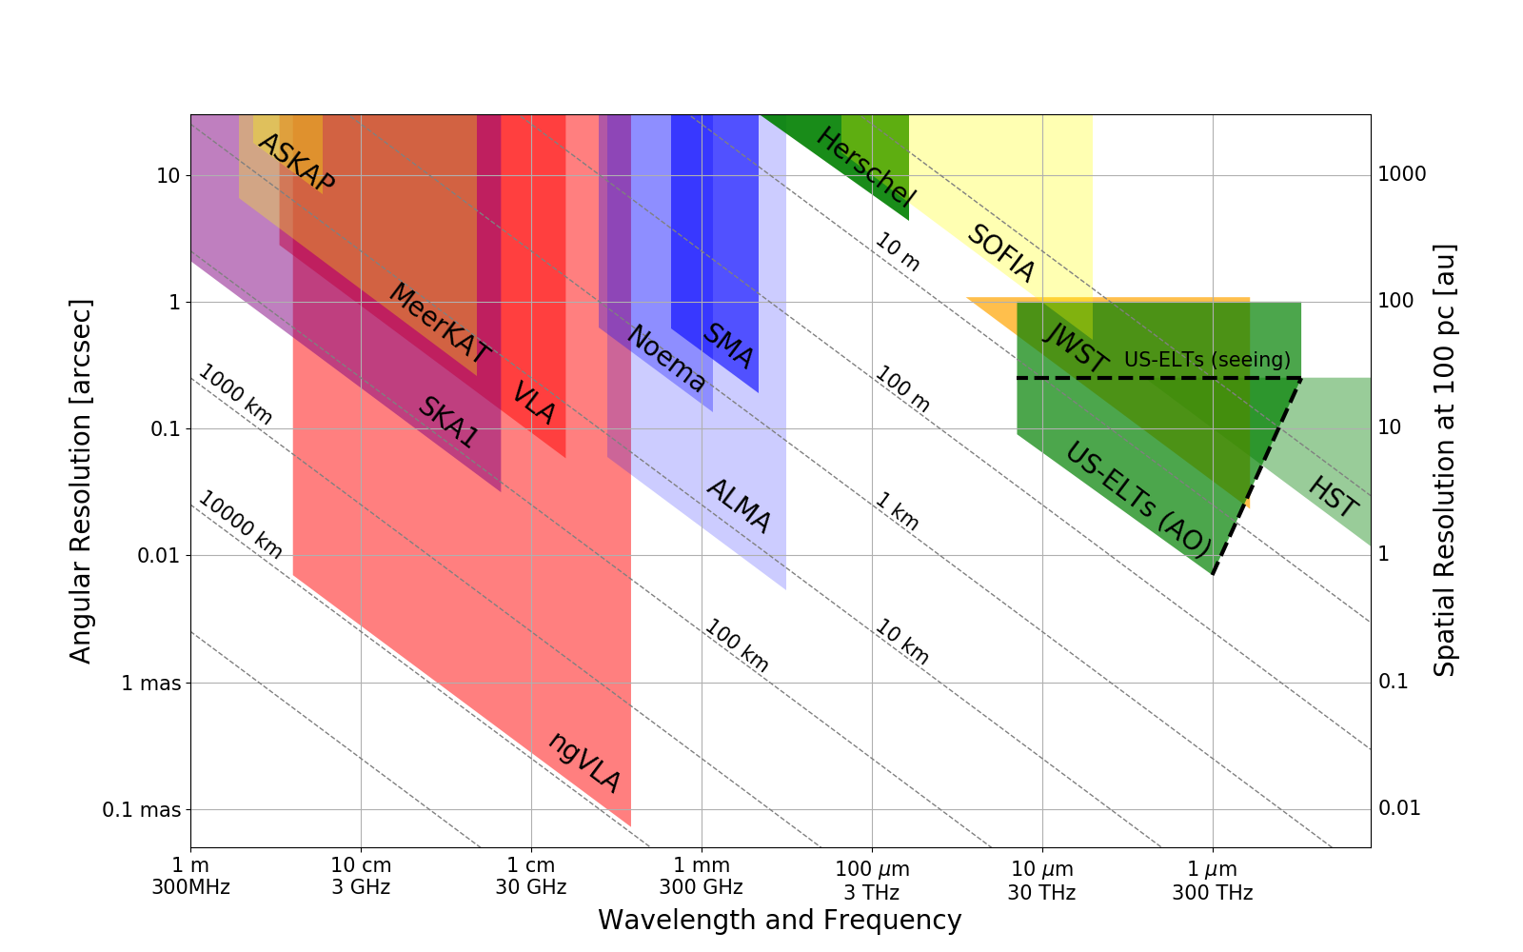
Bridging SKA & ALMA Scientifically
Thermal Imaging on mas Scales at λ ~ 0.3cm to 3cm
Terrestrial zone planet formation: 1AU @ 140pc
Complementary suite from cm to submm arrays for the mid-21st century
< 0.3cm: ALMA 2030 superb for chemistry, dust, fine structure lines
0.3 to 3cm: ngVLA superb for terrestrial planet formation, dense gas history, baryon cycle
> 3cm: SKA superb for pulsars, reionization, HI + continuum surveys
Notes:
Snapshot comparison of effective collecting area for dish-arrays expected in the 2030’s.
Assumes SKA deployment baseline (July 2017)
SKA 1
- 130 antennas, SKA bands 1, 2
- 67 antennas, SKA Band 5 a/b
MeerKAT:
- 64 antennas, bands 1, 2, 3
MeerKAT has receiver indexer with 4 slots

Slide 4


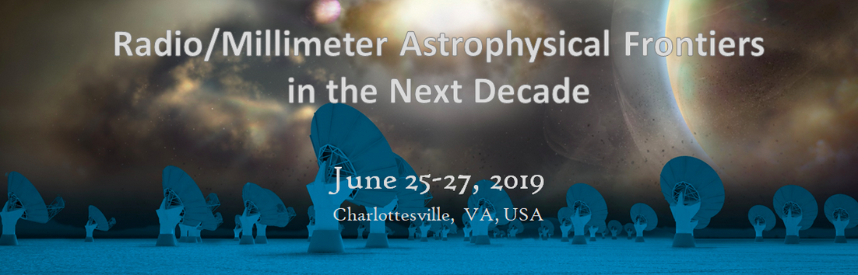
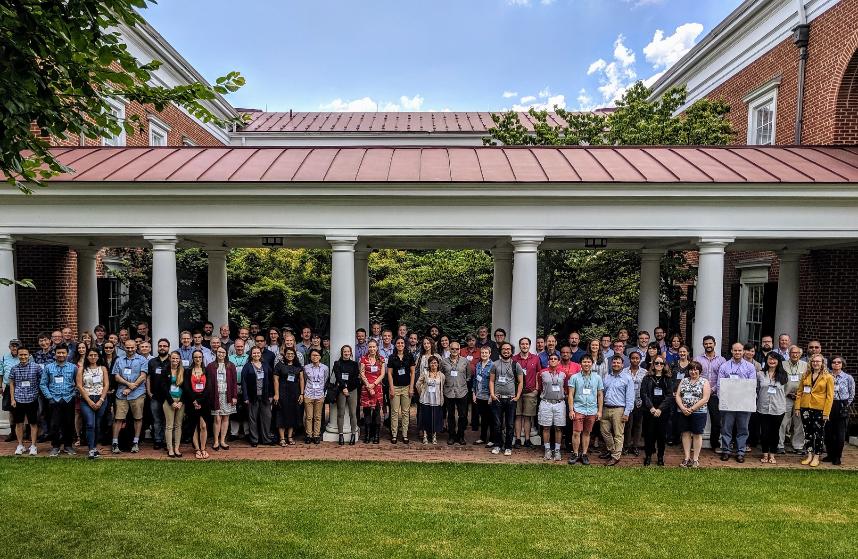
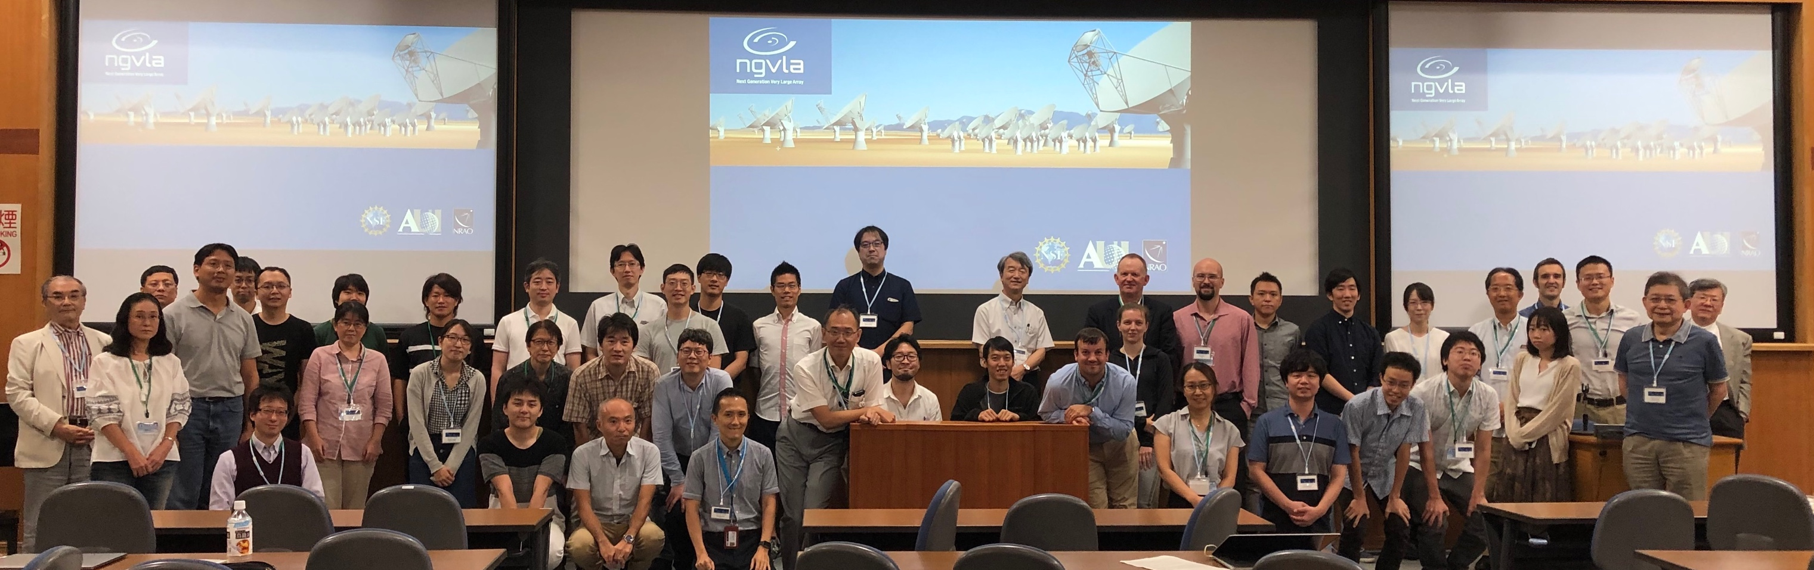

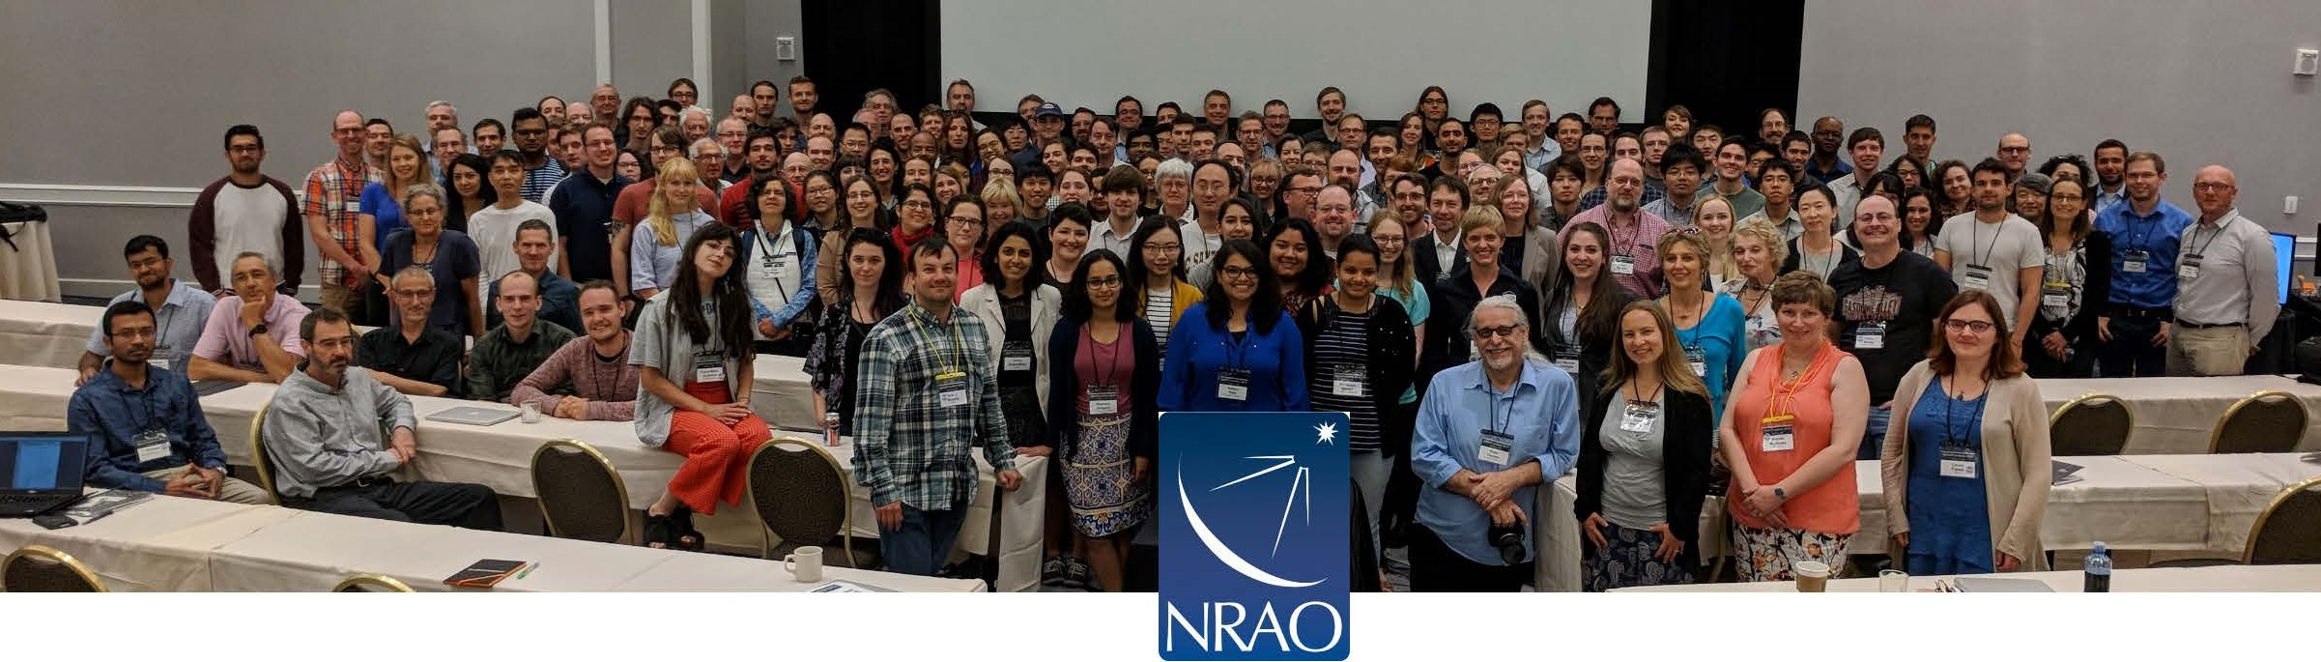
Developing the ngVLA Science Case and Design for DS 2020
Community-Driven, Growing, Evolving
https://ngvla.nrao.edu
Science and Technical Advisory Committees [Co-Chairs: Bolatto, Isella; Solano, Rupen]
Jan 2015 AAS to Present: International Science and Technical meetings
40 Community Design Studies, partially funded by NRAO
Series of community ‘Frontiers’ meetings: Portland 2018 to Minneapolis 2021
Sept. 2019 Mitaka

Slide 5
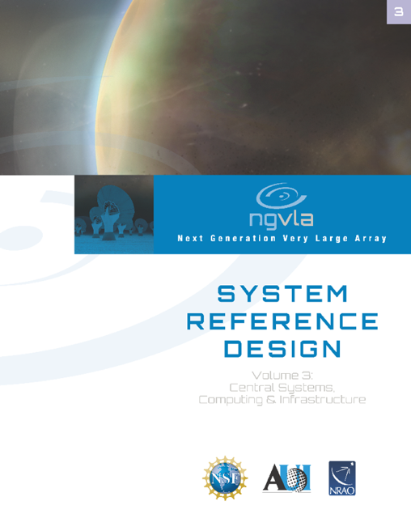
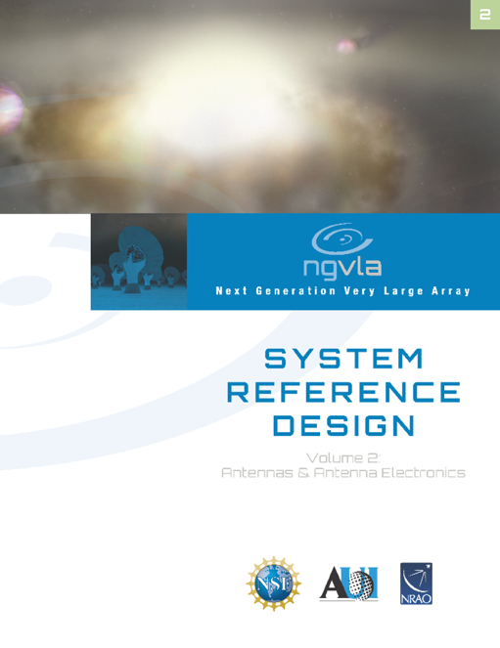
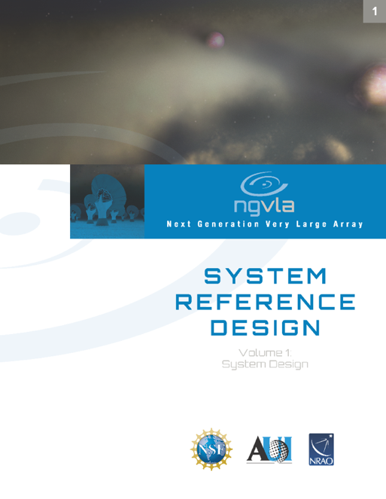
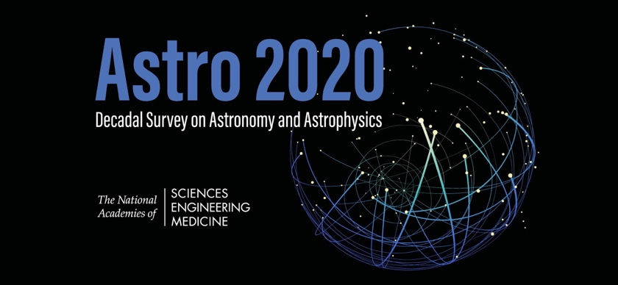
2019-2020 Highlights
ngVLA Science Book published
ngVLA Reference Design Concept published
Facilitated community submission of ngVLA science white papers to Astro2020 Decadal Survey: 80 papers submitted related to ngVLA!
Met with SKA Leadership to discuss joint access
Submitted and presented ngVLA facilities (APC) white paper to Astro2020 Decadal Survey
Submitted MSIP proposal for antenna detailed design and prototype
https://ngvla.nrao.edu/page/projdoc
Notes:
Completed Independent Cost Review (Oct 2019)
Science Book published by ASP in Dec 2018
88 peer-reviewed contributions
286 unique authors (c.f. 245 in LSST Science Book)

Slide 6
ngVLA Science Book
https://ngvla.nrao.edu/page/scibook
January 2019 published by the Astronomical Society of the Pacific
90 chapters, 850 pages, 300 authors
Sections
Current Summary of Project
Solar System
Planet Formation
Stellar Systems and Formation
Planetary Systems and Life
Galaxy Ecosystems
Galaxy Formation and Evolution
Formation and Evolution of Black Holes in the Era of multi-messenger Astronomy
Cosmology and Fundamental Physics

Slide 7
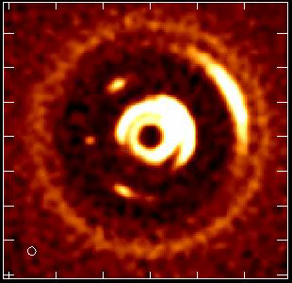
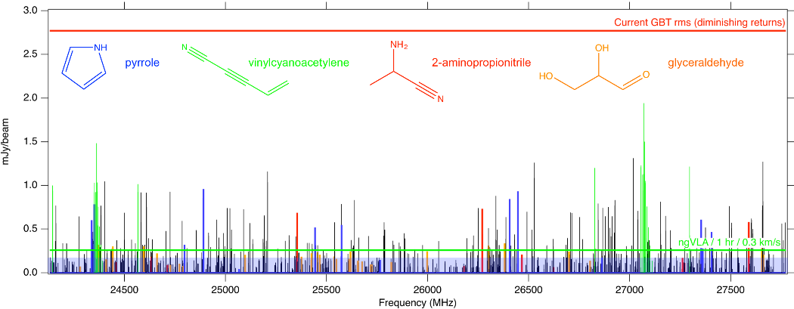
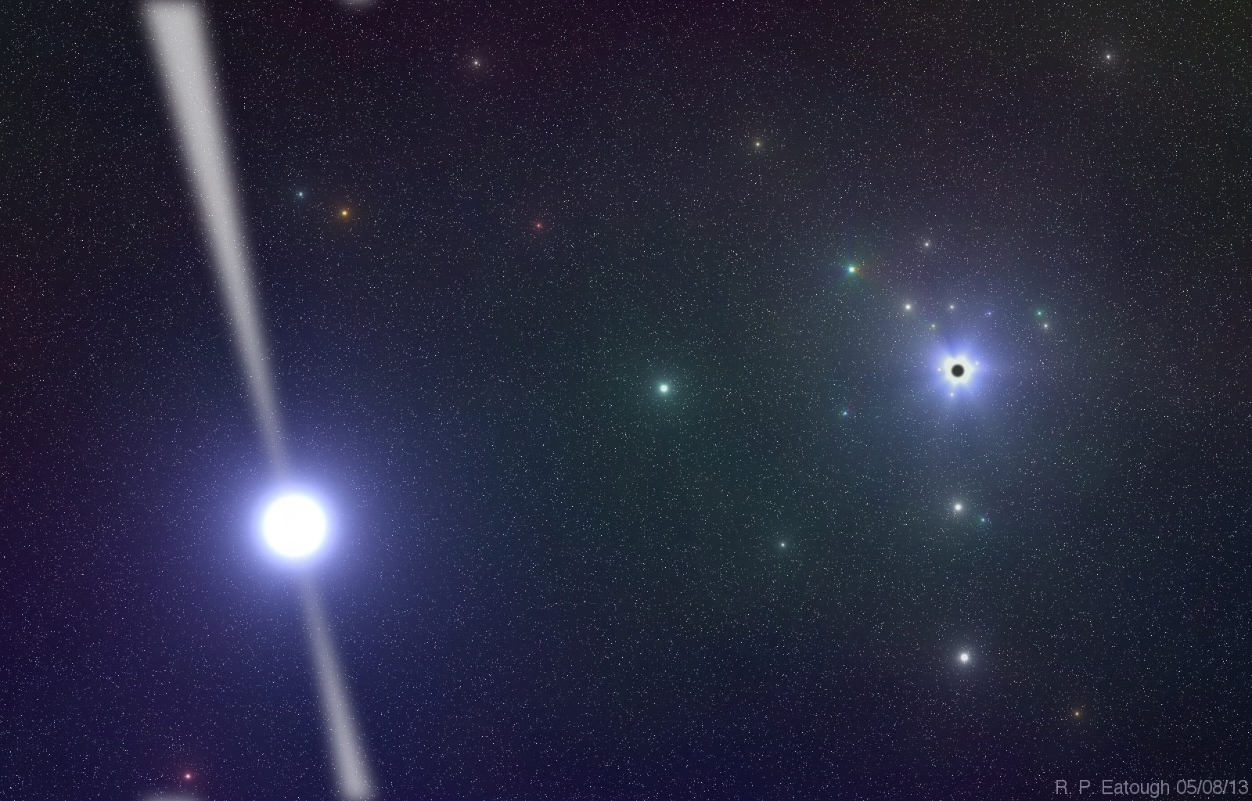
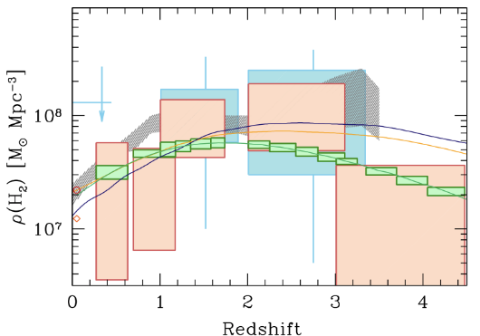
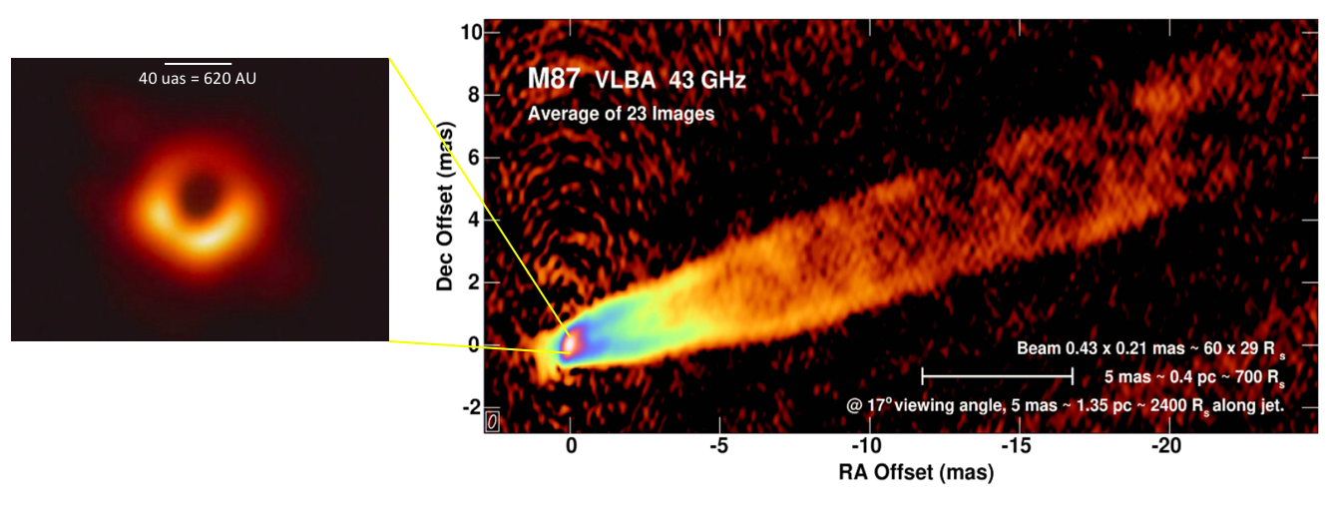
Key Science Mission
Developed by SAC; drive design
Unveiling the Formation of Solar System Analogues
Astrobiology: Probing the Initial Conditions for Life
Baryon Cycle: Charting the Assembly, Structure, and Evolution of Galaxies Over Cosmic Time
Using Pulsars in the Galactic Center as Fundamental Tests of Gravity
Physics and formation of Black Holes (‘Explosive Universe’)
NGVLA
ALMA

Slide 8
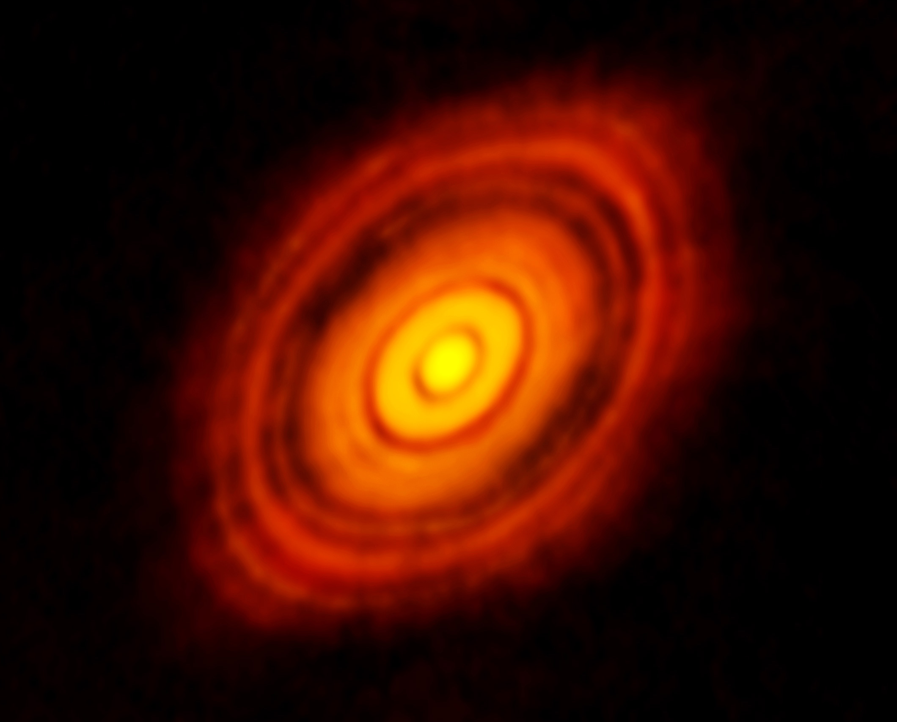
KSG1: Unveiling the Formation of Solar System Analogues
ALMA 250GHz (Brogan ea.) res = 40mas
ALMA and HL Tau: Rosetta Stone of planet formation around Solar-mass protostar
Distance = 140pc
1Myr protostar ~ 1 M_{o} w. 0.1 M_{o} dusty disk
Dust gaps and rings => forming planets
130AU = 1”
Isella ea.
Optically thick out to radius ~ 10AU at < 3mm wavelengths = ‘ngVLA zone’

Slide 9
KSG1: Unveiling the Formation of Solar System Analogues
ngVLA: Movies of Planet formation on AU-scales!
Simulated 100 GHz ngVLA observations of a newborn planetary system comprising a Jupiter analogue orbiting at 5 AU from a Solar type star, over ~ 10 years
Probe inner few AU-scales (‘Solar-system scales’): dust rings, gaps, and traps to T_{B} ~ 1 K at 10mas resolution
Image circumplanetary disks and sub-structures in the distribution of mm-size particles created by close-in planets, and measure the orbital motion of these features on monthly timescales
10mas ~ 1AU
Protoplanetary disk: 1 Myr old protostar at 140pc distance + proto-Jupiter observed at 100 GHz

Slide 10
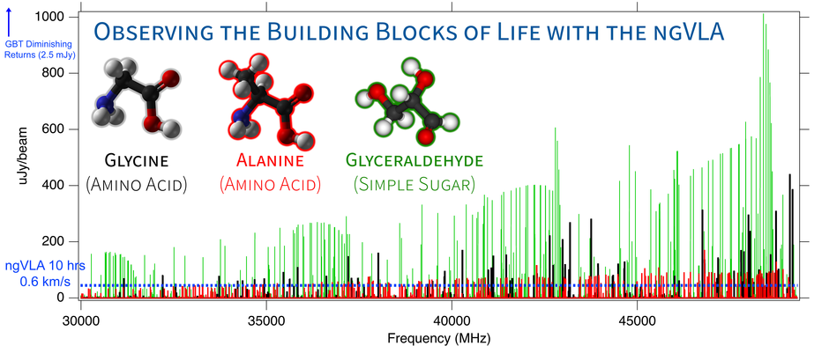
KSG2: Probing the Initial Conditions for Planetary Systems and Life with Astrochemistry
Critical frequency range and sensitivity to detect complex, prebiotic species to understand the chemical paths to biogenic molecules
Detect chiral molecules to test ideas about the origins of homochirality in biological systems
Brett McGuire, NRAO
Simulations of three biogenic molecules in a typical hot core source based on existing upper limits, assuming T = 80 K, dV = 3 km/s and a 5" source. The ngVLA's sensitivity to detect these lines for the first time in a 10 hr integration is shown as a dashed blue line. Diminishing returns with GBT integrations start around 2.5 mJy, and to detect any new molecules below that limit would require 100s to 1000s of hours.

Slide 11
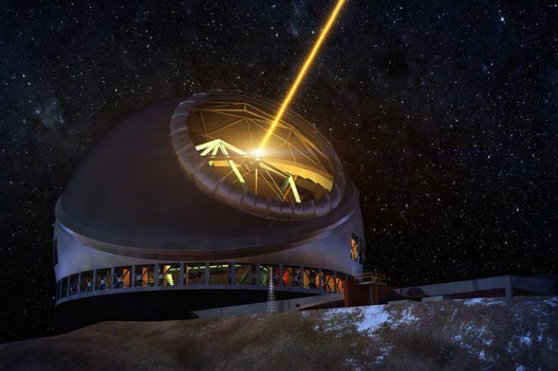
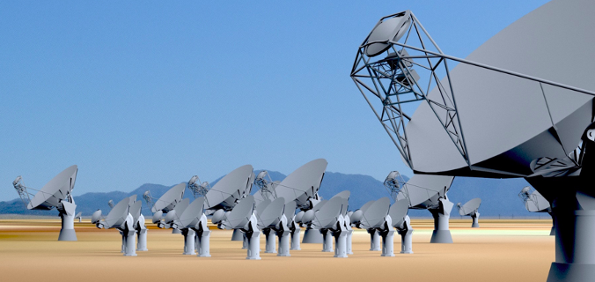
ELT/ngVLA Synergy: Solar System Analogues and the development of life
ELTs and exoplanets
Direct imaging of earth-like planets
Search for atmospheric bio-signatures (O₂)
ngVLA
Imaging formation of terrestrial-zone planets
Pre-biotic chemistry

Slide 12
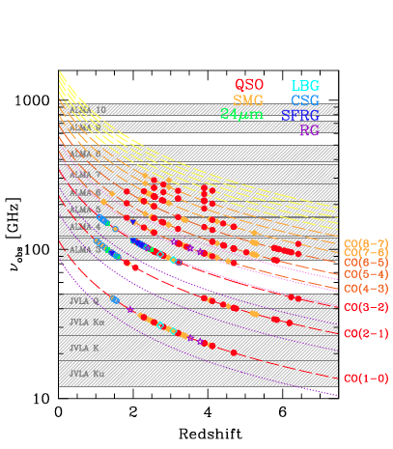
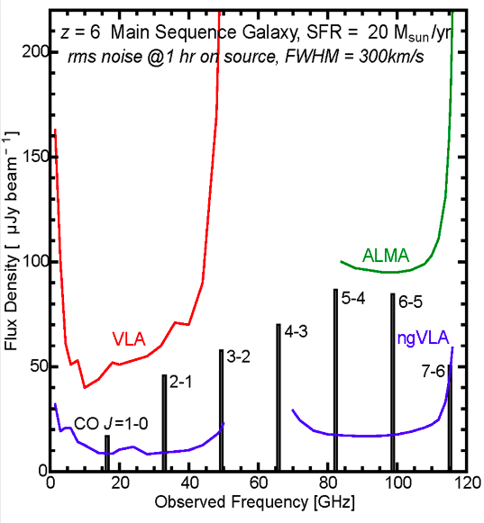
KSG3: Charting the Assembly, Structure, and Evolution of Galaxies Over Cosmic Time
NGVLA: trace molecular gas, the fuel for star formation, over cosmic time
Frequency range: ideal to study dominant molecular gas tracers (CO, HCN,HCO+…)
10x Sensitivity: ‘main sequence’ galaxies in ~ 1hr (M_{gas} ~ few x10⁹ Mo)
Bandwidth 2.5x current: large cosmic volume surveys
ALMA/Noema
ngVLA ‘sweet spot’
VLA
SKA 1

Slide 13
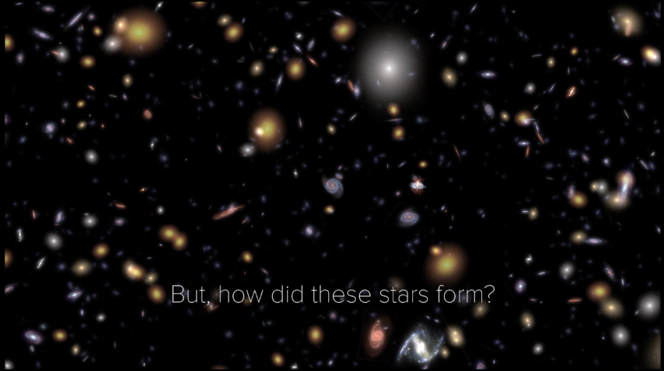
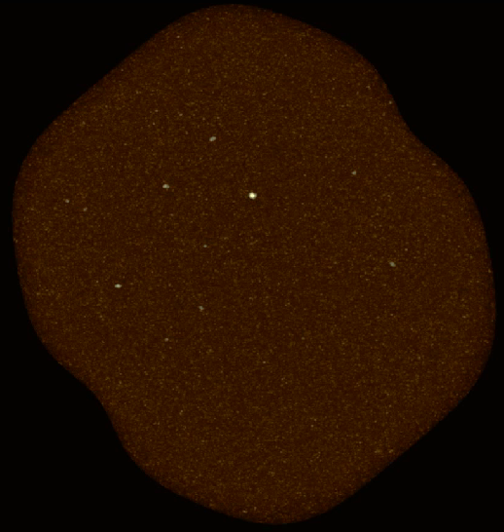
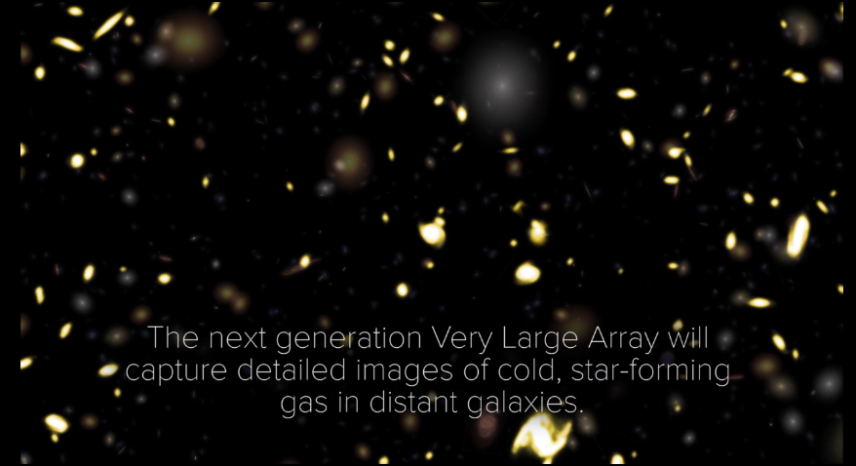
KSG3: Molecular Deep Fields in three dimensions
ASPECS
HST UDF ~ 5000 galaxies over ~ 5’ field
ngVLA ~ 3000 CO galaxies
ALMA 200 hrs: 36 CO galaxies
10x sensitivity + 2.5x bandwidth => 100-fold increase in CO detection rate over VLA, ALMA => Galaxy counts in CO ~ deepest optical fields, with redshifts!

Slide 14
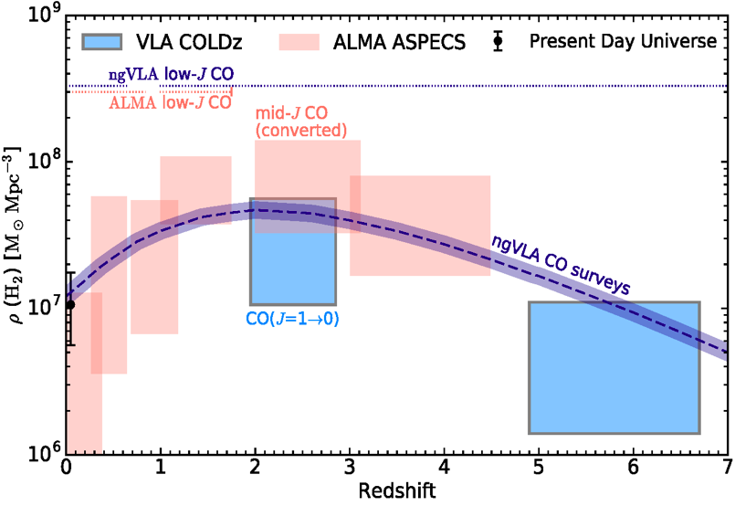
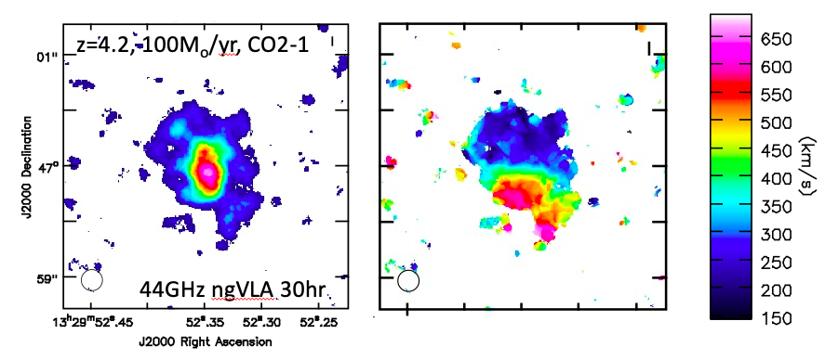
KSG3: Measuring the Dense Gas History of the Universe
Precise measurement of Dense Gas History of Universe
kpc-scale imaging of gas dynamics

Slide 15
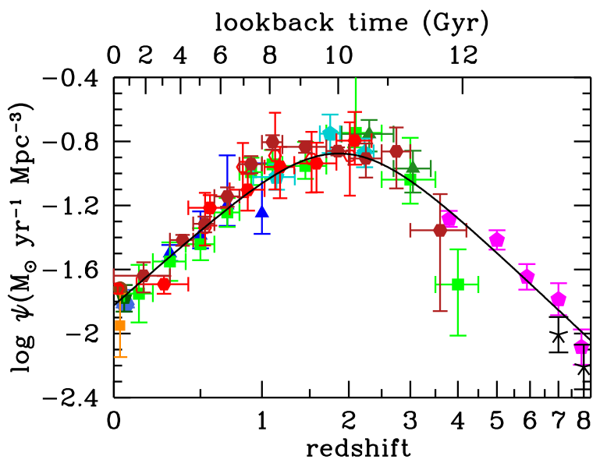
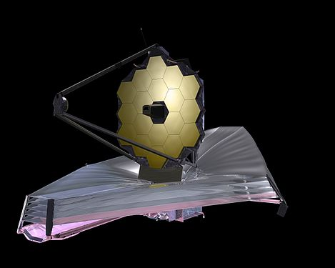
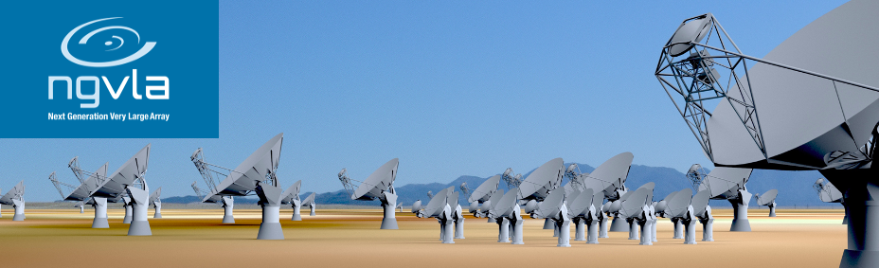
JWST/ngVLA Synergy: Cosmic Conversion of Gas to Stars
‘Precision galaxy formation’
JWST/ELTs: stars, star formation
ngVLA: cold gas fueling cosmic star formation

Slide 16
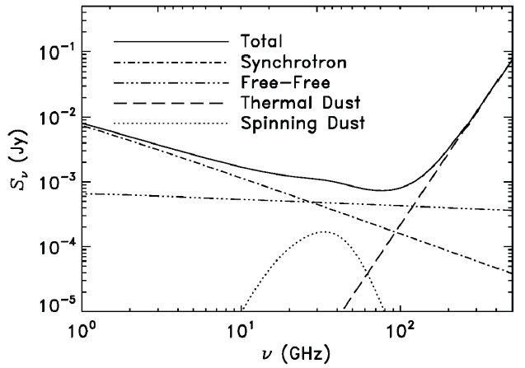
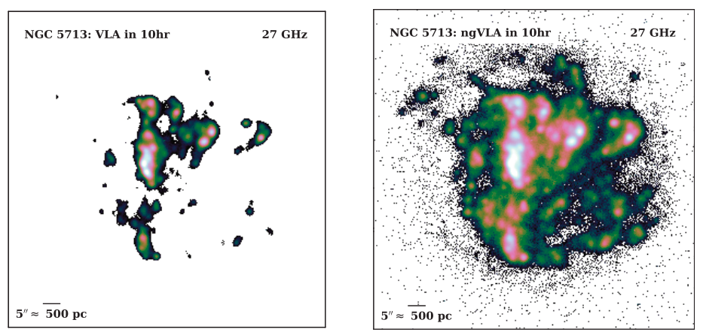
NGVLA: Free Free emission from peculiar spiral in Virgo
Local Group type-studies extended to the Virgo Cluster!
SF galaxy
NGC 5713: 30Mpc, 5 M_{o} yr⁻¹
ngVLA
FF estimated from Halpha
Freq range covers multiple radio emission mechanisms: synchrotron, free-free, cold (spinning?) dust, SZ effect
Free-Free ideal estimator of ionizing photon rate => SFR
rms (1cm, 10hrs) = 0.1uJy => HII region associated single O7.5 to Virgo
Broad-band => spatially/spectrally separate dust, FF, synchrotron

Slide 17
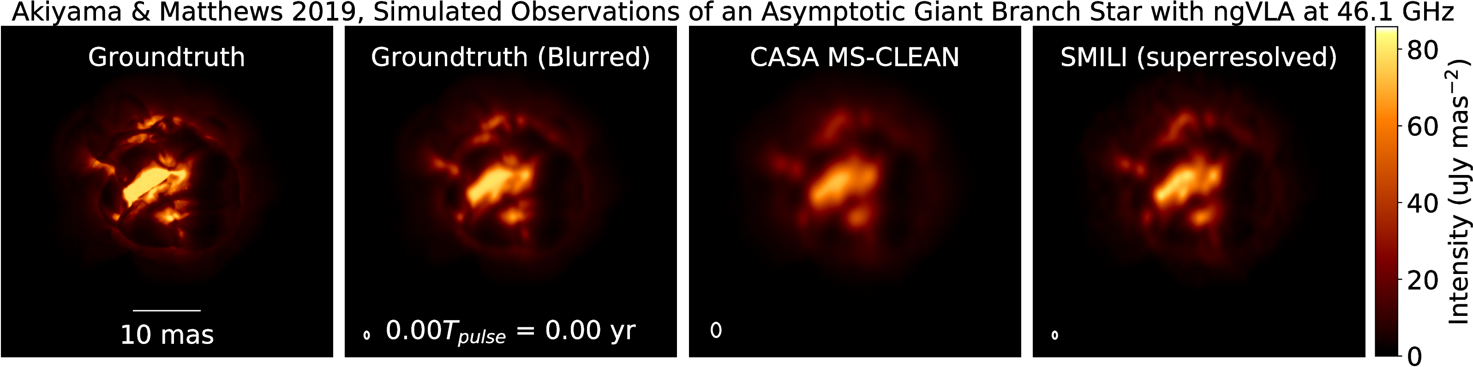
Science Highlight: Star Formation and Stellar Evolution
Movies of mass loss from AGB stars (Kiyama & Matthews ngVLA Memo 66)
Simulation: 3D hydrodynamic model of 1M_{o} AGB star at 150pc from Freytag et al. (2017):
ngVLA Main Array at 46 GHz
Resolution = 1.5 mas ~ 0.04 stellar radii
1.3 year pulse period, observed every 2-3 weeks
Notes:
Simulated movies of the gas motions in the radio photosphere of an asymptotic
giant branch (AGB) star as observed with the ngVLA Main Array at 46 GHz. The
angular resolution is ~1.5 mas, corresponding to roughly 0.04 stellar radii.
Each movie covers a single 1.3-year pulsation period for a model AGB star,
assuming observations every 2-3 weeks. The adopted distance was 150 pc.
AGB star atmospheres are highly dynamic owing to a combination of radial
pulsations, shocks, and large-scale convective processes. These stars also shed
large amounts of matter through cool, dense winds. Radio waves are emitted from
a portion of their atmospheres that lie at a radius of roughly twice the
visible photosphere, and just interior to the wind launch region.
The adopted brightness distribution for the radio photosphere model (the
"ground truth model" shown in the left hand frame) was based on a 3D
hydrodynamic model of an AGB star atmosphere from Freytag et al. (2017). The
Freytag et al. model is not specific to millimeter wavelengths, but was adapted
here for illustrative purposes. The second frame shows the ground truth model
blurred with a Gaussian kernel.
The two frames on the right show image reconstructions of the model based
on simulated ngVLA Main Array observations. The integration time was 2
hours per frame and the assumed bandwidth was 10 GHz in dual
polarizations. The second frame from the right shows a multi-scale CLEAN
reconstruction, while the frame on the right shows the result of a
regularized maximum likelihood reconstruction using the SMILI package of
Akiyama et al. (2019). While both methods do well at reproducing many of
the key features of the model, the SMILI version achieves superior angular
resolution.
These results underscore that the exquisite sensitivity and resolution of the
ngVLA will enable studies of the physical properties and kinematics of the
atmospheres of evolved stars in unprecedented detail.
Credit: K. Akiyama and L. D. Matthews, based on models adapted from B.
Freytag.

Slide 18
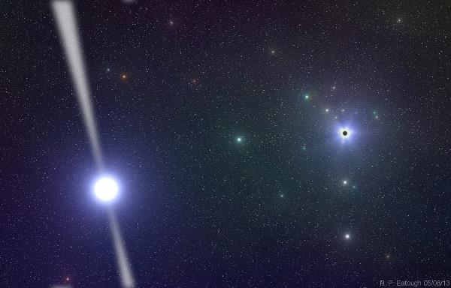
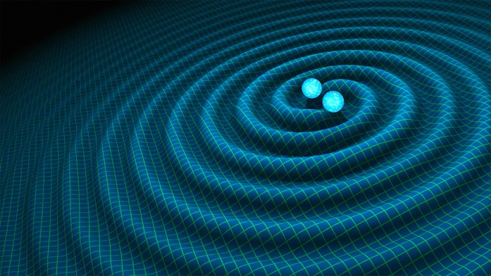
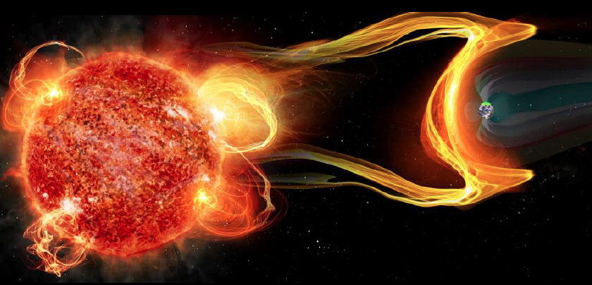
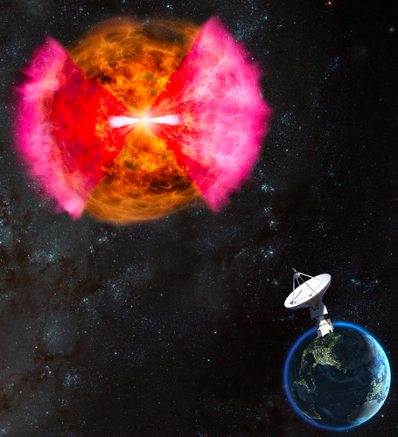
Versatility: Remarkable breadth of Science and Discovery Space
Time Domain
Galactic Center pulsars: testing GR
Gravitational Wave EM Follow-up: characterizing neutron star mergers
Exo-space weather and the impact on formation of life: M-dwarf flares
Bursting universe (FRB, GRB, TDE…)
Black Holes
Obscured Black Hole Growth and AGN/jet physics
Quasar-Mode Feedback and the SZ Effect
Nearby Universe
μas Astrometry: Galactic structure, local group proper motions
Imaging stellar photospheres
Solar system: Planetary atmospheres, minor planets

Slide 19
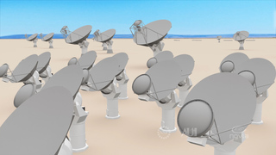
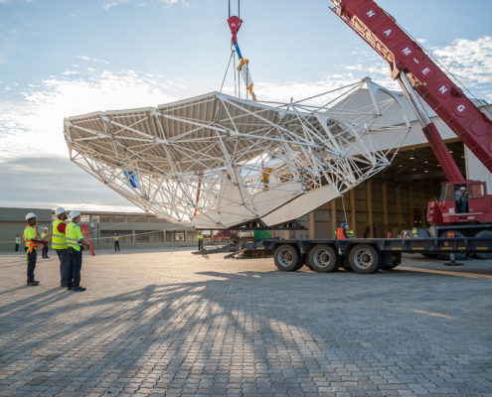
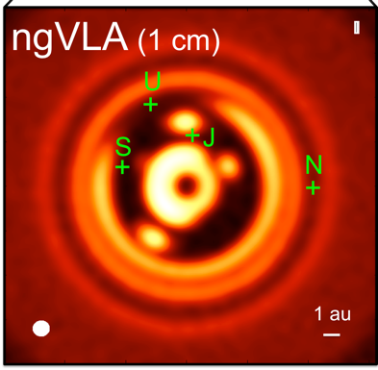
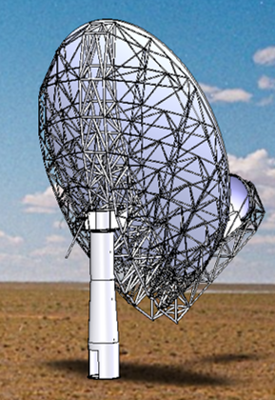
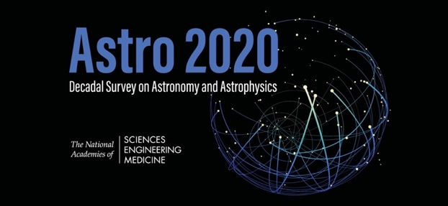
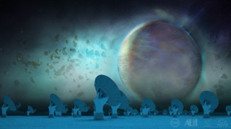

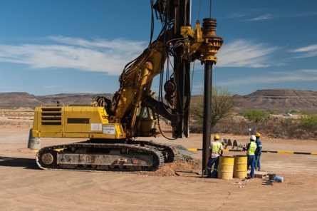
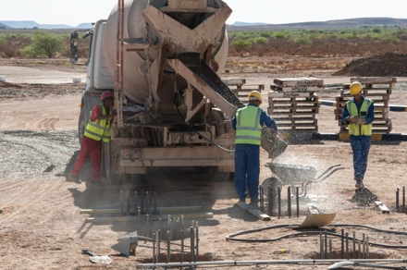
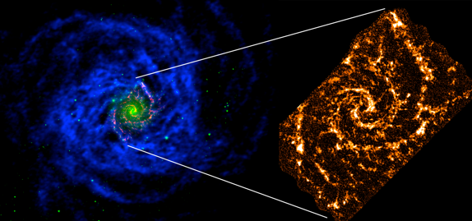
Project Timeline
2019
2021
2023
2025
2028
2034
ngVLA Submission to Astro2020
Prototype Delivered to VLA Site
ngVLA Construction →
Initiate ngVLA Early Science (> VLA capabilities)
Complete NSF/MREFC FDR
Achieve Full Science Operations
Submit ngVLA Proposal to NSF/MREFC
Astro2020 Recommendation Published

Slide 20
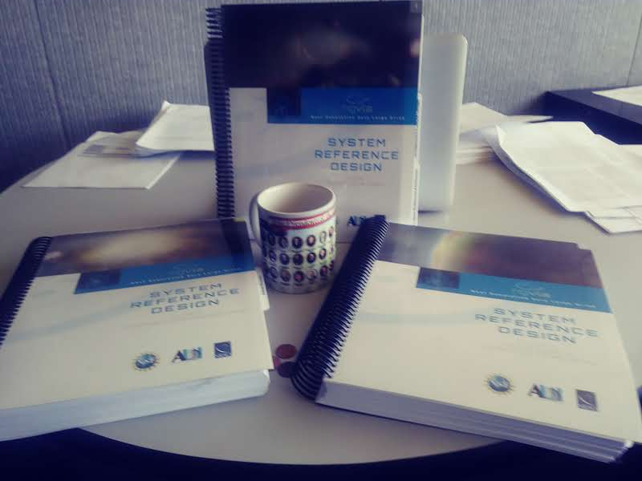
ngVLA: Advancing science into the mid-Century APC White Paper for DS 2020
Released Reference Design: low-technical-risk and costed concept
U.S. Multiagency Interest (DOD, NASA): ICRF, Space Situational Awareness, Spacecraft tracking/imaging, `burst-telemetry’
International participation: Japan, Mexico, Canada, Taiwan
** Annual operations estimate is BY2018 $92.9 M/yr.

Slide 21


Compact Objects and Energetic Phenomena in the Multi-Messenger Era 2021 July 23 - 25 Saint Paul, Minnesota, USA
SOC
Nicole Lloyd-Ronning (co-chair)
Tom Maccarone (co-chair)
Geoff Bower
Shami Chatterjee
Gregg Hallinan
Jim Hinton
Kelly Holley-Bockelmann
Joe Lazio
William Lee
Jess McIver
Masayuki Nakahata
Marcos Santander
Amanda Weinstein
Joan Wrobel
Meeting Themes
Discuss the current state of compact-object research that leverages on multi-messenger information.
Help planners define an interoperable suite of multi-messenger facilities for the 2030s and beyond. An example suite might include SKA, ngVLA, ELTs, LSST, CE/ET, LISA, and IceCube, as well as future X-ray missions.
The ngVLA is a design and development project of the NSF operated under cooperative agreement by AUI.
https://go.nrao.edu/ngVLA20

Slide 22
Many Thanks to:
The ngVLA Science and Technical Advisory committees.
All ngVLA Science Working Group Participants, White Paper, and Science Book Authors.
ngVLA Community Studies Participants.
National Science Foundation.

