Slide 1
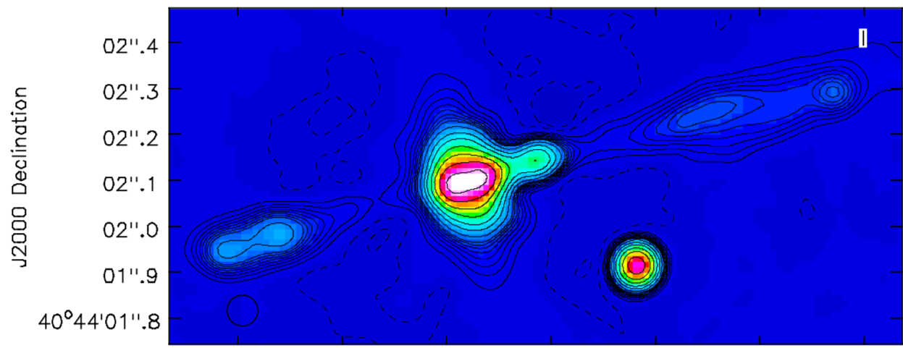
Imaging the ionized gas in the obscuring torus in Cygnus A
Carilli, Perley, Dhawan, Perley

Slide 2
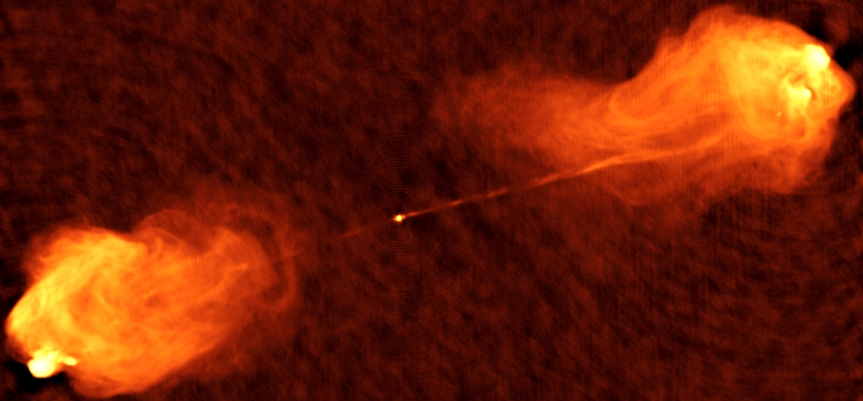
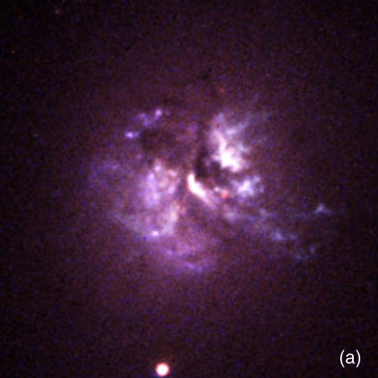
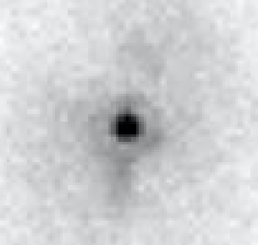
z = 0.057, L_{R} ~ 10⁴⁵ erg/s (‘10x closest’)
Giant Elliptical w. Buried quasar (type II AGN)
Scattered Broad Lines: Ha 26,000 km/s!
Optical/UV spectroscopy => SMBH ~ 2.5 x 10⁹ M_{o}
Compton thick X-ray nucleus: N_{H} ~ 4x10²³ cm⁻²
HI 21cm Absorption: N_{H} ~ 10²³⁻²⁴ cm⁻²
near/mid-IR spectra: A_{v} > 50
L_{bol} ~ 2.5x10¹² L_{o} (typical z ~ 1 quasars)
Far-IR spec/pol: dusty, obscuring ‘torus’ scale ~ 100pc
60” ~ 65kpc
HST Opt
5”
HST 2.2um

Slide 3
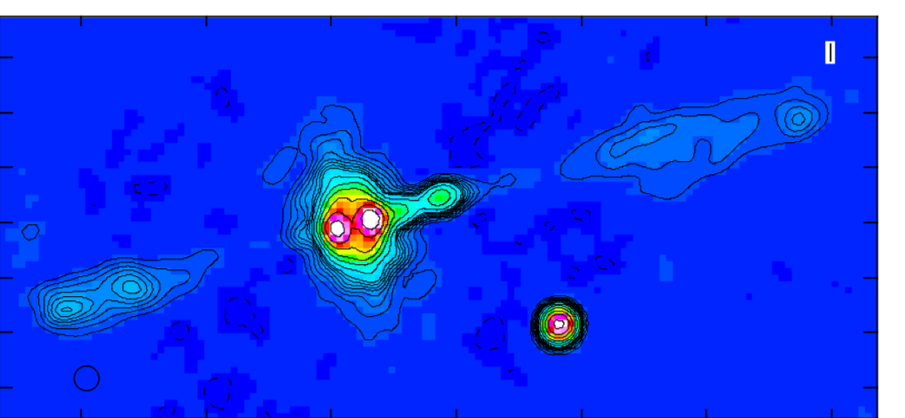
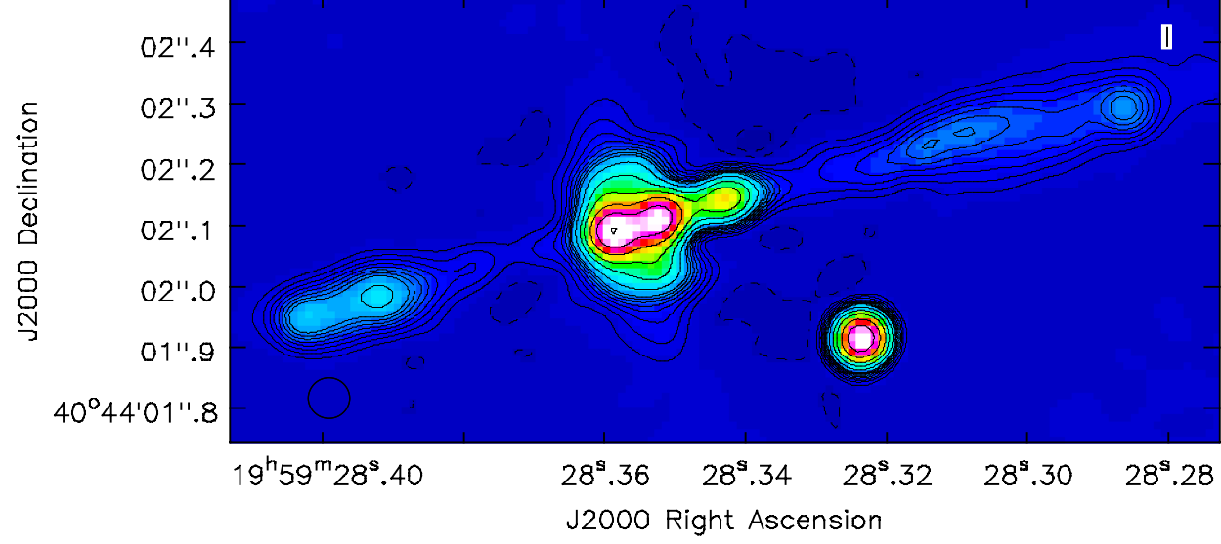
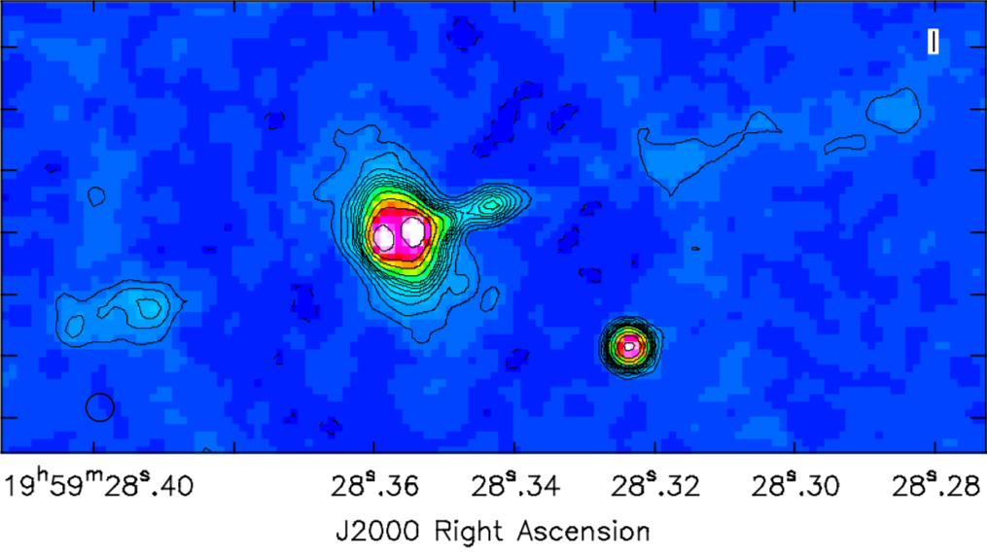
Maj Axis ~ 480mas
Min Axis ~ 260mas
1st contour = 50uJy/bm
19-47 GHz 67mas
30-38GHz 45mas
19-27 GHz 67mas
40-48GHz 45mas
Note: ~1 Jy point source subtracted from uv-data

Slide 4
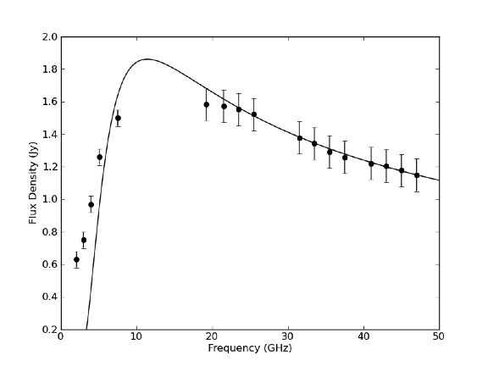
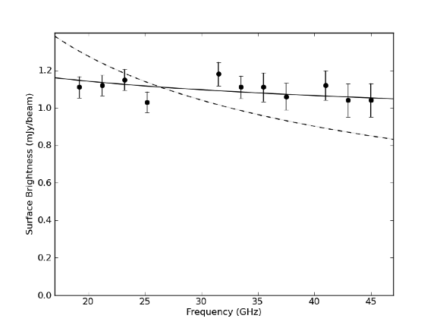
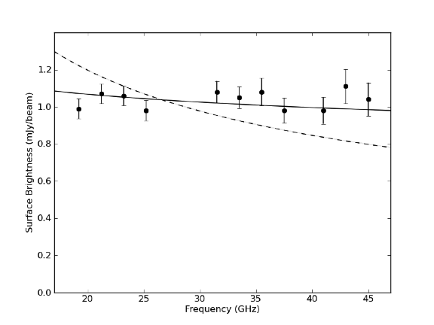
Core
+100mas
-100mas
Solid: 𝛂 = -0.5 + free-free w. 𝛕_{e} set by EM = 1.2x 10⁸ pc cm⁻⁶
Solid: 𝛂 = -0.1 = free-free
Dash: 𝛂 = -0.5 = Thomson Scattering
Flat spectra consistent w. free-free, inconsistent w. Thomson scattering of radio emission from core, or diffuse synchrotron
T_{B} (100mas) = 240 K => EM = 1.2x 10⁸ pc cm⁻⁶
Core spectrum: fit for alpha at Ka, Q, then set free-free absorption using EM from torus!

Slide 5
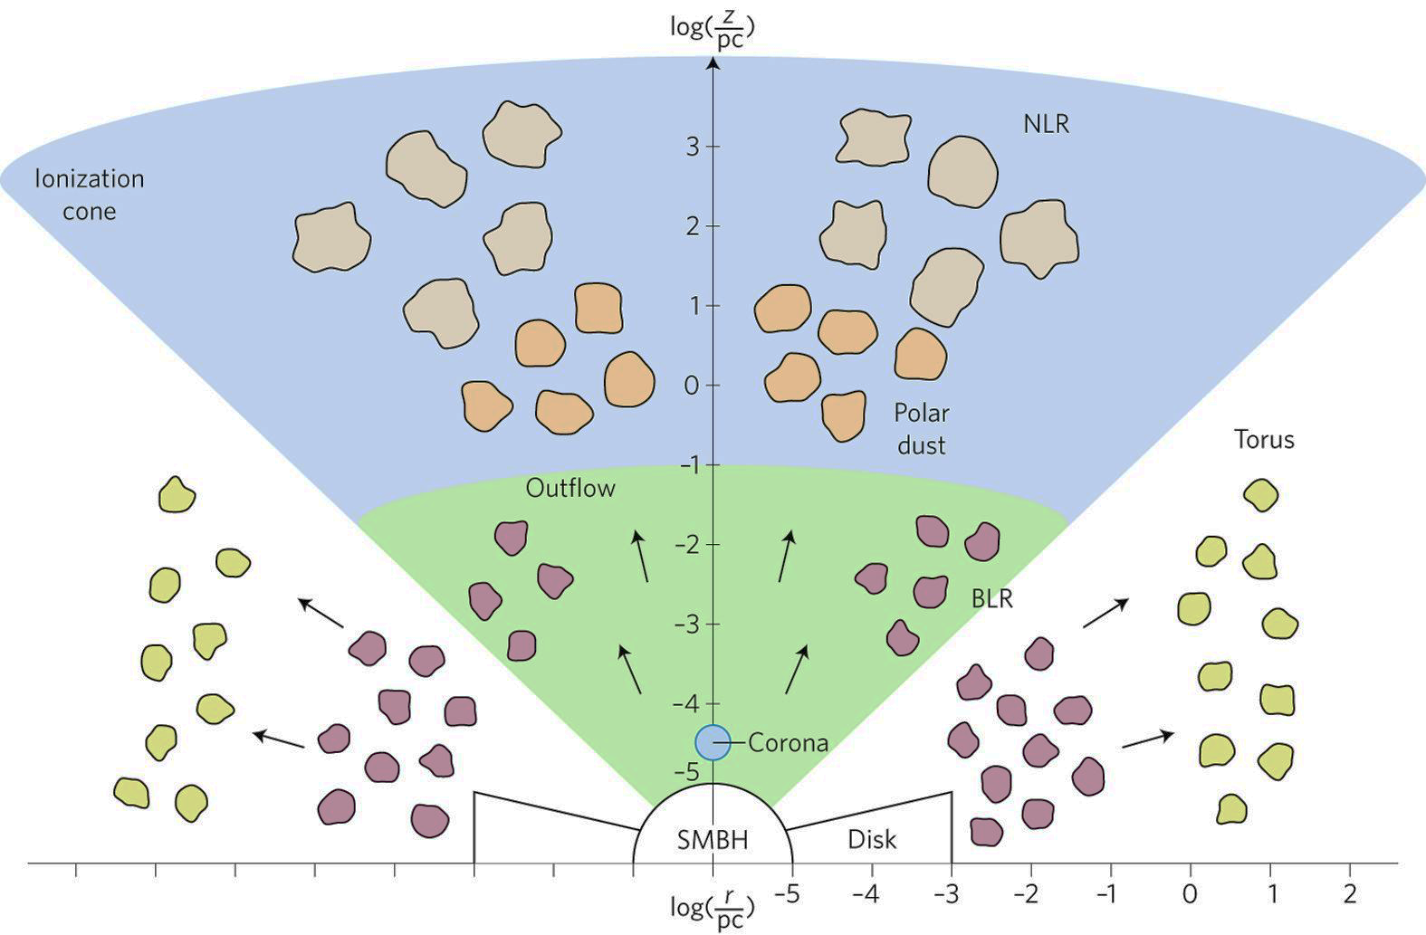
Torus Toy Model
max R ~ 260 pc, H ~ 143pc
ionization cone ½ opening angle ~ 62º
mean density (from EM) ~ 500 cm⁻³
Paradox: mean density => 𝛕_{e} ~ 0.26 => 170 mJy from Thomson scattering (total in torus ~ 21mJy)!
Solution: FF ∝ n_{e}² , Thomson ∝ n_{e} => Clumpy gas distribution, clump densities > 4000 cm⁻³
Clumpy torus consistent with MFP in X-rays and far IR (Nenkova ea.)
Pressure clumps > 5.5 x 10⁻⁸ dyne cm⁻²
Equipartition pressure in jet ~ 3x larger
Mass in dense gas ~ 10⁵ M_{o}
Jet Axis
𝜃_{IC} ~ 62º
H_{t} ~ 143 pc
R_{t} ~ 264 pc
Clumpy Torus
Ionization Cone
Ionization Cone
Adopted from Ramos-Almeida

