Slide 1
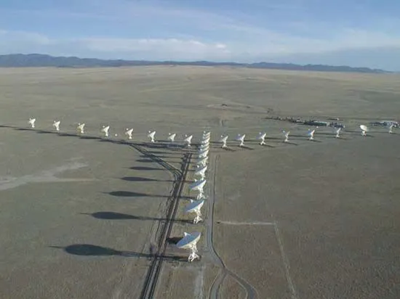
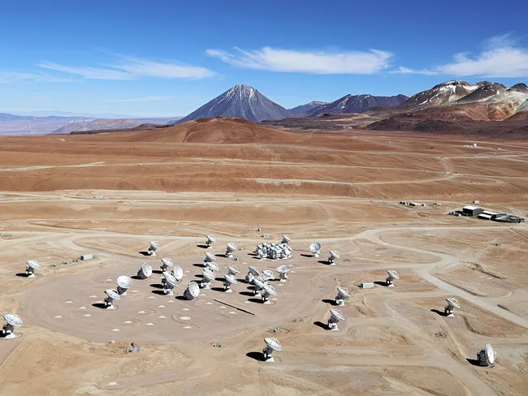
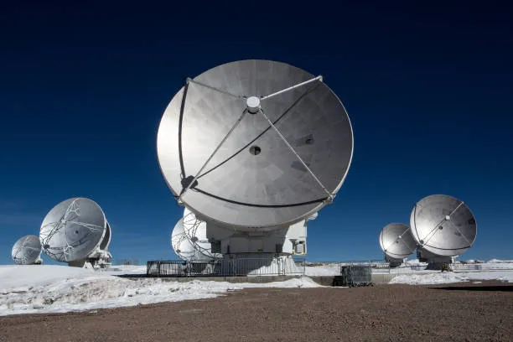
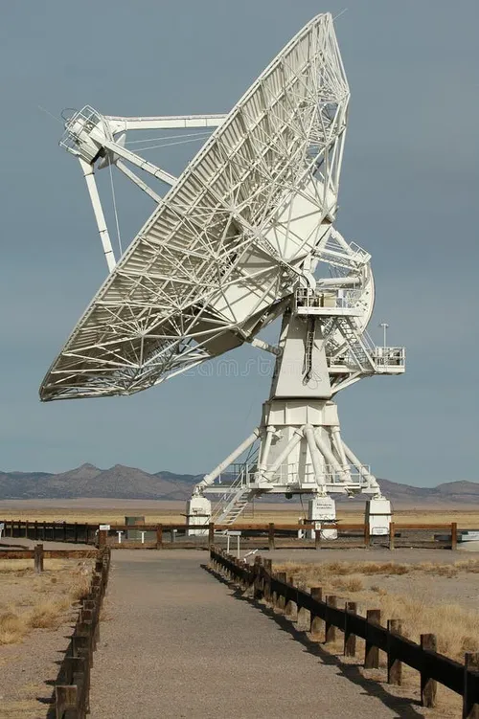
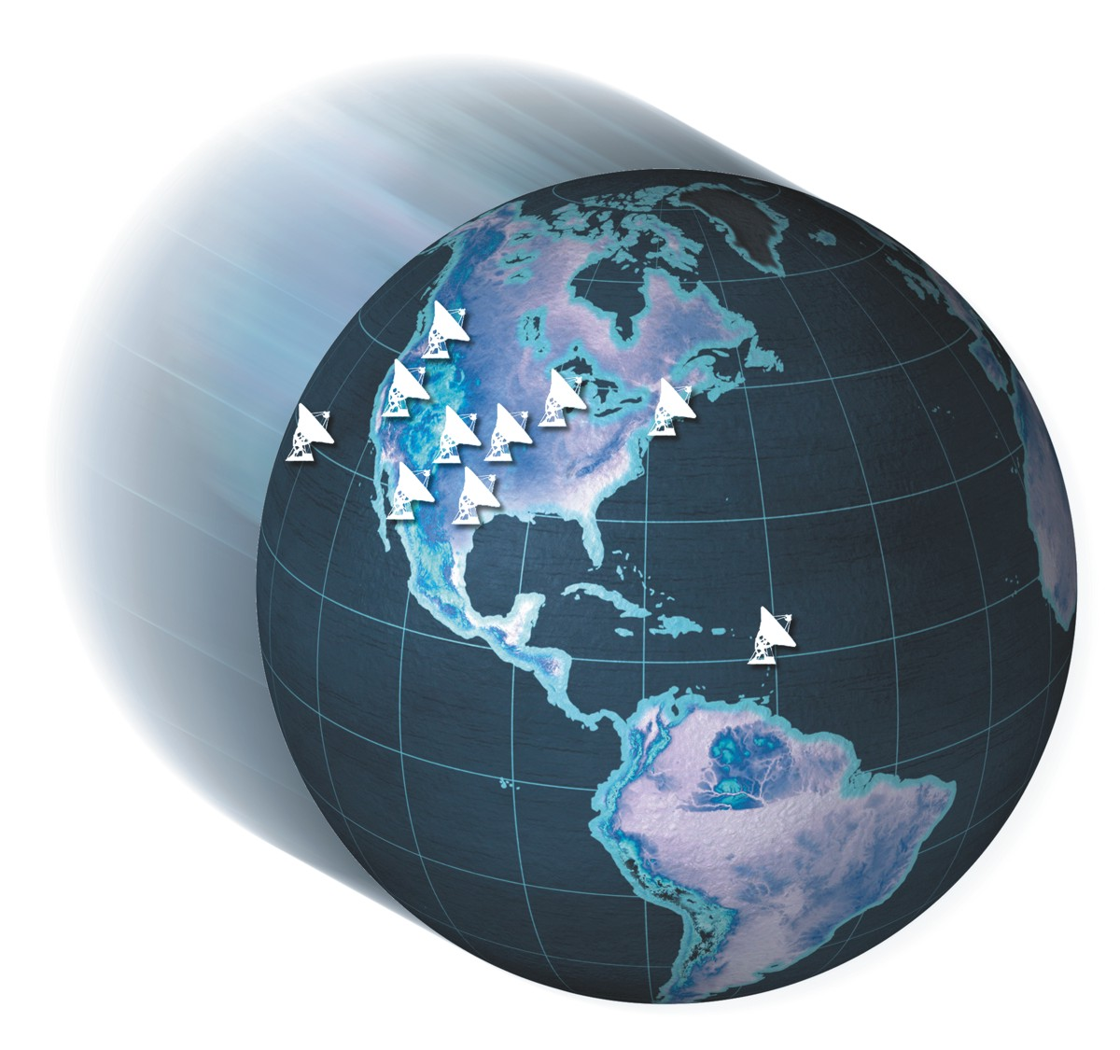
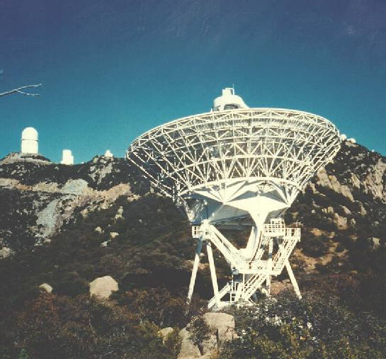
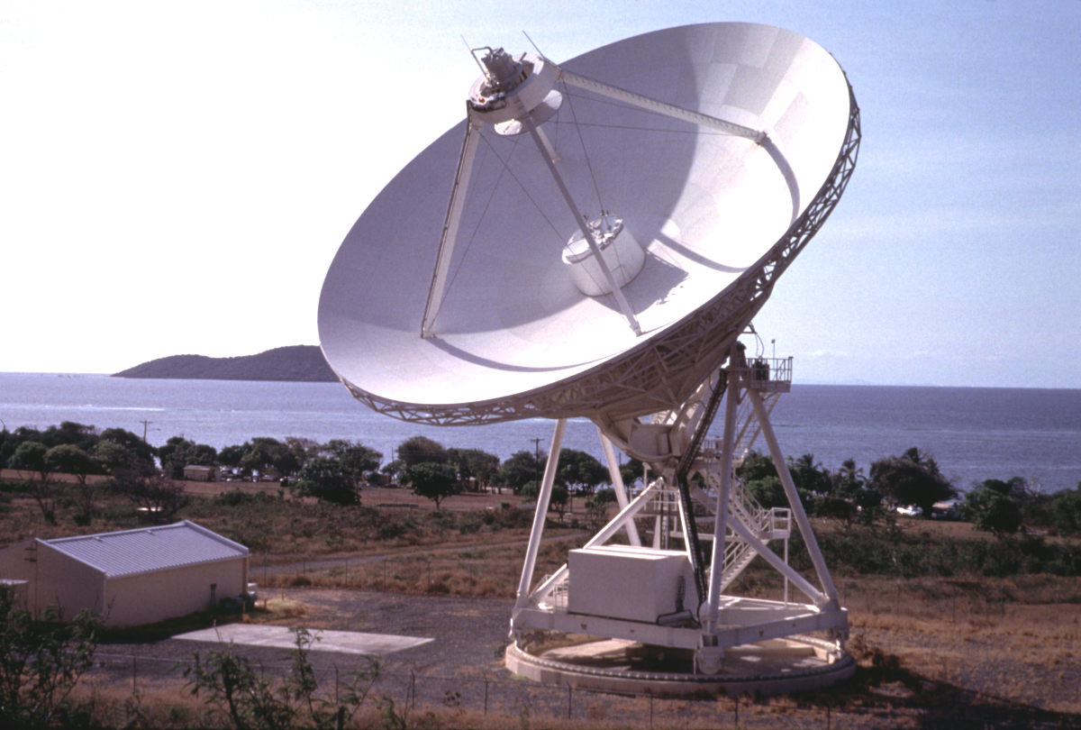
National Radio Astronomy Observatory
Jansky Very Large Array
Atacama Large Millimeter Array
Very Long Baseline Array

Slide 2
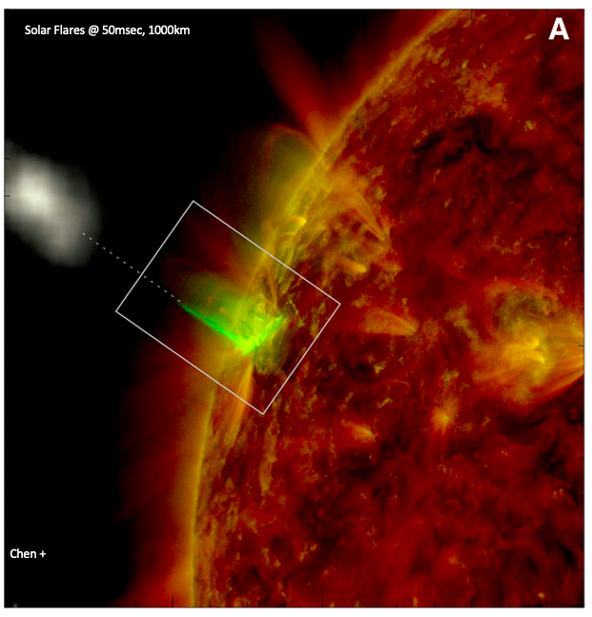
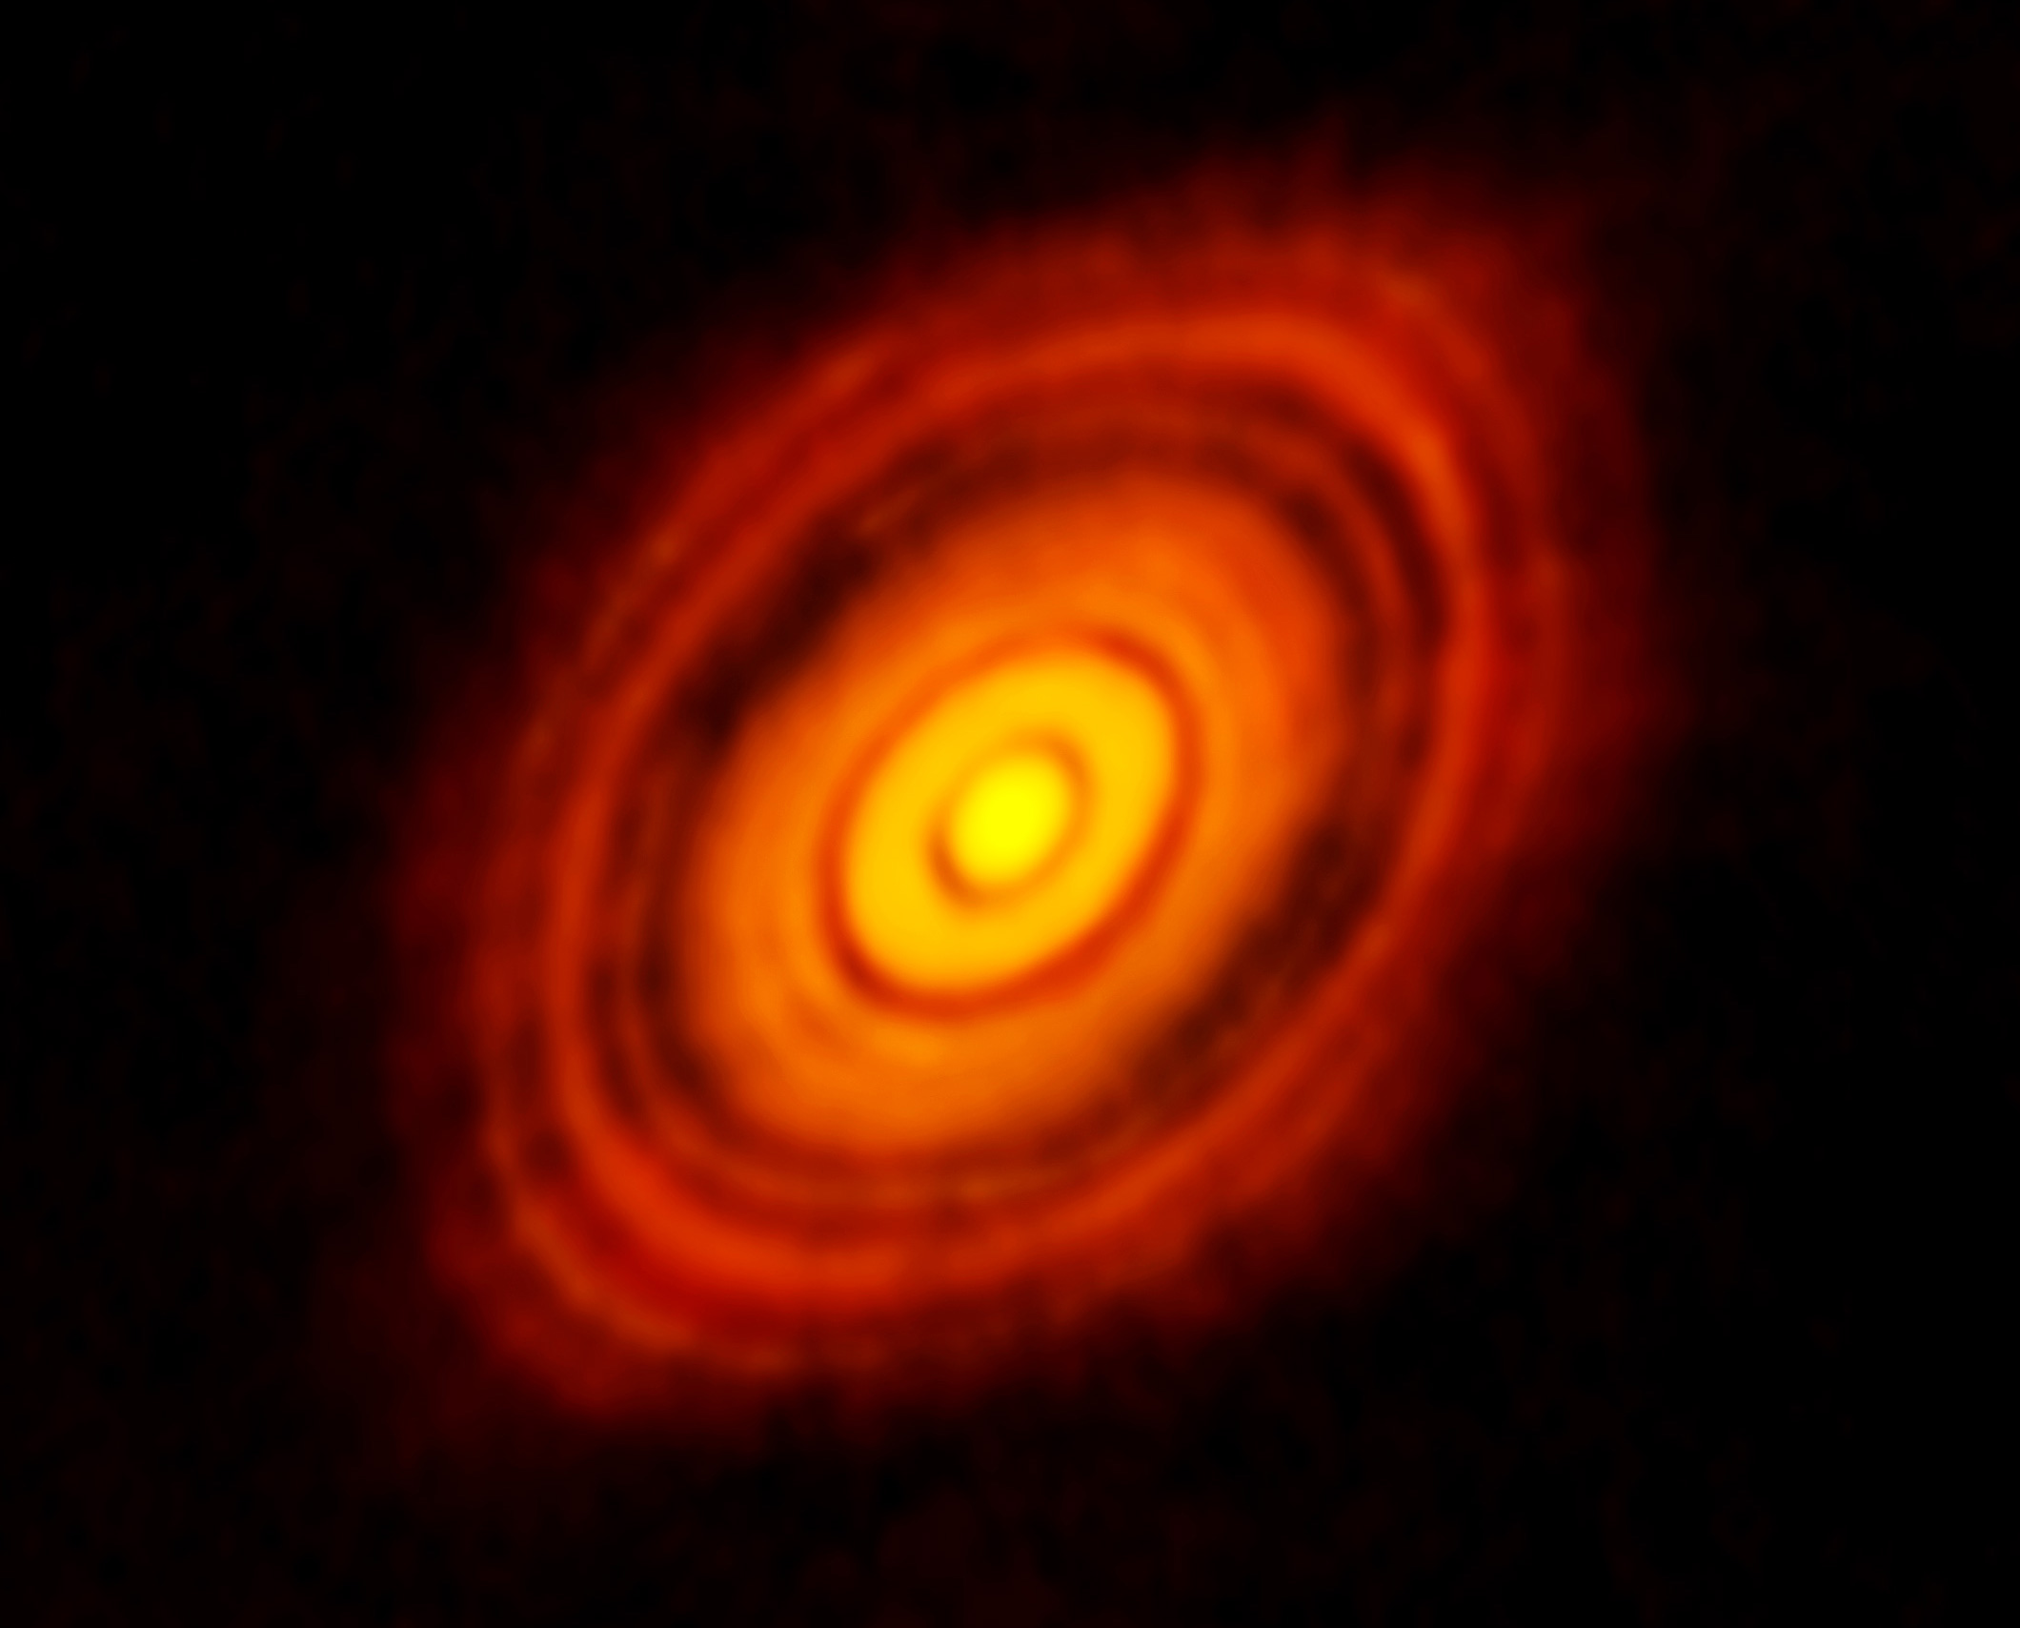
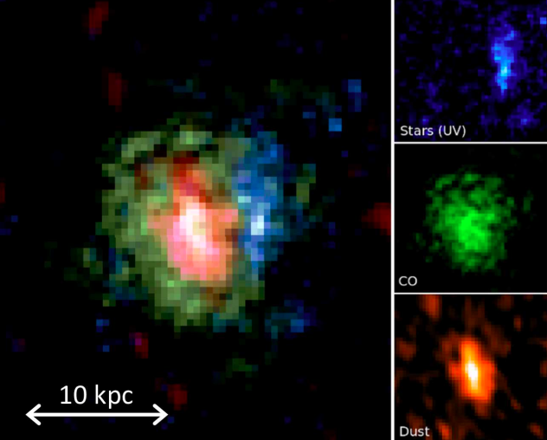
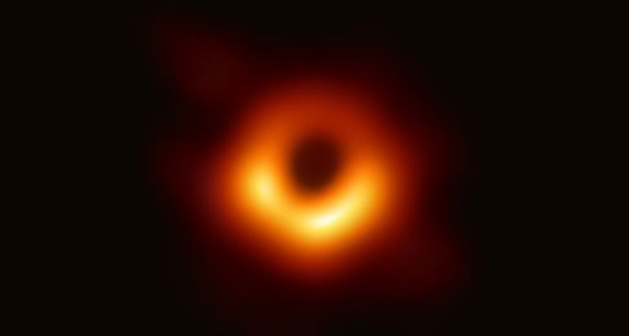
Science: the Sun to the Big Bang
ALMA 250GHz (Brogan ea.)
130AU = 1”
D ~ 12Glyr
M87 EHT 230 GHz @ 20uas resolution
M_{SMBH} = 6.5 x 10⁹ M_{o}
42uas = 0.01 Lyr = 5.6 R_{s}

Slide 3
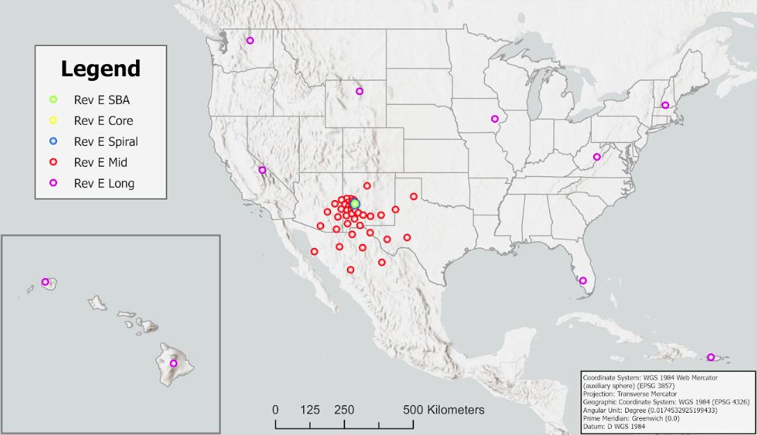
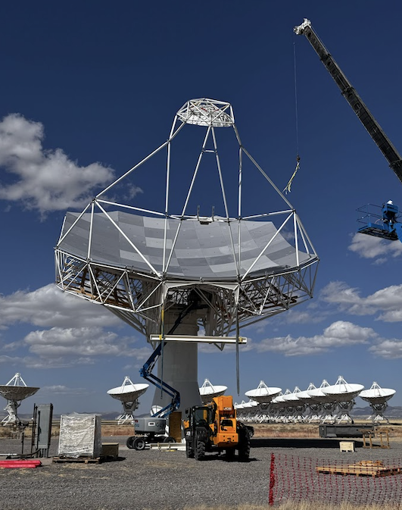
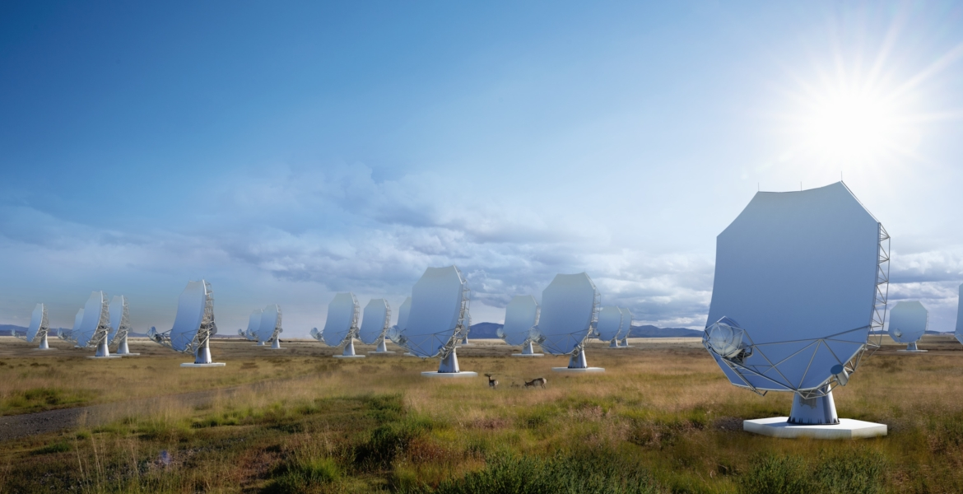
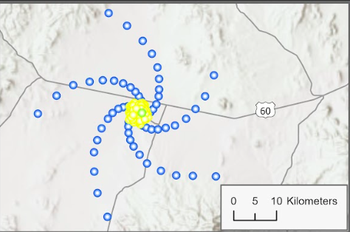
The next-generation Very Large Array
244 x 18m
10x capabilities
1.2 - 116 GHz

Slide 4
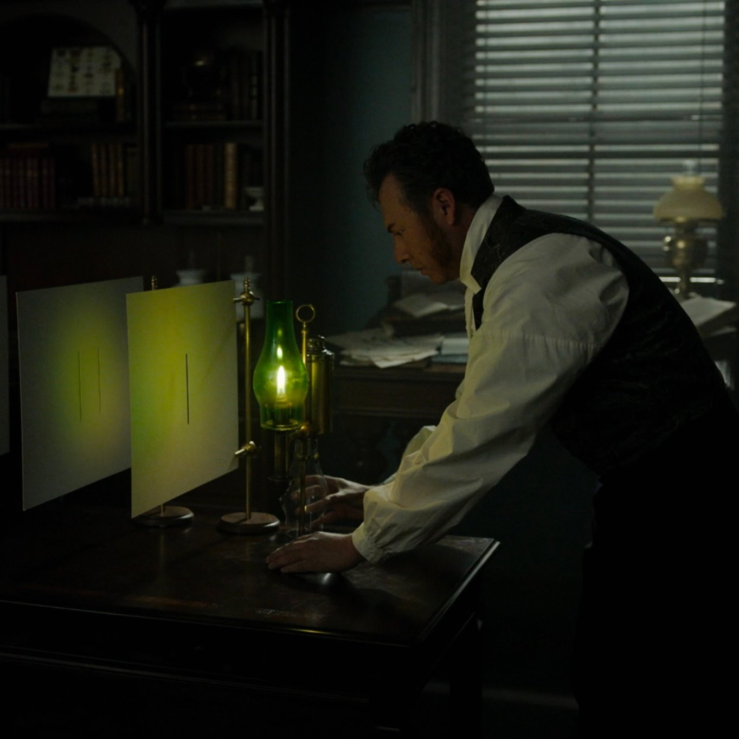
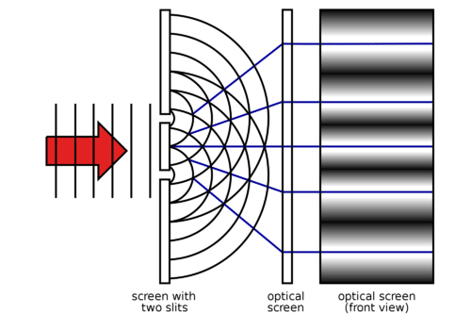
Optical Interferometry using Radio Astronomy Techniques
A new method for 𝛍m-size source characterization and wave-front sensing
Fourier optics, Huygens principle, and Young’s two slits
Carilli (NRAO), Nikolic (Cavendish), Thyagarajan (CSIRO), Torino, Iriso (ALBA)
Copyright © 2024 AUI, U. Cambridge, CELLS, CSIRO. All Rights Reserved
US patent 12,104,901
US patent app. No. 18/878,488
US patent app. No. 19/079,876

Slide 5
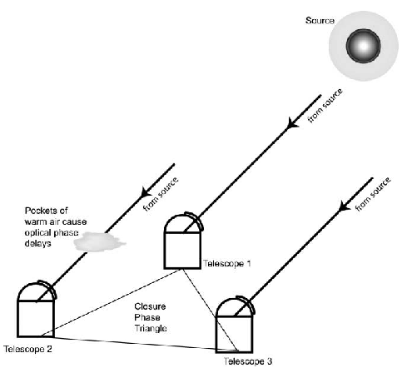

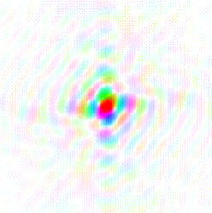
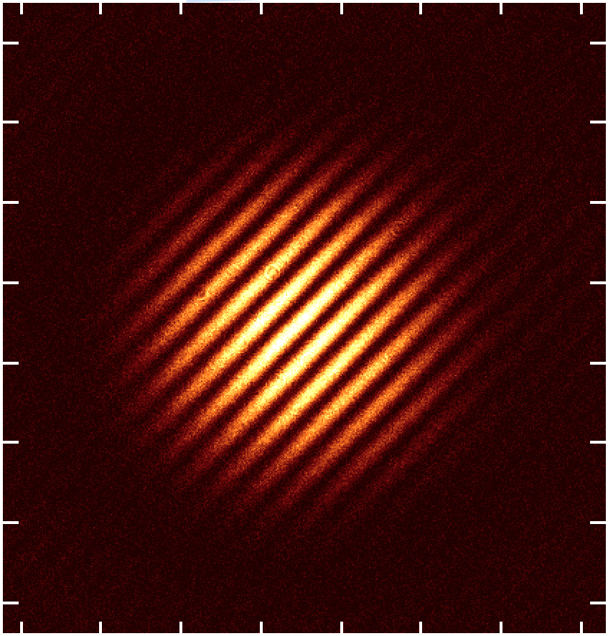





Van Cittert – Zernike Theorem
The cross-multiplication, or coherence, between the electromagnetic voltages measured at spatially distinct locations (’apertures’) = Fourier transform of the intensity distribution
Image plane
Aperture plane (complex)
FT
y
v
V_{i,j} = A_{i,j} e^{-i𝝓i,j}
x
u
u_{i,j} = (B_{i,j} / 𝜆)
𝛉 = 𝛌/B = 1/u
‘dirty image’ => deconvolution
‘self-calilbration’ = Wave Front Sensing
Voltage element gains

Slide 6
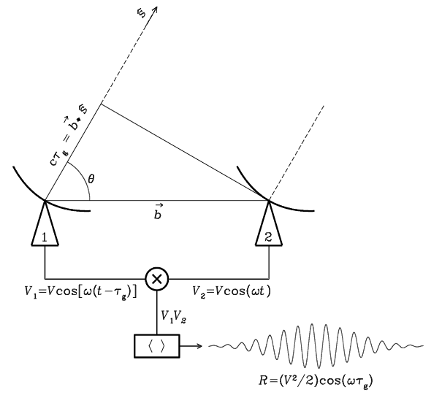
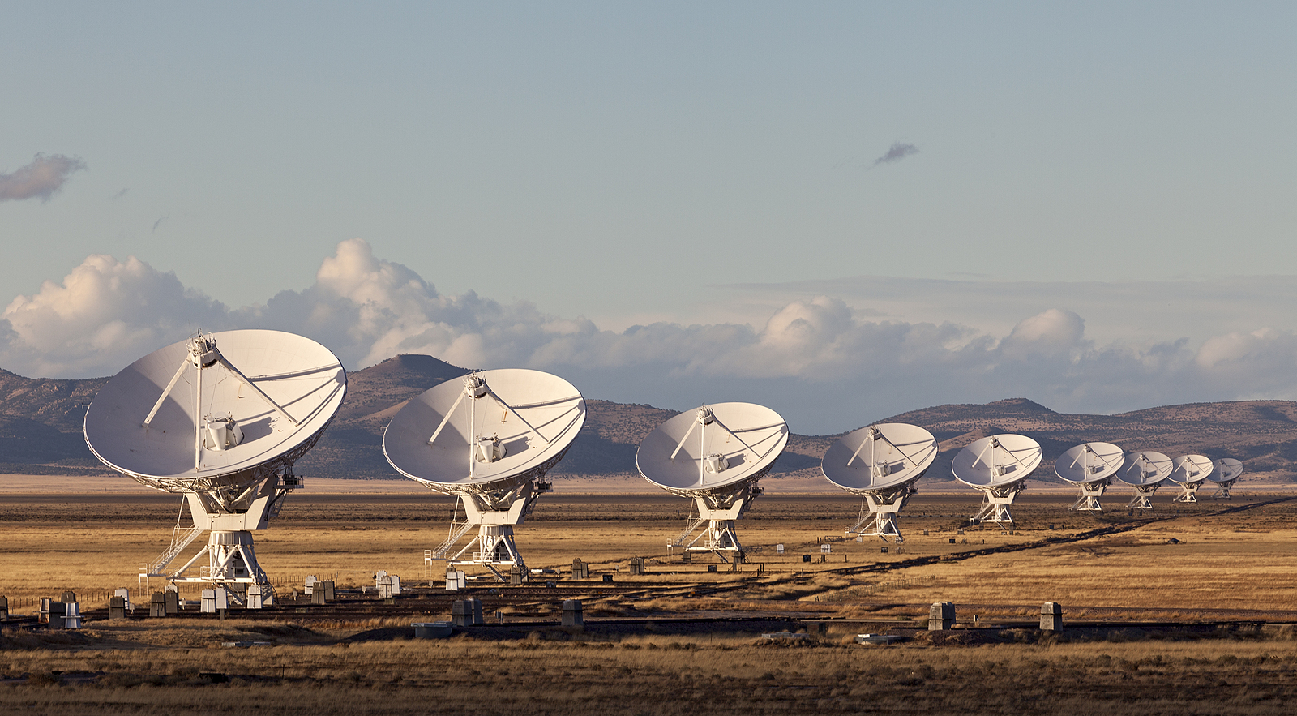
Radio measurements are visibilities = aperture plane
V_{i,j} = E_{i} x E_{j}* = A_{i,j} e^{-i𝝓i,j}
Coherent amplification of voltages, E
Geometric delays set by electronics
Complex cross multiply and average to visibilities
Images made from Fourier transform of visibilities

Slide 7
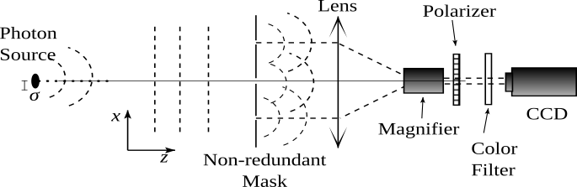
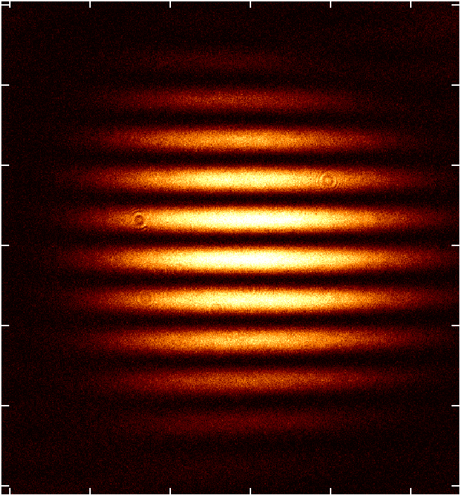
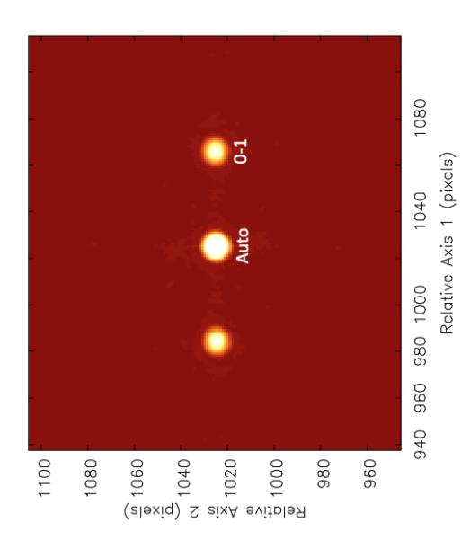
Optical measurements are images
𝛉 = 𝛌/B
V_{1,2} (A_{i,j,} 𝝓_{i,j}) = FT(Image)
Aperture mask + focus with lens (or mirrors)
Direct imaging of fringe pattern
Complex visibilities generated from FT(image)
v = B/𝛌

Slide 8
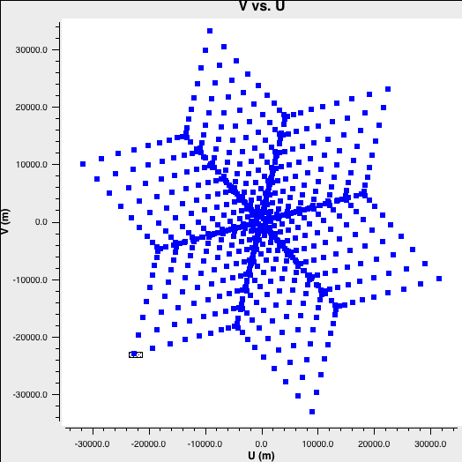
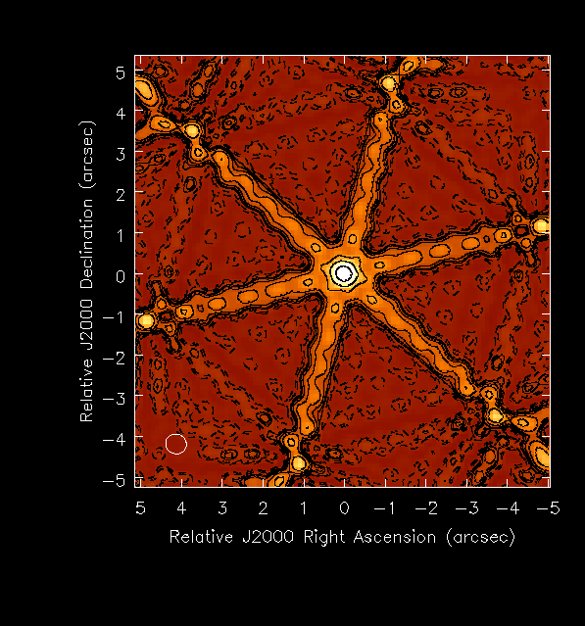
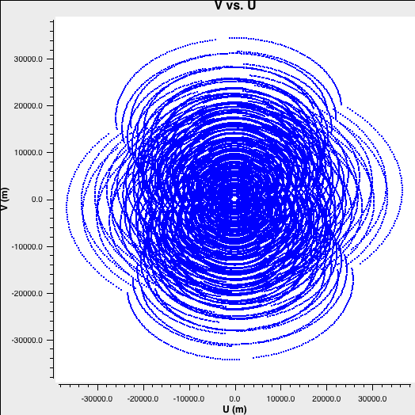
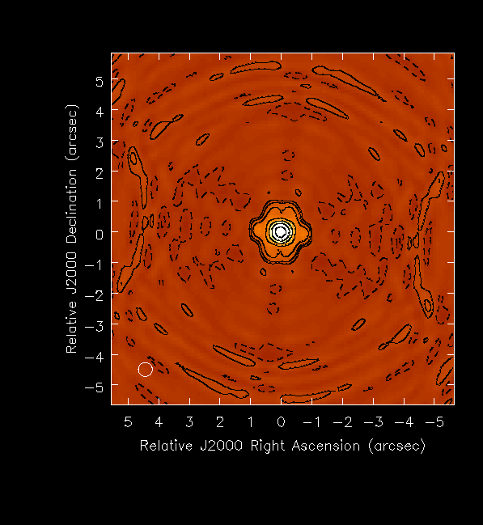
Quality of image depends on number of Fourier components:
N_{uv} = N_{ant}((N_{ant}-1)/2) = 351
Fourier = u,v coverage
PSF
FT
Sidelobes ~ 0.3
Earth rotation and bandwidth
N_{uv} = 351 x n_{t} x n_{ch} > 10⁵
Sidelobes ~ 0.03

Slide 9
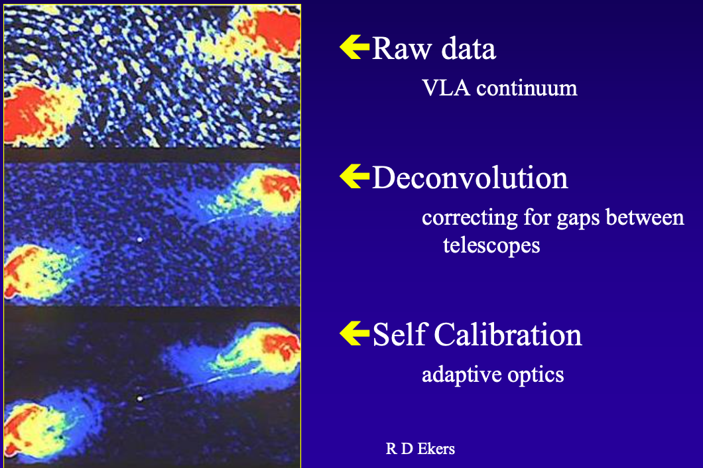
DNR ~ peak/rms ~ 100
= Wavefront sensor
Correct for element G_{i}
DNR ~ 10⁵

Slide 10
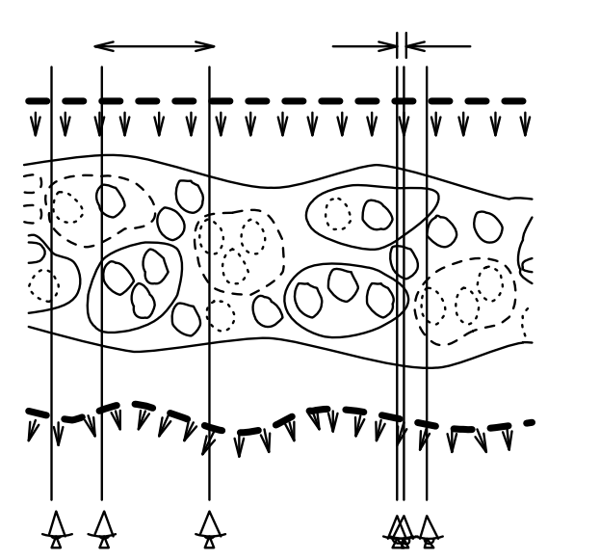
Self-Calibration: Joint fit of complex voltage gains and source structure
(1)
Start with measurements, 𝑉^{m}_{i,j} and simple source model, 𝑉^{s}_{i,j}
Invert equation (1) to derive complex element-based voltage gains, 𝐺_{i}, using an optimization criterion
Derive new source model from the gain-corrected 𝑉^{m}_{i,j} through model fitting or imaging (Fourier inversion) and deconvolution
Iterate: typically converges since there are more measurements than fitted parameters ([𝑁(𝑁 − 1)]/2 cross correlations vs. N gains plus source parameters)
𝛅L

Slide 11
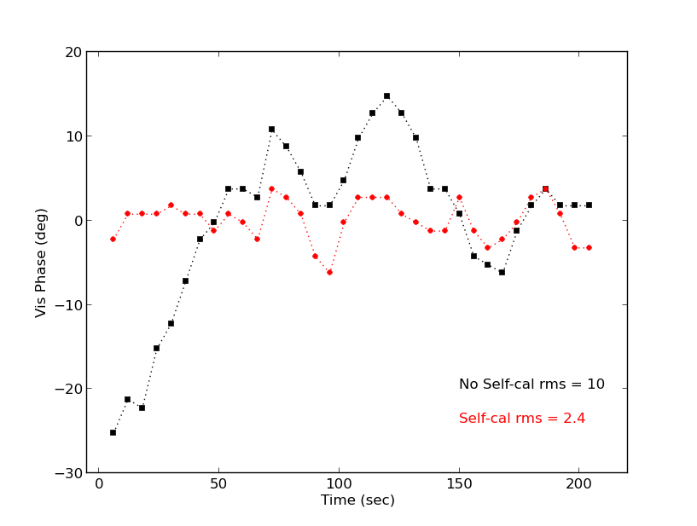
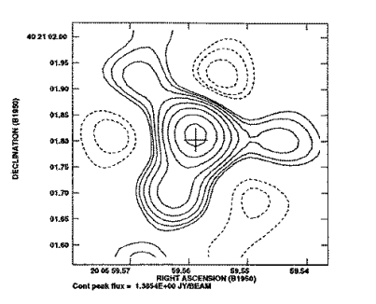
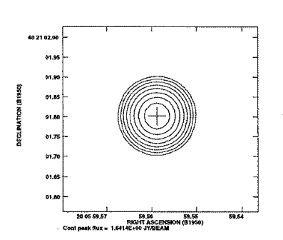
Self-Calibration: Wave-front Sensing
(1)
Gain amplitudes (a_{i}) = aperture plane illumination
Gain phases (𝛉_{i}) = photon path-length delay through system (wrt reference element) = wavefront sensor!
𝛅L
𝛅L = 𝛌 x 𝛉_{i}/360º
VLA 8 GHz
‘The wavefront cannot be directly measured, because it is determined by phase,’ Yi et al 2021

Slide 12
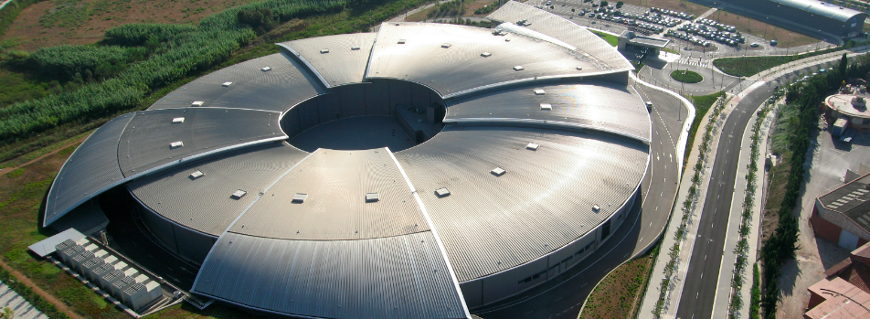
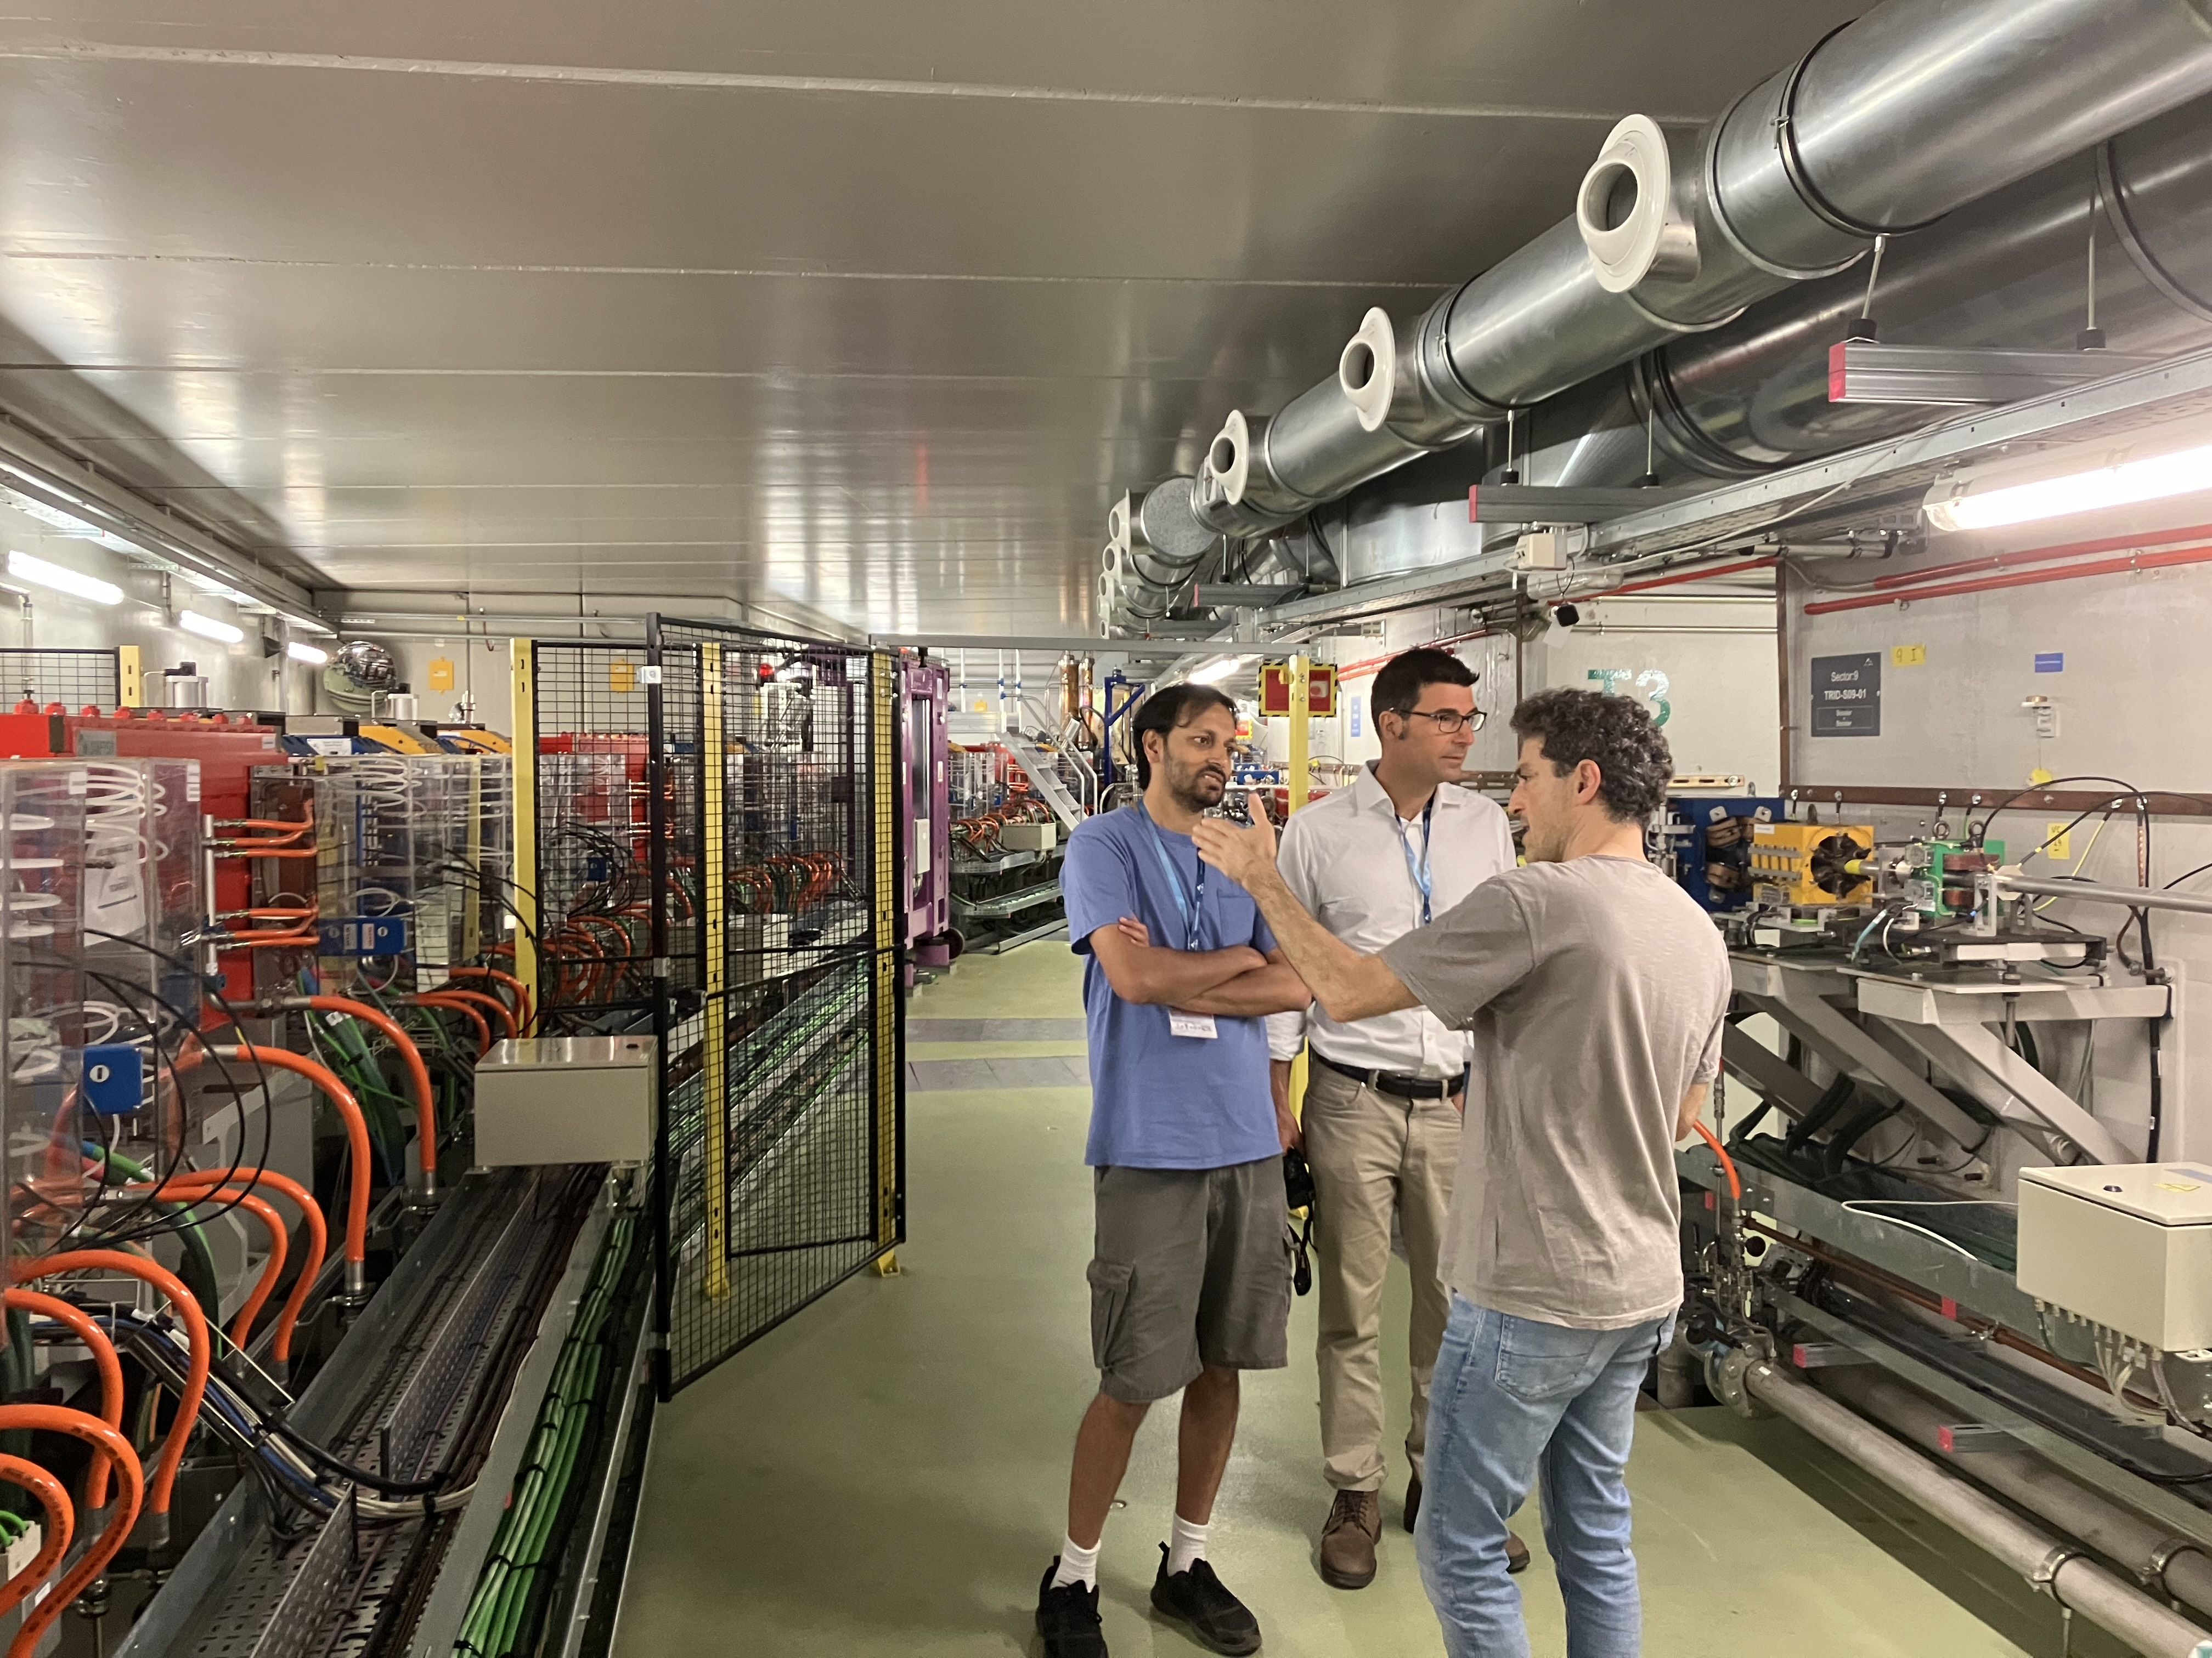
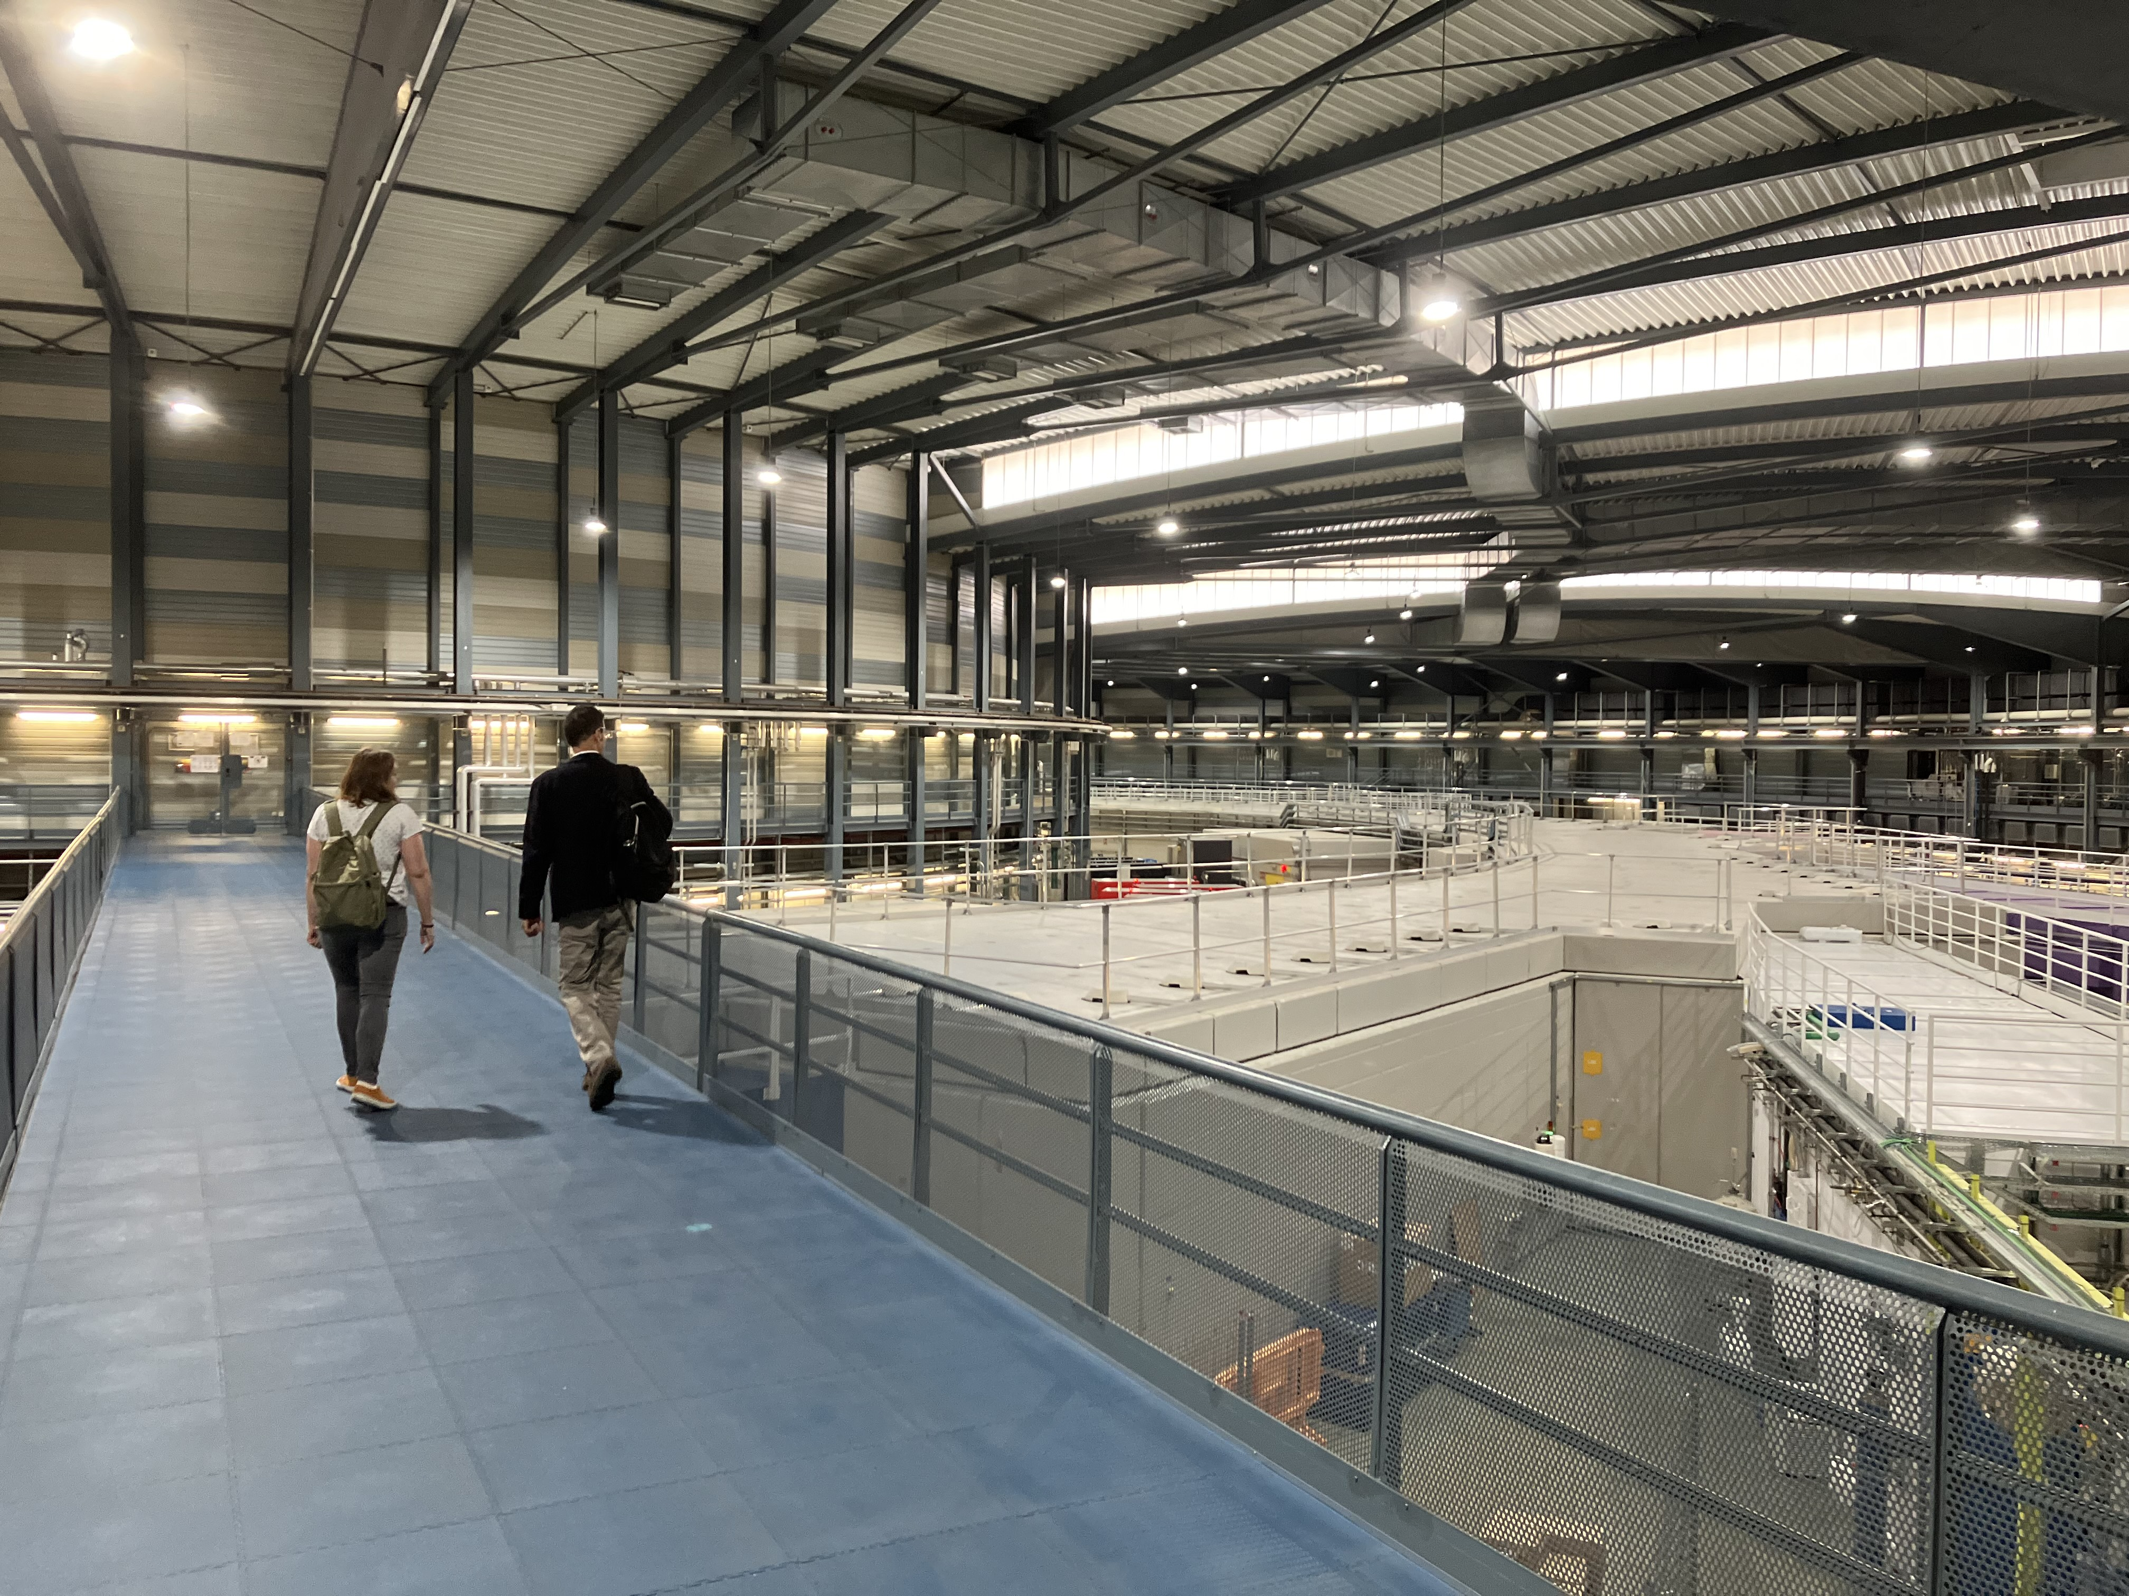
ALBA Synchrotron Light Source, Barcelona, Spain
Circumference = 270m
Electron energy = 3 GeV
Photons IR to X-ray

Slide 13
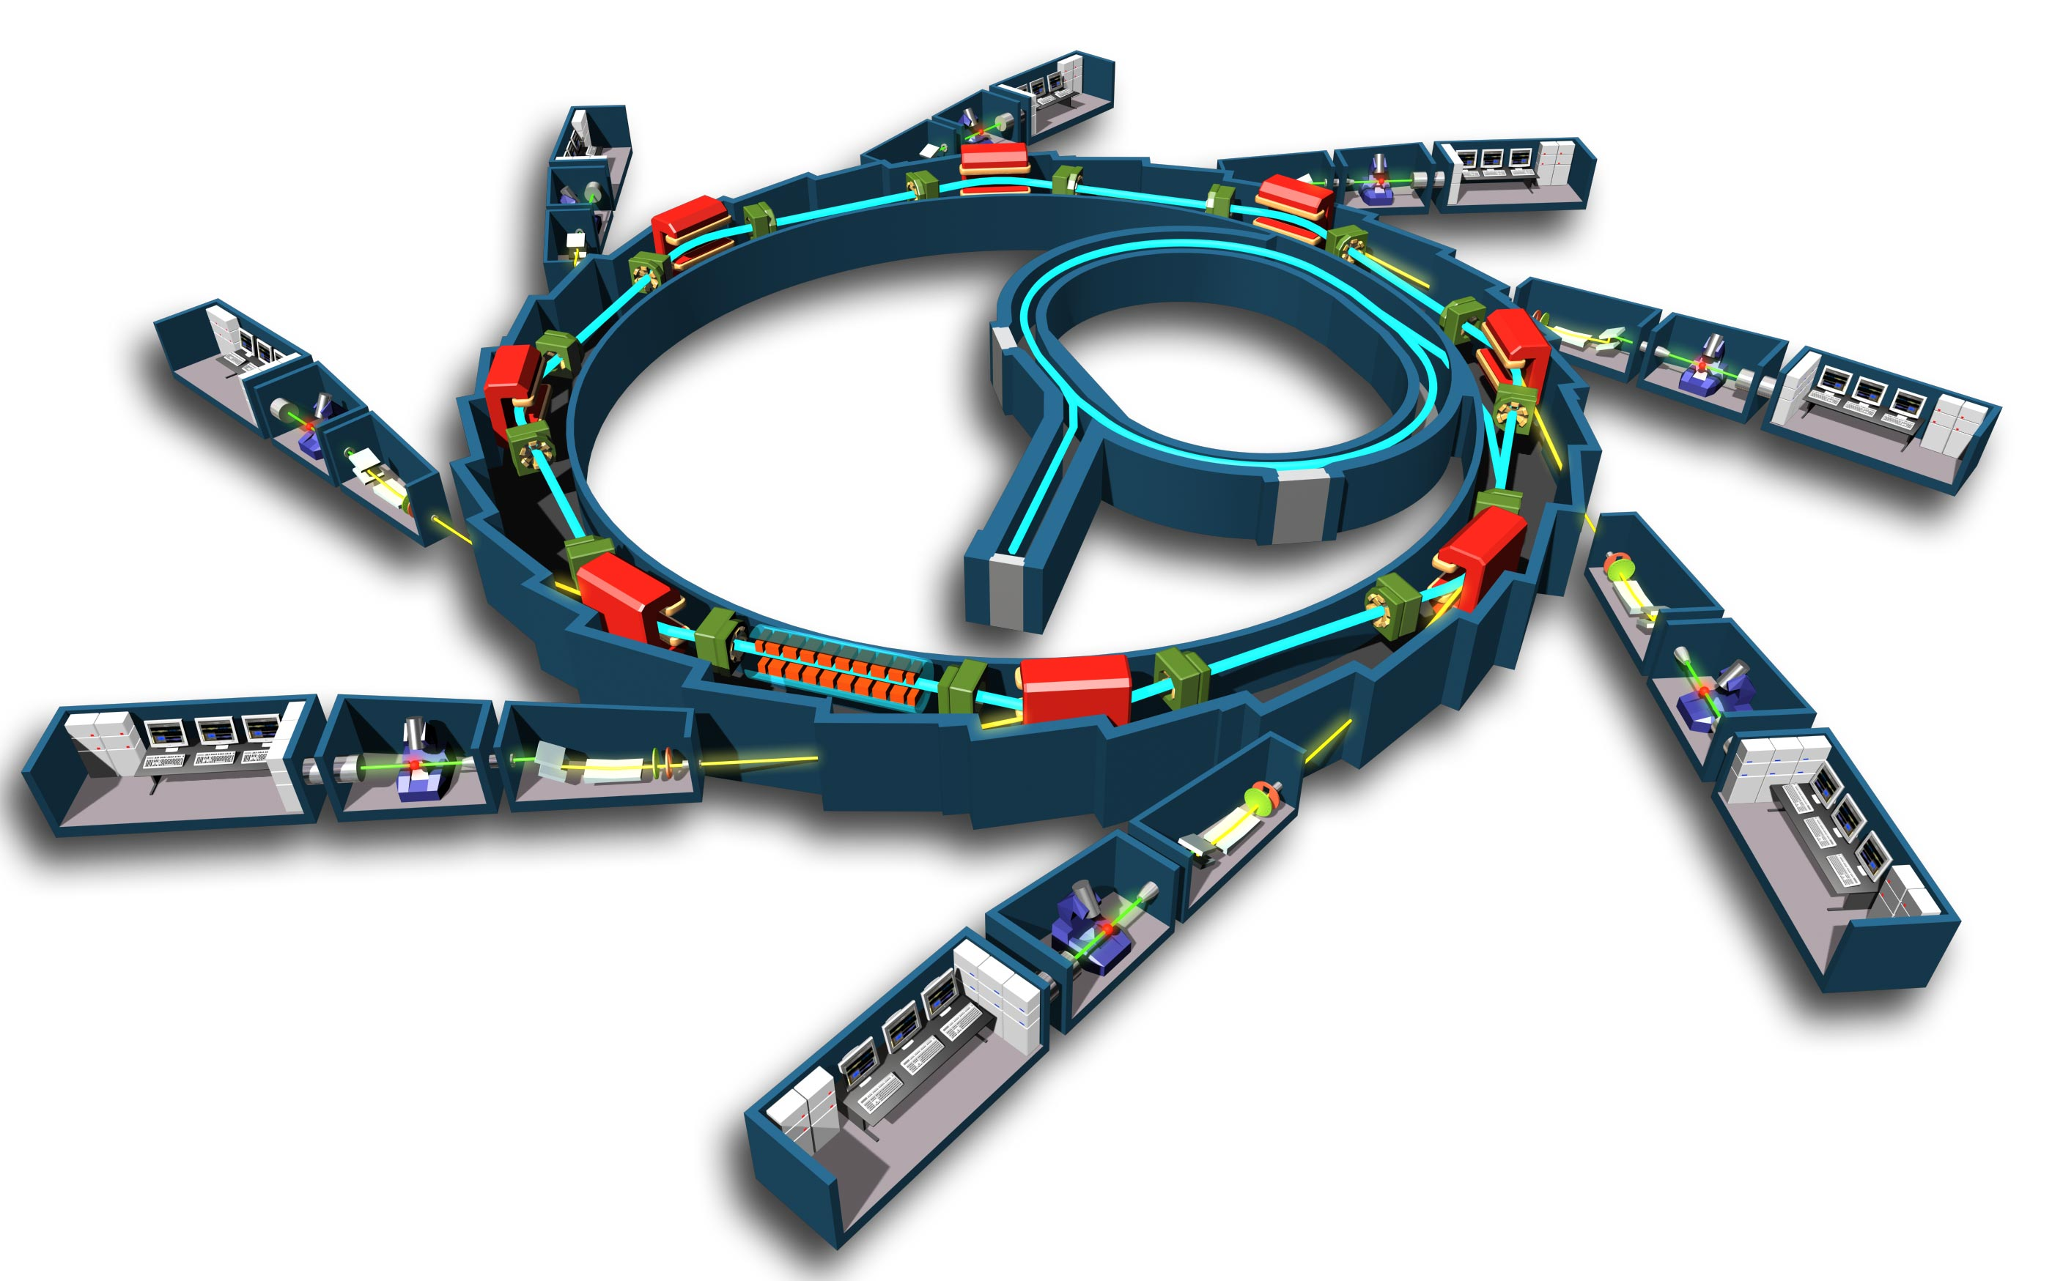
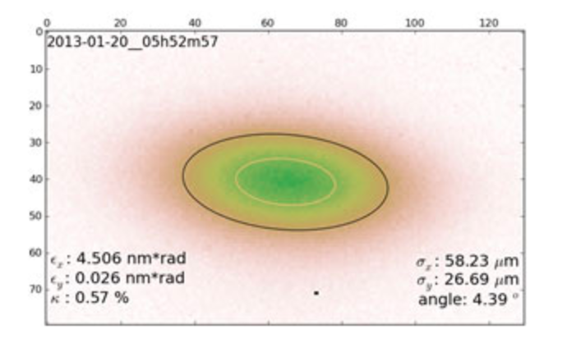
Storage Ring
Photon Beam lines = experiments
Bending magnet
Insertion Ring
e⁻ gun
Undulator or wiggler
Performance set by Gaussian e- beam size
smaller => better
X-ray crystallography and tomography
X-ray spectroscopy
X-ray metrology
X-ray lithography
Infrared spectroscopy
Optical interferometry

Slide 14
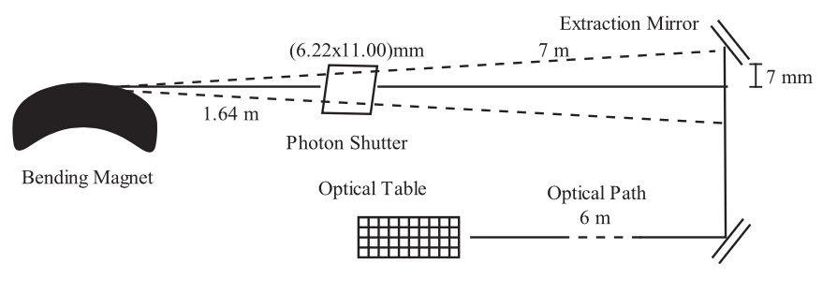
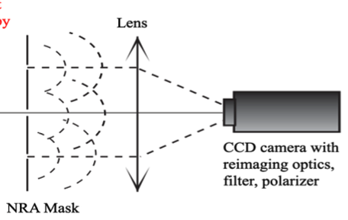
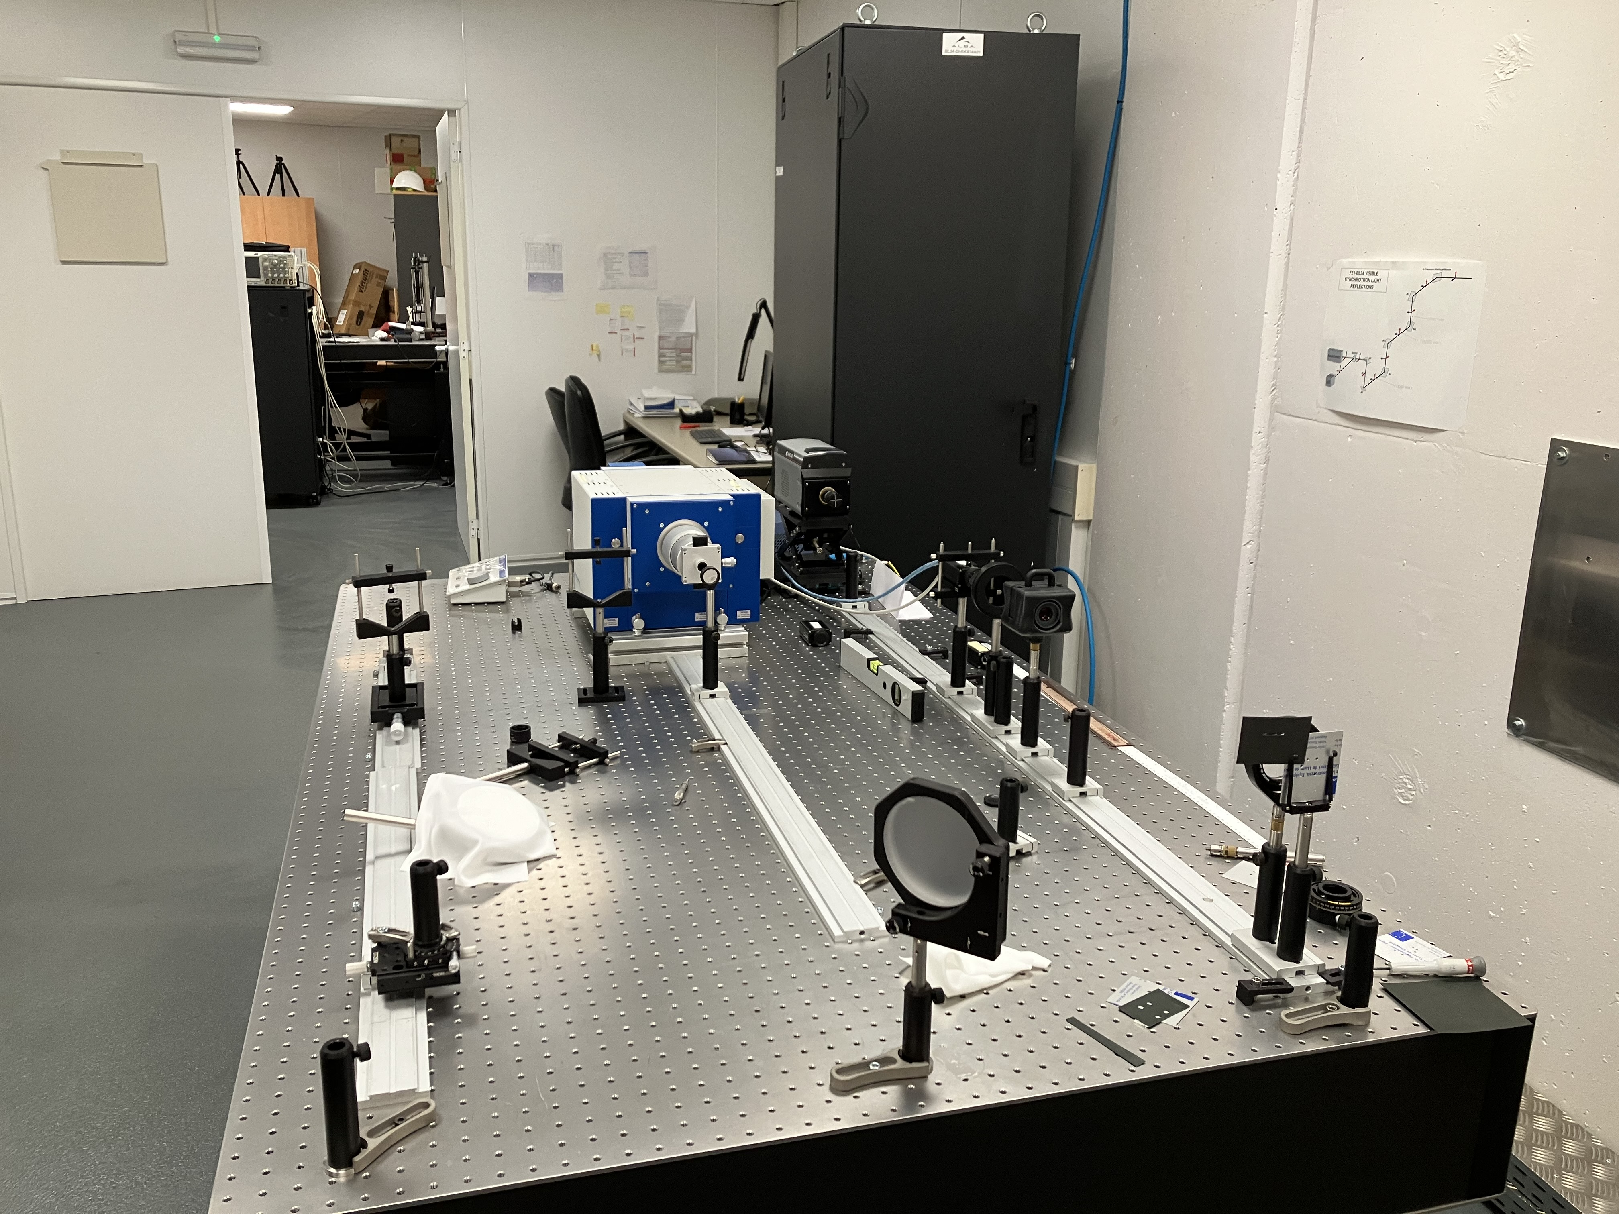
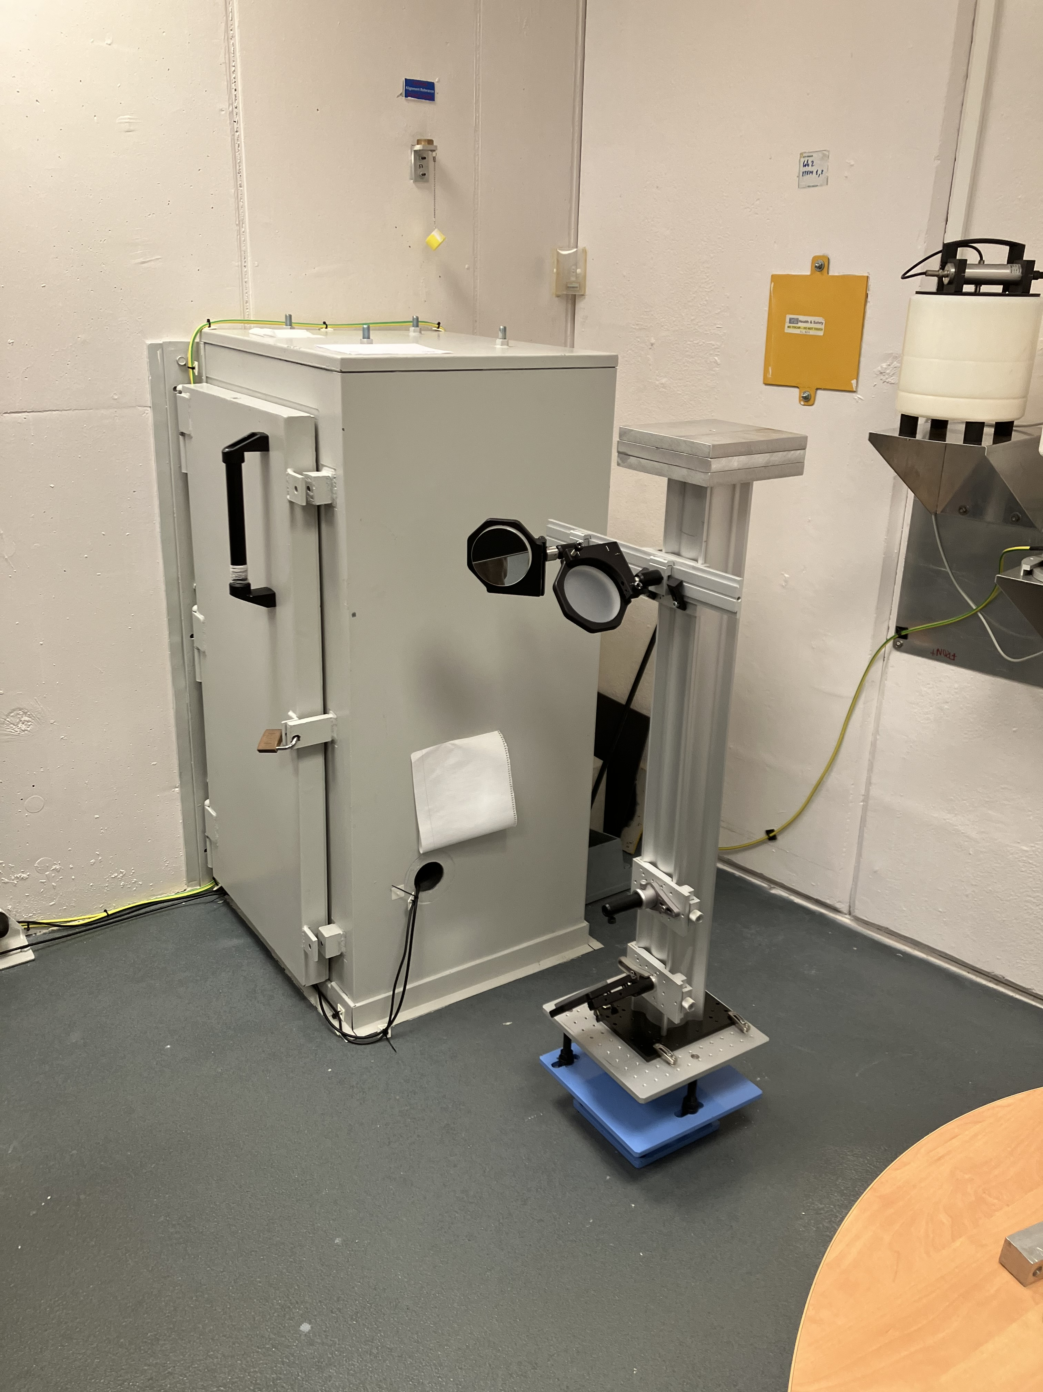
Xanadu: ALBA optical synchrotron radiation interferometry lab
Mask
Optical table
Filter, polarizer, reimaging optics, CCD
Lens
Fast CCD
Magnifier, polarizer, color filter
Mask + lens

Slide 15
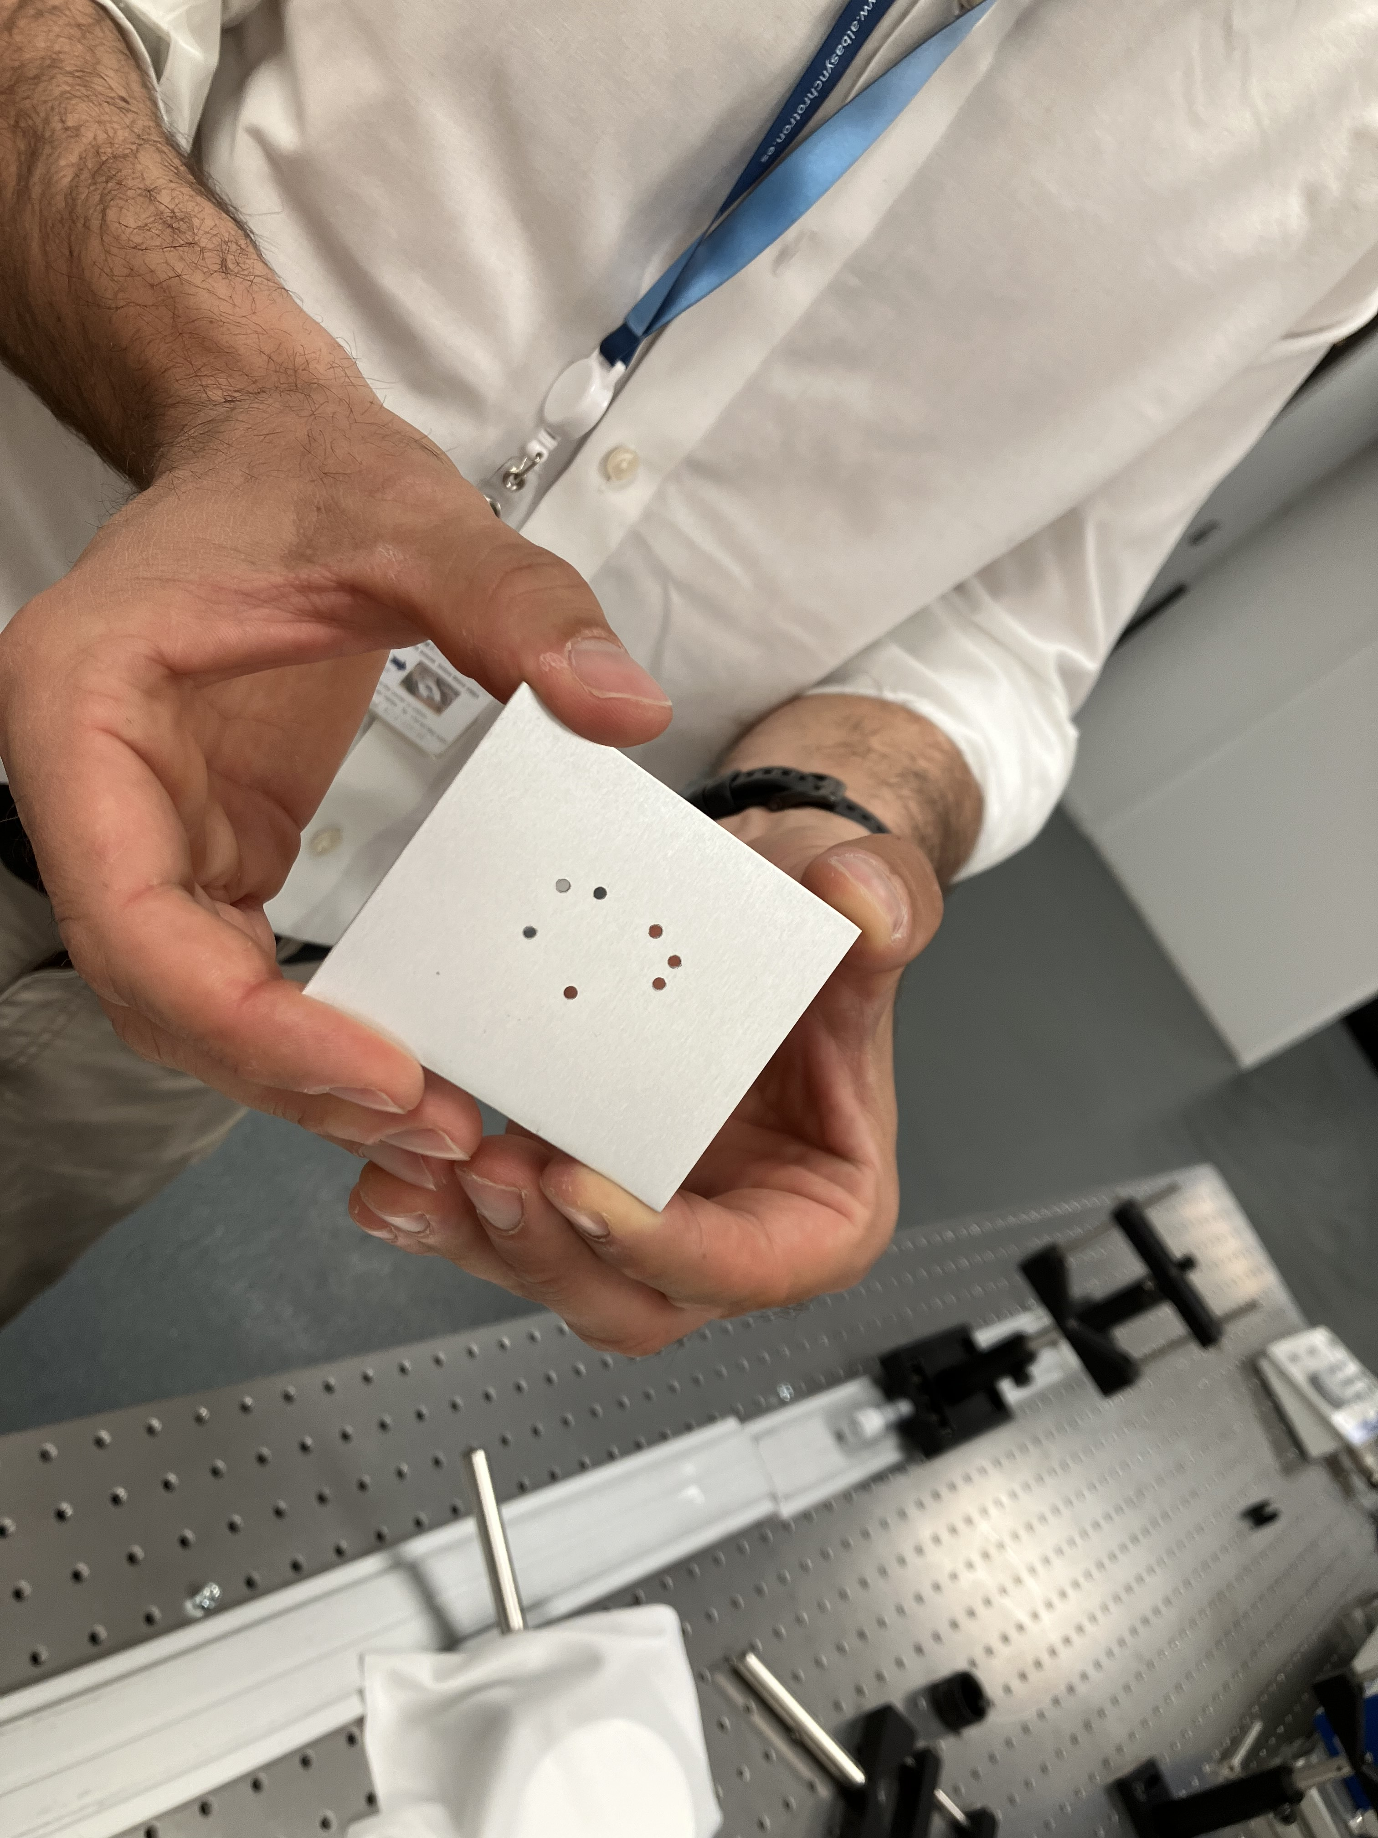
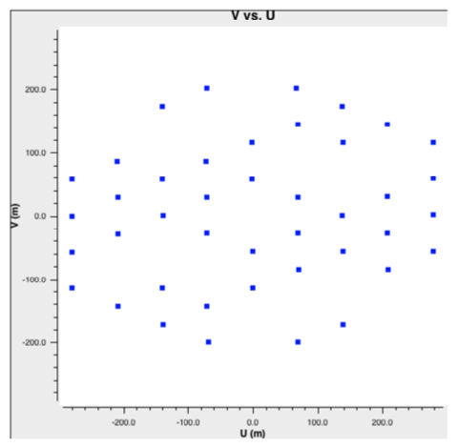
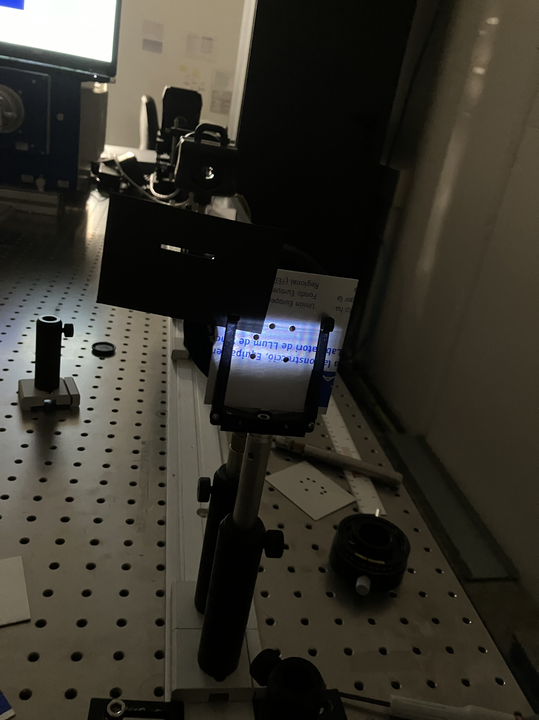
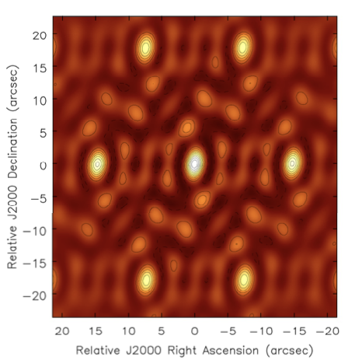
Example 7 hole non-redundant mask
Experiments
7 hole mask (JWST design)
Hole diameter = 2mm
Baselines 5mm to 24mm (3.7”)
Wavelength = 400nm
10⁷ photons/millisec
30 frames = 0.3ms every 1sec

Slide 16
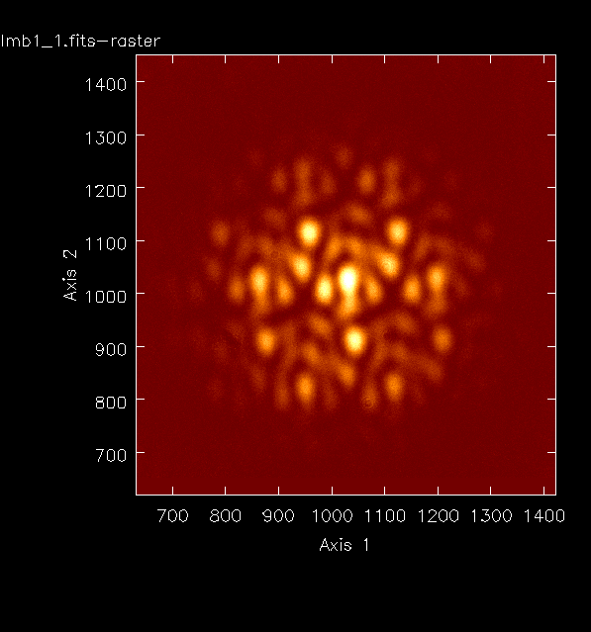
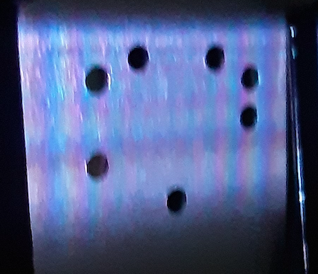
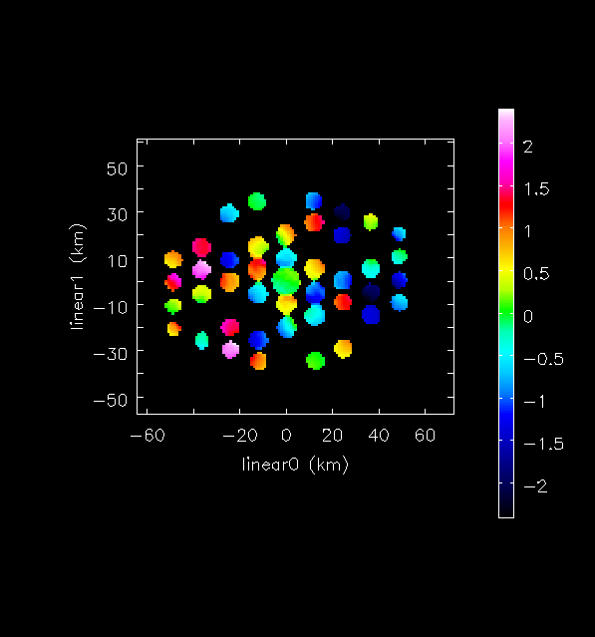

Non-redundant 7 hole Mask: JWST Template

Slide 17



Self-calibration Amplitudes = Illumination
Selfcal G_{amp} stable ~ 1%
Voltage gains differ by up to 30%
=> Power differs > 50%
1.24
1.19
1.23
1.19
1.31
1.11
Coherences > 60%
Stable < 1%
1.00

Slide 18



Electron Beam Size from Self-calibration
Maj = 59±0.1um
Min = 23±0.3um
PA = 16±0.2º
Without SC 280 12 15º

Slide 19


Visibility Phases and Wavefront Sensing
= 𝛌 x 𝛉_{i}/360º
Before Self-cal
After Self-cal
1-6, 2-5
rms ~ 1.2º = 1.3nm
[𝛔_{N𝛄} ~ 0.1% ~ 0.4nm]
rms = 28º = 31nm
Mean = static pathlength differences (’metrology’)
Variations (millisec) = vibrations and turbulence (‘adaptive optics’)
𝛅𝚽 is correlated between baselines => systematic 𝛅L, not noise
rms after self-cal much lower => measuring frame 𝛅L to high significance

Slide 20



Gain Phase Solutions encode 𝛅L
Mean 𝛉_{i} can be large (+/-180º)
Variations: rms ~ 20º (6nm); correlated between neighboring holes
0 nm
3
4
2
5
6
𝛅L = 𝛌 x 𝛉_{i}/360º
1,2,3
1
0
-220 nm
Subtract mean 𝛉_{i}: frame residual ~ gradient
28 nm
4,5,6
-167 nm

Slide 21




Tip-tilt wave-front distortion due to vibration
Tilts up to +/-50 nm across mask (~1”); random frame-to-frame
rms deviation from plane ~ 4 nm = higher order WF corrugations + noise
Need more holes for fitting higher orders

Slide 22
Wavefront sensing via interferometric self-calibration
Measure total photon path-length difference for each element relative to reference position in aperture plane: not ‘reference wave interference’ (Fizeau) nor ‘angle-based’ (Shack-Hartmann) method
𝛅L = 𝛌 x 𝛉_{i}/360º
Mean phase = static pathlength differences (’metrology’)
Variations (millisec) = vibrations and turbulence (‘adaptive optics’)
Precision: small fraction of wavelength
rms per vis after cal ~ 1.3nm. 7 hole mask => 6 vis per G_{i} => 𝛅L_{rms} ~ 0.6nm per frame
Precision for metrology average 30 frames => 0.1nm
Dynamic range set by phase wraps => 1 wavelength between pairs of elements
Fitting wavefront (Zernike) across mask could improve by factor few (similar to S-H)
Add spectral axis => improve dramatically: eg. measurements separated by 5% in 𝛌 increase dynamic range by factor 20 (‘global fringe fitting’ in VLBI = phase slope w. freq)
Aperture sampling is limited by requirement of non-redundant mask
Use fibers or micro-mirror array to fully sample aperture and generate series of non-redundant interferograms
Use ’over-constrained’ nature of self-cal to limit analysis to non-redundant u,v samples

Slide 23

Wavefront sensing via interferometric self-calibration
Are there similar methods in the field?
What are the current frontiers in WFS?
How might this technique fit-in?
arXiv:2503.10820
arXiv:2405.12090
arXiv:2409.11135
arXiv:2406.02114
JOSA-A 2024, 41, 1513
2022PASA...39...14T
JOSA-A 2022, 39, 2214
US patent 12,104,901
US patent app. No. 18/878,488
US patent app. No. 19/079,876

Slide 24

Estimate precision via simulations
Insert horizontal tilt and ‘step’ functions to real data
Run self-cal: recover distortions with 𝛉_{i} to < 1º

Slide 25

Why not a filled aperture?
Phase screen => image blurring = ‘seeing’ (filled aperture has infinite # of redundant baselines)
Diffraction limit => 𝛉_{source} < PSF => requires deconvolution (model fitting)
PSF of filled aperture is complex (diffraction edges, shutters… Not just airy disk)
PSF of interferometer is (almost) mathematically deterministic (sinusoids)
ALBA
e⁻ beam FWHM = 141x56um @15m
FWHM_{maj} = 1.9”
FWHM_{min} = 0.8”
Lens/shutter PSF FWHM ~ 6” w. complex 20% diffraction wings
Mask longest baseline = 24mm => fringe spacing at 540nm ~ 5”,
but PSF is known precisely and S/N is very high (10⁷ photons per vis) => facilitates model fitting
7”

Slide 26


Why non-redundant mask?
Decoherence on redundant baselines due to phase fluctuations across mask
Coherence for redundant samples lower by 5%
rms for redundant samples ~ 6x non-redundant

