Slide 1
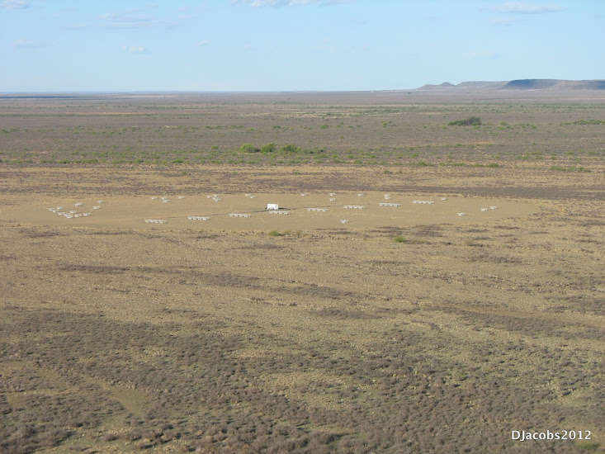
Cosmic Reionization
Chris Carilli, UNM, Sept. 5, 2015
I. Introduction: Cosmic Reionization
  Concept
  Constraints on evolution of neutral Intergalactic Medium (IGM)
II. HI 21cm cosmology
  Potential for 3D imaging of the evolution of early Universe
  Precision Array to Probe Epoch of Reionization: first results
  Hydrogen Epoch of Reionization Array: precision 21cm cosmology
Fan, Carilli, Keating 2006, ARAA, 44, 415
Furlanetto et al. 2006, Phys. Reports, 433, 181
Wyithe & Morales 2010, ARAA, 48, 127
Pritchard & Loeb 2012, Rep.Prog. Phys., 75, 690

Slide 2
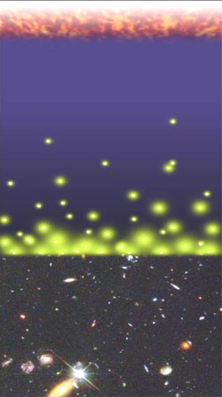
Big Bang f(HI) ~ 0
History of Normal Matter
Intergalactic Medium (mostly Hydrogen)
Recombination
0.4 Myr
z = 1000
f(HI) ~ 1
Reionization
0.4 – 1.0 Gyr
z ~ 6 to 12
f(HI) ~ 10⁻⁵
13.7Gyr
z = 0
Djorgovski/CIT

Slide 3
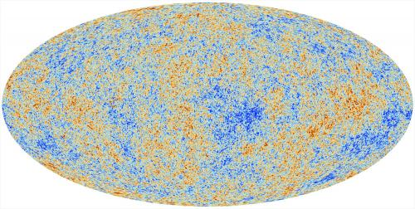
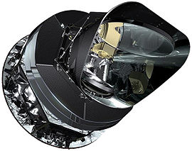
Cosmic microwave background radiation
Recombination
Early structure formation (0.4Myr)
Imprint of primordial structure from the Big Bang: seeds of galaxy formation
Planck

Slide 4
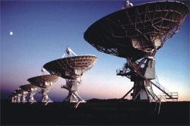
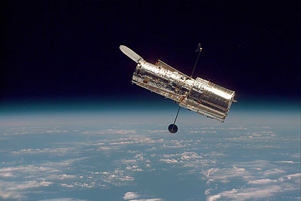
SDSS, HST, VLT, VLA…
Late structure formation Realm of the Galaxies (~ 1 – 13 Gyr)

Slide 5
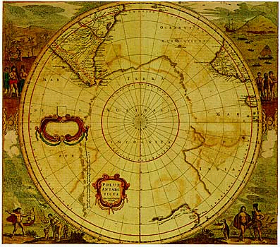
Universum incognitus
Dark ages
< 1Gyr
Last phase of cosmic evolution to be verified and explored
Cosmological benchmark: formation of first galaxies and quasars
Focus on key diagnostic: Evolution of the neutral intergalactic medium
  When?
  How fast?
  HI 21cm signal
Cosmic Reionization

Slide 6
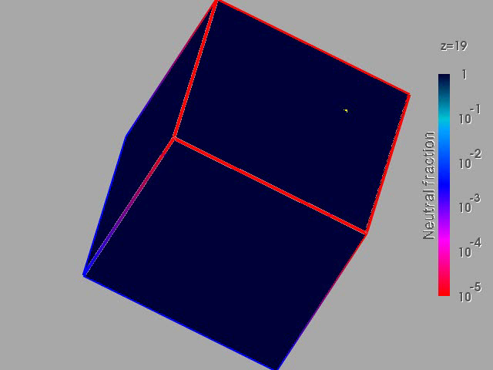
Numerical Simulation of the evolution of the IGM
F(HI) from z=20 to 5
t_{univ} = .2 to 1 Gyr
Three phases
Dark Ages
Isolated bubbles (slow)
Percolation (bubble overlap, fast): ‘cosmic phase transition’
10cMpc
(Gnedin & Fan 2006)

Slide 7
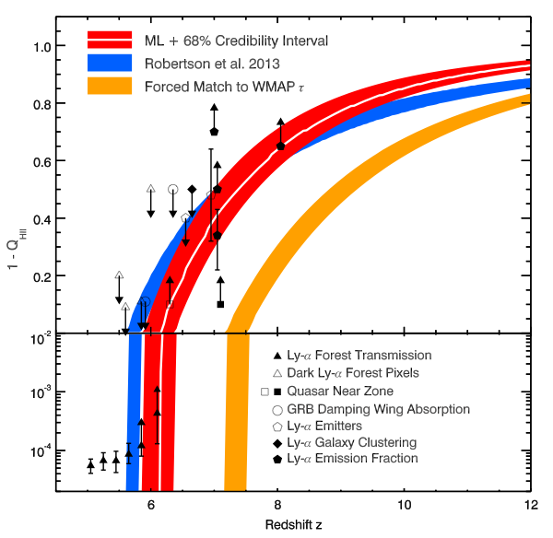
Evolution of the IGM neutral fraction (Robertson ea. 2015)
τ_{planck}
F_{HI_vol}
τ_{wmap}
10⁻⁴
1 Gyr
0.5 Gyr
Model based on star forming galaxies and τ_{CMB}

Slide 8
Lyα–based measurements
τ_{planck}
F_{HI_vol}
τ_{wmap}
Lya galaxies
Quasar near-zones
10⁻⁴
Gunn-Peterson effect
1 Gyr
0.5 Gyr
Model based on star forming galaxies and τ_{CMB}

Slide 9
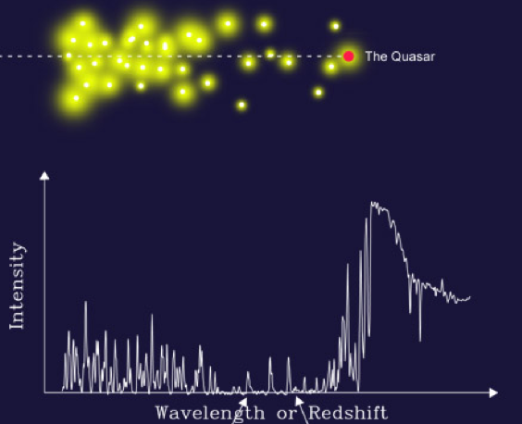
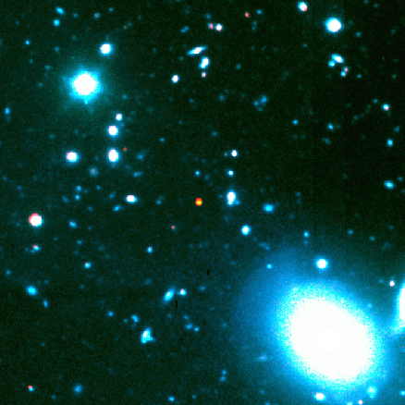
Lyα and the Gunn-Peterson Effect (1963)
z=6.4
t_{univ} ~ 0.9Gyr
Ionized
Late
Neutral
Early
Lya
Lya resonant scattering by neutral IGM
SDSS high z quasars

Slide 10
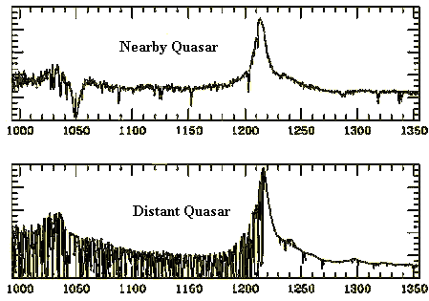
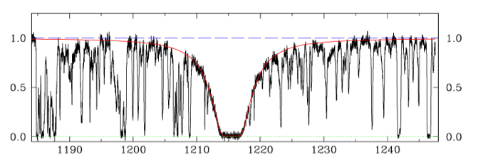
Neutral IGM after reionization = Lya forest
Lya resonant scattering by neutral gas in IGM clouds
Linear density inhomogeneities, δ~ 10
  N(HI) = 10¹³ – 10¹⁵ cm⁻²
  F(HI) ~ 10⁻⁵
Occasional Damped Lya system (disk galaxy): N(HI) > 10^{20.6} cm⁻²
z=0
z=3

Slide 11
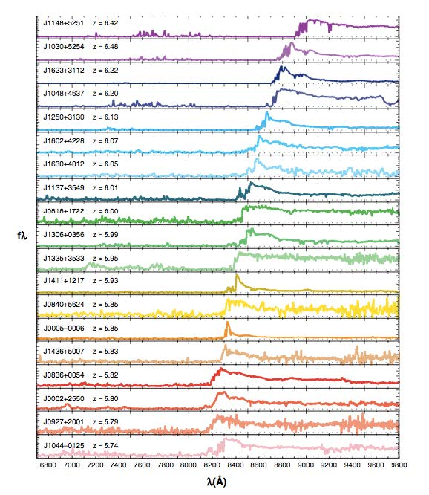
6.4
Gunn-Peterson effect
SDSS z~6 quasars
Opaque (τ > 5) at z>6
=> pushing into reionization?
5.7
SDSS quasars
Fan ea. 2006

Slide 12
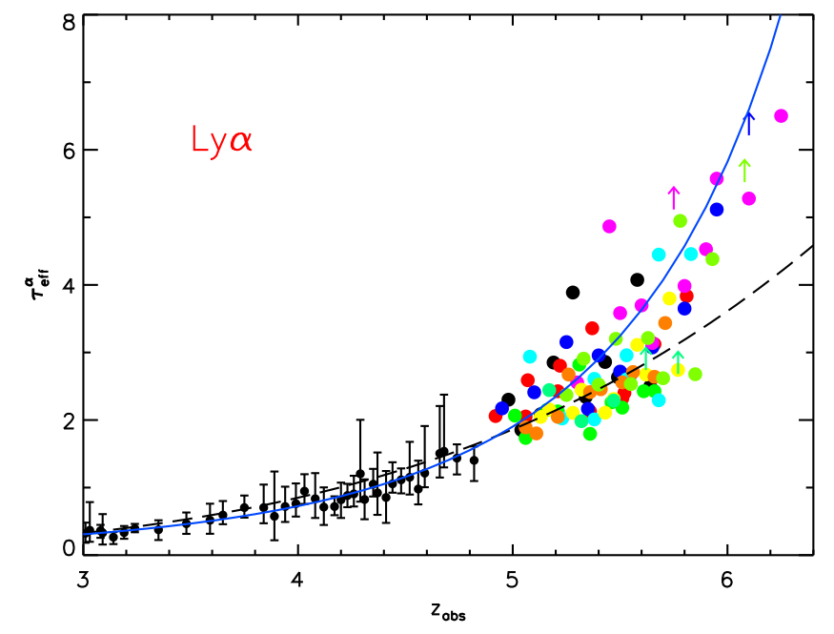
τ_{eff}
Gunn-Peterson constraints
on F(HI)
F(HI)_{v} ≥ few 10⁻⁴
Diffuse IGM:
τ_{GP} = 2.6e4 F(HI) (1+z)^{3/2}
Clumping: τ_{GP} dominated by high density regions => model ρ, T, UV_{BG} to derive F(HI)
F(HI)_{v} ~ few 10⁻⁵
Becker et al. 2011

Slide 13
F_{HI_vol}
Gunn-Peterson effect
GP => systematic (~10x) rise of F(HI) to z ~ 5.5 to 6.5
Challenge: GP saturates at very low neutral fraction (10⁻⁴)

Slide 14
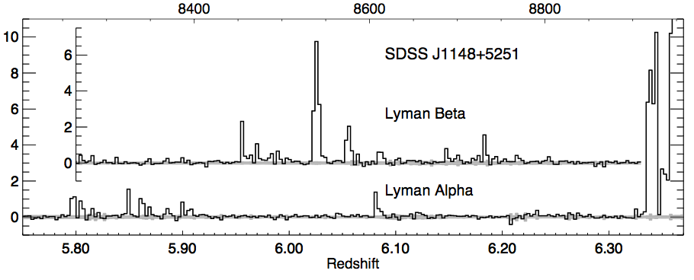
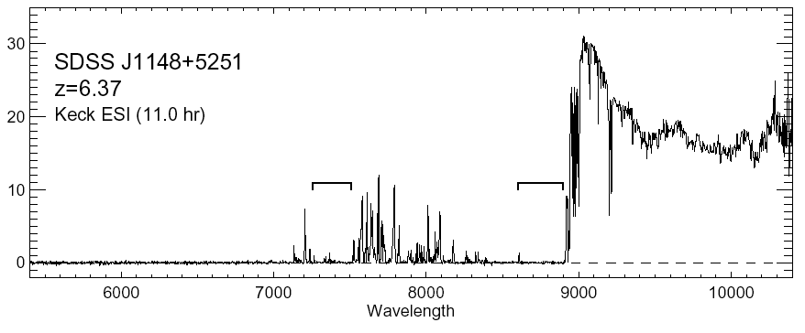
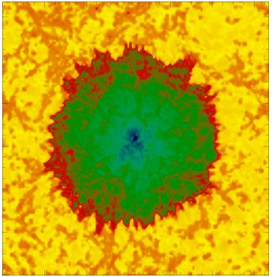
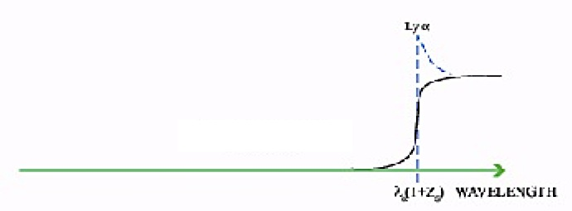
Quasar Near Zones
White et al. 2003
J1148+5251: Host galaxy redshift: z=6.419 (CO + [CII])
Quasar spectrum => photons leaking down to z=6.32
Time bounded Stromgren sphere
HI
HII
z_{host} – z_{GP} => R_{NZ} = 4.7Mpc ~ [L_{γ} t_{Q}/F_{HI}]^{1/3} (1+z)⁻¹

Slide 15
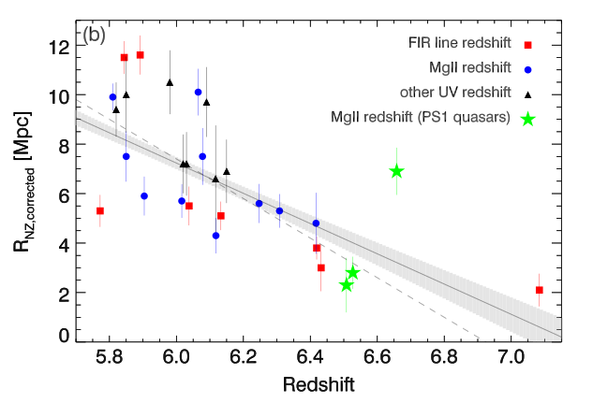
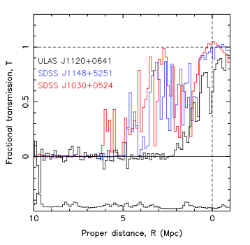
Quasar Near-Zones: R_{NZ} vs redshift
[normalized to M₁₄₅₀ = -27]
Venemans ea.
z ≤ 6.4
z=7.1
<R_{NZ}> decreases by factor ~ 9 from z=5.7 to 7.1
If CSS => F(HI) ≥ 0.04 by z ~ 7.1

Slide 16
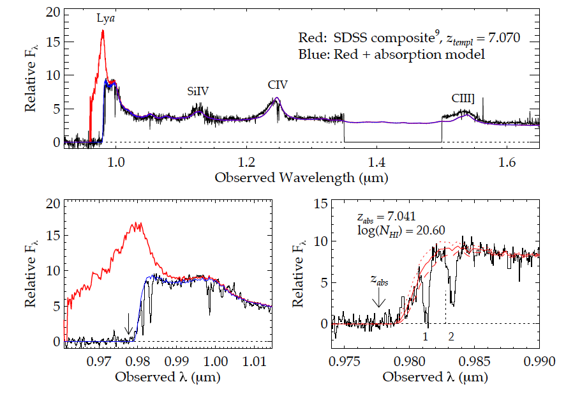
Highest redshift quasar (z=7.1)
Simcoe ea. 2012
(Bolton ea; Mortlock ea)
expected
Obs
Damped Lya profile: N(HI) ~ 10^{20.6} cm⁻²
Substantially neutral IGM: F(HI) > 0.1 at 2Mpc distance
Or galaxy at 2.6Mpc; probability ~ 5%

Slide 17
F_{HI_vol}
Quasar near-zones
QNZ + DLA => rapid rise in F(HI) z~6 to 7 (10⁻⁴ to > 0.1)
Challenge: based (mostly) on one z>7 quasar

Slide 18
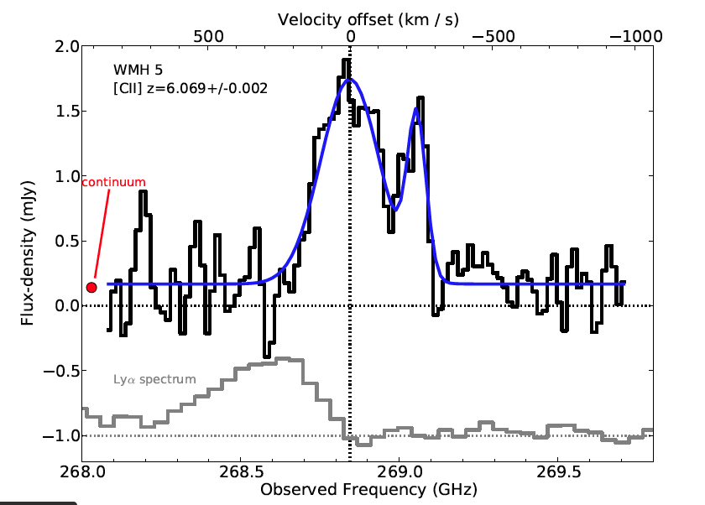
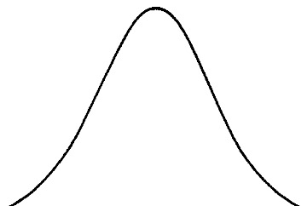
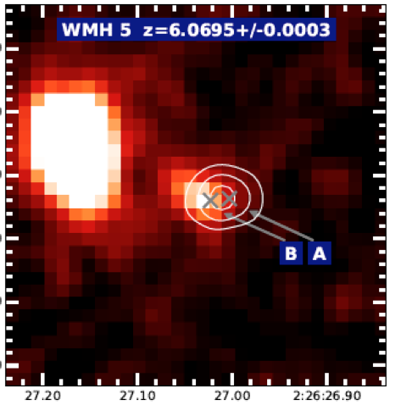
Galaxy demographics: effects of IGM on Lya galaxy counts
[CII] z=6.1
ALMA [CII] 158um at z ~ 6
LBGs at z > 6: easily detected [CII] => z_{host}
Blue-side of Lya highly attenuated
  GP scattering by IGM?
Search for change in Lya strength at z > 6
  Number of Lya selected galaxies
  Equiv. Width of Lya for Ly-break
expected
obs
Lya

Slide 19
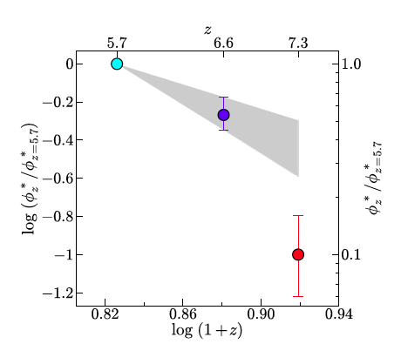
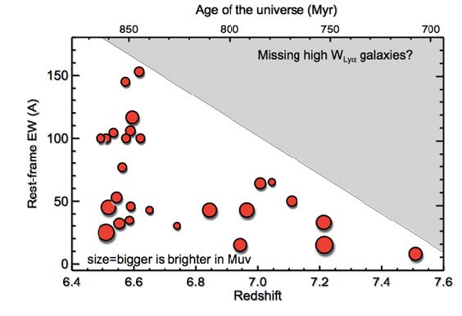
Galaxy demographics: Lyα line strength
Mpc⁻³
Narrow band surveys: Space density of LAEs decreases rapidly z > 6.5: Expected 65 at z=7.3, detected 7!
LBG spectroscopy: Lya line-to-continuum ratio drops at z > 6.5
Modeling attenuation by partially neutral IGM =>
  F(HI) ~ 0.5 at z ~ 7
Konno ea 2014

Slide 20
Galaxy demographics: Lyα line strength
F_{HI_vol}
Lya galaxies
Galaxy demographics suggests possibly 50% neutral at z~7!
Challenge: separating galaxy evolution from IGM effects

Slide 21
‘Cosmic phase transition’: rapid rise in neutral fraction at z ~ 7 Concordance model: SFHU + Lya-based + τ_{planck}
Roberston ea 2015
F_{HI_vol}
Lya-based techniques restricted latter stages of reionization
All values have systematic uncertainties w. large scatter. suggestive but not compelling => Need new means to probe neutral IGM

Slide 22
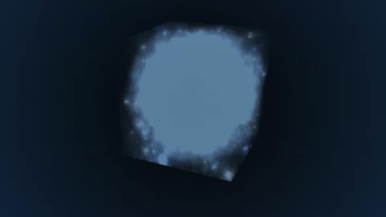
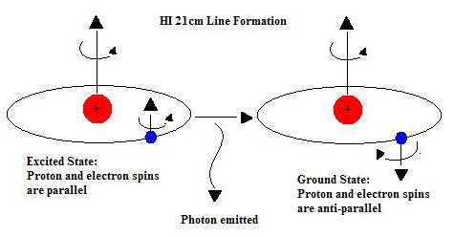
Seeing through the Fog: HI 21cm cosmology
z_{reion} ~ 6 to 12 => ν_{obs} = 1420MHz/(1+z) = 110MHz to 200MHz
Advantages of the 21cm line
Direct probe of neutral IGM
Spectral line signal => full three dimensional image of structure formation (freq = z = depth)
Low freq => very (very) large volume surveys (~ sterrad, z=7 to 11)
Hyperfine transition = weak => avoid saturation (translucent)

Slide 23
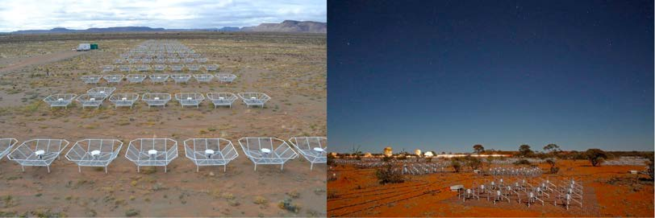
Renaissance at low freq: reionization experiments
1% to 10% of a square kilometer array at 100 to 200MHz
PAPER - ZA
MWA - Oz
Array | FoV deg² | Area m² | Type | Bmax km | Start Science obs
LOFAR | 25 | 3e4 | Tile | 2 | 2013
MWA-128 | 300 | 2e3 | Tile | 1.5 | 2013
PAPER-128 | 1600 | 1e3 | Dipole | 0.3/0.6 | 2013
HERA-331 | 64 | 5e4 | 14m parabola | 0.3/2 | 2017
SKA-I Low | 30 | 1e6 | Tile | 5 | 2021+
Note: LEDA/LWA targeting Dark Ages = Lower Frequency (< 80MHz)

Slide 24

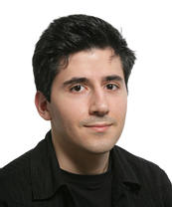
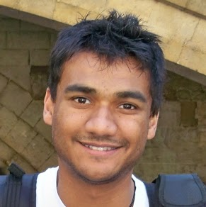
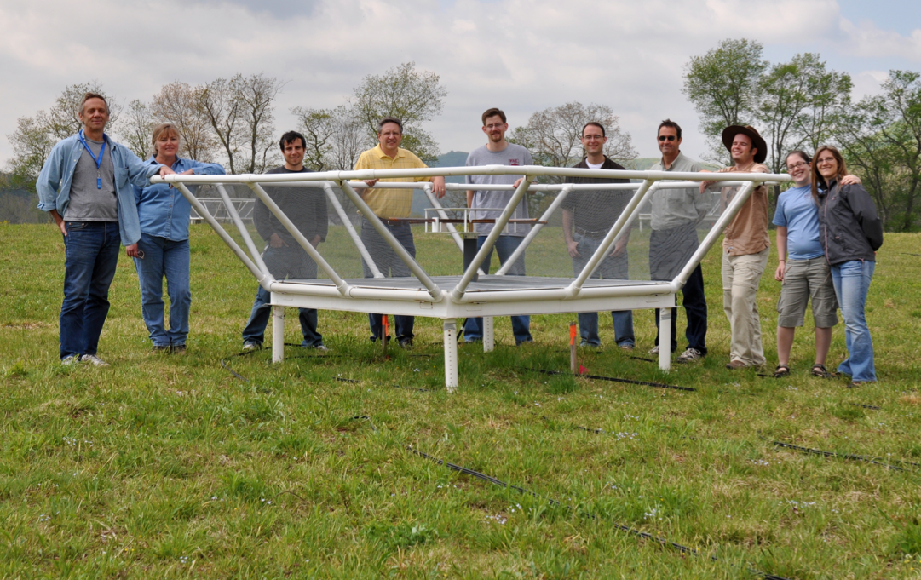
Precision Array to Probe Epoch of Reionization
Berkeley, NRAO, Penn, Cavendish, SKA/South Africa
Focus: low-ν array to study HI 21cm signal from reionization
Precision: emphasize engineering solutions first
Staged: work through problems before increasing investment

Slide 25
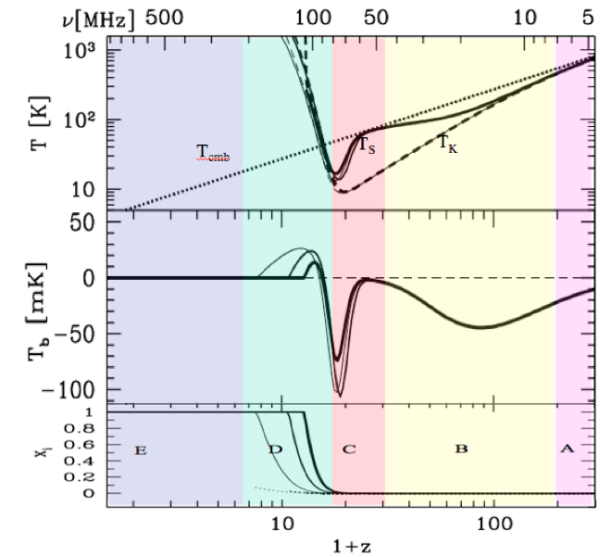
HI 21cm Signal
‘Richest of cosmological data sets’
z>200: T_{CMB} = T_{K}= T_{S}
z∼30 to 200: gas, photons decouple. T_{s} initially follows gas => absorption
z∼20 to 30: first stars => Lyα recouples T_{K} and T_{S} => strong absorption
z∼6 to 20: galaxy formation
Xray pre-heatiing => T_{K} > T_{CMB}
Reionization
(1+z)
(1+z)²
Astrophysics
linear cosmology
First stars
Pritchard & Loeb

Slide 26
HI 21cm Signal
‘Richest of cosmological data sets’
(1+z)
Astrophysics regime: Standard model requires
Star formation history
UV escape fraction
Density distribution (MFP)
Xray Lum to SFR ratio…
(1+z)²
Astrophysics
linear cosmology
First stars
Pritchard & Loeb

Slide 27
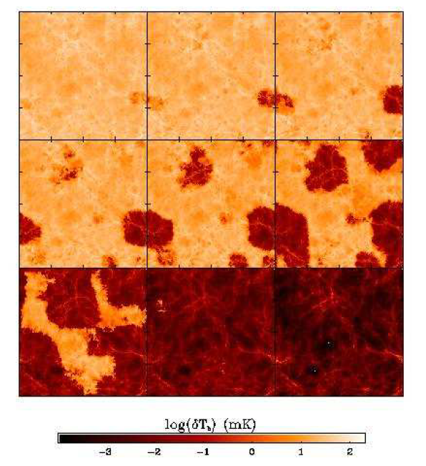
Signal end-game: HI 21cm ‘tomography’ of IGM
Challenge: Sensitivity
z=12, 110MHz
Imaging of typical structures requires full Square Kilometer Array
  S_{150MHz} (2’) ~ 8uJy
  SKA rms ~ 1.6uJy
Primary science driver for SKA-low
<T_{B}> ~ 20mK
z=6.5, 180 MHz
10cMpc = 4’
Furlanetto ea 2004

Slide 28
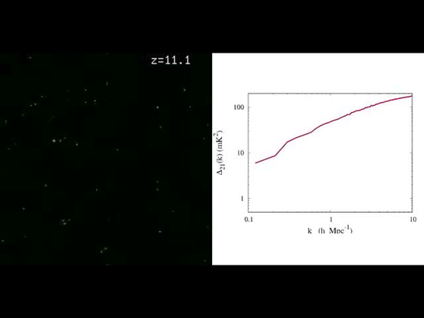
Pathfinder science goal
Evolution of 3D power spectrum in 21cm line
Early: density field
Warming: signal drop
Reionization:
  Flat ~ bubble scale (0.1 – 1 Mpc⁻¹)
  PS ~ 15 to 20mK²
30’, 3MHz
3’, 0.3MHz
mK²
10cMpc
cMpc⁻¹
Mcquinn

Slide 29
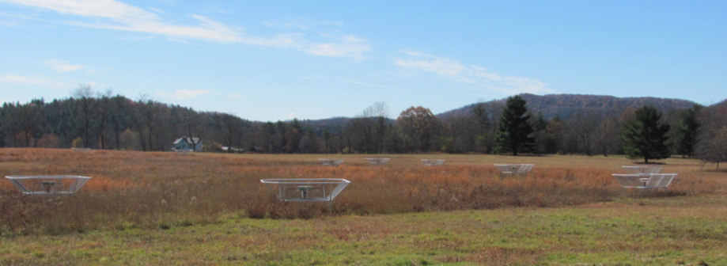
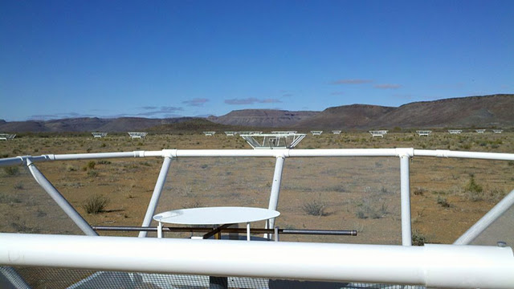
PAPER basics
Freq= 115 to 190 MHz (z= 6.5 to 11)
Single dipole elements + ‘flaps’ => FoV_{FWHM} ~ 40º
Max baseline = 300m => res ~ 15’
32 station engineering array in Greenbank, WV
128 antennae science array in Karoo, South Africa

Slide 30
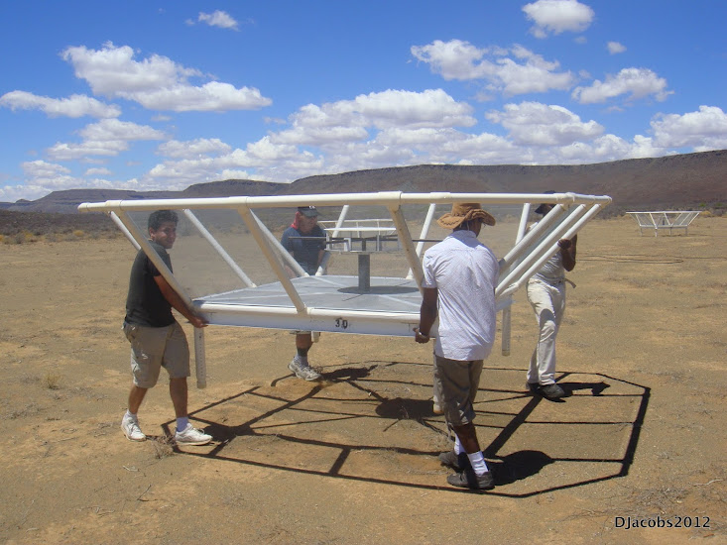
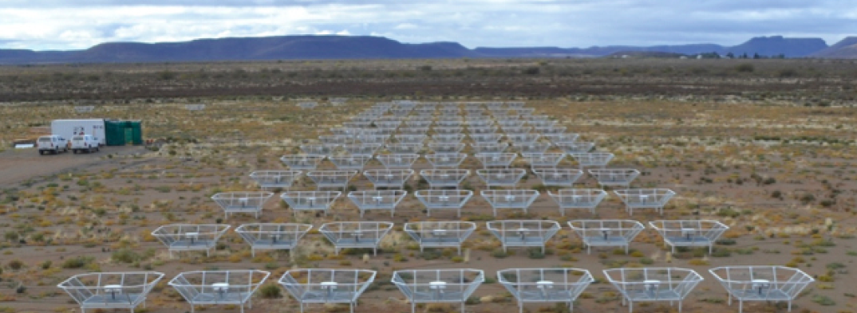
Reconfigurable => optimize for science goal
Minimum redundancy array
maximize u,v coverage => imaging
Maximum redundancy: delay spectrum analysis

Slide 31
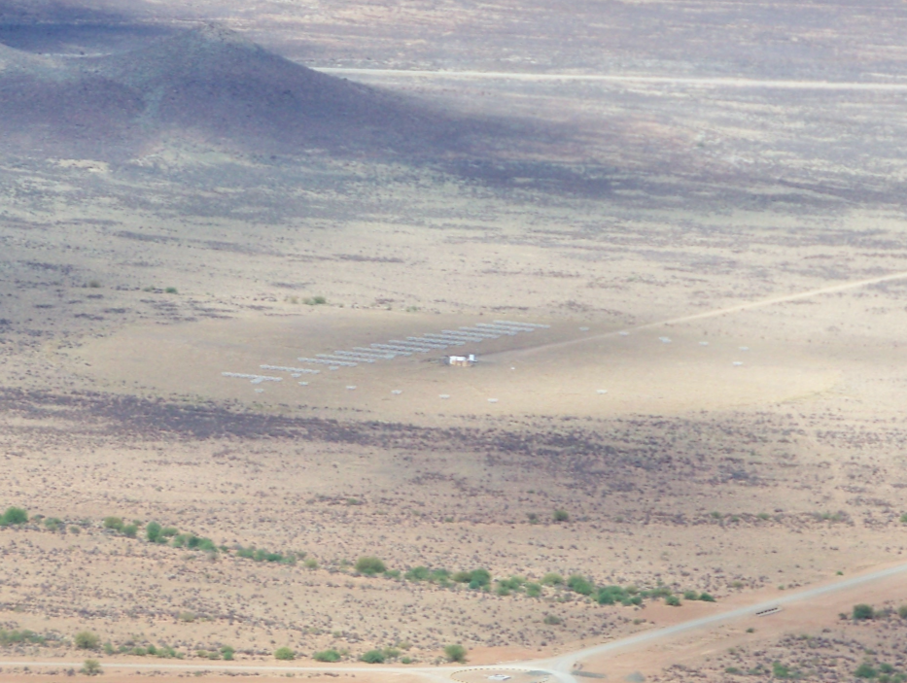
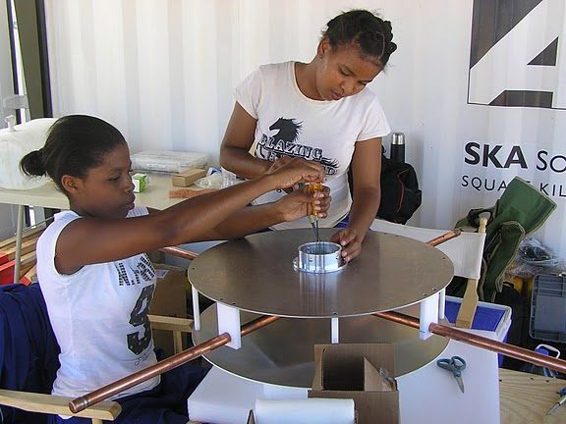
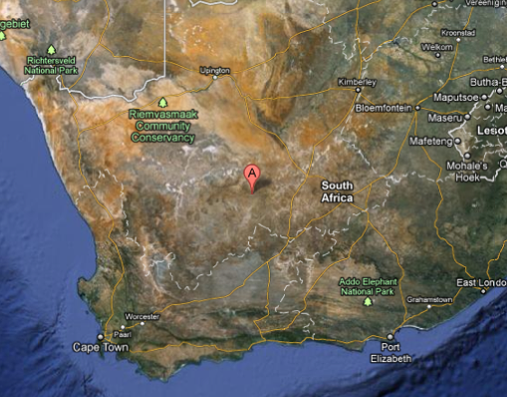
Established working array from scratch in 6 months, with help from ZA (SKA, Durban)
Univ. KwaZulu-Natal
PAPER
575 km
Cape Town

Slide 32
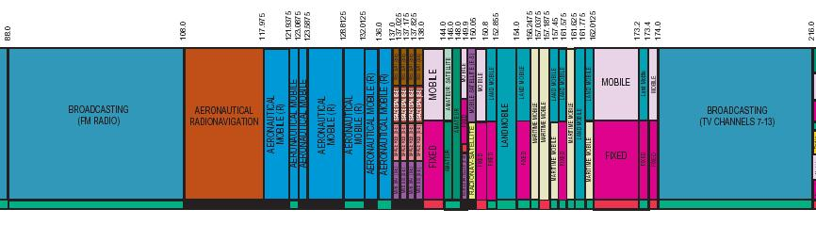
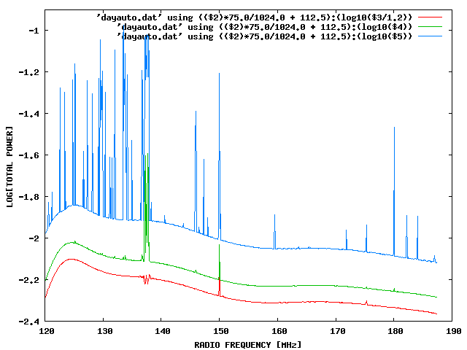
Challenge: Interference
100 MHz z=13
200 MHz z=6
Aircraft
TV

Slide 33
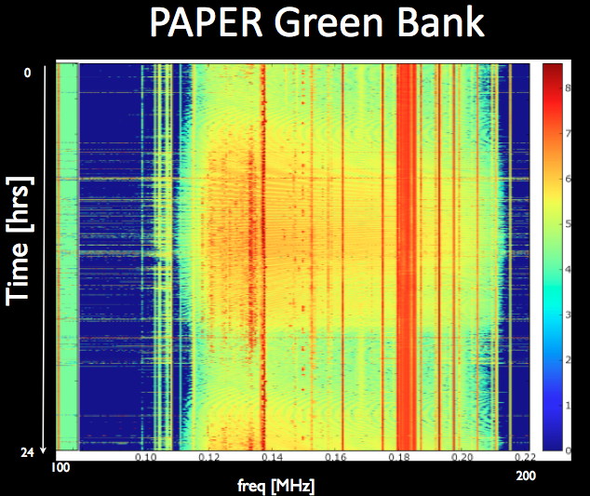
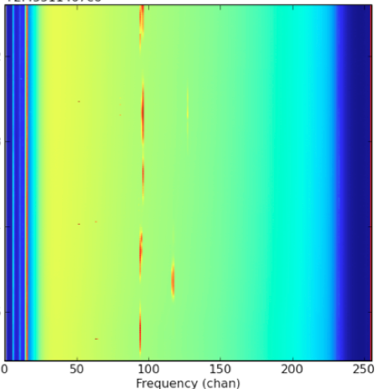
US ‘radio quiet zone’
ZA ‘radio quiet zone’
Karoo South Africa
TV
OrbComm
FM
ISS
OrbComm
100MHz
200MHz
100MHz
200MHz

Slide 34
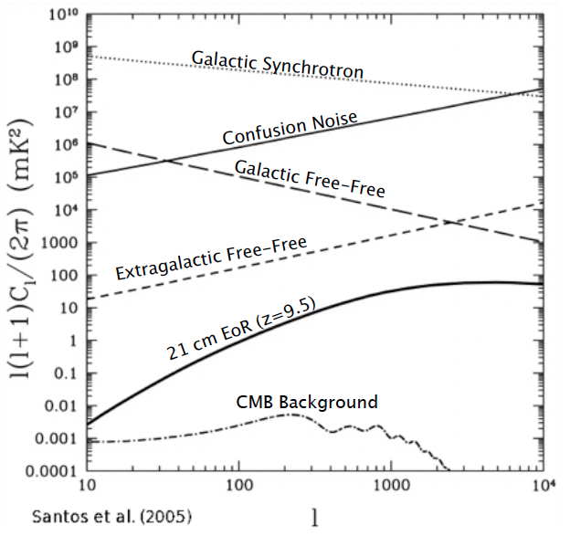
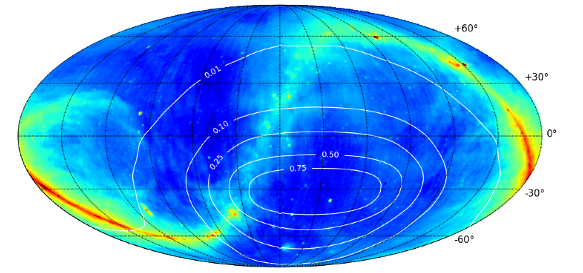
Challenge: Sky hot and confused at low frequency
Mean T_{B} coldest regions ~ 100 (ν/200 ΜΗz)^{-2.6} K = 10⁴ x 21cm signal
PS ~ 10⁶ x 21cm signal (mK²)
Egal synch
408MHz

Slide 35
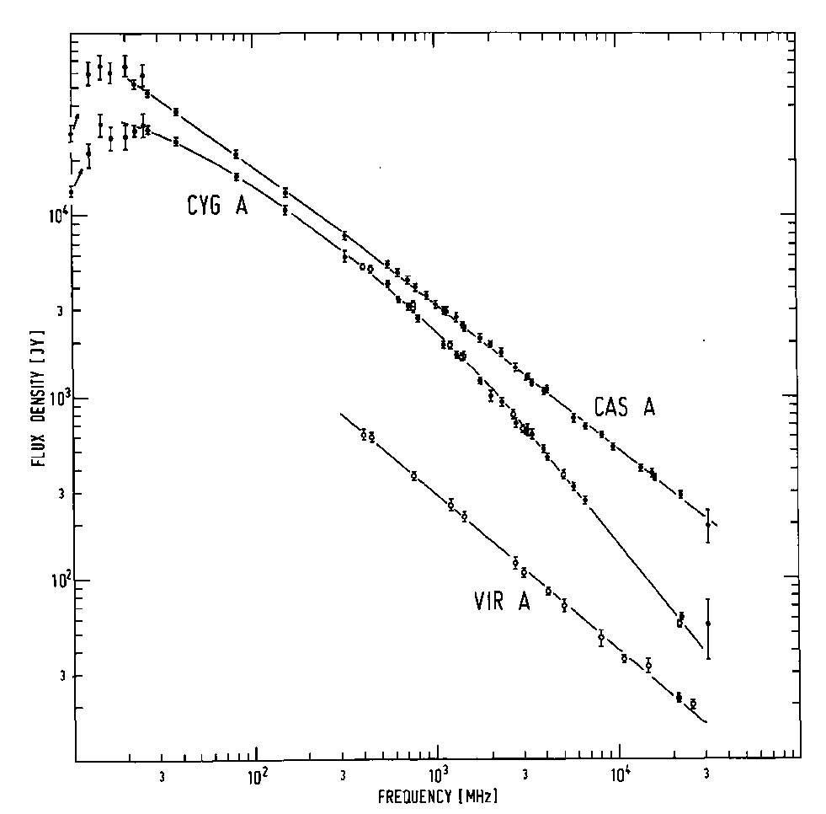

Solution: spectral decomposition
Foreground= non-thermal= featureless over ~ 100’s MHz
Signal = fine scale structure on scales ~ MHz
Signal/Sky < 10⁻⁴
z=13
z=7
Critical to mitigate freq dependent telescope response!

Slide 36




PAPER Antenna: ‘clean machine’
Sleeve dipole + flaps
Smooth, broad response in frequency and angle
Gain
10dB
120MHz
200MHz
LNA: T_{rx} = 110K, 30dB gain 120-180MHz

Slide 37

Focus on 3rd Dimension = Frequency (‘Delay spectrum’; Parsons ea.)
V_{Kelvin}(ν)
continuum
Line
Frequency maps to distance => Fourier conjugate (delay) maps to wavenumber (Mpc⁻¹)
Line-of-sight PS (k_{par}) per baseline, time: PS = square of F_{t}[V_{K}(ν)] = V²_{K}(τ)
Continuum naturally limited to low k_{par} (depending on baseline length)

Slide 38
Array configuration: Redundant spacings
Redundant spacing calibration: antenna complex gains (t, υ)
Add redundant spectra coherently at given time => ‘signal to noise’ of PS improves linearly with number of measurements, N, vs. as N^{1/2} with incoherent averaging (add and square vs. square and add)

Slide 39

PAPER power spectrum: z=8.4 (150MHz)
2years, 64antennas
Wedge: 10⁷ cont. avoidance (mK²)
k < 0.15: intrinsic continuum contamination
k > 0.2: bins consistent w. thermal noise (<2σ)
Most sensitive limit to date:
  Δ² (k)₂₁ < 360 mK²
continuum ‘wedge’ ~ 10⁹ mK²
T_{sys}= 500K
Standard model ~ 20mK²
Ali ea 2015

Slide 40


Limits on Early Xray heating by star formation
1st stars: Lya couples T_{s} to T_{k} << T_{cmb} => strong 21cm abs
IGM pre-heated by Xrays: T_{K} > T_{CMB} => weaker emission
Standard model assumes Xray/SFR for nearby galaxies
If no heating to z=8.4: T_{s} ~ 1.5K << T_{CMB} ~ 25K => absorption ~ 225 x stronger (mK²)
T_{s} ~ T_{k} > T_{cmb}
T_{s} = T_{cmb}
First Stars: Lya coupling
First Galaxies Xray warming
T_{s} ~ T_{k} < T_{cmb}
See: Fiaklov ea. Nature, 2015;
Pacuci ea. AA, 2014
Xray Binaries: mass transfer onto neutron star/BH

Slide 41

Limits on Early Xray heating by star formation
Argues for pre-heating IGM prior to reionizing w. nearby Xray/SFR relation
PAPER limits: T_{s} > 10K >> T_{min}~ 1.5K
z = 8.4
No Xray pre-heating
T_{s} > 10K
Standard model
T_{min} ~ 1.5K
Pober ea

Slide 42

Progress in HI 21cm cosmology (Aug 2015)
MWA
GMRT
PAPER
Beardsley ea. 2015

Slide 43
PAPER Final Steps
  128 elements
  2 years observing (2013-2015)
  10x improvement (in mK²)
  Explore systematics!
continuum ‘wedge’ ~ 10⁹ mK²
T_{sys}= 500K
PAPER 128
Standard model ~ 20mK²

Slide 44


Hydrogen Epoch of Reionization Array
331 x 14m parabolic transit antennas, 50 to 250MHz, in Karoo
MWA+PAPER+MITEoR: Berkeley, MIT, NRAO, Penn, Washington, ASU, Cavendish, SKA-ZA, U. KwaZulu-Natal
Build on experience: Optimal design for delay spectrum analysis + large scale structure imaging
Notes:
PSA-64, 32 antennas in a maximum-redundancy configuration, 30m between rows, 4m spacing within rows

Slide 45



HERA-331: Beyond detection
k=0.1 Mpc⁻¹
Order magnitude improvement in PS sensitivity
Detailed characterization of PS evolution
Direct imaging scales ~ 30-100 cMpc
Notes:
PSA-64, 32 antennas in a maximum-redundancy configuration, 30m between rows, 4m spacing within rows

Slide 46


F_{HI}
HERA: precision 21cm cosmology
Detailed measurement of evolution neutral fraction: z=6 to 20
Explore end of ‘dark ages’ (z ~ 15 to 20)
Few % contraints on reionization model parameters
  UV escape fraction
  Mass distribution star forming galaxies
  Clumping of IGM
(f_{esc})
(M_{gal})
clumping

Slide 47



Arecibo collecting area
450x Field of View
3 antenna test array: Green Bank
37 antennas in Karoo
MSIP1 (2014): Development + 37 element array ($2.2M)
MSIP2 (2016): 331 element science array ($16M)

Slide 48
Cosmic Reionization: last frontier in studies of large scale structure formation
1st insights (Lya: GP and related) suggest ‘cosmic phase transition’ F_{HI} ~ 10⁻⁵ to 0.5 at z ~ 5 – 8
HI 21cm cosmology: direct imaging of evolution of the early Universe.
  PAPER/MWA/LOFAR (2013-2015):
    First PS limits from PAPER 64: confirm Xray pre-heating
    PAPER 128: detection?
  HERA (2015-19): 331 x 14m parabolic antenna array for detailed PS characterization, evolution, and first imaging
  SKA-low (2021+): full IGM tomography at arcmin scales

Slide 49







Slide 50


PAPER: (Xilinx) FPGA + GPU correlator from Berkeley wireless lab (CASPER): double array each year for 4 yrs > Moore
ROACH2 F engine: sample/digitize, transform (τ → ν), using polyphase filter (‘preconvolution’)
GPU X engine: cross multiply V (B, ν)
Cross-connections: ‘packetized correlator’ using 10Gb Ethernet protocol + commercial data routers
Computing, processing, storage (Penn)
Cluster computing: 32 octal core servers
Store raw visibilities: RAIDS 120 TB after data compression (time, freq ave…)
AIPY (Berkeley), CASA, AIPS (NRAO)
Digital processing for large N arrays is solved problem
Data storage and analysis is not

Slide 51



Large scale polarization of the CMB
Temperature fluctuations = density inhomogeneities at the surface of last scattering
Polarized = Thomson scattering local quadrapol CMB
WMAP Hinshaw et al. 2008

Slide 52

Large scale polarization of the CMB (WMAP)
Angular power spectrum (~ rms fluctuations vs. scale)
Large scale polarization
  Integral measure of _{e} back to recombination
  Earlier => higher τ_{e}
  τ_{e} ~ σ_{T}ρL ~ (1+z)³/(1+z) ~ (1+z)²
  Large scale ~ horizon at z_{reion} l < 10 or angles > 10º
  Weak: uK rms ~ 1% total inten.
Sachs-Wolfe
Baryon Acoustic Oscillations: Sound horizon at recombination
_{e} = 0.087 +/- 0.015
Jarosik et al 2011, ApJS 192, 14

Slide 53

CMB large scale polarization: constraints on F(HI)
Rules-out high ionization fraction at z > 15
Allows for small (≤ 0.2) ionization to high z
Most ‘action’ at z ~ 8 – 13
1-F(HI)
Two-step reionization: 7 + z_{r}
Dunkley ea 2009, ApJ 180, 306

Slide 54


Challenge: array spectral sidelobes
Synthesized beam (PSF) is chromatic
Smooth spectral fitting over MHz bands does not remove far-out sidelobes of bright sources
Bright source subtraction requires better than 0.2% antenna calibration to reach thermal noise each day (Datta ea. 2010)
120 to 180 MHz

Slide 55


III. Continuum avoidance
Characteristic sidelobe scale in frequency (= k_{par}), is set by baseline length (=k_{perp})
10º
B=30m
Datta et al. 2010, ApJ, 724, 526
Parsons et al. 2012, ApJ, 756, 165
Parsons et al. 2012, ApJ, 753, 81
Parsons et al. 2013, ApJ, arXiv:1304.4991
Pober et al. 2013, ApJ, 768, L36
B=90m
130MHz
180MHz

Slide 56

III. EoR window and the Continuum Wedge
Delay or Freq⁻¹
‘EoR Window’
Wedge = ‘horizon limit’ for continuum sources
Baseline or Angle⁻¹
k_{perp} (angle) vs. k_{par}(freq) => continuum sources are naturally limited to max k_{par} in delay spectrum set by baseline length
Max. geometric baseline delay = ‘horizon limit’ for continuum sources
Line sources extend beyond wedge.

Slide 57


Cen A: PAPER + Xray
PAPER Imaging: unique parameter space (Stefan PhD Thesis, Cavendish)
Continuous ‘all-sky’ monitor (GRBs, XRBs...)
Sensitive to LSS (15deg at 15’ res)
Sensitivity(10min) ~ 5mJy
Broad freq range (120 – 180 MHz)
8º
Low freq spectrum => FF abs toward GC
20º

Slide 58


Evolution of the IGM neutral fraction: Robertson, Ellis ea. 2013

Slide 59


Quasar Near-Zones: 28 GP quasars at z=5.7 to 6.5
L_{UV}
R L_{γ}^{1/3}
L_{UV}
No correlation of UV luminosity with redshift
Correlation of R_{NZ} with UV luminosity
Note: significant intrinsic scatter due to local environ., t_{q}

Slide 60


21cm absorption toward first radio galaxies
19mJy
z=12
z=8
SKA+Gnedin simul
130MHz
159MHz
radio GP (τ=1%)
21 Forest (10%)
Only probe of small scale structure
Requires radio sources: expect 0.05 to 0.5 deg⁻² at z> 6 with S151 > 6 mJy

Slide 61


Galaxy demographics: effects of IGM on apparent galaxy counts
Willott et al. 2014
ALMA [CII] 158um at z ~ 6
[CII] 158um
LBGs at z=6.1: easily detected [CII] with only 25ant
Redshift comparison: Blue-side of Lya highly attenuated
  GP scattering by IGM?
Search for decrease in:
  Number of Lya emitting galaxies at z>6
  Equiv. Width of Lya for faint z > 6 galaxy candidates
Lya

Slide 62

HERA-331: Beyond detection
Detailed characterization of PS
 | Area (m²) | SNR Pessimistic | SNR Moderate | SNR Optimistic
SKA-low | 8e5 | 14 | 98 | 280
HERA | 5e4 | 19 | 23 | 80
LOFAR-core | 3e4 | 1.4 | 2.8 | 17
MWA-128 | 900 | 0.6 | 2.5 | 6.4
PAPER-128 | 530 | 1.7 | 1.9 | 8.9
Notes:
PSA-64, 32 antennas in a maximum-redundancy configuration, 30m between rows, 4m spacing within rows

Slide 63

Ruling out pathological (but not impossible?) models
Fiducial model z∼6 to 20: IGM warmed by pervasive hard X rays from 1st XRBs prior to reionizing => T_{K} > T_{CMB}
No warming => absorption against CMB (250mK)
T_{cmb}
T_{S}
T_{K}
No warming
E
D
C
B
A

Slide 64



Limits vs redshift (Jacobs)
k = 0.2 Mpc⁻¹
k = 0.3 Mpc⁻¹
mK²
Noise limited Power spectra, but only 32 ant
Still long way to go to expected signal ~ 20 mK²

Slide 65

Ruling out pathological (but not impossible?) cosmologies
Fiducial model z∼6 to 20: IGM warmed by pervasive hard X rays from 1st XRBs prior to reionizing => T_{K} > T_{CMB} => emission signal ~ few mK
No warming => absorption against CMB ~ 250mK
Argues for warming of IGM prior to reionizing
‘horizon limit’ = ‘wedge’
GMRT
No warming
T_{sys}=560K
Fiducial

Slide 66


Ionized near zones around z > 6 Quasars
Lya spectra provide evidence for existence for CSS
Size ~ 15’
Signal ~ 20 f(HI) mK = 0.5 f(HI) mJy
rms (HERA, 100hr, 1MHz) ~ 0.08 mJy
3D structure = powerful diagnostic
Rare but we observe huge volume: 64deg²; z=6 to 11
5Mpc
0.5 mJy
Wyithe et al. 2006

Slide 67



100Mhz
50Mhz

Slide 68


Finding galaxies within Cosmic Reionization
NB
1.2um
1.5um
0.9um
Lya z=7.3
Lyman-Break: broad band selection
Lya emitters: narrow band selection
Challenge: spectroscopic redshift confirmation

Slide 69

PAPER power spectrum: z=8.4
2years, 64antennas
Wedge: 10⁷ cont. avoidance (mK²)
k < 0.15: intrinsic continuum contamination
k > 0.2: bins consistent w. thermal noise (<2σ)
<PS> (k=.2 to .5) = 360 +/- 80 mK²
continuum ‘wedge’ ~ 10⁹ mK²
T_{sys}= 500K
Standard model ~ 20mK²
360 mK²
Ali ea 2015

Slide 70

Standard Model
A
D
E
C
B
SFHU
Low z Xray/SFR
UV escape fraction
Density distribution…

Slide 71
F_{HI}
Jacobs ea.
HERA: precision 21cm cosmology
Detailed measurement of evolution neutral IGM: z=6 to 20
Explore end of ‘dark ages’ (z ~ 15 to 20)
Inform science/tech SKA-low (2020+)

