Slide 1
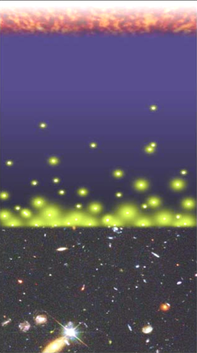
Cosmic reionization: The last frontier in observational cosmology
Chris Carilli (NRAO)
Summer Student Lecture July 2010
Brief introduction to cosmic reionization
Current observational constraints on reionization
HI 21cm signal from the neutral Intergalactic Medium (IGM): telescopes, signals, and challenges
Djorgovski + Caltech media lab

Slide 2
References
Fan, Carilli, Keating 2006, ‘Observational constrains on cosmic reionization,’ ARAA, 44, 415
Furlanetto et al. 2006, ‘Cosmology at low frequencies: The 21 cm transition and the high-redshift Universe’ Phys. Reports, 433, 181
Ellis 2006, ‘First Light in the Universe,’ Saas-Fee Advanced Courses, Volume 36
Morales & Wyithe 2010, ARAA

Slide 3
Big Bang f(HI) ~ 0
History of Baryons (mostly hydrogen)
Recombination
0.4 Myr
z = 1000
f(HI) ~ 1
Cosmic time
(Cosmic expansion)
Redshift
Reionization
0.8 Gyr
z ~ 7 to 15
f(HI) ~ 10⁻⁵
13.6Gyr
z = 0

Slide 4
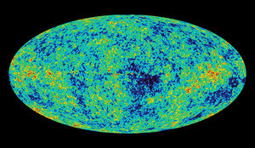
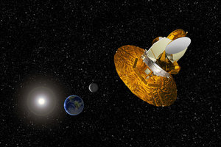
Cosmic microwave background radiation
Chris Carilli (NRAO)
Berlin June 29, 2005
Recombination
Early structure formation
WMAP – imprint of primordial structure from the Big Bang

Slide 5
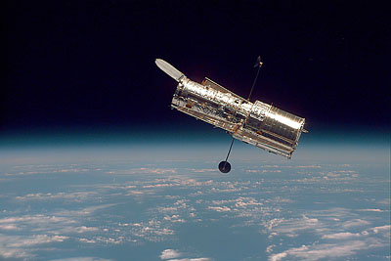
Hubble Space Telescope
Late structure formation Realm of the Galaxies

Slide 6
Last phase of cosmic evolution to be tested and explored
Reionization: ‘last cosmic phase transition’ = bench-mark in cosmic structure formation indicating the first luminous structures
Today’s focus: Evolution of the neutral intergalactic medium = ‘richest of all cosmological data sets’
Dark Ages
Cosmic Reionization

Slide 7
Numerical Simulations of the evolution of the Intergalactic Medium (IGM) through reionization
Three phases
Dark Ages
Isolated bubbles (slow)
Percolation (overlapping bubbles fast)
10Mpc
z=20 to 6; scale ~ superclusters of galaxies
Gnedin 2006

Slide 8
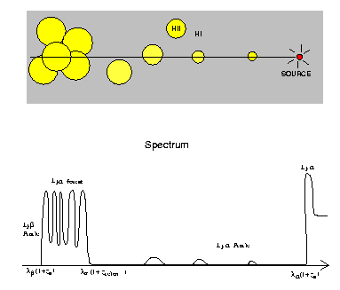
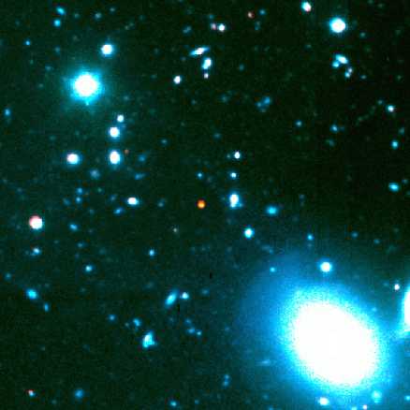
Constraint I: Gunn-Peterson Effect (Gunn + Peterson 1963)
ionized
neutral
z=6.4
quasar
z
Lya absorption by neutral IGM
SDSS high z quasars
Barkana and Loeb 2001

Slide 9
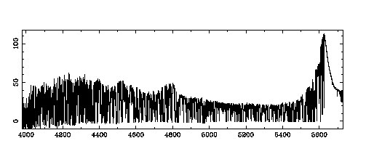
IGM after reionization
‘cosmic web’ = Ly alpha forest at z=3.6 (ρ < 10)
Womble 96
N(HI) = 10¹³ to 10¹⁵ cm⁻²
neutral fraction: f(HI) = 10⁻⁵ to 10⁻⁶

Slide 10
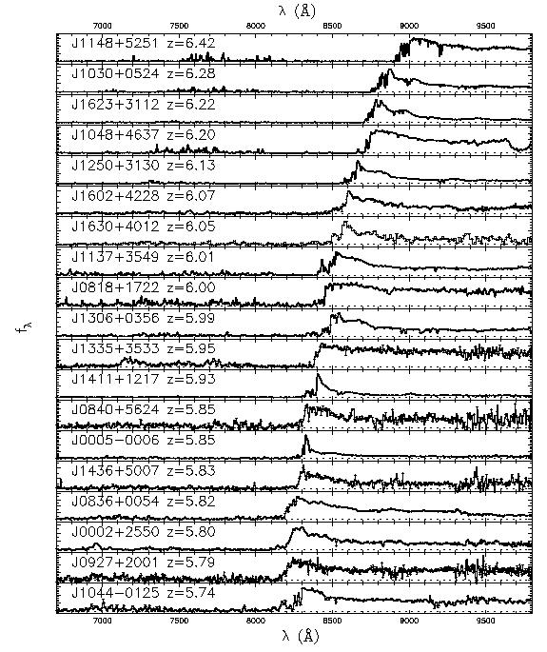
Constraint I: Gunn-Peterson absorption
6.4
SDSS z~6 quasars => pushing into reionization?
τGP = 2.6e4 f(HI) (1+z)^{3/2}
z=6.4
5.7
Fan et al 2006

Slide 11
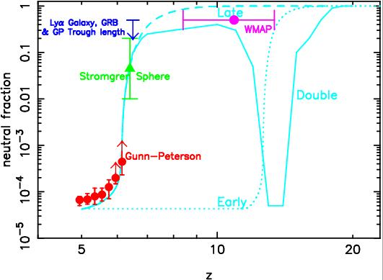
Gunn-Peterson limits to f(HI)
marked increase in neutral fraction at z~ 6
f(HI) ~ 6e-5 at z = 5
f(HI) > 5e-4 at z = 6
τ_{GP} >>1 for f(HI)>0.001 => low f() diagnostic
τ_{GP} to f(HI) conversion requires ‘clumping factor’
But…

Slide 12
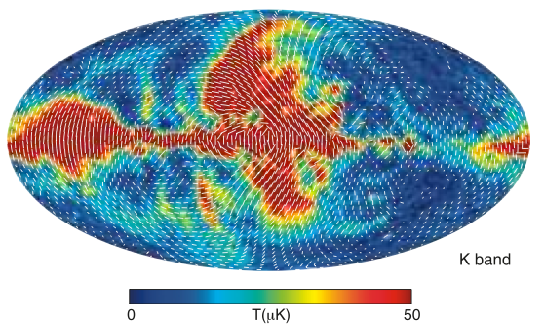
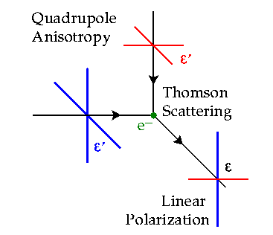
Constraint II: Large scale polarization of the CMB
Temperature fluctuations = density inhomogeneities at the surface of last scattering
e⁻ scattering CMB during reionization => polarized
Large scale: horizon scale at reionization ~ 10 deg
z=1000
Hinshaw et al. 2008

Slide 13
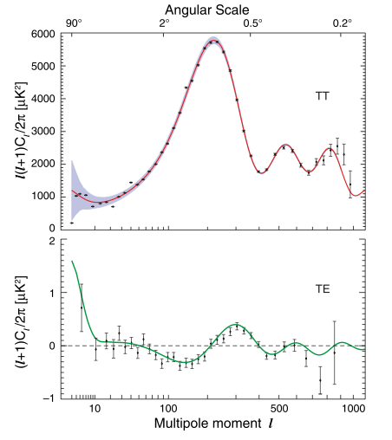
Constraint II: CMB large scale polarization WMAP
Angular power spectrum = variance as function of angular scale (square of visibility function)
Polarized signal is weak:
uK rms ~ 1% total intensity on scales l < 10 or angles > 20º
Baryon Acoustic Oscillations: Sound horizon at recombination
Jarosik et al 2010
_{e} = 0.087 +/- 0.015
~ d/mfp ~ d ne σe ∝ f(HI) (1+z)²

Slide 14
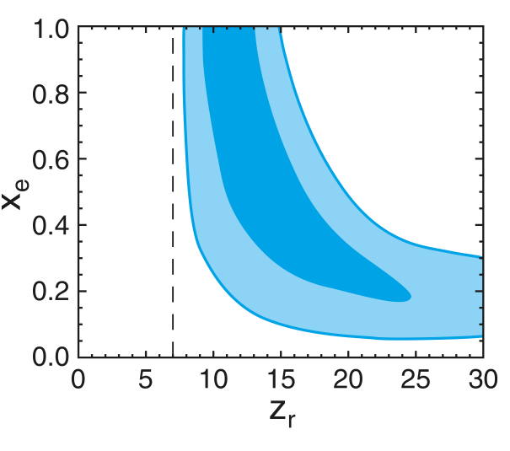
Constraint II: CMB large scale polarization
Rules-out high ionization fraction at z > 15
Allows for small (≤ 0.2) ionization to high z
Most action occurs at z ~ 7 to 15
Limitation: τe = integral measure to recombination => allows many IGM histories
Dunkley et al. 2008

Slide 15
Combined CMB + GP constraints on reionization
Rule-out rapid early or late reionization
Not ‘event’ but complex process, large variance: z_{reion} ~ 6 to 15
Good evidence for qualitative change in nature of IGM at z~6

Slide 16
Combined CMB + GP constraints on reionization
Amazing progress, but still limited diagnostics
Need direct probe of reionization: now to connect the dots?

Slide 17
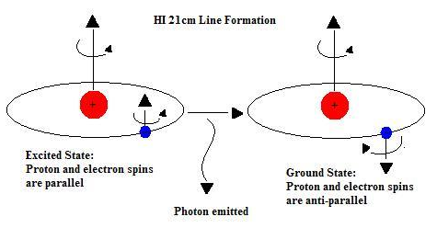
HI 21cm line: Most direct probe of the neutral IGM during cosmic reionization, and the preceding ‘dark ages’
Spin-spin coupling: magnetic hyperfine transition
Low frequencies: ν_{obs} = 1420MHz/(1+z) ≤ 200 MHz
Advantages of the 21cm line
Spectral line signal => full three dimensional diagnostic of structure formation.
Direct probe of IGM = dominant component of baryons during reinization/dark ages
Hyperfine transition = forbidden (weak) => avoid saturation

Slide 18
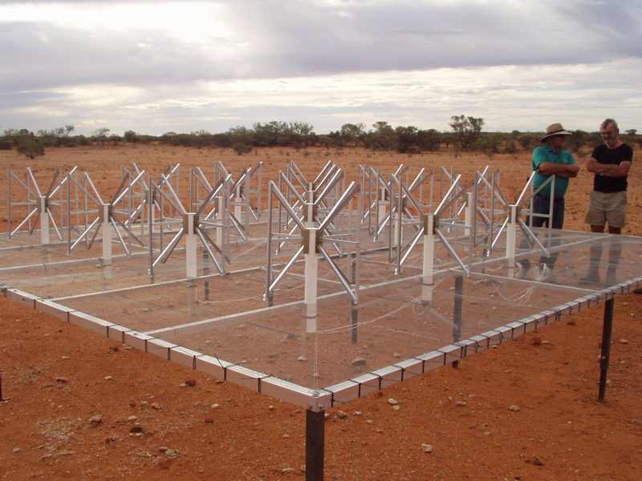
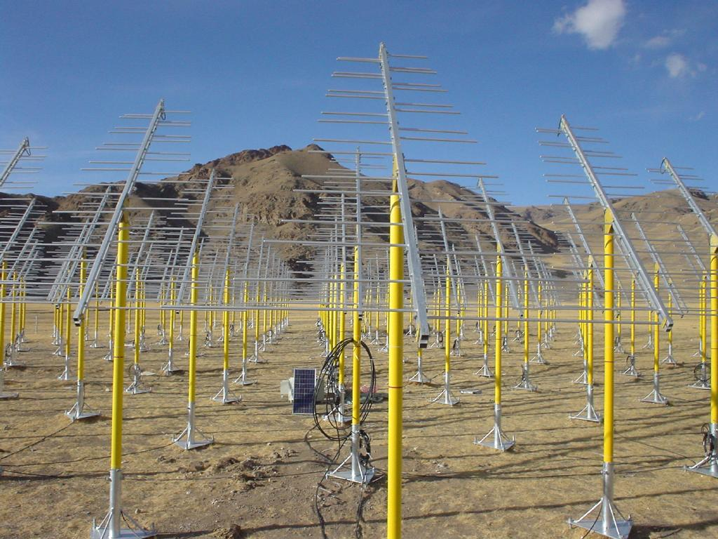
MWA (MIT/CfA/ANU)
32 Tile array deployment in WA 2009
21CMA (China): 10,000 Dipole array working in Western China 2008
Pathfinders: 1% to 10% of a square kilometer array
 | Site | Type | Freq MHz | Area m² | Goal | Date
GMRT | India | Parabola | 150-165 | 4e4 | CSS | 2009
21CMA | China | Dipole | 70-200 | 1e5 | PS | 2008
PAPER | GB/Oz/SA | Dipole | 110-200 | 5e3 | PS/CSS | 2009
MWAdemo | Oz | Aperture | 80-300 | 1e4 | PS/CSS | 2009
LOFAR | NL | Aperture | 115-240 | 1e5 | PS/CSS | 2010
SKA | ?? | Aperture | 30-300 | 1e6 | Imaging | ??

Slide 19
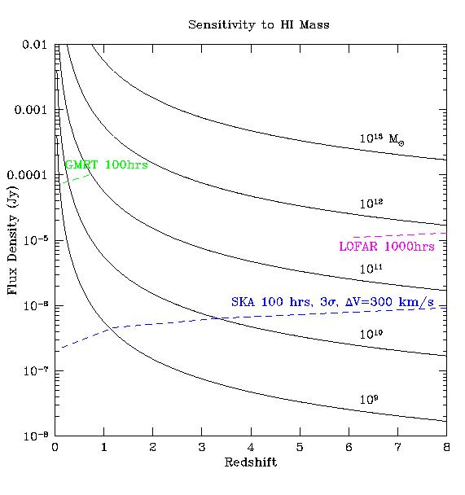
HI 21cm emission from neutral IGM: large scale structure, not individual galaxies
1e13 Mo
Large scale structure
cosmic density, ρ
neutral fraction, f(HI)
Temp: TK, TCMB, Tspin
1e9 M_{o} ~ Milky Way

Slide 20
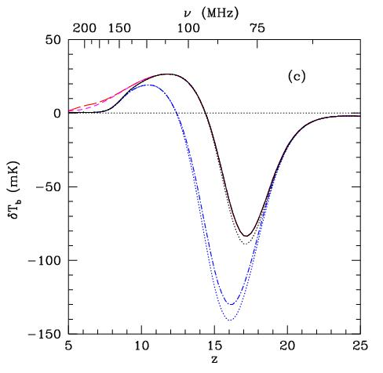
Signal I: Global (all sky) emission (eg. T_{CMB})
Signal ~ 20mK
T_{s} = T_{K} >T_{CMB}
Interplay of ρ, T, f(HI)
T_{s} = T_{CMB}
Feedback ‘slows-down’ galaxy formation
No Feedback
Resonant scattering of Lya from first galaxies (Field-Wouthuysen effect) couples T_{S} = T_{K} < T_{CMB}
Furlanetto, Oh, Briggs 06

Slide 21
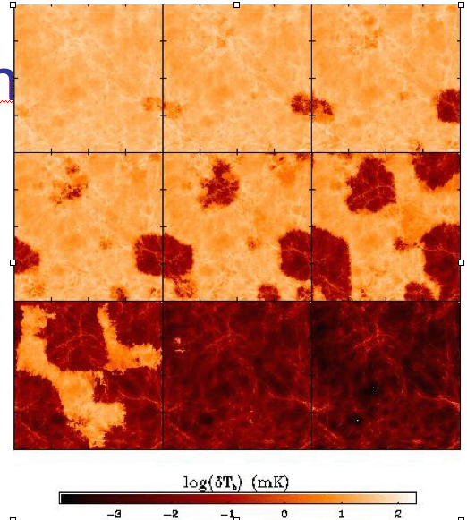
Signal II: HI 21cm Tomography of IGM
z=12
9
ΔTB(2’) ~ 20 mK
SKA rms ~4mK
Pathfinders: rms ~ 80mK
7.6
Furlanetto, Zaldarriaga + 2004

Slide 22
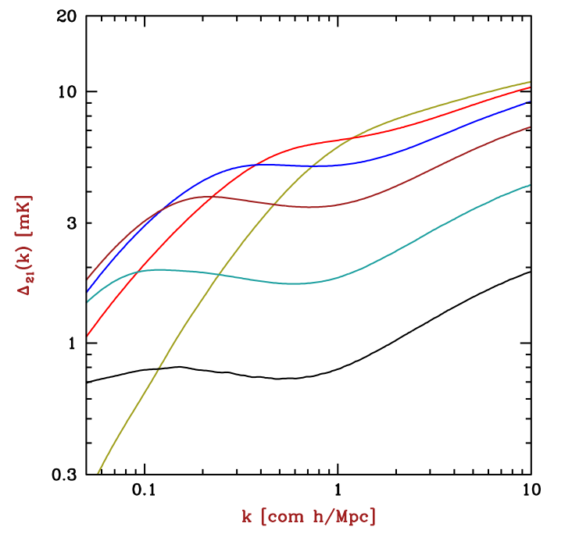
Signal III: 3D Power spectrum major advantage over CMB
characteristic bubble scale
z=10.5, f(HI) = 0.9
z=6.5, f(HI) = 0.02
Barkana 2009

Slide 23
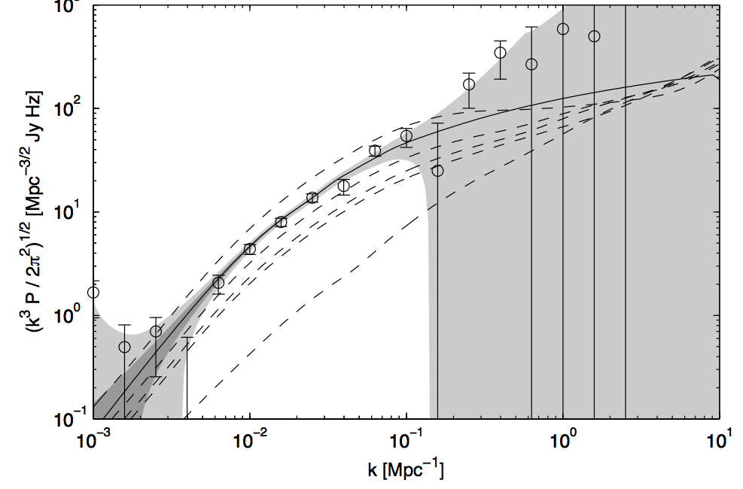
Signal III: 3D Power spectrum within reach of pathfinders
Pathfinders at z=8 (158MHz)
Bowman et al.

Slide 24
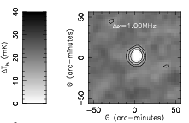
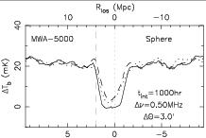
Signal V: Cosmic Stromgren spheres around z > 6 QSOs
Size ~ 15’
Signal ~ 20 x f(HI) mK
= 0.5 x f(HI) mJy
5Mpc
Wyithe et al. 2006
Lya spectra provide evidence for existence for CSS
21cm signal is within reach of pathfinder arrays
3D structure = powerful diagnostic
0.5 mJy

Slide 25
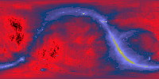
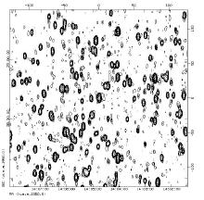
Challenge I: Low frequency foreground – hot, confused sky
Haslam, Eberg 408MHz
Coldest regions: T ~ 100 (ν/200 ΜΗz)^{-2.6} K = 10⁵ x 21cm signal
Highly ‘confused’: 1 source/deg² with S140 > 1 Jy

Slide 26
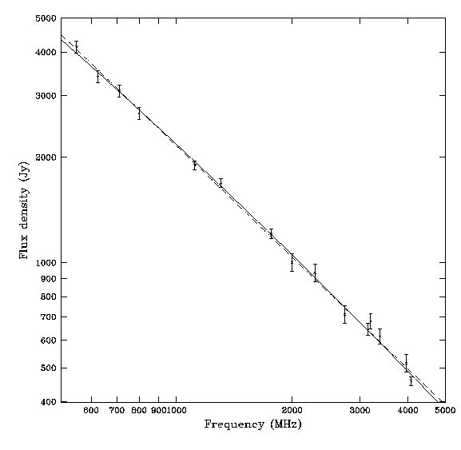
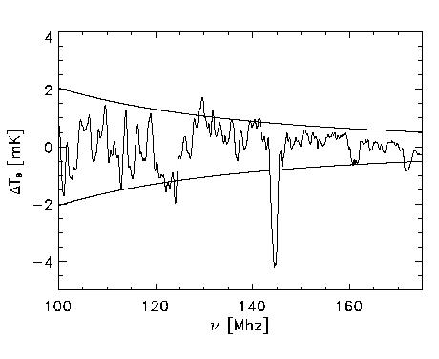
Solution: spectral decomposition (eg. Morales, Gnedin…)
Foreground = non-thermal = featureless over ~ 100’s MHz
Signal = fine scale structure on scales ~ few MHz
Cygnus A
Signal/Sky ~ 2e-5
10’ FoV; SKA 1000hrs
500MHz
5000MHz
Requires gain calibration to ~ 0.1% accuracy

Slide 27
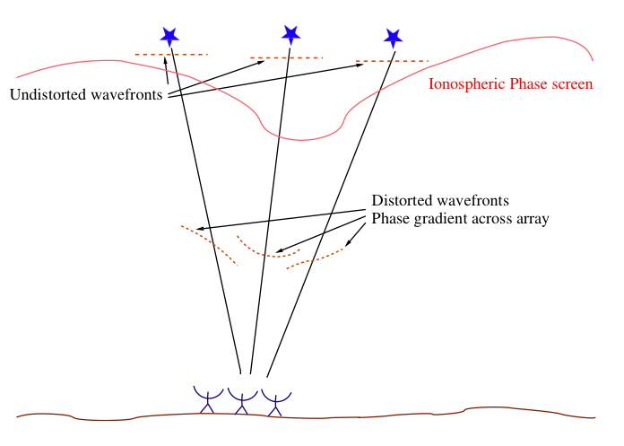
Challenge II: Ionospheric phase errors – varying e- content
‘Isoplanatic patch’ = few deg = few km
Speed of light in ionosphere is ν dependent function of n_{e}
Phase (path length) variation proportional to wavelength²

Slide 28
Challenge II: Ionospheric ‘seeing’
TIDs – ‘fuzz-out’ sources
Solution: spatial/temporal calibration = Wide field ‘rubber screen’ phase self-calibration using data-rich sky
15’
Virgo A VLA 74 MHz Lane + 02

Slide 29
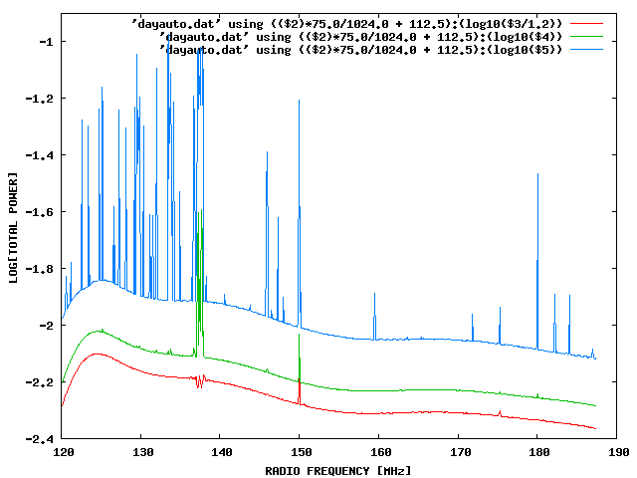
Challenge III: Interference
100 MHz z=13
200 MHz z=6
Solutions -- RFI Mitigation (Ellingson06)
Digital (Fourier) filtering
Beam nulling
Real-time ‘reference beam’
LOCATION!
Aircraft
Orbcomm
TV

Slide 30
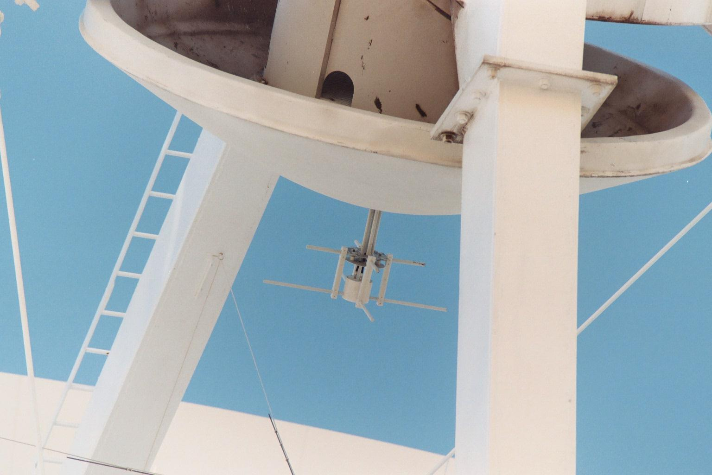
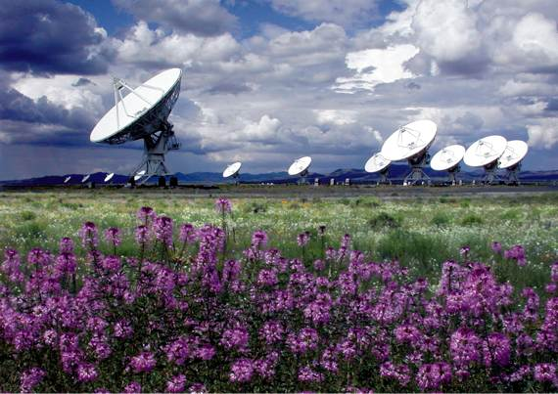
VLA-VHF: 180 – 200 MHz Prime focus X-dipole Greenhill, Blundell (SAO); Carilli, Perley (NRAO)
Leverage: existing telescopes, IF, correlator, operations
$110K design and construction
First light: Feb 16, 05
Four element interferometry: May 05
Goal: first CSS detection Winter 06/07

Slide 31
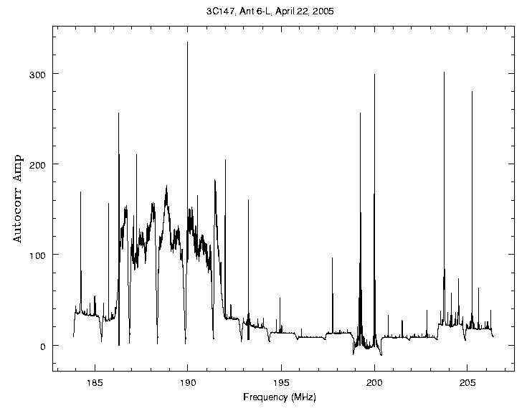
Project abandoned: Digital TV
KNMD Ch 9
150W at 100km
Expected line

Slide 32
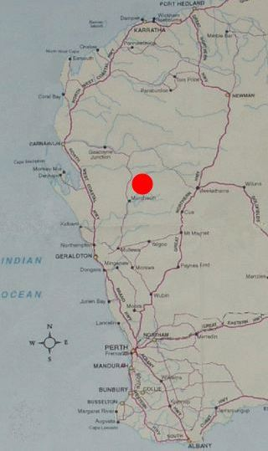
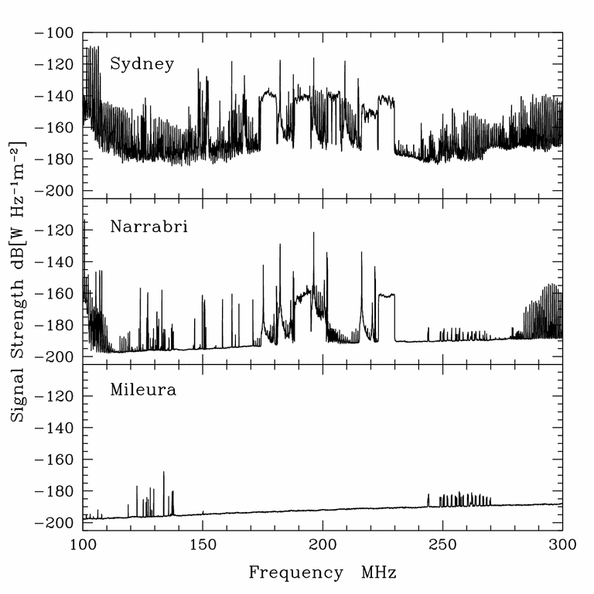
RFI mitigation: location, location location…
100 people km⁻²
~VLA
1 km⁻²
0.01 km⁻²
Chippendale & Beresford 2007

Slide 33
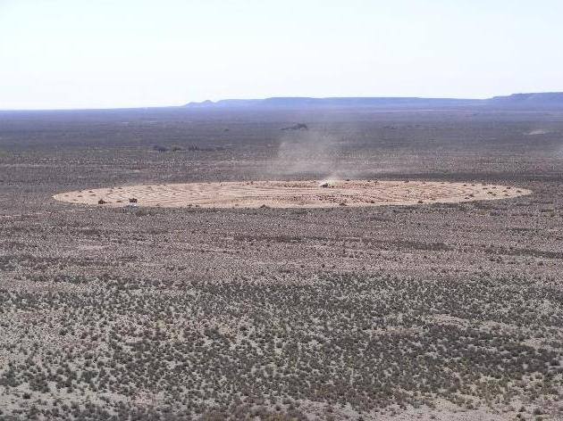
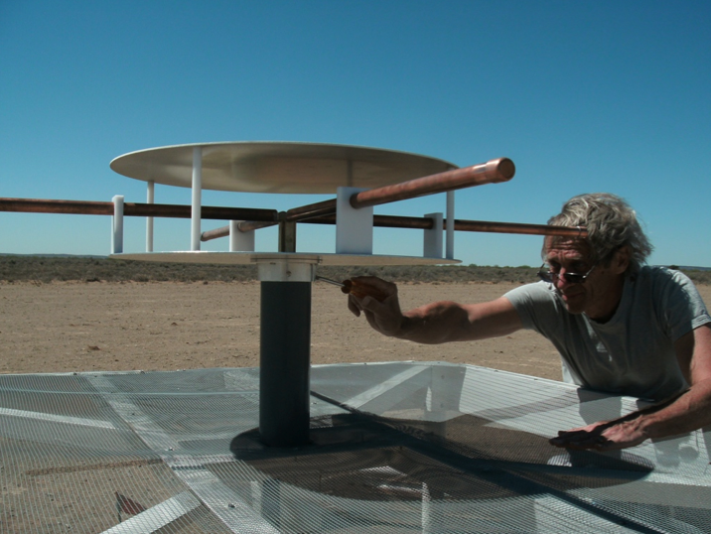
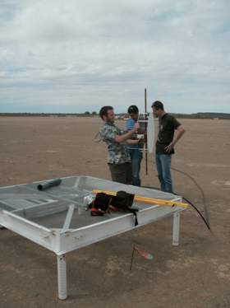
PAPER: Precisions Array to Probe the Epoch of Reionization
PIs Backer (UCB), Bradley (NRAO)
see Parsons et al. 2010
Optimize for reionization PS/CSS
FoV ~ 40deg, baselines ≤ 0.6km
Engineering array in RQ zone, Greenbank 16 stations
Science array in Karoo, South Africa 64 stations

Slide 34
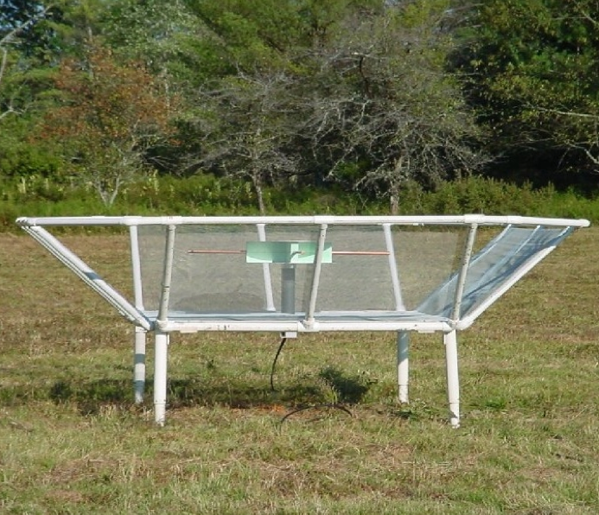
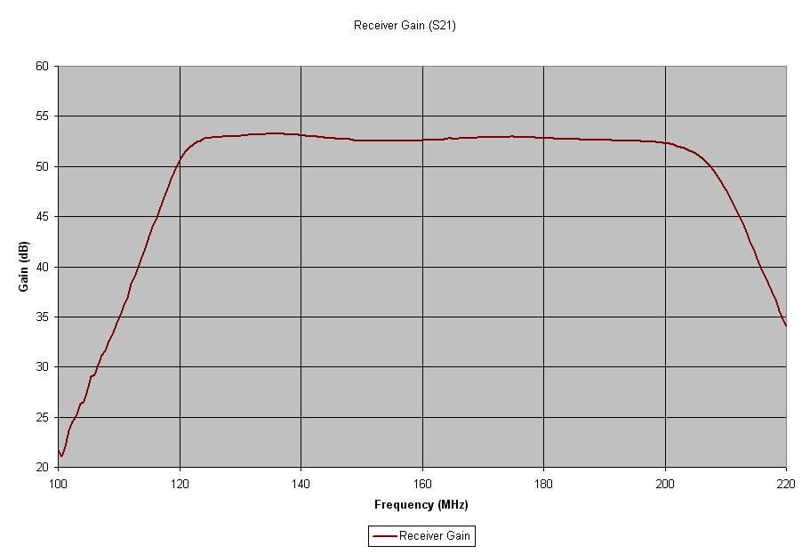
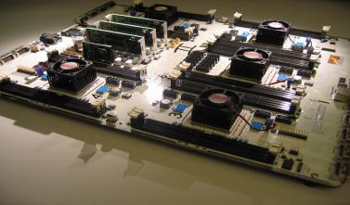
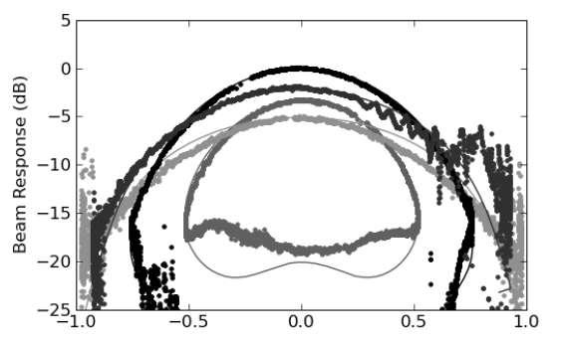
PAPER: Staged Engineering
Broad band sleeve dipole + flaps
FPGA-based correlator from Berkeley wireless lab
systematically tackle foregrounds, ionosphere, interference
100MHz
200MHz
Beam response
BEE2: 5 FPGAs, 500 Gops/s

Slide 35
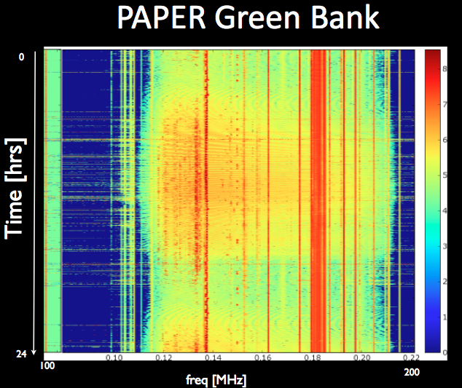
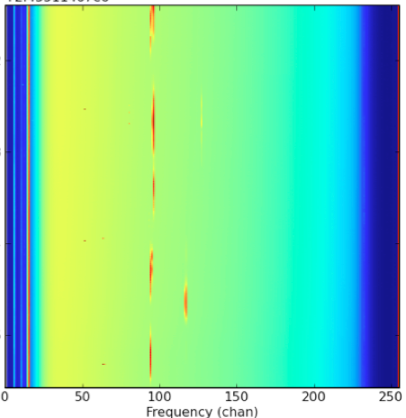
Interference
PAPER South Africa
FM
OrbComm
OrbComm
100MHz
200MHz
100MHz
200MHz

Slide 36
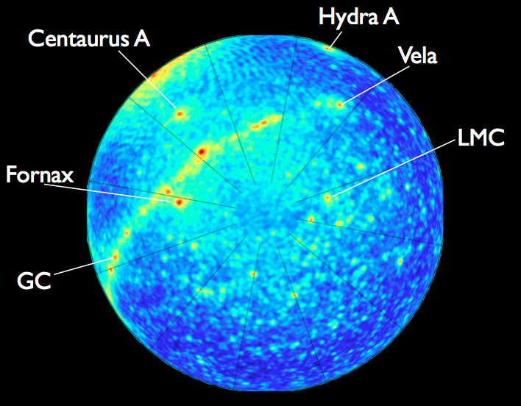
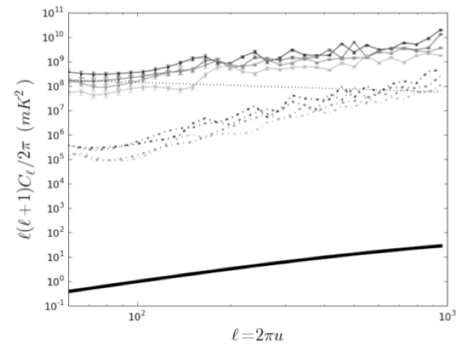
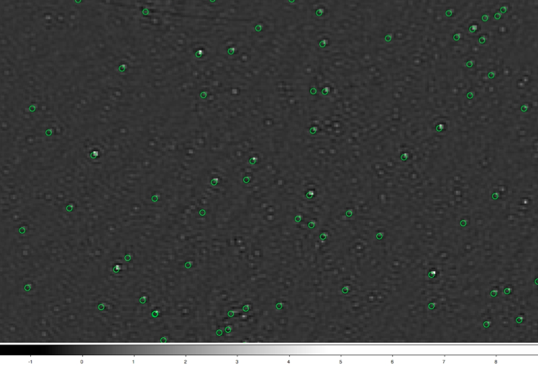
PAPER SA Southern Sky
150MHz
Detecting sources down to 1Jy (~2000x CSS signal)
10⁵
signal

Slide 37
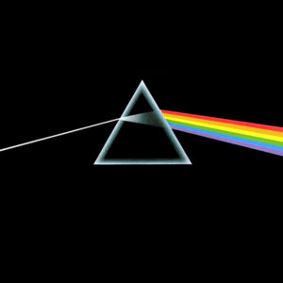
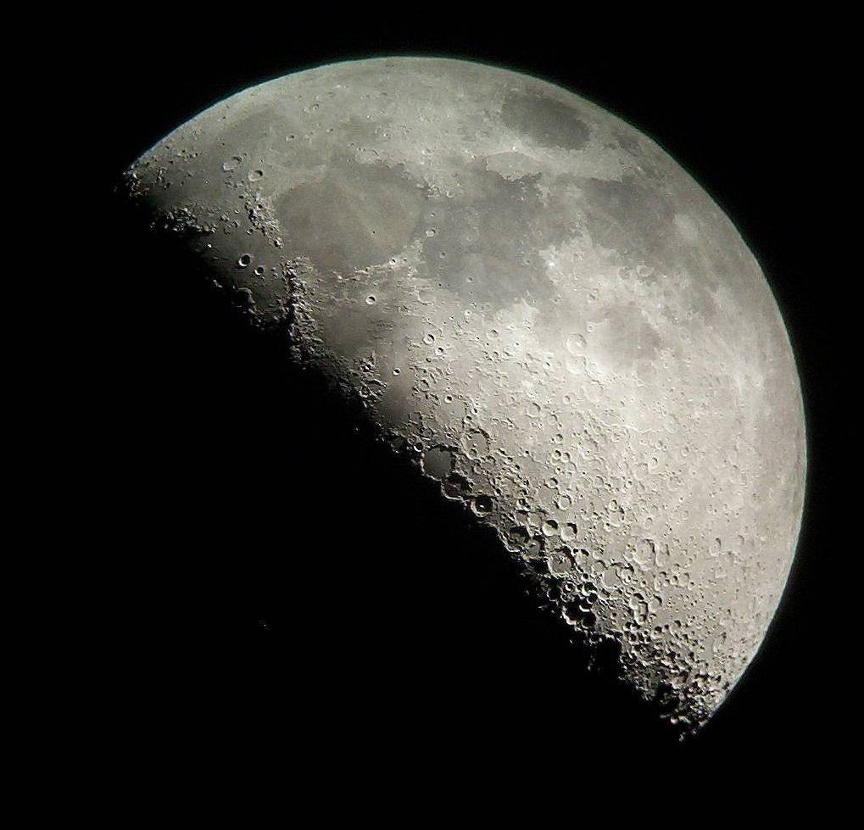
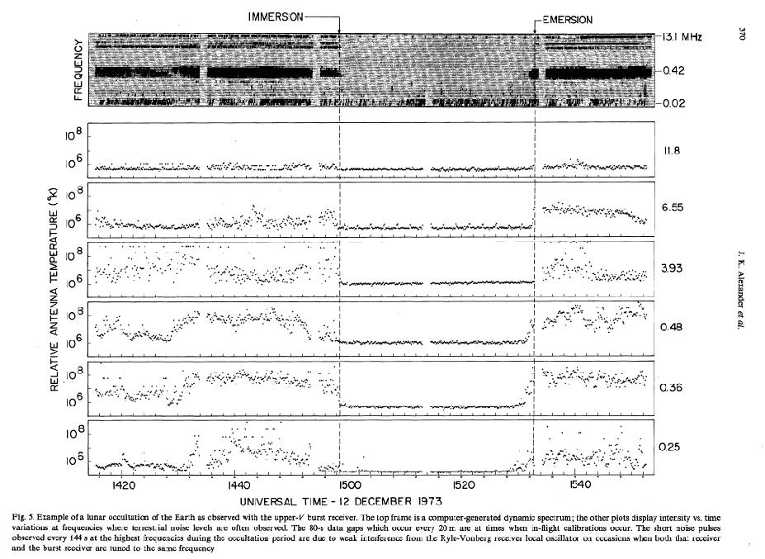
Probing the Dark Ages using a Lunar low frequency array
No interference
No ionosphere
Only place to study dark ages (< 60 MHz)
RAE2 1973
10MHz
Recognized as top astronomy priority for NASA Lunar exploration program (Livio ‘07)

Slide 38
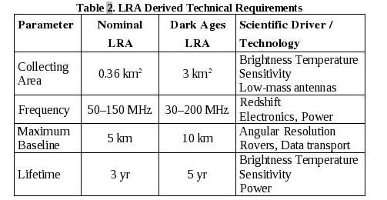
J. Burns, PI Colorado
Design specs for a ‘dark ages’ low frequency array on Moon
Relies on future heavy lift capabilities of Ares V (65 tons to moon)
http://lunar.colorado.edu/

Slide 39
Cosmic reionization: the last frontier in observational cosmology
First constraints: GP absorption + CMB large scale polarization => reionization is a complex process over z ~ 15 to 6
HI 21cm line is the most direct probe of reionization and the dark ages
Low freq pathfinders: promise of first detection of HI 21cm signal from reionization
SKA: ‘tomography’ of the evolution of the neutral IGM
LUNAR: probing the dark ages from the dark side of the moon
Dark Ages (> 0.4Myr)
Reionization (~ 1Gyr)

Slide 40
END
ESO

Slide 41
Sources responsible for reionization
Galaxies at z>7
<1um
>1um
HST/WFC3 Bouwens et al. 2010
Note: quasars (SMBH) are insufficient to cause reionization

Slide 42
Reionization by normal galaxies
Roberston + Ellis 2010
z ~ 7 requires f_{esc} > 0.2 and C < 30
z ~ 8 requires f_{esc} > 0.2 and C < 10

Slide 43
Spin Temperature
Collisions w. e⁻ and atoms
Ambient photons (predominantly CMB)
Lyα resonant scattering: Wouthuysen-Field effect = mixing of 1S HF levels through resonant scattering of Lyα drives T_{s} to T_{kin}
Lyα
21cm
hν₂₁/k = 0.067K
Each Lyα photon scatters ~ 1e5 times in IGM before redshifting out of freq window.

Slide 44
HI 21cm radiative transfer: large scale structure of the IGM
LSS: Neutral fraction / Cosmic density / Temperature: Spin, CMB
Furlanetto et al. 2006

Slide 45
Dark Ages HI 21cm signal
z > 200: Tγ = TK = Ts due to collisions + Thomson scattering => No signal
z ~ 30 to 200: TK decouples from Tγ, but collisions keep Ts ~ TK => absorption signal
z ~ 20 to 30: Density drops ∴ Ts~ Tγ => No signal
Tγ = 2.73(1+z)
TK = 0.026(1+z)²
Furlanetto et al. 2006

Slide 46
TK
Tγ
Enlightenment and Cosmic Reionization -- first luminous sources
z ~ 15 to 20: TS couples to TK via Lya scattering, but TK < Tγ => absorption
z ~ 6 to 15: IGM is heated (Xrays, Lya, shocks), partially ionized => emission
z < 6: IGM is fully ionized

Slide 47
Dark age HI 21cm signal: baryon oscillations
0.1
1.0
10 Mpc⁻¹
Barkana & Loeb: “Richest of all cosmological data sets”
Three dimensional in linear regime
Probe to k ~ 10³ Mpc⁻¹ vs. CMB limit set by photon diffusion ~ 0.2Mpc⁻¹
Alcock-Pascinsky effect
Kaiser effect + peculiar velocites

Slide 48
Challenge: sensitivity at very low frequency
PS detection
1 SKA, 1 yr, 30MHz (z=50), 0.1MHz
T_{Bsky} = 100(ν/200MHz)^{-2.7} K
= 1.7e4 K
At l=3000, k=0.3 Mpc⁻¹
Signal ~ 2 mK
Noise PS ~ 1 mK
Requires few SKAs

Slide 50
Chromatic aberration: Frequency differencing with MHz channels doesn’t work well due to frequency dependent far-out sidelobes
142, 174 MHz
Datta +
Dynamic range requirements on calibration errors
Daily cal errors < 0.2%
Monthly cal errors < 0.01%

Slide 51
Constraint II: Large scale polarization of the CMB
Thompson Scattering of the CMB during reionization
WMAP HINSHAW et al. 2008
Scattering CMB local quadrapole => polarized
Large scale: horizon scale at reionization ~ 10’s deg

Slide 52
Constraint II: Large scale polarization of the CMB
Temperature fluctuations = density inhomogeneities at the surface of last scattering
Scattering CMB during reionization => polarized
Large scale: horizon scale at reionization ~ 10 deg
z=1000

Slide 53
Signal IV: 21cm absorption toward first radio galaxies
19mJy
z=12
z=8
SKA+Gnedin simul
130MHz
159MHz
radio GP (τ=1%)
21 Forest (10%)
Only probe of small scale structure
Requires radio sources: expect 0.05 to 0.5 deg⁻² at z> 6 with S151 > 6 mJy

Slide 54
Beam nulling -- ASTRON/Dwingeloo (van Ardenne)
Factor 300 reduction in power

