Slide 1
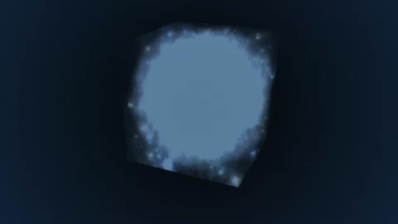
Seeing Through the “Fog”: HI 21cm cosmology z=20 to 5 (67 to 240 MHz)
Gnedin et al. (2006)
Hyperfine transition = weak => avoid saturation (translucent)
Direct probe of neutral IGM
Spectral line => 3D imaging of structure formation (freq = z = depth)
Low freq => very (very) large volume surveys (1sr, z=7 to 11)

Slide 2
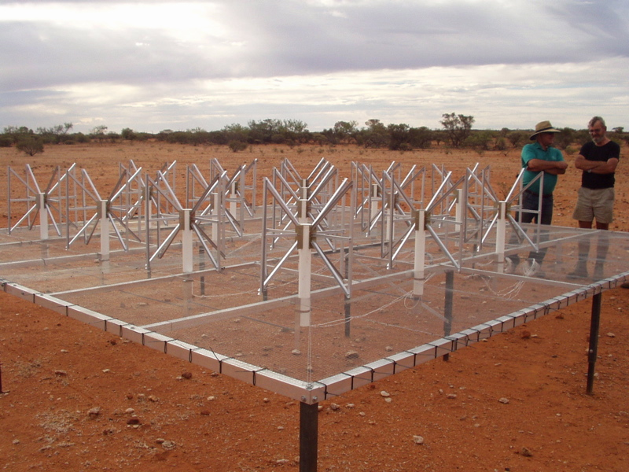
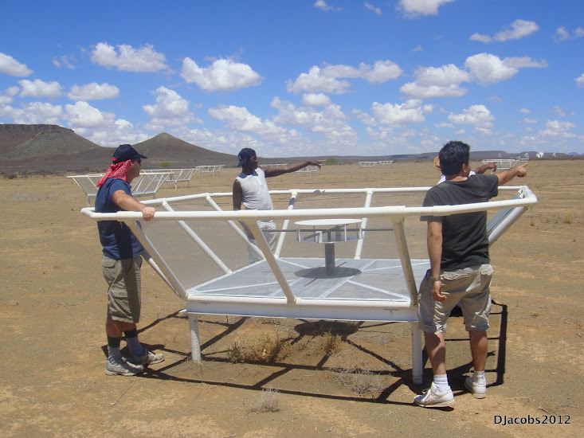
Renaissance at low freq: 1% to 10% of a square kilometer array
Array | FoV deg² | Area m² | Type | Bmax km | Start Science obs
LOFAR | 25 | 3e4 | Tile | 2 | 2013
MWA-128 | 300 | 2e3 | Tile | 1.5 | 2013
PAPER-128 | 1600 | 1e3 | Dipole | 0.3/0.6 | 2013
HERA-331 | 64 | 8e4 | 14m parabola | 0.3/2 | 2017
SKA-I Low | 30 | 1e6 | Tile | 5 | 2021+
MWA - Oz
PAPER - ZA

Slide 3
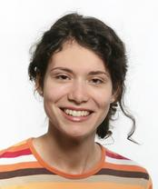
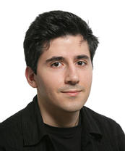
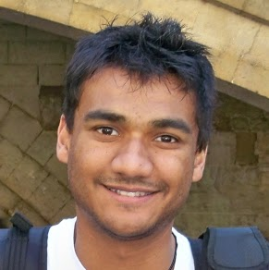
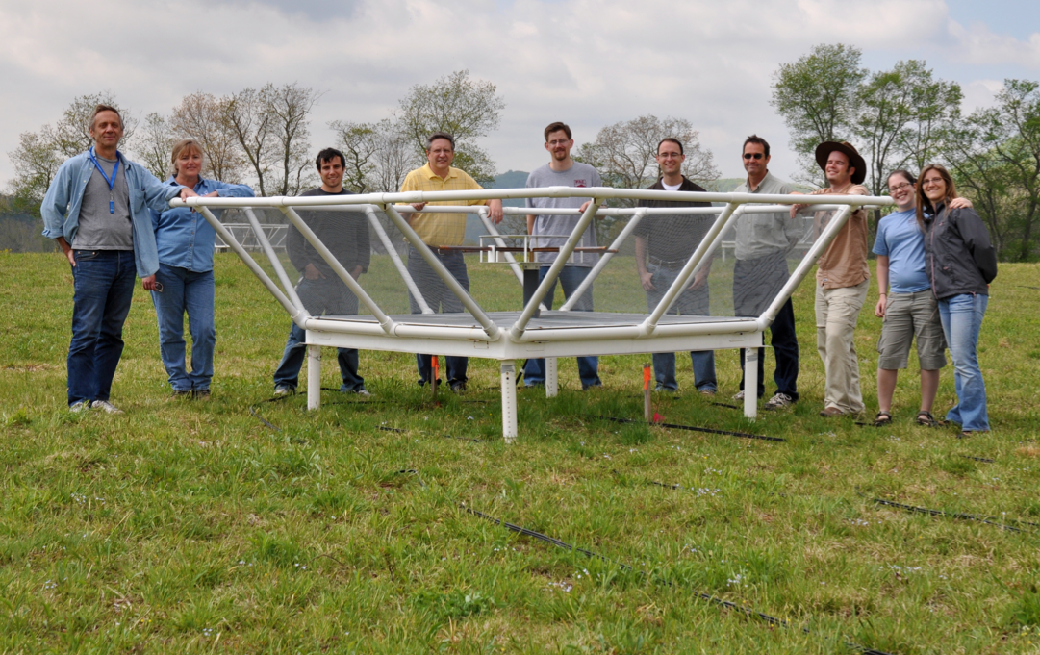
Precision Array to Probe Epoch of Reionization
Berkeley, NRAO, Penn, Cavendish, South Africa (SKA, KwaZulu Natal)
Focus: low-ν array to study HI 21cm signal from reionization
Precision: emphasize engineering solutions first
Staged: work through problems before increasing investment

Slide 4
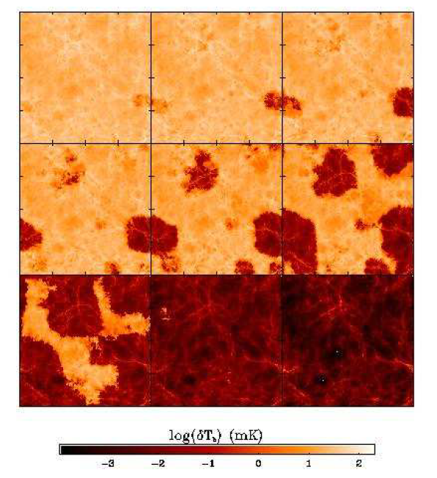
Signal end-game: HI 21cm imaging of IGM
Challenge: Sensitivity
z=12, 110MHz
<T_{B}> ~ 20mK
‘Richest of cosmological data sets’ (Loeb & Barkana)
Imaging of typical structures requires full SKA
S_{150MHz} (2’) ~ 8uJy
SKA rms ~ 1.6uJy
Primary science driver for SKA-low
z=6.5, 180 MHz
10cMpc = 4’
Furlanetto ea 2004

Slide 5
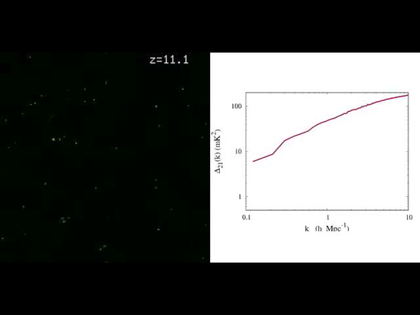
Pathfinder science goals
Evolution of 3D power spectrum in 21cm line
30’, 3MHz
3’, 0.3MHz
mK²
10cMpc
Mpc⁻¹
Mcquinn

Slide 6
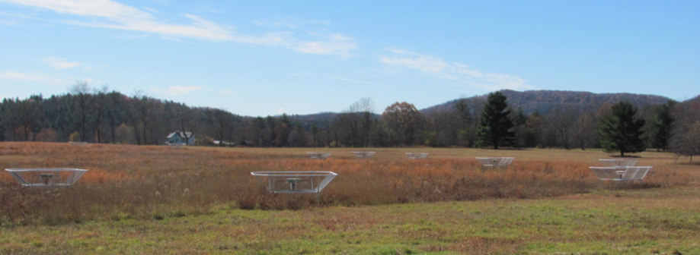
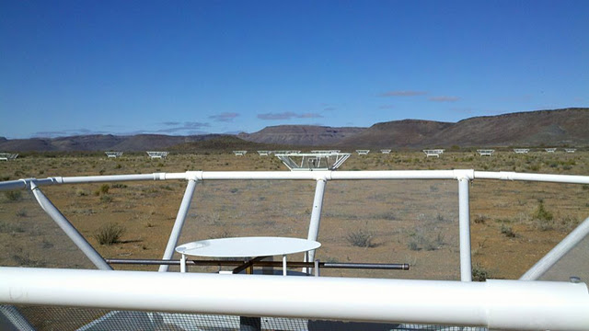
PAPER basics
Freq= 115 to 190 MHz (z= 6.5 to 11)
Single dipole elements + ‘flaps’ => FoV_{FWHM} ~ 40º
Max baseline = 300m => res ~ 15’
32 station engineering array in Greenbank, WV
Build-out to 128 antennae science array in Karoo, South Africa in 2013

Slide 7
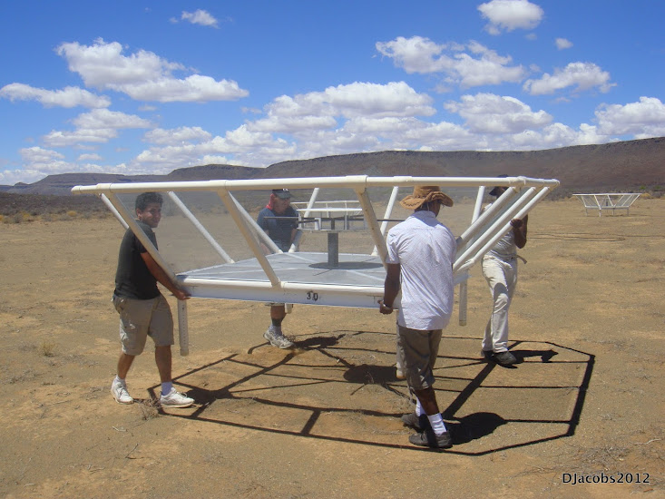
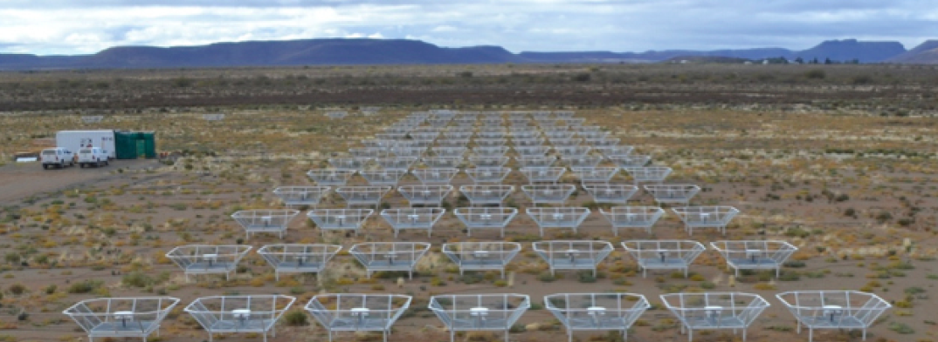
Reconfigurable => optimize for science goal
Minimum redundancy array
maximize u,v coverage => imaging
Maximum redundancy: delay spectrum analysis

Slide 8
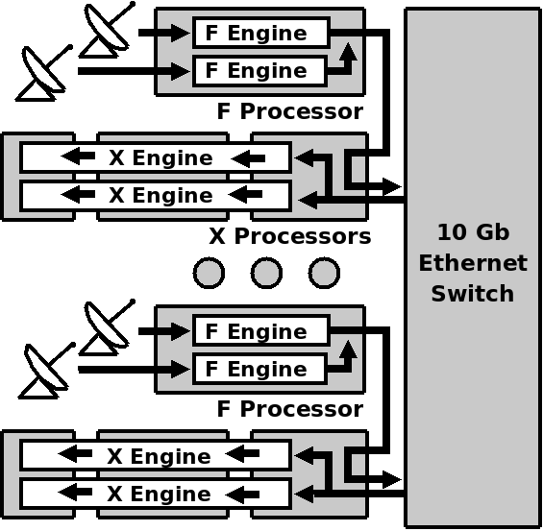
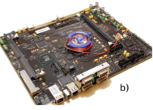
PAPER: (Xilinx) FPGA + GPU correlator from Berkeley wireless lab (CASPER): double array each year for 4 yrs > Moore
ROACH2 F engine: sample/digitize, transform (τ → ν), using polyphase filter (‘preconvolution’)
GPU X engine: cross multiply V (B, ν)
Cross-connections: ‘packetized correlator’ using 10Gb Ethernet protocol + commercial data routers
Computing, processing, storage (Penn)
Cluster computing: 32 octal core servers
Store raw visibilities: RAIDS 120 TB after data compression (time ave…)
AIPY (Berkeley), CASA, AIPS (NRAO)
Digital processing for large N arrays is solved problem
Data storage and analysis is not

Slide 9
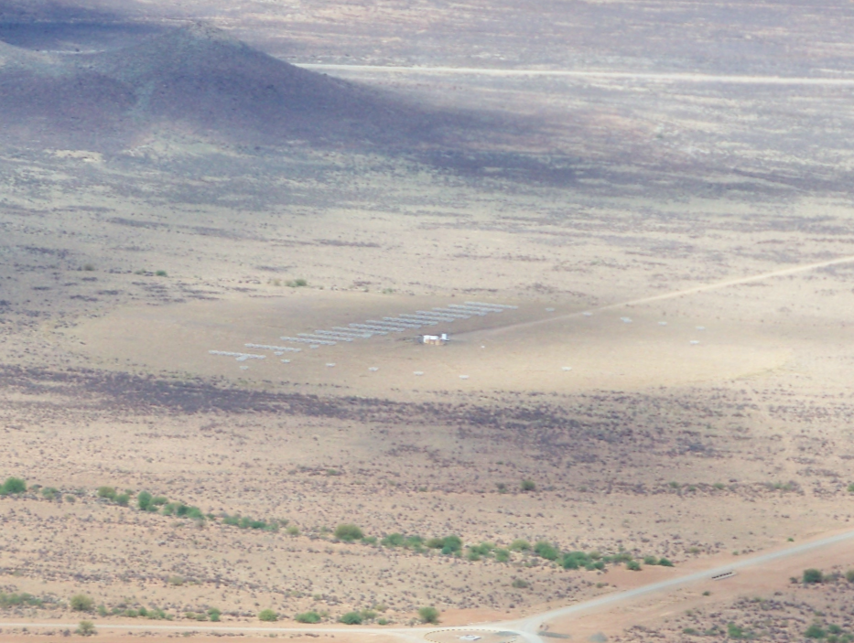
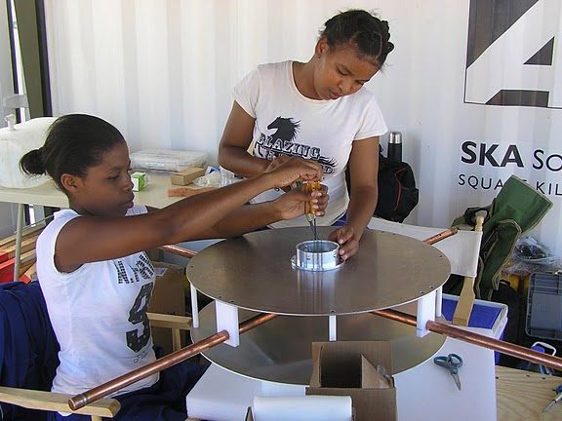
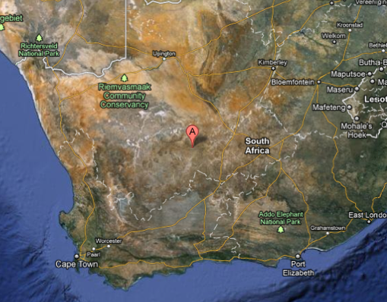
Established working array from scratch in 6 months, with help from ZA (SKA, Durban)
Univ. KwaZulu-Natal
PAPER
575 km
Cape Town

Slide 10
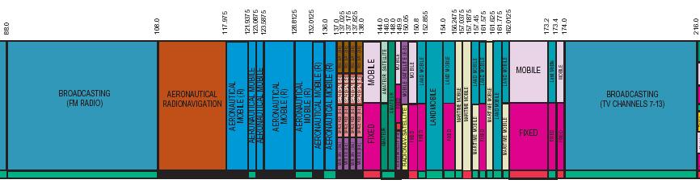
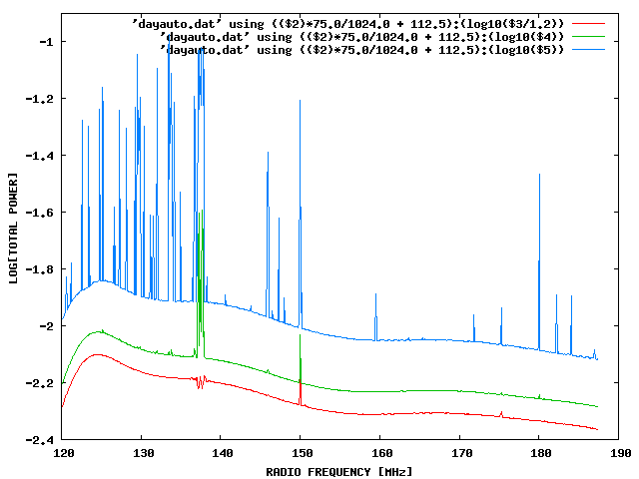
Challenge: Interference
100 MHz z=13
200 MHz z=6
Aircraft
TV

Slide 11
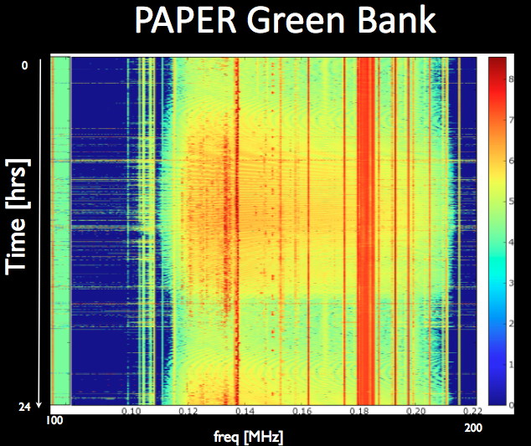
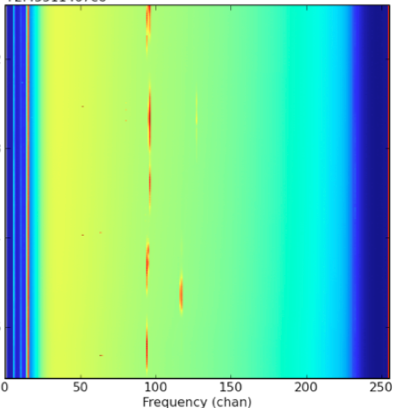
US ‘radio quiet zone’
ZA ‘radio quiet zone’
Karoo South Africa
TV
OrbComm
FM
ISS
OrbComm
100MHz
200MHz
100MHz
200MHz

Slide 12
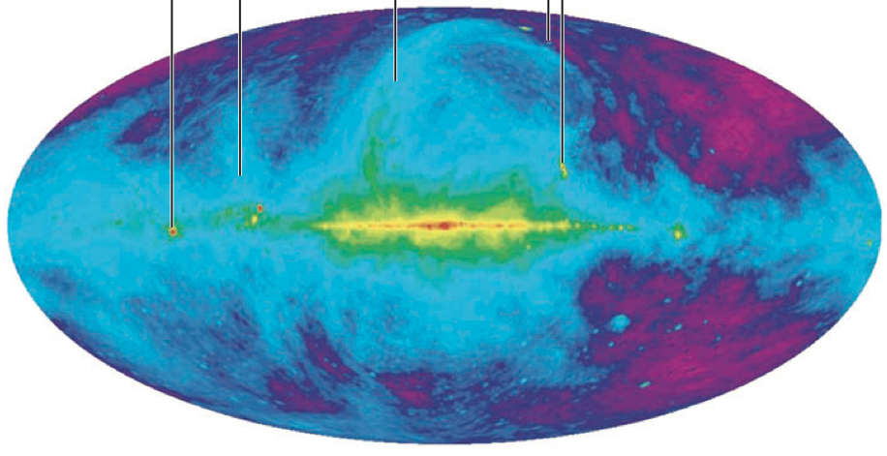
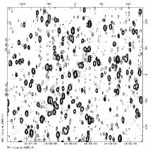
Challenge: sky is hot, confused at low freq
Haslam, Eberg 408MHz
Coldest regions: T ~ 100 (ν/200 ΜΗz)^{-2.6} K = 10⁴ x 21cm signal
Highly ‘confused’: 1 source/deg² with S140 > 1 Jy

Slide 13
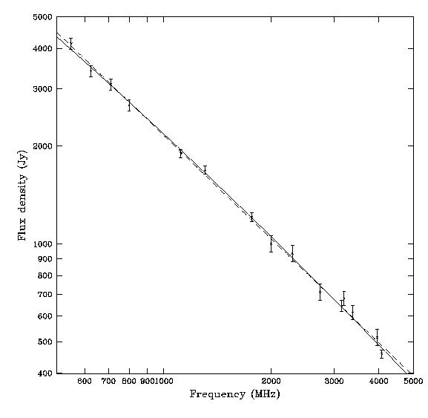
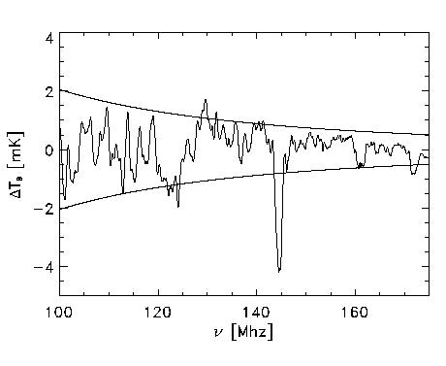
Solution: spectral decomposition
Foreground= non-thermal= featureless over ~ 100’s MHz
Signal = fine scale structure on scales ~ MHz
Cygnus A
Signal/Sky < 10⁻⁴
z=13
z=7
500MHz
5000MHz
Critical to mitigate freq dependent telescope response!

Slide 14
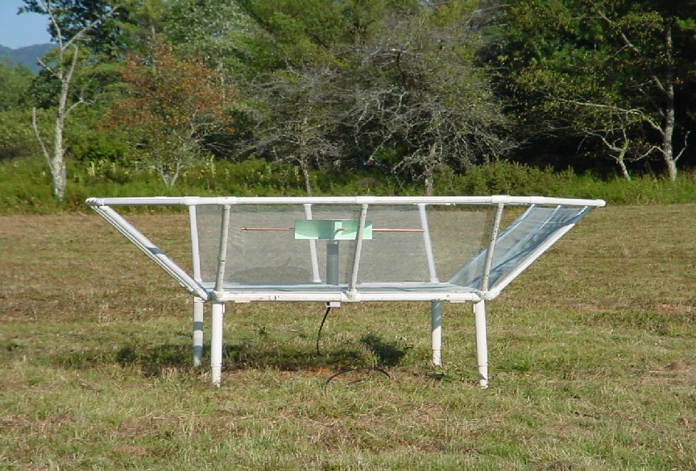
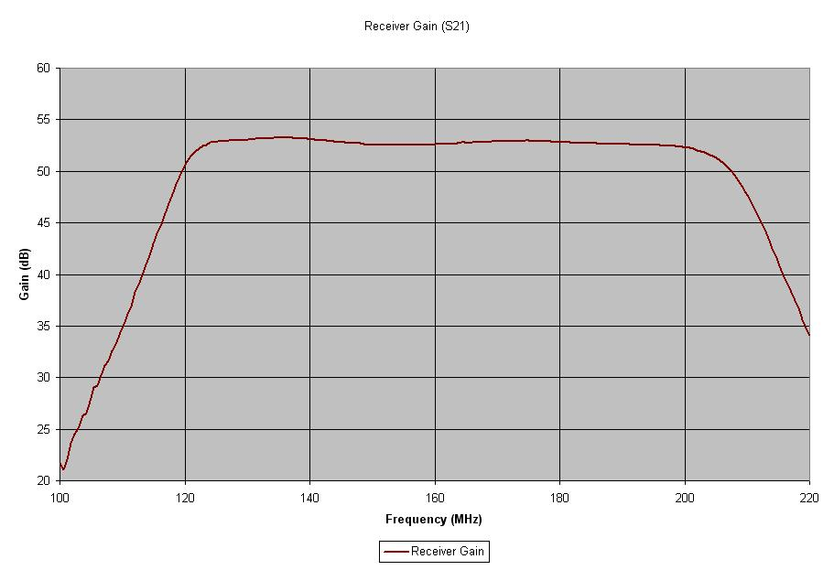
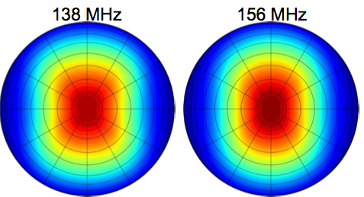
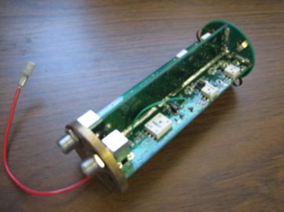
PAPER Antenna: ‘clean machine’
Sleeve dipole + flaps
Smooth, broad response in frequency and angle
Gain
10dB
120MHz
200MHz
LNA: T_{rx} = 110K, 30dB gain 120-180MHz

Slide 15
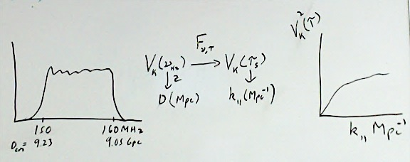
Power spectrum: ‘delay spectrum’ (Parsons ea.)
3D PS: ‘Parallel’ = line-of-sight (ν) ; ‘Perpendicular’= angular (sky-plane)
V_{Kelvin}(ν)
continuum
Line
Frequency maps to distance => Fourier conjugate (delay) maps to wavenumber (Mpc⁻¹)
Analyze line-of-sight PS (k_{par}) per baseline, time: PS = square of F_{t}[V_{K}(ν)] = V²_{K}(τ)
Continuum naturally limited to low k_{par} (depending on baseline length)

Slide 16
Redundant array: optimized for delay spectrum analysis
Redundant spacing calibration: antenna complex gains (t, υ)
Add spectra coherently in time => ‘signal to noise’ of PS improves linearly with number of measurements, N, vs. as N^{1/2} with incoherent averaging (add and square vs. square and add)

Slide 17
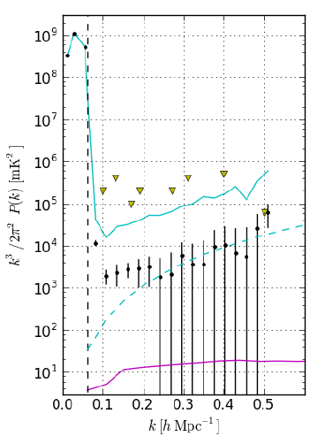
PAPER power spectrum: z=7.7 (Parsons ea 2014)
300hrs, 32ant, 70 redundant baselines of 30m length
Wedge: 5 order of magnitude continuum avoidance (mK²)
k ~ 0.1 to 0.2 h⁻¹ Mpc⁻¹:
k³/2π² P(k) < (52 mK)²
Best limits to date by 100x
Still inconsistent with thermal noise => residual (pol.) continuum?
Still 100x (in mK) above predictions of fiducial reionization models
‘horizon limit’ = ‘wedge’
GMRT
T_{sys}=560K
Fiducial

Slide 18
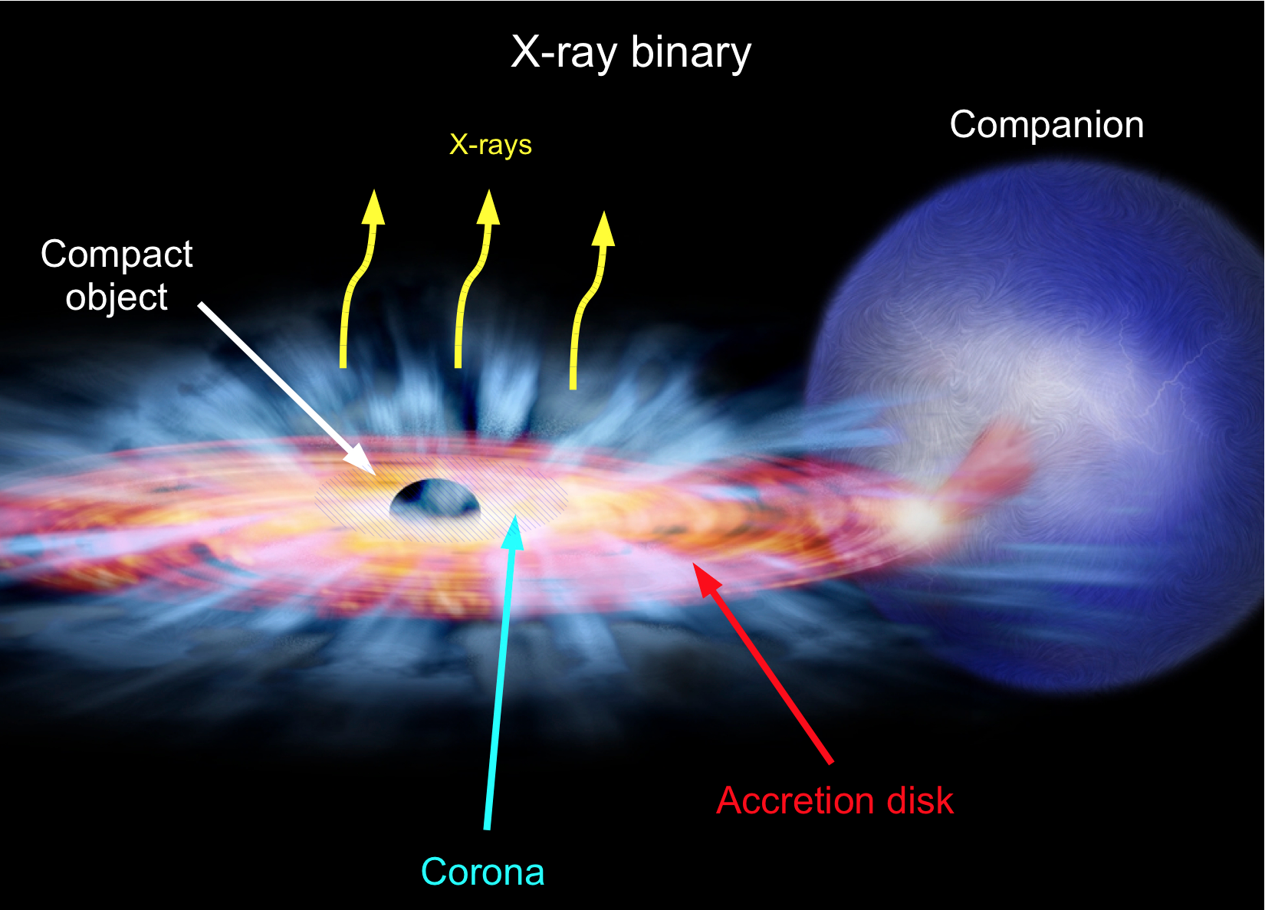
Ruling out pathological (but not impossible?) models
Fiducial model z∼6 to 20: IGM warmed by pervasive hard X rays from 1st XRBs prior to reionizing => T_{K} > T_{CMB} => emission signal ~ few mK
No warming => absorption against CMB (250mK)
Argues for warming of IGM prior to reionizing
‘horizon limit’ = ‘wedge’
GMRT
No warming
T_{sys}=560K
Fiducial

Slide 19
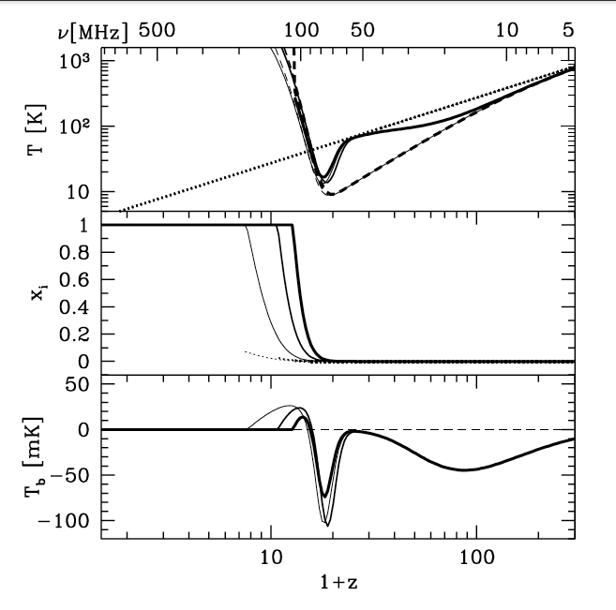
Ruling out pathological (but not impossible?) models
Fiducial model z∼6 to 20: IGM warmed by pervasive hard X rays from 1st XRBs prior to reionizing => T_{K} > T_{CMB}
No warming => absorption against CMB (250mK)
T_{cmb}
T_{S}
T_{K}
No warming
E
D
C
B
A

Slide 20
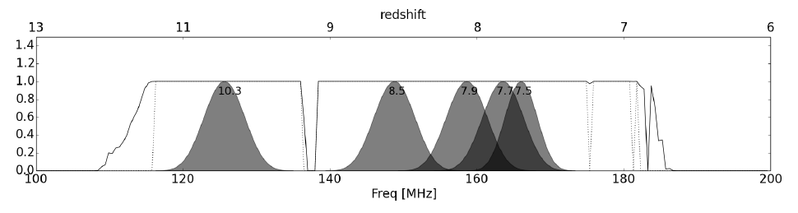
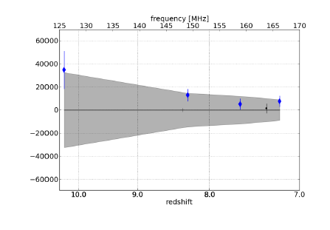
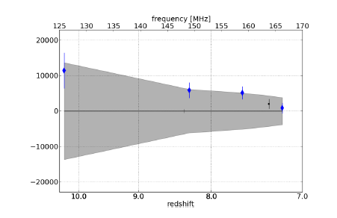
Limits vs redshift (Jacobs)
k = 0.2 Mpc⁻¹
k = 0.3 Mpc⁻¹
mK²
Noise limited Power spectra (32 ant)
Still long way to go to expected signal ~ 20 mK²

Slide 21
PAPER towards a detection in 2015
128 elements
2 years observing
Full polarization
~10x improvement (in mK) => detect fiducial model
PAPER 128
Fiducial

Slide 22
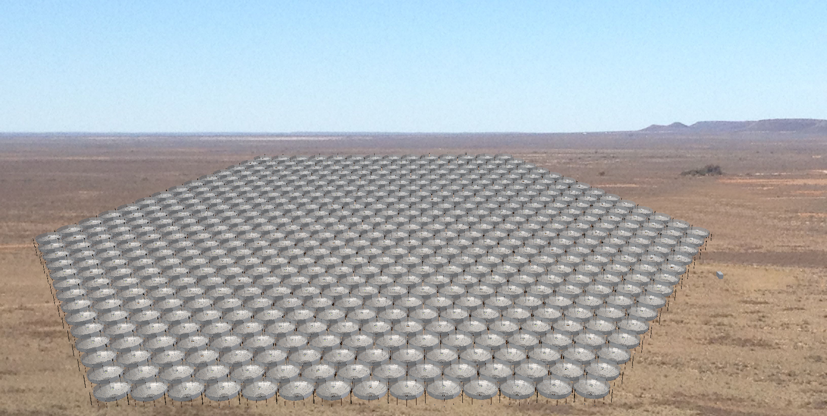
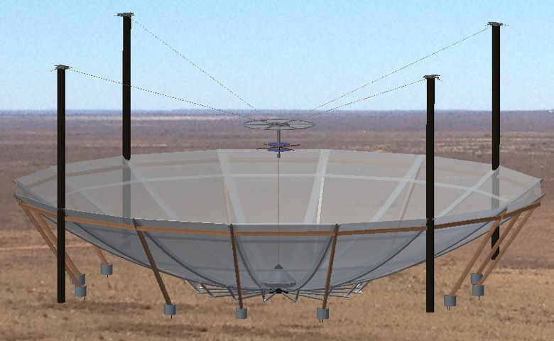
Hydrogen Epoch of Reionization Array
331 x 14m parabolic transit antennas (~Arecibo), 50 to 250MHz, in Karoo
MWA+PAPER+MITEoR collaboration: Berkeley, Cavendish, MIT, NRAO, Penn, Washington, ASU, SKA-ZA, U. KwaZulu-Natal
Build on PAPER/MWA experience to design next generation array: Optimal design for delay spectrum analysis + large scale structure imaging
Development 2014/15, construction 2016, science: 2017 - 19; Cost ~ $16M
Notes:
PSA-64, 32 antennas in a maximum-redundancy configuration, 30m between rows, 4m spacing within rows

Slide 23
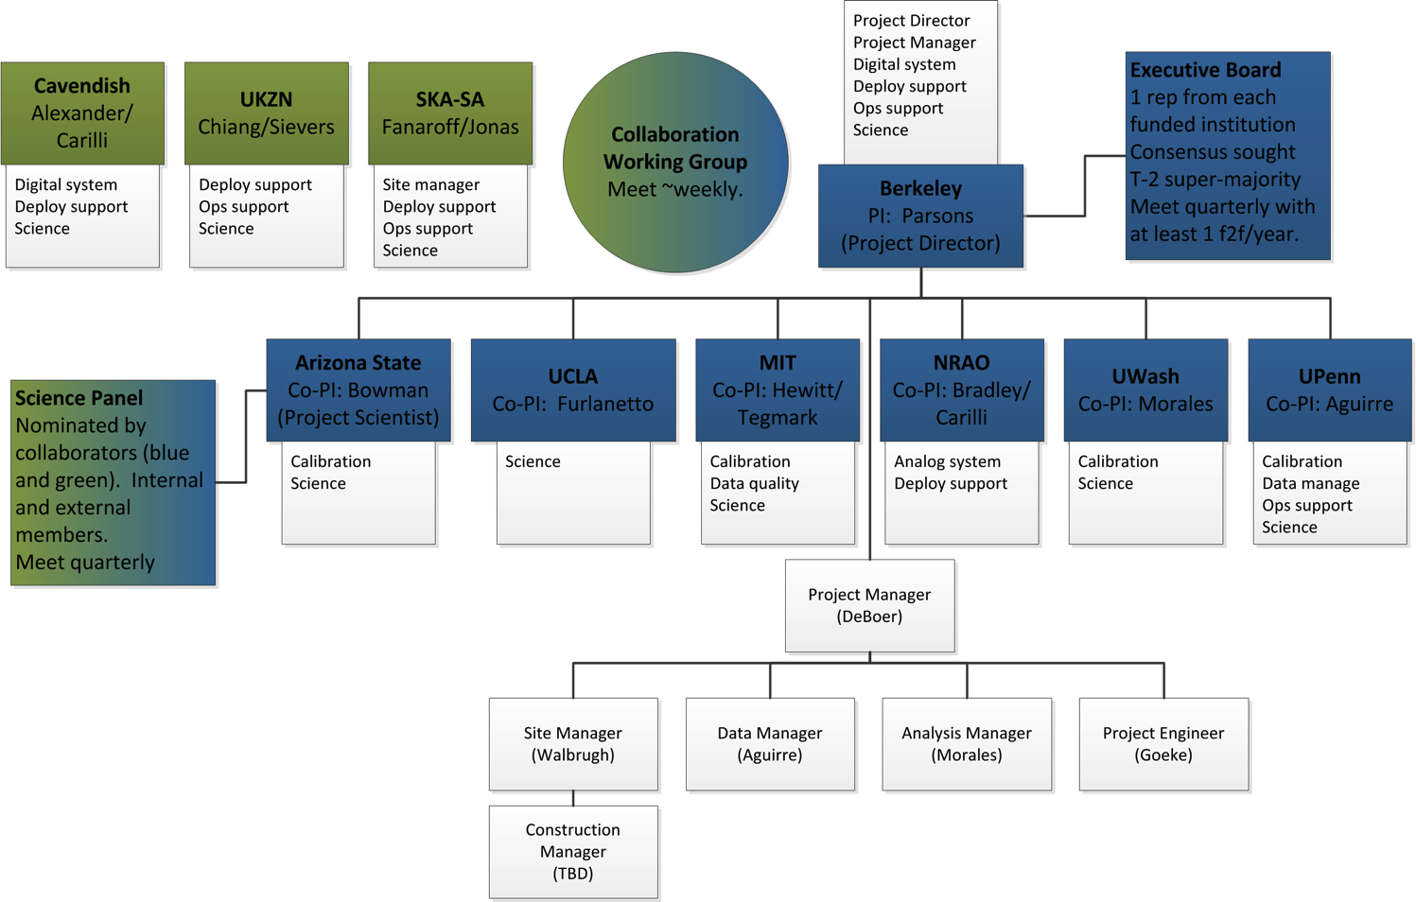
HERA development funded next 2 years (~15%) NSF Mid-Scale Innovations Program

Slide 24
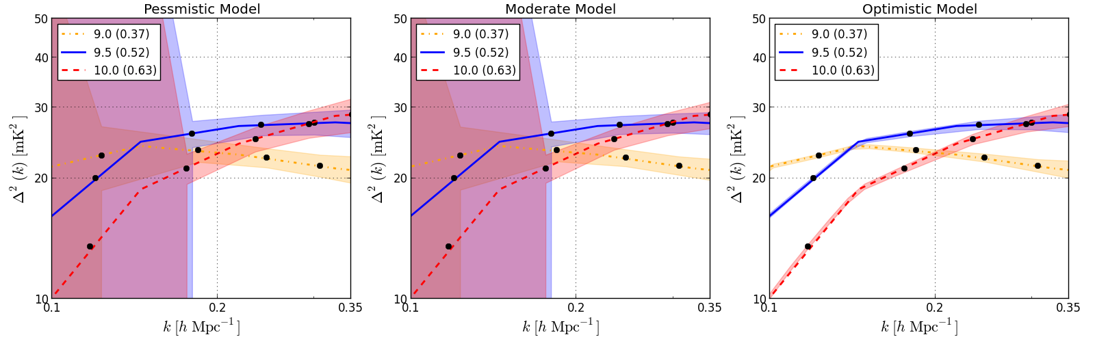
HERA-331
 | Area (m²) | SNR Pessimistic | SNR Moderate | SNR Optimistic
SKA-low | 8e5 | 14 | 98 | 280
HERA | 5e4 | 19 | 23 | 80
LOFAR-core | 3e4 | 1.4 | 2.8 | 17
MWA-128 | 900 | 0.6 | 2.5 | 6.4
PAPER-128 | 530 | 1.7 | 1.9 | 8.9
Pober ea 2014
Notes:
PSA-64, 32 antennas in a maximum-redundancy configuration, 30m between rows, 4m spacing within rows

Slide 25
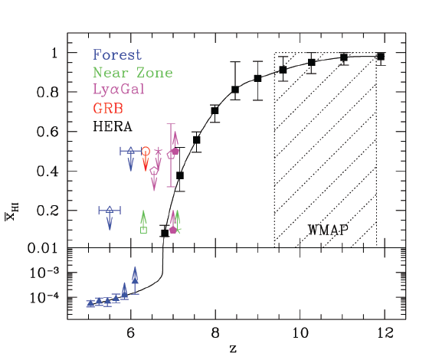
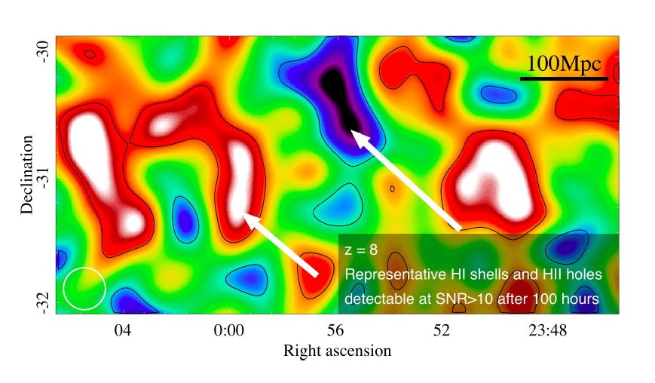
F_{HI}
Jacobs ea. McQuinn ea
HERA 331
Detailed characterization of evolution neutral IGM: z=6 to 20
Direct imaging scales ~ 30-100 cMpc (full 3D analysis)
Explore end of ‘dark ages’ (z ~ 15 to 20)
Inform science/tech SKA-low (2020+)

Slide 26
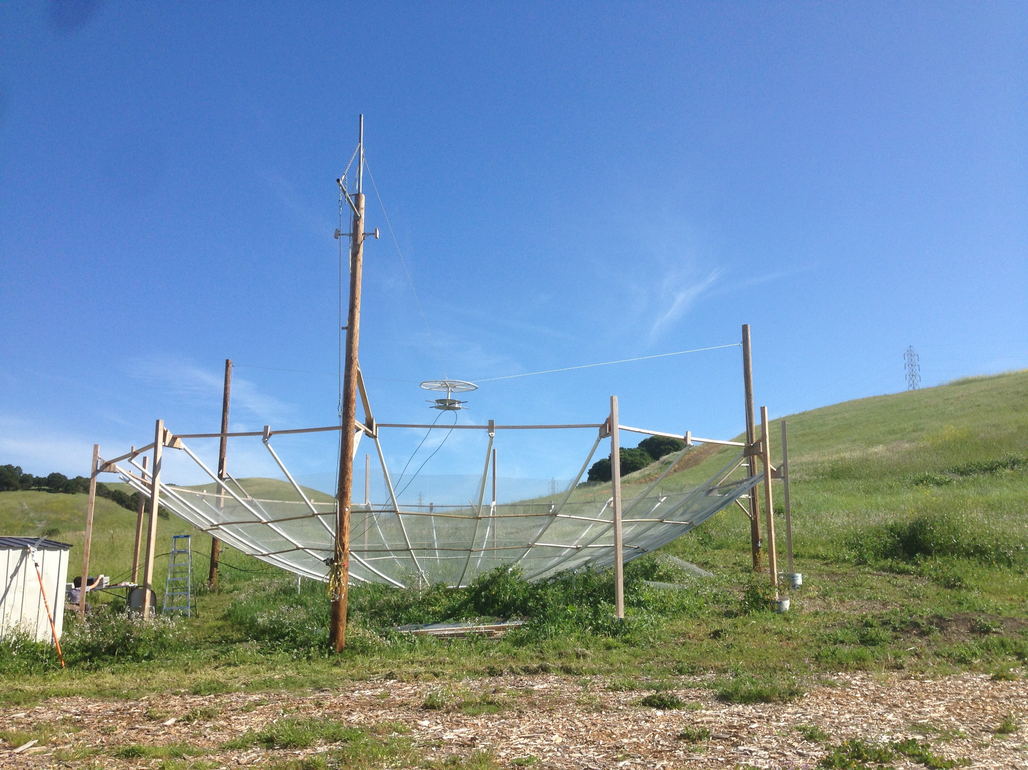
HI 21cm cosmology
PAPER (2014-2016):
First PS limits from PAPER 32: rule out pathological models
Build out to 128 in 2013, observe 2 years: constrain plausible models or first detection
HERA (2015-19): 331x 14m parabolic antenna array for detailed PS characterization, evolution, and first imaging
SKA-low (2021+): full IGM tomography at arcmin scales

