Slide 1
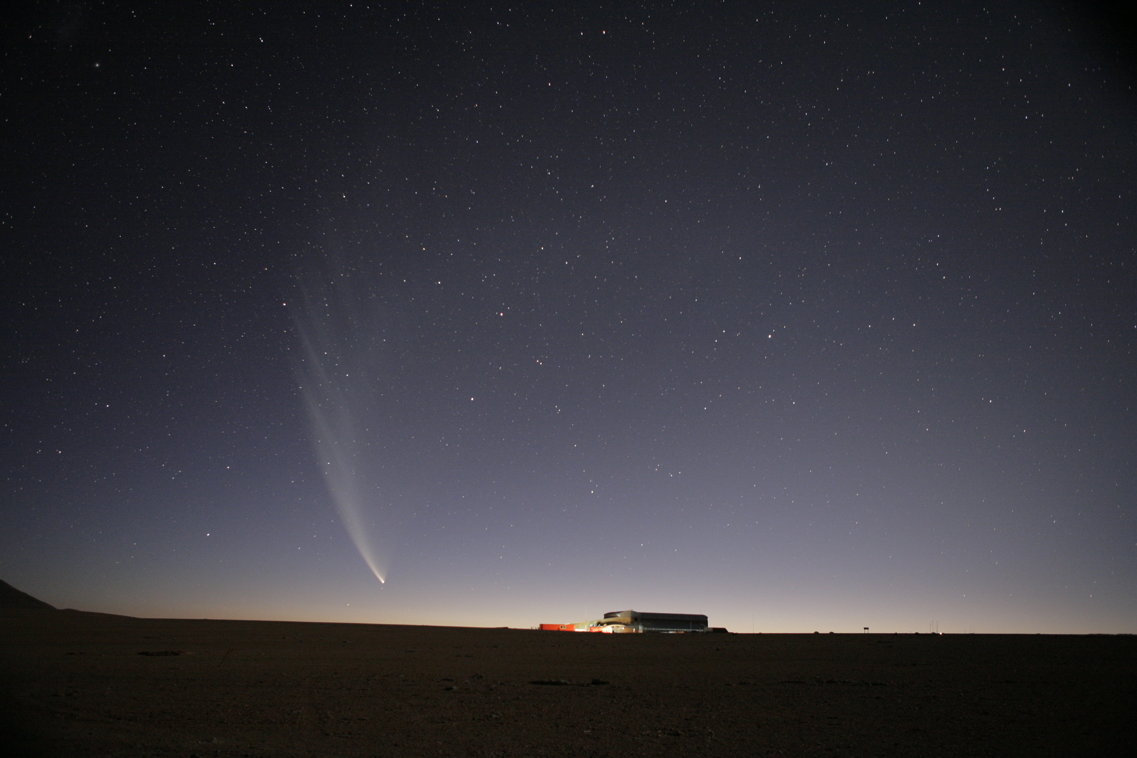
Recent Results on Reionization
Chris Carilli (NRAO)
LANL Cosmology School, July 2011
Review: constraints on IGM during reionization
CMB large scale polarization
Gunn-Peterson effect
Quasar near zones: a new tool
J1120+0641 quasar at z=7.1: the Game Changer
Lya emission from z=7 LBGs: also in the Game
[CO intensity mapping during reionization?]
ESO

Slide 2
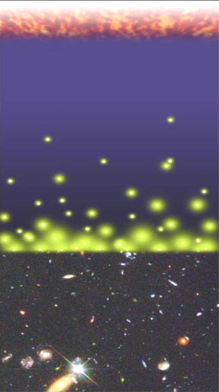
Big Bang f(HI) ~ 0
History of Baryons (mostly hydrogen)
Recombination
0.4 Myr
z = 1000
f(HI) ~ 1
Cosmic time
(Cosmic expansion)
Redshift
Reionization
0.8 Gyr
z ~ 7 to 15
f(HI) ~ 10⁻⁵
13.6Gyr
z = 0

Slide 3
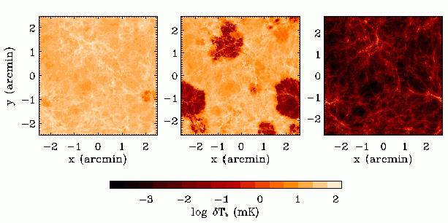
HI 21cm z=12
z=6
8Mpc
Dark Ages
Last epoch of cosmic evolution to be tested and explored
Reionization: ‘last cosmic phase transition’, setting a bench-mark in cosmic structure formation indicating the first luminous structures
Fundamental questions:
When?
How fast?
What sources are responsible?
Cosmic Reionization

Slide 4
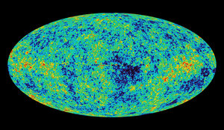
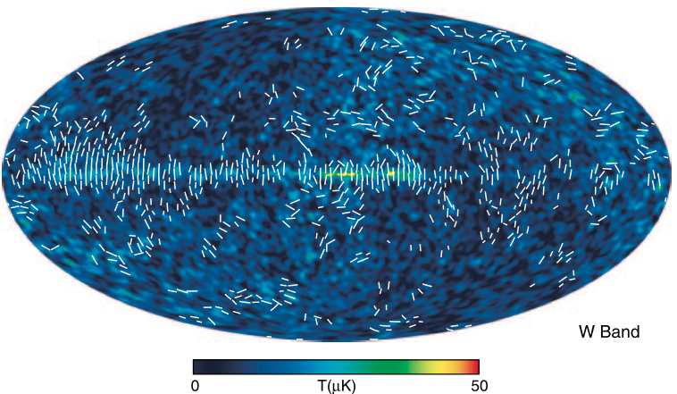
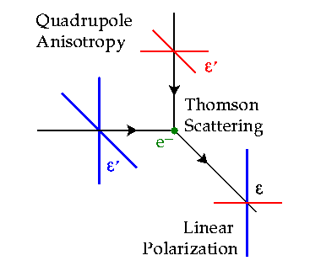
Constraint I: Large scale polarization of the CMB
Temperature fluctuations = density inhomogeneities at the surface of last scattering
e⁻ scattering CMB during reionization => polarized
Large scale: horizon scale at reionization ~ 10 deg
z=1000
Hinshaw et al. 2008

Slide 5
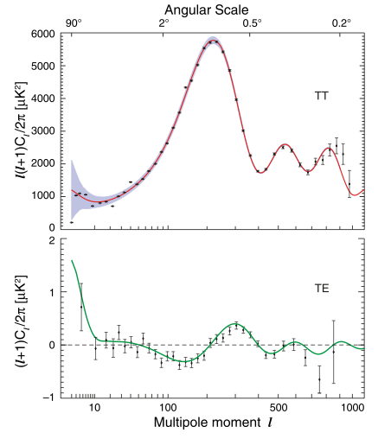
Constraint I: CMB large scale polarization WMAP
Angular power spectrum = variance as function of angular scale (square of visibility function)
Polarized signal is weak:
uK rms ~ 1% total intensity on scales l < 10 or angles > 20º
Baryon Acoustic Oscillations: Sound horizon at recombination
Jarosik et al 2010
_{e} = 0.087 +/- 0.015
~d/mfp ~ dneσe ∝ [1-f(HI)] (1+z)²

Slide 6
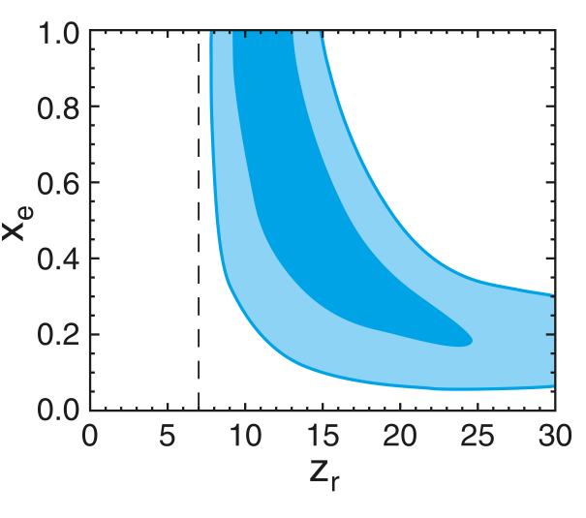
Constraint I: CMB large scale polarization
Rules-out high ionization fraction at z > 15
Allows for small (≤ 0.2) ionization to high z
Most action at z ~ 7 to 15: f(HI) < 0.5 at z ~ 11
Challenge: systematics extracting large scale signal
Dunkley et al. 2008

Slide 7
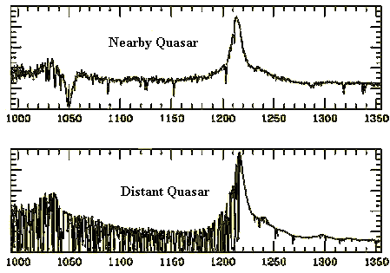
Constraint II: Gunn-Peterson effect
Neutral IGM after reionization = Lya forest
Lya resonant scattering by neutral gas in IGM clouds
Linear density inhomogeneities, δ~ 10
N(HI) = 10¹³ – 10¹⁵ cm⁻²
f(HI/HII) < 10⁻⁵
z=0
z=3

Slide 8
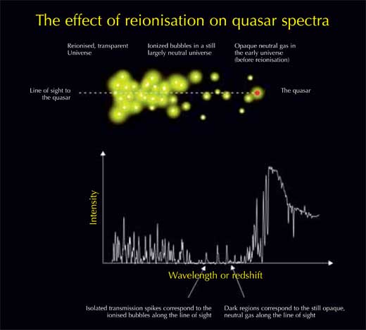
Gunn-Peterson absorption
Diffuse or clumpy: thickening of forest or true diffuse IGM?

Slide 9
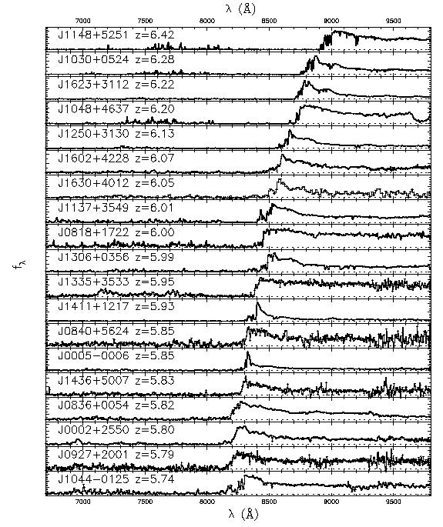
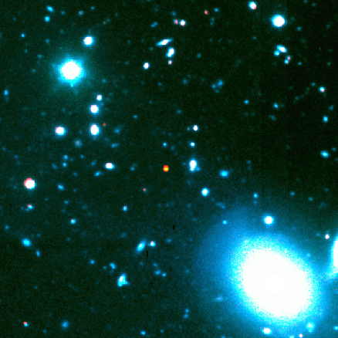
Gunn-Peterson effect
6.4
SDSS z~6 quasars
Clear increase of τ with z
Opaque at z>6
z=6.4
5.7
Fan et al 2006

Slide 10
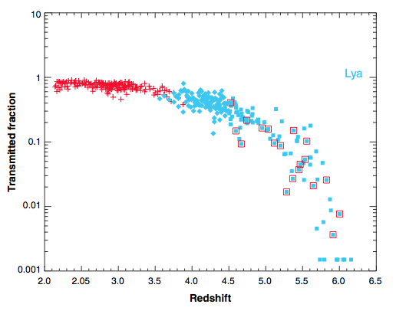
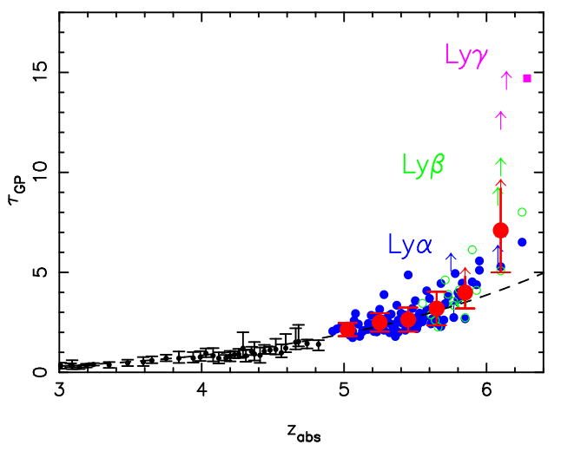
Gunn-Peterson opacity => N(HI)
τ_{GP} = 2.6e4 f(HI) (1+z)^{3/2}
f(HI) > few 10⁻³ at z> 6
Note: saturates at low neutral fraction
τ depends on clumping factor and resolution
Fan, Carilli, Keating

Slide 11
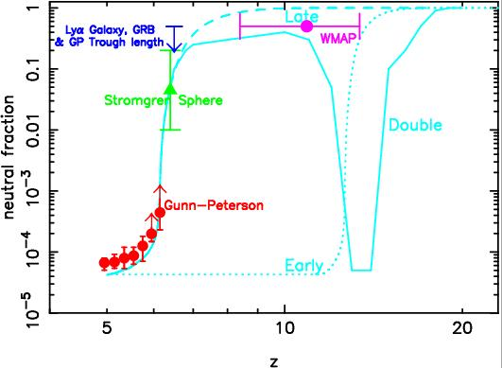
Local ionization?
CMBpol + GP => likely increase in f(HI) at z~6, with substantial ionization fraction persisting to z~11

Slide 12
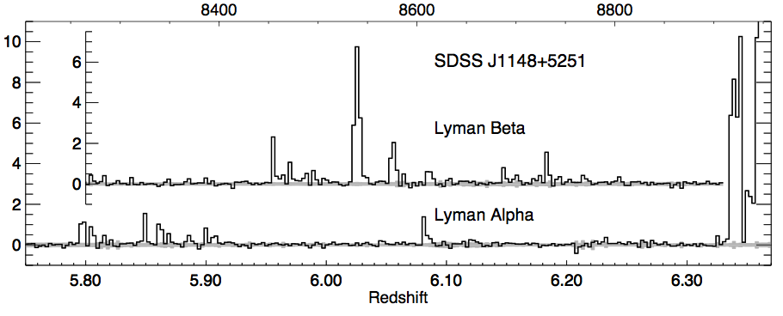
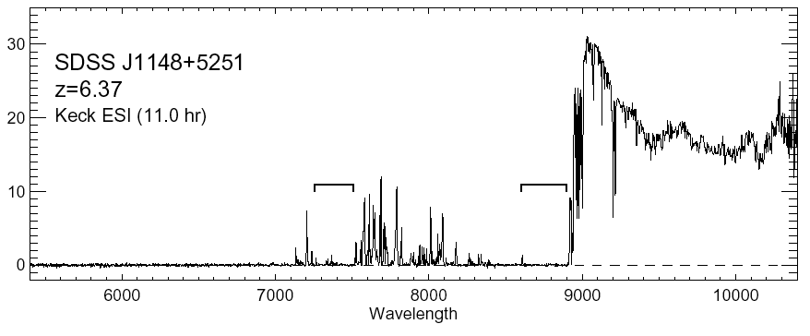
Quasar Near Zones: J1148+5251
Accurate host galaxy redshift from CO: z=6.419
Quasar spectrum => photons leaking down to z=6.32
White et al. 2003
‘time bounded’ Stromgren sphere ionized by quasar
Difference in z_{host} and z_{GP} =>
R_{NZ} = 4.7Mpc [f_{HI} L_{γ} t_{Q}]^{1/3} (1+z)⁻¹

Slide 13
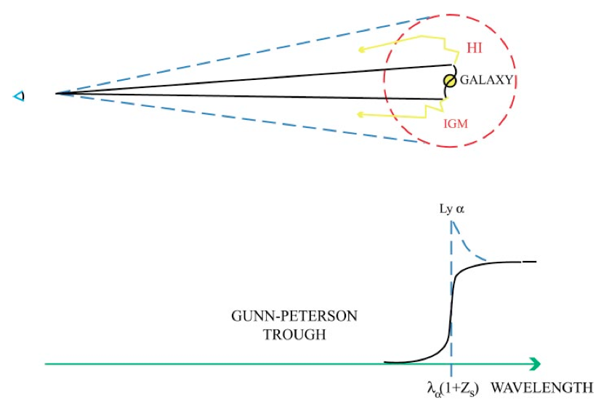
HI
HII
Loeb & Barkana

Slide 14
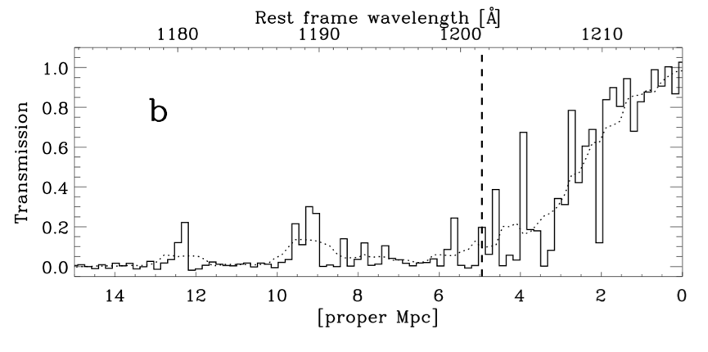
Quasar Near-Zones: sample of 28 quasars at z=5.7 to 6.5
(Carilli ea 2010; Willott ea 2010)
Need: z_{host} and z_{GP}
GP on-set redshift
Adopt fixed resolution of 20A
Find 1st point when transmission drops below 10% (of extrapolated) = well above typical GP level.
=> Relative, not absolute measurement
z = 6.1
Wyithe et al. 2010

Slide 15
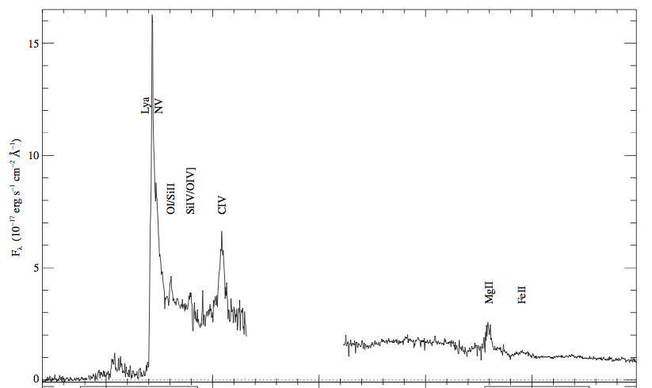
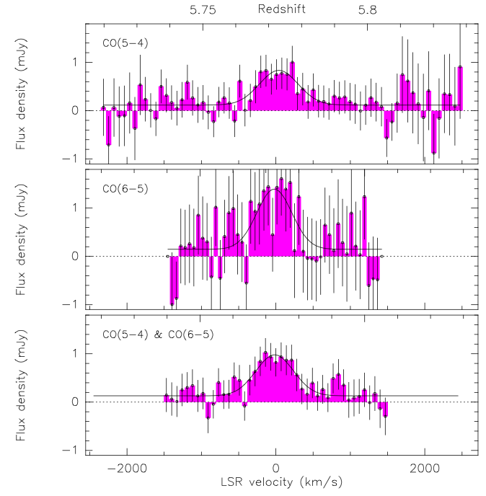
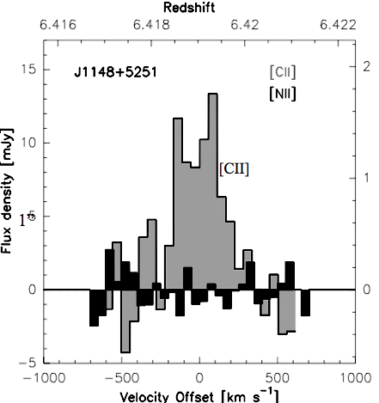
Host galaxy redshifts: CO (8), [CII] (3), MgII (14), UV (8)
dz = 0.05 for UV lines
dz = 0.01 for MgII
dz = 0.003 for CO, [CII]

Slide 16
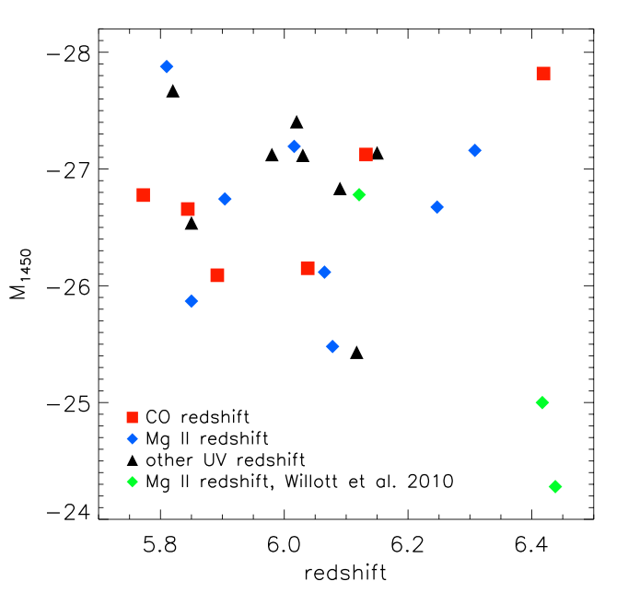
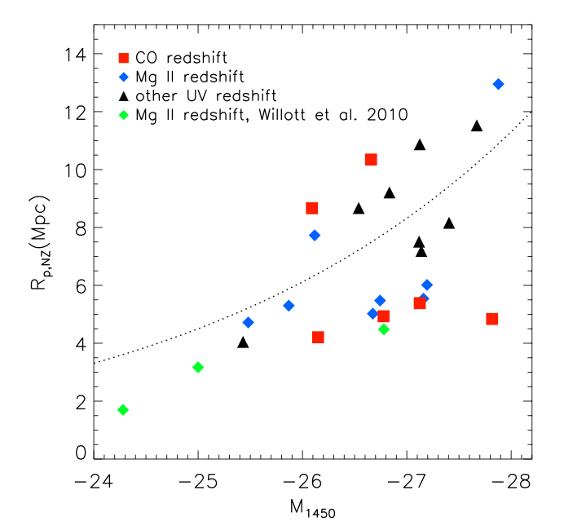
Quasar Near-Zones: 28 GP quasars at z=5.7 to 6.5
L_{UV}
R L_{γ}^{1/3}
L_{UV}
No correlation of UV luminosity with redshift
Correlation of R_{NZ} with UV luminosity

Slide 17
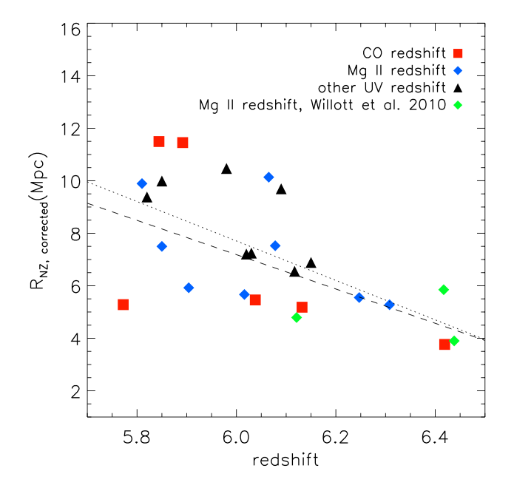
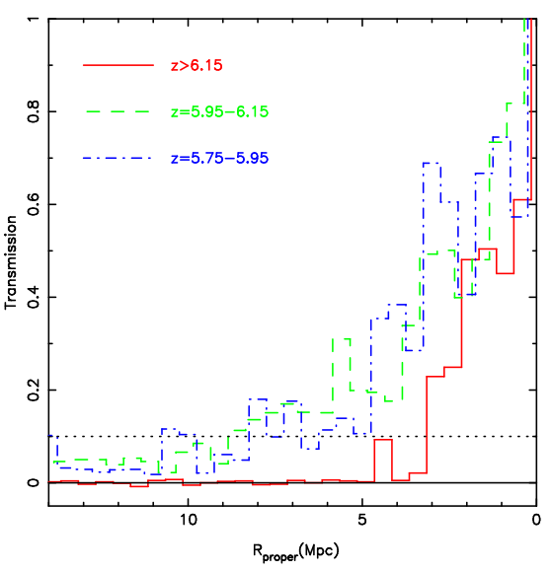
Quasar Near-Zones: R_{NZ} vs redshift
[normalized to M₁₄₅₀ = -27]
R_{NZ} = 7.3 – 6.5(z-6)
z>6.15
<R_{NZ}> decreases by factor 2.3 from z=5.7 to 6.5
If CSS => f_{HI} increases by factor ~ 10 (eg. 10⁻⁴ to 10⁻³)

Slide 18
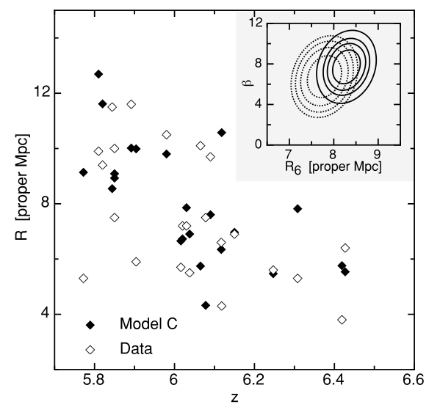
Alternative hypothesis to Stromgren sphere: Quasar Proximity Zones (Bolton & Wyithe)
R_{NZ} measures where density of ionizing photon from quasar > background photons (IGRF) =>
R_{NZ} [L_{γ}]^{1/2} (1+z)^{-9/4}
Increase in R_{NZ} from z=6.5 to 5.7 is then
due to rapid increase in mfp during overlap/
‘percolation’ stage of reionization
Either case (CSS or PZ) => rapid
evolution of IGM from z ~ 5.7 to 6.5

Slide 19
Local ionization?
QNZ
Quasar near-zones support notion of rapid rise in f(HI) at z ~6
ESO

Slide 20
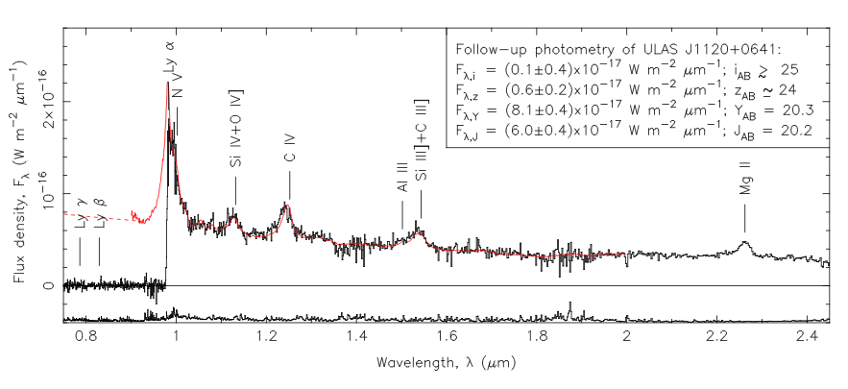
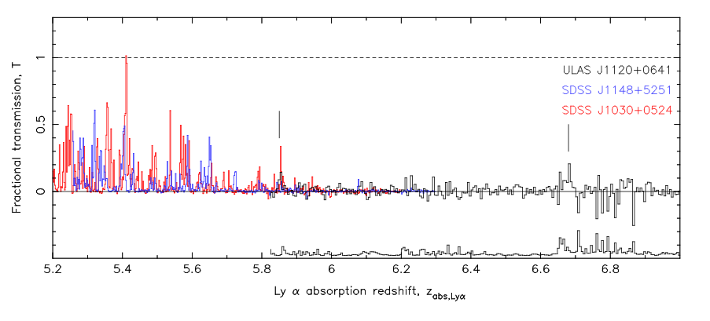
Breaking news: highest redshift quasar, z=7.1
Clear GP absorption trough: τ > 5 => IGM opaque to Lya
How to form 10⁹ M_{o} black hole in 750Myr?
Mortlock ea.
z=6.2, 6.4

Slide 21
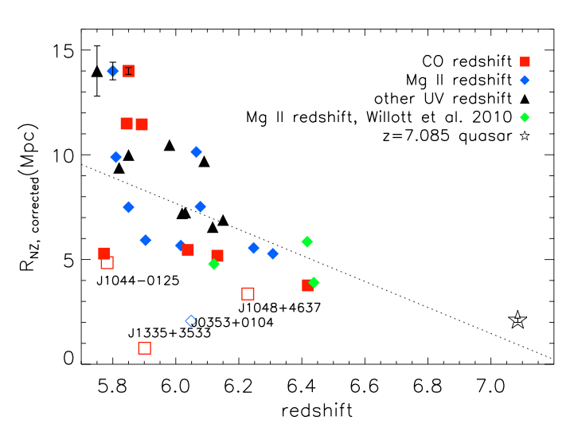
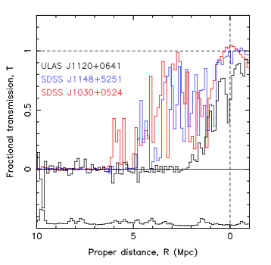
z=7.1 quasar near zone
Small ~ 2Mpc
Continues trend for decreasing NZ size

Slide 22
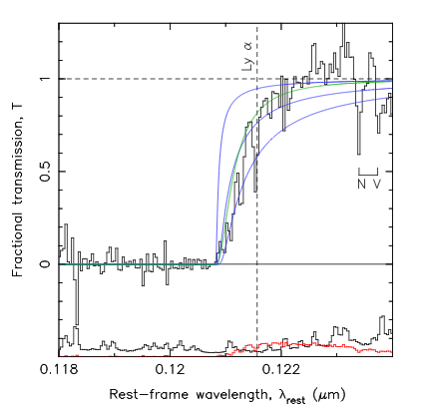
z=7.1 quasar: Damped Lya profile
N(HI) > 10^{20.5} cm⁻²
Substantially neutral IGM: f(HI) > 0.1 at 2Mpc distance or
Damped Lya galaxy at 2.6Mpc (probability ~ 5%) (Bolton ea.)
0.5
f(HI)=0.1
1.0
N(HI)=4e20 cm⁻² at 2.6Mpc

Slide 23
Gunn-Peterson effect
6.4
SDSS z~6 quasars => pushing into reionization?
z=6.4
5.7
Fan et al 2006

Slide 24
Q-DLA
Local ionization?
QNZ
DLA = Best evidence to date for very rapid rise in neutral fraction from z=6 to 7
ESO

Slide 25
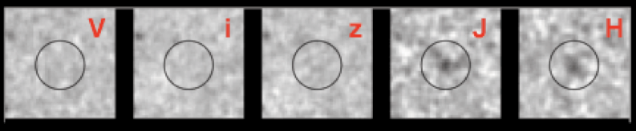
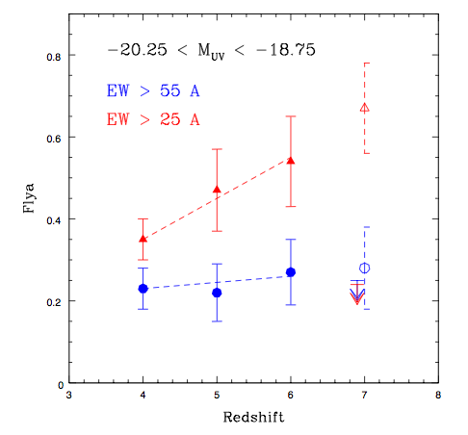
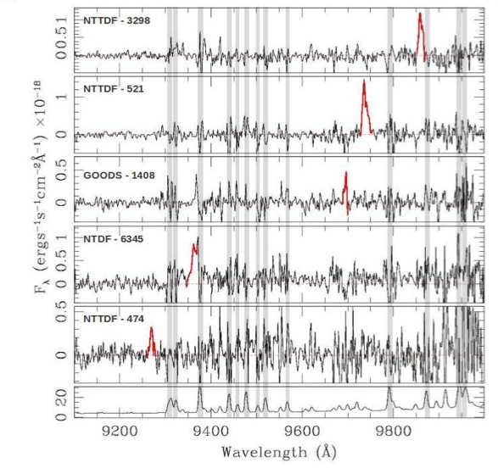
LBG galaxies at z=7: Lya spectroscopy
Observed increase in fraction of Lya detections of LBG with z

Slide 26
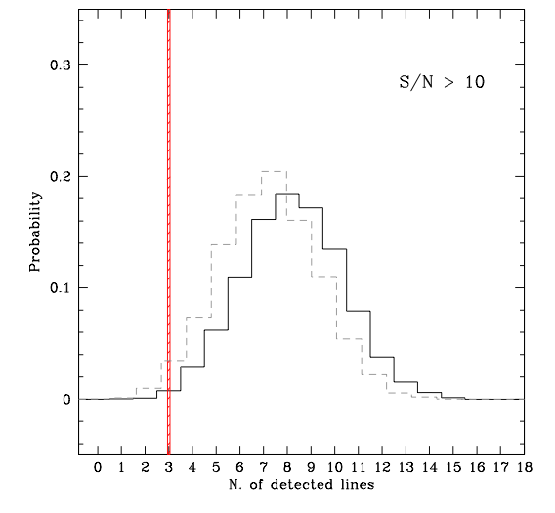
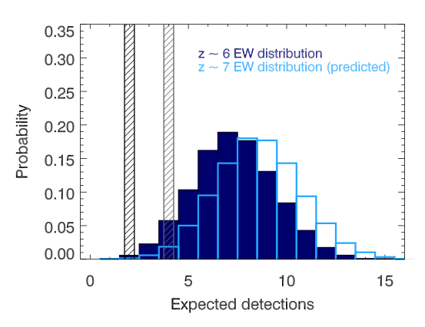
Schenker ea
LBG at z=7: fewer detected in Lya than expected
Expect 9, detect 3 (two independent samples) =>
Attenuation of Lya emission by wings of DLA due to neutral IGM or
Change in galaxy properties from z=6 to 7
More interlopers than they thought
Pentericci ea

Slide 27
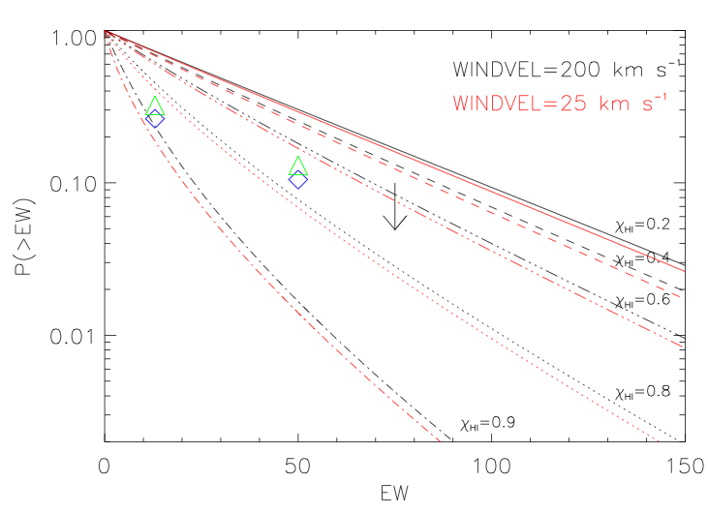
Pentericci ea: if drop-off in detections is due to DLA of IGM, modeling => f(HI) > 0.4 at z=7

Slide 28
LBG-DLA
Q-DLA
Local ionization?
Q-NZ
Cosmic phase transition! Numerous lines of evidence support a very rapid rise in neutral fraction at z ~ 6 to 7

Slide 29
Constraint I: CMB large scale polarization
Rules-out high ionization fraction at z > 15
Allows for small (≤ 0.2) ionization to high z
Most action occurs at z ~ 7 to 15
Challenge: systematics extracting large scale signal
Dunkley et al. 2008

Slide 30
END
ESO

Slide 31

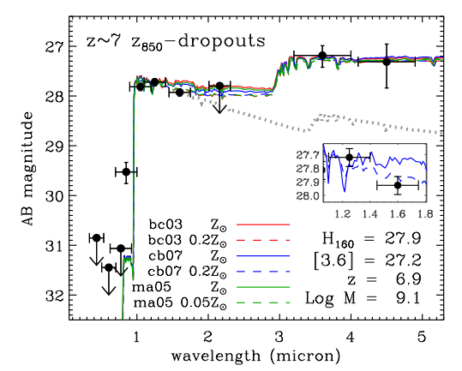
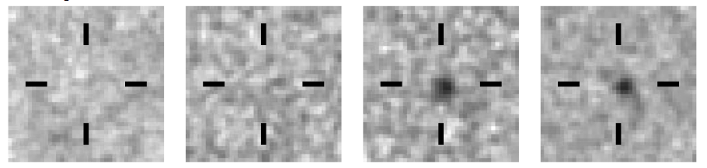
Sources responsible for reionization
Galaxies at z>7
<1um
>1um
HST/WFC3 Bouwens et al. 2010
Note: quasars (SMBH) are insufficient to cause reionization

Slide 32
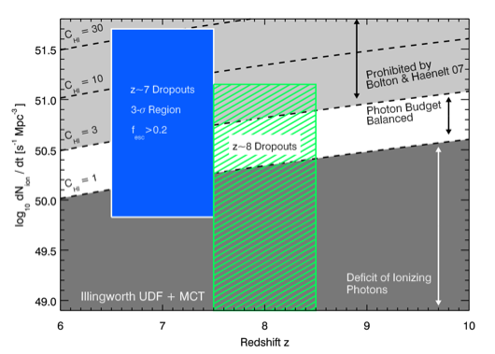
Reionization by normal galaxies
Roberston + Ellis 2010
z ~ 7 requires f_{esc} > 0.2 and C < 30
z ~ 8 requires f_{esc} > 0.2 and C < 10

