Slide 1
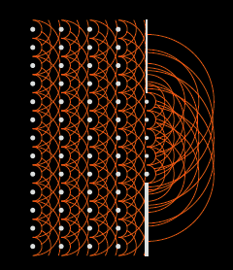
Closure Phase in the Image Plane
Shape-Orientation-Size Conservation
Image Plane Self Calibration
Chris Carilli, Nithya Thyagarajan, Bojan Nikolic
'A geometric view of closure phase in interferometry’, NT, CC 2022, PASA, 39, 14 [Shape-Orientation-Size Conservation]
’Image Plane Self-Calibration,’ CC, BN, NT 2022, JOSA-A, 39, 2214
Copyright © 2020 AUI/NRAO. All Rights Reserved.

Slide 2
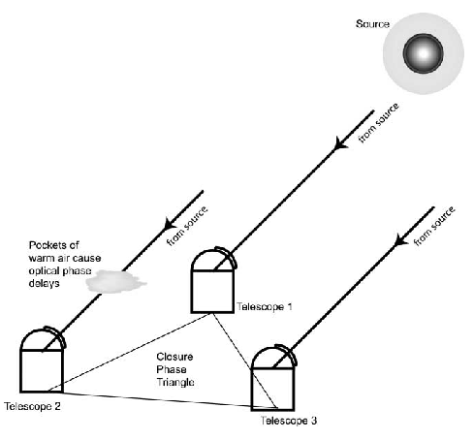





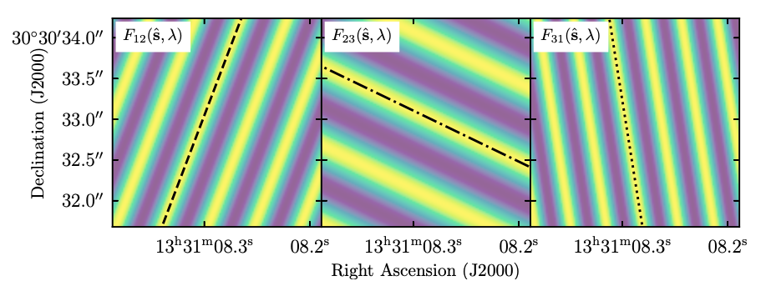
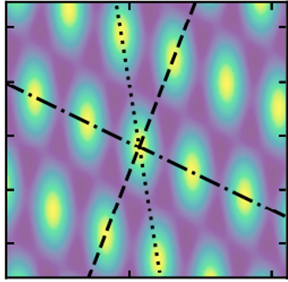
van Cittert-Zernicke Theorem: Three Element interferometer
Aperture plane
Aperture plane calibration: adopt model for V^{s}, equate to V^{m} w. least squares optimization for G_{i}; iterate
u_{i,j} = (B_{i,j} / 𝜆)
𝜹s₃₁
𝜙_{i,j} = 2𝜋 u_{i,j} 𝛿s_{i,j} =
2𝜋 [𝛿s_{i,j} / Fringe Spacing]
𝜹s
Image plane
+

Slide 3
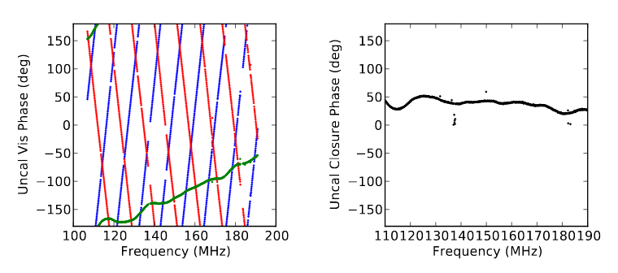
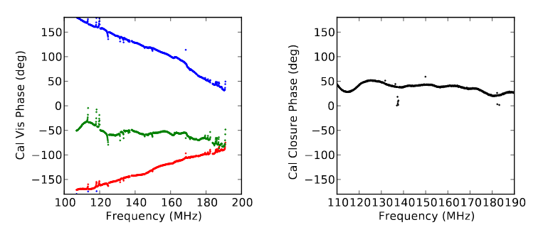


What to do when 𝛳_{i} are difficult to determine or unstable? Closure Phase
Triple Product or Bispectrum on closed triad
Galactic Center: uncalibrated
Vis 𝜱
Closure 𝜱
Galactic Center: calibrated
Closure phase is a function of the true sky-brightness distribution, independent of antenna-based phase errors and calibration
HERA at 150 MHz; Carilli et al. Radio Science, 2017

Slide 4
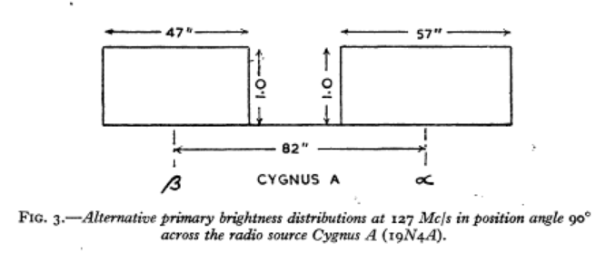
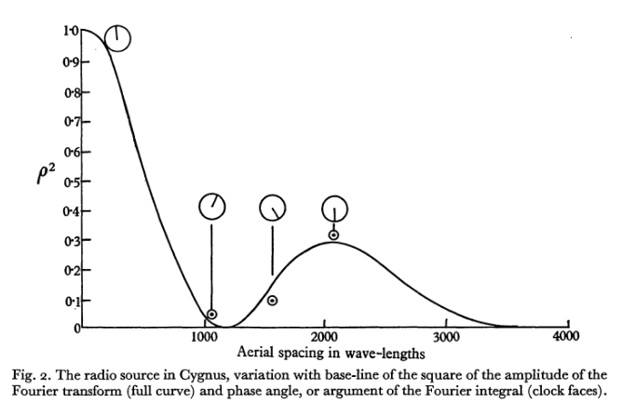
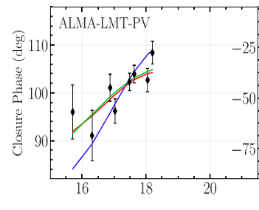
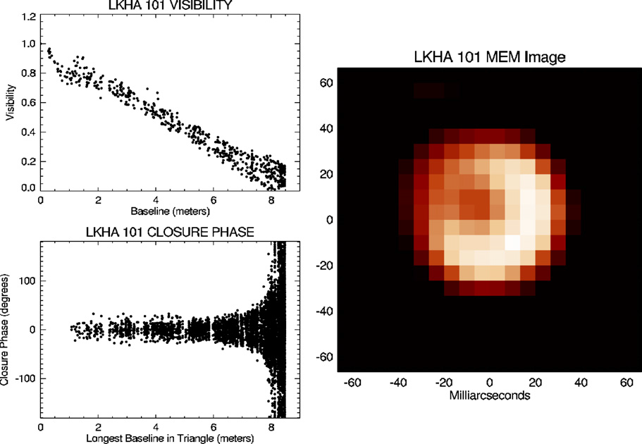
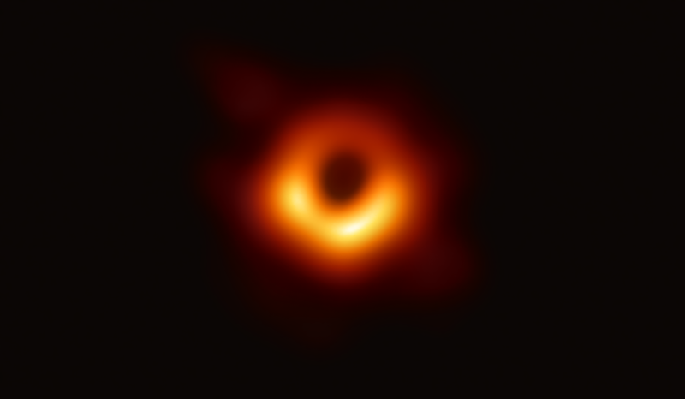
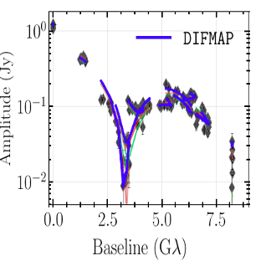
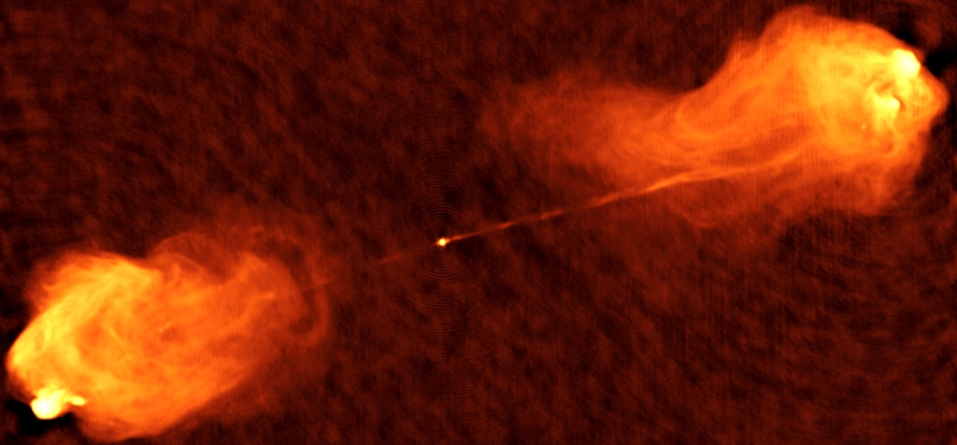
Closure Phase: Long established usage in astronomical interferometric imaging in phase-unstable conditions
  Conserved quantity in antenna-based gain calibration
  Phase-related sky-quantity for forward-modeling approaches w. Vis amplitudes
137 MHz Imaging of Cygnus A
Jennison 1956
Optical Interferometry
Dust shells around stars
Monnier+ 2007
240 GHz VLBI
EHT image of M87 SMBH; EHT+ 2019; Cheal + 2018
40uas

Slide 5
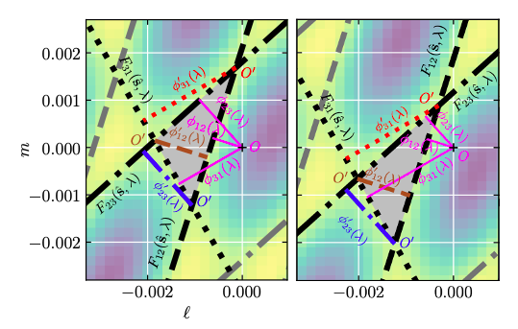

Closure phase in the Image Plane
Shape-Orientation-Size Conservation
A_{A3}
Fringe images on closed triad define ‘principle triangle’
Corrupt phase on one antenna by 80º = 𝜹𝜙₃
Baselines lengths and orientations unchanged: fixed fringe spacing and orientation
𝜹𝜙₃ affects 𝜙₂₃ and 𝜙₃₁ phases equally and oppositely => Constrained displacements of fringes along fringe₁₂
Shape, orientation, and size (SOS) of principle triangle is preserved: only translation allowed
Closure phase ∝ area of principle triangle
Model
Model + phase error
𝜹𝜙₃
A_{I3}
Not true for non-closing fringe triad
Not true for baseline-based (single fringe) error
𝜹𝜙₃

Slide 6
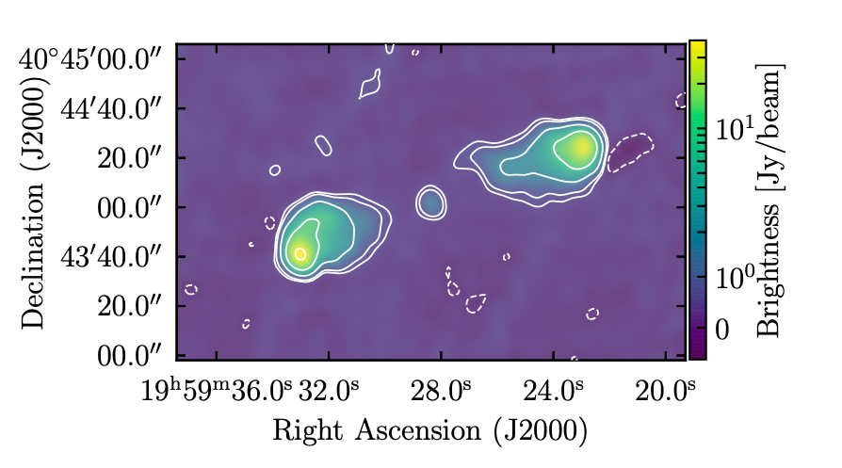
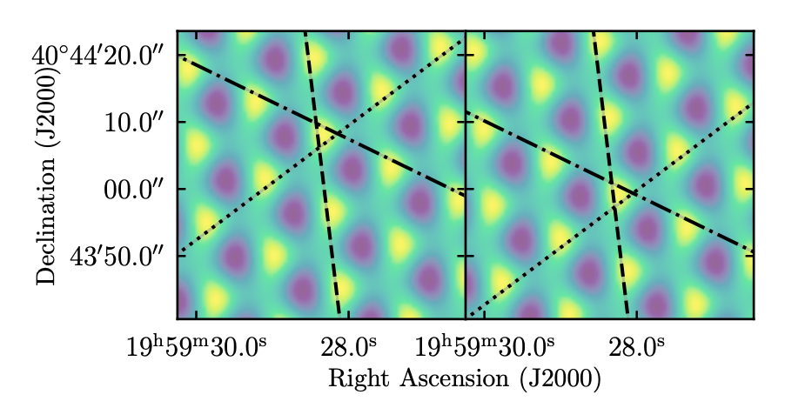
Shape-Orientation-Size Conservation: VLA Data
3C286 9 GHz
98% point source => 𝝍_{cl} ∼ 2.0º
1”
Cygnus A 8GHz
Complex source => 𝝍_{cl} = 113º
calibrated
80º antenna-phase error
Shift along uncorrupted fringe

Slide 7
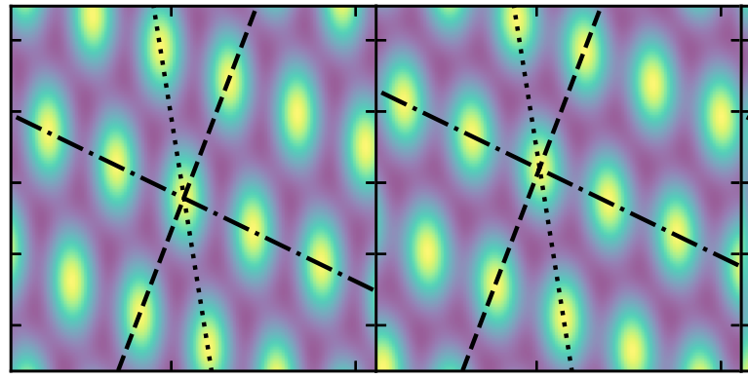
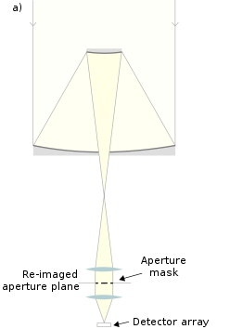
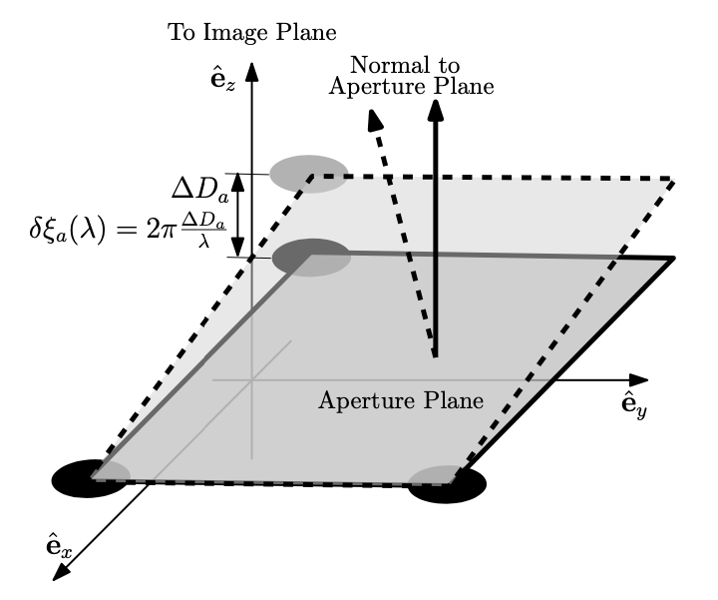
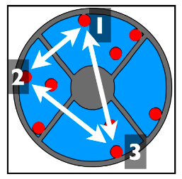
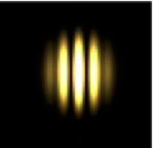
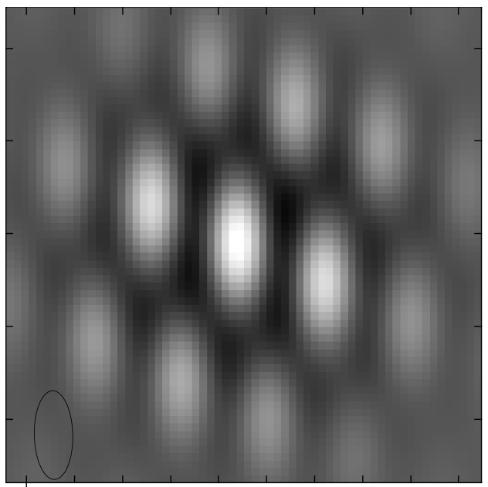
SOS and Aperture Masking
Three points define a plane
‘piston delay’
Delay corruption of one element => change optical path-length to focus
Leads to ‘tilt’ of triad in aperture plane => shift of image plane: for 3 elements, no other corruption/decoherence is possible
Image plane basis for closure phase, eg. closure phase is shift invariant
If phase errors are element-based => all images made with 3 element interferometer are true images of the sky, modulo unknown shifts
2 apertures
3 apertures
Copyright © 2020 AUI/NRAO. All Rights Reserved.

Slide 8
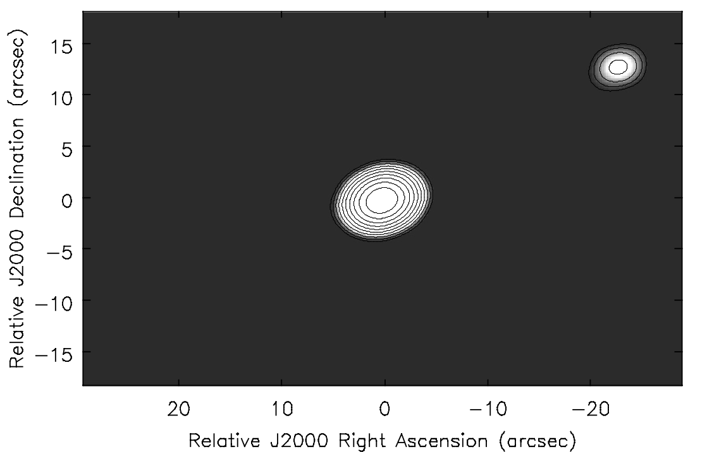
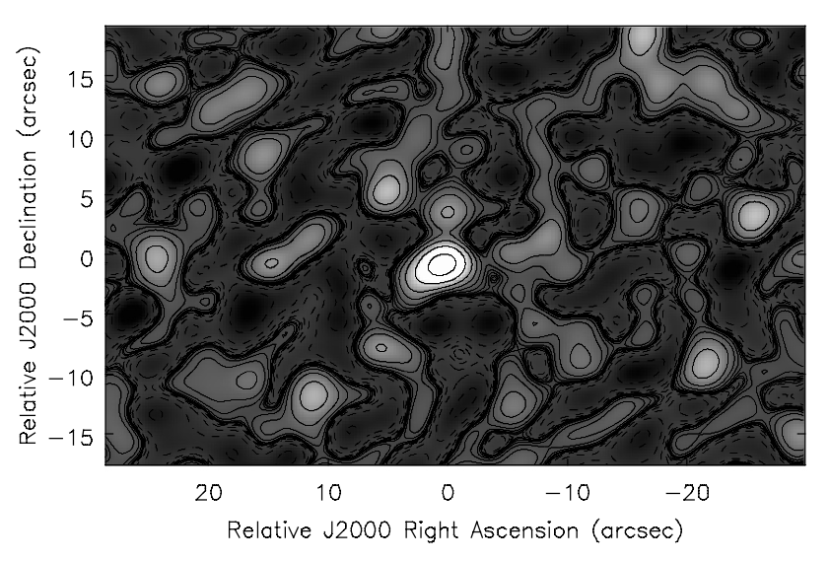
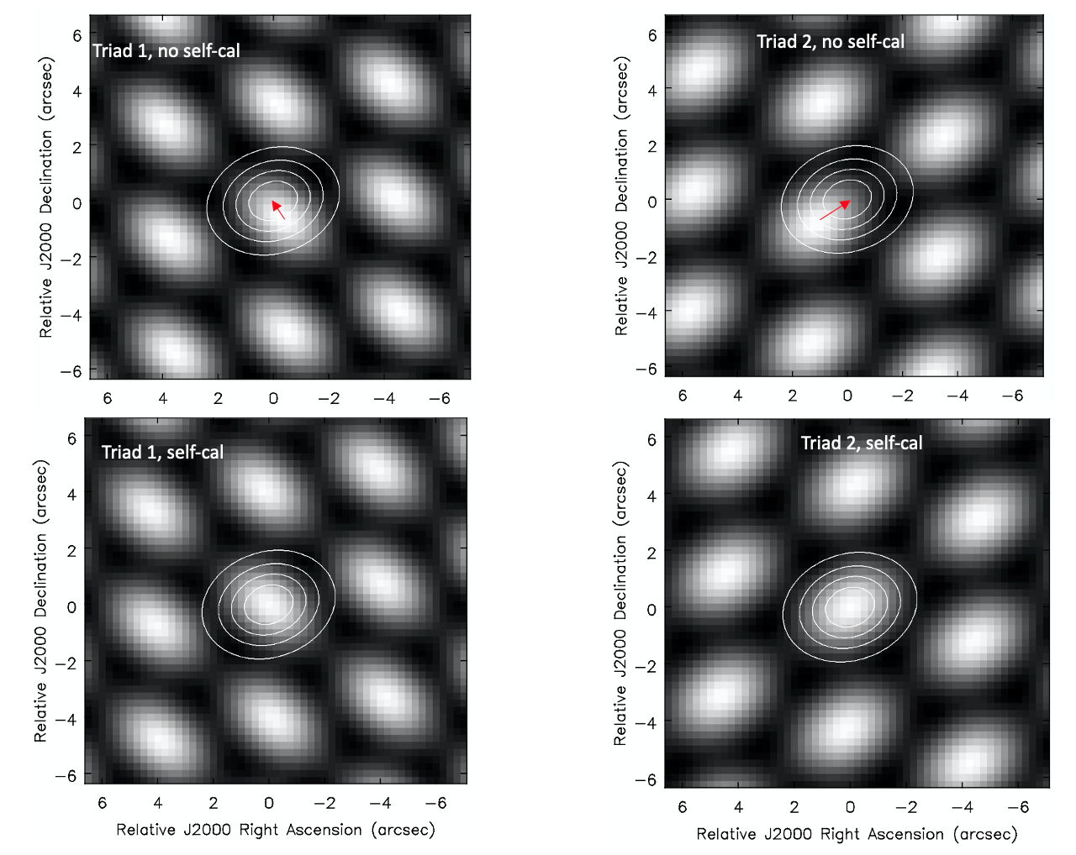
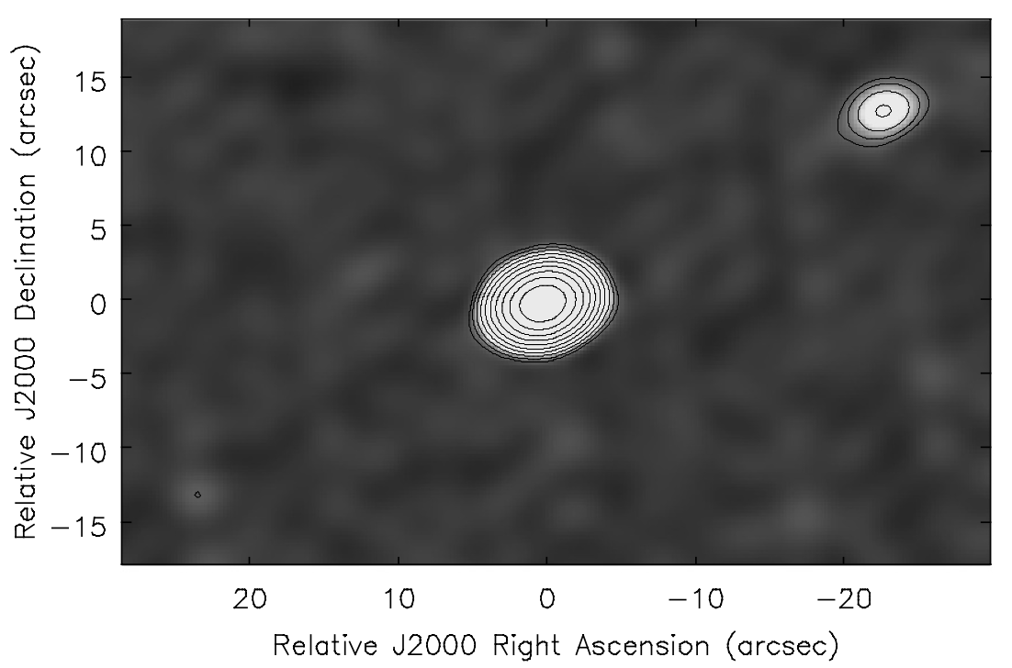
SOS Conservation => Image Plane Self-Calibration
Model: star/planet = 100/1
Model: Bright point plus faint companion (100/1) w. 14 element array
Generate 3-element images (364) = true images, but antenna-based delay errors => unknown relative shifts
Cross correlate each triad image with model image to derive shifts
Sum shifted images => coherent image of source with full array; iterate
80º errors, no self-calibration
80º phase errors
+
=
+
Triads 3, 4, … N_{triads}
80º errors plus self-calibration
+
=
Triads 3, 4, … N_{triads}
After IPSC shifts
+

Slide 9
Tests: 100/1 model, 10º phase errors, 14 elements (364 triads)
Aperture plane self-cal w. point-source model
Planet = 9.9 mJy
Rms = 0.09 mJy
Ghost = 0.20 mJy
Image plane self-cal w. point-source model
Planet = 6.3 mJy
Rms = 0.25 mJy
Ghost = 2.6 mJy
Image plane self-cal w. iteration
Planet = 9.0 mJy
Rms = 0.20 mJy
Ghost = 0.6 mJy
Other Tests
Brighter and fainter planet (10/1 and 1000/1)
Larger phase errors (80º)

Slide 10
Image Plane Self-Calibration: an application of SOS conservation
Image Plane SC converges, but Aperture Plane SC converges faster+better (for large N)
  Lower rms
  Weaker ghost
Ghost source: natural consequence of symmetrization in marginally constrained self-cal (Cornwell & Fomalont 1999; Linfield 1986)
Over-constraints = N_{vis}/(N_{ant} - 1) = (N_{ant}(N_{ant} - 1)/2) / (N_{ant} - 1) = N_{ant} / 2
  APSC (14 ant) = 7
  IPSC (triad-based = 3 ant) = 3/2
  Note: above true for Johnson (receiver) noise, but in optical interferometry, noise is NOT antenna based, but photon-counting and CCD read noise, back-ground…

Slide 11
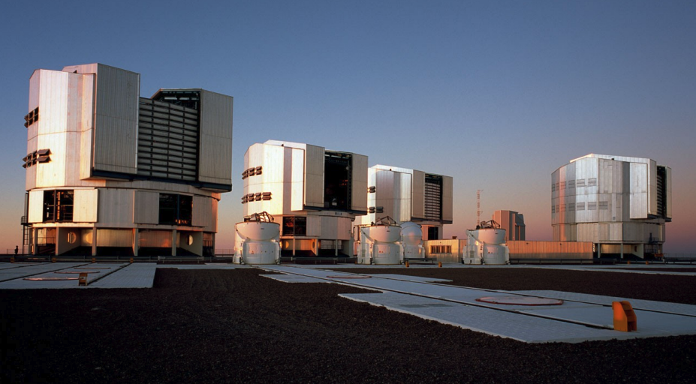
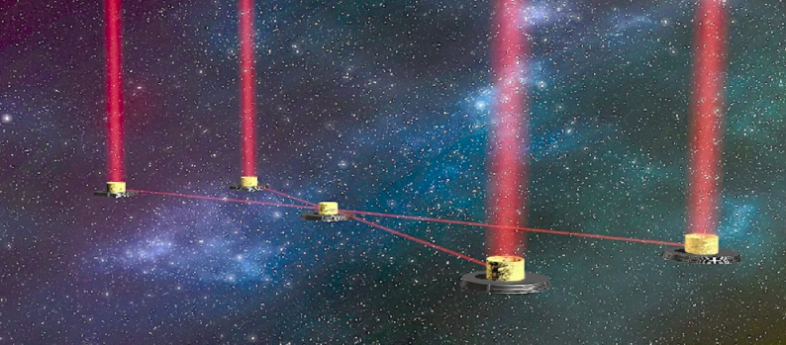
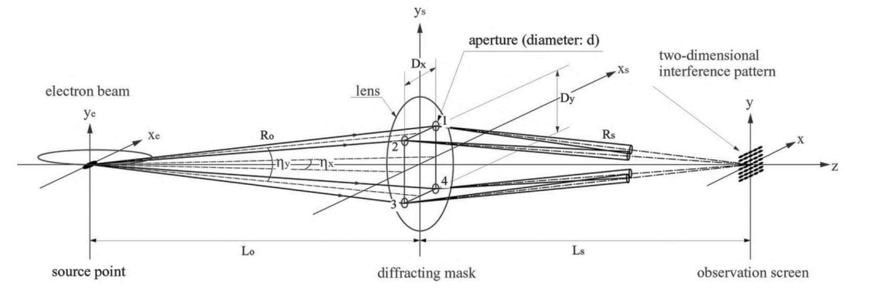
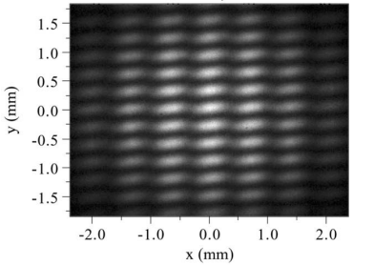
When might SOS and/or IPSC be useful?
Basic measurements in image plane
Small N
Amplitude and baseline-based errors small
All typical in optical laboratory and astronomical interferometric imaging
Examples: small N arrays w. image plane detection
VLTI: 4x8.2m + 4 x 1.8m (only 4 at time)
LIFE: space near-IR 4 x 3m elements
Synchrotron light source e– beam shape characterization
Inertial fusion reactor laser profiling/focus
Ultrasonic imaging, Seismology, X-ray crystallography…?
VLTI
Large Interferometer for Exoplanets
Spring-8 synchrotron light source; Masaki & Takano

