Slide 1
SKA Key Science: A Progressive Retrospective
Chris Carilli M/NRAO June 2014
KSP 2004: criteria, spin offs, mapping to current SWG
Score card: SKA Phase I
  Progress over a decade
  Role SKA phase I
Editorialize
Caveats:
  Subjective review of SWG reports, WP, Talks
  Phase I was never meant to do all KSP, but only some very well

Slide 2
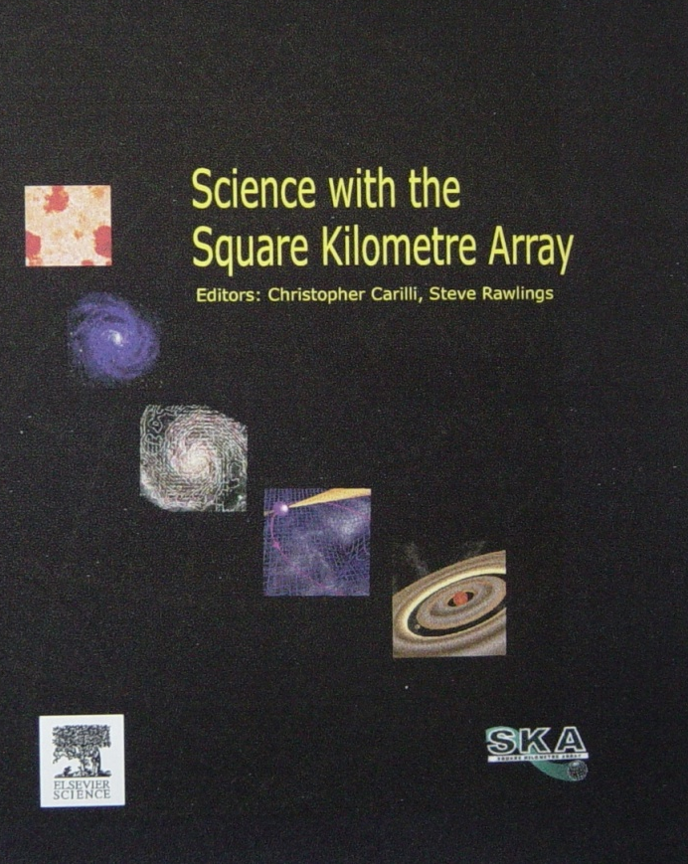
2004 KSP: spirit and spin-offs
Key science project criteria
Address important questions in fundamental astrophysics
Unique to SKA/radio (can’t be done any other way), or SKA plays crucial complementary role
Excites broader communities and funding agencies
Path-finders were big part of original goal (to me): in itself, a major victory! Midst of revolution – SKA ultimate expression
Low: Reionization – LOFAR, MWA, PAPER
Mid: Pulsar timing arrays – NANOgrav, EPTA, IPTA
Mid: Survey instruments – ASKAP, MeerKAT, Apertif
High: Jansky Very Large Array

Slide 3
Mapping: 2004 to 2014
KSP 2004
SWG 2014
Cradle of life
Strong fields test of gravity using pulsars
Origin, Evol. Cosmic Magnetism
Galaxy evolution, Cosmology, Dark Energy
Probing Dark Ages
Cradle of Life
Pulsars
Cosmic Magnetism
Continuum surveys
HI science
Cosmology
Cosmic Dawn/Reionization
Time Domain

Slide 4
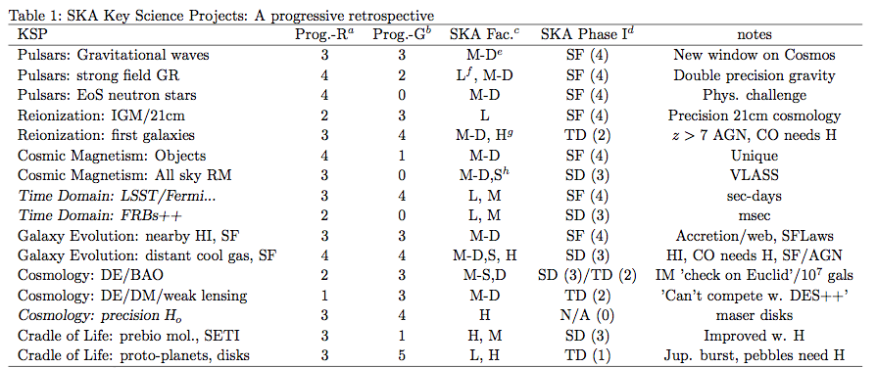
KSP/Phase I score card
Mid-Dish: 0.35 – 3 GHz (maybe 14GHz?)
Mid-Survey: 0.35 – 1.7 GHz
High: 10 to 40 GHz
Low: 50 to 350MHz
SF = Science Facility. Major progress
SD = Science Demonstrator. Some progress in KSP, inform phase II
TD = Technical Demonstrator. Minor progress in KSP, inform phase II
N/A = No progress in KSP w. phase I

Slide 5
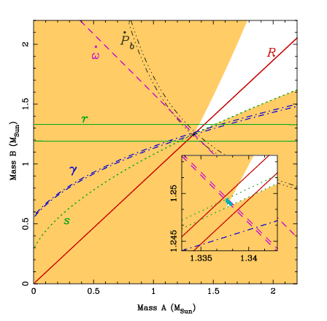
Pulsar timing: Double precision gravity and neutron star EoS
Strong field gravity: GR validity to better than 0.01%
Triple MSP system will provide best test ever of the Strong Equivalence Principle, 20-100 x Lunar laser ranging
Physics challenge – neutron star EoS: 2.01(4) M_{o} pulsar, 0.172(3) M_{o} white dwarf

Slide 6
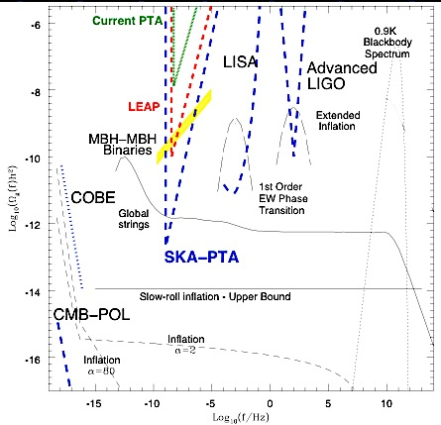
Gravitational waves: new window on the Cosmos
GW: expect first detection by IPTA
SKA Phase I
  GW physics: sources and characterization, inflation?
  BH – pulsar binary
  Galactic Center Pulsar?
  Extragalactic pulsars?
Expect three Nobel prizes
Mid-Core collecting area: do it!

Slide 7
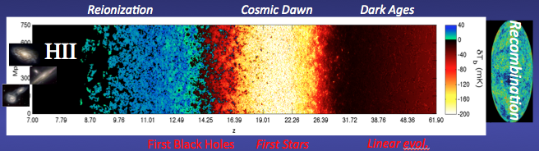
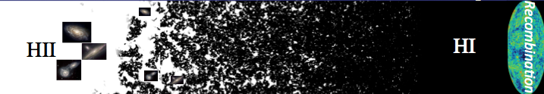
Reionization: Precision 21cm cosmology, into the Dark Ages
Tremendous efforts by talented early career theorists
Onus on path-finders to make detection!
Like CMB: design + obs + analysis + theory are coupled (Bayes)

Slide 8
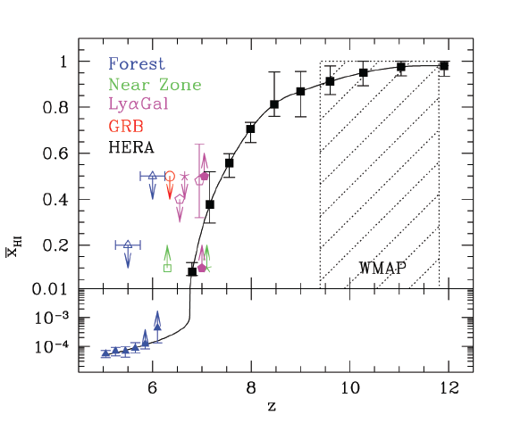
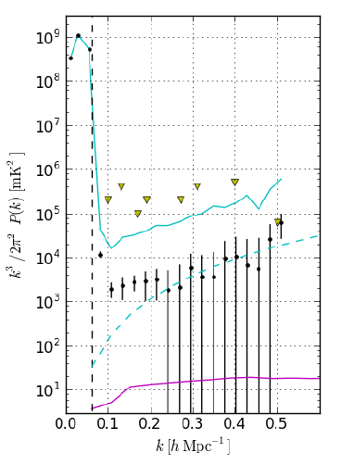
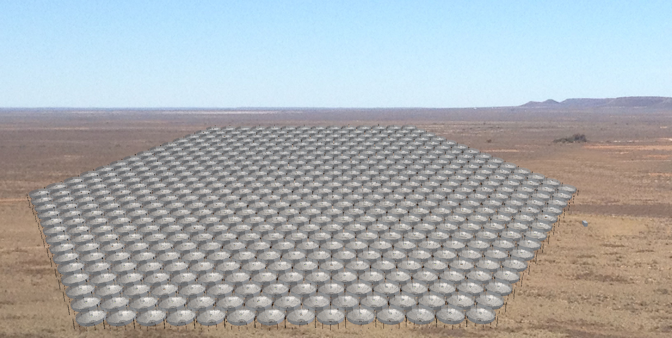
Reionization: Precision 21cm cosmology, into the Dark Ages
Optical limits: F_{HI}(z~8) ~ 0.5 (large scatter)
Current 21cm limits rule out pathological models
Detection in 2 years (LOFAR/PAPER/MWA)?
HERA will characterize F(HI) vs. z by 2019
Cosmic phase transition?
Parsons ea.
No warming
HERA 331 x 14m
Fiducial
PAPER 128

Slide 9
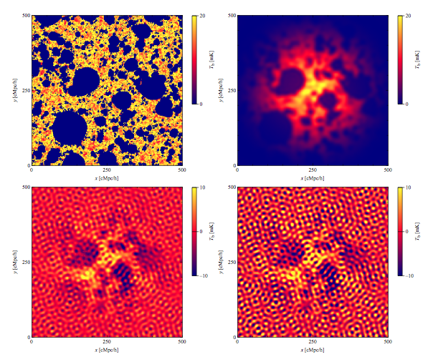
Reionization: Precision 21cm cosmology, into the Dark Ages
SKA Phase I
Image ‘average’ (arcmin) structures during reionization – highly non-Gaussian
Cross correlations (CMBpol, CO/CII IM…)
Push into ‘dark ages’ => real (linear) 21cm cosmology
Expect one Nobel prize

Slide 10
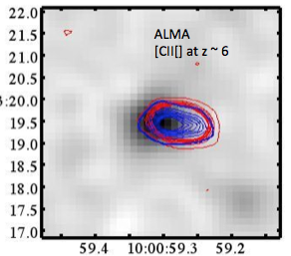
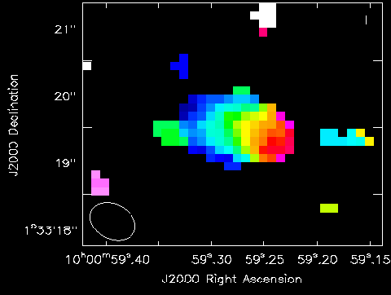
Reionization: first galaxies
Great progress in opt/nearIR/mm: Hundreds of z>8 candidates, but redshifts?
[CII] w. ALMA: revolutionary – z, dynamics, eg. 10 or 10 LBGs detected z=5 to 6
SKA phase I:
  Radio AGN z>7 (21cm forest)?
  CO: needs 30GHz
-125 to +125 km/s
Capak ea

Slide 11
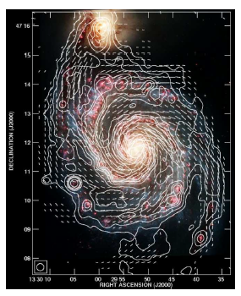
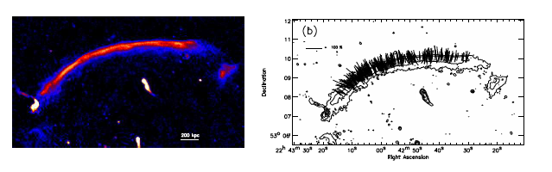
Cosmic magnetism: ‘Precision Magnetism’
Foundational radio astronomy: Phase I study of magnetized objects in Cosmos from pc to Mpc
  Milky Way, SF regions…
  Nearby galaxies
  AGN
  Clusters

Slide 12
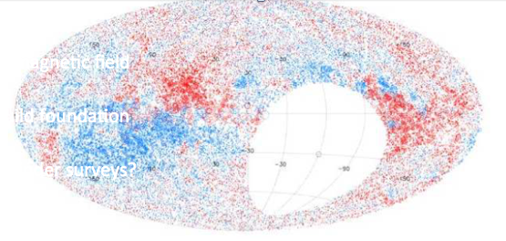
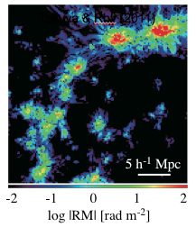
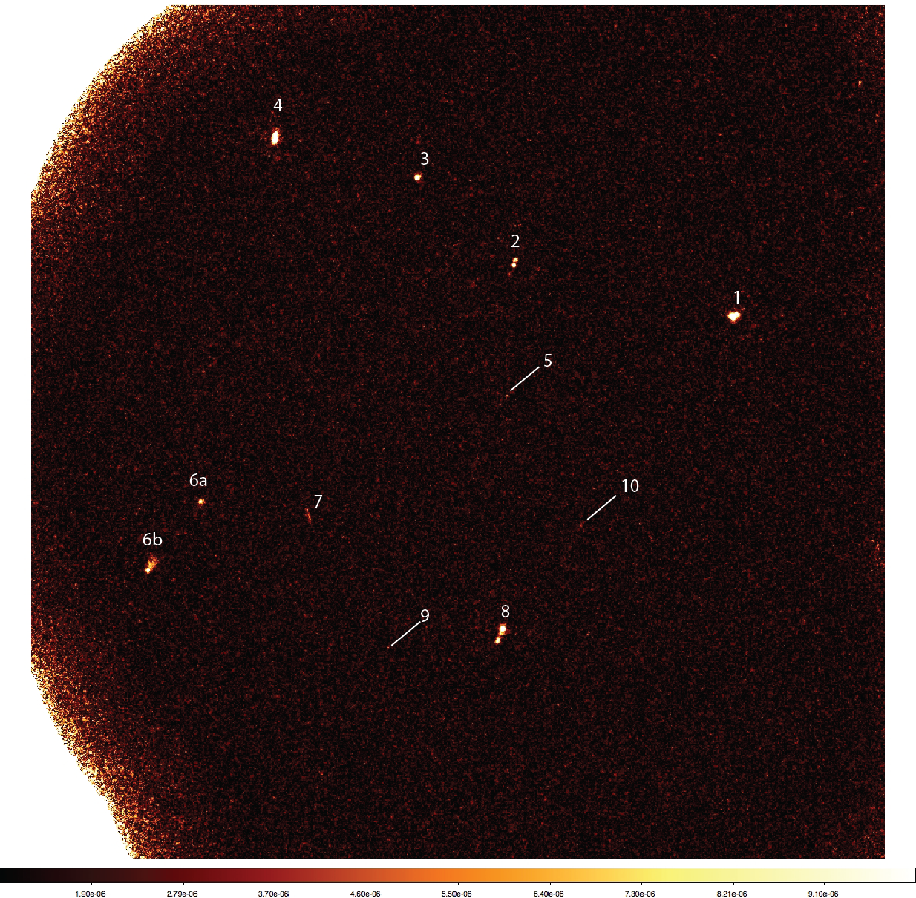
Cosmic magnetism: ‘Precision Magnetism’
All sky RM survey
Intergalactic magnetic field
  High redshift
  Cosmic web
‘crucial to build foundation for phase II’
VLA, GMRT: path-finder surveys
JVLA 5GHz
1uJy rms

Slide 13
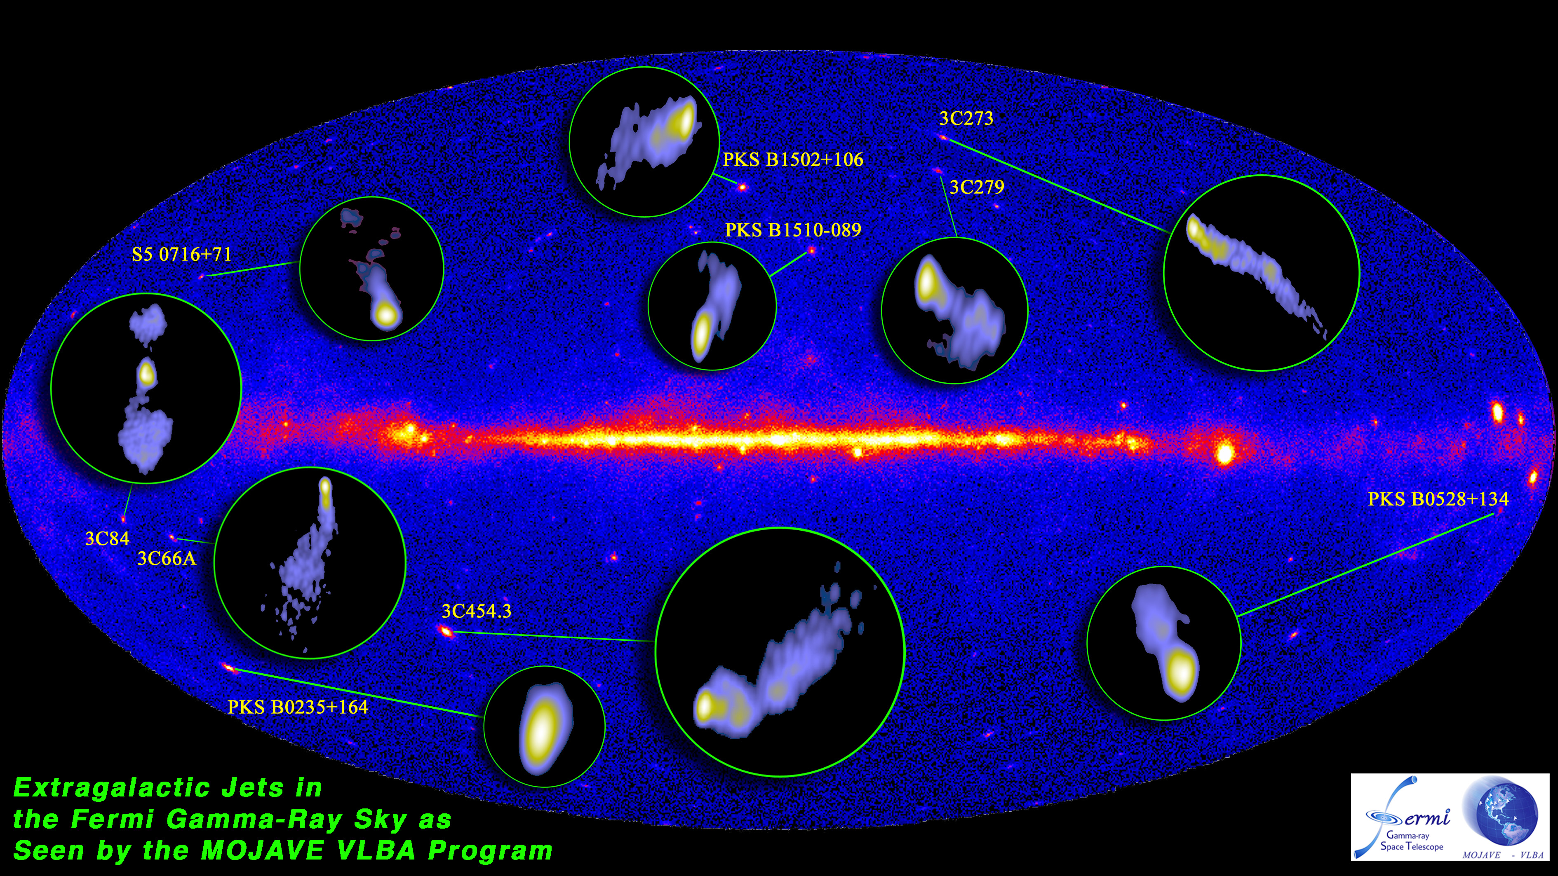
Time Domain: synoptic surveys and follow-up (sec – days)
Foundational radio astronomy
Major growth area (LSST, Fermi…): SKA I/radio synergy critical
Radio properties: Unique VLBI role in high energy source physics

Slide 14
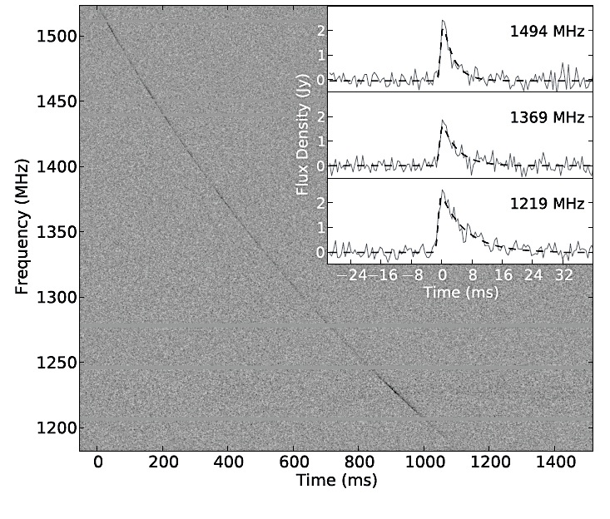
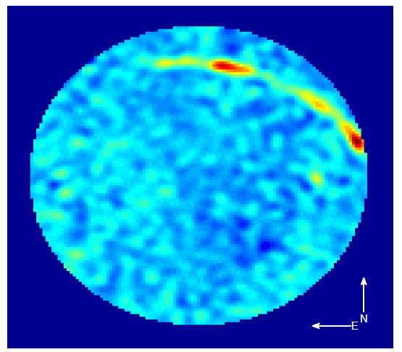
Time Domain: the bursty sky (msec – sec)
FRBs: Possible game changer? (Nobel?)
  Missing baryons? DE EoS?
  Extragalactic? Need identification!
New phenomena: low freq (kJy) cyclotron emission from meteor fireballs! Tracking space debris?
Commensal + transient buffers: do it (with ESA funding)!
LWA 30MHz
Odenberger ea

Slide 15
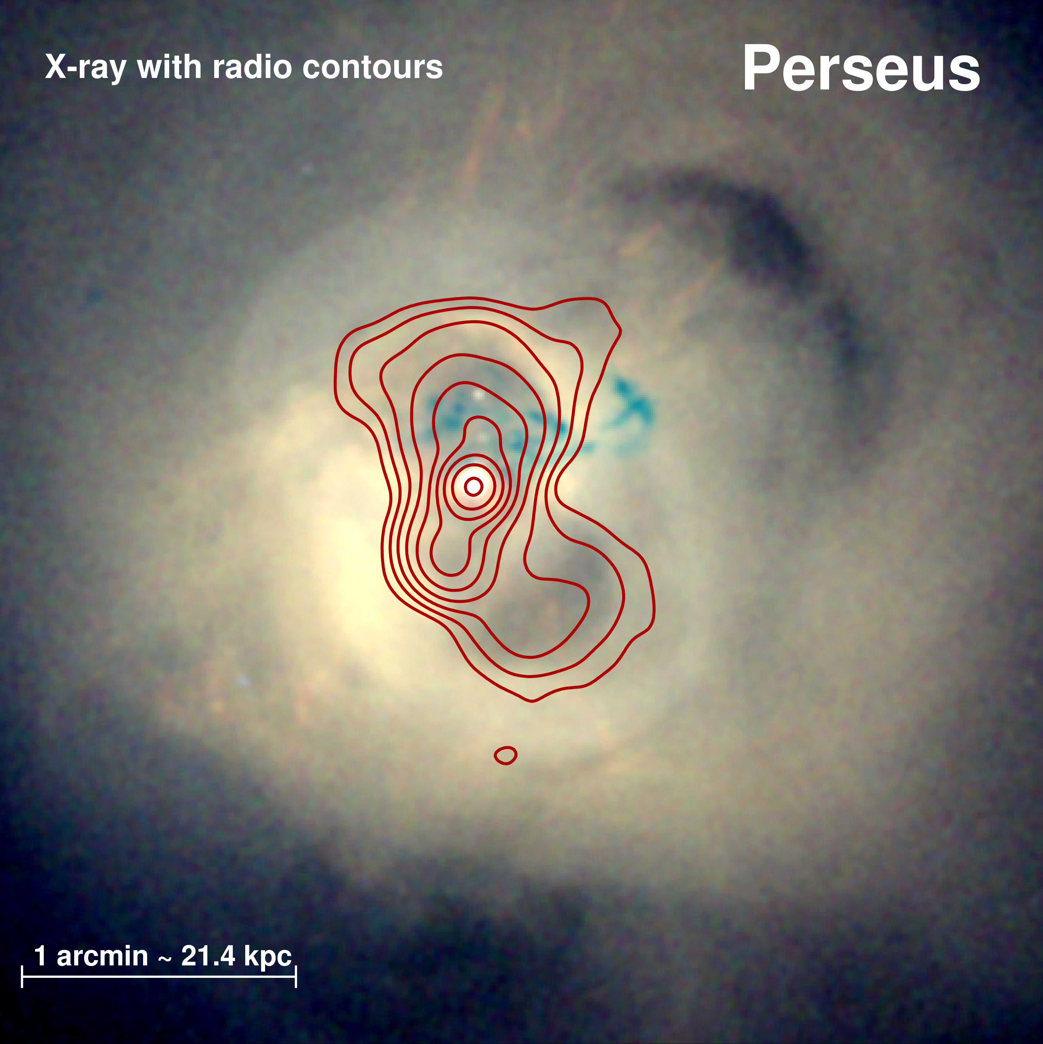
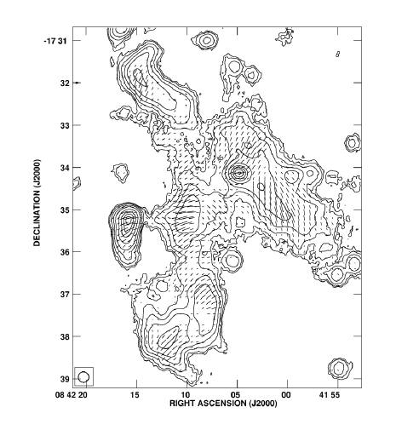
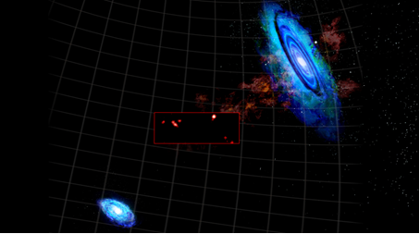
Galaxy evolution, nearby: accretion, star formation
Phase I: Foundational radio astronomy
  ISM, SF Laws, SNe, SNR…
  Baryon cycle: IGM accretion, outflows, tails…
  Non-HI line physics
  AGN, jets: radio mode feedback
3 Mpc
Wolfe ea 2013
‘Cosmic Web’
log(MHI): 4.6-5.6 M⊙ size: <3 - 6.4 kpc

Slide 16
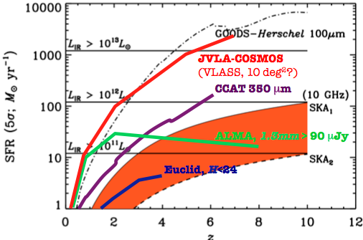
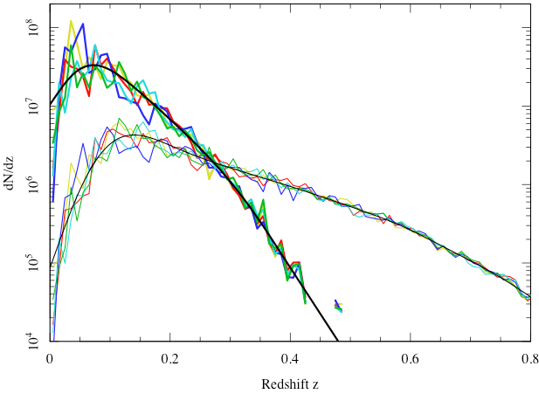
Galaxy evolution: HI and continuum deep fields
SKA Phase I
Continuum deep fields
  SFHU: Free-Free (most direct measure SFR, but be careful!)
  AGN w/o dust bias
HI deep fields
  mass function z ~ 1 vs. SFHU
  T-F, DM, absorp, LSS…
JVLA, WSRT, GMRT path-finders
HI wide
10⁷
HI deep
z=0.7

Slide 17
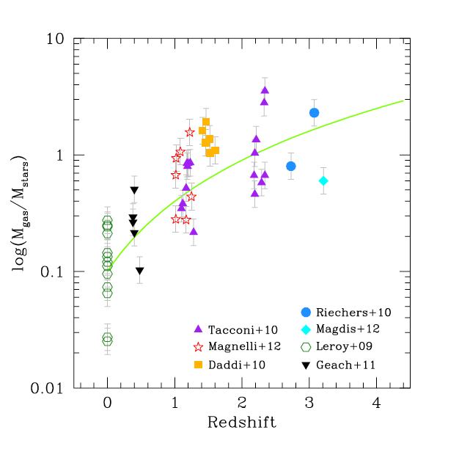
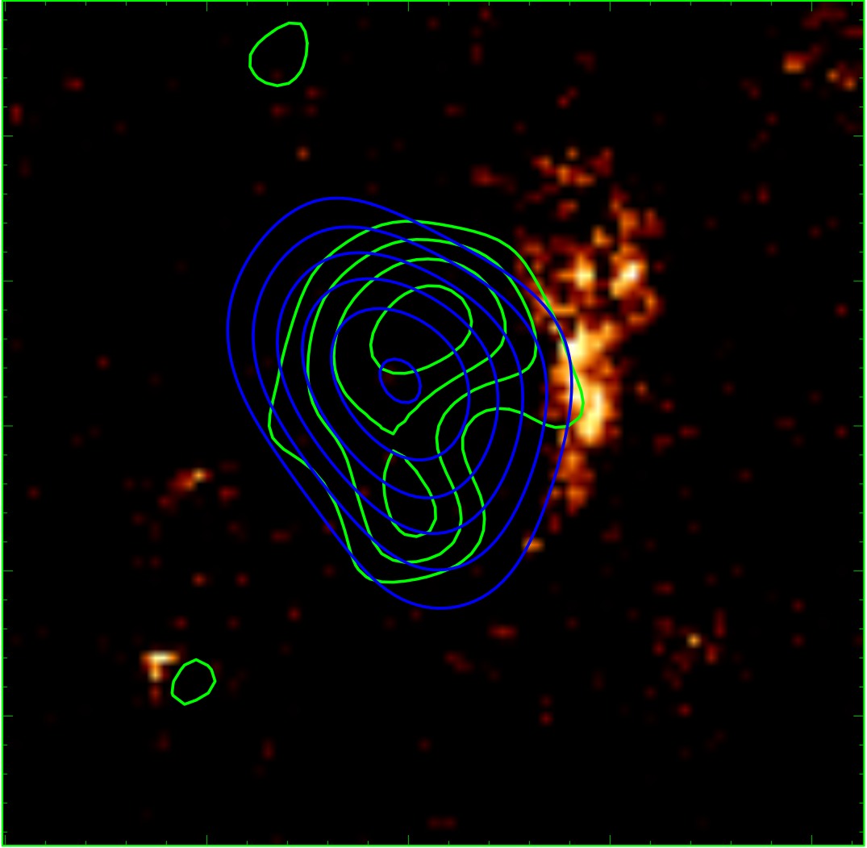
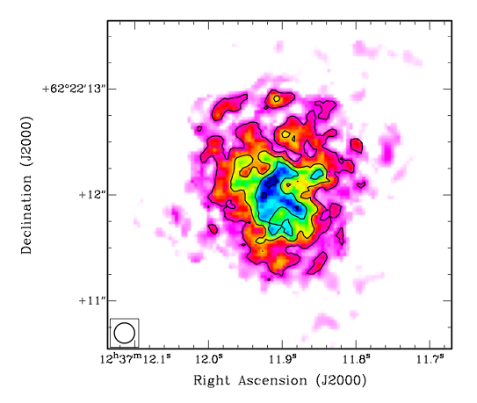
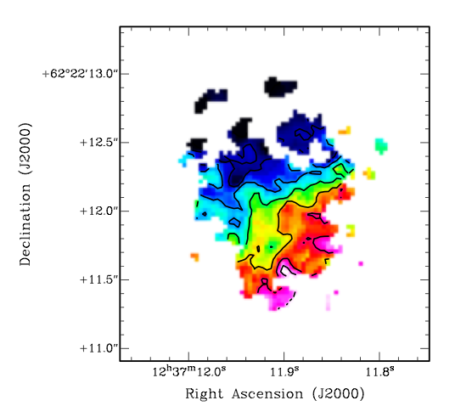
Galaxy evolution: gaseous history of Universe – molecules
Huge advances ALMA/JVLA/Bure…:
  Hundreds detections z>1
  imaging, excitation, chemistry
Goal: ‘Dense gas history of Univ.’ (H₂): fueling the SFHU (cf. Seymour)
Galaxies: gas-dominated at high z!
SKA Phase I: needs 30GHz for molecules
M_{g}/M*
1
0.1
z=3
GN20 z=4.05 VLA CO 2-1
CO 2-1 Mom0
-250 km/s
Mom1
7kpc
+
HST/CO/SUBMM
0.25”
+250 km/s
Hodge 2012

Slide 18
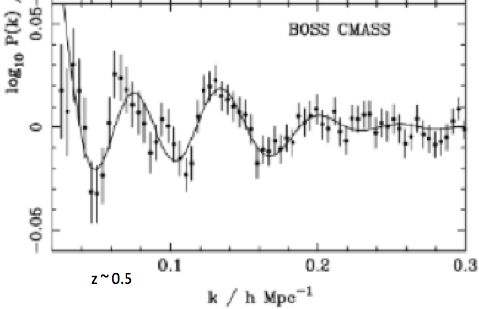
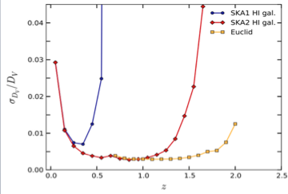
Cosmology: BAO via Intensity Mapping
Remarkably creative SWG!
Challenge: competition in opt/nearIR
BAO: SKA-I galaxy survey (10⁷ gal) – ‘pave way for Phase II 10⁹ gal. Not competitive with Euclid, Boss.’
SKA-I HI IM = ‘Beat’s Boss’!? Q: total power stability/interfer. calibration?
SKA-I gal. surv.: redshift space distortions – unique z range
z ~ 0.5
Bull, Abdalla ea

Slide 19
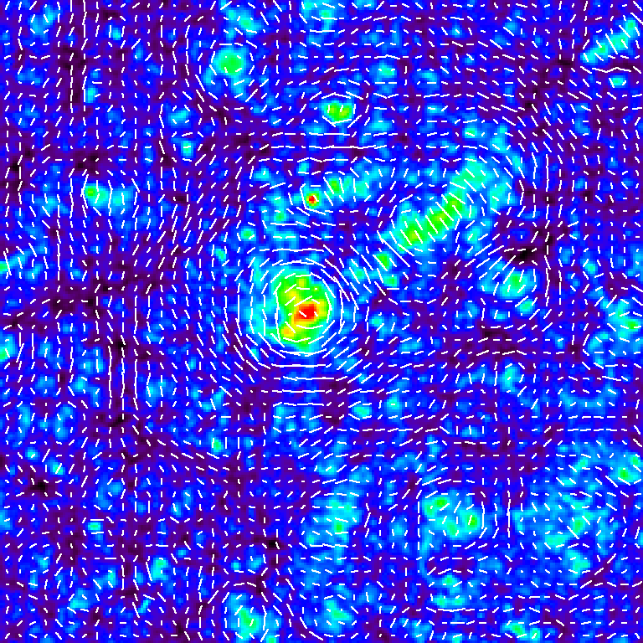
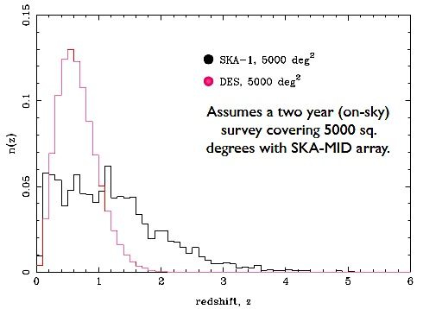
Cosmology: continuum deep field cosmology
Continuum survey cosmology
  Weak lensing
    Challenge: opt/nearIR competition via. DES++
    Systematics dominate: Xcorr radio/optical is key
    Polarization?
  ISW: cross correl w. CMB
  Non-Gaussianity: very LSS
‘complementary’ ‘check’ ‘calibration’: clarify key role SKA phase I. Emphasize unique aspects:
  Full Sky
  Different z, different systematics…
VLASS demo role
‘Cosmic shear’
weak lensing
z=3

Slide 20
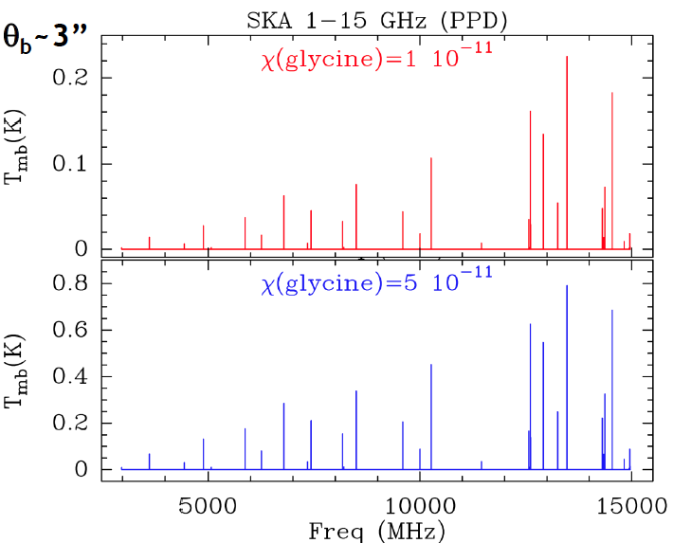
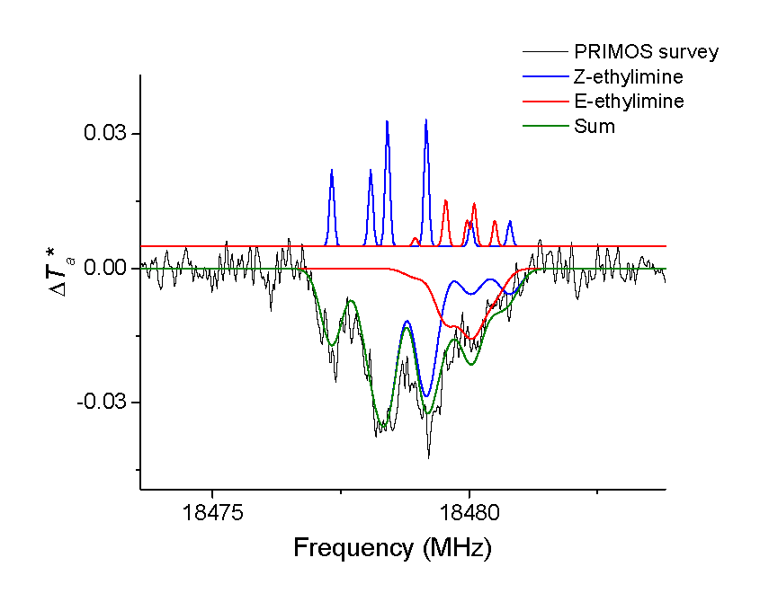
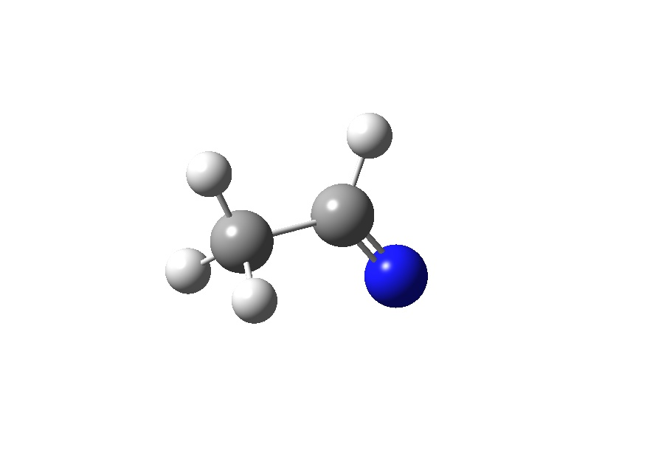

Cradle of life: search for exobiology
Glycine 3 – 15GHz
Steady progress w. GBT, ALMA, IRAM…
SKA Phase I
  Pre-biotic molecules: 14GHz big step
  SETI: Airport radar at 10pc – 10⁵ stars!
PRIMOS on GBT 18.5GHz
Ethanimine amino acid precursor
SETI

Slide 21
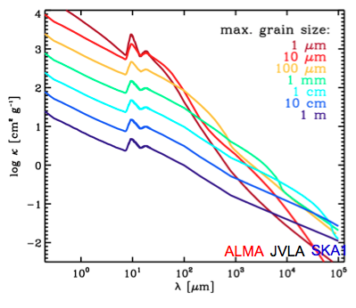
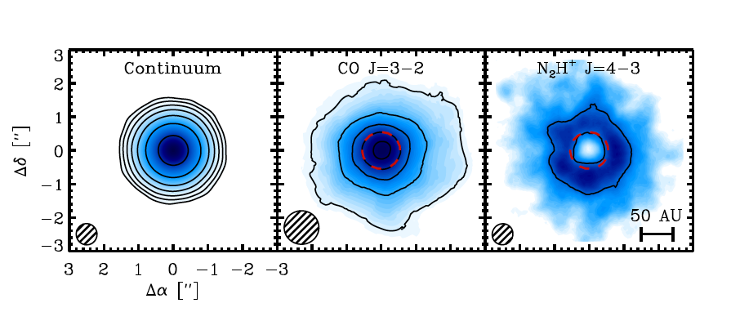
Cradle of life: planet formation
Exoplanets: biggest growth area (by far) in modern astrophysics
PP disks: Great progress w. ALMA, JVLA, Bure
SKA I: gotta make this connection (band 5)!
  Grain growth: peebles to rocks
  Planetary magnetic fields: auroral emission – key to life!
  14GHz provides critical complementarity, pulls in ALMA/JVLA community
  30GHz (band 5+) puts SKA I way out in front!
ALMA CO snow line in solar nebular analog

Slide 22
Editorial
Rebaseline:
  Configuration
    3000 km easy (even few out-riggers gives great science)
    Balance 3km – 300km: harder
  Band 5 → make thermal/planet connection!
    PP disks, exobio, high z CO, GC Pulsars, Transients, Cont. DF…
    Band 5+: why stop at 14? 30 GHz brings exponential gains
  Don’t risk killer apps
  Commensal critical: alternative spigots = alternative funding sources?
  Many 10⁴ hr surveys discussed, most with Mid-Dish?
What was missing:
  Masers disks and H_{o}
  Astrometry: Gal structure, local group motions…
  Solar system: Sun, radar, KPO, atmospheres, comets, space weather/ionosphere. High profile since exoplanet revolution
  Telemetry: what happened to movies from Mars (high)?

Slide 23
Editorial
‘You can have it all, but not all at once’: solicit parallel funding continuously, eg. ALMA development program, new partners, data spigots… => requires flexibility in initial design
PW’s ‘Unknowns’: hard sell at time. Physics torqued astronomy to experiments (DETF, Turner MPS…). Pendulum swinging back: general facilities may be back in vogue?
RB’s ‘left-field’: after 10yrs, most ideas fit nicely into SWG/KSP. Encouraging, but possibly disconcerting – where are really new ideas? I don’t complete agree:
  FRBs + cosmology, BAO via IM, Continuum cosmo., Dark ages…
  Planets (rocks, B fields…)
Exploit youthful creativity
Make full use of path-finders: revolution is already in progress!

Slide 24
SKA phase I
Can we sell a $1B observatory: Yes!
Killer apps
  Pulsars and gravity
  Imaging reionization, first light
Foundational applications for radio astronomy
  Magnetism
  Milky way and nearby galaxies: star formation, cool gas, cosmic web…
  Galaxy formation (SFHU, cool gas, DM, B…)
  AGN, high energy sources, synoptic surveys…
Possible game changers (high risk/high return)
  FRBs: as profound as pulsars!?
  BAO/IM and other cosmology apps: beat the Boss?
  Dark ages and linear HI 21cm cosmology
  Exoplanets/biology: band 5+
  SETI

