Slide 1
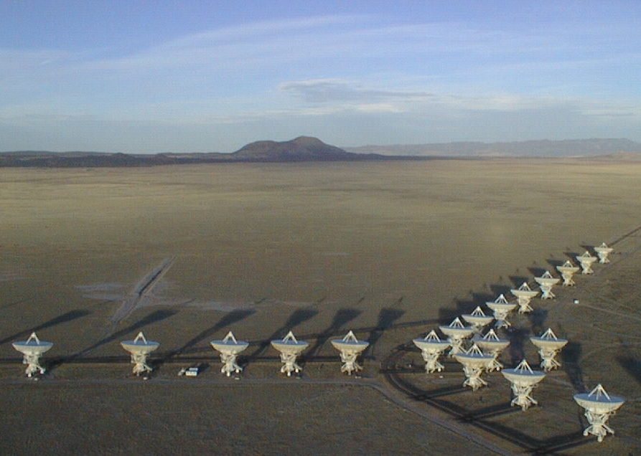
Cool gas in the distant Universe
Chris Carilli, Santa Fe Cosmology July 2015
Dense gas history of the Universe
Molecular diagnostics in galaxy formation
Main sequence galaxies: gas dominated disks
[CII] 158um line: a new window on galaxy formation
ISM physics and dynamics within 1Gyr of the Big Bang
z > 7 galaxies, SMBH, reionization and other cool stuff
Next Generation Very Large Array
Carilli & Walter 2013, ARAA, 51, 105

Slide 2
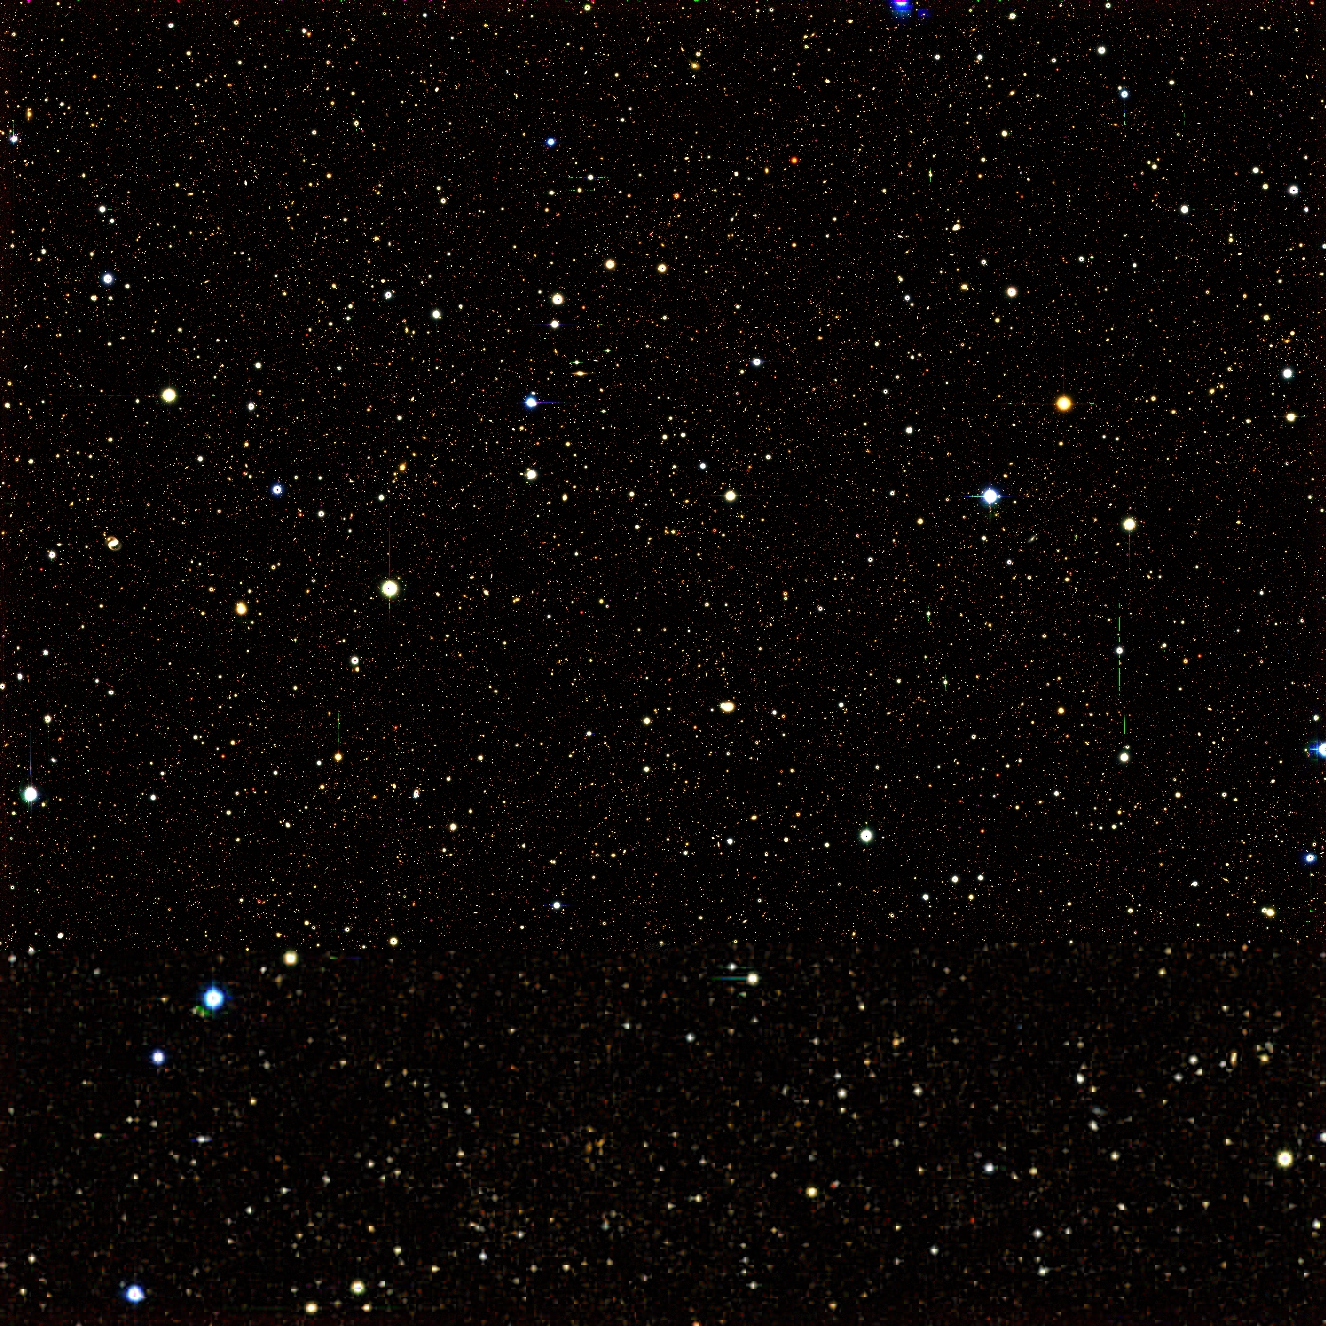
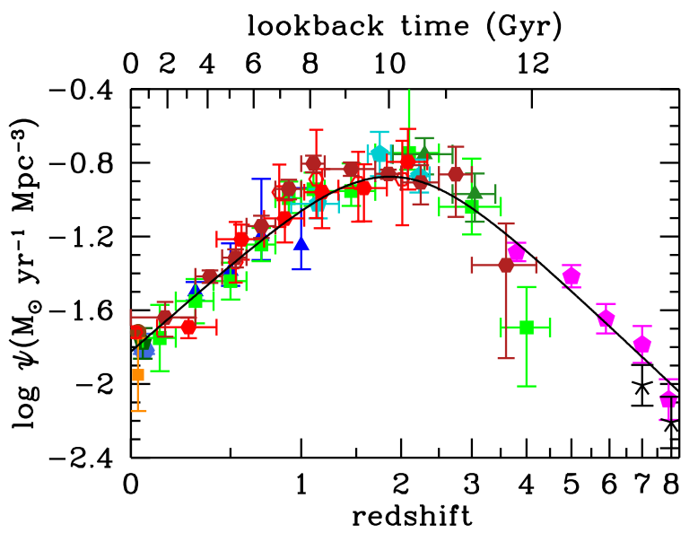
Star formation history of the Universe: primary legacy of cosmological deep fields
Madau & Dickinson
First light + cosmic reionization
epoch of galaxy assembly
~50% of present day stellar mass produced between z~1 to 3
Cosmic demise

Slide 3
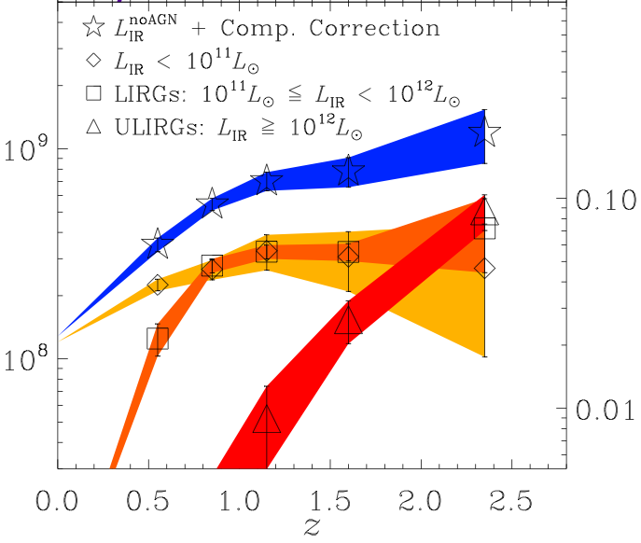


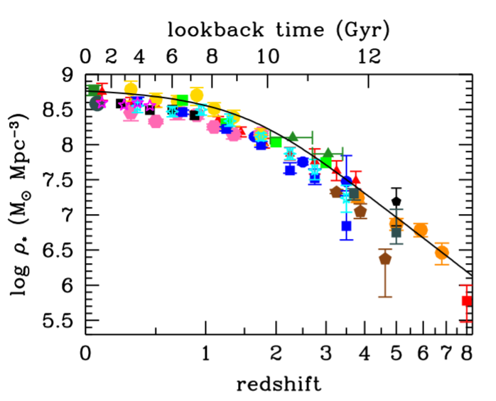
Next level of detail
SFR < 30 M_{o}/yr
SFR ~ 100 M_{o}/yr
SFR > 300 M_{o}/yr FIR > 10¹²L_{o}
Murphy ea
Cosmic star formation shifts to higher SFR galaxies with redshift
Massive galaxies form early
Stellar mass build-up parallels integral SFRD
Madau & Dickinson

Slide 4
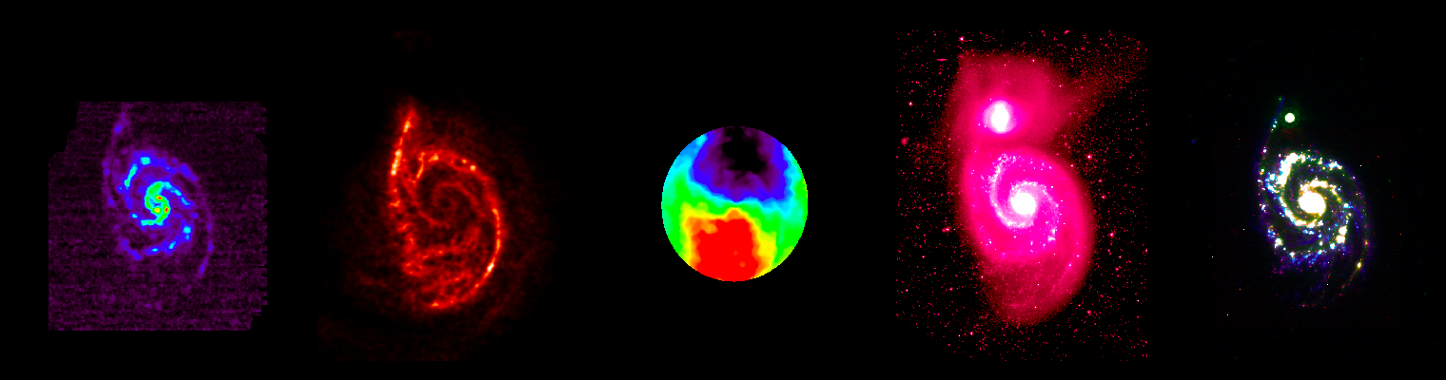
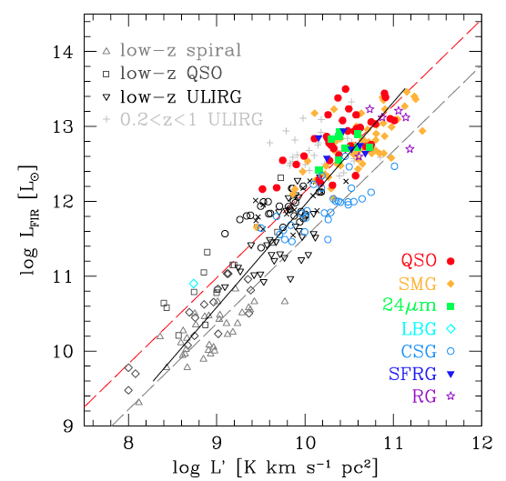
Missing half of galaxy formation
Cold gas = fuel for star formation
Stars form in Giant Molecular Clouds, dominated in mass by H₂
GMC (~30 pc), T ~20K, n_{GMC} > 10² cm⁻³
SF cores (1pc), n_{core} >10⁴ cm⁻³ , T > 50K
H₂ rotational transitions are forbidden, w. high T_{ex} ~ 500K
CO is best tracer: 2nd most abundant molecule, w. low T_{ex} ~ 5.5K, n_{cr} ~ 10³ cm⁻³
Evidence: L_{CO1-0} – FIR relation
CO2-1
Ha/UV/IR
SFR
index ~ 1
index ~ 1.4
L_{CO10} ~ M_{gas}

Slide 5
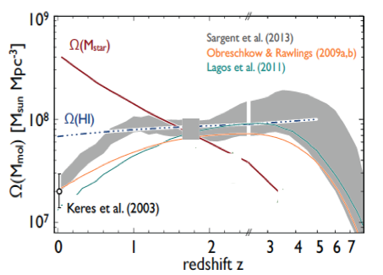
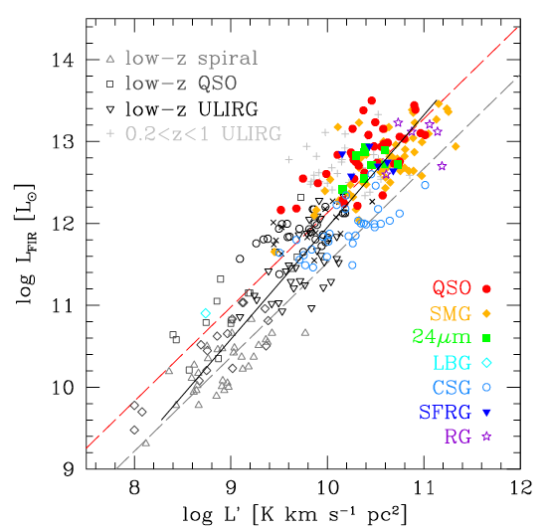
Cool Gas History of the Universe
SF Law
SFR
M_{gas}
Star formation ‘law’ => SFHU should be reflected in evolution of cool gas content of galaxies: source vs. sink

Slide 6
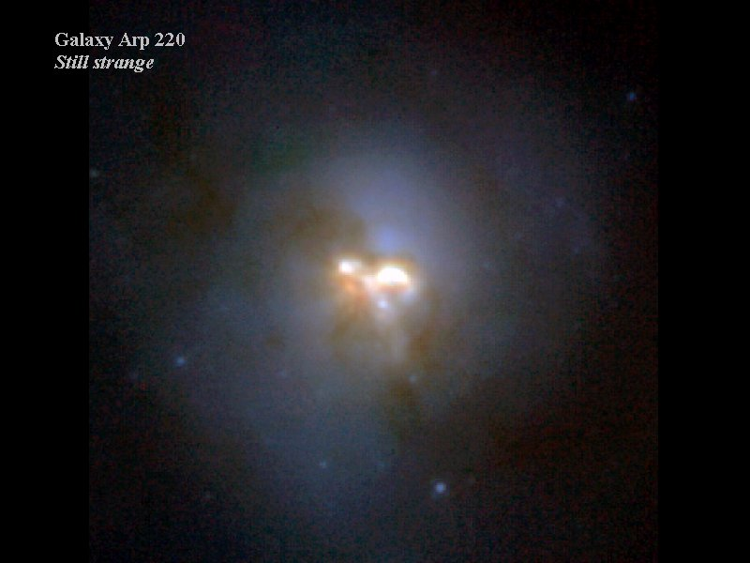
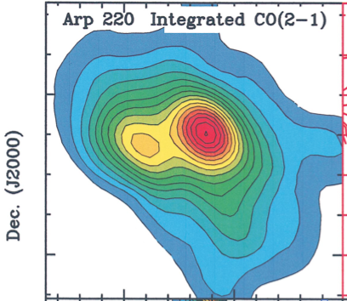
Gas mass: M(H₂) = α L_{CO(1-0)}
Bollatto ea. ARAA 2013
Spirals: Self-gravitating GMCs
α_{CO} ~ 4 M_{o}/(K km/s pc²)
10kpc
Nuclear Starburst: Rotating, dense nuclear disks. High pressure => more efficient converting gas to stars?
α_{CO} ~ 0.8
0.5kpc
Downes + Solomon
Other methods to derive M_{gas} at high z
Observe FIR + Dust-to-gas ratio (metalicity dependent; Scoville; Magdis)
Observe SFR + Star formation laws (Genzel)
Radiative transfer modeling (Ivison)
CO advantages: gas tracer, dynamics; disadvantage: observing time

Slide 7
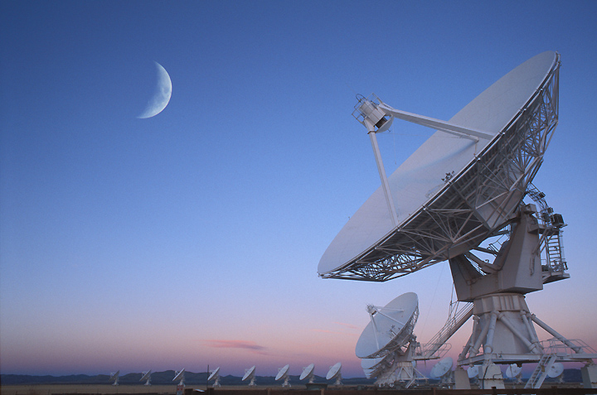
Cool gas in galaxies: new age
Karl G. Jansky Very Large Array
80x Bandwidth (8 GHz, full stokes), with 4000 channels
5x frequency coverage (continuous 1 to 50 GHz)
10x continuum sensitivity (<1uJy)
Spatial resolution ~ 40mas at 43 GHz
30% FBW, ie. 19 to 27 GHz => CO1-0 at z=3.2 to 5.0 => large cosmic volume searches for molecular gas

Slide 8
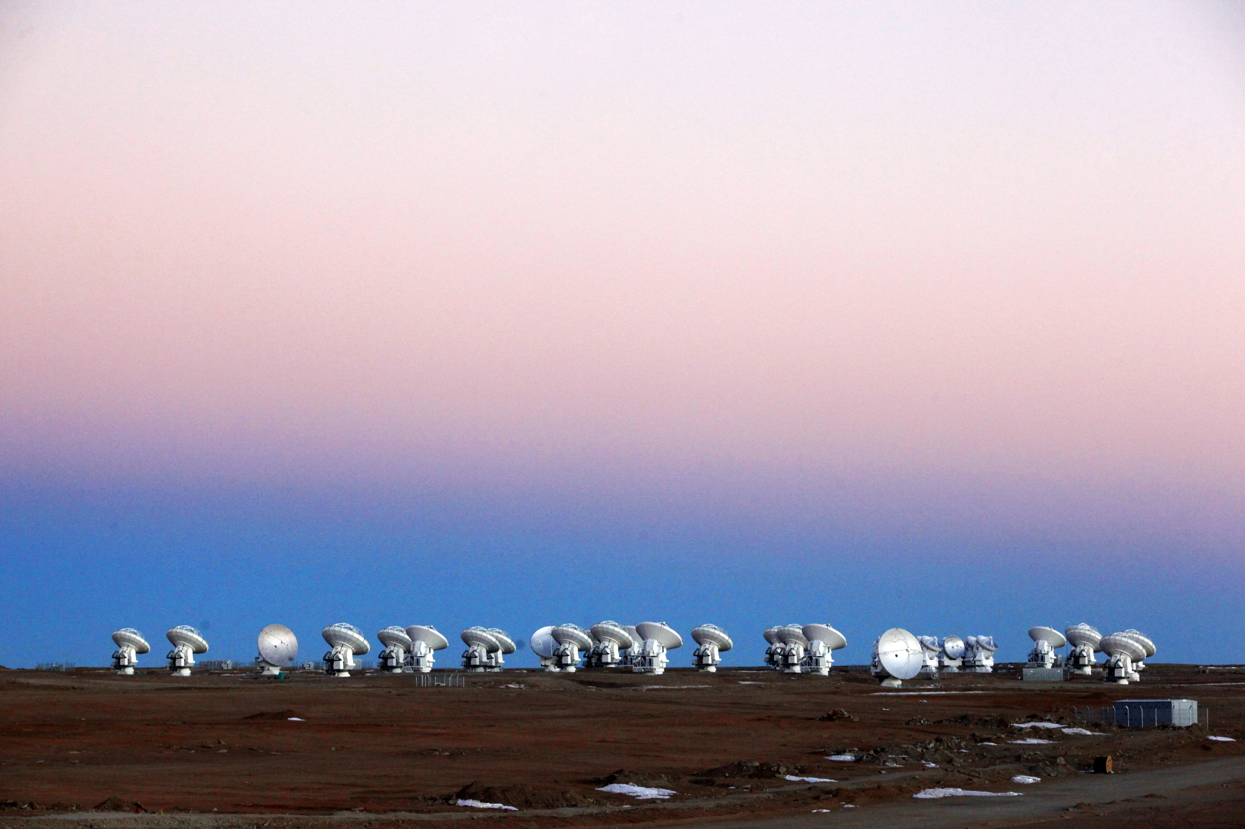
Atacama Large Milllimeter Array
High sensitivity array = 54x12m
Wide field imaging array = 12x7m
Frequencies = 80 GHz to 900 GHz
Resolution = 20mas at 800 GHz
Sensitivity = 13uJy in 1hr at 230GHz
> 10² times more sensitive than pervious submm arrays!
ALMA + JVLA represent an order of magnitude, or more, improvement in observational capabilities from 1 GHz to 1 THz!

Slide 9
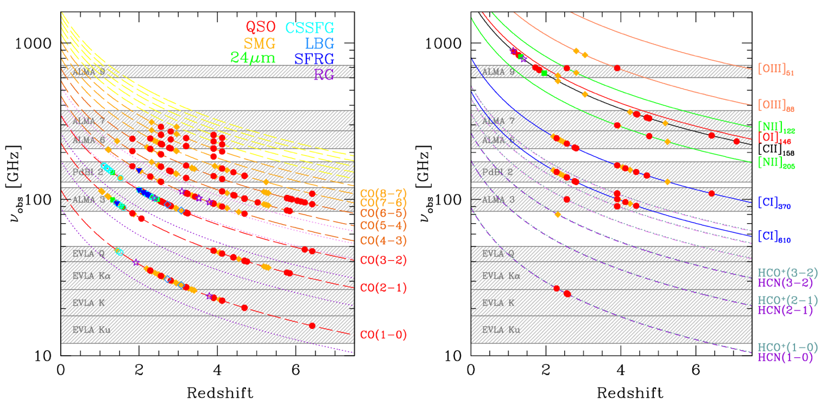
complementarity of different frequency bands
redshift coverage and detections: CO lines
redshift coverage and detections: other lines
ALMA – submm
JVLA – cm
Note: low J key to total mass determination => JVLA

Slide 10
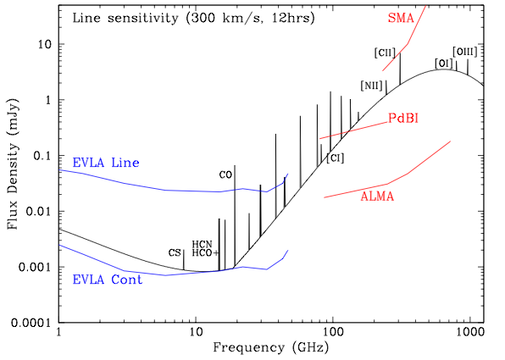
cm → submm diagnostics of galaxy formation
100 M_{o} yr⁻¹ at z=5
Low J CO emission: total gas mass, dynamics
High density gas tracers (HCN, HCO+)
Synch. + Free-Free = star formation
EVLA Line
High J molecular lines: gas excitation, physical conditions
Dust continuum = star formation
Atomic FIR fine structure lines: ISM gas coolant

Slide 11
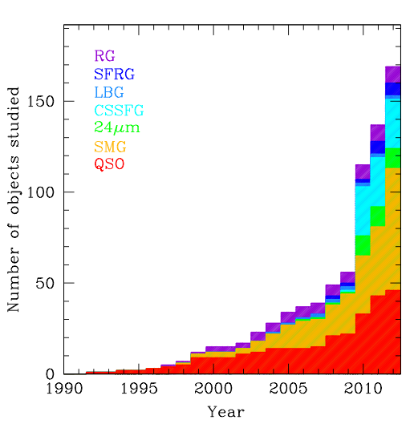
Cool gas detections at z>1 over time (pre-ALMA)
Main Sequence (FIR≤10¹² L_{o})
‘main sequence’:
SFR ≤ 10² M_{o}/yr,
ρ ≥ 10⁻⁴ Mpc⁻³
HyLIRG (FIR~10¹³ L_{o})
‘starburst’:
SFR ≥ 10³ M_{o}/yr
ρ ≤ 10⁻⁵ Mpc⁻³
Rapid rise in last few years:
New instrumentation (Bure, JVLA, GBT)
New population: Main sequence SF galaxies (sBzK/BX/BM…)

Slide 12
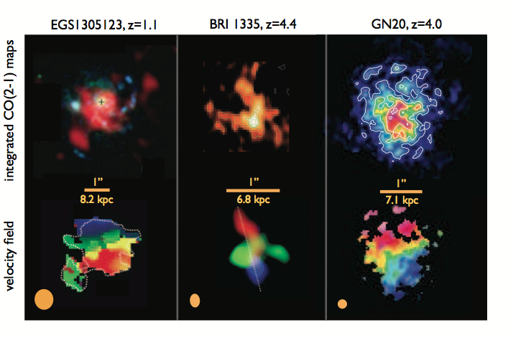
Beyond blobology: Spectroscopic imaging ‘n_{ch} x 1000 words’
Bure
VLA
VLA
Main Sequence
Quasar
Submm galaxy
MSG: SFR ≤ 10² M_{o}/yr, ρ ≥ 10⁻⁴ Mpc⁻³, clumpy, turbulent, rotating 10kpc disks
Quasars: SFR ≥ 10³ M_{o}/yr, ρ ≤ 10⁻⁵ Mpc⁻³, highly disturbed, chaotic CO
SMG: SFR ≥ 10³ M_{o}/yr, ρ ≤ 10⁻⁵ Mpc⁻³, Mixed bag: major mergers and large disks

Slide 13
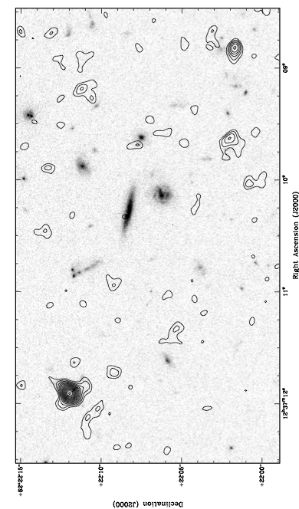
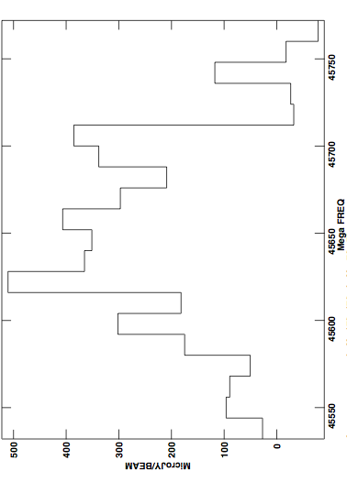
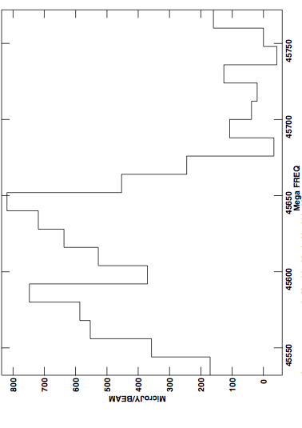
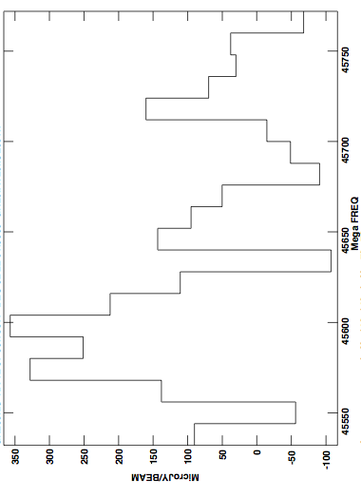
GN20 z=4.0: early, clustered massive galaxy formation
0.4mJy
0.7mJy
+
GN20 z=4.055
+
+
+
5”
0.3mJy
GN20.2b 4.056
+
+
+
+
GN20.2a 4.051
+
+
Over-density: 3 SMGs + 19 LBGs at z_{ph} ~ 4 within ~ 1 arcmin
JVLA early science: 45GHz, 256MHz BW, ~ 100hrs
Detect CO2-1 from 3 SMGs

Slide 14
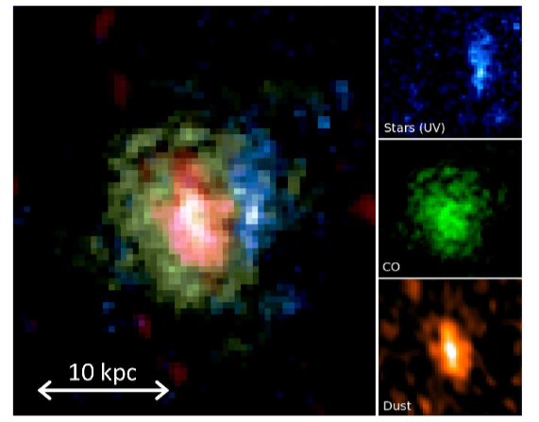
GN20: Extreme, highly obscured star formation event at t_{univ} ~ 1.6Gyr
HyLIRG: FIR = 2 10¹³ L_{o}
Only trace light in HST/I band
SFR = 3000 M_{o} yr⁻¹
Large gas disk ~ 14kpc
M* ~ 2.3 10¹¹ M_{o} ?
M_{gas} = 1.3 10¹¹ (α/0.8) M_{o}
Hodge ea

Slide 15
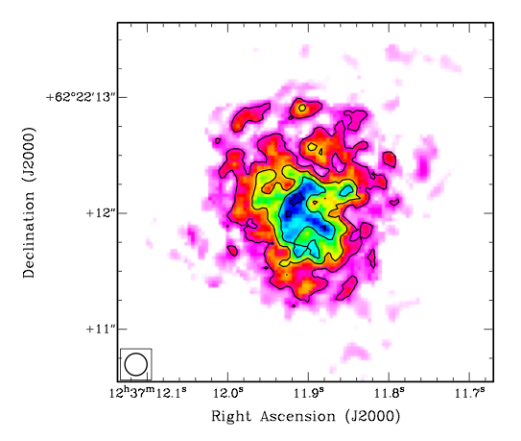
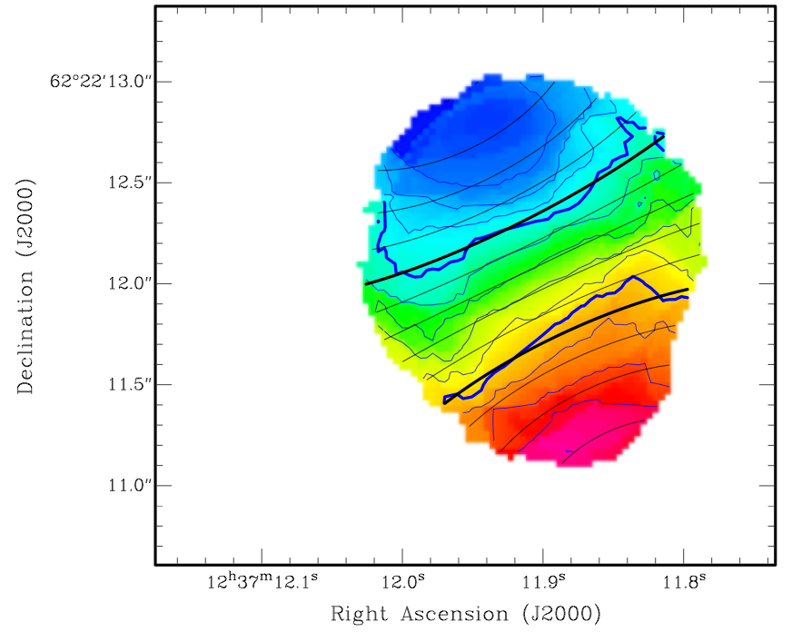
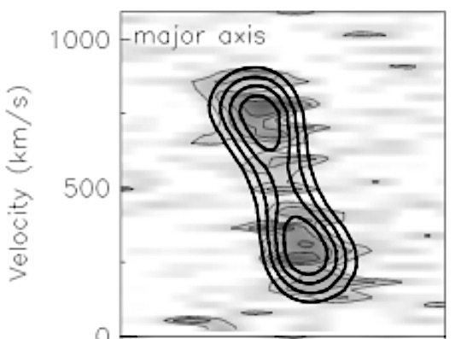

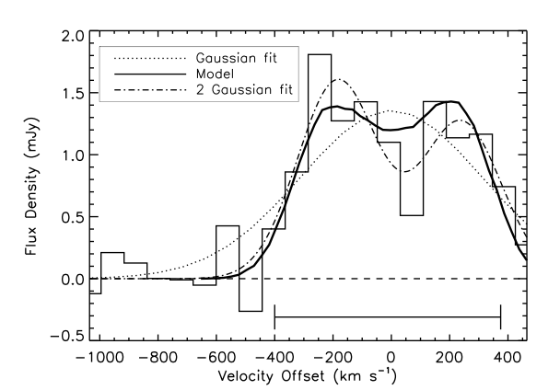
CO 2-1
-300 km/s
7kpc
1”
+300 km/s
0.25”
Gas dynamics: rotating disk model
R_{max} ~ 7 kpc
V_{rot} = 575 km/s (!)
I = 30º
M_{dyn} = 5.4 10¹¹ M_{o}
Extreme starbursts/SMGs need not be major mergers
What drives starburst? Cluster harassment? Post-merger gas rich disk?
+

Slide 16
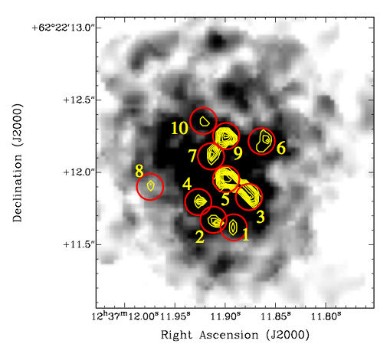
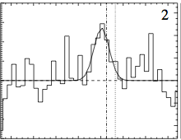
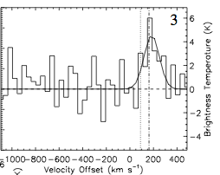
CO at HST-resolution: 0.15” ~ 1kpc
0.5”
T_{b} ~ 20K, σ_{v} ~ 100 km/s
Self-gravitating super-GMCs?
M_{dyn} ~ M_{gas} ~ 10⁹ (α/0.8) M_{o}
Hodge ea 2012

Slide 17
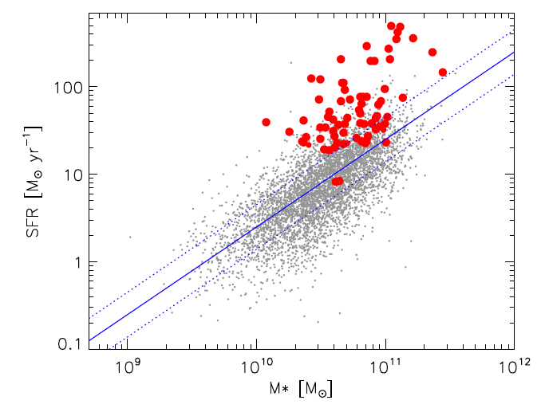
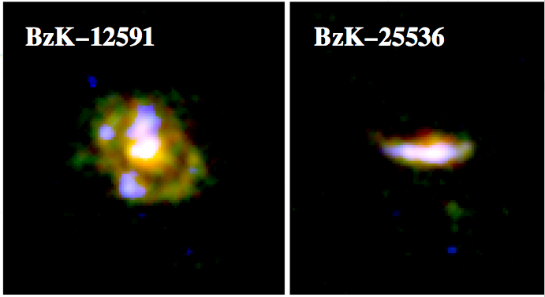
Main sequence (color selected) galaxies
Elbaz ea
Starburst
10kpc
Main sequence
sBzK/BX/BM/LBG…
Color-selection: identify thousands z~1–3 star forming galaxies
SFR ~ 10 to 100 M_{o}/yr, M* ~ 10¹⁰ M_{o} : ‘typical z~2 SF galaxies’
Define a ‘main sequence’ in M_{star} – SFR, clearly delineated from SMGs (‘starburst’)
Common ~ 5 arcmin⁻² ~ 100x SMG

Slide 18
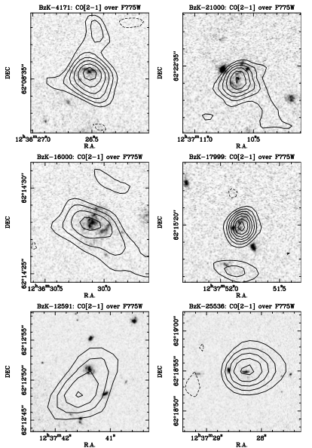
Daddi ea (2010): Bure CO obs of 6 main sequence galaxies at z ~ 1.5
6 of 6 sBzK detected in CO
CO luminosities approaching SMGs but,
FIR (SFR) ≤ 10% SMGs
Massive gas reservoirs without hyper-starbursts?

Slide 19
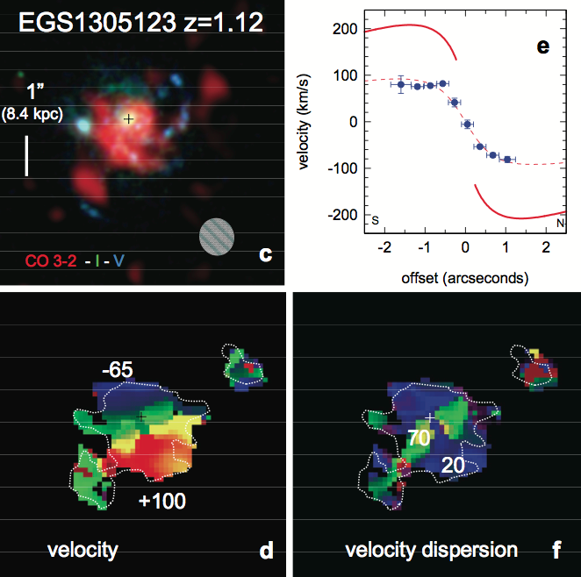
MSG: PdBI imaging (Tacconi ea 10,13)
CO galaxy size ~10 kpc
Clear rotation: v_{rot} ~ 200 km/s
SF clump physics
Giant clumps ~ 1 kpc
M_{gas} ~ 10⁹M_{o}
Turbulent: σ_{v} > 20 km/s

Slide 20
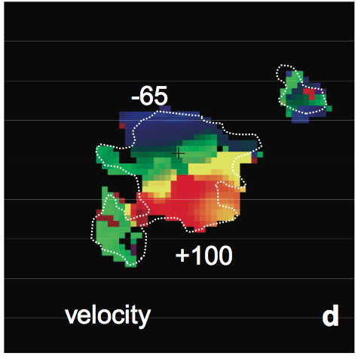
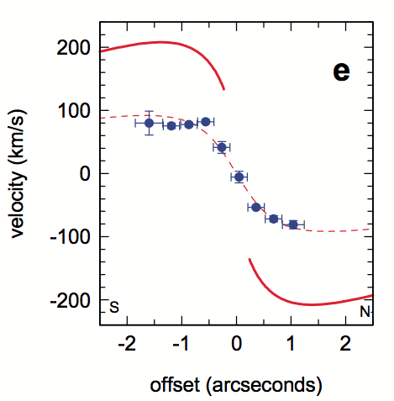
Conversion factor: L’_{CO} = α M_{H2}
-300 km/s
Observe: M_{dyn,} M*
‘Model’: M_{DM} ~ 25%
Assume rest is gas =>
MSG: α _{CO} ~ 4 ~ MW/GMCs
SMG: α_{CO} ~ 1 ~ Starburst
+300 km/s
z=4.0
But… factor 2 uncertainty in all quantities => Notional but not proven!
z=1.1

Slide 21
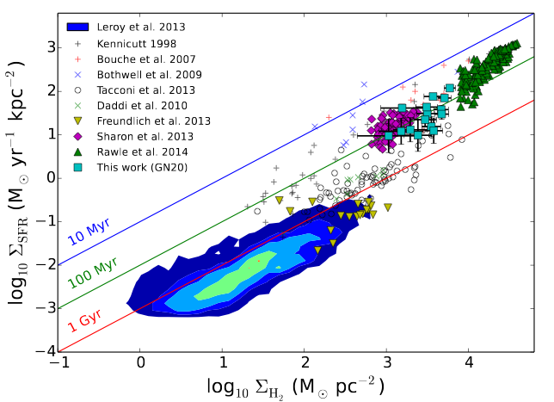
Spatially resolved SF laws at high z
GN20/SMG
MSG
Hodge ea.
Possibly 2 sequences: depletion time, t_{d} = M_{gas}/SFR
SMG/starburst: t_{d} < 10⁸ (α/0.8) yrs
MSG/disk: t_{d} ~ 10⁹ (α/4) yrs

Slide 22
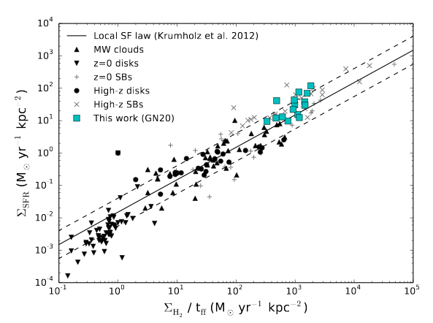
Dictated by dynamical timescales?
Why? SB regions are dense => free fall time on small scales is short
t_{ff} ~ R/v_{rot} ~ ρ^{-1/2}
In all cases, t_{d} << t_{H} => require gas resupply from IGM
Note: all modulo conversion factor!

Slide 23
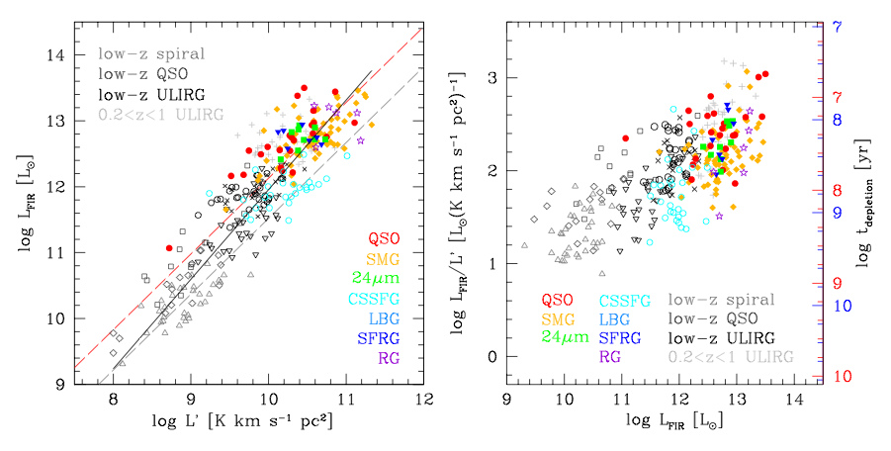
Empirical relationship
α=4
SB
SB
α=0.8
MSG
MSG
Suggests 2 sequences, but conversion factor remains problematic

Slide 24
CO excitation
quasar ~ constant T_{b} to high order ~ Arp220 nucl. ~ GMC SF core
SMG: intermediate between SB nuclei and MW
Often large, cooler gas component
MSG: between MW and SMG
quasars
ν²
Arp220
SMGs
MSGs
Physical conditions: radiative transfer modeling
MW ~ GMC (~30 pc), T ~ 20K, n_{GMC} ~ 10² cm⁻³
Arp220 ~ SF cores (1pc), n_{core} > 10⁴ cm⁻³ , T > 50K

Slide 25
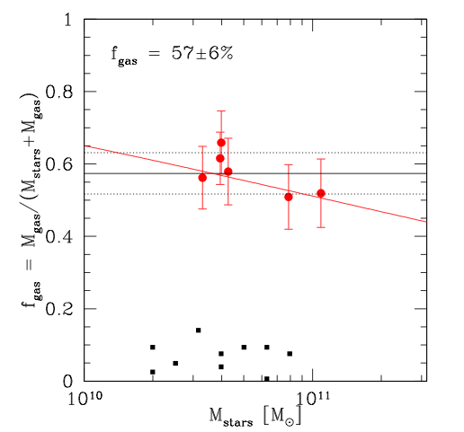
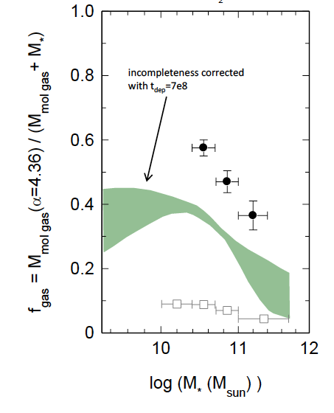
MSG: Baryon fraction is dominated by cool gas, not stars
Daddi ea 2010
Tacconi ea 2013
sBzK z~1.5
z~0 spirals
Decreases with increasing M*

Slide 26
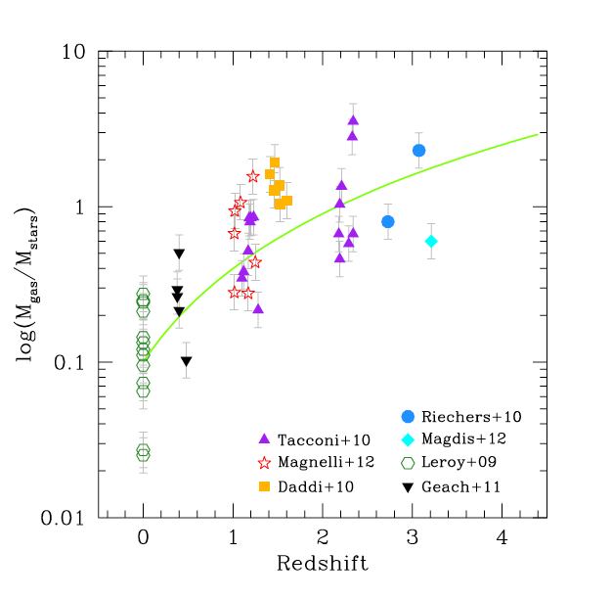
Evolution of gas fraction: epoch of peak cosmic SF rate density (z~2) = epoch of gas-dominated disks
~ L’_{CO}/R
(1+z)²
All star forming disk galaxies w. M* ≥ 10¹⁰ M_{o}
All points assume α~ 4 => empirical ratio ~ L’_{CO}/R_{rest}

Slide 27
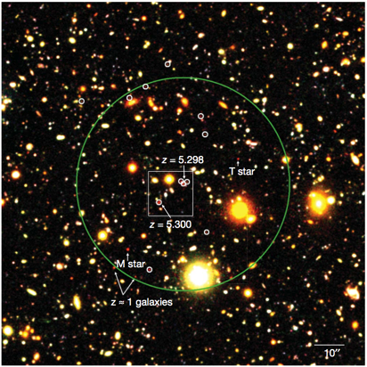
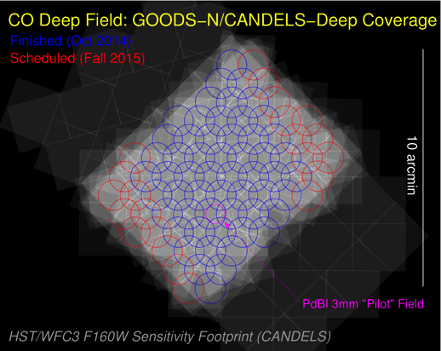
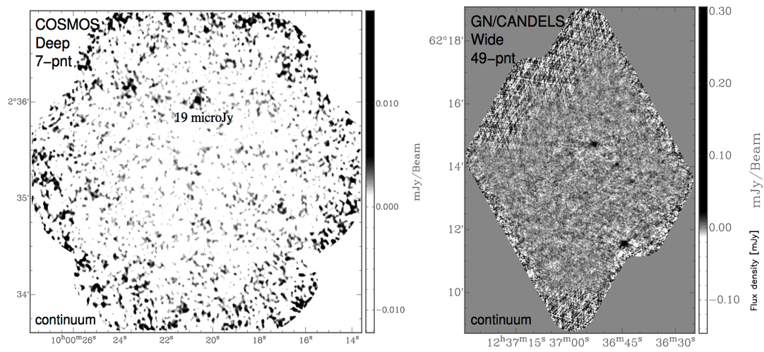
Molecular Deep Field: Blind survey CGHU
JVLA 350hrs
30 – 38 GHz =>
CO1-0 z = 2.0 – 2.8
CO 2-1 z= 5.0 – 6.7
10 + 50 arcmin²
rms_{cont}~ 3uJy
rms per 100km/s < 0.1mJy => M_{H2} = few e9 M_{o}
7 arcmin² COSMOS
50 arcmin² “wide” field in GOODS-N

Slide 28
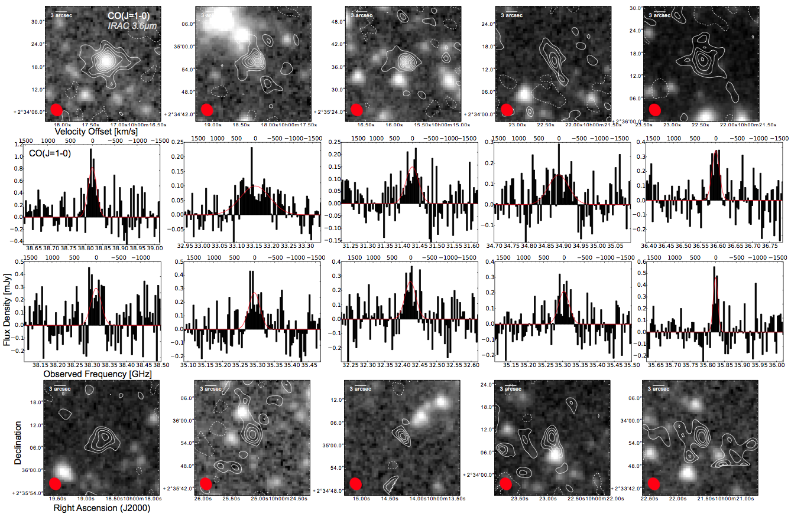
Molecular Deep Field: “Blind CO Detections”
Complex data set ~20 TB, 4x4096 channels
Candidate z>2 CO Line Emitters
Notes:
4x4096: polarizations

Slide 29
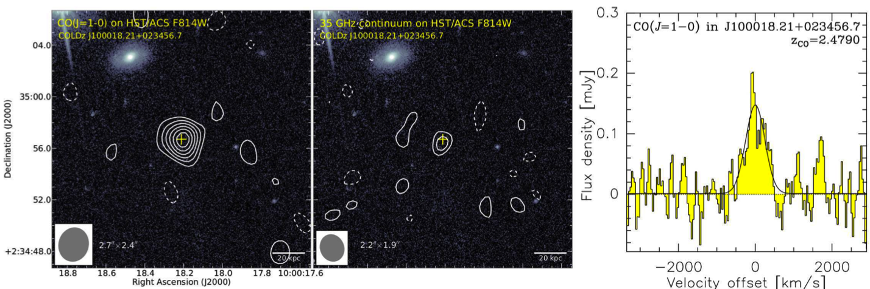
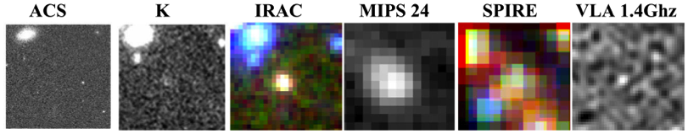
CO selected galaxies: Faint, Massive Galaxy at z=2.48
Lentati et al. 2015
Line
Continuum
Optically- and 850 µm-undetected galaxy at z=2.5
Broad line: 570 km/s
M_{gas} = 7 ×10¹⁰ (α/3.2)M
Massive, dusty “main sequence” galaxy? SFR ~ 250 M_{o} yr⁻¹
Finding galaxies missed by optical or (sub)mm surveys

Slide 30
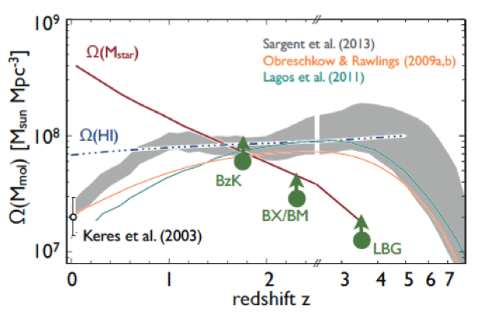
Cool Gas History of the Universe
SF Law
SFR
M_{gas}
SFHU has been delineated in remarkable detail back to reionization, as function of environment, luminosity, stellar mass…
SF laws => SFHU is reflection of CGHU: study of galaxy evolution is shifting to CGHU (source vs sink)
Epoch of galaxy assembly = epoch of gas dominated disks

Slide 31
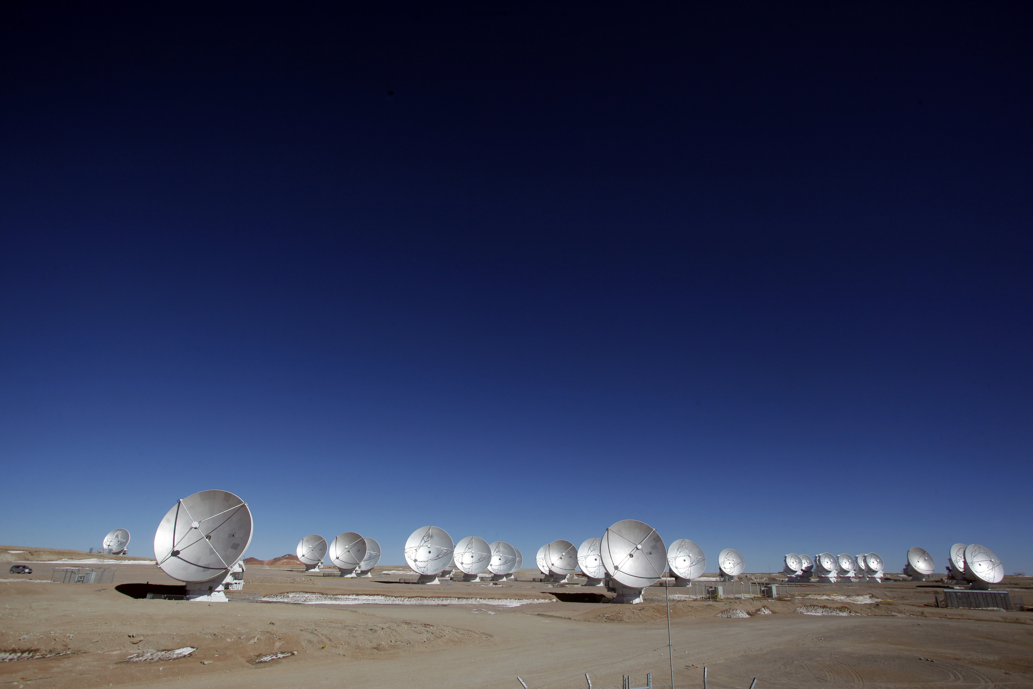
[CII] 158um line: a new window on the high redshift Universe

Slide 32
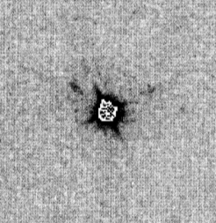




Salome ea. 2012
+
BRI1202-0725 z=4.7
HyLIRG (10¹³L_{o}) pair:
Quasar host
Obscured SMG
SFR ~ 10³; M_{H2} ~ 10¹¹
+
4”
+
+
HST 814 Hu ea 96
SMA
[CII] 158um
334GHz, 20hrs
Iono ea 2007

Slide 33


[CII] in 1202-0725
Wagg ea
ALMA SV
20min, 16 ants
334GHz
SMA 20hrs

Slide 34

Good news: [CII] is everywhere!
[CII] 158um line (1900GHz) is dominant cooling mechanism for cool gas, and most luminous line from star forming galaxies from DC to FIR:
0.3% of FIR luminosity of MW
[CII]/CO₁₋₀ ~ 1000
E_{ion} = 11.2eV => traces ionized and neutral gas: PDR, CNM, WNM, WIM => Good dynamical tracer
Problem: low z requires space, but, z > 1 => [CII] redshifts to ALMA bands (< 900 GHz)
Galactic census (Pineda ea)
Dense PDRs (30%)
Cold HI (25%)
CO–dark H₂ (25%)
Ionized gas (20%)
Various with galaxy

Slide 35

Bad news: CII is everywhere!
SMC/LMC
[CII]/FIR up to factor ~ 100 scatter!
Quantitative measure of ??
Low metallicity: enhanced [CII]/FIR (lower dust attenuation => large UV heating zone)
Can be suppressed in SB nuclei: dust opacity or charged grains?
Might lose CNM contribution at z > 6 due to CMB contrast (Vallini ea)?
MW
SB nuclei
11

Slide 36


[CII]: the great elixir (or koolaid)?
Claimed to be a tracer of
Star formation rate
H₂, HI, and HII mass (independently)!
Radiation field
Abundances…
Usually requires other info (T_{dust}, FSL…)
Focus: [CII] tool for
Gas dynamics
ISM evolution
Spectroscopic redshifts
de Looze ea
‘This ubiquity of C+ with the varying contributions of these different components of the interstellar medium to the total energy radiated by C+ in different galaxies makes calibration of the [CII] versus star–formation rate a difficult task.’ Goldsmith ea

Slide 37
The new age of [CII]: number of detections at z>1

Slide 38



BR1202-0725 z=4.7: anatomy of a hyper-starburst
Disks AND mergers
LAE1
SMG
G3
700km/s
G4
QSO
LAE2
rms=100uJy
Two hyper-starbursts (SMG and BAL quasar host): FIR ~ 3x10¹³ L_{o} ; SFR ~ 3x10³ M_{o}/yr; M_{BH} ~ 10⁹ M_{o}
Two ‘normal’ LAE: SFR ~ 10² M_{o}/yr

Slide 39

[CII] in 1202: Imaging cool gas dynamics at z=4.7
Quasar, SMG: Broad, strong lines
Tidal bridge across LAE1, as expected in gas-rich merger
Possible quasar outflow, or further tidal feature, toward LAE2
SMG
LAE1
Q
LAE2

Slide 40


Dynamics reveals all: major merger of gas rich galaxies driving massive galaxy/group/BH formation 1Gyr of Big Bang
-500km/s
SMG
7kpc
LAE1
Q
LAE2
+500km/s
Tidal stream connecting hyper-starbursts, narrow dV
SMG: warped disk, highly optically obscured
HyLIRG QSO host, with outflow seen in [CII] and CO, high dV
LAE1: Ly-alpha + [CII] in tidal gas stream?
LAE2: dust and [CII] in outflow?

Slide 41



Aztec 159: disk dynamics at z=4.6 (Karim ea.)
ALMA 340 GHz: 20min, 30 ant, 0.35” res
SMG in Cosmos
No ACS
FIR = 0.7e13 L_{o}
SFR = 700 M_{o} yr⁻¹
M* = 1.1e11 M_{o} ?
Dust < 0.2”
3GHz 340GHz
JVLA: 50uJy at 3Ghz
ALMA: 3mJy at 340 GHz

Slide 42



ALMA [CII]
‘double horn’, Width ~ 700 km/s
[CII] = 5e9 L_{o} ~ 100x MW
[CII]/FIR ~ 0.0008 ~ 0.25 x MW
Clear velocity gradient ~ 1”
Mom0
Mom1
Karim ea

Slide 43
+350 km/s
-350 km/s
GALPAK (Bouchet): exponential disk
Spiral galaxy rotation: butterfly pattern!

Slide 44

Search for dark matter: detailed rotation curves for 1st galaxies
Intrinsic
Smoothed
Karim ea.
V_{rot} = 470 km/s, i = 48º, R_{turnover} = 0.16 kpc
Dynamical mass at last point (2.6kpc) = 1.3e11 M_{o}
Dark matter? Need: distribution stars + cool gas w. same resolution
Generally: [CII] + ALMA => dynamical imaging ~ HI in nearby dwarfs

Slide 45




ISM evolution in first galaxies
ALMA observations of Lyman Break galaxies z ~ 6
1hr per source, 30 ants, 0.5” res
Capak ea.: 10 LBGs at z ~ 5.5
Willott ea.: 2 LBGs at z ~ 6.1
SFR ~ 10 to 100 M_{o} yr⁻¹ (luminous, but otherwise typical)
Overall:
11 detected in [CII] (non-detection = AGN)
4 or 5 in dust continuum

Slide 46


Build-up of ISM at z ~ 6
L_{[CII]}/L_{FIR}
z~6 LBGs
L_{IR}/L₁₆₀₀
[CII]/FIR ~ SMC/LMC => low metalicity (ie. Dust/Gas)
IR/1600 => SMC-type dust (silicates, amorphous carbon?) => changes SFHU?
Generally: [CII] can be strong w/o dust => don’t select on dust!

Slide 47




Identifying galaxies in 3D
z=5.5
Dynamical masses, stellar masses, and the search for dark matter
-110 km/s
+110 km/s

Slide 48


Evidence for increasingly neutral IGM z>6?
Weak, asymmetric Lya w. velocity offset => resonant scattering by IGM (Gunn-Petterson)?

Slide 49



Weighing z>6 quasar host galaxies (Wang ea; Willott ea.)
300GHz, 0.5” res, 1hr, 17ant
Dust Wang ea
[CII]
-200 km/s
+300 km/s
7/7 detected [CII] + dust
Sizes ~ 2-3kpc, clear velocity gradients
Maximal SB disk ~ 1000 M_{o} yr⁻¹ kpc⁻²
M_{dyn} ~ few e10 to 1e11 M_{o}
M_{BH} ~ 1e8 to 1e10 M_{o}
Larger BHs than expected in some cases?
Generally: [CII], CO may be only way to get M_{gal}
M_{BH}
Low z
M_{dyn}

Slide 50






Redshift frontier: z > 7
Quasar host z=7.0
Early, inhomogeneous enrichment IGM
Host redshift + DLA profile => neutral IGM
Venemans ea
Maiolino ea
Lyman Break galaxy z=7.1
Offset => satellite accretion?
[CII]
Ota ea
Lyman α emitter z=7.2 ?

Slide 51



[CII] Deep Fields (Aravena ea)
ALMA 212 – 272GHz ([CII] z=6 to 8)
UDF 7 pointings, 1arcmin²
rms(cont) = 12uJy/beam => 10M_{o} yr⁻¹
[CII] luminosities ~ 10 M_{o} yr⁻¹
LBG candidate z=6.4

Slide 52

[CII] 158um line: a new window on the high redshift Universe
Dynamics first galaxies
Anatomy of early galaxy formation
Rotation curves: in search of dark matter
Build up of ISM at z > 5
Redshifts into reionization (z > 7)

