Slide 1
Cosmic Reionization
Chris Carilli (M/NRAO)
Vatican Summer School June 2014
I. Introduction: Cosmic Reionization
Concept
Constraints on evolution of neutral Intergalactic Medium (IGM)\
II. Sources of reionization (Trenti)
III. HI 21cm line
Potential for direct imaging of the evolution of early Universe
Precision Array to Probe Epoch of Reionization: first results
Hydrogen Epoch of Reionization Array: building toward the SKA

Slide 2
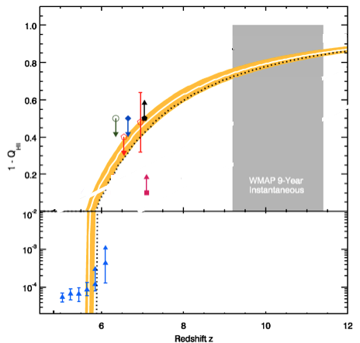
1Gyr
0.5Gyr
Robertson ea. 2013
F_{HI_vol}
Amazing progress: rapid increase in neutral fraction from z~6 to 8 (10⁻⁴ to 0.5) = ‘cosmic phase transition’?
All values have systematic uncertainties: suggestive but not compelling => Need new means to probe neutral IGM

Slide 3
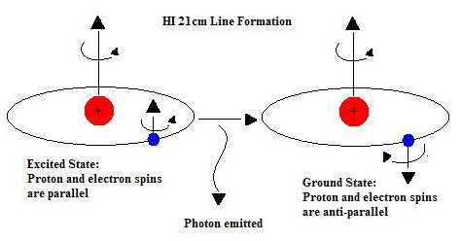
HI 21cm line: Most direct probe of the neutral IGM
Low frequencies: z_{reion} ~ 6 to 12 => ν_{obs} = 1420MHz/(1+z) = 110MHz to 200MHz
Advantages of the 21cm line
Direct probe of neutral IGM
Spectral line signal => full three dimensional image of structure formation (freq = z = depth)
Low freq => very (very) large volume surveys (1sr, z=7 to 11)
Hyperfine transition = weak => avoid saturation (translucent)
Lya lifetime ~ 1nanosec; 21cm lifetime ~ 10⁷ yrs

Slide 4
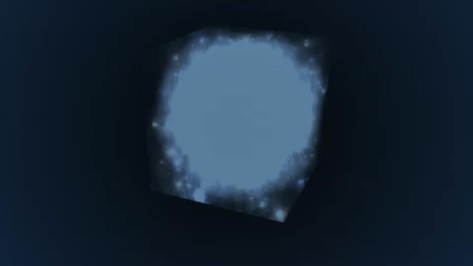
Seeing Through the “Fog”: HI 21cm cosmology z=20 to 5 (67 to 240 MHz)
Gnedin et al. (2006)

Slide 5
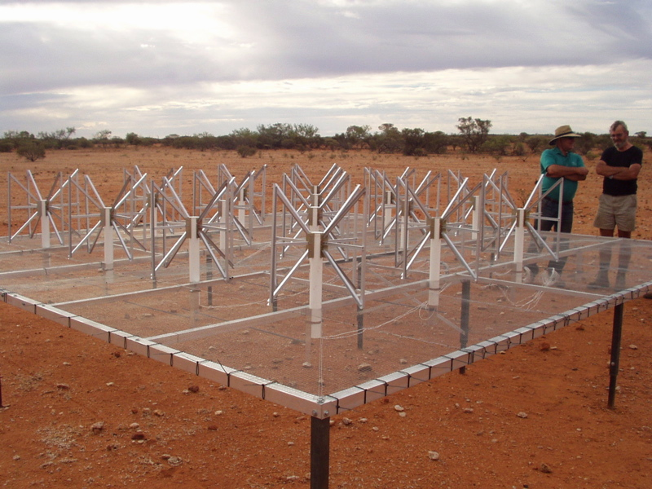
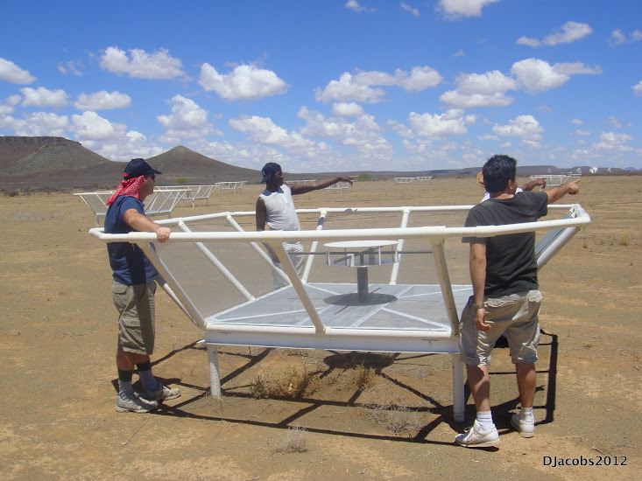
Renaissance at low freq: 1% to 10% of a square kilometer array
MWA - Oz
PAPER - ZA
Array | FoV deg² | Area m² | Type | Bmax km | Start Science obs
LOFAR | 25 | 3e4 | Tile | 2 | 2013
MWA-128 | 300 | 2e3 | Tile | 1.5 | 2013
PAPER-128 | 1600 | 1e3 | Dipole | 0.3/0.6 | 2013
HERA-568 | 64 | 8e4 | 14m parabola | 0.3/2 | 2017
SKA-I Low | 30 | 1e6 | Tile | 5 | 2021+

Slide 6
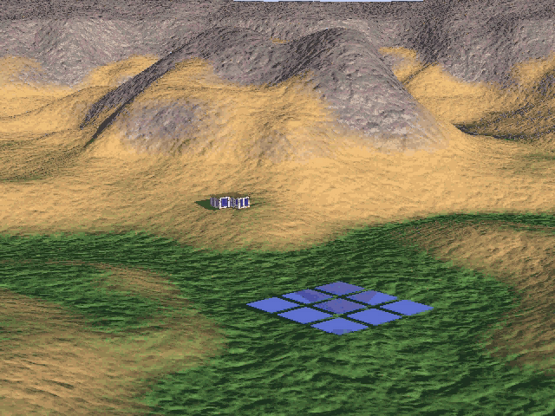

Slide 7
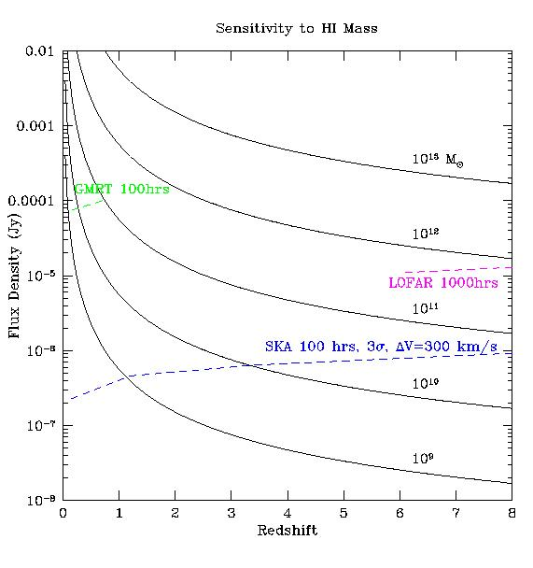
HI 21cm emission from neutral IGM: large scale structure, not individual galaxies (‘intensity mapping’)
1e13 Mo
Large scale structure
cosmic density, ρ
neutral fraction, f(HI)
Temp: TK, TCMB, Tspin
1e9 M_{o} ~ Milky Way

Slide 8
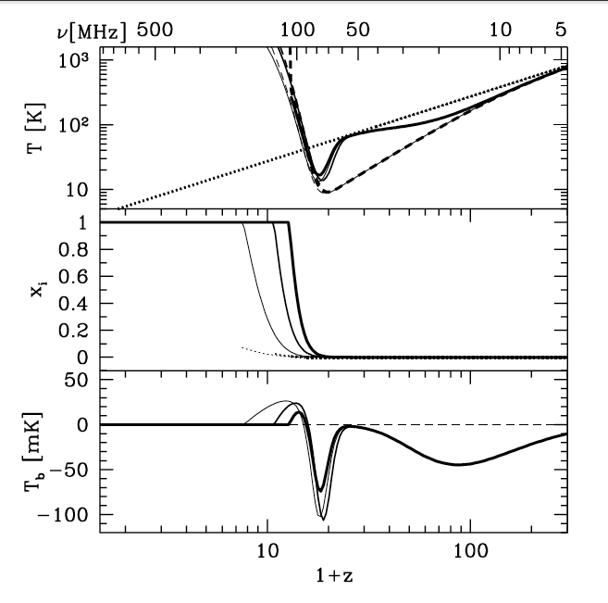
‘Richest of cosmological data sets’
z>200: T_{CMB} = T_{K}= T_{S} by residual e-, photon, and gas collisions. No signal.
z∼30 to 200: gas cools as T_{k} ≈ (1+z)² vs. T_{CMB} ≈ (1 + z), but T_{S} = T_{K} via collisions => absorption, until density drops and T_{s} → T_{CMB}
z∼20 to 30: first stars => Lyα photons couples T_{K} and T_{S} => 21-cm absorption
z∼6 to 20: IGM warmed by hard X rays => T_{K} > T_{CMB}. T_{S} coupled to T_{K} by Lya. Reionization is proceeding => bubble dominated
IGM reionized
T_{cmb}
T_{S}
T_{K}
E
D
C
B
A
First stars
Pritchard & Loeb

Slide 9
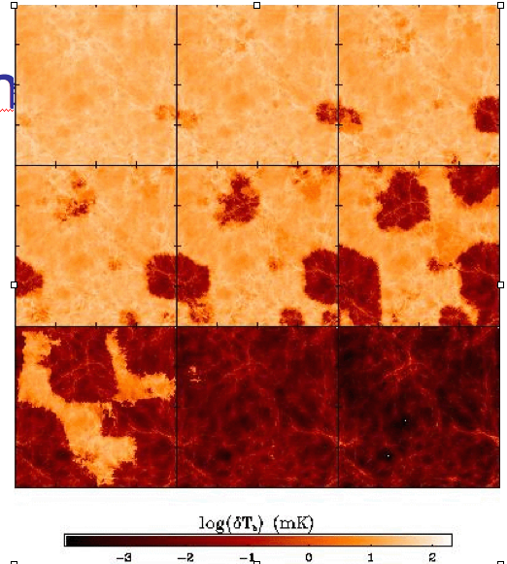
Signal I: HI 21cm Tomography of IGM
z=12
9
ΔTB(2’) ~ 20 mK
SKA rms ~4mK
Pathfinders: rms ~ 80mK
7.6
Furlanetto, Zaldarriaga + 2004

Slide 10
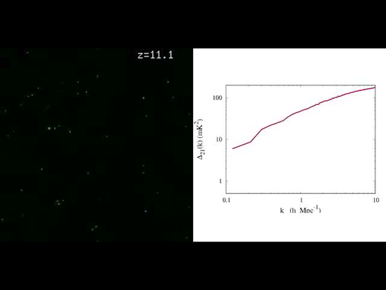
Signal II: Pathfinder science goals
Evolution of 3D power spectrum in 21cm line
30’, 3MHz
3’, 0.3MHz
mK²
10cMpc
Mpc⁻¹
Mcquinn

Slide 11
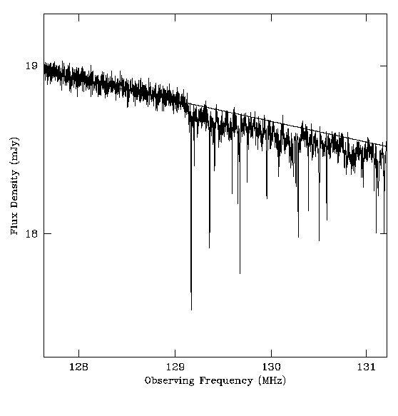
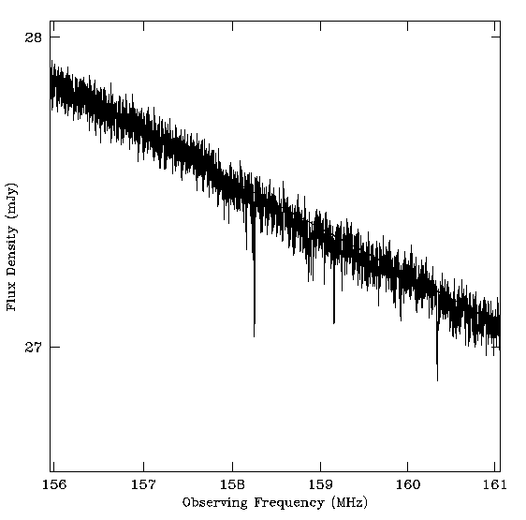
Signal III: 21cm absorption toward first radio galaxies
19mJy
z=12
z=8
SKA+Gnedin simul
130MHz
159MHz
radio GP (τ=1%)
21 Forest (10%)
Only probe of small scale structure
Requires radio sources: expect 0.05 to 0.5 deg⁻² at z> 6 with S151 > 6 mJy

Slide 12
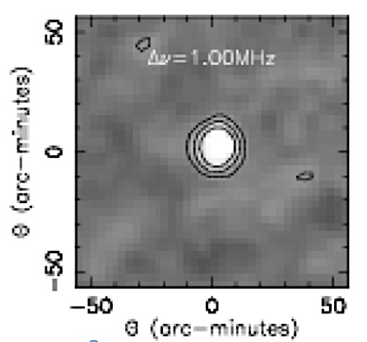
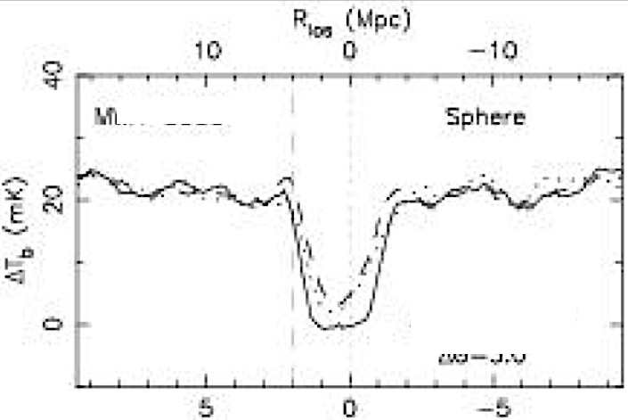
Signal IV: quasar near zones at z > 6
Lya spectra provide evidence for existence for CSS
Size ~ 15’
Signal ~ 20 f(HI) mK = 0.5 f(HI) mJy
rms (HERA, 100hr, 1MHz) ~ 0.08 mJy
3D structure = powerful diagnostic
Rare but we observe huge volume: 64deg²; z=6 to 11
5Mpc
Wyithe et al. 2006
0.5 mJy

Slide 13
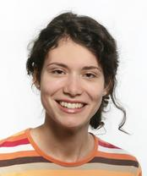
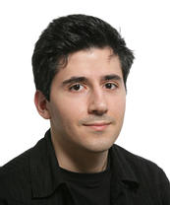
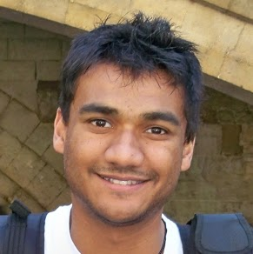
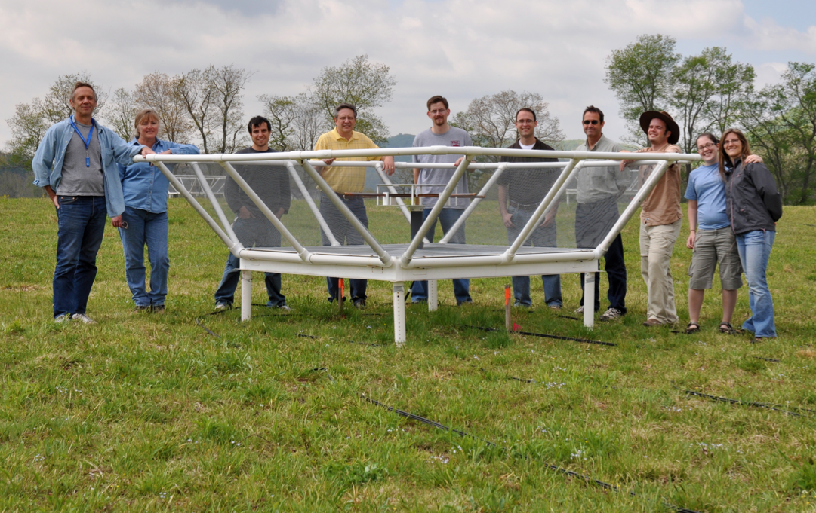
Precision Array to Probe Epoch of Reionization
Don Backer Array: Berkeley, NRAO, Penn, Cavendish, SKA/South Africa
Focus: low-ν array to study HI 21cm signal from reionization
Precision: emphasize engineering solutions first
Staged: work through problems before increasing investment

Slide 14
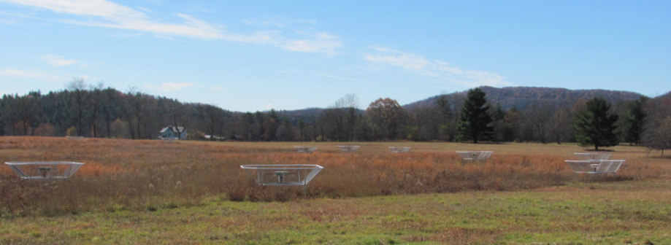
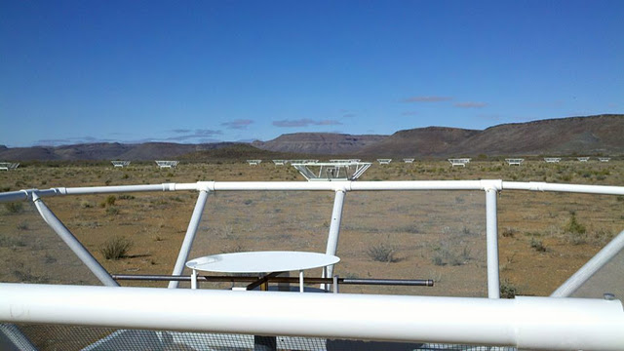
PAPER basics
Freq= 115 to 190 MHz (z= 6.5 to 11)
Single dipole elements + ‘flaps’ => FoV_{FWHM} ~ 40º
Max baseline = 300m => res ~ 15’
32 station engineering array in Greenbank, WV
128 antennae science array in Karoo, South Africa

Slide 15
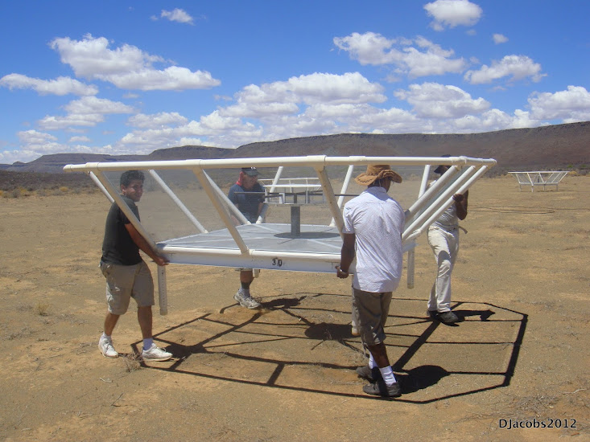
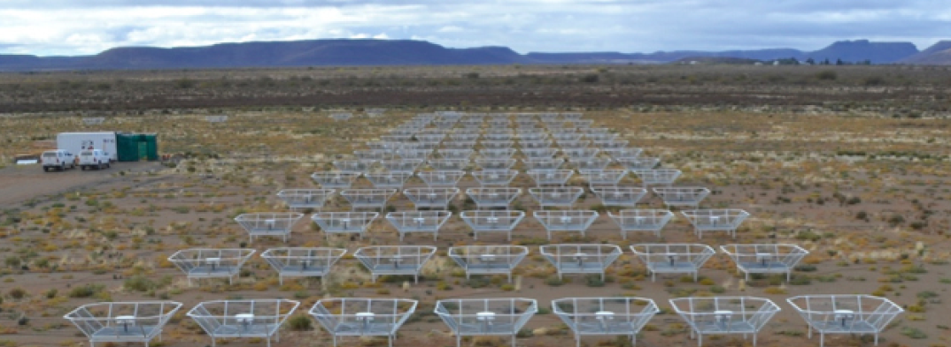
Reconfigurable => optimize for science goal
Minimum redundancy array
maximize u,v coverage => imaging
Maximum redundancy: delay spectrum analysis

Slide 16
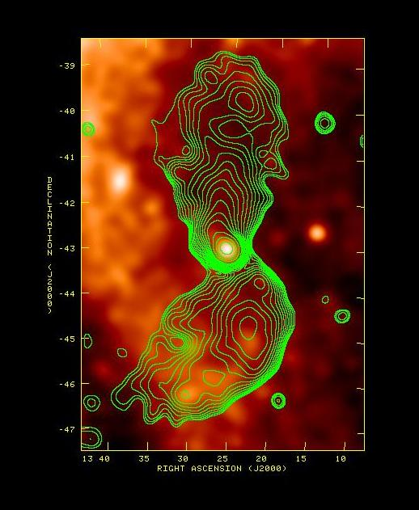
Cen A: PAPER + Xray
PAPER Imaging: unique parameter space
Continuous ‘all-sky’ monitor (GRBs, XRBs...)
Sensitive to LSS (15deg at 15’ res)
Sensitivity(10min) ~ 5mJy
Broad freq range (120 – 180 MHz)
8º
20º

Slide 17
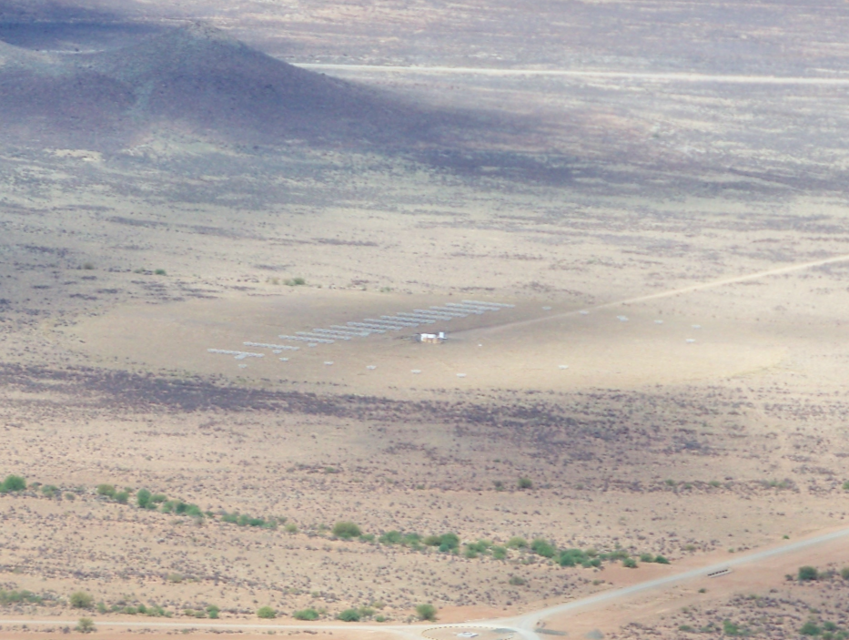
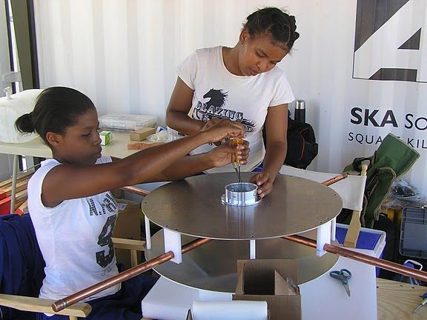
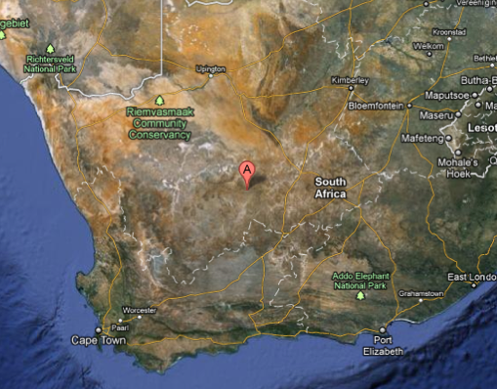
Established working array from scratch in 6 months, with help from ZA (SKA, Durban)
Univ. KwaZulu-Natal
PAPER
575 km
Cape Town

Slide 18
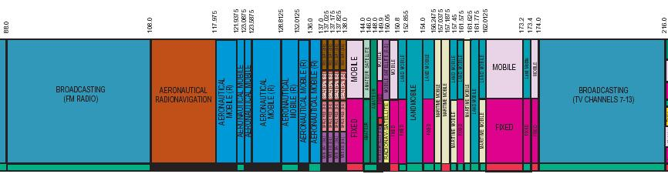
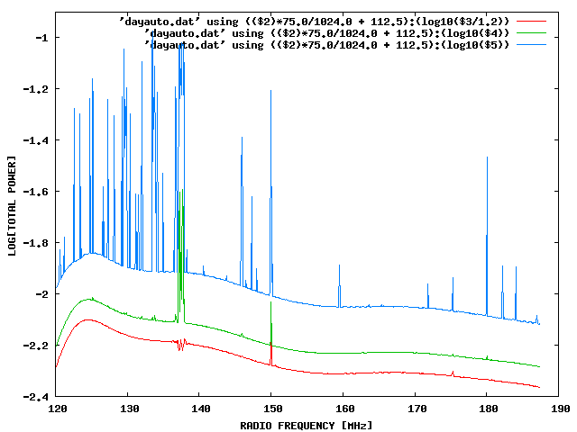
Challenge: Interference
100 MHz z=13
200 MHz z=6
Aircraft
Orbcomm
TV

Slide 19
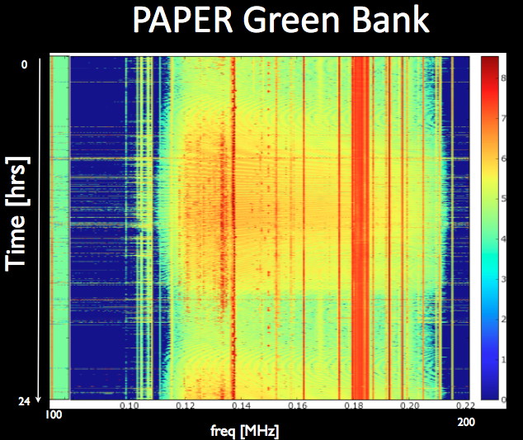
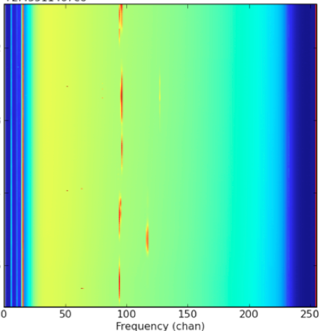
US ‘radio quiet zone’
ZA ‘radio quiet zone’
Karoo South Africa
TV
OrbComm
FM
ISS
OrbComm
100MHz
200MHz
100MHz
200MHz

Slide 20
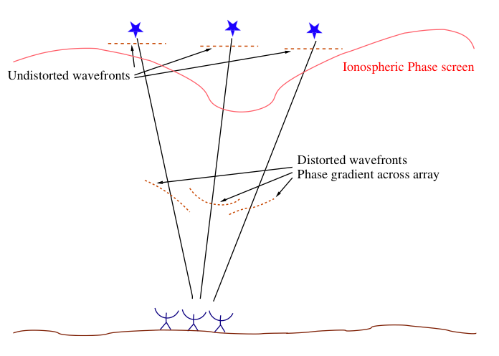
Challenge II: Ionospheric phase errors – varying e- content
‘Isoplanatic patch’ = few deg = few km
Speed of light in ionosphere is ν dependent function of n_{e}
Phase (path length) variation proportional to wavelength²

Slide 21
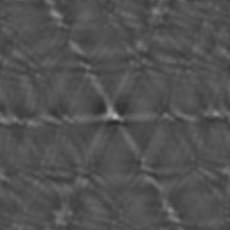
Challenge II: Ionospheric ‘seeing’
Traveling ionospheric disturbances– ‘fuzz-out’ sources
Solution: spatial/temporal calibration = Wide field ‘rubber screen’ phase self-calibration using data-rich sky
Ionosphere opaque at plasma freq ~ 5MHz
15’
Virgo A VLA 74 MHz Lane + 02

Slide 22
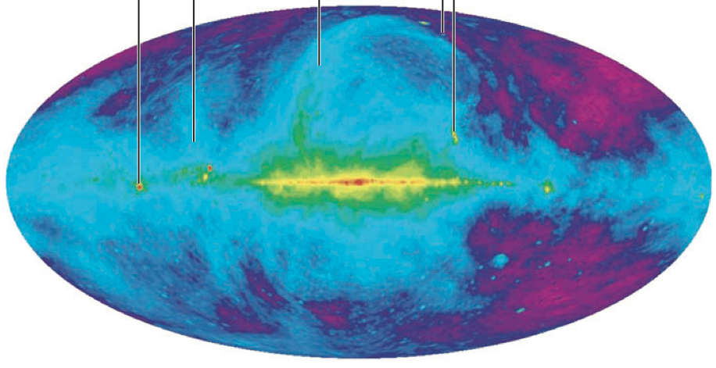
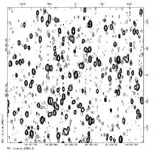
Challenge: sky is hot, confused at low freq
Haslam, Eberg 408MHz
Coldest regions: T ~ 100 (ν/200 ΜΗz)^{-2.6} K = 10⁴ x 21cm signal
Highly ‘confused’: 1 source/deg² with S140 > 1 Jy

Slide 23
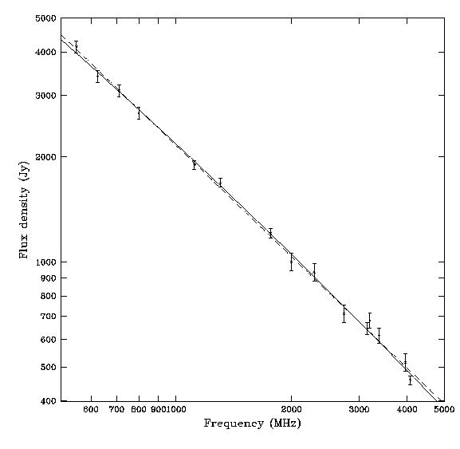
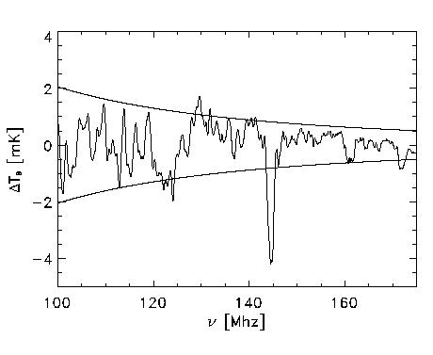
Solution: spectral decomposition
Foreground= non-thermal= featureless over ~ 100’s MHz
Signal = fine scale structure on scales ~ MHz
Cygnus A
Signal/Sky ~ 10⁻⁵
z=13
z=7
500MHz
5000MHz
Critical to mitigate freq dependent telescope response!

Slide 24
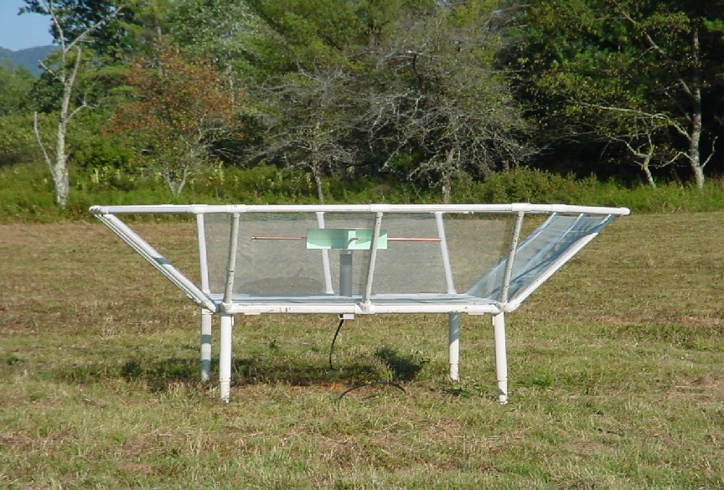
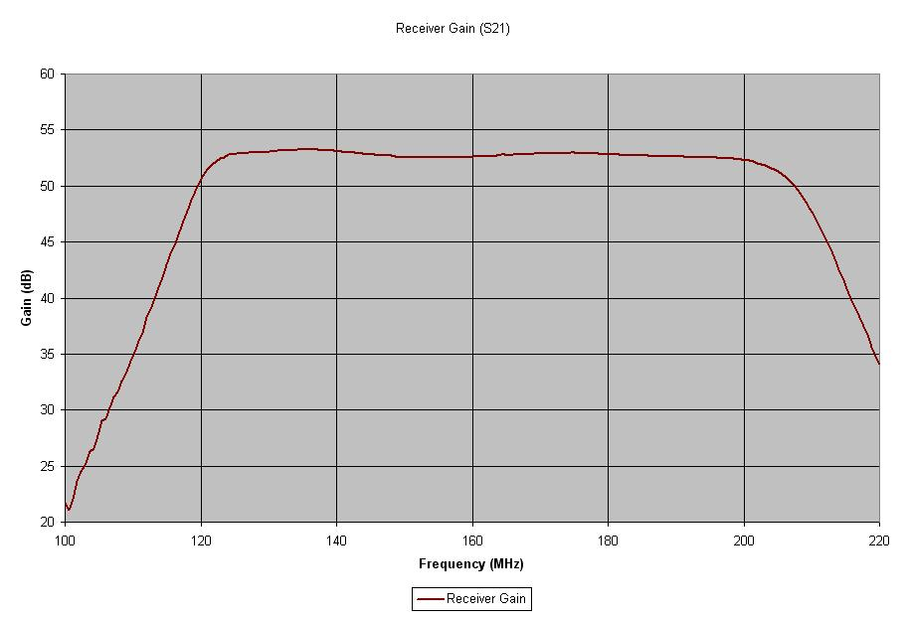
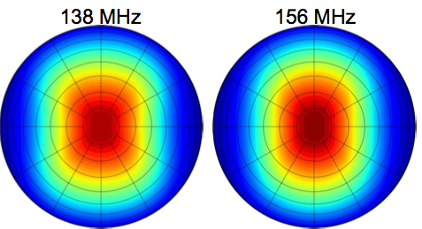
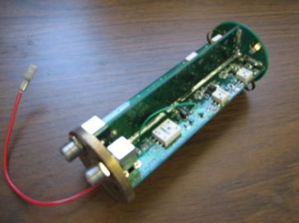
PAPER Antenna: ‘clean machine’
Sleeve dipole + flaps
Smooth, broad response in frequency and angle
Gain
10dB
120MHz
200MHz
LNA: T_{rx} = 110K, 30dB gain 120-180MHz

Slide 25
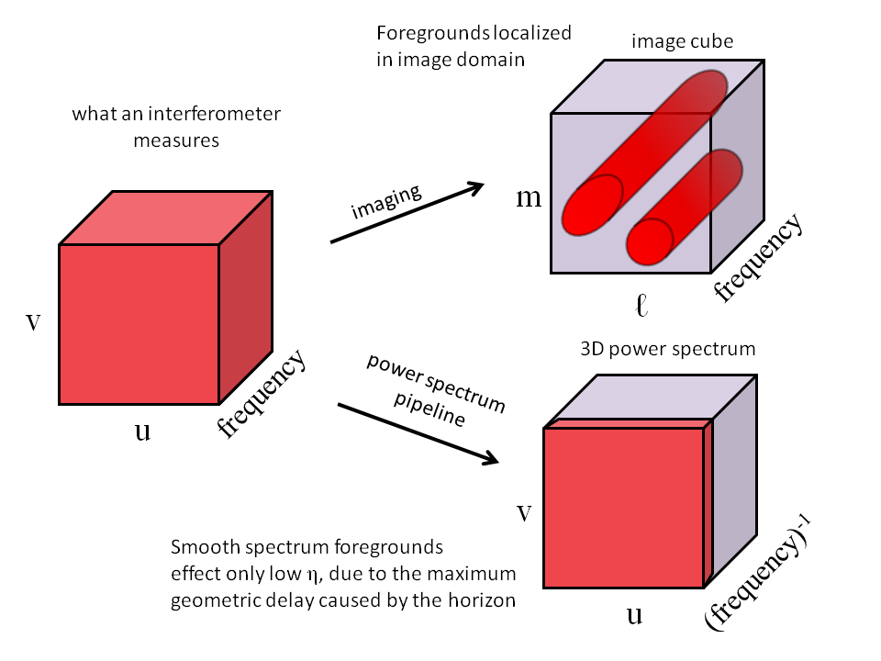
Foregrounds and Fourier Transforms
= B/λ
k_{y}
k||
k_{x}

Slide 26
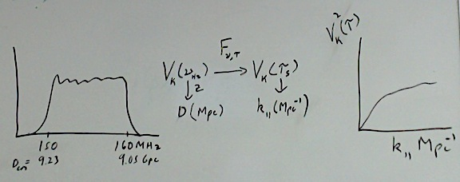
Power spectrum: ‘delay spectrum’ (Parsons ea.)
3D PS: ‘Parallel’ = line-of-sight (ν) ; ‘Perpendicular’= angular (sky-plane)
V_{Kelvin}(ν)
Focus on Frequency:
Frequency maps to distance => Fourier conjugate (delay) maps linearly to wavenumber (Mpc⁻¹)
Analyze line-of-sight PS (k_{par}) per baseline, time: PS = square of F_{t}[V_{K}(ν)] = V²_{K}(τ)
Ignore angular PS (k_{perp})

Slide 27
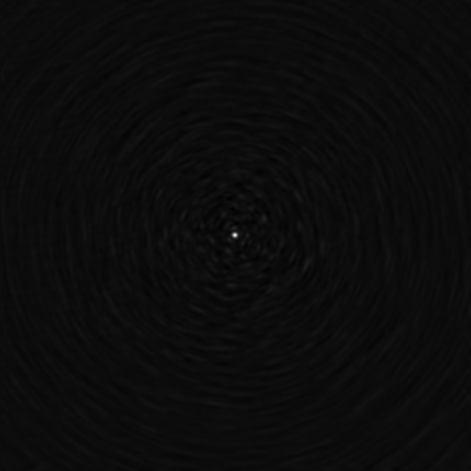
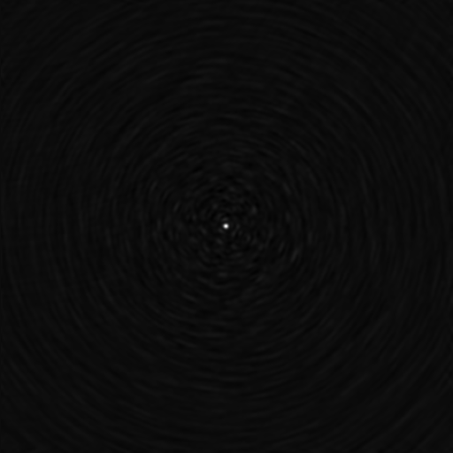
Challenge: array spectral sidelobes
Synthesized beam (PSF) is chromatic
Smooth spectral fitting over MHz bands does not remove far-out sidelobes of bright sources
Bright source subtraction requires better than 0.2% antenna calibration to reach thermal noise each day (Datta ea. 2010)
120 to 180 MHz

Slide 28
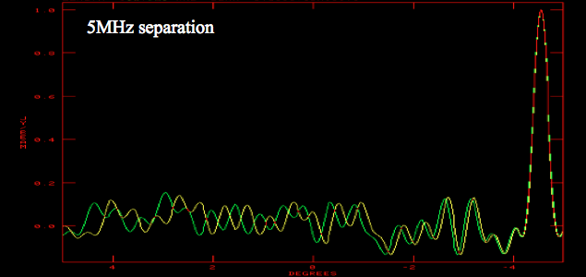
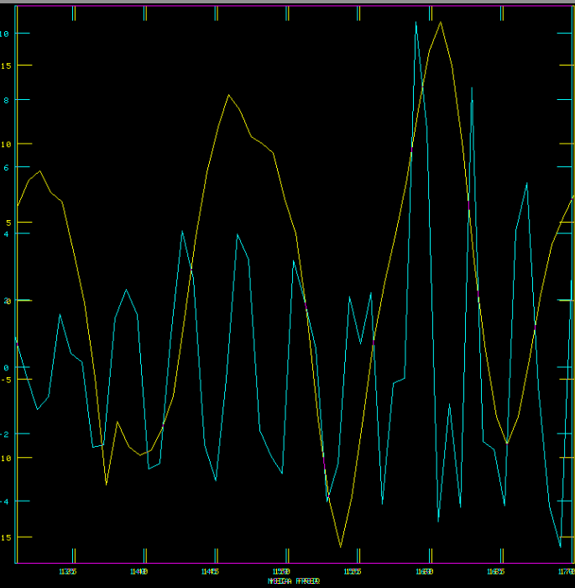
III. Continuum avoidance
Characteristic sidelobe scale in frequency (= k_{par}), is set by baseline length (=k_{perp})
10º
B=30m
Datta et al. 2010, ApJ, 724, 526
Parsons et al. 2012, ApJ, 756, 165
Parsons et al. 2012, ApJ, 753, 81
Parsons et al. 2013, ApJ, arXiv:1304.4991
Pober et al. 2013, ApJ, 768, L36
B=90m
130MHz
180MHz

Slide 29
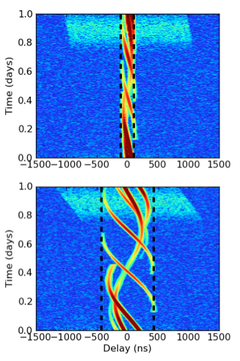
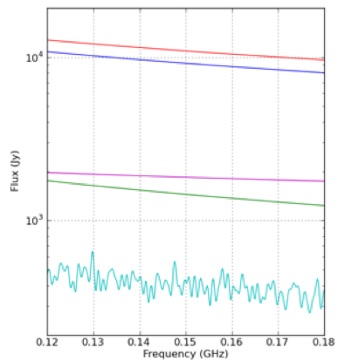
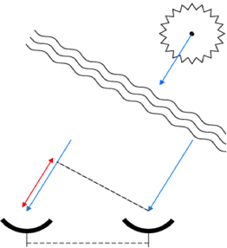
The Delay Transform
B=30m
Delay, τ
B=150m
τ_{max} = B/c
Continuum source ~ ‘delta function’ in delay transform, w. τ = f(time), naturally limited to τ_{max} = B/c = ‘horizon limit’ for continuum sources
Line sources extend beyond wedge in DS

Slide 30
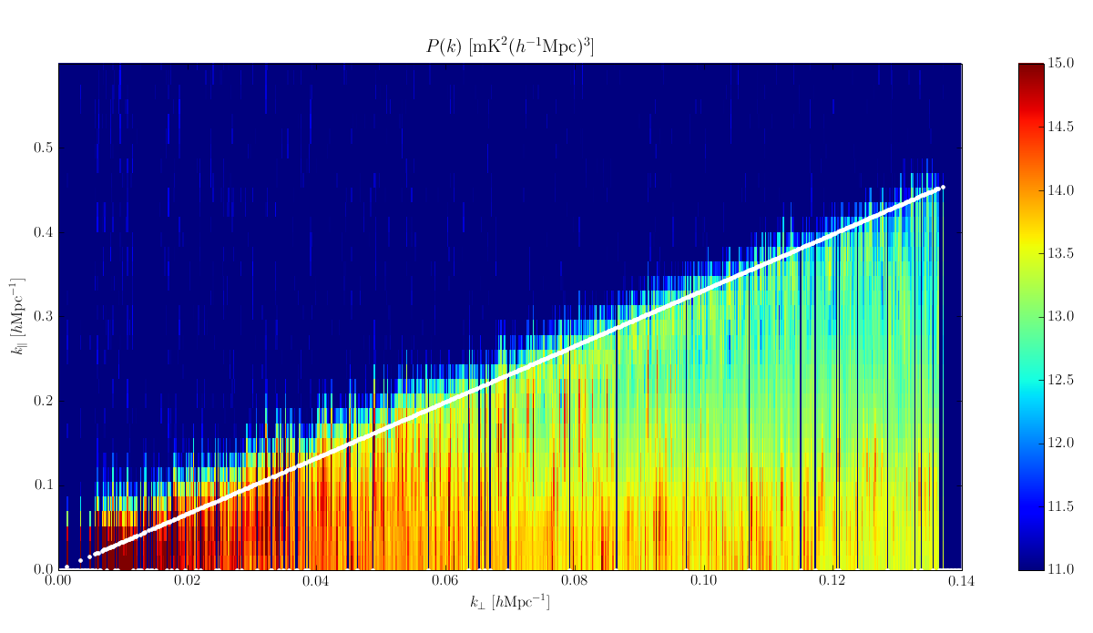
II. EoR window and the Continuum Wedge
k_{par} ~ Delay or Freq⁻¹
‘EoR Window’
Wedge = ‘horizon limit’ for continuum sources
150m
30m
k_{perp} ~ Baseline or Angle⁻¹
Cut out wedge = natural filtering of continuum sources

Slide 31
III. Redundant spacings
Redundant spacing calibration: antenna complex gains (t, υ)
N identical measurements at given time => ‘signal to noise’ of PS improves linearly with number of measurements, N, vs. as N^{1/2} with incoherent averaging (add and square vs. square and add)

Slide 32

PAPER 32 Power spectrum
300hrs, 32ant, 70 redundant baselines of 30m length
k ~ 0.1 to 0.2 h⁻¹ Mpc⁻¹:
k³/2π² P(k) < 2600 mK²
5 order of magnitude continuum suppression
Best limits to date by 100x
Still inconsistent with thermal noise => residual (pol.) continuum?
Still 100x above predictions of fiducial reionizaiton models (eg. McQuinn ea)
‘horizon limit’ = ‘wedge’
Paciga ea GMRT
T_{sys}=560K
Fiducial

Slide 33
Ruling out pathological (but not impossible?) models
‘horizon limit’ = ‘wedge’
Model: neutral IGM remains cold (no large-scale Xray warming), but enough Lya to couple T_{s} and T_{K} and reionization proceeds locally => <T_{B}> ~ 400mK
No warming
Fiducial

Slide 34
‘Richest of cosmological data sets’
z>200: T_{CMB} = T_{K}= T_{S} by residual e-, photon, and gas collisions. No signal.
z∼30 to 200: gas cools as T_{k} ≈ (1+z)² vs. T_{CMB} ≈ (1 + z), but T_{S} = T_{K} via collisions => absorption, until density drops and T_{s} → T_{CMB}
z∼20 to 30: first stars => Lyα photons couples T_{K} and T_{S} => 21-cm absorption
z∼6 to 20: IGM warmed by hard X rays => T_{K} > T_{CMB}. T_{S} coupled to T_{K} by Lya. Reionization is proceeding => bubble dominated
IGM reionized
T_{cmb}
T_{S}
T_{K}
No warming
E
D
C
B
A

Slide 35
PAPER towards a detection in 2015
Build-out 2013
128 elements
2 years observing
Full polarization (get to thermal noise)
~10x improvement (in mK) => detect fiducial model
PAPER 128
Fiducial

Slide 36


Hydrogen Epoch of Reionization Array
361 x 14m parabolic transit antennas (~Arecibo), 50 to 250MHz, in Karoo
MWA+PAPER collaboration: Berkeley, Cavendish, MIT, NRAO, Penn, Washington, ASU, SKA-ZA, U. KwaZulu-Natal
Build on PAPER/MWA experience to design next generation array: Optimal design for delay spectrum analysis + large scale structure imaging
Construction start 2015, science: 2017 to 2019; Cost ~ $16M
Notes:
PSA-64, 32 antennas in a maximum-redundancy configuration, 30m between rows, 4m spacing within rows

Slide 37

HERA is a finalist (1 of 12) in the NSF Mid-Scale Innovations Program

Slide 38

HERA-331
 | Area (m²) | SNR Pessimistic | SNR Moderate | SNR Optimistic
SKA-low | 8e5 | 14 | 98 | 280
HERA | 5e4 | 19 | 23 | 80
LOFAR-core | 3e4 | 1.4 | 2.8 | 17
MWA-128 | 900 | 0.6 | 2.5 | 6.4
PAPER-128 | 530 | 1.7 | 1.9 | 8.9
Notes:
PSA-64, 32 antennas in a maximum-redundancy configuration, 30m between rows, 4m spacing within rows

Slide 39


F_{HI}
Jacobs ea. McQuinn ea
HERA 331
Detailed characterization of evolution neutral IGM: z=6 to 20
Direct imaging scales ~ 30-100 cMpc (full 3D analysis)
Explore end of ‘dark ages’ (z ~ 15 to 20)
Inform science/tech SKA-low (2020+)

Slide 40

HERA 568
Explore end of ‘dark ages’ (z ~ 15 to 20)
Real (linear) cosmology

Slide 41


Slide 42



Probing the Dark Ages using a Lunar low frequency array
No interference
No ionosphere
Best place to study dark ages (< 60 MHz)
RAE2 1973
10MHz
Recognized as top astronomy priority for NASA Lunar exploration program (Livio ‘07)

Slide 43



J. Burns, PI Colorado
Design specs for a ‘dark ages’ low frequency array on Moon
Relies on future heavy lift capabilities of Ares V (65 tons to moon)
http://lunar.colorado.edu/

Slide 44

Cosmic Reionization: last frontier in studies of large scale structure formation
HI 21cm: direct imaging of evolution of the early Universe
PAPER (2013-2015):
First PS limits from PAPER 32: rule out pathological models
Build out to 128 in 2013, observe 2 years: constrain plausible models or first detection
HERA (2015-19): 331 x 14m parabolic antenna array for detailed PS characterization, evolution, and first imaging
SKA-low (2021+): full IGM tomography at arcmin scales
Dark ages: 21cm cosmology from the Moon

Slide 45







Slide 46



The HERA Dish
Notes:
PSA-64, 32 antennas in a maximum-redundancy configuration, 30m between rows, 4m spacing within rows

Slide 47

Signal I: Global (all sky) emission (eg. T_{CMB})
Signal ~ 20mK
Interplay of ρ, T, f(HI)
Feedback ‘slows-down’ galaxy formation
No Feedback
Resonant scattering of Lya from first galaxies (Field-Wouthuysen effect) couples T_{S} to T_{K} which is < T_{CMB}
Furlanetto, Oh, Briggs 06

