Slide 1
Cosmic Reionization
Chris Carilli (M/NRAO)
Vatican Summer School June 2014
I. Introduction: Cosmic Reionization
Concept
Cool gas in z > 6 galaxies: quasar hosts
Constraints on evolution of neutral Intergalactic Medium (IGM)
[Sources driving reionization – Trenti]
II. HI 21cm line
Potential for direct imaging of the evolution of early Universe
Precision Array to Probe Epoch of Reionization: first results
Hydrogen Epoch of Reionization Array: building toward the SKA

Slide 2
Cosmic Reionization
Loeb & Furlanetto ‘The first galaxies in the Universe’
Fan, Carilli, Keating 2006, ARAA, 44, 415
Furlanetto et al. 2006, Phys. Reports, 433, 181
Wyithe & Morales 2010, ARAA, 48, 127
Pritchard & Loeb 2012, Rep.Prog. Phys., 75, 6901

Slide 3
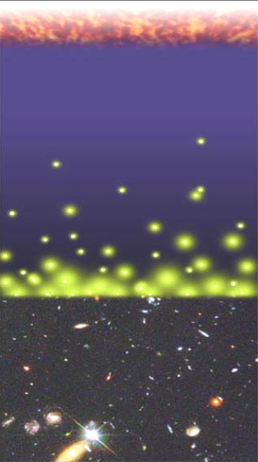
Big Bang f(HI) ~ 0
History of Normal Matter (IGM ~ H)
Recombination
0.4 Myr
z = 1000
f(HI) ~ 1
Reionization
0.4 – 1.0 Gyr
z ~ 6 to 12
f(HI) ~ 10⁻⁵
13.6Gyr
z = 0
Djorgovski/CIT

Slide 4
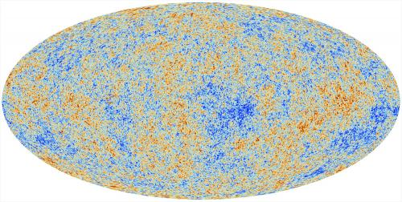
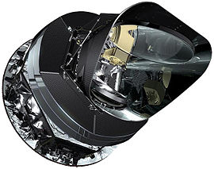
Cosmic microwave background radiation
Recombination
Early structure formation
Imprint of primordial structure from the Big Bang: seeds of galaxy formation
Planck

Slide 5
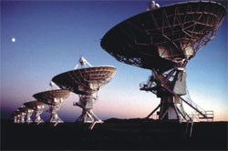
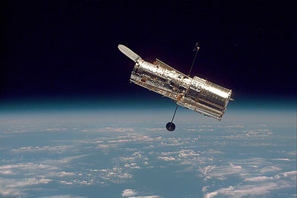
HST, VLT, VLA…
Late structure formation Realm of the Galaxies

Slide 6
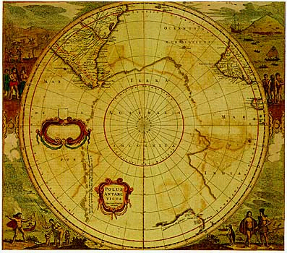
Universum incognitus
Dark ages
Last phase of cosmic evolution to be tested and explored
Cosmological benchmark: formation of first galaxies and quasars
Focus on key diagnostic: Evolution of the neutral IGM through reionization
When?
How fast?
HI 21cm signal
Cosmic Reionization

Slide 7
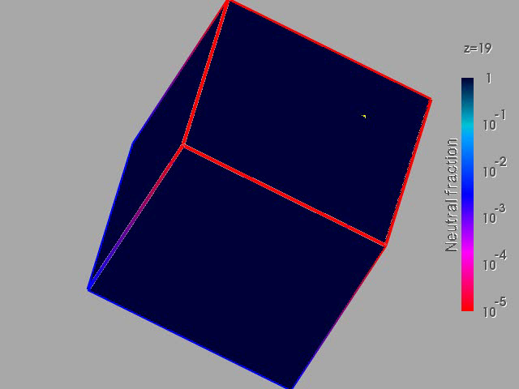
Numerical simulation of the evolution of the IGM
F(HI) from z=20 to 5
Three phases
Dark Ages
Isolated bubbles (slow)
Percolation (bubble overlap, fast): ‘cosmic phase transition’
10cMpc
(Gnedin & Fan 2006)

Slide 8
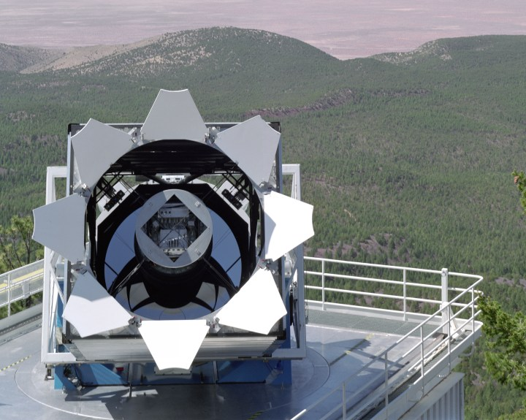
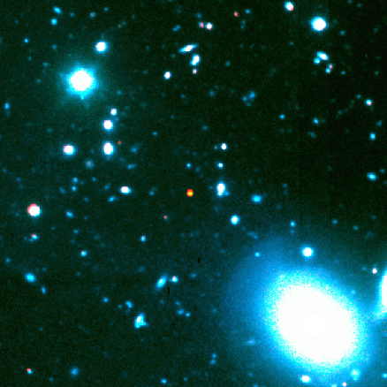
SDSS
Apache Point NM
Dust and cool gas at z~6: Quasar host galaxies at t_{univ}<1Gyr
Why quasars?
Rapidly increasing samples:
z>4: thousands
z>5: hundreds
z>6: tens
Spectroscopic redshifts
Extreme (massive) systems:
L_{bol} ~10¹⁴ L_{o}=> M_{BH}~ 10⁹ M_{o} => M_{bulge} ~ 10¹² M_{o}
1148+5251 z=6.42

Slide 9
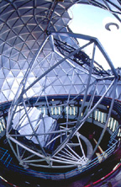
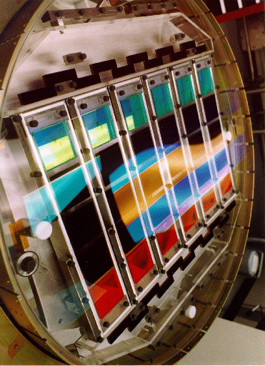
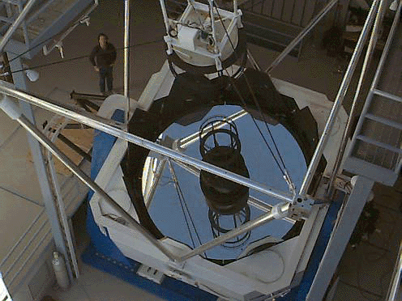
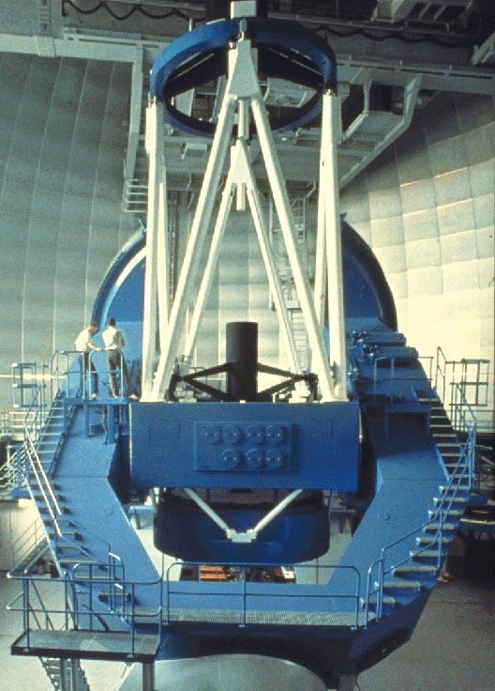
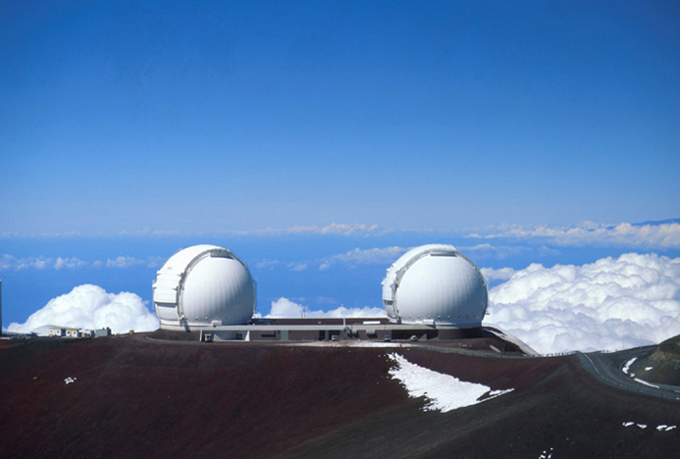
Sloan Digital Sky Survey -- Finding the most distant quasars: needles in a haystack
Hobby-Eberly (Texas)
9.2m
APO 3.5m
Keck (Hawaii) 10m
SDSS database:
40 million objects
Calar Alto (Spain)
3.5m
4. Detailed spectra
8 new quasars at z~6
1 in 5,000,000!
2..Photometric pre-selection:
~200 objects
3. Photometric and spectroscopic
Identification ~20 objects

Slide 10
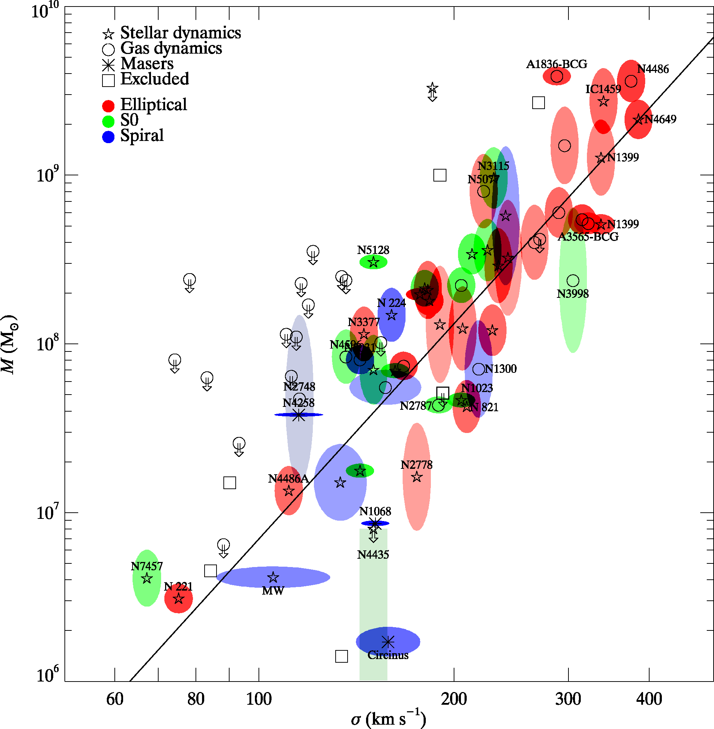
Quasar host galaxies MBH–Mbulge relation
Kormendy & Ho 2013 ARAA 51, 511
MBH=0.002 Mbulge
M_{BH}
σ ~ M_{bulge}^{1/2}
All low z spheroidal galaxies have central SMBH
‘Causal connection between SMBH and spheroidal galaxy formation’
Luminous high z QSOs have massive host galaxies (1e12 Mo)

Slide 11
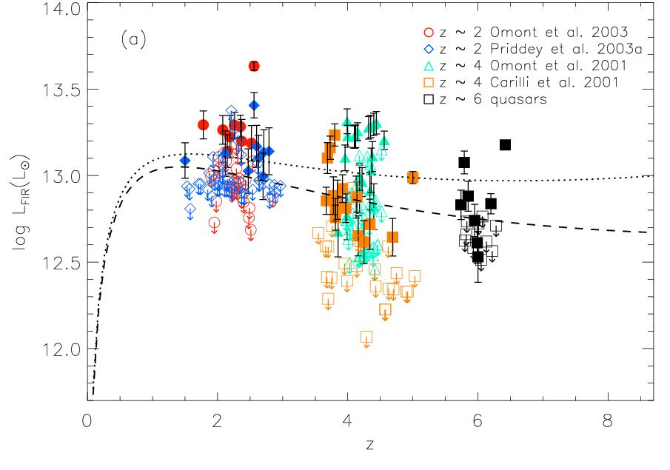
Dust in high z quasar host galaxies: 250 GHz surveys
HyLIRG
Wang sample 33 z>5.7 quasars
30% of z>2 quasars have S₂₅₀ > 2mJy
LFIR ~ 0.3 to 2 x10¹³ L_{o}
M_{dust} ~ 1.5 to 5.5 x10⁸ M_{o} (κ_{125um} = 19 cm² g⁻¹)

Slide 12
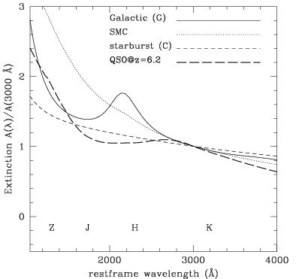
Dust formation at t_{univ}<1Gyr?
AGB Winds > 10⁹yr
High mass star formation?
‘Smoking quasars’: dust formed in BLR winds/shocks
ISM dust formation
Extinction toward z=6.2 QSO + z~6 GRBs => different mean grain properties at z>4
Larger, silicate + amorphous carbon dust grains formed in core collapse SNe vs. eg. graphite
SMC, z<4 quasars
Galactic
z~6 quasar, GRBs
Stratta ea. ApJ, 2007, ApJ 661, L9
Perley ea. MNRAS, 406 2473

Slide 13
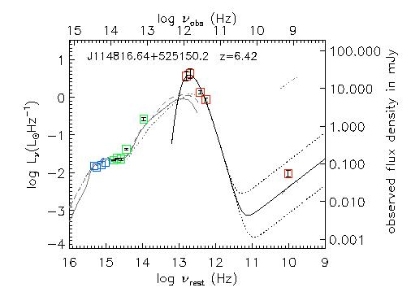
Dust heating? Radio to near-IR SED
Star formation
low z QSO SED
T_{D} ~ 1000K
Radio-FIR correlation
FIR excess = 47K dust
SED = star forming galaxy with SFR ~ 400 to 2000 M_{o} yr⁻¹

Slide 14
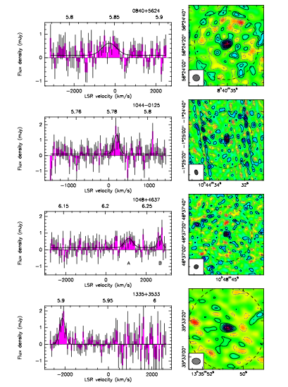
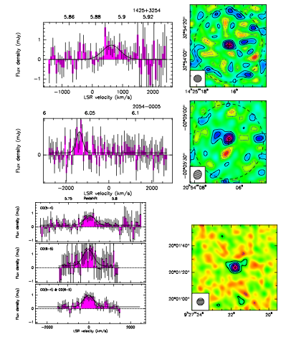
Fuel for star formation? Molecular gas: 11 CO detections at z ~ 6 with PdBI, VLA
M(H₂) ~ 0.7 to 3 x10¹⁰ (α/0.8) M_{o}
Δv = 200 to 800 km/s
Accurate host galaxy redshifts
1mJy

Slide 15
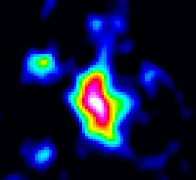
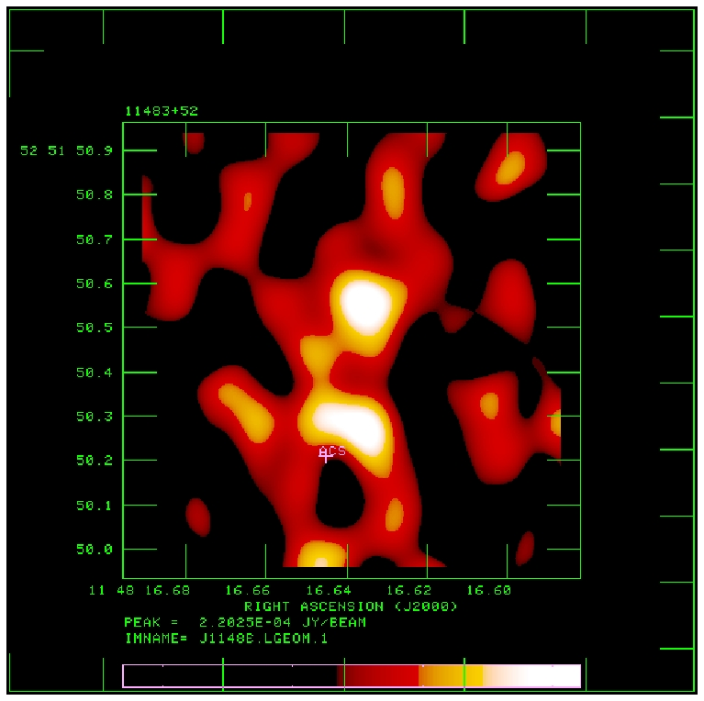
VLA imaging at 0.15” resolution
J1148+5251 z=6.4 CO3-2 VLA
IRAM
1” ~ 5.5kpc
0.3”
+
Size ~ 6 kpc, but half emission from two clumps:
sizes < 0.15” (0.8kpc)
T_{B} ~ 30 K ~ optically thick
Galaxy merger + 2 nuclear SB

Slide 16
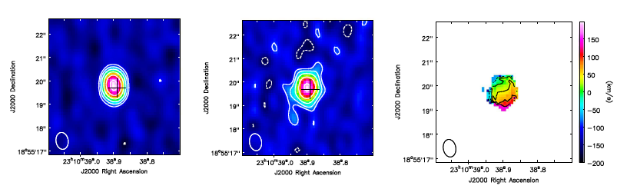
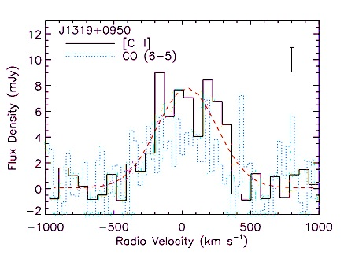
ALMA imaging [CII]: 5 of 5 detected
Dust Wang ea
Gas
-200 km/s
+300 km/s
300GHz, 0.5” res
1hr, 17ant
Coeval starburst – AGN: forming massive galaxies at t_{univ} < 1Gyr
Sizes ~ 2-3kpc, clear velocity gradients
M_{dyn} ~ 5e10 M_{o,} M_{H2} ~ 3e10 (α/0.8) M_{o}
SFR > 10³ M_{o}/yr => build large elliptical galaxy in 10⁸ yrs
Early formation of SMBH > 10⁸ M_{o}

Slide 17
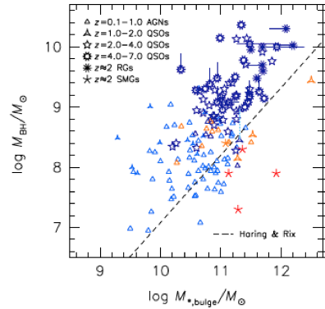
Break-down of M_{BH} -- M_{bulge} relation at high z
Use [CII], CO rotation curves to get host galaxy dynamical mass
<M_{BH}/M_{bulge}> ~ 15 higher at z>2 => Black holes form first?
Caveats:
need better CO, [CII] imaging (size, i)
Bias for optically selected quasars (face-on)?
At high z, CO only method to derive M_{bulge}

Slide 18
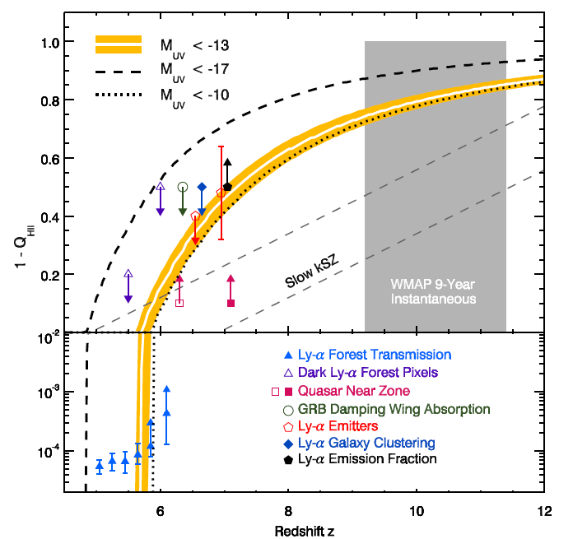
Evolution of the IGM neutral fraction: Robertson ea. 2013
1 Gyr
0.5 Gyr
F_{HI_vol}
Lya-galaxies
Quasar Near-zones
Gunn-Peterson

Slide 19
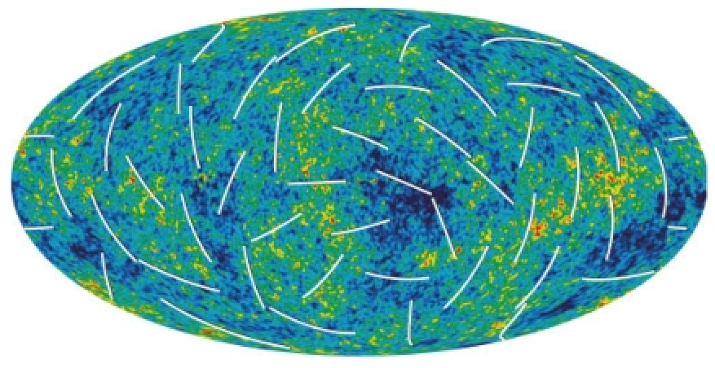
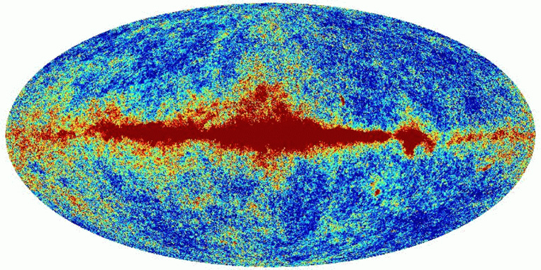
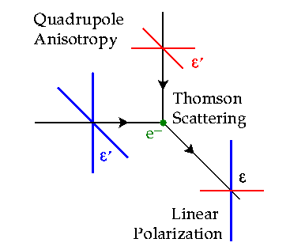
Large scale polarization of the CMB
Temperature fluctuations = density inhomogeneities at the surface of last scattering
Polarized = Thomson scattering local quadrapol CMB
WMAP Hinshaw et al. 2008

Slide 20
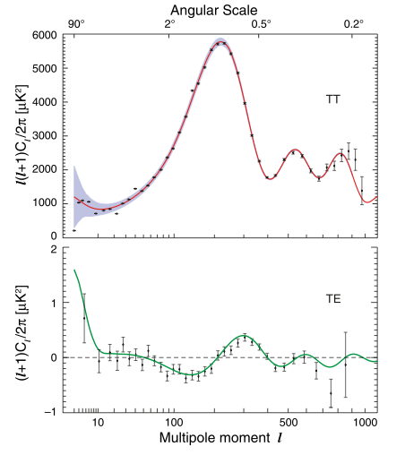
Large scale polarization of the CMB (WMAP)
Angular power spectrum (~ rms fluctuations vs. scale)
Large scale polarization
Integral measure of _{e} back to recombination
Earlier => higher τ_{e}
τ_{e} ~ σ_{T}ρL ~ (1+z)³/(1+z) ~ (1+z)²
Large scale ~ horizon at z_{reion} l < 10 or angles > 10º
Weak: uK rms ~ 1% total inten.
Sachs-Wolfe
Baryon Acoustic Oscillations: Sound horizon at recombination
_{e} = 0.087 +/- 0.015
Jarosik et al 2011, ApJS 192, 14

Slide 21
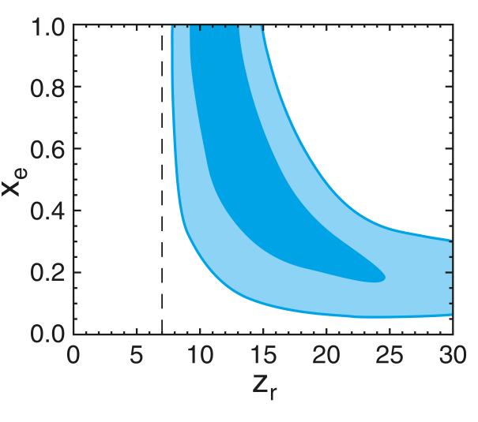
CMB large scale polarization: constraints on F(HI)
Rules-out high ionization fraction at z > 15
Allows for small (≤ 0.2) ionization to high z
Most ‘action’ at z ~ 8 – 13
1-F(HI)
Two-step reionization: 7 + z_{r}
Dunkley ea 2009, ApJ 180, 306

Slide 22
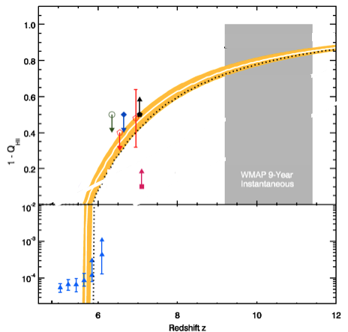
CMB large scale polarization: constraints on F(HI)
F_{HI_vol}
Systematics in extracting large scale signal
Highly model dependent: Integral measure of _{e}

Slide 23
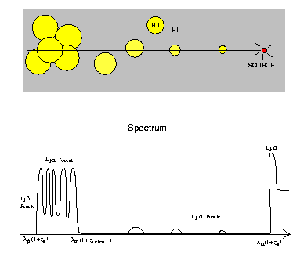
Gunn-Peterson Effect (Gunn + Peterson 1963)
ionized
neutral
z=6.4
t_{univ} ~ 0.9Gyr
quasar
z
SDSS high z quasars
Lya resonant scattering by neutral IGM
Barkana and Loeb 2001

Slide 24
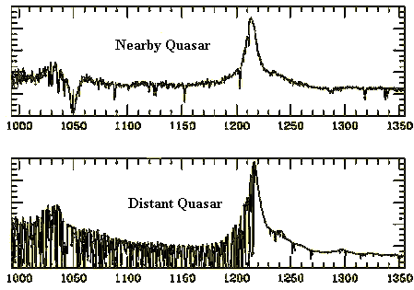
Neutral IGM after reionization = Lya forest
Lya resonant scattering by neutral gas in IGM clouds
Linear density inhomogeneities, δ~ 10
N(HI) = 10¹³ – 10¹⁵ cm⁻²
F(HI) ~ 10⁻⁵
z=0
z=3

Slide 25
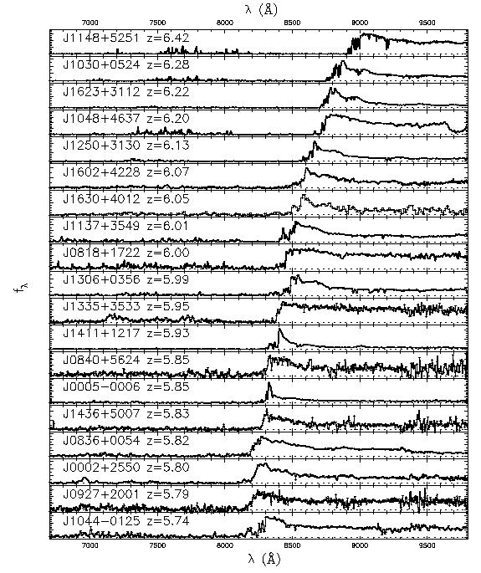
6.4
Gunn-Peterson effect
SDSS z~6 quasars
Opaque (τ > 5) at z>6
=> pushing into reionization?
5.7
SDSS quasars
Fan et al 2006

Slide 26
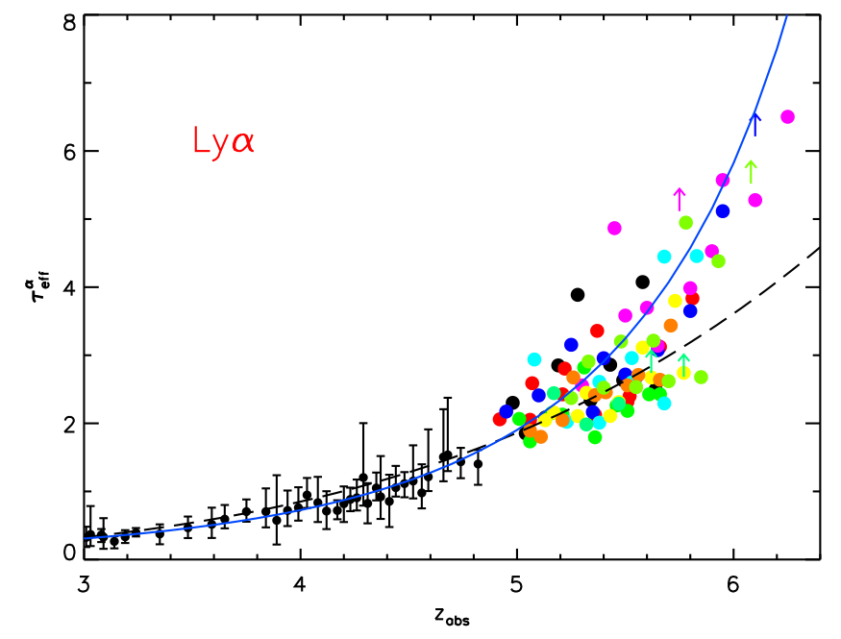
τ_{eff}
Gunn-Peterson constraints
on F(HI)
Diffuse IGM:
τ_{GP} = 2.6e4 F(HI) (1+z)^{3/2}
Clumping: τ_{GP} dominated by higher density regions => need models of ρ, T, UV_{BG} to derive F(HI)
Becker et al. 2011
z<4: F(HI)_{v} ~ 10⁻⁵
z~6: F(HI)_{v} ≥ 10⁻⁴

Slide 27
F_{HI_vol}
GP => systematic (~10x) rise of F(HI) to z ~ 5.5 to 6.5
Challenge: GP saturates at very low neutral fraction (10⁻⁴)

Slide 28
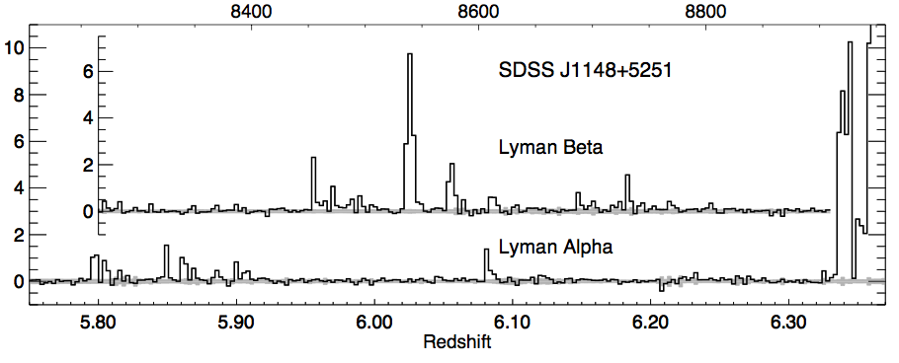
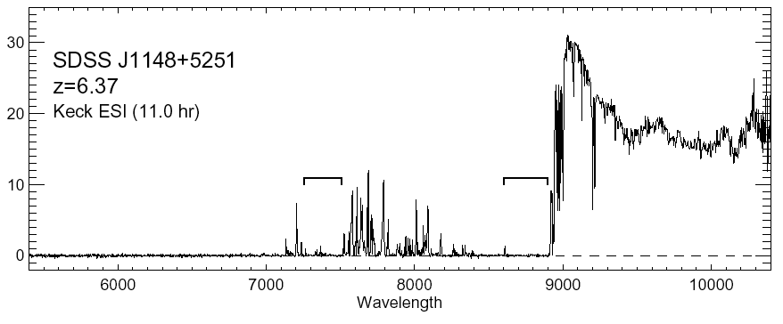
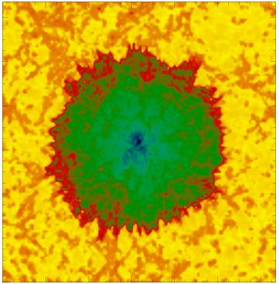
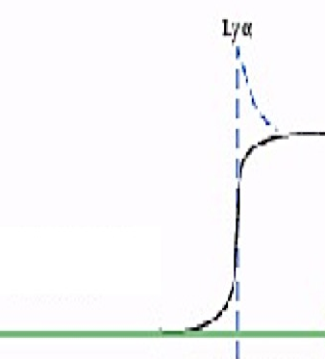
Quasar Near Zones
White et al. 2003
J1148+5251: Host galaxy redshift: z=6.419 (CO + [CII])
Quasar spectrum => photons leaking down to z=6.32
Time bounded Stromgren sphere (ionized by quasar?)
cf. ‘proximity zone’ interpretation, Bolton & Haehnelt 2007
HI
HII
z_{host} – z_{GP} => R_{NZ} = 4.7Mpc ~ [L_{γ} t_{Q}/F_{HI}]^{1/3} (1+z)⁻¹

Slide 29
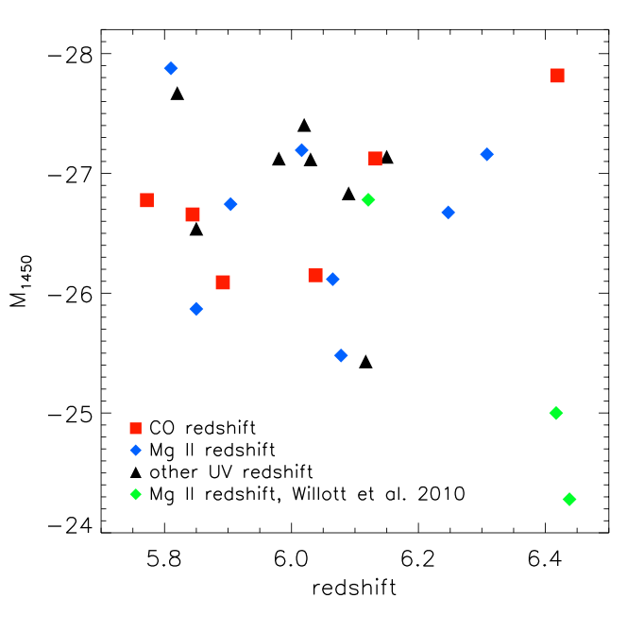
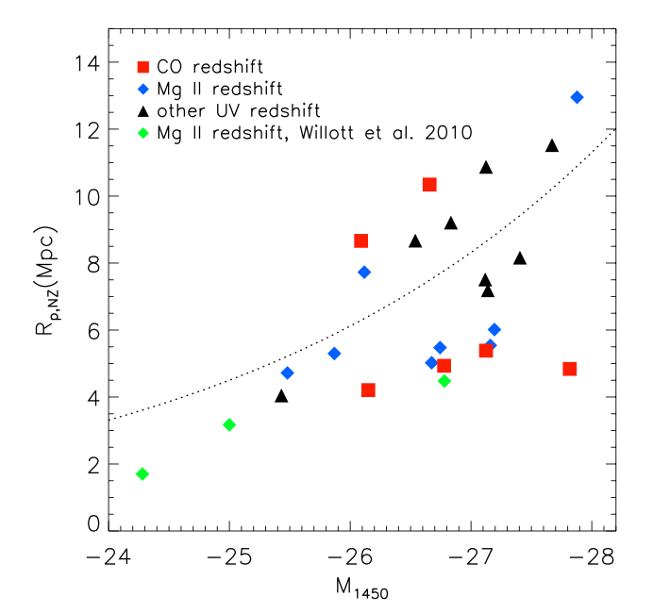
Quasar Near-Zones: 28 GP quasars at z=5.7 to 6.5
L_{UV}
R L_{γ}^{1/3}
L_{UV}
No correlation of UV luminosity with redshift
Correlation of R_{NZ} with UV luminosity
Note: significant intrinsic scatter due to local environ., t_{q}

Slide 30
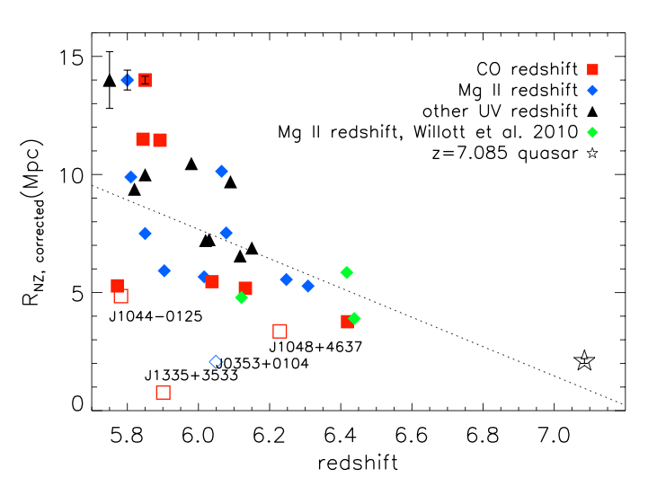
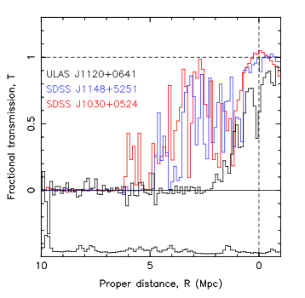
Quasar Near-Zones: R_{NZ} vs redshift
[normalized to M₁₄₅₀ = -27]
<R_{NZ}> decreases by ~10x from z=5.7 to 7.1
z ≤ 6.4
z=7.1
5Mpc
0Mpc
<R_{NZ}> decreases by factor ~ 10 from z=5.7 to 7.1
If CSS => F(HI) ≥ 0.1 by z ~ 7.1

Slide 31
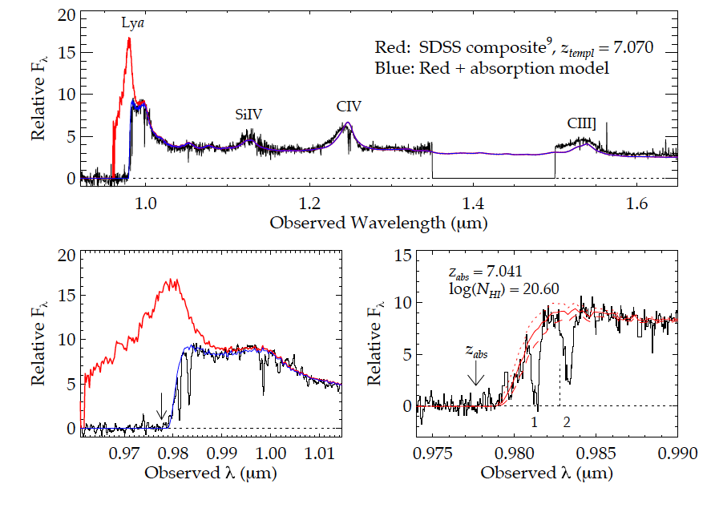
Highest redshift quasar (z=7.1)
Simcoe ea. 2012
(Bolton ea; Mortlock ea)
Damped Lya profile: N(HI) ~ 4x10²⁰ cm⁻²
Substantially neutral IGM: F(HI) > 0.1 at 2Mpc distance [or galaxy at 2.6Mpc; probability ~ 5%)]

Slide 32
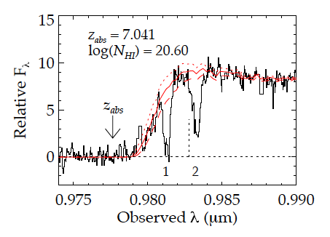
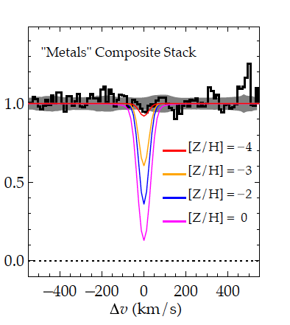
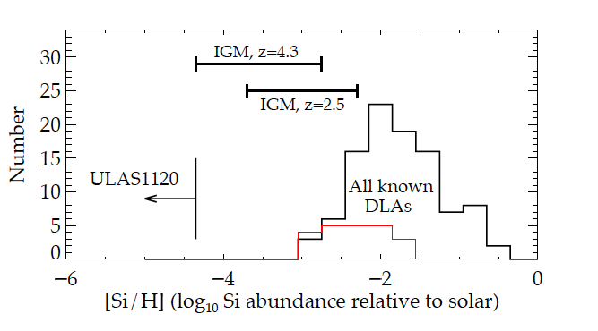
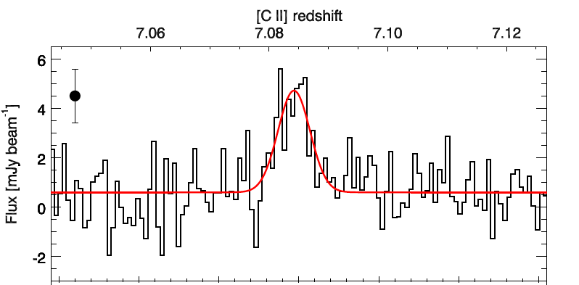
Highly Heterogeneous metalicities: galaxy vs. IGM
Z/H < -4
Simcoe ea.
[CII] + Dust detection of host galaxy => enriched ISM, but,
Very low metalicity of IGM just 2 Mpc away
Venemans ea.
[CII] 158um
Intermittency: Large variations expected during epoch of first galaxy formation

Slide 33
F_{HI_vol}
QNZ + DLA => rapid rise in F(HI) z~6 to 7 (10⁻⁴ to > 0.1)
Challenge: based (mostly) on one z>7 quasar

Slide 34
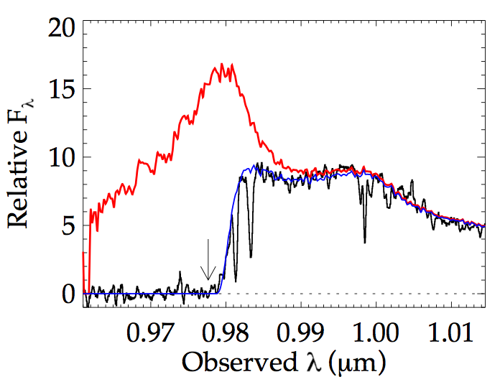

Galaxy demographics: effects of IGM on apparent galaxy counts
Lya
z=7.1 quasar
Lya
Typical z~5 to 6 galaxy
(Stark ea)
Neutral IGM attenuates Lya emission from early galaxies
Search for decrease in:
Number of Lya emitting galaxies at z>6
Equiv. Width of Lya for LBG candidates at z > 6

Slide 35


Galaxy demographics: Lyα emitters
NB survey Cosmos + Goods North
Space density of LAEs decreases faster from z=6 to 7 than expected from galaxy evolution
Expected 65, detected 7 at z=7.3!
Modeling attenuation by partially neutral IGM =>
F(HI) ~ 0.5 at z ~ 7
Konno ea 2014
z_{lya} = 7.3

Slide 36


Galaxy demographics: effects of IGM on apparent galaxy counts
Strength of Lya from LBGs
LBGs: dramatic drop in EW Lya at z > 6
F(HI) > 0.3 at z~8
Tilvi ea 2014; Treu et al. 2013

Slide 37
F_{HI_vol}
LAEs
LBGs
Galaxy demographics suggests possibly 50% neutral at z~7!
Challenge: separating galaxy evolution from IGM effects

Slide 38
1Gyr
0.5Gyr
Robertson ea. 2013
F_{HI_vol}
Amazing progress (paradigm shift): rapid increase in neutral fraction from z~6 to 7 (10⁻⁴ to 0.5) = ‘cosmic phase transition’?
All values have systematic uncertainties: suggestive but not compelling => Need new means to probe neutral IGM

Slide 39
1Gyr
0.5Gyr
Robertson ea. 2013
F_{HI_vol}
Reconciling with CMB pol:
tail of SF to high z driving 10% neutral fraction to z ~ 12
consistent with old galaxies (> 1Gyr) at z > 3 => z_{form} > 10

Slide 40

Cosmic Reionization: last frontier in studies of large scale structure formation
1st insights (Lya: GP and related) => ‘cosmic phase transition’ F_{HI} ~ 10⁻⁵ to 0.5 from z=5 to 7?
All measurements
Highly model dependent
Low F(HI) probes
Wide scatter, mostly limits
CMB pol ‘kluge’?

