Slide 1
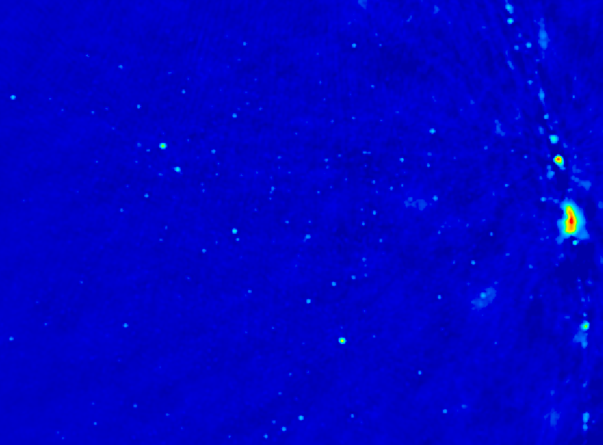
Cosmic Reionization
Chris Carilli (M/NRAO)
Fermi Lab, Nov. 2014
I. Introduction: Cosmic Reionization
  Concept
  Constraints on evolution of neutral Intergalactic Medium (IGM)
II. HI 21cm cosmology
  Potential for 3D imaging of the evolution of early Universe
  Precision Array to Probe Epoch of Reionization: first results
  Hydrogen Epoch of Reionization Array: building toward the SKA
Fan, Carilli, Keating 2006, ARAA, 44, 415
Furlanetto et al. 2006, Phys. Reports, 433, 181
Wyithe & Morales 2010, ARAA, 48, 127
Pritchard & Loeb 2012, Rep.Prog. Phys., 75, 690

Slide 2
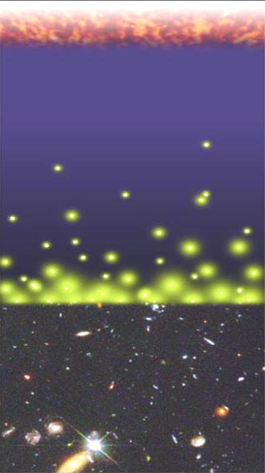
History of Normal Matter
Intergalactic Medium (mostly H)
Big Bang f(HI) ~ 0
Recombination
0.4 Myr
z = 1000
f(HI) ~ 1
Reionization
0.4 – 1.0 Gyr
z ~ 6 to 12
f(HI) ~ 10⁻⁵
13.6Gyr
z = 0
Djorgovski/CIT

Slide 3
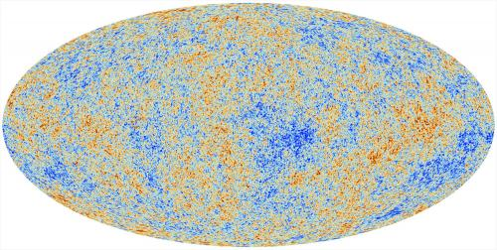
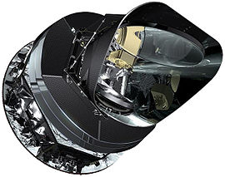
Cosmic microwave background radiation
Recombination
Early structure formation (4x10⁵ years)
Imprint of primordial structure from the Big Bang: seeds of galaxy formation
Planck

Slide 4
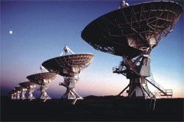
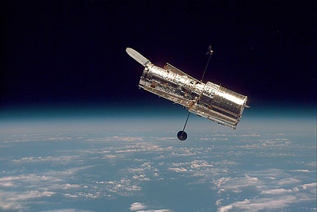
SDSS, HST, VLT, VLA…
Late structure formation Realm of the Galaxies (~ 10¹⁰ years)

Slide 5
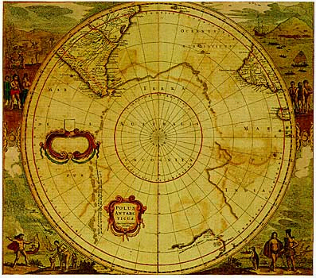
Universum incognitus
Dark ages
< 10⁹ years
Last phase of cosmic evolution to be verified and explored
Cosmological benchmark: formation of first galaxies and quasars
Focus on key diagnostic: Evolution of the neutral IGM through reionization
  When?
  How fast?
  HI 21cm signal
Cosmic Reionization

Slide 6
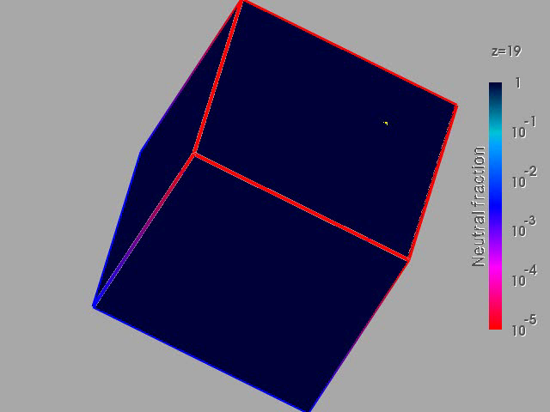
Numerical Simulation of the evolution of the IGM
F(HI) from z=20 to 5
t_{univ} = .2 to 1 Gyr
Three phases
Dark Ages
Isolated bubbles (slow)
Percolation (bubble overlap, fast): ‘cosmic phase transition’
10cMpc
(Gnedin & Fan 2006)

Slide 7
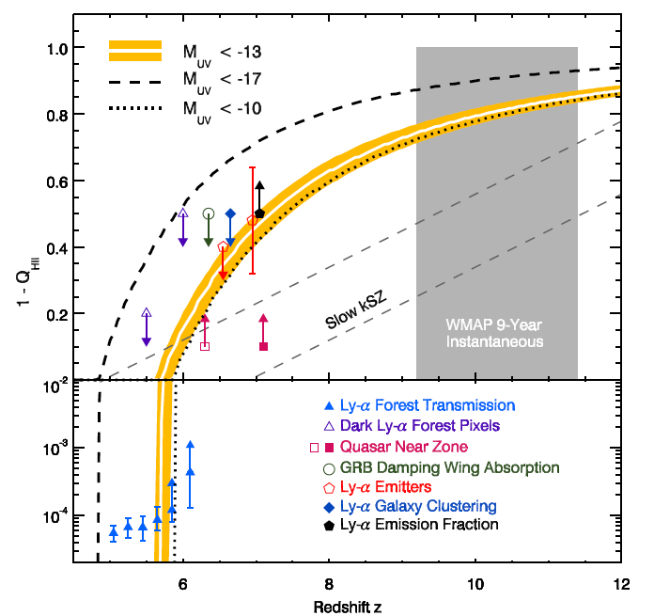
Evolution of the IGM neutral fraction: Robertson, Ellis ea. 2013
1 Gyr
0.5 Gyr
F_{HI_vol}
Lya-galaxies
Quasar Near-zones
Gunn-Peterson

Slide 8
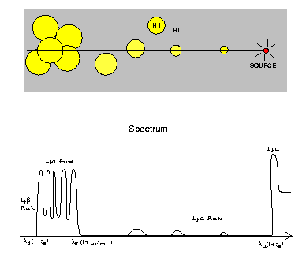
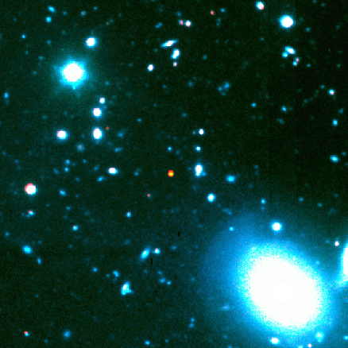
Gunn-Peterson Effect (Gunn + Peterson 1963)
ionized
neutral
z=6.4
t_{univ} ~ 0.9Gyr
quasar
z
SDSS high z quasars
Lya resonant scattering by neutral IGM
Barkana and Loeb 2001

Slide 9
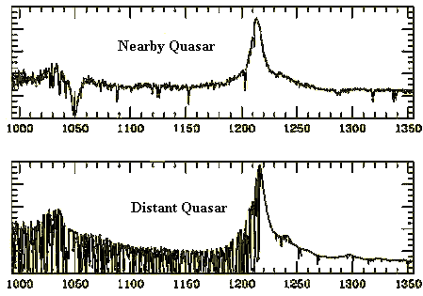
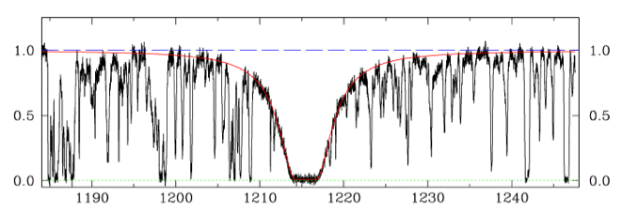
Neutral IGM after reionization = Lya forest
Lya resonant scattering by neutral gas in IGM clouds
Linear density inhomogeneities, δ~ 10
N(HI) = 10¹³ – 10¹⁵ cm⁻²
F(HI) ~ 10⁻⁵
Occasional Damped Lya system (disk galaxy): N(HI) > 10^{20.6} cm⁻²
z=0
z=3

Slide 10
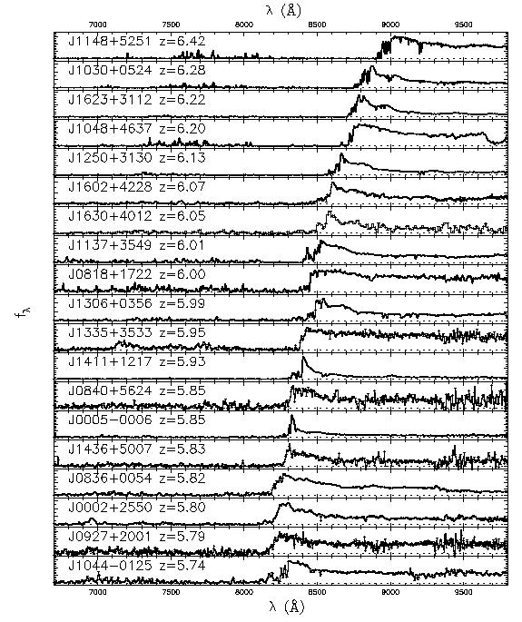
6.4
Gunn-Peterson effect
SDSS z~6 quasars
Opaque (τ > 5) at z>6
=> pushing into reionization?
5.7
SDSS quasars
Fan et al 2006

Slide 11
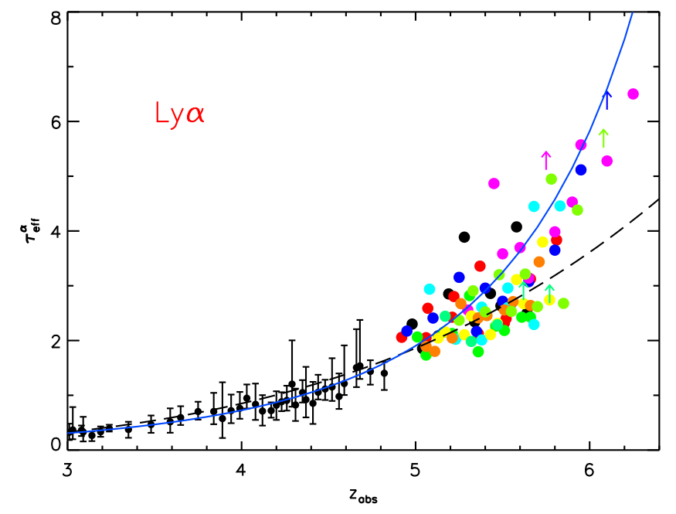
τ_{eff}
Gunn-Peterson constraints
on F(HI)
Diffuse IGM:
τ_{GP} = 2.6e4 F(HI) (1+z)^{3/2}
Clumping: τ_{GP} dominated by high density regions => need models of ρ, T, UV_{BG} to derive F(HI)
Becker et al. 2011
z<4: F(HI)_{v} ~ 10⁻⁵
z~6: F(HI)_{v} ≥ 10⁻⁴

Slide 12
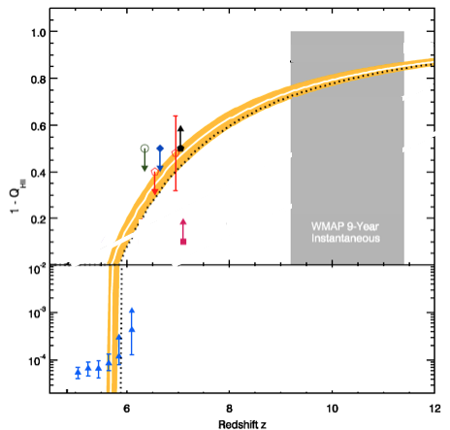
F_{HI_vol}
GP => systematic (~10x) rise of F(HI) to z ~ 5.5 to 6.5
Challenge: GP saturates at very low neutral fraction (10⁻⁴)

Slide 13
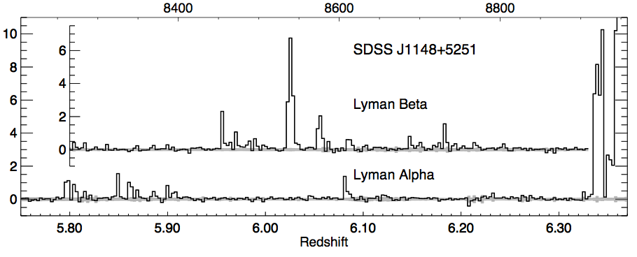
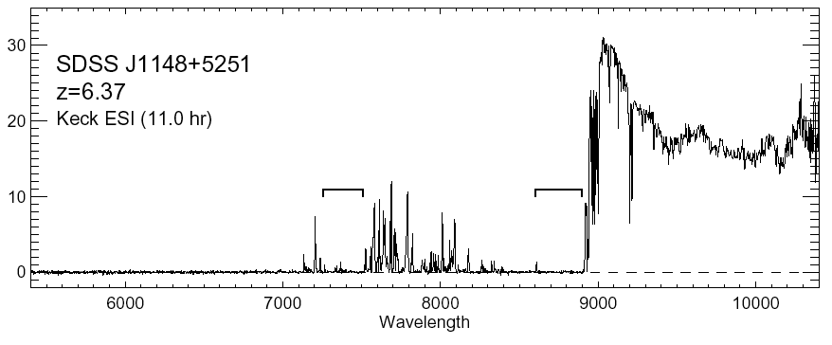
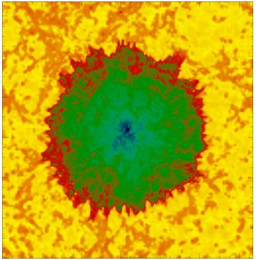
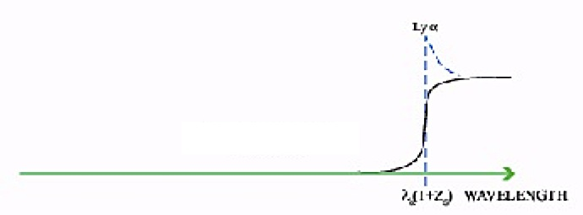
Quasar Near Zones
White et al. 2003
J1148+5251: Host galaxy redshift: z=6.419 (CO + [CII])
Quasar spectrum => photons leaking down to z=6.32
Time bounded Stromgren sphere (ionized by quasar?)
HI
HII
z_{host} – z_{GP} => R_{NZ} = 4.7Mpc ~ [L_{γ} t_{Q}/F_{HI}]^{1/3} (1+z)⁻¹

Slide 14
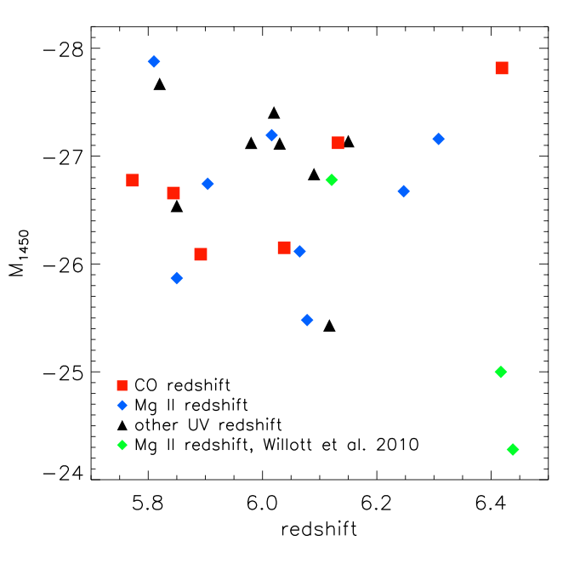
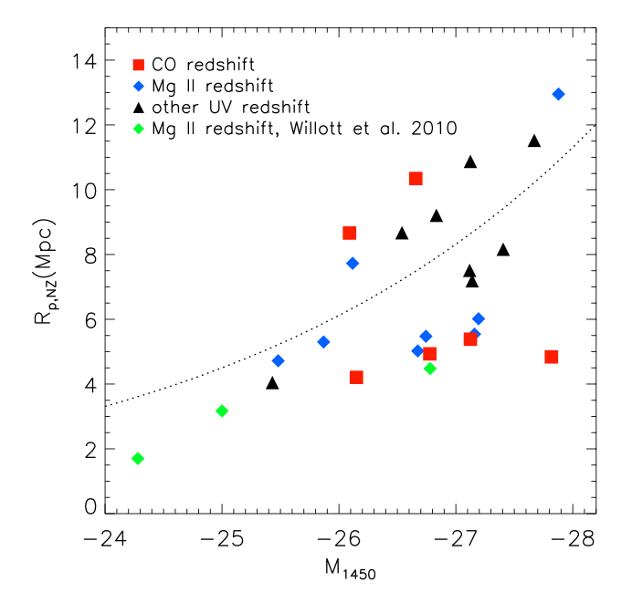
Quasar Near-Zones: 28 GP quasars at z=5.7 to 6.5
L_{UV}
R L_{γ}^{1/3}
L_{UV}
No correlation of UV luminosity with redshift
Correlation of R_{NZ} with UV luminosity
Note: significant intrinsic scatter due to local environ., t_{q}

Slide 15
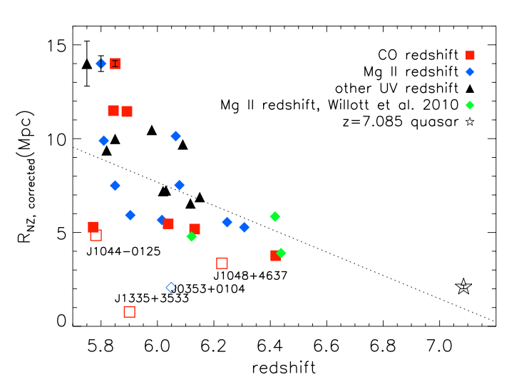
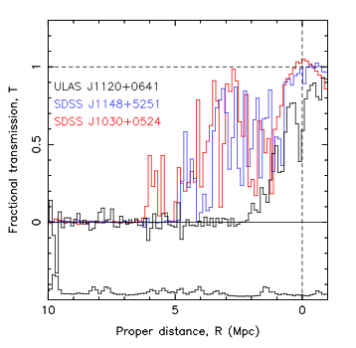
Quasar Near-Zones: R_{NZ} vs redshift
[normalized to M₁₄₅₀ = -27]
<R_{NZ}> decreases by ~10x from z=5.7 to 7.1
z ≤ 6.4
z=7.1
5Mpc
0Mpc
<R_{NZ}> decreases by factor ~ 10 from z=5.7 to 7.1
If CSS => F(HI) ≥ 0.1 by z ~ 7.1

Slide 16
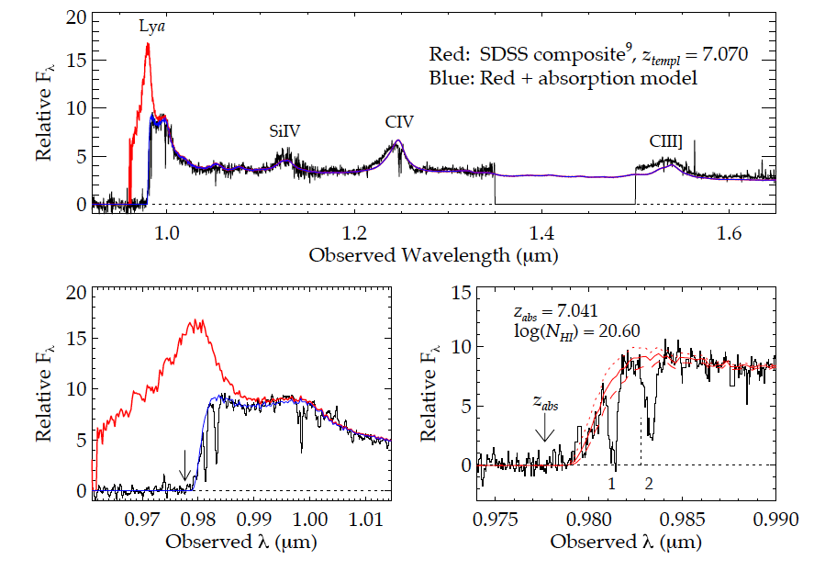
Highest redshift quasar (z=7.1)
Simcoe ea. 2012
(Bolton ea; Mortlock ea)
Damped Lya profile: N(HI) ~ 10^{20.6} cm⁻²
Substantially neutral IGM: F(HI) > 0.1 at 2Mpc distance
Or galaxy at 2.6Mpc; probability ~ 5%

Slide 17
F_{HI_vol}
QNZ + DLA => rapid rise in F(HI) z~6 to 7 (10⁻⁴ to > 0.1)
Challenge: based (mostly) on one z>7 quasar

Slide 18
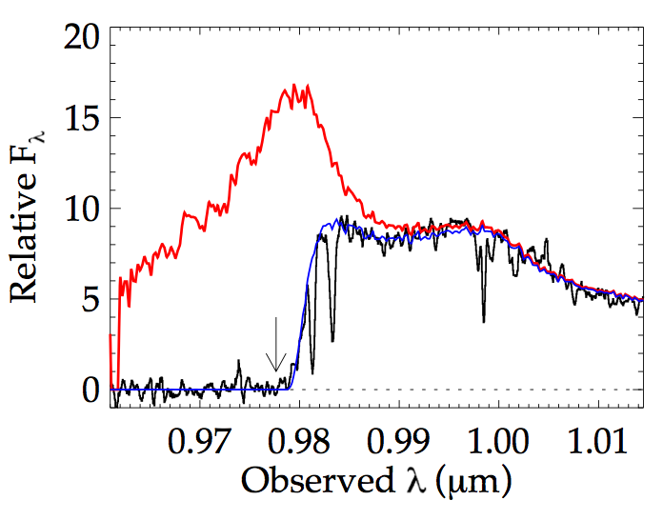
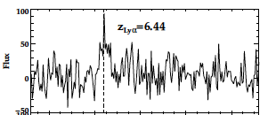
Galaxy demographics: effects of IGM on apparent galaxy counts
Lya
z=7.1 quasar
Lya
Typical z~5 to 6 galaxy
(Stark ea)
Neutral IGM attenuates Lya emission from early galaxies
Search for decrease in:
  Number of Lya emitting galaxies at z>6
  Equiv. Width of Lya for faint z > 6 galaxy candidates

Slide 19
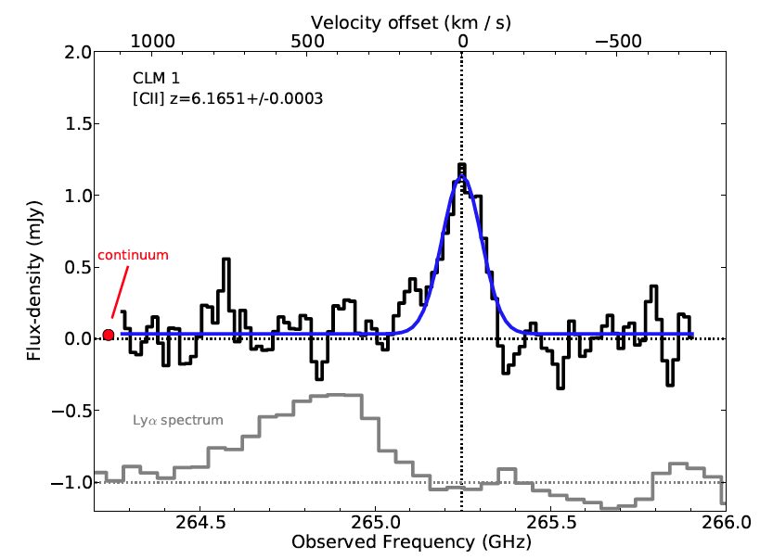
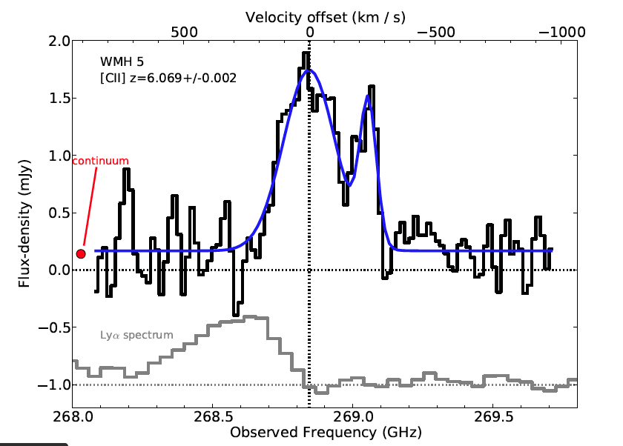
ALMA [CII] 158um at z ~ 6
Willott et al. 2014
LBGs at z=6.1: easily detected [CII] with only 25ant
Redshift comparison: Blue-side of Lya highly attenuated
GP scattering by IGM?
or (increased) internal scattering by ISM
[CII] 158um
Lya

Slide 20
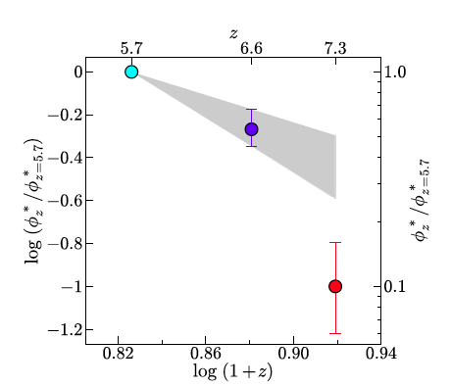

Galaxy demographics: Lyα emitters
Narrow band surveys in Lya
Space density of LAEs decreases faster from z=6 to 7 than expected from galaxy evolution
Expected 65, detected 7 at z=7.3!
Modeling attenuation by partially neutral IGM =>
  F(HI) ~ 0.5 at z ~ 7
Konno ea 2014
z_{lya} = 7.3

Slide 21
F_{HI_vol}
Galaxy demographics suggests possibly 50% neutral at z~7!
Challenge: separating galaxy evolution from IGM effects

Slide 22
1Gyr
0.5Gyr
Robertson ea. 2013
F_{HI_vol}
Amazing progress (paradigm shift): rapid increase in neutral fraction from z~6 to 7 (10⁻⁴ to 0.5) = ‘cosmic phase transition’?
Lya-based techniques restricted latter stages of reionization
All values have systematic uncertainties w. large scatter. suggestive but not compelling => Need new means to probe neutral IGM

Slide 23
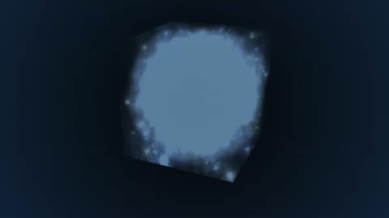
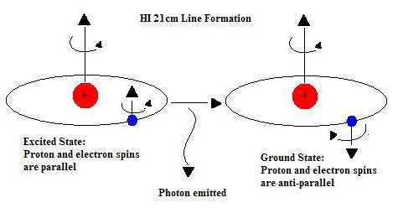
Seeing through the Fog: HI 21cm cosmology
z_{reion} ~ 6 to 12 => ν_{obs} = 1420MHz/(1+z) = 110MHz to 200MHz
Advantages of the 21cm line
Direct probe of neutral IGM
Spectral line signal => full three dimensional image of structure formation (freq = z = depth)
Low freq => very (very) large volume surveys (~ sterrad, z=7 to 11)
Hyperfine transition = weak => avoid saturation (translucent)

Slide 24
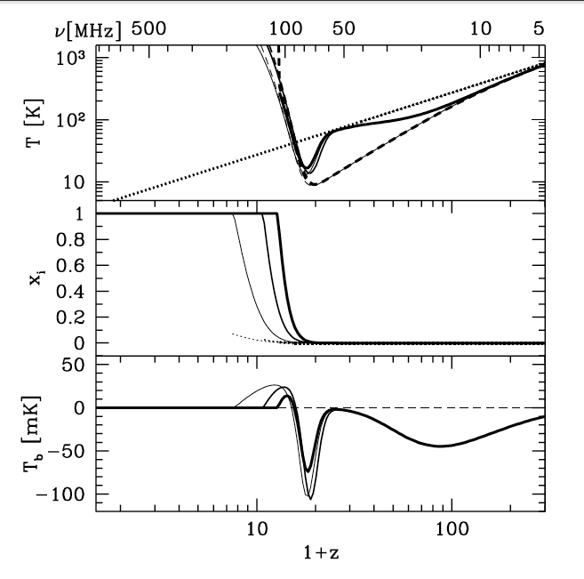
‘Richest of cosmological data sets’
z>200: T_{CMB} = T_{K}= T_{S} by residual e-, photon, and gas collisions. No signal.
z∼30 to 200: gas cools as T_{k} ≈ (1+z)² vs. T_{CMB} ≈ (1 + z), but T_{S} = T_{K} via collisions => absorption, until density drops and T_{s} → T_{CMB}
z∼20 to 30: first stars => Lyα photons couples T_{K} and T_{S} => 21-cm absorption
z∼6 to 20: IGM warmed by hard X rays => T_{K} > T_{CMB}. T_{S} coupled to T_{K} by Lya. Reionization is proceeding => bubble dominated
IGM reionized
T_{cmb}
T_{S}
T_{K}
E
D
C
B
A
First stars
Pritchard & Loeb

Slide 25
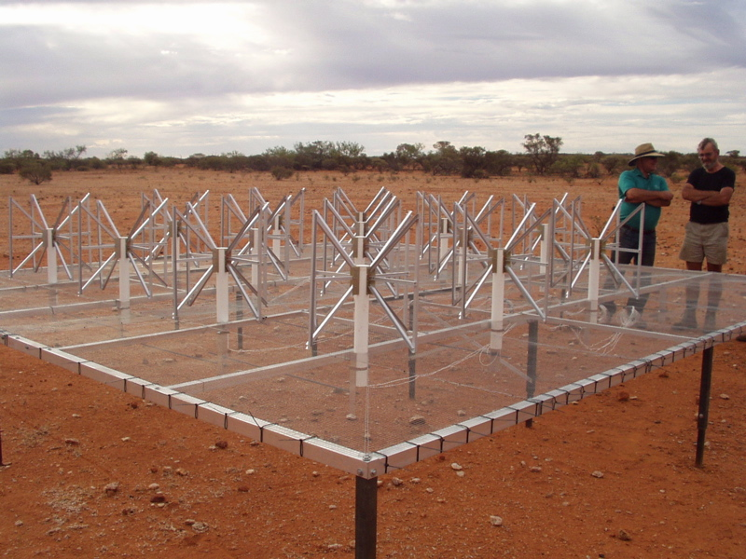
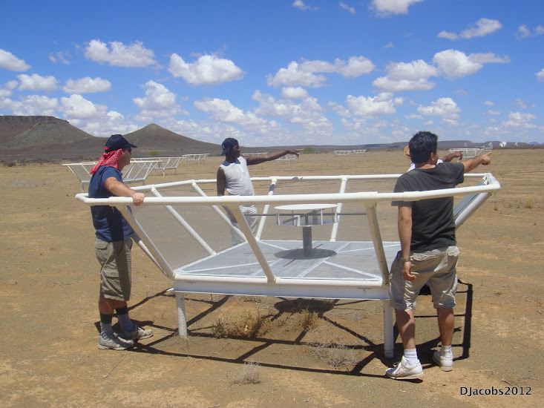
Renaissance at low freq: 1% to 10% of a square kilometer array
MWA - Oz
PAPER - ZA
Array | FoV deg² | Area m² | Type | Bmax km | Start Science obs
LOFAR | 25 | 3e4 | Tile | 2 | 2013
MWA-128 | 300 | 2e3 | Tile | 1.5 | 2013
PAPER-128 | 1600 | 1e3 | Dipole | 0.3/0.6 | 2013
HERA-331 | 64 | 5e4 | 14m parabola | 0.3/2 | 2017
SKA-I Low | 30 | 1e6 | Tile | 5 | 2021+

Slide 26
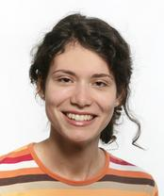
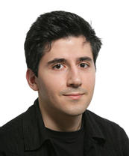
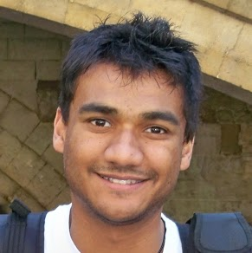
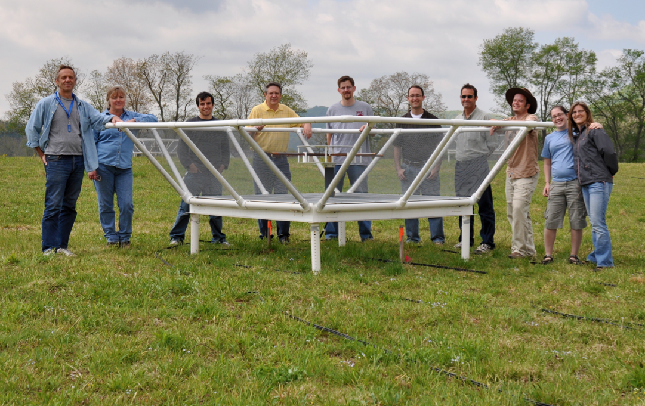
Precision Array to Probe Epoch of Reionization
Don Backer Array: Berkeley, NRAO, Penn, Cavendish, SKA/South Africa
Focus: low-ν array to study HI 21cm signal from reionization
Precision: emphasize engineering solutions first
Staged: work through problems before increasing investment

Slide 27
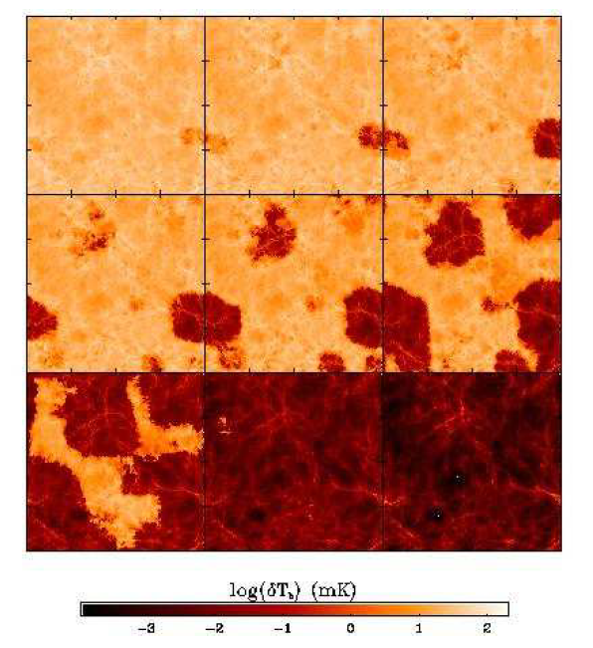
Signal end-game: HI 21cm ‘tomography’ of IGM
Challenge: Sensitivity
z=12, 110MHz
Imaging of typical structures requires full Square Kilometer Array
  S_{150MHz} (2’) ~ 8uJy
  SKA rms ~ 1.6uJy
Primary science driver for SKA-low
<T_{B}> ~ 20mK
z=6.5, 180 MHz
10cMpc = 4’
Furlanetto ea 2004

Slide 28
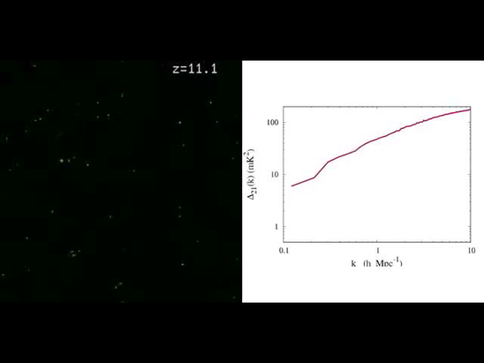
Pathfinder science goals
Evolution of 3D power spectrum in 21cm line
30’, 3MHz
3’, 0.3MHz
mK²
10cMpc
Mpc⁻¹
Mcquinn
start: trace density field
pre-warming: signal drop
Reionization: bubble scale
Full ionization: signal loss

Slide 29
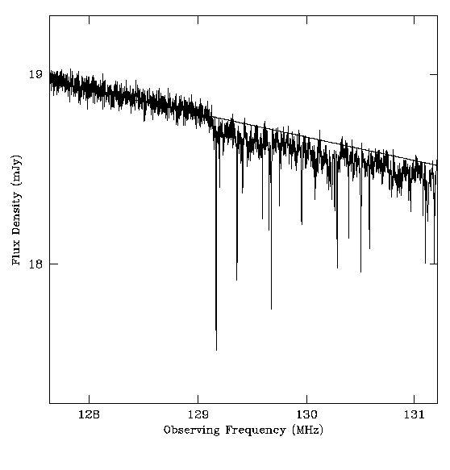
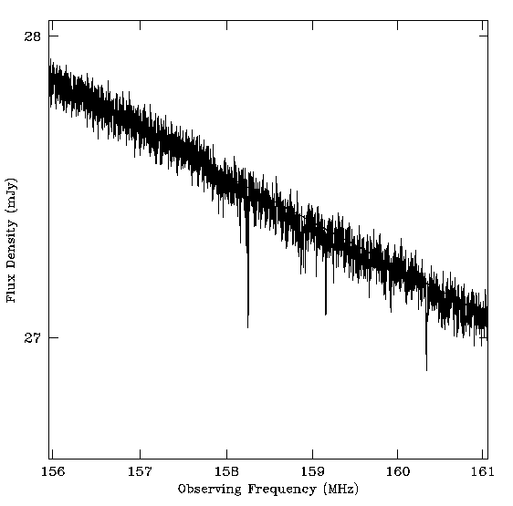
21cm absorption toward first radio galaxies
19mJy
z=12
z=8
SKA+Gnedin simul
130MHz
159MHz
radio GP (τ=1%)
21 Forest (10%)
Only probe of small scale structure
Requires radio sources: expect 0.05 to 0.5 deg⁻² at z> 6 with S151 > 6 mJy

Slide 30
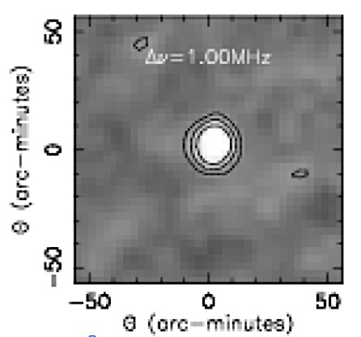
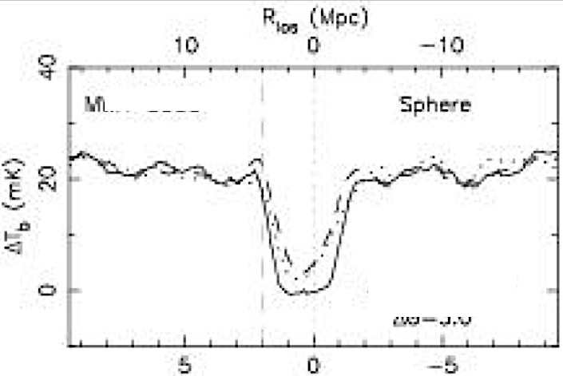
Ionized near zones around z > 6 Quasars
Lya spectra provide evidence for existence for CSS
Size ~ 15’
Signal ~ 20 f(HI) mK = 0.5 f(HI) mJy
rms (HERA, 100hr, 1MHz) ~ 0.08 mJy
3D structure = powerful diagnostic
Rare but we observe huge volume: 64deg²; z=6 to 11
5Mpc
Wyithe et al. 2006
0.5 mJy

Slide 31
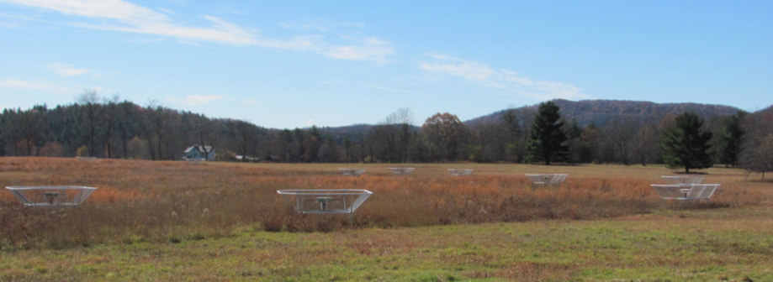
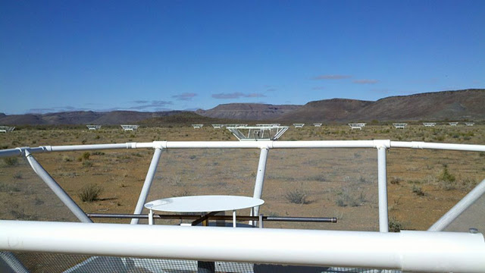
PAPER basics
Freq= 115 to 190 MHz (z= 6.5 to 11)
Single dipole elements + ‘flaps’ => FoV_{FWHM} ~ 40º
Max baseline = 300m => res ~ 15’
32 station engineering array in Greenbank, WV
128 antennae science array in Karoo, South Africa

Slide 32
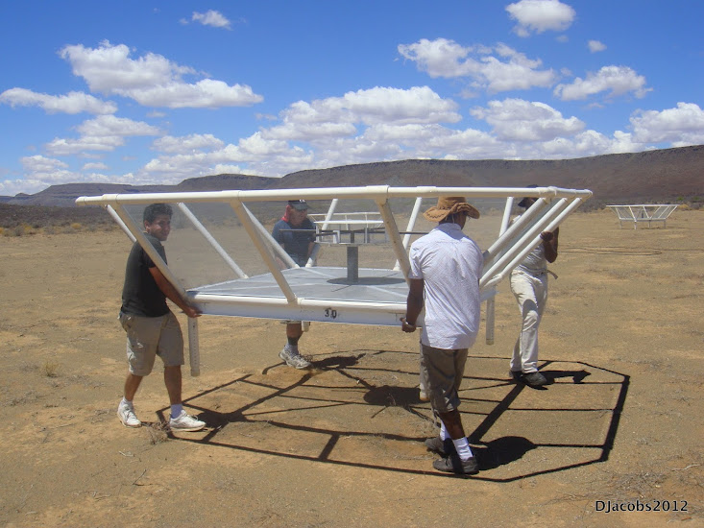
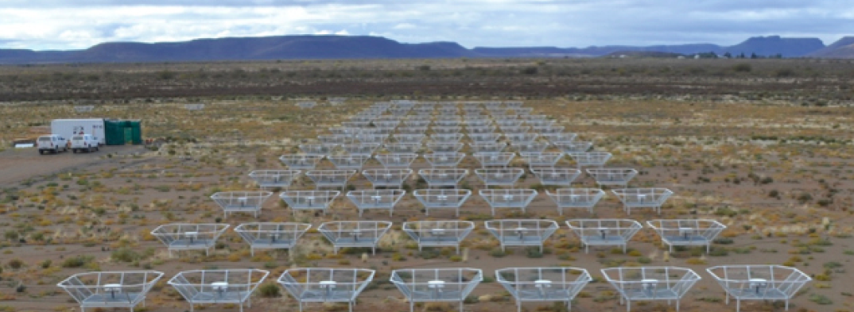
Reconfigurable => optimize for science goal
Minimum redundancy array
maximize u,v coverage => imaging
Maximum redundancy: delay spectrum analysis

Slide 33
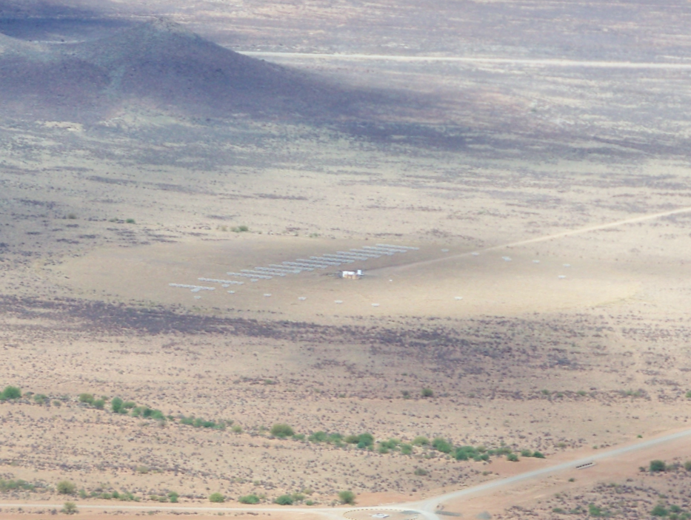


Established working array from scratch in 6 months, with help from ZA (SKA, Durban)
Univ. KwaZulu-Natal
PAPER
575 km
Cape Town

Slide 34


Challenge: Interference
100 MHz z=13
200 MHz z=6
Aircraft
TV

Slide 35


US ‘radio quiet zone’
ZA ‘radio quiet zone’
Karoo South Africa
TV
OrbComm
FM
ISS
OrbComm
100MHz
200MHz
100MHz
200MHz

Slide 36


Challenge: sky is hot, confused at low freq
Haslam, Eberg 408MHz
Coldest regions: T ~ 100 (ν/200 ΜΗz)^{-2.6} K = 10⁴ x 21cm signal
Highly ‘confused’: 1 source/deg² with S140 > 1 Jy

Slide 37


Solution: spectral decomposition
Foreground= non-thermal= featureless over ~ 100’s MHz
Signal = fine scale structure on scales ~ MHz
Cygnus A
Signal/Sky < 10⁻⁴
z=13
z=7
500MHz
5000MHz
Critical to mitigate freq dependent telescope response!

Slide 38




PAPER Antenna: ‘clean machine’
Sleeve dipole + flaps
Smooth, broad response in frequency and angle
Gain
10dB
120MHz
200MHz
LNA: T_{rx} = 110K, 30dB gain 120-180MHz

Slide 39


PAPER: (Xilinx) FPGA + GPU correlator from Berkeley wireless lab (CASPER): double array each year for 4 yrs > Moore
ROACH2 F engine: sample/digitize, transform (τ → ν), using polyphase filter (‘preconvolution’)
GPU X engine: cross multiply V (B, ν)
Cross-connections: ‘packetized correlator’ using 10Gb Ethernet protocol + commercial data routers
Computing, processing, storage (Penn)
Cluster computing: 32 octal core servers
Store raw visibilities: RAIDS 120 TB after data compression (time, freq ave…)
AIPY (Berkeley), CASA, AIPS (NRAO)
Digital processing for large N arrays is solved problem
Data storage and analysis is not

Slide 40
Array configuration: Redundant spacings
Redundant spacing calibration: antenna complex gains (t, υ)
Add redundant spectra coherently at given time => ‘signal to noise’ of PS improves linearly with number of measurements, N, vs. as N^{1/2} with incoherent averaging (add and square vs. square and add)

Slide 41

Focus on 3rd Dimension (freq): ‘delay spectrum’ (Parsons ea.)
3D PS: ‘Parallel’ = line-of-sight (ν) ; ‘Perpendicular’= angular (sky-plane)
V_{Kelvin}(ν)
continuum
Line
Frequency maps to distance => Fourier conjugate (delay) maps to wavenumber (Mpc⁻¹)
Line-of-sight PS (k_{par}) per baseline, time: PS = square of F_{t}[V_{K}(ν)] = V²_{K}(τ)
Continuum naturally limited to low k_{par} (depending on baseline length)

Slide 42

PAPER power spectrum: z=7.7
300hrs, 32ant, 70 redundant baselines of 30m length
Wedge: 5 order of magnitude continuum avoidance (mK²)
k ~ 0.1 to 0.2 h⁻¹ Mpc⁻¹:
k³/2π² P(k) < (52 mK)²
Best limits to date by 100x
Still inconsistent with thermal noise => residual (pol.) continuum?
Still 100x above predictions of fiducial reionization models
‘horizon limit’ = ‘wedge’
GMRT
T_{sys}=560K
Fiducial

Slide 43

Ruling out pathological (but not impossible?) cosmologies
Fiducial model z∼6 to 20: IGM warmed by pervasive hard X rays from 1st XRBs prior to reionizing => T_{K} > T_{CMB} => emission signal ~ few mK
No warming => absorption against CMB ~ 250mK
Argues for warming of IGM prior to reionizing
‘horizon limit’ = ‘wedge’
GMRT
No warming
T_{sys}=560K
Fiducial

Slide 44
Ruling out pathological (but not impossible?) models
Fiducial model z∼6 to 20: IGM warmed by pervasive hard X rays from 1st XRBs prior to reionizing => T_{K} > T_{CMB}
No warming => absorption against CMB (250mK)
T_{cmb}
T_{S}
T_{K}
No warming
E
D
C
B
A

Slide 45



Limits vs redshift (Jacobs)
k = 0.2 Mpc⁻¹
k = 0.3 Mpc⁻¹
mK²
Noise limited Power spectra, but only 32 ant
Still long way to go to expected signal ~ 20 mK²

Slide 46
PAPER towards a detection in 2015
Build-out 2013
  128 elements
  2 years observing
  Full polarization
  ~10x improvement (in mK) => detect fiducial model
PAPER 128
Fiducial

Slide 47


Hydrogen Epoch of Reionization Array
331 x 14m parabolic transit antennas (~Arecibo), 50 to 250MHz, in Karoo
MWA+PAPER+MITEoR: Berkeley, Cavendish, MIT, NRAO, Penn, Washington, ASU, SKA-ZA, U. KwaZulu-Natal
Build on PAPER/MWA experience to design next generation array: Optimal design for delay spectrum analysis + large scale structure imaging
Construction start 2015, science: 2017 to 2019; Development + 37 element array funded via MSIP ~ $2.2M; Total Cost ~ $16M
Notes:
PSA-64, 32 antennas in a maximum-redundancy configuration, 30m between rows, 4m spacing within rows

Slide 48

HERA-331
 | Area (m²) | SNR Pessimistic | SNR Moderate | SNR Optimistic
SKA-low | 8e5 | 14 | 98 | 280
HERA | 5e4 | 19 | 23 | 80
LOFAR-core | 3e4 | 1.4 | 2.8 | 17
MWA-128 | 900 | 0.6 | 2.5 | 6.4
PAPER-128 | 530 | 1.7 | 1.9 | 8.9
Pober ea 2014
Notes:
PSA-64, 32 antennas in a maximum-redundancy configuration, 30m between rows, 4m spacing within rows

Slide 49


F_{HI}
Jacobs ea. McQuinn ea
HERA: beyond detection nIGM, to characterization/astrophysics
Detailed characterization of evolution neutral IGM: z=6 to 20
Direct imaging scales ~ 30-100 cMpc (full 3D analysis)
Explore end of ‘dark ages’ (z ~ 15 to 20)
Inform science/tech SKA-low (2020+)

Slide 50

Cosmic Reionization: last frontier in studies of large scale structure formation
1st insights (Lya: GP and related) => ‘cosmic phase transition’ F_{HI} ~ 10⁻⁵ to 0.5 from z=5 to 7?
HI 21cm cosmology: direct imaging of evolution of the early Universe. Staged development:
  PAPER/MWA/LOFAR (2013-2015):
    First PS limits from PAPER 32: rule out pathological models
    Build out to 128 in 2013, observe 2 years: constrain plausible models or first detection
  HERA (2015-19): 568 x 14m parabolic antenna array for detailed PS characterization, evolution, and first imaging
  SKA-low (2021+): full IGM tomography at arcmin scales

Slide 51







Slide 52



Large scale polarization of the CMB
Temperature fluctuations = density inhomogeneities at the surface of last scattering
Polarized = Thomson scattering local quadrapol CMB
WMAP Hinshaw et al. 2008

Slide 53

Large scale polarization of the CMB (WMAP)
Angular power spectrum (~ rms fluctuations vs. scale)
Large scale polarization
  Integral measure of _{e} back to recombination
  Earlier => higher τ_{e}
  τ_{e} ~ σ_{T}ρL ~ (1+z)³/(1+z) ~ (1+z)²
  Large scale ~ horizon at z_{reion} l < 10 or angles > 10º
  Weak: uK rms ~ 1% total inten.
Sachs-Wolfe
Baryon Acoustic Oscillations: Sound horizon at recombination
_{e} = 0.087 +/- 0.015
Jarosik et al 2011, ApJS 192, 14

Slide 54

CMB large scale polarization: constraints on F(HI)
Rules-out high ionization fraction at z > 15
Allows for small (≤ 0.2) ionization to high z
Most ‘action’ at z ~ 8 – 13
1-F(HI)
Two-step reionization: 7 + z_{r}
Dunkley ea 2009, ApJ 180, 306

Slide 55


Challenge: array spectral sidelobes
Synthesized beam (PSF) is chromatic
Smooth spectral fitting over MHz bands does not remove far-out sidelobes of bright sources
Bright source subtraction requires better than 0.2% antenna calibration to reach thermal noise each day (Datta ea. 2010)
120 to 180 MHz

Slide 56


III. Continuum avoidance
Characteristic sidelobe scale in frequency (= k_{par}), is set by baseline length (=k_{perp})
10º
B=30m
Datta et al. 2010, ApJ, 724, 526
Parsons et al. 2012, ApJ, 756, 165
Parsons et al. 2012, ApJ, 753, 81
Parsons et al. 2013, ApJ, arXiv:1304.4991
Pober et al. 2013, ApJ, 768, L36
B=90m
130MHz
180MHz

Slide 57

III. EoR window and the Continuum Wedge
Delay or Freq⁻¹
‘EoR Window’
Wedge = ‘horizon limit’ for continuum sources
Baseline or Angle⁻¹
k_{perp} (angle) vs. k_{par}(freq) => continuum sources are naturally limited to max k_{par} in delay spectrum set by baseline length
Max. geometric baseline delay = ‘horizon limit’ for continuum sources
Line sources extend beyond wedge.

Slide 58


Cen A: PAPER + Xray
PAPER Imaging: unique parameter space (Stefan PhD Thesis, Cavendish)
Continuous ‘all-sky’ monitor (GRBs, XRBs...)
Sensitive to LSS (15deg at 15’ res)
Sensitivity(10min) ~ 5mJy
Broad freq range (120 – 180 MHz)
8º
Low freq spectrum => FF abs toward GC
20º

