Slide 1
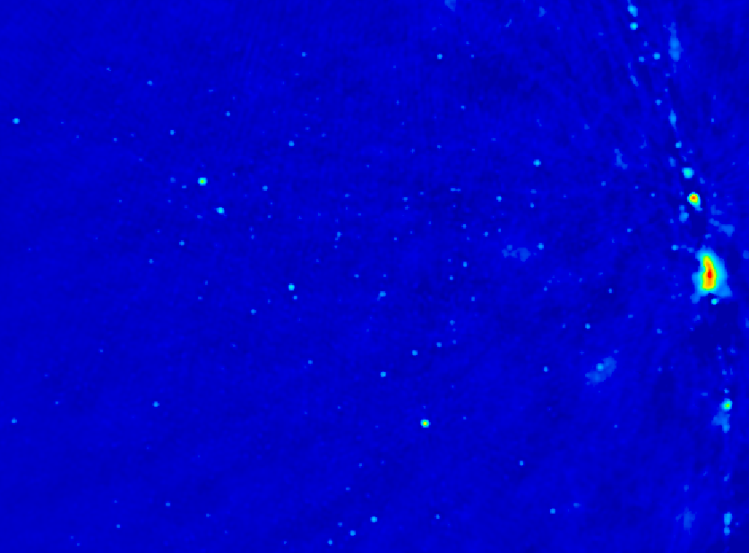
Cosmic Reionization
Chris Carilli (M/NRAO)
Caltech, November 2013
I. Introduction: Cosmic Reionization
  Concept
  Constraints on evolution of neutral Intergalactic Medium
II. HI 21cm line
  Potential for direct detection of neutral IGM
  Precision Array to Probe Epoch of Reionization: first results
  Hydrogen Epoch of Reionization Array
Fan, Carilli, Keating 2006, ARAA, 44, 415
Furlanetto et al. 2006, Phys. Reports, 433, 181
Wyithe & Morales 2010, ARAA, 48, 127
Pritchard & Loeb 2012, Rep.Prog. Phys., 75, 6901

Slide 2
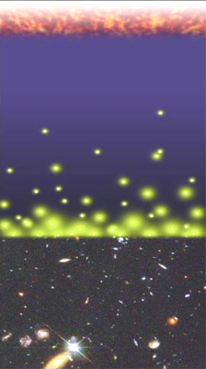
Big Bang f(HI) ~ 0
History of Normal Matter (IGM ~ H)
Recombination
0.4 Myr
z = 1000
f(HI) ~ 1
Reionization
0.4 – 1.0 Gyr
z ~ 6 to 12
f(HI) ~ 10⁻⁵
13.6Gyr
z = 0
Djorgovski/CIT

Slide 3
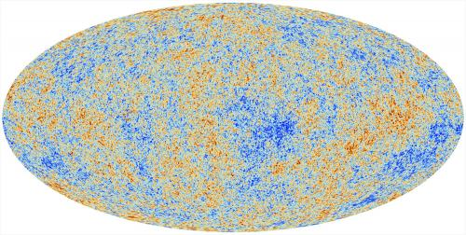
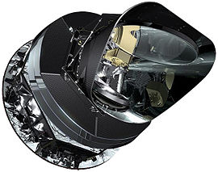
Cosmic microwave background radiation
Recombination
Early structure formation
Imprint of primordial structure from the Big Bang
Planck

Slide 4
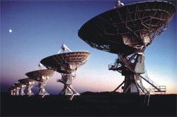
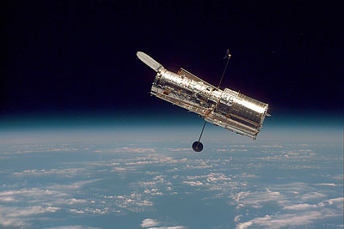
HST, VLT, VLA…
Late structure formation Realm of the Galaxies

Slide 5
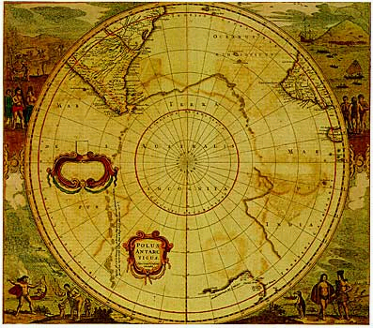
Universum incognitus
Dark ages
Last phase of cosmic evolution to be tested and explored
Cosmological benchmark: formation of first galaxies and quasars
Today’s focus: Evolution of the neutral IGM and reionization
  When?
  How fast?
  HI 21cm signal
Cosmic Reionization

Slide 6
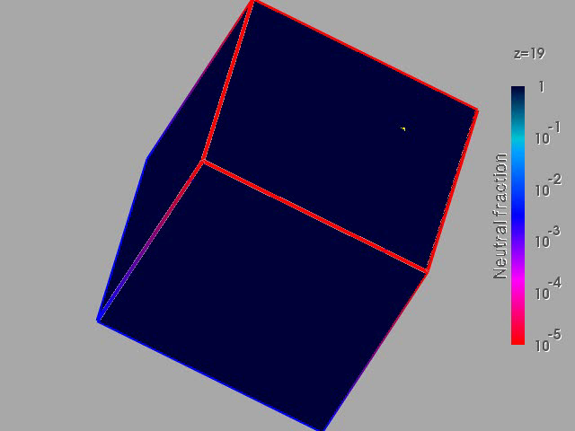
Numerical Simulation of the evolution of the IGM
F(HI) from z=20 to 5
Three phases
Dark Ages
Isolated bubbles (slow)
Percolation (bubble overlap, fast): ‘cosmic phase transition’
10cMpc
(Gnedin & Fan 2006)

Slide 7
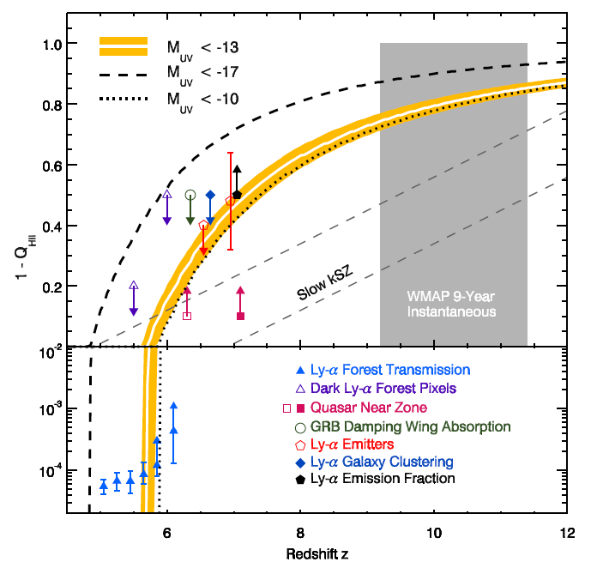
Evolution of the IGM neutral fraction: Robertson ea. 2013
F_{HI_vol}
Lya-galaxies
Quasar Near-zones
Gunn-Peterson

Slide 8
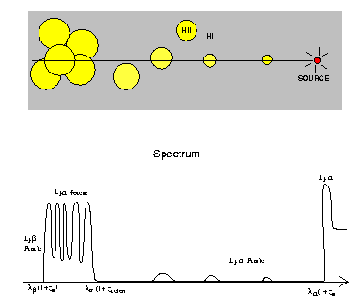
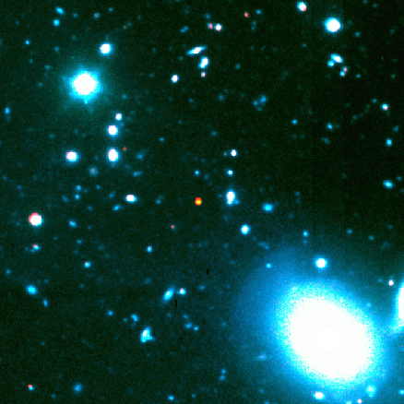
Gunn-Peterson Effect (Gunn + Peterson 1963)
ionized
neutral
z=6.4
quasar
z
SDSS high z quasars
Lya resonant scattering by neutral IGM
Barkana and Loeb 2001

Slide 9
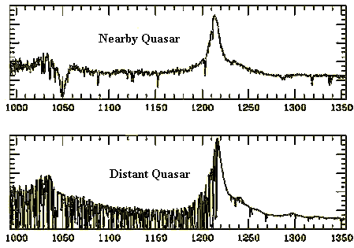
Neutral IGM after reionization = Lya forest
Lya resonant scattering by neutral gas in IGM clouds
Linear density inhomogeneities, δ~ 10
N(HI) = 10¹³ – 10¹⁵ cm⁻²
F(HI) ~ 10⁻⁵
z=0
z=3

Slide 10
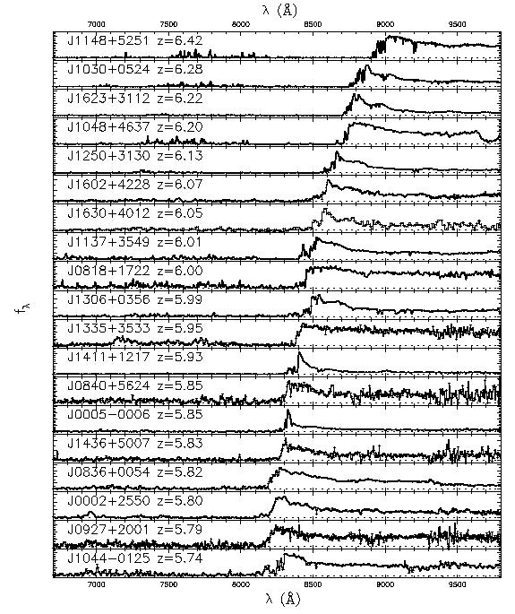
6.4
Gunn-Peterson effect
SDSS z~6 quasars
Opaque (τ > 5) at z>6
=> pushing into reionization?
5.7
SDSS quasars
Fan et al 2006

Slide 11
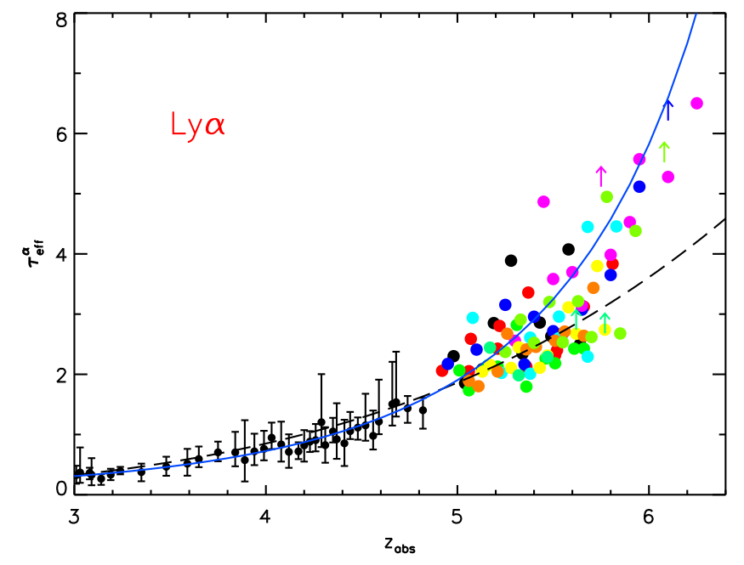
τ_{eff}
Gunn-Peterson constraints
on F(HI)
Diffuse IGM:
τ_{GP} = 2.6e4 F(HI) (1+z)^{3/2}
Clumping: τ_{GP} dominated by higher density regions => need models of ρ, T, UV_{BG} to derive F(HI)
Becker et al. 2011
z<4: F(HI)_{v} ~ 10⁻⁵
z~6: F(HI)_{v} ≥ 10⁻⁴

Slide 12
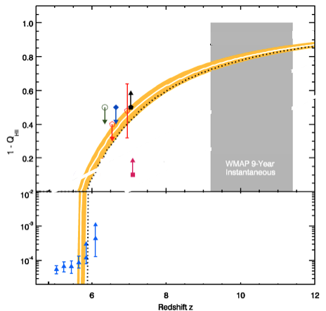
F_{HI_vol}
GP => systematic (~10x) rise of F(HI) to z ~ 5.5 to 6.5
Challenge: GP saturates at very low neutral fraction (10⁻⁴)

Slide 13
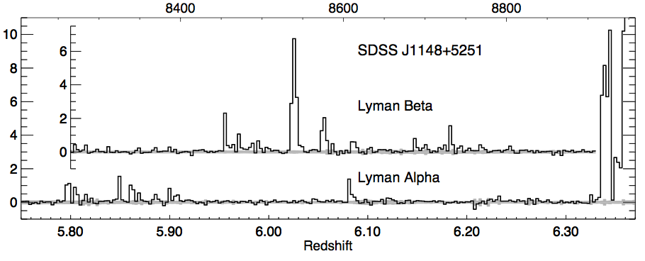
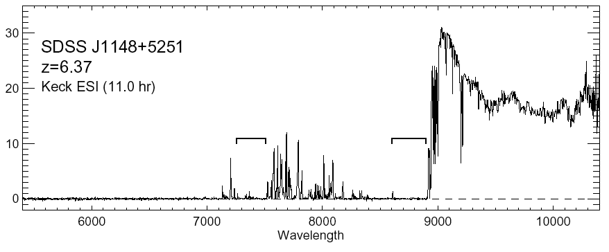
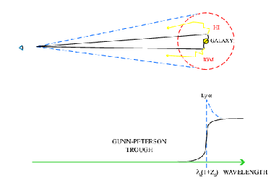
Quasar Near Zones
White et al. 2003
J1148+5251: Host galaxy redshift: z=6.419
Quasar spectrum => photons leaking down to z=6.32
Time bounded Stromgren sphere (ionized by quasar?)
cf. ‘proximity zone’ interpretation, Bolton & Haehnelt 2007
HI
HII
z_{host} – z_{GP} => R_{NZ} = 4.7Mpc ~ [L_{γ} t_{Q}/F_{HI}]^{1/3} (1+z)⁻¹

Slide 14
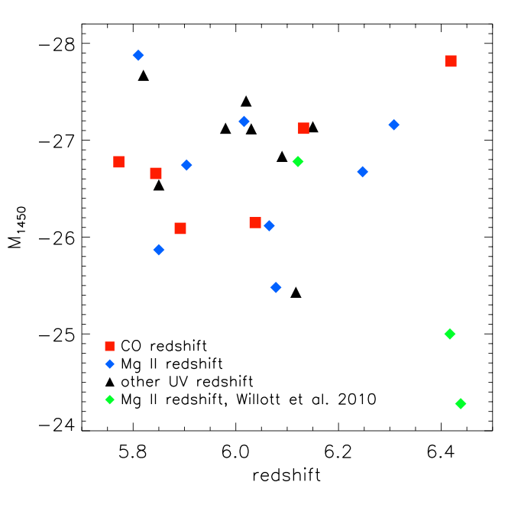
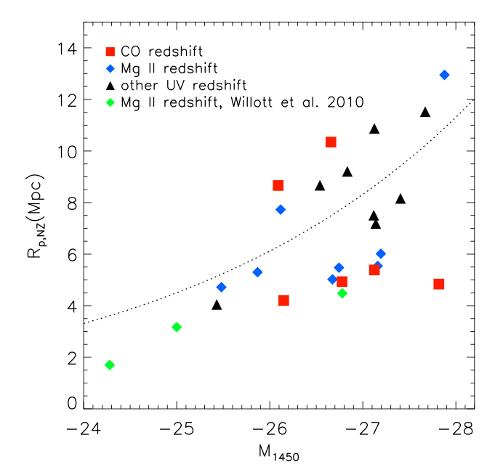
Quasar Near-Zones: 28 GP quasars at z=5.7 to 6.5
L_{UV}
R L_{γ}^{1/3}
L_{UV}
No correlation of UV luminosity with redshift
Correlation of R_{NZ} with UV luminosity
Note: significant intrinsic scatter due to local environ., t_{q}

Slide 15
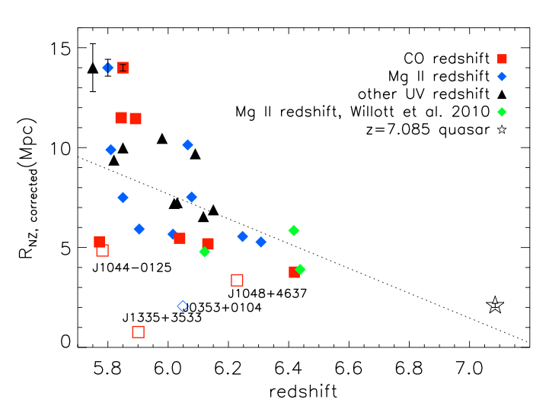
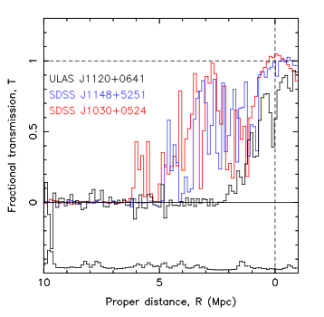
Quasar Near-Zones: R_{NZ} vs redshift
[normalized to M₁₄₅₀ = -27]
<R_{NZ}> decreases by ~10x from z=5.7 to 7.1
z ≤ 6.4
z=7.1
<R_{NZ}> decreases by factor ~ 10 from z=5.7 to 7.1
If CSS => F(HI) ≥ 0.1 by z ~ 7.1

Slide 16
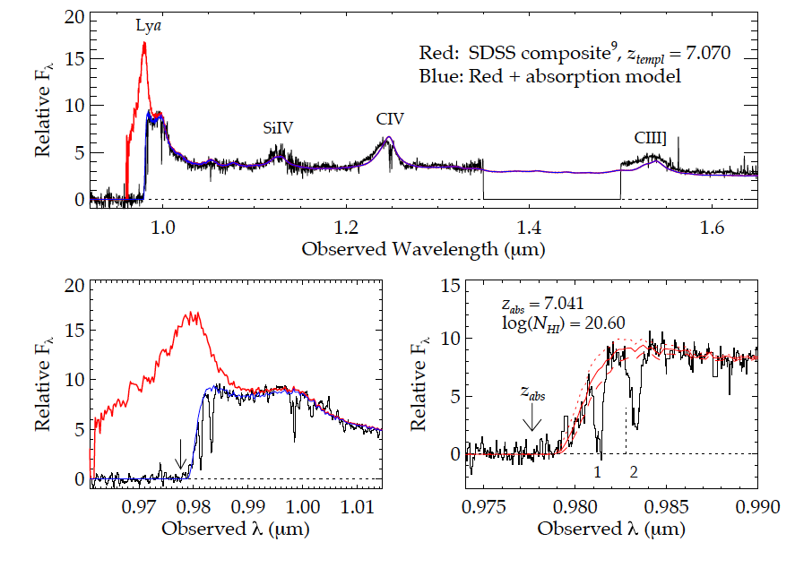
Highest redshift quasar (z=7.1)
Simcoe ea. 2012
(Bolton ea; Mortlock ea)
Damped Lya profile: N(HI) ~ 10^{20.6} cm⁻²
Substantially neutral IGM: F(HI) > 0.1 at 2Mpc distance [or galaxy at 2.6Mpc; probability ~ 5%)]

Slide 17
F_{HI_vol}
QNZ + DLA => rapid rise in F(HI) z~6 to 7 (10⁻⁴ to > 0.1)
Challenge: based (mostly) on one z>7 quasar

Slide 18
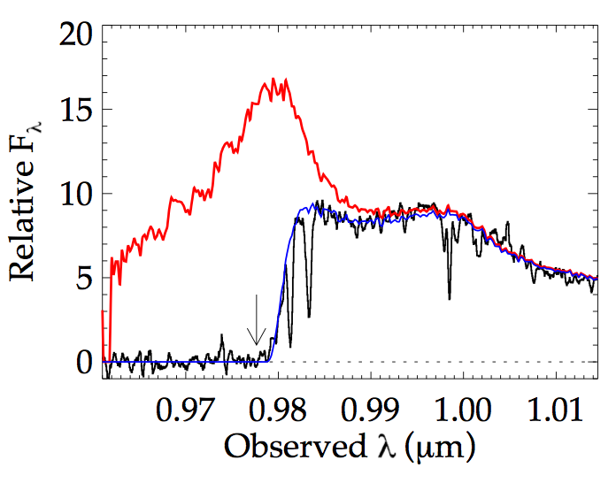
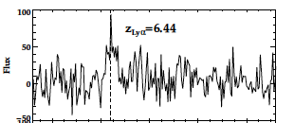
Galaxy demographics: effects of IGM on apparent galaxy counts
Lya
z=7.1 quasar
Lya
Typical z~5 to 6 galaxy
(Stark ea)
Neutral IGM attenuates Lya emission from early galaxies
Search for decrease in:
  Number of Lya emitting galaxies at z>6
  Equiv. Width of Lya for faint z > 6 galaxy candidates

Slide 19
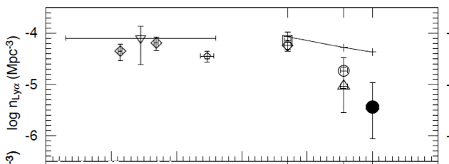
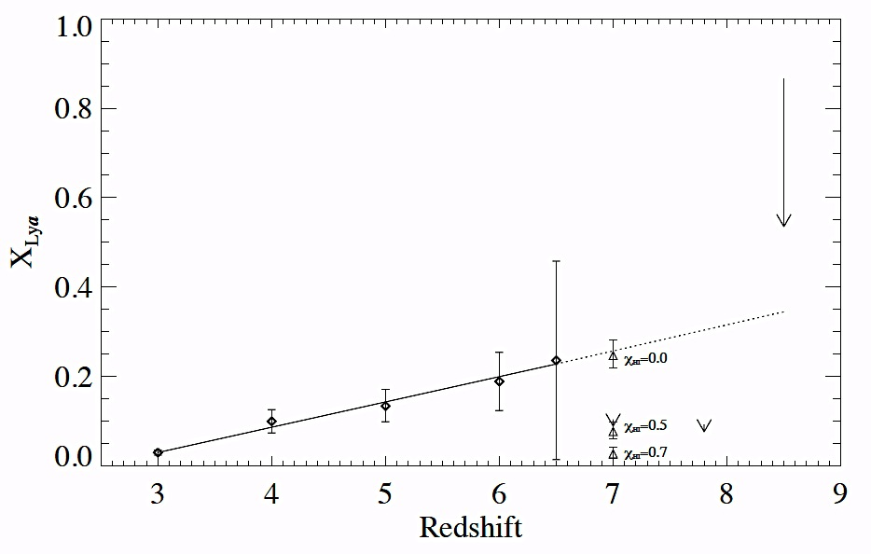
Galaxy demographics: effects of IGM on apparent galaxy counts
Ota ea. 2008
expected
Space density of Lya emitting galaxies decreases faster from z=6 to 7 than expected from galaxy evolution
EW Lya decreases z=6 to 7
Modeling attenuation by partially neutral IGM => F(HI) ~ 0.5 at z ~ 7
observed
3
4
5
6
7
Bunker ea; Treu ea; Stark ea
F(HI) ~ 0.5

Slide 20
F_{HI_vol}
Galaxy demographics suggests possibly 50% neutral at z~7!
Challenge: separating galaxy evolution from IGM effects

Slide 21
0.95Gyr
0.65Gyr
0.48Gyr
Robertson ea. 2013
F_{HI_vol}
Amazing progress (paradigm shift): rapid increase in neutral fraction from z~6 to 7 (10⁻⁴ to 0.5) = ‘cosmic phase transition’?
All values have systematic uncertainties: suggestive but not compelling => Need new means to probe neutral IGM

Slide 22
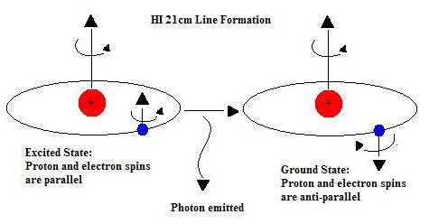
HI 21cm line: Most direct probe of the neutral IGM
Low frequencies:
ν_{obs} = 1420MHz/(1+z) ≤ 200 MHz
Advantages of the 21cm line
Direct probe of neutral IGM
Spectral line signal => full three dimensional image of structure formation (freq = z = depth)
Low freq => very (very) large volume surveys (1sr, z=7 to 11)
Hyperfine transition = weak => avoid saturation (translucent)

Slide 23
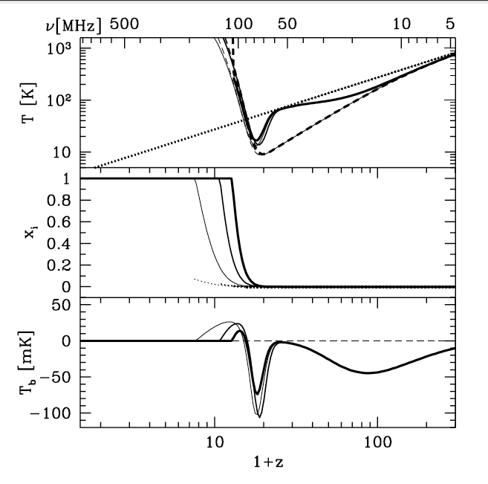
HI 21cm obs of neutral IGM
‘Richest cosmological data set’
T_{cmb}
T_{S}
T_{K}
First stars
First stars
Pritchard & Loeb

Slide 24
HI 21cm obs of neutral IGM
‘Richest cosmological data set’
T_{cmb}
T_{S}
T_{K}
Galaxies
First stars
Linear
Reionization
Pritchard & Loeb

Slide 25
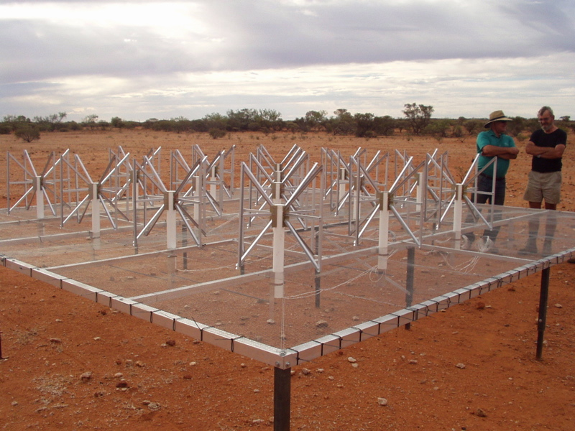
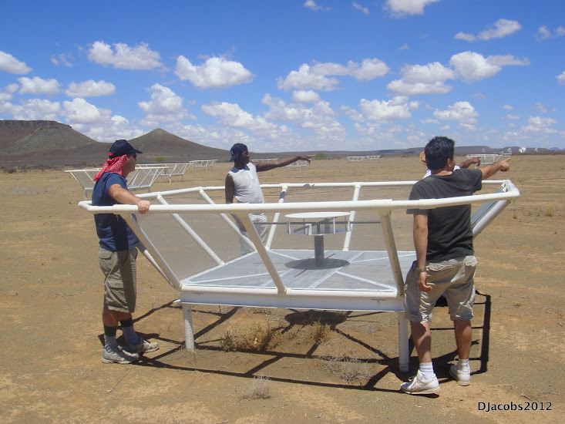
MWA - Oz
PAPER - ZA
Rennaissance at low freq: 1% to 10% of a square kilometer array
Array | FoV deg² | Area m² | Type | Bmax km | Start Science obs
LOFAR | 25 | 3e4 | Tile | 2 | 2013
MWA-128 | 300 | 2e3 | Tile | 1.5 | 2013
PAPER-128 | 1600 | 1e3 | Dipole | 0.3/0.6 | 2013
HERA-568 | 64 | 8e4 | 14m parabola | 0.3/2 | 2017
SKA-I Low | 30 | 1e6 | Tile | 5 | 2021+

Slide 26
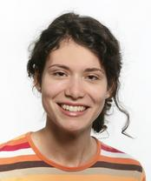
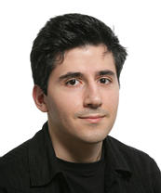
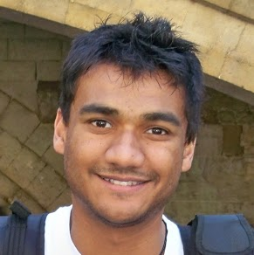
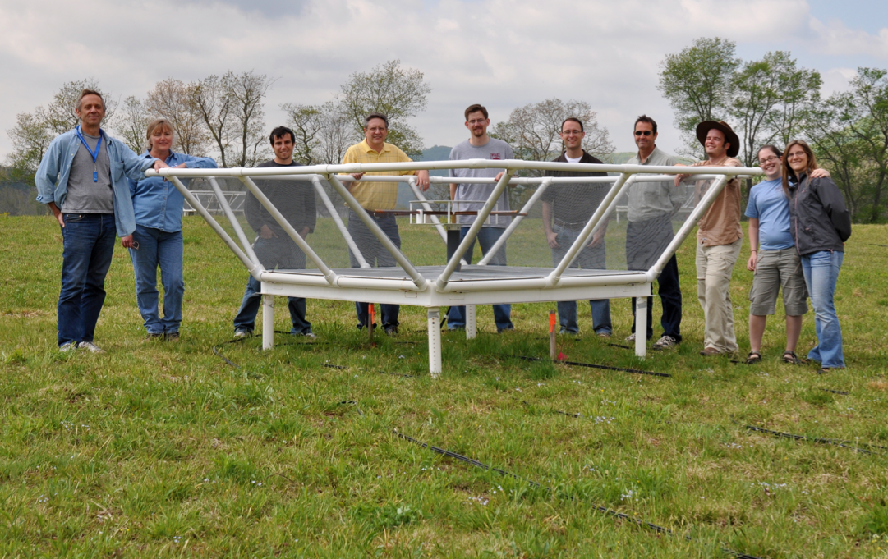
Precision Array to Probe Epoch of Reionization
Don C. Backer Array: Berkeley, NRAO, Penn, SKA/South Africa
Focus: low-ν array to study HI 21cm signal from reionization
Precision: emphasize engineering solutions first
Staged: work through problems before increasing investment

Slide 27
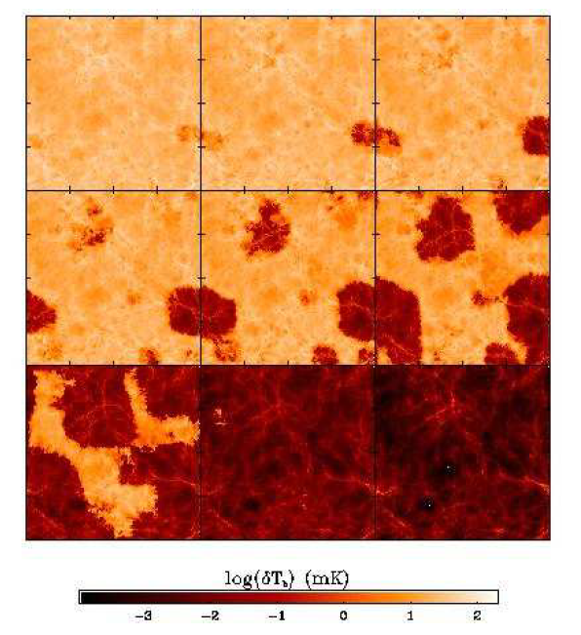
Signal end-game: HI 21cm ‘tomography’ of IGM
Challenge: Sensitivity
z=12
ν₂₁= 109 MHz
9
Imaging of typical structures requires full Square Kilometer Array
ΔTB(2’) ~ 20 mK ~ 8uJy
SKA rms ~ 4mK
z=7.6
165 MHz
10cMpc = 4’
Furlanetto ea 2004

Slide 28
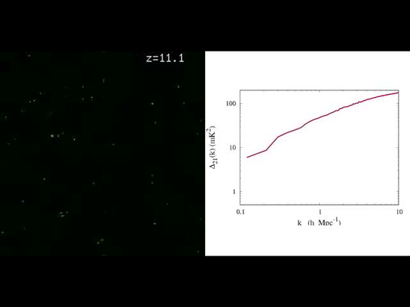
Near-term Reionization: Pathfinder science goals
Evolution of 3D power spectrum in 21cm line
30’
3’
10cMpc
Mcquinn

Slide 29
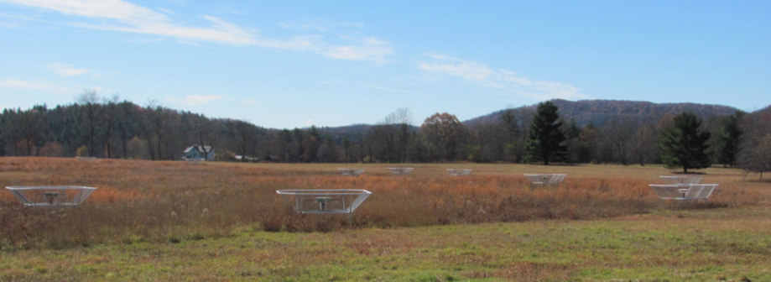
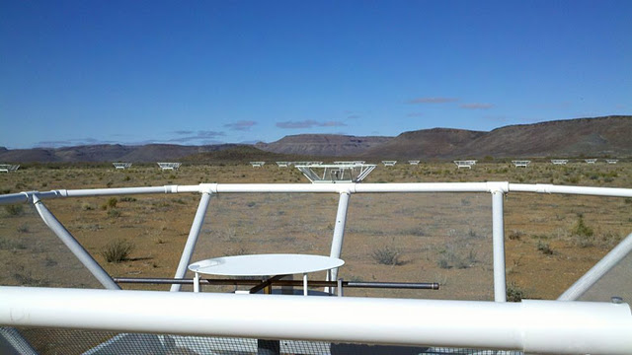
PAPER basics
Freq= 115 to 190 MHz (z= 6.5 to 11)
Single dipole elements + ‘flaps’ => FoV_{FWHM} ~ 40º
Max baseline = 300m => res ~ 15’
32 station engineering array in Greenbank, WV
Build-out to 128 antennae science array in Karoo, South Africa in 2013

Slide 30
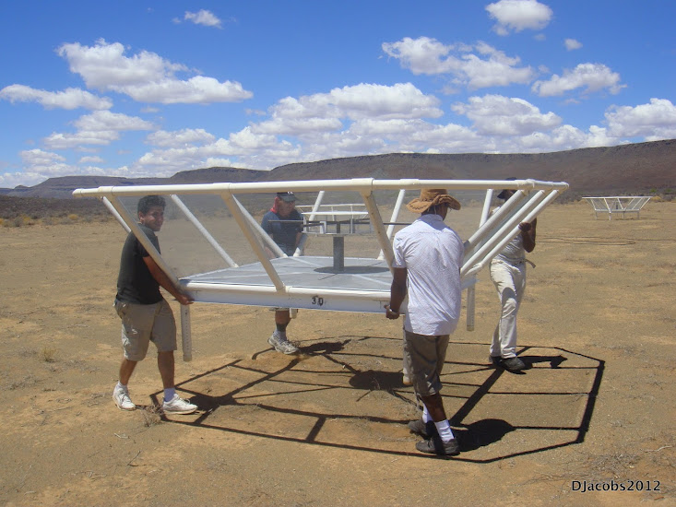
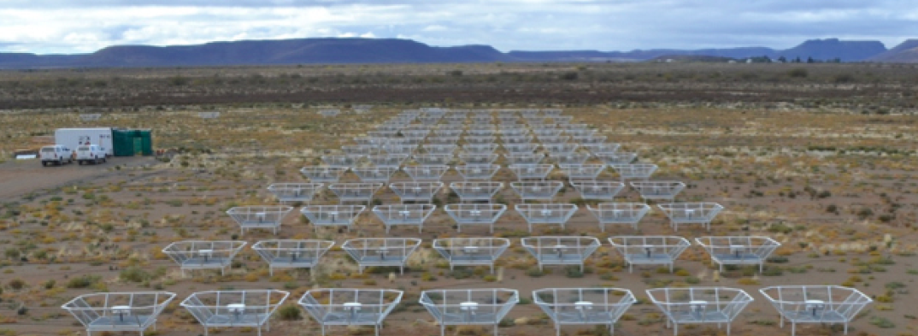
Reconfigurable => optimize for science goal
Minimum redundancy array
maximize u,v coverage => imaging
Maximum redundancy: delay spectrum analysis

Slide 31
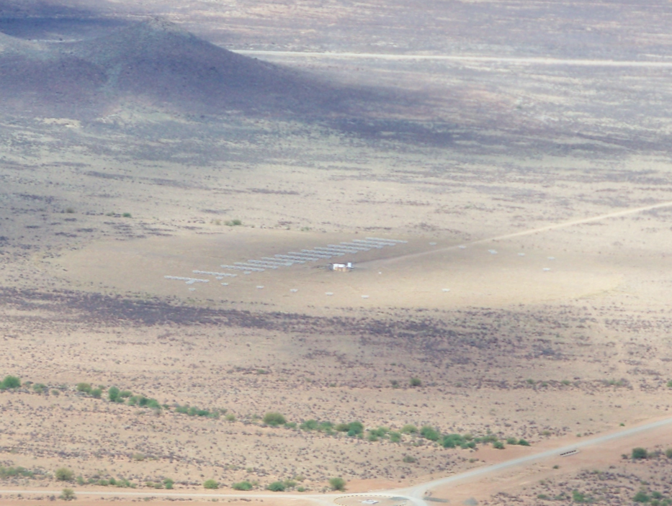
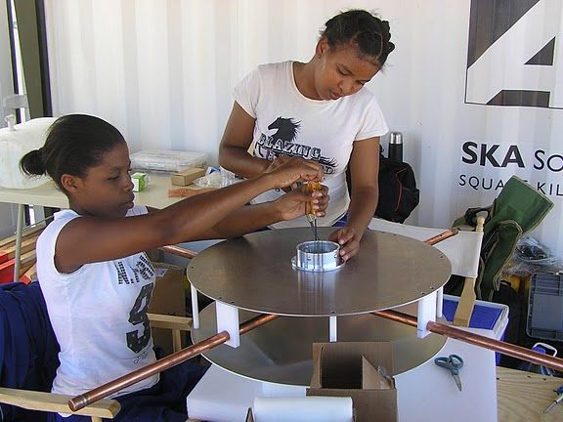
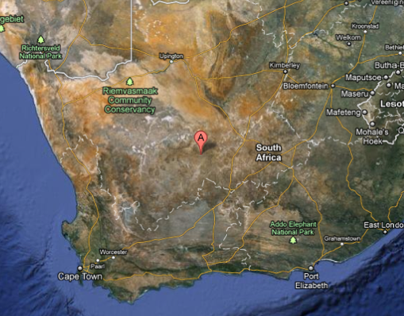
Established working array from scratch in 6 months, with help from ZA (SKA, Durban)
Univ. KwaZulu-Natal
PAPER
575 km
Cape Town

Slide 32
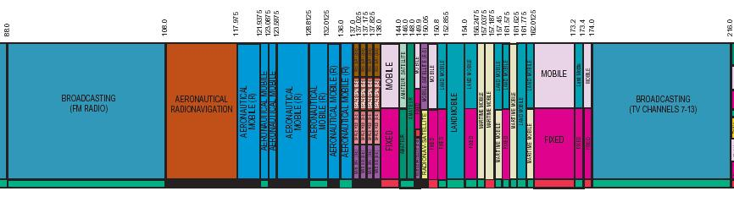
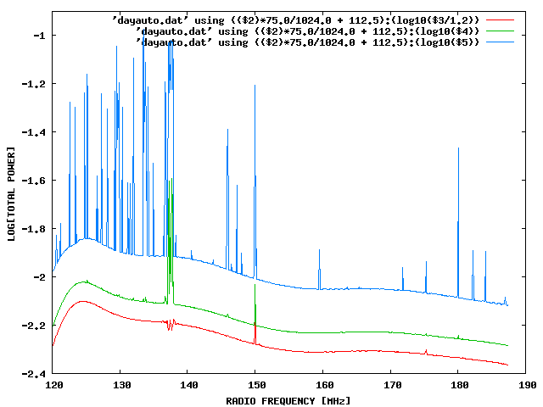
Challenge: Interference
100 MHz z=13
200 MHz z=6
Aircraft
Orbcomm
TV

Slide 33
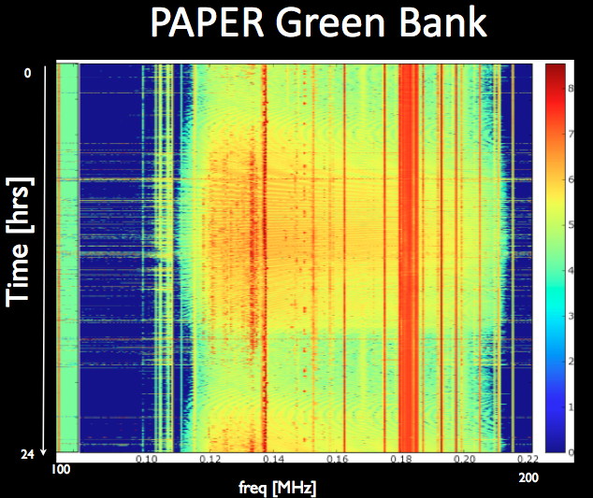
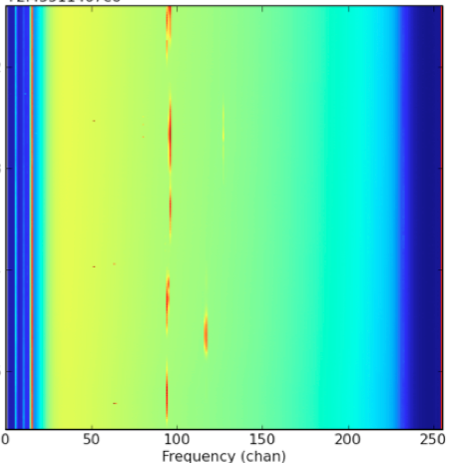
US ‘radio quiet zone’
ZA ‘radio quiet zone’
Karoo South Africa
TV
OrbComm
FM
ISS
OrbComm
100MHz
200MHz
100MHz
200MHz

Slide 34
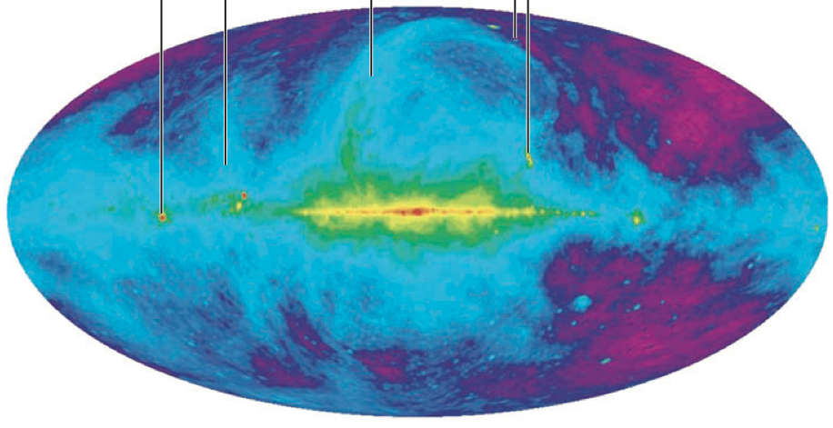
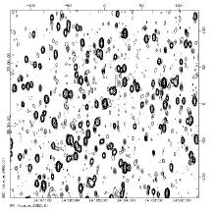
Challenge: sky is hot, confused at low freq
Haslam, Eberg 408MHz
Coldest regions: T ~ 100 (ν/200 ΜΗz)^{-2.6} K = 10⁴ x 21cm signal
Highly ‘confused’: 1 source/deg² with S140 > 1 Jy

Slide 35


Solution: spectral decomposition
Foreground= non-thermal= featureless over ~ 100’s MHz
Signal = fine scale structure on scales ~ MHz
Cygnus A
Signal/Sky ~ 10⁻⁵
z=13
z=7
500MHz
5000MHz
Critical to mitigate freq dependent telescope response!

Slide 36




PAPER Antenna: ‘clean machine’
Sleeve dipole + flaps
Smooth, broad response in frequency and angle
Gain
10dB
120MHz
200MHz
LNA: T_{rx} = 110K, 30dB gain 120-180MHz

Slide 37


Challenge: array spectral sidelobes
Synthesized beam (PSF) is chromatic
Smooth spectral fitting over MHz bands does not remove far-out sidelobes of bright sources
Bright source subtraction requires better than 0.2% antenna calibration to reach thermal noise each day (Datta ea. 2010)
120 to 180 MHz

Slide 38

Power spectrum: I. ‘delay spectrum’ (Parsons ea.)
V_{Kelvin}(ν)
Focus on Frequency:
Frequency maps to distance => Fourier conjugate (delay) maps linearly to wavenumber (Mpc⁻¹)
Analyze line-of-sight PS in frequency (k_{par}) per baseline, time: PS = square of F_{t}[V_{K}(ν)] = V²_{K}(τ)
Ignore PS in angle (k_{perp})

Slide 39
II. Redundant spacings
Redundant spacing calibration: antenna complex gains (t, υ)
Add spectra coherently in time => ‘signal to noise’ of PS improves linearly with number of measurements, N, vs. as N^{1/2} with incoherent averaging (add and square vs. square and add)

Slide 40


III. Continuum avoidance: The Wedge
Characteristic sidelobe scale in frequency (= k_{par}), is set by baseline length (=k_{perp})
10º
B=30m
Datta et al. 2010, ApJ, 724, 526
Parsons et al. 2012, ApJ, 756, 165
Parsons et al. 2012, ApJ, 753, 81
Parsons et al. 2013, ApJ, arXiv:1304.4991
Pober et al. 2013, ApJ, 768, L36
B=90m
130MHz
180MHz

Slide 41

III. EoR window: The Wedge
Delay or Freq⁻¹
‘EoR Window’
Wedge = ‘horizon limit’ for continuum sources
Baseline or Angle⁻¹
k_{perp} (angle) vs. k_{par}(freq) => continuum sources are naturally limited to max k_{par} in delay spectrum set by baseline length.
Line sources extend beyond wedge.
Max. geometric baseline delay = ‘horizon limit’ for continuum sources

Slide 42

PAPER Power spectrum: z=7.7
300hrs, 32ant, 70 redundant baselines of 30m length
Wedge: 5 order of magnitude continuum avoidance (mK²)
k ~ 0.1 to 0.2 h⁻¹ Mpc⁻¹:
k³/2π² P(k) < (52 mK)²
Best limits to date by 100x
Still inconsistent with thermal noise => residual (pol.) continuum?
Still 100x above predictions of fiducial reionization models (eg. Mcquinn ea)
‘horizon limit’ = ‘wedge’
GMRT
T_{sys}=560K
Fiducial

Slide 43
Ruling out pathological (but not impossible?) models
‘horizon limit’ = ‘wedge’
Model: neutral IGM remains cold (no large-scale Xray warming), but enough Lya to couple T_{s} and T_{K} and reionization proceeds locally => <T_{B}> ~ 300mK
Argues for early Xray warming of IGM
GMRT
No warming
T_{sys}=560K
Fiducial

Slide 44
Strong (absorption) 21cm signal expected if IGM is not warmed (by Xrays or shocks) prior to being ionized
T_{cmb}
T_{S}
T_{K}
No warming
First stars

Slide 45
PAPER towards a detection in 2015
Build-out 2013
  128 elements
  2 years observing
  Full polarization (get to thermal noise)
  ~10x improvement (in mK) => detect fiducial model
PAPER 128
Fiducial

Slide 46


Hydrogen Epoch of Reionization Array
568 x 14m parabolic transit antennas, 50MHz to 250MHz, in Karoo
MWA+PAPER MSIP collaboration: Berkeley, Cavendish, MIT, NRAO, Penn, Washington, ASU, SKA-ZA, U. KwaZulu-Natal
Build on PAPER/MWA experience to design next generation array: Optimal design for delay spectrum analysis + large scale structure imaging
Construction start 2015, science: 2017 to 2019
Notes:
PSA-64, 32 antennas in a maximum-redundancy configuration, 30m between rows, 4m spacing within rows

Slide 47


F_{HI}
Jacobs ea. McQuinn ea
HERA 568
Detailed characterization of evolution neutral IGM: z=6 to 20
Direct imaging scales ~ 30-100 cMpc
Explore end of ‘dark ages’ (z ~ 15 to 20)
Inform science/tech SKA-low (2020+)

Slide 48

Cosmic Reionization: last frontier in studies of large scale structure formation
1st insights (Lya: GP and related) => ‘cosmic phase transition’ F_{HI} ~ 10⁻⁵ to 0.5 from z=5 to 7?
HI 21cm: direct observation of neutral IGM
  PAPER (2013-2015):
    First PS limits from PAPER 32: rule out pathological models
    Build out to 128 in 2013, observe 2 years: constrain plausible models or first detection
  HERA (2015-19): 568 x 14m parabolic antenna array for detailed PS characterization, evolution, and first imaging
  SKA-low (2021+): full IGM tomography at arcmin scales

Slide 49







Slide 50

Constraint I: Large scale polarization of the CMB (WMAP)
Thomson scattering CMB (local quadrupole) predominantly during reionization => polarized
Integral measure of _{e} back to recombination
Large scale ~ horizon at z_{reion} l < 10 or angles > 10º
Weak: uK rms ~ 1% total inten.
Sachs-Wolfe
Baryon Acoustic Oscillations: Sound horizon at recombination
_{e} = 0.087 +/- 0.015
Jarosik et al 2011, ApJS 192, 14

Slide 51
HERA Cost & Timeline
Total Cost ~ $15M to $20M
Year 1 (Sept. 2014 – Aug. 2015): Augment PAPER-128 with 128 MWA tiles and 16 prototype dishes. Begin development of new site for hosting 576-element dish array.
Year 2 (Sept. 2015 – Aug. 2016): Conduct observations with hybrid array. Develop production dish array components. Continue infrastructure development.
Year 3 (Sept. 2016 – Aug. 2017). Install first half (288 elements) of dish array. Conduct commissioning observations July, 2017. Conduct second season of observations with hybrid array.
Year 4 (Sept. 2017 – Aug. 2018). Conduct science observations with the first half of the dish array. Install second half of the dish array afterward.
Year 5 (Sept. 2018 – Aug. 2019). Conduct science observations with full 576-element dish array.
Notes:
PSA-64, 32 antennas in a maximum-redundancy configuration, 30m between rows, 4m spacing within rows

Slide 52


PAPER: (Xilinx) FPGA + GPU correlator from Berkeley wireless lab (CASPER)
ROACH2 F engine: sample/digitize, transform (τ → ν), using polyphase filter (‘preconvolution’)
GPU X engine: cross multiply V (B, ν)
Cross-connections: ‘packetized correlator’ using 10Gb Ethernet protocol + commercial data routers
Computing, processing, storage (Penn)
Cluster computing: 32 octal core servers
Store raw visibilities: RAIDS 120 TB after data compression (time ave…)
AIPY (Berkeley), CASA, AIPS (NRAO)

Slide 53

Chromatic sidelobes have min structure in freq (max structure in k_{par}) set by baseline length

Slide 54
Evolution of the IGM neutral fraction: Robertson ea. 2013
F_{HI_vol}

Slide 55

Near-term Reionization: Pathfinder science goals
3D power spectrum in 21cm line
30’
3’
characteristic bubble scale
z =12, f(HI) ~ 0.9
z = 8, f(HI) ~ 0.5 ‘fiducial’
z=6, f(HI) ~ 0.02
Barkana 2009

Slide 56


Challenge: array spectral sidelobes
Synthesized beam (PSF) is chromatic
Smooth spectral fitting over MHz bands does not remove far-out sidelobes of bright sources
Bright source subtraction requires better than 0.2% antenna calibration to reach thermal noise each day (Datta ea. 2010)
1MHz separation
R ~ 17cMpc
10º
5MHz separation

Slide 57
HI 21cm obs of neutral IGM
‘Richest cosmological data set’
z>200: T_{CMB} = T_{K}= T_{S} by residual e-, photon, and gas collisions. No signal.
z∼30 to 200: gas cools as T_{k} ≈ (1+z)² vs. T_{CMB} ≈ (1 + z), but T_{S} = T_{K} via collisions => absorption, until density drops and T_{s} → T_{CMB}
z∼20 to 30: first stars => Lyα photons couples T_{K} and T_{S} => 21-cm absorption
z∼6 to 20: IGM warmed by hard X rays => T_{K} > T_{CMB}. T_{S} coupled to T_{K} by Lya. Reionization is proceeding => bubble dominated
IGM reionized
T_{cmb}
T_{S}
T_{K}
E
D
C
B
A
First stars
Pritchard & Loeb

Slide 58

HERA 568
Explore end of ‘dark ages’ (z ~ 15 to 20)

