Slide 1
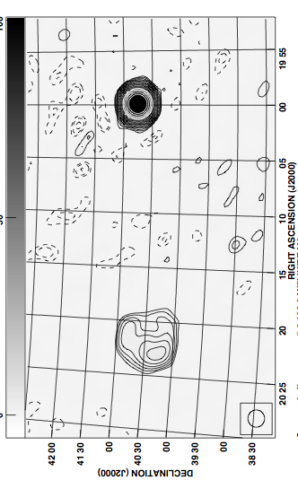
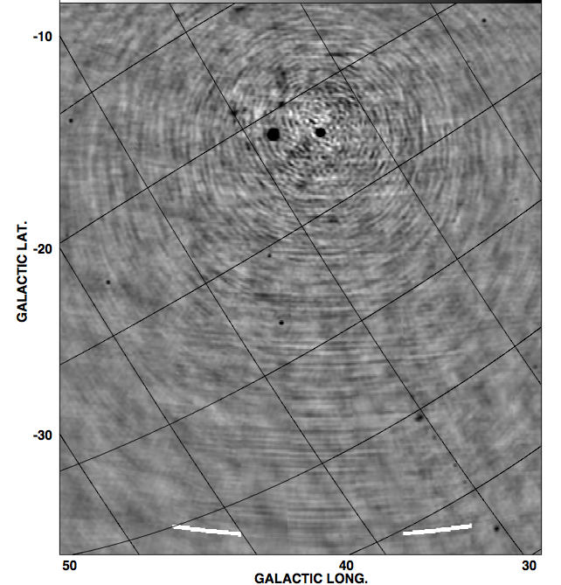
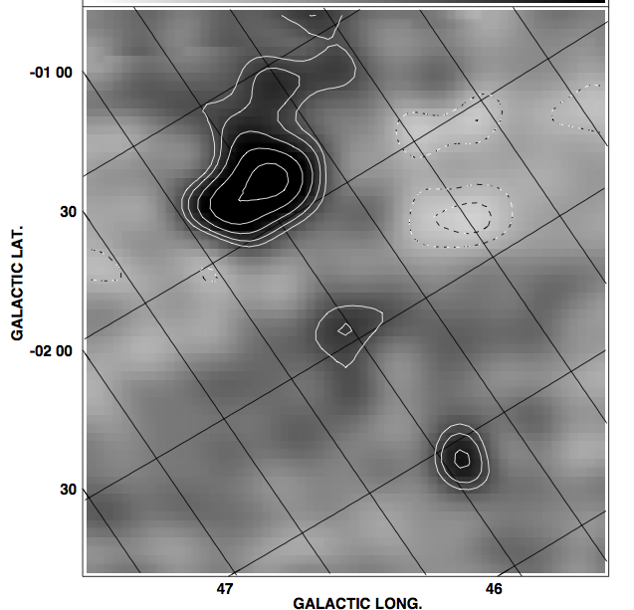
PAPER GB32 at 150MHz AIPS reduction
CygX G78.2+2.1
Cygnus A
1 hour, 6MHz
18’ resolution
DNR ~ 5000
Weakest src ~ 10 Jy
Galactic plane
W51 G49.2-0.7

Slide 2
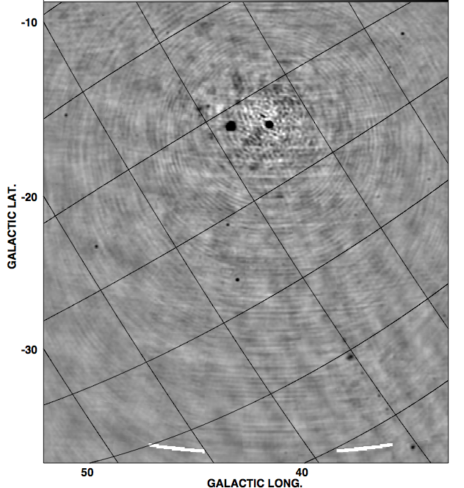
PAPER GB32 at 150MHz AIPS reduction
CygX G78.2+2.1
Cygnus A
1 hour, 12MHz
18’ resolution
DNR ~ 6500
Weakest src ~ 7 Jy
Galactic plane
W51 G49.2-0.7

Slide 3
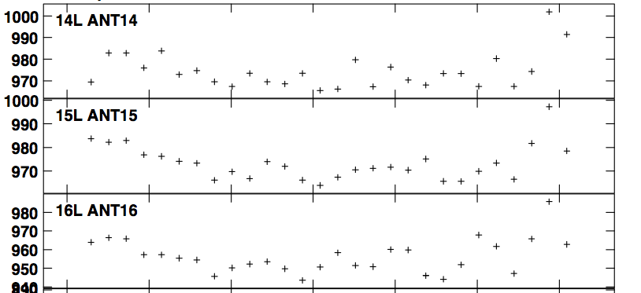
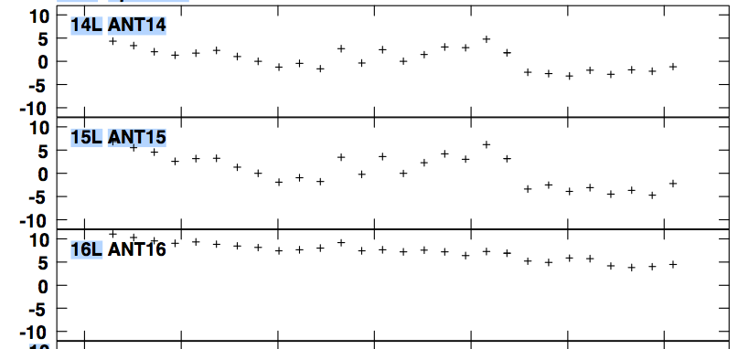
AIPS standard selfcal, imaging, editing: System is stable over 1hr
Amplitude ~ +/- 1%
Phases ~ +/- few deg

Slide 4
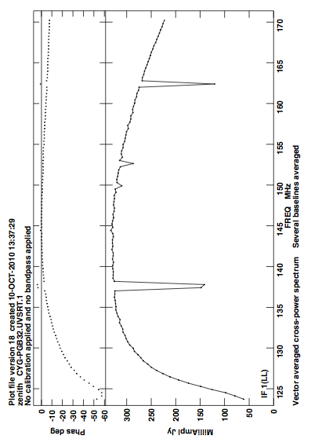
Interference in GB: looks manageable (for now)

Slide 5
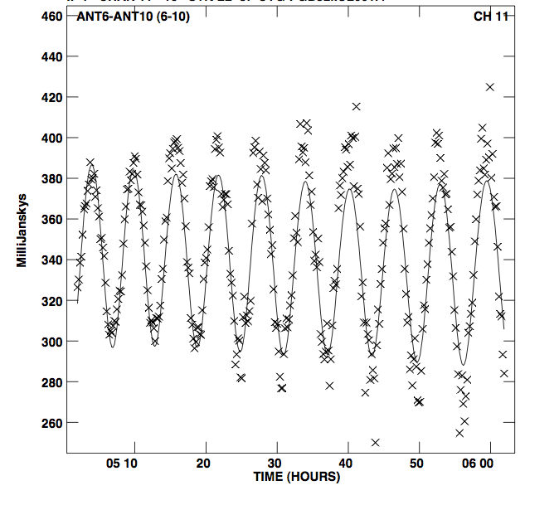
Difficulties with ‘standard packages’: violation of (most) tenets of SIRAII
Octave bandwidth: spectral synthesis
Full-sky imaging: 3D
Visibilities dominated by Cyg + Cas
Transit instrument => continuous primary beam correction
Currently resorting to ‘snapshot’ imaging in time and frequency (bookkeeping nightmare, and strictly linear gain!)
Need optimized pipeline with PB correction vs. time [but perhaps not for PS analysis, where bright source removal is paramount]

Slide 6
PAPER and HERA: A2010
a staged approach to reionization
HERA-I: detect the reionization signal and measure a few of its most general properties, such as the power spectrum, over a limited range of spatial scales and cosmic redshifts. The HERA-I program is currently being actively pursued in the United States, spearheaded by Murchison Widefield Array (MWA) and Precision Array to Probe the Epoch of Reionization (PAPER), which are testing alternative approaches.
HERA-II: aims at detailed characterization of the power spectrum of the fluctuations and other statistical measures of the signal. The HERA-II experiment will require approximately a factor of 10 increase in the collecting area (to about 0.1 square km)
=> mid-decade design decision, informed by path-finders.
HERA-III: stage aims at direct imaging of neutral hydrogen during the reionization epoch. Such an instrument would require of the order of 1 square kilometer of collecting area and is a natural candidate for the long-wavelength component of the Square Kilometer Array project. Even in the most optimistic scenario, construction of such a telescope cannot start earlier than 2020. HERA-II will set the stage for HERA-III/SKA-low.

Slide 7
PAPER and HERA: A2010
Establish MWA-PAPER coordinating group: not decision making body, but point of contact in spirit of HERA and mid-decade decision
Reionization special session at AAS Jan 2011
Establish HERA web-site w. memo series
Revise HERA A2010 submission, based on report: ‘post-decade survey white paper’
Detect HI 21cm signal from reionization in the next 2 years (!!)

Slide 8
PAPER and HERA: technical issues for 2015 decision
Antennas: tiles vs. ‘(very) cheap parabolas’. Delay transform requires very clean beam vs. freq, angle
Configuration: power spectrum vs. imaging may have very different requirements (again, see delay transform analysis)
Data storage: if at all possible, store visibilities! Question: does ionosphere fundamentally dictate averaging time?
Calibration (total and polarized intensity): need to explore, but techniques exist
Interference: looks manageable
Site: interaction with other activity?
DSP (large N correlators and interconnect): looks manageable. caveat: complexity management (Manley/Parsons)
  Roach II can handle 256 antennas with current architecture
  Likely Roach-approach can scale to 1000 elements
  40 Gb/s ethernet available next year (Altera)
  Power demand: follows moore’s law?

