Slide 1
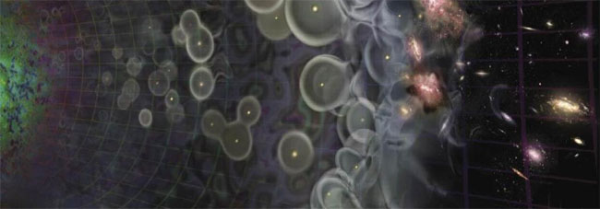
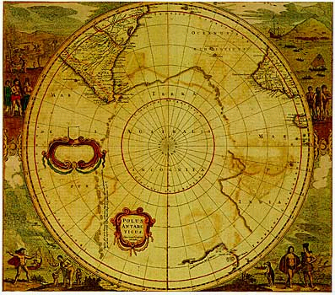
Universum Incognita
Cosmic reionization
Last frontier in studies of cosmic structure formation = benchmark for formation 1st galaxies
HI 21cm studies of neutral IGM will be as fundamental as studies of CMB
Terra Incognita

Slide 2
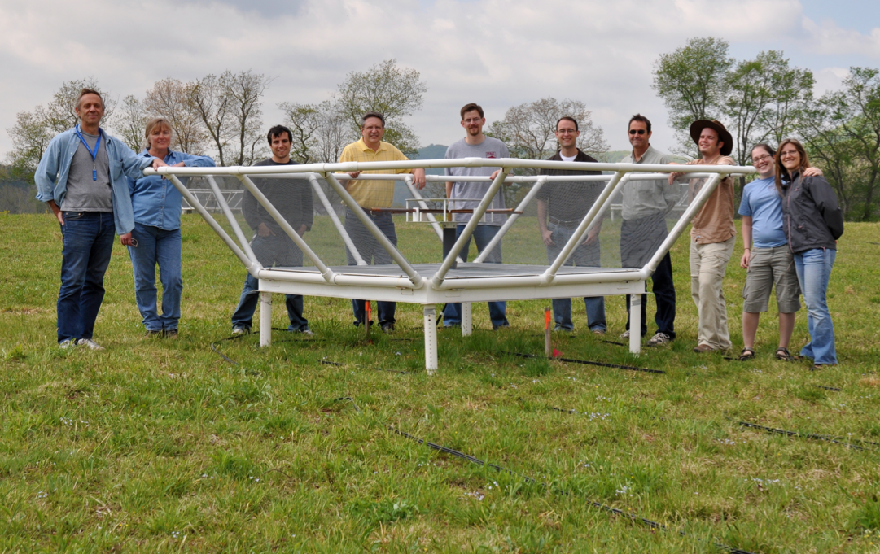

Precision Array to Probe Epoch of Reionization
Berkeley, NRAO, Penn, South Africa
Focused: HI 21cm studies of reionization drives design exclusively
Precision: emphasize engineering solutions first – relieve pressure on S/W
Staged: work through problems before major investment

Slide 3
PAPER: Staged exploration of parameter space
Site: 32 antenna engineering array in Greenbank, WV, USA and build-out to 128 antenna science array in Karoo, South Africa
Configurations: reconfigurable to explore eg. maximally (PS) and minimally (imaging) redundant configurations
Antennas: broad-band, sleeve dipole + ground screen w. flaps: smooth, broad response in angle/frequency
DSP: FPGA-based, scalable correlator from CASPER Berkeley wireless lab
Computing and data storage: cluster computing + 120 TB RAID at Penn. Key: store raw uv data
Data analysis: specialized AIPY S/W including calibration, editing, imaging, PS analysis (Parsons) + FITS export to AIPS and CASA for general wide-field, wide-band tools/exploration

Slide 4
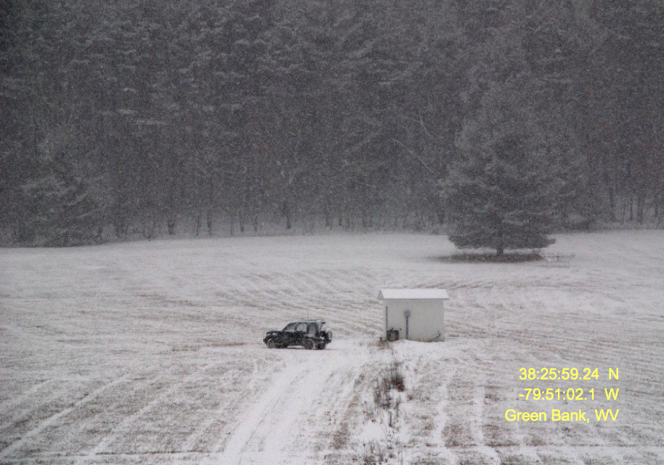
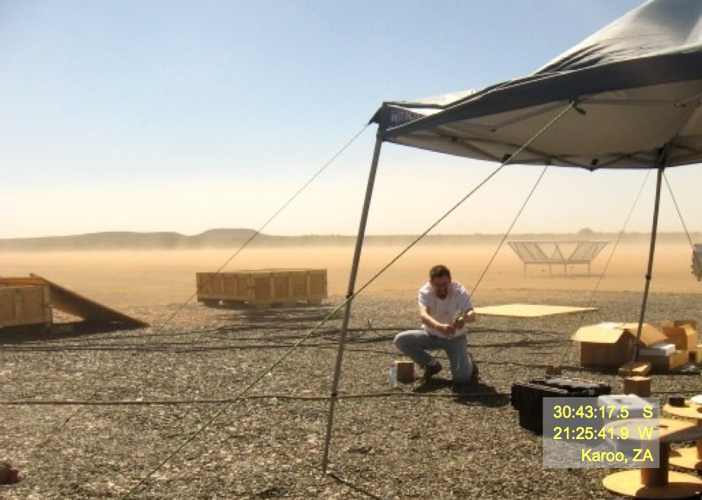
Braving the harsh winters in Green Bank, WV
32 station engineering array: critical for testing
Braving the harsh summers in Karoo, SA
Currently 32 stations, build-out to 128 station science array in 2011

Slide 5
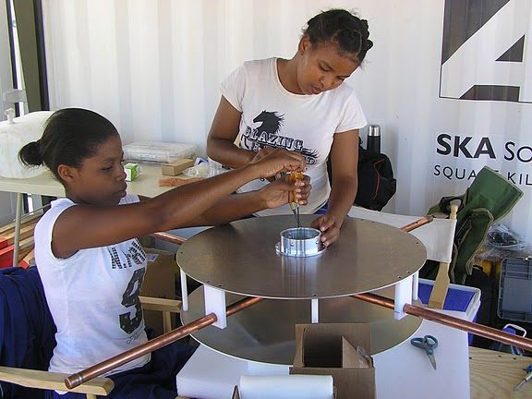
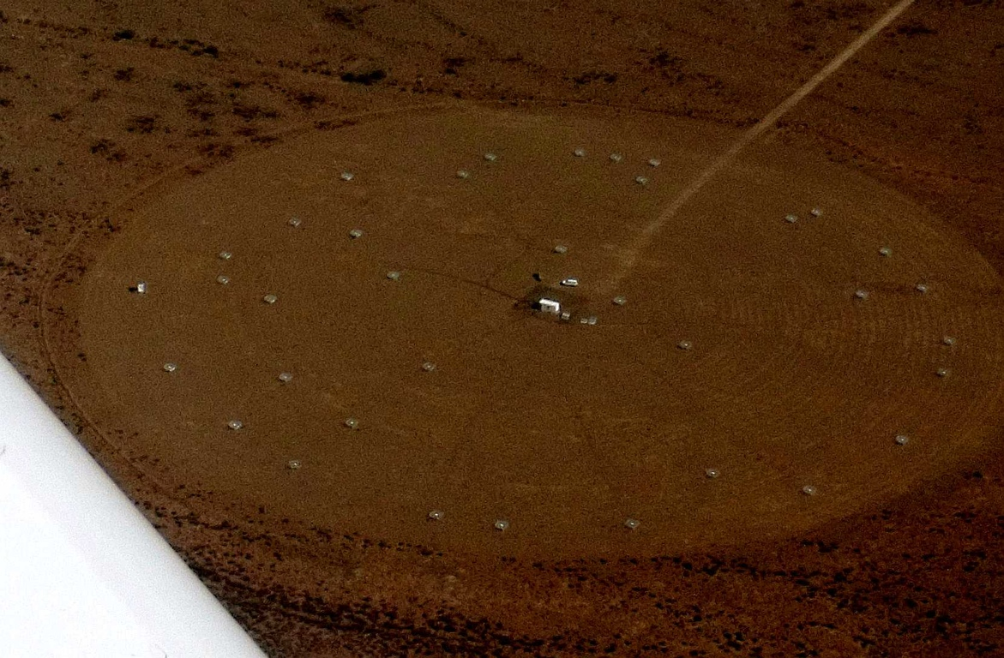
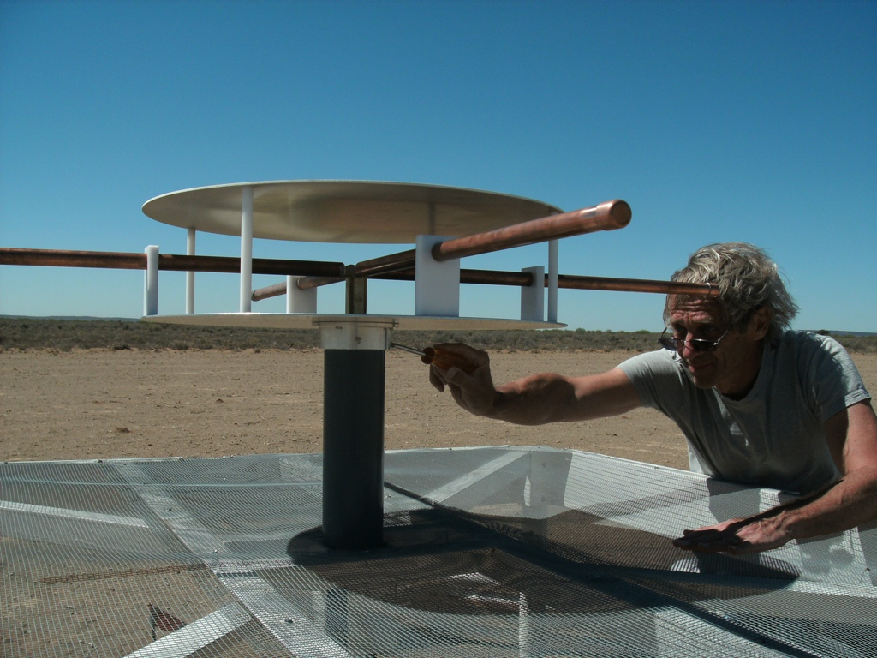
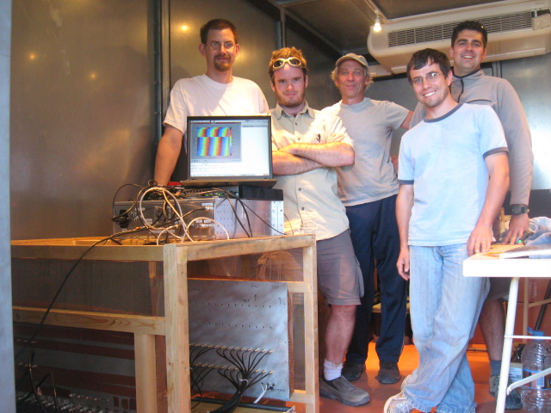
2010: 32 stations in Karoo, SA
Established working array from scratch in < 1 yr, with invaluable help from SA (SKA, Durbin)
Durbin University of Technology

Slide 6
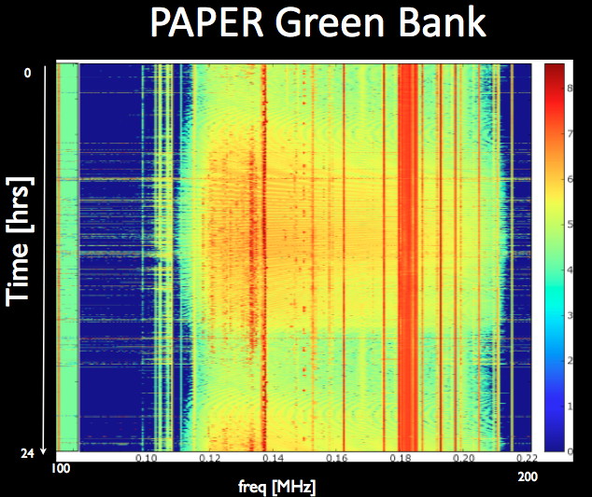
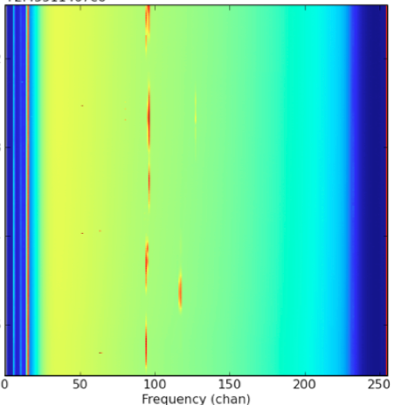
Interference
PAPER South Africa
OrbComm
FM
ISS
OrbComm
100MHz
200MHz
100MHz
200MHz

Slide 7
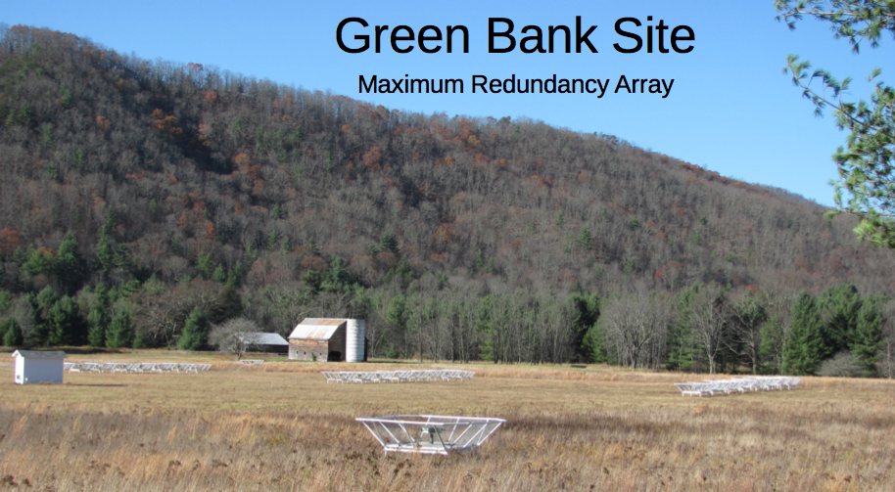
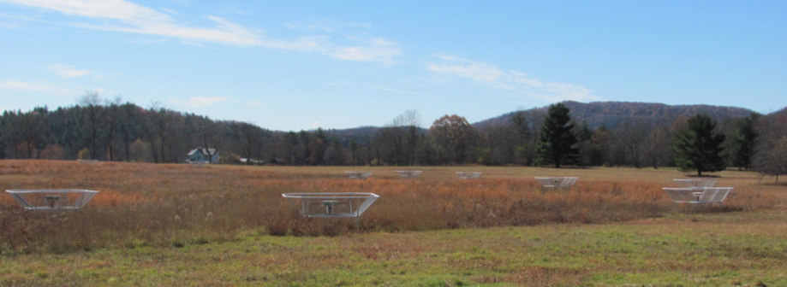
Reconfigurable
Delay transform PS analysis
Minimum redundancy Array
Imaging

Slide 8
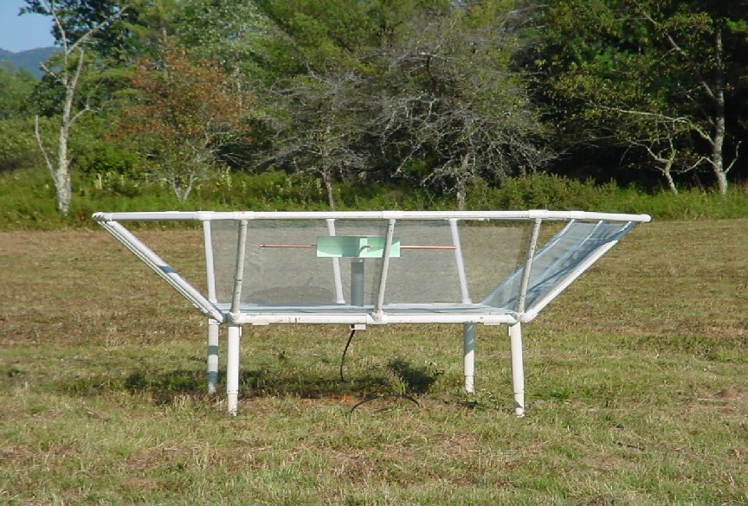
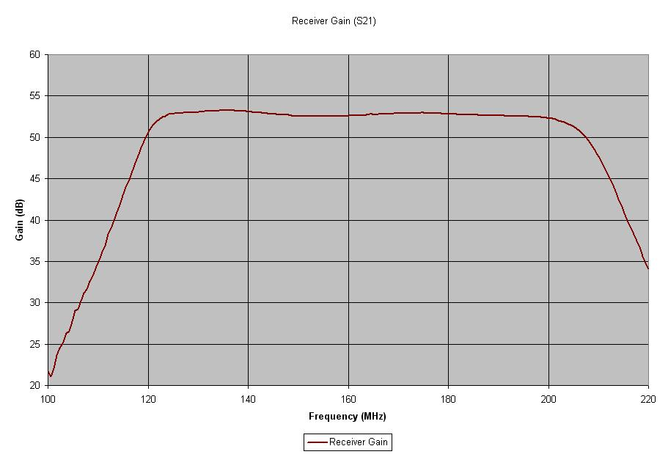
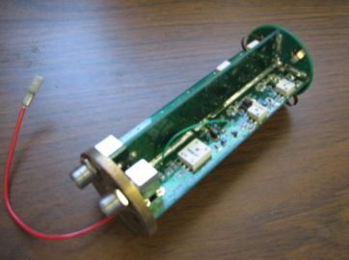
PAPER Antenna: sleeve dipole + flaps
‘Clean machine’: smooth, broad response in frequency and angle ‘Poor man’s parabola’
100MHz
200MHz
LNA: T_{rx} = 110K, 30dB gain 120-180MHz

Slide 9
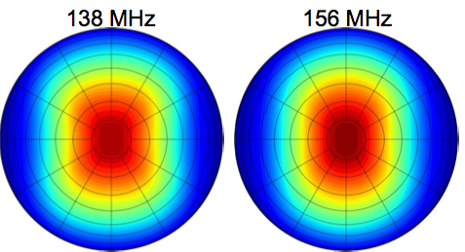
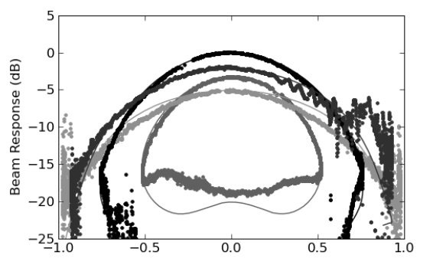
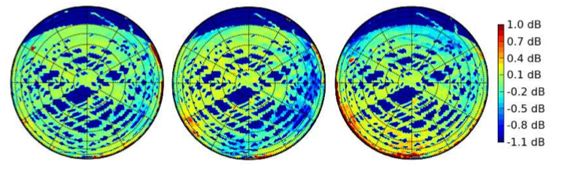
PAPER Primary beam
Measure power pattern using Orbcom at 136MHz

Slide 10
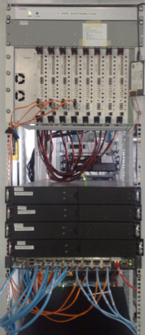
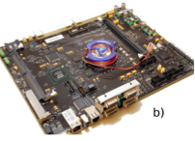
PAPER: (Xilinx) FPGA-base correlator from Berkeley wireless lab (CASPER)
IBOB F engine: sample, digitize, transform (τ → ν), using polyphase filter (‘preconvolution’)
ROACH X engine: cross multiply V (baseline, ν)
Cross-connections: ‘packetized correlator’ using 10Gb Ethernet protocol + commercial data routers
ROACH II: Easily scalable and reconfigurable. Estimate current architecture is scalable to 256 antennas w. 100MHz bandwidth
Computing and data storage (Penn)
Cluster computing: 32 octal core servers
Store raw visibilities: RAIDS 120 TB
Future: GPU processors?

Slide 11
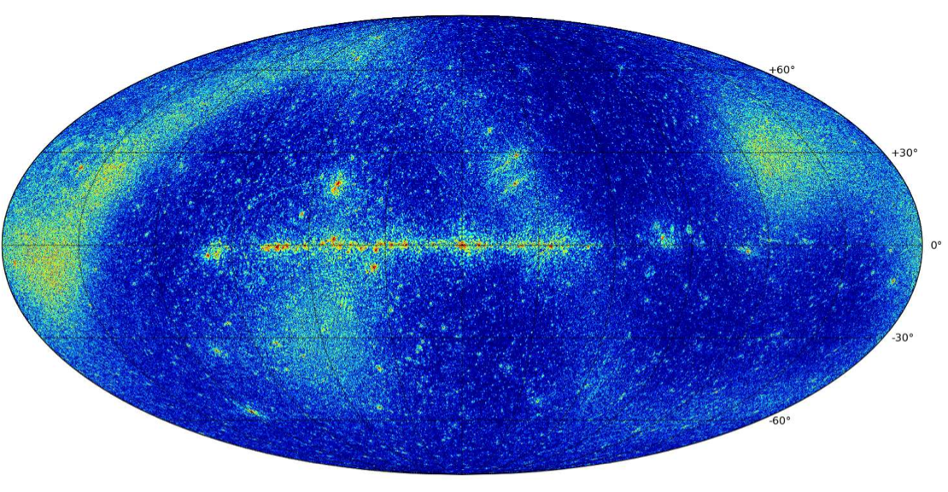
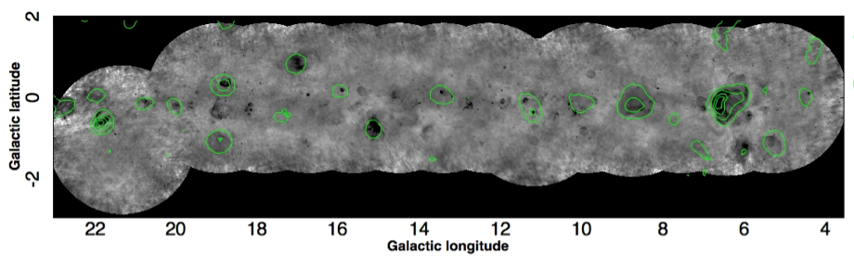
Data Analysis: AIPY redux
PAPER SA + GB 32 Station Image: 15’ res, 120 – 180 MHz
~ 1 Jy sensitivity in deep regions
Comparison to Brogan VLA 327MHz [Unique scale, freq, sensitivity]
uncataloged

Slide 12
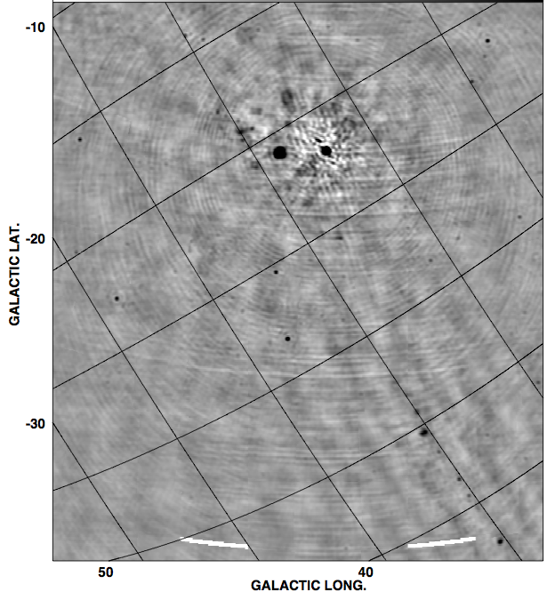
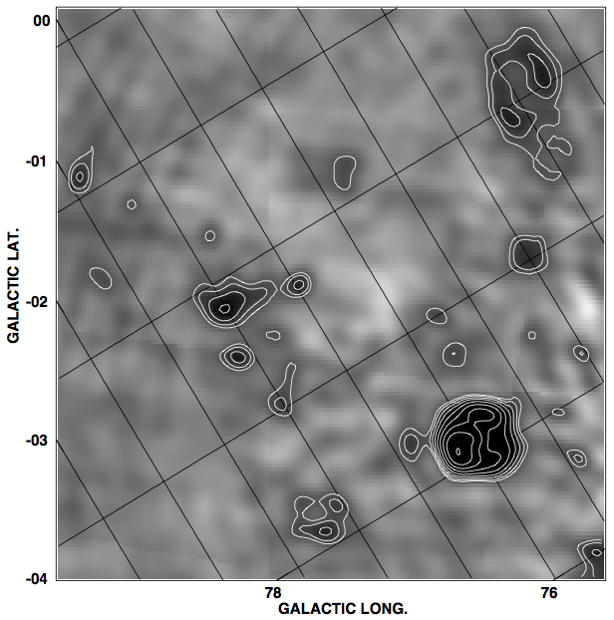
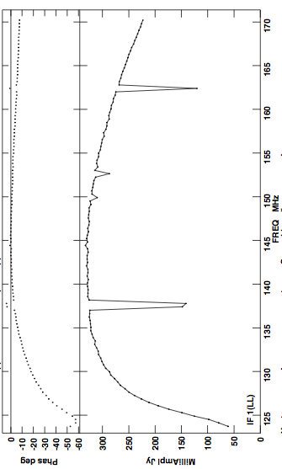
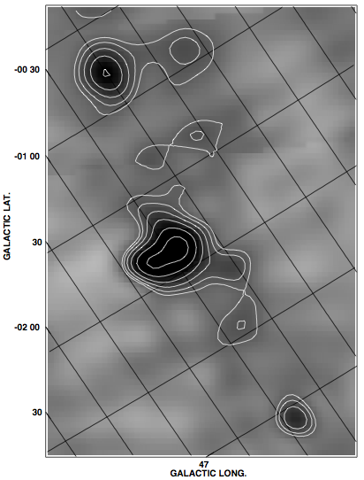
PAPER GB AIPS Redux
CygX region
G82.2+5.3
120MHz
180MHz
Cygnus A
G78.2+2.1
W51 region
Galactic plane
1 hour, BW=30MHz
18’ resolution
DNR ~ 9500
Weakest src ~ 4 Jy
G49.2-0.7

Slide 13
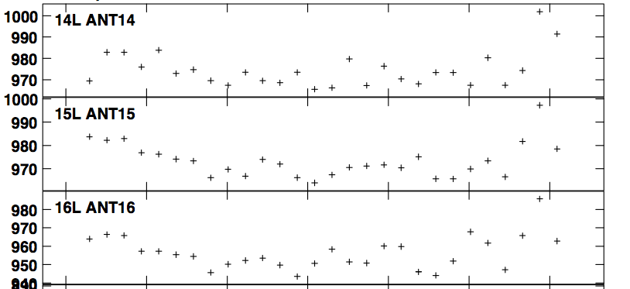
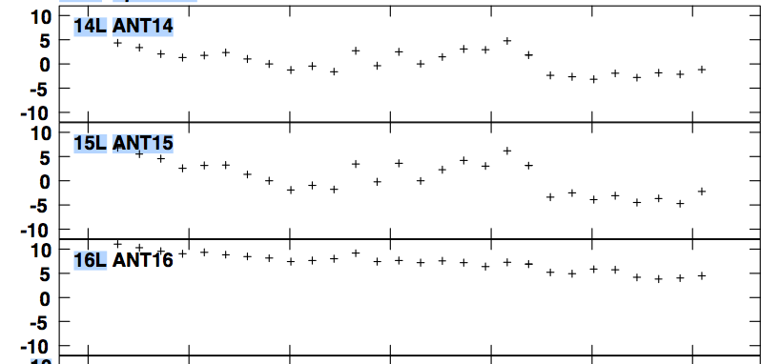
AIPS standard selfcal, imaging, editing: System is stable over 1hr
Amplitude ~ +/- 1%
Phases ~ +/- few deg

Slide 14
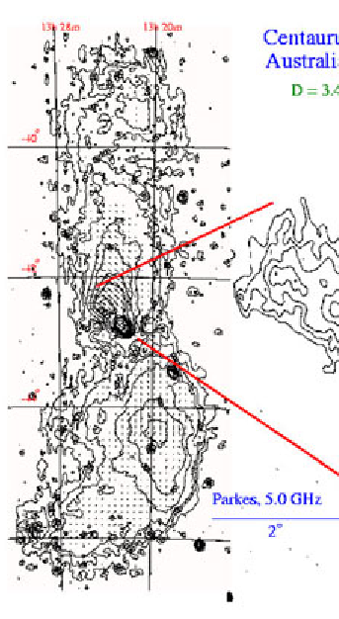
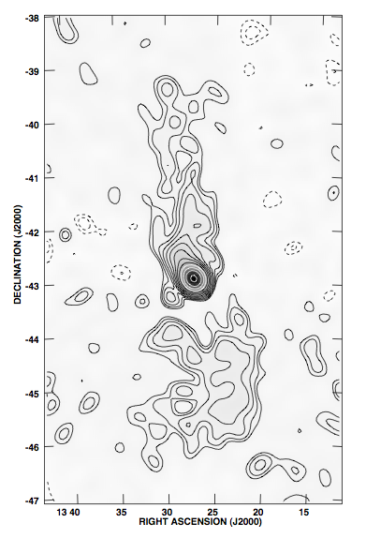
Cen A CASA Redux
1hr observation

Slide 15
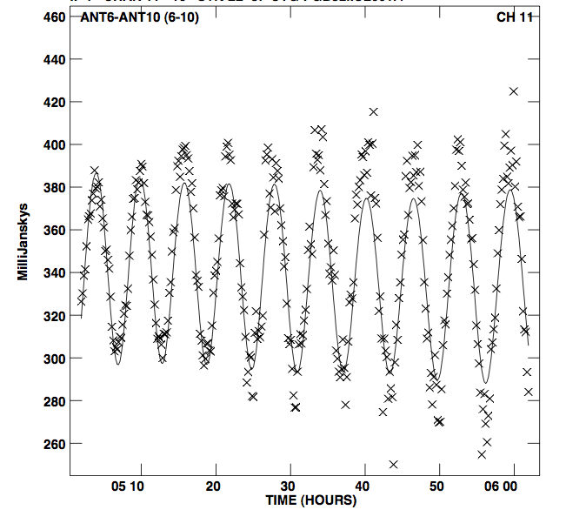
Difficulties with ‘standard packages’: violation of (most) tenets of SIRAII
Cyg-Cas dominant northern sky
Octave bandwidth: spectral synthesis
Full-sky imaging: 3D
Transit instrument => continuous primary beam correction
Currently resorting to ‘snapshot’ imaging in time and frequency ➔ Need optimized pipeline with PB correction vs. time = ‘OtF mosaic at sidereal rate’

Slide 16
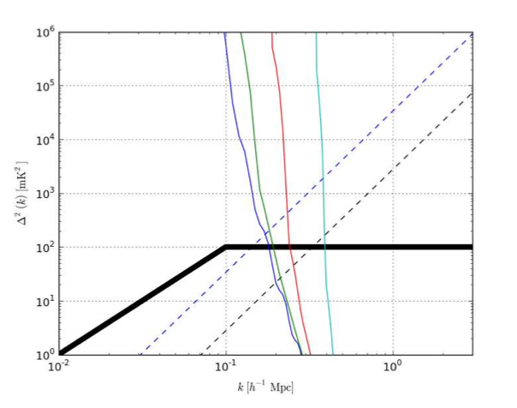
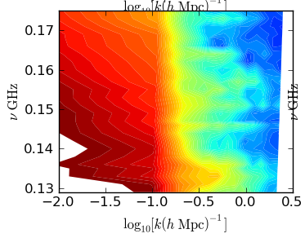
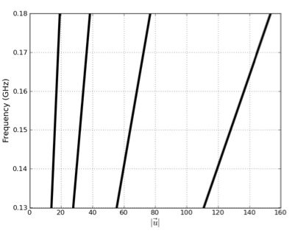
PS analysis: Delay Transform (Parsons)
Foregrounds: sharp cut-off (no suppression)
HI Bubble dominanted epoch?
Sensitivity in 1 campaign
signal
Baseline-based, PS analysis in freq = z
Synch. Foregrounds have sharp cut-off
Minimize spatial mode-mixing using short baselines, and narrow bands
Max redundant array ➔ PS detection with PSA128 in 120d w. 3 flds, 2hrs/fld/day
Wide band analysis is critical
Mode mixing: spatial and spectral freq

Slide 17
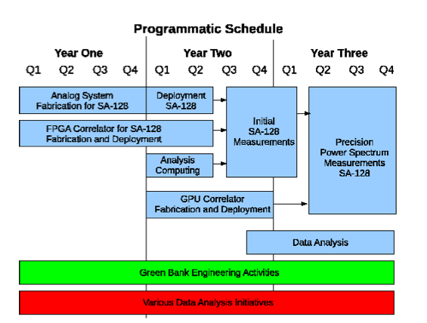

Slide 18
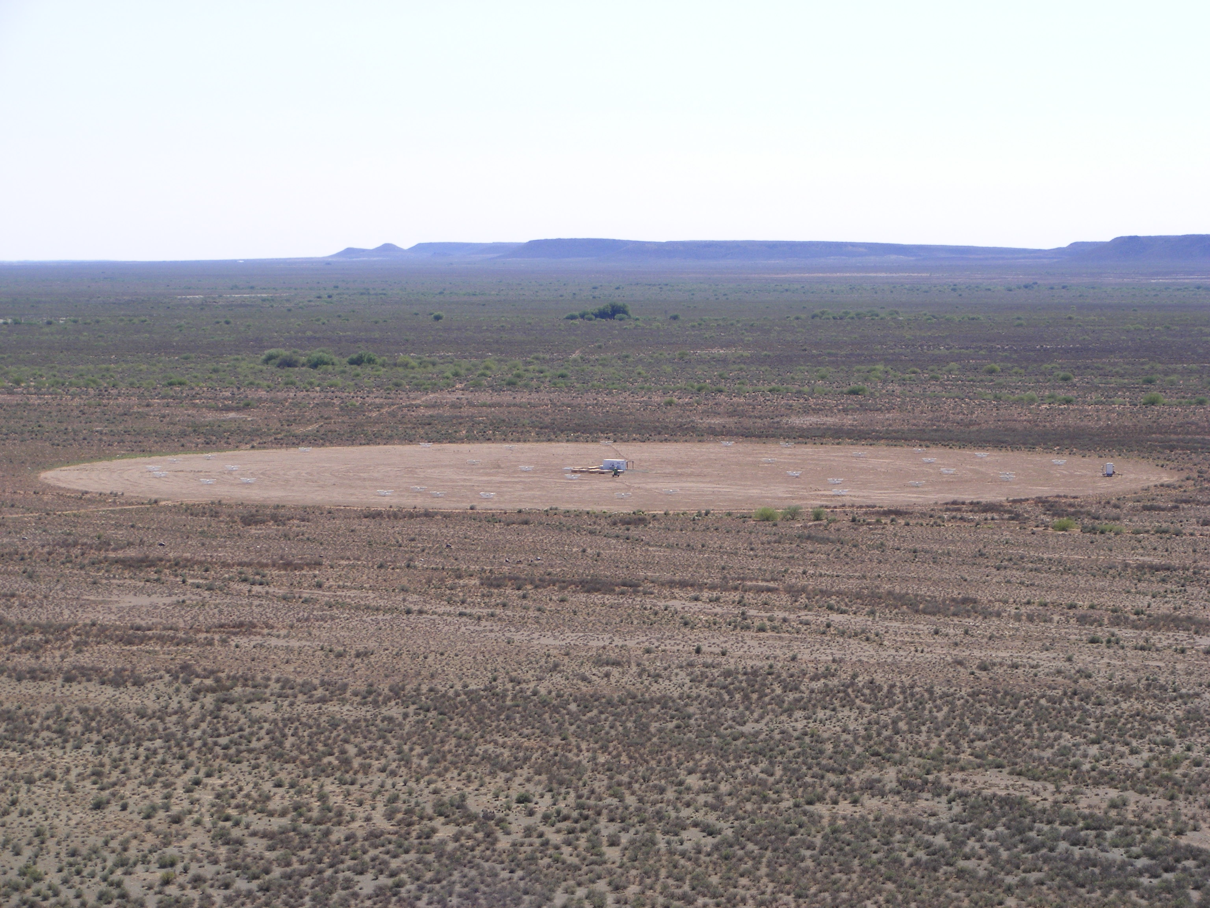
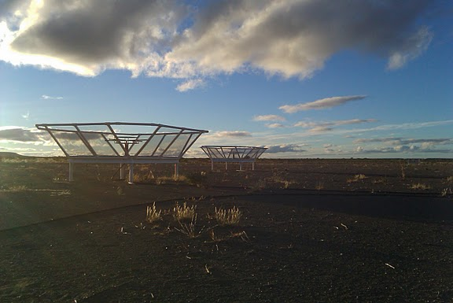
END

Slide 19
PAPER: First detection of the HI 21cm signal from reionization by 2013!

Slide 20
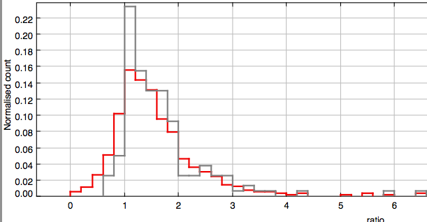
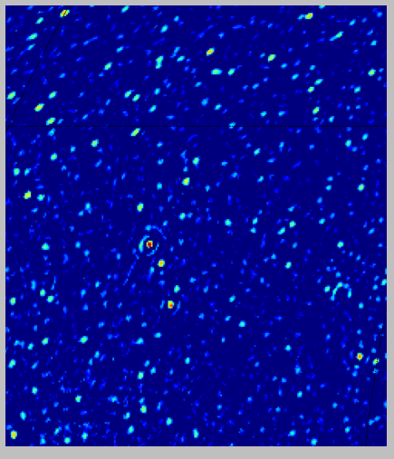
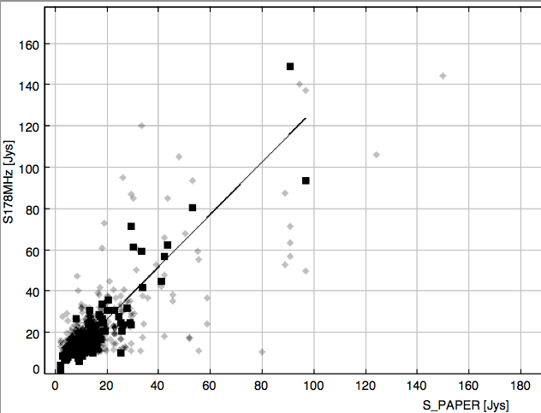
Comparisons: point source catalog Molonglo ‘178MHz’

Slide 21
PAPER and HERA: A2010
a staged approach to reionization
HERA-I: detect the reionization signal and measure a few of its most general properties, such as the power spectrum, over a limited range of spatial scales and cosmic redshifts. The HERA-I program is currently being actively pursued in the United States, spearheaded by Murchison Widefield Array (MWA) and Precision Array to Probe the Epoch of Reionization (PAPER), which are testing alternative approaches.
HERA-II: aims at detailed characterization of the power spectrum of the fluctuations and other statistical measures of the signal. The HERA-II experiment will require approximately a factor of 10 increase in the collecting area (to about 0.1 square km)
=> mid-decade design decision, informed by path-finders.
HERA-III: stage aims at direct imaging of neutral hydrogen during the reionization epoch. Such an instrument would require of the order of 1 square kilometer of collecting area and is a natural candidate for the long-wavelength component of the Square Kilometer Array project. Even in the most optimistic scenario, construction of such a telescope cannot start earlier than 2020. HERA-II will set the stage for HERA-III/SKA-low.

Slide 22
PAPER and HERA: A2010
Establish MWA-PAPER coordinating group: not decision making body, but point of contact in spirit of HERA and mid-decade decision
Reionization special session at AAS Jan 2011
Establish HERA web-site w. memo series
Revise HERA A2010 submission, based on report: ‘post-decade survey white paper’
Detect HI 21cm signal from reionization in the next 2 years (!!)

Slide 23
PAPER and HERA: technical issues for 2015 decision
Antennas: tiles vs. ‘(very) cheap parabolas’. Delay transform requires very clean beam vs. freq, angle
Configuration: power spectrum vs. imaging may have very different requirements (again, see delay transform analysis)
Data storage: if at all possible, store visibilities! Question: does ionosphere fundamentally dictate averaging time?
Calibration (total and polarized intensity): need to explore, but techniques exist
Interference: looks manageable
Site: interaction with other activity?
DSP (large N correlators and interconnect): looks manageable. caveat: complexity management (Manley/Parsons)
Roach II can handle 256 antennas with current architecture
Likely Roach-approach can scale to 1000 elements
40 Gb/s ethernet available next year (Altera)
Power demand: follows moore’s law?

