Slide 1
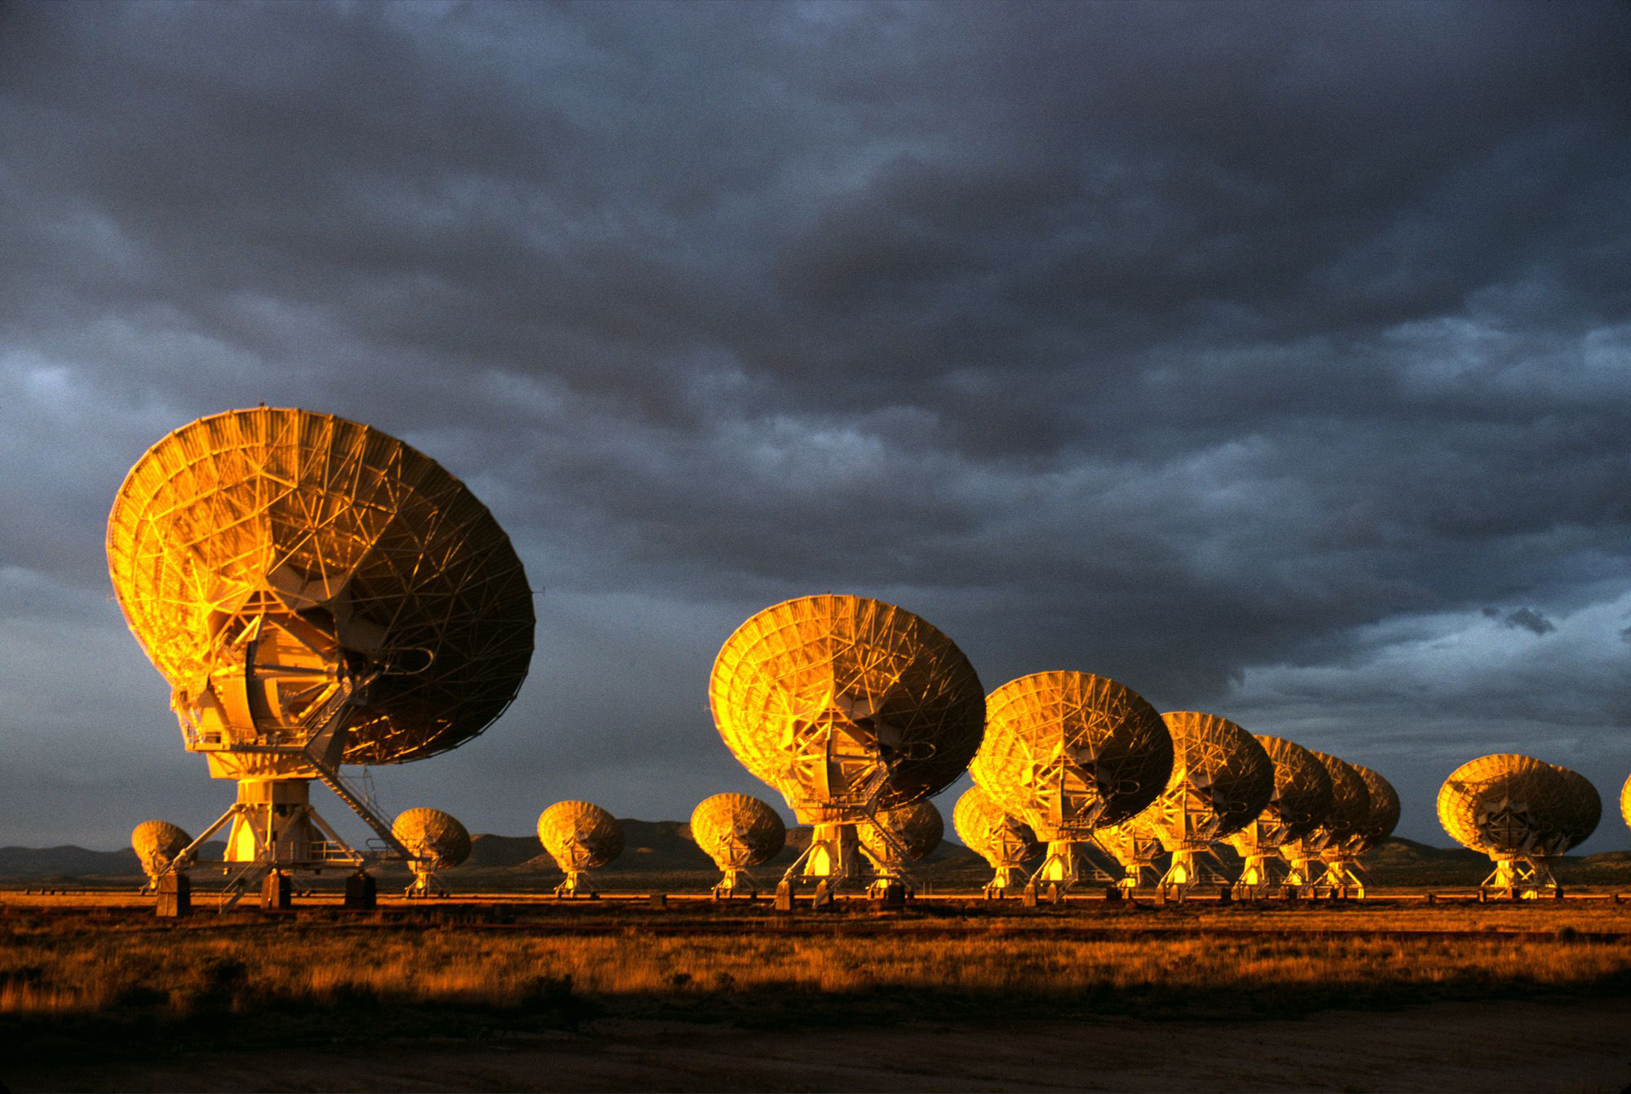
The Very Large Array: Global Powerhouse in Radio Astronomy for 44 years
1972 – Approved by Congress
1975 – 1st antenna
1980 – Full science operations
2001 – Jansky VLA major electronics upgrade approved by NSF
2011 – JVLA full science ops

Slide 2
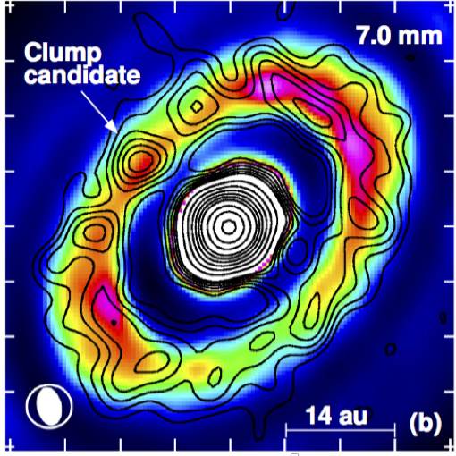
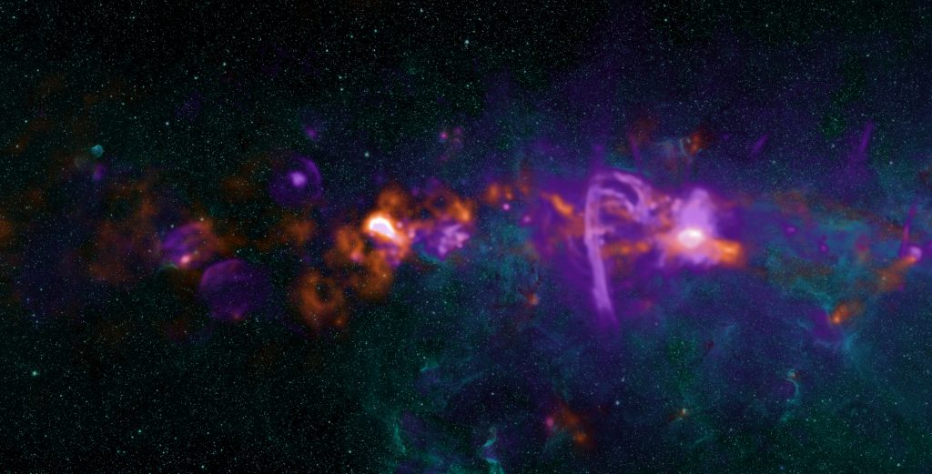
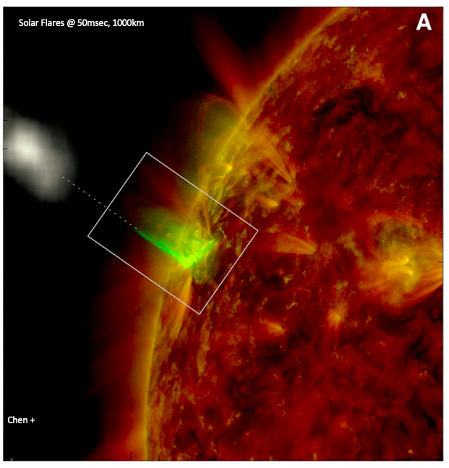
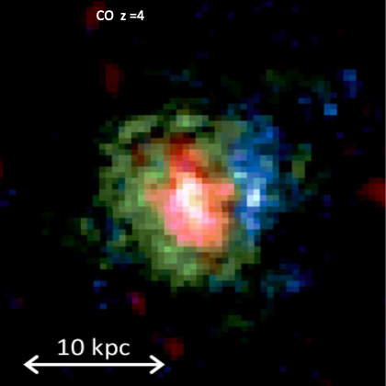
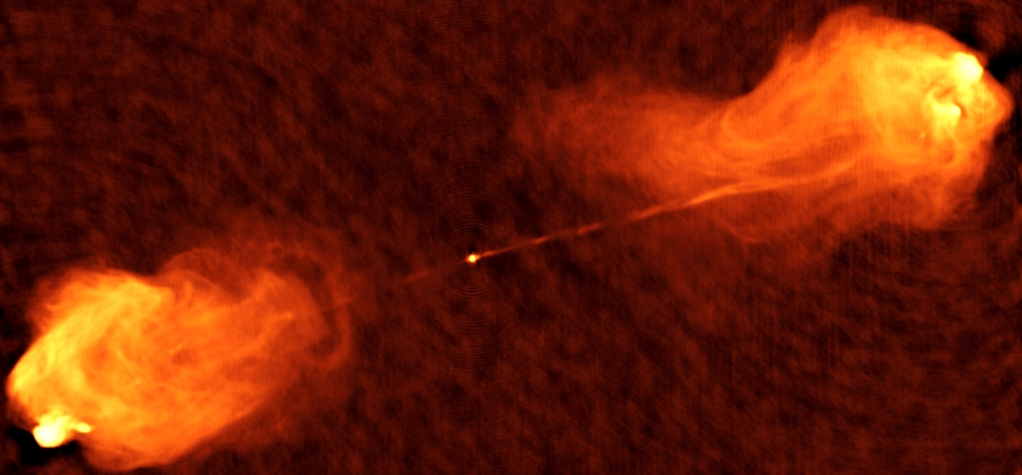
VLA: world’s most powerful radio telescope since 1980
Among the most productive telescopes of all-time at any wavelength
16,000 proposals, 12,000 papers, 400 PhD theses
Planet formation
Why? Versatility!
Isella +

Slide 3
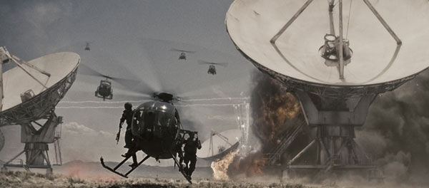
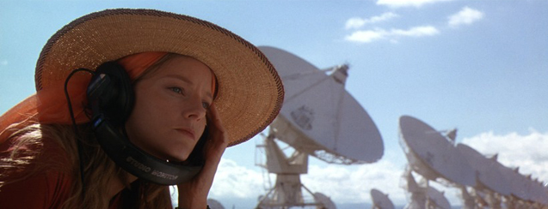

Slide 4
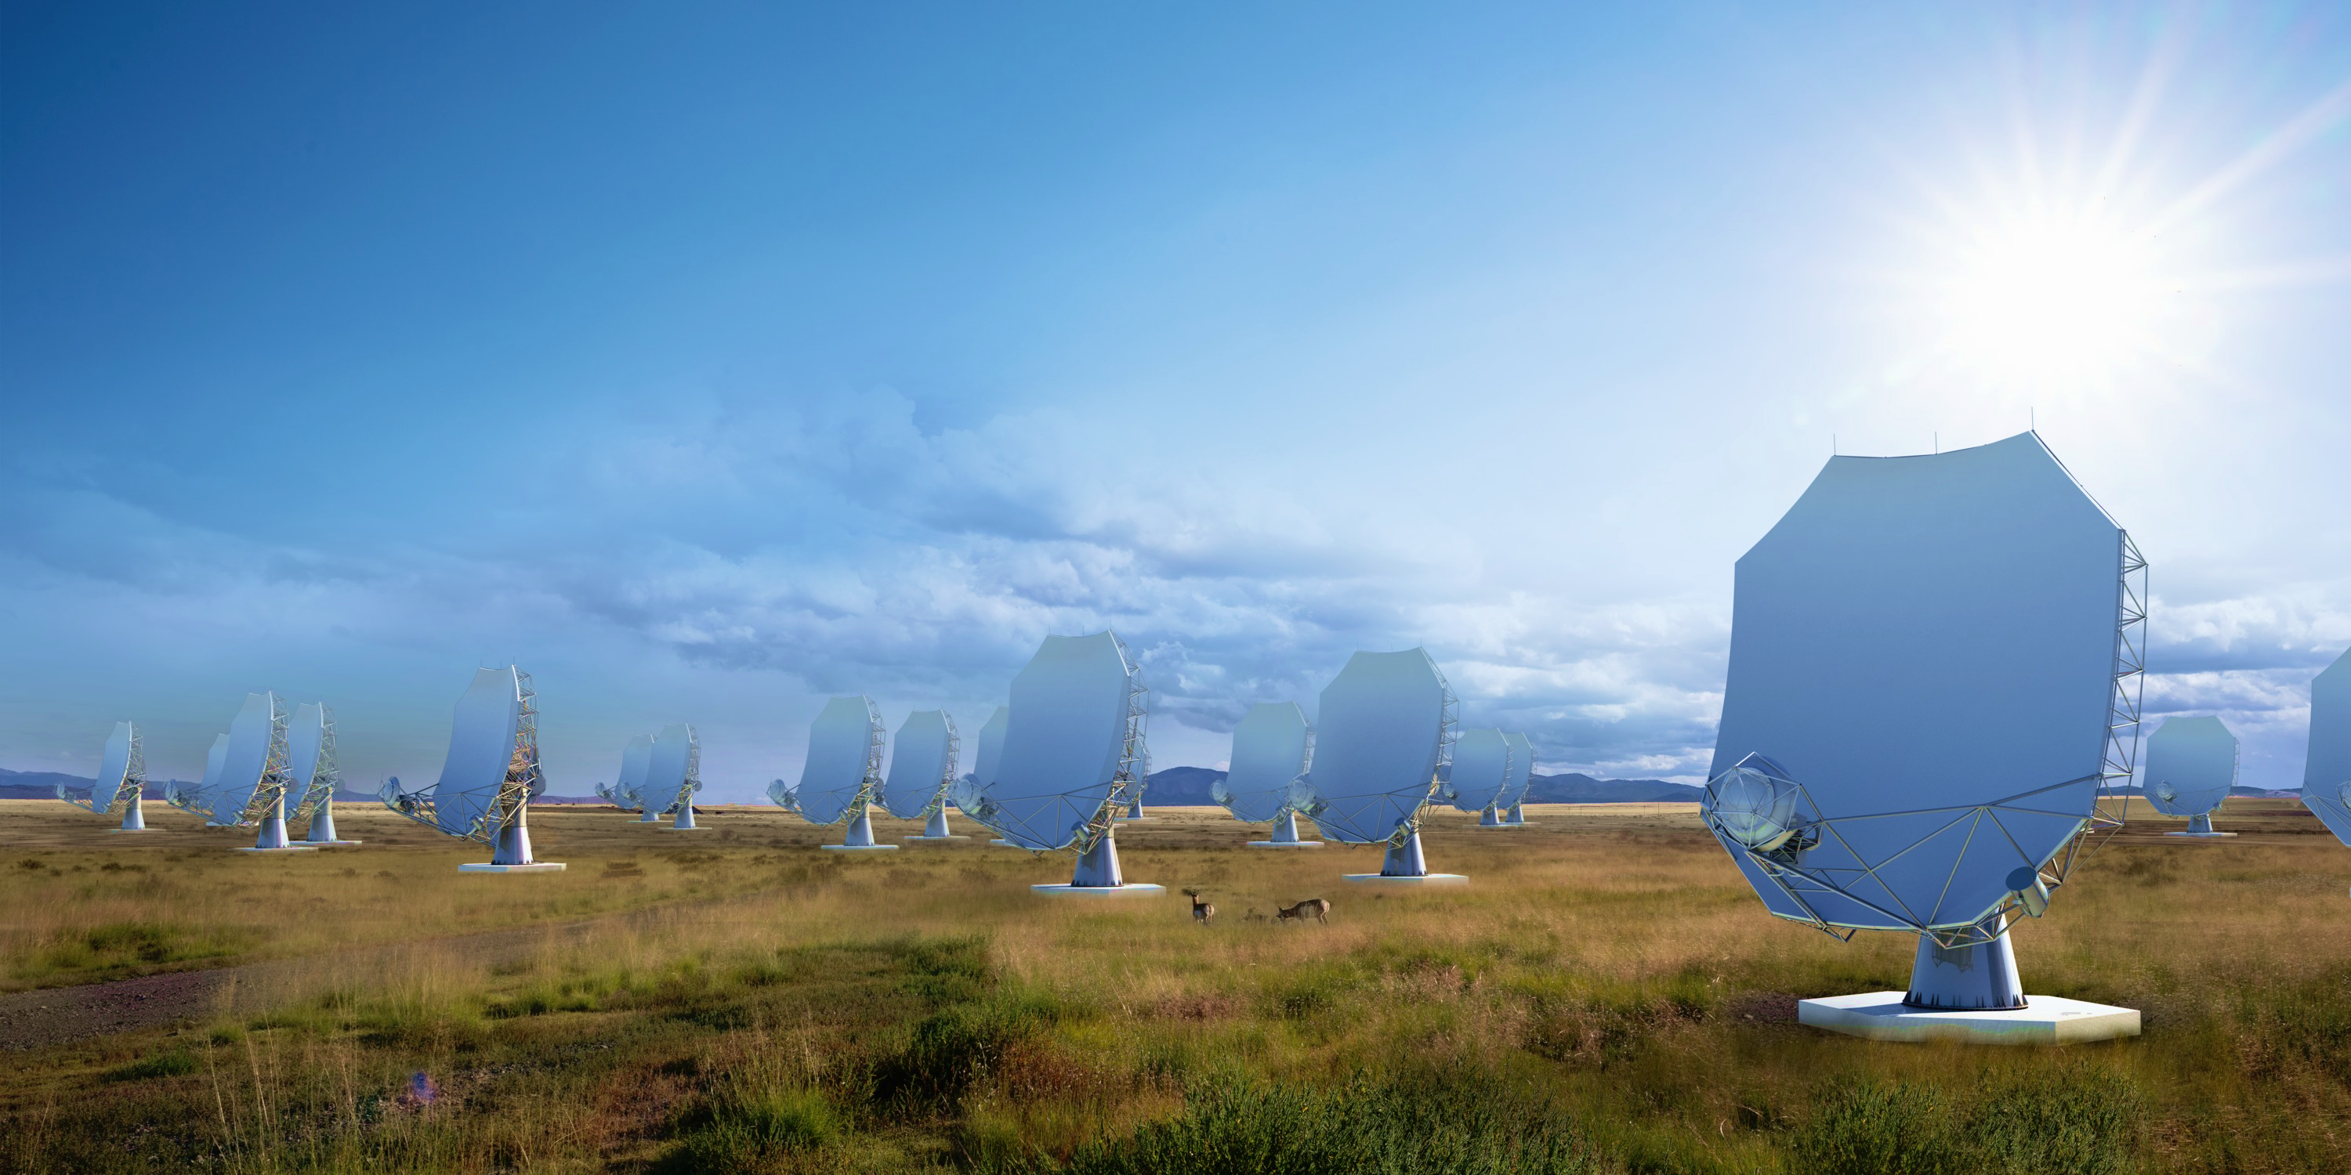
The next-generation Very Large Array
A new facility for a new millennium, replace the VLA and VLBA to tackle new scientific frontiers into the mid-21st Century
10x area of JVLA/ALMA/VLBA
1.2 - 116 GHz Frequency Coverage
244 x 18m + 19 x 6m offset Gregorian Antennas
Centered at VLA site, extending over USA & MX
High and dry sites for 115 GHz
Fixed antenna locations

Slide 5
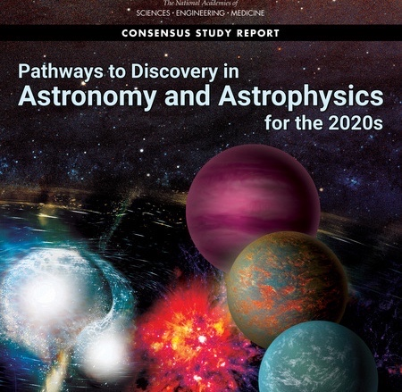
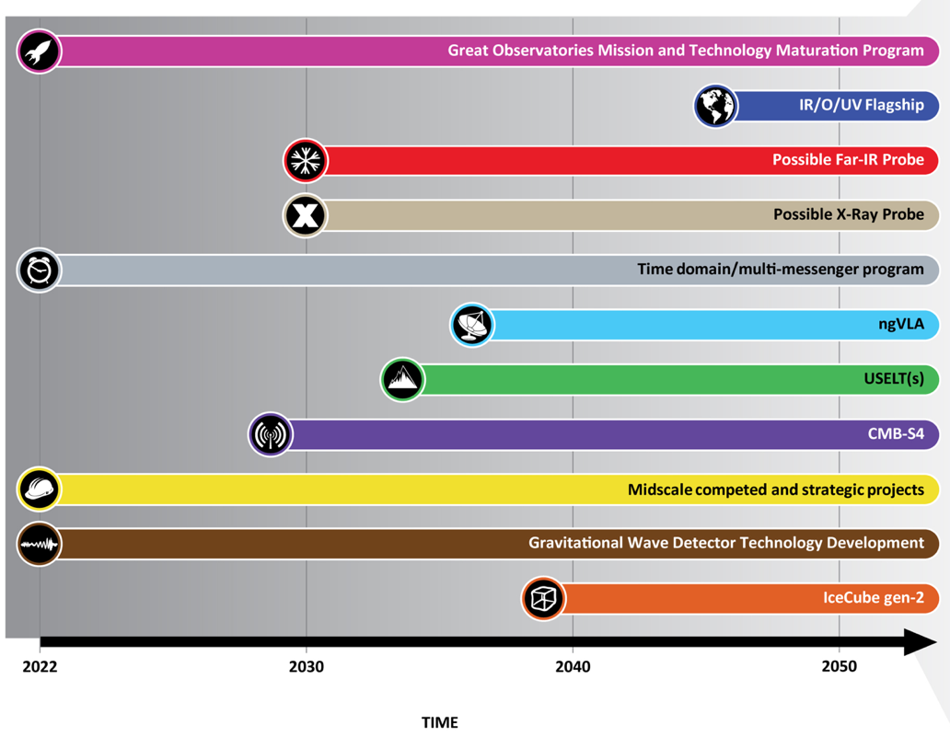
Astro2020 identified the ngVLA as a high-priority large, ground-based facility whose construction should start this decade.
Notes:
ngVLA essentially checked off every box of Astro2020 scientific priorities.

Slide 6
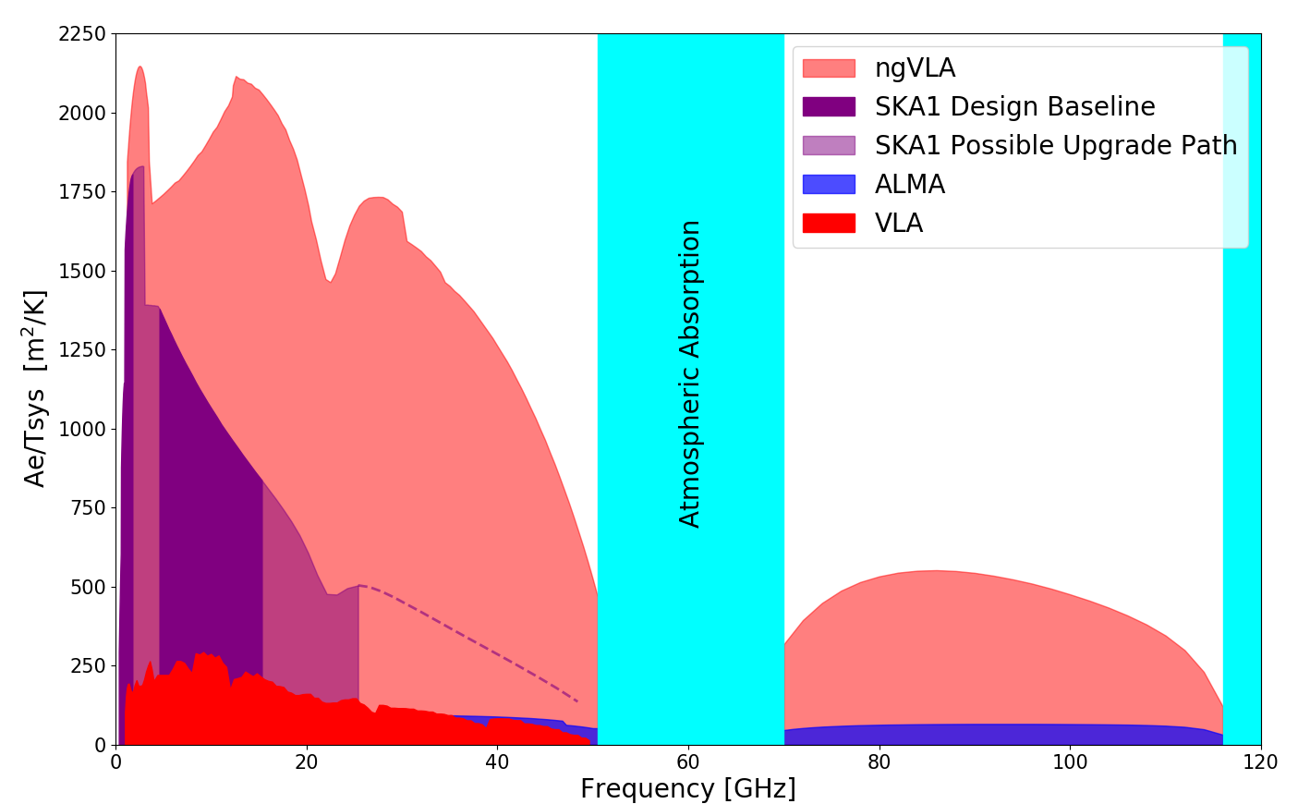
New Parameter (‘Discovery’) Space for the mid-Century
Complementary suite of arrays from meter to submm
> 120GHz: ALMA 2030 superb for chemistry, dust, fine structure lines
1.0 - 116GHz: ngVLA superb for terrestrial planet formation, dense gas history, black holes
< 15 GHz: SKA superb for pulsars, reionization, HI + continuum imaging
Notes:
Snapshot comparison of effective collecting area for dish-arrays expected in the 2030’s.

Slide 7
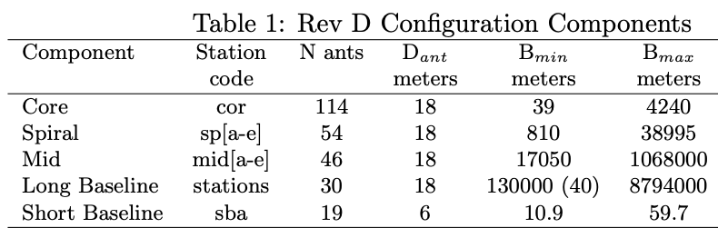
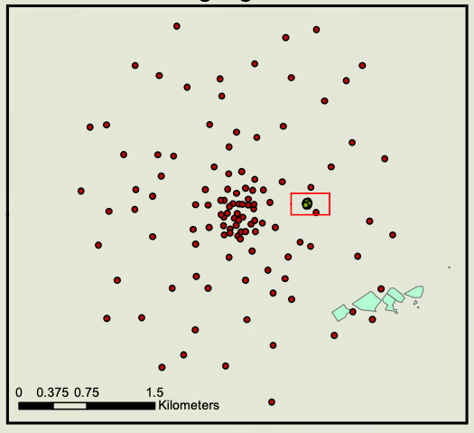
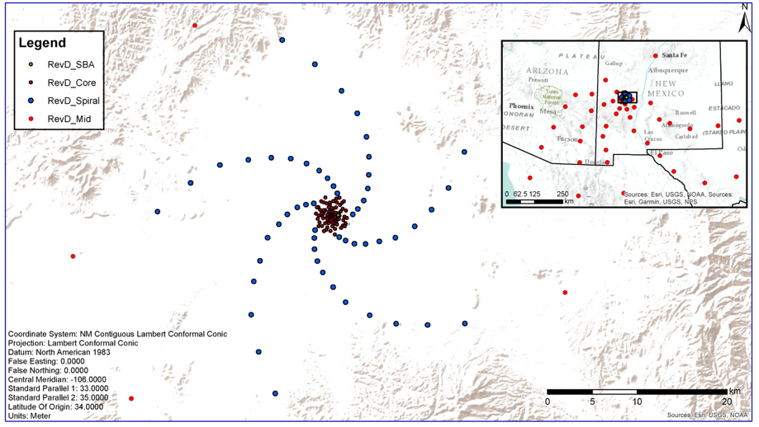
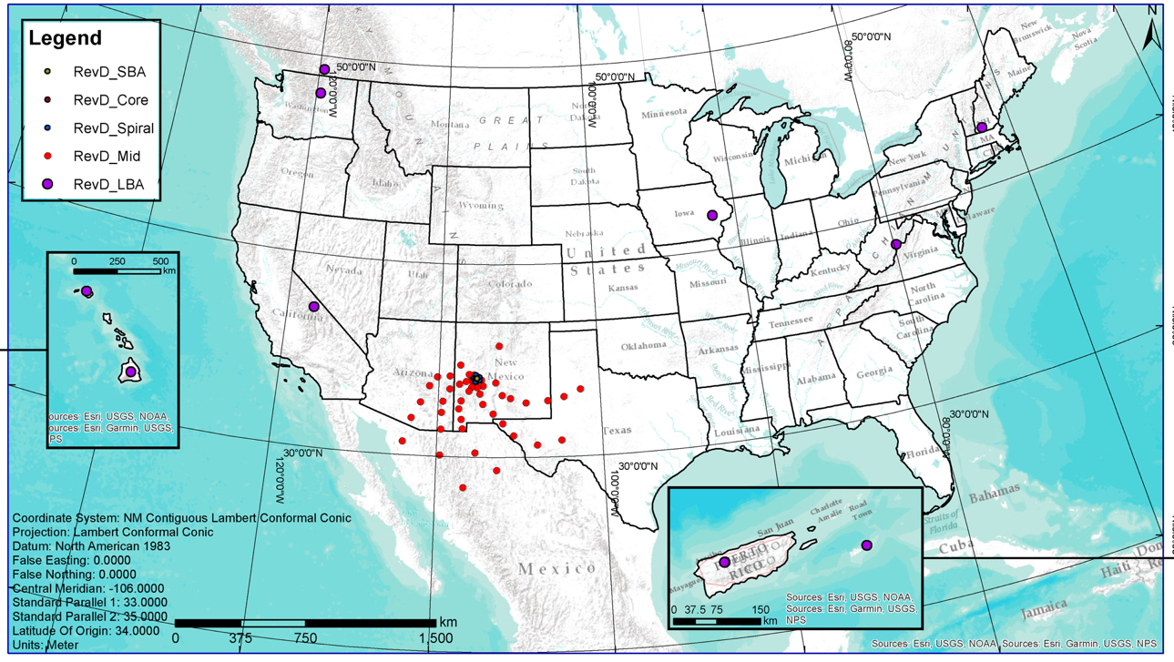
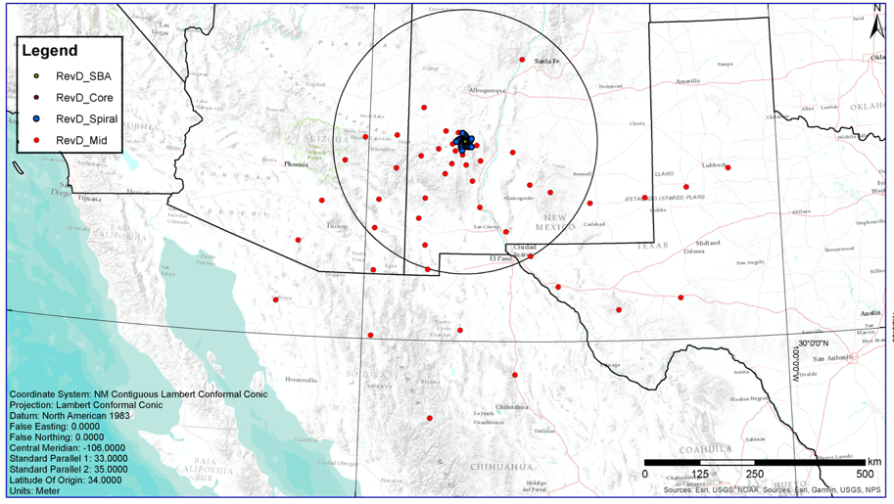
10m to 9000km => 200” to 0.2 mas @ 32GHz
350 miles

Slide 8
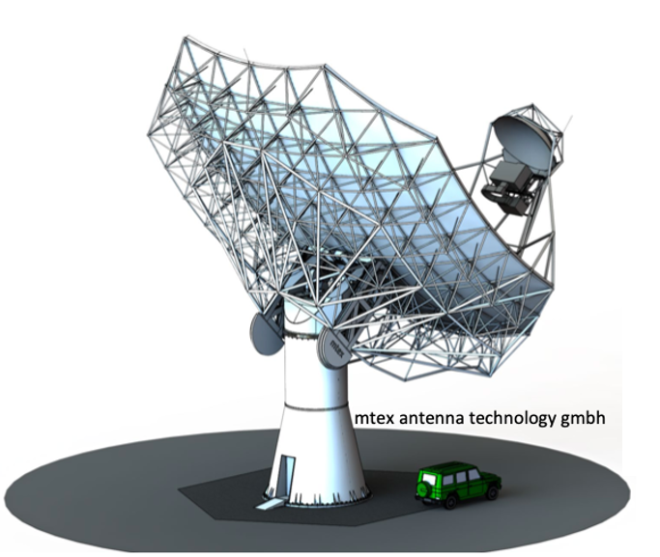
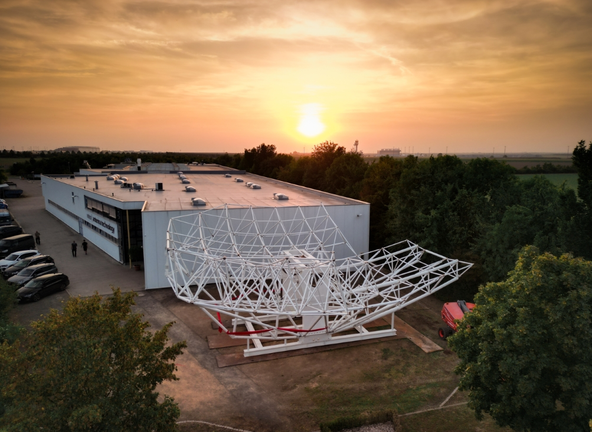
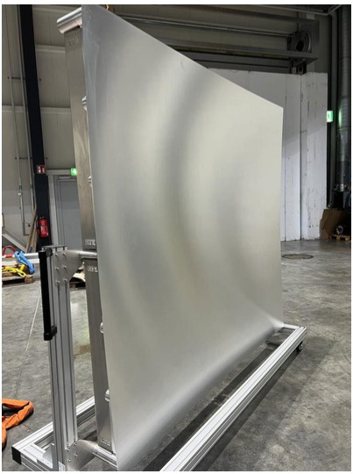
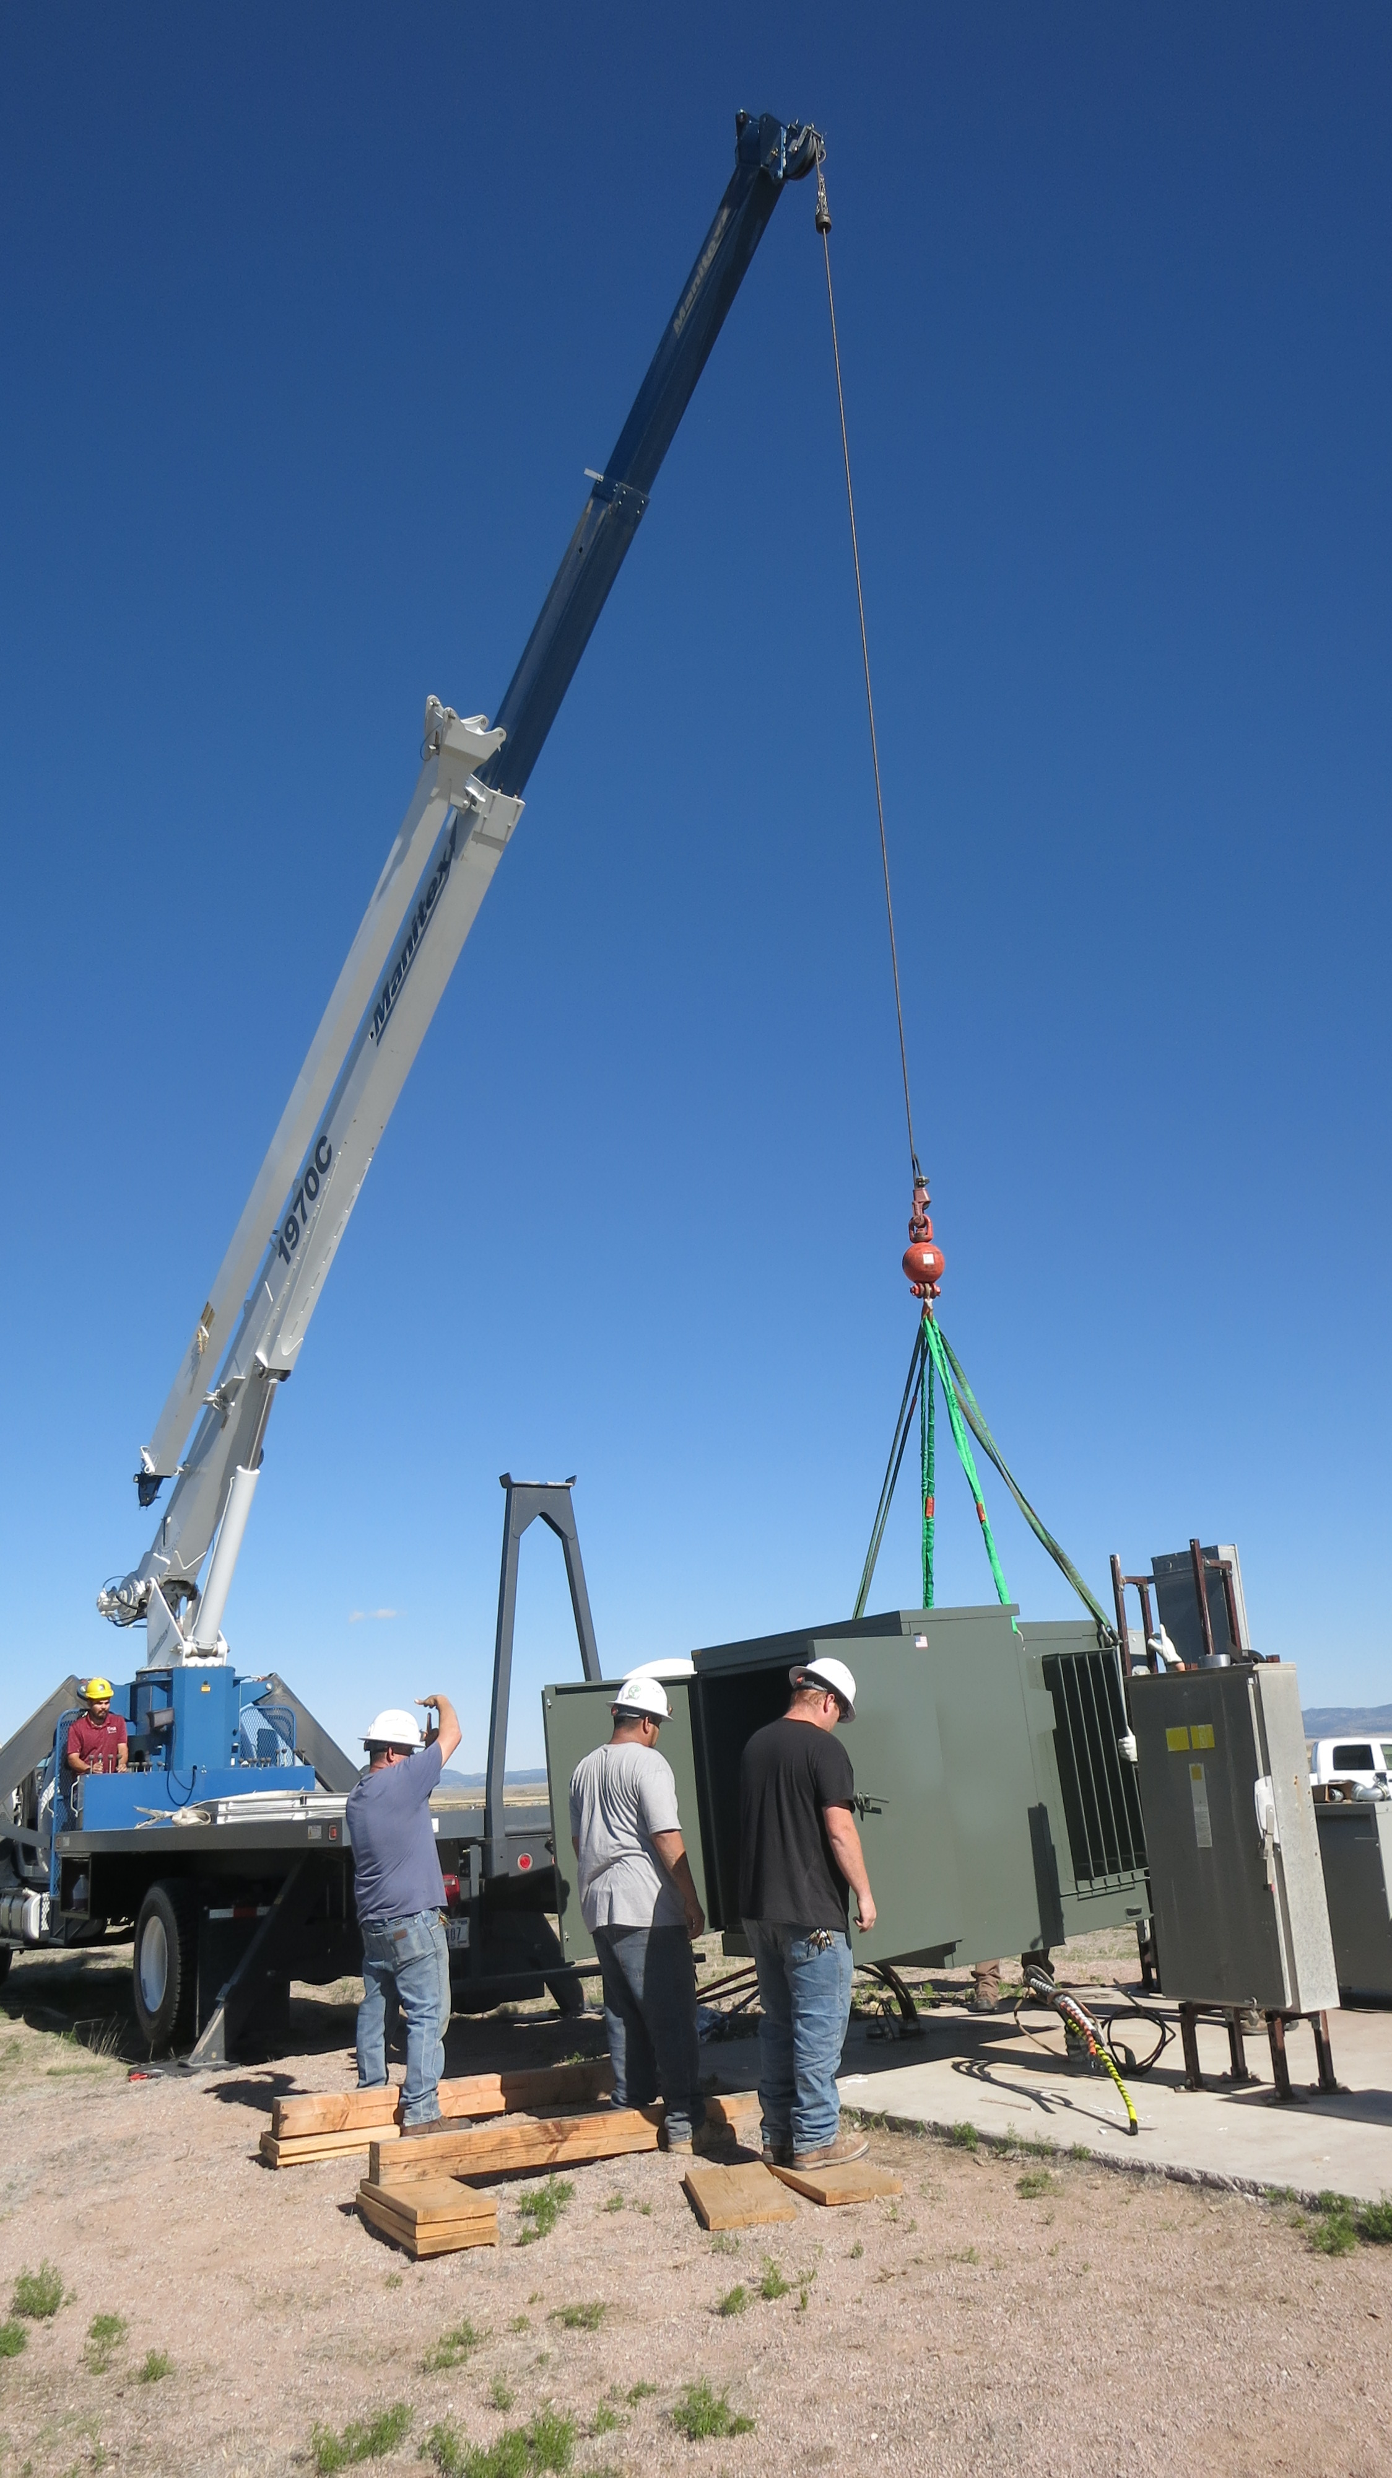
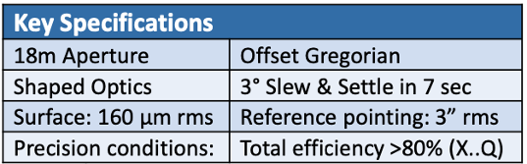
2019 Reference Design: Build from ALMA, JVLA, SKA development
low-technical-risk and well costed
MTEX Saxony, DE
Delivery to Site end 2024
U.S. Multiagency Interest (DOD, NASA): ICRF, Space Situational Awareness (radar), Spacecraft tracking/imaging, `burst-telemetry’

Slide 9
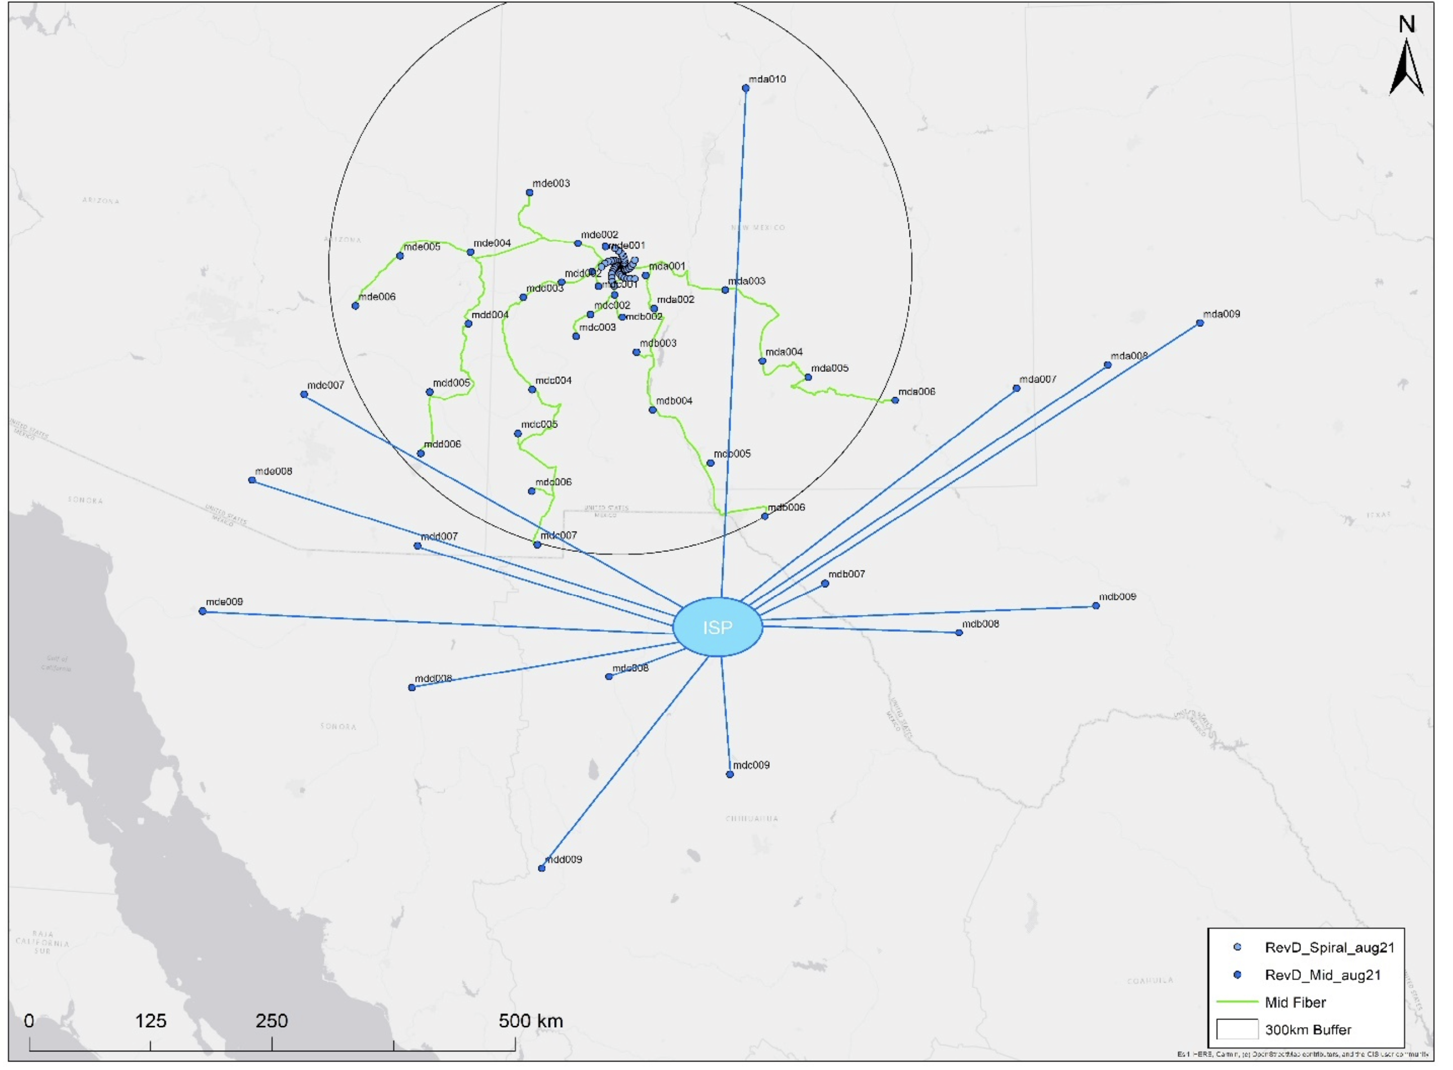
Fiber: real time VLBI
Dedicated lines < 300 km
ISP leased bandwidth > 300 km
Data Rates
Data rate into correlator ~ 800 Gbps per antenna => 210 Tbps
Archive: 20 PB/mo, 240 PB/yr
Power
Correlator ~ 1 MW, Antennas ~ 3.6MW
Exploring power purchasing agreement: on-site photovoltaic system

Slide 10
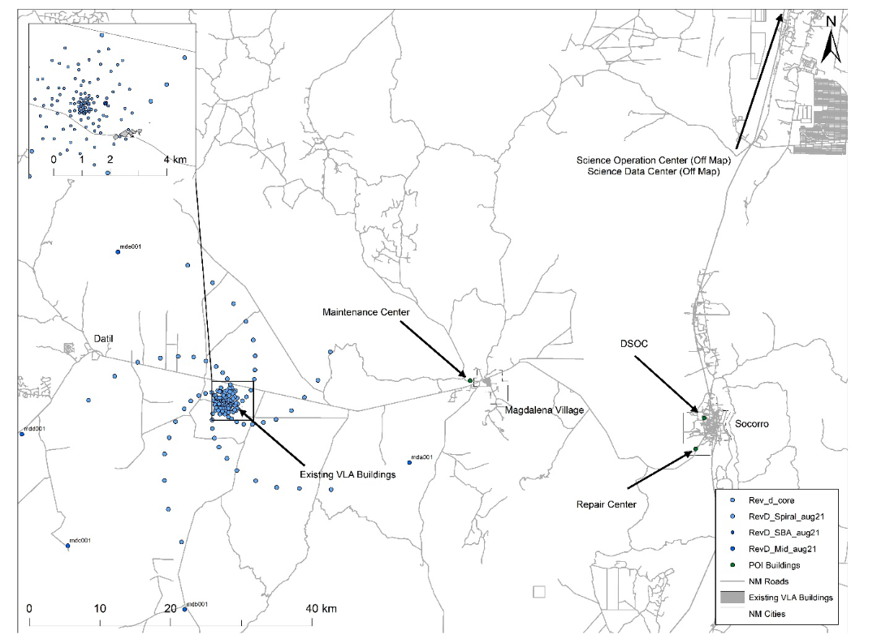
Operations
Total Staff NM
450 Direct
150 Contract
MOU w. UNM
Possible host science and data center
State infrastructure development w. eLWA (fiber to remote areas)
Tech Offices at NMT
ABQ: Science Ops and Data Center
Maintenance Center
Correlator and Control Building
Repair Center

Slide 11
January 2019 Science Book published by the ASP: 90 chapters, 850 pages, 300 authors
ngVLA Science
Strength in Versatility: Planets to Cosmology
ngvla.nrao.edu
Science Advisory Committee Key Science Goals
Unveiling the Formation of Solar System Analogues on Terrestrial Scales
Probing the Initial Conditions for Planetary Systems and Life with Astrochemistry
Charting the Assembly, Structure, and Evolution of Galaxies Over Cosmic Time
Using Pulsars in the Galactic Center as Fundamental Tests of Gravity
Understanding the Formation and Evolution of Stellar and Supermassive BH’s in the Era of Multi-Messenger Astronomy

Slide 12
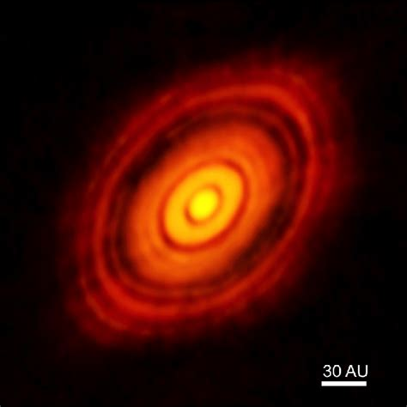
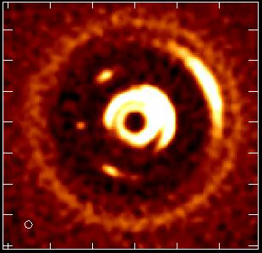
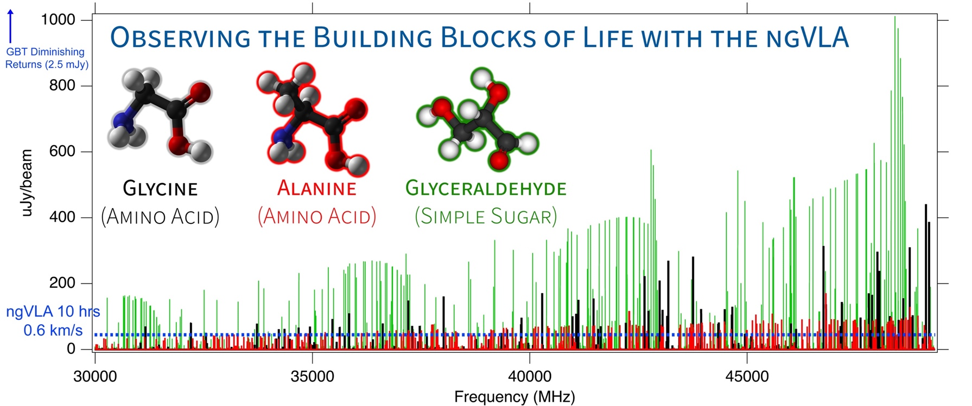
The Formation of Solar System Analogs
Movies of Planet Formation on sub-AU scales
HL Tau
ALMA 230 GHz
ngVLA 100 GHz
Dusty protoplanetary disk 1M_{o} proto-star 1Myr, at 140pc distance
Forming Jupiter: Monthly obs. over few years at 7mas resolution (1 AU)
Notes:
HD 163296
ALMA observation of HD163296 at 1mm along with a simulated 1 cm ngVLA observations (Ricci et al. 2019) of the innermost 24 au region at 1 au resolution for Jupiter-, Saturn-, and Neptune-like planets.
The distribution of exoplanets and young planets embedded in circumstellar disks: Then ngVLA will discover many hundreds of planets with orbital periods <10 yr.
The ngVLA will measure the orbital motion of planets and related features on monthly timescales:
Simulated 100 GHz ngVLA observations of a newborn planetary system comprising a Jupiter analogue orbiting at 5 AU from a Solar type star.

Slide 13
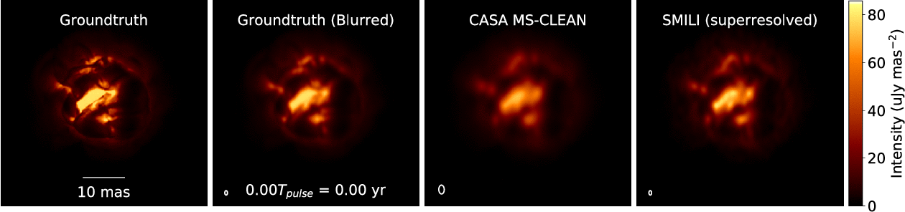
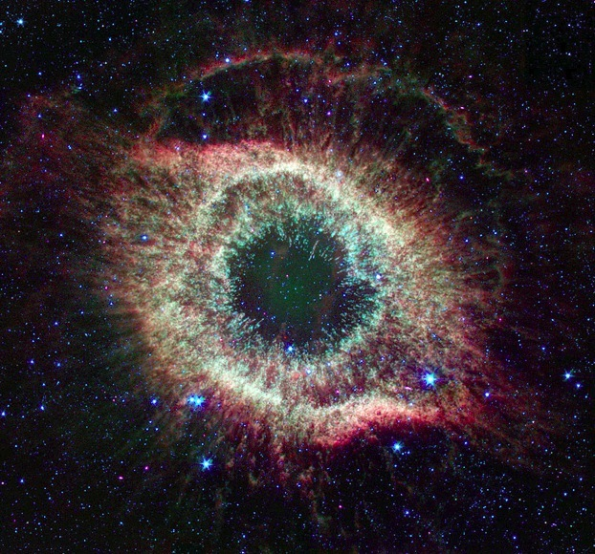
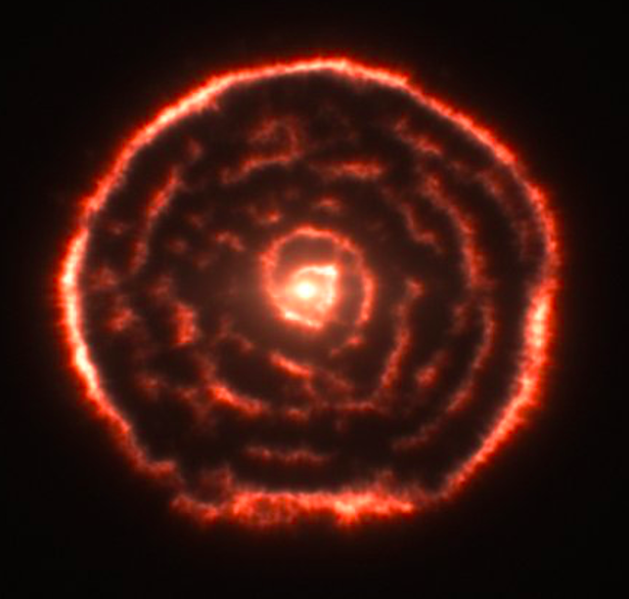
Stellar end-of-life: resolving stars! Movies of extreme mass-loss in evolved (‘AGB’) stars
Primary enrichment mechanism of ISM
ngVLA
JWST
ALMA
ngVLA
80000 AU
8000 AU
0.5 AU
ngVLA imaging of ‘boiling’ AGB star atmosphere (Akiyama & Mathews 2021)
ngVLA @ 46 GHz; 1.5 mas ~ 0.04 stellar radii at d=150pc
1.3 year pulse period observed every 2-3 weeks
Notes:
Simulated movies of the gas motions in the radio photosphere of an asymptotic
giant branch (AGB) star as observed with the ngVLA Main Array at 46 GHz. The
angular resolution is ~1.5 mas, corresponding to roughly 0.04 stellar radii.
Each movie covers a single 1.3-year pulsation period for a model AGB star,
assuming observations every 2-3 weeks. The adopted distance was 150 pc.
AGB star atmospheres are highly dynamic owing to a combination of radial
pulsations, shocks, and large-scale convective processes. These stars also shed
large amounts of matter through cool, dense winds. Radio waves are emitted from
a portion of their atmospheres that lie at a radius of roughly twice the
visible photosphere, and just interior to the wind launch region.
The adopted brightness distribution for the radio photosphere model (the
"ground truth model" shown in the left hand frame) was based on a 3D
hydrodynamic model of an AGB star atmosphere from Freytag et al. (2017). The
Freytag et al. model is not specific to millimeter wavelengths, but was adapted
here for illustrative purposes. The second frame shows the ground truth model
blurred with a Gaussian kernel.
The two frames on the right show image reconstructions of the model based
on simulated ngVLA Main Array observations. The integration time was 2
hours per frame and the assumed bandwidth was 10 GHz in dual
polarizations. The second frame from the right shows a multi-scale CLEAN
reconstruction, while the frame on the right shows the result of a
regularized maximum likelihood reconstruction using the SMILI package of
Akiyama et al. (2019). While both methods do well at reproducing many of
the key features of the model, the SMILI version achieves superior angular
resolution.
These results underscore that the exquisite sensitivity and resolution of the
ngVLA will enable studies of the physical properties and kinematics of the
atmospheres of evolved stars in unprecedented detail.
Credit: K. Akiyama and L. D. Matthews, based on models adapted from B.
Freytag.

Slide 14
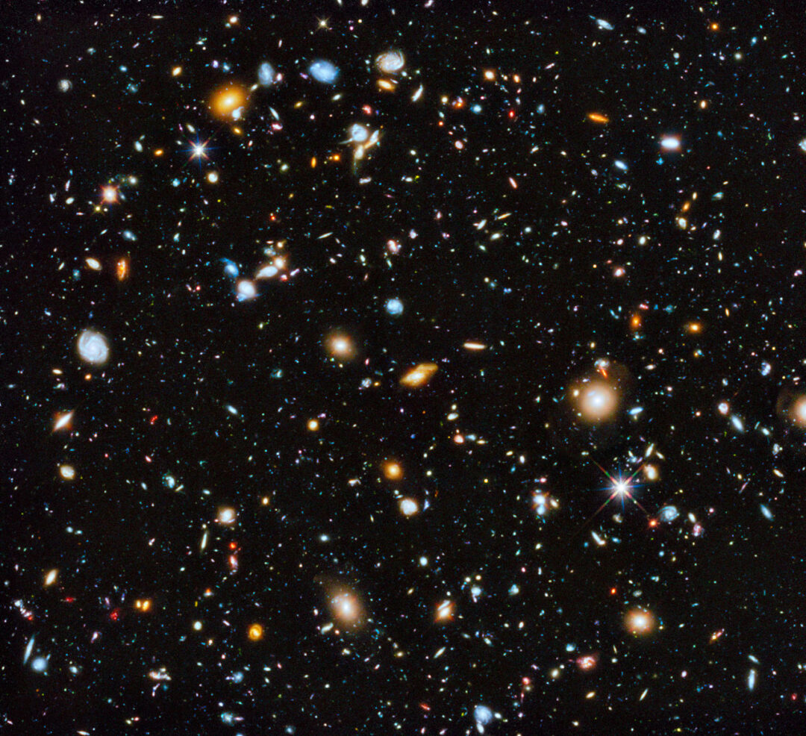
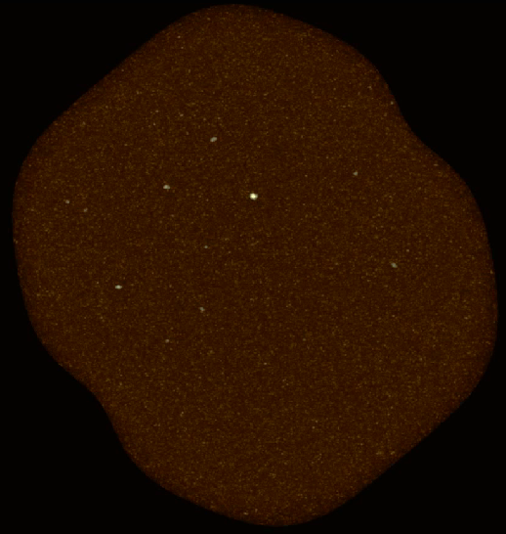
JWST Deep Field ~ 5000 galaxies t_{univ} = 0.25 Gyr
ngVLA reveals the molecular gas = fuel for star formation
ALMA: 36 CO galaxies to t_{univ} = 3.3 Gyr
100-fold increase in CO detection rate => Galaxy counts ~ deepest optical fields, with redshifts!

Slide 15
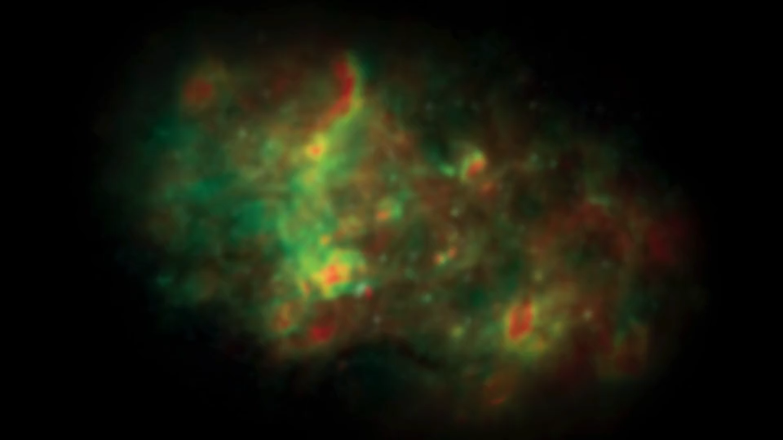

Slide 16
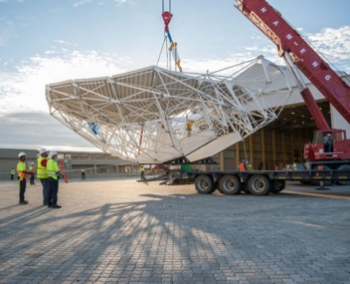
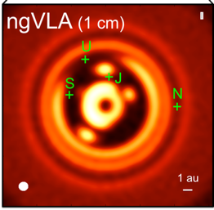
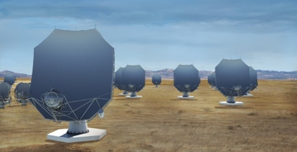
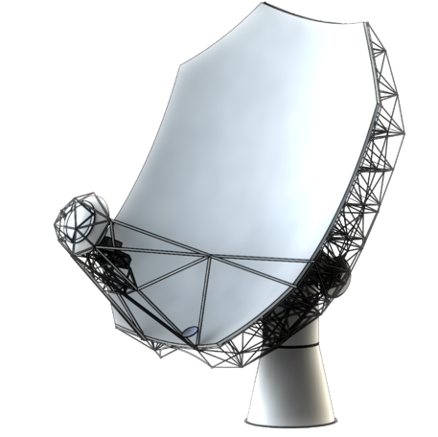
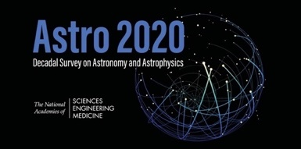
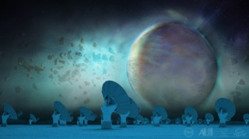
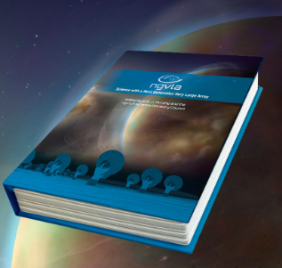
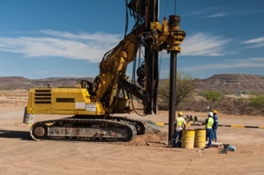
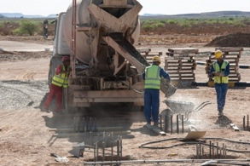
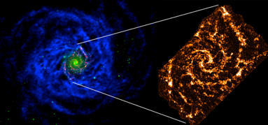
Project Timeline
2018
2019
2021
2023
2026
2029
2035
Astro2020 submission
Prototype antenna at VLA Site
Construction
Early Science Operations (> VLA capabilities)
Full Science Operations
Science Book
Ref. Design
NSF/MREFC FDR
NSF development funds
Construction full cost accounting: $2.3B [FY2018]
Astro2020 Report
July 2023: ‘NSF has formally entered the ngVLA project into the MREFC design process at the Conceptual Design Phase. The NSF-led Conceptual Design Review is expected next Spring.’
Sept 2023: ‘Three year NSF development funding at $7M/year.’

Slide 17
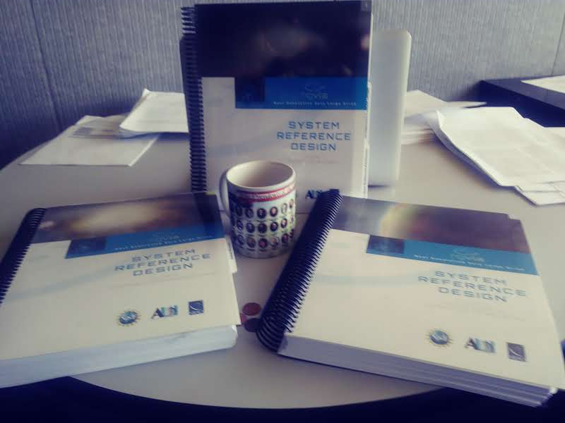
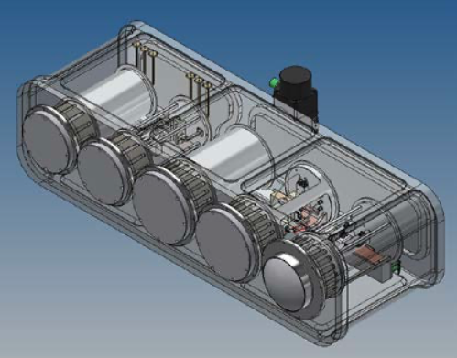
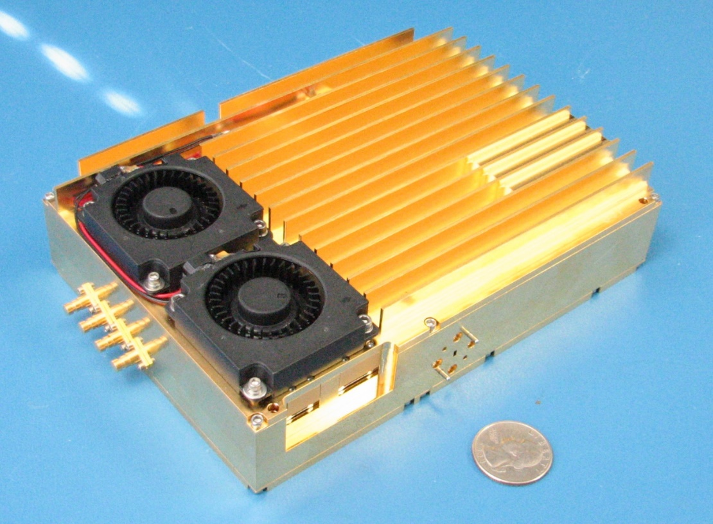
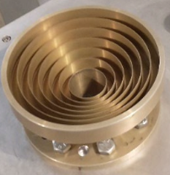
Technical Design: Well advanced and costed
2019 Reference Design: Build on ALMA, JVLA, SKA development => low-technical-risk and well costed [efforts to optimize life-cycle cost]
U.S. Multiagency Interest (DOD, NASA): ICRF, Space Situational Awareness (radar), Spacecraft tracking/imaging, `burst-telemetry’
6 bands from 1 to 116 GHz
2 cryo units (current VLA = 8): T_{rx} ~ 10 – 20 K
Integrated Receiver and Digitizer: RF signal -> mix to baseband; sampled and digitized (8bit) to fiber (BW = 20 GHz)
All compact and field replaceable
Saxony, Germany

Slide 18
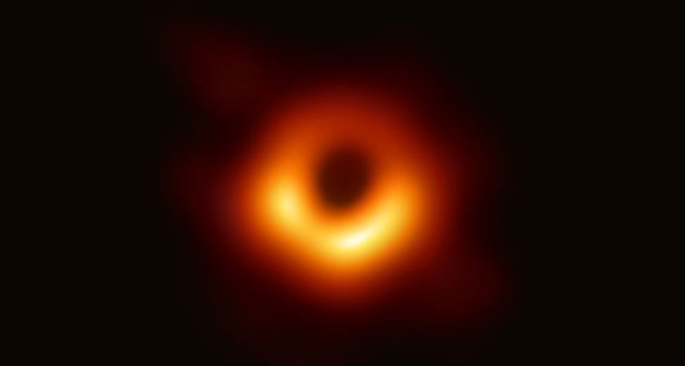
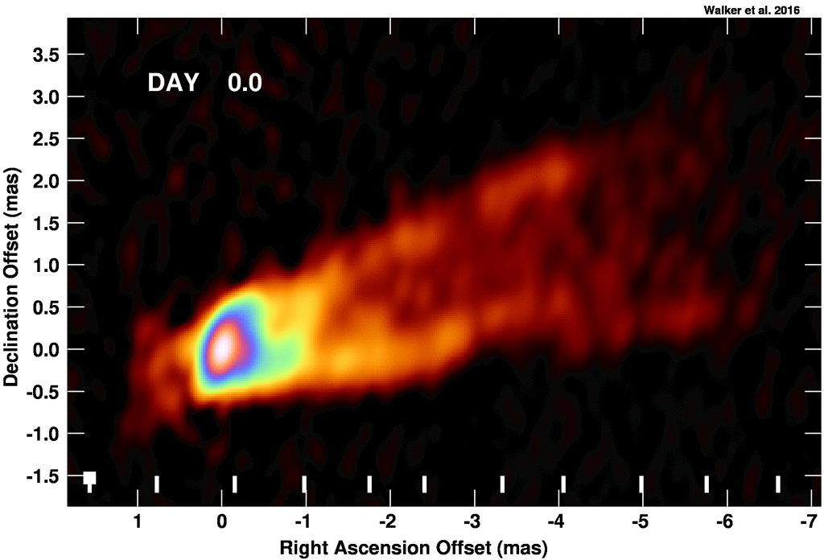
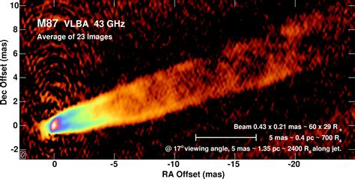

Imaging the Black Hole Disk – Jet connection
M87 EHT 230 GHz @ 20uas
M_{SMBH} = 6.5 x 10⁹ M_{o}
V_{app} up to 6c
42uas = 5.6 R_{s}
Walker + 2018
GMVA 90 GHz @ 40uas
Walker + 2018
50uas
R ~ 8.4 R_{s}
Lu et al. 2023
500uas

Slide 19




ngEHT + ngVLA 90 GHz
M87 90 GHz GMVA @ 40uas: R ~ 8 R_{s}
ngVLA + ngEHT
FWHM = 54x46uas
rms = 5.8 uJy/bm
Lu et al. 2023
Adding ngVLA increases total collecting area by factor ~ 4.5
Much better coverage of Fourier Plane => greatly improved imaging from scales 100uas to 100”

