Slide 1
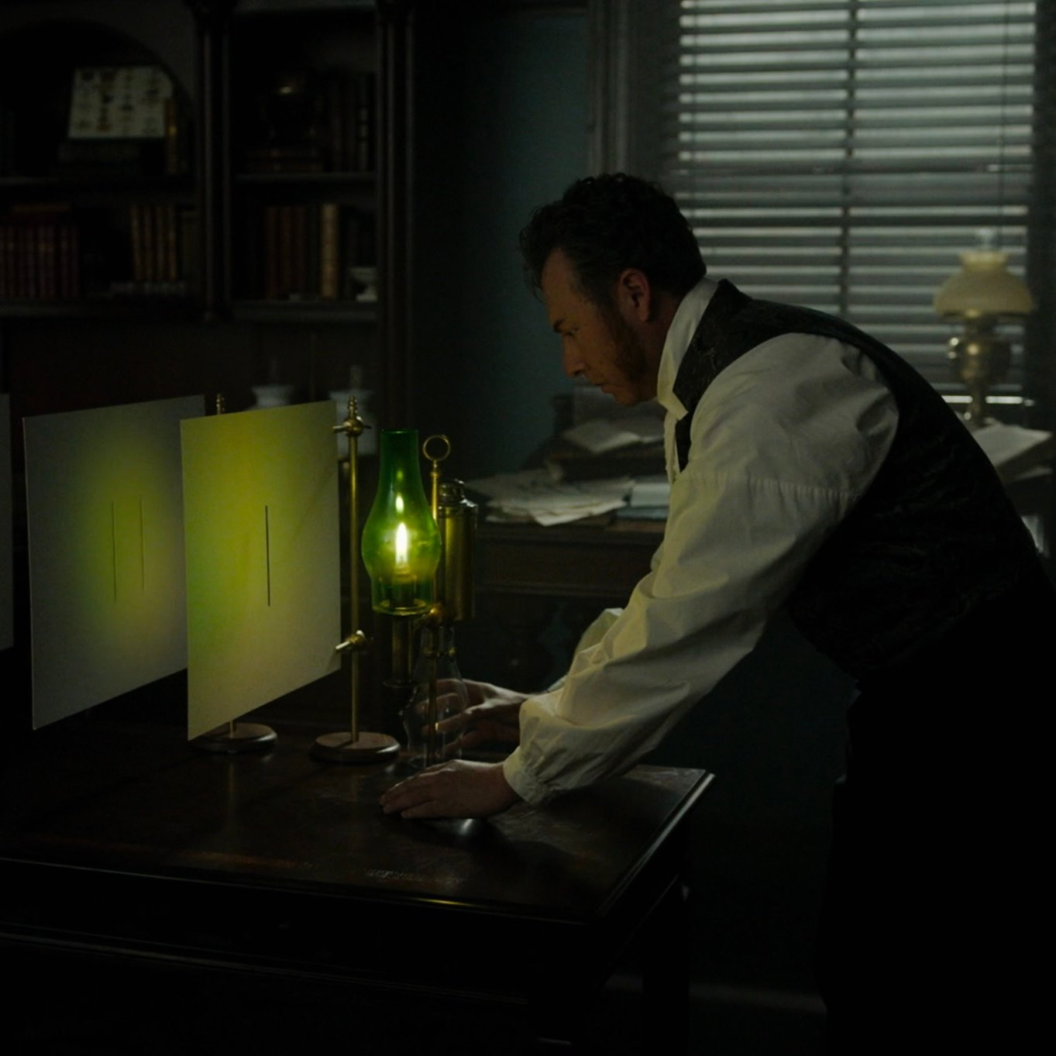
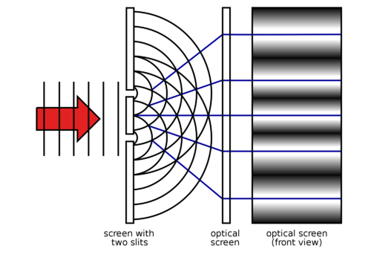

Optical Interferometry using Radio Astronomy Techniques
New method real-time, non-invasive micron-size source characterization
New method in wave-front sensing
Fourier optics, Huygens principle, and Young’s two slits
Carilli (NRAO), Nikolic (Cavendish), Thyagarajan (CSIRO), Torino, Iriso (ALBA)
Copyright © 2024 AUI, U. Cambridge, CELLS, CSIRO. All Rights Reserved

Slide 2
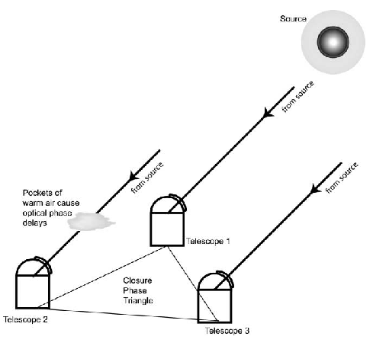
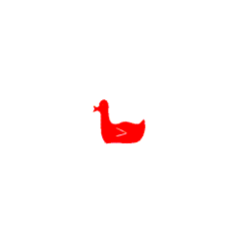
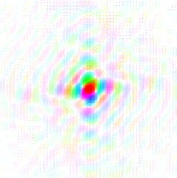
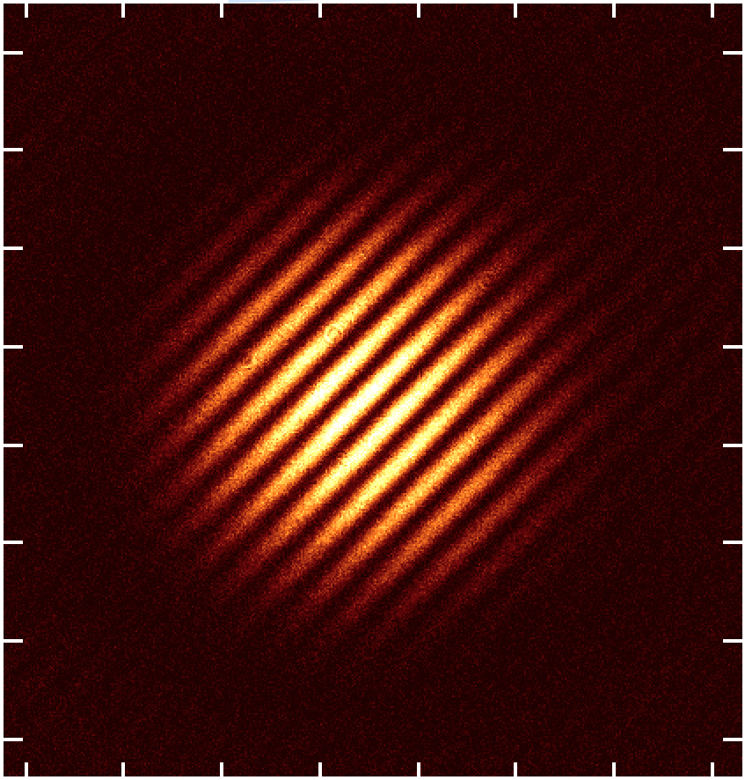
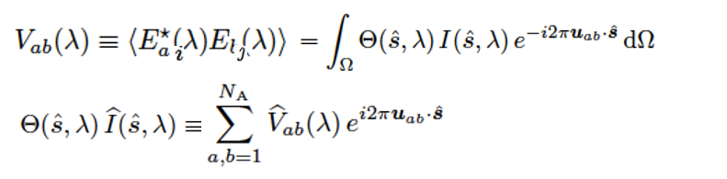
Van Cittert – Zernike Theorem
The cross-multiplication, or coherence, between the electromagnetic voltages measured at spatially distinct locations (’apertures’) = Fourier transform of the intensity distribution
Image plane
Aperture plane (complex)
FT
y
v
V_{i,j} = A_{i,j} e^{-i𝝓i,j}
x
u
u_{i,j} = (B_{i,j} / 𝜆)
𝛉 = 𝛌/B = 1/u
Image
Orientation and spatial frequency set by geometry of baseline
Strength determined by amplitude of visibility
Position of fringe determined by phase

Slide 3
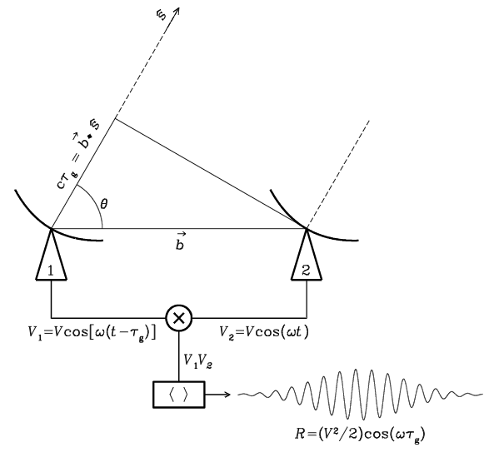
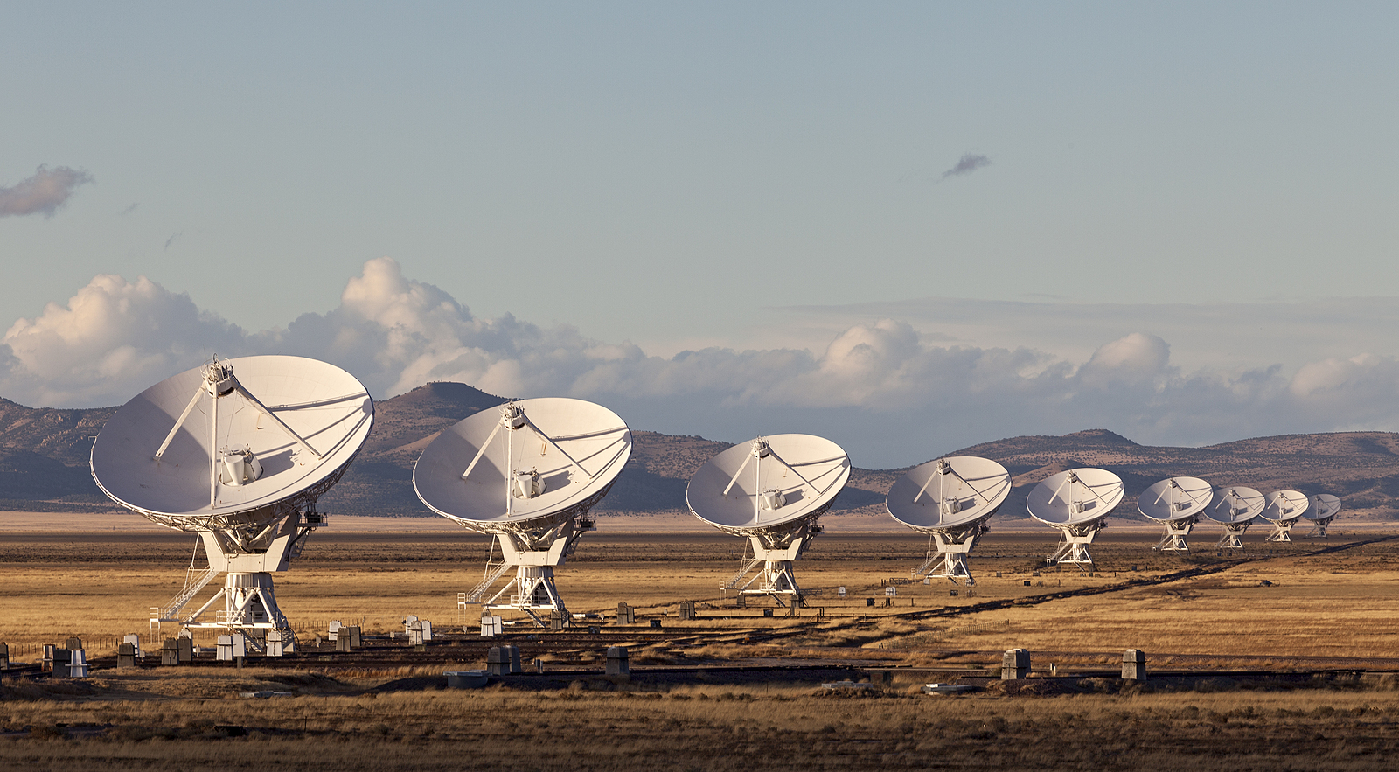
Radio measurements are visibilities = aperture plane
V_{i,j} = E_{i} x E_{j}* = A_{i,j} e^{-i𝝓i,j}
Coherent amplification of voltages, E
Geometric delays set by electronics
Complex cross multiply and average to visibilities
Images made from Fourier transform of visibilities

Slide 4
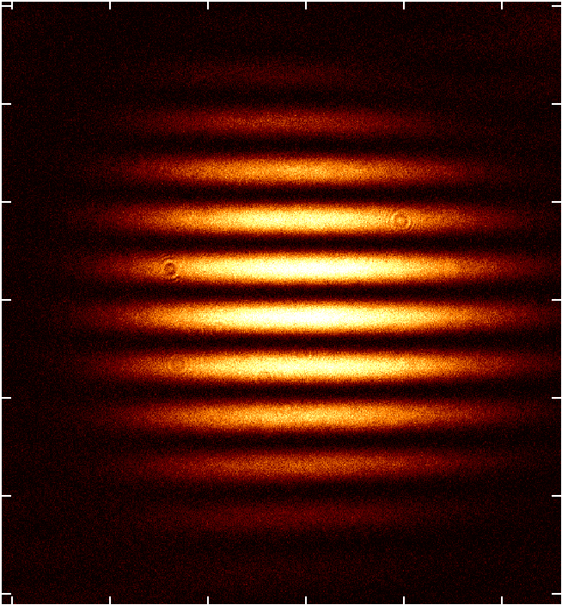
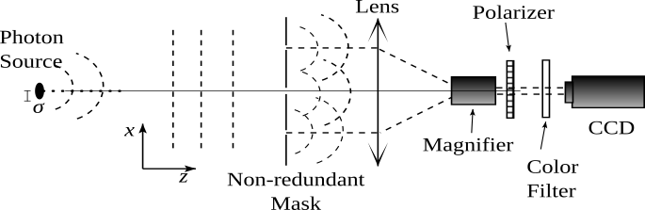
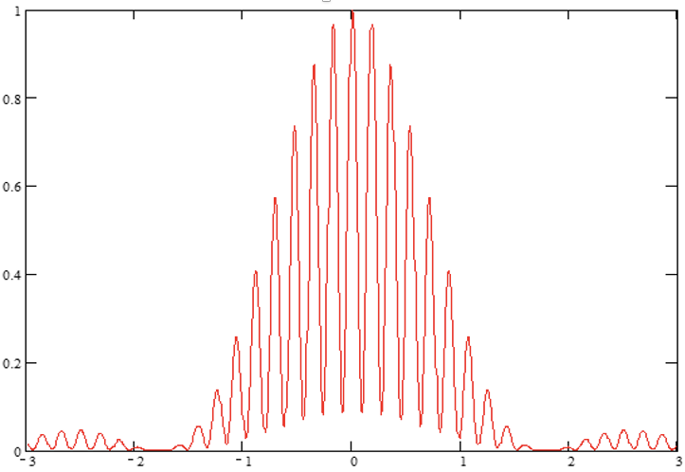
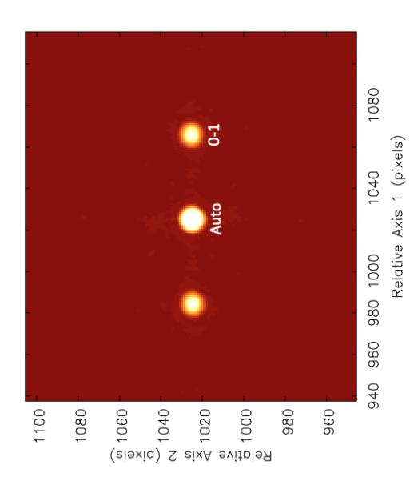
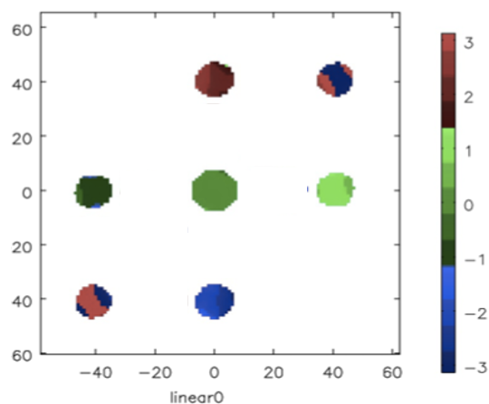
Optical: aperture mask + focusing optics => image of fringe
𝛉 = 𝛌/B
1
0
Complex visibilities generated from FT(image)
Autocorrelation = I₀ + I₁ = sum photons in image
I₀₁ = sum photons in u,v sample 0-1
V₀₁ = visibility or coherence = I₀₁ / (I₀ + I₁)
Michelson 1891
V₀₁ = (S_{max} – S_{min})/(S_{max} + S_{min})
v = B/𝛌
1-0
V_{1,2} (A_{i,j,} 𝝓_{i,j}) = FT(Image)

Slide 5
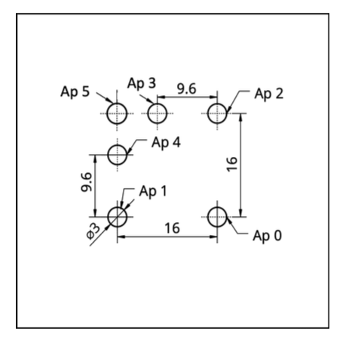
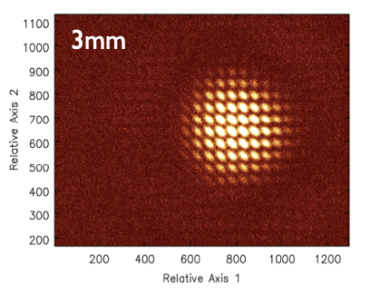
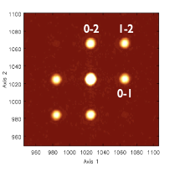
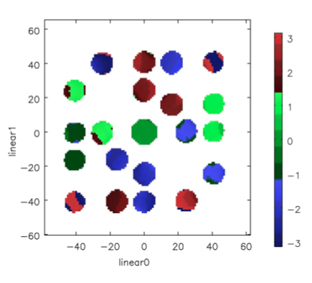
3 Hole Mask
Auto = I₀ + I₁+ I₂
V₀₁ = I₀₁ / (I₀ + I₁)
V₁₂ = I₁₂ / (I₁ + I₂)
V₂₀ = I₂₀ / (I₂ + I₀)
Challenge: to derive V_{ij} need to know I₀, I₁, I₂ separately
v
Auto
u

Slide 6
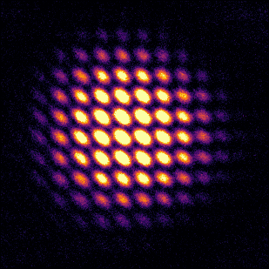
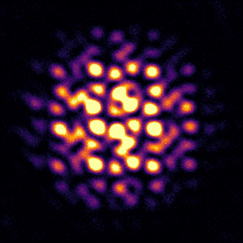
Phase fluctuations: Decoherence
Closure Phase in Image Domain
Shape-Orientation-Size conservation
3 Hole Mask
5 Hole Mask

Slide 7

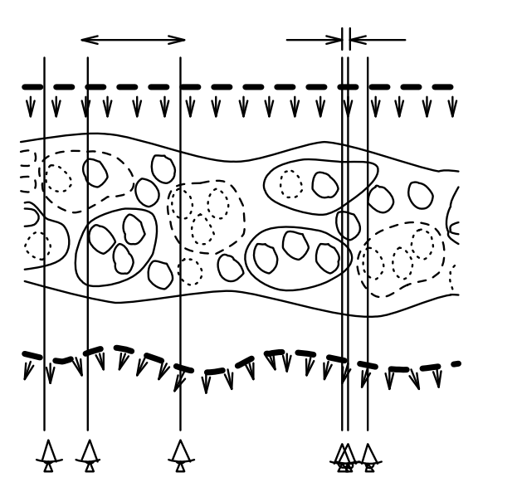
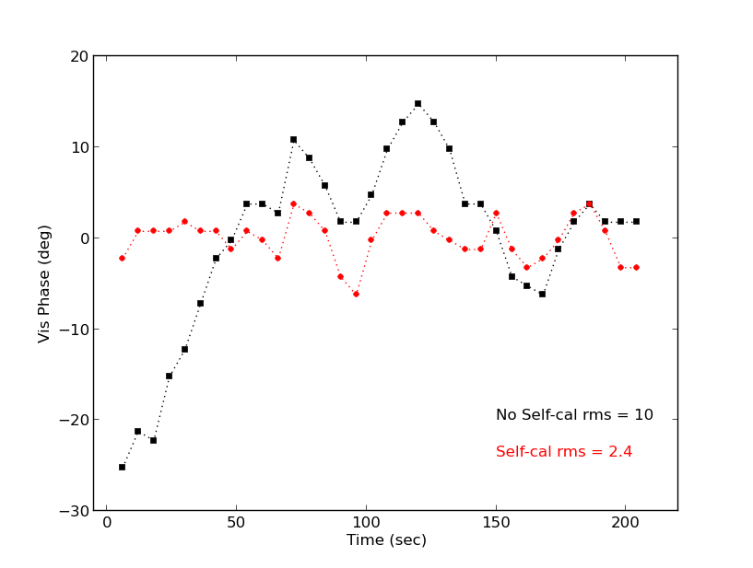
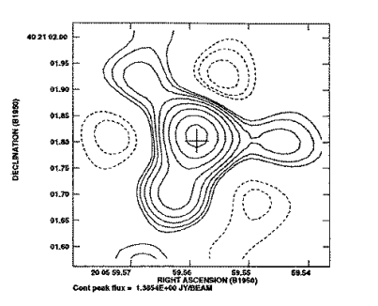
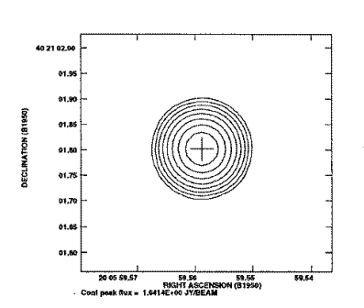
Self-Calibration: Joint fit complex voltage gains and source structure
(1)
Start with measurements, 𝑉^{m}_{i,j} and simple source model, 𝑉^{s}_{i,j}
Invert equation (1) to derive complex element-based voltage gains, 𝐺_{i}
Derive new source model from the gain-corrected 𝑉^{m}_{i,j} through model fitting or imaging and deconvolution
Iterate to convergence: more measurements than free parameters ([𝑁(𝑁 − 1)]/2 cross correlations vs. N gains plus source parameters)
𝛅L = 𝛌 x 𝛉_{i}/360º
VLA 8 GHz
Gain amp, a_{i} = aperture plane illumination
Gain phases, 𝛉_{i} ∝ photon path-length delay through system = 𝛅L: wavefront sensing!
Self-cal has never been done in optical interferometry!
Schwab 1981; Cornwell & Wilkinson 1981; Readhead & Wilkinson 1978

Slide 8
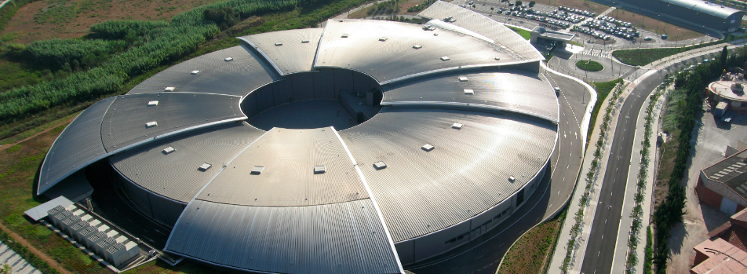
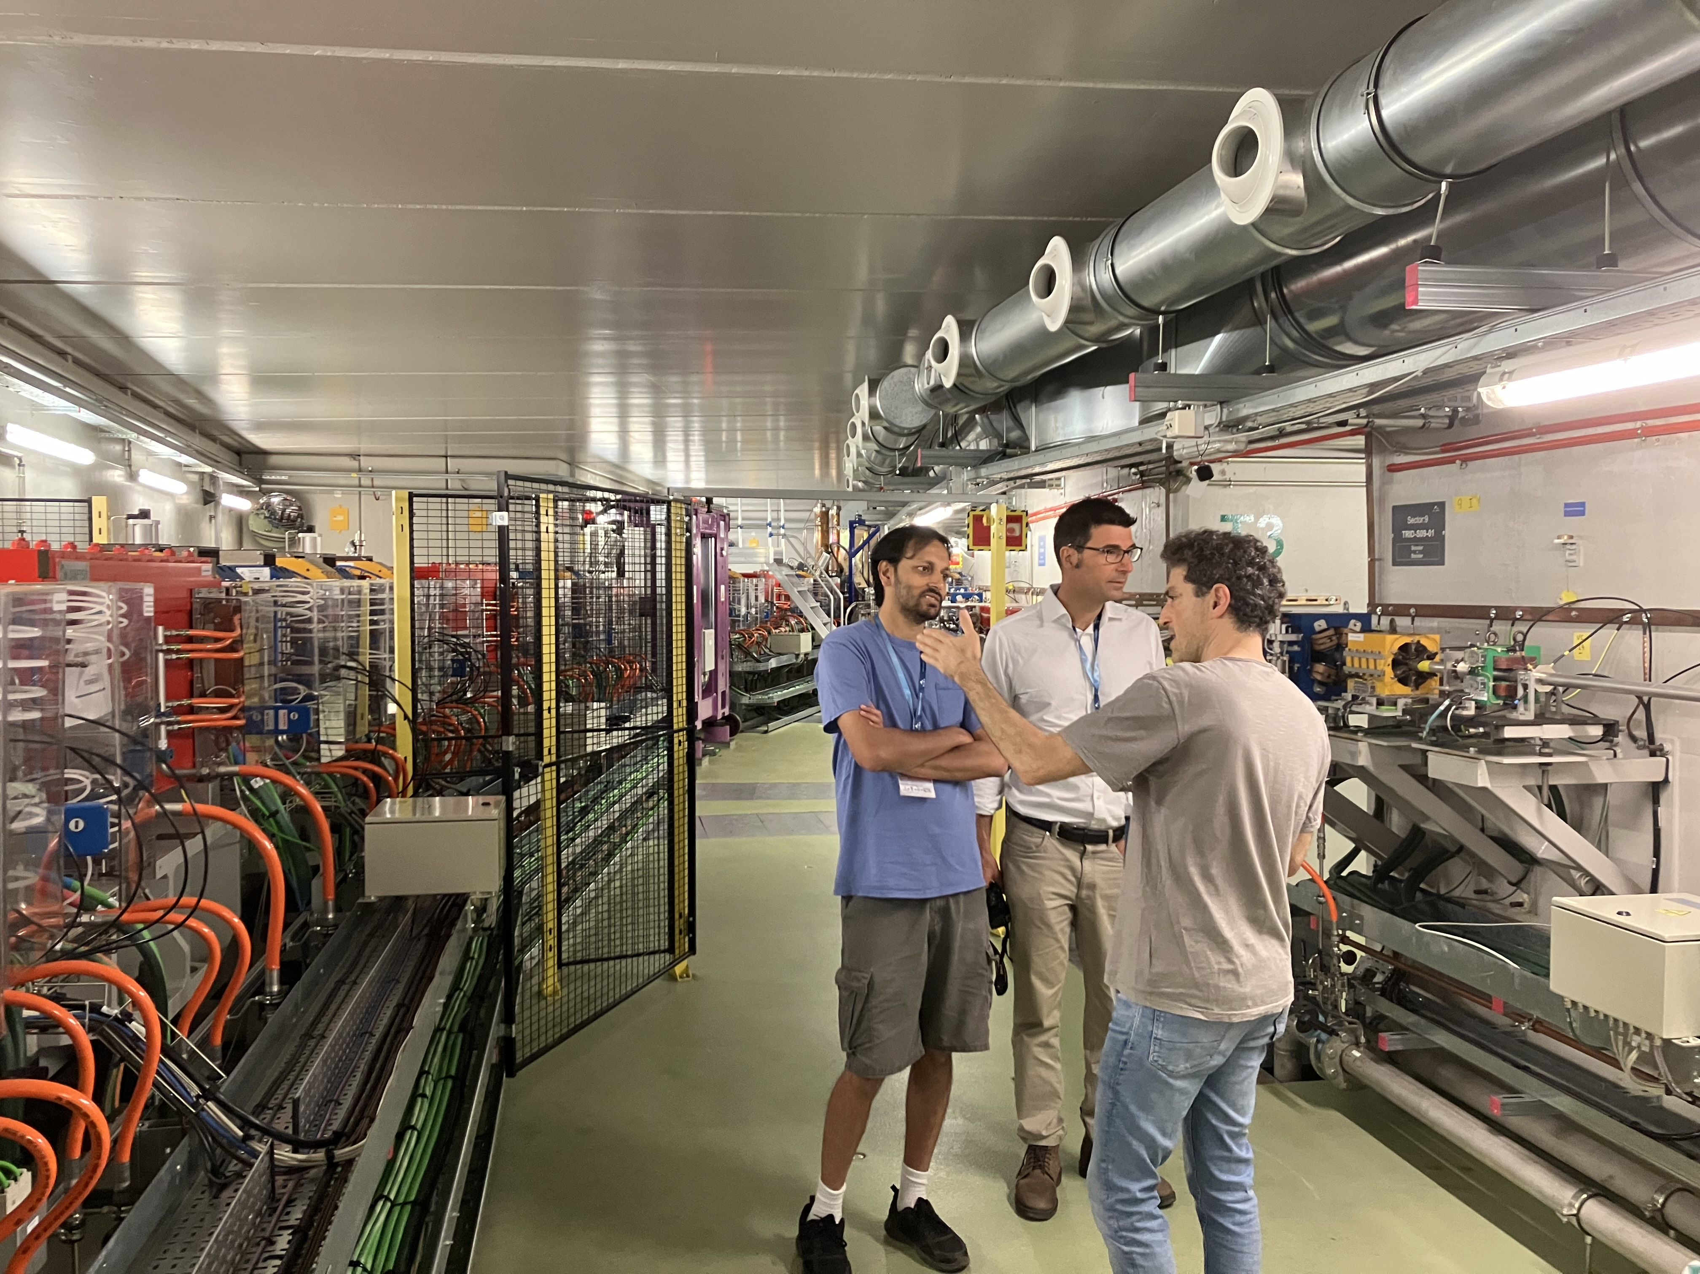
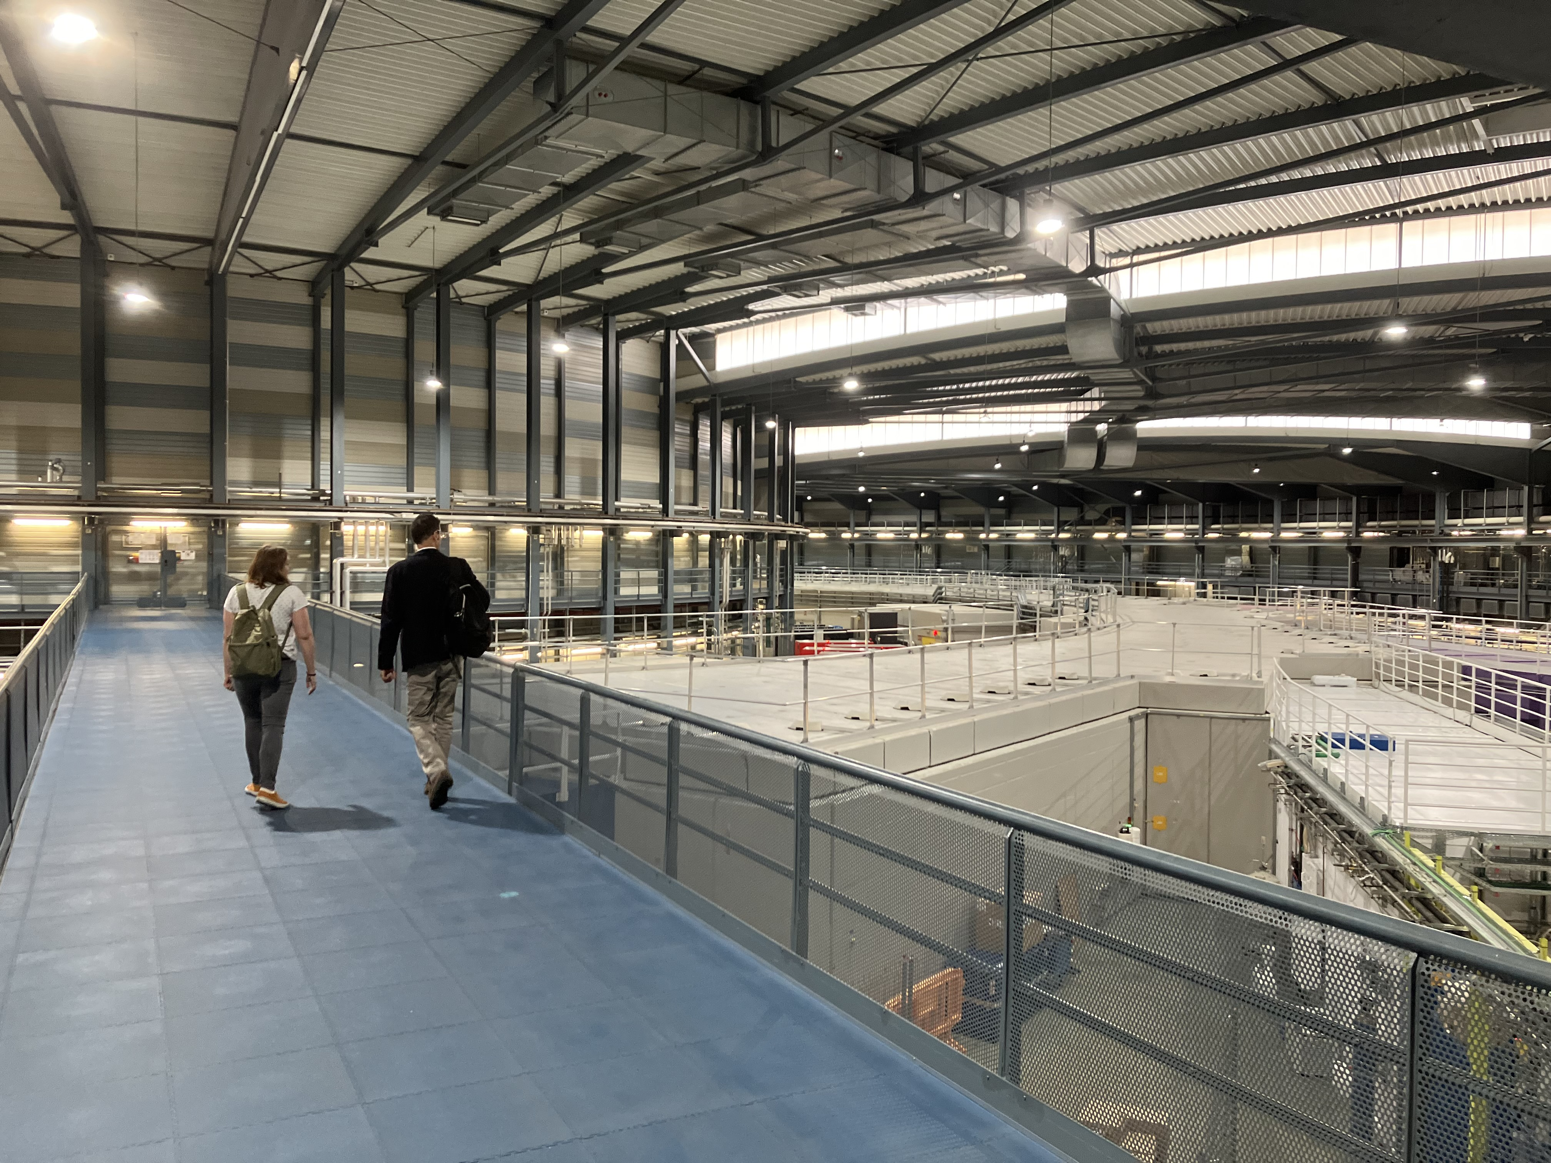
ALBA Synchrotron Light Source, Barcelona, Spain
Circumference = 270m
Electron energy = 3 GeV
Photons IR to X-ray
10¹⁰ optical photons/millisec

Slide 9
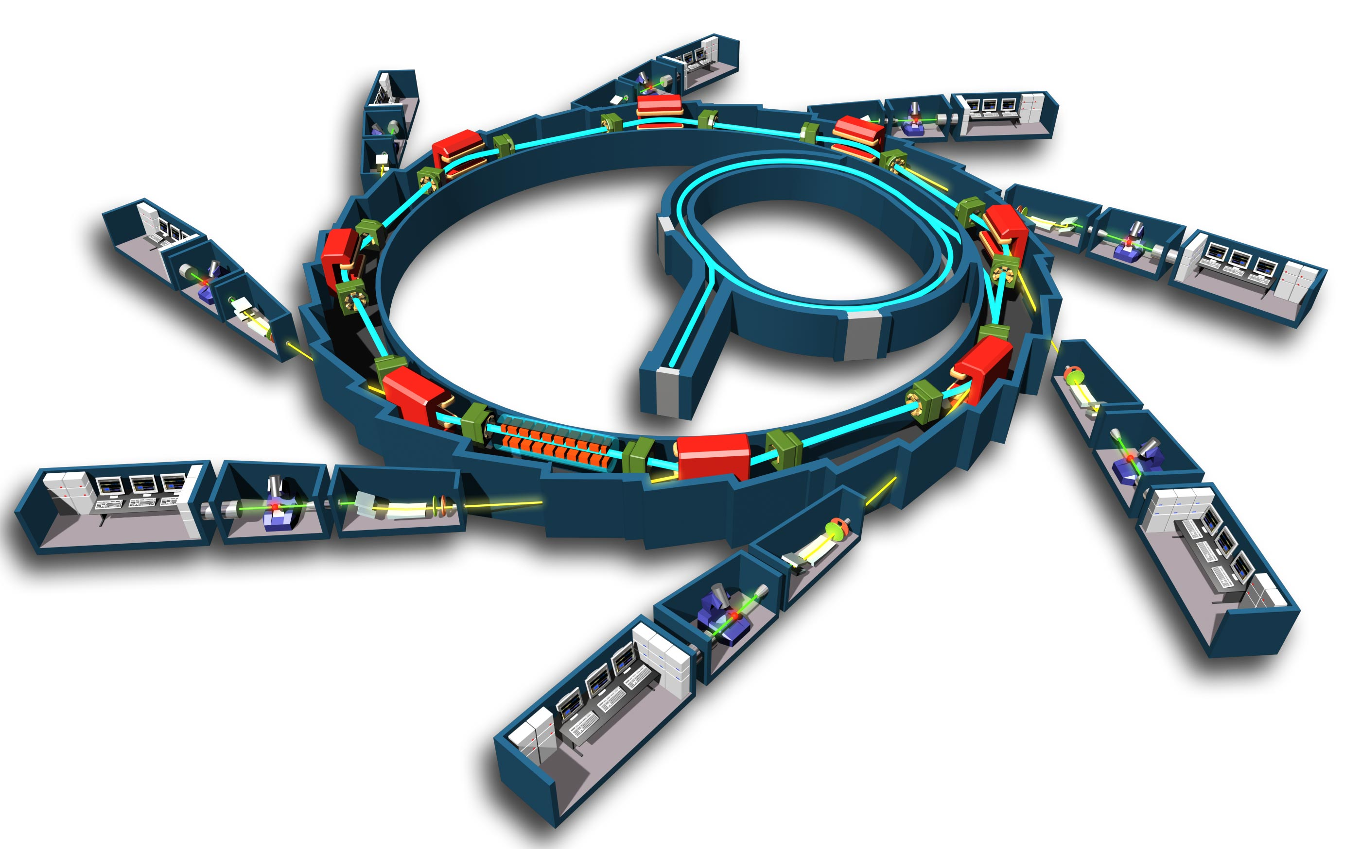
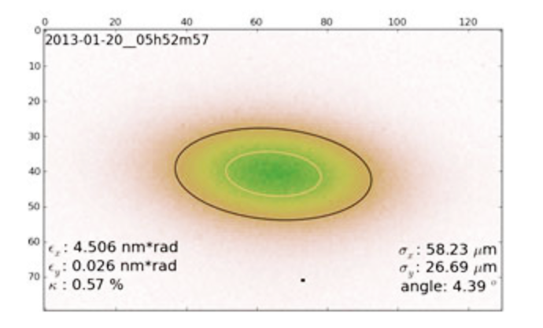
Storage Ring
Photon Beam lines = experiments
Bending magnet
Insertion Ring
e⁻ gun
Undulator or wiggler
Key performance metric: Gaussian e⁻ beam size
smaller => better
X-ray crystallography
X-ray spectroscopy
X-ray metrology
X-ray lithography
Infrared spectroscopy
Optical interferometry

Slide 10
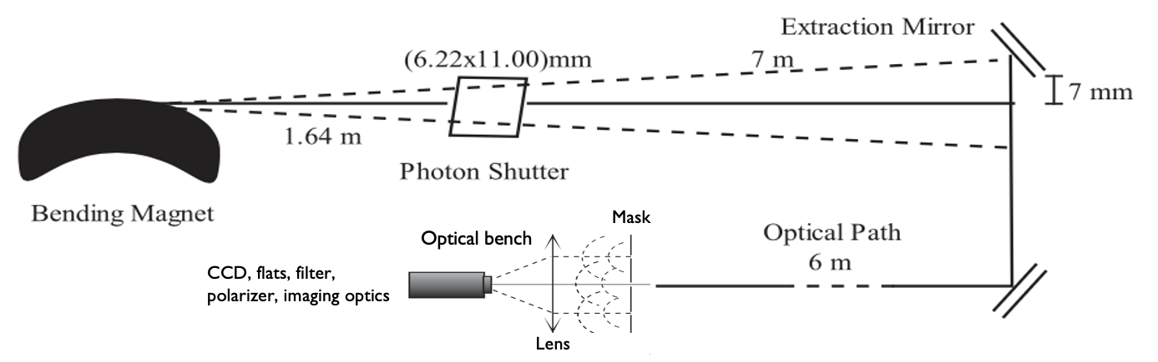
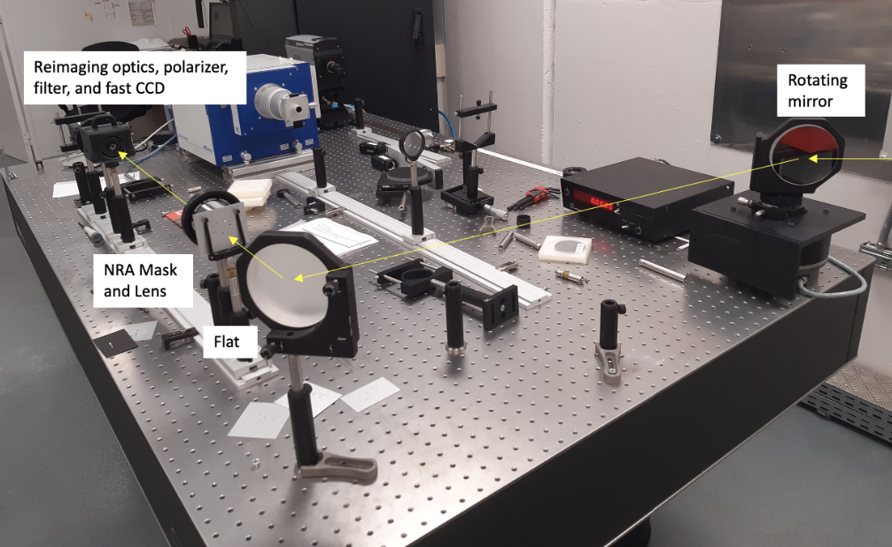
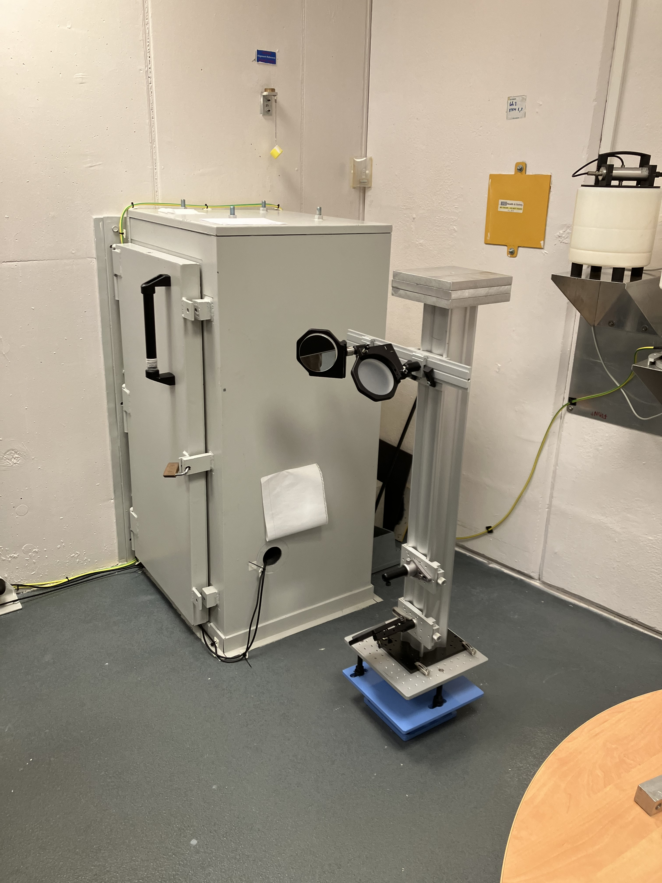
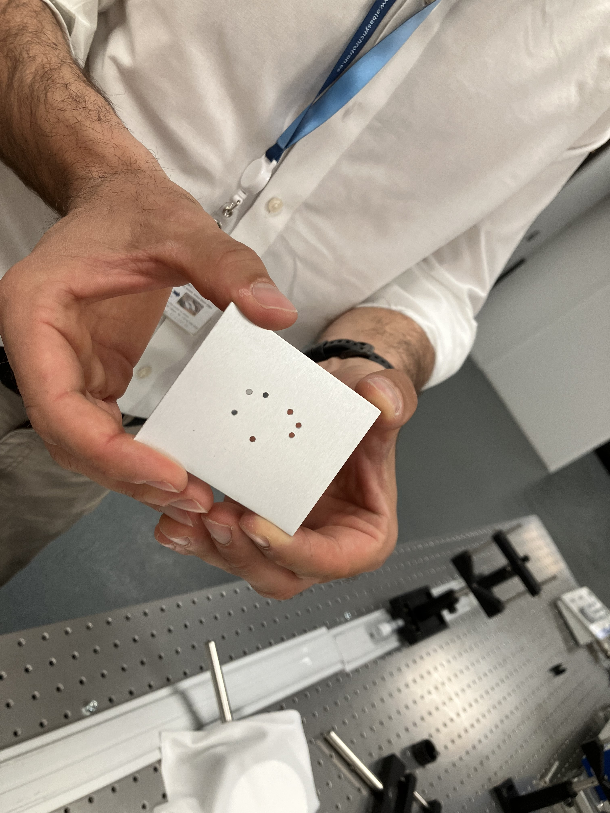
Xanadu: ALBA optical synchrotron radiation interferometry lab
Experiments
7 hole mask
2mm diameter holes
Baselines 5mm to 24mm (3.7”)
Wavelength = 400nm
30 frames = 0.3ms every 1sec

Slide 11
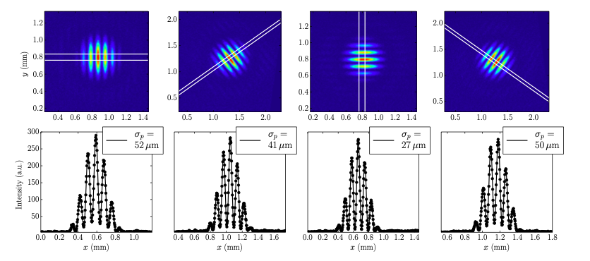
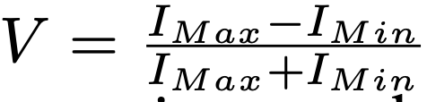
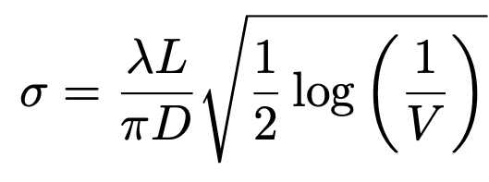
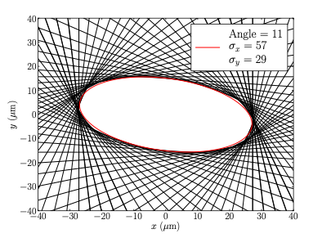
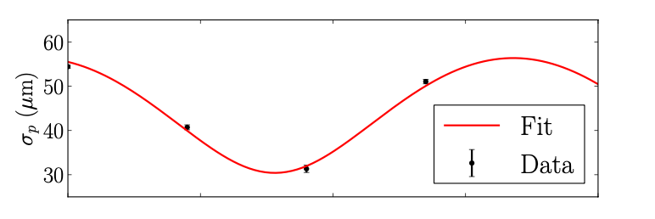
Rotated Two Hole Method: ‘Young’s slit’ plus Gaussian Model
Torino & Iriso w. Mitsuhashi method
Limitations
Slow: cannot be done in real time
Modest accuracy (~ 6%)

Slide 12
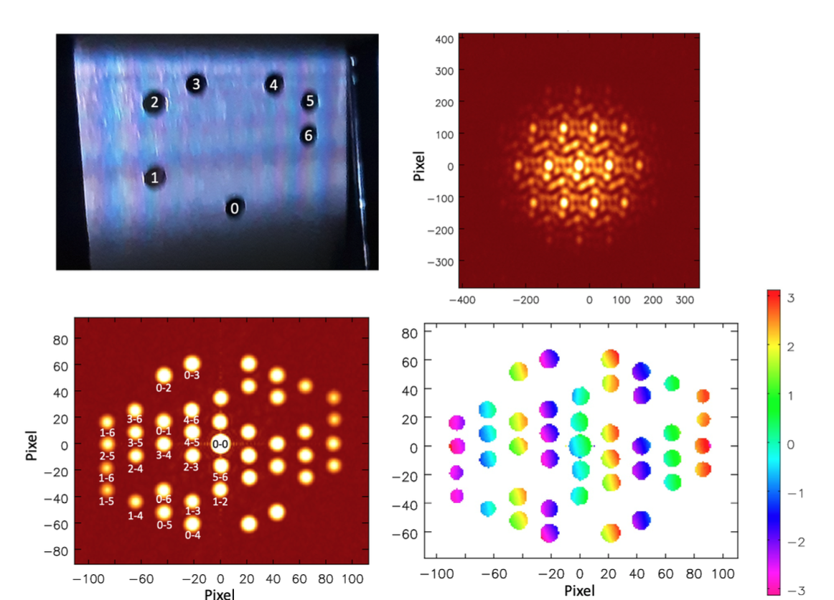
Non-redundant 7 hole Mask: JWST Template
v
u

Slide 13
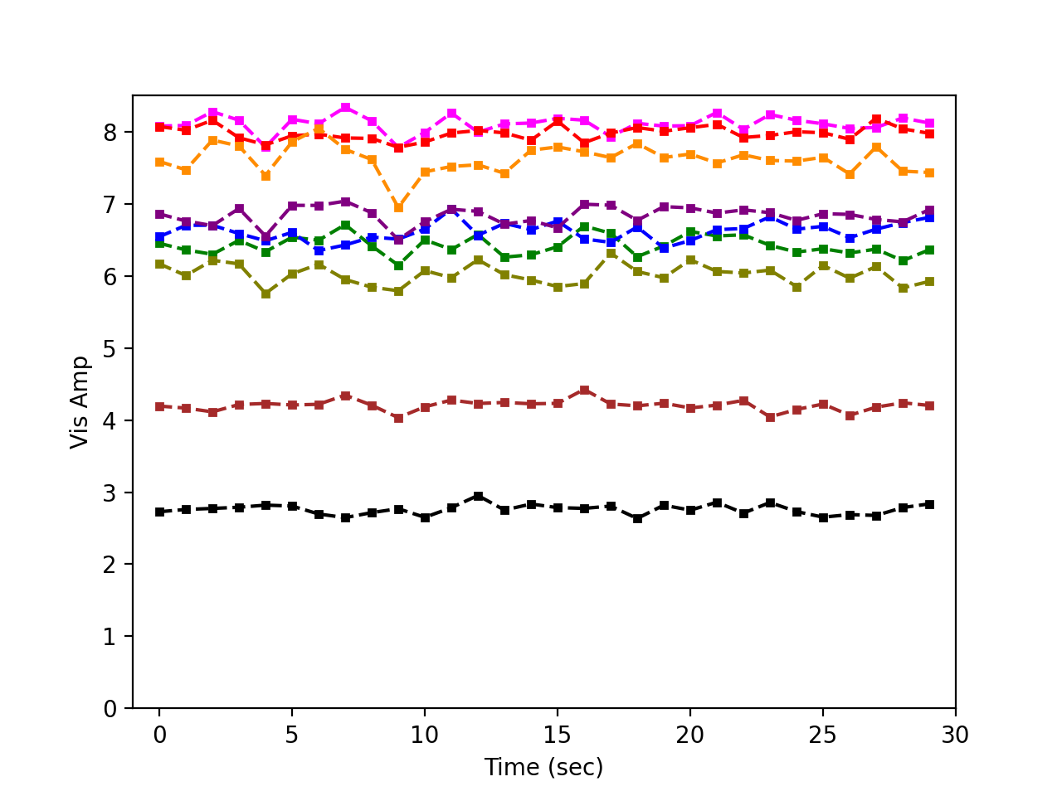
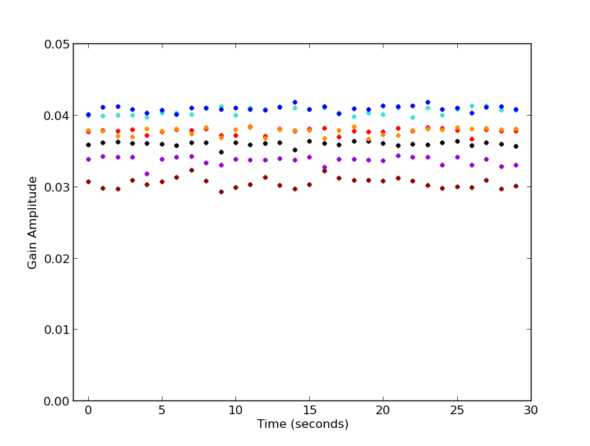
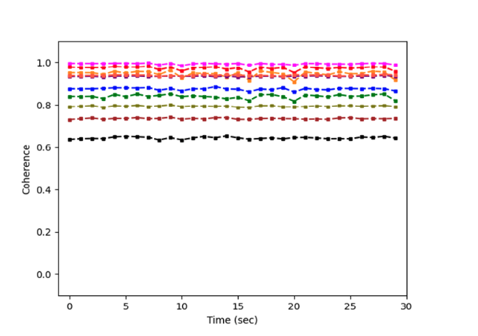
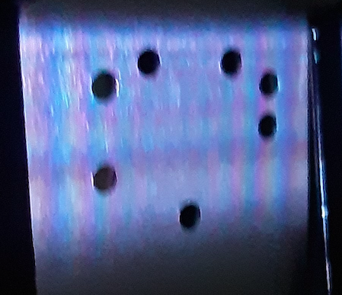
Gaussian model self-calibration in CASA: amplitudes = illumination
Selfcal G_{amp} stable ~ 1%
Voltage gains differ by up to 30%
1.24
1.19
1.23
1.19
1.31
1.11
Coherences > 60%
Stable < 1%
1.00

Slide 14
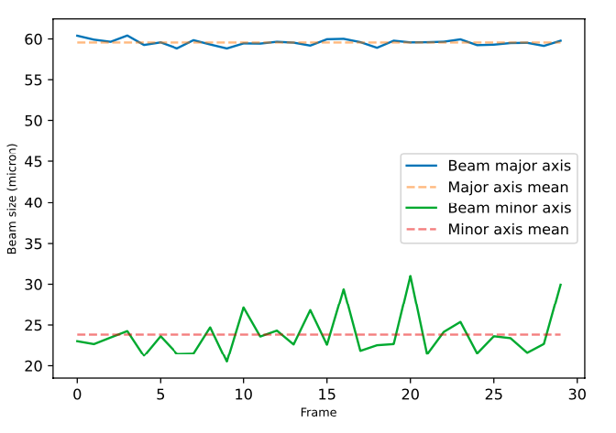
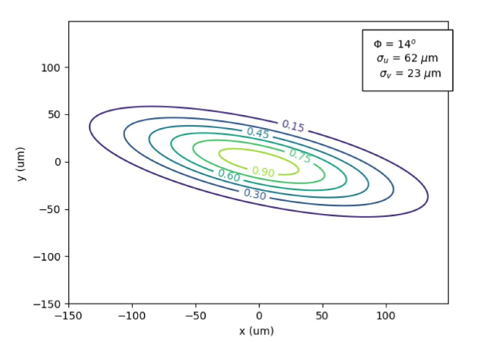
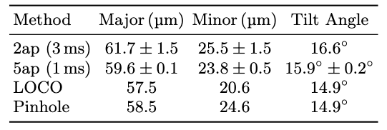
Real-time 2D Electron Beam Shape to 1% accuracy
Gaussian model fit to coherences
7ap 59.0±0.1. 23.5±0.3 16±0.2º
Without SC 66 40 5º

Slide 15
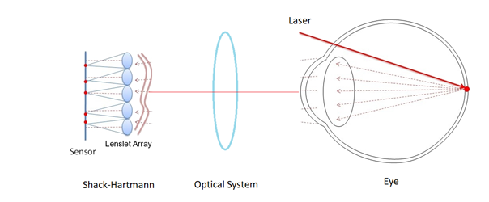
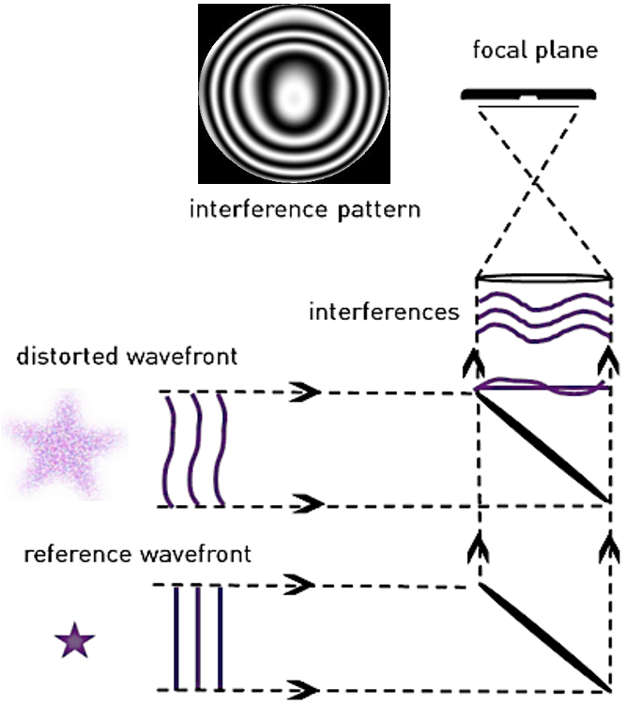
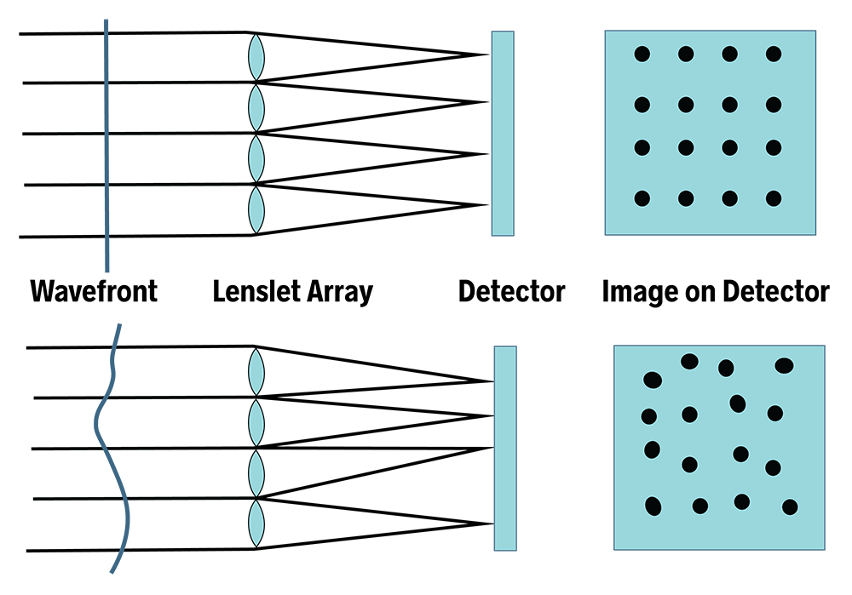
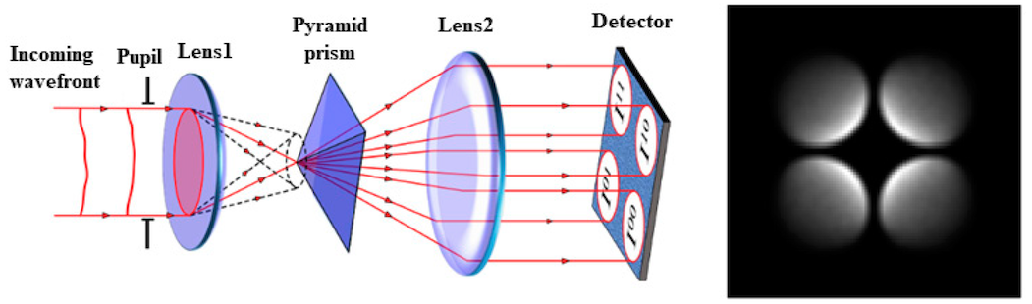
Wavefront Sensing: measure surface of constant phase of EM wave
real-time adaptive optics to correct optical distortions (eg. laser communications, directed energy systems…)
metrology in ultra-precise (nanometer) manufacturing
medical ophthalmology (eg. guided LASIK)
Wavefront sensor used in ophthalmology
Reference Beam (Fizeau 1851)
Gradient-based (Shack-Hartmann 1904)
Generalize Foucault knife-edge (1858; ‘pyramid’)

Slide 16


Visibility Phases and Wavefront Sensing
= 𝛌 x 𝛉_{i}/360º
Before Self-cal
After Self-cal
1-6, 2-5
rms ~ 1.2º = 1.3nm
[𝛔_{N𝛄} ~ 0.1% ~ 0.4nm]
rms = 28º = 31nm
Mean = static pathlength differences (’metrology’)
Variations (millisec) = vibrations and turbulence (‘adaptive optics’)
𝛅𝚽 is correlated between baselines => systematic 𝛅L, not noise
rms after self-cal much lower => measuring frame 𝛅L to high significance

Slide 17

Gain Phase Solutions encode 𝛅L = 𝛌 x 𝛉_{i}/360º
Rotating mirror tests
Tests: 0”, 2”, 4”, 6”, 8” wavefront tilts around Y axis (= X tilt)
Mean 𝛉_{i} = (mostly) tilt
Variations: rms ~ 30º (33 nm); correlated between neighboring holes
4” tilt
3
4
2
5
6
1
0

Slide 18



Best fit plane: reproduce WF tilts to ~ 0.1”

Slide 19


Static non-planar metrology
Non-planar static metrology distortions seen up to 12 nm: repeatable between experiments to rms ~ 2 nm at each hole
Fitting higher order (Zernike) modes: 7-holes insufficient to constrain all but tip-tilt
Need better sampling of aperture plane (more holes)

Slide 20




Adaptive optics: tip-tilt wave-front variations due to vibration
0.3ms exposures every 1 sec
Tilts up to 0.5”
Random frame-to-frame

Slide 21
Wavefront sensing via interferometric self-calibration
Mean phase = static pathlength differences to nm-precision (’metrology’)
Variations (millisec) = vibrations and turbulence (‘adaptive optics’)
Measure full shape of wavefront = total photon path-length difference to each aperture element relative to reference position
Not ‘reference wave interference’ (Fizeau)
Not ‘gradient-based’ (Shack-Hartmann)
Not generalized Foucault knife-edge (pyramid)
‘The wavefront cannot be directly measured, because it is determined by phase,’ Yi et al Nature Comm 2021
Dynamic range set by phase wraps => 1 wavelength between pairs of elements
Fitting wavefront (Zernike) across mask could improve by factor few
Add spectral axis => improve dramatically: eg. measurements separated by 5% in 𝛌 increase dynamic range by factor 20 (‘global fringe fitting’ in VLBI)
Aperture sampling is limited by requirement of non-redundant mask
Use fibers or micro-mirror array to fully sample aperture and generate series of non-redundant interferograms
Use ’over-constrained’ nature of self-cal to limit analysis to non-redundant u,v samples

Slide 22

Source characterization using optical masking interferometry with radio astronomical techniques
Real-time, non-invasive measurement of micron scale sources to ~ 1% accuracy
Wavefront sensing: full WF shape with nm precision on msec timescales
US patent 12,104,901
US patent app. No. 18/878,488
US patent app. No. 19/079,876
arXiv:2503.10820
arXiv:2405.12090
arXiv:2409.11135
arXiv:2406.02114
JOSA-A 2024, 41, 1513
2022PASA...39...14T
JOSA-A 2022, 39, 2214

Slide 23

Hole size => Airy disk = ‘primary beam’
FT => u,v ‘smearing’ by primary beam
3mm
5mm
0-2
1-2
v
0-1
u

Slide 24


Why non-redundant mask?
Decoherence on redundant baselines due to phase fluctuations across mask
Coherence for redundant samples lower by 5%
rms for redundant samples ~ 6x non-redundant

