Slide 1
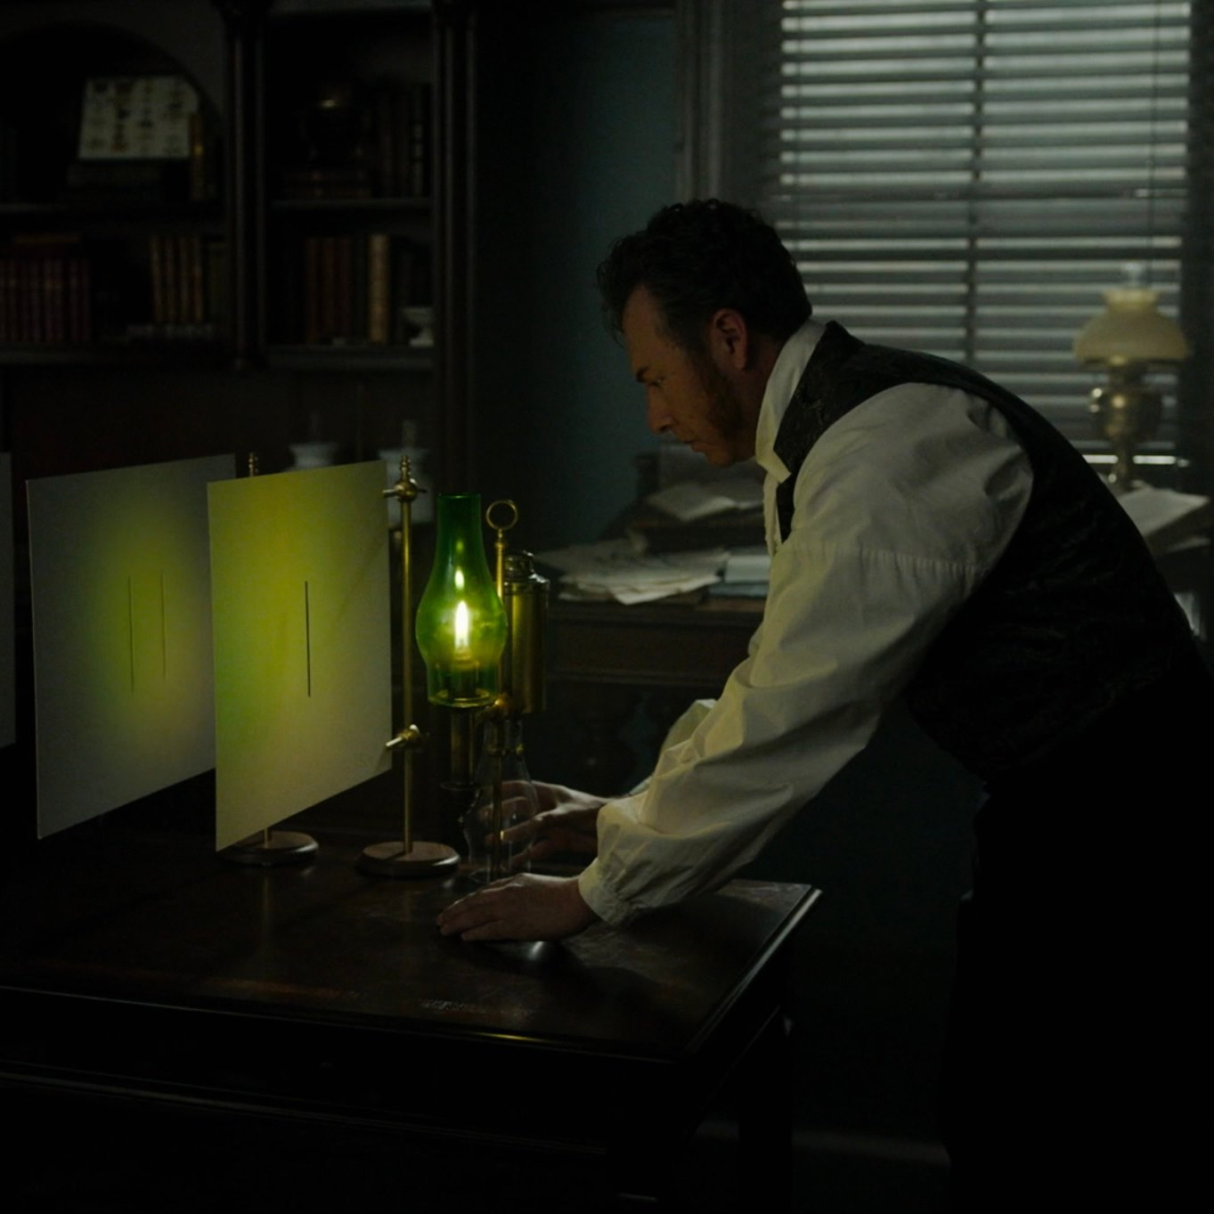
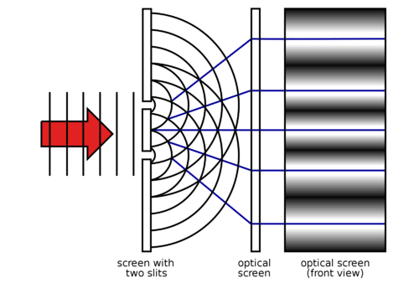
Optical Interferometric Imaging of the ALBA Synchrotron Light Source using Astronomical Techniques
Fourier optics, Huygens principle, and Young’s two slits
Carilli (NRAO), Nikolic (Cavendish), Thyagarajan (CSIRO)
Torino, Iriso (ALBA)
Copyright © 2024 AUI, U. Cambridge, CELLS, CSIRO. All Rights Reserved

Slide 2
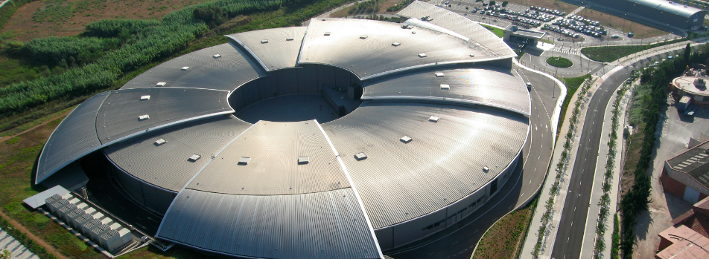
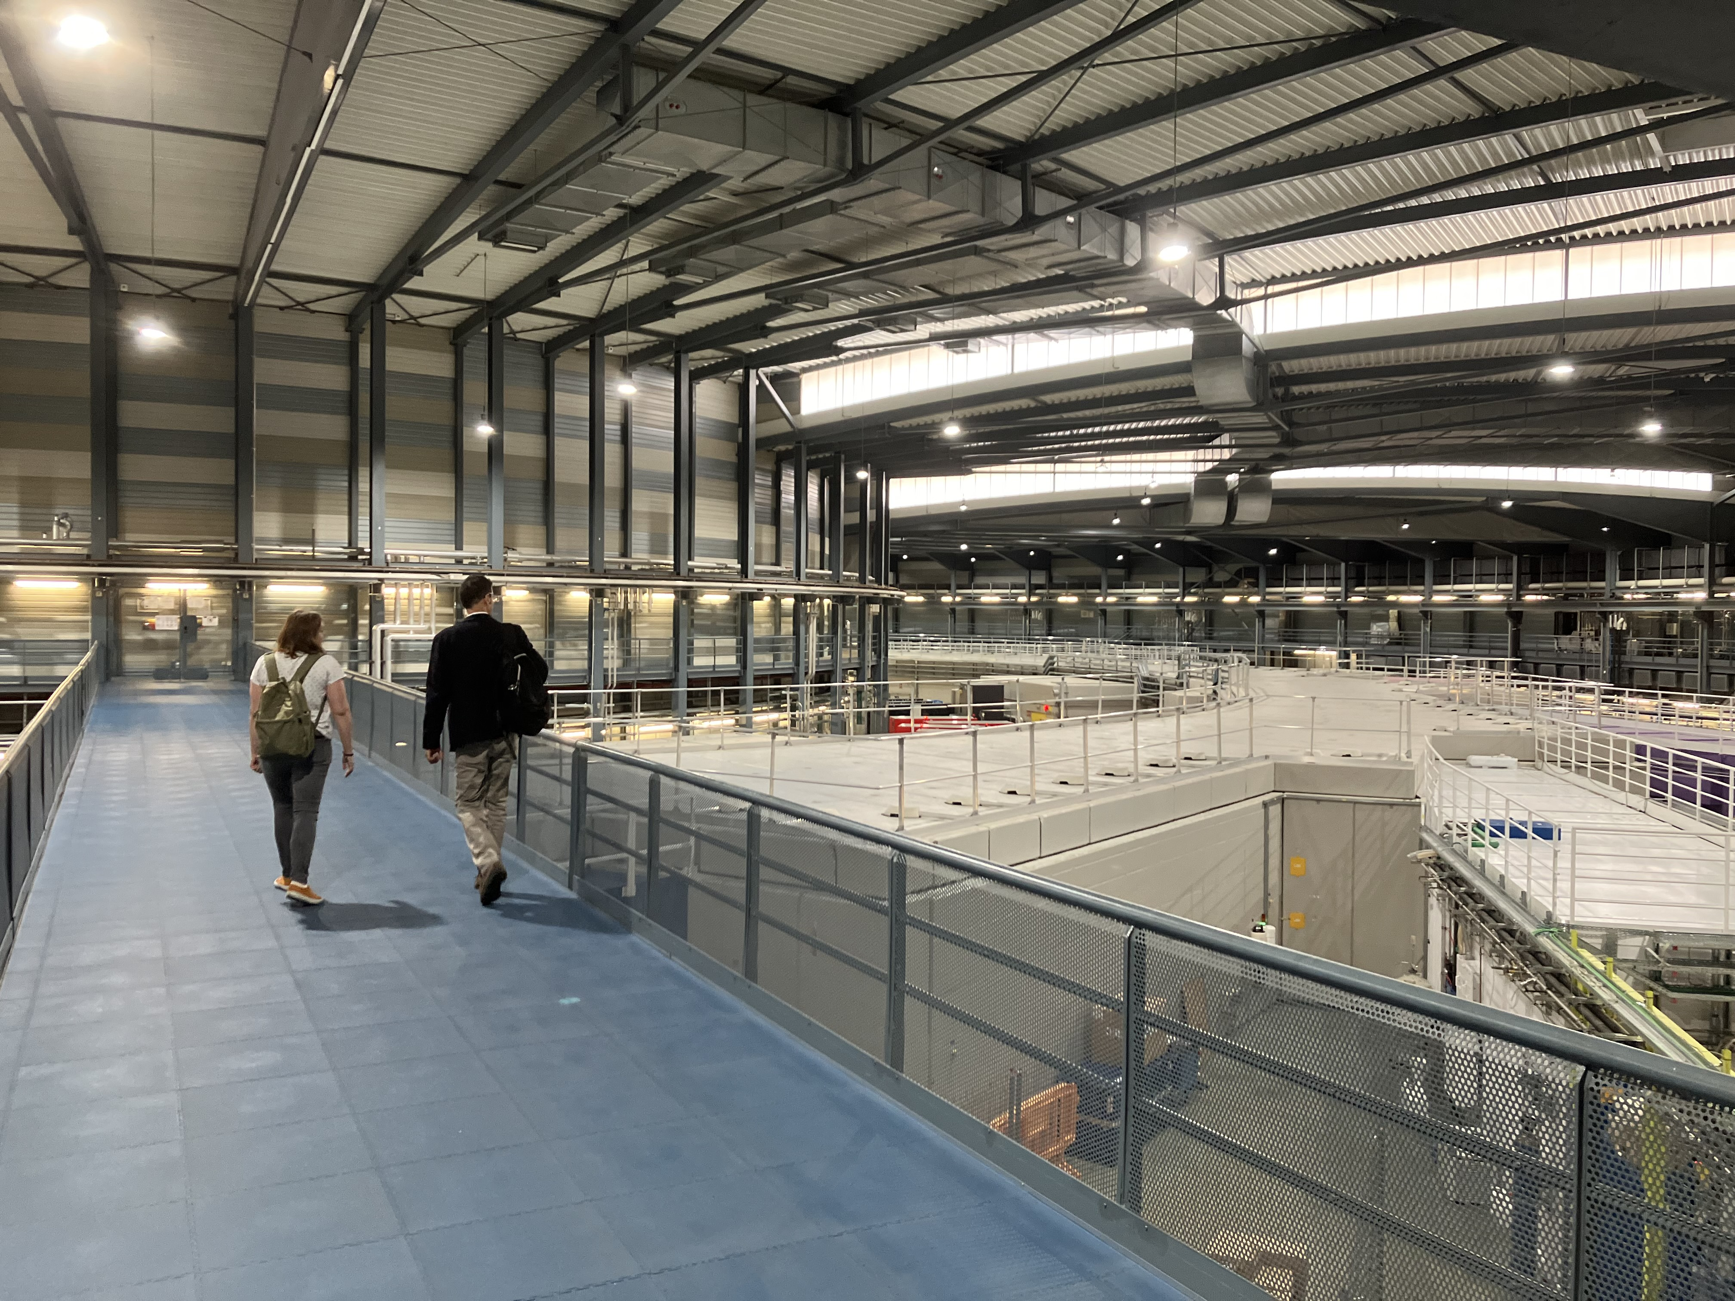
ALBA Synchrotron Light Source, Barcelona, Spain
Circumference = 270m
Electron energy = 3 GeV
Photon energy up to 70 keV
Emittance = 4.5 nm-rad

Slide 3
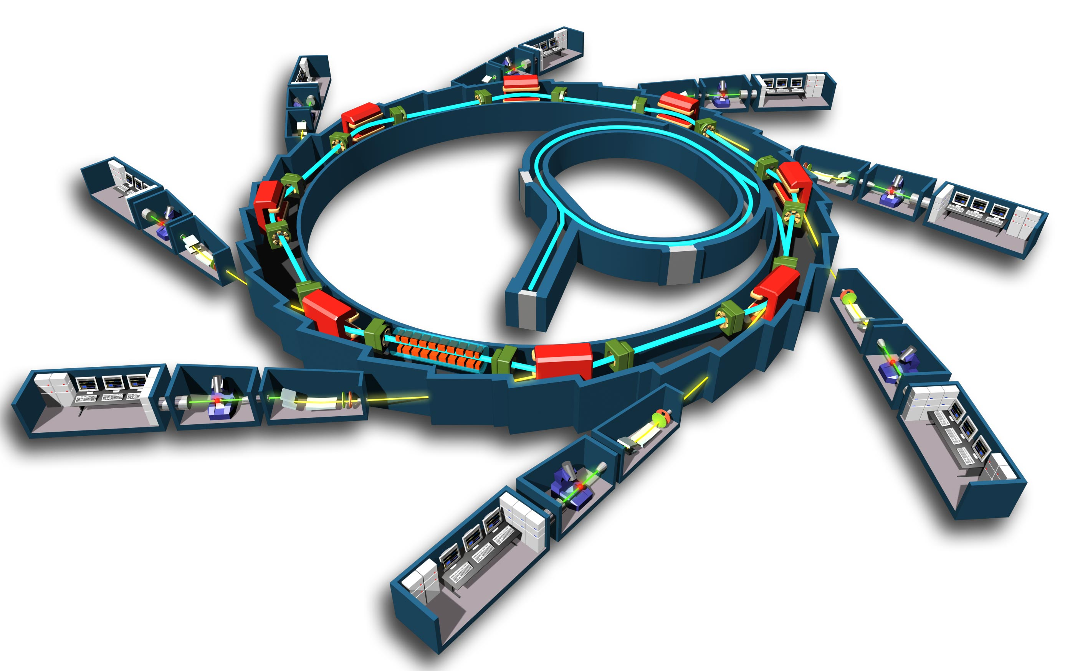
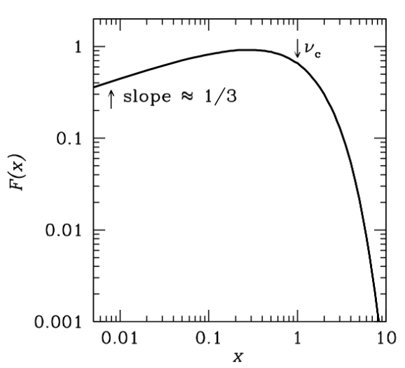
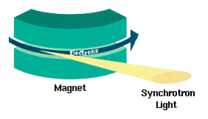
Storage Ring
Photon Beam lines = experiments
Bending magnet
Insertion Ring
e⁻ gun
Undulator or wiggler
Radial acceleration at bending magnets
I_{𝛎} ∝ 𝛎^{𝞪}
Doppler beaming
70keV

Slide 4

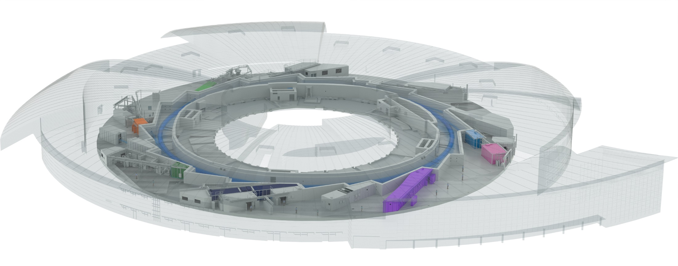

ALBA Today
Public Institution
50% Spanish “Ministerio de Ciencia”
50% Catalan “Department de Recerca & Universitats”
12 operating photon beam lines
2500 experiments/year in metrology, material, and life science
BOREAS
FAXTOR
(in commissioning)
BL34 – Xanadu
MINERVA
CIRCE
MIRAS
CLAESS
MSPD
LOREA
XAIRA
(in commissioning)
Cryo-EM
NOTOS
MISTRAL
TEM
InCAEM
(in constr.)
3SBAR
(in constr.)
XALOC
NCD-SWEET
Metrology Research
Material Science Research
Life Science Research
Accelerator Research

Slide 5
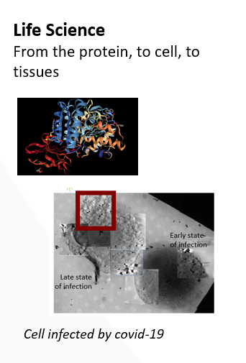
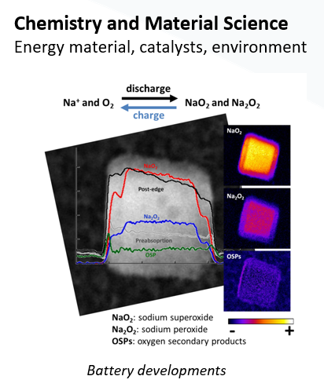
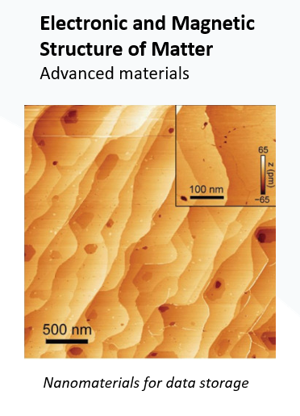
ALBA Synchrotron Research
X-ray crystallography and tomography
X-ray spectroscopy
X-ray metrology (Athena)
X-ray lithography
Infrared spectroscopy

Slide 6
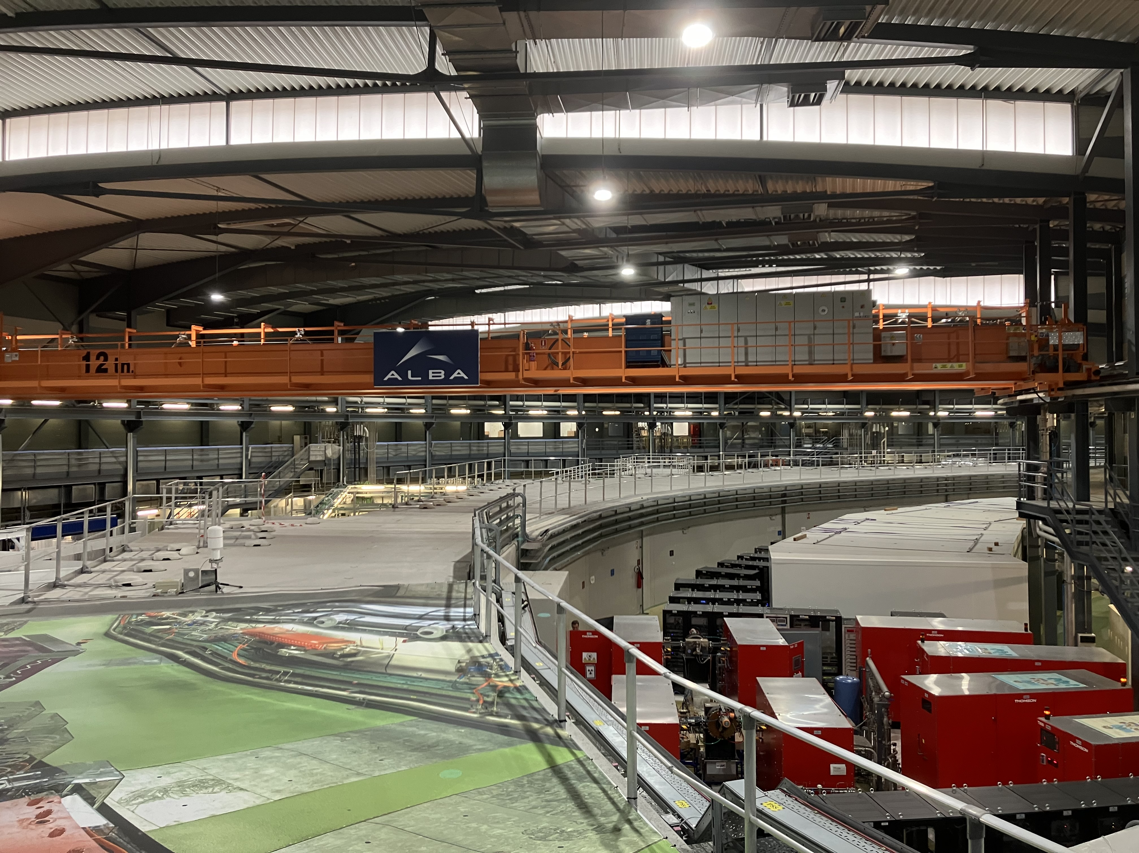
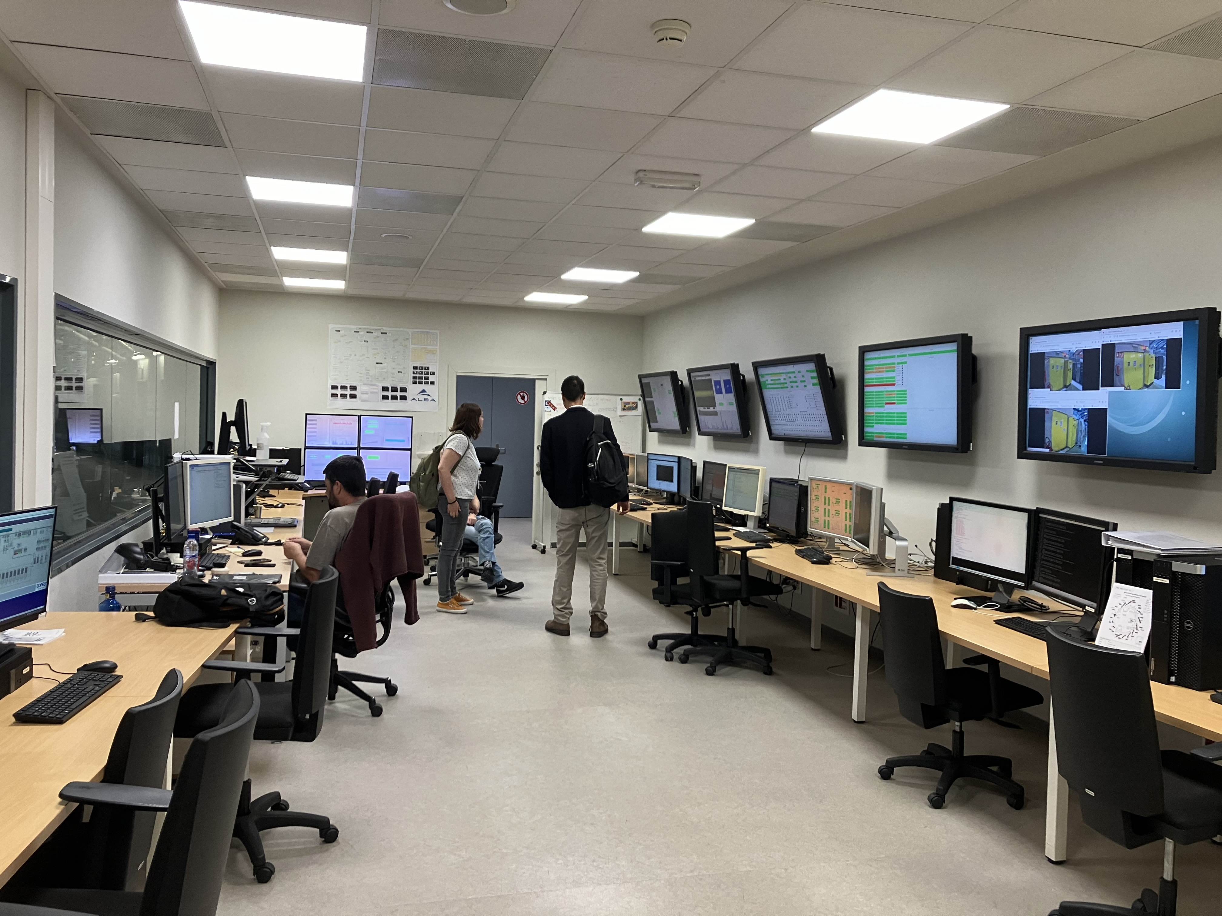
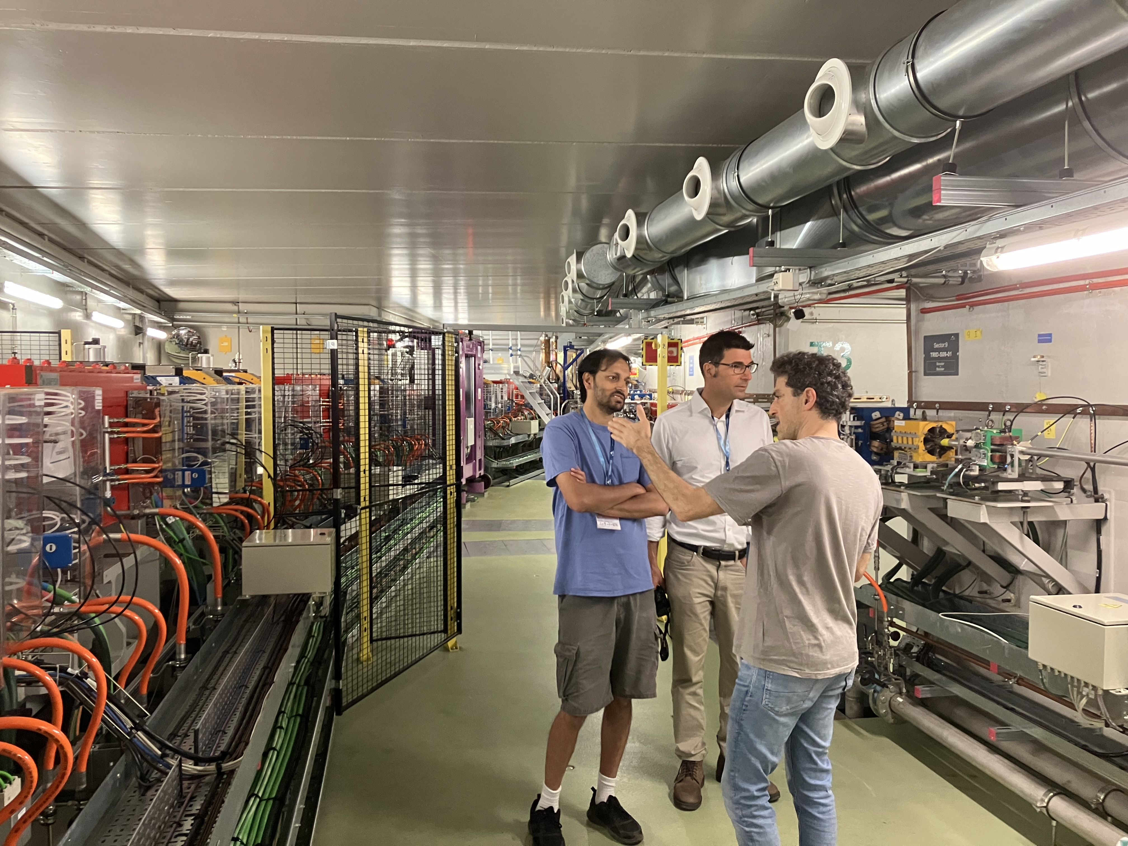
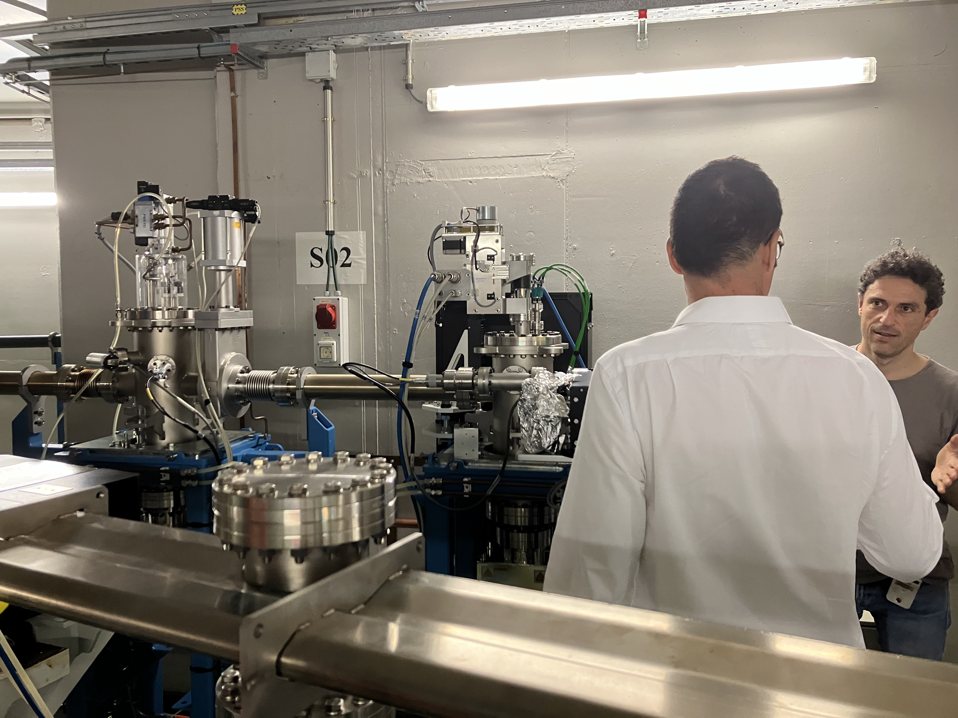

Slide 7
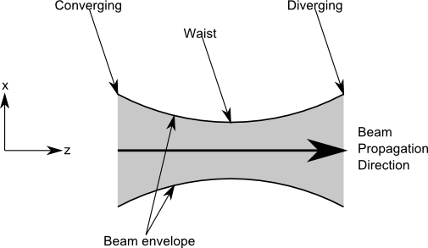
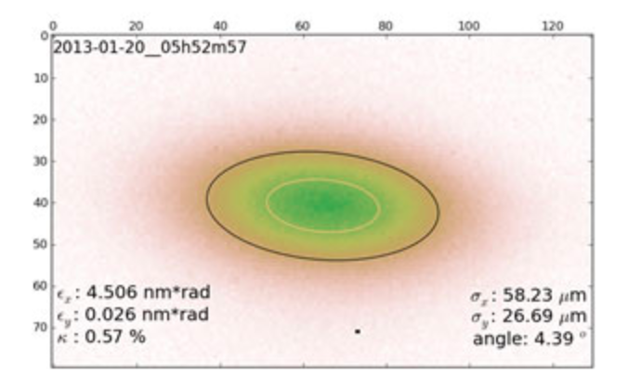
Key Performance Metric: Emittance
Emittance = e⁻ beam area x momentum vectors
Low emittance => concentrated and focused photon beam => higher brightness
‘quality of experiments depends on the knowledge of the e⁻ beam shape’
e⁻
Measurement methods
X-ray pinhole camera
LOCO magnetic lattice analysis + beam position monitors
Optical synchrotron radiation interferometry (SRI)
X-ray pinhole => highly Gaussian ~10¹² e⁻

Slide 8
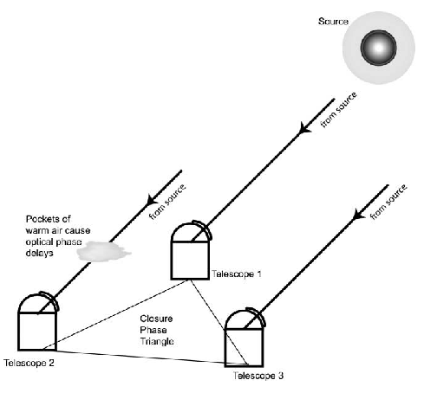

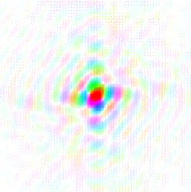






Van Cittert – Zernike Theorem
The cross-multiplication, or coherence, between the electromagnetic voltages measured at spatially distinct locations (’apertures’) = Fourier transform of the intensity distribution
V_{i,j} = A_{i,j,} 𝝓_{i,j}
FT
y
v
u_{i,j} = (B_{i,j} / 𝜆)
Image plane
Aperture plane
x
u
‘dirty image’ => deconvolution
‘self-calilbration’ = Wave Front Sensing
Voltage gains

Slide 9
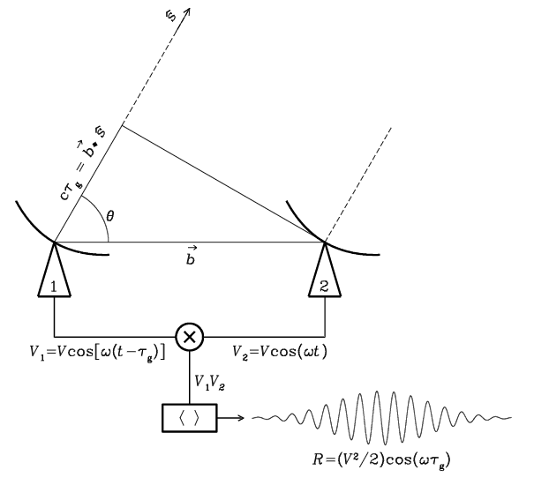
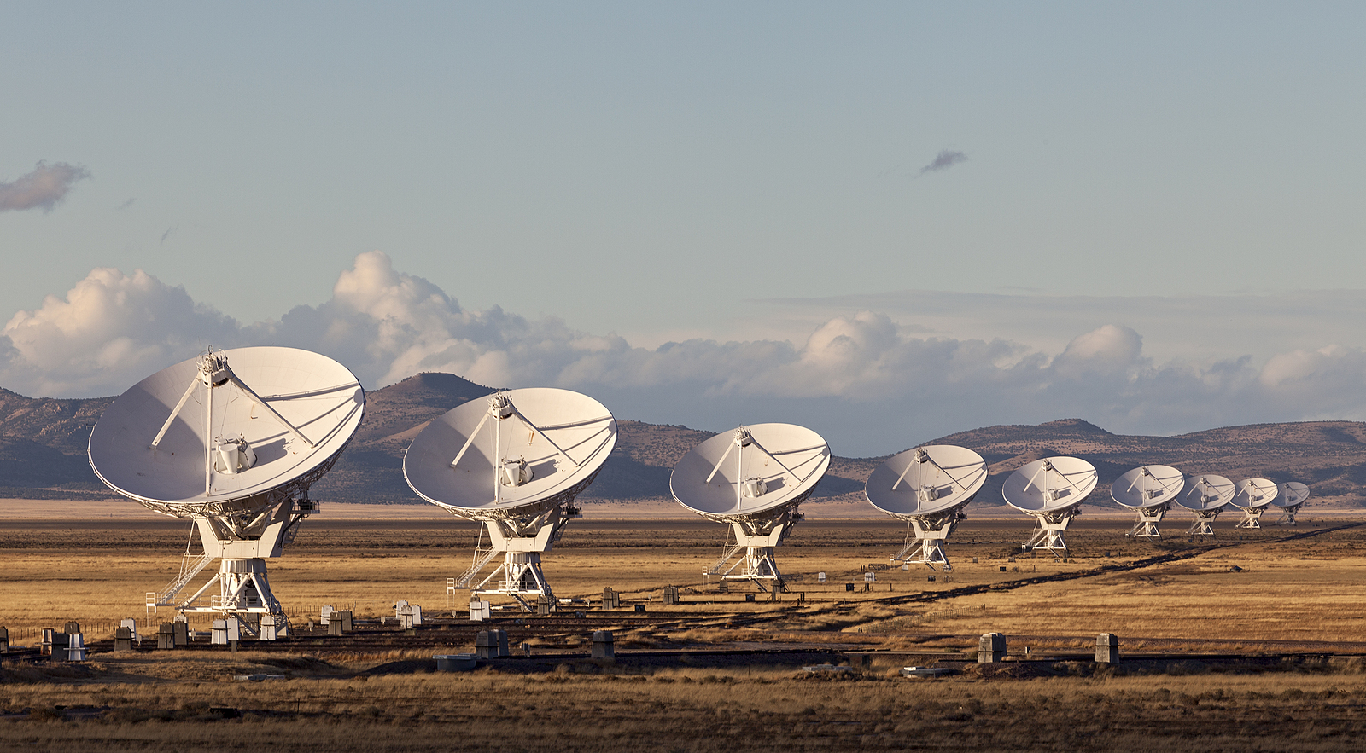

Radio measurements are visibilities = aperture plane
V_{i,j} = E_{i} x E_{j}* = A_{i,j,} 𝝓_{i,j}
Coherent amplification of voltages, E
Geometric delays set by electronics
Complex cross multiply and average to visibilities
Images made from Fourier transform of visibilities
Note: negative surface brightnesses => unphysical due to lack of total power

Slide 10
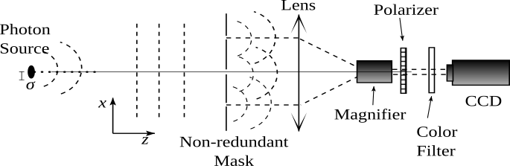
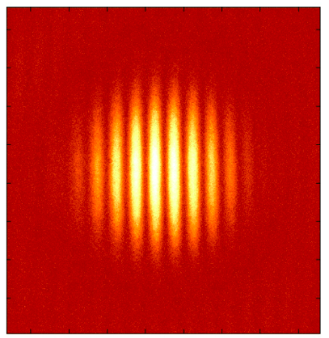
Optical measurements are images
V_{1,2} (A_{i,j,} 𝝓_{i,j}) = FT(Image)
Aperture mask + coherent focus with lens (or mirrors)
Direct imaging of fringe pattern
Visibilities generated from FT(image)

Slide 11
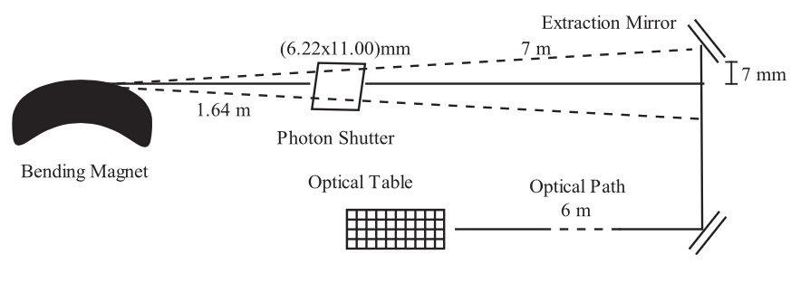
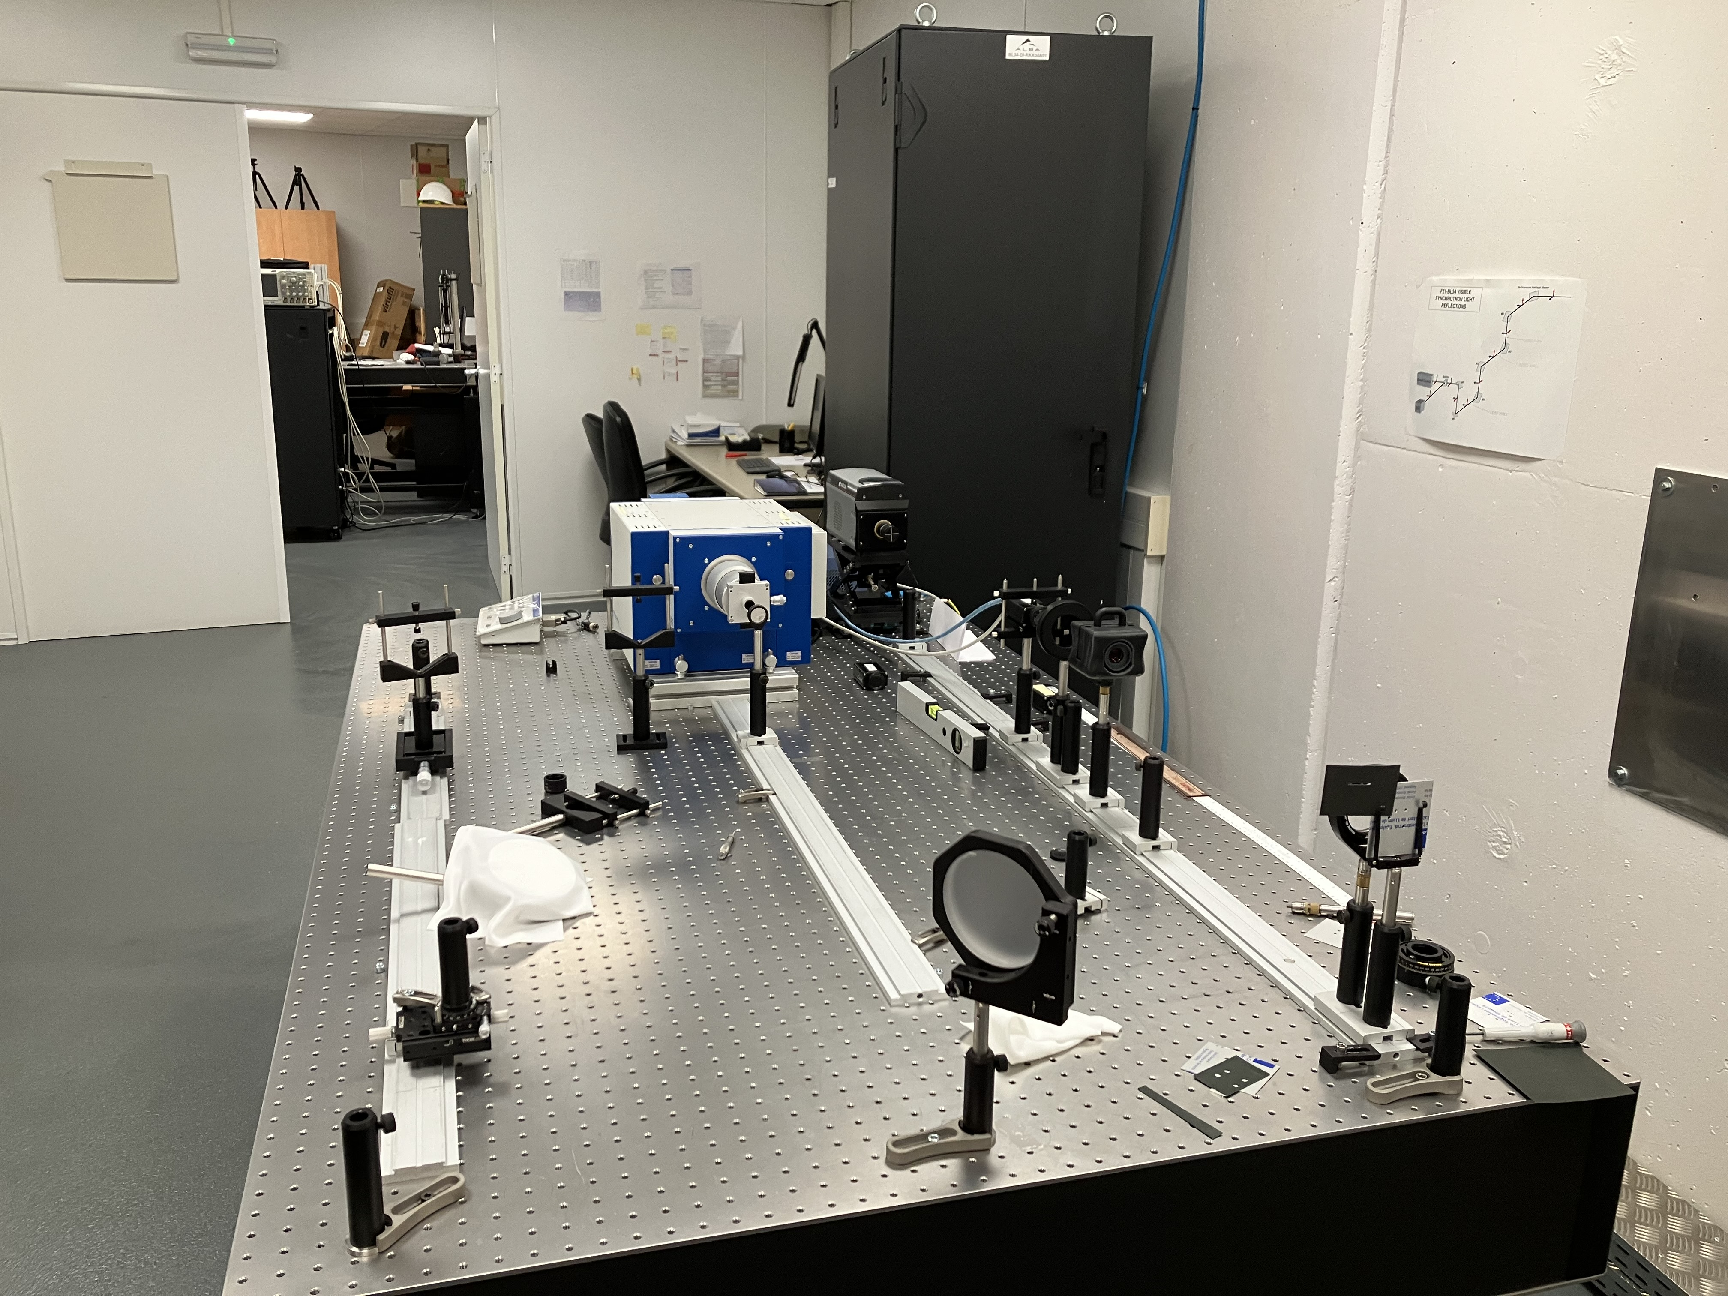
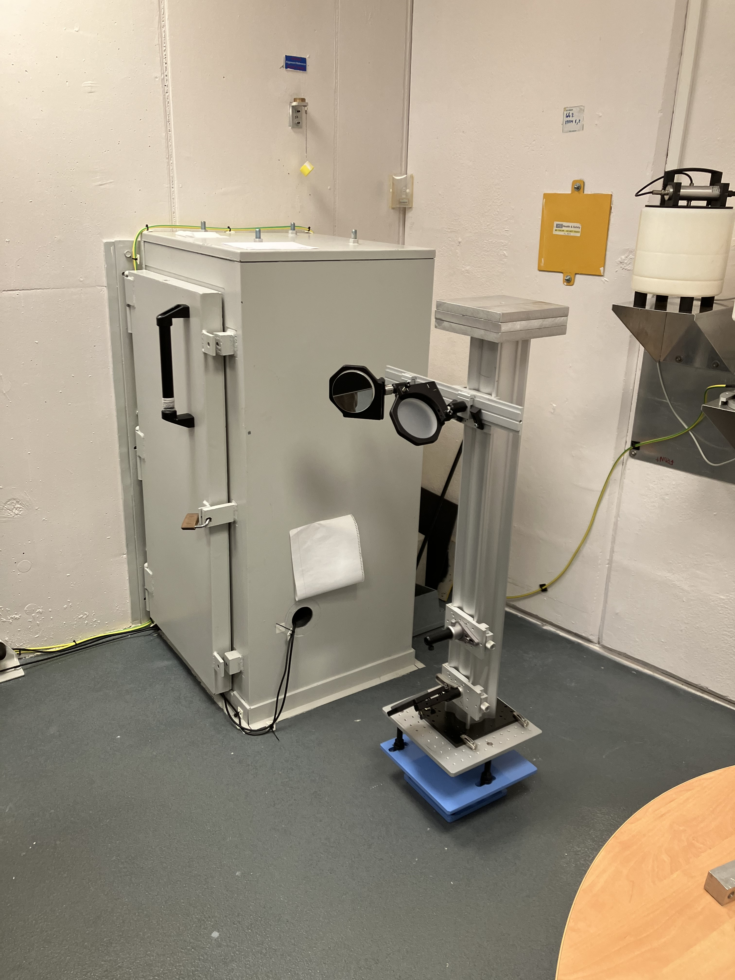
Xanadu: ALBA optical synchrotron radiation interferometry lab
𝛌 = 540nm
Fast CCD
Magnifier, polarizer, color filter
Mask + lens

Slide 12
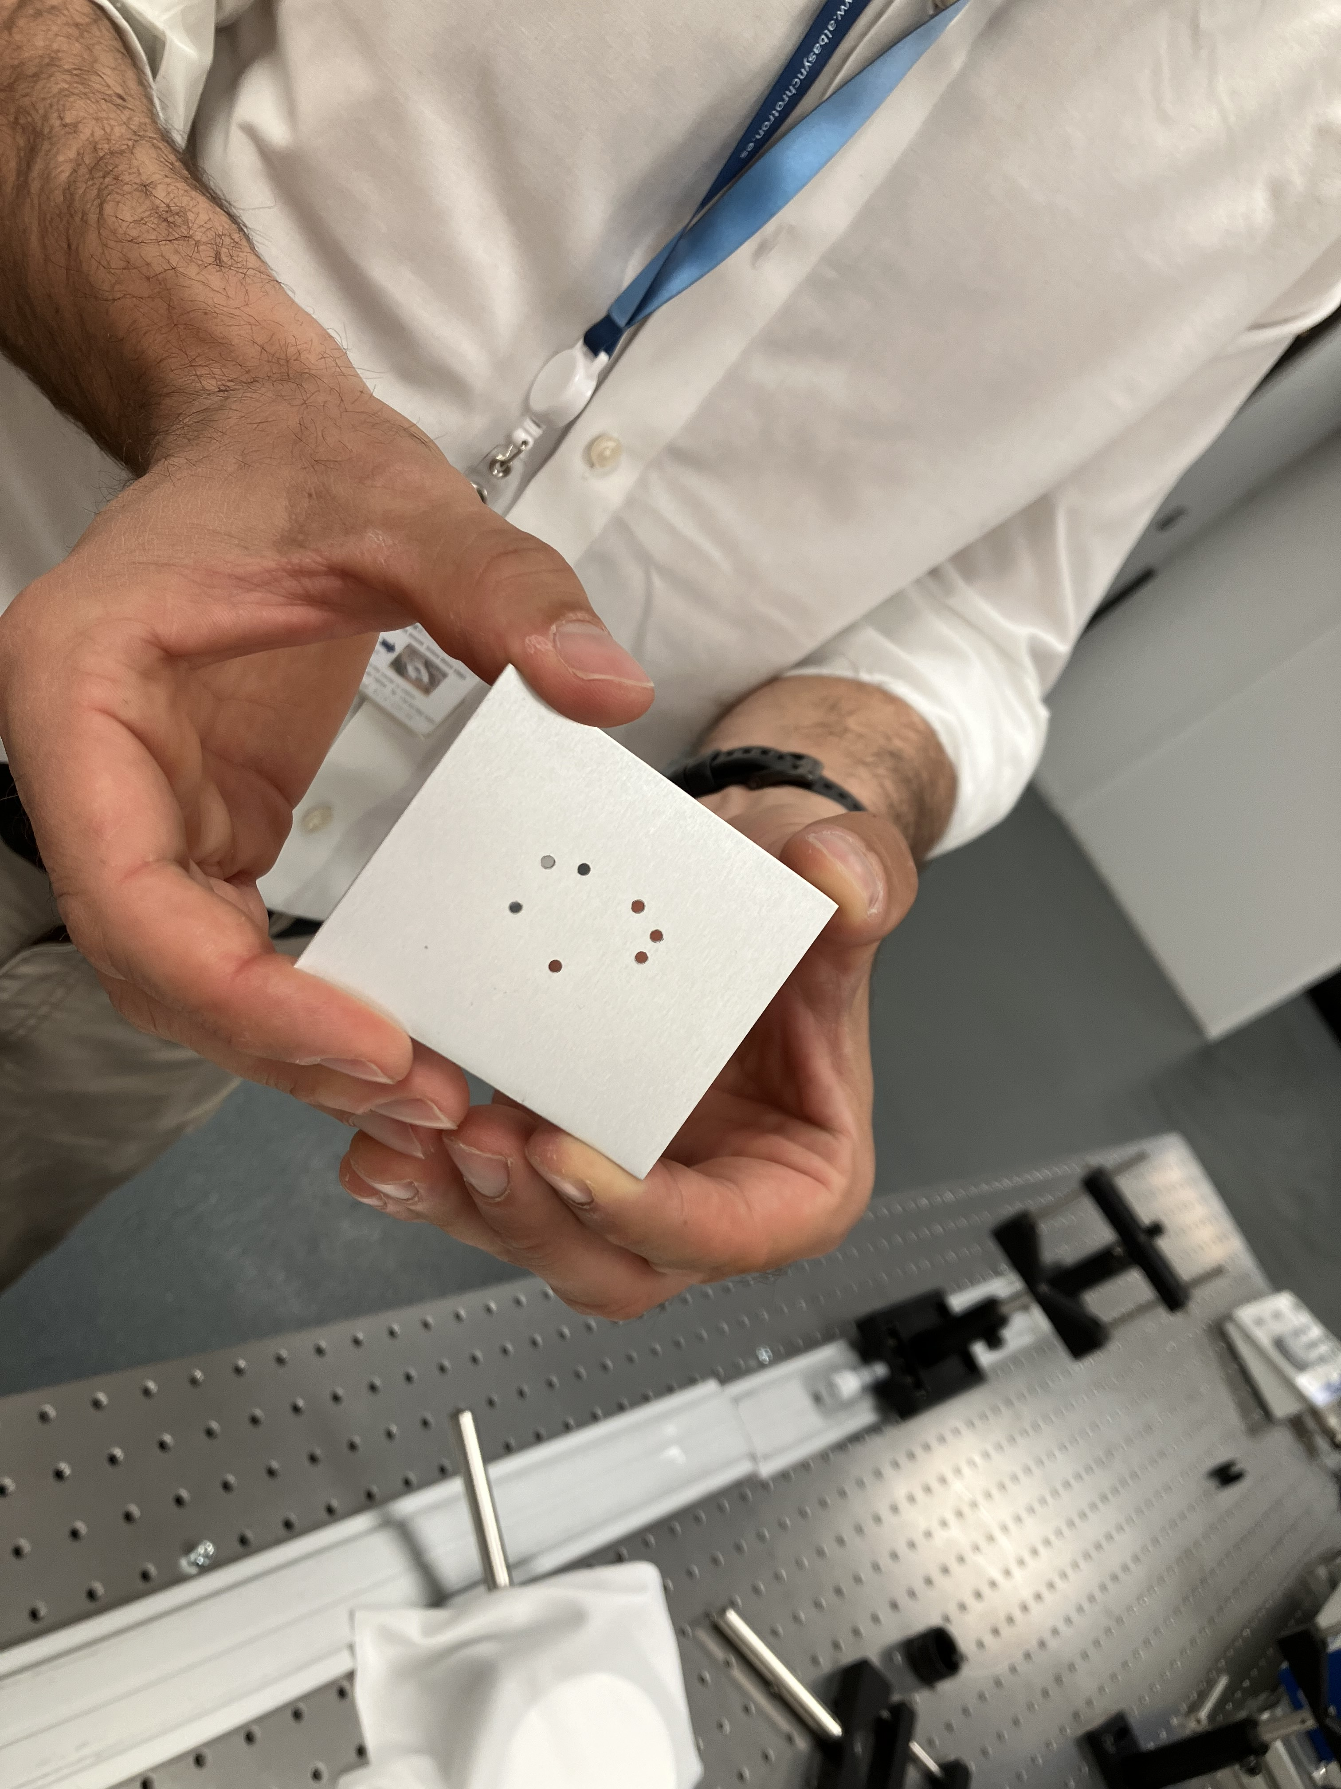
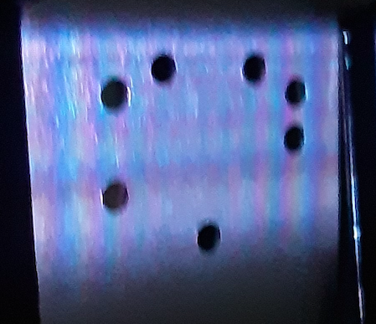
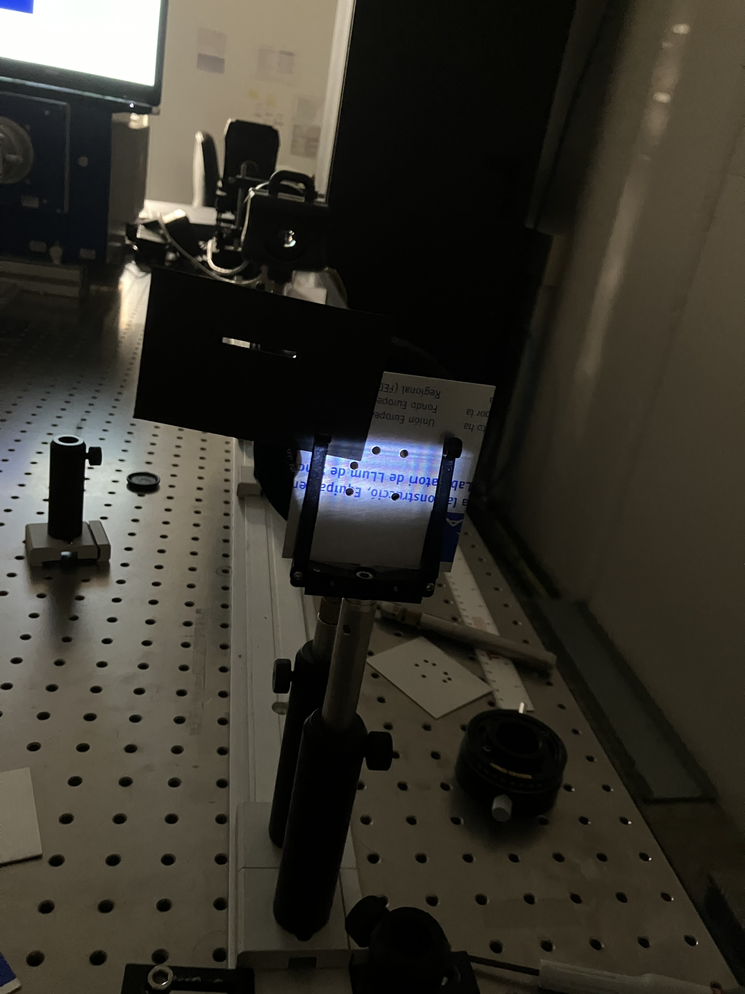
Example 7 hole non-redundant mask

Slide 13
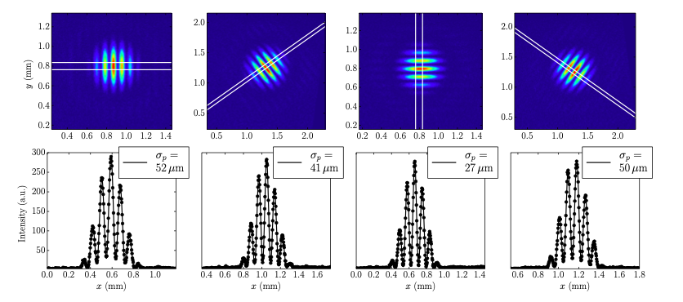
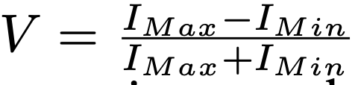
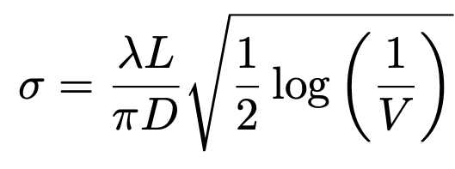
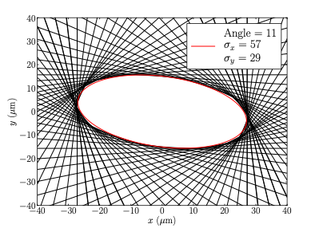
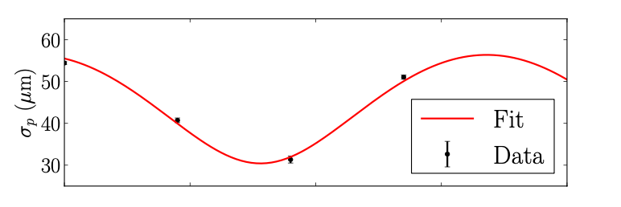
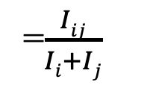
Rotated Two Hole Method: ‘Young’s slit’ plus Gaussian Model
Torino & Iriso w. Mitsuhashi method
=$\frac{Iij}{Ii+Ij}$
Limitations
Slow: cannot be done in real time
Relatively low S/N

Slide 14
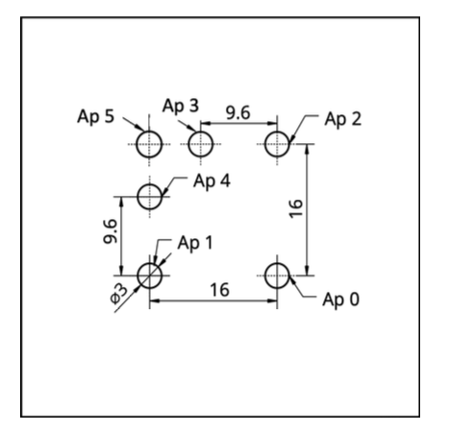
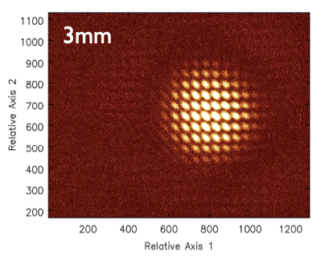
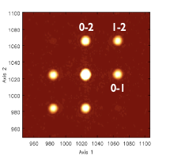
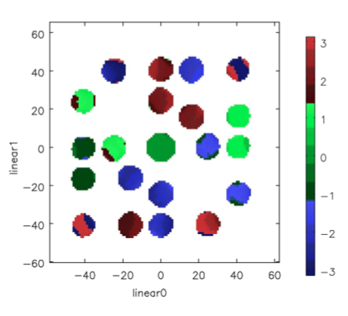
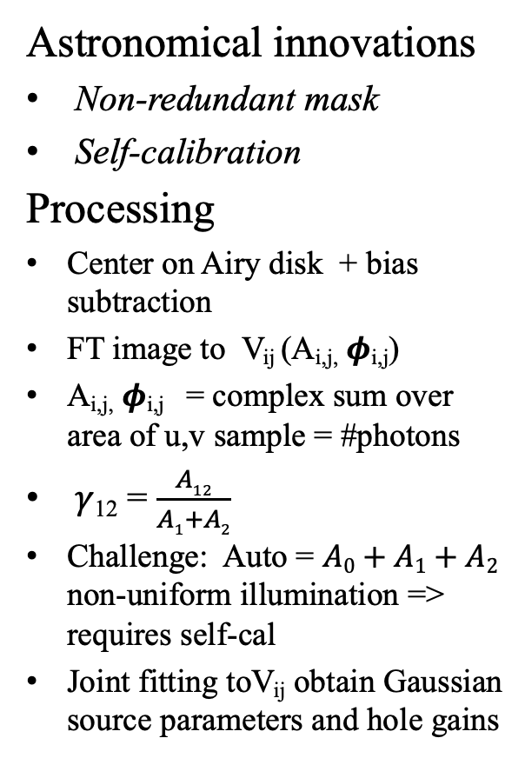
New method: Multi-hole, 2-Dimensional masking SRI
Astronomical innovations
Non-redundant mask
Self-calibration
Processing
Center on Airy disk + bias subtraction
FT image to V_{ij} (A_{i,j,} 𝝓_{i,j})
A_{i,j,} 𝝓_{i,j} = complex sum over area of u,v sample = #photons
𝛾₁₂ = $\frac{A12}{A1+A2}$
Challenge: Auto = $A0+A1+A2$ non-uniform illumination => requires self-cal
Joint fitting toV_{ij} obtain Gaussian source parameters and hole gains
v
Auto
u

Slide 15
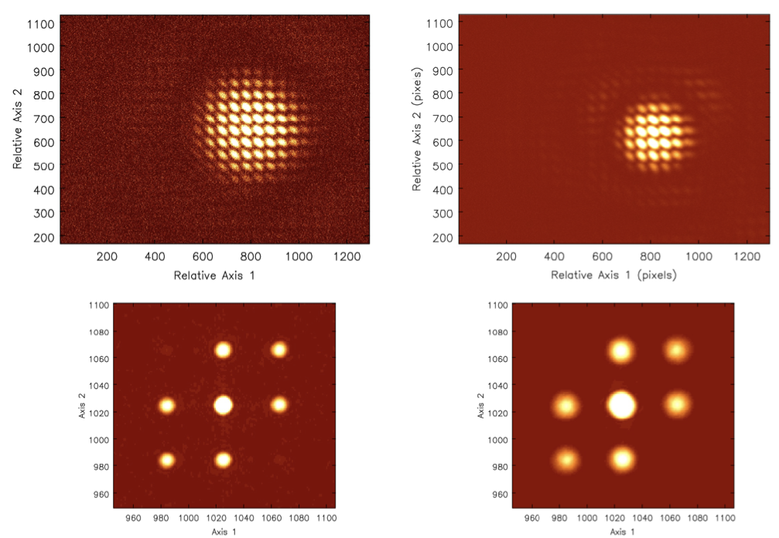
Hole size => Airy disk = ‘primary beam’
FT => u,v ‘smearing’ by primary beam
3mm
5mm
0-2
1-2
v
0-1
u

Slide 16
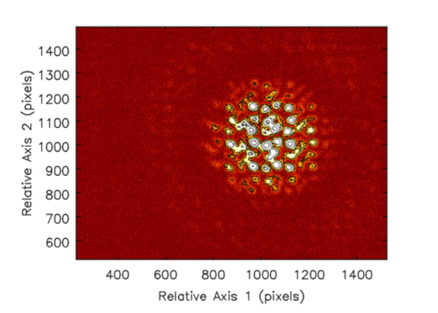
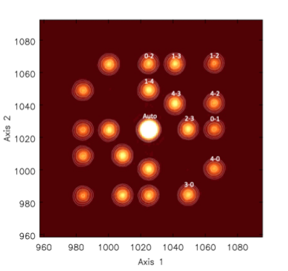
Multi-hole, 2D non-redundant mask SRI w. self-calibration
Experiments
Experiments w. 2, 3, 5, 6, 7 hole masks
Hole sizes = 2mm to 5mm
Baselines to 24mm
Wavelength = 400nm and 540nm
30 frames = 0.3ms to 3ms every 1sec
Tests: real-time adjustment of beam size
5 hole non-redundant mask

Slide 17
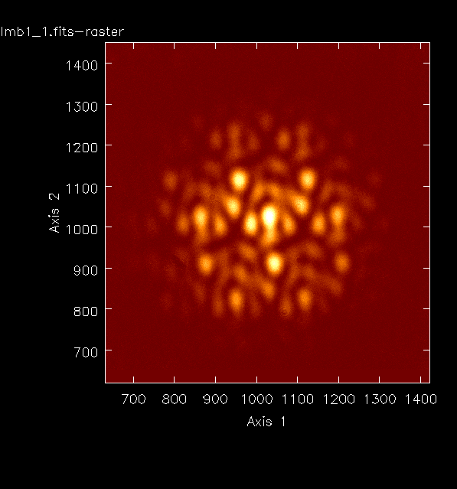
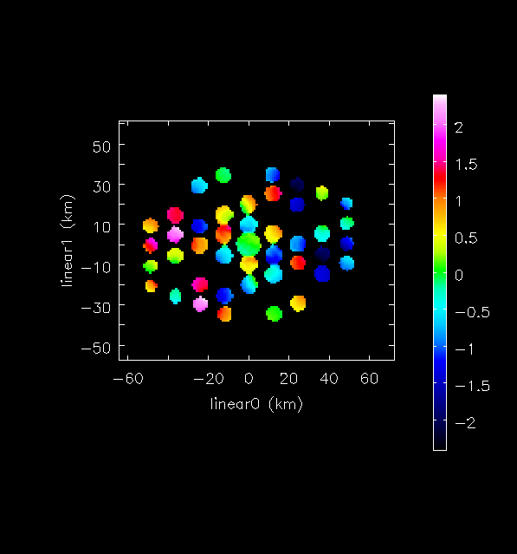
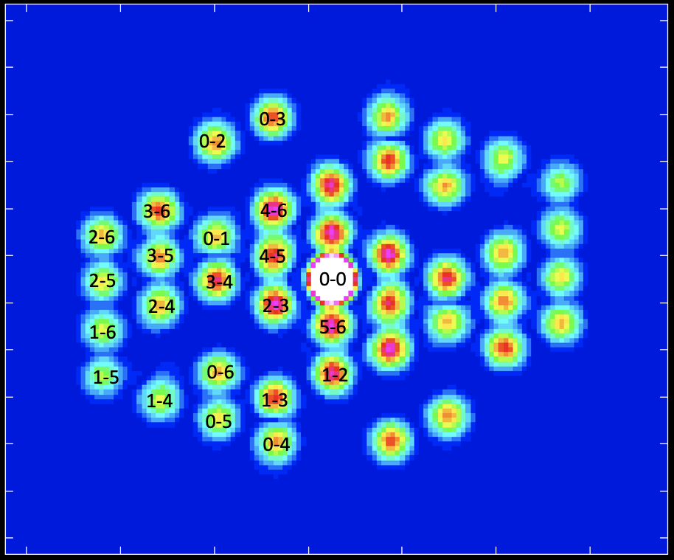
Non-redundant 7 hole Mask: JWST Template

Slide 18
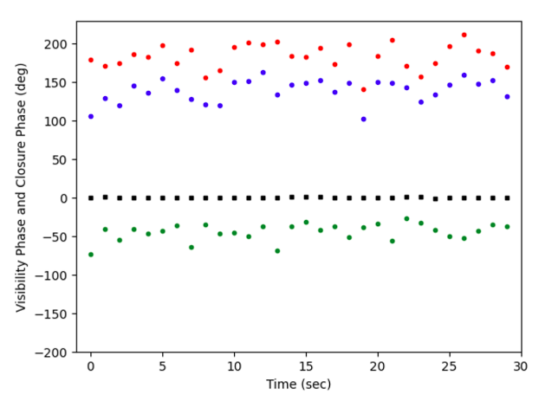
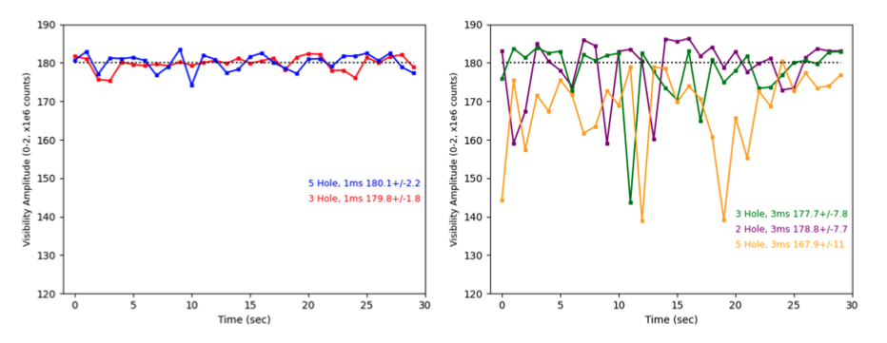
𝛟₁₂
Why short t_{frame}?
𝛟₃₁
Phases: rms 1ms ~ 15º
Vibrations and/or turbulence
Closure phase 0º; rms < 1º
aperture based errors
point-symmetric source
𝛟₁₂₃
𝛟₂₃
0-2 3ms
rms ~ 5%,
<amp> lower by up to 5%
0-2 1ms
rms~ 1%

Slide 19
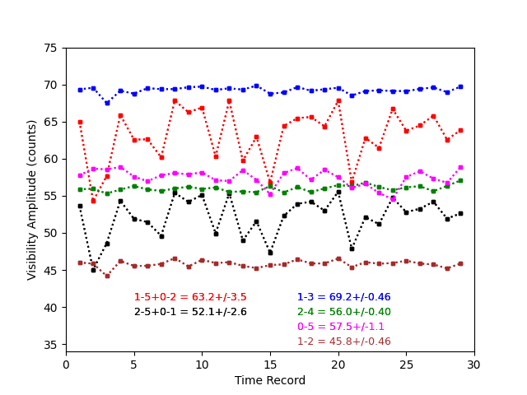

Why non-redundant mask?
Decoherence on redundant baselines due to phase fluctuations across mask
Coherence for redundant samples lower by 5%
rms for redundant samples ~ 6x non-redundant

Slide 20
Why Self-Calibration?
Ap3 0.122
Ap4 0.117
Ap5 0.117
Ap2 0.121
Ap1 0.109
Ap6 0.129
Ap0 0.098
Hole-based gain solutions
Amp: illumination ~25% voltage difference
=> ~50% power difference

Slide 21
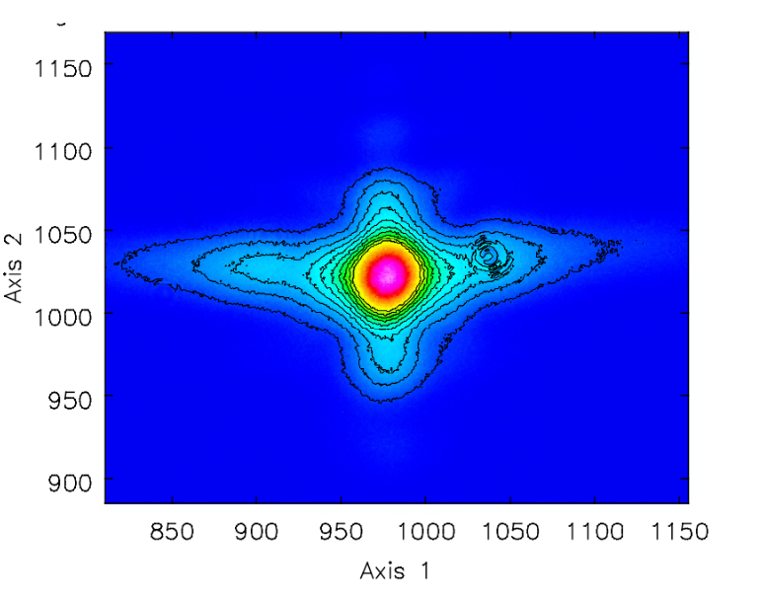
Why not a filled aperture?
Phase screen => image blurring = ‘seeing’ (filled aperture has infinite # of redundant baselines)
Diffraction limit => 𝛉_{source} < PSF => requires deconvolution (model fitting)
PSF of filled aperture is complex (diffraction edges, shutters… Not just airy disk)
PSF of interferometer is (almost) mathematically deterministic (sinusoids)
ALBA
e⁻ beam FWHM = 141x56um @15m
FWHM_{maj} = 1.9”
FWHM_{min} = 0.8”
Lens/shutter PSF FWHM ~ 6” w. complex 20% diffraction wings
Mask longest baseline = 24mm => fringe spacing at 540nm ~ 5”,
but PSF is known precisely and S/N is very high (10⁷ photons per vis) => facilitates model fitting
7”

Slide 22





Self-cal Method 1 w. 5 Hole data
Gaussian model fitting to Vis Amp w. G_{amp} Selfcal
Selfcal G_{amp} stable ~ 1%
Differ up to 30%
Coherences > 60%

Slide 23


Method 1: Gaussian model fitting to Vis Amp w. G_{amp} Selfcal
𝜎 = 60um
Bmaj ~ 59.6 +/- 0.1 um
Bmin ~ 23.8 +/- 0.5 um
Coherences are high but so is S/N => can fit for model much smaller than PSF
Errors = rms of time series/root(30)
Minor axis is worse due to resolution

Slide 24


Method 1: Gaussian model fitting to Vis Amp w. G_{amp} Selfcal
Without SC 66 40 5º

Slide 25

Tests w. 7 hole mask: Changing e⁻ beam size

Slide 26




Method 2: Image model reconstruction via CASA complex gain calibration
7-hole mask w. 4 rotation angles
Start w. point source and GAINCAL for each rotation
Gaussian UVMODELFIT to all SC data
Use new Gaussian model in GAINCAL
Iterate
PSF
71%
PSF
30%

Slide 27


Method 2: Image model reconstruction via CASA complex gain calibration
Converges quickly
Axes within ~ few um; PA within 1º of Method 1
Gain amplitudes within 1% of Method 1

Slide 28


CLEAN deconvolution of 7-hole SC data (0º rotation)
400nm
540nm
Model*PSF
400nm
540nm
540nm not Gaussian due to poor u,v coverage and resolution
400nm does better on B_{maj} but B_{min} still ‘unresolved’
FWHM CLEAN PSF 540nm = 4.6” x 2.8”
FWHM CLEAN PSF 400nm = 3.4” x 2.1”
Source FWHM_{maj} ~ 1.9”; FWHM_{min} ~ 0.8”

Slide 29
Summary
New SRI method for rapid (msec), accurate, non-invasive 2D e⁻ beam characterization
Self-calibration corrects for non-uniform illumination
Non-redundancy avoids decoherence and image smearing
Self-cal phase solutions provide precise wave-front sensor
Future
More experiments at ALBA
generalize to more holes and more complex sources
EUV: higher resolution
SRI beam monitor at DESY (Germany), SPring8 (Japan)
Improved diagnostics in next-gen synchrotron sources with lower emittance (Brookhaven NSLS-II, Argonne APS, ALBA-2, Swiss LS)
Free Electron and/or Fusion reactor laser beam characterization
EUV source shape of laser-induced plasma light sources used in lithographic microchip manufacturing (ASML)

Slide 30

arXiv:2405.12090
arXiv:2409.11135
arXiv:2406.02114
JOSA-A 2024, 41, 1513
2022PASA...39...14T
JOSA-A 2022, 39, 2214
US patent 12,104,901
US Provisional patents: RL 8127.306USPR, RL 8127.035.GBPR

Slide 31



Closure Phase in Image Domain
Shape-Orientation-Size conservation
3 Hole Mask
5 Hole Mask

Slide 32

Wave Front Sensor
179º
134º
73º
-41º
0º
Phase = millisec timescale wavefront sensor
High accuracy: dL_{𝜸} = 𝝺 x (d𝞍/360º)
Gradient: tip/tilt
Jitter: rms ~ 15º = 22nm

