Slide 1

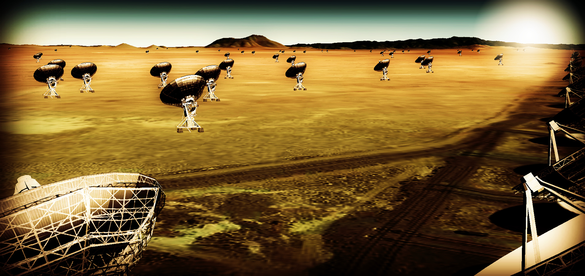
Thermal imaging on mas scales at λ ~ 0.3cm to 3cm
Effective area ~ 10x JVLA, ALMA (~ 300 x 18m)
Resolution ~ 10x JVLA, ALMA (B_{max} ~ 300km)
Frequency range ~ 1 to 115 GHz
https://science.nrao.edu/futures/ngvla

Slide 2
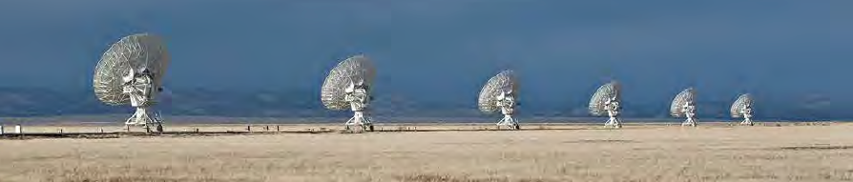
Community process
Jan 2015, Jan 2016: AAS community science meetings
April 2015, Dec 2015: Technology meetings (Pasadena, Socorro)
Dec 2015, Aug 2016: Kavli-sponsored RMS meetings (Chicago, Baltimore)
Nov 2015 Science working group reports (200 pages, 125 authors)
Circle of Life (Isella, Moullet, Hull)
Galaxy ecosystems (Murphy, Leroy)
Galaxy assembly (Lacy, Casey, Hodge)
Time domain, Cosmology, Physics (Bower, Demorest)
http://library.nrao.edu/ngvla.shtml
Jan 2017 AAS poster session on community design studies, URSI special session
June 2017 Science meeting Socorro, NM
Aug 2017? final Kavli RMS meeting (Berkeley)

Slide 3
Community process
Science Advisory Committee
Chairs: Bolatto (Maryland), Isella (Rice)
Review Community studies proposals
Reconstitute science working groups
SOC for science meeting June
Science case: ‘science book’
White papers for DS2020
Science requirements → technical specifications
Technical Advisory Committee
Under recruitment
Community studies
13 science studies: broaden case, investigate design implications
12 technical studies: explore key technical challenges

Slide 4
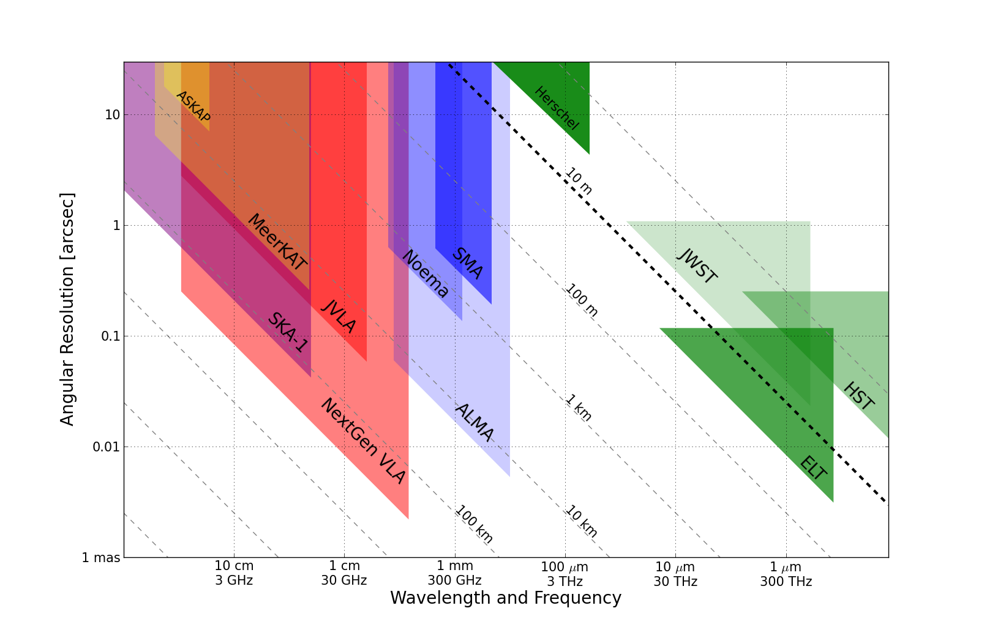
Killer Gap
Thermal imaging on mas scales at λ ~ 0.3cm to 3cm
1AU @ 140pc
Terrestrial zone planet formation
Resolution ~ 10mas @ 1cm (300km)
Synergy w. ALMA submm, future ELTs

Slide 5
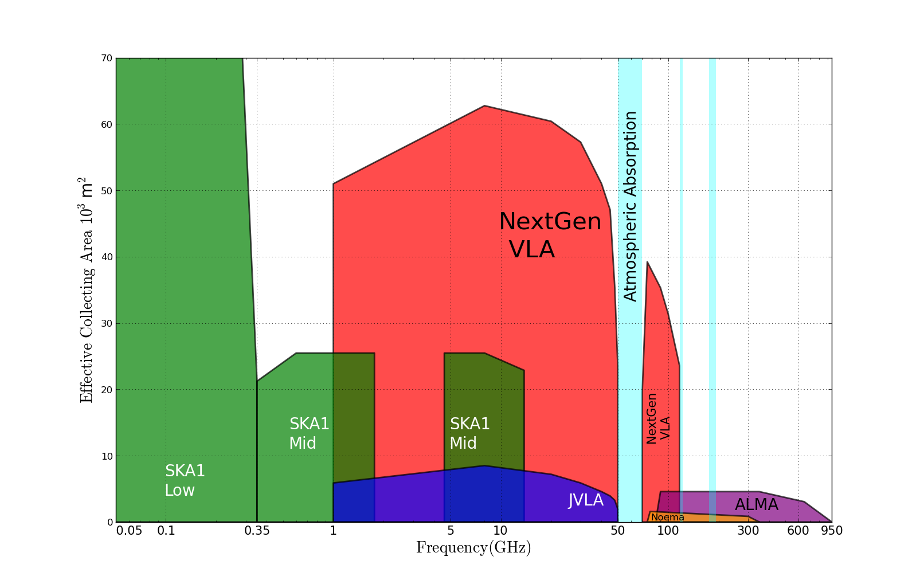
Killer Gap
Thermal imaging on mas scales at λ ~ 0.3cm to 3cm
5x
Sensitivity ~ 100 nanoJy @ 1cm, 10hr, BW = 20GHz
T_{B} ~ 1K @ 1cm, 10mas
Spectrum above 15GHz rich in ground state molecular lines

Slide 6
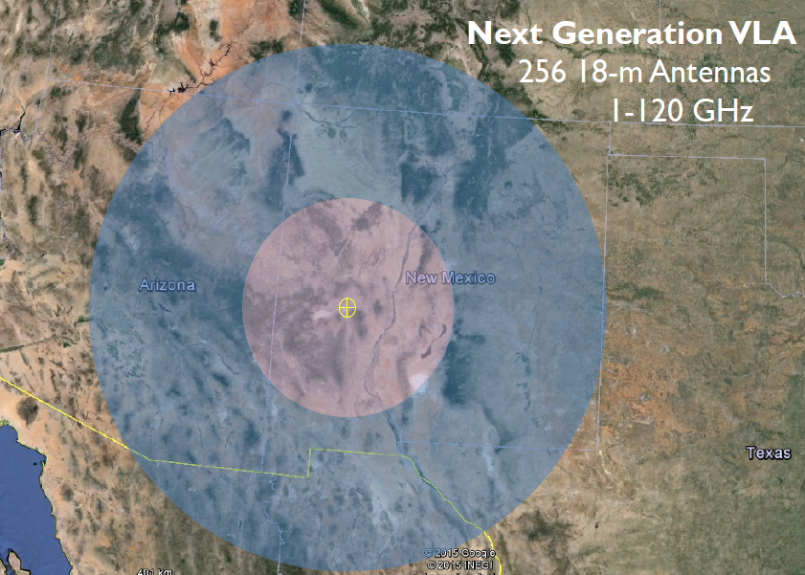
JVLA: Good 3mm site, elev. ~ 2200m
30% in core: b < 3km ~ 1” at 30GHz
60% in mid: b < 30km ~ 0.1”
90% in long: b < 300km ~ 0.01”
10% in VLB: b ~ 3000km ~ 0.001”
550km

Slide 7
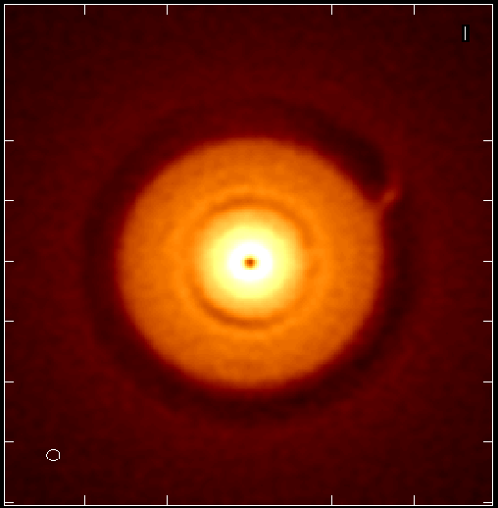
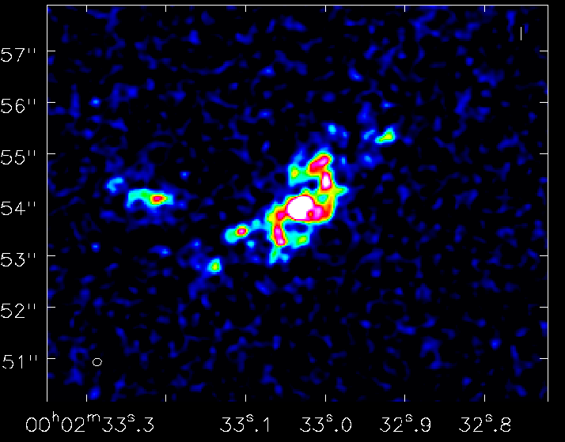
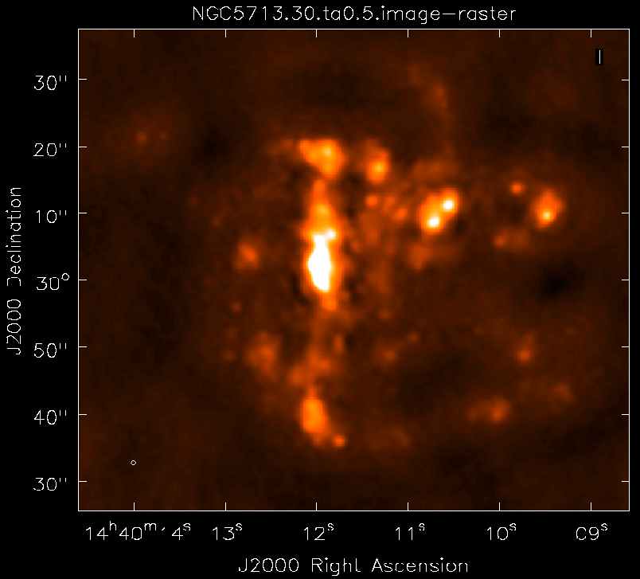
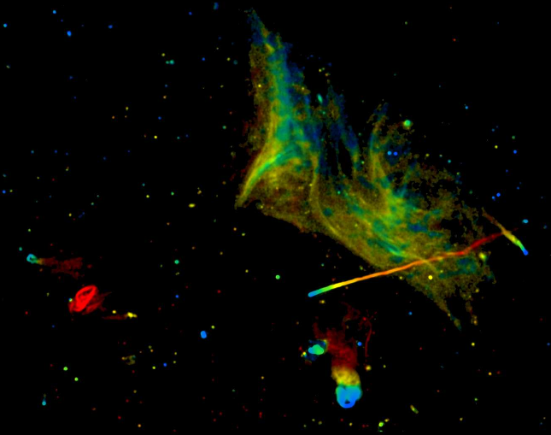
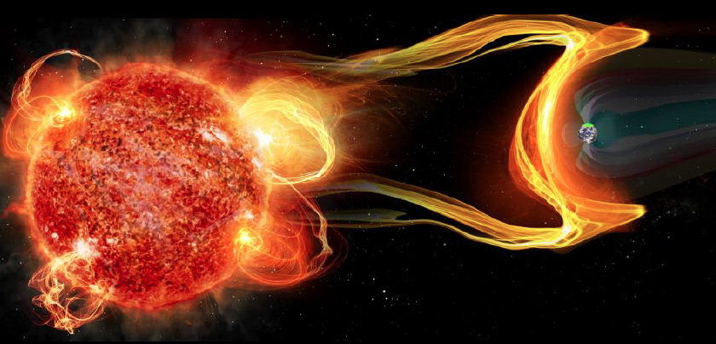
SWGs: community-driven, growing and evolving
Cradle of Life: Terrestrial planet formation
Galaxy ecosystems: wide field, high res/sens imaging
Galaxy formation: Cool gas history of the Universe
Time domain and Physics: Exo-space weather
http://library.nrao.edu/ngvla.shtml

Slide 8
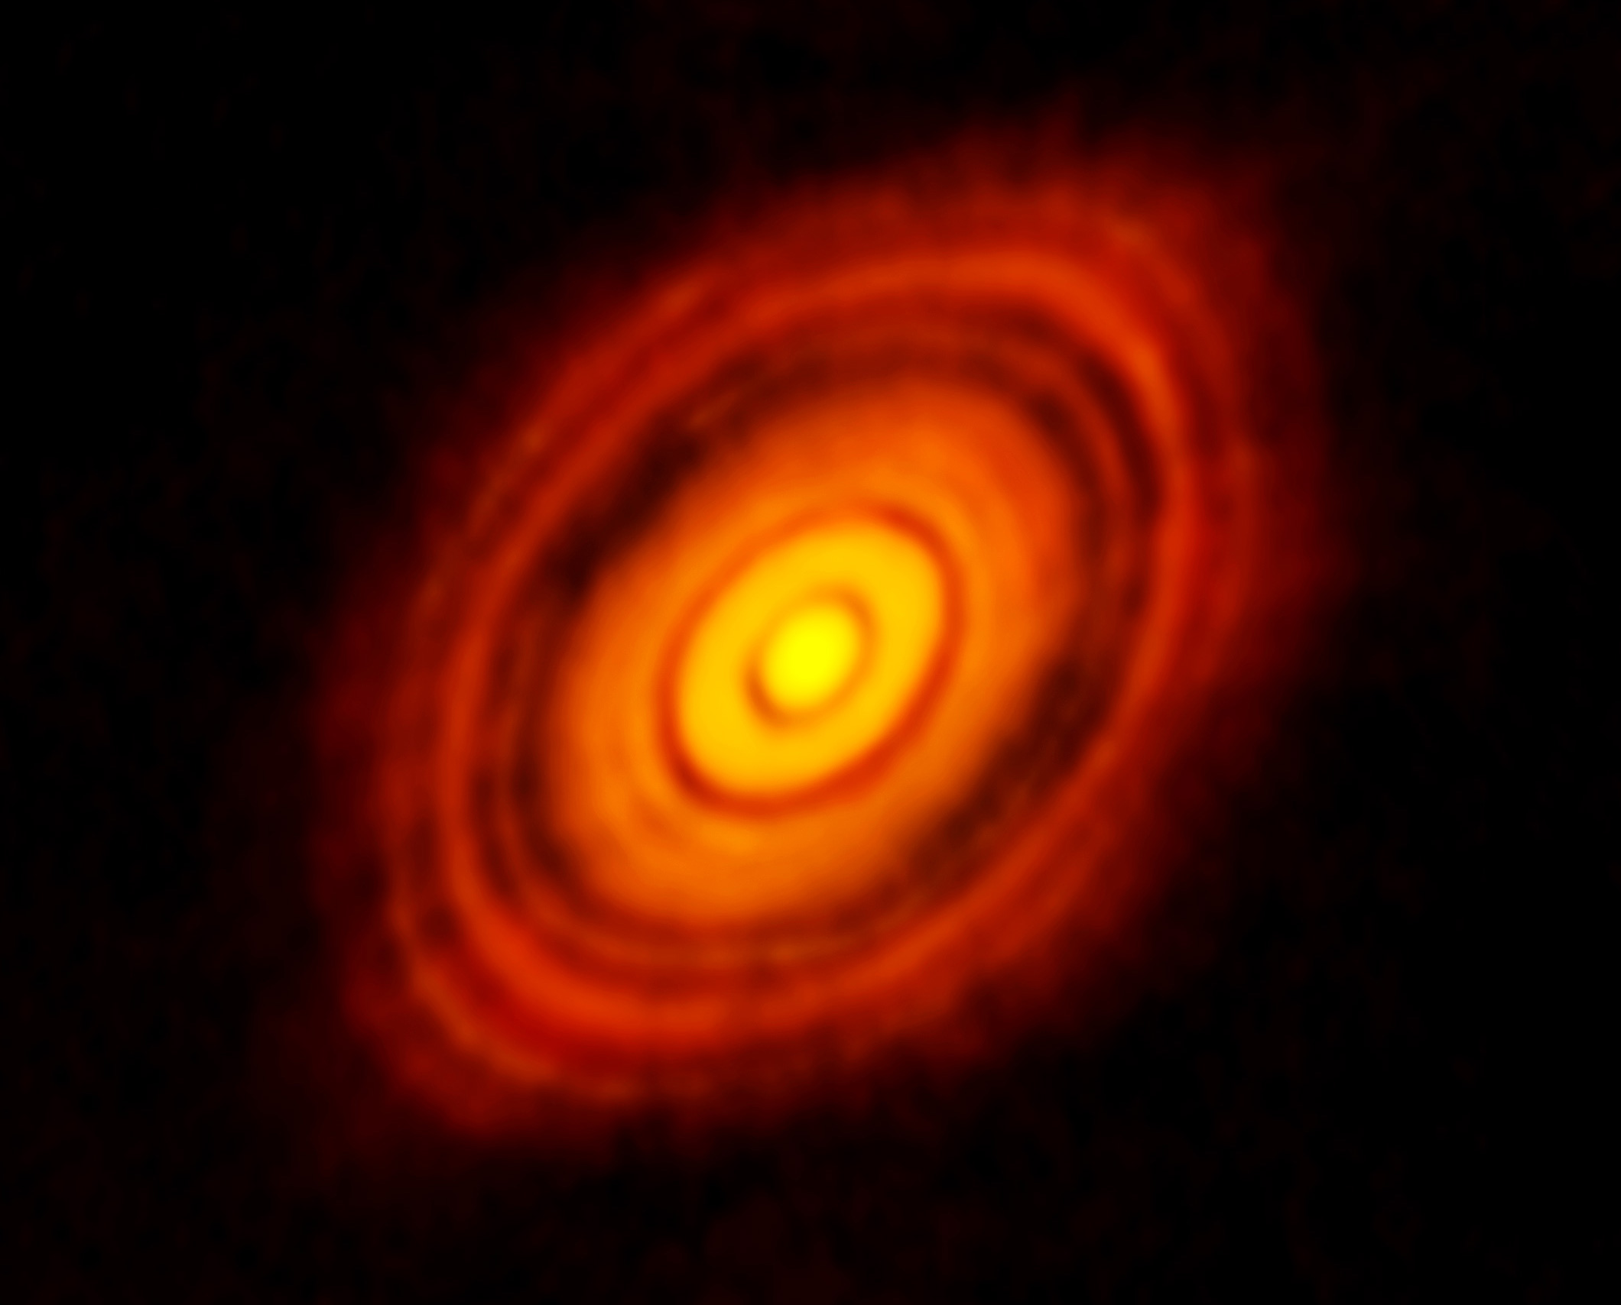
SWG1: Terrestrial zone planet formation
Current state-of-art in planet formation: ALMA images of HL tau
ALMA 250GHz Brogan ea.
Rosetta-stone of planet formation around Solar-mass protostar
Distance = 140pc
1Myr old protostar ~ 1 M_{o} + 0.1 M_{o} dusty disk
Inner few AU disk optically thick in mm/submm
100AU 0.7” at 140pc
Inner 10AU = ngVLA zone @ 10mas res

Slide 9
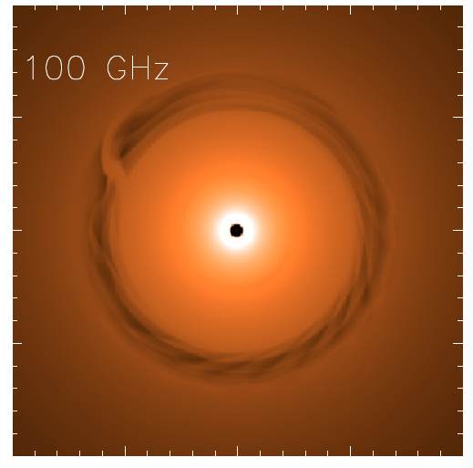
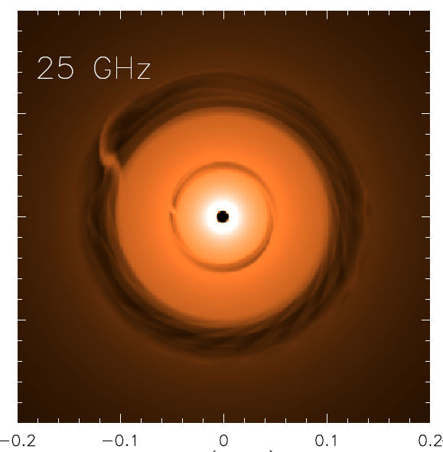
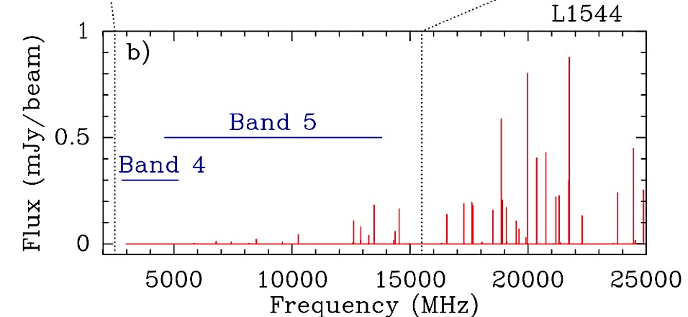
ngVLA: 1Myr Protoplanetary disk at 140pc distance
Saturn at 13AU
Jupiter at 6AU
ngVLA 100hr 25GHz, 10mas
0.1” = 13AU
Isella Dust Model
Model
rms = 90nJy/bm = 1K
Inner gaps < 10AU optically thick at 100GHz
‘movies of planet formation’: Image inner gaps + annual motions
Circumplanetary disks: accretion on to planets
Image grain size stratification: poorly understood transition from dust to planetesimal to planets
Spectrum rich in pre-biotic molecules: simple amino acids
Glycine; Codella ea. 2014
SKA
ngVLA

Slide 10
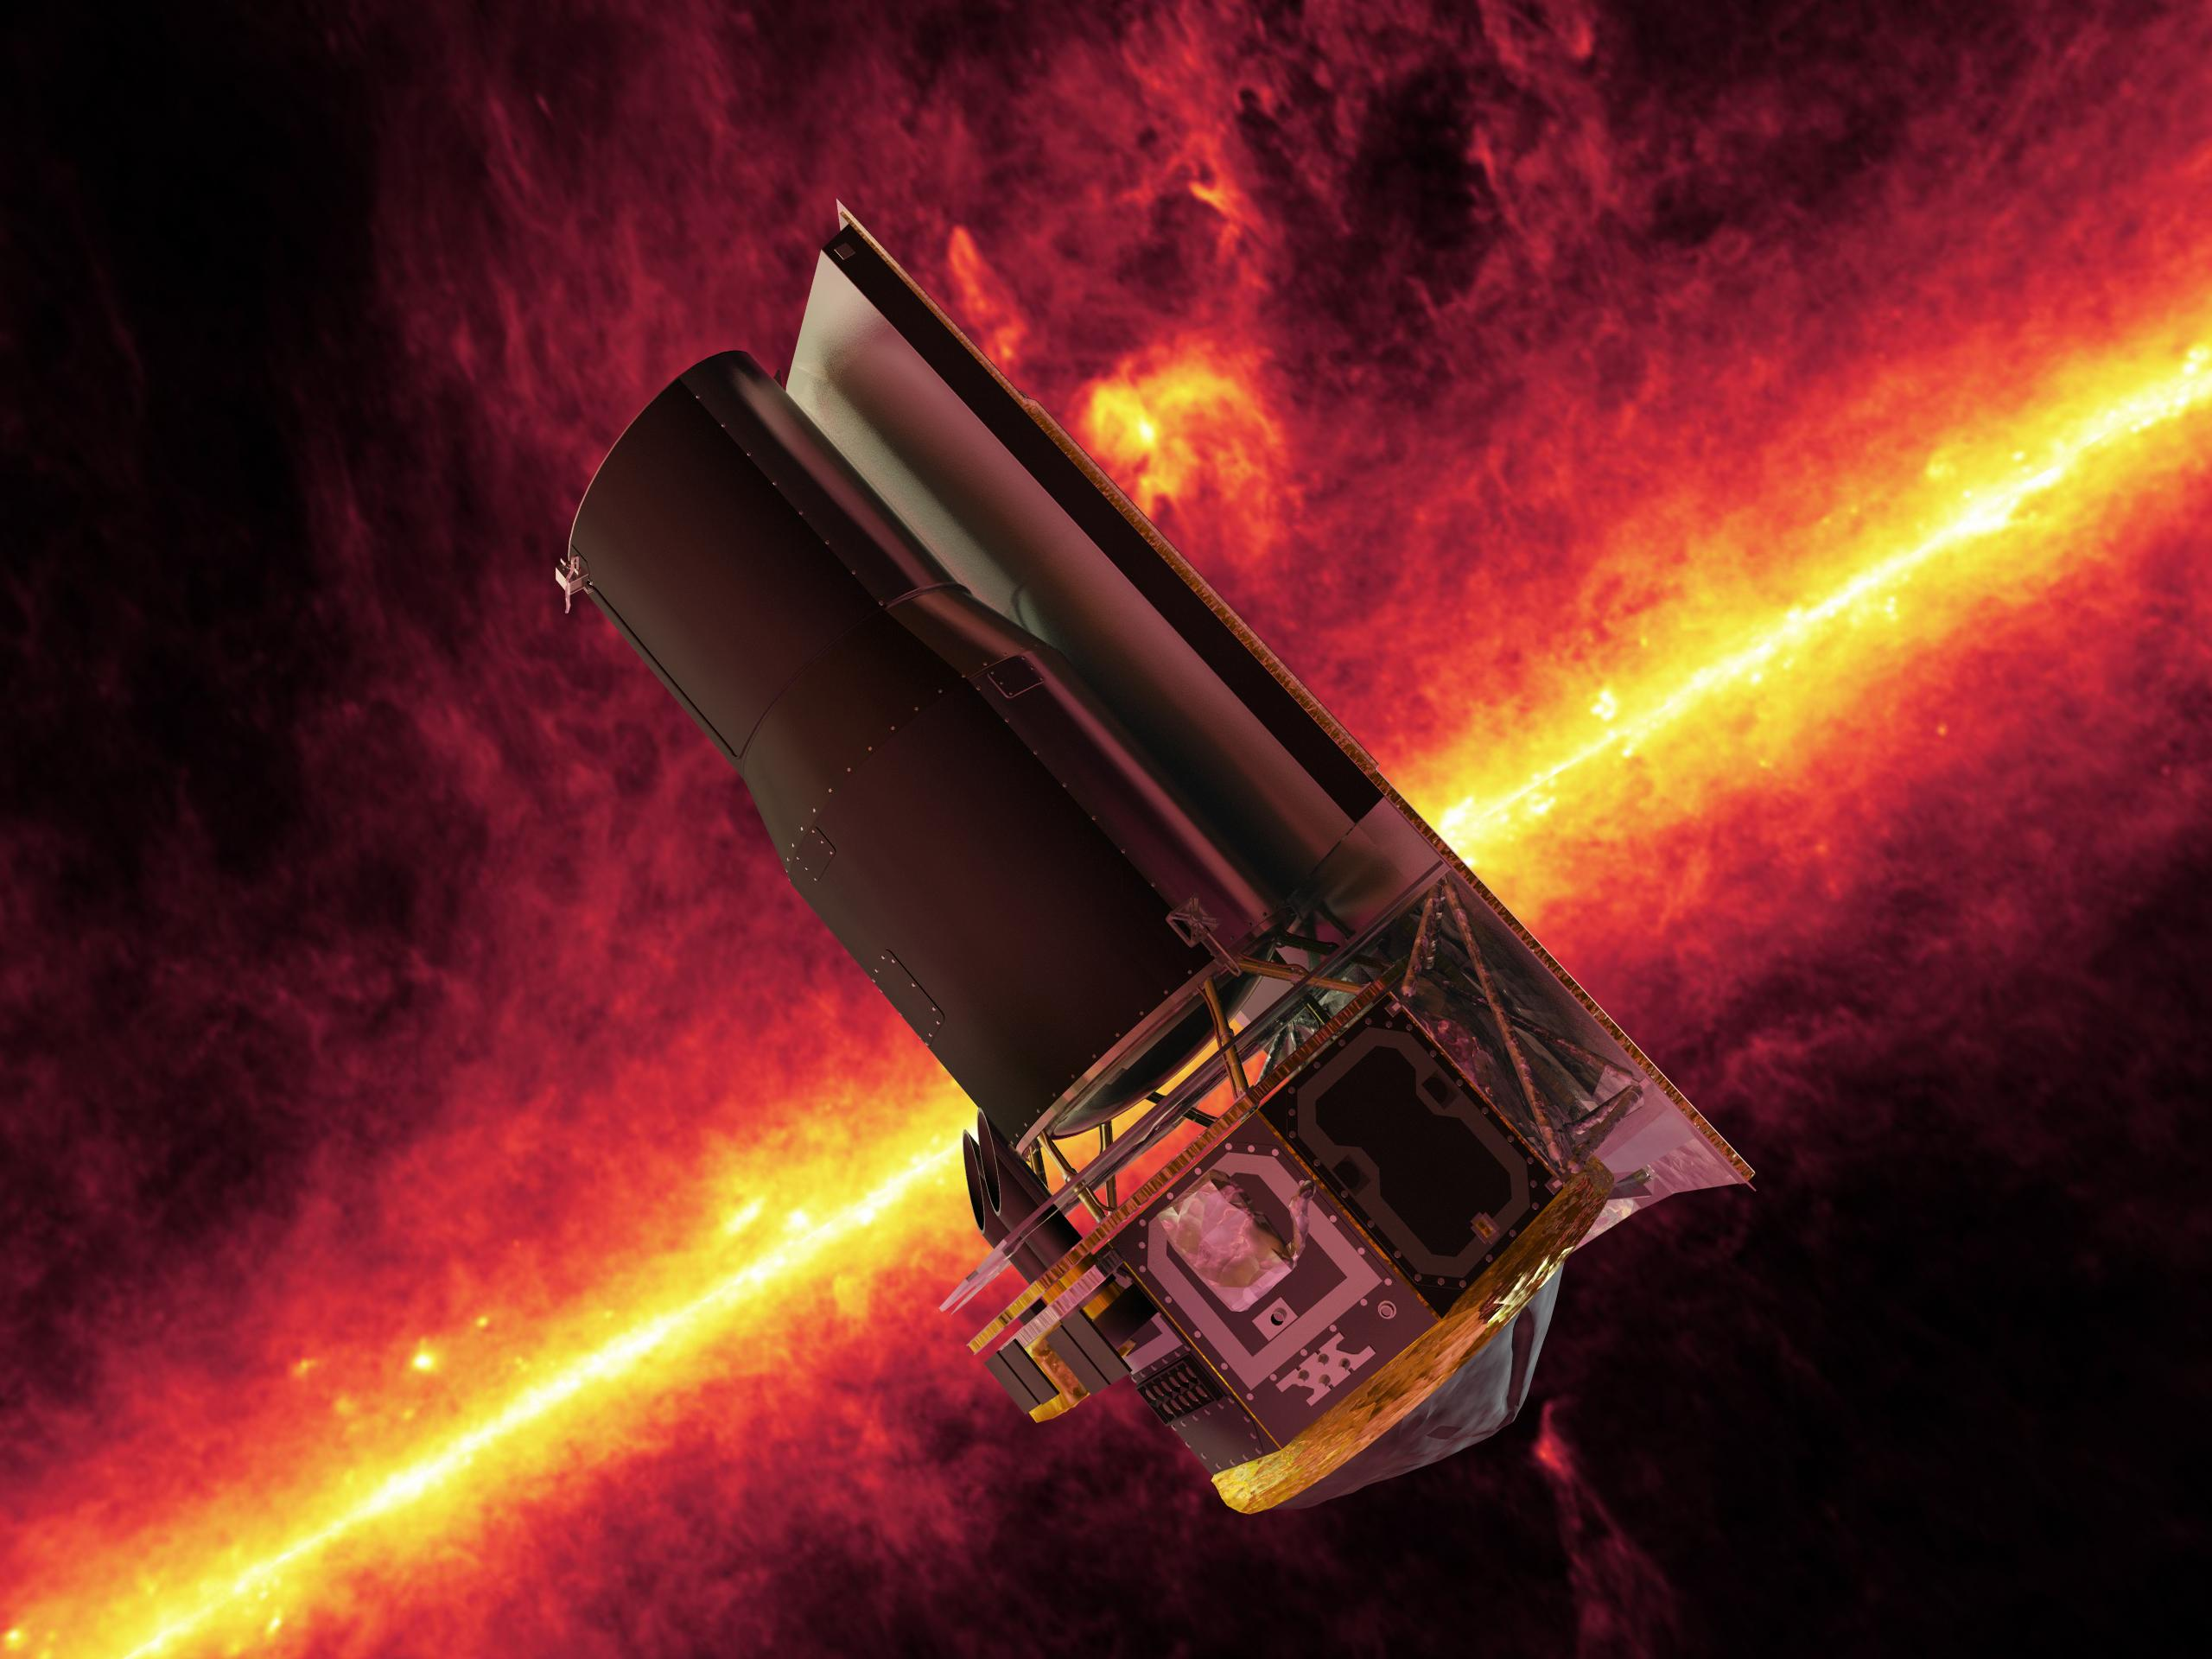
ng-Synergy: Terrestrial zone exoplanets
From Birth to Maturity
HabEx
Habitable Exoplanet imaging mission
Direct detection of earth-like planets
Search for atmospheric bio-signatures
ngVLA
Imaging formation of terrestrial planets
Pre-biotic chemistry

Slide 11
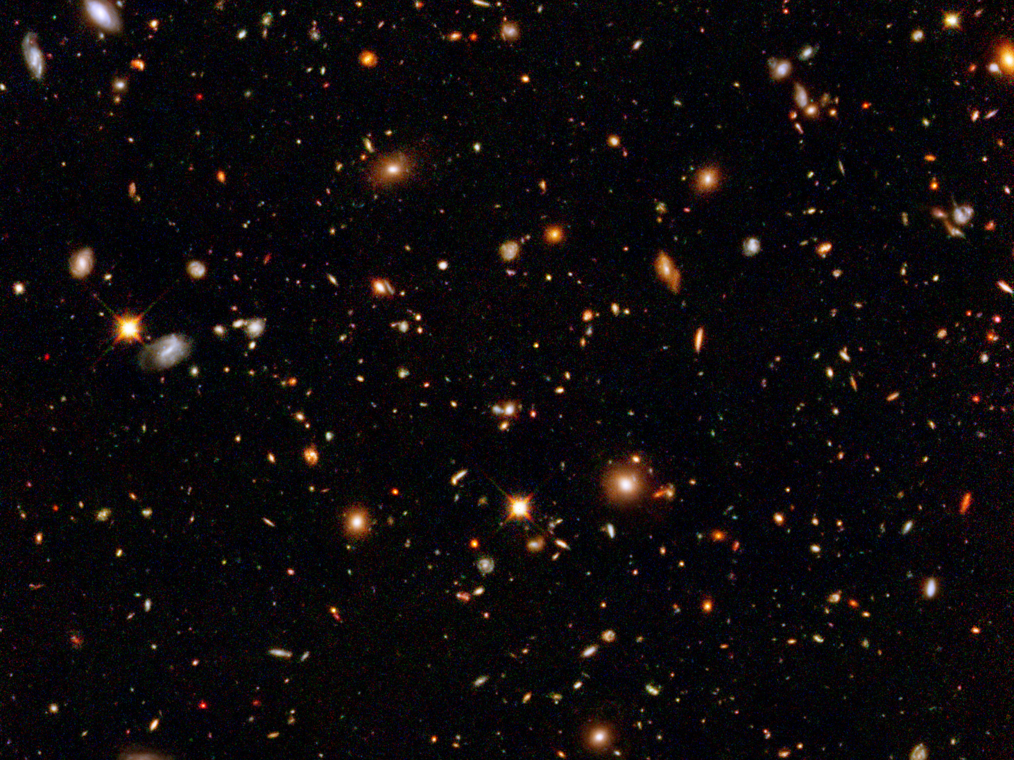
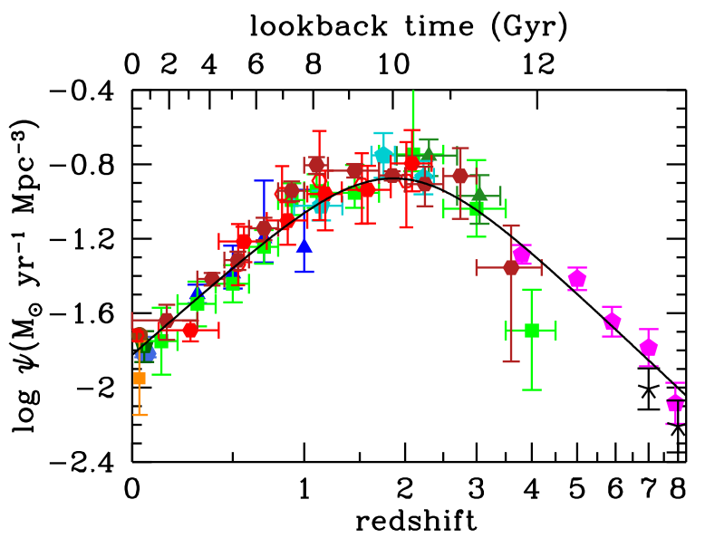
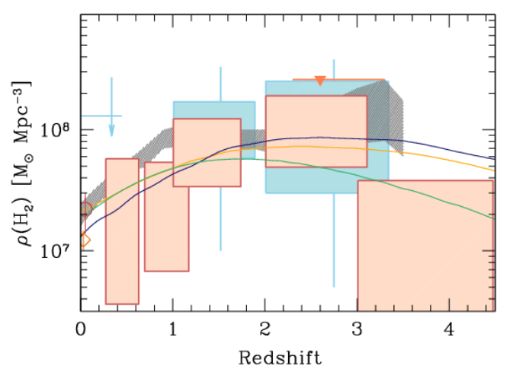
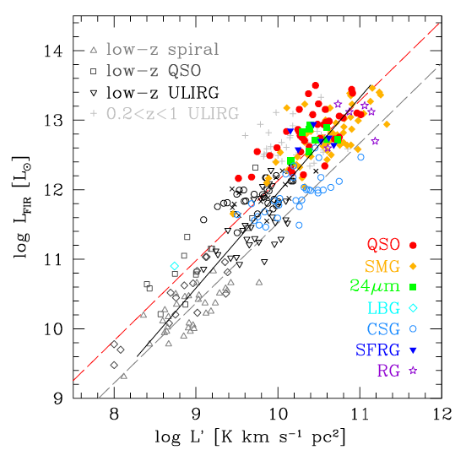
SWG3: Dense Gas History of the Universe
‘Missing half of galaxy formation’
First ALMA CO deep field (Walter ea)
‘SF law’
FIR ~ SFR
FIR ~ SFR
L_{CO} ~ M_{gas}
SFHU has been delineated in remarkable detail back to reionization
SF laws => SFHU is consequence of DGHU
ALMA, JVLA, Noema: first attempts at CO deep fields (~ 20 galaxies)

Slide 12
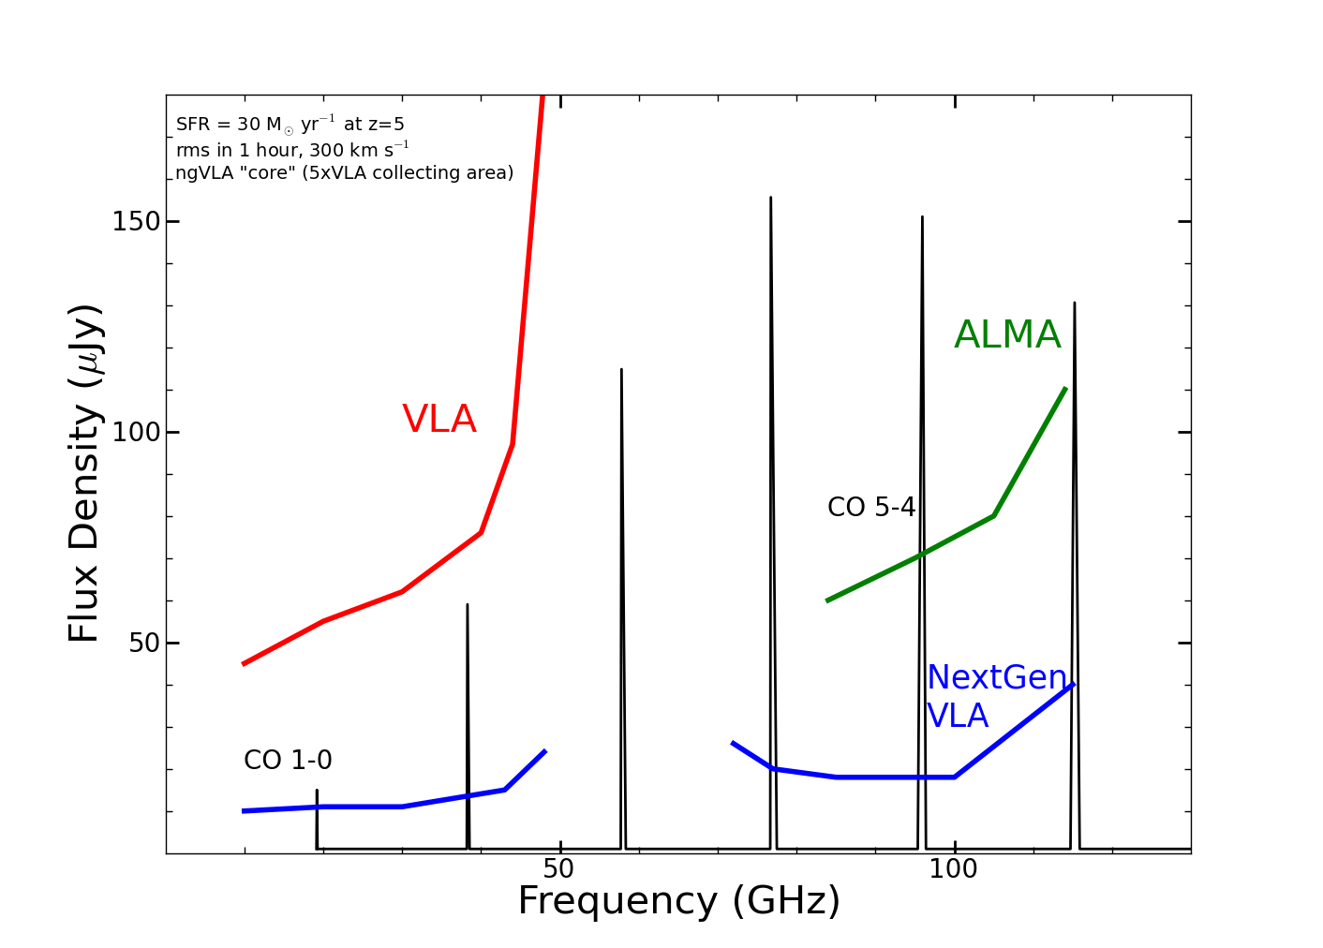
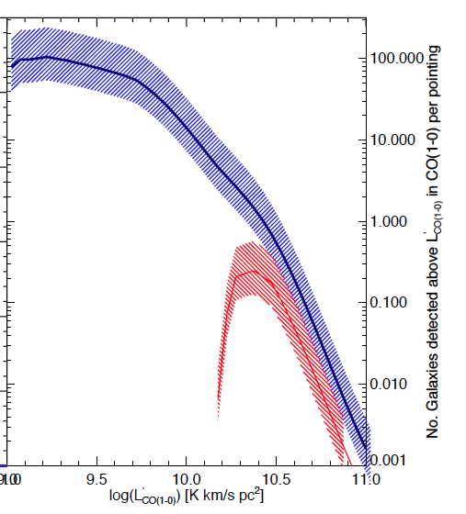
ngVLA: Revolutionize molecular deep fields
CO emission from ‘main sequence’ galaxies at high z in 1 hour
z=5, 30 M_{o}/yr, 1hr, 300 km/s
z>1.5 galaxies in CO
ngVLA
50 to 100-fold increase in number of CO galaxies/hr
JVLA ~ 1, M_{gas} > 10¹⁰ M_{o}
ngVLA ~ 100, M_{gas} > 2x10⁹ M_{o}
Galaxy counts in CO ~ deepest optical fields, with redshifts!
JVLA, ALMA
Casey ea

Slide 13
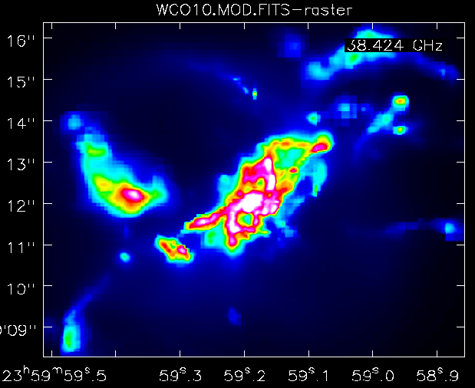
Imaging ’fuel for star formation’ during epoch of galaxy assembly: massive disk galaxy
1” = 7kpc
z=2, CO1-0
Narayanan Model
ngVLA, 10hr, 38GHz
Resolution = 0.15” => 1kpc
Sensitivity = 12uJy (100 km/s, 10hr) => few 10⁸ M_{o} at z ~ 2
Distributed gas dynamics: Fisher-Tully at z=2!

Slide 14
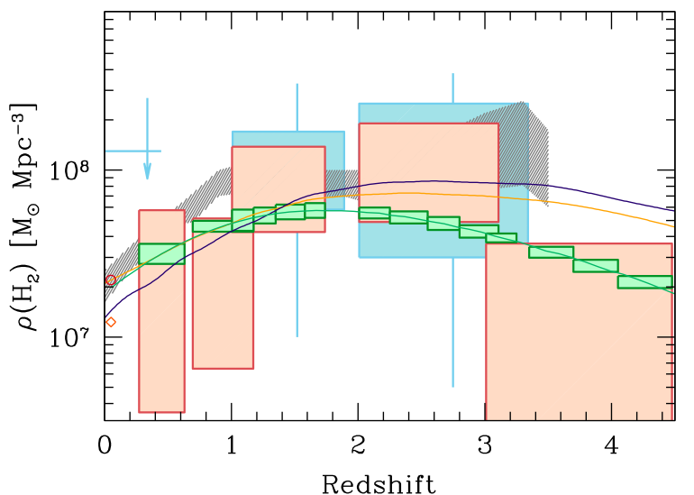
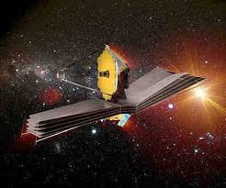
ng-Synergy: Cosmic Cycle of Gas to Stars
‘Precision galaxy formation’
Gas
NGVLA
ALMA
Decarli
JWST/ELT: stars and star formation
ngVLA: cold gas fueling cosmic star formation

Slide 15
Next step: Science Requirements to Telescope Specifications
Goal | Science Requirement | Array Specification
Terrestrial zone | Optically thin | Freq ~ 15 to 50GHz
planet formation | 1AU at 130pc @ 30GHz | B ~ 300km
 | 1K in 10hrs @ 10mas, 30GHz | A_{full} ~ 300 x 18m; BW ~ 20GHz
Dense gas history | CO 1-0 to z=8 | Freq = 15 to 115GHz
of the Universe | M_{gas} = 10⁹ M_{o} at z = 3 in 1hr | A_{mid} ~ 70% to B ~ 30km
 | 500pc resolution at z = 3 (60mas) | 30km
 | Large volume surveys | Octave Band Ratio
Baryon cycle | T_{B} < 0.2K (1hr, 10 km/s, 80GHz, 1”) | A_{core} ~ 30% to B ~ 2km
 | Continuum science | Octave BR; Linear pol to 0.1%
Time domain | Explosive follow-up (GRBs, GW/EM…) | Minute trigger response time
 | Blind discoveries (eg. FRBs) | millisec searches
 | Exo-space weather: 1uJy in 1min | Freq ~ 1 to 20GHz A_{full} ~ 300 x 18m Circular pol to few %

Slide 16
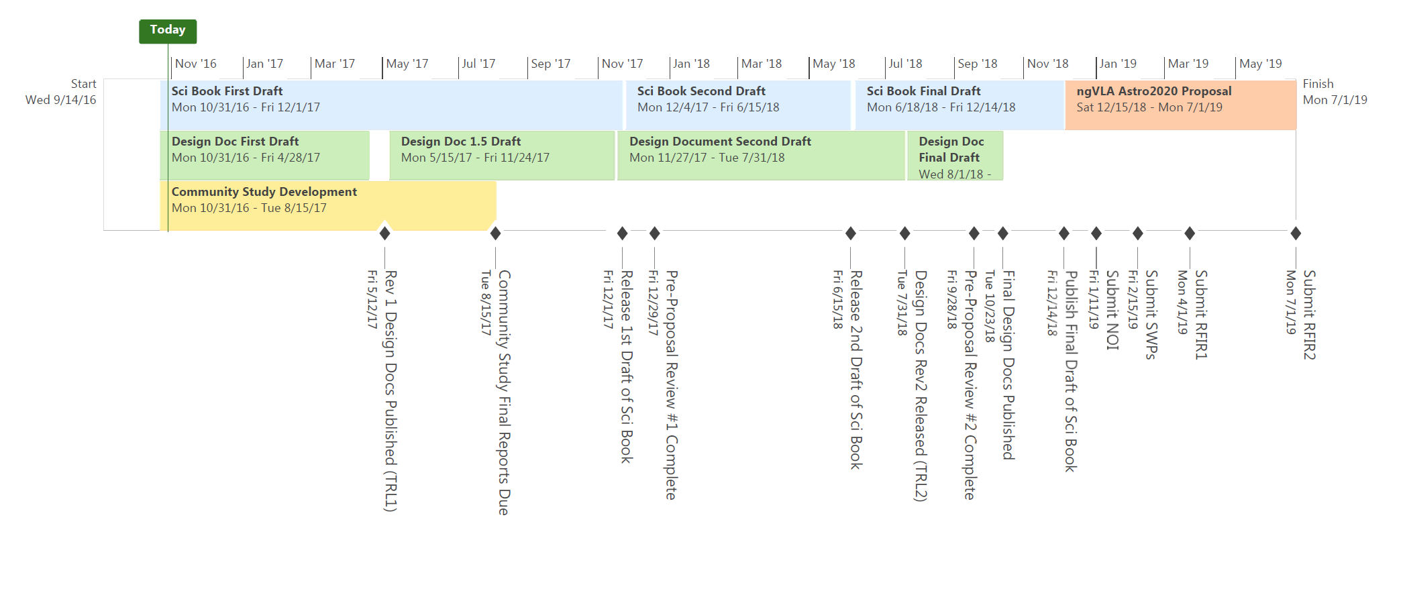
Road to Astro2020
Community TDP
Goal: PDR-level ‘proposal’ to 2020 Decade Survey
Compelling science program & defensibly costed design of all major elements
ngVLA Project Office
Established mid Sept.
ngVLA Science Advisory Council
Membership Announced Sept. 30
ngVLA Community Studies
Approved Studies Announced Nov. 2
ngVLA Technical Advisory Council
Nominations: NRAO enews 12/16

Slide 17
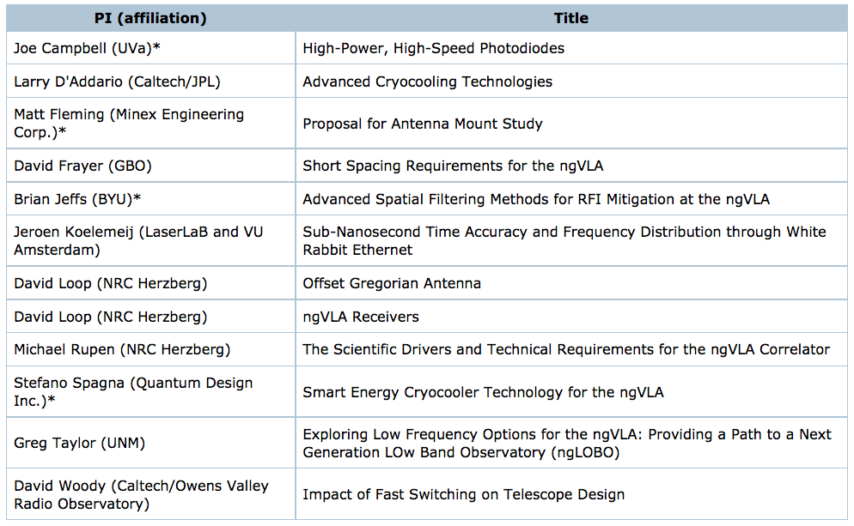
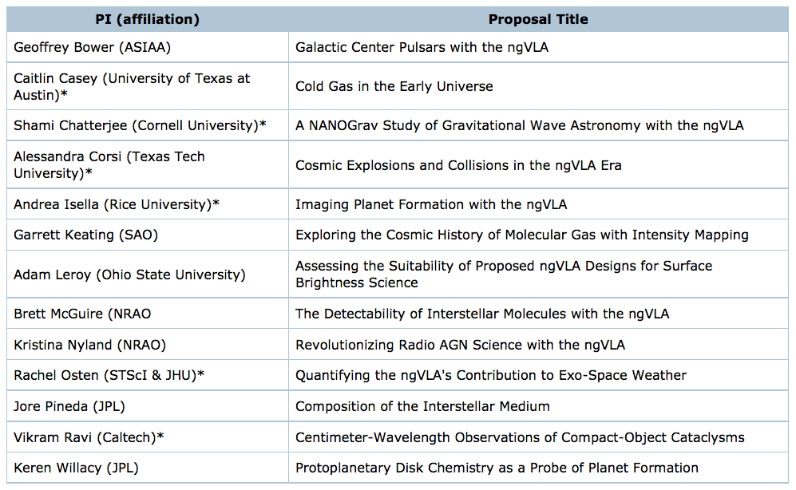
Community Design Studies
https://science.nrao.edu/futures/ngvla/ngvla-community-studies-approved-programs
Provides the community an opportunity to make core contributions to the design
NRAO support for studies program
Provide some travel and page charge support for all
Additional support up to $25K
Goals of science studies
Guide design
Highlight Science for broad astrophys community
Graphics for public presentation
Refereed publications or memos; present at June ngVLA meeting

Slide 18
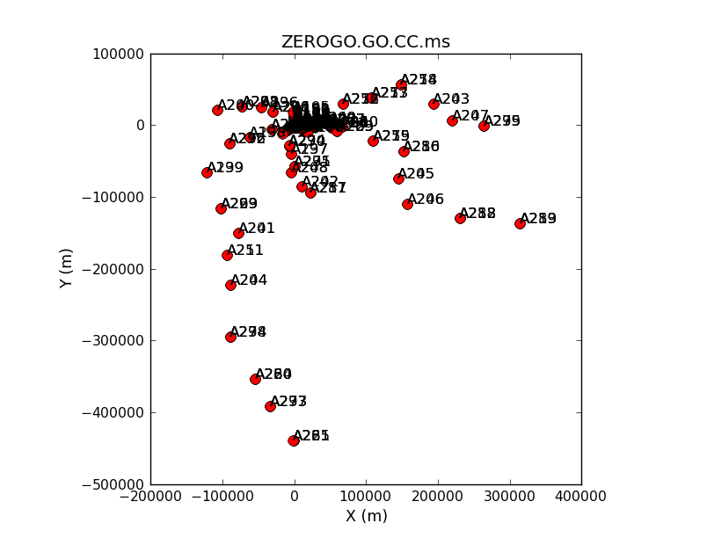
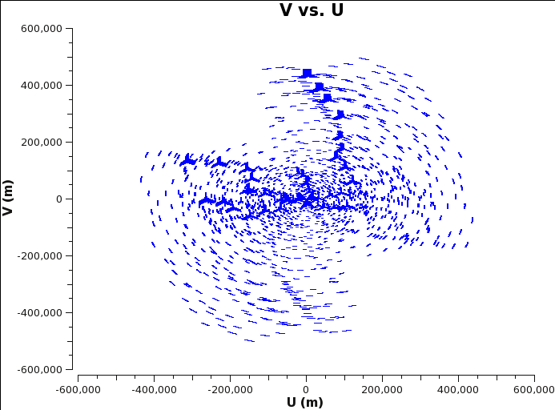
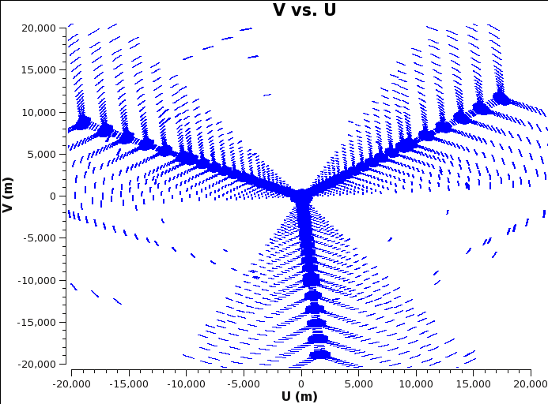
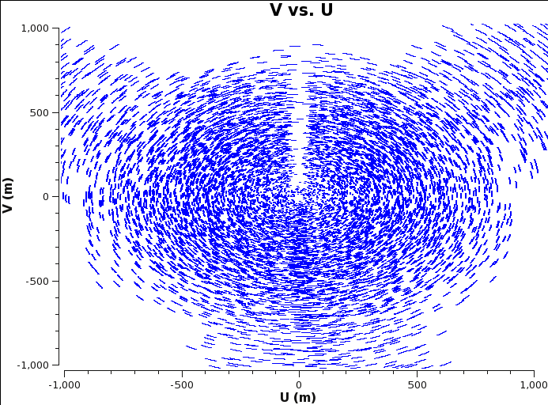
Simulation tools: Configurations
Three configurations (300ant, B_{max} ~ 300 to 500km)
‘Fat rings’ with core of 20% vs 40% within 1km
Southwest
Constrained by land access, fiber, power…
40% core + reuse Y pads + outer ‘mini-stations’ (2-3 ant)
CASA simulator
Simobserve: generate mock.ms from FITS model images
Add thermal noise
Explore imaging capabilities (uv weighting, subarrays...)
Explore wide field: mosaic and total power
200km
https://science.nrao.edu/futures/ngvla/documents-publications
Full: 500km
Y: 20km
Core: 1km

Slide 19
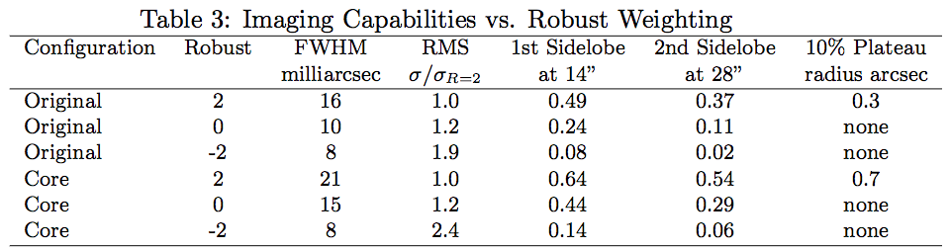
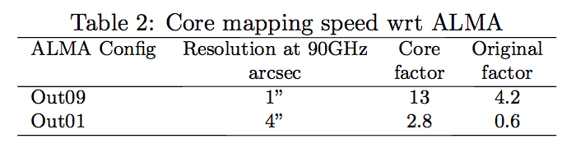
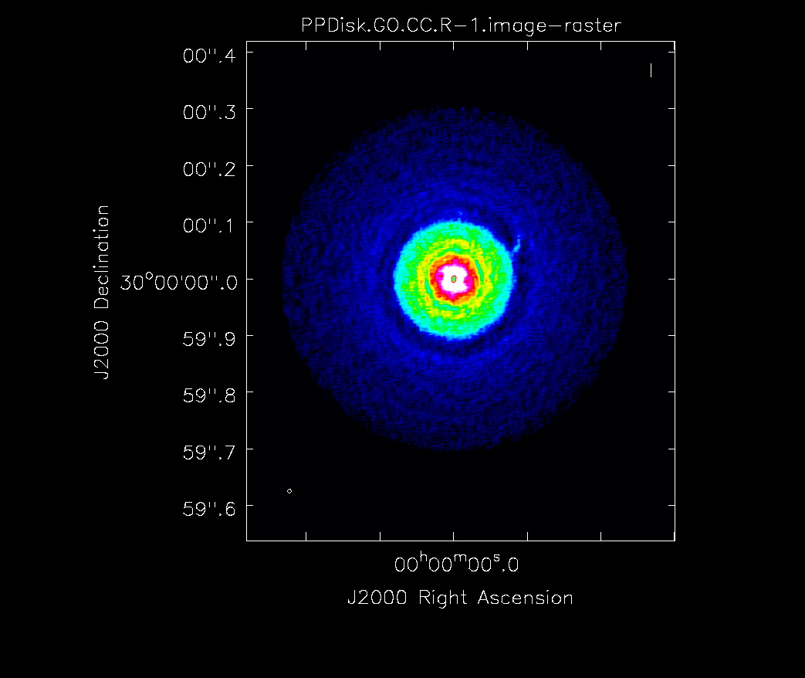
HL tau disk simulated observation with Southwest array, R=-2 weighting

Slide 20
Up-coming events
AAS poster session Jan 2017
URSI special session Jan 2017
Science meeting: Socorro, June 26-29, 2017
Kavli III RMS community meeting: Aug 2017? (Berkeley)
https://science.nrao.edu/futures/ngvla

Slide 21
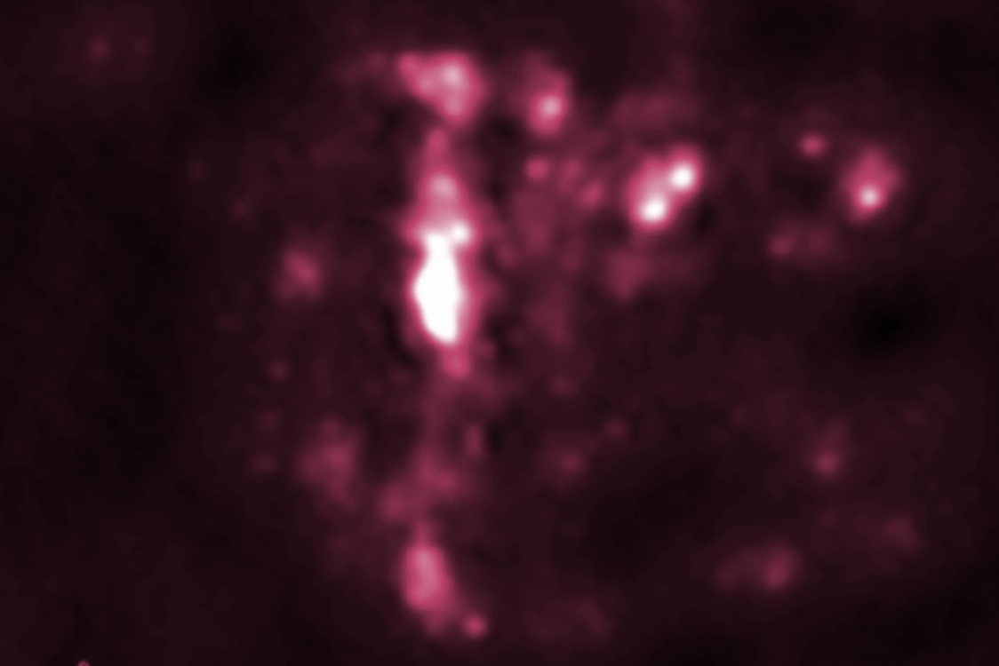
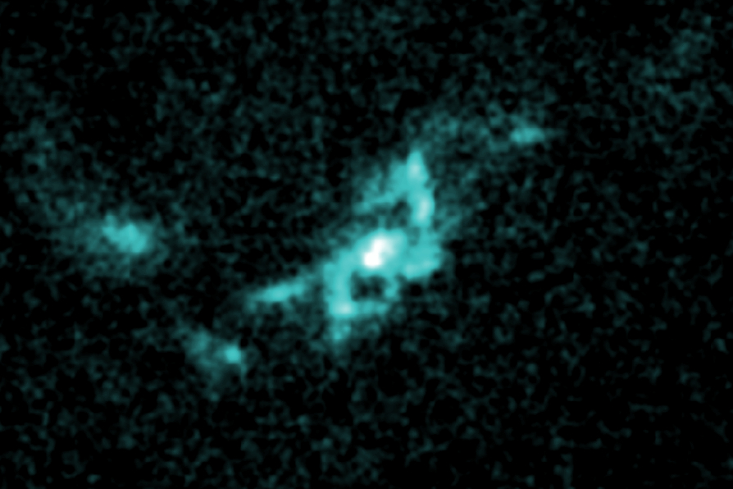
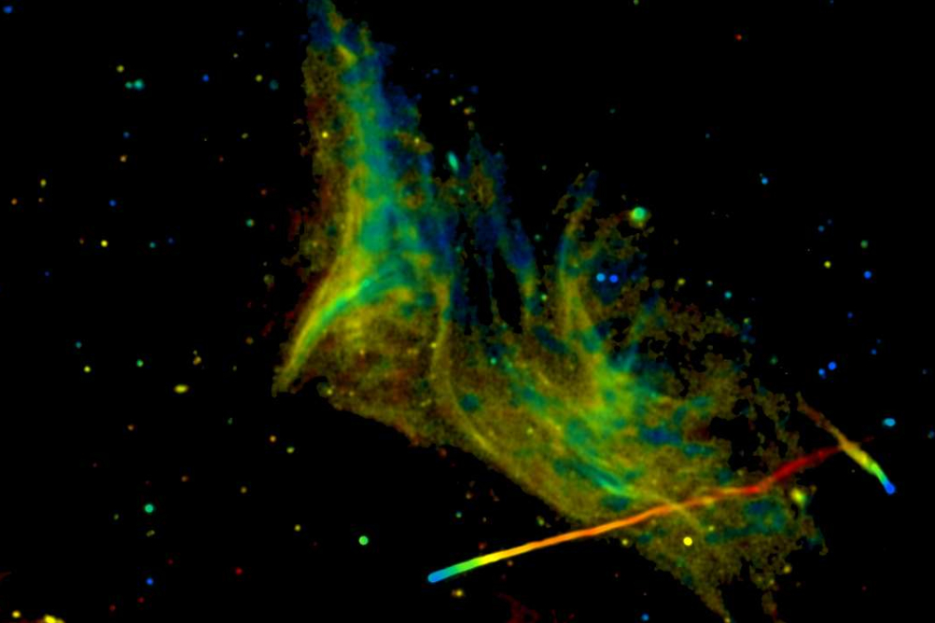
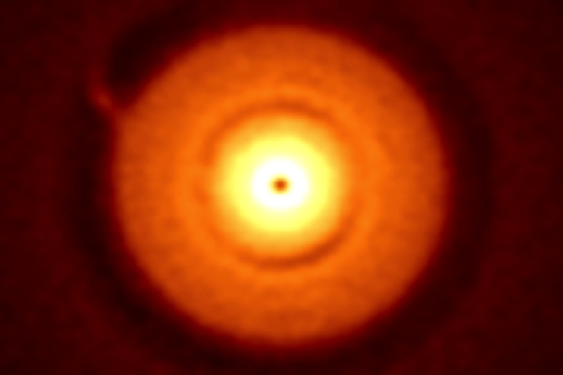
Developing the ngVLA Science Program Workshop Socorro, NM USA June 26-29, 2017
Registration website: science.nrao.edu/science/meetings/2017/ngvla-science-program/
Scientific Organizing Committee
David Wilner [Chair] (CfA)
Caitlin Casey (UT Austin)
James Di Francesco (NRC-Victoria)
Gregg Hallinan (Caltech)
Kotaro Kohno (University of Tokyo)
Cornelia Lang (University of Iowa)
Joe Lazio (JPL)
Adam Leroy (Ohio State)
Lauren Loinard (UNAM)
Eric Murphy (NRAO - ex officio)
Fabian Walter (MPIfA)
The NRAO announces a workshop focused on developing the science program for the Next Generation Very Large Array. The ngVLA design entails an interferometric array with 10 times larger effective collecting area and 10 times higher spatial resolution than the current VLA and ALMA, optimized for operation in the frequency range 10GHz to 50GHz, with reasonable performance over 1.2GHz to 115GHz. The ngVLA is optimized for
observations at wavelengths between the superb performance of ALMA at submm wavelengths, and the future SKA-1 at a few centimeter and longer wavelengths. The ngVLA opens a new window on the Universe through ultra-sensitive imaging of thermal line and continuum emission down to milliarcecond resolution, as well as unprecedented broad band continuum
polarimetric imaging of non-thermal processes.
Local Organizing Committee
Chris Carilli [Chair]
Lori Appel
Amy Kimball
Frank Schinzel
Meeting registration is free.
ngVLA
The Next Generation Very Large Array

Slide 22
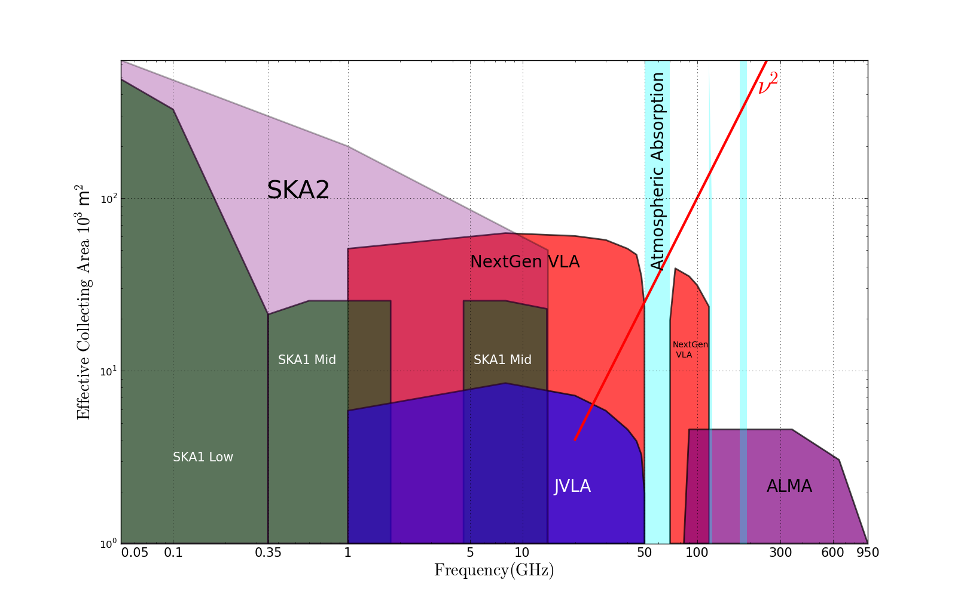
Radio facilities into mid-Century
2030
Complementary suite from meter to submm, appropriate for the mid-21st century
< 3mm: ALMA 2030 superb for chemistry, dust, fine structure lines
3cm to 3mm: ngVLA superb for terrestrial planet formation, dense gas history of Universe, baryon cycle
> 3cm: SKA superb for pulsars, reionization, HI surveys

Slide 23
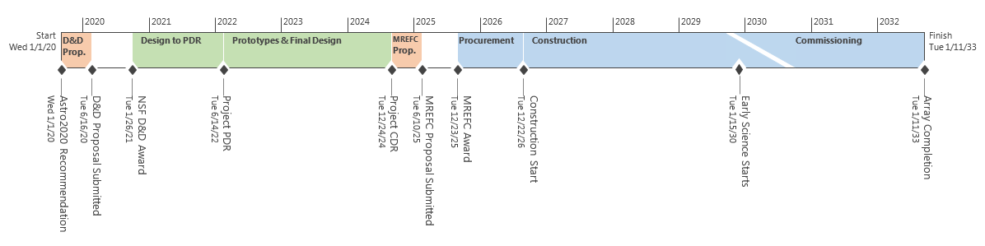
Notional Long-term Schedule to Completion

