Slide 1

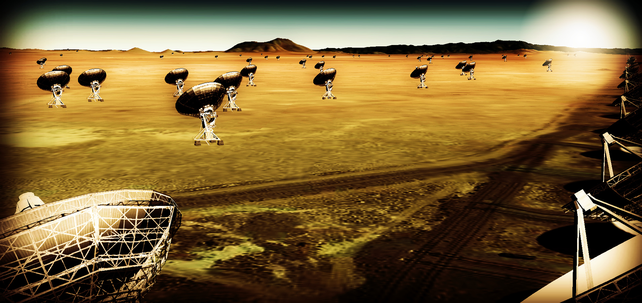
Effective area at 40GHz ~ 10x JVLA?
Frequency range: 1 – 50, 70 – 115 GHz?
~18m antennas w. 50% to few km + 40% to 200km + 10% to 3000km?

Slide 2
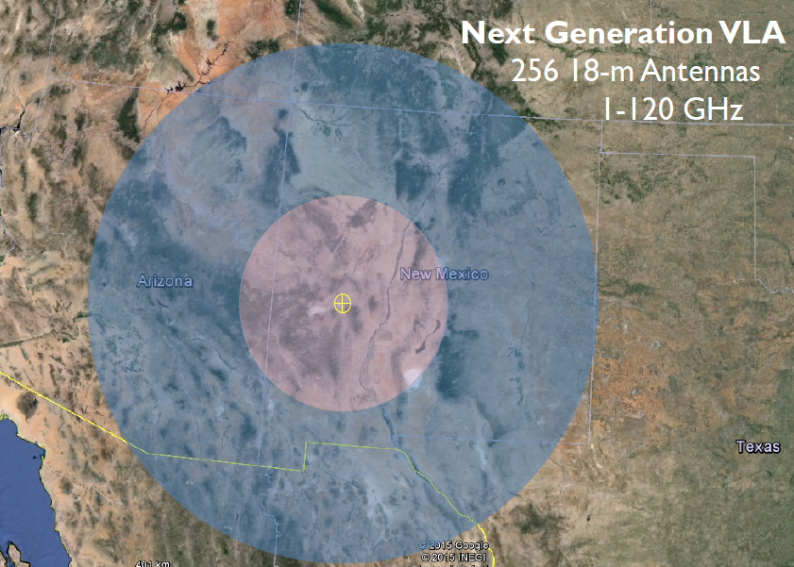
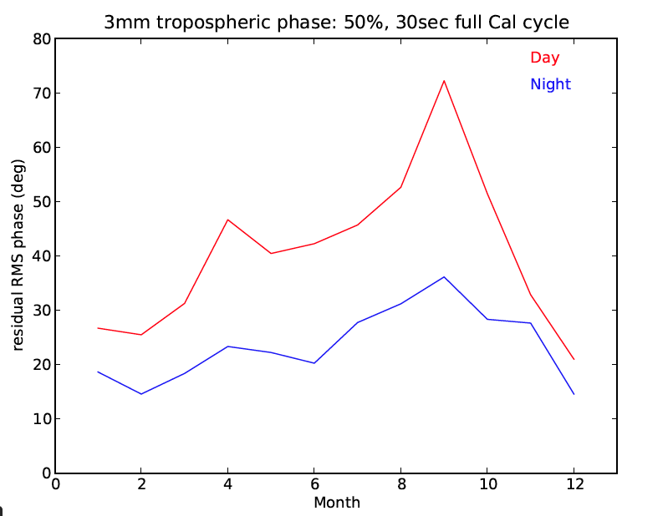
JVLA: Good 3mm site: elev. ~ 2200m
550km

Slide 3
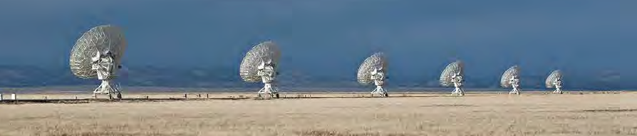
Process to date
Jan 2015: AAS Jan community discussion
https://science.nrao.edu/science/meetings/2015/aas225/next-gen-vla/ngvla
March 2015: Science working group white papers
Circle of Life (Isella, Moullet, Hull)
Galaxy ecosystems (Murphy, Leroy)
Galaxy assembly (Lacy, Casey, Hodge)
Time domain, Cosmology, Physics (Bower, Demorest)
April 2015: Pasadena technology meeting
Fall 2015
SWG workshop: define KSP and requirements
Second technical meeting: LO/IF, data transmission?

Slide 4
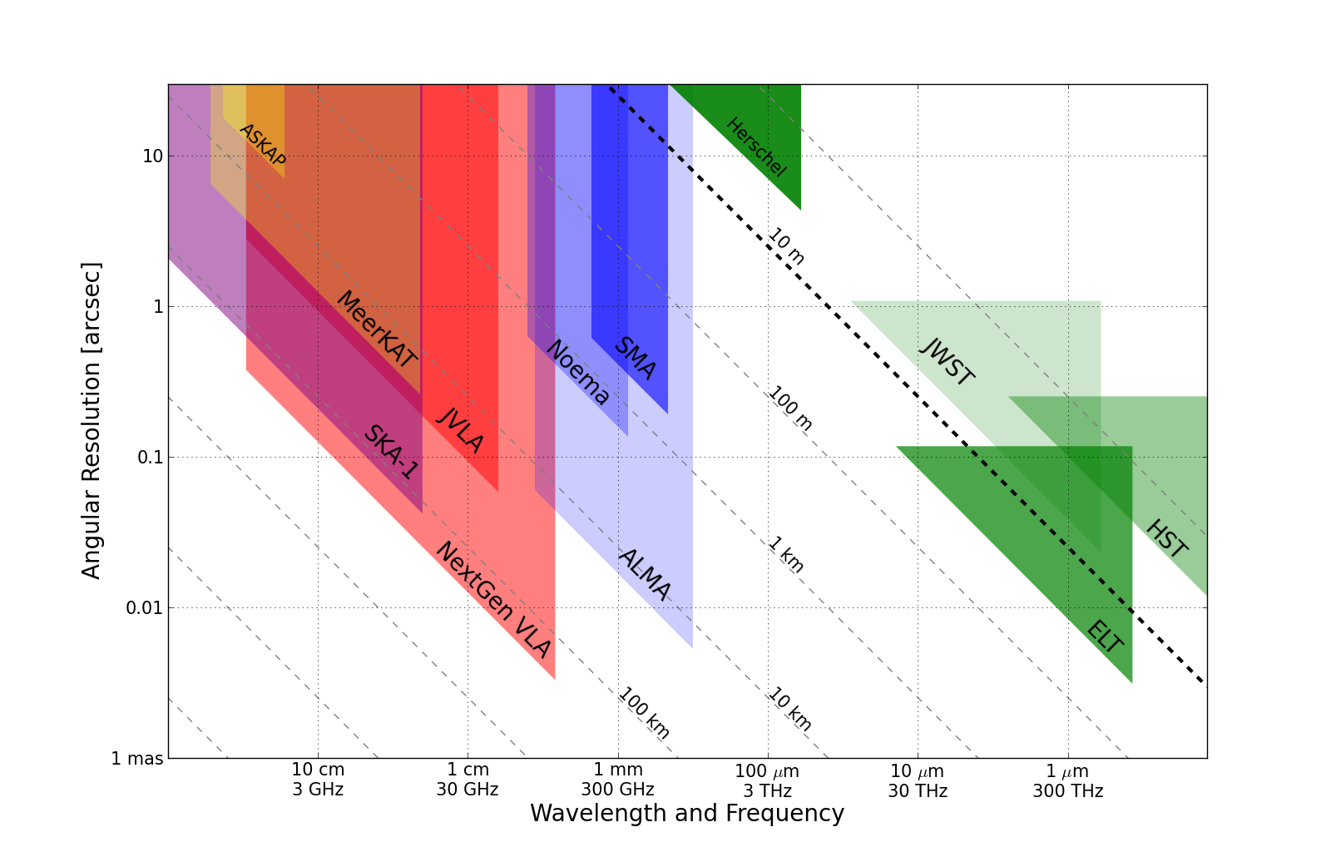
Killer Gap
Thermal imaging on mas scales at λ ~ 0.3cm to 3cm
B. Kent
1AU @ 140pc
Resolution ~ 15mas @ 1cm (200km)

Slide 5
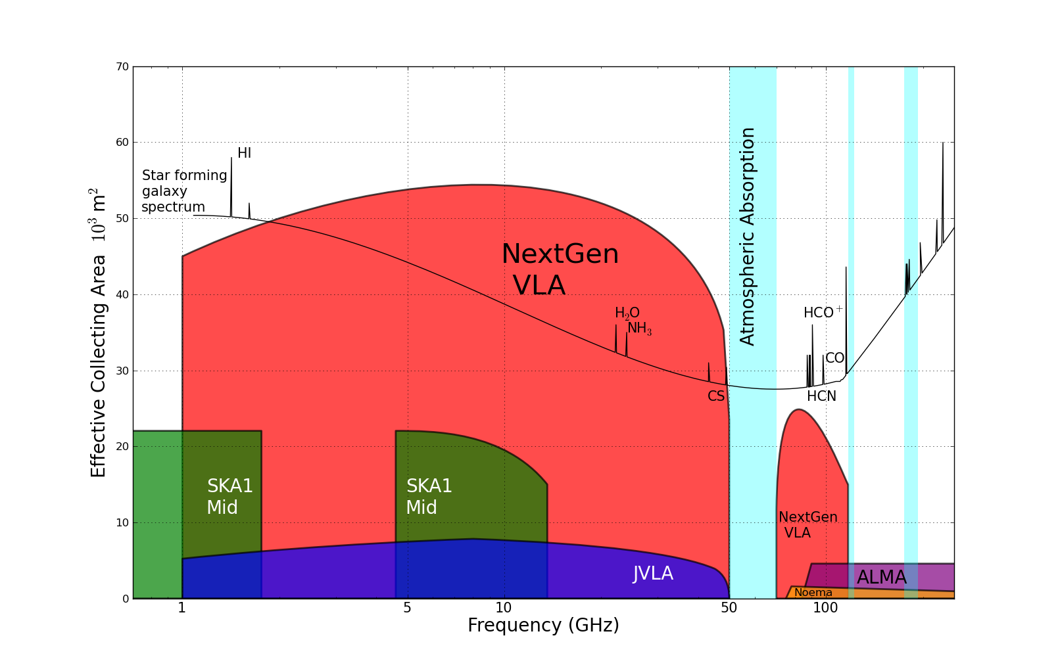
Killer Gap
Thermal imaging on mas scales at λ ~ 0.3cm to 3cm
Sensitivity ~ 200nJy @ 1cm, 10hr, 8GHz
T_{B} ~ 1K @ 1cm, 15mas
Molecular lines prevalent above 15GHz

Slide 6
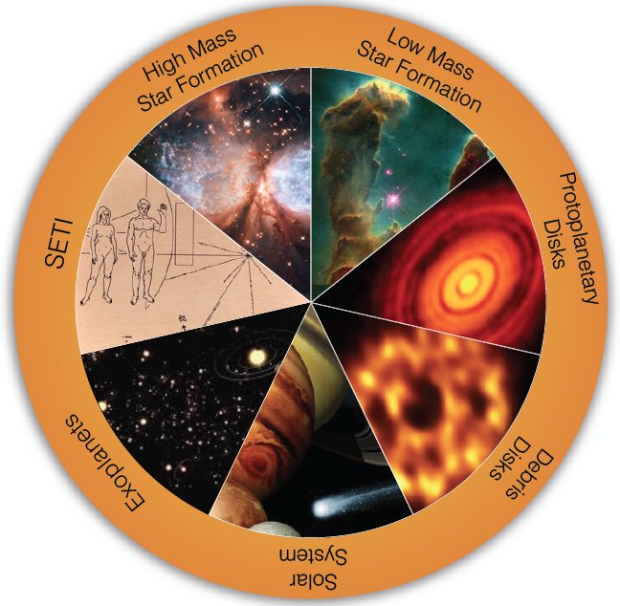
Circle of Life: origin stars, planets, life
Accretion in dust-obscured early phases
chemistry
Origin of stellar multiplicity
Organic chemistry
Aircraft radar from nearby planetary systems in 10min
Terrestrial zone planet formation
biology
Pre-biotic chemistry
Magnetospheres and exo-space weather
Pre-biotic molecules
Imaging chemistry, dynamics deep in planetary atmospheres

Slide 7
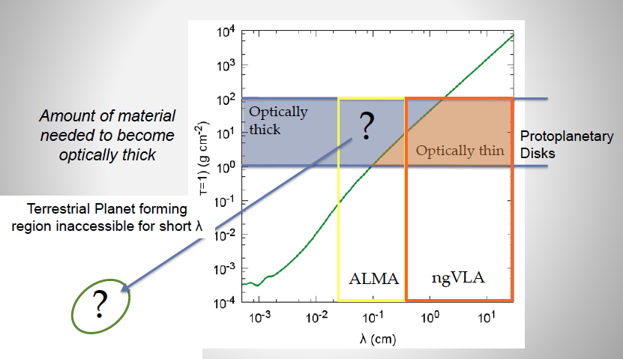
Terrestrial zone planet formation: ngVLA zone
τ ~ 1
~ few AU

Slide 8
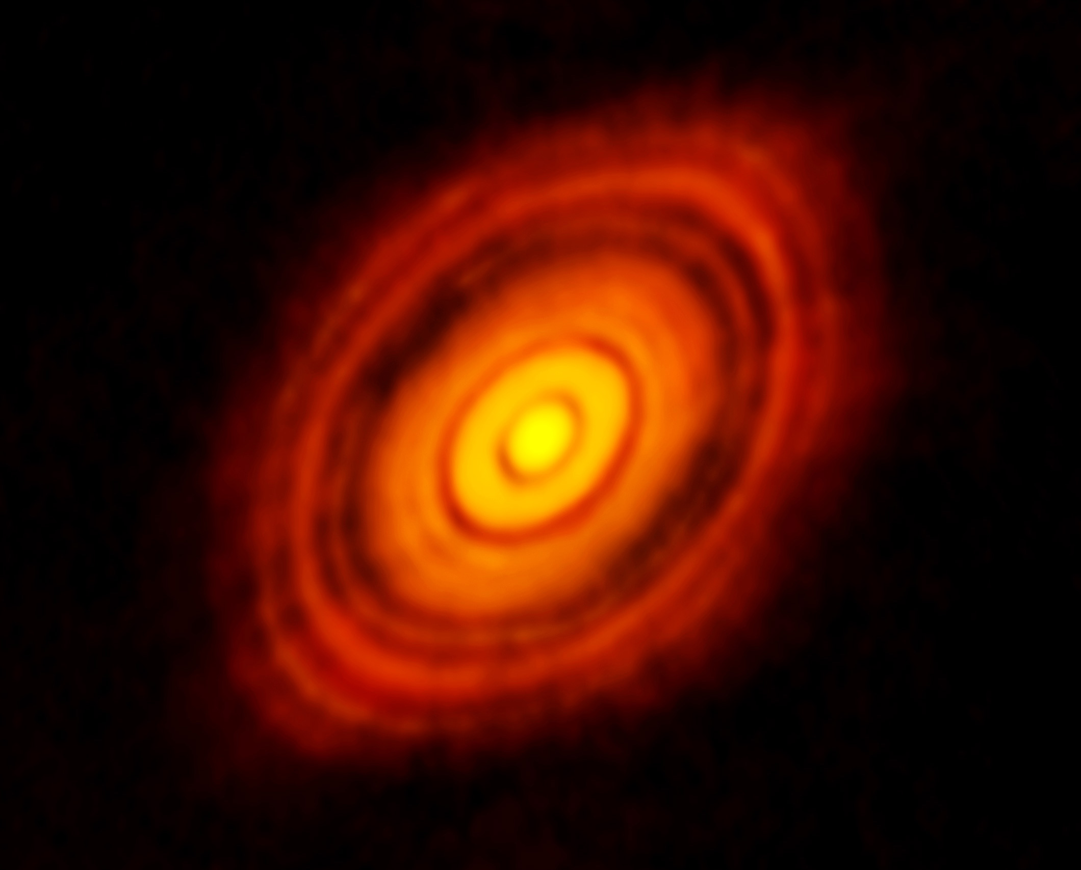
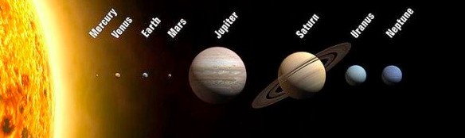
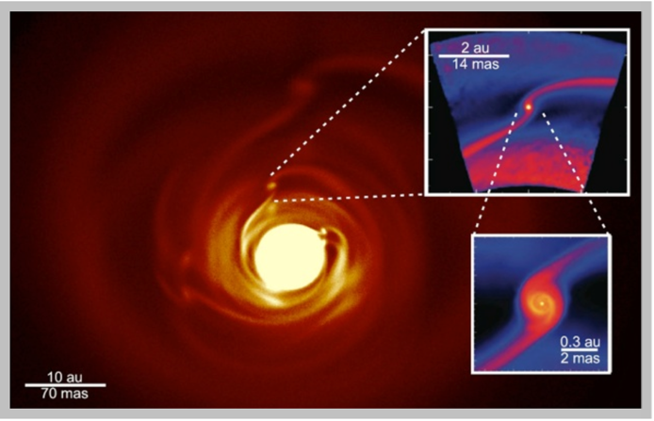
Terrestrial planet formation imager
See through dust to pebbles: inner few AU disk optically thick in mm/submm
Grain size stratification at 0.3cm to 3cm
Poorly understood transition from dust to planetesimals
Annual motions
100AU
ngVLA zone
T_{B}(1cm) ~ ??K
ALMA zone
τ = 1 at λ > 1cm
τ = 1 at λ < 1mm
Circumplanetary disks: imaging accretion on to planets?

Slide 9
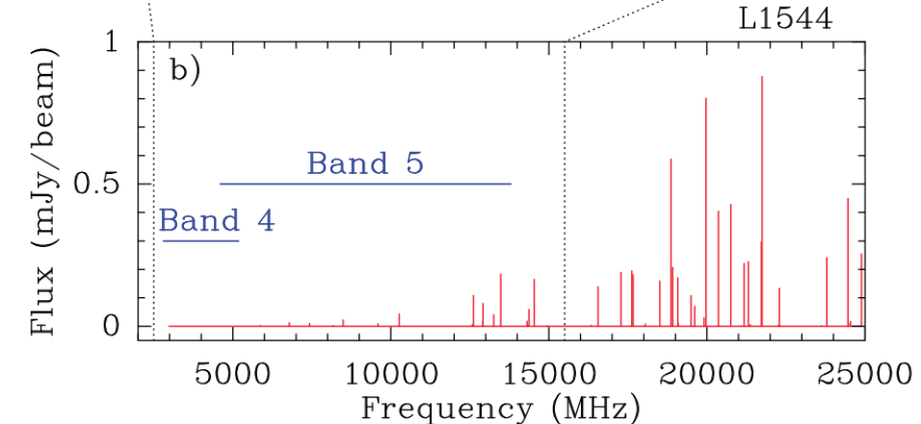
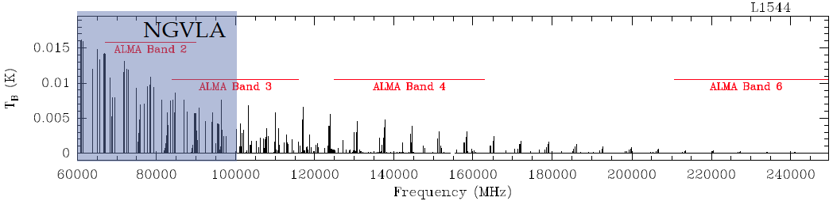
Circle of life: pre-biochemistry
Glycine
Pre-biotic molecules: rich spectra in 0.3cm to 3cm regime
Complex organics: ice chemistry in cold regions
Ammonia and water
Codella ea. 2014
SKA
ngVLA
Jimenez-Sierra ea 2014

Slide 10
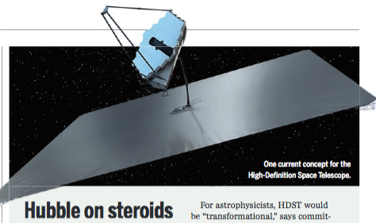
ng-Synergy: Terrestrial zone exoplanets
‘ALMA is to HST/Kepler as
ngVLA is to HDST’
ngVLA
Imaging terrestrial planet formation
Pre-biotic chemistry
High Definition Space Telescope (12m) top science goal
Direct drection of earth-like planets
Search for atmospheric bio-signatures

Slide 11
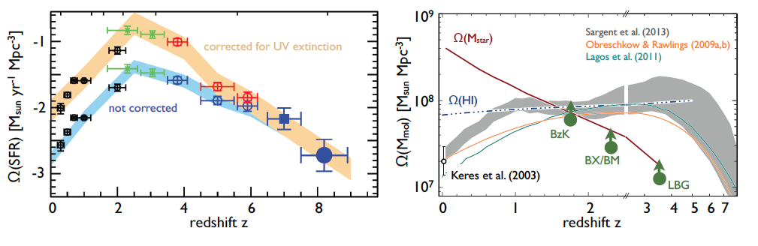
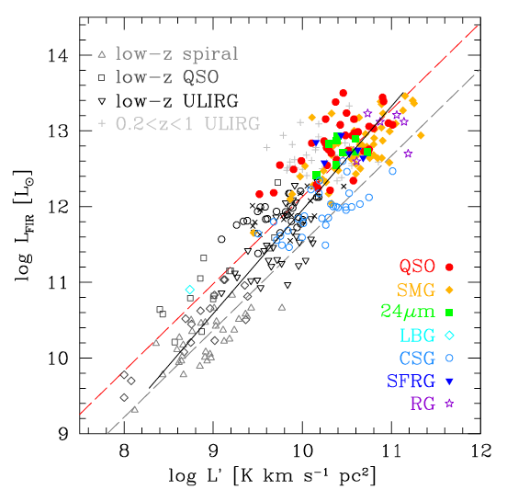
Galaxy assembly (Casey + SWG3): Dense gas history of Universe
Missing half of galaxy formation
SF Law
SFR
Gas mass (L_{CO 1-0})

Slide 12
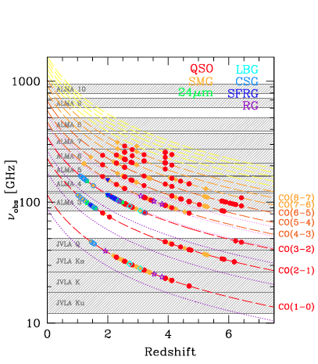
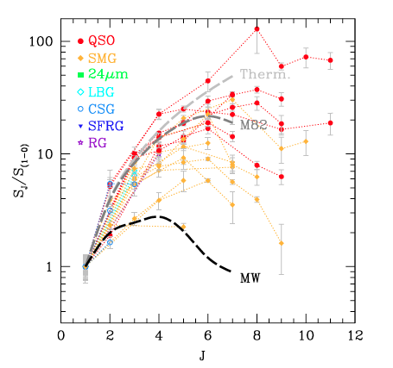
Low order CO: key total molecular gas mass tracer
Gas mass: ‘calibrted’ from CO 1-0 as tracer of H₂
Total mol. gas mass
+ ALMA => gas excitation
Dense gas tracers associated w. SF cores: HCN, HCO+
ALMA
ngVLA ‘sweet spot’
10x uncertainty
VLA/GBT
SKA

Slide 13
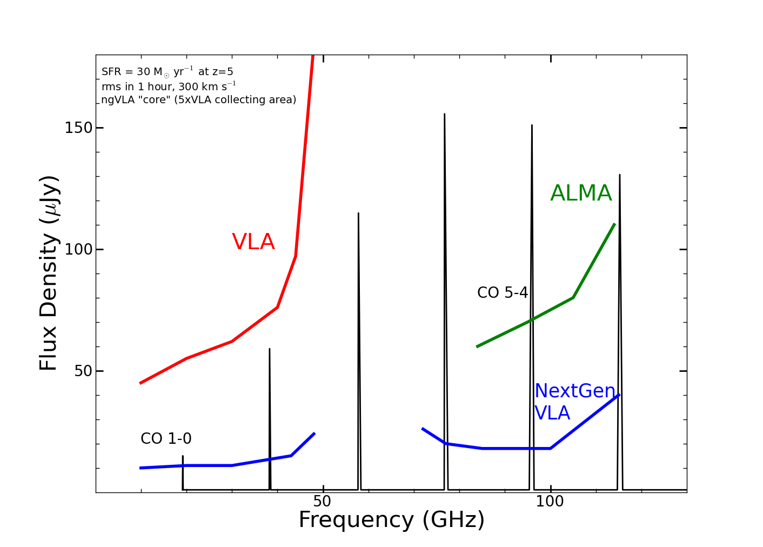
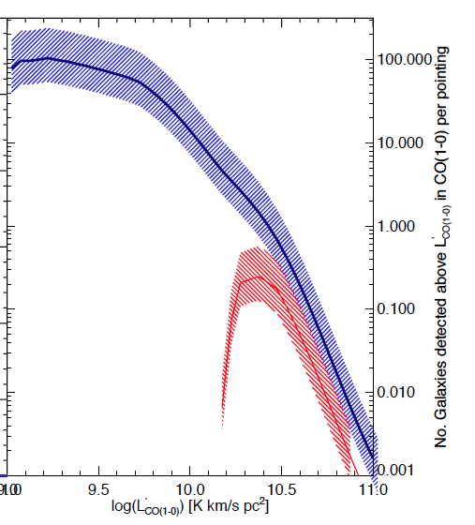
New horizon in molecular cosmological surveys
CO emission from typical star forming, ‘main sequence’ galaxies at high z
z=5, 30 M_{o}/yr
1hr, 300 km/s
GBT
Number galaxies per hour
ngVLA
Increased sensitivity and BW => dramatic increase molecular survey capabilities. Number of CO galaxies/hr:
JVLA ~ 0.1 to 1, M_{gas} > 10¹⁰ M_{o}
ngVLA: tens to hundreds, M_{gas} > 2x10⁹ M_{o}
JVLA

Slide 14
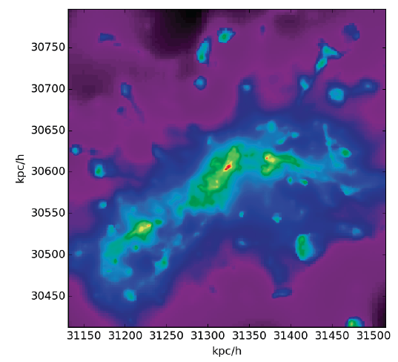
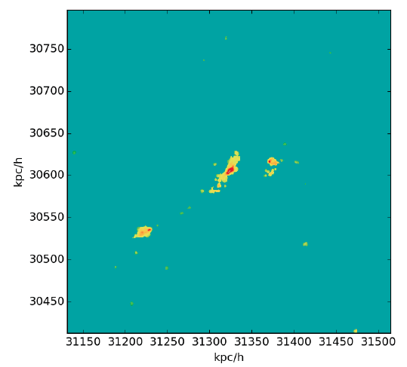
Galaxy assembly: Imaging on 1 kpc-scales
Low order: distributed gas dynamics, not just dense cores
w. ALMA dust imaging: resolved star formation laws
CO 1-0
z ~ 3
CO 3-2
n_{cr} > 10⁴ cm⁻³
n_{cr} ~ 10³ cm⁻³
Narayanan

Slide 15
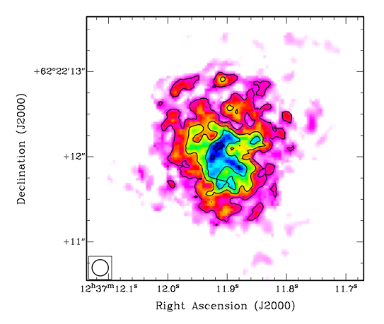
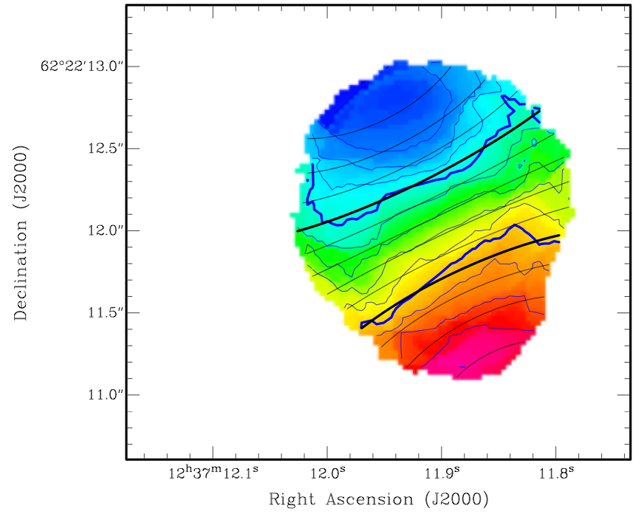
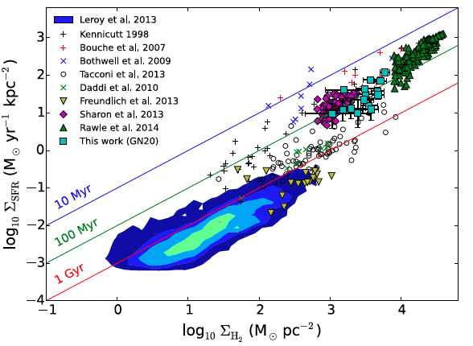
JVLA state of art
Beyond blob-ology
CO 2-1 Mom0
-300 km/s
7kpc
GN20 CO2-1 at 0.25”
14kpc rotating disk
M_{dyn} = 5.4 10¹¹ M_{o}
M_{gas} = 1.3 10¹¹ (α/0.8)
=> α < 2
1”
+300 km/s
0.25”
Hodge ea.
GN20
120 hours on JVLA
few hours on ngVLA
Spatially resolved SF Law

Slide 16
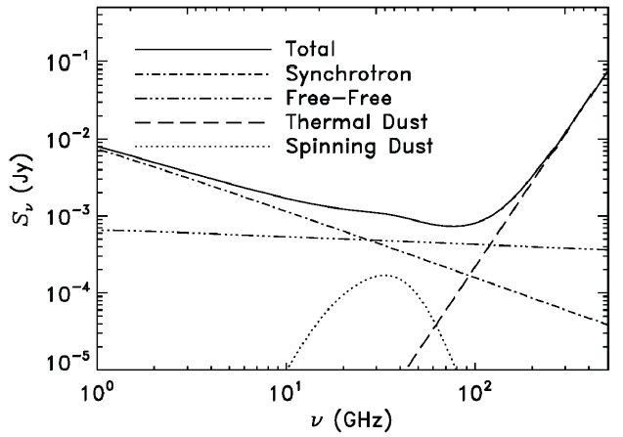
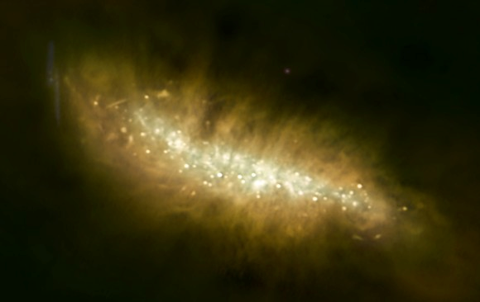
Galaxy eco-systems (Murphy + SWG2)
Wide field, high res. mapping of Milky Way and nearby Galaxies
ngVLA
Broad-Band Continuum Imaging
Cover multiple radio emission mechanisms: synchrotron, free-free, cold (spinning?) dust, SZ effect
Independent estimates of SFR
Physics of cosmic rays, ionized gas, dust, and hot gas around galaxies

Slide 17
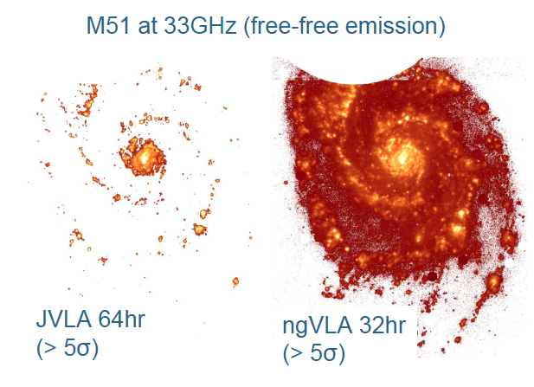
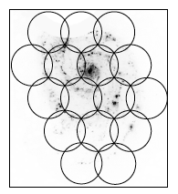
Free-Free (est. from Hα) = Direct measure of ionizing photon rate without [NII] or extinction corrections
2hr/ptg: rms ~ 400 nJy/bm
Equivalent map would take 200 to 300x longer with JVLA ~2500 hr

Slide 18
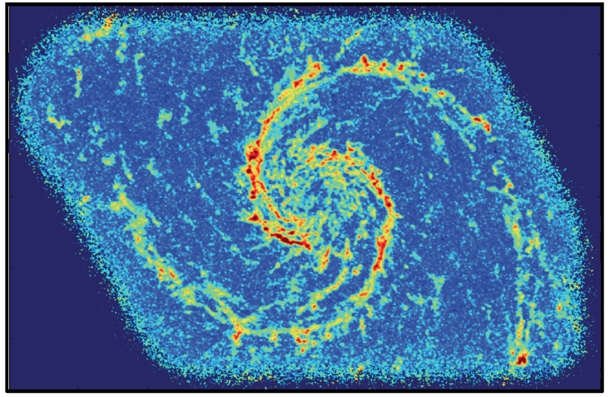
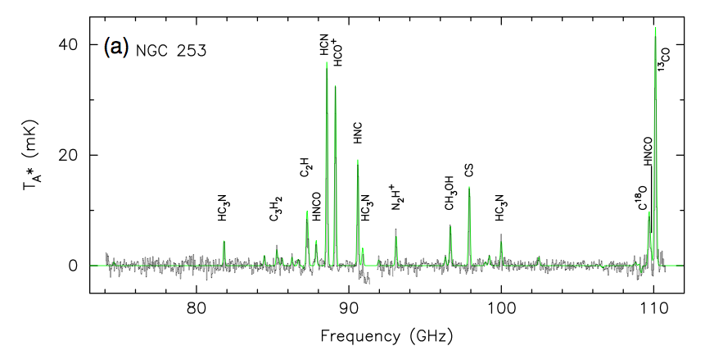
Spectral Line Mapping: Map cool ISM 10x faster than ALMA (‘gold mine’ A. Leroy)
Astrochemically rich frequency range: 10 – 110, w. 1st order transitions of major astrochemical tracers
0.1” => 3pc at M51.
10K sens. in 1hr, 10 km/s, 1cm
Schinerer ea.
Snell ea

Slide 19
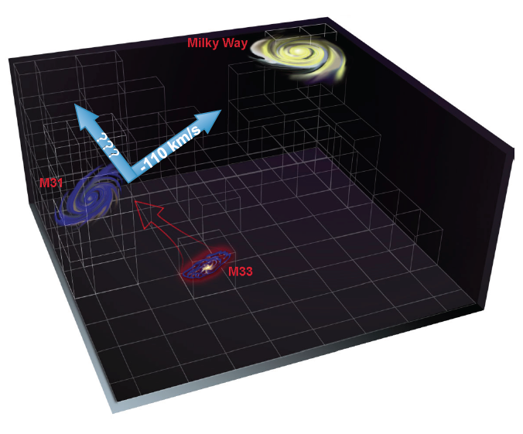
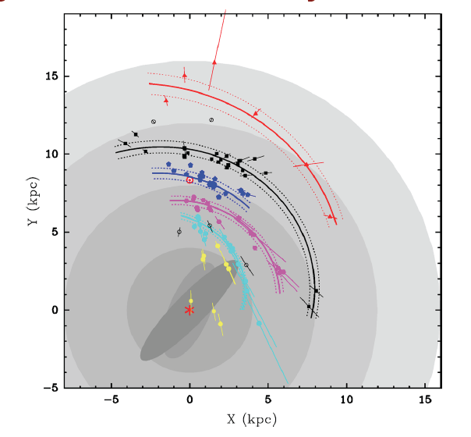
Galaxy eco-systems: VLBI uas astrometry
Gal. SF region masers: Complete view of spiral structure of MW
Egal proper motions w. masers (+ AGN?): 3D imaging of dynamics of local group => dark matter, real-time cosmology
Not DNR limited imaging => few big antennas ~ 10% area
Local group proper motions ~ uas/year

Slide 20
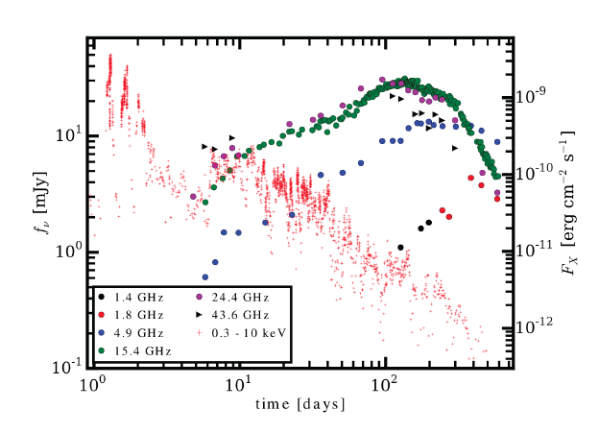
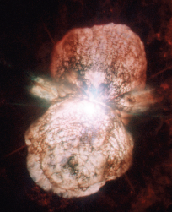
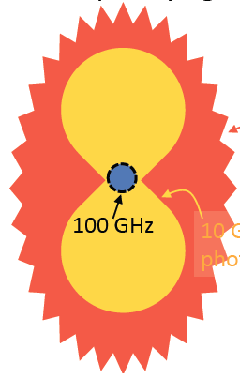
Physics, cosmology, time domain
(Bower et al. SWG4)
GBR/TDE: late time jet shock
15GHz
Time domain: phenomena peaking at 0.3cm to 3cm – ‘High frequencies critical’ (G. Hallinan)
FRBs, TDEs
Novae: ‘peeling onion’
Radio counterparts to GW events
Galactic Center Pulsars
10GHz
1GHz

Slide 21
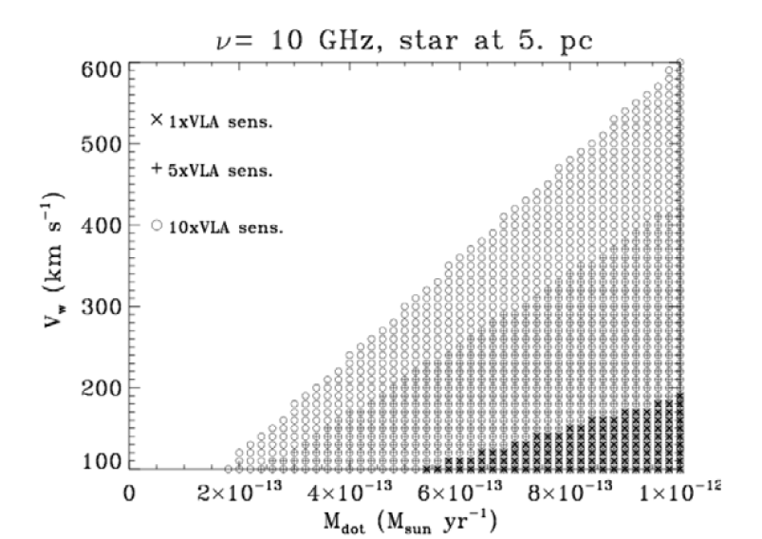
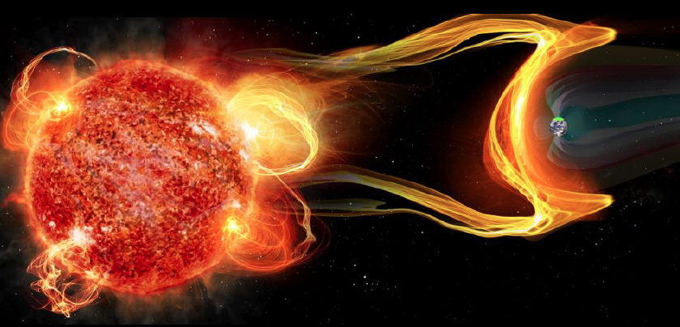
Star – Planet interactions: exospace weather (Hallinan)
NGVLA most sensitive telescope for study of stellar radio phenomena
Thermal phenomena at mas resolution
Radio photospheres: resolve radio surfaces of supergiants to 1kpc
Detect winds in young stars: mass loss rates few 10⁻¹³ M_{o}/yr at 5pc
Planetary magnetic fields: defending life
M dwarfs most likely hosts habitable planets, but very active, flares up to 10⁴ x Sun
Flares + CME erode planetary atmosphere

Slide 22
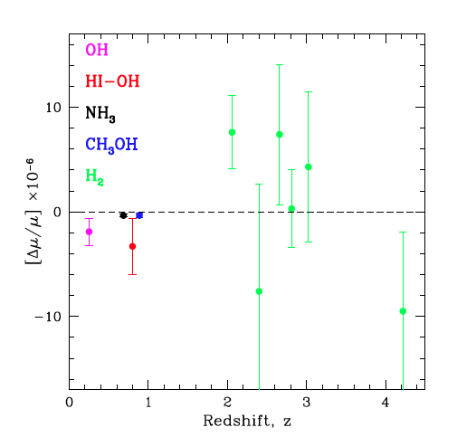
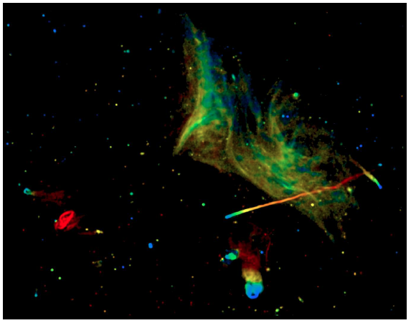
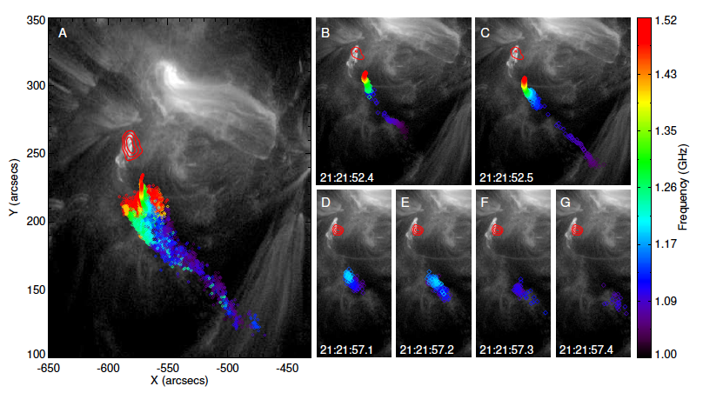
Physics, cosmology
Megamasers and H_{o}: double precision cosmology
Evolution of fundamental constants using radio absorption lines: best lines in K through Q band
S-Z for individual galaxies
Plasma Universe
Magnetic reconnection vs. shock acceleration: broad band phenomena
Mpc-scale cluster emission
100ms solar flares

Slide 23
Key Science projects
Imaging terrestrial zone planet formation + prebiotic chemistry
Dense gas history of Universe
Time domain: exospace weather
Wide field, high res. thermal line + cont. imaging
VLBI astrometric applications
Next steps
Quantify! physical modeling + configurations + simulations
Focused workshop on science case, calculations, Fall 2015
Larger community meeting Spring 2016

Slide 24
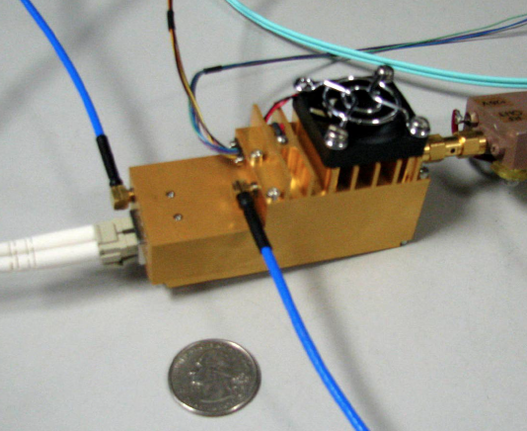
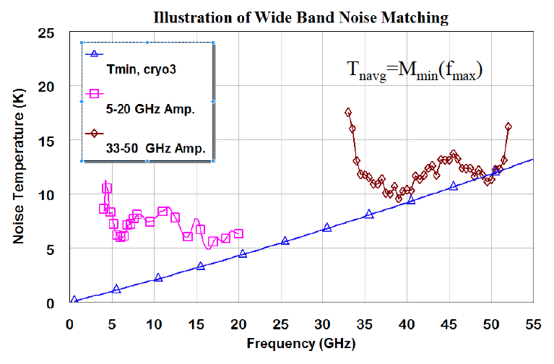
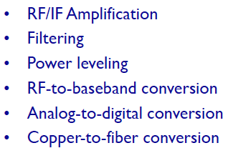
Pasadena Technical Meeting (Weinreb)
https://safe.nrao.edu/wiki/bin/view/NGVLA/NGVLAWorkshopApril2015
Antennas (Padin, Napier, Woody, Lamb…)
12-25m, 75% eff at 40GHz
Offaxis (high/low), symmetric?
Hydroform, panel?
Reconfigurable?
Feeds, Receivers (Weinreb, Pospiezalski, Morgan…)
1 – 115GHz: 3 bands? 4 bands? more?
Correlator: FPGA (Casper), GPU (nVidia), ASIC (JPL), Hybrid (DRAO)
Conclusions
No major single-point failures
Could build today for not-unreasonable cost
Development geared to minimize construction and operational cost
Morgan mmic: Rack full of warm electronics in your hand

Slide 25
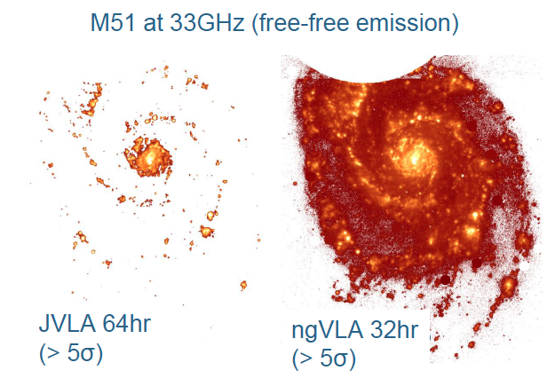
Need for large single dish
Short/zero spacings: big problem with missing flux for Galactic and nearby galaxies
Two size antennas? (probably not short enough B?)
Total power on some array antennas?
Large single dish + FPAs?
VLBI applications: Mostly astrometry
Imaging DNR not big issue.
Collecting area is big issue => few large antennas
Imaging 10’ at 1cm requires ~ 3m baselines!
10’

Slide 27
Site quality at 3mm
Elevation = 2200m
ALMA Test Facility: good site at 90GHz, fair at 230GHz (~ PdBI)
Years of phase/opacity monitoring:
Very good much year at night
Reasonable half year in day
Phase Cal studies: Fast Switching, WVR, paired array/antenna

Slide 28
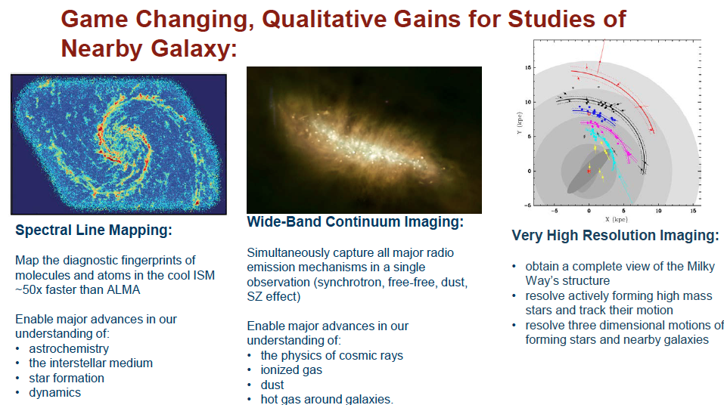
Galaxy eco-systems (Murphy + SWG2)

Slide 29
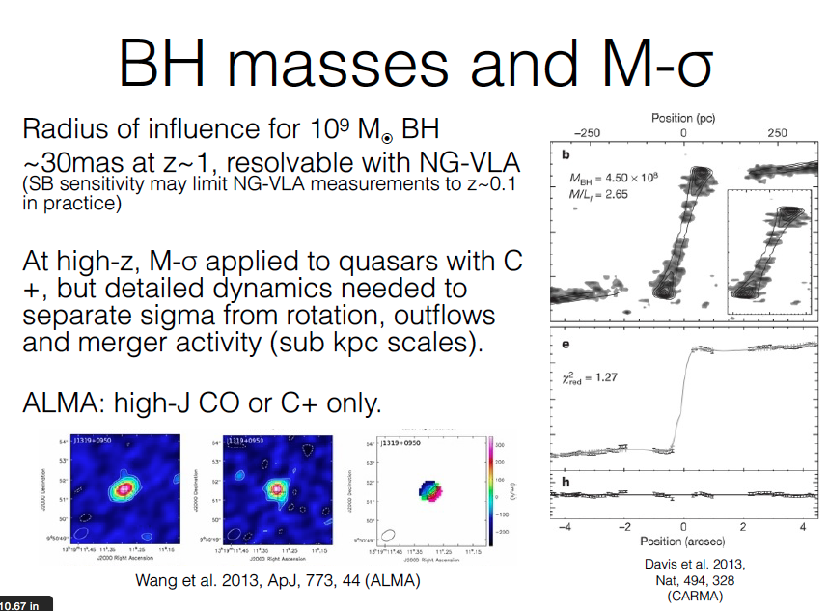

Slide 30
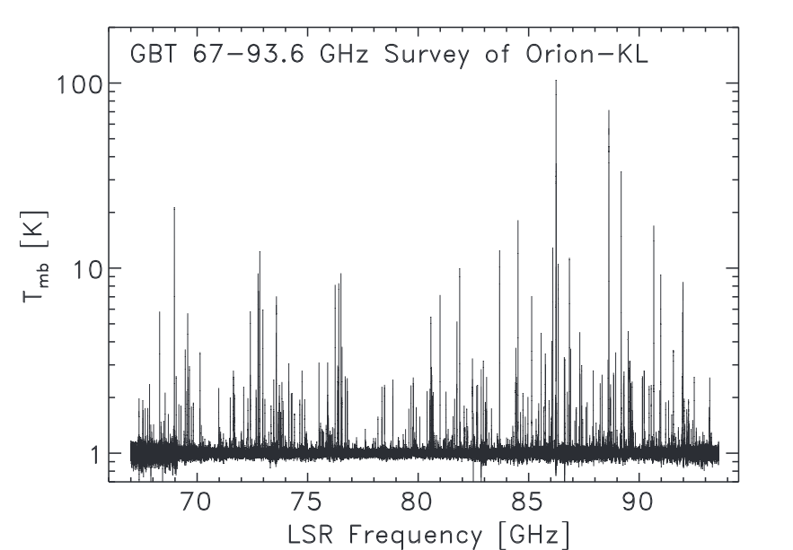
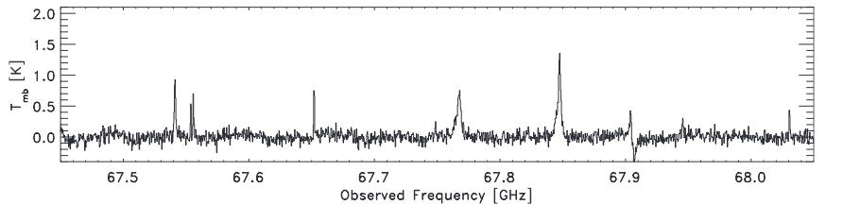
Spectral Line Mapping @ 10GHz to 100GHz on pc-scales
Map cool ISM 10x faster than ALMA
First order transitions of major astrochemical tracers
Baryon cycle: following life cycle of gas to stars to gas
Schinerer ea.
Frayer ea. 2015

Slide 31
Science with a Next Generation Very Large Array
Notional Specifications
Physical area 6 x VLA, but higher efficiency > 30 GHz
Frequency range: 1 – 50, 70 – 115 GHz
Configuration: 50% to few km + 40% to 200km + 10% to 3000km
Design to minimize operations costs (‘not much more than JVLA’)

Slide 32
Killer Gap
Thermal imaging on mas scales at λ ~ 0.3cm to 3cm
Many other parameters: FoV, Bandwidth, T_{sys}, RFI occupation, UV coverage (dynamic range, surface brightness), Atmospheric opacity and Phase stability, Pointing…
Relative metrics depend on science application

Slide 33
Stars and planet in
Exospace weather (Hallinan)
Thermal phenomena at mas resolution
Radio photospheres: resolve radio surfaces of supergiants to 1kpc
Detect winds in young stars: mass loss rates few 10⁻¹³ M_{o}/yr at 5pc
Planetary magnetic fields: defending life
M dwarfs most likely candidates to host habitable planets, but… often very active, w. flares up to 10⁴ times more energetic than Sun
Flares –> photochemical reactions lead to atmospheric loss
Coronal mass ejections –> can erode atmosphere

