Slide 1

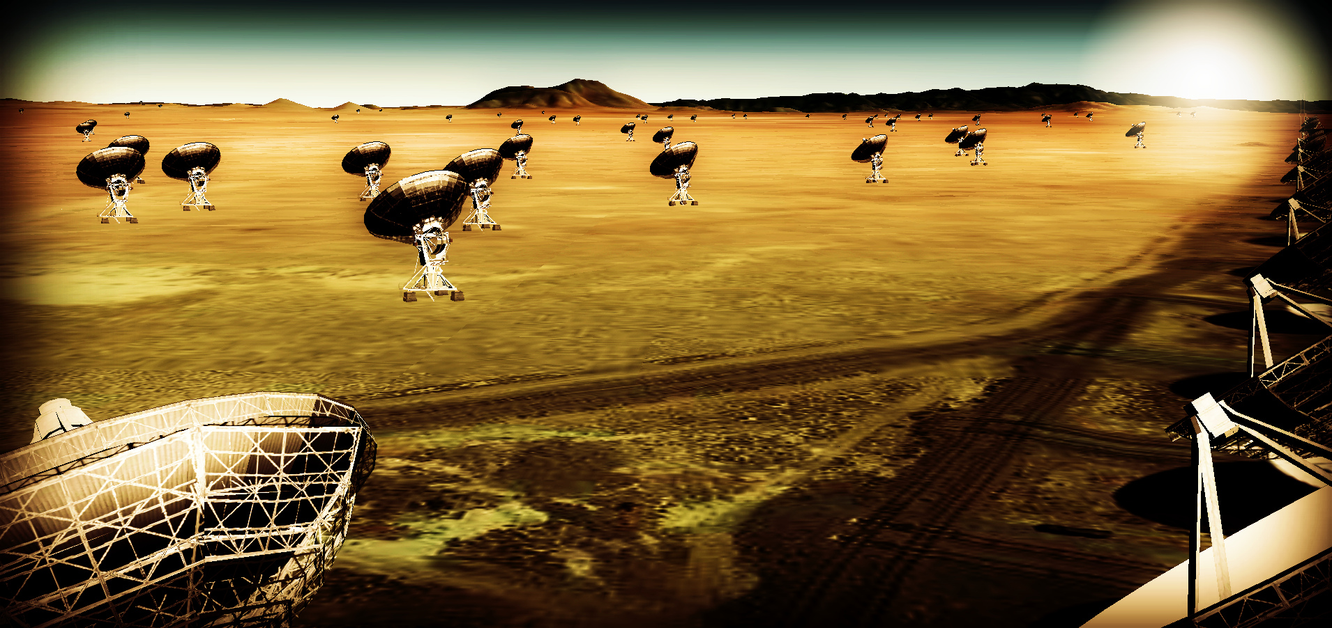
Effective area ~ 10x JVLA, ALMA
Resolution ~ 10x JVLA, ALMA
Frequency range ~ 1 to 115 GHz
https://science.nrao.edu/futures/ngvla

Slide 2
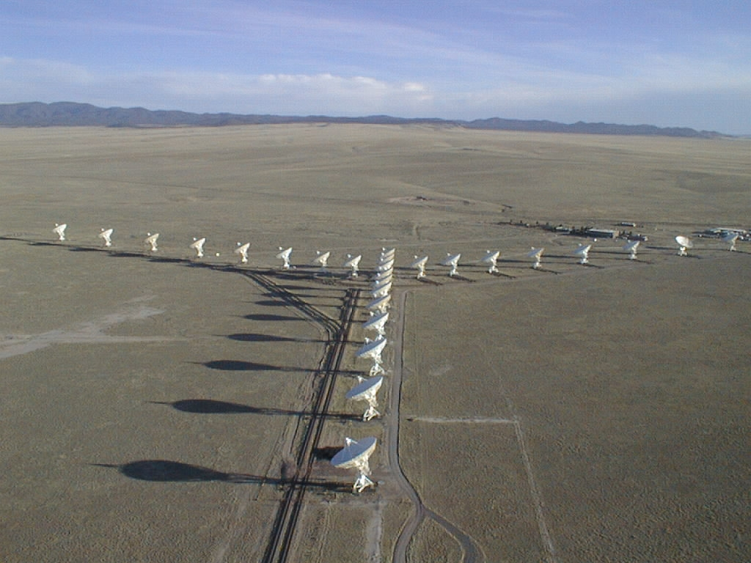
The Very Large Array: few min history
1972 – Approved by Congress
1975 – 1st antenna
1980 – Full science operations
2001 – Major upgrade approved by NSF (all new electronics)
2011 – Jansky VLA full science ops

Slide 3
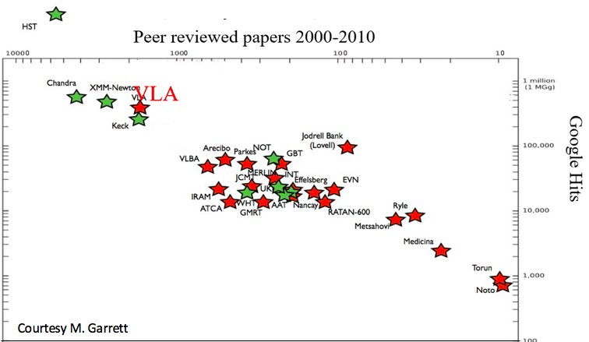
Radio Astronomy Powerhouse from 1980 to present
400 proposals per year, oversubscription ~ 3/1
~ 300 PhD theses
The VLA is among the most productive telescopes ever!

Slide 4
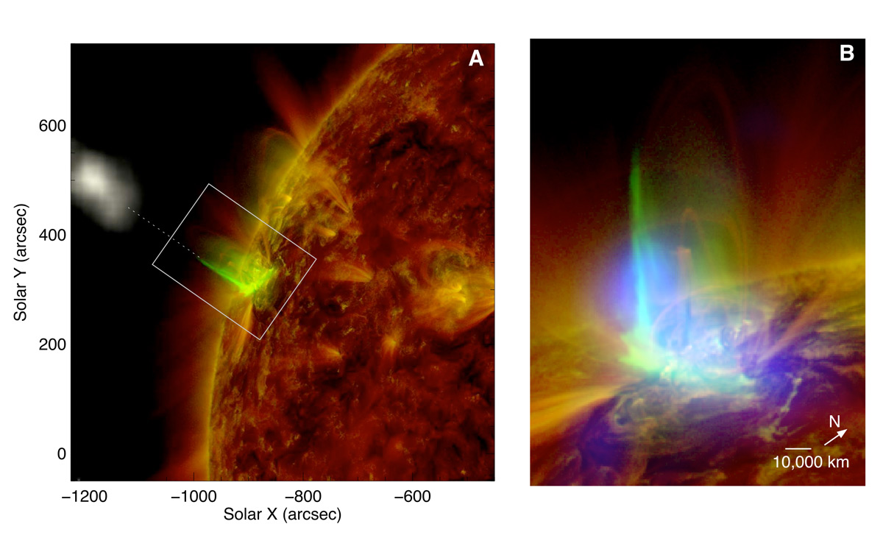
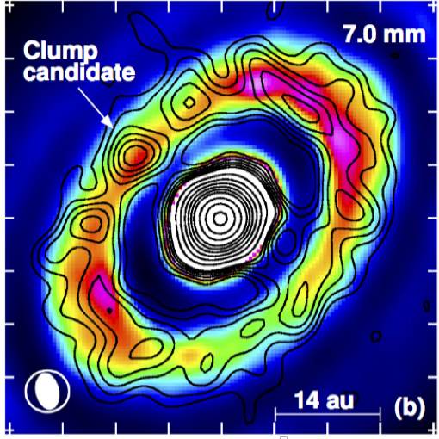
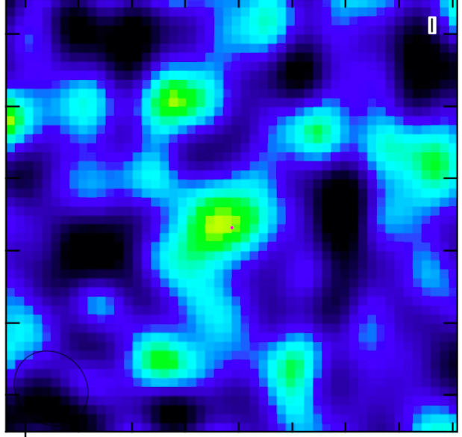
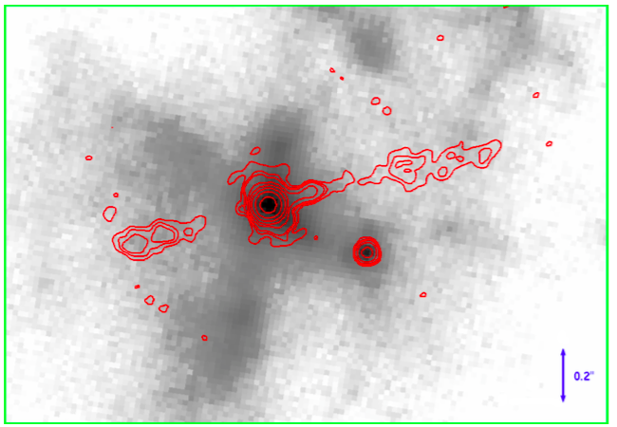
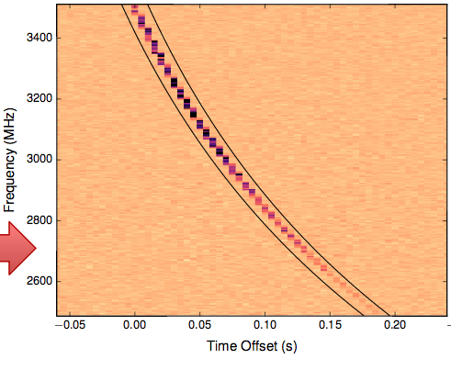
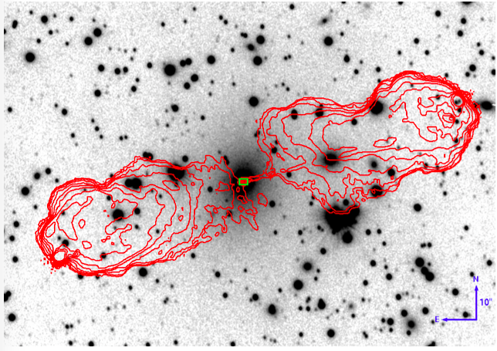
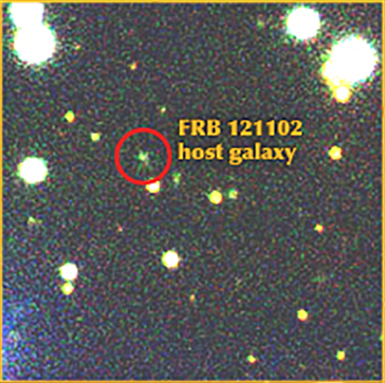
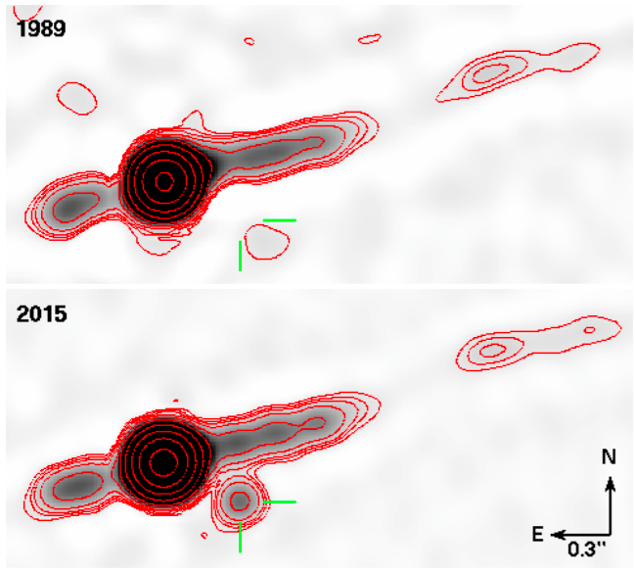
Why? Unique, broad science appeal
Planet formation res=10AU
Cold dust and gas @ z=7.X
Solar Flares @ 50msec, 1000km
Chen +
Isella +
Walter +
Cygnus A is a Binary SMBH!
msec burst
DM ~ 1000 pc cm⁻³
0.4kpc
z=0.1
1985
Localization of FRB: a new tool for cosmology
2015
Perley +
Chatterjee +

Slide 5
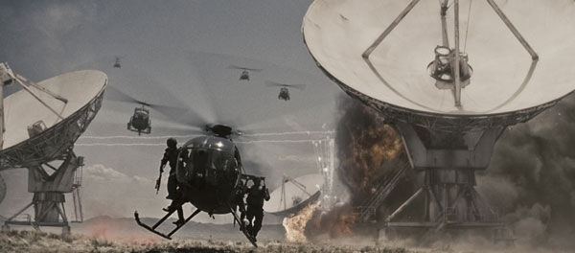

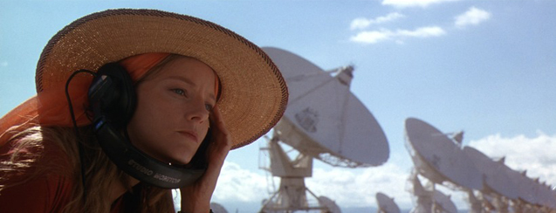
”I've always wanted to see the Very Large Array in New Mexico. It's not the biggest in the world, of course, or the most modern, but it is iconic, and I grew up wanting to see it. It's quite spectacular. Out there in the desert.” John Luther
Contact / T4

Slide 6
Radio facility for the mid-21st century: 10x resolution and sensitivity of JVLA and ALMA
New window: Thermal imaging on mas scales at λ ~ 0.3cm to 3cm
Design: new parameter space
Science
Circle of Life: planet and star formation, astrochemistry/bio
Galaxy ecosystems: Baryon cycle in MW and nearby galaxies
Galaxy formation: star formation, B fields, and molecular gas back to 1st galaxies
Time domain and Physics: Cosmic explosions, Exo-space weather, galaxy SZ
Process and Goal: preparation for 2020 Decade Survey

Slide 7
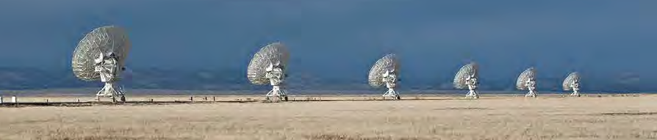
Community process
Jan 2015, 2016, 2017, 2018: AAS community science meetings and sessions
April 2015, Dec 2015, Jan 2017: Technology meetings (CIT, Socorro, URSI)
Dec 2015, Aug 2016, Aug 2017: Kavli-sponsored RMS meetings (Chicago, Baltimore, Berkeley)
Nov 2015: Science working group science program reports (200 pages, 125 authors) http://library.nrao.edu/ngvla.shtml
Circle of Life (Isella, Moullet, Hull)
Galaxy ecosystems (Murphy, Leroy)
Galaxy assembly (Lacy, Casey, Hodge)
Time domain, Cosmology, Physics (Bower, Demorest)
June 2017 Science meeting Socorro, NM

Slide 8
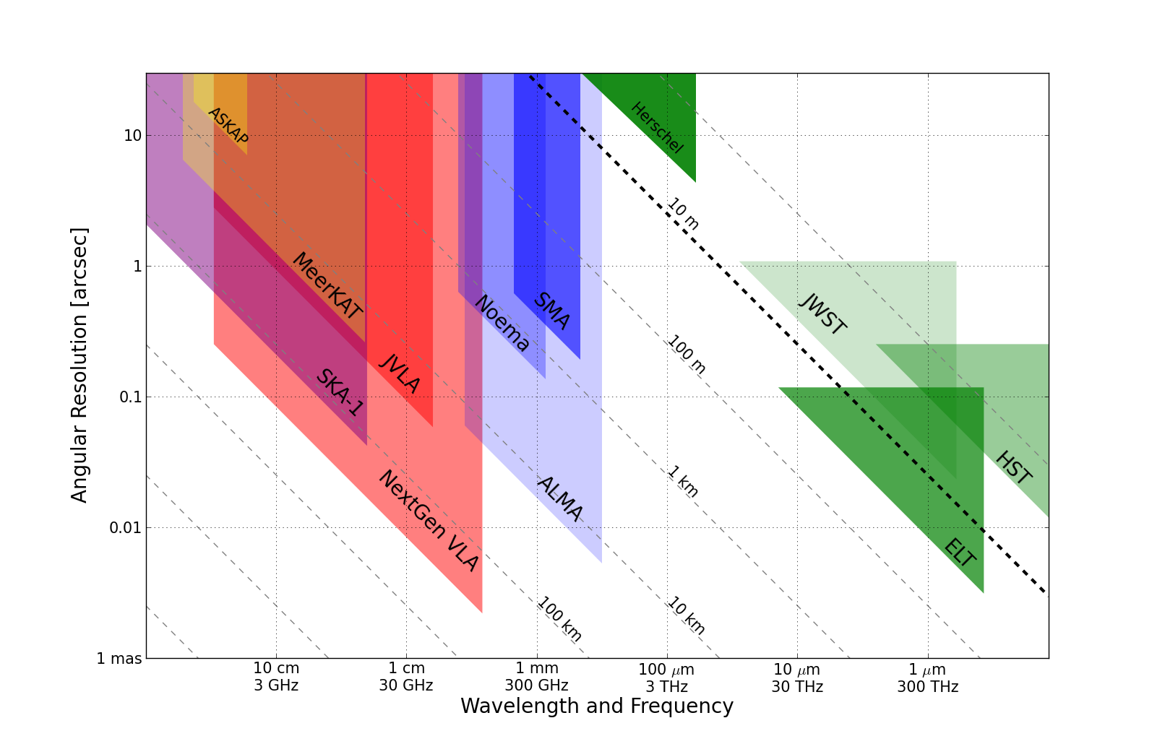
Killer Gap
Thermal imaging on mas scales at λ ~ 0.3cm to 3cm
1AU @ 140pc
Terrestrial zone planet formation
Resolution ~ 10mas @ 1cm (300km)
Radio parity w. ALMA, future ELTs

Slide 9
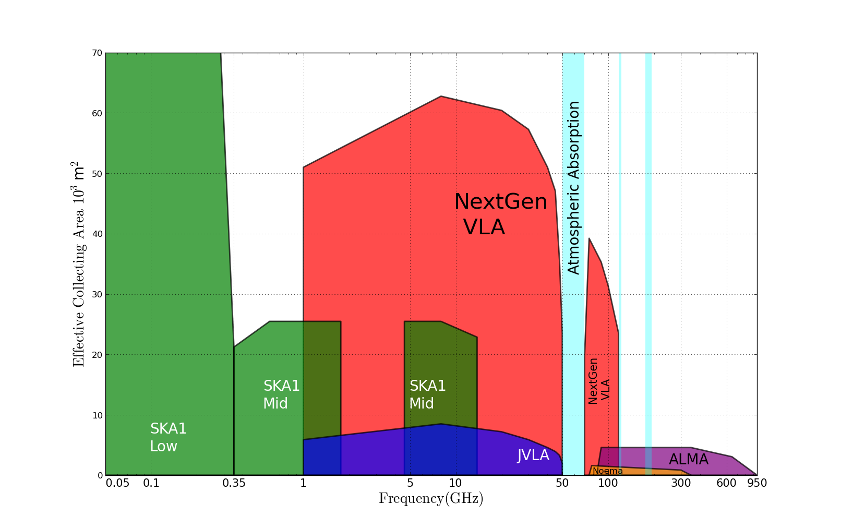
Killer Gap
Thermal imaging on mas scales at λ ~ 0.3cm to 3cm
5x
Sensitivity ~ 100 nanoJy @ 1cm, 10hr, BW = 20GHz
T_{B} ~ 1K @ 1cm, 10mas
Spectrum above 15GHz rich in ground state molecular lines

Slide 10
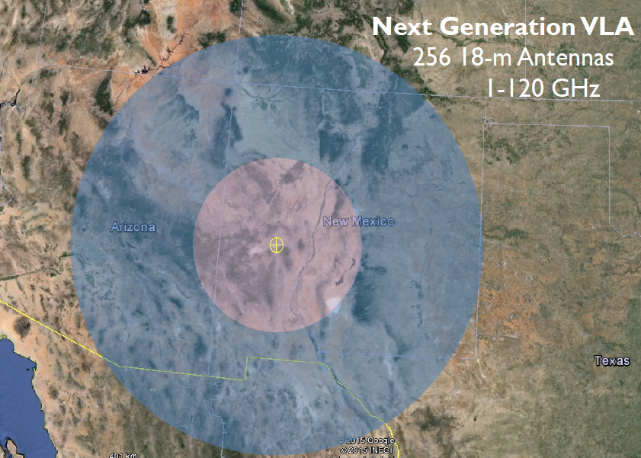
JVLA: Good 3mm site, elev. ~ 2200m
30% in core: b < 3km ~ 1” at 30GHz
60% in mid: b < 30km ~ 0.1”
90% in long: b < 300km ~ 0.01”
10% in VLB: b ~ 3000km ~ 0.001”
550km

Slide 11
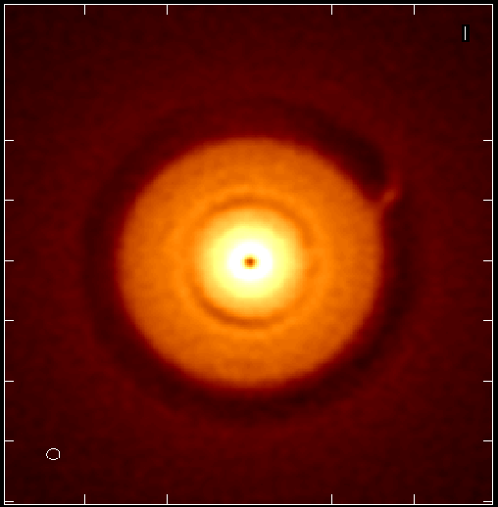
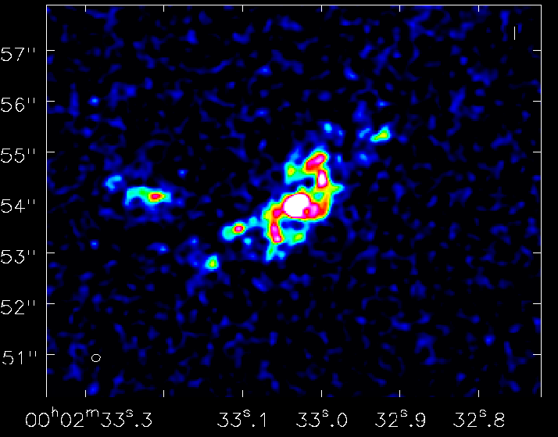
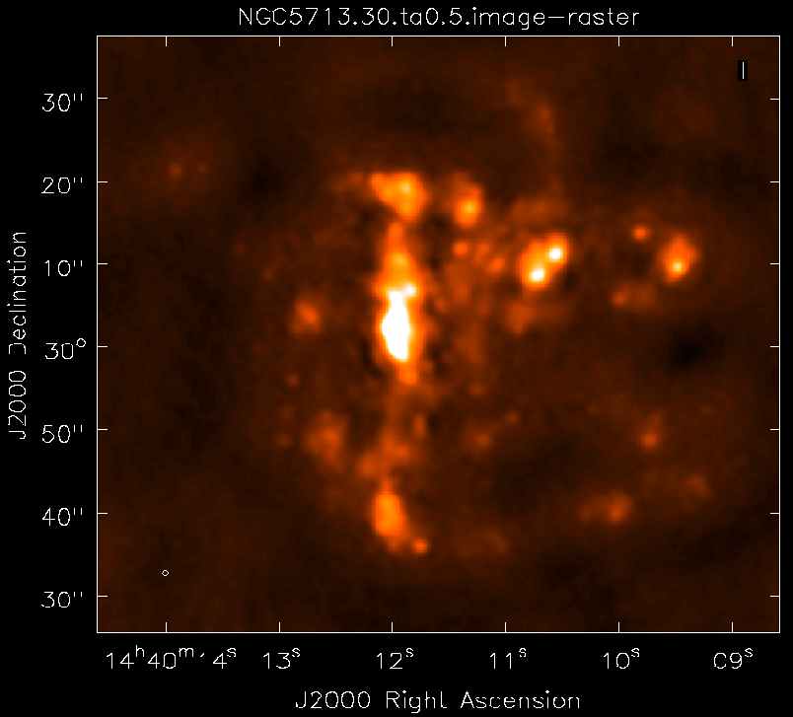
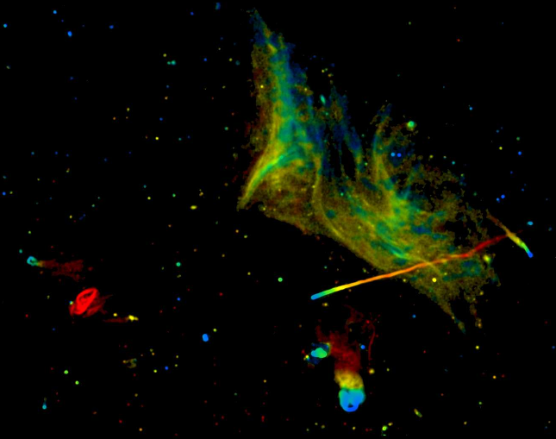
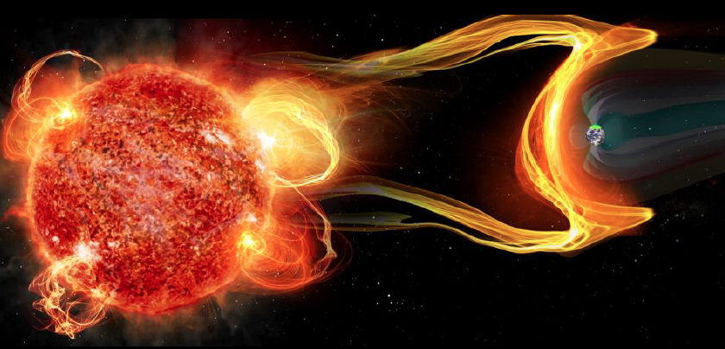
Science examples
Cradle of Life: Terrestrial planet formation + pre-biochemistry
Galaxy ecosystems: wide field imaging
Galaxy formation: Cool gas history of the Universe (ASPECS)
Time domain and Physics: Exo-space weather
http://library.nrao.edu/ngvla.shtml

Slide 12
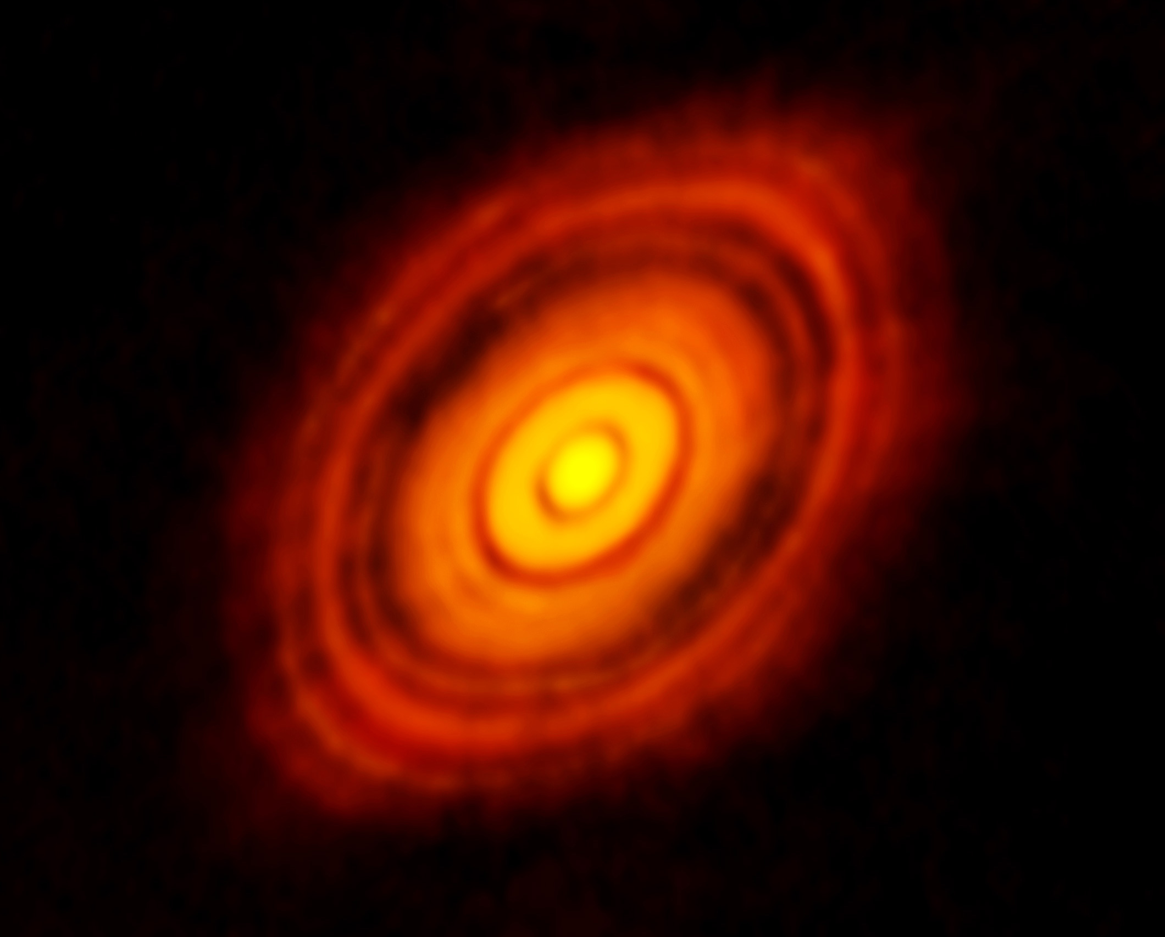
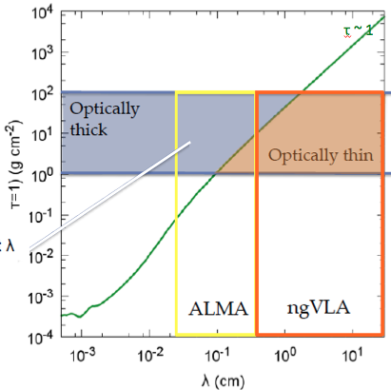
SWG1: terrestrial planet formation
ALMA 250GHz: State of Art Brogan ea.
HL Tau: Icon of planet formation around Solar-mass protostar
Distance = 140pc
1Myr protostar ~ 1 M_{o} w. 0.1 M_{o} dusty disk
100AU = 0.7”
Inner ~ 10AU optically thick at mm wavelengths = ‘ngVLA zone’

Slide 13
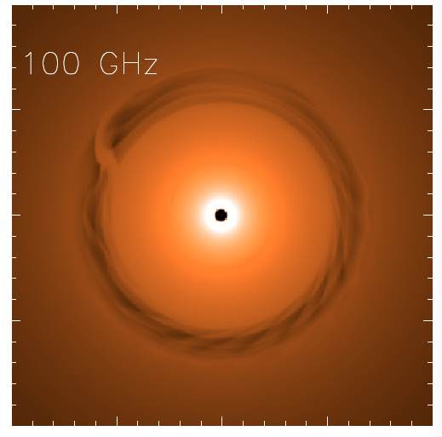
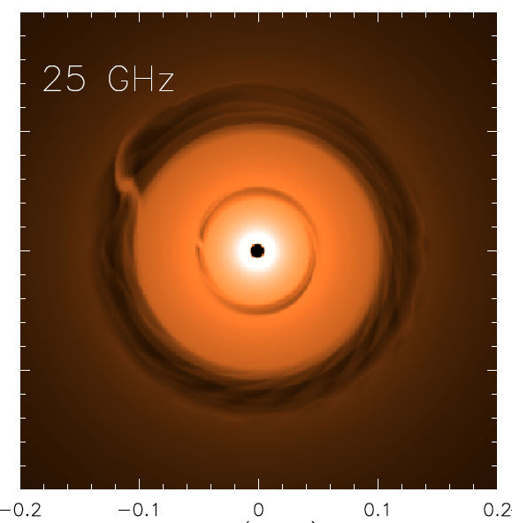
NGVLA: 1Myr Protoplanetary disk at 140pc distance
Saturn at 13AU
Jupiter at 6AU
ngVLA 100hr 25GHz
res = 10mas ~ 1AU
0.1” = 13AU
Isella Dust Model
Model
rms = 90nJy/bm = 1K
Inner gap optically thick at 100GHz
ngVLA: Image both gaps + annual motions (‘movies of planet formation’)
Circumplanetary disks: imaging accretion on to planets
Grain size stratification: Image poorly understood transition from dust to planetesimal to planets at 1AU resolution

Slide 14
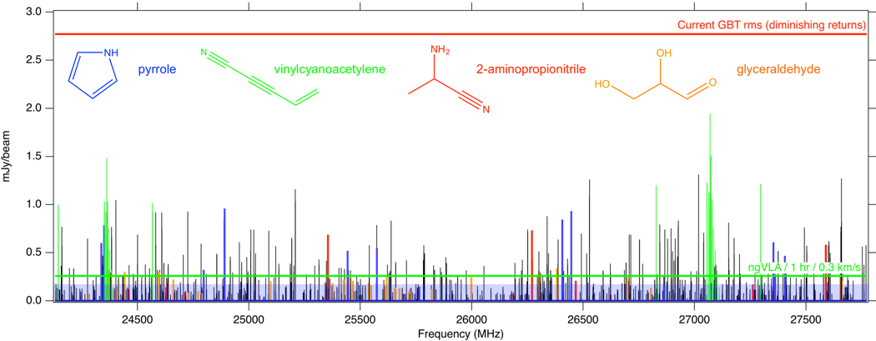
Pre-biotic Chemistry from Cores to Disks
Complex organic molecules = building blocks of life
Line blending is a killer in the submm
ngVLA opens a new window on pre-biotic chemistry (eg. simple amino acids), in particular in colder regions
Sgr B2 core McGuire
Notes:
This is a simulation of ~30 complex organic molecules, not currently detected in the ISM, but which are good candidates for detection. I have highlighted in colors example of these molecules which are important for understanding chemical evolution (e.g., increasingly complex carbon-nitrogen chains), probing chirality (e.g., glyceraldehyde), are part of largely unknown cyclic/aromatic chemistry (e.g. pyrrole), or are excellent candidates for being direct precursors to amino acids and other biogenic species (e.g. aminopropionitrile).
The simulation assumes that the emission is coming from a compact, 1" hot core in Sgr B2(N), from molecules with column densities of 10^12 - 10^14 cm-2, at T = 200 K, and with a linewidth of 3 km/s.
The simulation does *not* contain any currently-detected species, meaning that a real spectrum in this frequency range would have many, many bright lines off the scale of this graph.
The red horizontal line is the ~rms of the current GBT PRIMOS observations. These suffer greatly from beam dilution, as the 1" source is diluted in a 30" GBT beam. This rms is about what we can reasonably get with reasonable integration times at the GBT. Drilling deeper will take far longer than is feasible for a survey.
The green line is taken from the ngVLA tech specs page for line sensitivity at 10 km/s in 1 hr, degraded for 0.3 km/s channels.
The blue shaded region is the area in which I project, from a statistical analysis of the PRIMOS observations, we will hit line-confusion in this frequency range. There is little point in integrating more than 3 sigma deeper than this.
So what are the take-away messages here?
1) the ngVLA will almost certainly provide access to a wealth of new molecular detections of molecules similar to the representative species shown here
2) the ngVLA in reasonable integration times (say 4-20 hours) should hit line confusion in this most molecularly-rich galactic source at the 3 sigma level, something that the GBT and (J/E)VLA cannot hope to accomplish.

Slide 15
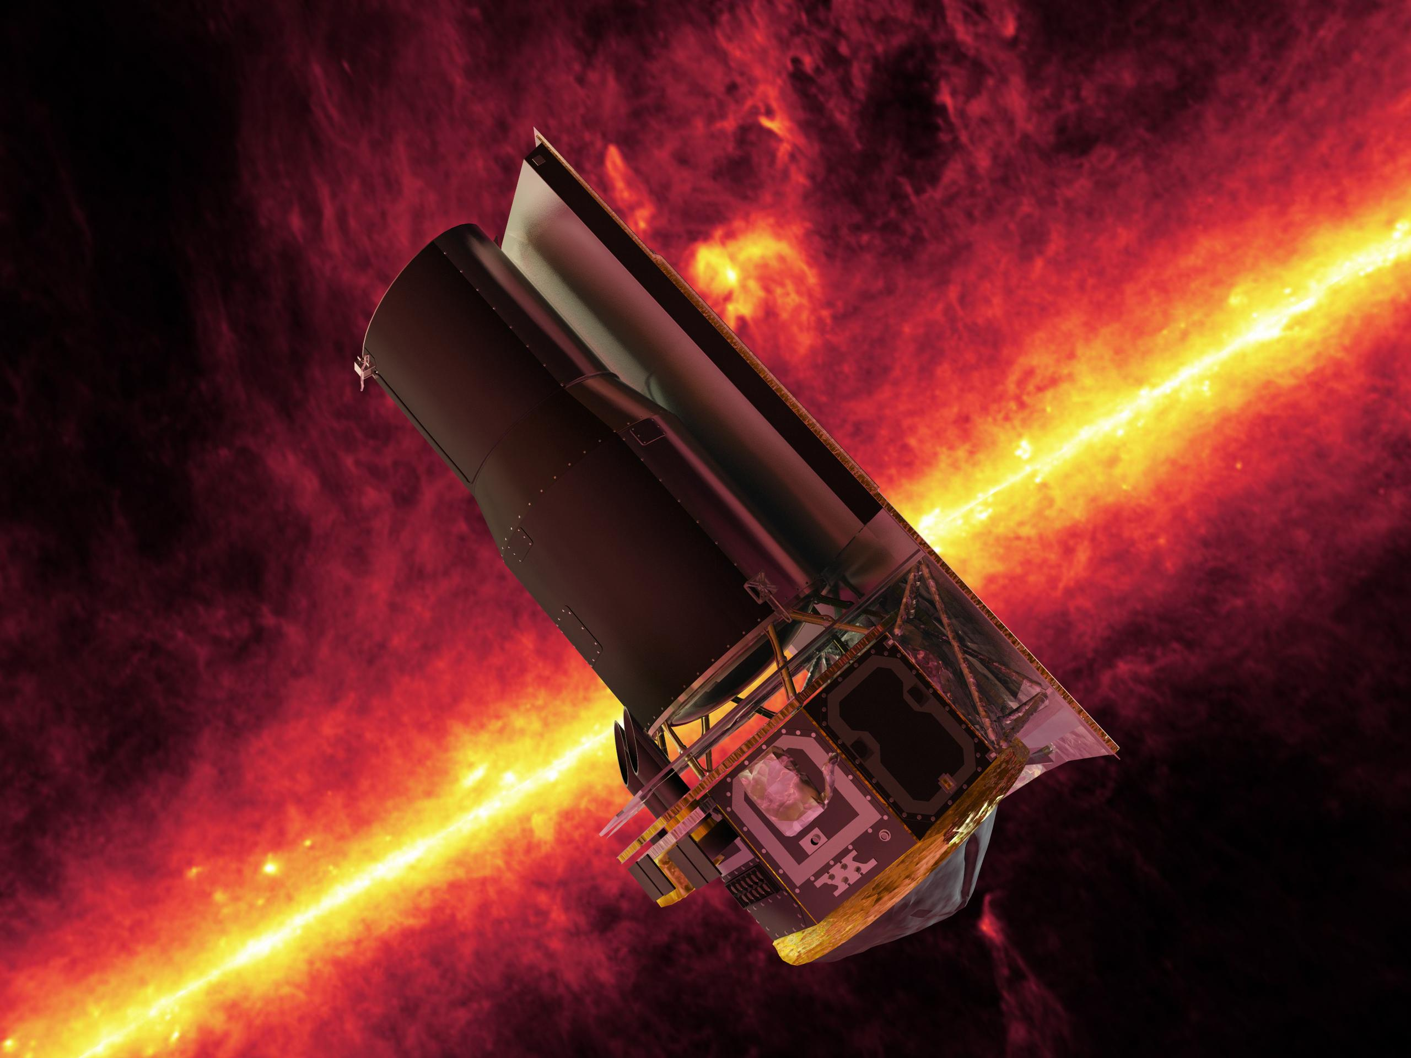
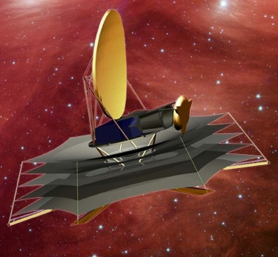
ng-Synergy: Terrestrial zone exoplanets and life
Habitable Exoplanet imaging mission
Direct detection of earth-like planets
Search for atmospheric bio-signatures
Origins Space Telescope
Prevalence of water
ngVLA
Imaging formation of terrestrial planets
Pre-biotic chemistry

Slide 16
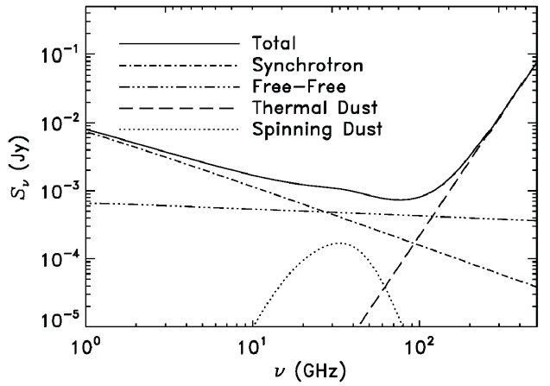
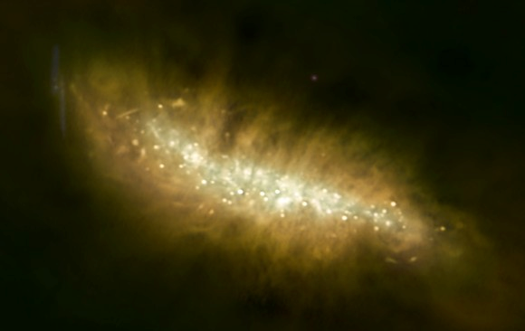
SWG2: Galaxy eco-systems and the Baryon cycle
Wide field, high res. mapping of Milky Way and nearby Galaxies
M82
ngVLA
Broad-Band Continuum Imaging
Cover multiple radio emission mechanisms: synchrotron, free-free, cold (spinning?) dust, SZ effect
Independent, obscuration free estimates of SFR
Physics of cosmic rays, ionized gas, dust, and hot gas around galaxies

Slide 17
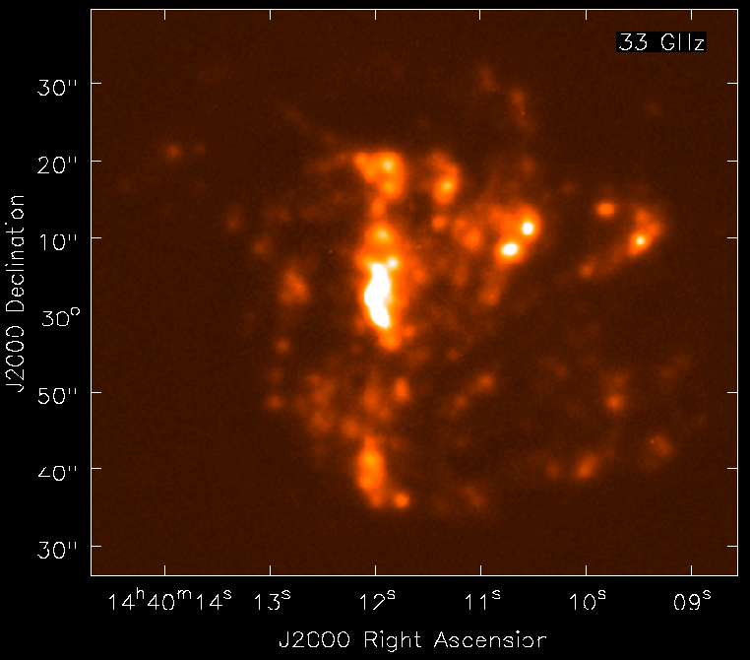
NGVLA: Free Free emission from peculiar spiral in Virgo
NGC 5713: distance ~ 30Mpc, SFR ~ 5 M_{o} yr⁻¹
Model 33GHz FF (from Hα)
NGVLA 10hrs, res = 0.5” ~ 70pc
1kpc
Free-Free ‘best’ star formation rate estimator
rms (1cm, 10hrs) = 0.1uJy => HII region associated single O7.5
Broad -band: spatially/spectrally separate thermal/non-thermal
Local-group-type studies out to Virgo!

Slide 18
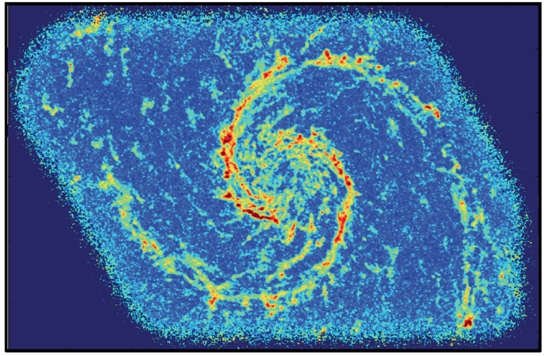
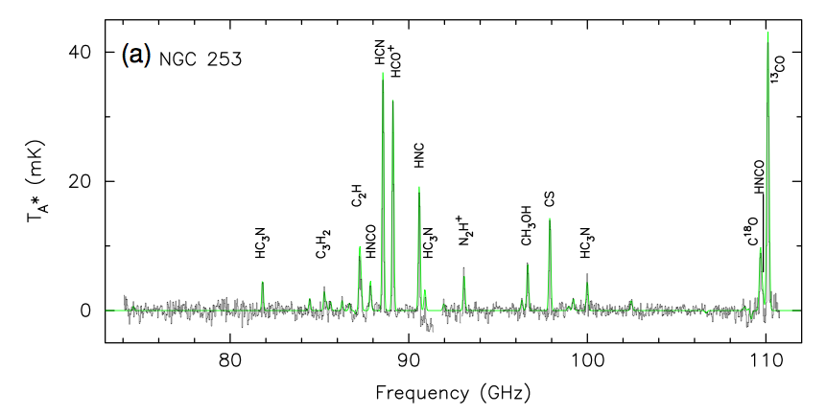
Schinnerer ea.
Spectral Lines: Map cool ISM 10x faster than currently possible
Rich frequency range: 1st order transitions of prime astrochemical + dense gas tracers
CO mapping: tens hours w. ALMA
Other lines are 10x fainter => need ngVLA
CO1-0 Bure 200hr, 1”
Snell ea

Slide 19
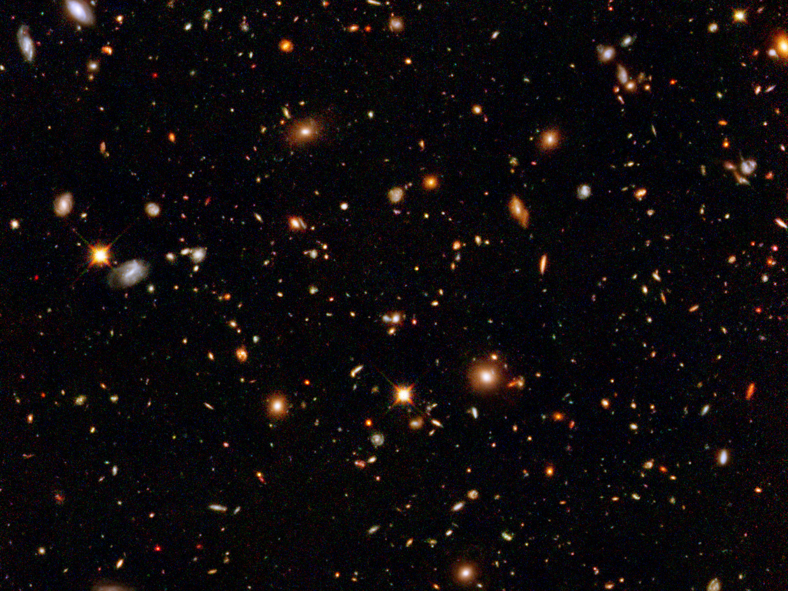
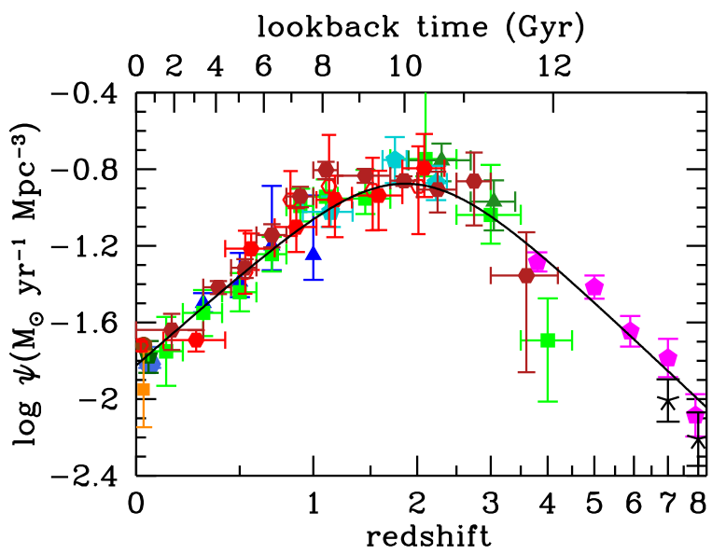
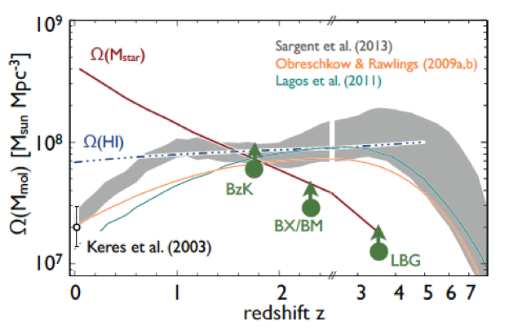
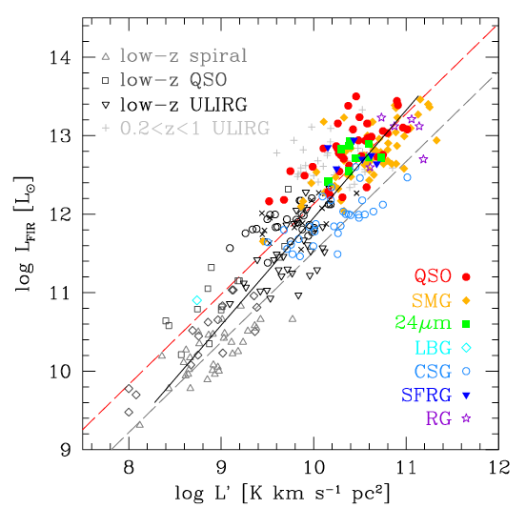
SWG3: Dense Gas History of the Universe
‘Missing half of galaxy formation’
Madua & Dickenson
‘SF Law’
FIR ~ SFR
FIR ~ SFR
L_{CO} ~ M_{gas}
SFHU has been delineated in remarkable detail back to reionization
SF laws => SFHU is consequence of DGHU
ALMA, JVLA, Noema: study of galaxy evolution is shifting to DGHU

Slide 20
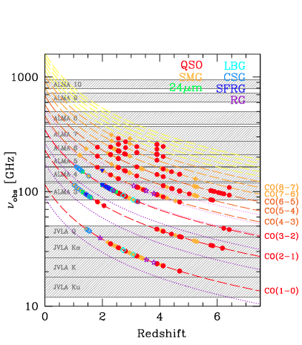
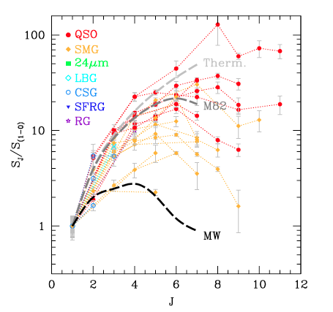
Low order CO: key total molecular gas mass tracer
M_{H2} = α x L_{CO1-0}
Total molecular gas mass
w. ALMA => gas excitation
Dense gas tracers associated w. SF cores: HCN, HCO+
ALMA/Noema
ngVLA ‘sweet spot’
10x uncertainty
VLA
SKA 1

Slide 21
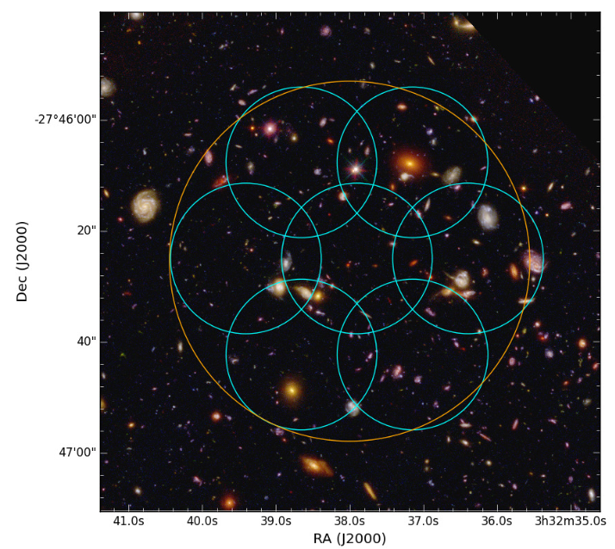
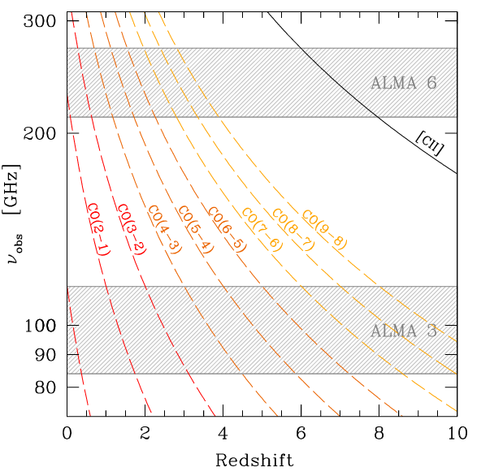
ALMA Spectral Line Survey in UDF (ASPECS-I)
1st volumetric ‘molecular deep field’
PI Walter, Decarli (EU), Co-PI Aravena (Chile), Co-PI Carilli (USA)
Bands 3 and 6: 20hr/band, 35ants; line rms ~ 0.3mJy, cont. rms ~ 10uJy
1arcmin² in UDF: best multi-𝜆 field
Molecular gas masses to ‘knee’ mass function ~ few x 10⁹ M_{o}
Dust continuum: SFR ~ 10 M_{o}/yr at z =1 to 6
[CII] from z > 6 LBG/LAEs

Slide 22
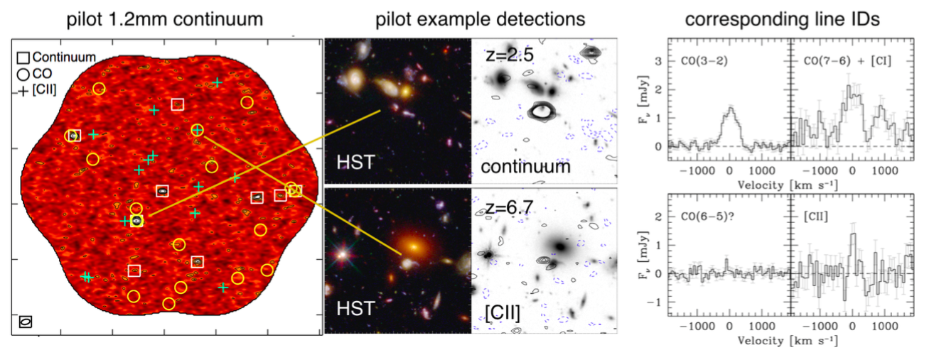
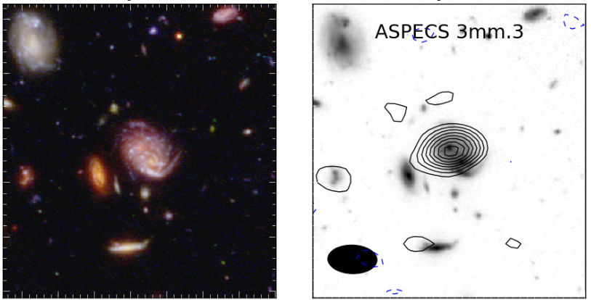
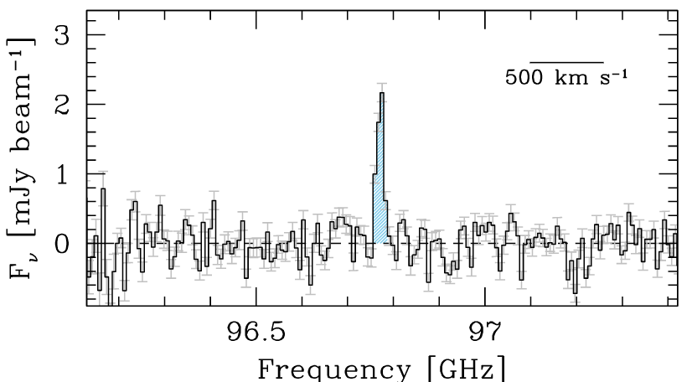
ASPECS-I 7 papers, Oct. 2016
z=1.4
CO 2-1
10 line candidates band 3: CO various redshifts (Walter, Decarli)
11 line candidates band 6: CO, [CII] (Walter, Decarli)
9 dust continuum sources band 6 (Aravena)
LBG Stacking: Dust corrected SFHU from z=1 to 10 (Bouwens)
Possible ~ 6 [CII] detection of LBG candidates at z=6 to 8 (Aravena)
Implications for CO/[CII] intensity mapping and CMB spectrum (Carilli)

Slide 23
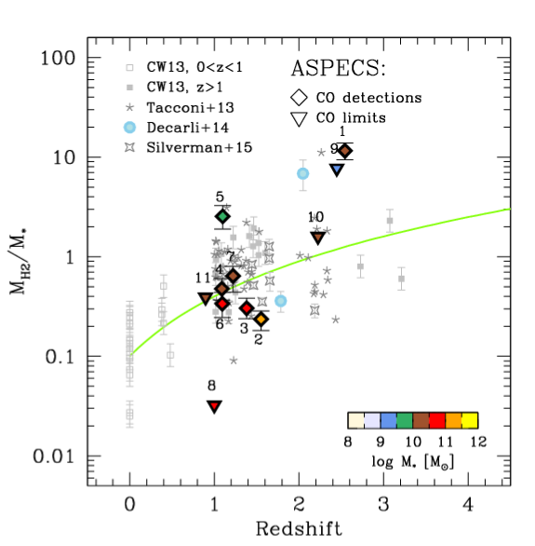
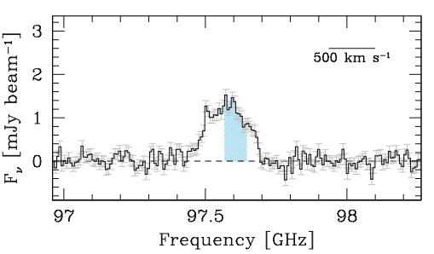
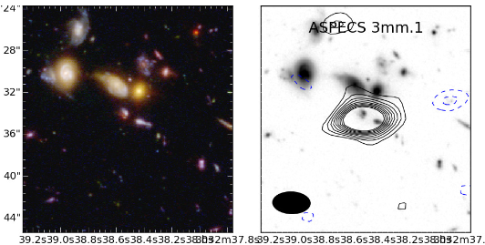
Evolution of gas fraction: fundamental change in ‘main sequence’ galaxies
CO 3-2
z=2.5
Order magnitude increase in mean gas ’baryon fraction’ (M_{H2} / M*) from z=0 to 2 (see also Daddi+, Tacconi+, Schinnerer+…)
M_{gas} = 2.0e11 (𝛼/3.6) M_{o}
M* = 1.6e10 M_{o}

Slide 24
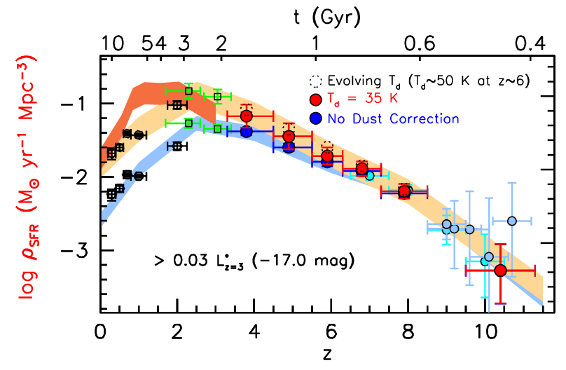
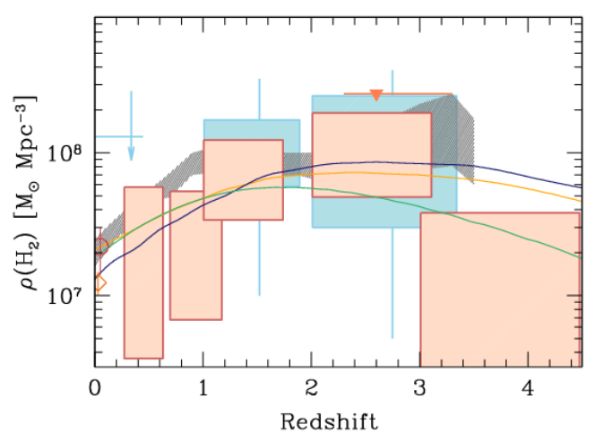
ASPECS: 1st Unbiased Dense Gas History of Universe, plus new dust-corrected SFHU
Epoch of peak cosmic SF rate density (z~2) = epoch of gas-dominated ‘main sequence’ disk galaxies

Slide 25


How to do substantially better?
ngVLA: Revolutionize Molecular deep fields
CO emission from ‘main sequence’ galaxies at high z in 1 hour
z=5, 30 M_{o}/yr, 1hr, 300 km/s
ngVLA
10x sensitivity + 2/1 fractional BW => ~ 50 to 100-fold increase in number of CO galaxies/hour
JVLA ~ 1, M_{gas} > 10¹⁰ M_{o}
ngVLA ~ 100, M_{gas} > 2x10⁹ M_{o}
Galaxy counts in CO ~ deepest optical fields!
JVLA, ALMA
Casey ea

Slide 26

Imaging ’fuel for star formation’ during epoch of galaxy assembly: massive disk galaxy
1” = 7kpc
z=2, CO1-0
Narayanan Model
ngVLA, 10hr, 38GHz
Resolution = 0.15” => 1kpc
Sensitivity = 12uJy (100 km/s, 10hr) => few 10⁸ M_{o} at z ~ 2
Distributed gas dynamics: Fisher-Tully at z=2!

Slide 27


Next-Gen Synergy: Cosmic Conversion of Gas to Stars
‘Precision galaxy formation’
Gas
NGVLA
ALMA
Decarli
JWST/ELT/OST: stars, star formation, dust
ngVLA: cold gas fueling cosmic star formation

Slide 28


SWG4: Physics, cosmology, time domain
Exo-planet space weather environments: impact on the development of life
ngVLA ~ 10⁻¹³ M_{o}/yr
M-dwarf flares ~ 10⁴ x Sun!
VLA
M-Dwarfs: most likely to host habitable planets, but very active (strong winds and flares)
NGVLA new-window on broad-band radio phenomena = key observables of exo-space weather
Wind – planet interaction => evaporation of atmospheres
Non-thermal flares and aurorae: Star-planet magnetospheric interactions
M-dwarf cyclotron emission, w. B ~ 2000G!
Hallinan)

Slide 29






Next step: Fine-tune Science Requirements and Map Them to Telescope Specifications (70 use cases to date!)
Goal | Science Requirement | Array Specification
Terrestrial-Zone Planet Formation | Optically thin | Freq ~ 15 to 50GHz
 | 1AU at 130pc @ 30GHz | B < 300-500km
 | 1K in 10hrs @ 10mas, 30GHz | A_{full} ~ 300 x 18m; BW ~ 20GHz
Dense gas History of the Universe | CO 1-0 to z=8 | Freq = 15 to 115GHz
 | M_{gas} = 10⁹ M_{o} at z = 3 in 1hr | A_{mid} ~ 70% to B ~ 30km
 | 500pc resolution at z = 3 (60mas) | 30km
 | Large volume surveys | Octave Band Ratio
Baryon Cycling | T_{B} < 0.2K (1hr, 10 km/s, 80GHz, 1”) | A_{core} >30% to B ~ 2km
 | Continuum science | Octave BR; Linear pol to 0.1%
Time Domain, Cosmology, Physics | Explosive follow-up (GRBs, GW/EM…) | Minute trigger response time
 | Blind discoveries (e.g.. FRBs) | millisecond searches
 | Exo-space weather: 1uJy in 1min | Freq ~ 1 to 20GHz A_{full} ~ 10x JVLA Circular pol to few %

Slide 30

Science/Technical Issues Under Discussion
Need to grow/refine/prioritize science program
Phase calibration
Paired antennas, dedicated reference array, water vapor radiometers, fast switching, self-calibration
Antenna diameter, optical configuration
offset Gregorian/Cassegrain, symmetric Cassegrain, other
Receiver band definition & Frequency cutoffs
Tradeoffs between system temperature, aperture efficiency, beam shape, operating cost, etc. with receiver band ratio
Array configuration
Sensitivity at low and high spatial resolution: CASA simulation tools
Fixed or moveable antennas
Minimal configurations for science goals
VLBI implementation
Design for Life-cycle costs: construction AND operations
Notes:
Self calibration: Too few and too weak sources at high frequency
Fast switching: More rigid structure, larger drive motors, enhanced electrical infrastructure, reduced time on source
Dedicated reference array: Separate antenna design (~100 x 4m); maximizes time on source
Paired antennas: Identical antennas, with half on source of interest and other half on reference source
Water vapor radiometers: 183 GHz works well on ALMA; VLA attempts at 22 GHz inconclusive
Sensitivity to low surface brightness. Options:
Large array of smaller diameter (~12m) antennas
Compact array of smaller diameter antennas at the core of the overall array (similar to ALMA)
Large single dish (e.g. GBT)
VLBI implementation. Options:
Used in concert with other, existing telescopes
~20% of collecting area, perhaps in groups of antennas, on long baselines

Slide 31

Antenna Concepts 12 to 25m Diameter: optimize for science vs. total cost
Antenna designs include: off-axis Gregorian, single composite primary antennas, symmetric Cassegrain, etc.
Off-axis parabola minimizes scattering, spillover, and sidelobes
Performance and maintenance requirements favor a receiver feed arm on the low side of the reflector

Slide 32


Receiver/Feed Configuration Concepts Cover max. freq range with minimum number receivers, dewars
Baseline
6-band/3-Dewar Concept
4-band/1-Dewar Concept
pwv=1mm
elev = 45°
NRAO
Caltech/JPL
Comparison of WBF (4-band/1-Dewar) with baseline (6-band/3-dewar) and UWB (3 band; JPL concept shown using CSIRO dielectric loaded feed) designs
BW ratios: 2/1 current; 3/1 under testing; 6/1 research project
1.2 – 4.2 GHz – An LNA for this range can be realized with <4K noise and a QRFH; feed covering down to 1.2 GHz can be completely cooled to reduce system noise
4.2 – 15 GHz – Excellent LNA available with < 6K noise in this range.
15 - 50 GHz – LNA needs development but <15K appears feasible.
70-116 GHz – A conventional high-efficiency corrugated horn. The LNAs are being developed for ALMA band 2/3 and 25K LNA noise is now achieved over most of this band.

Slide 33




Array Simulation Tools
Three configurations (300ant, B_{max} ~ 300 to 5000km)
‘Fat rings’ with core of 20% vs 40% within 1km
Southwest
Constrained by land access, fiber, power…
40% core + reuse Y + outer ‘mini-stations’ (2-3 ant)
CASA simulator
Simobserve: generate mock.ms from FITS images
Add thermal noise
Explore imaging capabilities (uv weights, subarrays..)
Explore wide field: mosaic
https://science.nrao.edu/futures/ngvla/documents-publications
Full: 500km
Y: 20km
Core: 1km

Slide 34
ngVLA Science Advisory Council (SAC)
SAC is the interface between the science community & NRAO
Recent/Current Activities:
Reviewed Community studies proposals
Reconstitute science working groups: Science Case/Requirement Capture
SOC for science meeting in June
Lead Science case: ‘science book’ & DS2020 White Papers
Alberto Bolatto (University of Maryland)
Shami Chatterjee (Cornell)
Caitlin Casey (UT Austin)
Laura Chomiuk (Michigan State University)
Imke de Pater (UC Berkeley)
Mark Dickinson (NOAO)
James Di Francesco (NRC-Victoria)
Gregg Hallinan (Caltech)
Andrea Isella (Rice University)
Kotaro Kohno (University of Tokyo)
Kelsey Johnson (University of Virginia)
Shri Kulkarni (Caltech)
Cornelia Lang (University of Iowa: SWG2)
Joseph Lazio (JPL: SWG4)
Adam Leroy (Ohio State)
Laurent Loinard (UNAM)
Brenda Matthews (NRC-Victoria: SWG1)
Rachel Osten (STScI)
Mark Reid (CfA/SAO)
Dominik Riechers (Cornell: SWG4)
Fabian Walter (MPIfA)
David Wilner (CfA/SAO)
BF = Co-chairs and SWG chairs

Slide 35

ngVLA Technical Advisory Council (TAC)
TAC is the interface between the engineering & computing community and NRAO
Membership was selected to cover a broad range of expertise in relevant technical areas including:
Antennas, low-noise receiver systems, cryogenics, data transmission, correlators, and data processing
Sarah Church (Stanford)
Larry D’Addario (JPL)
Sean Dougherty (NRC)
Mark Gurwell (CfA)
Andy Harris (U. Maryland)
Tetsuo Hasegawa (NAOJ)
Jeff Kantor (LSST)
Stan Kurtz (UNAM)
James Lamb (Caltech)
Michael Rupen (NRC)
Melissa Soriano (JPL)
Sander Weinreb (Caltech)
Co-chairs

Slide 36

ngVLA Community Studies Program
Provides the astronomy and technical communities an opportunity to make in-depth contributions to the ngVLA design
NRAO support for studies program:
Provide travel and page charge support for most accepted proposals
Support a portion at level of ~$10K – $25K
Received 26 Proposals, approved and listed online
13 Science Proposals (6 requesting additional funding)
13 Technical Proposals (4 requesting additional funding)
Study reports to take the form of a refereed publication or ngVLA memorandum; present at June ngVLA science meeting.
https://science.nrao.edu/futures/ngvla/ngvla-community-studies-approved-programs

Slide 37

Estimated Price Tag (Initial Internal Preliminary Costing Exercise)
Target construction baseline budget ~ $1.5B
with U.S. as majority partner
Target operations budget of <$75M (< 3x current VLA)
Array operations, maintenance, computing, archiving, etc.
Partnerships
Domestic and international partnerships expected
Anticipating “Open Skies” policy
Is this SKA-High? Scientifically, the right direction

Slide 38

National, International, and Industrial Partnerships
Possible US Multiagency Interest [incl. VLBI -- see Use Cases]
International Celestial Reference Frame (aeronautical guidance)
Spacecraft tracking/imaging, ‘burst-telemetry’ (mission-critical events)
Space situational awareness
Current International Involvement in SAC, TAC
Canada, Mexico, Japan, Germany, Netherlands, Taiwan
Current Industrial Involvement in Community Design Studies
REhnu Inc., Minex Engineering Corp, LaserLaB, Quantum Design

Slide 39



NRL/UNM: Commensal Low Frequency Science Low cost, No impact on high frequency performance
LWA: all sky w/ multiple beams
LOBO: Current VLITE+LWA => Low Band Observatory 250-450MHz
ngLOBO: Leverage ngVLA infrastructure (land/fiber/power) for commensal LF capabilities
5 – 150 MHz: dipole arrays alongside ngVLA stations (LWA style)
150 – 800 MHz commensal prime focus feeds on ngVLA antennas (VLITE style)
Science: “free photons” to explore transients, pulsars, space weather, exoplanets, redshifted HI, etc.
VLITE in 1 yr: >50% of visible sky, >6000 hrs (Clarke ea 2017)

Slide 40

The Road to Astro 2020
Goal: CoDR-level ‘proposal’ to 2020 Decade Survey
Compelling science program & defensibly costed design of all major elements
Today
Start Wed 9/14/16
Nov '16
Jan '17
Mar '17
May '17
Jul '17
Sep '17
Nov '17
Jan '18
Mar '18
May '18
Jul '18
Sep '18
Nov '18
Jan '19
Mar '19
May '19
Finish Mon 7/1/19
Sci Case Capture Mon 10/31/16 - Wed 5/30/17
Sci Book First Draft Thu 6/1/17 - Fri 12/1/17
Sci Book Second Draft Mon 12/4/17 - Fri 6/15/18
Sci Book Final Draft Mon 6/18/18 - Fri 12/14/18
ngVLA Astro2020 Proposal Sat 12/15/18 - Mon 7/1/19
Ref. Design First Draft Mon 10/31/16 - Fri 4/28/17
Rev 1 Design Docs Published (TRL1) Fri 5/12/17
Ref. Design 1.5 Draft Mon 5/15/17 - Fri 11/24/17
Reference Design Second Draft Mon 11/27/17 - Tue 7/31/18
Final Draft
Tue 10/23/18
Community Study Development Mon 10/31/16 - Tue 8/15/17
Rev 1.5 Design Docs Published (TRL1)
Release 2nd Draft of Sci Book Fri 6/15/18
Publish Final Draft of Sci Book Fri 12/14/18
Submit RFIR1 Mon 4/1/19
Design Docs Rev2 Released for Review (TRL2) Tue 7/31/18
Submit RFIR2 Mon 7/1/19
Release 1st Draft of Sci Book Fri 12/1/17
Submit NOI Fri 1/11/19
Final Design Docs Published Tue 10/23/18
Submit SWPs Fri 2/15/19
Pre-Proposal Review #1 Complete
US Radio Futures Conference #3
Community Study Final Reports Due Tue 8/15/17
Pre-Proposal Review #2 Complete Fri 9/28/18

Slide 41



Notional Long-Term MREFC Schedule

Slide 42

Radio facilities into mid-Century
2030
Powerful, complementary suite @ meter to submm for mid-21st century
< 3mm: ALMA 2030 superb for chemistry, dust, fine structure lines
3cm to 3mm: ngVLA superb for terrestrial planet formation, dense gas history of Universe, baryon cycle
> 3cm: SKA superb for pulsars, reionization, HI surveys

Slide 43




Developing the ngVLA Science Program Workshop Socorro, NM USA June 26-29, 2017
Registration website: science.nrao.edu/science/meetings/2017/ngvla-science-program/
Scientific Organizing Committee
David Wilner [Chair] (CfA)
Caitlin Casey (UT Austin)
James Di Francesco (NRC-Victoria)
Gregg Hallinan (Caltech)
Kotaro Kohno (University of Tokyo)
Cornelia Lang (University of Iowa)
Joe Lazio (JPL)
Adam Leroy (Ohio State)
Lauren Loinard (UNAM)
Eric Murphy (NRAO - ex officio)
Fabian Walter (MPIfA)
The NRAO announces a workshop focused on developing the science program for the Next Generation Very Large Array. The ngVLA design entails an interferometric array with 10 times larger effective collecting area and 10 times higher spatial resolution than the current VLA and ALMA, optimized for operation in the frequency range 10GHz to 50GHz, with reasonable performance over 1.2GHz to 115GHz. The ngVLA is optimized for
observations at wavelengths between the superb performance of ALMA at submm wavelengths, and the future SKA-1 at a few centimeter and longer wavelengths. The ngVLA opens a new window on the Universe through ultra-sensitive imaging of thermal line and continuum emission down to milliarcecond resolution, as well as unprecedented broad band continuum
polarimetric imaging of non-thermal processes.
Local Organizing Committee
Chris Carilli
Lori Appel
Amy Kimball
Frank Schinzel
Meeting registration is free.
ngVLA
The Next Generation Very Large Array

Slide 44
Thanks to:
Science and Technical Advisory Committees
Science working groups
Science white paper authors
Community studies participants

Slide 45



Highly Synergistic with Other Facilities on Similar Timescales
SKA/ngVLA
Atomic/non-thermal
Molecular/thermal
ALMA/ngVLA
Warm/star-forming
Cold/dense fuel for SF
LUVOIR/HabEx/ngVLA
Image earth-like planets
Image terrestrial-zone planets forming
OST (FIR surveyor) /ngVLA
C/WNM/WIM, FSL, Dust
Cold Molecular Medium

Slide 46

Why? Broad science appeal.
Cold dust and gas @ z=7.X
Solar Flares @ 50msec, 1000km
Planet formation at 10AU
Hodge ea .
CO2-1 z=4.0
HST
VLA
Bure
Chen +
Isella +
msec burst
DM ~ 1000 pc cm⁻⁶
Cygnus A is a Binary SMBH!
0.4kpc
z=0.1
1985
Localization of FRB: a new tool for cosmology
2015
Perley +
Chatterjee +

Slide 47

Broad Appeal: 2010 Decade Survey
Notes:
http://arxiv.org/abs/1405.1456
The Intrinsic Two-Dimensional Size of Sagittarius A*
Bower et al. 2014 ApJ in press

Slide 48
Option: U.S. VLBI Growth
Replace existing VLBI antennas/infrastructure with ngVLA technology
Introduce new ~1000km baseline stations (e.g., Texas) to bridge gap between ngVLA & existing VLBA baselines
Cross correlate VLBI antennas with phased ngVLA

