Slide 1

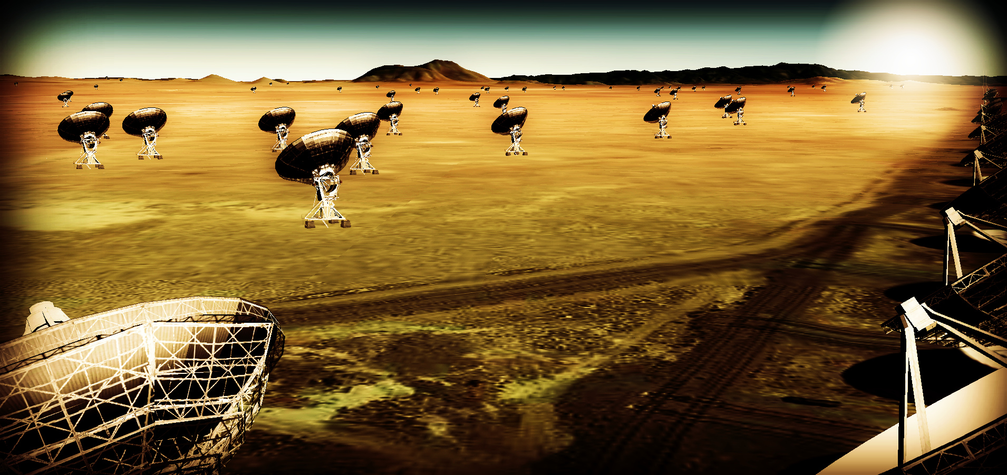
Effective area at 40GHz ~ 10x JVLA
Resolution ~ 10x JVLA
Frequency range: 1 – 50, 70 – 115 GHz
https://science.nrao.edu/futures/ngvla

Slide 2
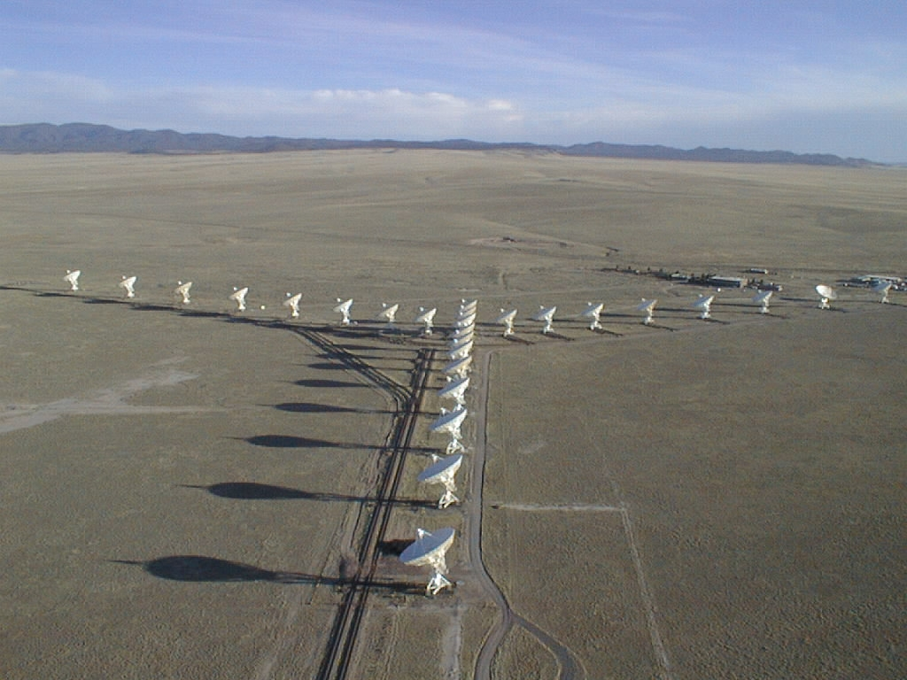
The Very Large Array: 2 min history
1972 – Approved by Congress
1980 – Full science operations
2001 – Complete electronics upgrade approved by NSF
2011 – Jansky VLA full science ops

Slide 3
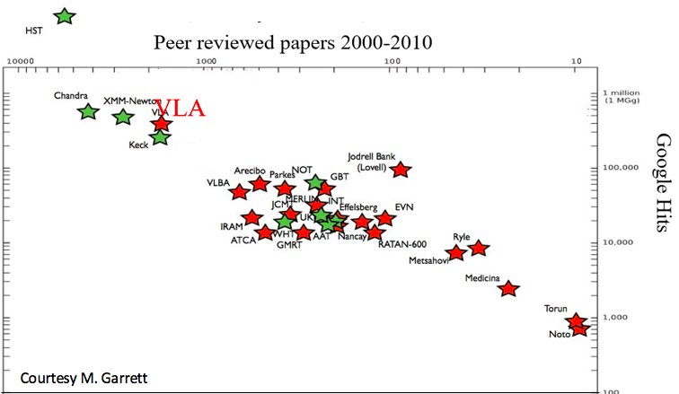
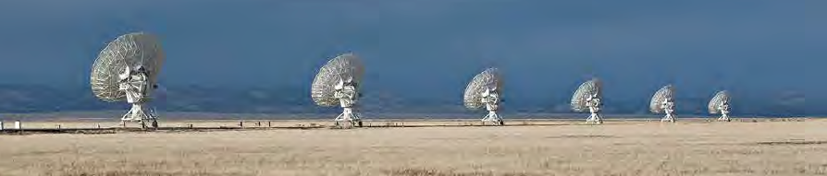
Radio Astronomy Powerhouse from 1980 to present
~6,000 refereed papers with ~250,000 citations
300 PhD theses
The VLA has been the most productive ground-based telescope ever!

Slide 4
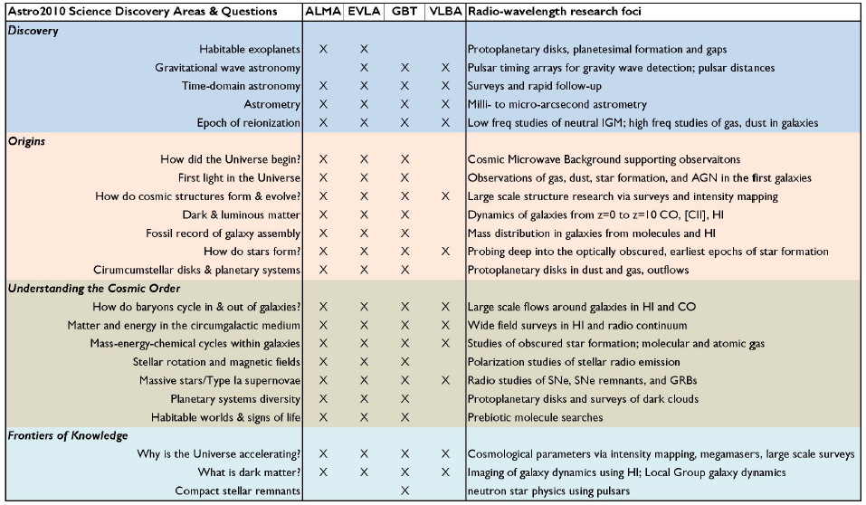
2010 Decade Survey: Broad Appeal
Notes:
http://arxiv.org/abs/1405.1456
The Intrinsic Two-Dimensional Size of Sagittarius A*
Bower et al. 2014 ApJ in press

Slide 5
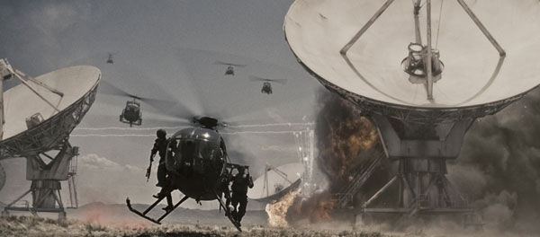

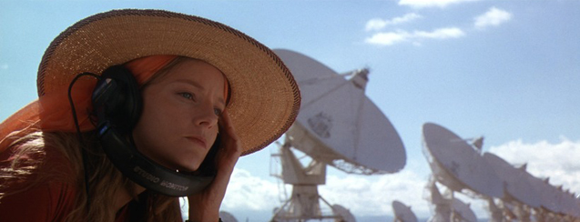
”I've always wanted to see the Very Large Array in New Mexico. It's not the biggest in the world, of course, or the most modern, but it is iconic, and I grew up wanting to see it. It's quite spectacular. Out there in the desert.” John Luther
Contact / T4

Slide 6
10x VLA res. + sens of JVLA: new regime in radio astronomy Thermal imaging on mas scales at λ ~ 0.3cm to 3cm
Process and Design
Science
Cradle of Life: Terrestrial planet formation
Galaxy ecosystems: Baryon cycle
Galaxy formation: Cool gas history of the Universe
Time domain and Physics: Exo-space weather
Goals: 2020 Decade Survey and Global radio astronomy in 2030

Slide 7
Community process to date (16 months!)
Jan 2015, Jan 2016: AAS community science meetings
April 2015, Dec 2015: Technology meetings (Pasadena, Socorro)
Dec 2015, Aug 2016: Kavli-sponsored RMS meetings (Chicago, Baltimore)
Nov 2015: Science working group science program reports (200 pages, 125 authors) http://library.nrao.edu/ngvla.shtml
Circle of Life (Isella, Moullet, Hull)
Galaxy ecosystems (Murphy, Leroy)
Galaxy assembly (Lacy, Casey, Hodge)
Time domain, Cosmology, Physics (Bower, Demorest)
Early times: Design and Science are ‘under construction’ – need your help!

Slide 8
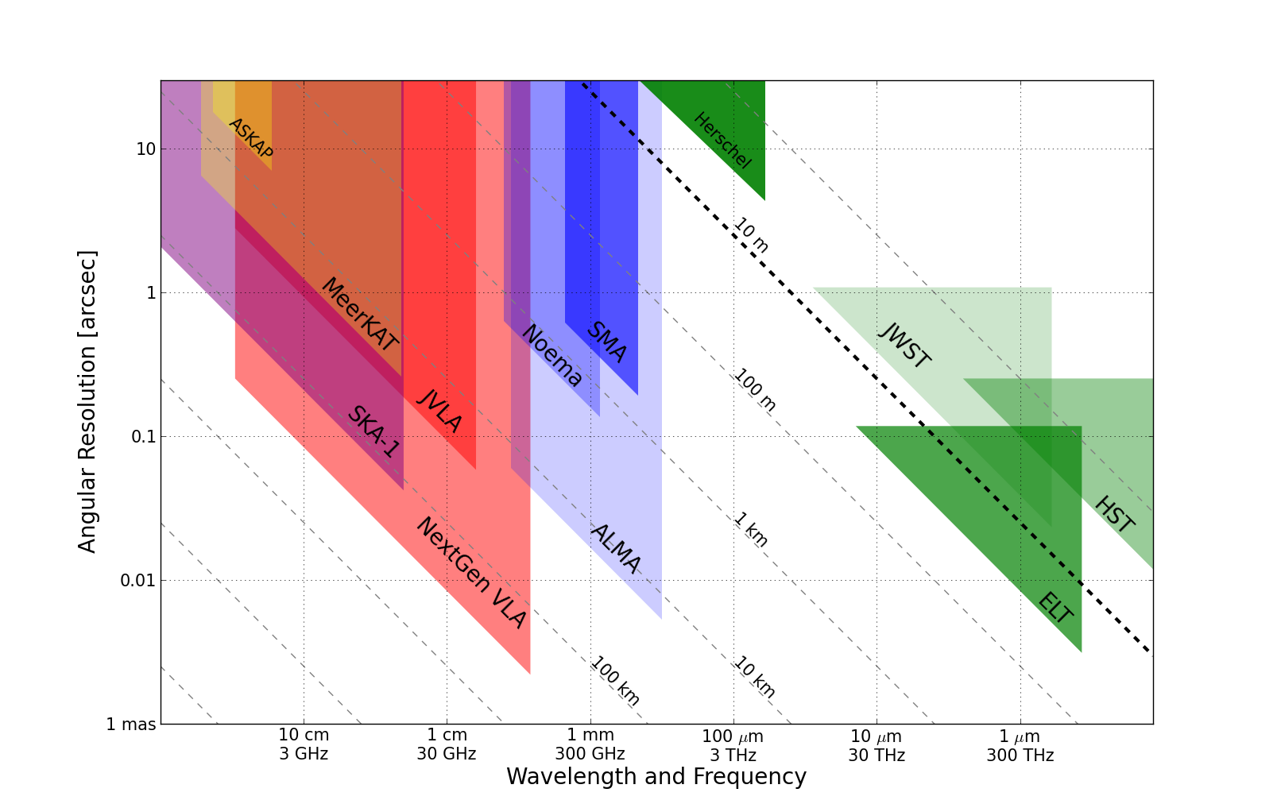
Killer Gap
Thermal imaging on mas scales at λ ~ 0.3cm to 3cm
1AU @ 140pc
Terrestrial zone planet formation
Resolution ~ 10mas @ 1cm (300km)
Synergy w. ALMA, future ELTs, NGST

Slide 9
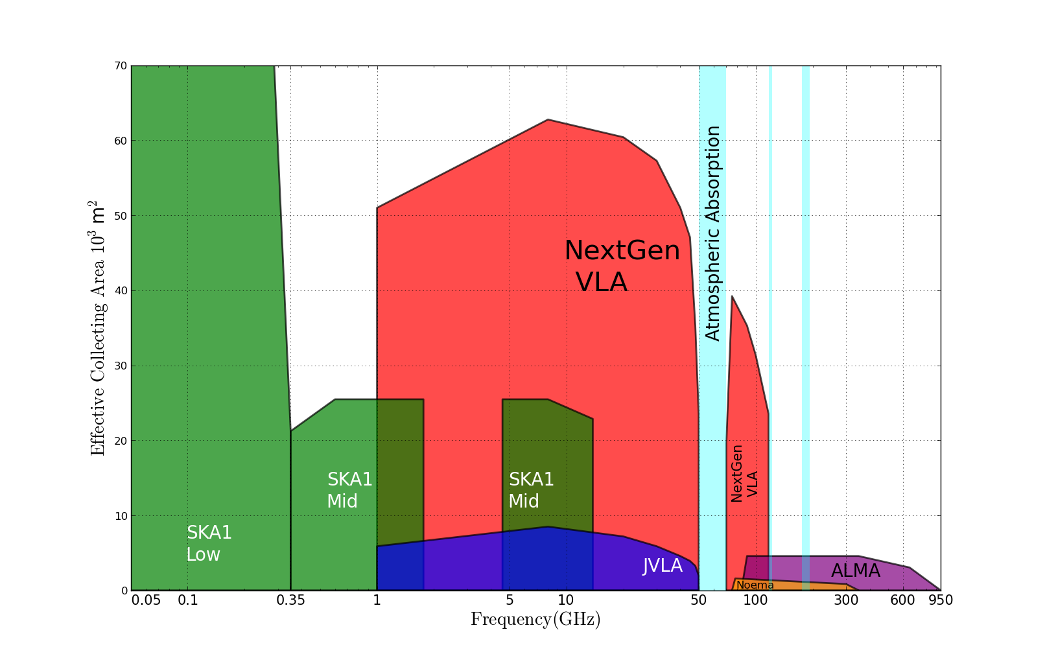
Killer Gap
Thermal imaging on mas scales at λ ~ 0.3cm to 3cm
5x
Sensitivity ~ 100 nanoJy @ 1cm, 10hr, BW = 20GHz
T_{B} ~ 1K @ 1cm, 10mas
Molecular lines become prevalent above 15GHz

Slide 10
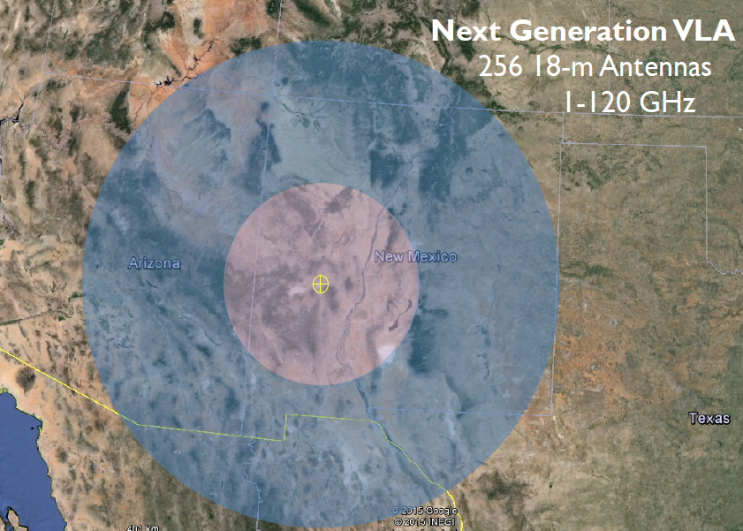
JVLA: Good 3mm site, elev. ~ 2200m
30% in core: b < 3km ~ 1” at 30GHz
60% in mid: b < 30km ~ 0.1”
90% in long: b < 300km ~ 0.01”
10% in VLB: b ~ 3000km ~ 0.001”
550km

Slide 11
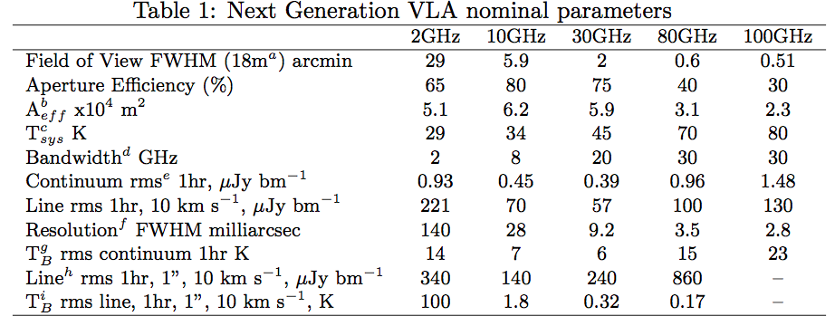
Improvements over JVLA
10x Sensitivity
10x Resolution
1 – 115GHz (vs. 1 – 50GHz)

Slide 12
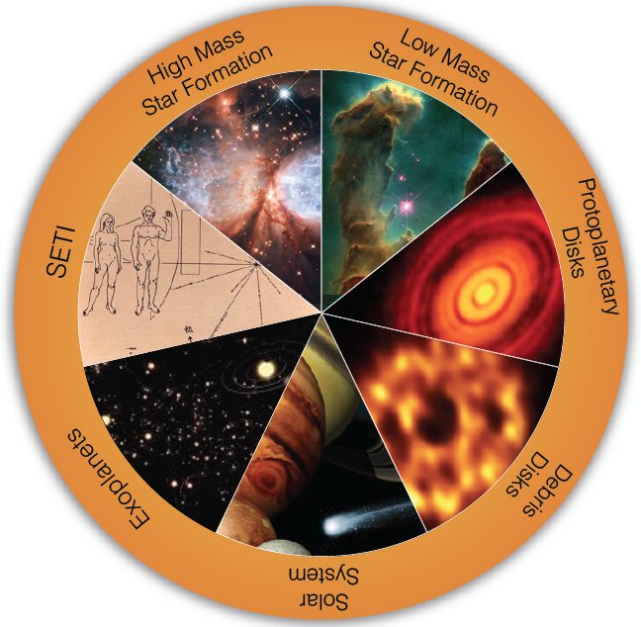
SWG1 Circle of Life: origin stars, planets, life
Accretion in dust-obscured early phases
chemistry
Origin of stellar multiplicity
Organic chemistry
Aircraft radar from nearby planetary systems in 10min
Terrestrial zone planet formation
biology
Pre-biotic chemistry
Magnetospheres and exo-space weather
Pre-biotic molecules
Imaging chemistry, dynamics deep in planetary atmospheres

Slide 13
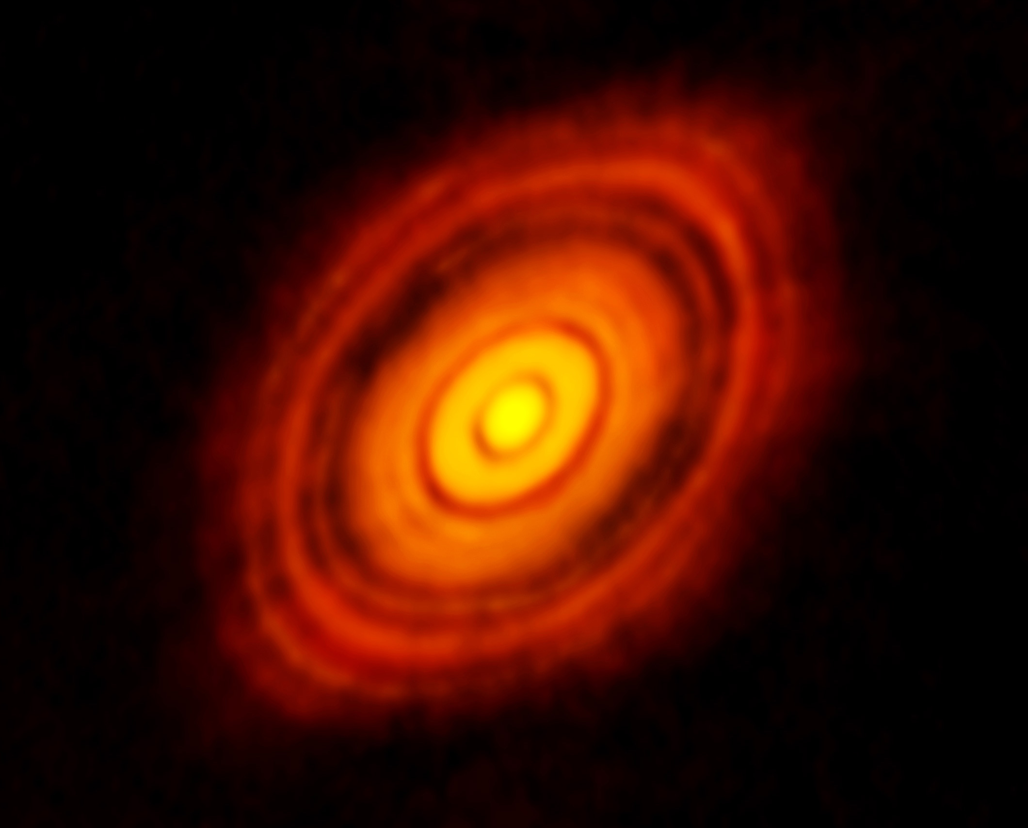
ngVLA: Terrestrial zone planet formation imager
ALMA 250GHz Brogan ea.
HL Tau w. ALMA: Rosetta-stone of planet formation at 140pc distance
1Myr old protostar ~ 1 M_{o} w. 0.1 M_{o} dusty disk
Inner few AU disk optically thick in mm/submm
100AU 0.7” at 140pc
Inner 10AU = ngVLA zone @ 10mas res

Slide 14
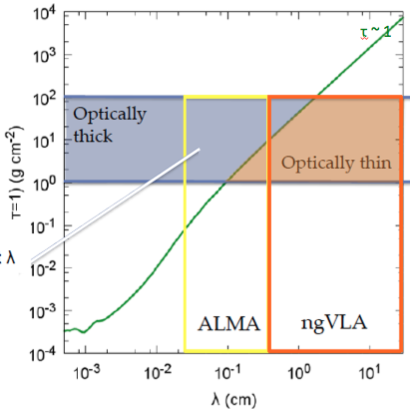
Terrestrial zone planet formation = ‘ngVLA zone’
Areal density for τ > 1
Typical ~ 1Myr protoplanetary disk at R ~ few AU
ALMA gets AU-res. in submm, but disk is optically thick!
Isella ea.

Slide 15
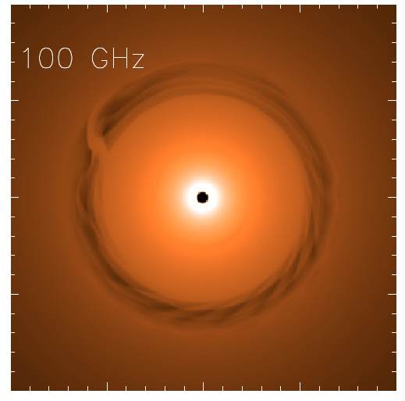
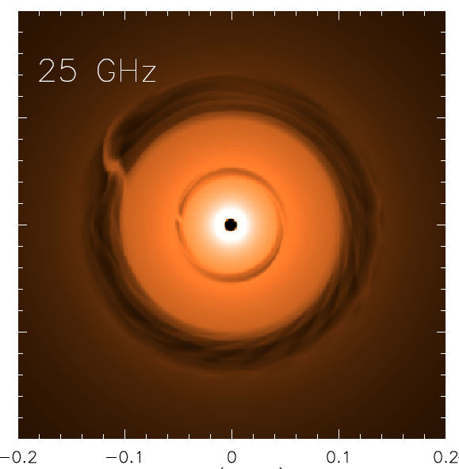
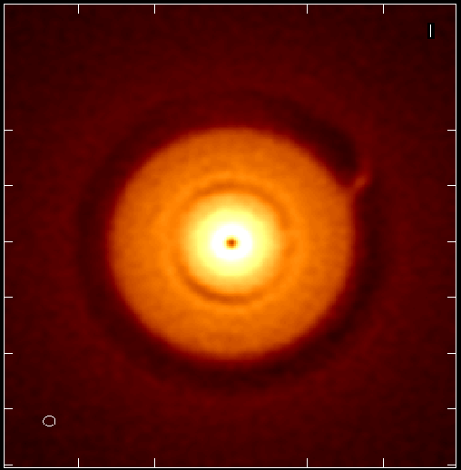
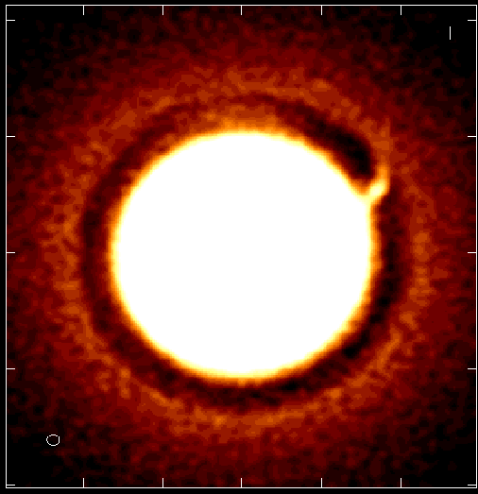
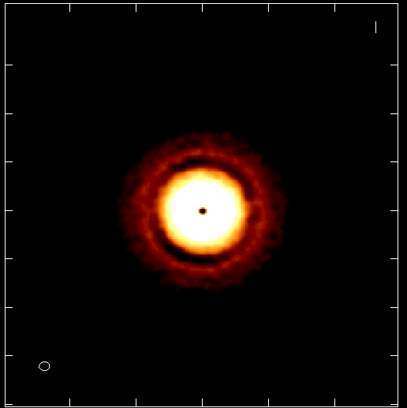
NGVLA: 1Myr Protoplantary disk at 140pc distance
Jupiter at 13AU Saturn at 6AU
ngVLA 100hr 25GHz 10mas
0.1” = 13AU
Isella Dust Model
model
rms = 90nJy/bm = 1K
Inner gap opt. thick at 100GHz
Image both gaps + annual motions
Circumplanetary disks: imaging accretion on to planets
Grain size stratification: Image poorly understood transition from dust to planetesimals
ngVLA: image inner gap
ngVLA: planet accretion!
Isella + Carilli

Slide 16
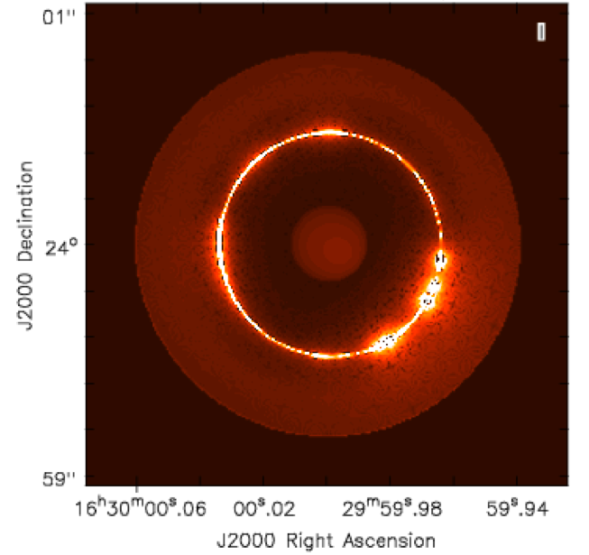
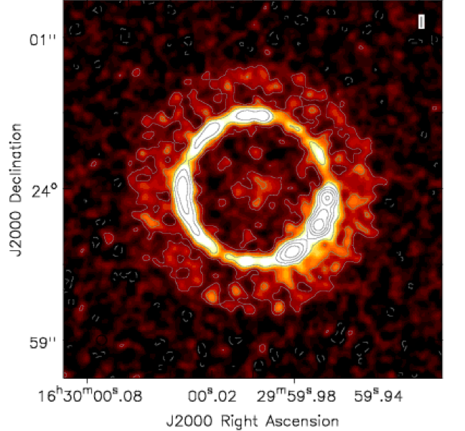
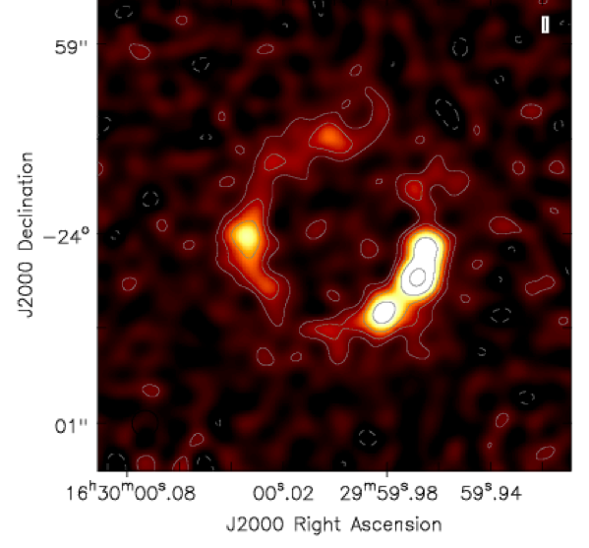
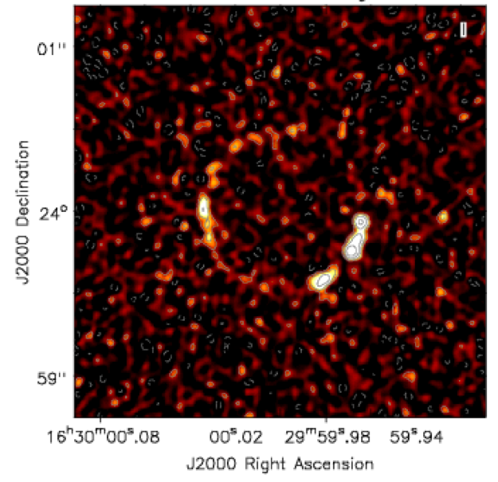
Ricci Model at 30GHz
Next Gen. VLA at 0.06” res
TW Hya ~ 10Myr PP Disk
1 M_{o} protostar + 0.1M_{o} disk
Dust trap caused by gaseous vortex at 60AU => narrow dust ring
Planets may coalesce around dust knots in ring
60AU
Ricci ea
ALMA Band 1 at 0.12”
JVLA at 0.06”

Slide 17
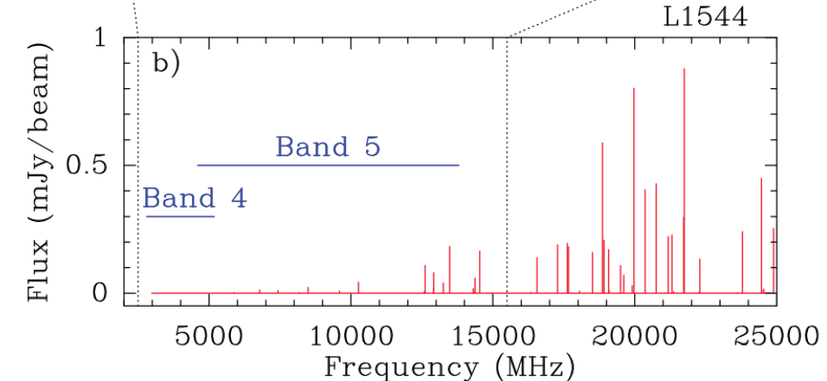
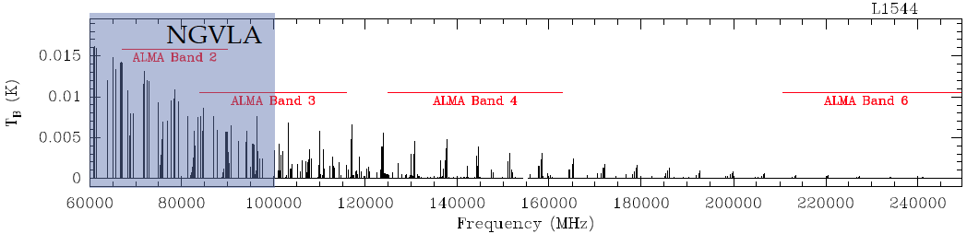
Circle of life: pre-biochemistry
Glycine
Pre-biotic molecules: rich spectra in 0.3cm to 3cm regime
Complex organics: ice chemistry in cold regions
Ammonia and water: temperature, evolutionary state, PP disks, comets, atmospheres…
Codella ea. 2014
SKA
ngVLA
Jimenez-Sierra ea 2014

Slide 18
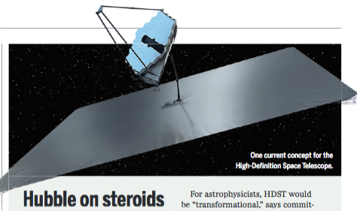
ng-Synergy: Solar-system zone exoplanets
‘ALMA is to HST/Kepler as ngVLA is to HDST’
High Definition Space Telescope Terrestrial planets = top science goal
Direct detection of earth-like planets
Search for atmospheric bio-signatures
ngVLA
Imaging formation of terrestrial planets
Pre-biotic chemistry

Slide 19
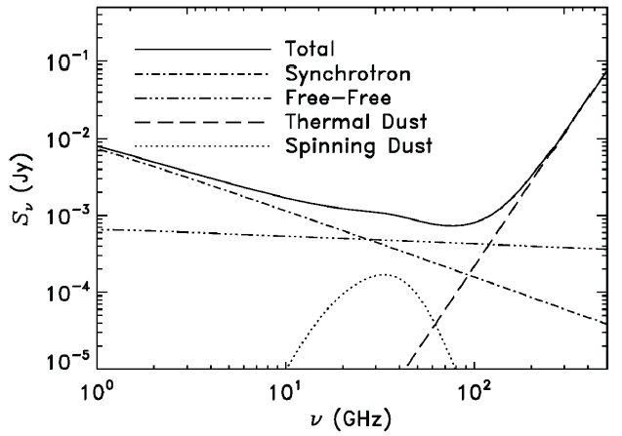
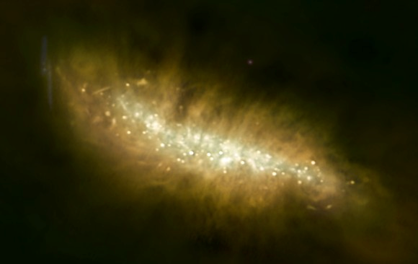
SWG2: Galaxy eco-systems: Baryon cycle
Wide field, high res. mapping of Milky Way and nearby Galaxies
M82
ngVLA
Broad-Band Continuum Imaging
Cover multiple radio emission mechanisms: synchrotron, free-free, cold (spinning?) dust, SZ effect
Independent, obscuration free estimates of SFR
Physics of cosmic rays, ionized gas, dust, and hot gas around galaxies

Slide 20
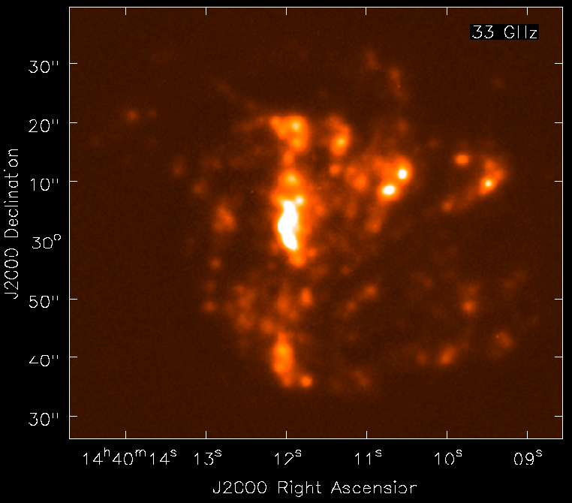
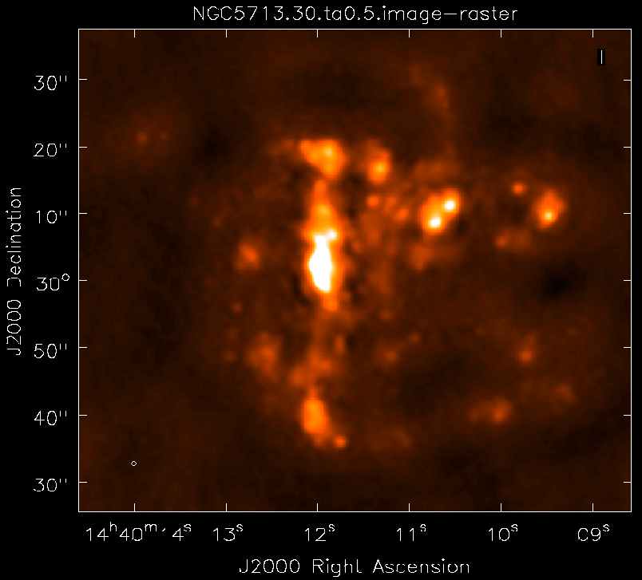
NGVLA: Free Free emission from peculiar spiral in Virgo
NGC 5713: distance ~ 30Mpc, total SFR ~ 5 M_{o} yr⁻¹
Model 33GHz FF (from Hα)
NGVLA 10hrs, 0.5” res
1kpc
Murphy + Carilli
Free-Free ideal estimator of ionizing photon rate
rms (1cm, 10hrs) = 0.1uJy => HII region associated single O7.5
Broad -band: spatially/spectrally separate thermal/non-thermal
Local-group-type studies out to Virgo!

Slide 21
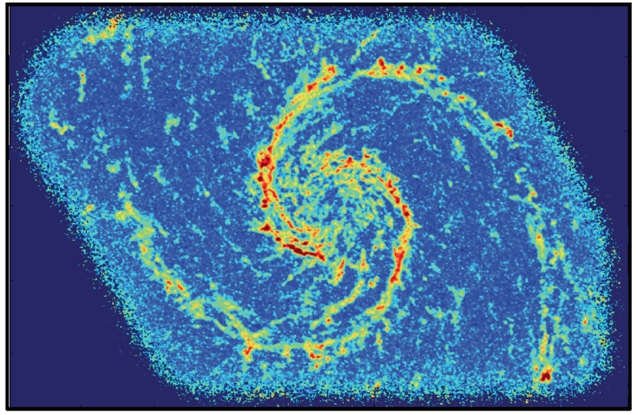
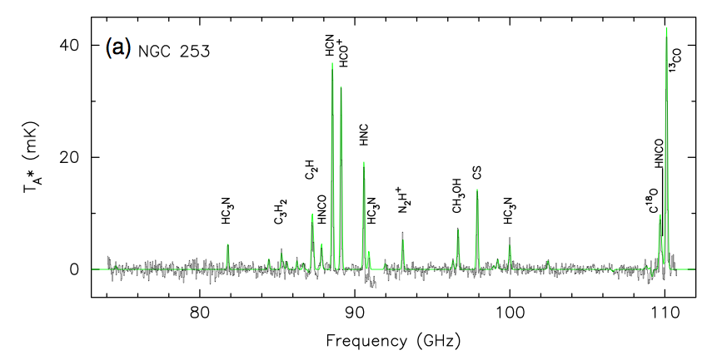
Schinnerer ea.
Spectral Line Mapping: Map cool ISM 10x faster than ALMA
Rich frequency range: 1st order transitions of prime astrochemical + dense gas tracers
CO mapping: tens hours w. ALMA
Other lines are 10x fainter => need ngVLA
CO1-0 Bure 200hr, 1”
Snell ea

Slide 22
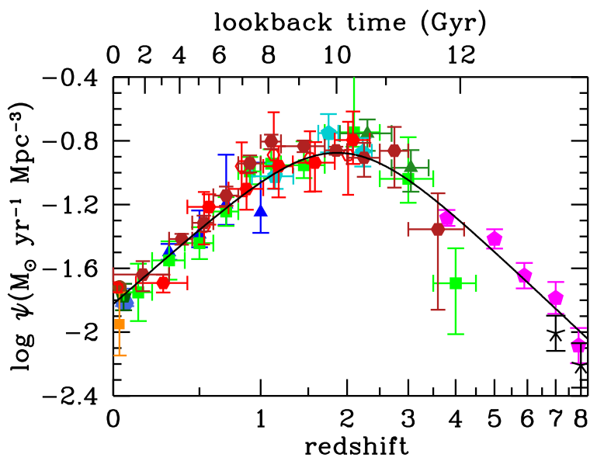
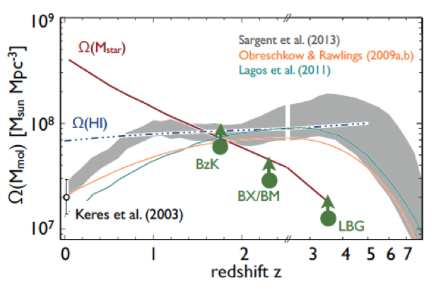
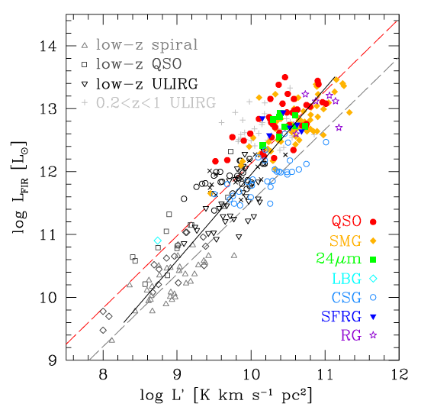
SWG3: Cool Gas History of the Universe
SF Law
FIR ~ SFR
L_{CO} ~ M_{gas}
‘Missing half of galaxy formation’
SFHU has been delineated in remarkable detail back to reionization
SF laws => SFHU is reflection of CGHU: study of galaxy evolution is shifting to CGHU

Slide 23
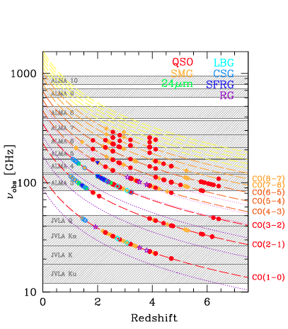
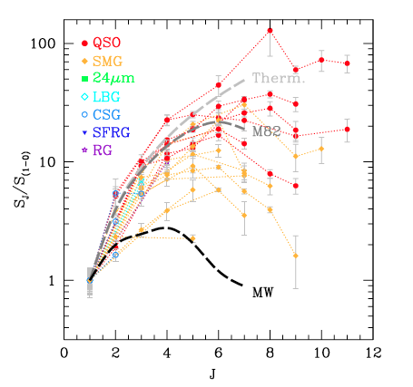
Low order CO: key total molecular gas mass tracer
M_{H2} = α x L_{CO1-0}
Total molecular gas mass
w. ALMA => gas excitation
Dense gas tracers associated w. SF cores: HCN, HCO+
ALMA
ngVLA ‘sweet spot’
10x uncertainty
VLA/GBT
SKA 1

Slide 24
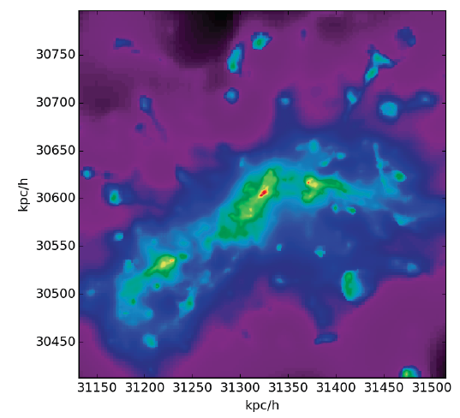
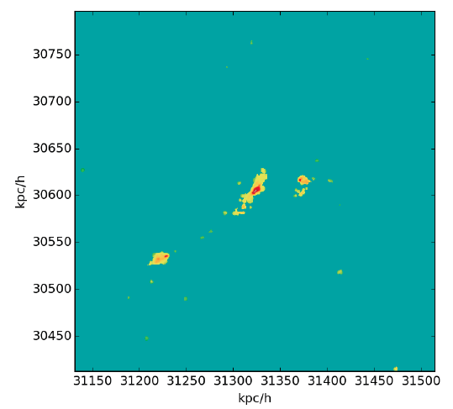
Galaxy assembly: Imaging on 1 kpc-scales
Low order: large scale gas dynamics, not just dense cores
w. ALMA dust imaging: resolved star formation laws at ~ 1kpc
CO 1-0
z ~ 3
CO 3-2
n_{cr} > 10⁴ cm⁻³
n_{cr} ~ 10³ cm⁻³
Narayanan

Slide 25
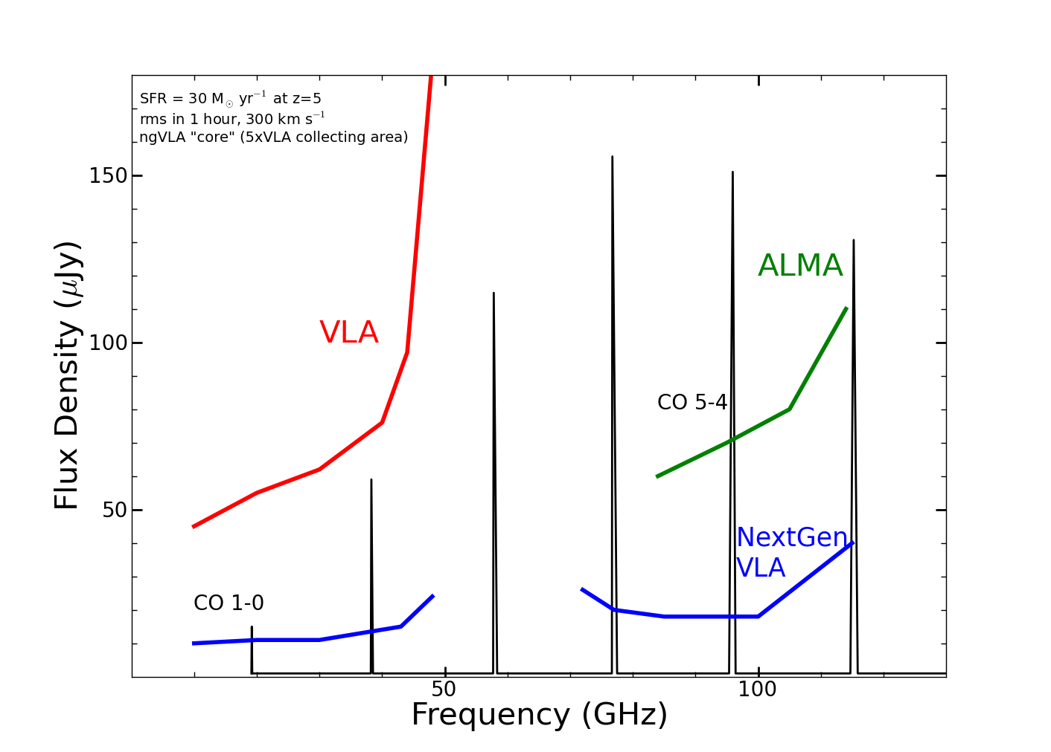
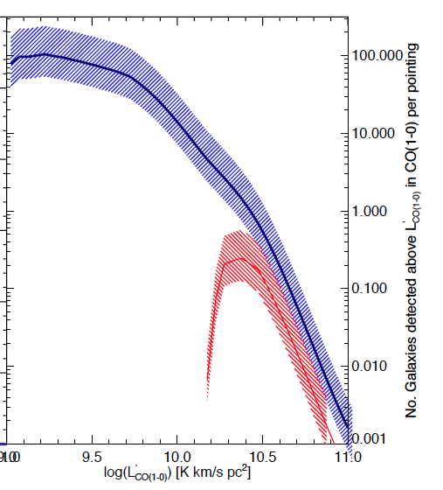
New horizon in molecular cosmological surveys
CO emission from typical star forming, ‘main sequence’ galaxies at high z in 1 hour
z=5, 30 M_{o}/yr, 1hr, 300 km/s
GBT
GBT
Number galaxies per hour 20 – 40GHz
ngVLA
100-fold increase molecular survey capabilities. Number of CO galaxies/hour:
JVLA ~ 0.1 to 1, M_{gas} > 10¹⁰ M_{o}
ngVLA > 100, M_{gas} > 2x10⁹ M_{o}
JVLA
Casey ea

Slide 26
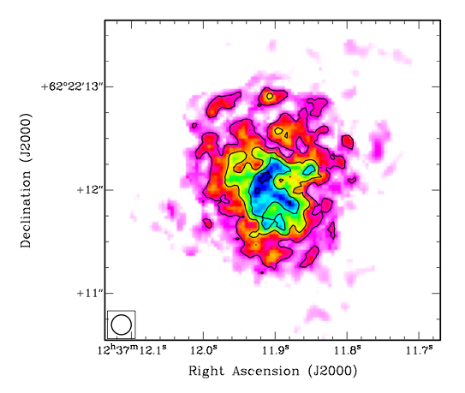
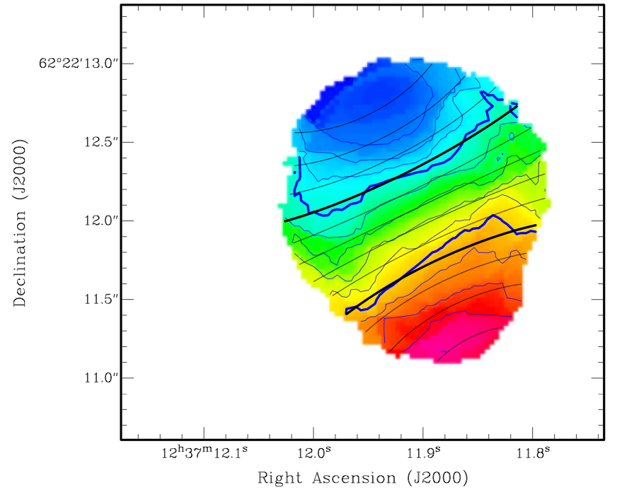
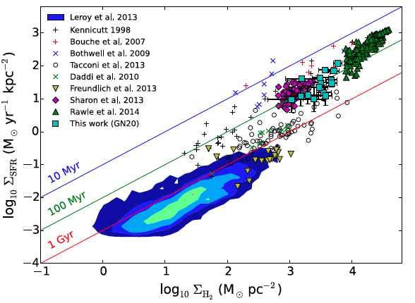
JVLA state of art
Beyond blob-ology
CO 2-1 z=4.0
-300 km/s
7kpc
GN20: SMG at z=4.0
M_{H2} ~ 1.0 10¹¹ M_{o}
Resolved gas dynamics
14kpc rotating disk
M_{dyn} = 5.4 10¹¹ M_{o}
Resolved SF law
1”
+300 km/s
0.25”
Hodge ea.
Resolved SF Law
GN20
100 hours on JVLA
1hour on ngVLA

Slide 27
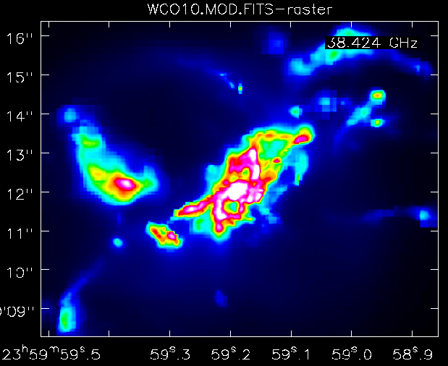
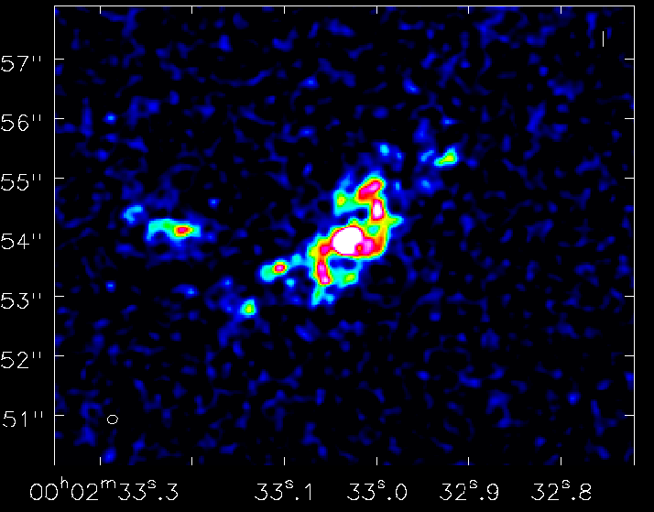
ngVLA: SMG at z=2, CO1-0
Narayanan + Carilli
1” = 7kpc
Model
ngVLA
38GHz, 10hrs
rms(100 km/s) = 12uJy => 2e8 (α/0.8) M_{o} !
Resolution = 0.15” = 1kpc
Low mass satellite galaxies, streamers, accretion
Dynamics: Fisher-Tully at z=2!

Slide 28
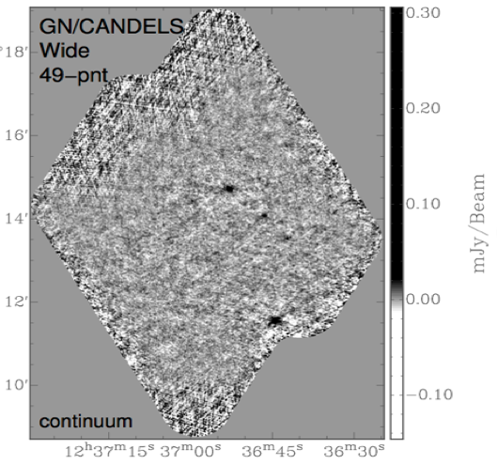
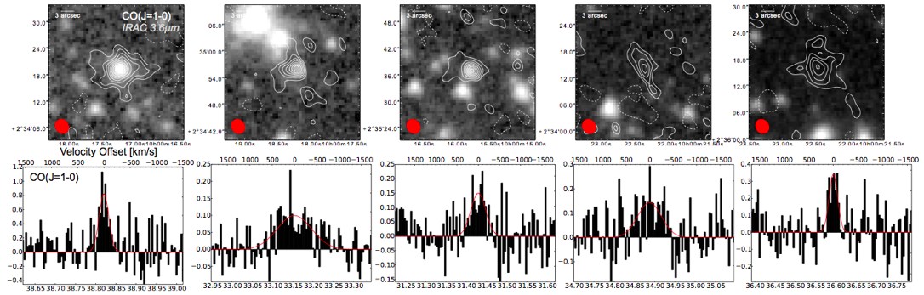
State of Art: JVLA, ALMA CO Deep Fields
3uJy
JVLA 350hrs: 30-38GHz
ALMA 40hrs: 82-115, 212 – 272
Field sizes ~ 1 to 50 arcmin²
z=3
z=2
~ 20 CO galaxies per ALMA, JVLA survey w. M_{H2} ~ 10¹⁰ M_{o}
Main sequence: SFR ~ 10 to 100 M_{o}/yr
‘CO-selected’ galaxies: faint in optical and submm

Slide 29
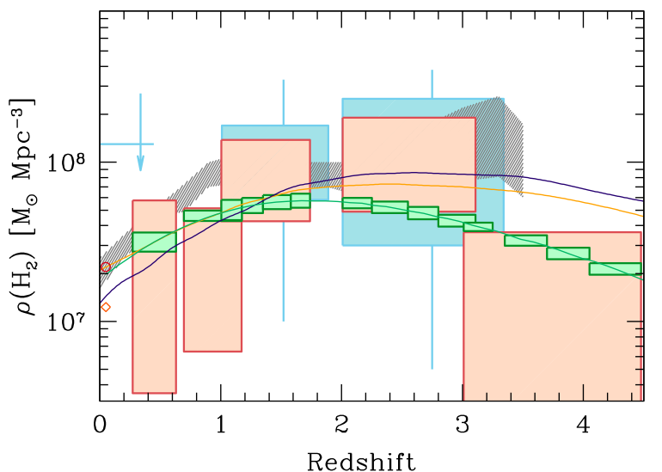
ngVLA: Cool gas history of Universe
Decarli ea.
10’s galaxies JVLA, ALMA: first-pass at CGHU
NGVLA => 1000’s of galaxies
Quantitative evolution of CO luminosity function and cosmic gas density = ‘missing half of galaxy formation’
Bure
ngVLA
ALMA

Slide 30
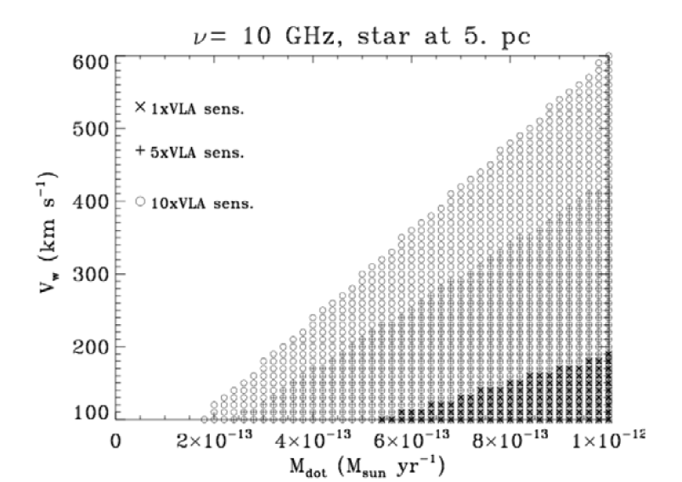


SWG4: Physics, cosmology, time domain
Star – Planet interactions: exo-space weather
ngVLA ~ 10⁻¹³ M_{o}/yr
M-dwarf flares ~ 10⁴ x Sun!
VLA
NGVLA most sensitive telescope to study broad-band radio phenomena = key observables of exo-space weather
Thermal emission from M-Dwarf winds: most likely to host habitable planets, but very active. Wind – planet interaction => evaporation of atmospheres
Non-thermal Brown Dwarf aurorae: Star-planet magnetospheric interactions
Dictate exo-planet environs, and the development of life!
cyclotron emission, w. B ~ 2000G!
Hallinan)

Slide 31

VLBI uas astrometry (baselines ~ 3000km)
Local group 3D dynamics via proper motions + parallax of masers, weak AGN to 10uas/year
Local group dark matter content
Ultimate fate of Milky Way
Local group proper motions:
10 uas/year = 40 km/s (Darling)

Slide 32

VLBI uas astrometry: Real Time Cosmology (Darling 2013)
Main cosmological observables are functions of time
dz/dt = H_{o}(1+z) – H(z)
dD_{L}/dt / D_{L} = H_{o} + dz/dt (1+z)⁻¹
dD_{A}/dt / D_{A} = H_{o} – dz/dt (1+z)⁻¹
But VERY SMALL
H_{o} ~ 7 x 10⁻¹¹ yr ⁻¹ ~ 15 μas yr ⁻¹
Anisotropy of Hubble expansion, or cosmic rotation, to 0.7% H_{o}
Baryon Acoustic Oscillations at z=0.5
𝜃_{BAO} = 4.5° (l~40)
d𝜃_{BAO}/dt_{o} ~ − H_{o}𝜃_{BAO} ~ –1.2 μas yr ⁻¹
Convergent (E-mode) signal at l ~ 40 showing real-time evolution of the BAO is detectable with ngVLA w. VLBI
Proper motion ‘power spectrum’
ngVLA astrometric grid: 10⁴ AGN each to 10 μas yr ⁻¹
Global detection of correlated signals of 0.1 μas yr⁻¹

Slide 33


Cosmology & Physics
+Chandra
S-Z for individual galaxies
ngVLA (1cm, 3”, 10hrs) ~ 1uK
nT ~ 10⁶ over 10kpc => 20uK
Evolution of fundamental constants
(eg. FSC, e⁻/p mass ratio) using radio absorption lines: 10x better than UV absorption lines ~ 10⁻⁷ at z > 1
Kanekar ea

Slide 34
Preliminary Key Science
Key Science Goal | Synergy
Imaging Terrestrial zone planet formation + prebiotic chemistry | HDST terrestrial planet imaging + life-signs
Cool gas history of Universe: fuel for star formation | JWST, ELT: stellar mass and SFRs
Time domain: exospace weather, explosive Universe | LSST
Baryon cycle: wide field, high resolution thermal line + cont. imaging | FIR Surveyor
VLBI astrometric applications: real time cosmology | CMB

Slide 35

Next step: Sci. Requirements to Tel. Specifications
Goal | Science Requirement | Array Specification
TPF | Optically thin | Freq ~ 15 to 50GHz
 | 1AU at 130pc @ 30GHz | B ~ 300km
 | 1K in 10hrs @ 10mas, 30GHz | A_{full} ~ 300 x 18m; BW ~ 20GHz
CGHU | CO 1-0 to z=8 | Freq = 15 to 115GHz
 | M_{gas} = 10⁹ M_{o} at z = 3 in 1hr | A_{mid} ~ 70% to B ~ 30km
 | 500pc resolution at z = 3 (60mas) | 30km
 | Large volume surveys | Octave Band Ratio
Baryon Cycle | T_{B} < 0.2K (1hr, 10 km/s, 80GHz, 1”) | A_{core} ~ 30% to B ~ 2km
 | Continuum science | Octave BR; Linear pol to 0.1%
Time Domain | Explosive follow-up (GRBs, GW/EM…) | Minute trigger response time
 | Blind discoveries (eg. FRBs) | millisec searches
 | Exo-space weather: 1uJy in 1min | Freq ~ 1 to 20GHz A_{full} ~ 300 x 18m Circular pol to few %

Slide 36


Goal: PDR-level ‘proposal’ to 2020 Decade Survey for major D+D program
Killer science program
Costed design of all major elements
Science Requirements
Telescope specs
Project book spread sheets + detailed cost model

Slide 37



JPL + NRAO Hosted Technical Meetings
Antennas
12 to 25m w. 75% eff at 40GHz
Offaxis vs. symmetric?
Hydroform, panel?
Feeds, Receivers: performance at > 2:1 band ratio?
1 – 115GHz: 4 bands? 6 bands?
Correlator: FPGA, GPU, ASIC, Hybrid all viable
Archive and Post-processing: reasonable for key science programs
Operations costed from ALMA. JVLA
Conclusions
No major single-point failures
Could build today for not-unreasonable cost
Development focus on minimizing construction and operations cost
Morgan mmic: Rack full of warm electronics in your hand

Slide 38
Living documents requiring testing and simulation: areas to explore – with your help!
Science program
Physical models and mock observations: need ‘deep dives’
Broaden program: what’s missing?
Configuration
Balance: Core (3km) vs. mid (30km) vs. long (300km)
Some fraction reconfigurable
Need for total power
VLBI implementation
Phase Calibration: WVR, Cal. Array, Fast Switching
https://science.nrao.edu/futures/ngvla
Science working group meeting early 2017 in Socorro

Slide 39

Radio facilities @ 2030
++
> 3cm: SKA-2 superb for pulsars, reionization, HI surveys
3cm to 3mm: ngVLA superb for Terrestrial planet formation, Cool gas history of Universe, Baryon cycle
< 3mm: ALMA++ superb for Chem, dust, fine structure lines

Slide 41



Imaging stellar photospheres
Red supergiant Betelgeuse at 40GHZ
JVLA res = 40mas
Schematic Model
ngVLA: res = 8mas
rms = 0.25uJy/beam = 2.4K
100mas
90mas
JVLA: <Tb> = 3000K plus structure at +/- 10%
10hrs at 40GHz w. ngVLA
Stellar rotation

Slide 42


Plasma Universe
Mpc-scale cluster emission
1000km. 100msec scale solar flares
Relativistic particle acceleration: Magnetic reconnection vs. shock acceleration through broad-band spectra
S-Z for individual galaxies
ngVLA-short (1cm, 3”, 10hrs) ~ 1uK
nT ~ 10⁶ over 10kpc => 20uK

Slide 43



GBR/TDE: late time jet shock
Exploding Universe: bursts are brighter and peak earlier at high frequency (0.3cm to 3cm)
GRB, TDE, FRB
Novae: ‘peeling onion’
Radio counterparts to GW events
Galactic Center Pulsars
15GHz
10GHz
1GHz

