Slide 1

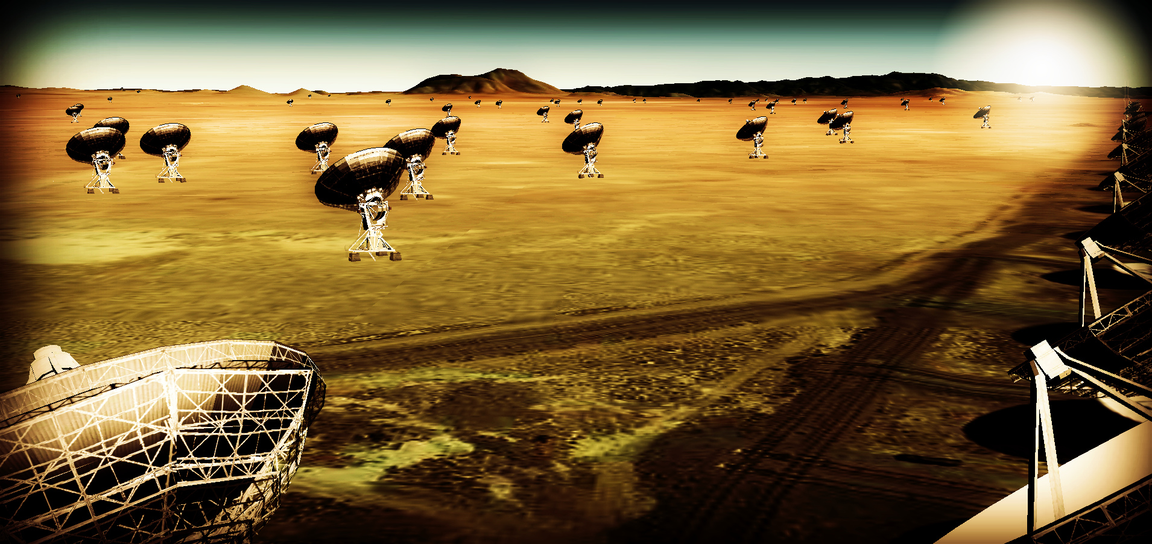
Effective area at 40GHz ~ 10x JVLA
Frequency range: 1 – 50, 70 – 115 GHz
~18m antennas w. 50% to few km + 40% to 200km + 10% to 3000km?
Design goal: minimize operations costs

Slide 2
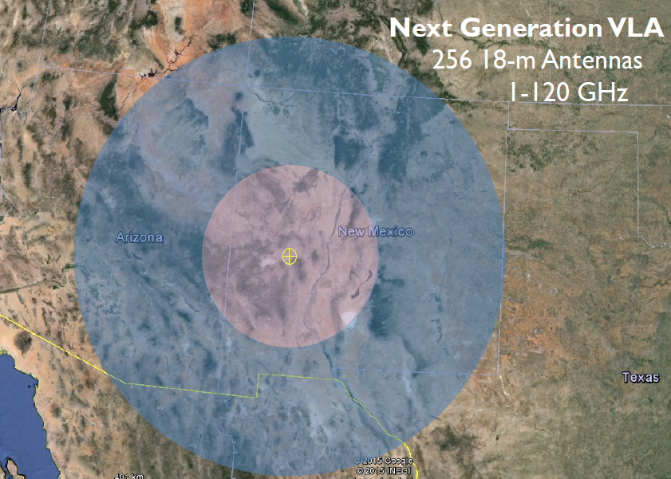
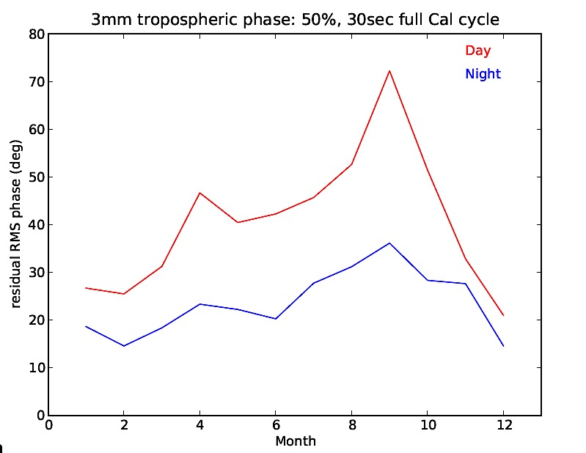
JVLA: Good 3mm site, elev. ~ 2200m
Residual phase rms after calibration
90% coherence
550km

Slide 3
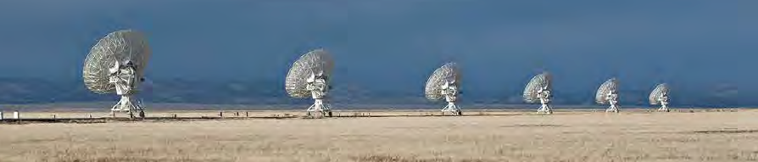
Process to date
Jan 2015: AAS Jan community discussion
  https://science.nrao.edu/science/meetings/2015/aas225/next-gen-vla/ngvla
March 2015: Science working group white papers
  Circle of Life (Isella, Moullet, Hull)
  Galaxy ecosystems (Murphy, Leroy)
  Galaxy assembly (Lacy, Casey, Hodge)
  Time domain, Cosmology, Physics (Bower, Demorest)
April 2015: Pasadena technology meeting
Fall 2015
  SWG define Key Use Cases → science requirements → telescope specs
  Second technical meeting: LO/IF, data transmission, operations, computing

Slide 4
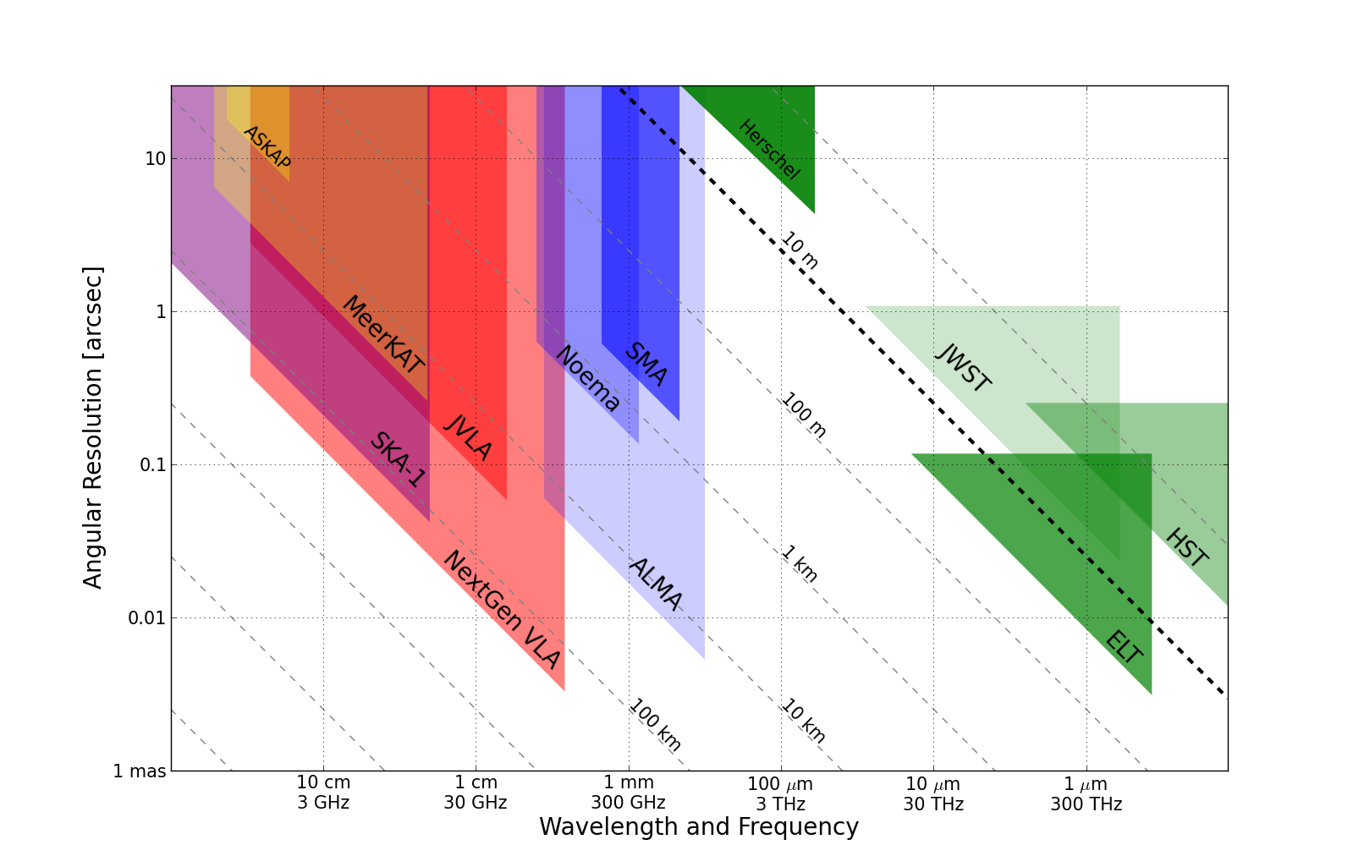
Killer Gap
Thermal imaging on mas scales at λ ~ 0.3cm to 3cm
Kent + Carilli
1AU @ 140pc
Terrestrial zone planet formation
Resolution ~ 15mas @ 1cm (200km)

Slide 5
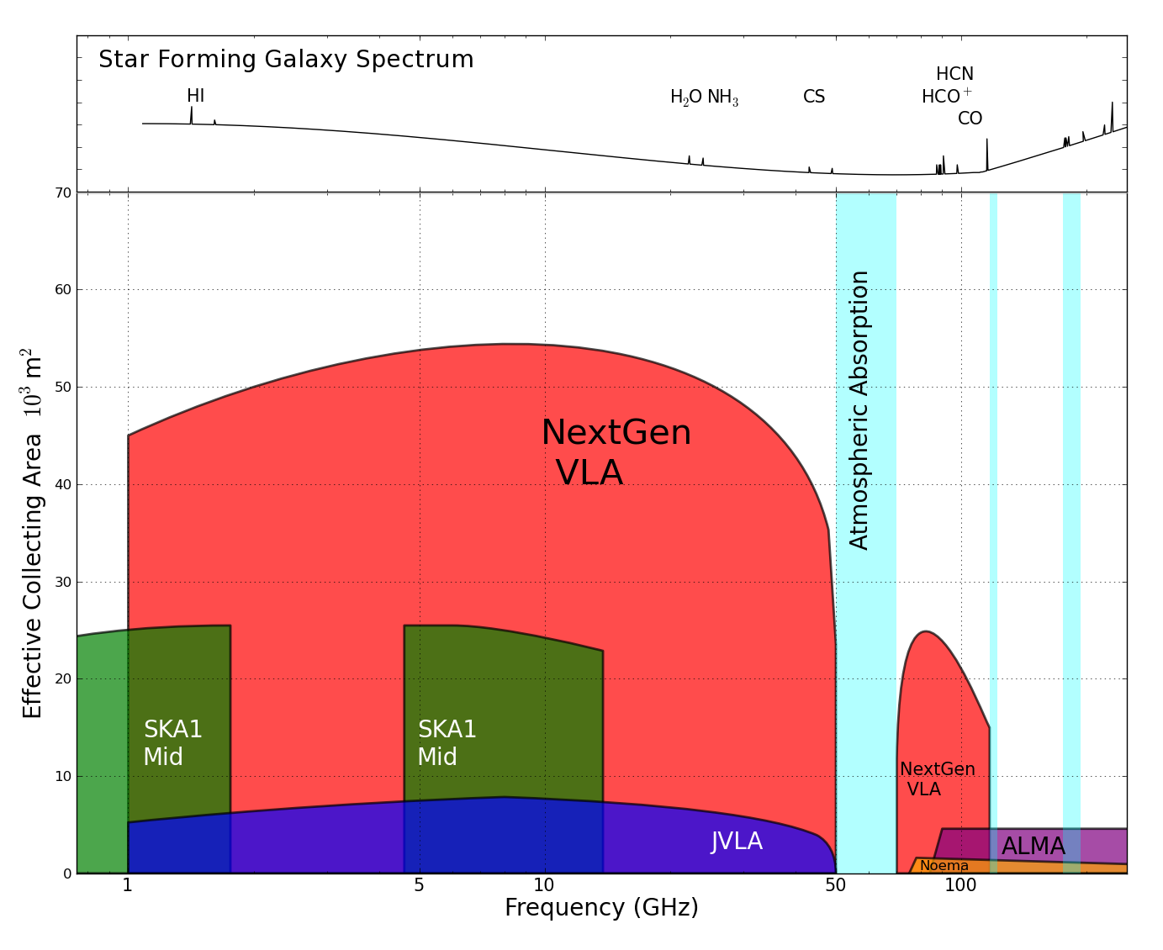
Killer Gap
Thermal imaging on mas scales at λ ~ 0.3cm to 3cm
Sensitivity ~ 130nJy @ 1cm, 10hr, BW = 20GHz
T_{B} ~ 0.6K @ 1cm, 15mas
Molecular lines become prevalent above 15GHz

Slide 6
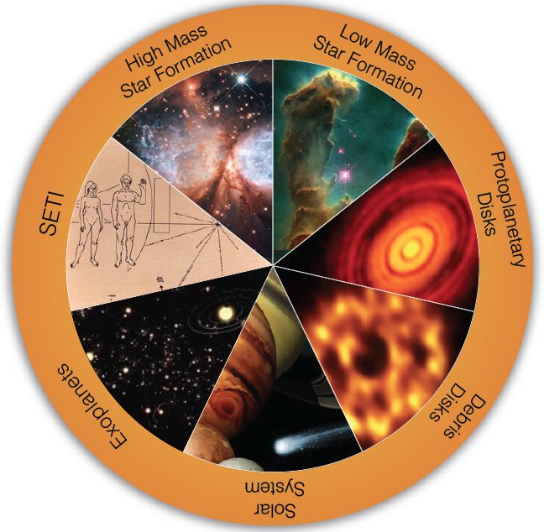
Circle of Life: origin stars, planets, life
  Accretion in dust-obscured early phases
chemistry
  Origin of stellar multiplicity
Organic chemistry
Aircraft radar from nearby planetary systems in 10min
Terrestrial zone planet formation
biology
Pre-biotic chemistry
Magnetospheres and exo-space weather
Pre-biotic molecules
Imaging chemistry, dynamics deep in planetary atmospheres

Slide 7
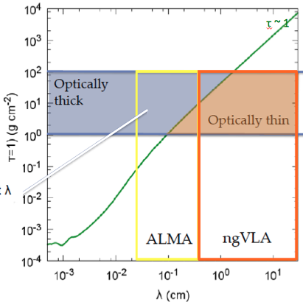
Terrestrial zone planet formation: ngVLA zone
Areal density => τ > 1
Typical protoplanetary disks at R ~ few AU
Optically thick at short ALMA wavelengths, but unresolved at long ALMA wavelengths

Slide 8
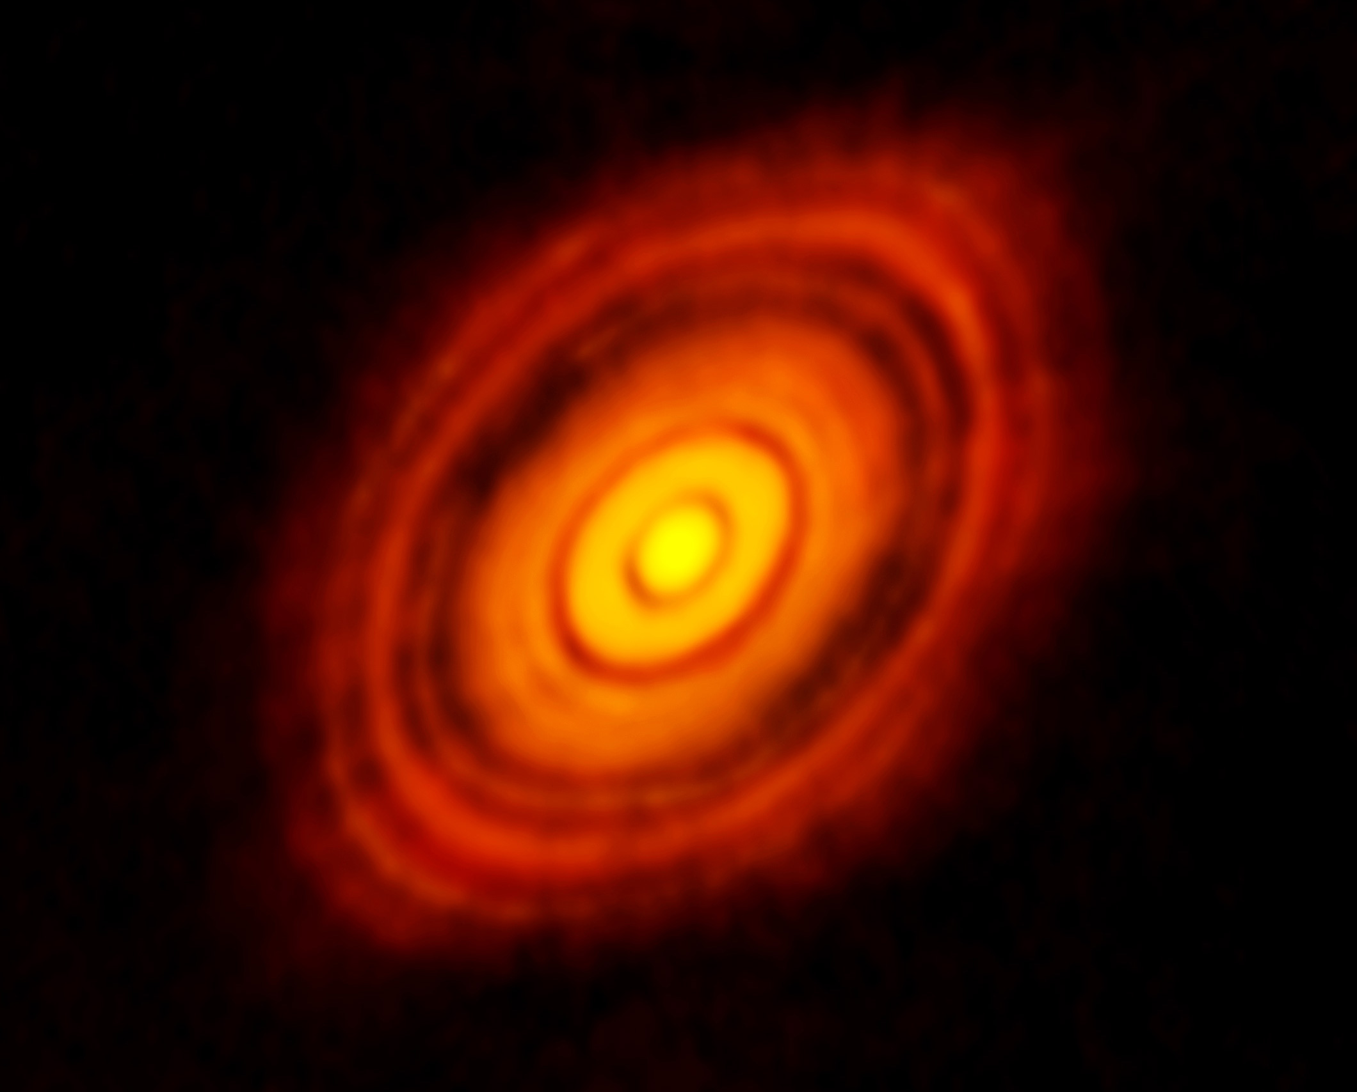
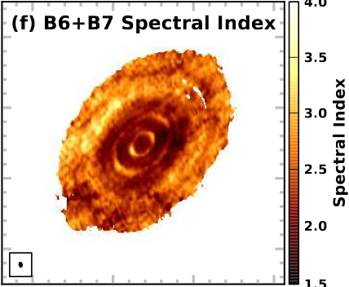
ALMA 250GHz Brogan ea.
ngVLA: Terrestrial zone planet formation imager
  See through dust to pebbles: inner few AU disk optically thick in mm/submm
Grain size stratification at 0.3cm to 3cm
  Poorly understood transition from dust to planetesimals
  SI => combination of grain growth and optical depth
  Annual motions
100AU 0.7” at 140pc
Inner 10AU = ngVLA zone @ 10mas res

Slide 9
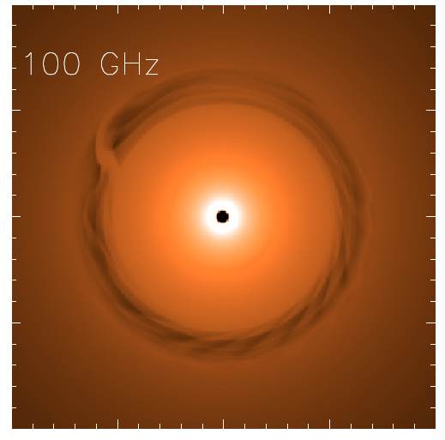
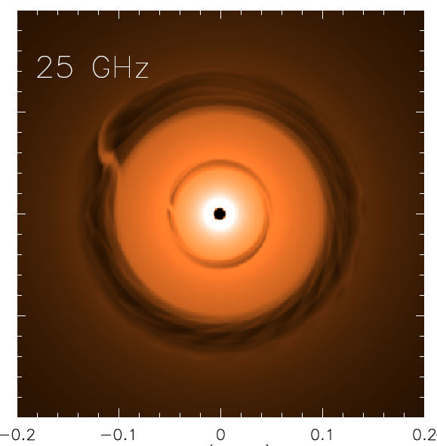
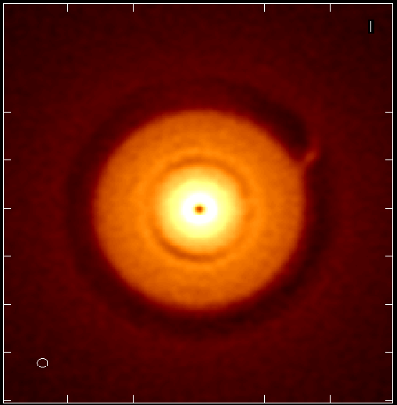
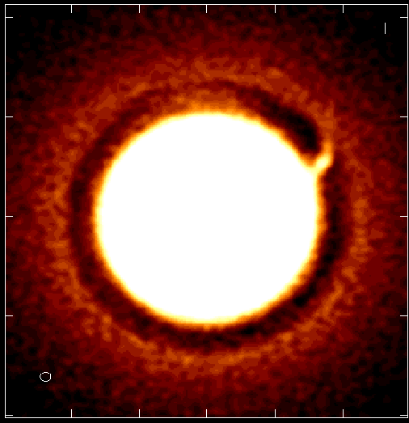
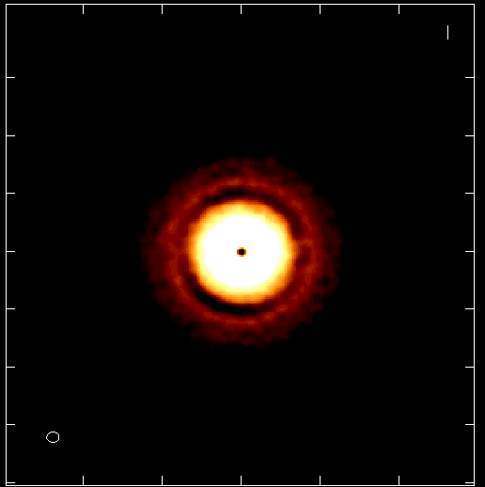
Protoplantary disk at 130pc distance
ngVLA 100hr 25GHz 10mas
0.1” = 13AU
model
model
rms = 90nJy/bm = 1K
Jupiter at 13AU, Saturn at 6AU
Inner gap optically thick even at 100GHz
Image both gaps
Circumplanetary disks: imaging accretion on to planets
ngVLA: planet accretion!
ngVLA: image inner gap
Isella + Carilli

Slide 10
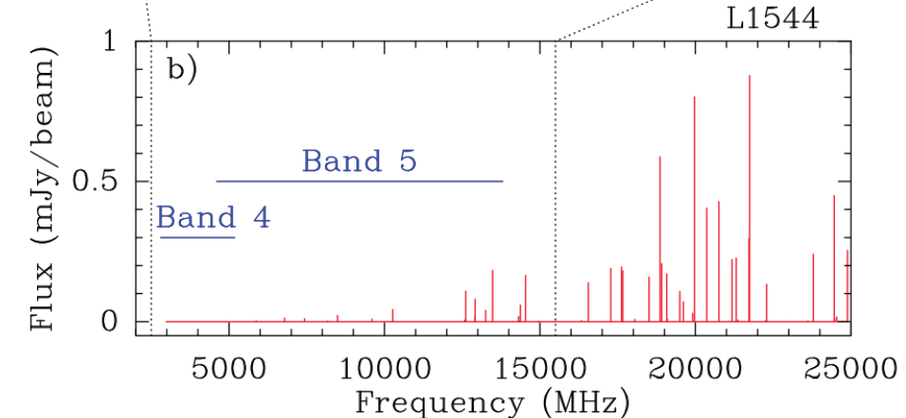
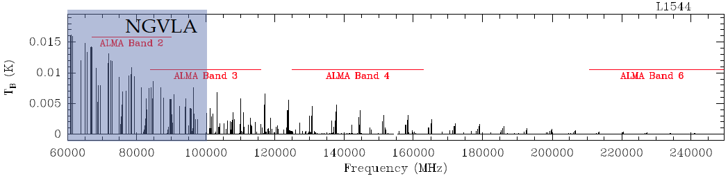
Circle of life: pre-biochemistry
Glycine
Pre-biotic molecules: rich spectra in 0.3cm to 3cm regime
Complex organics: ice chemistry in cold regions
Ammonia and water: temperature, evolutionary state, PP disks, comets, atmospheres…
Codella ea. 2014
SKA
ngVLA
Jimenez-Sierra ea 2014

Slide 11
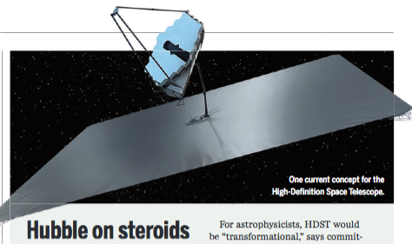
ng-Synergy: Solar-system zone exoplanets
‘ALMA is to HST/Kepler as ngVLA is to HDST’
High Definition Space Telescope Terrestrial planets: top science goal
Direct detection of earth-like planets
Search for atmospheric bio-signatures
ngVLA
Imaging formation terrestrial planets
Pre-biotic chemistry

Slide 12
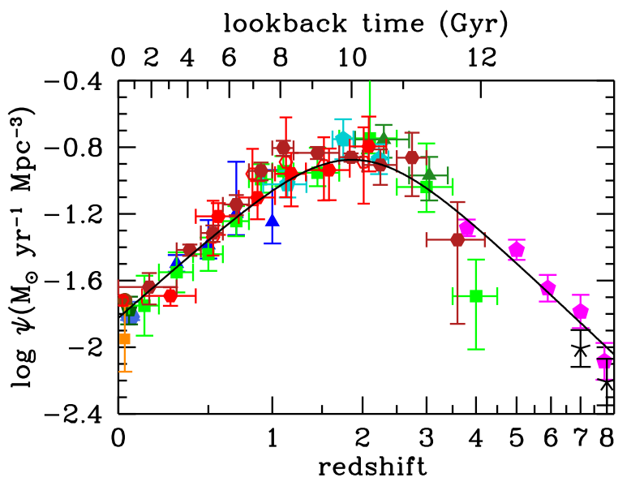
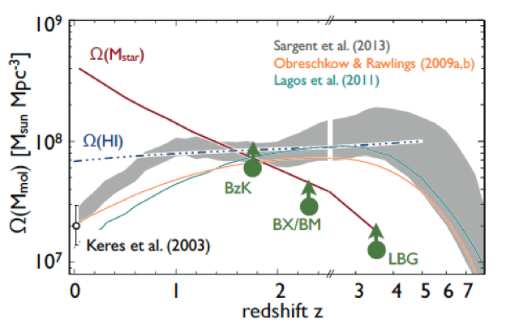
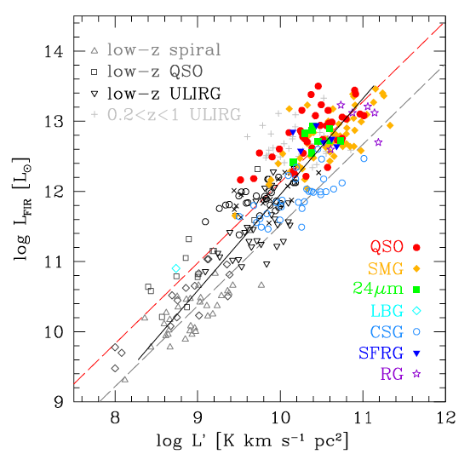
Galaxy assembly: Cool gas history of Universe
Missing half of galaxy formation
SF Law
SFR
Gas mass (L_{CO 1-0})

Slide 13
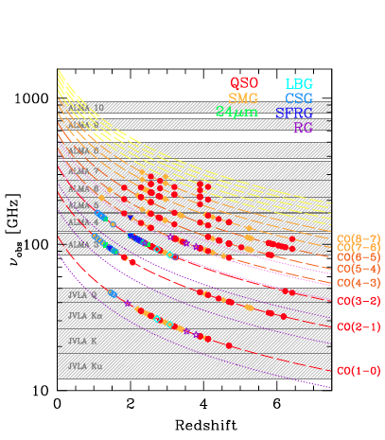
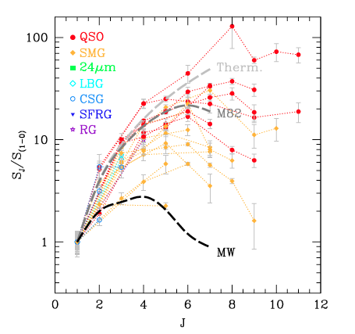
Low order CO: key total molecular gas mass tracer
M_{H2} = α x L_{CO1-0}
Total molecular gas mass
w. ALMA => gas excitation
Dense gas tracers associated w. SF cores: HCN, HCO+
ALMA
ngVLA ‘sweet spot’
10x uncertainty
VLA/GBT
SKA1

Slide 14
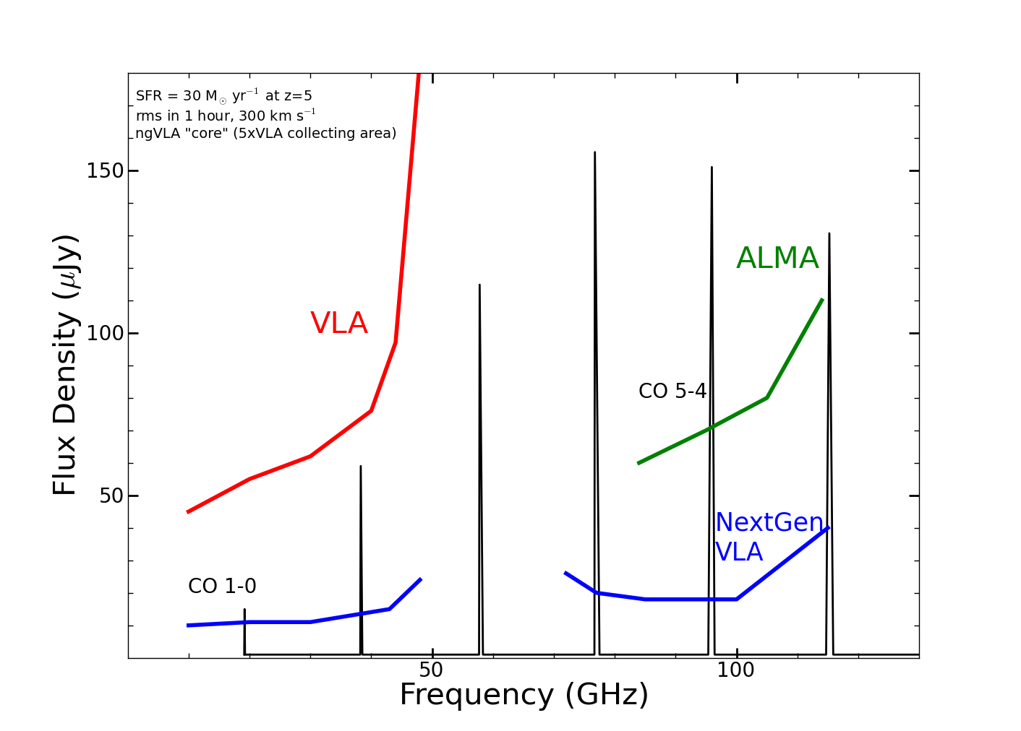
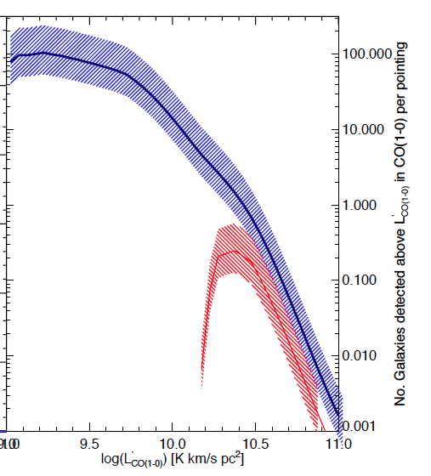
New horizon in molecular cosmological surveys
CO emission from typical star forming, ‘main sequence’ galaxies at high z in 1 hour
z=5, 30 M_{o}/yr
1hr, 300 km/s
GBT
GBT
Number galaxies per hour
ngVLA
Increased sensitivity and BW => dramatic increase molecular survey capabilities. Number of CO galaxies/hour, 20 – 40 GHz:
JVLA ~ 0.1 to 1, M_{gas} > 10¹⁰ M_{o}
ngVLA: tens to hundreds, M_{gas} > 2x10⁹ M_{o}
JVLA

Slide 15
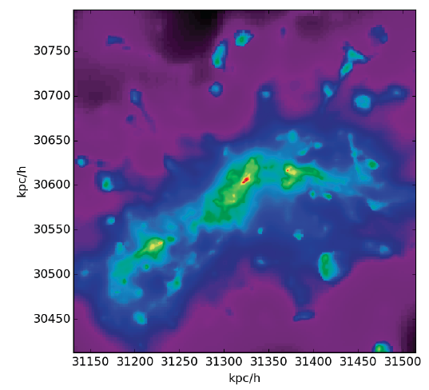
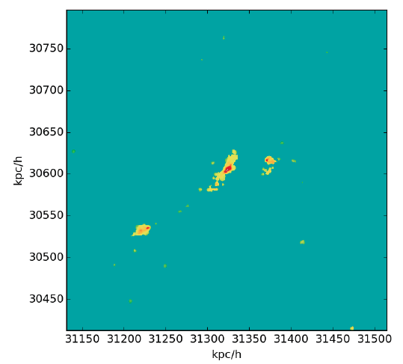
Galaxy assembly: Imaging on 1 kpc-scales
Low order: large scale gas dynamics, not just dense cores
w. ALMA dust imaging: resolved star formation laws
CO 1-0
z ~ 3
CO 3-2
n_{cr} > 10⁴ cm⁻³
n_{cr} ~ 10³ cm⁻³
Narayanan

Slide 16
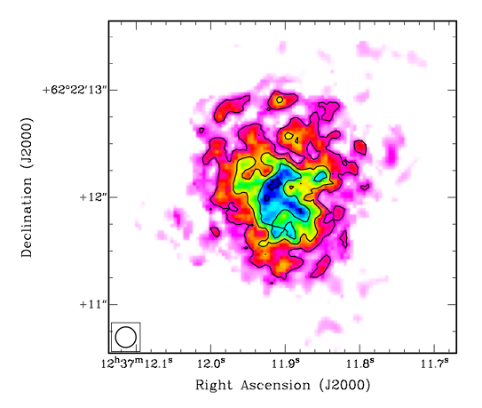
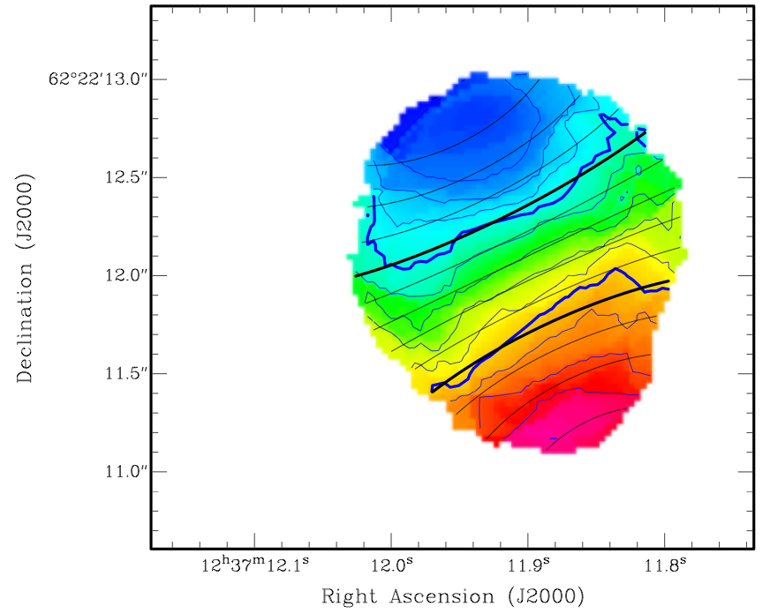
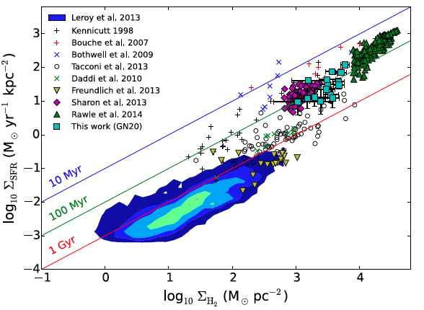
JVLA state of art
Beyond blob-ology
CO 2-1 z=4.0
-300 km/s
7kpc
GN20 z=4.0
CO2-1 at 0.25”
Resolved gas dynamics
  14kpc rotating disk
    M_{dyn} = 5.4 10¹¹ M_{o}
  Resolve SF law
1”
+300 km/s
0.25”
Hodge ea.
GN20
120 hours on JVLA
Few hours on ngVLA
Spatially resolved SF Law

Slide 17
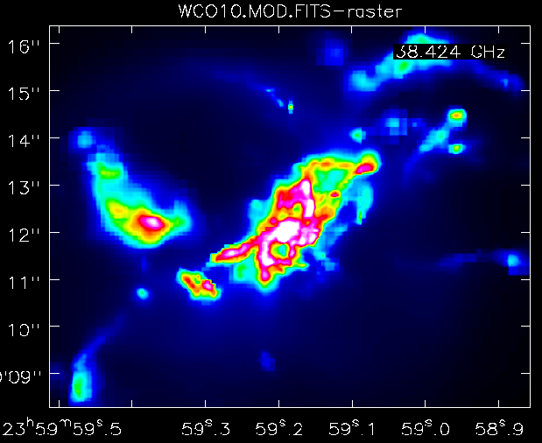
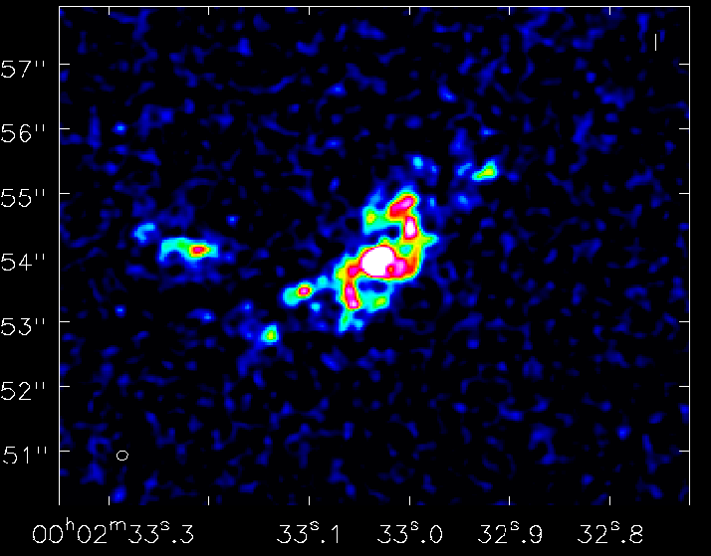
ngVLA Simulation: SMG at z=2, CO1-0
1”
Model
ngVLA
Narayana ea.
38GHz, 10hrs
rms(100 km/s) = 12uJy
Resolution = 0.15”
Low mass companions, streamers, accretion?

Slide 18
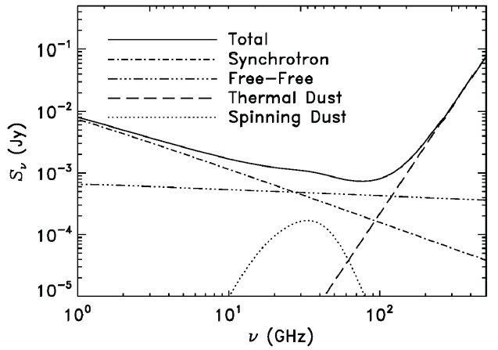
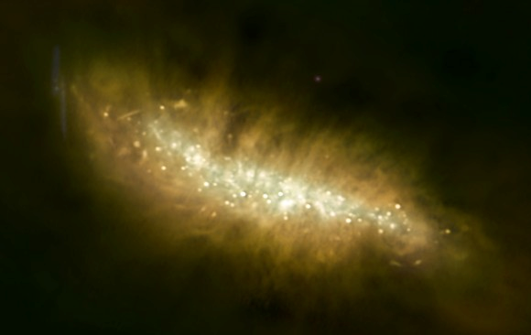
Galaxy eco-systems
Wide field, high res. mapping of Milky Way and nearby Galaxies
ngVLA
Broad-Band Continuum Imaging
Cover multiple radio emission mechanisms: synchrotron, free-free, cold (spinning?) dust, SZ effect
Independent, obscuration free estimates of SFR
Physics of cosmic rays, ionized gas, dust, and hot gas around galaxies

Slide 19
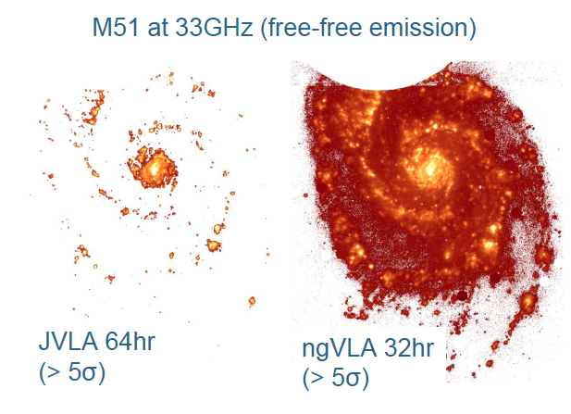
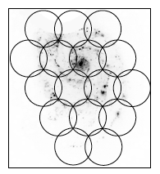
Free-Free (est. from Hα) = Direct measure of ionizing photon rate without [NII] or extinction corrections
2hr/ptg: rms ~ 400 nJy/bm
Equivalent map would take 2500hr with JVLA

Slide 20
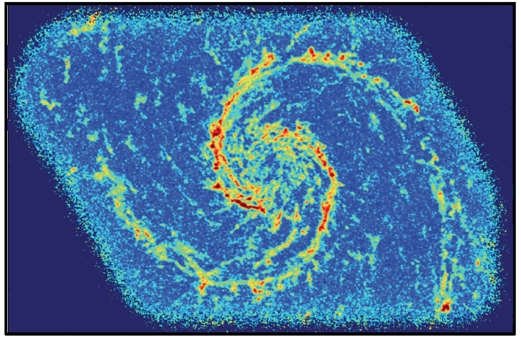
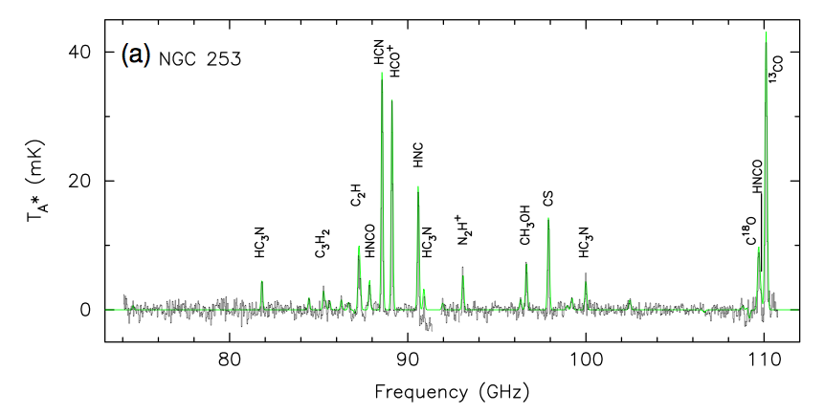
Schinerer ea.
Spectral Line Mapping: Map cool ISM 10x faster than ALMA (‘gold mine’ A. Leroy)
Rich frequency range: 1st order transitions of major astrochemical, dense gas tracers
Current CO mapping: tens hours
Other tracers: 10x fainter => need ngVLA
CO1-0 Bure 200hr, 1”
Snell ea

Slide 21
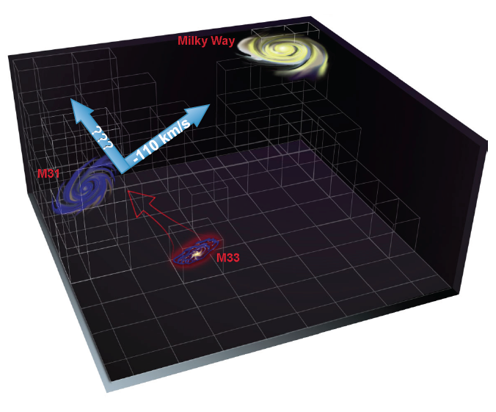
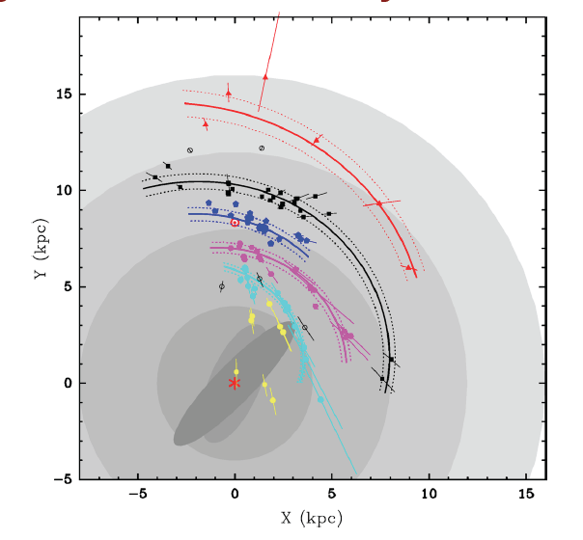
Galaxy eco-systems: VLBI uas astrometry
Gal. SF region masers: Complete view of spiral structure of MW
Local group cosmology: proper motions + parallax w. masers + AGN: 0.1 uas/yr => dark matter, fate MW, real-time cosmology (local Hubble expansion)
Not DNR limited imaging => few big antennas ~ 10% area
Reid ea
Local group proper motions 0.1 uas/year = 0.4 km/s!

Slide 22
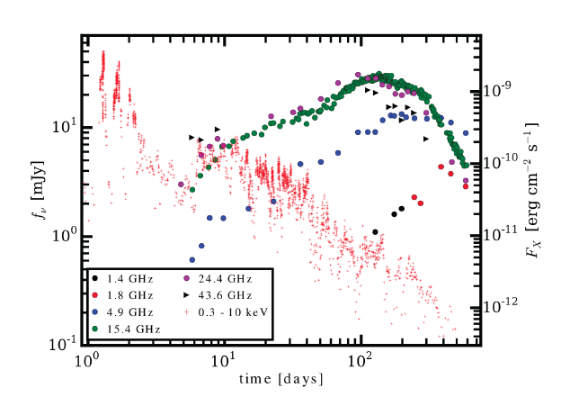
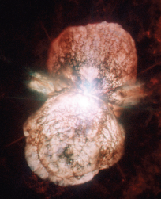
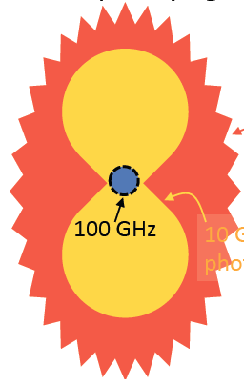
Physics, cosmology, time domain
(Bower et al. SWG4)
GBR/TDE: late time jet shock
15GHz
Time domain: bursts brighter and peak earlier at high frequency (0.3cm to 3cm)
  GRB, TDE, FRB
  Novae: ‘peeling onion’
  Radio counterparts to GW events
  Galactic Center Pulsars
10GHz
1GHz

Slide 23
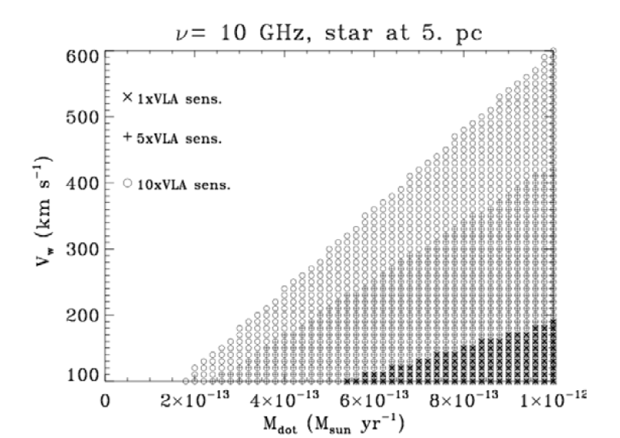
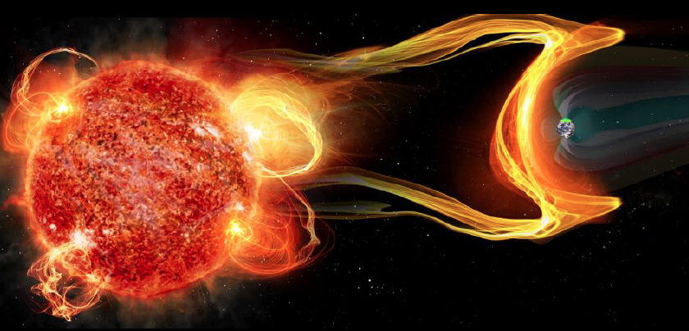
Star – Planet interactions: exo-space weather (Hallinan)
  10⁻¹³ M_{o}/yr
NGVLA most sensitive telescope for study of stellar radio phenomena
Cool stellar mass loss in ionized stellar wind ➜ higher radio frequencies for detection
Star -- exoplanet interactions: evaporation of planetary atmospheres
  M dwarfs most likely hosts habitable planets, but very active, flares up to 10⁴ x Sun
NGVLA provides the most sensitive detection of the thermal stellar wind, CMEs….

Slide 24
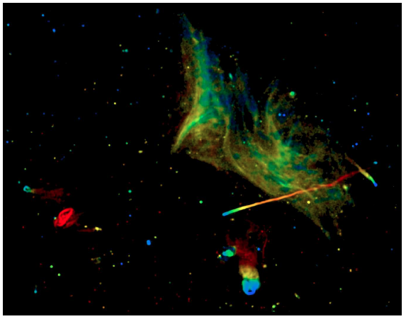
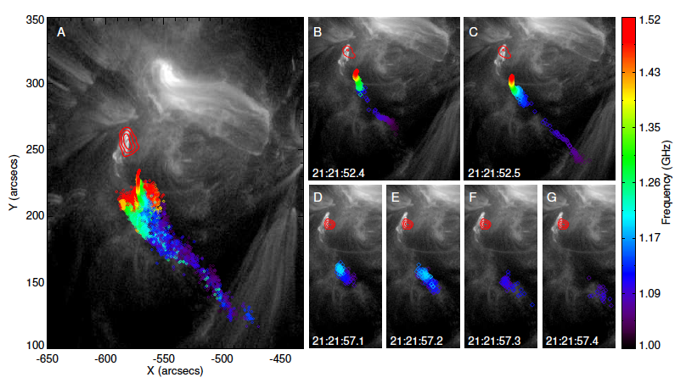
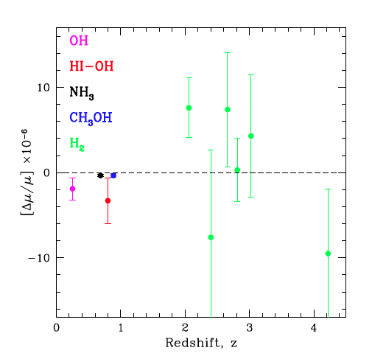
Plasma Universe
Mpc-scale cluster emission
1000km. 100msec scale solar flares
Magnetic reconnection vs. shock acceleration: broad band phenomena
S-Z for individual galaxies
  ngVLA-short (1cm, 3”, 10hrs) ~ 1uK
  nT ~ 10⁶ over 10kpc => 20uK
Evolution of fundamental constants using radio absorption lines: most promising ~ 1cm
Kanekar ea

Slide 25
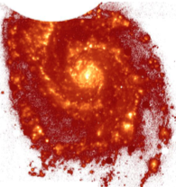
Killer Apps
Imaging Solar-system zone planet formation + prebiotic chemistry – synergy with HDST
Cool gas history of Universe – synergy JWST, TMT…
Time domain: exospace weather – synergy LSST
Baryon cycle: wide field, high res. thermal line + cont. imaging
VLBI astrometric applications: local group cosmology
Next steps
  KSUC → requirements → specs: physical modeling + configurations + simulations
  AAS ngVLA day: Jan 4, 2016
  Larger community meeting Spring 2016

Slide 26
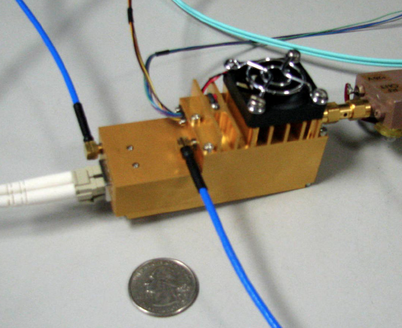


Pasadena Technical Meeting (Weinreb)
https://safe.nrao.edu/wiki/bin/view/NGVLA/NGVLAWorkshopApril2015
Antennas (Padin, Napier, Woody, Lamb…)
  12 to 25m? 75% eff at 40GHz
  Offaxis (high/low), symmetric?
  Hydroform, panel?
  Reconfigurable?
Feeds, Receivers (Weinreb, Pospiezalski, Morgan…)
  1 – 115GHz: 3 bands? 4 bands? more?
Correlator: FPGA (Casper), GPU (nVidia), ASIC (JPL), Hybrid (DRAO)
Conclusions
No major single-point failures
Could build today for not-unreasonable cost
Development geared to minimize construction and operational cost
Computational also true: data processing not bottle neck
Morgan mmic: Rack full of warm electronics in your hand

Slide 27

Need for large single dish
Short/zero spacings: big problem with missing flux for Galactic and nearby galaxies
  Two size antennas? (probably not short enough?)
  Total power on some array antennas?
  Large single dish + FPAs?
VLBI applications: Mostly astrometry
  Imaging DNR not big issue.
  Collecting area is big issue => few large antennas
Imaging 10’ at 1cm requires ~ 3m baselines!
10’

Slide 29

Killer Gap
Thermal imaging on mas scales at λ ~ 0.3cm to 3cm
Many other parameters: FoV, Bandwidth, T_{sys}, RFI occupation, UV coverage (dynamic range, surface brightness), Atmospheric opacity and Phase stability, Pointing…
Relative metrics depend on science application

Slide 30

Star – Planet interactions: exospace weather (Hallinan)
aOrionis, VLA 40mas, Lim ea.
NGVLA most sensitive telescope for study of stellar radio phenomena
• Thermal phenomena at mas resolution
  Radio photospheres: resolve radio surfaces of supergiants to 1kpc
  Detect winds in young stars: mass loss rates few 10⁻¹³ M_{o}/yr at 5pc
  the direct detection (free-free emission) of the activity-driven stellar winds of young stars, investigating the impact on stellar evolution (mass loss) and the impact on habitability of orbiting planets (removal of the atmosphere).
  ngVLA will be the only instrument that can systematically measure the stellar winds directly for a population of young stars over a wide mass range (e.g. F-M dwarfs) and as a function of stellar age. Do all planets orbiting M dwarfs have their atmospheres blown off at a young age, for example?
Planetary magnetic fields: key defense for the development of life
  M dwarfs most likely hosts habitable planets, but very active, flares up to 10⁴ x Sun
  Flares + CME erode planetary atmosphere

Slide 31

Galaxy assembly: Cool gas history of Universe
Missing half of galaxy formation
SF Law
SFR
Gas mass (L_{CO 1-0})

Slide 32
ALMA 250GHz Brogan ea.
ngVLA: Terrestrial zone planet formation imager
  See through dust to pebbles: inner few AU disk optically thick in mm/submm
Grain size stratification at 0.3cm to 3cm
  Poorly understood transition from dust to planetesimals
  SI => combination of grain growth and optical depth
  Annual motions
100AU 0.7” at 140pc
ngVLA Simulation 25GHz
Inner 10AU = ngVLA zone @ 10mas res

