Slide 1

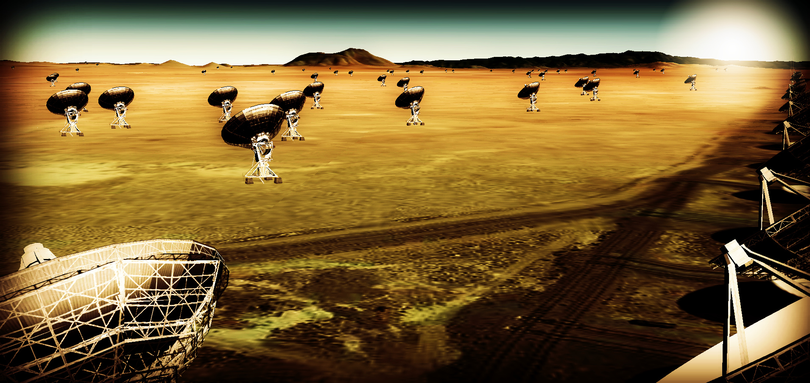
Effective area ~ 10x JVLA, ALMA
Resolution ~ 10x JVLA, ALMA
Frequency range ~ 1 to 115 GHz
https://science.nrao.edu/futures/ngvla

Slide 2
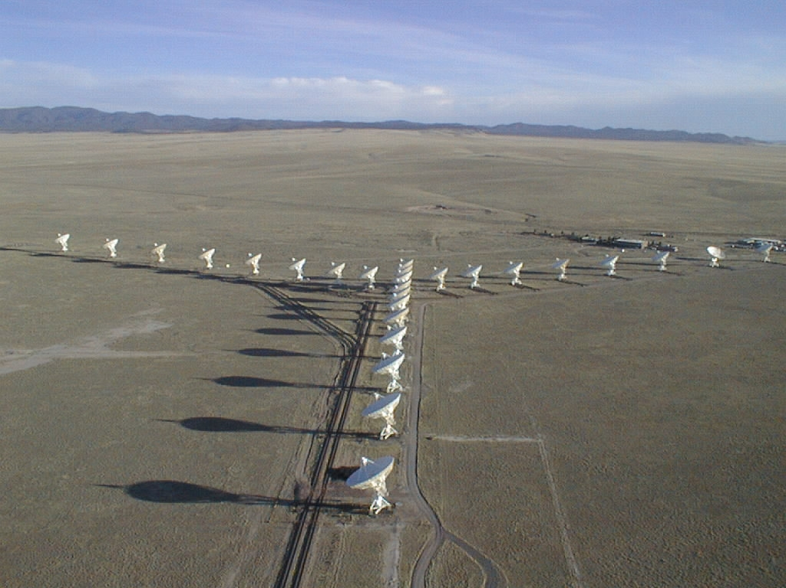
The Very Large Array: 2 min history
1972 – Approved by Congress
1980 – Full science operations
2001 – Major upgrade approved by NSF (all new electronics)
2011 – Jansky VLA full science ops

Slide 3
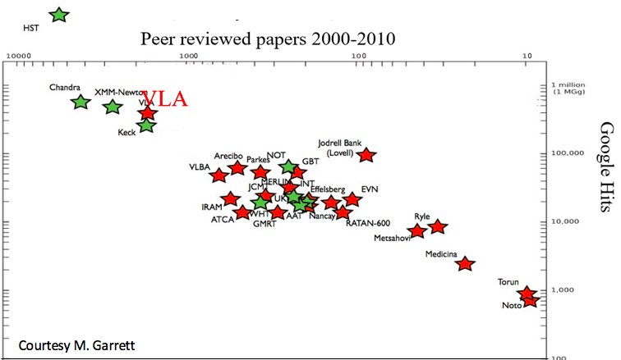
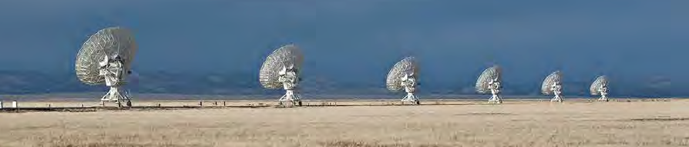
Radio Astronomy Powerhouse from 1980 to present
400 to 500 proposals per year
~ 300 PhD theses
The VLA is among the most productive telescopes ever!

Slide 4
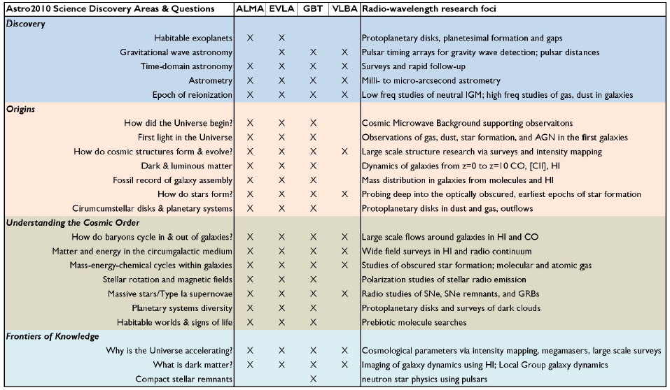
2010 Decade Survey: Broad Appeal
Notes:
http://arxiv.org/abs/1405.1456
The Intrinsic Two-Dimensional Size of Sagittarius A*
Bower et al. 2014 ApJ in press

Slide 5
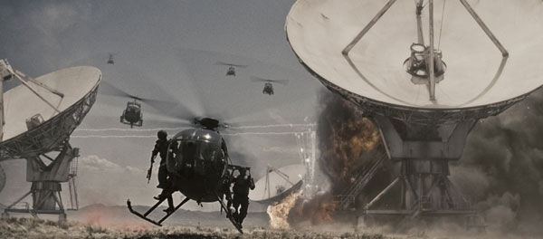

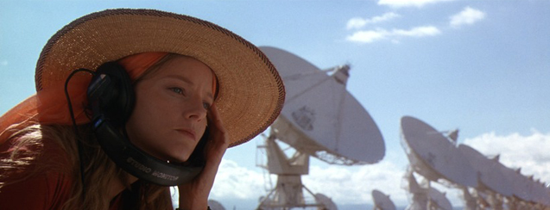
”I've always wanted to see the Very Large Array in New Mexico. It's not the biggest in the world, of course, or the most modern, but it is iconic, and I grew up wanting to see it. It's quite spectacular. Out there in the desert.” John Luther
Contact / T4

Slide 6
10x resolution and sensitivity of JVLA and ALMA
New window: Thermal imaging on mas scales at λ ~ 0.3cm to 3cm
Process and core design parameters
Science
Circle of Life: planet and star formation, astrochemistry/bio
Galaxy ecosystems: Baryon cycle in MW and nearby galaxies
Galaxy formation: star formation, B fields, and molecular gas back to 1st galaxies
Time domain and Physics: Cosmic explosions, Exo-space weather, galaxy SZ
Goal: science and technical proposal to 2020 Decade Survey

Slide 7
Community process
Jan 2015, Jan 2016: AAS community science meetings
April 2015, Dec 2015: Technology meetings (Pasadena, Socorro)
Dec 2015, Aug 2016: Kavli-sponsored RMS meetings (Chicago, Baltimore)
Nov 2015: Science working group science program reports (200 pages, 125 authors) http://library.nrao.edu/ngvla.shtml
Circle of Life (Isella, Moullet, Hull)
Galaxy ecosystems (Murphy, Leroy)
Galaxy assembly (Lacy, Casey, Hodge)
Time domain, Cosmology, Physics (Bower, Demorest)
Jan 2017 AAS poster session on community design studies, URSI special session
June 2017 Science meeting Socorro, NM
Aug 2017 final Kavli RMS meeting (Berkeley)

Slide 8
Science Advisory Committee
Chairs: Bollatto (Maryland), Isella (Rice)
Review Community studies proposals
Reconstitute science working groups
SOC for science meeting June
Science case: ‘science book’
White papers for DS2020
Science requirements → technical specifications
Technical Advisory Committee
Under recruitment
Community studies
13 science studies: broaden case, investigate design implications
12 technical studies: explore key technical challenges

Slide 9
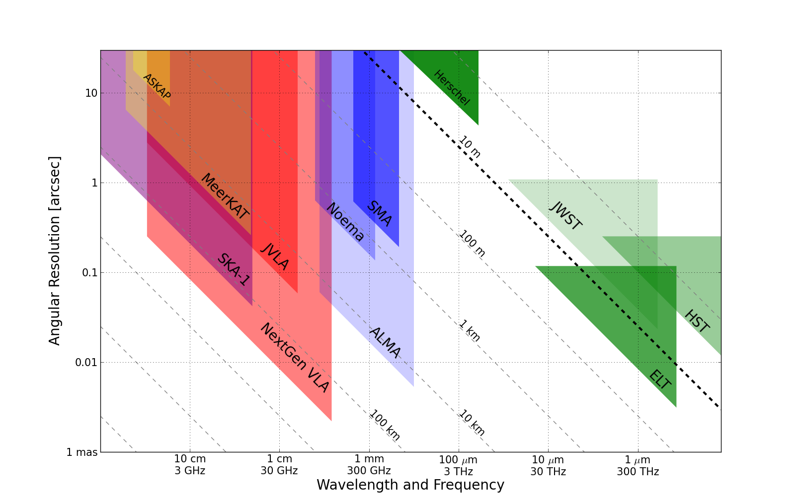
Killer Gap
Thermal imaging on mas scales at λ ~ 0.3cm to 3cm
1AU @ 140pc
Terrestrial zone planet formation
Resolution ~ 10mas @ 1cm (300km)
Synergy w. ALMA, future ELTs

Slide 10
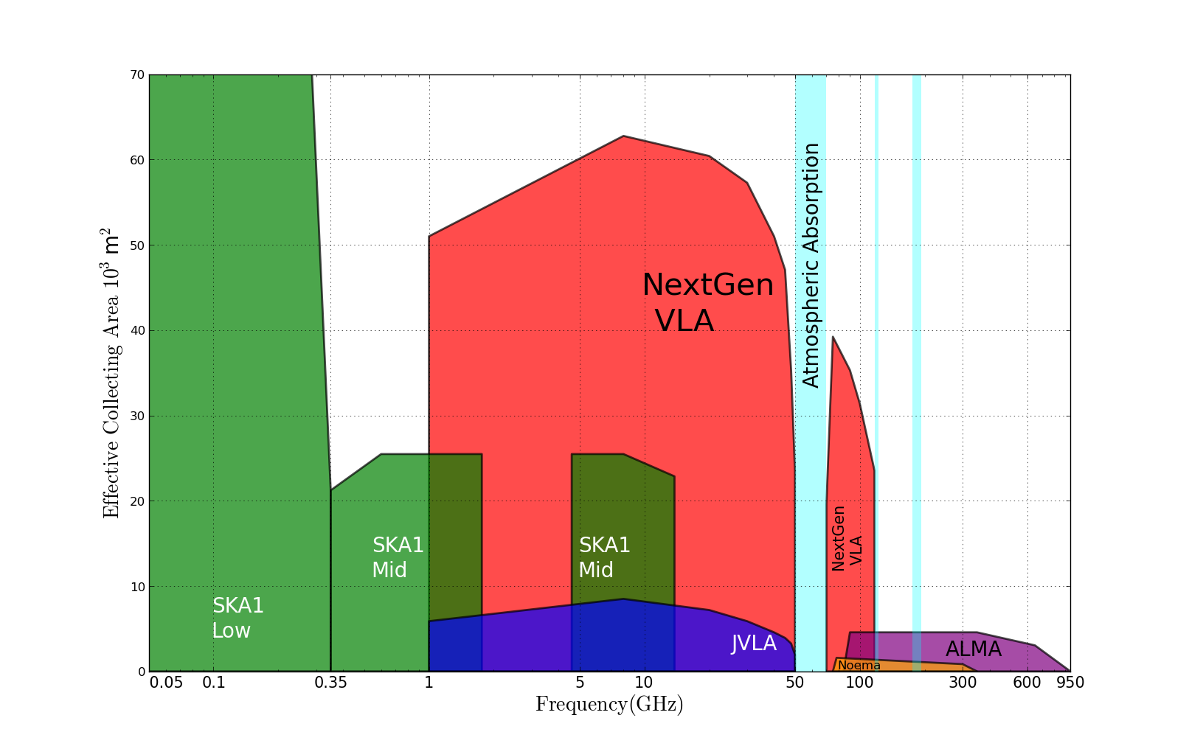
Killer Gap
Thermal imaging on mas scales at λ ~ 0.3cm to 3cm
5x
Sensitivity ~ 100 nanoJy @ 1cm, 10hr, BW = 20GHz
T_{B} ~ 1K @ 1cm, 10mas
Spectrum above 15GHz rich in ground state molecular lines

Slide 11
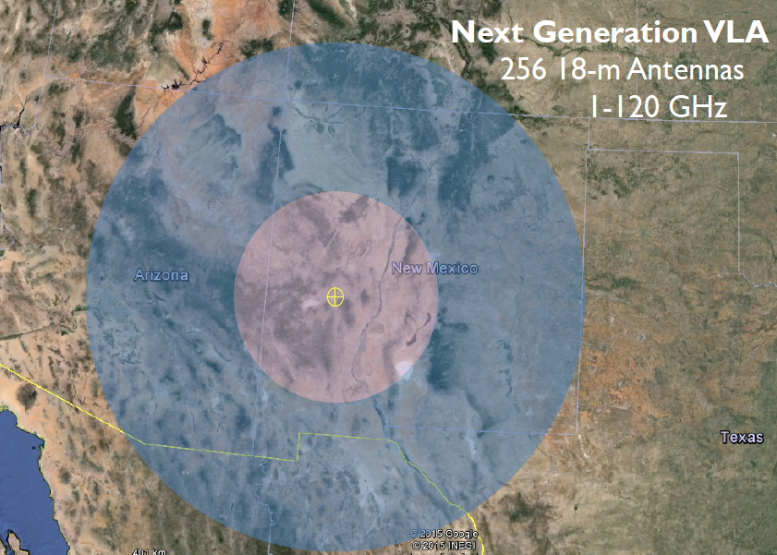
JVLA: Good 3mm site, elev. ~ 2200m
30% in core: b < 3km ~ 1” at 30GHz
60% in mid: b < 30km ~ 0.1”
90% in long: b < 300km ~ 0.01”
10% in VLB: b ~ 3000km ~ 0.001”
550km

Slide 12
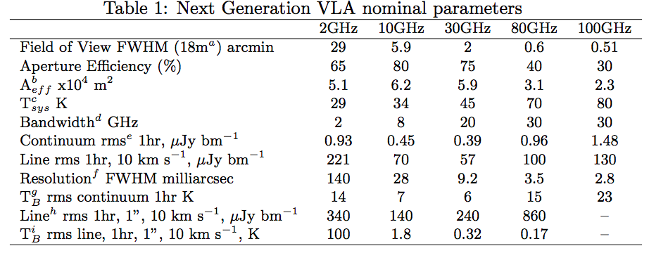
Memo 5 @ http://library.nrao.edu/ngvla.shtml

Slide 13
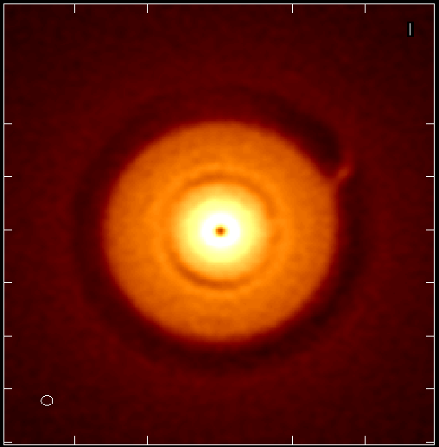
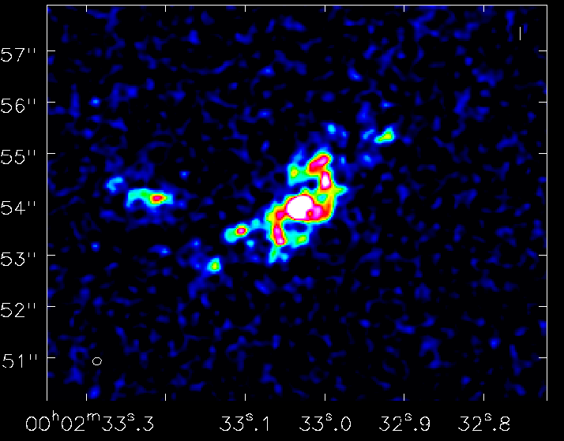
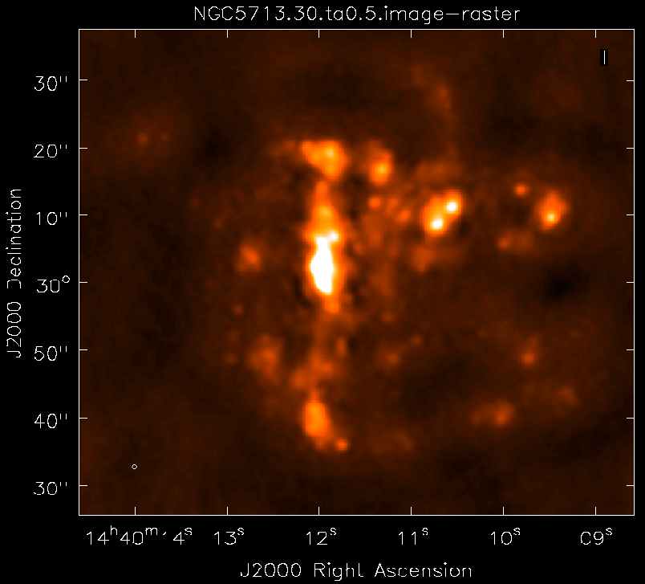
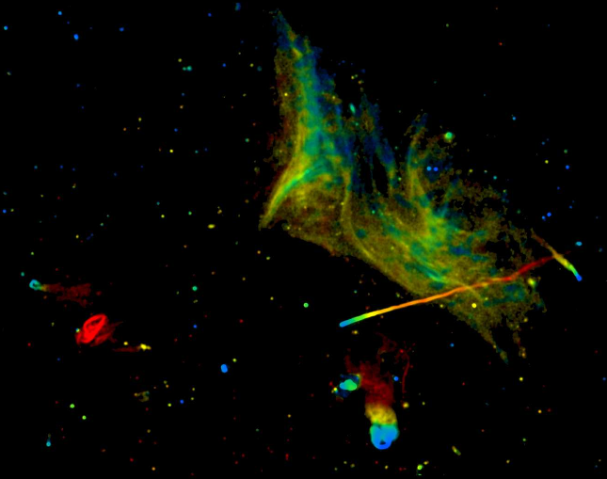
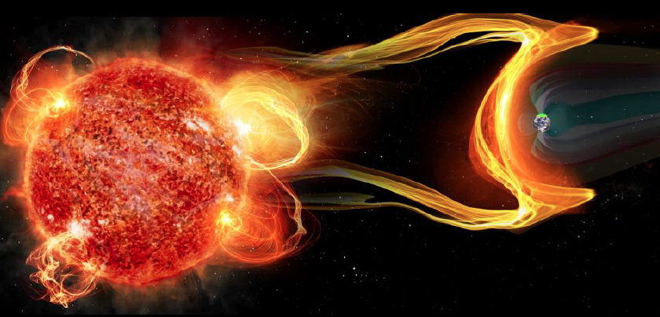
Science examples
Cradle of Life: Terrestrial planet formation
Galaxy ecosystems: wide field imaging
Galaxy formation: Cool gas history of the Universe (ASPECS)
Time domain and Physics: Exo-space weather
http://library.nrao.edu/ngvla.shtml

Slide 14
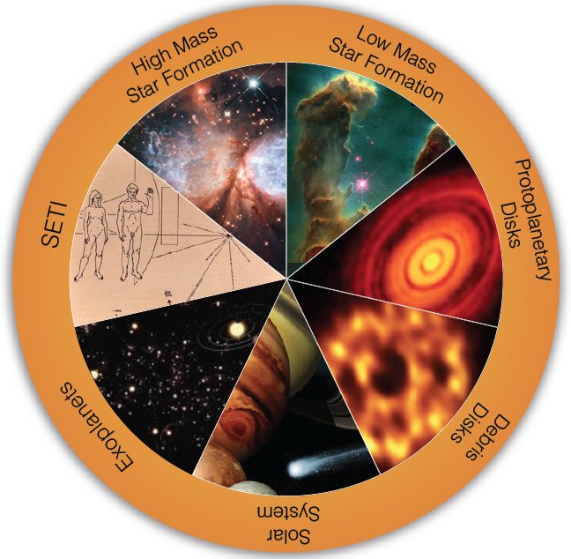
SWG1 Circle of Life: origin stars, planets, life
Accretion in dust-obscured early phases
chemistry
Origin of stellar multiplicity
Organic chemistry
Aircraft radar from nearby planetary systems in 10min
Terrestrial zone planet formation
biology
Pre-biotic chemistry
Magnetospheres and exo-space weather
Pre-biotic molecules
Imaging chemistry, dynamics deep in planetary atmospheres

Slide 15
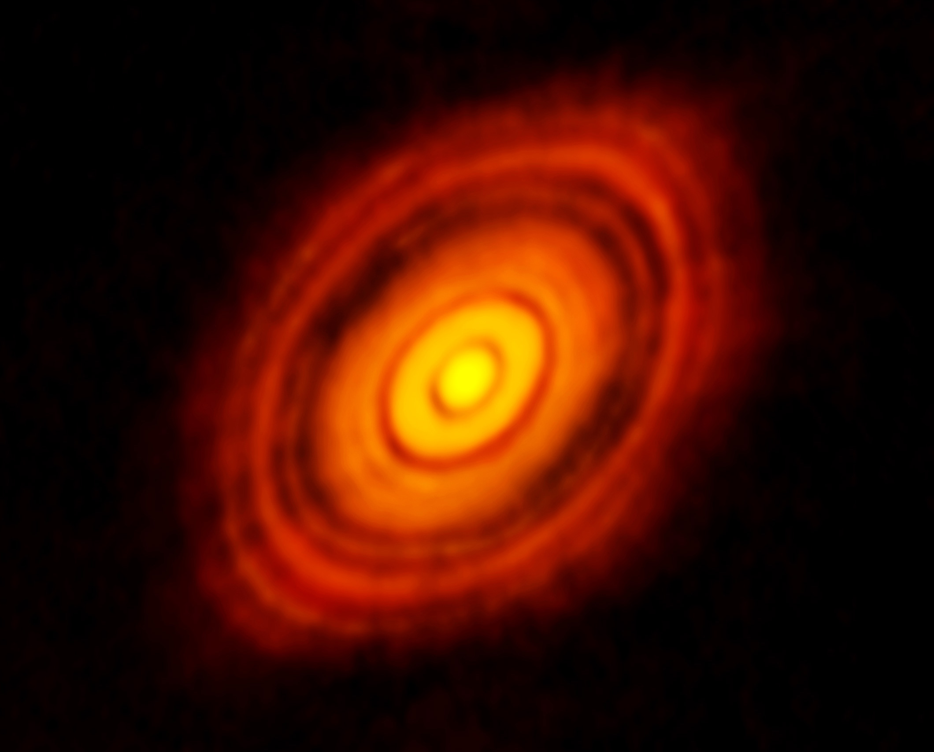
Current state-of-art in planet formation
ALMA images of HL tau
ALMA 250GHz Brogan ea.
HL Tau: Rosetta-stone of planet formation around Solar-mass protostar
Distance = 140pc
1Myr old protostar ~ 1 M_{o} w. 0.1 M_{o} dusty disk
Inner few AU disk optically thick in mm/submm
100AU 0.7” at 140pc
Inner 10AU = ngVLA zone @ 10mas res

Slide 16
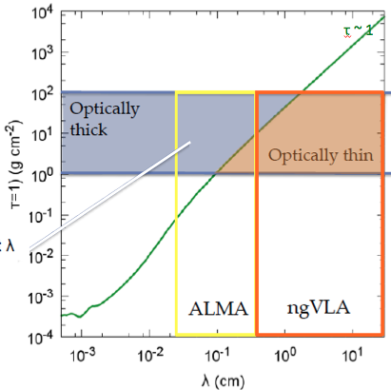
Terrestrial zone planet formation = ‘ngVLA zone’
Areal density for τ > 1
Typical ~ 1Myr protoplanetary disk at R ~ few AU
ALMA gets AU-res. in submm, but disk is optically thick!
Isella ea.

Slide 17
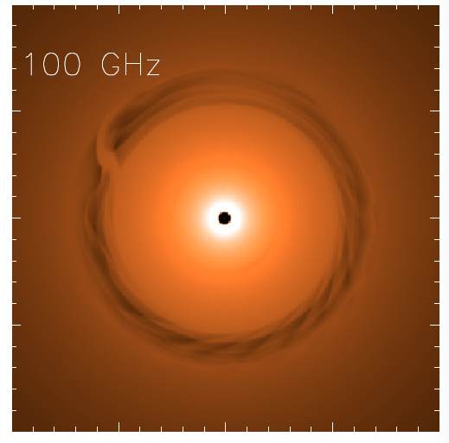
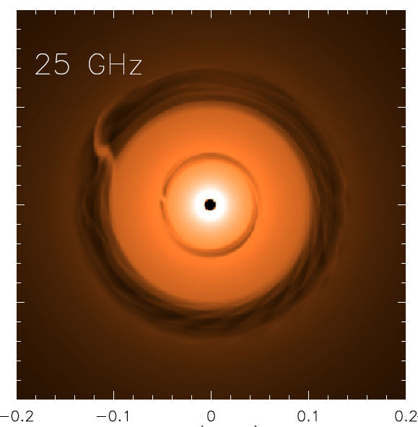
NGVLA: 1Myr Protoplanetary disk at 140pc distance
Saturn at 13AU Jupiter at 6AU
ngVLA 100hr 25GHz, 10mas
0.1” = 13AU
Isella Dust Model
Model
rms = 90nJy/bm = 1K
Inner gap optically thick at 100GHz
ngVLA at 25GHz, 10mas (1.4AU): Image both gaps + annual motions (‘movies of planet formation’)
Circumplanetary disks: imaging accretion on to planets
Grain size stratification: Image poorly understood transition from dust to planetesimal to planets at !AU resolution

Slide 18
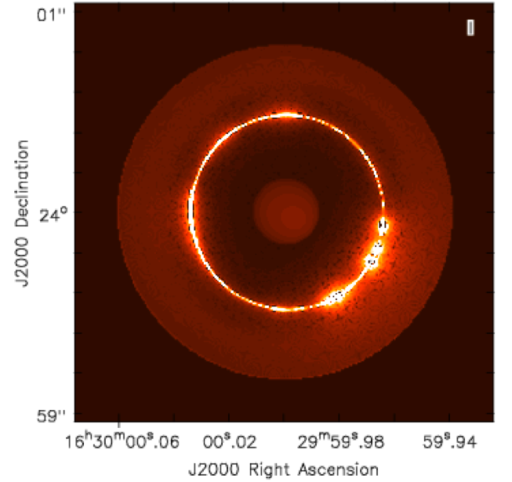
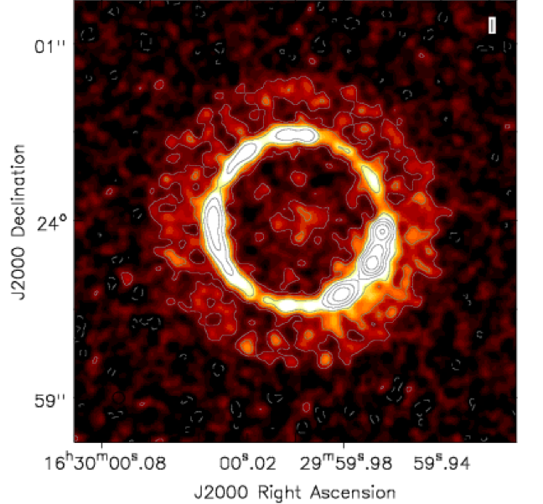
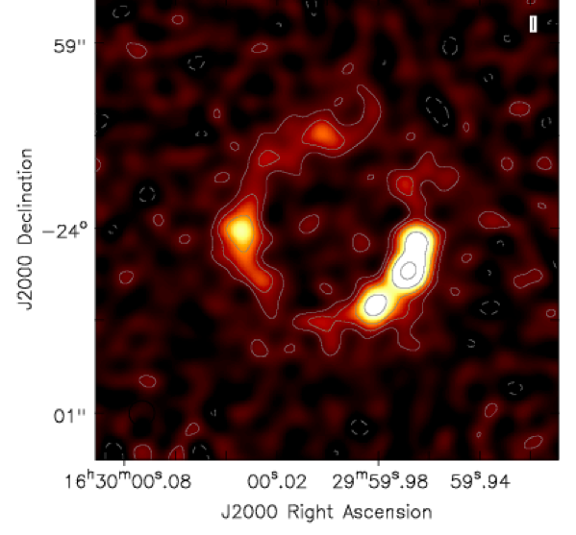
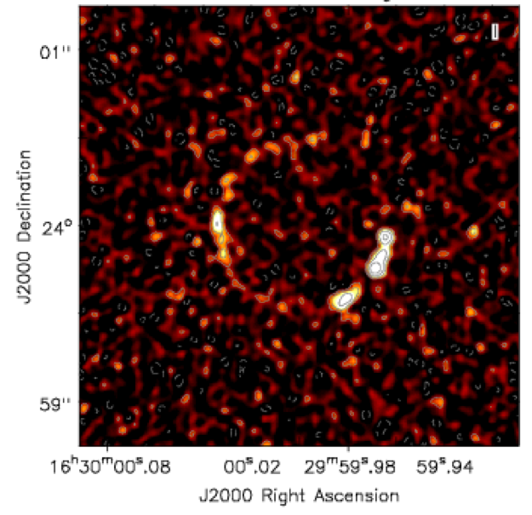
Ricci Model at 30GHz
Next Gen. VLA at 0.06” res
TW Hya ~ 10Myr PP → Debris Disk
1 M_{o} star + 0.1M_{o} disk
Dust trap caused by gaseous vortex at 60AU => narrow dust ring
Planets may coalesce around dust knots in ring
60AU
Ricci ea
ALMA Band 1 at 0.12”
JVLA at 0.06”

Slide 19
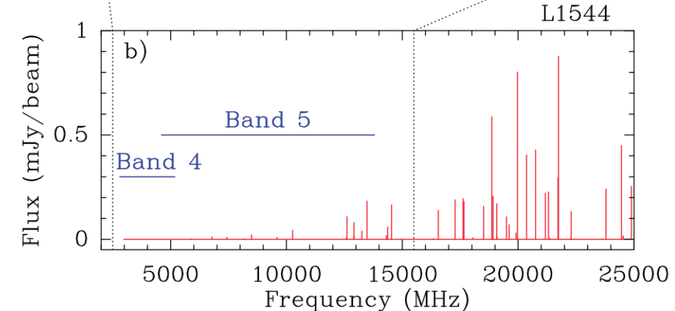
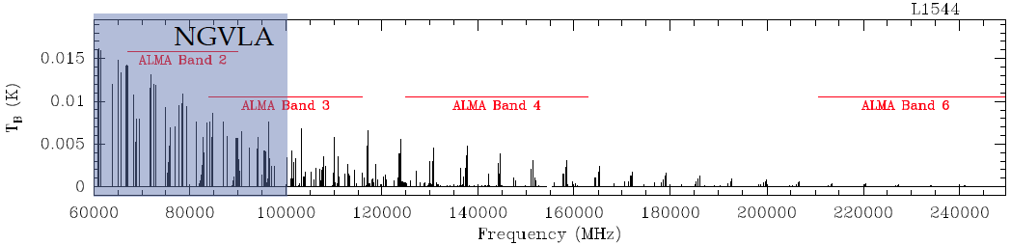
Circle of life: pre-biochemistry
Glycine
Pre-biotic molecules: rich spectra in 0.3cm to 3cm regime
Complex organics: ice chemistry in cold regions
Ammonia and water: temperature, evolutionary state, PP disks, comets, atmospheres…
Codella ea. 2014
SKA
ngVLA
Jimenez-Sierra ea 2014

Slide 20
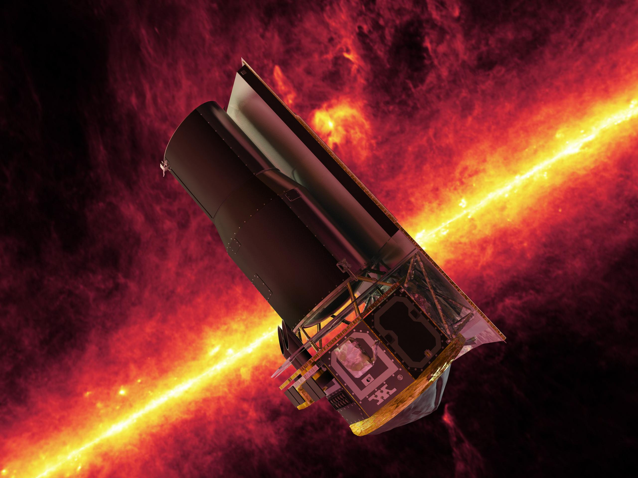
ng-Synergy: Terrestrial zone exoplanets
Habitable Exoplanet imaging mission (HabEx)
Direct detection of earth-like planets
Search for atmospheric bio-signatures
ngVLA
Imaging formation of terrestrial planets
Pre-biotic chemistry

Slide 21
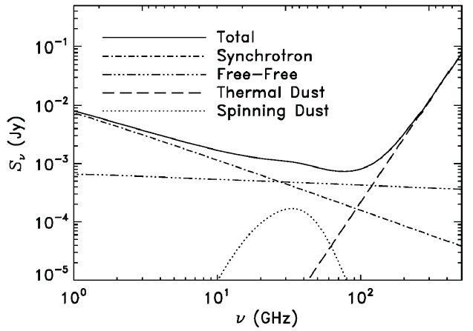
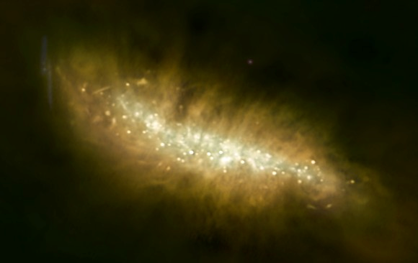
SWG2: Galaxy eco-systems and the Baryon cycle
Wide field, high res. mapping of Milky Way and nearby Galaxies
M82
ngVLA
Broad-Band Continuum Imaging
Cover multiple radio emission mechanisms: synchrotron, free-free, cold (spinning?) dust, SZ effect
Independent, obscuration free estimates of SFR
Physics of cosmic rays, ionized gas, dust, and hot gas around galaxies

Slide 22
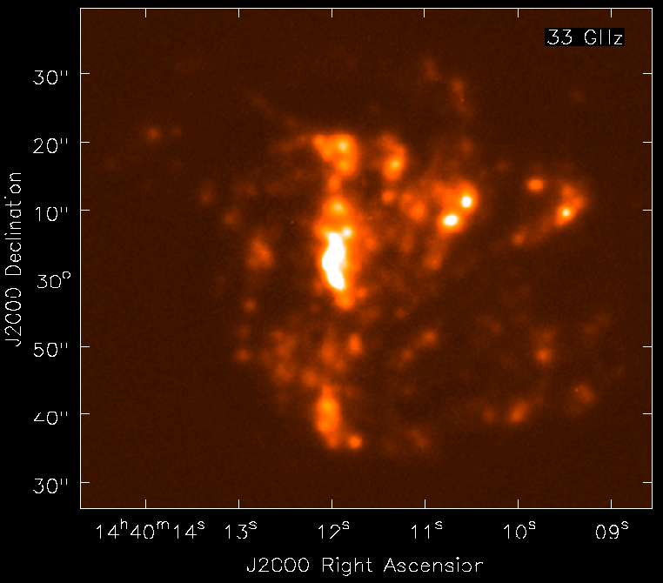
NGVLA: Free Free emission from peculiar spiral in Virgo
NGC 5713: distance ~ 30Mpc, total SFR ~ 5 M_{o} yr⁻¹
Model 33GHz FF (from Hα)
NGVLA 10hrs, 0.5” res
1kpc
Murphy + Carilli
Free-Free ‘best’ star formation rate estimator
rms (1cm, 10hrs) = 0.1uJy => HII region associated single O7.5
Broad -band: spatially/spectrally separate thermal/non-thermal
Local-group-type studies out to Virgo!

Slide 23
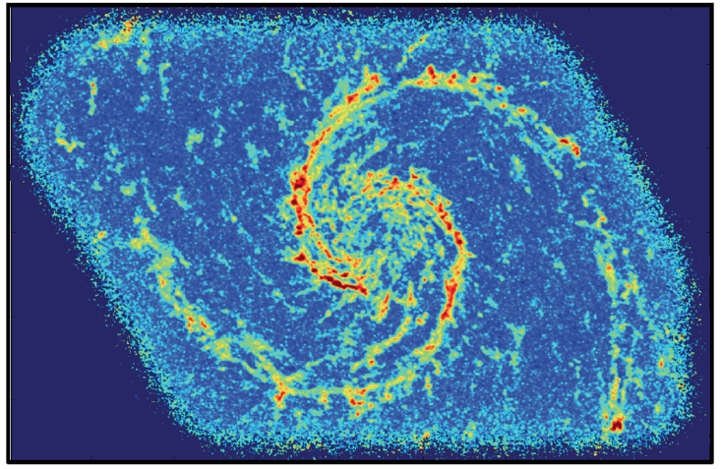
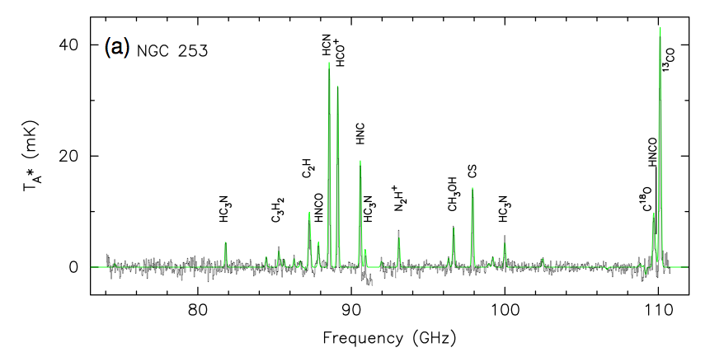
Schinnerer ea.
Spectral Line Mapping: Map cool ISM 10x faster than ALMA
Rich frequency range: 1st order transitions of prime astrochemical + dense gas tracers
CO mapping: tens hours w. ALMA
Other lines are 10x fainter => need ngVLA
CO1-0 Bure 200hr, 1”
Snell ea

Slide 24
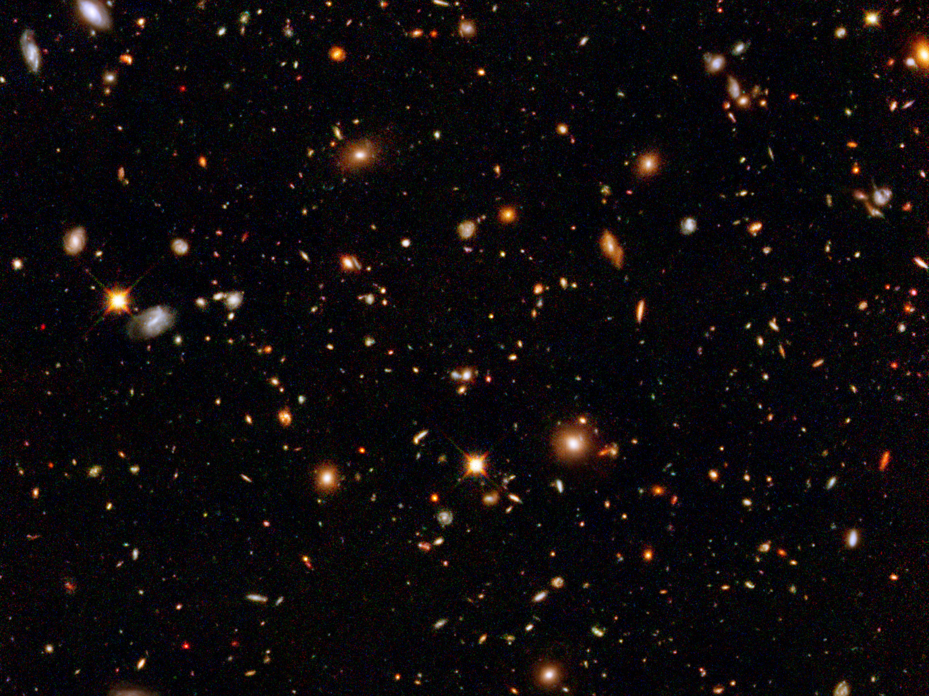
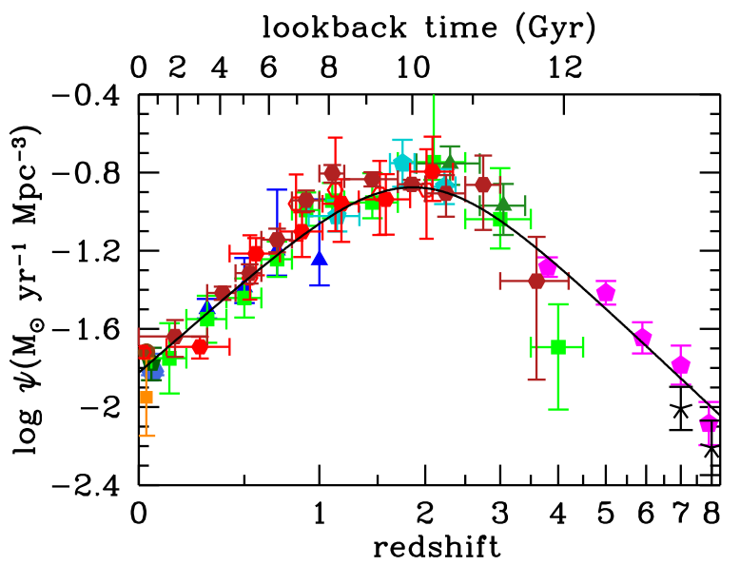
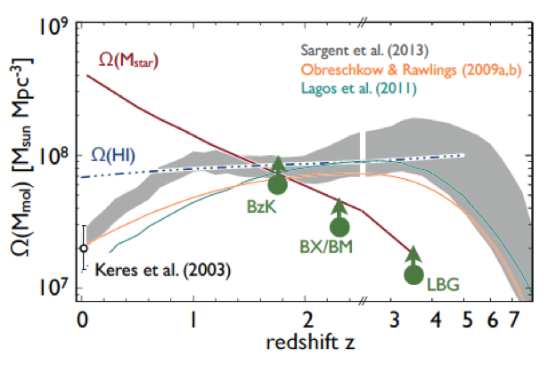
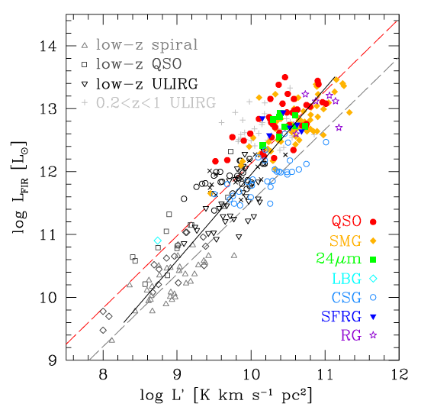
SWG3: Dense Gas History of the Universe
‘Missing half of galaxy formation’
‘SF Law’
FIR ~ SFR
FIR ~ SFR
L_{CO} ~ M_{gas}
SFHU has been delineated in remarkable detail back to reionization
SF laws => SFHU is consequence of DGHU
ALMA, JVLA, Noema: study of galaxy evolution is shifting to DGHU

Slide 25
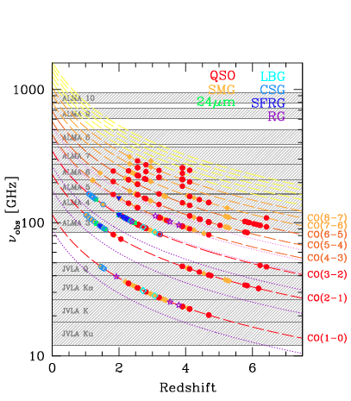
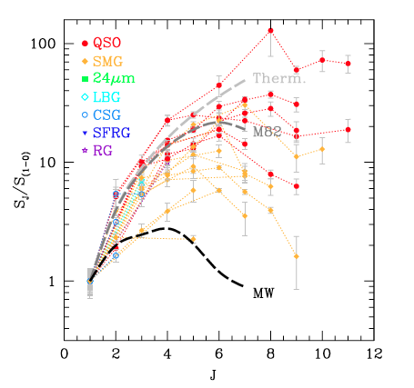
Low order CO: key total molecular gas mass tracer
M_{H2} = α x L_{CO1-0}
Total molecular gas mass
w. ALMA => gas excitation
Dense gas tracers associated w. SF cores: HCN, HCO+
ALMA
ngVLA ‘sweet spot’
10x uncertainty
VLA
SKA 1

Slide 26
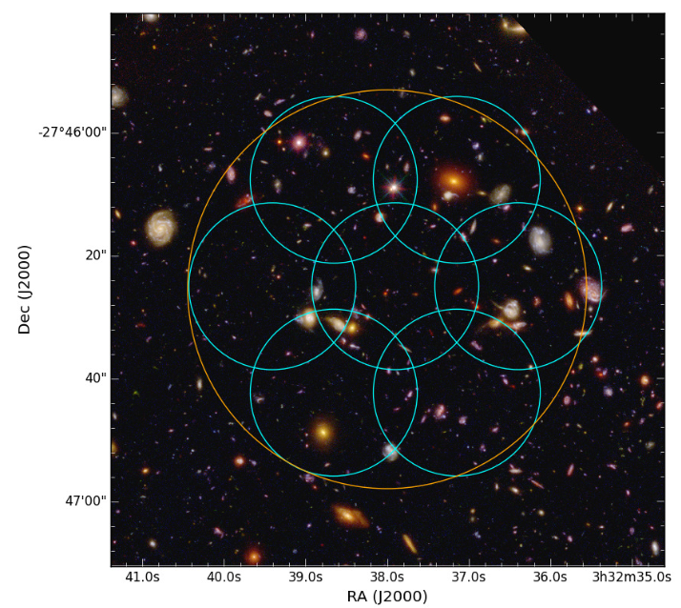
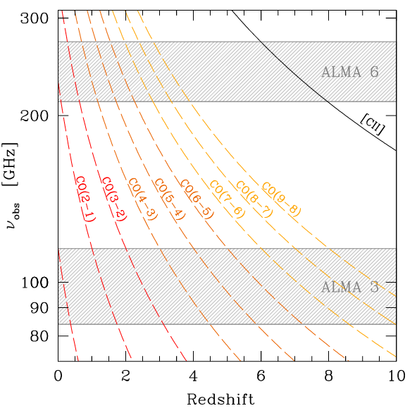
ALMA Spectral Line Survey in UDF (ASPECS-I)
1st volumetric ‘molecular deep field’
PI Walter, Decarli (EU), Co-PI Aravena (Chile), Co-PI Carilli (USA)
Bands 3 and 6: 20hr/band, 35ants; line rms ~ 0.3mJy, cont. rms ~ 10uJy
1arcmin² in UDF: best multi-𝜆 field
Molecular gas masses to ‘knee’ mass function ~ few x 10⁹ M_{o}
Dust continuum: SFR ~ 10 M_{o}/yr at z =1 to 6
[CII] from z > 6 LBG/LAEs

Slide 27
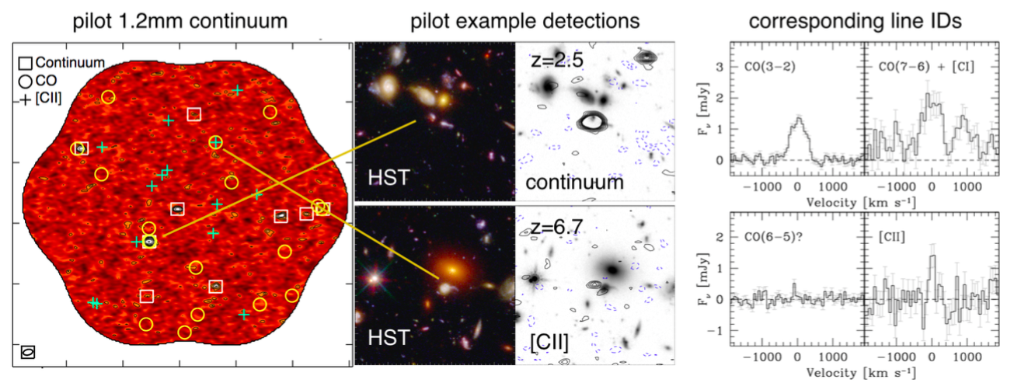
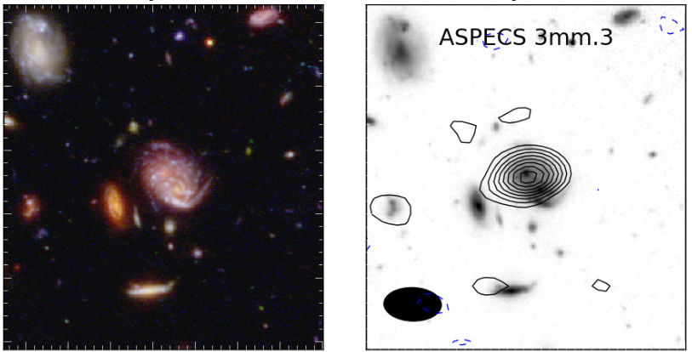
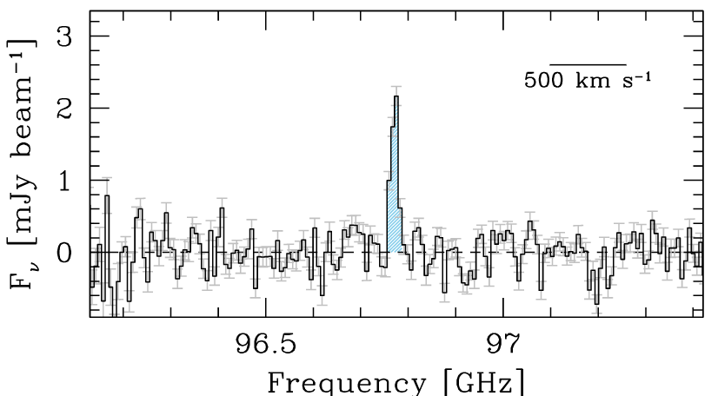
ASPECS-I 7 papers, Oct. 2016
z=1.4
CO 2-1
10 line candidates band 3: CO various redshifts (Walter, Decarli)
11 line candidates band 6: CO, [CII] (Walter, Decarli)
9 dust continuum sources band 6 (Aravena)
LBG Stacking: Dust corrected SFHU from z=1 to 10 (Bouwens)
Possible ~ 6 [CII] detection of LBG candidates at z=6 to 8 (Aravena)
Implications for CO/[CII] intensity mapping and CMB spectrum (Carilli)

Slide 28
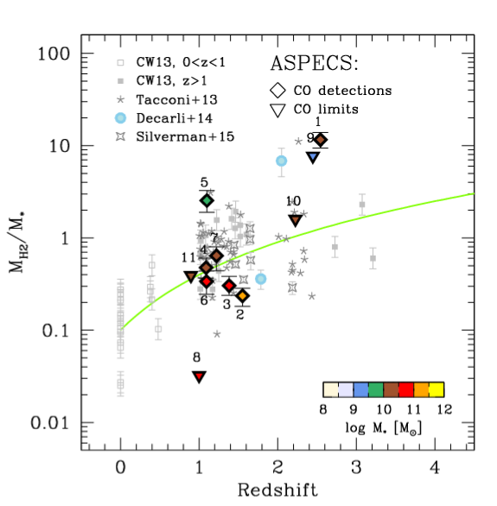
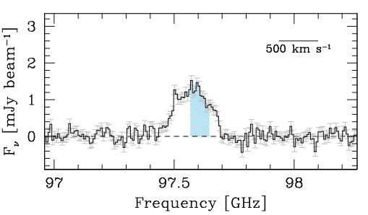
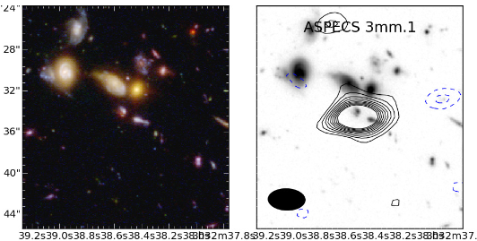
Evolution of gas fraction: fundamental change in ‘main sequence’ galaxies
CO 3-2
z=2.5
Order magnitude increase in mean gas ’baryon fraction’ (M_{H2} / M*) from z=0 to 2
M_{gas} = 2.0e11 (𝛼/3.6) M_{o}
M* = 1.6e10 M_{o}

Slide 29
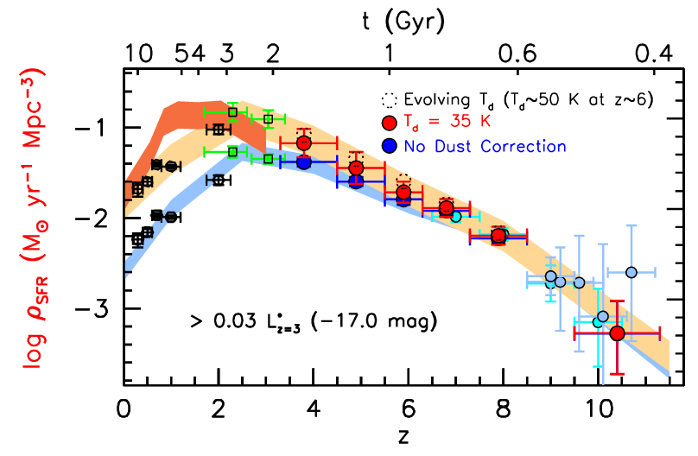
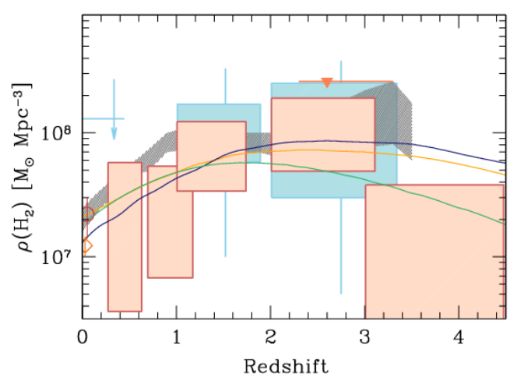
1st Unbiased Dense Gas History of Universe, and
New dust-corrected SFHU
Epoch of peak cosmic SF rate density (z~2) = epoch of gas-dominated ‘main sequence’ disk galaxies

Slide 30
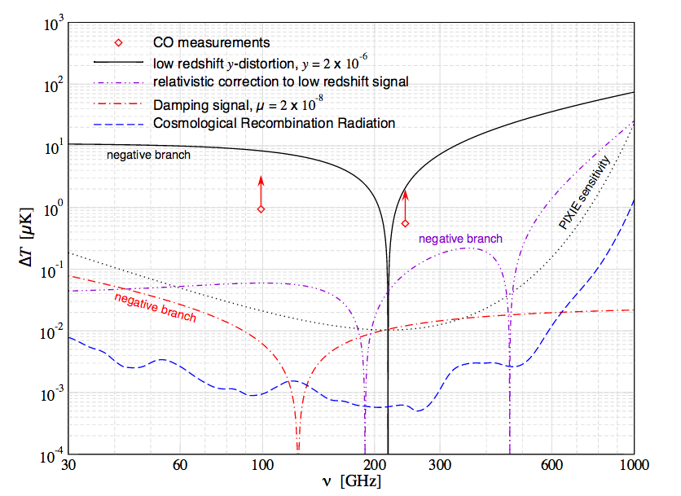
‘Cosmology’ application
Guide for CO, [CII] intensity mapping experiments
Estimating line foregrounds for CMB spectra distortions
Sum ASPECS line detections in 90GHz and 240 GHz bands: T_{B} ~ 1uK
Line foreground >> PIXIE sensitivity => need robust removal techniques
Compton y: partial up-scattering of CMB blackbody photons by hot plasma during reionization or in clusters and galaxies at lower z (‘single scattering’)
u-distortion: Dissipation of small-scale fluctuations in the primordial photon-baryon plasma (‘multiple scattering’)
ASPECS
Carilli, Chluba ea

Slide 31



ASPECS – II: pushing the limits of ALMA
Band 3 64hrs, Band 6 85hrs, 40+ antennas
Wider and Deeper
5x area of pilot survey
70% deeper in pilot field
Observations: Dec 2016 to Mar 2017
Unbiased census of cool gas that fuels the star formation history of the Universe

Slide 32


How to do substantially better?
ngVLA: Revolutionize Molecular deep fields
CO emission from ‘main sequence’ galaxies at high z in 1 hour
z=5, 30 M_{o}/yr, 1hr, 300 km/s
ngVLA
10x sensitivity + 2/1 fractional BW => ~ 50 to 100-fold increase in number of CO galaxies/hour
JVLA ~ 1, M_{gas} > 10¹⁰ M_{o}
ngVLA ~ 100, M_{gas} > 2x10⁹ M_{o}
Galaxy counts in CO ~ deepest optical fields!
JVLA, ALMA
Casey ea

Slide 33


Galaxy assembly: Imaging gas on 1 kpc-scales
Low order: large scale gas dynamics, not just dense cores
w. ALMA dust imaging: resolved star formation laws at ~ 1kpc
CO 1-0
z ~ 3
CO 3-2
n_{cr} > 10⁴ cm⁻³
n_{cr} ~ 10³ cm⁻³
Narayanan

Slide 34

Imaging ’fuel for star formation’ during epoch of galaxy assembly: massive disk galaxy
1” = 7kpc
z=2, CO1-0
Narayanan Model
ngVLA, 10hr, 38GHz
Resolution = 0.15” => 1kpc
Sensitivity = 12uJy (100 km/s, 10hr) => few 10⁸ M_{o} at z ~ 2
Distributed gas dynamics: Fisher-Tully at z=2!

Slide 35


Next-Gen Synergy: Cosmic Cycle of Gas to Stars
‘Precision galaxy formation’
Gas
NGVLA
ALMA
Decarli
JWST/ELT: stars and star formation
ngVLA: cold gas fueling cosmic star formation

Slide 36


SWG4: Physics, cosmology, time domain
Star – Planet interactions: exo-space weather
ngVLA ~ 10⁻¹³ M_{o}/yr
M-dwarf flares ~ 10⁴ x Sun!
VLA
NGVLA most sensitive telescope to study broad-band radio phenomena: key observables of exo-space weather
Thermal emission from M-Dwarf winds: most likely to host habitable planets, but very active. Wind – planet interaction => evaporation of atmospheres
Non-thermal Brown Dwarf aurorae: Star-planet magnetospheric interactions
Determine exo-planet space weather environments: impact on the development of life
[See: Earth-like planet in habitable zone, Proxima Centauri b]
cyclotron emission, w. B ~ 2000G!
Hallinan)

Slide 37
Very (Very) Large Scale Structure with CO intensity mapping at 30GHz
Interferometry with 1km ‘core’ + Total power
Excellent sensitivity down to scales k ~ 0.01 h/Mpc at z ~ 3
Low k cut-off at matter-radiation ‘equality scale’ (horizon at z~3600)
Test cosmological principle and gravity on largest scales
Primordial non-Gaussianity: manifest on largest scales?
Keating & Bower

Slide 38

What’s next? Identify Key Science
Primary role of SAC
Key Science Goal | Synergy
Imaging Terrestrial zone planet formation + prebiotic chemistry | HabEx terrestrial planet imaging + life-signs
Cool gas history of Universe: fuel for star formation | JWST, ELT: stellar mass and SFHU
Time domain: exospace weather, explosive Universe | LSST, HabEx
Baryon cycle: wide field, high resolution thermal line + cont. | FIR Surveyor
VLBI astrometric applications: real time cosmology | CMB

Slide 39
What’s next? Sci. Requirements to Tel. Specifications
Goal | Science Requirement | Array Specification
TPF | Optically thin | Freq ~ 15 to 50GHz
 | 1AU at 130pc @ 30GHz | B ~ 300km
 | 1K in 10hrs @ 10mas, 30GHz | A_{full} ~ 300 x 18m; BW ~ 20GHz
CGHU | CO 1-0 to z=8 | Freq = 15 to 115GHz
 | M_{gas} = 10⁹ M_{o} at z = 3 in 1hr | A_{mid} ~ 70% to B ~ 30km
 | 500pc resolution at z = 3 (60mas) | 30km
 | Large volume surveys | Octave Band Ratio
Baryon Cycle | T_{B} < 0.2K (1hr, 10 km/s, 80GHz, 1”) | A_{core} ~ 30% to B ~ 2km
 | Continuum science | Octave BR; Linear pol to 0.1%
Time Domain | Explosive follow-up (GRBs, GW/EM…) | Minute trigger response time
 | Blind discoveries (eg. FRBs) | millisec searches
 | Exo-space weather: 1uJy in 1min | Freq ~ 1 to 20GHz A_{full} ~ 300 x 18m Circular pol to few %

Slide 40

Road to Astro2020
Community TDP
Goal: PDR-level ‘proposal’ to 2020 Decade Survey
Compelling science program & defensibly costed design of all major elements
ngVLA Project Office
Established mid Sept.
ngVLA Science Advisory Council
Membership Announced Sept. 30
ngVLA Community Studies
Approved Studies Announced Nov. 2
ngVLA Technical Advisory Council
Nominations: NRAO enews 12/16

Slide 41


Community Design Studies
https://science.nrao.edu/futures/ngvla/ngvla-community-studies-approved-programs
Provides the community an opportunity to make core contributions to the design
NRAO support for studies program:
Provide some travel and page charge support for all
Additional support up to $25K (refereed)
Reports: refereed publication or ngVLA memorandum; present at June ngVLA science meeting.

Slide 42



Design elements: JPL + NRAO Hosted Technical Meetings
Antennas
12 to 25m w. 75% eff at 40GHz
Offaxis vs. symmetric?
Hydroform, panel?
Feeds, Receivers: performance at > 2:1 band ratio?
1 – 115GHz: 4 bands? 6 bands?
Correlator: FPGA, GPU, ASIC, Hybrid all viable
Archive and Post-processing: reasonable for key science programs
Operations costed from ALMA, JVLA
Conclusions
No fundamental technical hurdles
Development focus on minimizing construction and operations cost
Morgan mmic: Rack full of warm electronics in your hand

Slide 43
Science case development and studies: work in progress, led by SAC
Science program
KSPs: Physical models and detailed ‘mock observations’
Broaden program: what’s missing?
Configuration: ripe for exploration
Balance: Core (3km) vs. mid (30km) vs. long (300km)?
Some fraction reconfigurable?
Need for total power?
VLBI implementation?
Goals of science studies
Guide design
Highlight Science for community
Graphics for presentation

Slide 44




Simulation Tools
Three configurations (300ant, B_{max} ~ 300 to 500km)
‘Fat rings’ with core of 20% vs 40% within 1km
Southwest
Constrained by land access, fiber, power…
40% core + reuse Y pads + outer ‘mini-stations’ (2-3 ant)
CASA simulator
Simobserve: generate mock.ms from FITS model images
Add thermal noise
Explore imaging capabilities (uv weighting, subarrays...)
Explore wide field: mosaic and total power
200km
https://science.nrao.edu/futures/ngvla/documents-publications
Full: 500km
Y: 20km
Core: 1km

Slide 45



HL tau disk simulated observation with Southwest array, R=-2 weighting

Slide 46

Notional Long-term Schedule to Completion

Slide 47

Radio facilities into mid-Century
2030
Complementary suite from meter to submm, appropriate for the mid-21st century
< 3mm: ALMA 2030 superb for chemistry, dust, fine structure lines
3cm to 3mm: ngVLA superb for terrestrial planet formation, dense gas history of Universe, baryon cycle
> 3cm: SKA superb for pulsars, reionization, HI surveys

Slide 48
Up-coming events
AAS poster session Jan 2017
URSI special session Jan 2017
Science meeting: Socorro, June 26-29, 2017
Kavli III RMS community meeting: Aug 2017 (Berkeley)
https://science.nrao.edu/futures/ngvla

Slide 49



Imaging stellar photospheres
Red supergiant Betelgeuse at 40GHZ
JVLA res = 40mas
Schematic Model
ngVLA: res = 8mas
rms = 0.25uJy/beam = 2.4K
100mas
90mas
JVLA: <Tb> = 3000K plus structure at +/- 10%
10hrs at 40GHz w. ngVLA
Stellar rotation

Slide 50


Plasma Universe
Mpc-scale cluster emission
1000km. 100msec scale solar flares
Relativistic particle acceleration: Magnetic reconnection vs. shock acceleration through broad-band spectra
S-Z for individual galaxies
ngVLA-short (1cm, 3”, 10hrs) ~ 1uK
nT ~ 10⁶ over 10kpc => 20uK

Slide 51



GBR/TDE: late time jet shock
Exploding Universe: bursts are brighter and peak earlier at high frequency (0.3cm to 3cm)
GRB, TDE, FRB
Novae: ‘peeling onion’
Radio counterparts to GW events
Galactic Center Pulsars
15GHz
10GHz
1GHz

Slide 52


Cosmology & Physics
+Chandra
S-Z for individual galaxies
ngVLA (1cm, 3”, 10hrs) ~ 1uK
nT ~ 10⁶ over 10kpc => 20uK
Evolution of fundamental constants
(eg. FSC, e⁻/p mass ratio) using radio absorption lines: 10x better than UV absorption lines ~ 10⁻⁷ at z > 1
Kanekar ea

Slide 53
VLBI uas astrometry (baselines ~ 3000km)
VLBI stations + ngVLA as ultra-sensitive ‘anchor’ element => proper motions + parallax of stellar masers, weak AGN to 10uas/year
Local group dark matter content
Ultimate fate of Milky Way
Local group proper motions:
10 uas/year = 40 km/s (Darling)

Slide 54

VLBI uas astrometry: Real Time Cosmology (Darling 2013)
Cosmological observables are functions of time
dz/dt = H_{o}(1+z) – H(z)
dD_{L}/dt / D_{L} = H_{o} + dz/dt (1+z)⁻¹
dD_{A}/dt / D_{A} = H_{o} – dz/dt (1+z)⁻¹
But VERY SMALL
H_{o} ~ 7 x 10⁻¹¹ yr ⁻¹ ~ 15 μas yr ⁻¹
Baryon Acoustic Oscillations at z=0.5
𝜃_{BAO} = 4.5° (l~40)
d𝜃_{BAO}/dt_{o} ~ − H_{o}𝜃_{BAO} ~ –1.2 μas yr ⁻¹
Convergent (E-mode) signal at l ~ 40 showing real-time evolution of the BAO is detectable with ngVLA + VLBI
Anisotropy of Hubble expansion, or cosmic rotation, to 0.7% H_{o}
Proper motion ‘power spectrum’
ngVLA astrometric grid: 10⁴ AGN each to 10 μas yr ⁻¹
Global detection of correlated signals of 0.1 μas yr⁻¹

