Slide 1

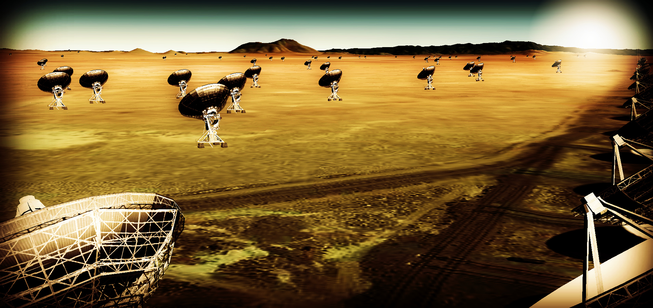
Effective area at 40GHz ~ 10x JVLA
Frequency range: 1 – 50, 70 – 115 GHz
~18m antennas w. 50% to few km + 40% to 200km + 10% to 3000km?
Design goal: minimize mass production and operations costs

Slide 2
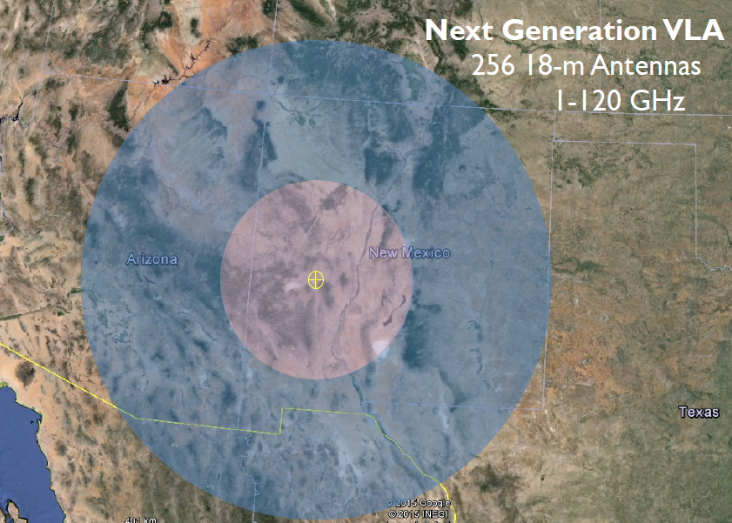
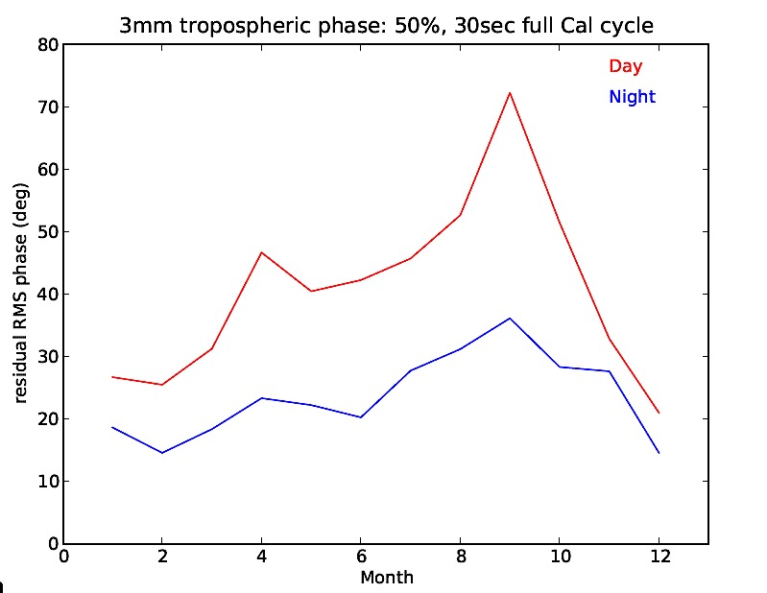
JVLA: Good 3mm site, elev. ~ 2200m
Residual phase rms after calibration
90% coherence
550km

Slide 3
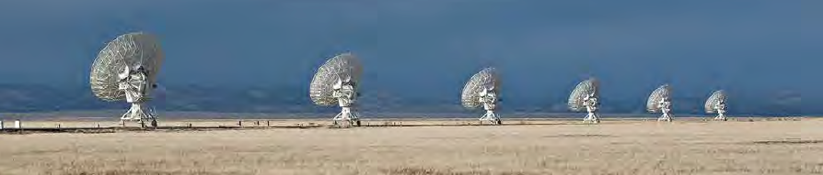
Process to date
Jan 2015: AAS Jan community discussion
https://science.nrao.edu/science/meetings/2015/aas225/next-gen-vla/ngvla
March 2015: Science working group white papers
Circle of Life (Isella, Moullet, Hull)
Galaxy ecosystems (Murphy, Leroy)
Galaxy assembly (Lacy, Casey, Hodge)
Time domain, Cosmology, Physics (Bower, Demorest)
April 2015: Pasadena technology meeting
Fall 2015
SWG final White papers end August
Key Use Cases → science requirements → telescope specs
Second technical meeting: LO/IF, data transmission, operations, computing

Slide 4
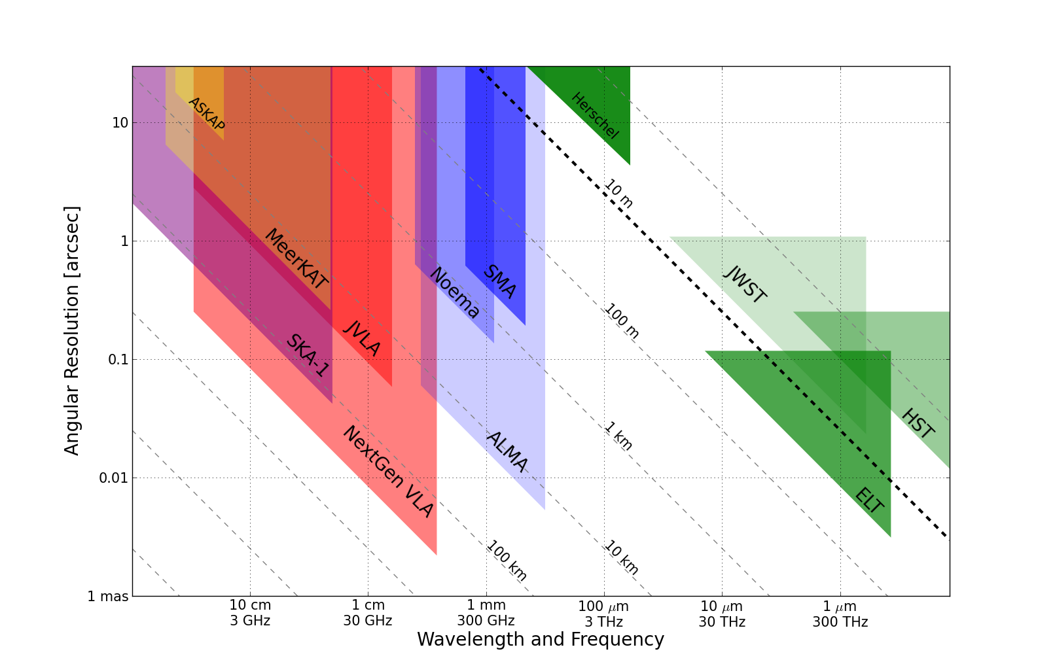
Killer Gap
Thermal imaging on mas scales at λ ~ 0.3cm to 3cm
Kent + Carilli
1AU @ 140pc
Terrestrial zone planet formation
Resolution ~ 10mas @ 1cm (300km)

Slide 5
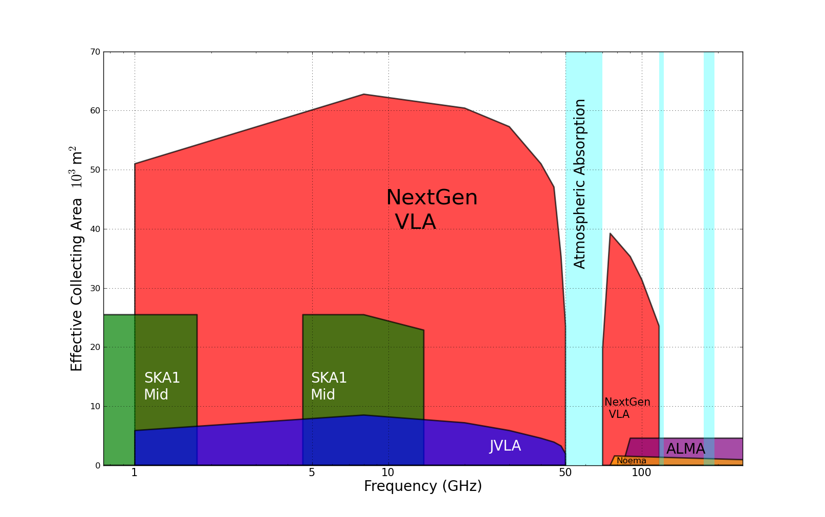
Killer Gap
Thermal imaging on mas scales at λ ~ 0.3cm to 3cm
Sensitivity ~ 0.1uJy @ 1cm, 10hr, BW = 20GHz
T_{B} ~ 1K @ 1cm, 10mas
Molecular lines become prevalent above 15GHz

Slide 6
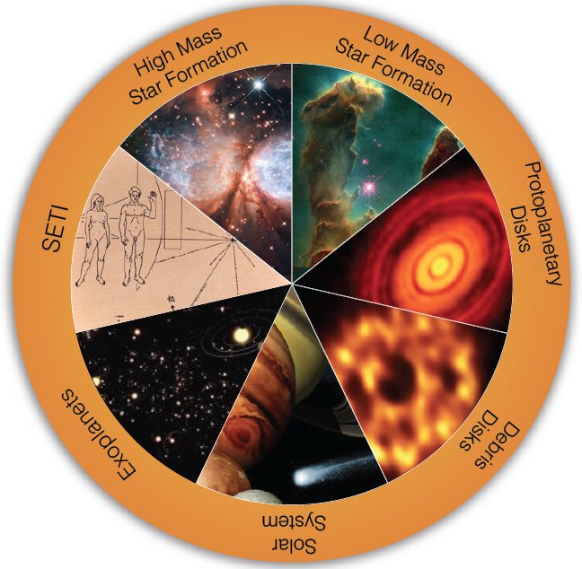
Circle of Life: origin stars, planets, life
Accretion in dust-obscured early phases
chemistry
Origin of stellar multiplicity
Organic chemistry
Aircraft radar from nearby planetary systems in 10min
Terrestrial zone planet formation
biology
Pre-biotic chemistry
Magnetospheres and exo-space weather
Pre-biotic molecules
Imaging chemistry, dynamics deep in planetary atmospheres

Slide 7
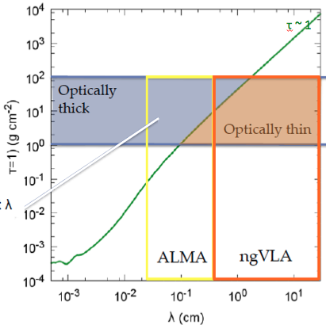
Terrestrial zone planet formation = ‘ngVLA zone’
Areal density for τ > 1
Typical ~ 1Myr protoplanetary disk at R ~ few AU
Optically thick at short ALMA wavelengths, but unresolved at long ALMA wavelengths
Isella ea.

Slide 8
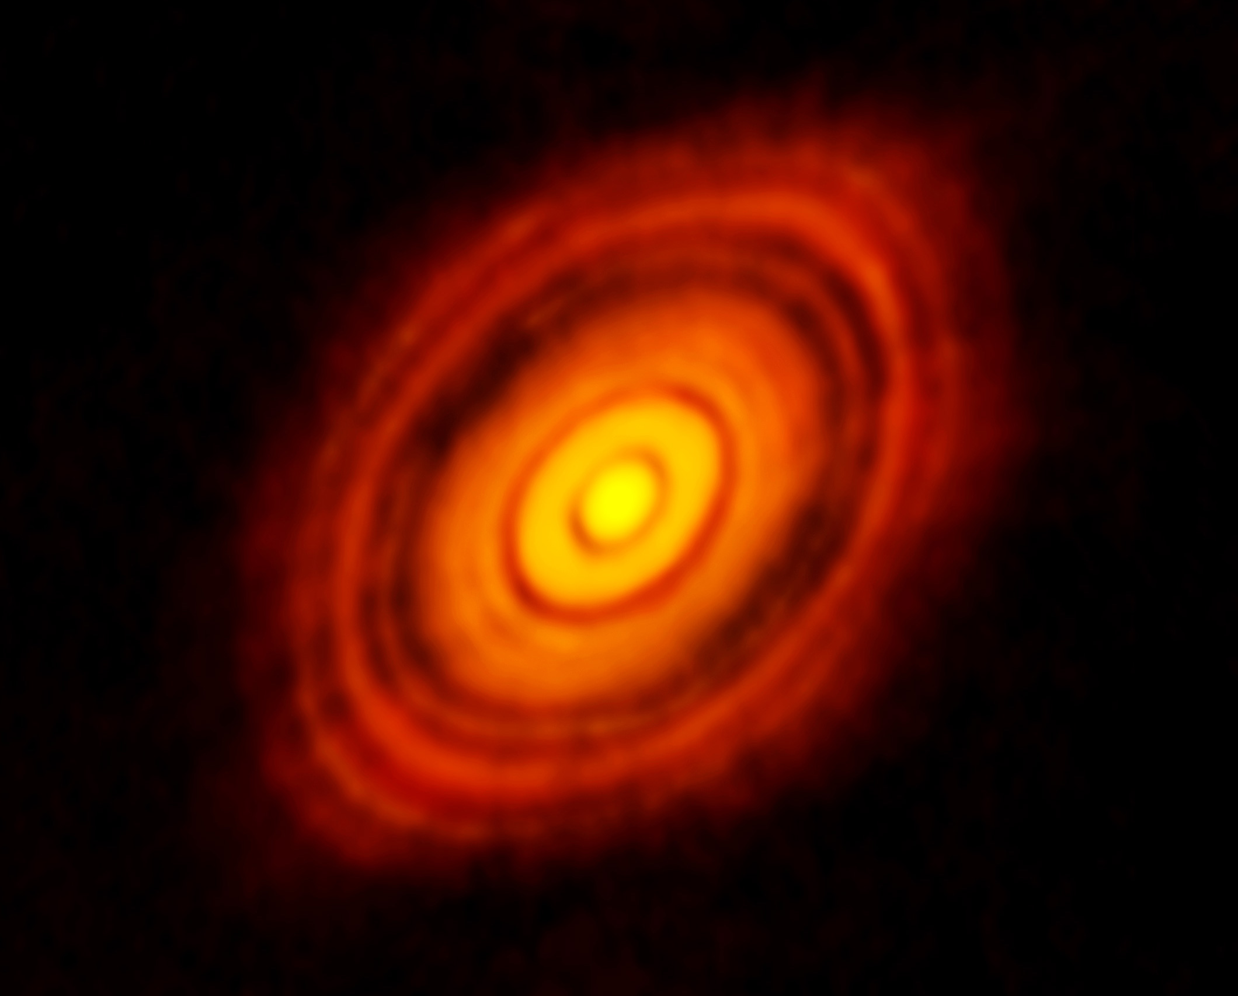
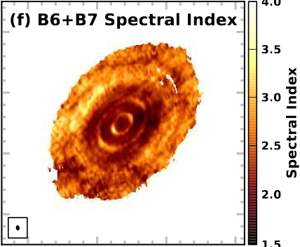
ALMA 250GHz Brogan ea.
ngVLA: Terrestrial zone planet formation imager
See through dust to pebbles: inner few AU disk optically thick in mm/submm
Grain size stratification at 0.3cm to 3cm
Poorly understood transition from dust to planetesimals
SI => combination of grain growth and optical depth
100AU 0.7” at 140pc
Inner 10AU = ngVLA zone @ 10mas res

Slide 9
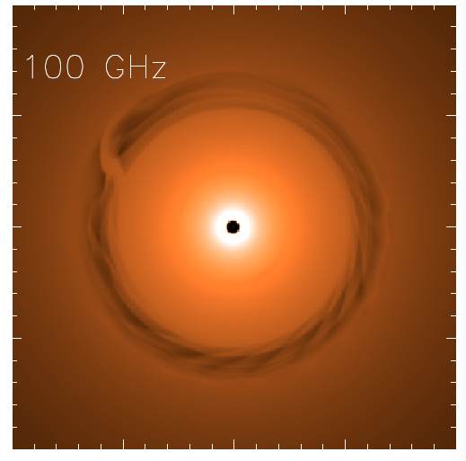
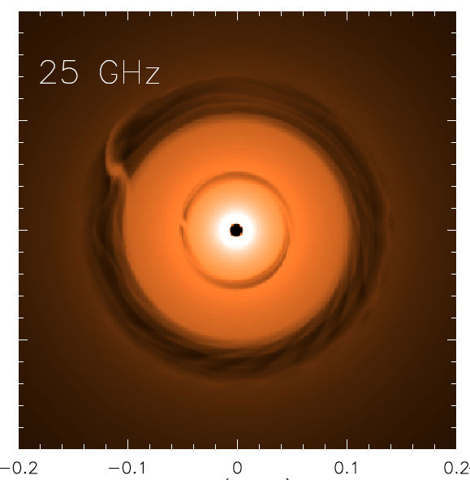
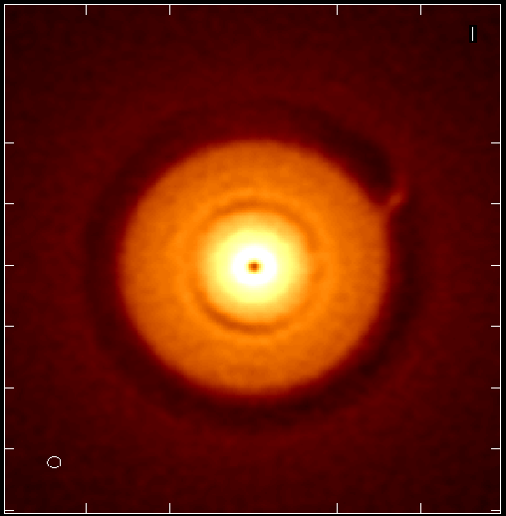
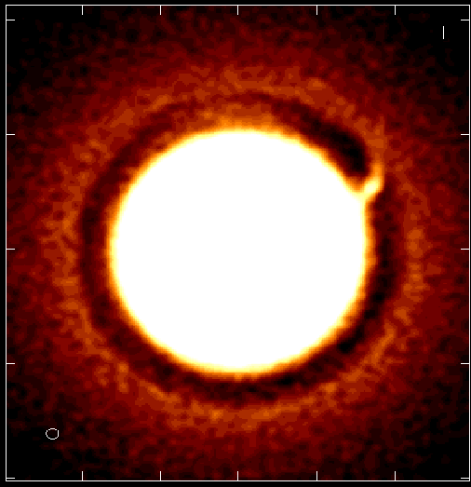
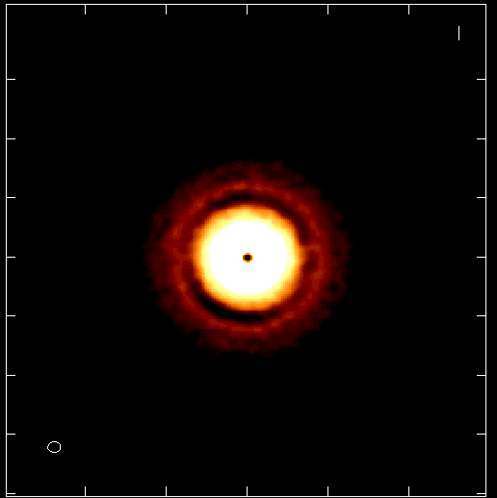
NGVLA: Protoplantary disk at 130pc distance
ngVLA 100hr 25GHz 10mas
0.1” = 13AU
model
model
rms = 90nJy/bm = 1K
Jupiter at 13AU, Saturn at 6AU
Inner gap optically thick at 100GHz
Image both gaps + annual motions
Circumplanetary disks: imaging accretion on to planets
ngVLA: planet accretion!
ngVLA: image inner gap
Isella + Carilli

Slide 10
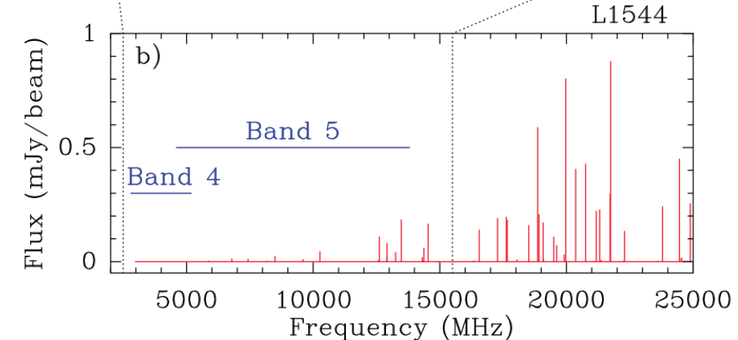
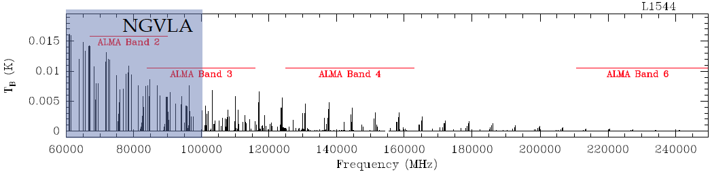
Circle of life: pre-biochemistry
Glycine
Pre-biotic molecules: rich spectra in 0.3cm to 3cm regime
Complex organics: ice chemistry in cold regions
Ammonia and water: temperature, evolutionary state, PP disks, comets, atmospheres…
Codella ea. 2014
SKA
ngVLA
Jimenez-Sierra ea 2014

Slide 11
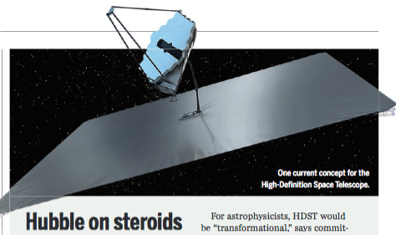
ng-Synergy: Solar-system zone exoplanets
‘ALMA is to HST/Kepler as ngVLA is to HDST’
High Definition Space Telescope Terrestrial planets: top science goal
Direct detection of earth-like planets
Search for atmospheric bio-signatures
ngVLA
Imaging formation of terrestrial planets
Pre-biotic chemistry

Slide 12
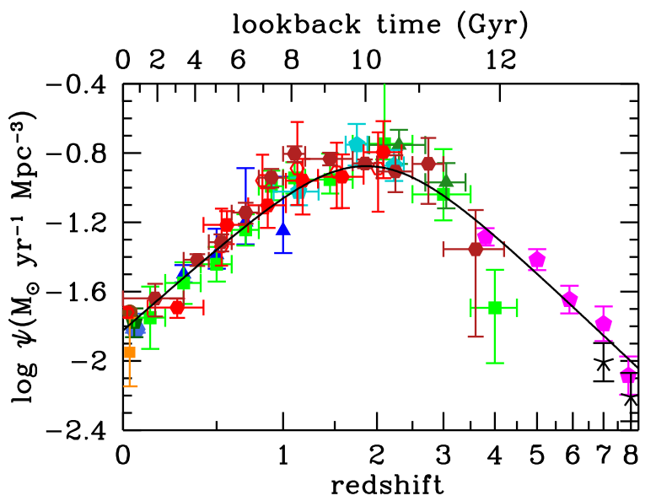
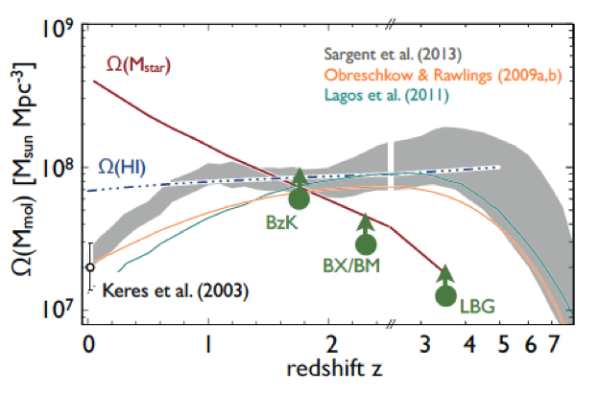
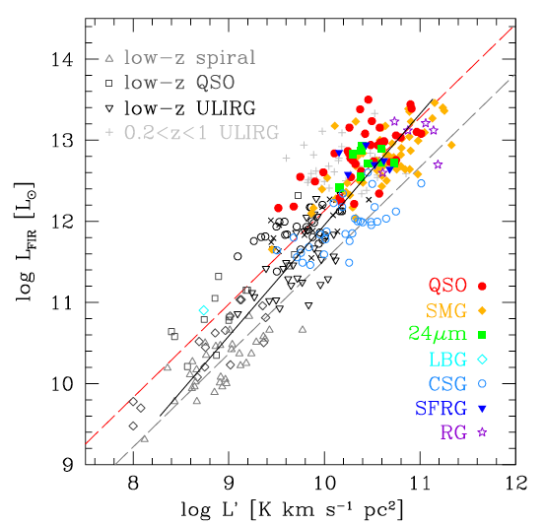
Cool Gas History of the Universe
SF Law
SFR
M_{gas}
SFHU has been delineated in remarkable detail back to reionization
SF laws => SFHU is reflection of CGHU: study of galaxy evolution is shifting to CGHU (source vs sink)

Slide 13
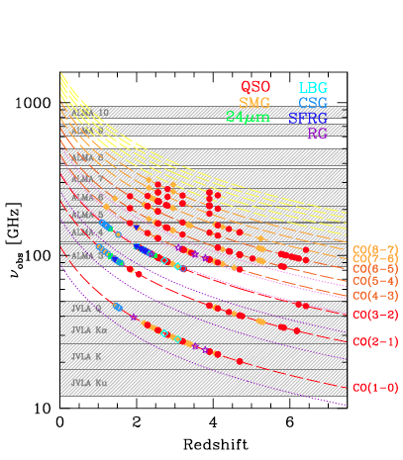
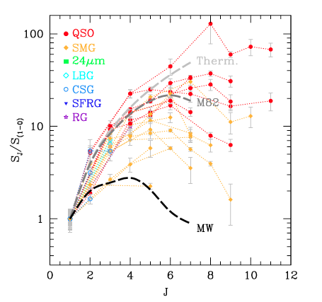
Low order CO: key total molecular gas mass tracer
M_{H2} = α x L_{CO1-0}
Total molecular gas mass
w. ALMA => gas excitation
Dense gas tracers associated w. SF cores: HCN, HCO+
ALMA
ngVLA ‘sweet spot’
10x uncertainty
VLA/GBT
SKA 1

Slide 14
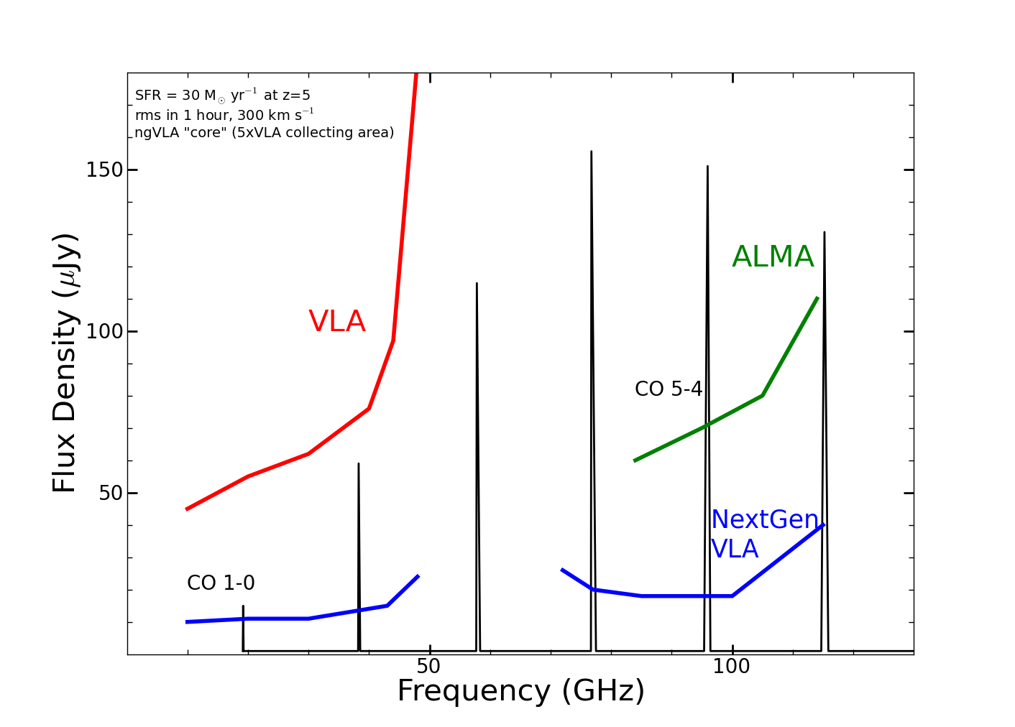
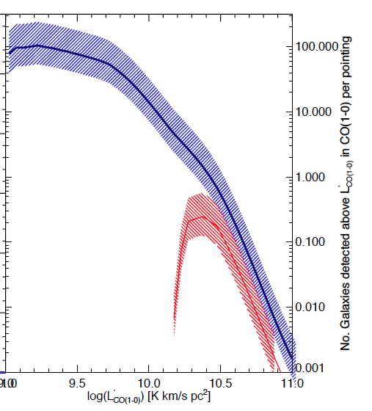
New horizon in molecular cosmological surveys
CO emission from typical star forming, ‘main sequence’ galaxies at high z in 1 hour
z=5, 30 M_{o}/yr
1hr, 300 km/s
GBT
GBT
Number galaxies per hour
ngVLA
Increased sensitivity and BW => dramatic increase molecular survey capabilities. Number of CO galaxies/hour, 20 – 40 GHz:
JVLA ~ 0.1 to 1, M_{gas} > 10¹⁰ M_{o}
ngVLA: tens to hundreds, M_{gas} > 2x10⁹ M_{o}
JVLA
Casey ea

Slide 15
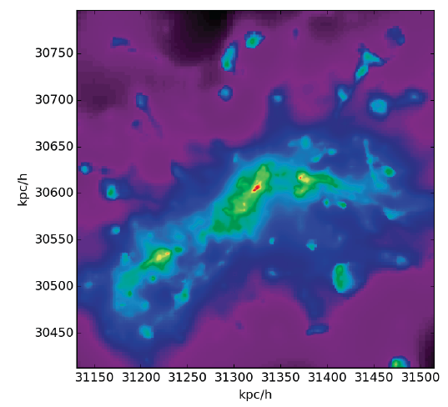
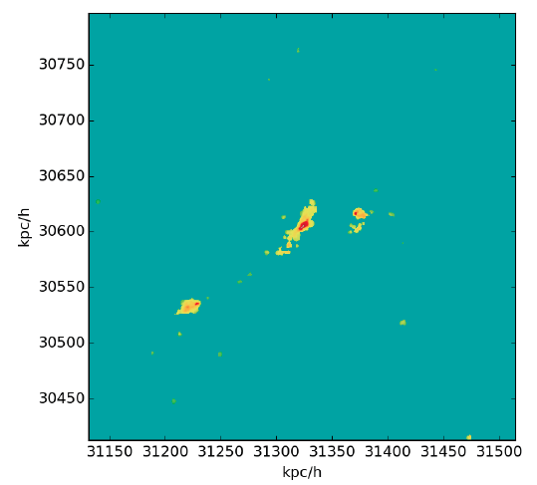
Galaxy assembly: Imaging on 1 kpc-scales
Low order: large scale gas dynamics, not just dense cores
w. ALMA dust imaging: resolved star formation laws at ~ 1kpc
CO 1-0
z ~ 3
CO 3-2
n_{cr} > 10⁴ cm⁻³
n_{cr} ~ 10³ cm⁻³
Narayanan

Slide 16
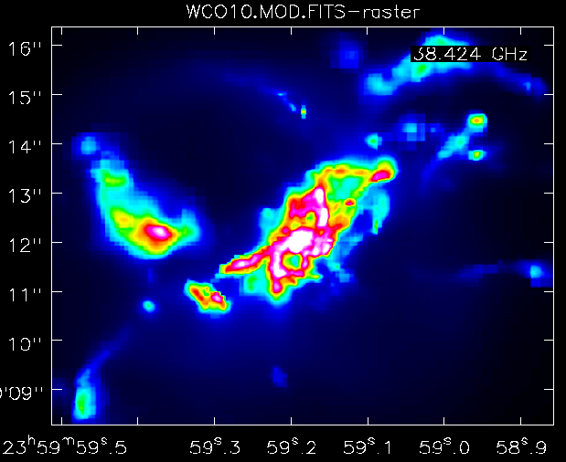
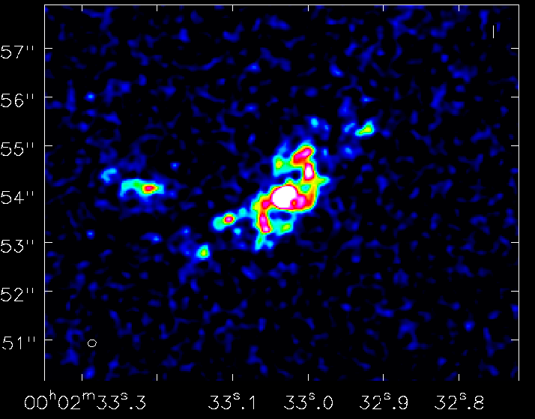
ngVLA: SMG at z=2, CO1-0
Narayanan + Carilli
1” = 7kpc
Model
ngVLA
38GHz, 10hrs
rms(100 km/s) = 12uJy => 2e8 (α/0.8) M_{o} !
Resolution = 0.15”
Low mass sattelite galaxies, streamers, accretion?

Slide 17
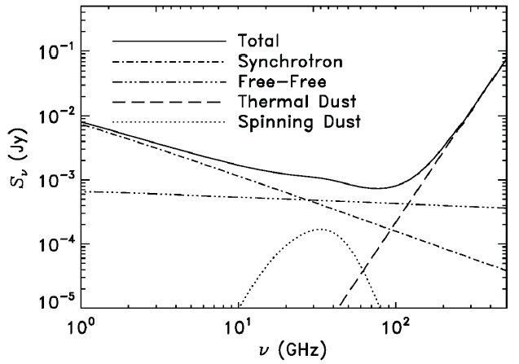
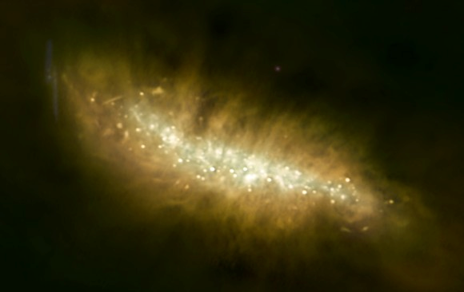
Galaxy eco-systems
Wide field, high res. mapping of Milky Way and nearby Galaxies
ngVLA
Broad-Band Continuum Imaging
Cover multiple radio emission mechanisms: synchrotron, free-free, cold (spinning?) dust, SZ effect
Independent, obscuration free estimates of SFR
Physics of cosmic rays, ionized gas, dust, and hot gas around galaxies

Slide 18
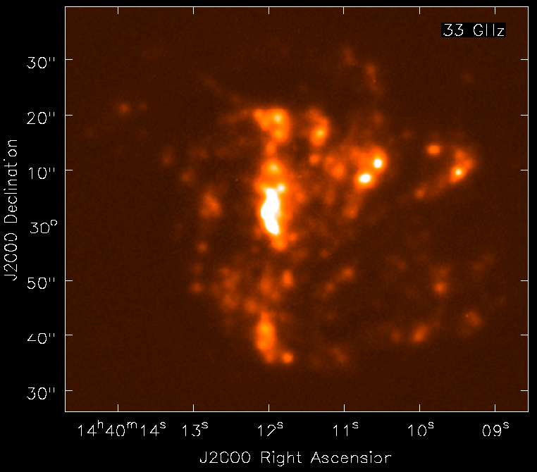
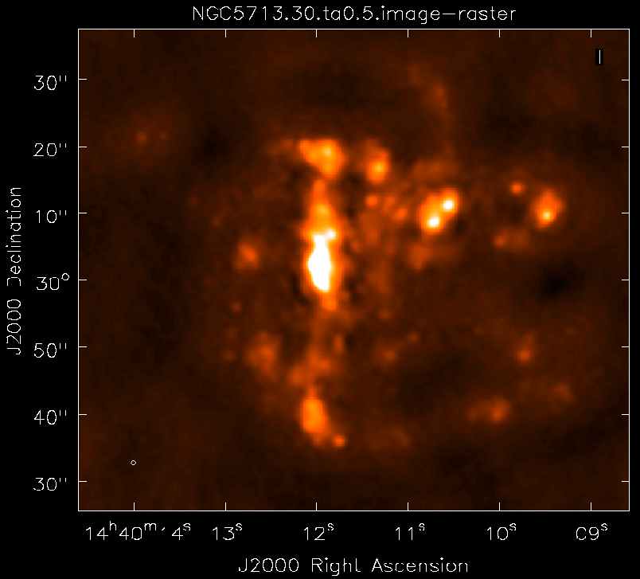
NGVLA: Free Free emission from peculiar spiral in Virgo
Model 33GHz FF (from Hα)
NGVLA 10hrs, 0.5” res
1kpc
Murphy + Carilli
NGC 5713: distance ~ 30Mpc, total SFR ~ 5 M_{o} yr⁻¹
Free-Free ideal estimator of ionizing photon rate
Full array point source sensitivity at 1cm, 10hrs is 0.1uJy => HII region associated single O7.5 main sequence star
BW+resolution => spatially/spectrally separate thermal/non-thermal
Local-group-type studies out to Virgo!

Slide 19
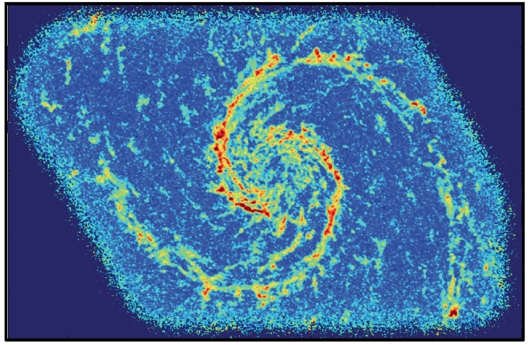
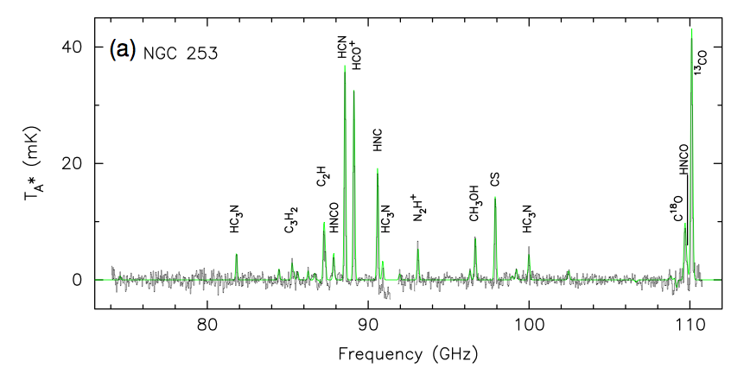
Schinerer ea.
Spectral Line Mapping: Map cool ISM 10x faster than ALMA (‘gold mine’ A. Leroy)
Rich frequency range: 1st order transitions of major astrochemical, dense gas tracers
Current CO mapping: tens hours
Other tracers: 10x fainter => need ngVLA
CO1-0 Bure 200hr, 1”
Snell ea

Slide 20
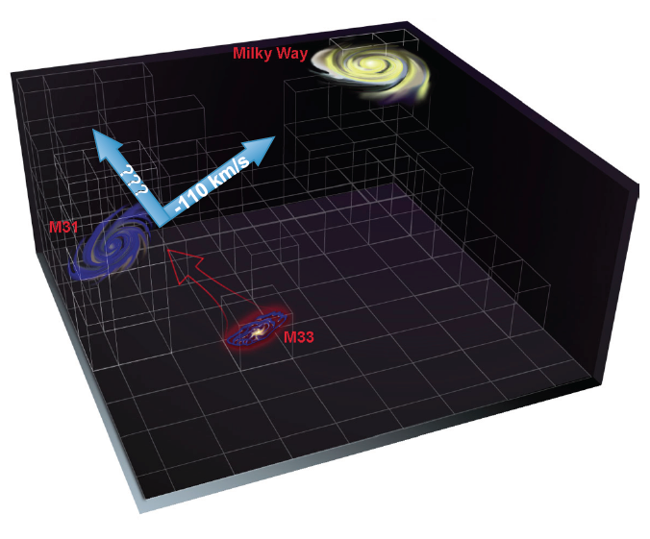
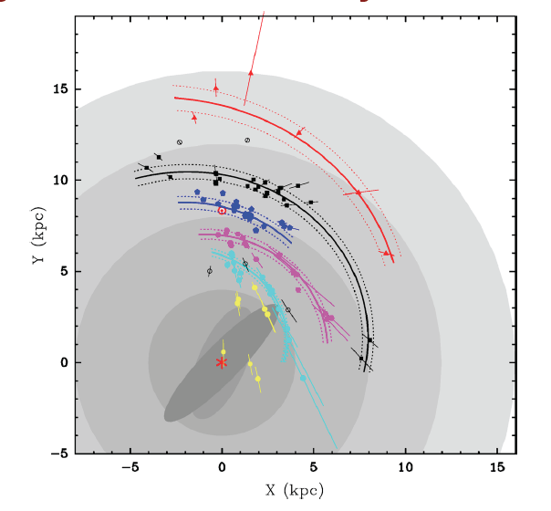
VLBI uas astrometry
Spiral structure of MW: masers in SF regions to far side of Galaxy
Local group cosmology: proper motions + parallax w. masers + AGN: 0.1 uas/yr => dark matter, fate MW, real-time cosmology (local Hubble expansion)
Not DNR limited imaging => include few big antennas ~ 10% area?
Reid ea
Local group proper motions 0.1 uas/year = 0.4 km/s!
(Darling)

Slide 21
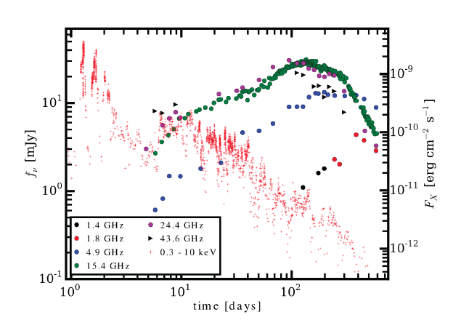
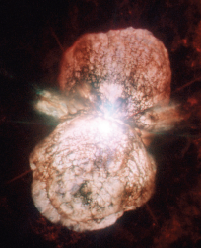
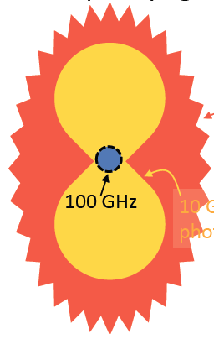
Physics, cosmology, time domain
(Bower et al. SWG4)
GBR/TDE: late time jet shock
15GHz
Time domain: bursts brighter and peak earlier at high frequency (0.3cm to 3cm)
GRB, TDE, FRB
Novae: ‘peeling onion’
Radio counterparts to GW events
Galactic Center Pulsars
10GHz
1GHz

Slide 22
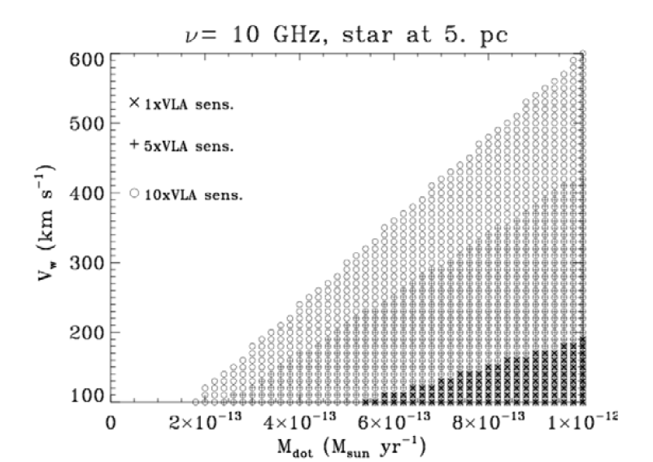
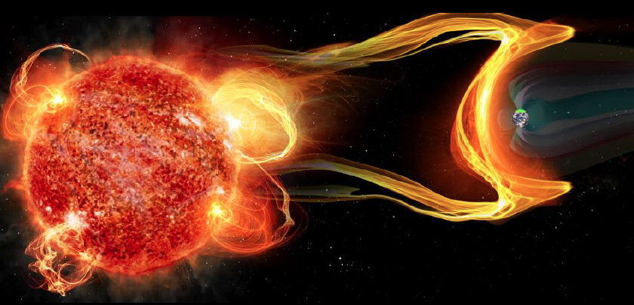
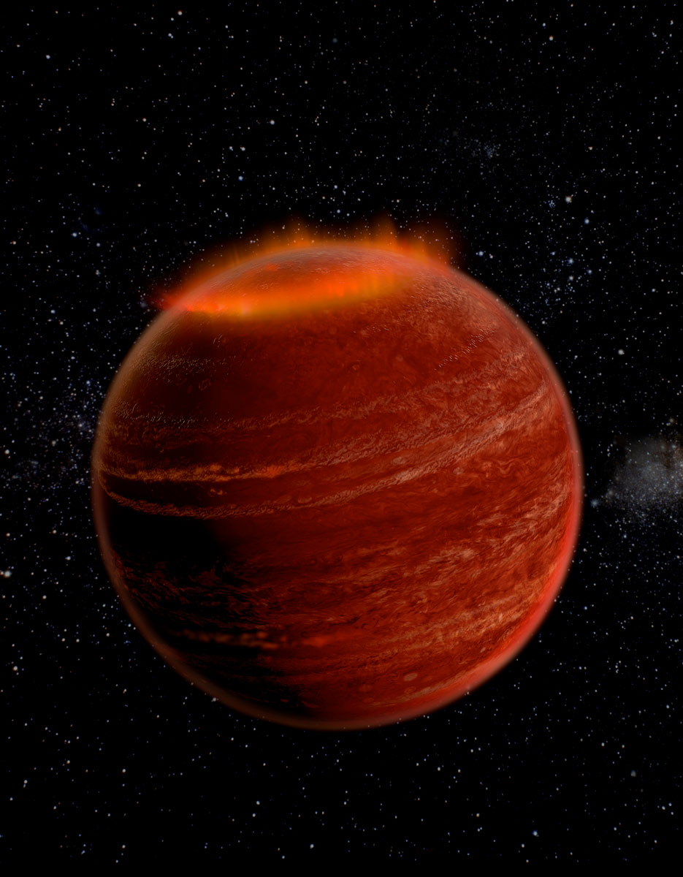
Star – Planet interactions: exo-space weather
NGVLA most sensitive telescope to study broad-band stellar radio phenomena
10⁻¹³ M_{o}/yr
Thermal stellar winds
M dwarfs most likely hosts habitable planets, but very active, flares up to 10⁴ x Sun
Wind – planet interactions => early evaporation of planetary atmospheres?
Brown dwarf Auroras! Star-planet magnetospheric interactions
Key drivers of exo-space weather: dictate exo-planet environments (and the development of life)
Hallinan)
cyclotron emission, w. B ~ 2000G!

Slide 23
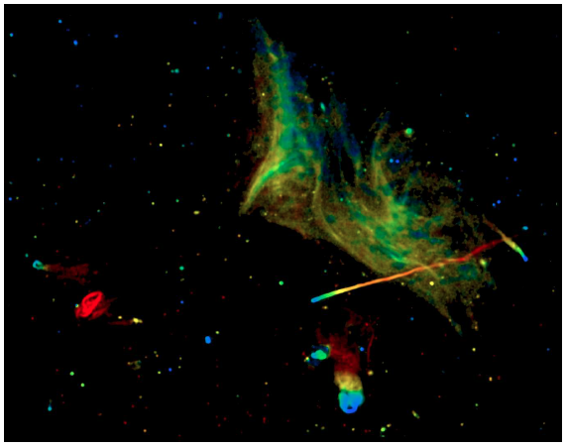
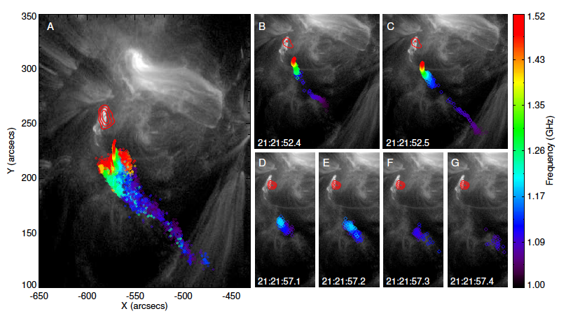
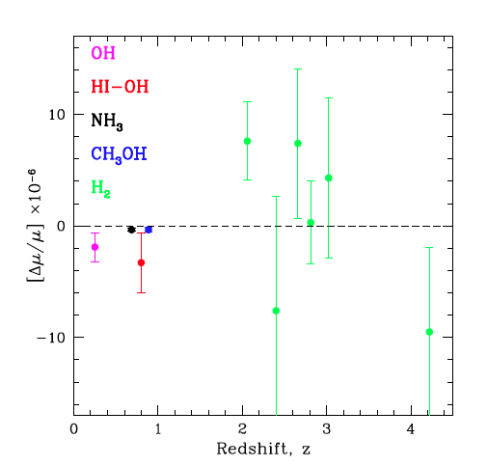
Plasma Universe
Mpc-scale cluster emission
1000km. 100msec scale solar flares
Magnetic reconnection vs. shock acceleration: broad band phenomena
S-Z for individual galaxies
ngVLA-short (1cm, 3”, 10hrs) ~ 1uK
nT ~ 10⁶ over 10kpc => 20uK
Evolution of fundamental constants using radio absorption lines: most promising ~ 1cm
Kanekar ea

Slide 24
Preliminary Key Science
Imaging Solar-system zone planet formation + prebiotic chemistry – synergy with HDST
Cool gas history of Universe – synergy JWST, TMT…
Time domain: exospace weather – synergy LSST
Baryon cycle: wide field, high res. thermal line + cont. imaging – synergy Far IR surveyor
VLBI astrometric applications: local group cosmology
Next steps: Maturing process w. ‘living docs’
KS → requirements → specs: physical modeling + configurations + simulations
2nd technical meeting, Fall 2015, CV
AAS ngVLA day: Jan 4, 2016
Larger community meeting Spring 2016

Slide 25
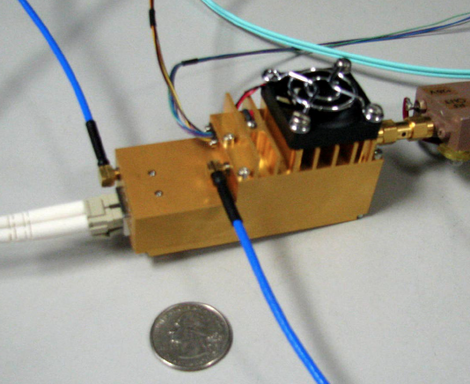
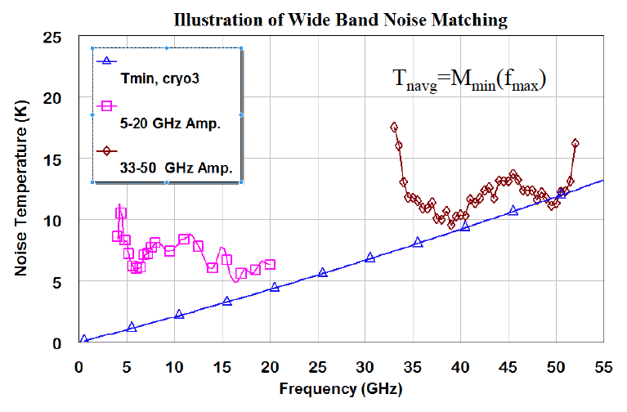
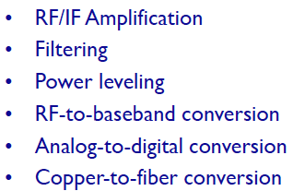
Pasadena Technical Meeting (Weinreb)
https://safe.nrao.edu/wiki/bin/view/NGVLA/NGVLAWorkshopApril2015
Antennas (Padin, Napier, Woody, Lamb…)
12m to 25m? 75% eff at 30GHz
Offaxis (high/low), symmetric?
Hydroform, panel?
Reconfigurable?
Feeds, Receivers (Weinreb, Pospiezalski, Morgan…)
1 – 115GHz: 3 bands? 4 bands? more?
Correlator: FPGA (Casper), GPU (nVidia), ASIC (JPL), Hybrid (DRAO)
Conclusions
No major single-point failures
Could build today for not-unreasonable cost
Development geared to optimize performance and minimize mass production and operational cost
Data processing for KSP also not likely bottle neck
Morgan mmic: Rack full of warm electronics in your hand

Slide 27
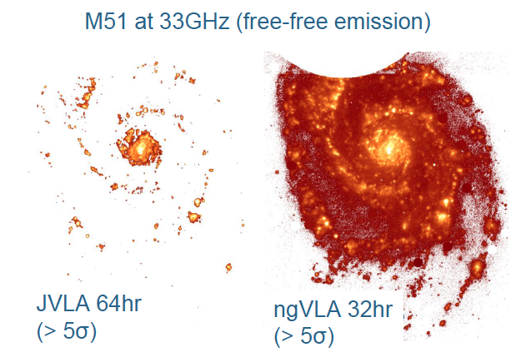
Need for large single dish
Short/zero spacings: big problem with missing flux for Galactic and nearby galaxies
Two size antennas? (probably not short enough?)
Total power on some array antennas?
Large single dish + FPAs?
VLBI applications: Mostly astrometry
Imaging DNR not big issue.
Collecting area is big issue => few large antennas
Imaging 10’ at 1cm requires ~ 3m baselines!
10’

Slide 28
Killer Gap
Thermal imaging on mas scales at λ ~ 0.3cm to 3cm
Many other parameters: FoV, Bandwidth, T_{sys}, RFI occupation, UV coverage (dynamic range, surface brightness), Atmospheric opacity and Phase stability, Pointing…
Relative metrics depend on science application

Slide 29


Slide 30



JVLA state of art
Beyond blob-ology
CO 2-1 z=4.0
-300 km/s
7kpc
GN20 z=4.0
CO2-1 at 0.25”
Resolved gas dynamics
14kpc rotating disk
M_{dyn} = 5.4 10¹¹ M_{o}
Resolve SF law
1”
+300 km/s
0.25”
Hodge ea.
GN20
120 hours on JVLA
Few hours on ngVLA
Spatially resolved SF Law

Slide 31
HL Tau
ALMA 250GHz Brogan ea.
ngVLA: Terrestrial zone planet formation imager
Class I to II transitional protostar (~ 1Myr) w. ~ 1 M_{o} star + 0.1 M_{o} dust disk
Disk inner 10 AU is optically thick at mm/submm
ngVLA/cm probes the inner disk
Gaps due to planets on solar system scales
Grain size stratification at 0.3cm to 3cm: Poorly understood transition from dust to planetesimals
Annual motions
100AU 0.7” at 140pc
ngVLA simulation 25GHz
Inner 15AU = ngVLA zone @ 10mas res.

