Slide 1

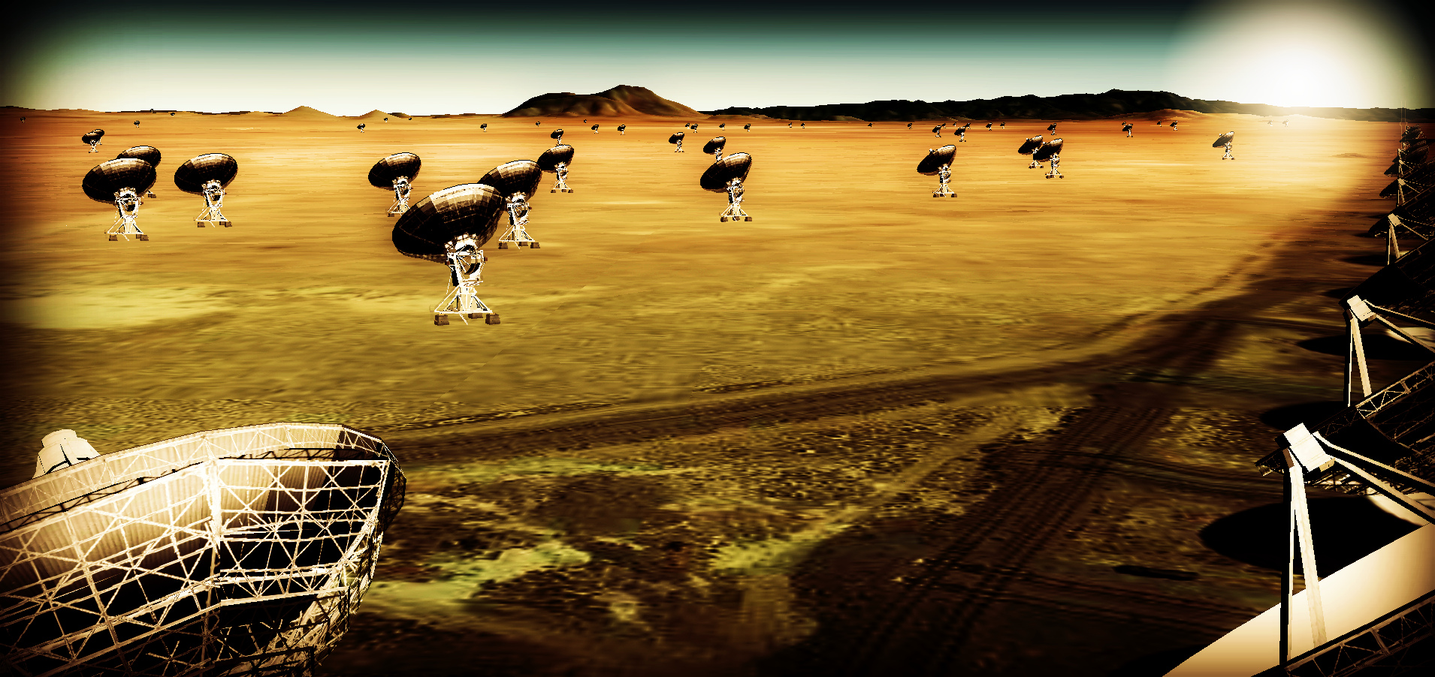
10x Effective Area JVLA, ALMA
Frequency Range: 1 – 115 GHz
10x Resolution w. 50% to few km + 50% to 300km + VLBI

Slide 2
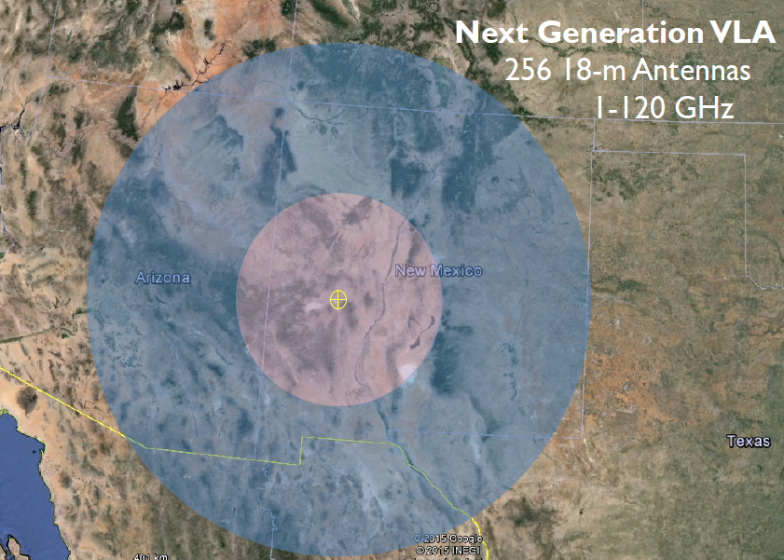
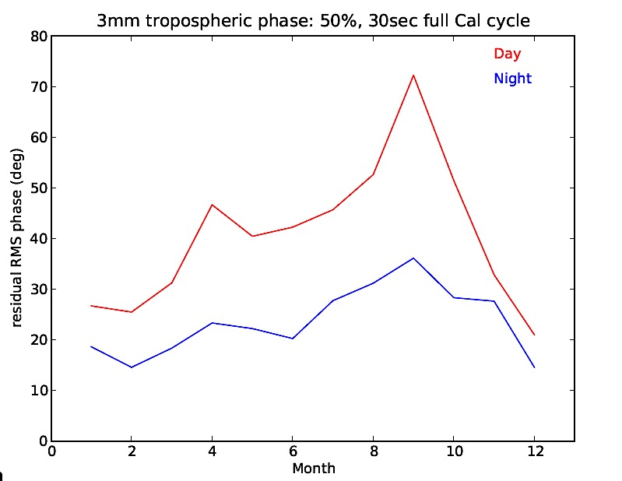
JVLA: Good 3mm site, elev. ~ 2200m
Residual phase rms after calibration
90% coherence
550km

Slide 3
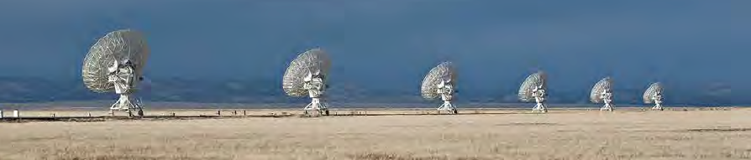
Process to date https://science.nrao.edu/futures/ngvla
AAS Community Day January 2015
Science working group reports October 2015
Circle of Life (Isella, Moullet, Hull)
Galaxy ecosystems (Murphy, Leroy)
Galaxy assembly (Lacy, Casey, Hodge)
Time domain, Cosmology, Physics (Bower, Demorest)
Technical meetings
April 2015 Pasadena: Antennas, Receivers, Correlator
December 2015 Socorro: Operations, Post-processing, LO/IF
Future
AAS Community Day January 4 2015
Key Use Cases → science requirements → telescope specs (small grants?)
Third Technical meeting ?

Slide 4
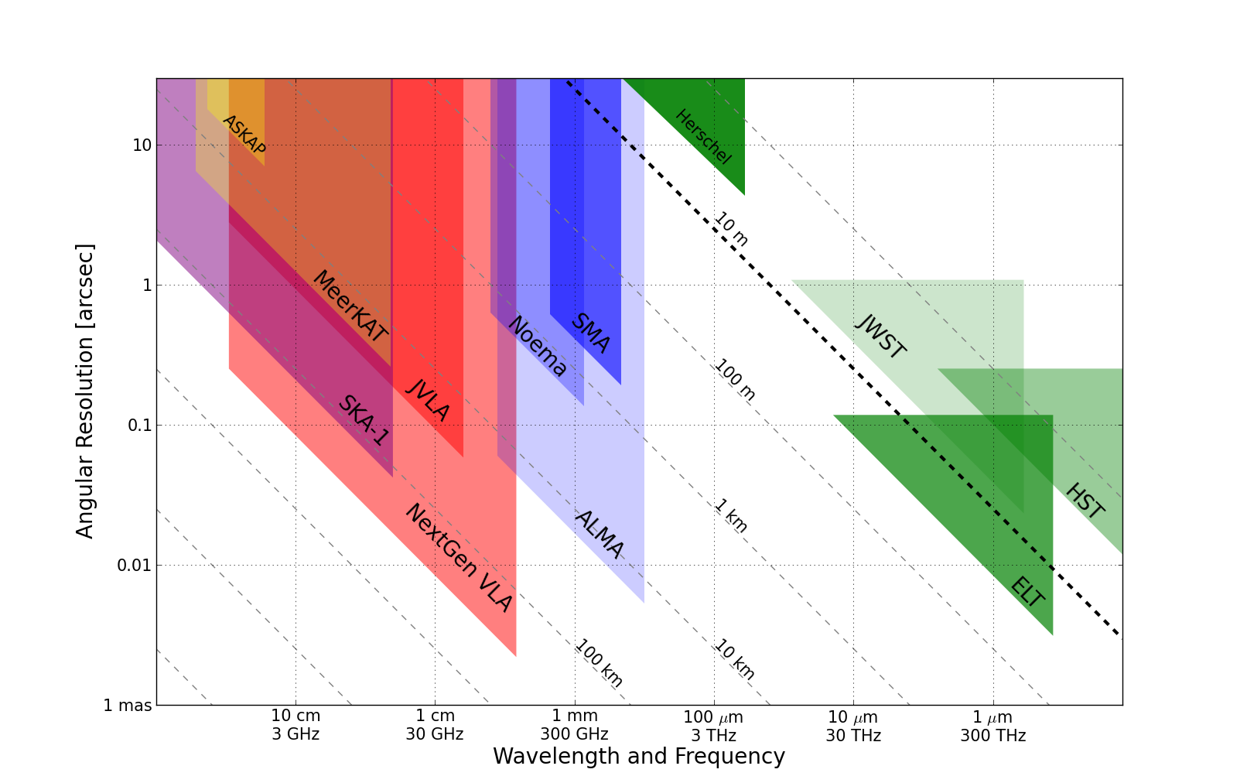
Killer Gap
Thermal imaging on mas scales at λ ~ 0.3cm to 3cm
1AU @ 140pc
Terrestrial zone planet formation
Resolution ~ 10mas @ 1cm (300km)
Synergy w. ALMA, future ELTs, NGST

Slide 5
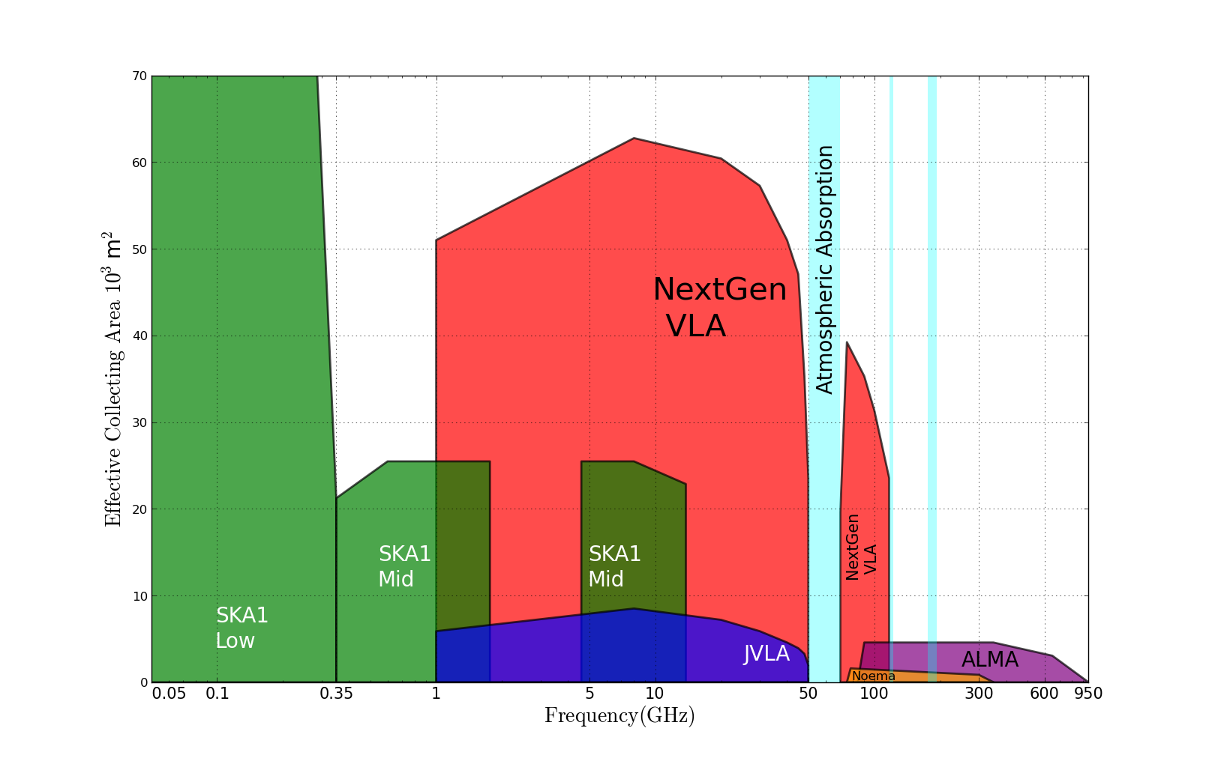
Killer Gap
Thermal imaging on mas scales at λ ~ 0.3cm to 3cm
5x
Sensitivity ~ 100 nJy @ 1cm, 10hr, BW = 20GHz
T_{B} ~ 1K @ 1cm, 10mas
Molecular lines become prevalent above 15GHz

Slide 6
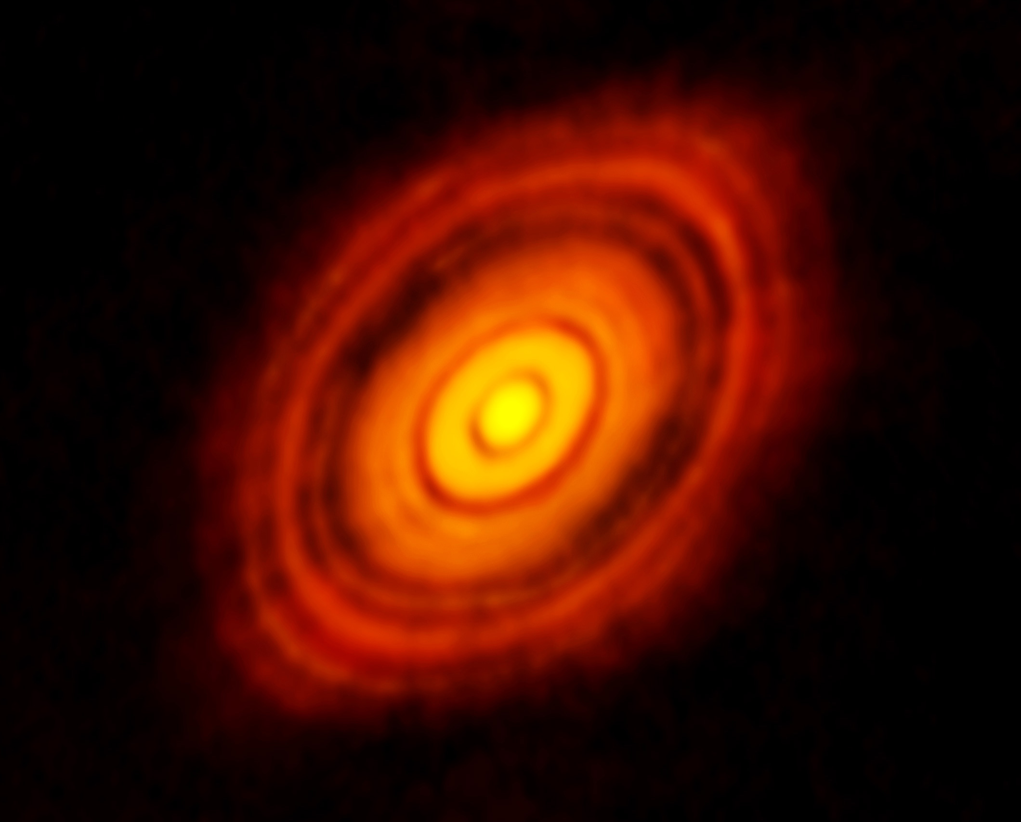
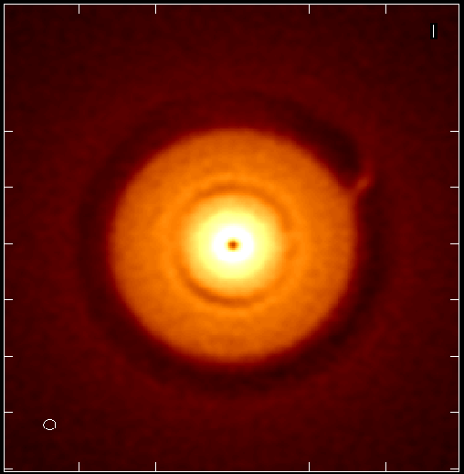
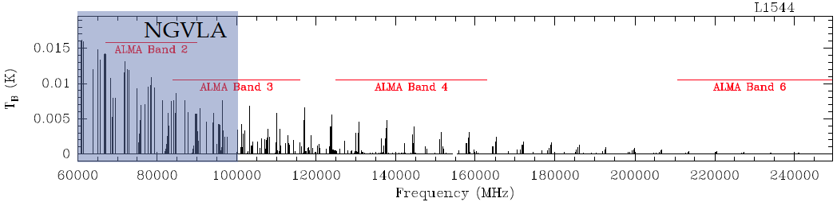
SWG1: Terrestrial zone planet formation imager
ALMA 250GHz Brogan ea.
Protoplantary disks: Inner ~ 20AU disk optically thick in mm/submm
ngVLA cm: Grain growth and stratification from dust to pebbles to planets. Simulation:
Jupiter at 13AU, Saturn at 6AU: annual motions
Circumplanetary disks: planet accretion
Pre-biotic molecules: rich spectra in 0.3cm to 3cm regime
100AU 0.7” at 140pc
ngVLA 25GHz @ 10mas
rms = 1K
model
model
Glycine
Jimenez-Sierra ea 2014

Slide 7
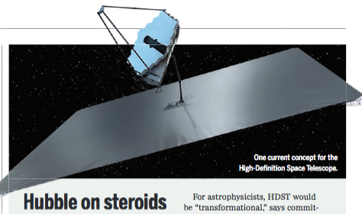
Next-Gen Synergy: Solar-system zone exoplanets
‘ALMA is to HST/Kepler as ngVLA is to HDST’
High Definition Space Telescope Terrestrial planets: top science goal
Direct imaging of earth-like planets
Search for atmospheric bio-signatures
ngVLA
Imaging formation of terrestrial planets
Pre-biotic chemistry

Slide 8
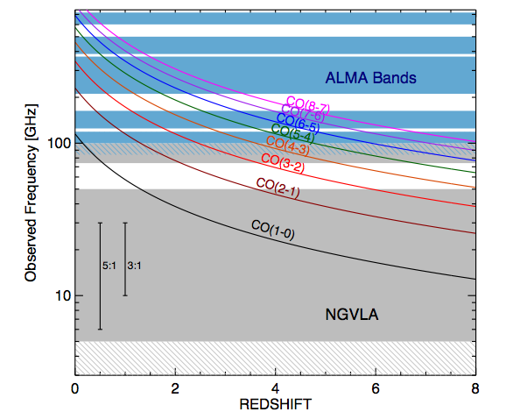
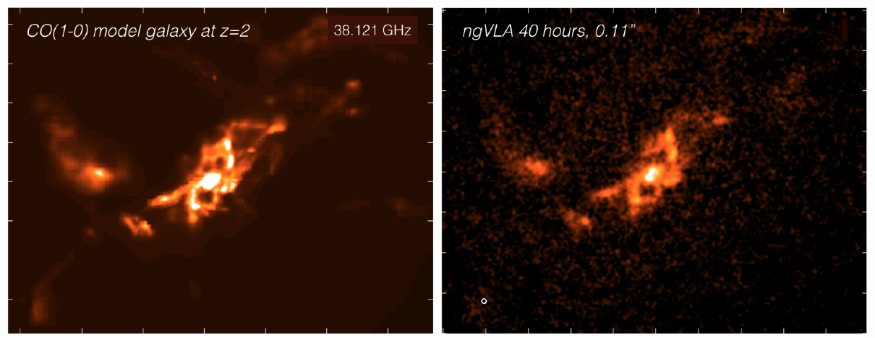
SWG3: Cool Gas History of the Universe – Tracing the fuel for star formation through cosmic time
Low order CO = molec. gas mass tracer
10x sens: z > 1 ‘main sequence’ galaxies in 1hr w. M_{gas} ~ 10⁹ M_{o}
Dense gas tracers (HCN, HCO+…)
Blind surveys: 100s galaxies/hr (vs. ~ 1 w. JVLA)
Sub-kpc imaging: large scale gas dynamics
Synergy w. ALMA: Gas excitation, dust + SF laws
1” = 7kpc

Slide 9
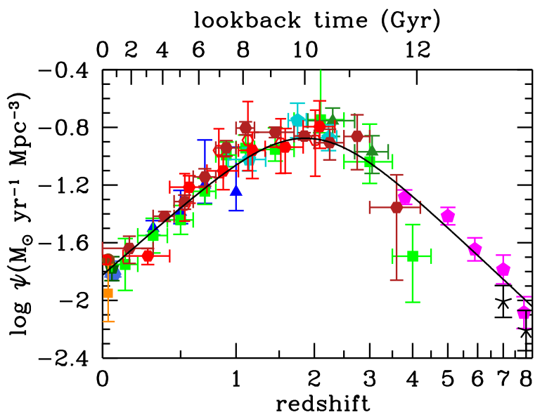
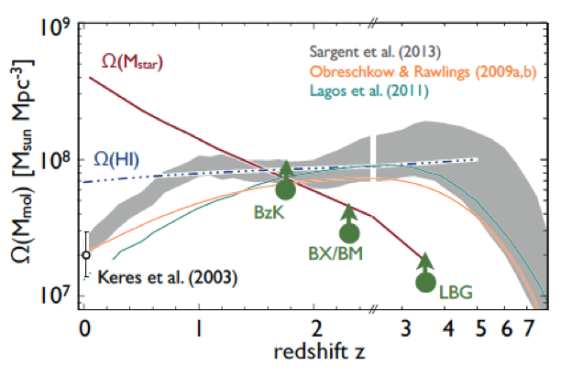
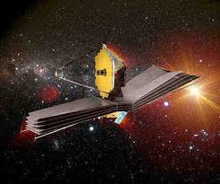
Next-Gen Synergy: Cosmic Gas to Stars Cycle
ngVLA: cold gas driving cosmic star formation
JWST/TMT: stars and star formation

Slide 10
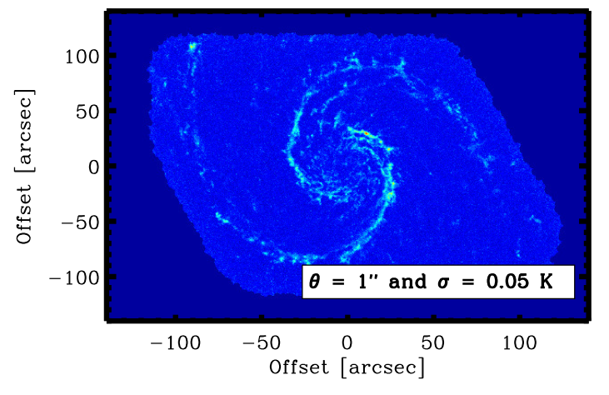
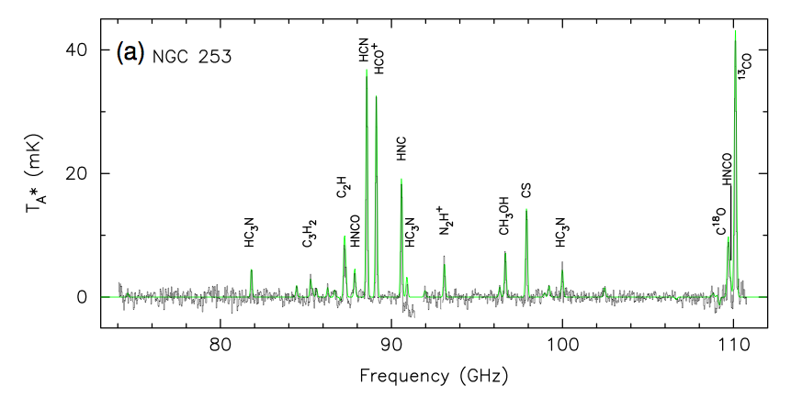
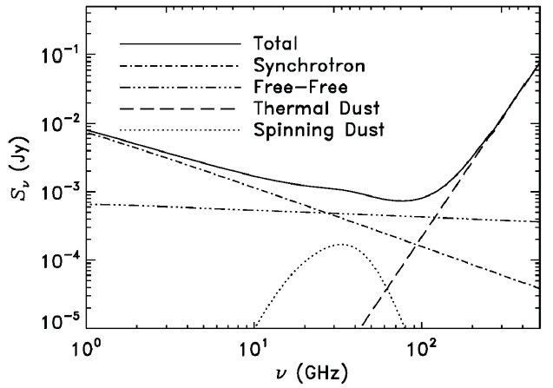
SWG2: wide field imaging10x faster than ALMA – MW/Local group science out to Virgo!
HCN M51
Spectral lines
Ground state transitions of primary astrochemical, dense gas tracers
Unprecedented view of Baryon Cycle
Broad-Band Continuum
Synchrotron, free-free, cold (spinning?) dust, SZ effect
Obscuration free estimates of SFR
Physics of cosmic rays, ionized gas, dust, and hot gas around galaxies
Synergy: FIR Explorer, TMT…
ngVLA

Slide 11
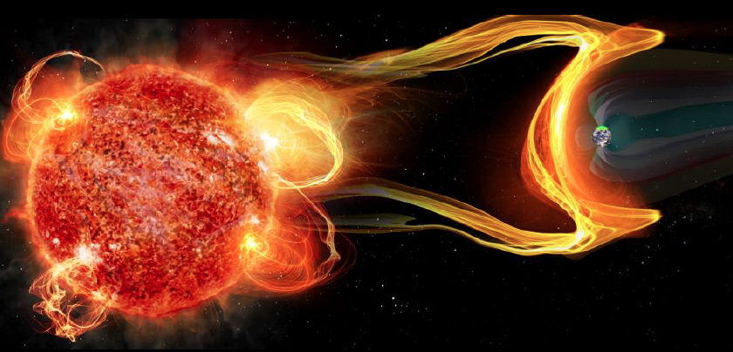
SWG4: Exploring the Time Domain – NGVLA most sensitive telescope to study broad-band temporal phenomena
Explosive Universe (TDEs, GRBs, Blazars, GW/EM, FRBs?): high frequency peaks higher and earlier
Exo-space weather: exo-planet environments and the development of life
Thermal stellar winds to 10⁻¹³ M_{o}/yr
Brown dwarf Auroras: Star-planet magnetospheric interactions
Synergy: LSST, LIGO, FERMI++…

Slide 12
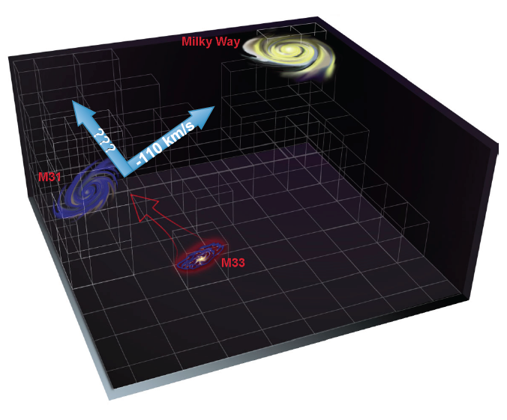
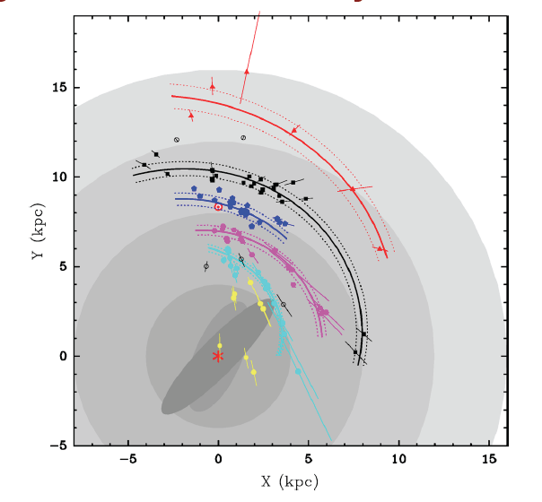
VLBI uas astrometry
Local group cosmology: proper motions + parallax w. masers + AGN: 0.1 uas/yr => dark matter, fate MW, real-time cosmology: watch local Hubble expansion!
Spiral structure of MW: masers in SF regions to far side of Galaxy
Reid ea
Local group proper motions 0.1 uas/year = 0.4 km/s!
(Darling)

Slide 13
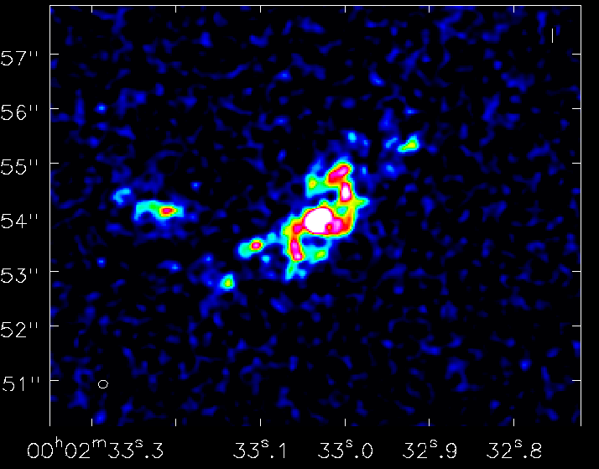
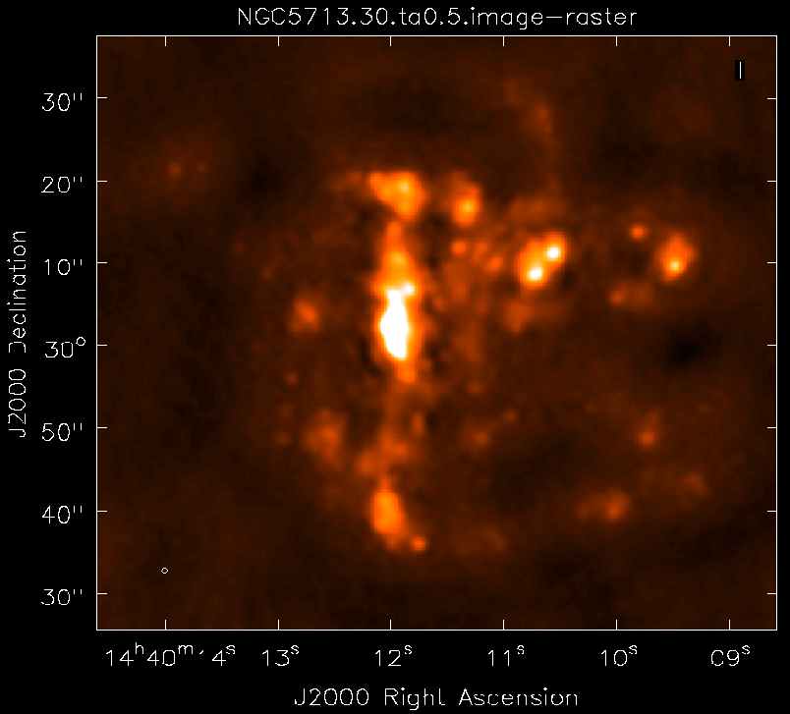
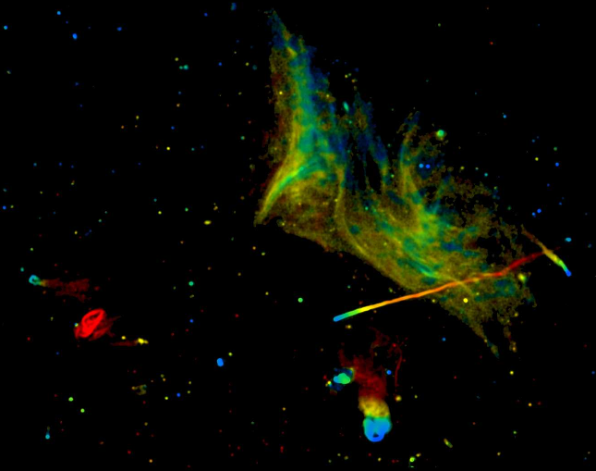
Next steps: Requirements to Specifications
Goal | Science Requirement | Array Specification
TPF | Optically thin | Freq ~ 15 to 50GHz
 | 1AU at 130pc @ 30GHz | B ~ 300km
 | 1K in 10hrs @ 10mas, 30GHz | A_{full} ~ 300 x 18m; BW ~ 20GHz
CGHU | CO 1-0 to z=8 | Freq = 15 to 115GHz
 | M_{gas} = 10⁹ M_{o} at z = 3 in 1hr | A_{mid} ~ 70% to B ~ 30km
 | 500pc resolution at z = 3 (60mas) | 30km
 | Large volume surveys | Octave Band Ratio
Baryon Cycle | T_{B} < 0.2K (1hr, 10 km/s, 80GHz, 1”) | A_{core} ~ 30% to B ~ 2km
 | Continuum science | Octave BR; Linear pol to 0.1%
Time Domain | Explosive follow-up (GRBs, GW/EM…) | Minute trigger response time
 | Blind discoveries (eg. FRBs) | millisec searches
 | Exo-space weather: 1uJy in 1min | Freq ~ 1 to 20GHz A_{full} ~ 300 x 18m Circular pol to few %

Slide 14
Next steps: Requirements to Specifications
Antennas
12m to 25m: FoV requirements
On vs. off axis: DNR requirements
Configuration: need simulations
Balance: Core (1km) vs. mid (30km) vs. long (300km)
Some fraction reconfigurable
Need for large single dish + cameras or compact array
Receivers
Band ratios: performance v. number
Low frequency limit
Phase Calibration: testing at JVLA
VLBI implementation: need simulations
New stations vs. ‘ad hoc’

Slide 15
Next Steps: Science Case is not Static!
Science Advisory Committee
Future workshops
SWG focused meetings
Broad community meeting: Open call for papers, early 2017?
Possible small grants program
NRAO sci-tech support for simulations/calculations
Goal: compelling Sci/Tech proposal to DS2020

Slide 16
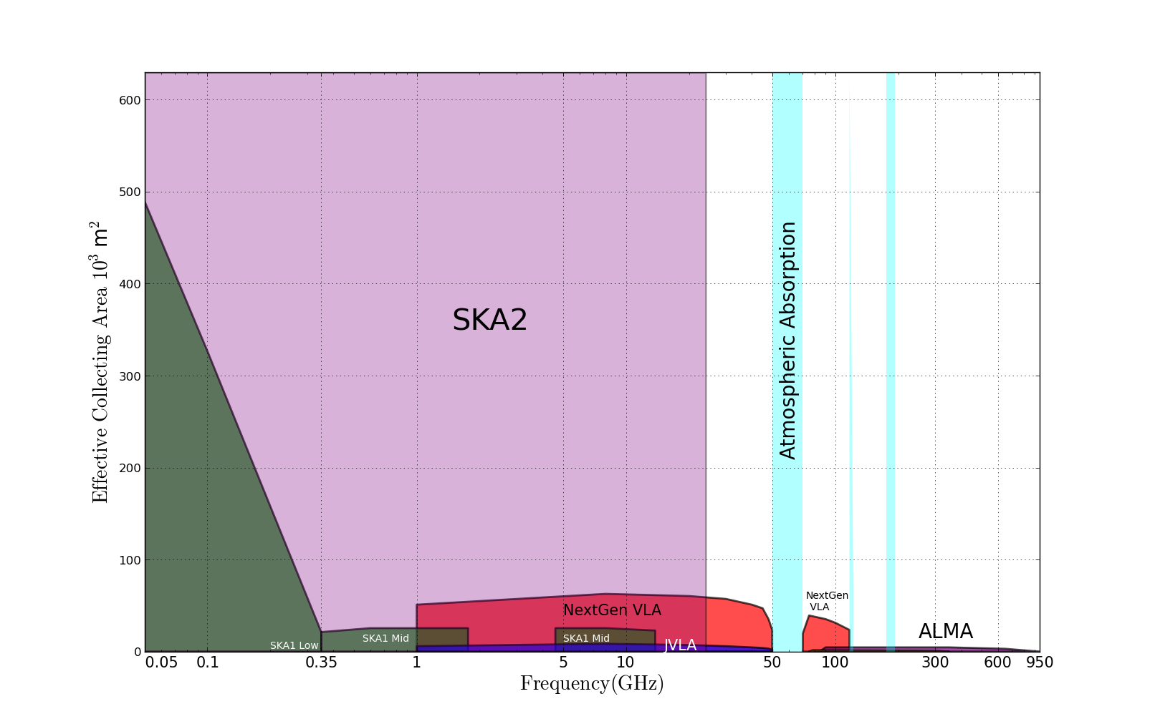
Killer Gap
Thermal imaging on mas scales at λ ~ 0.3cm to 3cm
?
Phase 2 SKA: status unknown? 20 to 115GHz remains new window, regardless

