Slide 1
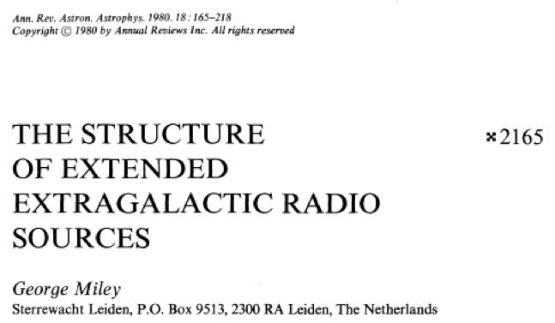
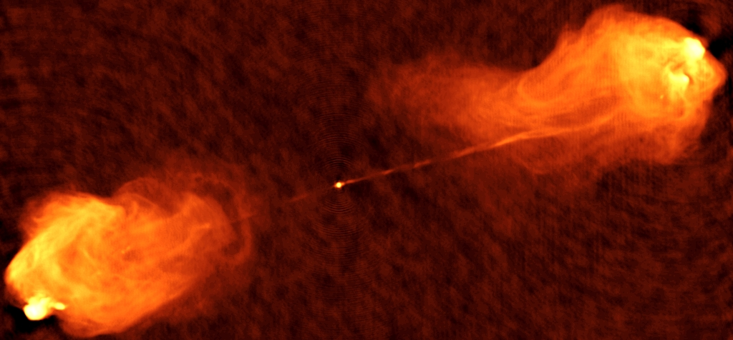
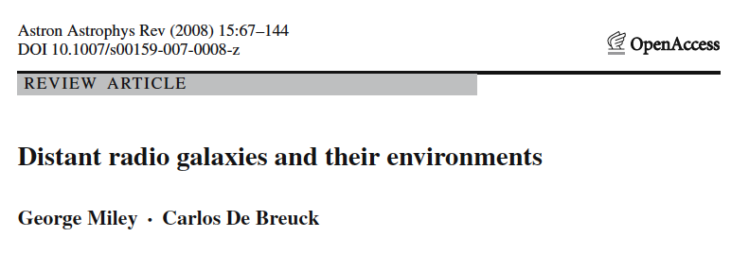
Anatomy of Extragalactic Radio Sources
Miley Symposium May, 2013, Chris Carilli NRAO
‘Physics of Radio Galaxies’
‘Radio Galaxies as beacons to early, massive galaxy formation’

Slide 2
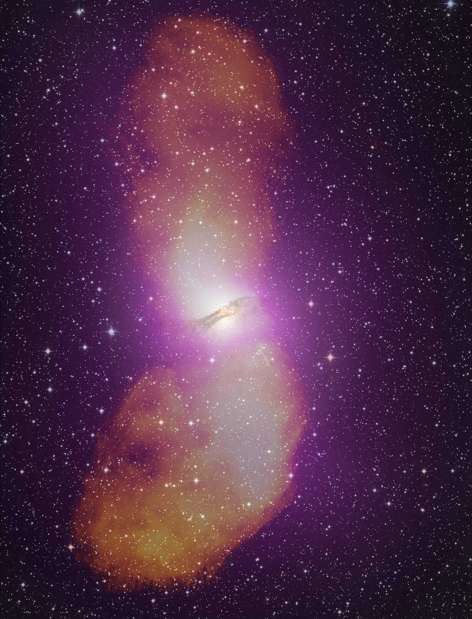
Anatomy at low redshift
VLA 5GHz
Parkes 5GHz
Central Engine: accreting SMBH (>10⁸ M_{o})
Jets: collimated outflow
600kpc
Origin of FRI/FRII dicotomy?
120kpc
Lobes: ‘jet waste products’ [outflow or backlow]
Hot spots: jet terminal shock
High luminosity (FRII, L_{R} > 10⁴⁴ erg/s)
Edge brightened => supersonic, terminal shock w. backflow
Low luminosity (FRII, L_{R} < 10⁴⁴ erg/s)
Edge darkened => trans/subsonic, dissipative jet w. buoyant outflow

Slide 3
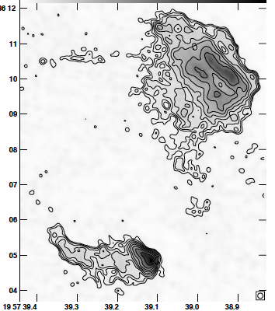
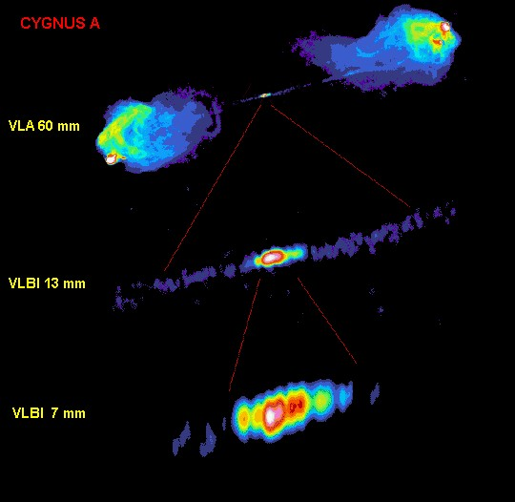
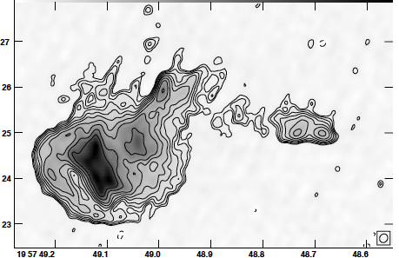
Largest ‘connected’ structures in the Universe
Collimated flow from 1pc to 1 Mpc
2kpc
120kpc
Terminal jet shocks: double structure 60kpc from core
Central energy source and Jet creation?
Jet collimation?
Jet composition?
Jet launch ~ 100R_{s} ~ 0.02pc
γ ~ few
5pc

Slide 4
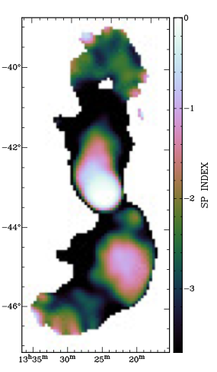
Relativistic particle energetics
VLA
PAPER 120 – 180 MHz
Stefan ea
α= -0.5 to -1.2
Seed particle problem?
TeV CRs (synch. Xrays)?
Spectral steepening vs. continuous curvature?
Fermi I acceleration in terminal jet shocks
Radiative/expansion losses in lobe backflow => t_{lobe} ~ 10⁷ yr, v_{adv} ~ 0.01c
Acceleration near core, radiative losses down lobe: t_{lobe} > 10⁸ yr
Fermi II reaccelerated in regions of ‘heavy weather’ at end lobes

Slide 5
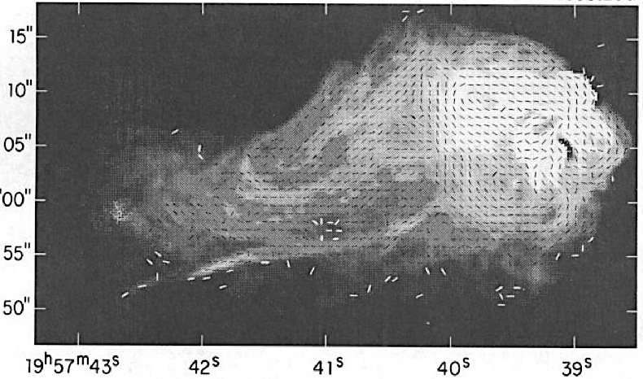
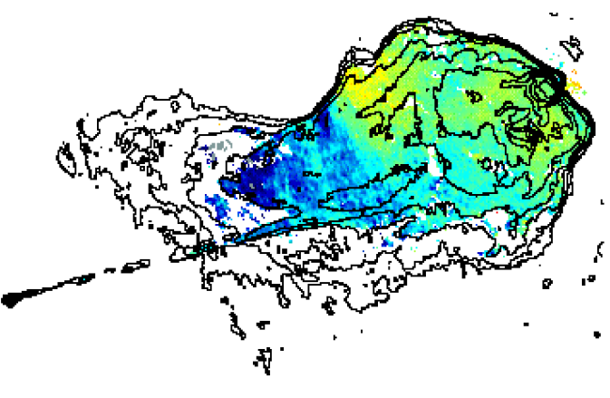
Polarization
Polarized up to 50%
B field follows jet, filaments, hard edges => compression/sheer
B_{ME} ~ 10 to 100uG
Large rotation measures => magnetized screen = ICM? (B_{ICM} ~ few uG)
Ordered RM structures scales ~ 10kpc
Lobe dynamics: field or thermal gas driven?
Extreme RMs: ICM or lobe boundary?
-2000, +2000 rad/m²

Slide 6
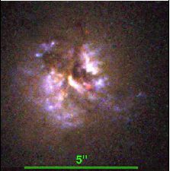
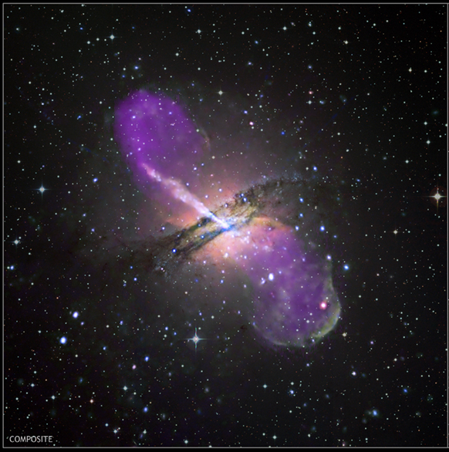
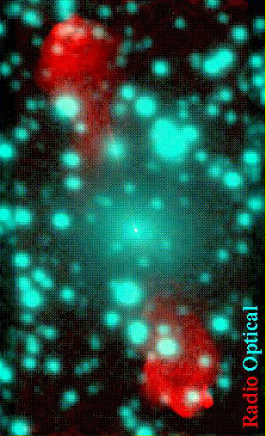
Massive parent galaxies
50kpc
Massive galaxies are dominated by old stellar populations: how/when did they form?
Giant elliptical (M* ~ 10¹² M_{o})
Center massive clusters (M_{dyn}>10¹⁴ M_{o})
Dust lanes => Recent ‘(re)fueling’ by merger with gas rich galaxy
SFR < 100 M_{o}/yr

Slide 7
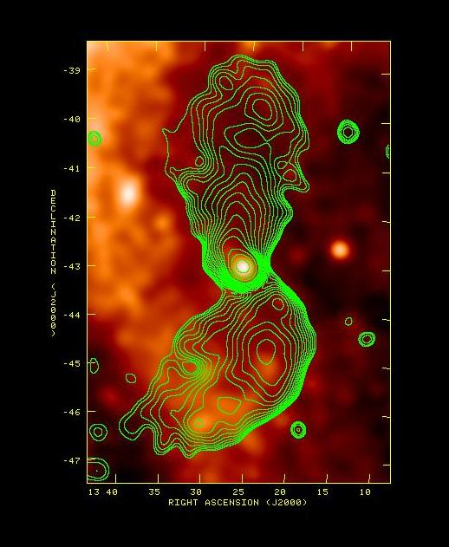
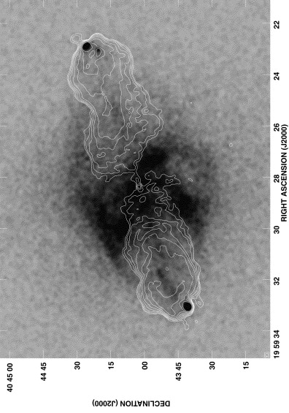
Non-thermal Xrays: inverse Compton => B
VLA 5GHz + Chandra (Wilson ea)
PAPER 150MHz + RASS (Stefan ea)
10º
IC from jets, hotspots => B_{IC} ~ 100 uG => P_{HS} ~ 10⁻⁹ dyn/cm² > 100xICM
Thermal => Lobe-ICM interaction => full hydrodyn. model expanding radio source
Xray/radio knots S.lobe => B_{IC} ~ B_{ME} ~ 1uG => P_{lobe} ~ P_{IGM} ~ 10⁻¹³ dyn/cm²

Slide 8
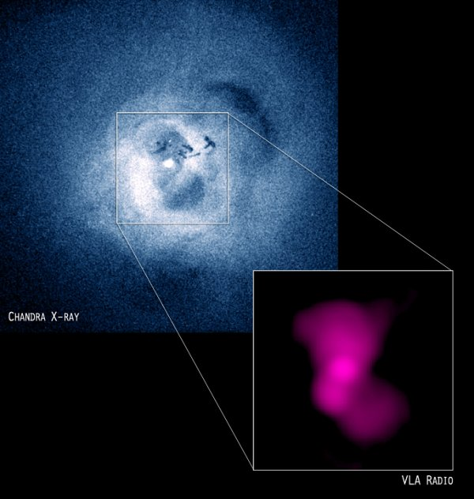
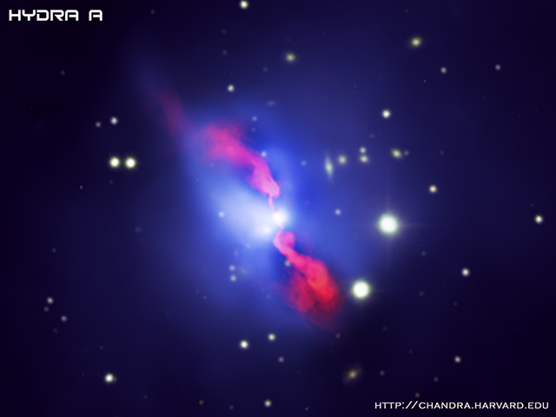
Xray clusters: ‘Negative feedback’ (‘radio mode’)
1Mpc
Cool gas
Magnetically dominated cool filaments
CO
Relative duty cycle: gas cooling vs. radio jet activity?
Perseus A (McNamara)
Mpc-scale cluster Xray halo: T_{x} ~ 10⁸ K, L_{x} ~ 10⁴⁵ erg/s, M_{gas} ~ 10¹³ M_{o}
Radio ‘cavity’ power (PV/t_{bouy}) can balance cooling of ICM => inhibit late-time galaxy growth by gas accretion
Solves mystery: why do big galaxies stop growing?

Slide 9
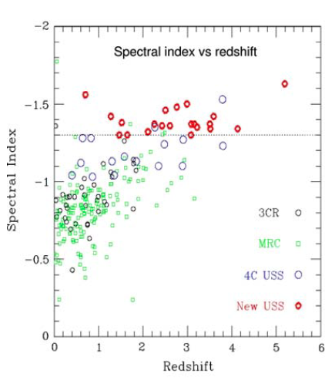
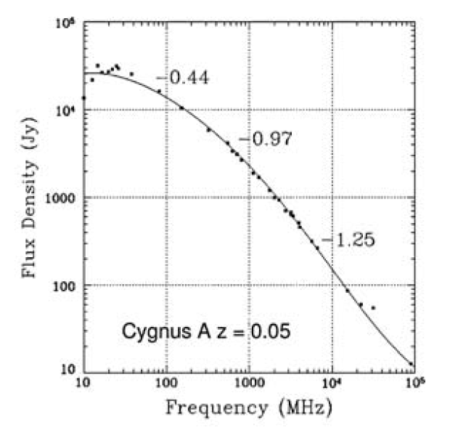
Anatomy at high redshift
Miley technique: Ultrasteep spectrum radio sources
Miley hypothesis c. 1990: high z radio galaxies are beacons to massive galaxy and cluster formation in the early Universe

Slide 10
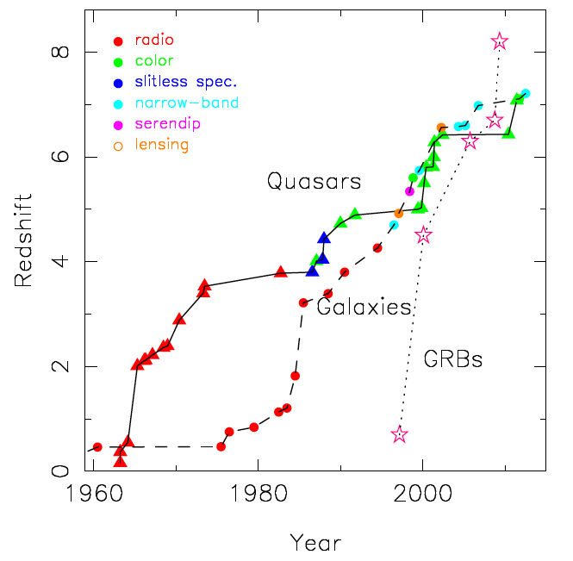
From X. Fan
‘Miley step’
About 200 RG at z>2 discovered to 2010
More than 50% by Leiden group

Slide 11
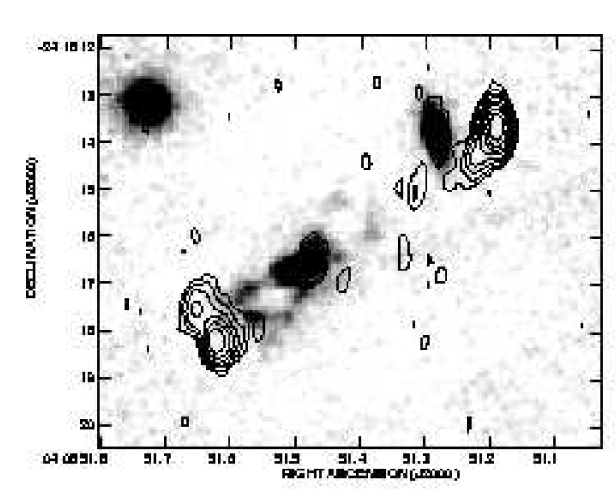
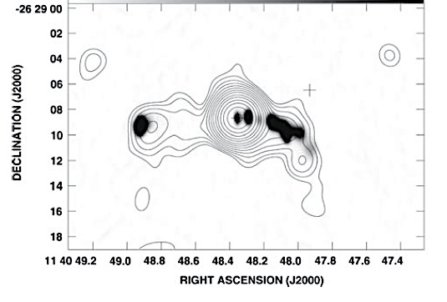
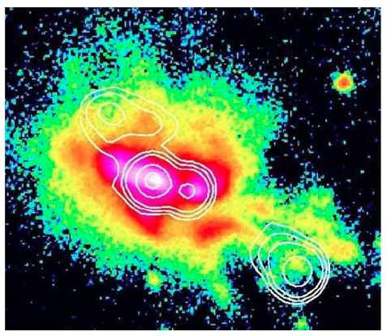
‘The great alignment’: jets, stars, gas…
z=2.5
Optical-radio alignment
Giant Lya halos (100kpc)
Radio-Xrays: IC emission B_{IC} ~ B_{ME}
stars-jets
VLA-Chandra
z=2.2
Xray-jets
B_{IC} ~ 100uG
z=3.8 gas-jets
100kpc

Slide 12
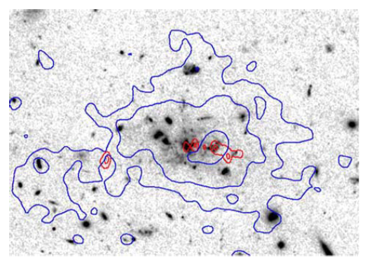
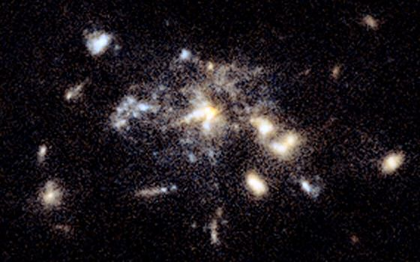
Spider web galaxy z=2.2
Giant, aligned radio/Lya/HST
Protocluster: ten’s LBGs, σ ~ 1000 km/s
SFR > 1000 M_{o}/yr
Extreme rotation measures: 6000 rad/m²
What causes these > 100kpc alignments?
‘Positive feedback’: Jet induced star formation?
250kpc

Slide 13
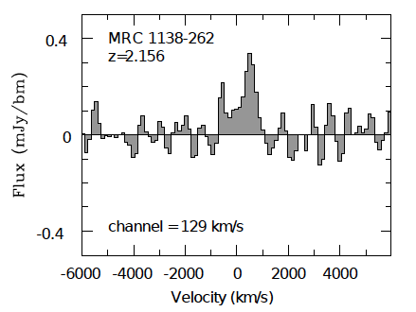
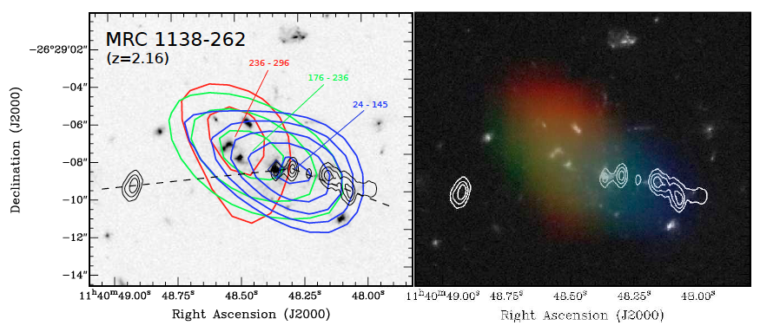
Latest anatomical part: Molecular gas = fuel for star formation
CO1-0 in Spider Web => 10¹⁰ M_{o} in molecular gas
Distributed over 60kpc
Velocity gradient: rotation or interaction?
Aligned with radio jet
ATCA
Emonts ea

Slide 14
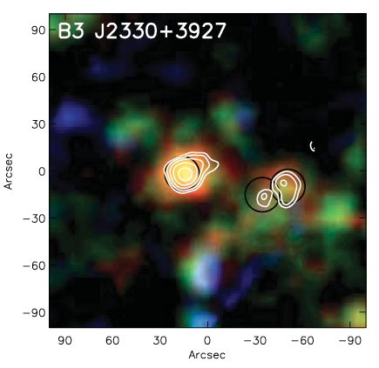
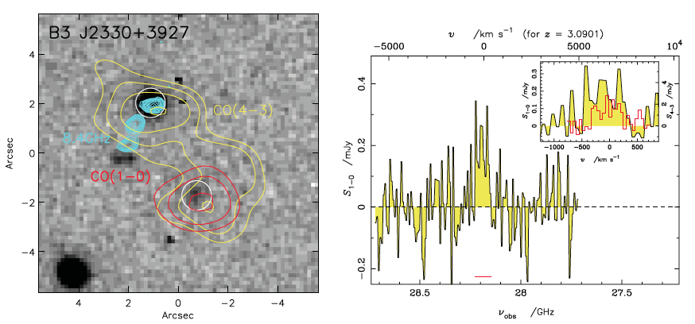
Beacons to early massive galaxy formation
CO detections common (Bure, JVLA, ALMA, ATCA, GBT):
M_{gas} > 10¹⁰ M_{o}
Distributed over large area (10-100 kpc)
Dust: Multiple starbursts (SMGs) w. SFR ~ 1000 M_{o}/yr
Herschel FIR
Ivison ea.
Origin most massive galaxies?
Coeval SMBH and massive galaxy formation in extreme starbursts driven by gas rich mergers in dense protoclusters at t_{univ} < 2Gyr, possibly orchestrated by jet on 100 kpc scales
z=3.09
JVLA CO1-0
Bure CO4-3
40kpc

Slide 15
