Slide 1
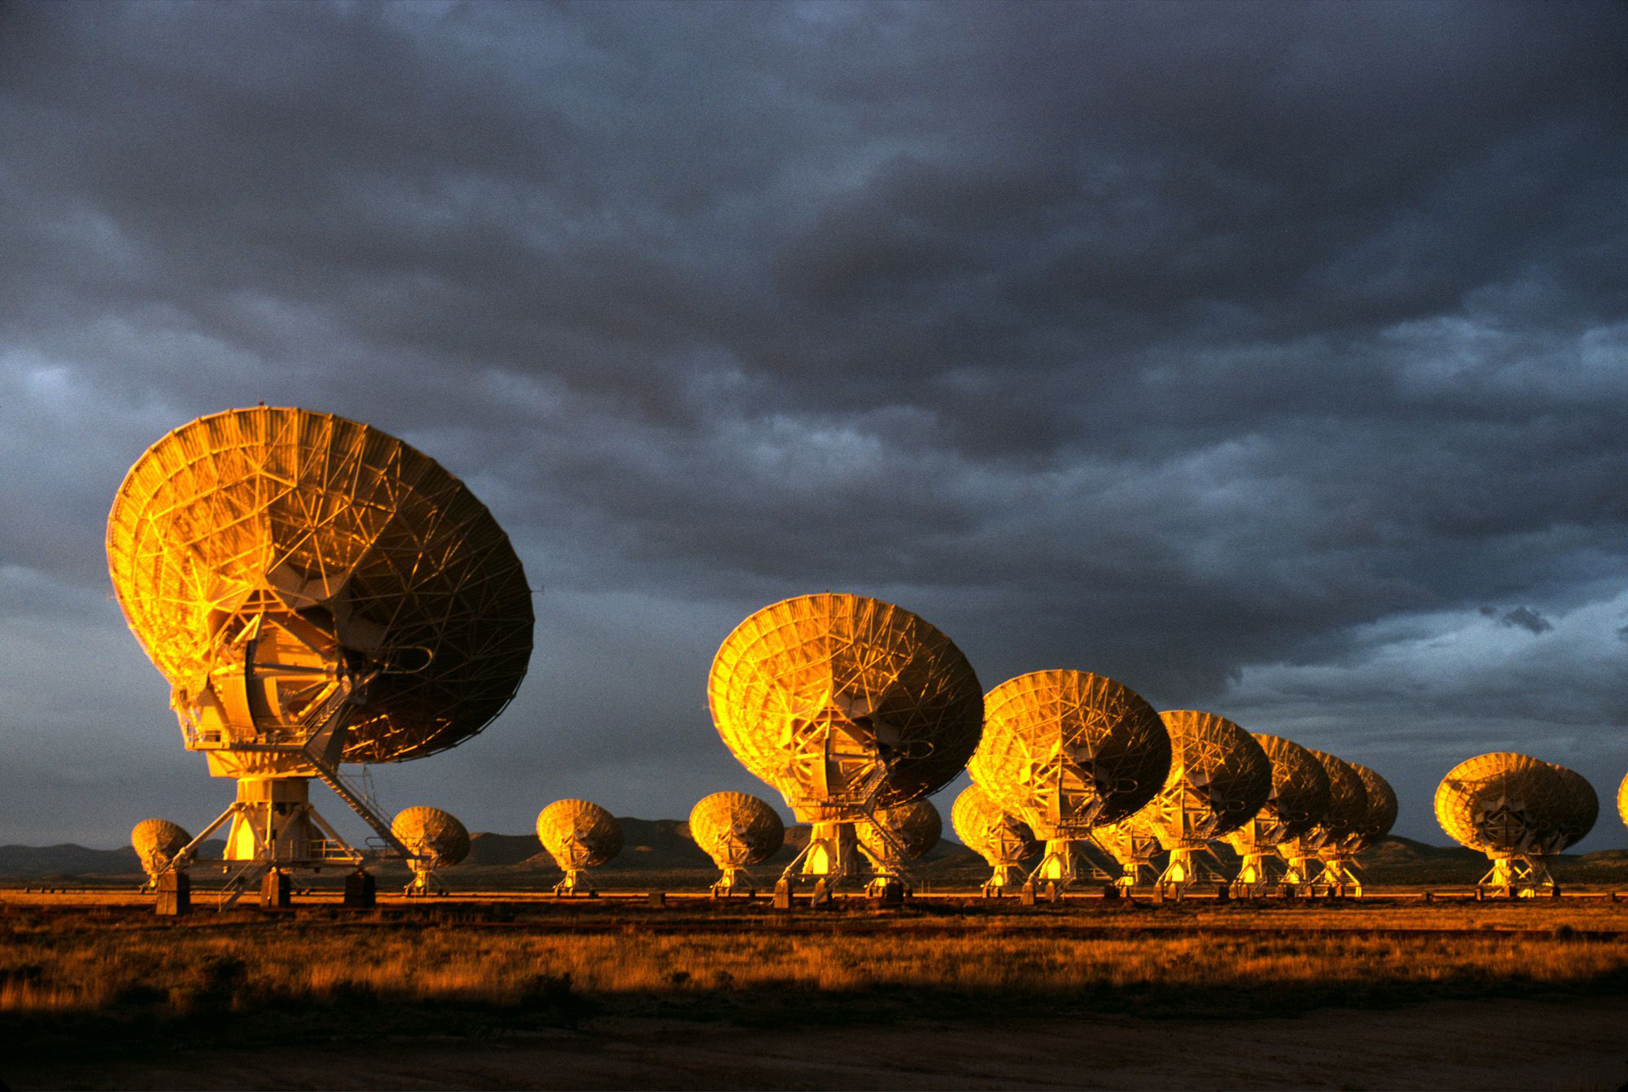
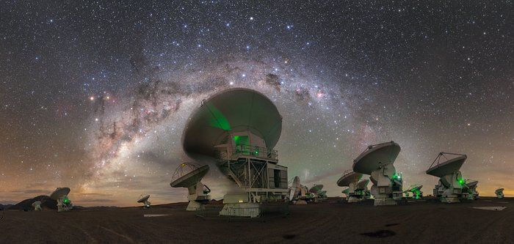

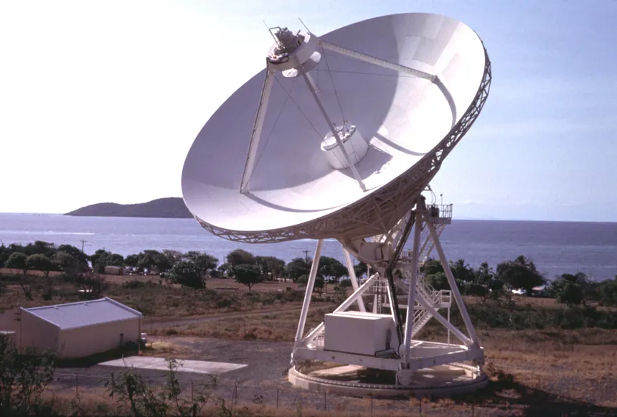
US National Radio Astronomy Observatory
Jansky Very Large Array (NM)
75MHz – 50 GHz (4m – 7mm)
27 x 25m dishes
B = 30m – 40 km
Atacama Large Millimeter Array (Chile)
30GHz – 850GHz (1cm – 0.35mm)
54 x 12m dishes
B = 10m – 15km
Very Long Baseline Array
1GHz – 90GHz (30cm – 3mm)
10 x 22m dishes
B = 200km - 8500km

Slide 2
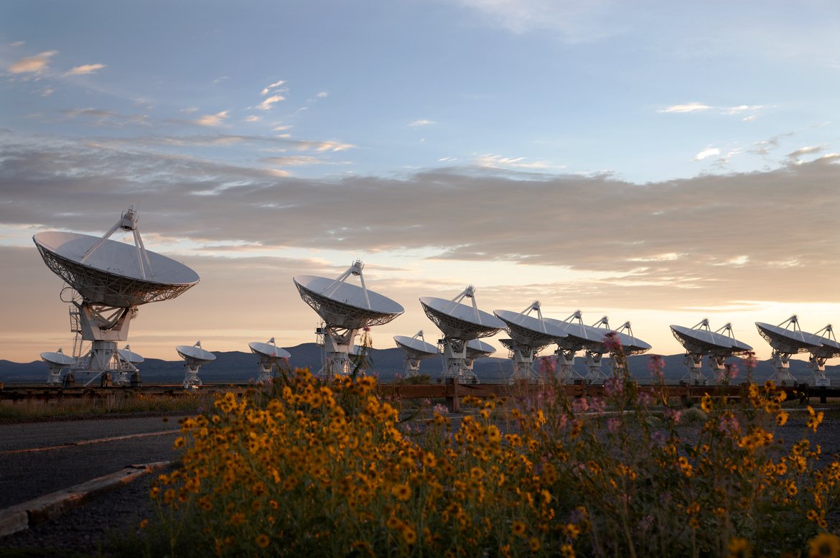
The Very Large Array
Global Powerhouse in Radio Astronomy for 50 years
1972 – Approved by Congress
1975 – 1st antenna
1980 – Full science operations
1992 – Mexico-USA 43 GHz upgrade
2001 – Jansky VLA major electronics upgrade
2011 – JVLA full science ops

Slide 3
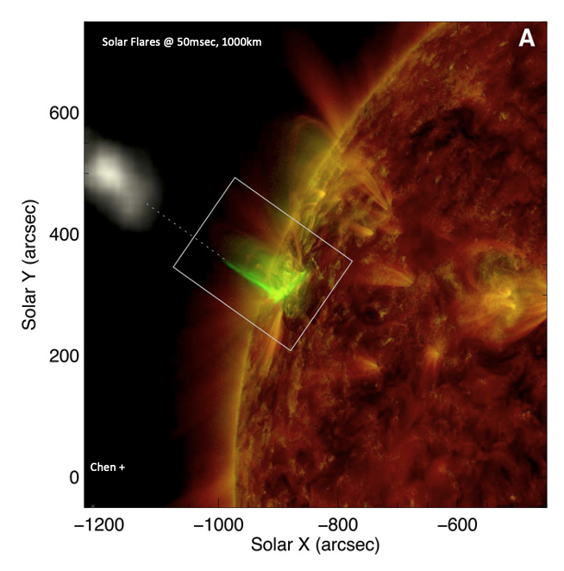
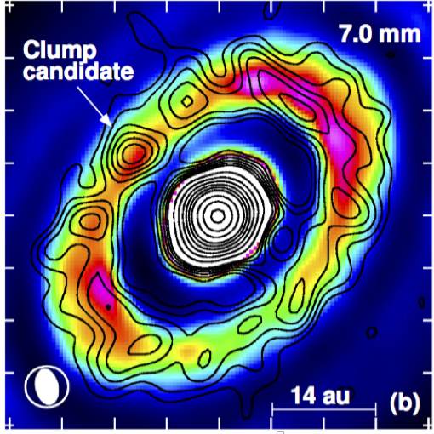
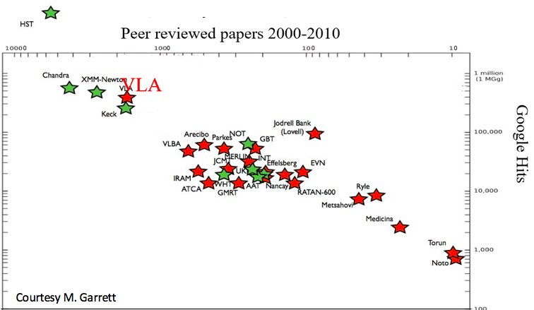
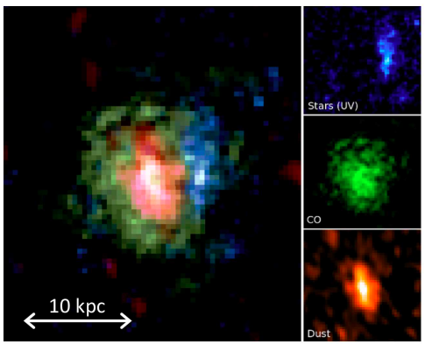
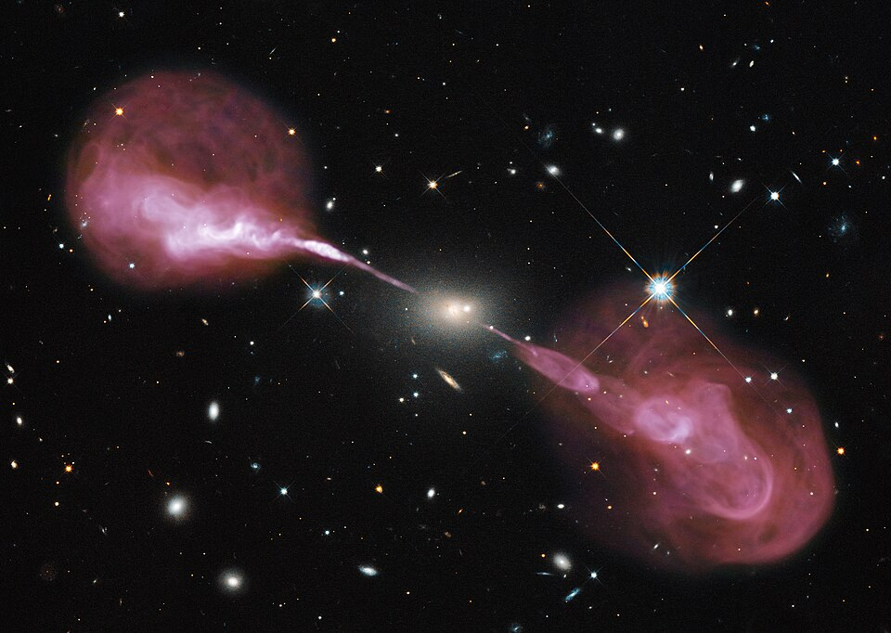
Radio Astronomy Powerhouse from 1980 to present: Versatility!
10x publication rate any other radio facility
300 proposals per year, oversubscription ~ 2.5/1
> 500 PhD theses
Among the most productive telescopes all-time
Isella +
100 kLyr
CO z =4

Slide 4
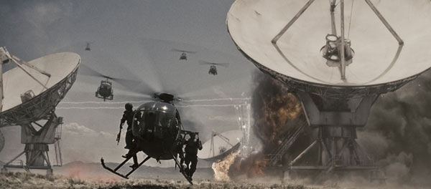
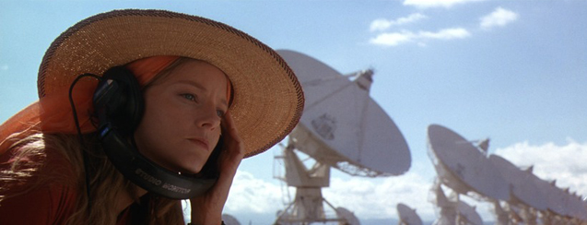
The Very Large Array
Icon in Popular Science for 50 Years
Contact / T4

Slide 5
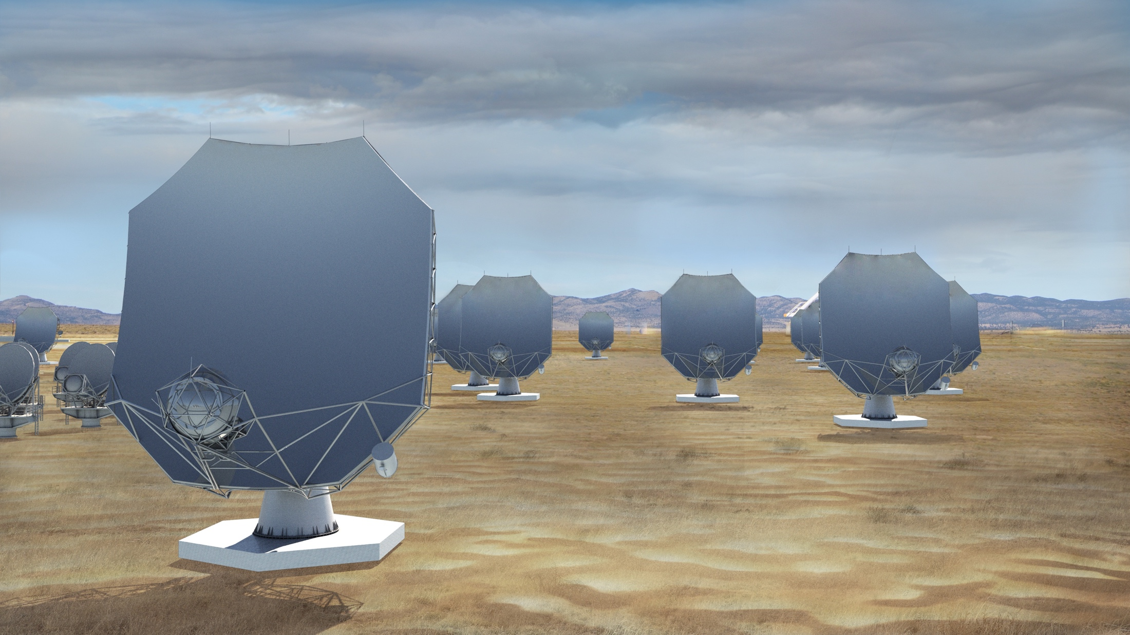
The next-generation Very Large Array (ngVLA)
A new facility for a new millennium: replace the VLA and VLBA to tackle new Scientific Frontiers into the mid-Century
Thermal imaging at milli-arcsec scales (<10K @ 7mas, 3mm)
10x area of JVLA/ALMA/VLBA
1.2 - 116 GHz Frequency Coverage
244 x 18m + 19 x 6m
  Centered at VLA site, extending over USA & MX
  High and dry sites for 115 GHz
  Fixed antenna locations
Notes:
Will be the next U.S. Flagship Radio Observatory.

Slide 6
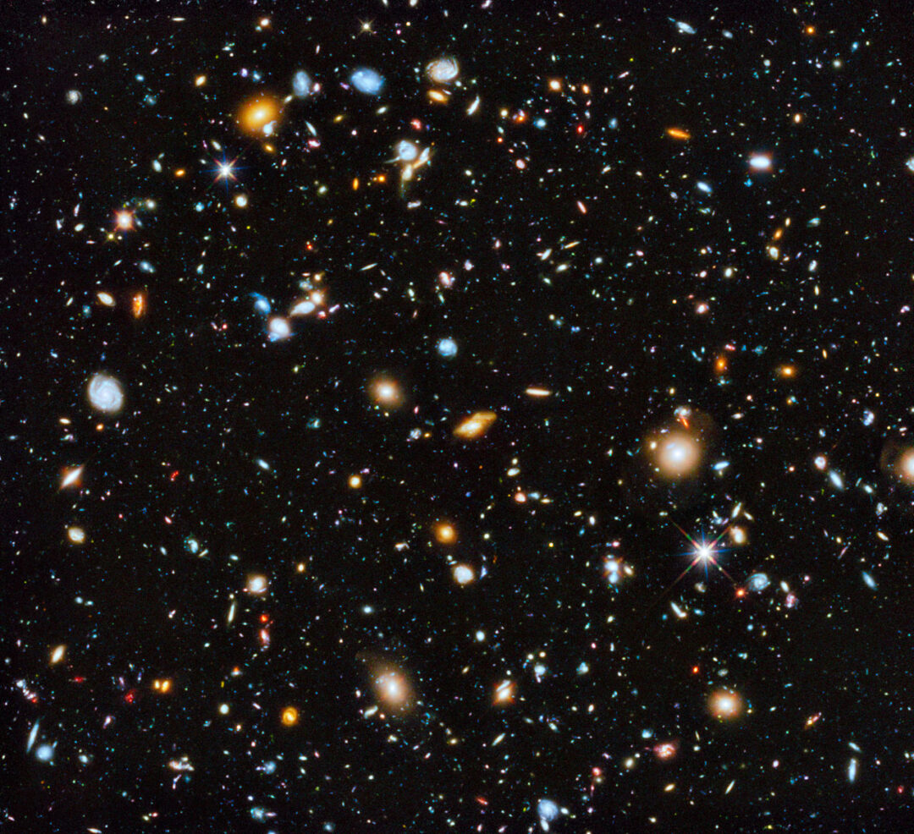
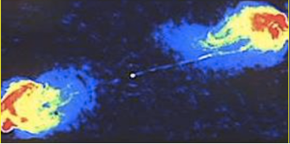
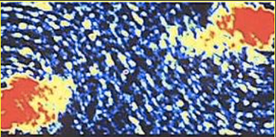
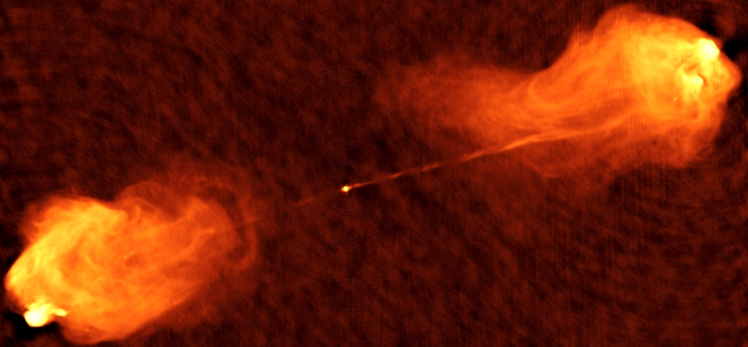
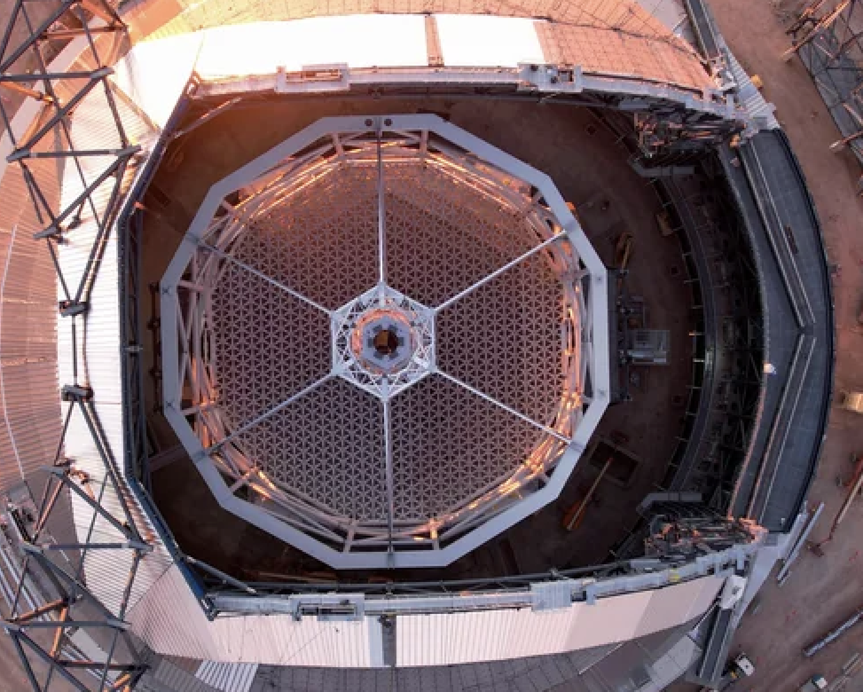
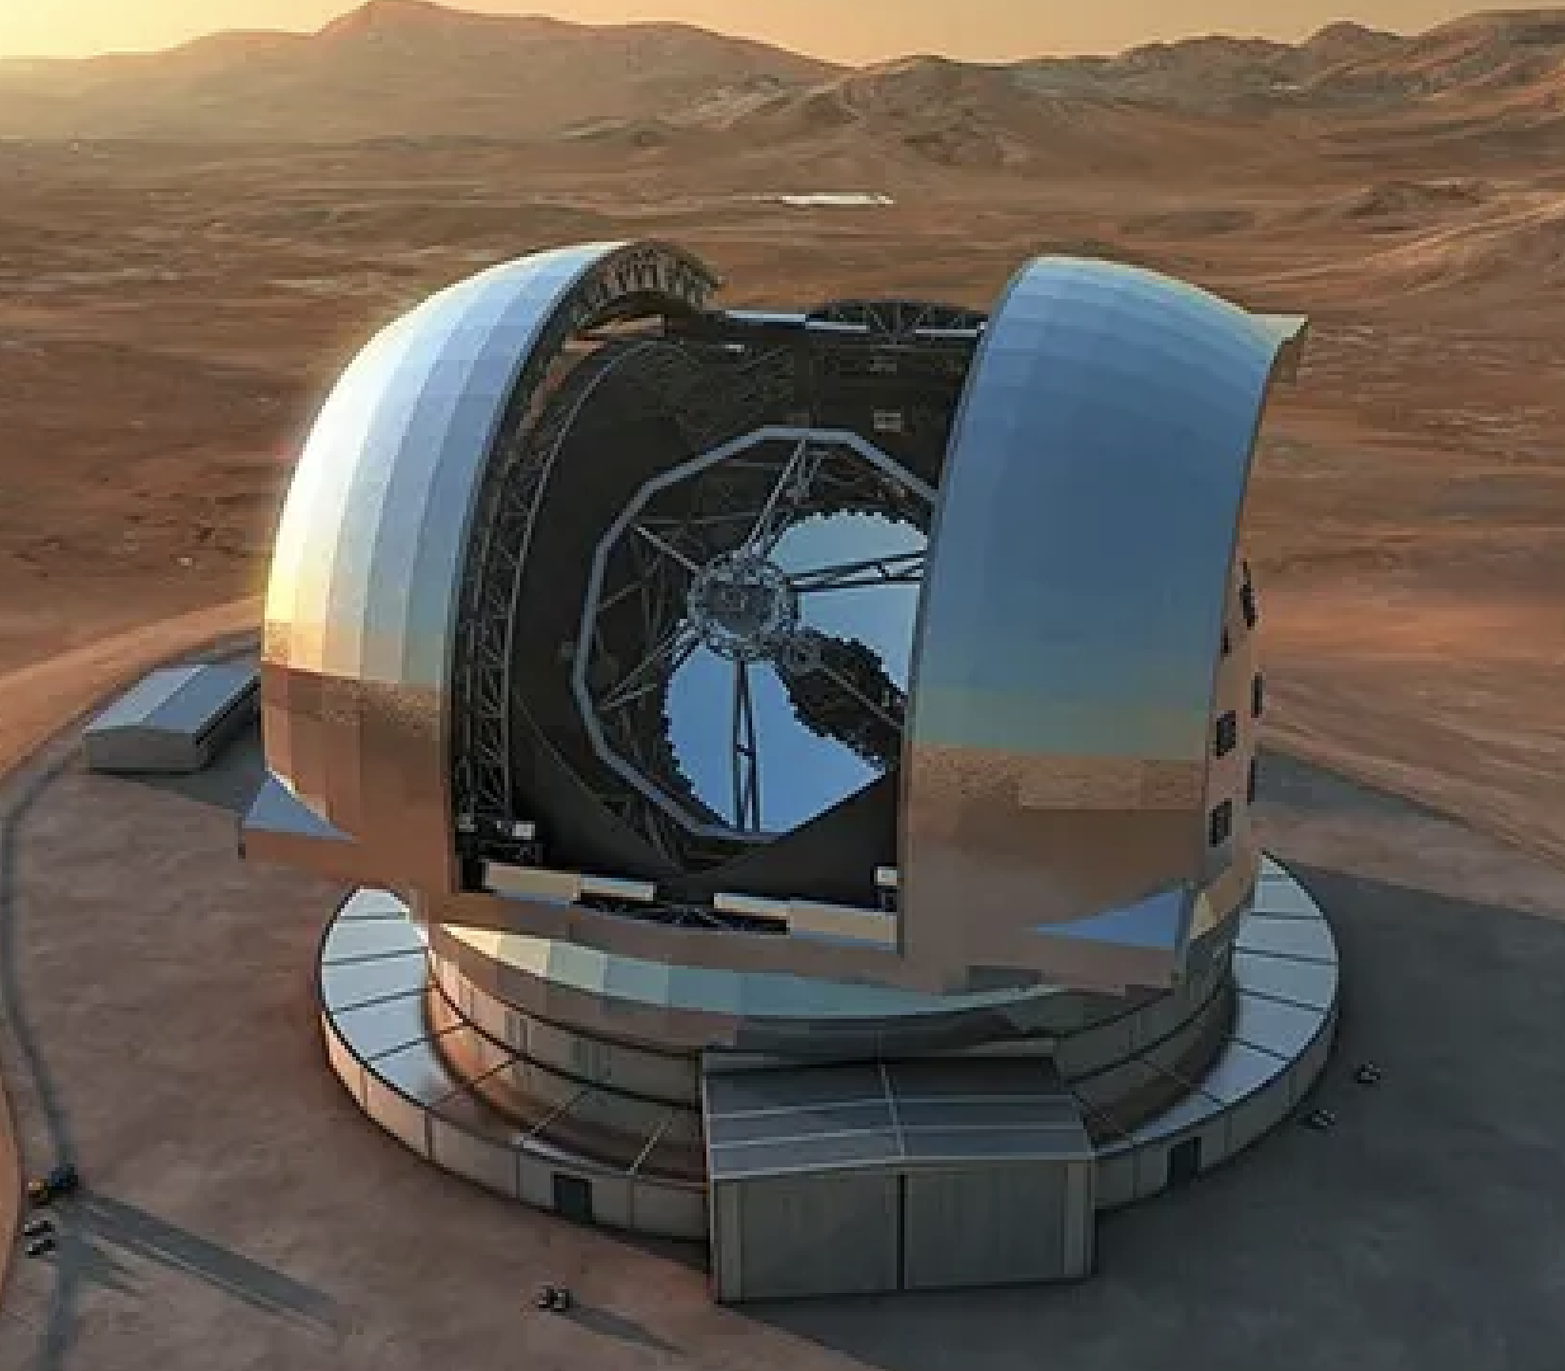
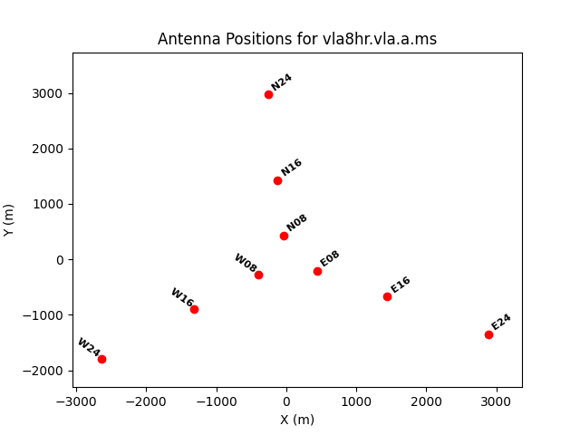
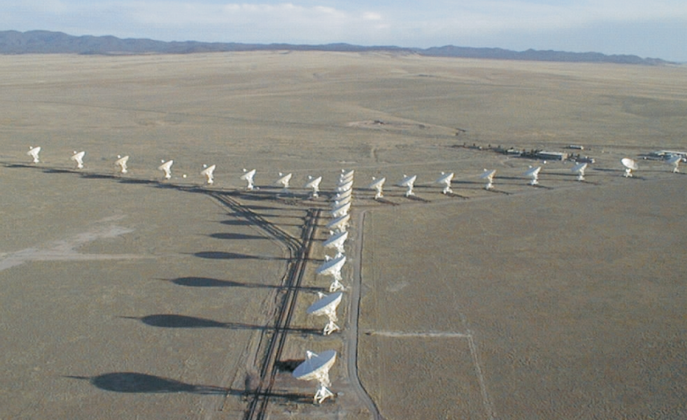
Resolution ~ λ/D
Optical: D = 10 m, λ = 600 nm => R = 13 mas
Radio: D = 40 km, λ = 3 mm => R = 15 mas

Slide 7
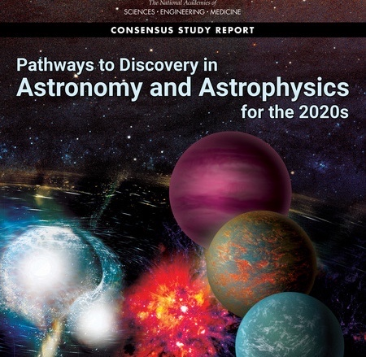
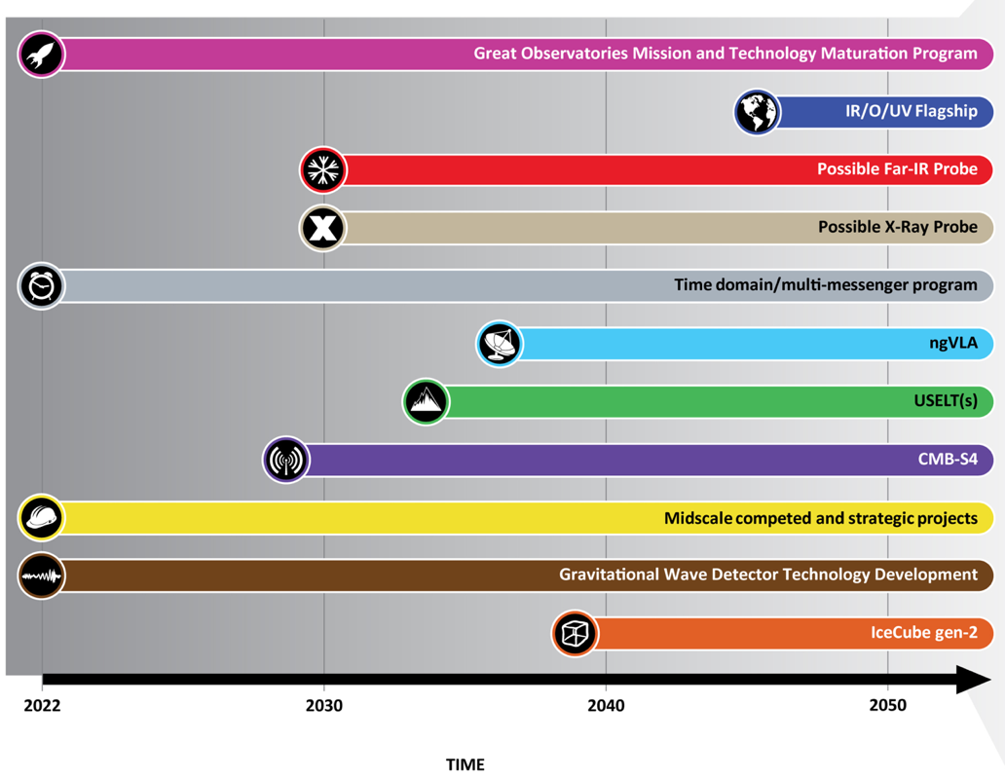
Astro2020 identified the ngVLA as a high-priority large, ground-based facility whose construction should start this decade.
Notes:
ngVLA essentially checked off every box of Astro2020 scientific priorities.

Slide 8
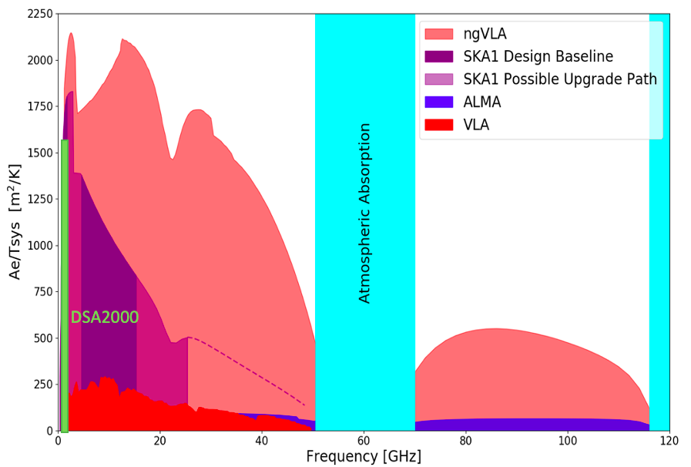
New Parameter (‘Discovery’) Space for the mid-Century
Complementary suite of arrays from meter to submm wavelengths
> 120GHz: ALMA 2030 superb for chemistry, dust, fine structure lines
  1.0 - 116GHz: ngVLA superb for terrestrial planet formation, dense gas history, black holes
  < 15 GHz: SKA superb for pulsars, reionization, HI + continuum imaging
Notes:
Snapshot comparison of effective collecting area for dish-arrays expected in the 2030’s.

Slide 9
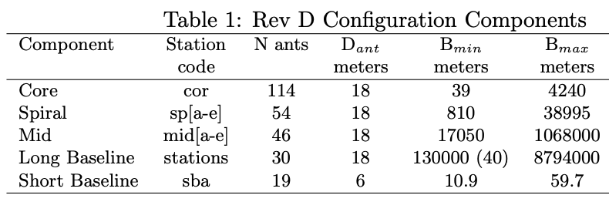
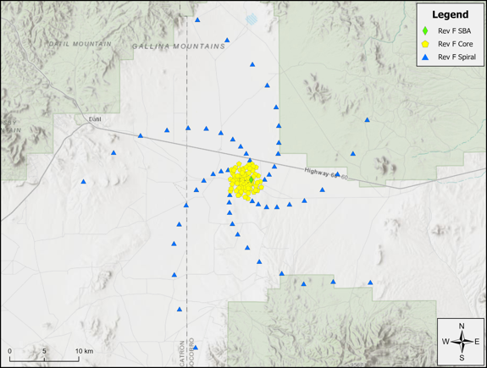
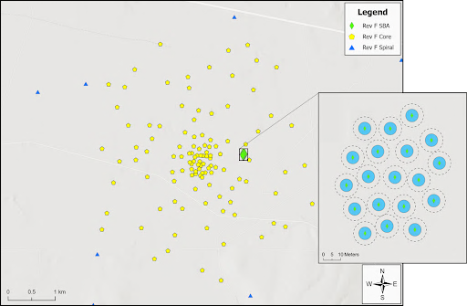
Resolution at 32GHz
0.44”
0.045”
0.018”
0.002”
34”
10m
1km
10km

Slide 10
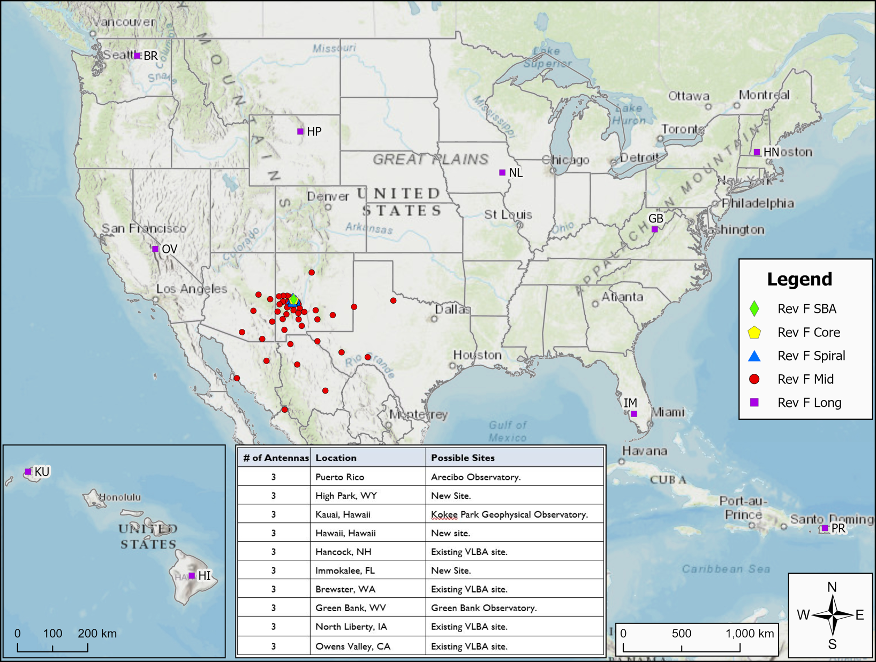
10m to 8000km => 200” to 0.2 mas @ 32GHz: subarrays will be key usage

Slide 11
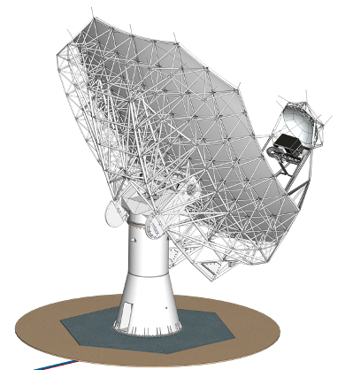

18m Prototype Antenna
Key Specifications
18m Aperture | Offset Gregorian
Shaped Optics | 3° Slew & Settle in 7 sec
Surface: 160 µm rms | Reference pointing: 3” rms
Precision conditions: | Total efficiency >80% (X..Q)
Status
Antenna proto-type contract 2022 to MTEX
Delivered to VLA site end 2025
Testing includes correlation with VLA

Slide 12
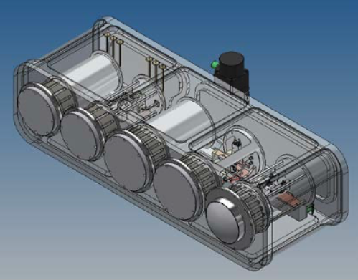
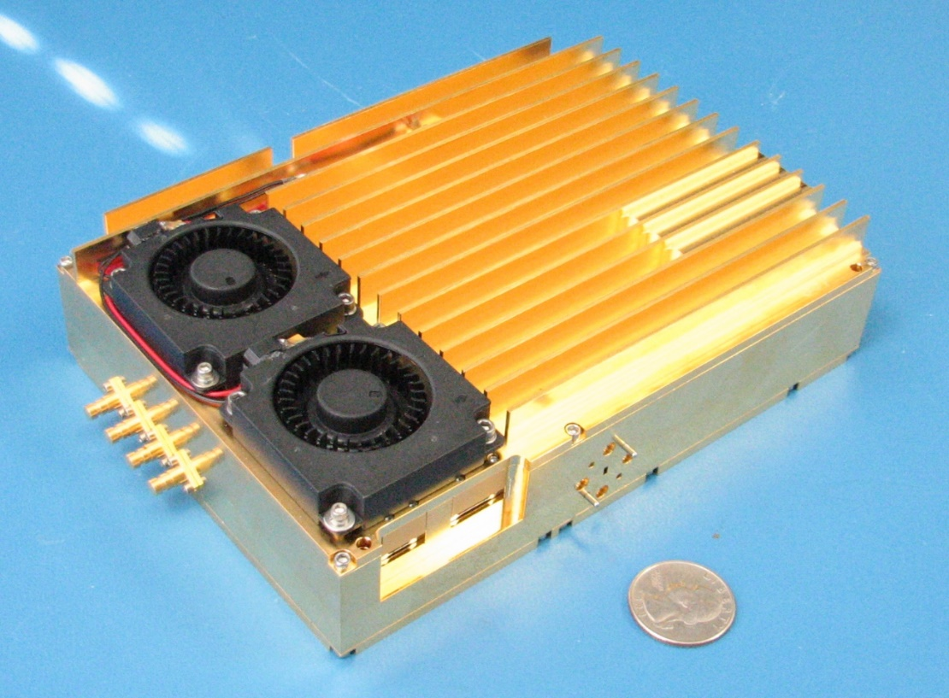
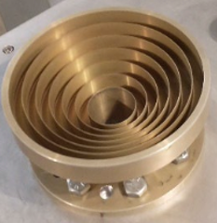
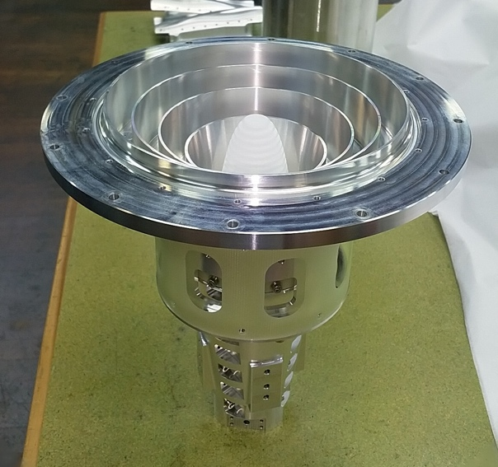
Technical Design: Well advanced and costed
Reference Design: Build on ALMA, JVLA, SKA development => low-technical-risk, well costed, optimize life-cycle cost
U.S. agencies (DOD, NASA): ICRF, Geodesy, Space Situational Awareness (radar), Spacecraft tracking/imaging/telemetry
International partners: Mexico, Japan, others?
Integrated Receiver and Digitizer: RF signal -> mix to baseband; sampled and digitized (8bit) to fiber; 20 GHz BW
All compact and field replaceable
Band # | Freq. Range (GHz)
1 | 1.2 - 3.5
2 | 3.5 - 12.3
3 | 12.3 - 20.5
4 | 20.5 - 34
5 | 30.5 - 50.5
6 | 70 - 116
Correlator / Beamformer | Requirement (design)
digital efficiency | >95%
narrowest channel | <1 kHz
total # channels | >240,000
sub-band width | <250MHz (218.75)
total bandwidth | >14GHz/pol (20)
# formed beams | 10
Saxony, Germany

Slide 13
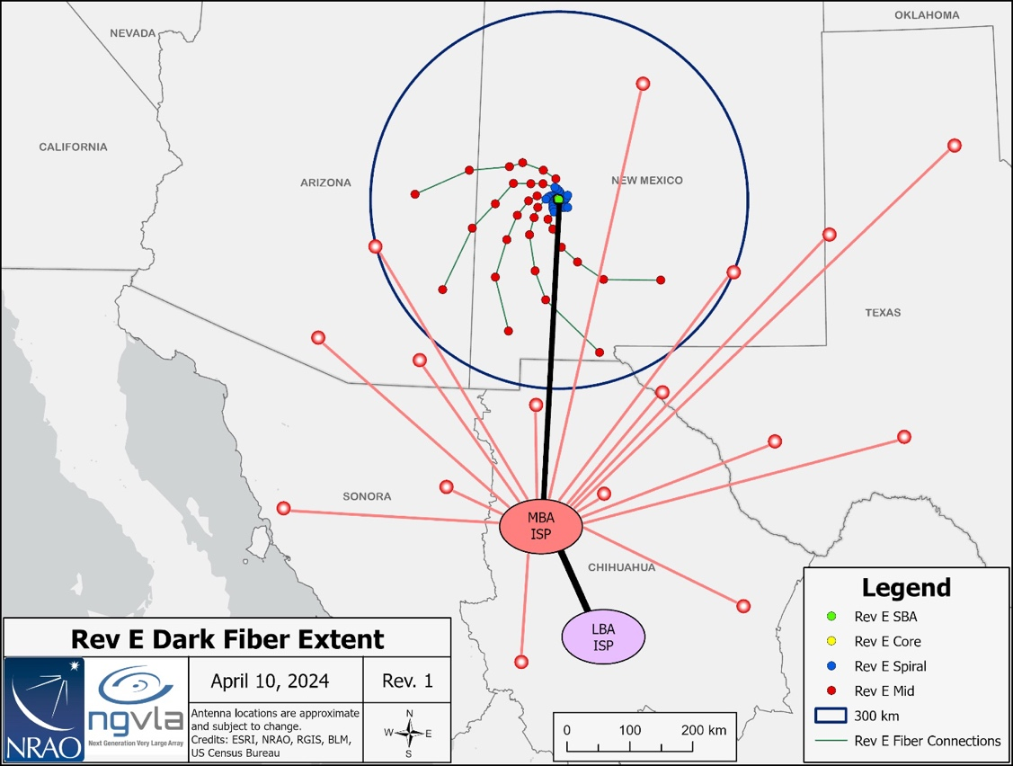
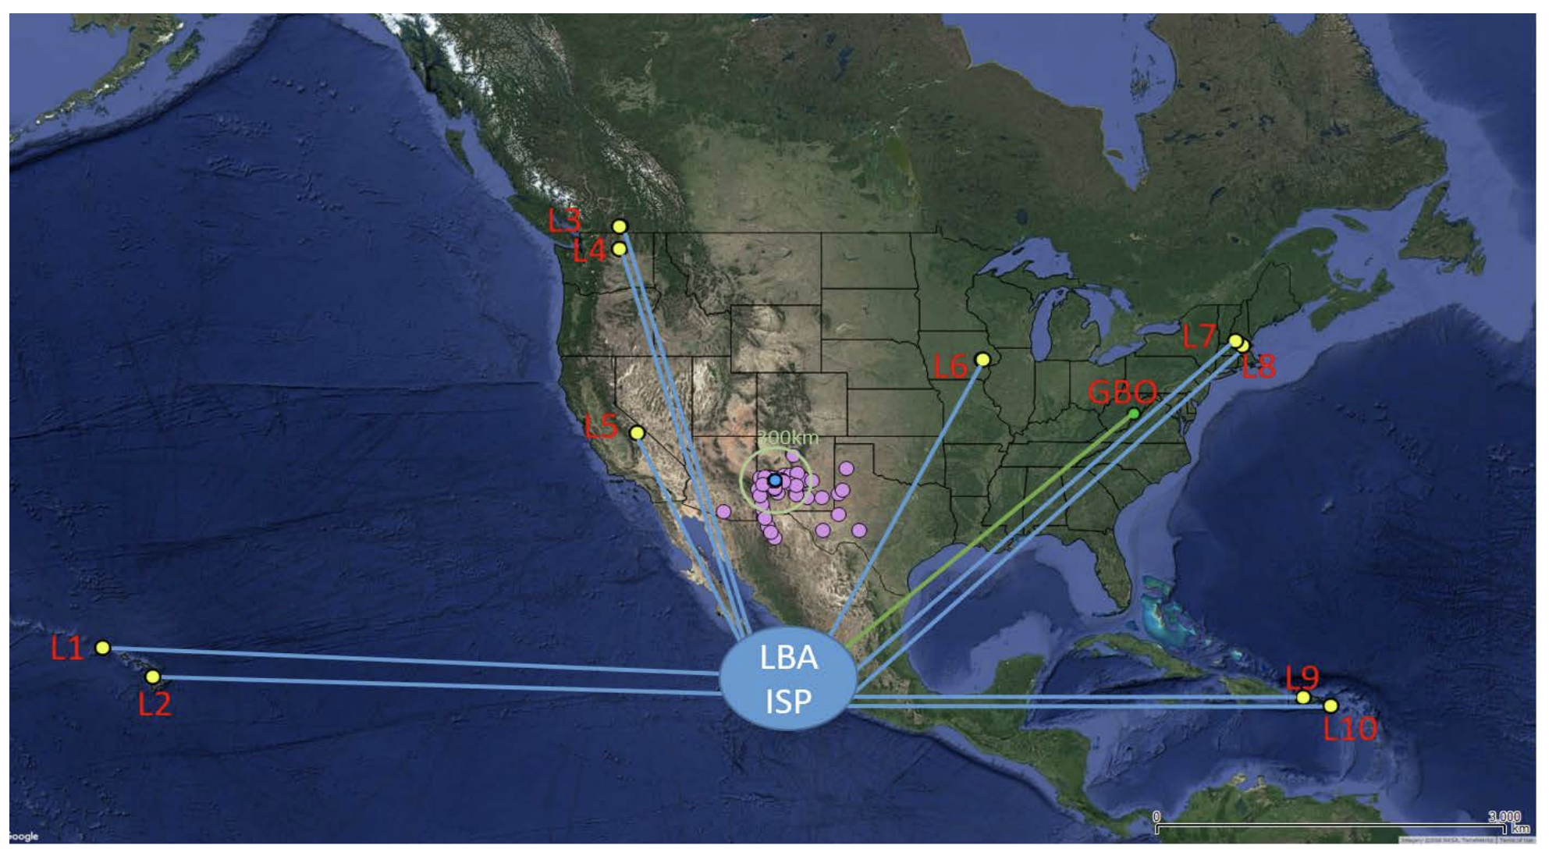
Fiber: real time connection to central correlator
Dedicated lines < 300 km
ISP leased bandwidth > 300 km
Data Rates
Data rate into correlator ~ 800 Gbps per antenna => 210 Tbps total
Archive: 240 PB/yr
Power
Correlator ~ 1 MW, Antennas ~ 3.6MW
Exploring power purchasing agreement: on-site photovoltaic system
Long Haul Fiber Workgroup Preliminary Report 020.60.00.00.00-0002-REP-A-LONG_HAUL_FIBER_WORKGROUP_REPORT

Slide 14
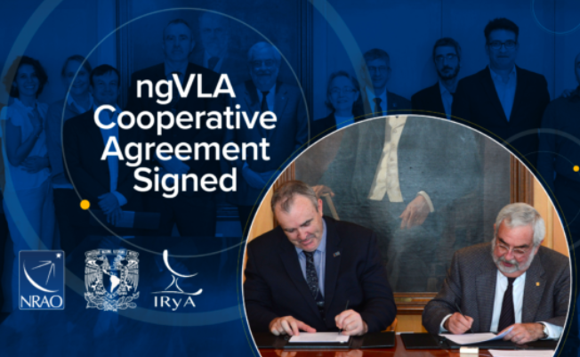
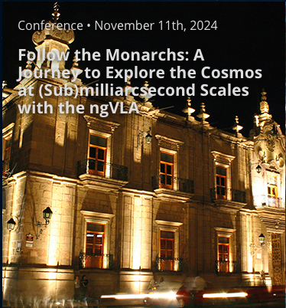
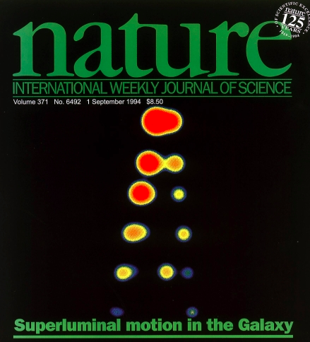
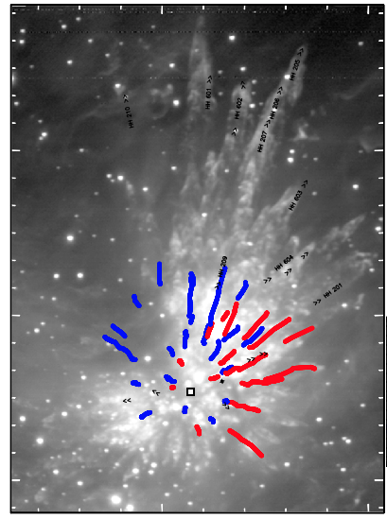
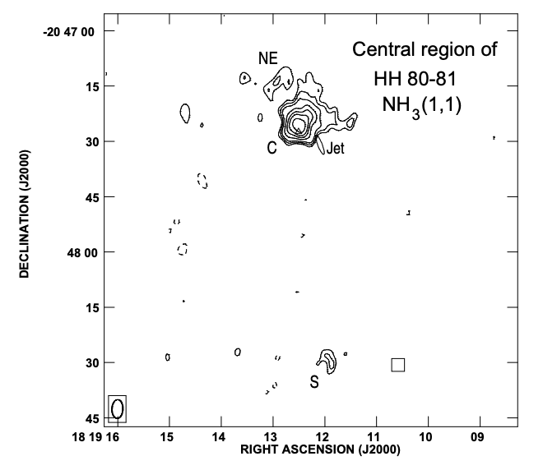
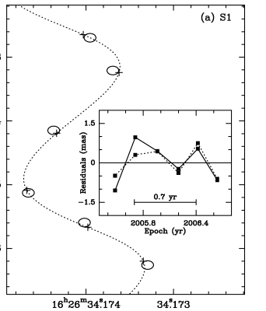
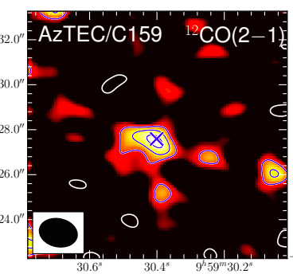
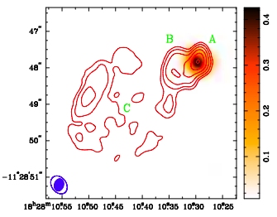
Mexican connection: historically deep and currently vital
43GHz receivers 1992: led by Prof. L. Rodriguez (Jansky lecturer 2021). Inspired JVLA and now ngVLA
Broad scientific usage VLA/VLBA: protostars to the 1st galaxies
ngVLA involvement: MOU NRAO-UNAM Nov 2022
  Science Advisory Committee: Loinard , Carrasco-Gonzales
  Technical Advisory Committee: Kurtz
  Science and technical working groups: Zapata, Pasetto, Jimenez-Andrade, Galvan-Madrid, Trejo
𝛍quasars: Mirabel & Rodriguez
Stellar outflows: Zapata
Massive star formation: Gomez, Galvan-Madrid
𝛍as astrometry: Loinard
Molecular gas z = 4.3, Jimenez

Slide 15
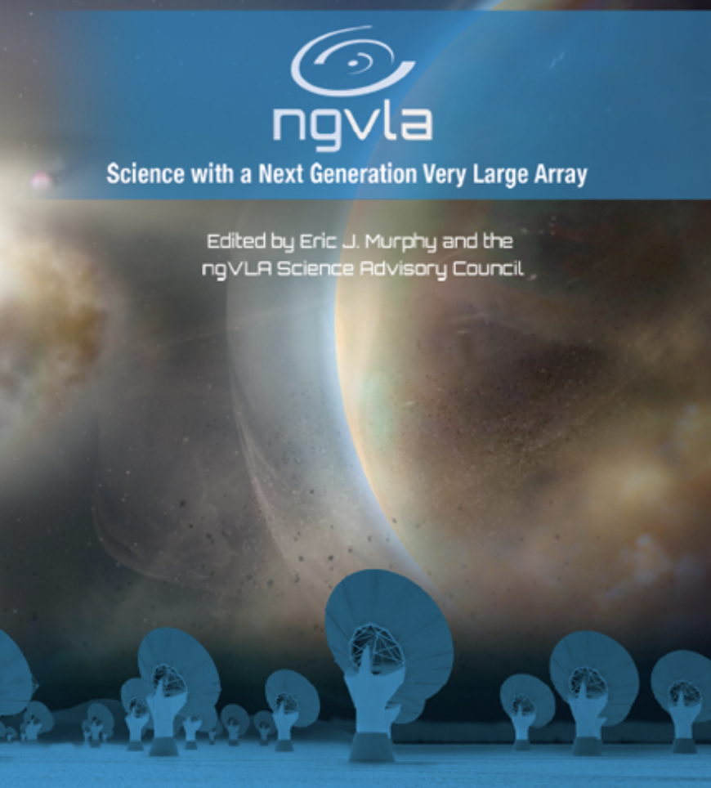
ngVLA Science
Strength in Versatility
Planets to Cosmology
Science Advisor Committee and Working Groups
Chairs: D. Wilner and B. Matthews
  SWG1: Stars, Planetary Systems, and their Origins
  SWG2: Astrochemistry and the Emergence of Life
  SWG3: Galaxies and Galaxy Evolution
  SWG4: Pulsars, Cosmology, and Fundamental Physics
  SWG5: Exploring the Dynamic Universe
2019 Science Book: 90 chapters, 300 authors
Key Science: SAC ngVLA Memo 125
Formation of Solar System Analogues on Terrestrial Scales
Initial Conditions for Planets and Life with Astrochemistry
Charting the Assembly, Structure, and Evolution of Galaxies
Galactic Center Pulars as Fundamental Tests of Gravity
Understanding the Formation and Evolution of Stellar and Supermassive in the Era of Multi-Messenger Astronomy

Slide 16
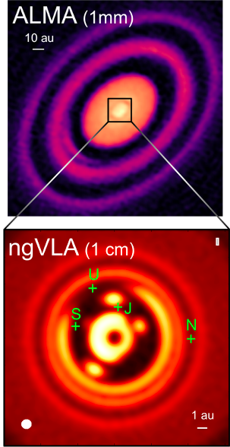
KSG1: Unveiling the Formation of Solar System Analogues
The ngVLA will image planet formation in systems similar to our own Solar System, down to planet masses of a few earth masses
Required resolution: 7mas = 1 AU at 140 pc
ALMA has this resolution at > 350 GHz but PP disks are optically thick in inner 10 AU!
ngVLA can achieve the required sensitivity and resolution at 30 to 100 GHz, where inner disk is optically thin
Ricci, Isella…
Notes:
HD 163296
ALMA observation of HD163296 at 1mm along with a simulated 1 cm ngVLA observations (Ricci et al. 2019) of the innermost 24 au region at 1 au resolution for Jupiter-, Saturn-, and Neptune-like planets.
The distribution of exoplanets and young planets embedded in circumstellar disks: Then ngVLA will discover many hundreds of planets with orbital periods <10 yr.
The ngVLA will measure the orbital motion of planets and related features on monthly timescales:
Simulated 100 GHz ngVLA observations of a newborn planetary system comprising a Jupiter analogue orbiting at 5 AU from a Solar type star.

Slide 17
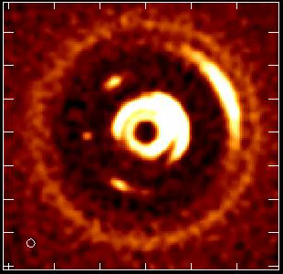
Movies of Planet Formation
Forming Jupiter in 1Myr solar mass protostar and disk at 140 pc
Monthly obs. over few years at 100 GHz, 7mas resolution (1 AU at 140pc)
Image dust gaps and traps, and potentially the circumplanetary disk = accretion onto planet itself!
L. Ricci
Notes:
HD 163296
ALMA observation of HD163296 at 1mm along with a simulated 1 cm ngVLA observations (Ricci et al. 2019) of the innermost 24 au region at 1 au resolution for Jupiter-, Saturn-, and Neptune-like planets.
The distribution of exoplanets and young planets embedded in circumstellar disks: Then ngVLA will discover many hundreds of planets with orbital periods <10 yr.
The ngVLA will measure the orbital motion of planets and related features on monthly timescales:
Simulated 100 GHz ngVLA observations of a newborn planetary system comprising a Jupiter analogue orbiting at 5 AU from a Solar type star.

Slide 18
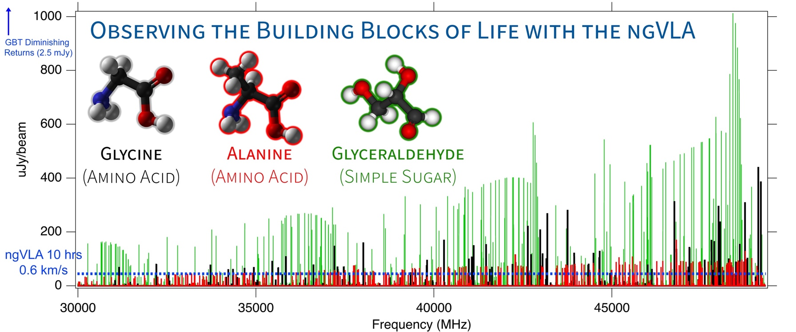
KSG2: Probing the Initial Conditions for Life with Astrochemistry
  The ngVLA can detect complex pre-biotic molecules and provide the chemical initial conditions in forming solar systems and individual planets
Credit: Brett McGuire (NRAO)
Notes:
This is a simulation of ~3 complex organic molecules, not currently detected in the ISM, but which are good candidates for detection.
The simulation assumes that the emission is coming from a compact, 1" hot core in Sgr B2(N), from molecules with column densities of 10^12 - 10^14 cm-2, at T = 200 K, and with a linewidth of 3 km/s.
The simulation does *not* contain any currently-detected species, meaning that a real spectrum in this frequency range would have many, many bright lines off the scale of this graph.
The red horizontal line is the ~rms of the current GBT PRIMOS observations. These suffer greatly from beam dilution, as the 1" source is diluted in a 30" GBT beam. This rms is about what we can reasonably get with reasonable integration times at the GBT. Drilling deeper will take far longer than is feasible for a survey.
The green line is taken from the ngVLA tech specs page for line sensitivity at 10 km/s in 1 hr, degraded for 0.3 km/s channels.
The blue shaded region is the area in which I project, from a statistical analysis of the PRIMOS observations, we will hit line-confusion in this frequency range. There is little point in integrating more than 3 sigma deeper than this.
So what are the take-away messages here?
1) the ngVLA will almost certainly provide access to a wealth of new molecular detections of molecules similar to the representative species shown here
2) the ngVLA in reasonable integration times (say 4-20 hours) should hit line confusion in this most molecularly-rich galactic source at the 3 sigma level, something that the GBT and (J/E)VLA cannot hope to accomplish.

Slide 19
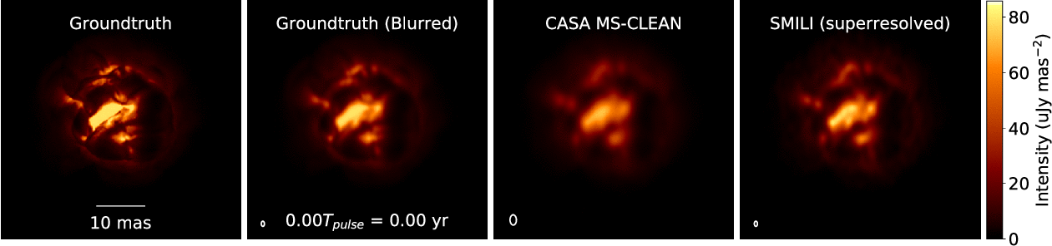
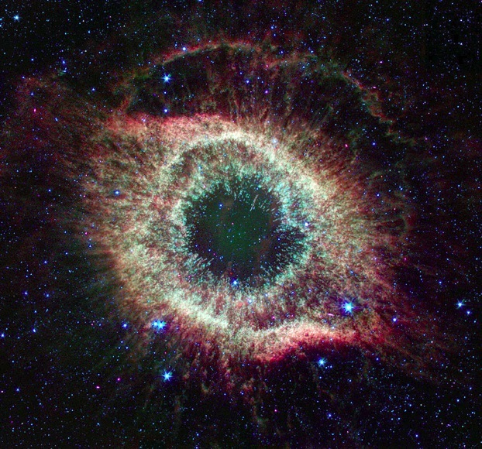
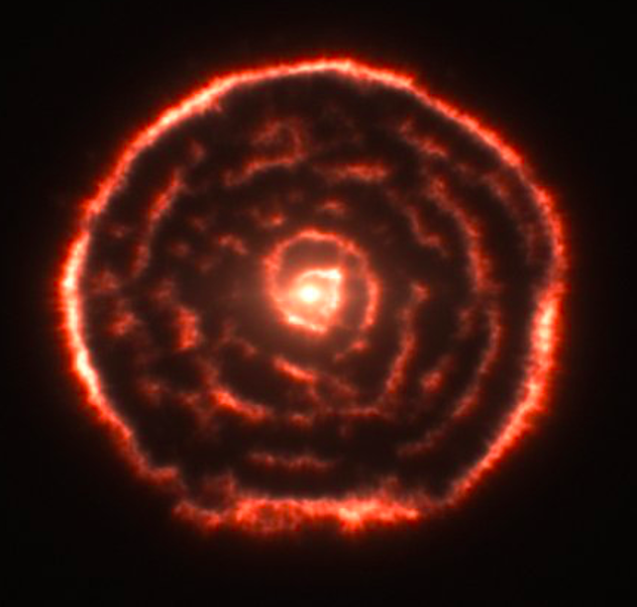
Stellar end-of-life: movies of stars
Movies of extreme mass-loss in evolved (AGB) stars
Primary enrichment mechanism of ISM
ngVLA
JWST
ALMA
ngVLA
Radio photosphere
80000 AU
8000 AU
8 AU
Petretti, Akiyama & Mathews 2021
ngVLA imaging of ‘boiling’ AGB star atmosphere
  ngVLA @ 46 GHz; 1.5 mas ~ 0.04 stellar radii at d=150pc
  1.3 year pulse period observed every 2-3 weeks
Notes:
Simulated movies of the gas motions in the radio photosphere of an asymptotic
giant branch (AGB) star as observed with the ngVLA Main Array at 46 GHz. The
angular resolution is ~1.5 mas, corresponding to roughly 0.04 stellar radii.
Each movie covers a single 1.3-year pulsation period for a model AGB star,
assuming observations every 2-3 weeks. The adopted distance was 150 pc.
AGB star atmospheres are highly dynamic owing to a combination of radial
pulsations, shocks, and large-scale convective processes. These stars also shed
large amounts of matter through cool, dense winds. Radio waves are emitted from
a portion of their atmospheres that lie at a radius of roughly twice the
visible photosphere, and just interior to the wind launch region.
The adopted brightness distribution for the radio photosphere model (the
"ground truth model" shown in the left hand frame) was based on a 3D
hydrodynamic model of an AGB star atmosphere from Freytag et al. (2017). The
Freytag et al. model is not specific to millimeter wavelengths, but was adapted
here for illustrative purposes. The second frame shows the ground truth model
blurred with a Gaussian kernel.
The two frames on the right show image reconstructions of the model based
on simulated ngVLA Main Array observations. The integration time was 2
hours per frame and the assumed bandwidth was 10 GHz in dual
polarizations. The second frame from the right shows a multi-scale CLEAN
reconstruction, while the frame on the right shows the result of a
regularized maximum likelihood reconstruction using the SMILI package of
Akiyama et al. (2019). While both methods do well at reproducing many of
the key features of the model, the SMILI version achieves superior angular
resolution.
These results underscore that the exquisite sensitivity and resolution of the
ngVLA will enable studies of the physical properties and kinematics of the
atmospheres of evolved stars in unprecedented detail.
Credit: K. Akiyama and L. D. Matthews, based on models adapted from B.
Freytag.

Slide 20
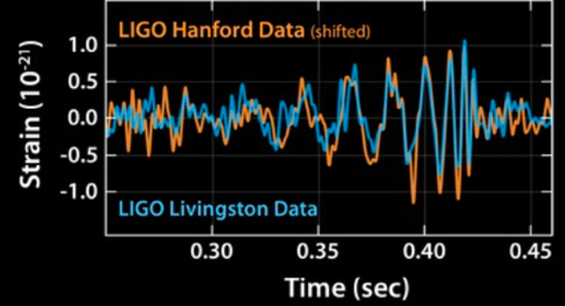



KSG 5: New Windows on the Dynamic Universe
Multi-messenger, time-domain astronomy (LIGO, neutrino sources, LSST, Euclid surveys, GRBs, TDEs…): radio provides unique tools to unlock physics of the ‘explosive universe’
Dobie ea. 2018;
Mooley ea. 2018
Radio light curve and VLBA imaging => emerging relativistic jet from merging binary black holes: a wide-angle jet which is trapped by the explosion debris
1st GW source: multi-wavelength campaign discovered the EM counter-part to merging binary ~ 30 M_{o} black-holes, identified with a galaxy at 430 Mpc
ngVLA 30x search volume => Expect 10 to 20 searchable LIGO events/year
sub-mas resolution => ONLY method to determine EM source sizes and shapes on scales < 0.6 pc

Slide 21





Imaging Black Holes
Event Horizon Telescope
M87 @ 230 GHz, 20uas resolution
General relativistic shadow
  Diameter = 42 uas = 5.6 R_{s}
M_{SMBH} = 6.5 x 10⁹ M_{o}
Virgo A at 40 Mlyr (14Mpc)
V ~6c
Walker + 2018
1 ly
100 kly

Slide 22


April 2018 GMVA 90 GHz
Surprise! Global mm VLBI at 90 GHz imaging also shows ‘ring’
1.5x larger
Jet base seen on scales ~ 0.1 pc
M87 90 GHz results open a new ngVLA key science program: imaging the accretion disk – jet connection on scales ~ 10 R_{s}
90 GHz @ 40uas: R ~ 8.4 R_{s}
50uas
Lu et al. 2023
0.5mas ~ 1lyr
Walker + 2018

Slide 23




Imaging the Black Hole Disk – Jet connection
Future Global VLBI at 90 GHz incl. ngVLA
ngVLA: increases total collecting area 4.5x
Dynamic range = 35,000
Core well resolved
Disk-Jet connection: precise imaging from 0.1 to 2 pc
Resolution = 37uas
Doeleman + 2023
ngVLA + ngEHT
FWHM = 50 uas
rms = 5.8 uJy/bm

Slide 24




KSG3: Molecular Deep Fields in three dimensions
Epoch of Galaxy Assembly
Revealing the ‘missing half’ of galaxy formation: the molecular gas = fuel for star formation
ngVLA ~ 3000 CO galaxies
HST UDF ~ 5000 galaxies over ~ 5’ field
ASPECS ALMA 200 hrs: 36 CO galaxies z ~ 1 to 3
10x sensitivity + 2.5x bandwidth => 100-fold increase in CO detection rate over VLA, ALMA => Galaxy counts in CO ~ deepest optical fields, with redshifts!

Slide 25


KSG3: Measuring the Dense Gas History of the Universe
Precise measurement of Dense Gas History of Universe
kpc-scale imaging of gas dynamics: Dark matter?

Slide 26





Prototype: First Fringes and Images May 1 2026
‘Start’ on source 3C84
Baseline: ngVLA – VLA/E08
First image 3C84 w. ngVLA+VLA
8.3 GHz, 0.3” res
DNR ~ 50k
System works from Rx through IF to correlator to CASA!

Slide 27








Project Timeline
2018
2019
2021
2023
2026
2029
2030
2033
2038
Astro2020 submission
MX CoA
1st fringes
Construction
Early Science
NSF/MREFC CoDR
Full Science Operations
Science Book
Ref. Design
NSF development funds
Prototype at VLA
NSF/MREFC FDR
Astro2020 Report

Slide 28

ngvla.nrao.edu
ngVLA Science Meetings
  2026: Multidisciplinary, Tohoku U., Japan
  2027: Long Baseline Science in DC Area

Slide 29






Fourier optics, Huygens principle, and Young’s two slits
𝜹s₃₁
𝛉 = 𝛌/B
3 element interferometer
V_{i,j} = A_{i,j} e^{-i𝝓i,j}

Slide 30





Fourier = u,v coverage
PSF
Quality of image depends on number of Baselines = Fourier components:
N_{uv} = N_{ant}((N_{ant}-1)/2) = 351
FT
Sidelobes ~ 0.3
Earth rotation: synthesize a ‘radio mirror’ with diameter = tens to thousands of km
Sidelobes ~ 0.03

Slide 31

DNR ~ peak/rms ~ 100
Correct for element G_{i}
DNR ~ 10⁵

