Slide 1
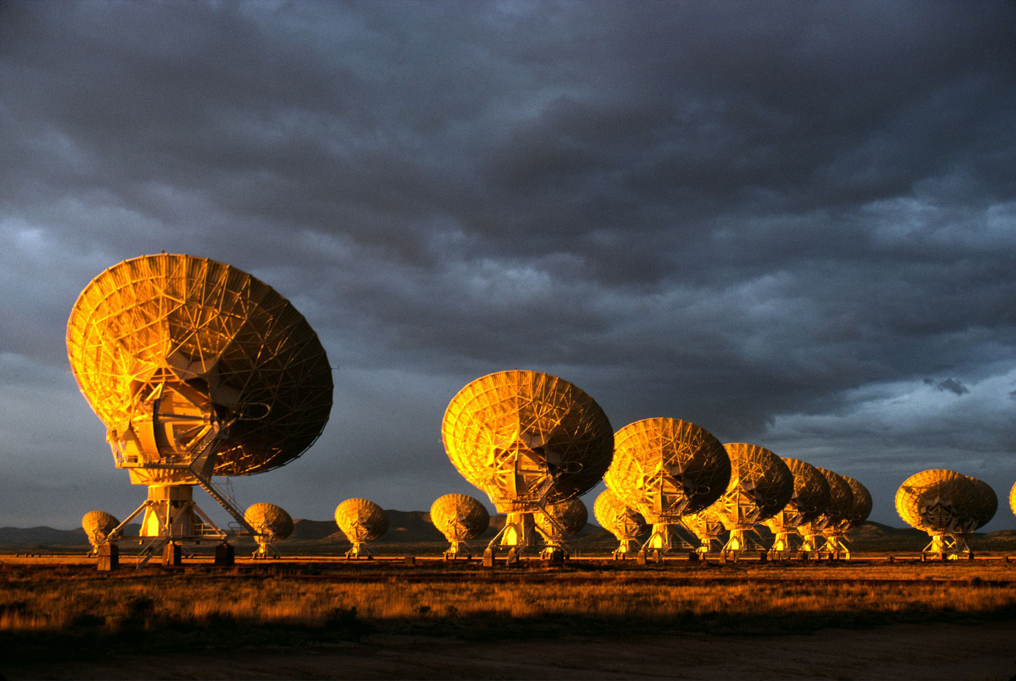
The Very Large Array: Global Powerhouse in Radio Astronomy for 40+ years
1972 – Approved by Congress
1975 – 1st antenna
1980 – Full science operations
1992 – Mexican-led 43 GHz upgrade: first foray into high frequencies
2001 – Jansky VLA major electronics upgrade approved by NSF
2011 – JVLA full science ops

Slide 2
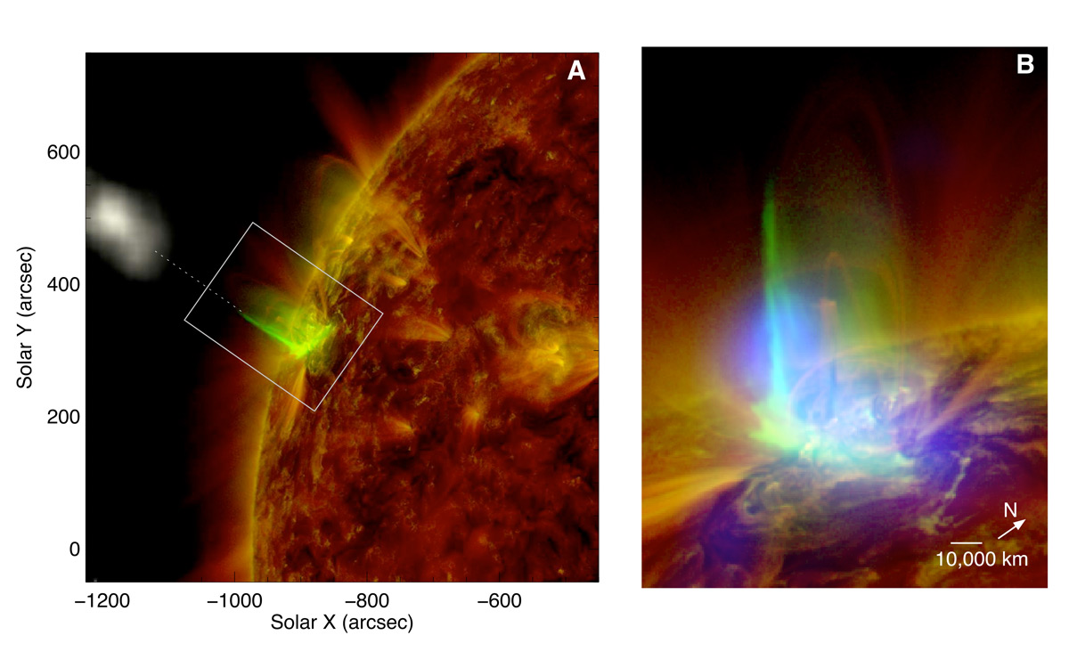
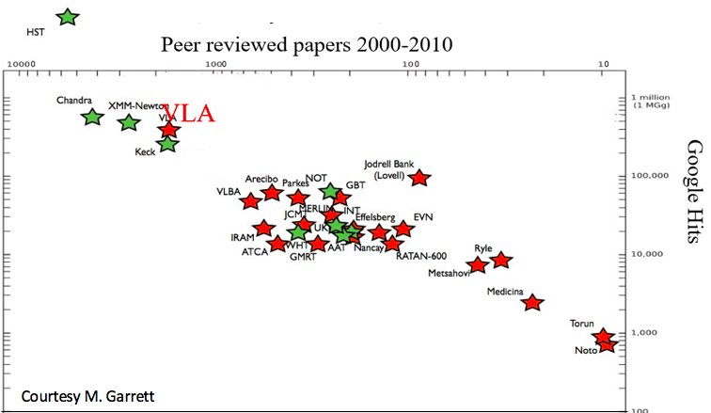
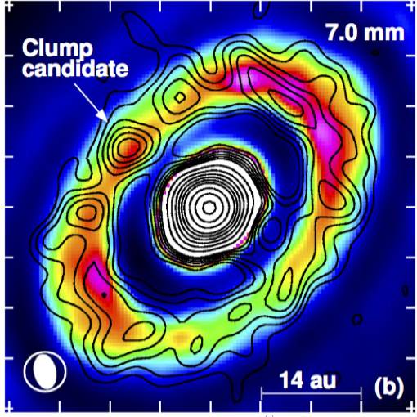
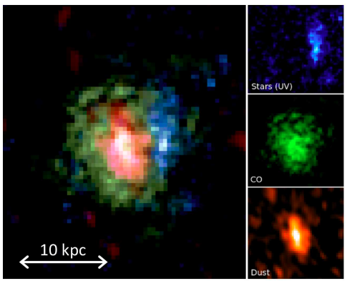
Radio Astronomy Powerhouse from 1980 to present: why? Versatility!
300 proposals per year, oversubscription ~ 2.5/1 for 4 decades
> 400 PhD theses
Among the most productive telescopes all-time
Solar Flares @ 50msec, 1000km
Chen +
Planet formation @ 10Au
CO z =4
Isella +

Slide 3
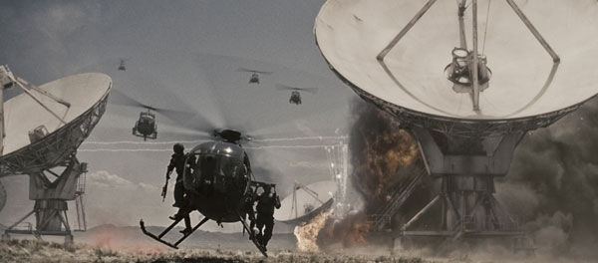

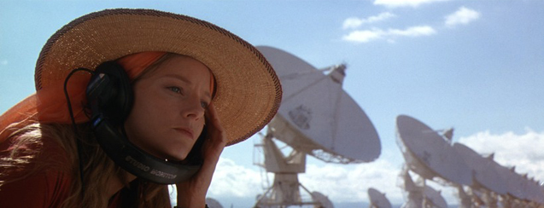
”I've always wanted to see the Very Large Array in New Mexico. It's not the biggest in the world, of course, or the most modern, but it is iconic, and I grew up wanting to see it. It's quite spectacular. Out there in the desert.” John Luther
Contact / T4

Slide 4
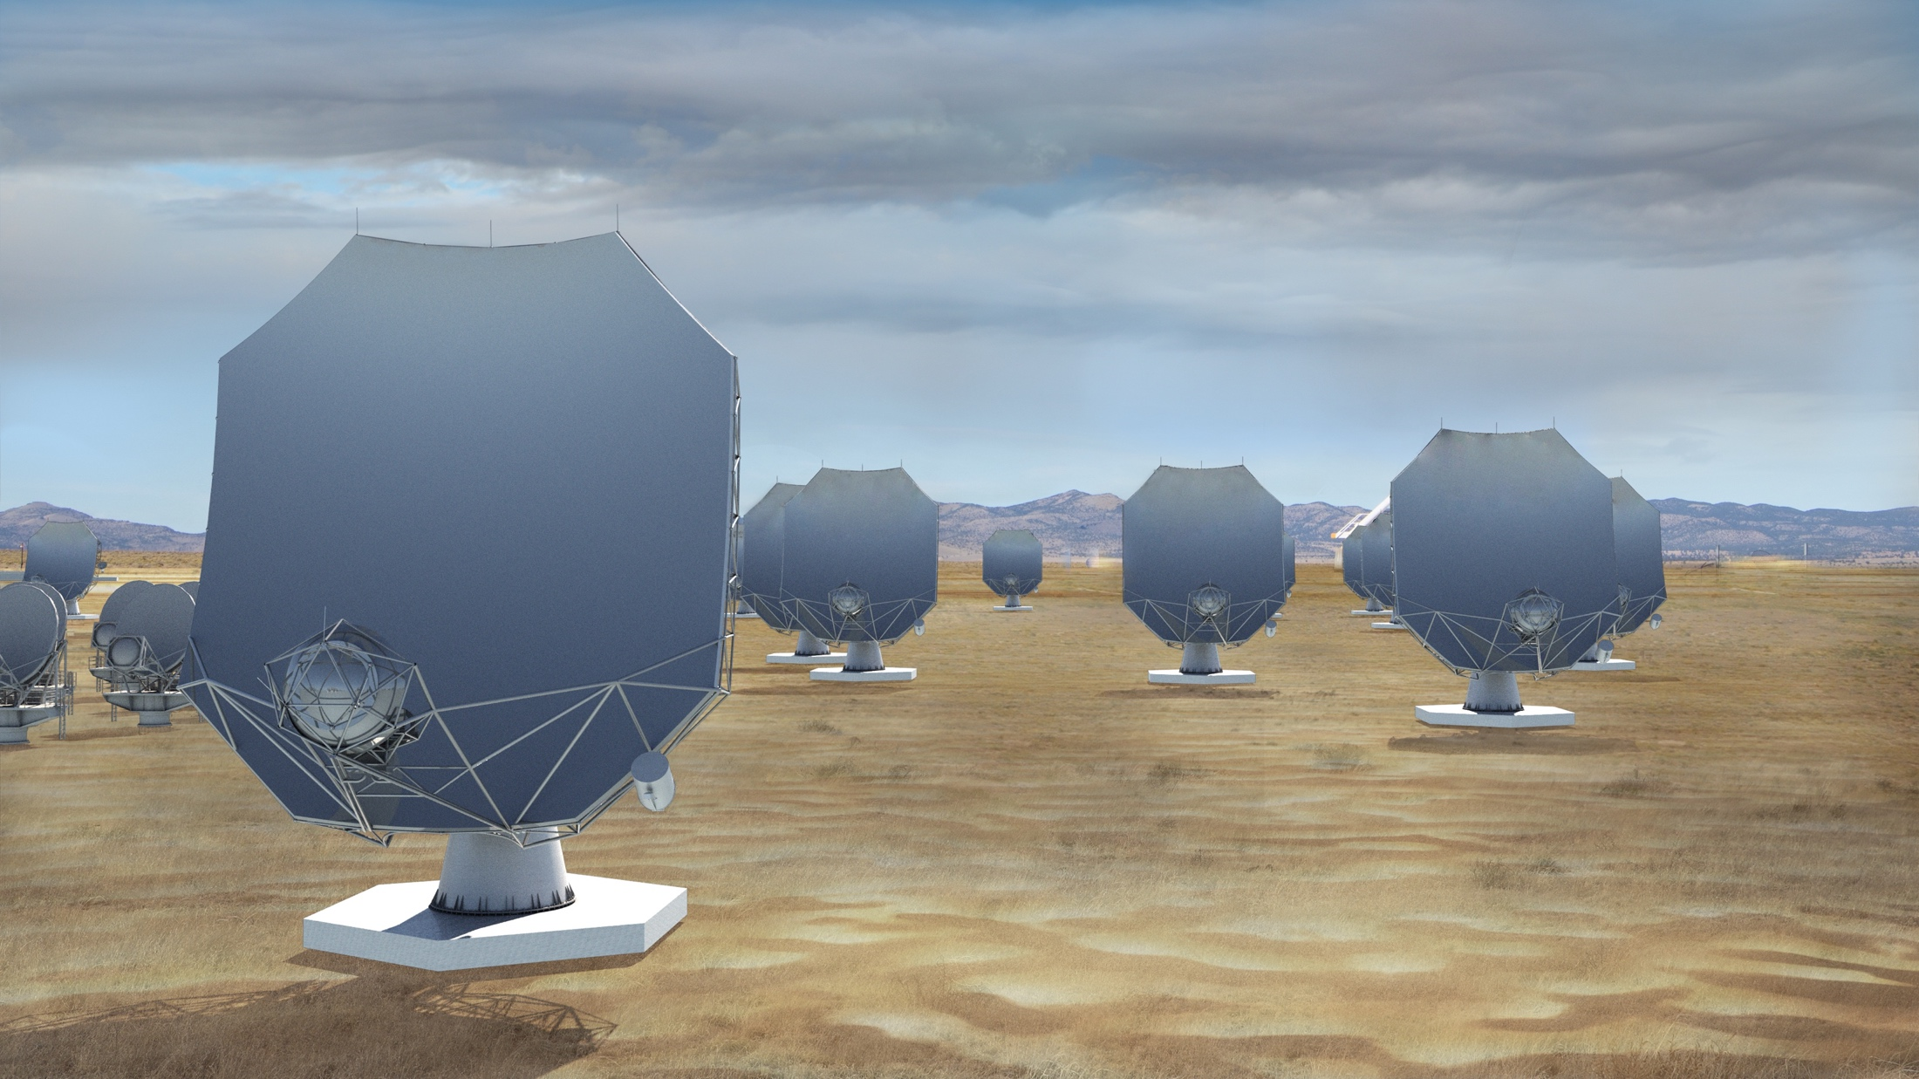
The next-generation Very Large Array (ngVLA)
A new facility for a new millennium: replace the VLA and VLBA to tackle new Scientific Frontiers into the mid-Century
Thermal imaging at milli-arcsec scales (<10K @ 7mas, 3mm)
10x area of JVLA/ALMA/VLBA
10x higher resolution than JVLA/ALMA
1.2 - 116 GHz Frequency Coverage
244 x 18m + 19 x 6m offset Gregorian Antennas
Centered at VLA site, extending over USA & MX
High and dry sites for 115 GHz
Fixed antenna locations
Notes:
Will be the next U.S. Flagship Radio Observatory.

Slide 5
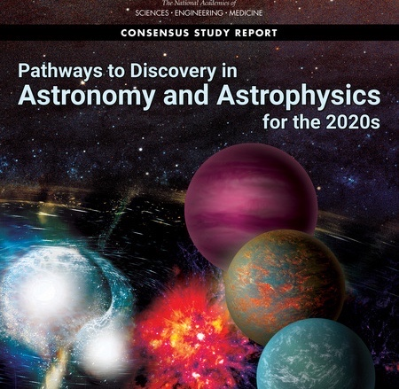
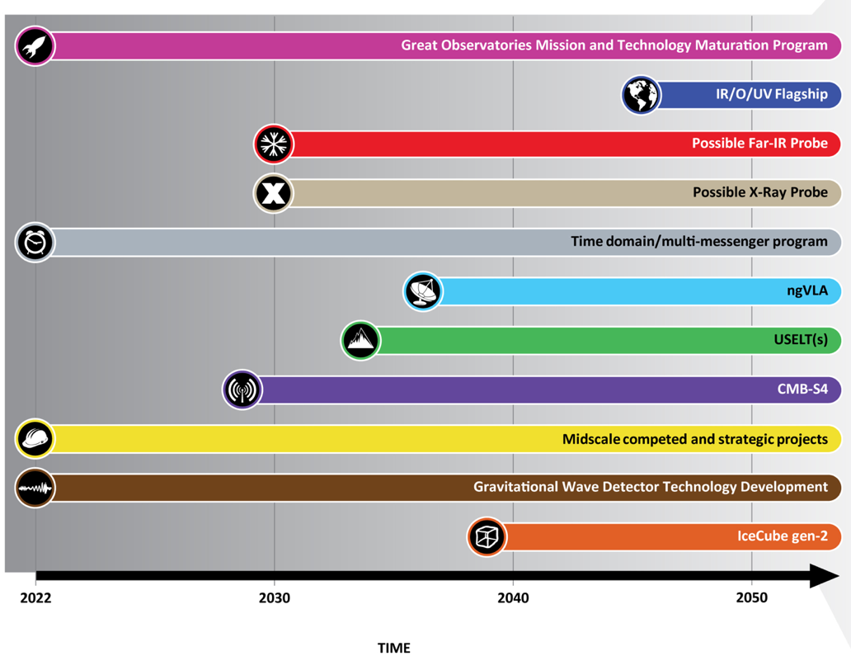
Astro2020 identified the ngVLA as a high-priority large, ground-based facility whose construction should start this decade.
Notes:
ngVLA essentially checked off every box of Astro2020 scientific priorities.

Slide 6
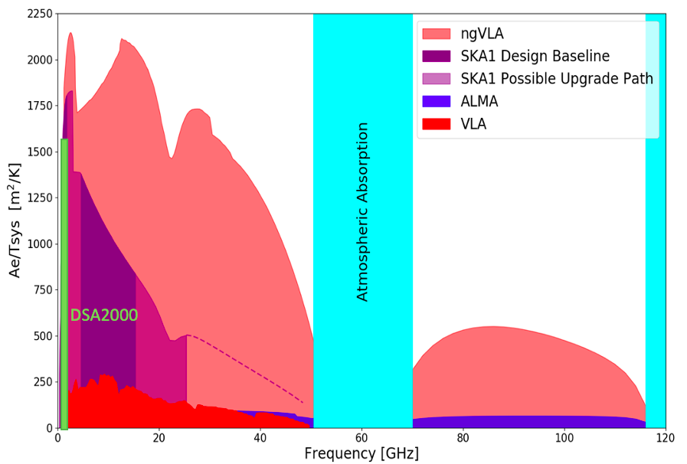
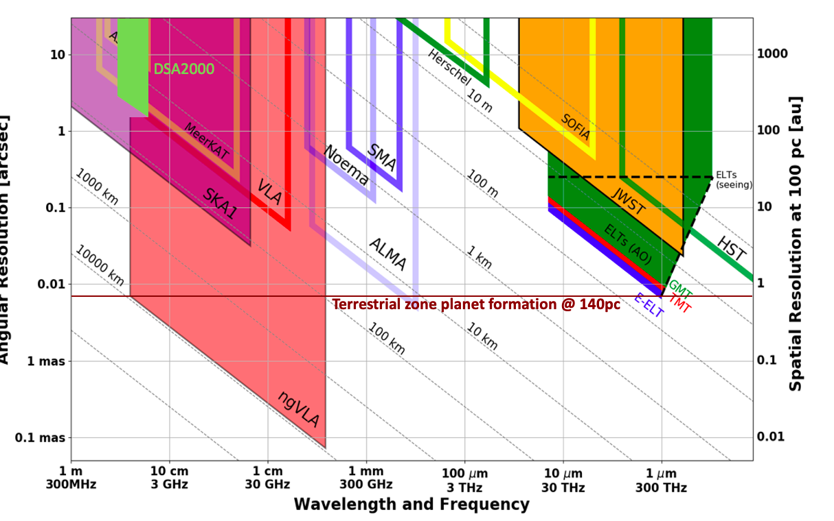
New Parameter (‘Discovery’) Space for the mid-Century
Complementary suite of arrays from meter to submm wavelengths
> 120GHz: ALMA 2030 superb for chemistry, dust, fine structure lines
1.0 - 116GHz: ngVLA superb for terrestrial planet formation, dense gas history, black holes
< 15 GHz: SKA superb for pulsars, reionization, HI + continuum imaging
Notes:
Snapshot comparison of effective collecting area for dish-arrays expected in the 2030’s.

Slide 7
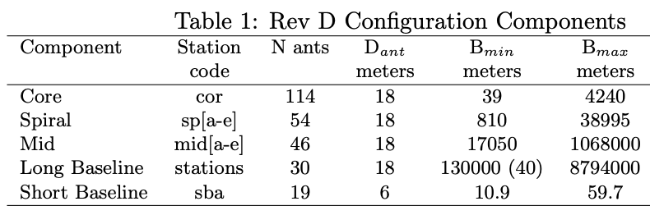
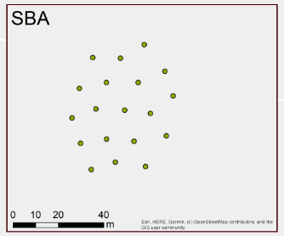
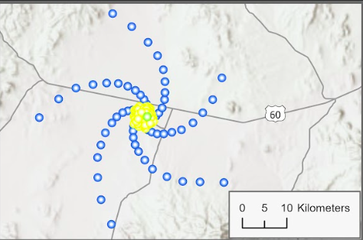
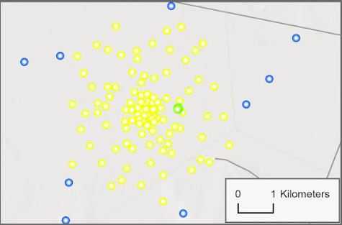
350 miles

Slide 8
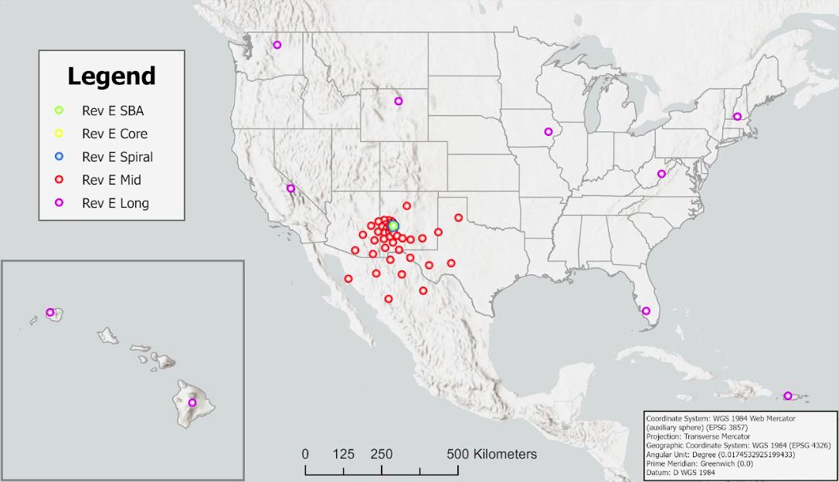
10m to 9000km => 200” to 0.2 mas @ 32GHz: subarrays will be key usage
Real-time fiber IF data transmission to all antennas

Slide 9
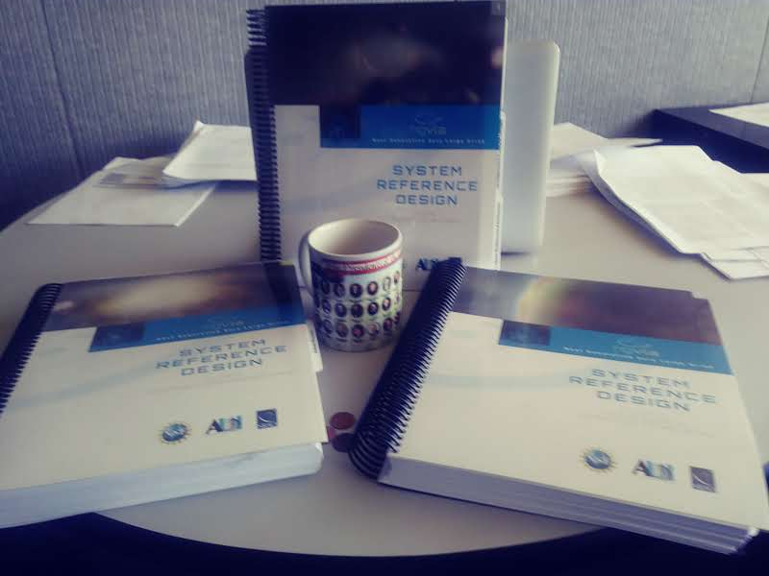
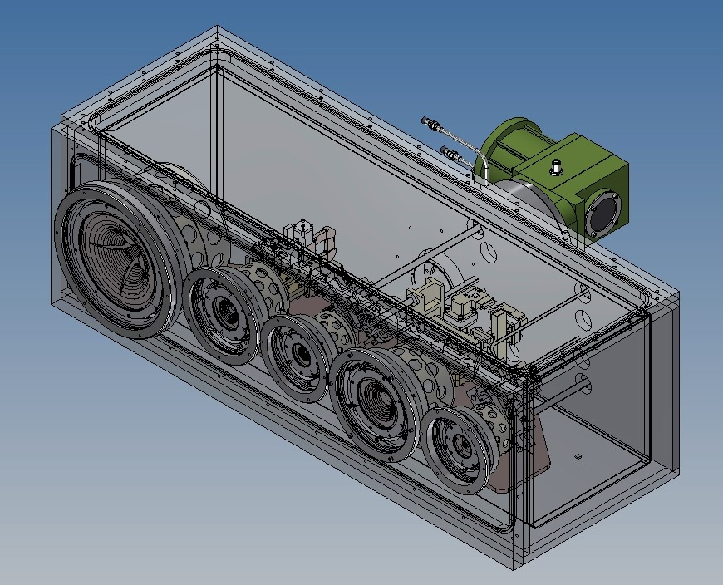
Technical Design: Well advanced and costed
2019 Reference Design: Build on ALMA, JVLA, SKA development => low-technical-risk and well costed concept
U.S. Multiagency Interest (DOD, NASA): ICRF, Space Situational Awareness (radar), Spacecraft tracking/imaging, `burst-telemetry’
Band # | Dewar | f_{L} GHz | f_{M} GHz | f_{H} GHz | f_{H}: f_{L} | Max BW GHz | rms 1hr uJy | Resolution mas
1 | A | 1.2 | 2.35 | 3.5 | 2.91 | 2.7 | 0.30 | 3
2 | B | 3.5 | 7.90 | 12.3 | 3.51 | 8 | 0.21 | 1
3 | B | 12.3 | 16.4 | 20.5 | 1.67 | 8 | 0.20 | 0.5
4 | B | 20.5 | 27.3 | 34.0 | 1.66 | 14 | 0.23 | 0.3
5 | B | 30.5 | 40.5 | 50.5 | 1.66 | 20 | 0.31 | 0.2
6 | B | 70.0 | 93.0 | 116 | 1.66 | 20 | 0.76 | 0.08
Saxony, Germany

Slide 10

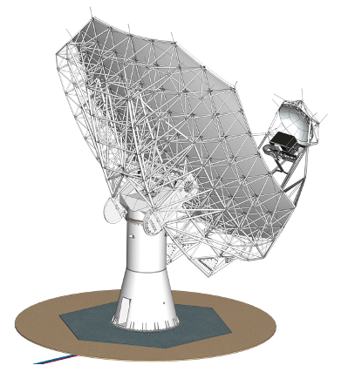
18m Prototype Antenna
76 Al. Main Reflector Panels, 5-pt supports.
19 Al. Sub Reflector Panels w/ Hexapod
Tube and Node BUS
Steel Pedestal
RFI Chamber w/ Electronics/servo
CFRP Feed Arm
Metrology (Tilt meter, temp sensors)
Status
Antenna proto-type contract 2022 to MTEX: under construction in Germany & Spain.
Delivery to VLA site in mid 2024.
Testing includes correlation with VLA and VLBA antennas.
Key Specifications
18m Aperture | Offset Gregorian
Shaped Optics | 3° Slew & Settle in 7 sec
Surface: 160 µm rms | Reference pointing: 3” rms
Precision conditions: | Total efficiency >80% (X..Q)

Slide 11
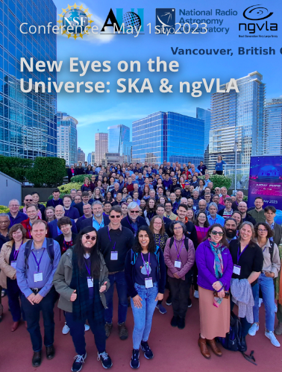
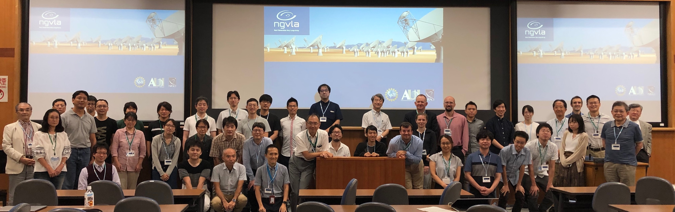

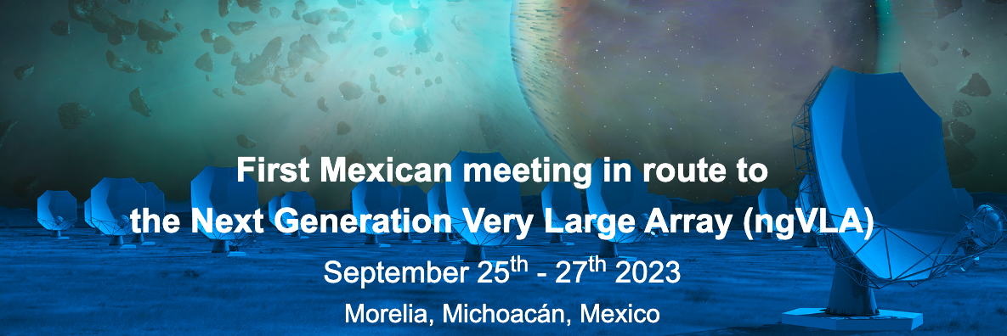
International Participation and Collaboration
Mitaka Japan

Slide 12

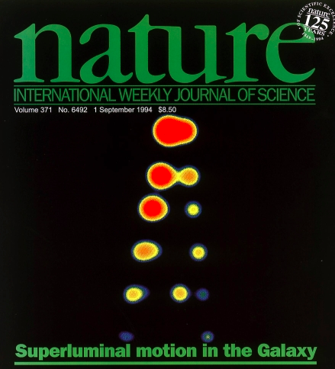
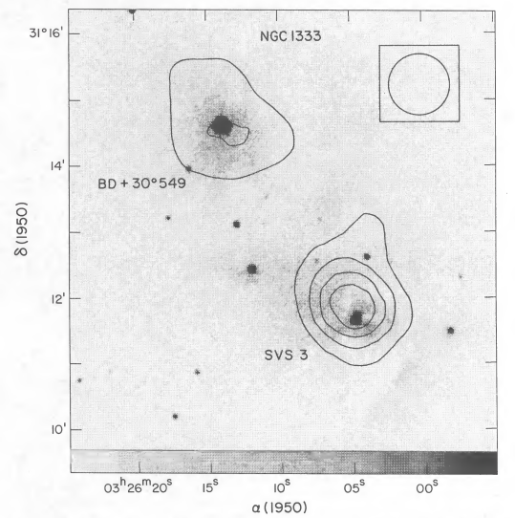
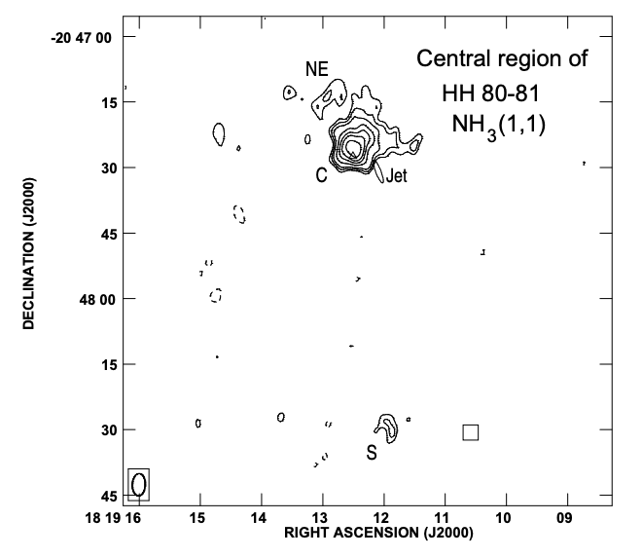
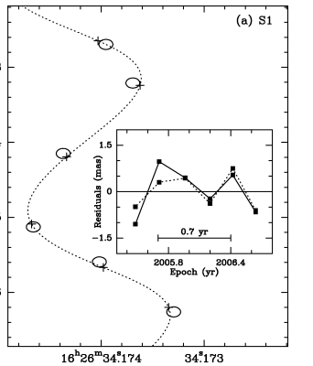
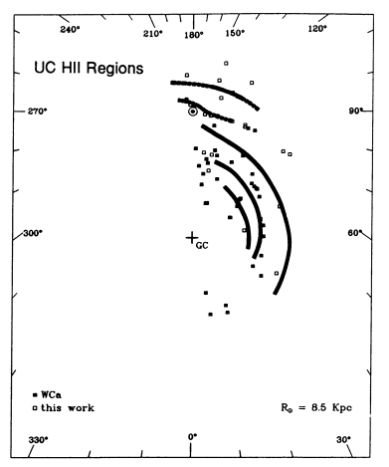
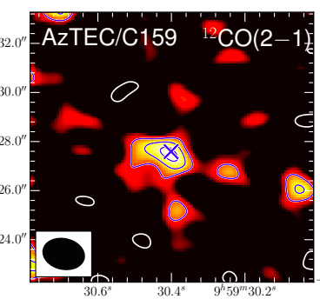
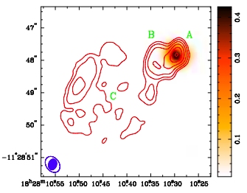
Mexican connection: historically deep and currently vital
Q-band (43GHz) receivers 1992: first foray into 𝛎 > 22GHz, led by Prof. L. Rodriguez (Jansky lecturer 2021). Results inspired JVLA and now ngVLA.
Broad scientific usage VLA/VLBA: protostars to the first galaxies
ngVLA involvement: MOU NRAO-UNAM Nov 2022
Science Advisory Committee: Loinard , Carrasco-Gonzales
Technical Advisory Committee: Kurtz
Science and technical working groups: Zapata, Pasetto, Jimenez-Andrade, Galvan-Madrid, Trejo
𝛍quasars: Mirabel & Rodriguez 1994
Stellar outflows: Rodriguez, Lozano 1990
Massive star formation: Gomez + 2003; Galvan-Madrid + 2009
𝛍as astrometry: Loinard + 2008
UCHII: Kurtz + 1994
Molecular gas z = 4.3, Jimenez + 2022

Slide 13
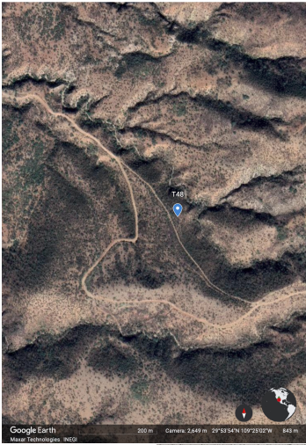
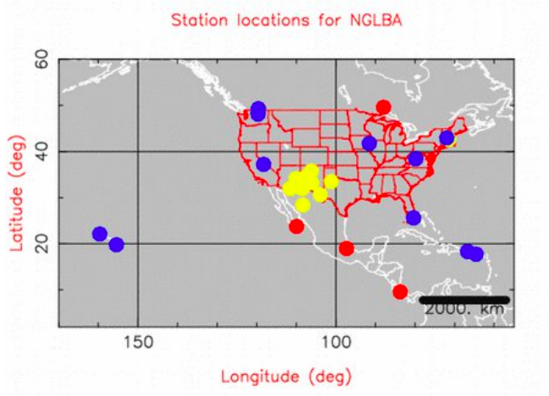
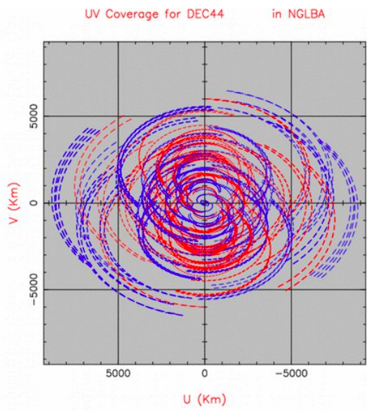
Configuration work (Trejo +)
Site Dev MID stations in Sierras of Senora & Chihuahua
antenna foundations
buildings for remote sites stations
Fiber and power
Site monitoring equipment
Potential LONG stations: Baja, LMT-site
Trejo + Watson ngVLA memo 111
Walker ngVLA memo 84
Walker ngVLA memo 84

Slide 14
January 2019 Science Book published by the ASP: 90 chapters, 850 pages, 300 authors
ngVLA Science
Strength in Versatility: Planets to Cosmology
ngvla.nrao.edu
Science Advisor Committee and Working Groups
Chairs: D. Wilner and B. Matthews
SWG1: Stars, Planetary Systems, and their Origins [Co-Chairs: B. Matthews (NRC-Victoria) & D. Wilner (CfA)]
SWG2: Astrochemistry and the Molecular Emergence of Life [B. McGuire (MIT) & J. Bergner (Chicago)]
SWG3: Galaxies and Galaxy Evolution [F. Walter (MPIA) & R. Somerville (Flatiron/CCA)]
SWG4: Pulsars, Cosmology, and Fundamental Physics [M. DeCesar (George Mason) & A. van der Horst (GWU)]
SWG5: Exploring the Dynamic Universe [R. Osten (STScI) & A. Corsi (TTU)]

Slide 15
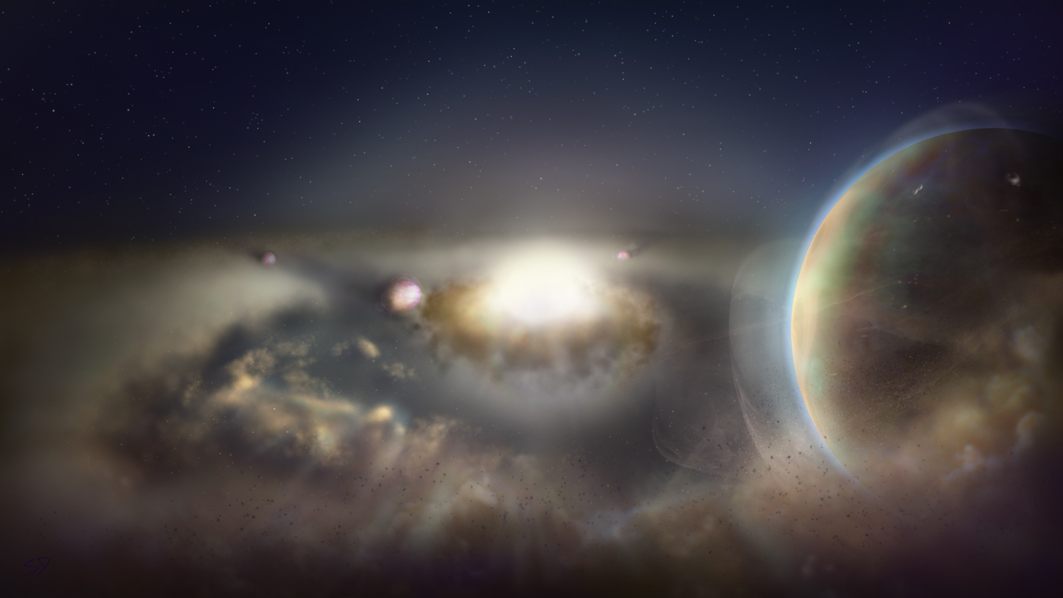
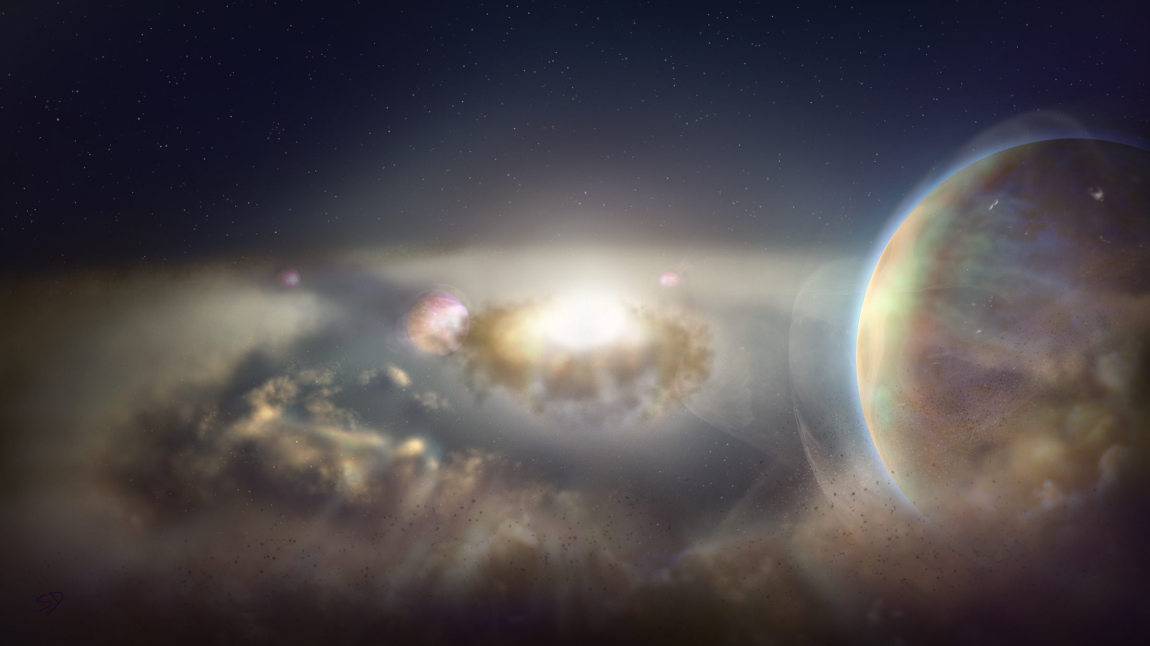
Key Science Goals https://ngvla.nrao.edu/page/scibook
Unveiling the Formation of Solar System Analogues on Terrestrial Scales
Probing the Initial Conditions for Planetary Systems and Life with Astrochemistry
Charting the Assembly, Structure, and Evolution of Galaxies Over Cosmic Time
Using Pulsars in the Galactic Center as Fundamental Tests of Gravity
Understanding the Formation and Evolution of Stellar and Supermassive BH’s in the Era of Multi-Messenger Astronomy

Slide 16
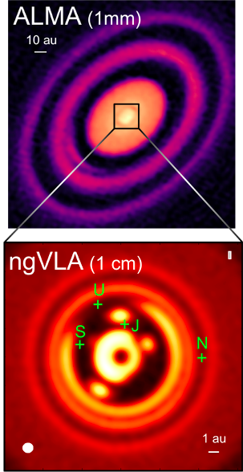
KSG1: Unveiling the Formation of Solar System Analogues
The ngVLA will image planet formation in systems similar to our own Solar System, down to planet masses of a few earth masses
Required resolution: 7mas = 1 AU at 140 pc
ALMA has this resolution at > 350 GHz but PP disks are optically thick in inner 10 AU!
ngVLA can achieve this sensitivity and resolution at 30 to 100 GHz, where inner disk is optically thin
Ricci, Isella…
Notes:
HD 163296
ALMA observation of HD163296 at 1mm along with a simulated 1 cm ngVLA observations (Ricci et al. 2019) of the innermost 24 au region at 1 au resolution for Jupiter-, Saturn-, and Neptune-like planets.
The distribution of exoplanets and young planets embedded in circumstellar disks: Then ngVLA will discover many hundreds of planets with orbital periods <10 yr.
The ngVLA will measure the orbital motion of planets and related features on monthly timescales:
Simulated 100 GHz ngVLA observations of a newborn planetary system comprising a Jupiter analogue orbiting at 5 AU from a Solar type star.

Slide 17
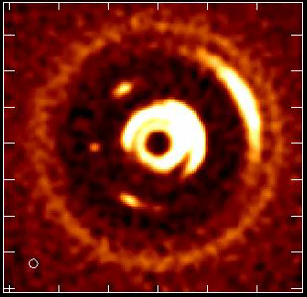
Movies of Planet Formation
Forming Jupiter in 1Myr solar mass protostar and disk at 140 pc
Monthly obs. over few years at 100 GHz, 7mas resolution (1 AU at 140pc)
Image dust gaps and traps, and potentially the circumplanetary disk = accretion onto planet itself!
L. Ricci
Notes:
HD 163296
ALMA observation of HD163296 at 1mm along with a simulated 1 cm ngVLA observations (Ricci et al. 2019) of the innermost 24 au region at 1 au resolution for Jupiter-, Saturn-, and Neptune-like planets.
The distribution of exoplanets and young planets embedded in circumstellar disks: Then ngVLA will discover many hundreds of planets with orbital periods <10 yr.
The ngVLA will measure the orbital motion of planets and related features on monthly timescales:
Simulated 100 GHz ngVLA observations of a newborn planetary system comprising a Jupiter analogue orbiting at 5 AU from a Solar type star.

Slide 18
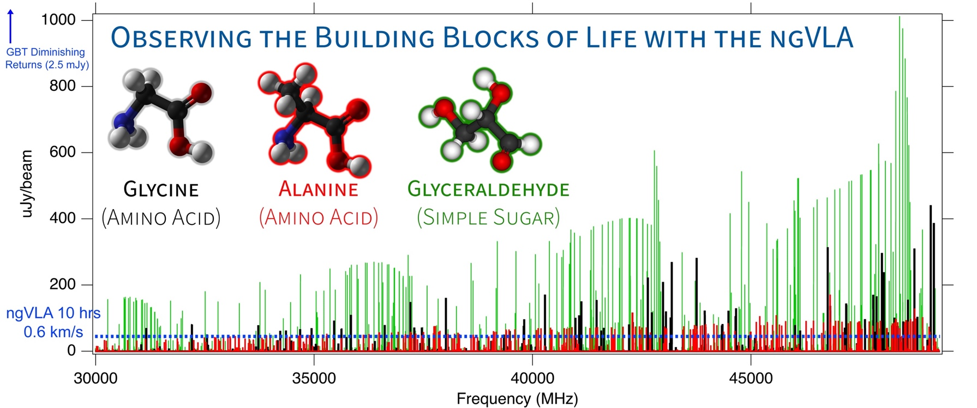
KSG2: Probing the Initial Conditions for Life with Astrochemistry
The ngVLA can detect complex pre-biotic molecules and provide the chemical initial conditions in forming solar systems and individual planets
Credit: Brett McGuire (NRAO)
Notes:
This is a simulation of ~3 complex organic molecules, not currently detected in the ISM, but which are good candidates for detection.
The simulation assumes that the emission is coming from a compact, 1" hot core in Sgr B2(N), from molecules with column densities of 10^12 - 10^14 cm-2, at T = 200 K, and with a linewidth of 3 km/s.
The simulation does *not* contain any currently-detected species, meaning that a real spectrum in this frequency range would have many, many bright lines off the scale of this graph.
The red horizontal line is the ~rms of the current GBT PRIMOS observations. These suffer greatly from beam dilution, as the 1" source is diluted in a 30" GBT beam. This rms is about what we can reasonably get with reasonable integration times at the GBT. Drilling deeper will take far longer than is feasible for a survey.
The green line is taken from the ngVLA tech specs page for line sensitivity at 10 km/s in 1 hr, degraded for 0.3 km/s channels.
The blue shaded region is the area in which I project, from a statistical analysis of the PRIMOS observations, we will hit line-confusion in this frequency range. There is little point in integrating more than 3 sigma deeper than this.
So what are the take-away messages here?
1) the ngVLA will almost certainly provide access to a wealth of new molecular detections of molecules similar to the representative species shown here
2) the ngVLA in reasonable integration times (say 4-20 hours) should hit line confusion in this most molecularly-rich galactic source at the 3 sigma level, something that the GBT and (J/E)VLA cannot hope to accomplish.

Slide 19
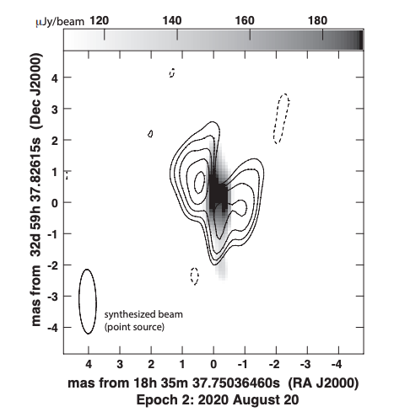
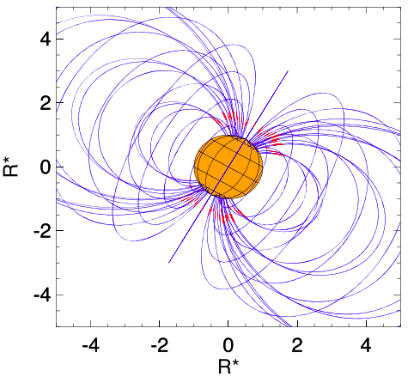
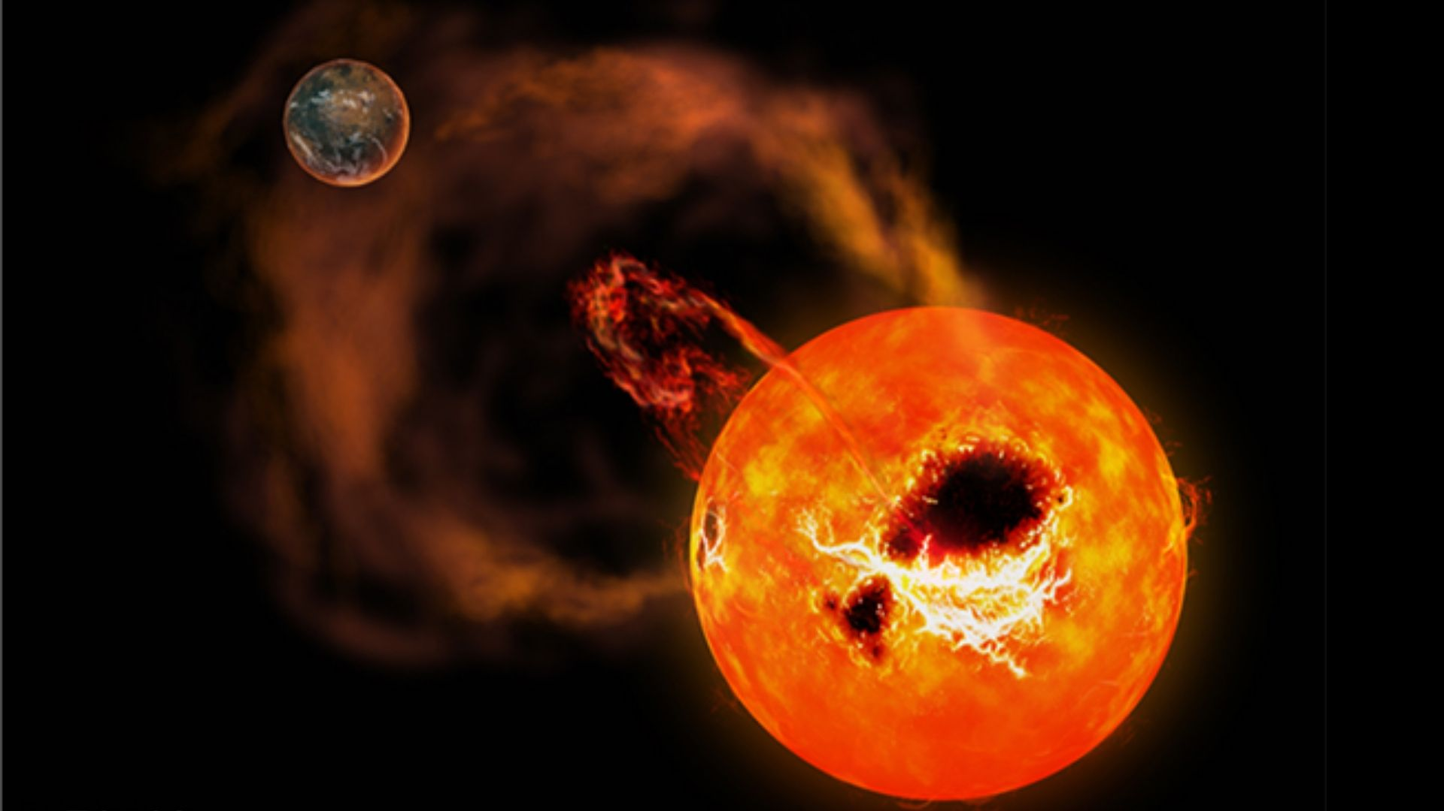
Extreme Exo-space Weather: Impediment to Life
M-dwarfs: most likely stars to host habitable planets. M-dwarfs are known to be very active (flares, aurora), w. strong mag. fields ~ 3kG => strong star-planet interactions
Star-planet magnetospheric interactions => deleterious effect on life: key term in Drake equation
ngVLA: sub-uJy at sub-mas => increase searchable volume by factor ~30 => hundreds of dwarf targets
VLBA image of 77M_{J} ultra-cool dwarf star at 6pc. Contours: unpolarized radiation belt emission out to 18 R* ; Grayscale: polarized auroral emission similar to Jupiter – Io (Kao et al. 2023).
Radiation belts
Aurora
VLBA 8 GHz
rms ~ 12 uJy/beam

Slide 20
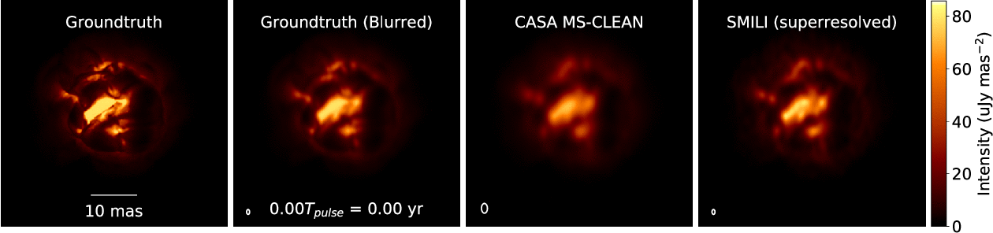
Stellar Radio Photospheres Movies of extreme mass-loss in evolved stars
Primary enrichment mechanism of ISM
ngVLA imaging of ‘boiling’ AGB star atmosphere (Akiyama & Mathews 2021)
ngVLA @ 46 GHz; 1.5 mas ~ 0.04 stellar radii at d=150pc
1.3 year pulse period observed every 2-3 weeks
ngVLA can resolve and determine R*, T_{B} for > 10000 stars, incl. 500 MS stars of all spectral types: Radio ‘HR diagram’ at 85 GHz
Notes:
Simulated movies of the gas motions in the radio photosphere of an asymptotic
giant branch (AGB) star as observed with the ngVLA Main Array at 46 GHz. The
angular resolution is ~1.5 mas, corresponding to roughly 0.04 stellar radii.
Each movie covers a single 1.3-year pulsation period for a model AGB star,
assuming observations every 2-3 weeks. The adopted distance was 150 pc.
AGB star atmospheres are highly dynamic owing to a combination of radial
pulsations, shocks, and large-scale convective processes. These stars also shed
large amounts of matter through cool, dense winds. Radio waves are emitted from
a portion of their atmospheres that lie at a radius of roughly twice the
visible photosphere, and just interior to the wind launch region.
The adopted brightness distribution for the radio photosphere model (the
"ground truth model" shown in the left hand frame) was based on a 3D
hydrodynamic model of an AGB star atmosphere from Freytag et al. (2017). The
Freytag et al. model is not specific to millimeter wavelengths, but was adapted
here for illustrative purposes. The second frame shows the ground truth model
blurred with a Gaussian kernel.
The two frames on the right show image reconstructions of the model based
on simulated ngVLA Main Array observations. The integration time was 2
hours per frame and the assumed bandwidth was 10 GHz in dual
polarizations. The second frame from the right shows a multi-scale CLEAN
reconstruction, while the frame on the right shows the result of a
regularized maximum likelihood reconstruction using the SMILI package of
Akiyama et al. (2019). While both methods do well at reproducing many of
the key features of the model, the SMILI version achieves superior angular
resolution.
These results underscore that the exquisite sensitivity and resolution of the
ngVLA will enable studies of the physical properties and kinematics of the
atmospheres of evolved stars in unprecedented detail.
Credit: K. Akiyama and L. D. Matthews, based on models adapted from B.
Freytag.

Slide 21
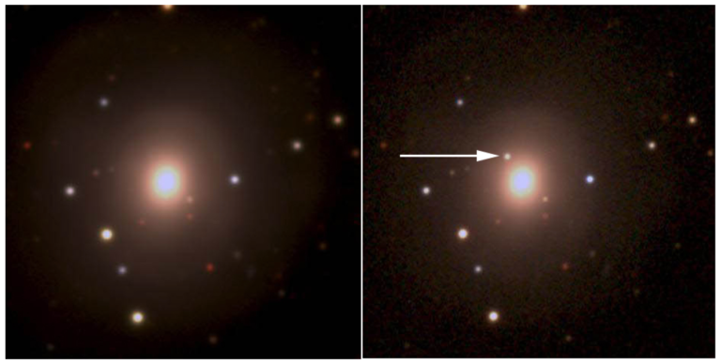
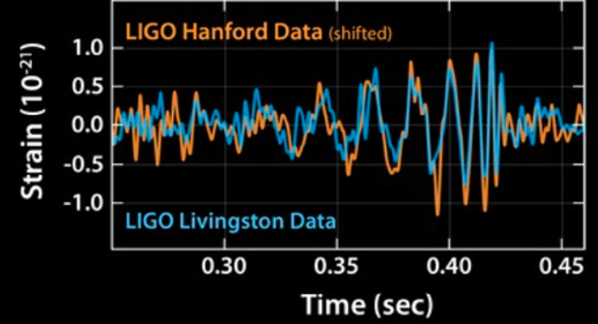
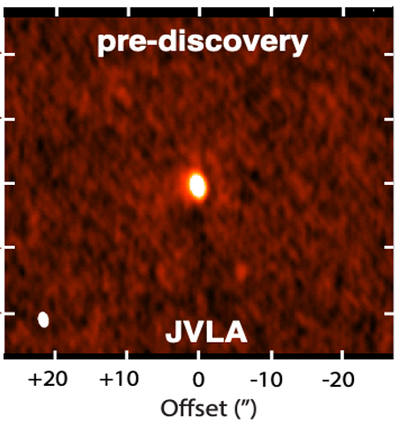
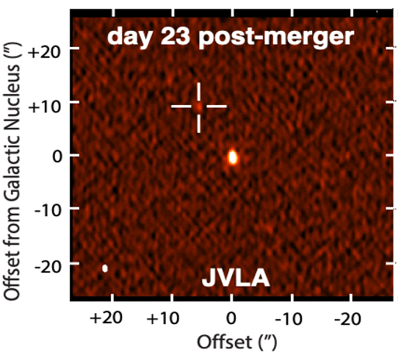
KSG 5: New Windows on the Dynamic Universe
Optical Pan ea. 2017
10”
Gravitational Waves Source: The multi-wavelength campaign that discovered the EM counter-part to the merging binary ~ 30 M_{o} black-holes, identified with a galaxy at z = 0.093.
Hallinan ea. 2017

Slide 22
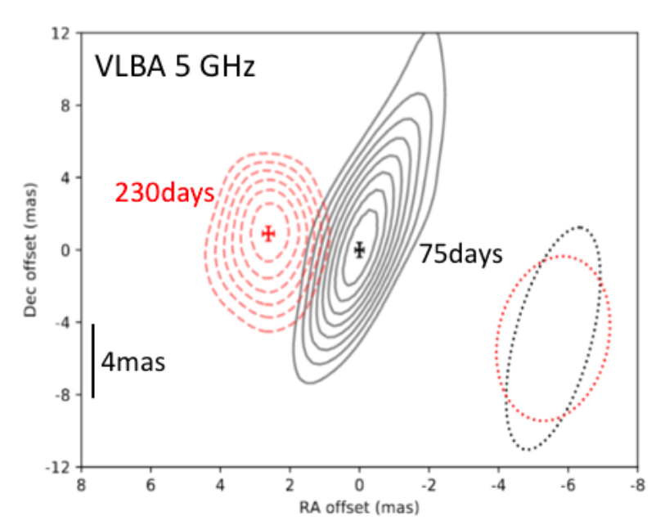
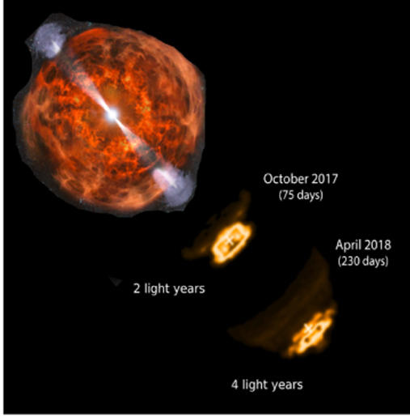
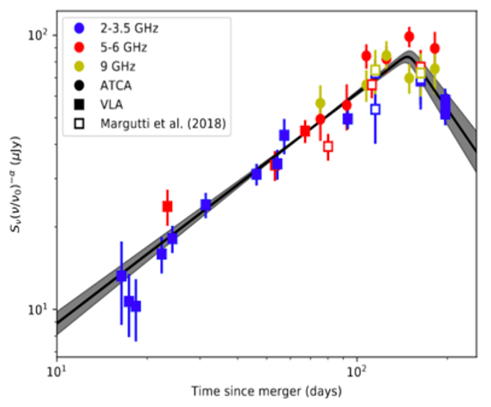
High resolution (mas), broad band radio was key to determining the physics: A smothered, emerging relativistic jet
v = 4c
Radio light curve and VLBA imaging => emerging relativistic jet from merging binary black holes: a wide angle jet which is trapped by the explosion debris (Dobie ea. 2018; Mooley ea. 2018).

Slide 23
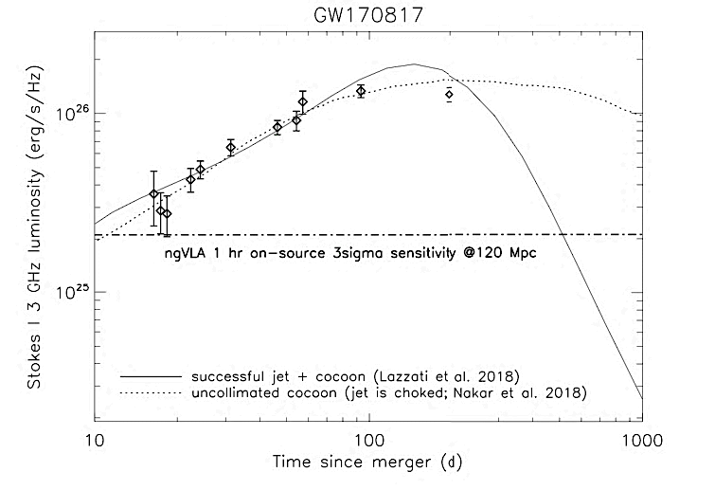

GW170817 at 30 Mpc
ngVLA and Gravitational Wave Sources
VLA sensitivity limit => detect radio emission from merging neutron stars to 40 Mpc.
ngVLA: 10x sensitivity => 3x further => 27x search volume. Expect 10 to 20 searchable LIGO events/year
sub-mas resolution => ONLY method to determine EM source sizes and shapes on scales < 0.6 pc
Multi-messenger, time-domain astronomy (LIGO, Blazar neutrino sources, LSST and Euclid synoptic surveys, GRBs, TDEs…): radio provides unique tools unlocking physics of the ‘explosive universe’
Corsi ea. 2019

Slide 24




Imaging the Black Hole Disk – Jet connection
V_{app} up to 6c
M87 EHT 230 GHz @ 20uas resolution
M_{SMBH} = 6.5 x 10⁹ M_{o}
Walker + 2018
42uas = 5.6 R_{s}
90 GHz GMVA @ 40uas: R ~ 8.4 R_{s}
Event Horizon Telescope imaging of the general relativistic shadow of the SMBH in M87 and Sgr A* has reinvigorated interest in radio AGN and their accretion disks and relativistic jets.
GMVA 90 GHz imaging also shows ‘ring’ but 1.5x larger, plus jet on scales ~ 0.1 pc
M87 90 GHz results open a new ngVLA key science program: imaging the accretion disk – jet connection on scales ≥ 10 R_{s}
Walker + 2018
50uas
Lu et al. 2023
0.5mas

Slide 25



ngEHT vs. ngEHT + ngVLA at 90 GHz
ngEHT
US-Africa
ngEHT + ngVLA
HI-Euro
ngEHT
Doeleman + 2023
GLT-Chile
86 GHz w. 10 GHz bandwidth
12hr synthesis
Adding ngVLA increases total collecting area by factor ~ 4.5
Much better uv-coverage baselines <= 6000 km
Much improved calibration capabilities
Mitigate calibration error susceptibility (∝ 1/N_{ant}, for full cross-correlation)
Major improvement in sensitivity and uv-coverage for space VLBI

Slide 26






M87 90 GHz simulations
64uas
M87 90 GHz GMVA @ 40uas: R ~ 8 R_{s}
ngEHT
FWHM = 52x45uas
rms = 20 uJy/bm
90 GHz Model: 64uas ring + scaled Walker 43 GHz VLBA Jet
Lu et al. 2023
Factor 2 contours x 20uJy/beam
3.5x lower noise
Bright sources
Comparable imaging on longest baselines (< 0.1mas)
Much better imaging for structure on scales > 0.5mas
Faint sources: Much greater sensitivity on all scales
ngVLA + ngEHT
FWHM = 54x46uas
rms = 5.8 uJy/bm

Slide 27




KSG3: Molecular Deep Fields in three dimensions
Revealing the ‘missing half’ of galaxy formation: the molecular gas = fuel for star formation
ASPECS ALMA 200 hrs: 36 CO galaxies z ~ 1 to 3
ngVLA ~ 3000 CO galaxies
HST UDF ~ 5000 galaxies over ~ 5’ field
10x sensitivity + 2.5x bandwidth => 100-fold increase in CO detection rate over VLA, ALMA => Galaxy counts in CO ~ deepest optical fields, with redshifts!

Slide 28



KSG3: Measuring the Dense Gas History of the Universe
Precise measurement of Dense Gas History of Universe
kpc-scale imaging of gas dynamics

Slide 29










Project Timeline
2018
2019
2021
2023
2026
2029
2035
Astro2020 submission
Prototype antenna at VLA Site
Construction
Early Science Operations (> VLA capabilities)
Full Science Operations
Science Book
Ref. Design
NSF/MREFC FDR
NSF development funds
Construction full cost accounting: $2.3B [FY2018]
Astro2020 Report
July 2023: ‘NSF has formally entered the ngVLA project into the MREFC design process at the Conceptual Design Phase. The NSF-led Conceptual Design Review is expected next Spring.’
Sept 2023: ‘Three year NSF development funding at $7M/year.’

Slide 30









Prototype manufacturing and site antenna infrastructure
Saxony, DE

Slide 32
Imaging Black Holes and their Jets
64uas
M87 90 GHz GMVA @ 40uas: R ~ 8 R_{s}
50uas
90 GHz Model: 64uas ring + scaled Walker 43 GHz VLBA Jet
Lu et al. 2023
Factor 2 contours x 20uJy/beam
ngEHT
FWHM = 52x45uas
rms = 23 uJy/bm
ngVLA + ngEHT
FWHM = 54x46uas
rms = 5.8 uJy/bm

Slide 33

KSG4: Using Pulsars in the Galactic Center as Fundamental Tests of Gravity
Predicted population of pulsars in the Galactic Center: need high frequency due to ISM pulse dispersion
Pulsars = clocks moving in the spacetime potential of Sgr A* SMBH: ultimate tests of strong field GR
Use the population of pulsars in the Galactic Center to constrain its
Star formation history
Stellar dynamics
Stellar evolution
Magnetoionic medium
By discovering pulsars around Sgr A*, the ngVLA will provide new opportunities to test theories of gravity.

Slide 34

ngVLA Project
Project Office leadership team:
Project Director: Tony Beasley
Project Scientist: Eric Murphy
Project Engineer: Rob Selina
System Engineer: Pieter Kotze
Project Managers: Willem Esterhuyse & Bill Hojnowski
11 Integrated Product Teams (IPTs).
MREFC project definition.
Actively engaged science/technical advisory councils.

Slide 35

Front End Concept
6 Bands in 2 Cryogenic Dewars.
1.2-3.5 GHz and 3.5-12.3 GHz Quad-Ridge Horns, 3.25:1 bandwidth, coaxial LNAs.
12.3-50.5 GHz using three 1.67:1 BW corrugated horns and waveguide LNAs.
70-116 GHz 1.67:1 BW corrugated horn and waveguide LNAs with block down conversion.
Single stage down-conversion to baseband for 5 bands. Direct SSB or IQ sampling using modular devices @ FE.
Two-stage Gifford-McMahon cryogenic system with variable-speed cryocoolers and compressors for reference design.

