Slide 1
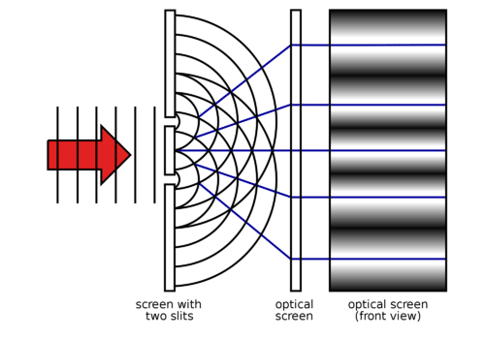
Optical Masking Interferometry using Radio Astronomy Techniques
Fourier Imaging, Deconvolution, and Self-calibration
Measuring the size and shape of extremely bright, micron-scale light sources: synchrotrons, free-electron lasers, plasma light source lithography…
Nano-meter wavefront sensing: metrology and manufacturing, ophthalmology, directed energy…
C. Carilli (NRAO), B. Nikolic (Cavendish), L. Torino (CELLS/ALBA), U. Iriso (CELLS/ALBA), N. Thyagarajan (CSIRO)
Fourier optics, Huygens principle, and Young’s two slits
US patent 12,104,901
US patent app. No. 18/878,488
US patent app. No. 19/079,876
Copyright © 2024 AUI, U. Cambridge, CELLS/ALBA, CSIRO. All Rights Reserved

Slide 2
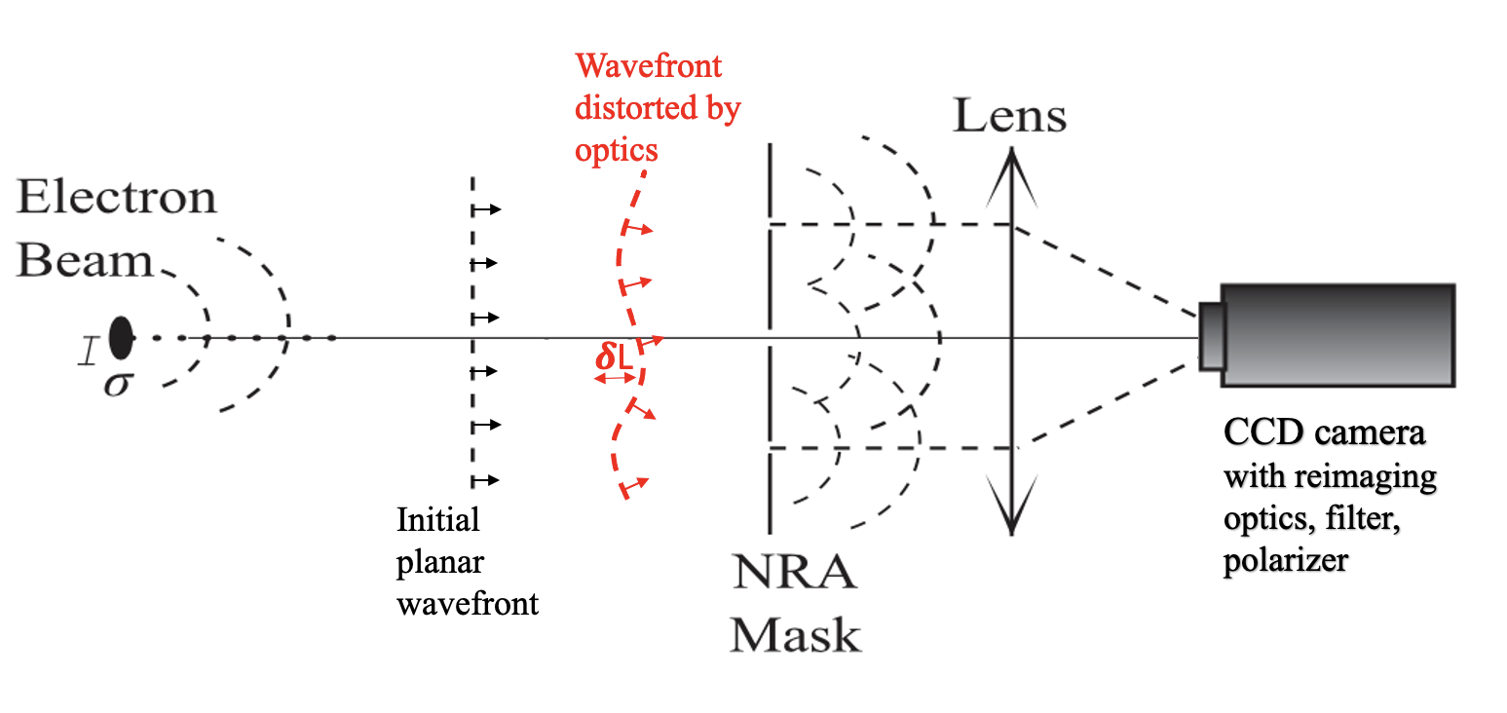
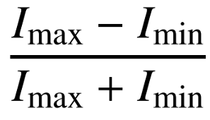
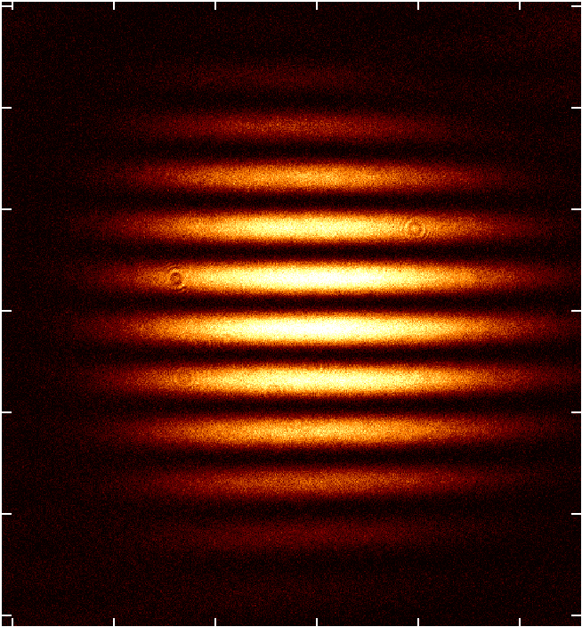
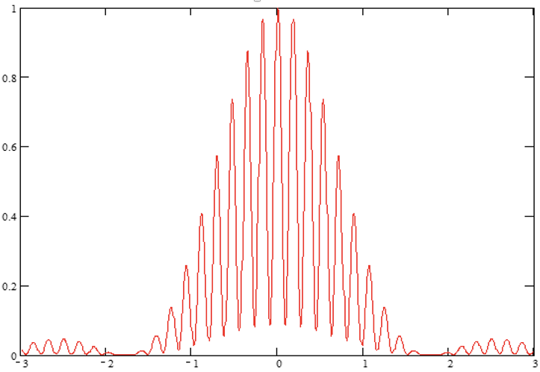
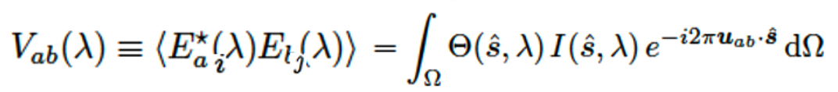
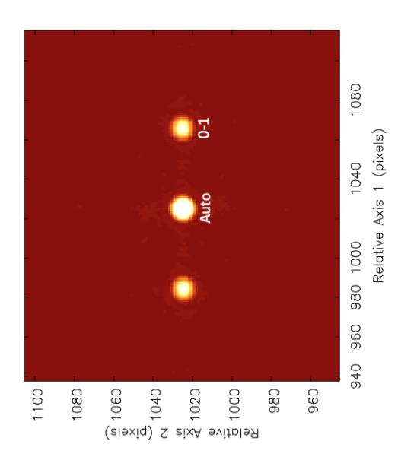
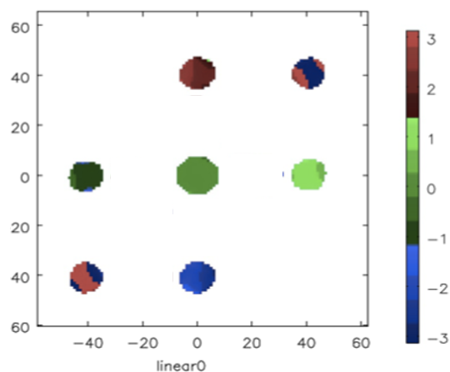
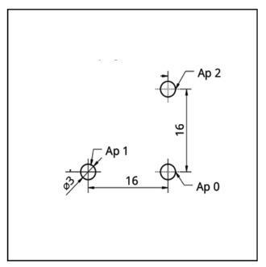
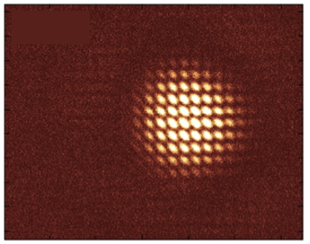
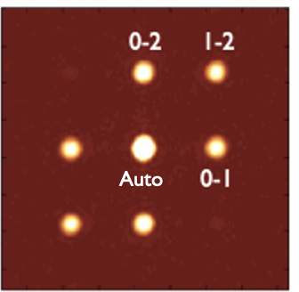
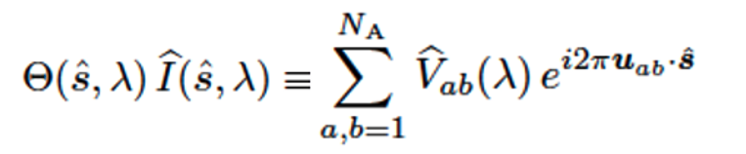
Aperture Mask Interferometry
A_{i,j} =
Planar wavefront
𝛉 = 𝛌/B
Light Source
FT
= A_{i,j} e^{-i𝝓i,j}
v = B/𝛌
v
rad
1-0
FT
u
Orientation and spatial frequency set by geometry of baseline
Position of fringe determined by phase
Strength determined by ‘mutual coherence’

Slide 3

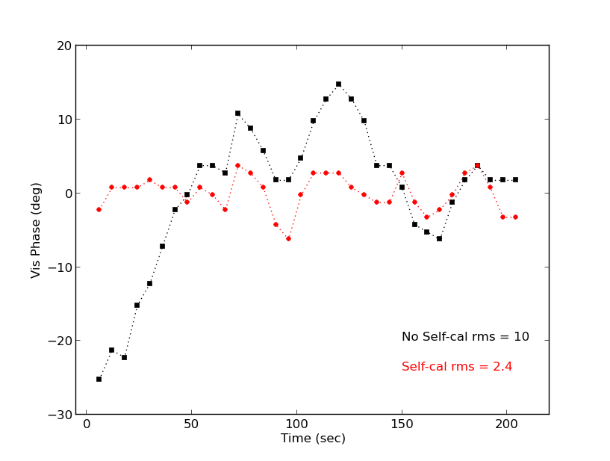
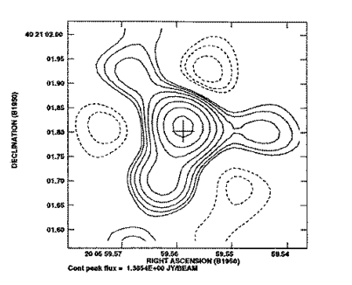
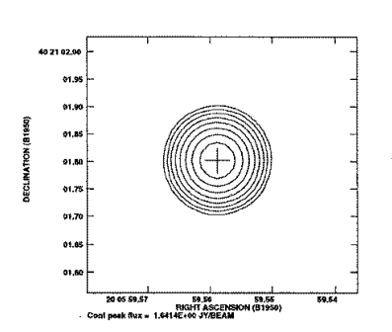
Self-Calibration
Propagation effects distort/attenuate wavefront
Solution: Joint fit complex voltage gains and source structure
Over-constrained: [𝑁(𝑁 − 1)]/2 Vis vs. N_{gains} + M_{src}
Measured Visibilities
Light Source
Source Model Visibilities
Solve element gains
Correct visibilities
Gain amp, a_{i} = aperture plane illumination
Gain phases, 𝛉_{i} ∝ photon path-length through system
𝛅L = 𝛌 x 𝛉_{i}/360º = wavefront sensing
VLA 8 GHz
Generate new model (fitting / deconvolution)

Slide 4
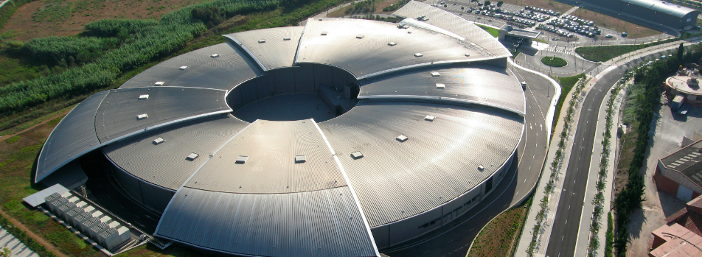
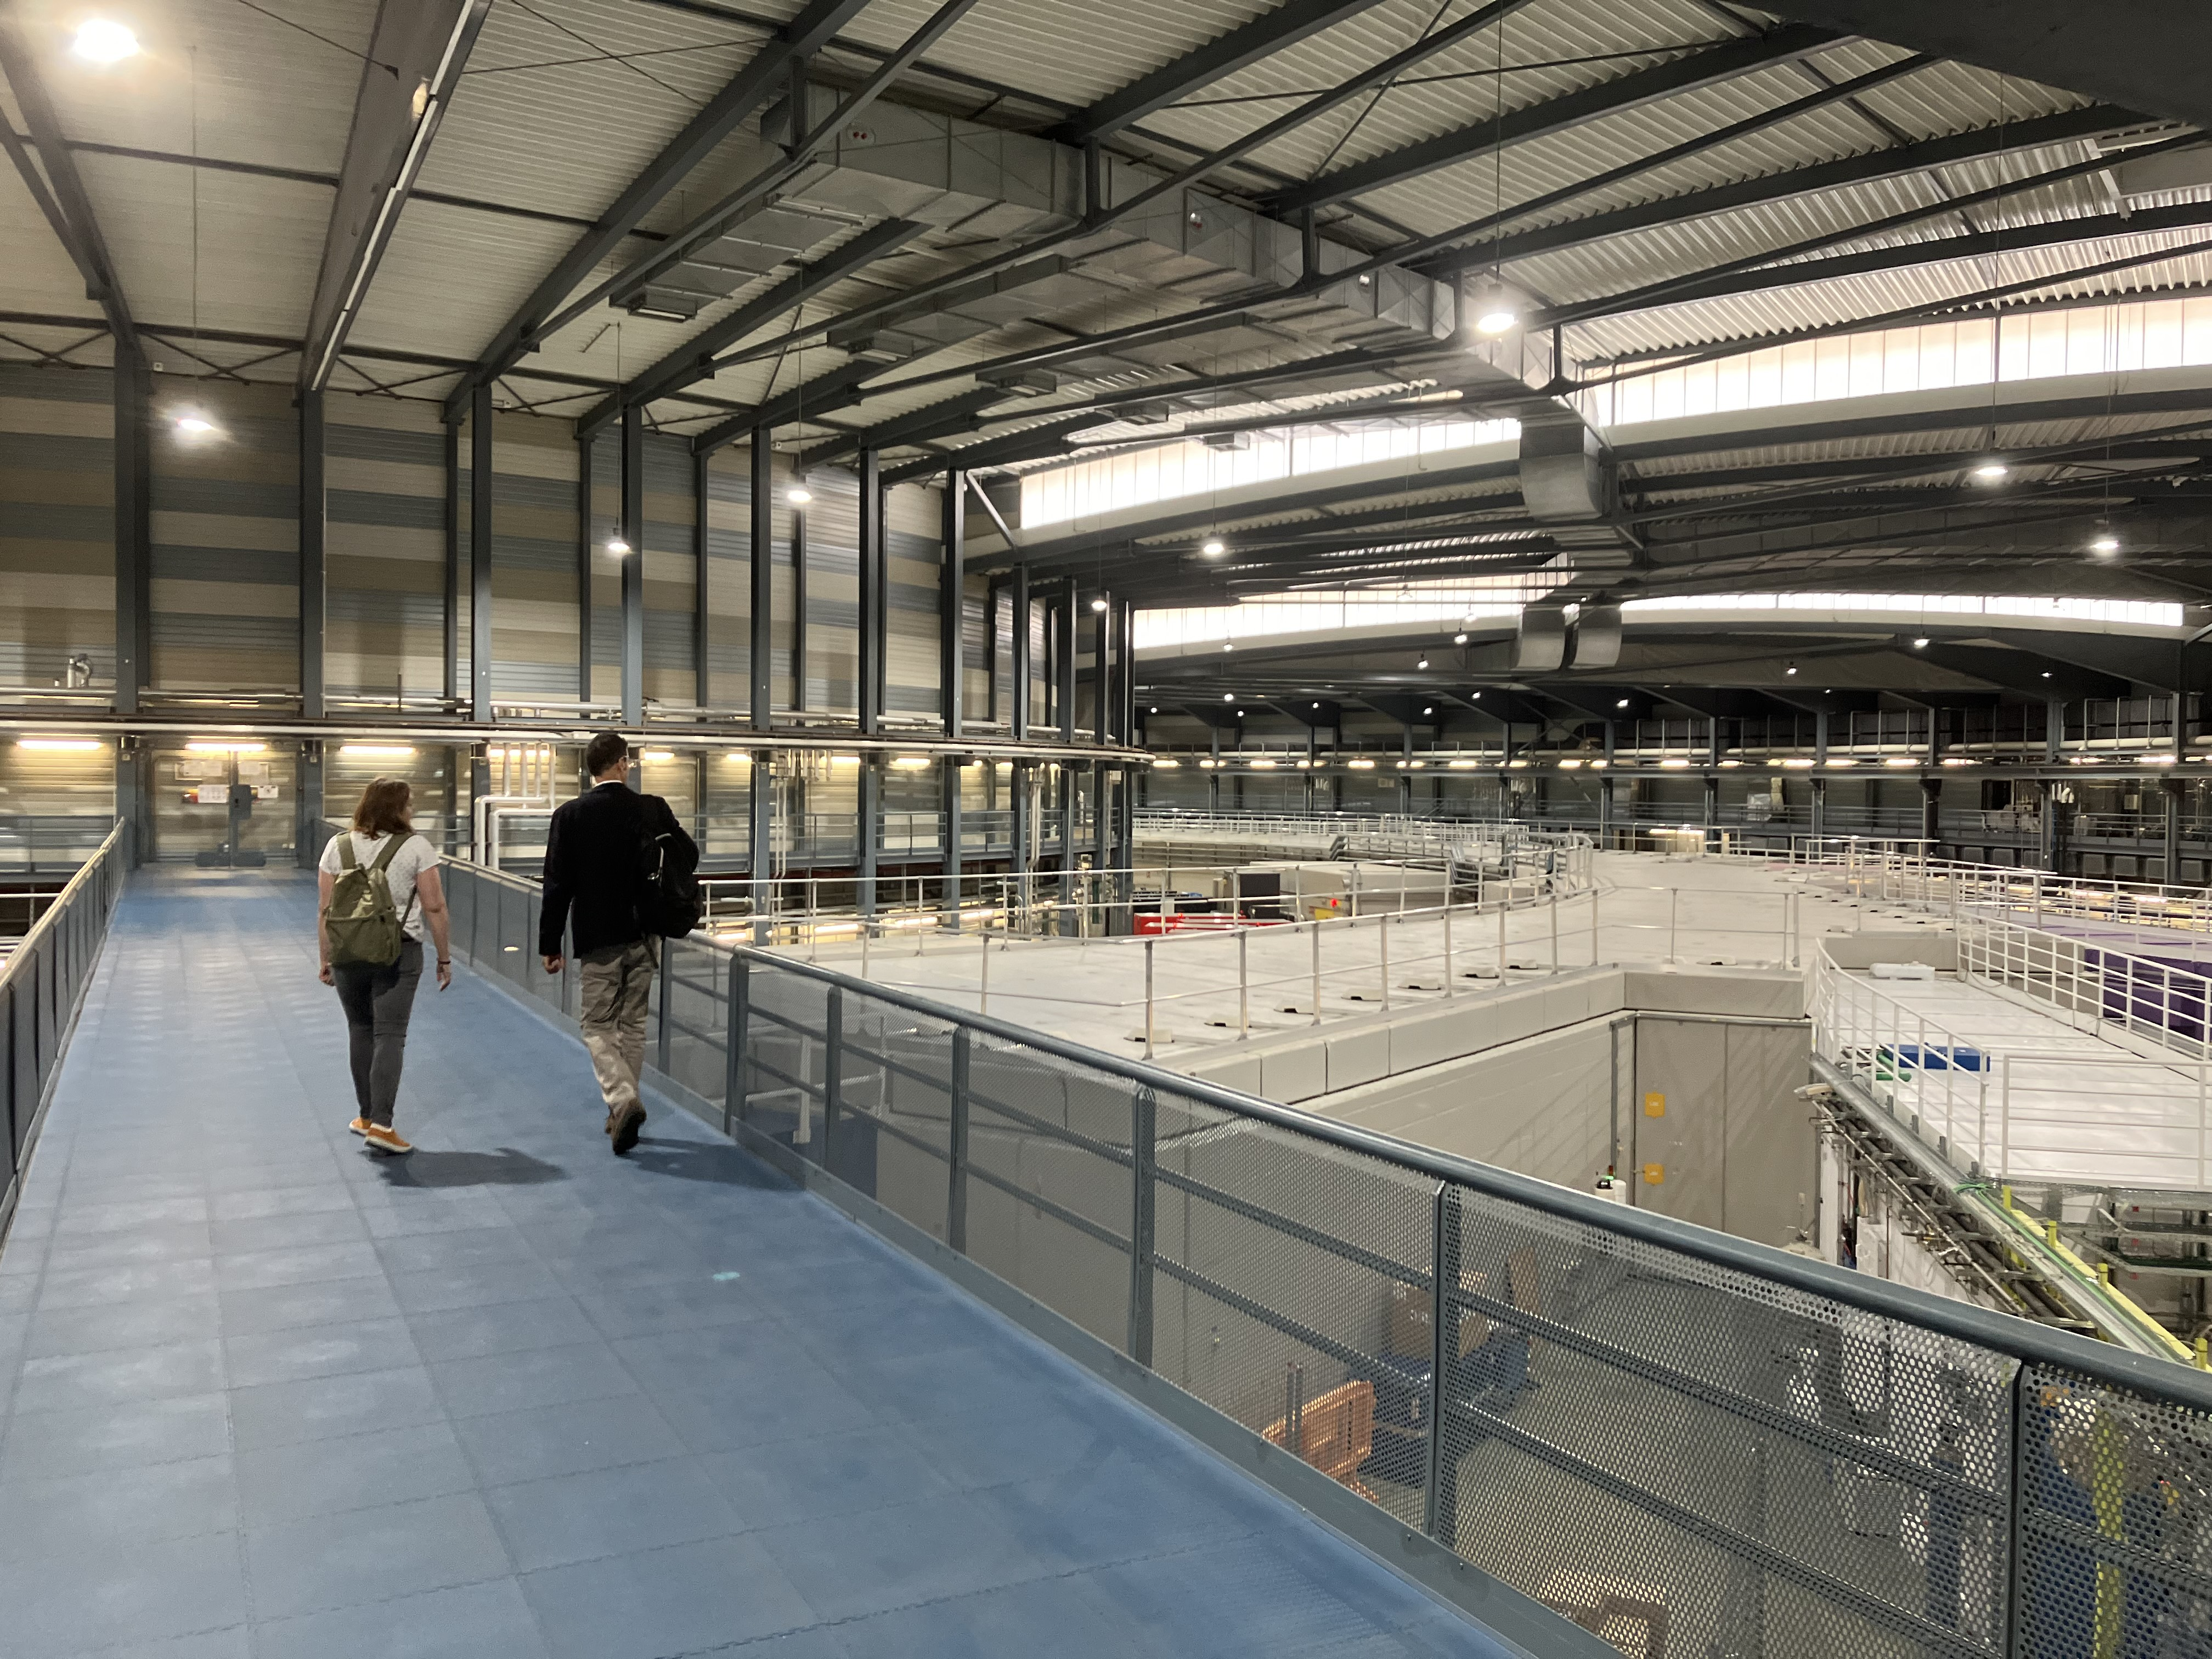
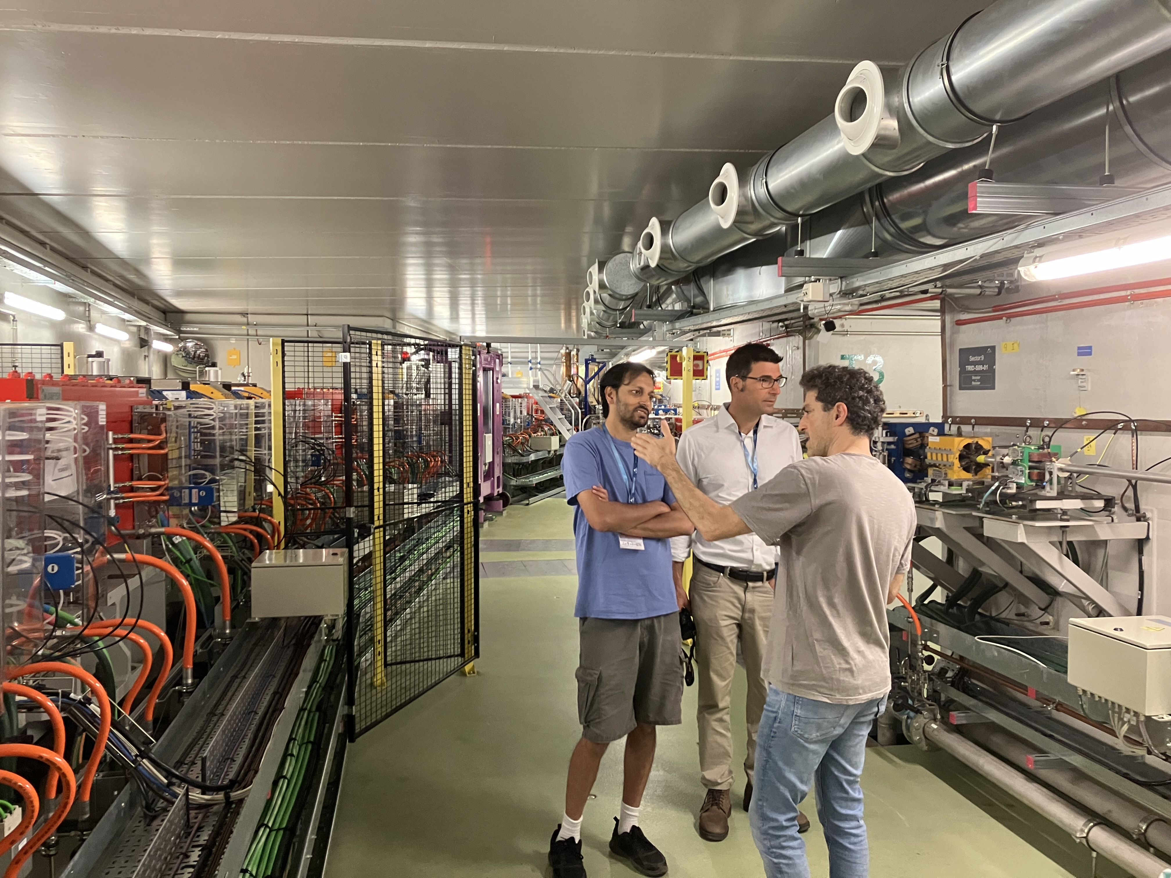
ALBA Synchrotron Light Source, Barcelona, Spain
Circumference = 270m
Electron energy = 3 GeV
Synchrotron photons IR to X-ray
10⁹ optical photons/millisec

Slide 5
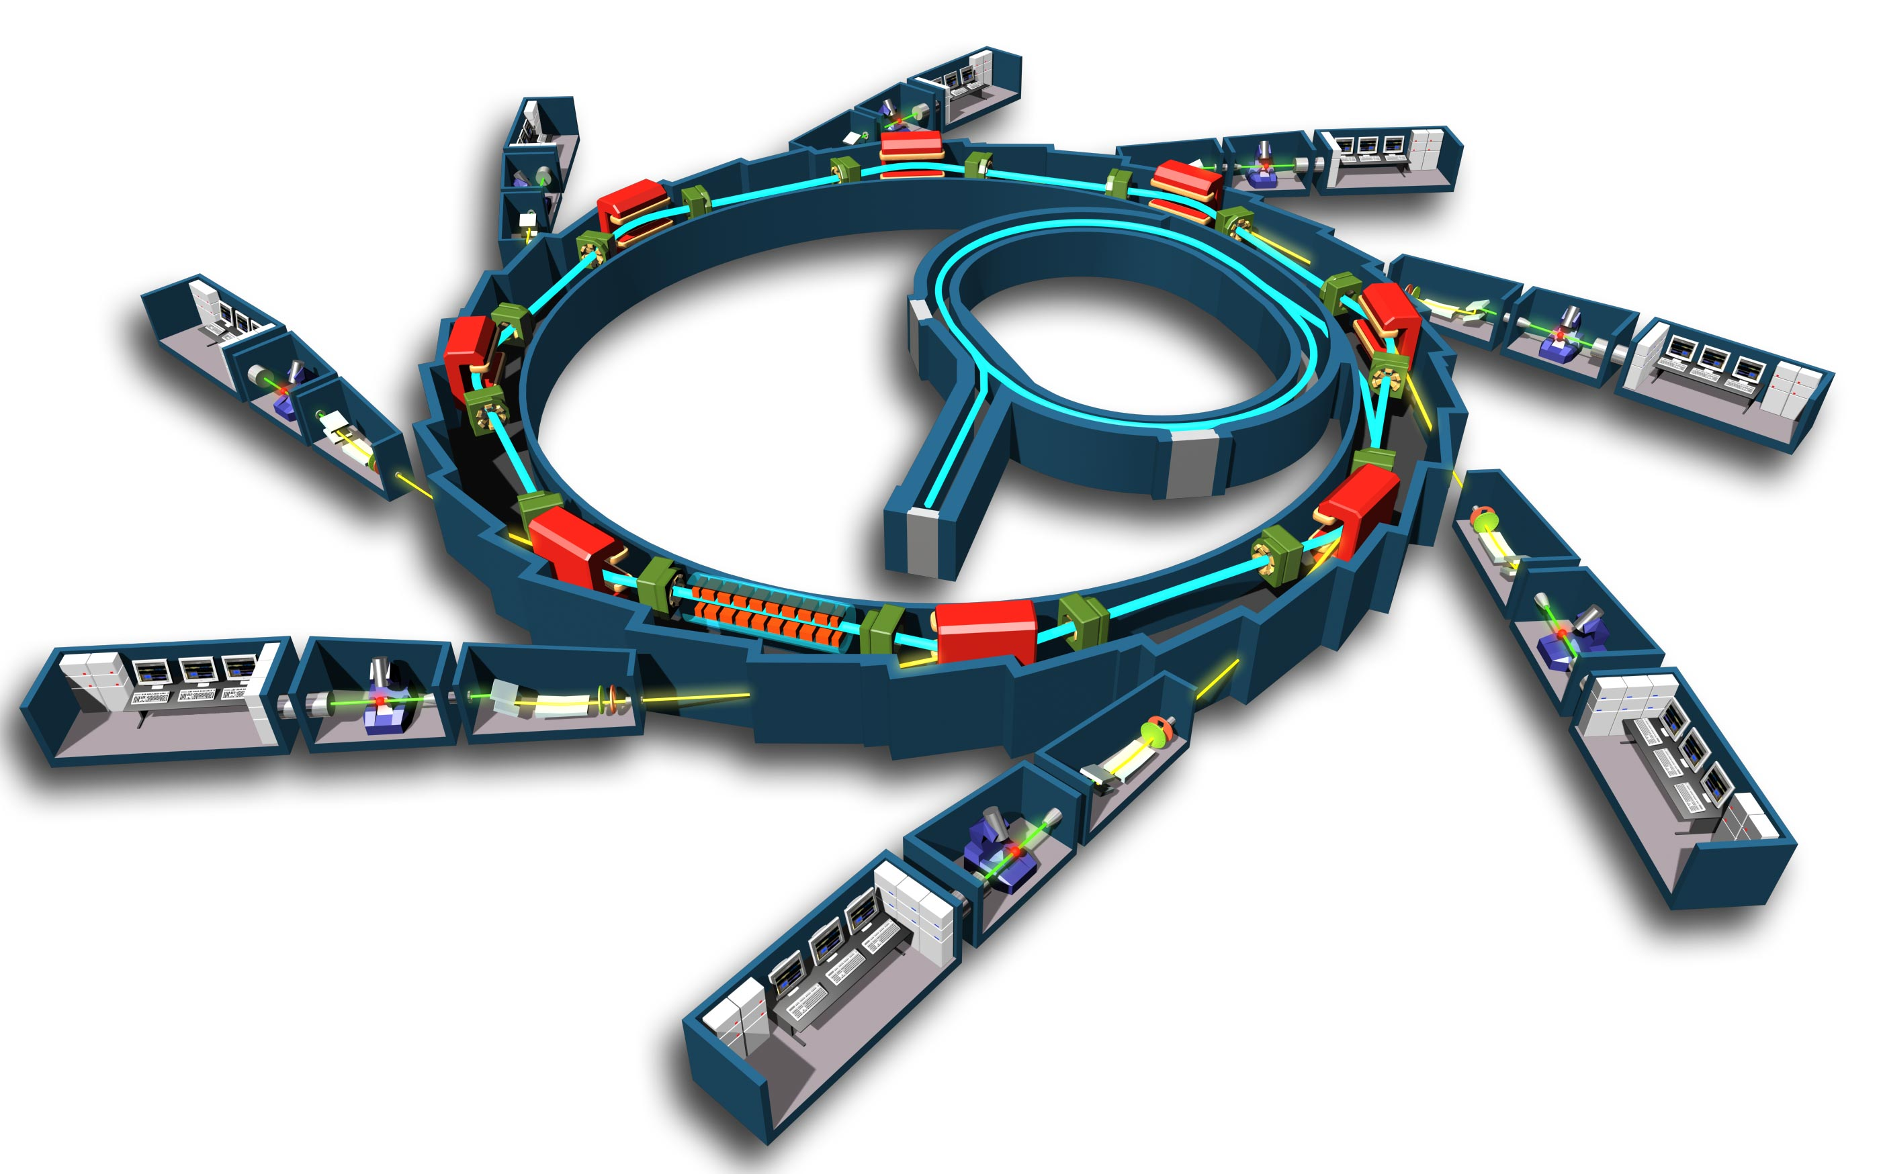
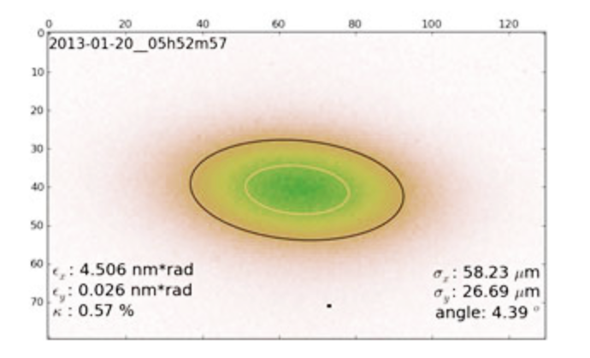
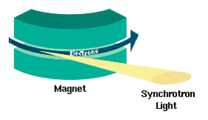
Storage Ring
X-ray crystallography
X-ray spectroscopy
X-ray metrology
X-ray lithography
Infrared spectroscopy
Optical interferometry
Photon Beam lines = experiments
Bending magnet
Insertion Ring
e⁻ gun
Undulator or wiggler
Key performance metric: Gaussian e⁻ beam size
smaller => better
Radial acceleration at bending magnets
Doppler beaming
60um x 24 um
Xray pinhole

Slide 6
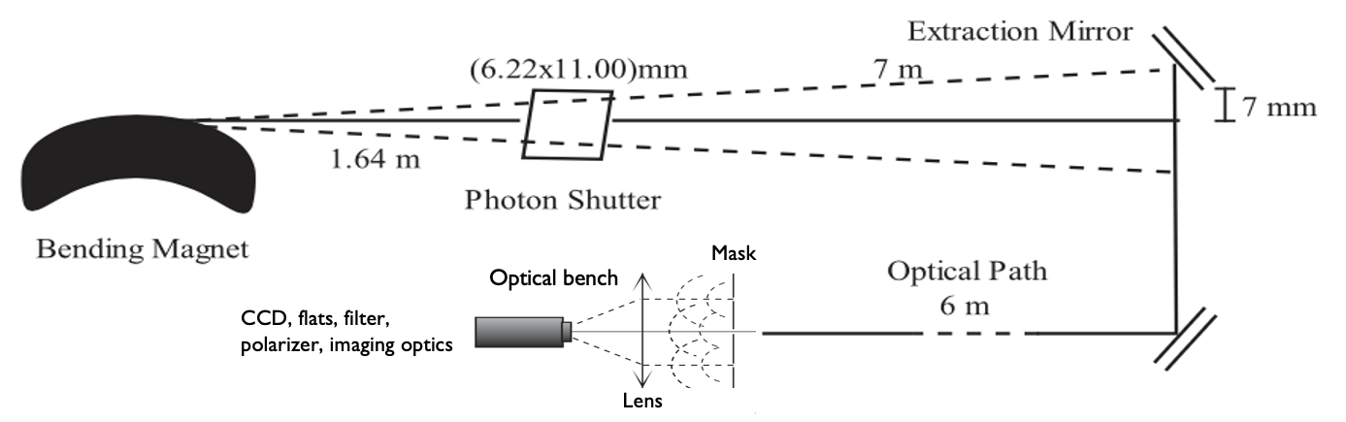
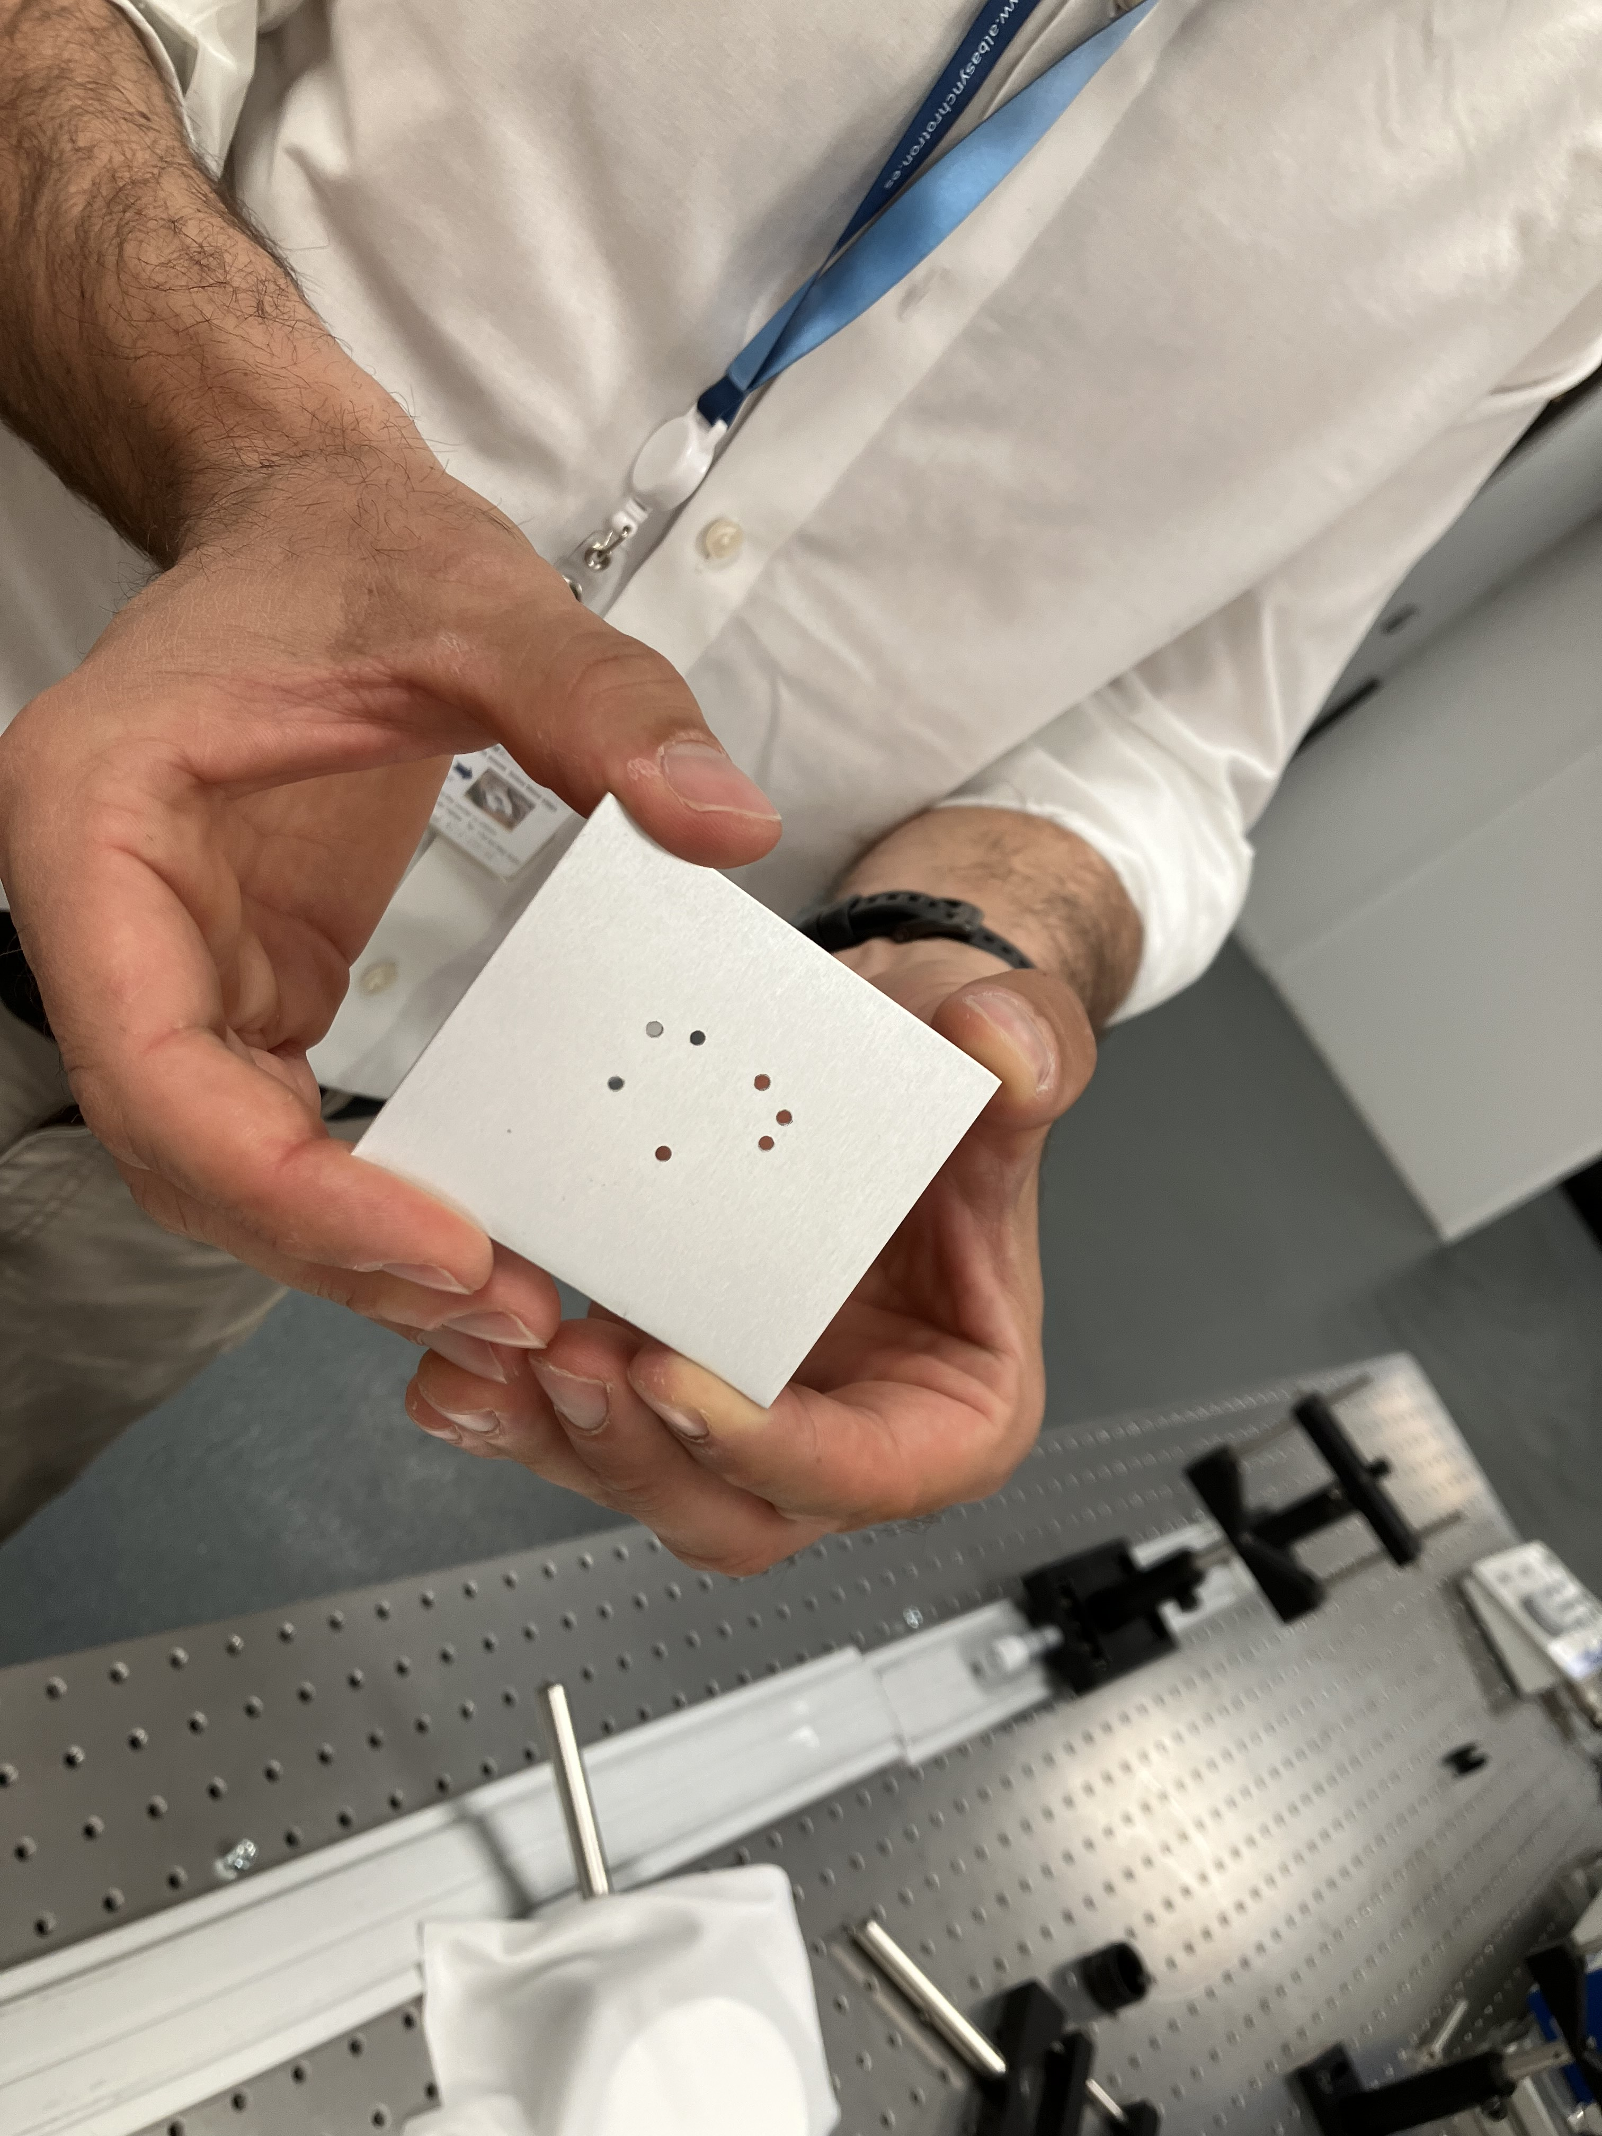
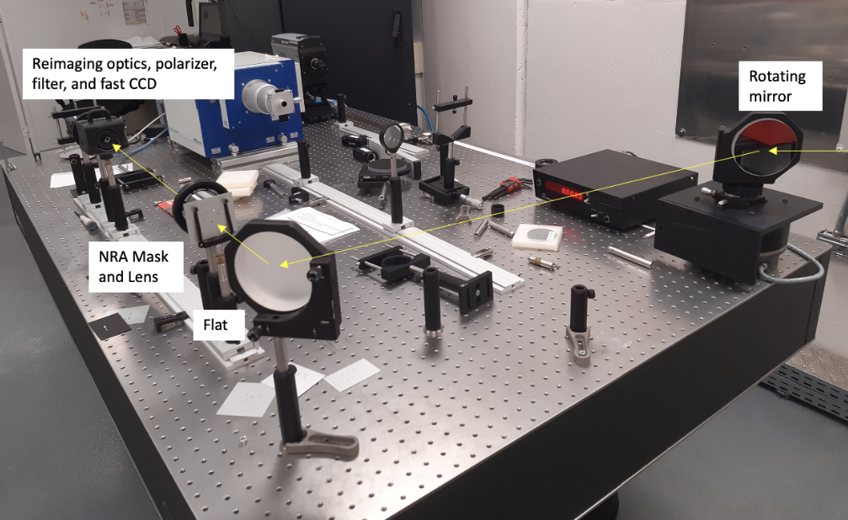
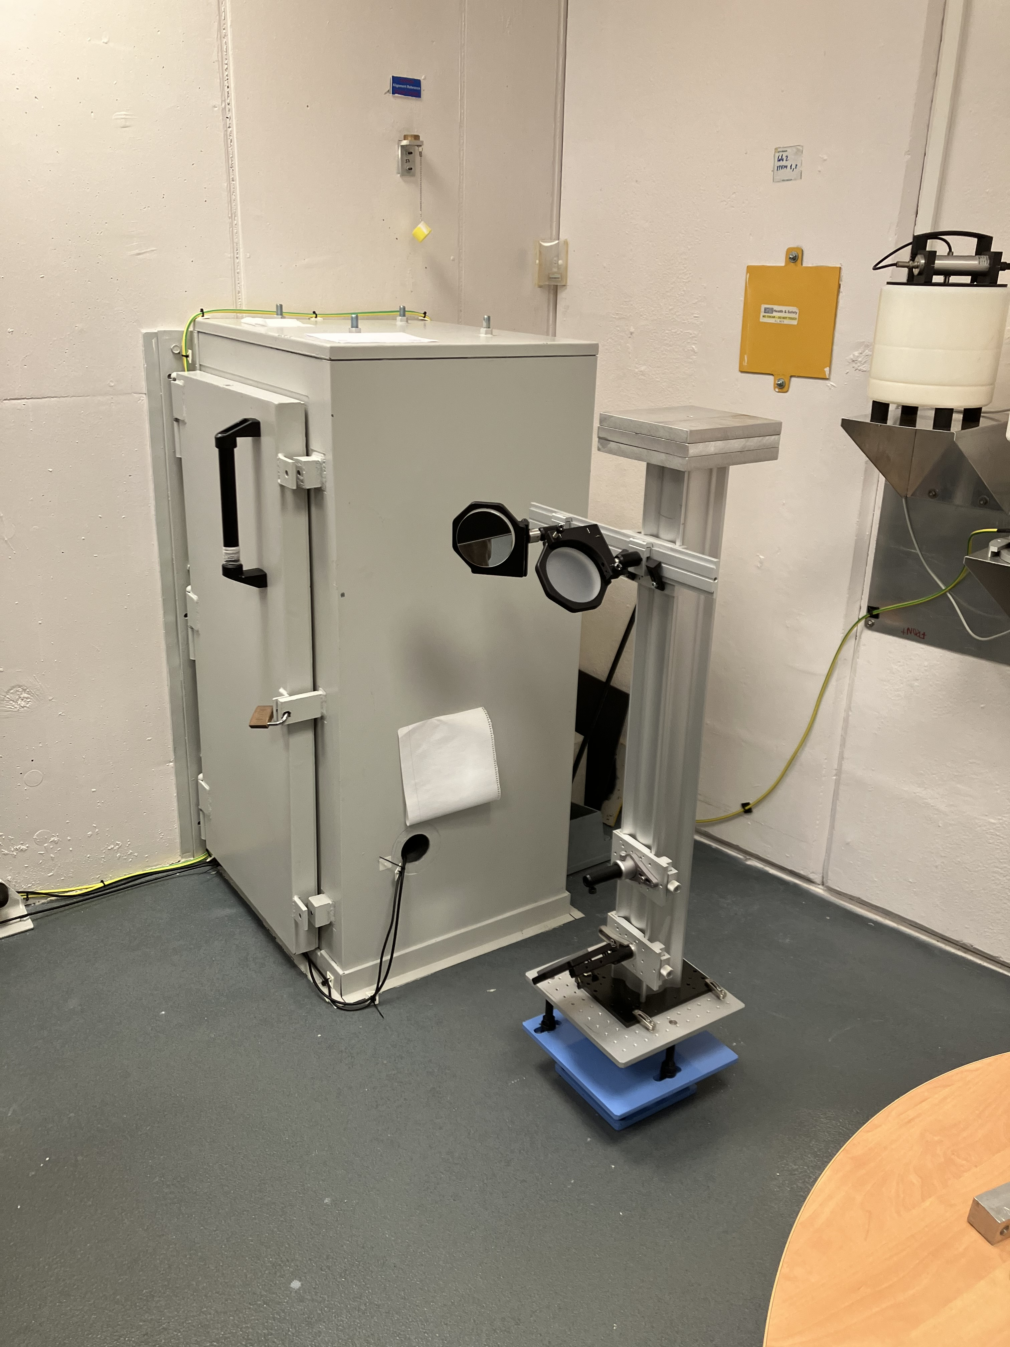
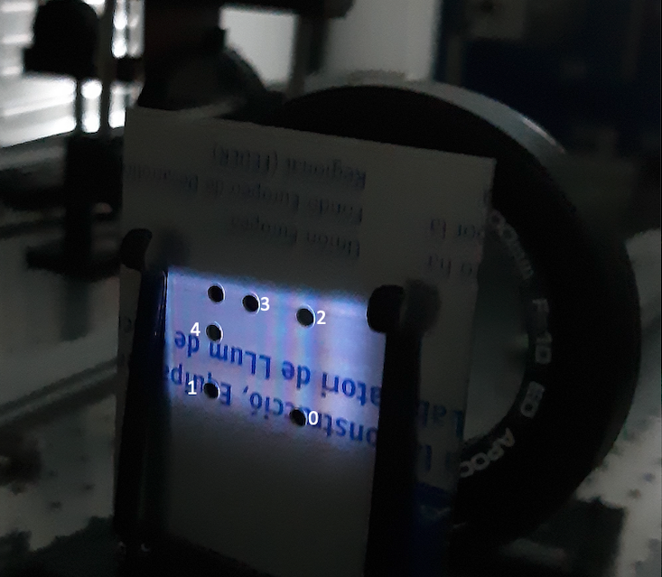
Xanadu: ALBA optical synchrotron radiation interferometry lab
Experiments
2 to 7 hole masks
1mm diameter holes
Baselines 5mm to 24mm (3.5”)
Wavelength = 400nm
30 frames: 0.3ms every 1sec

Slide 7
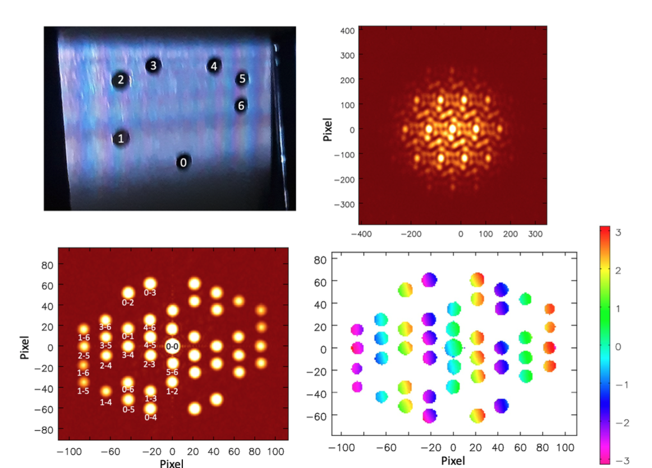
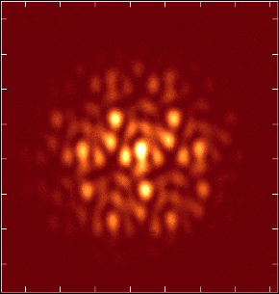
Non-redundant 7 hole Mask: JWST Template
v
u

Slide 8
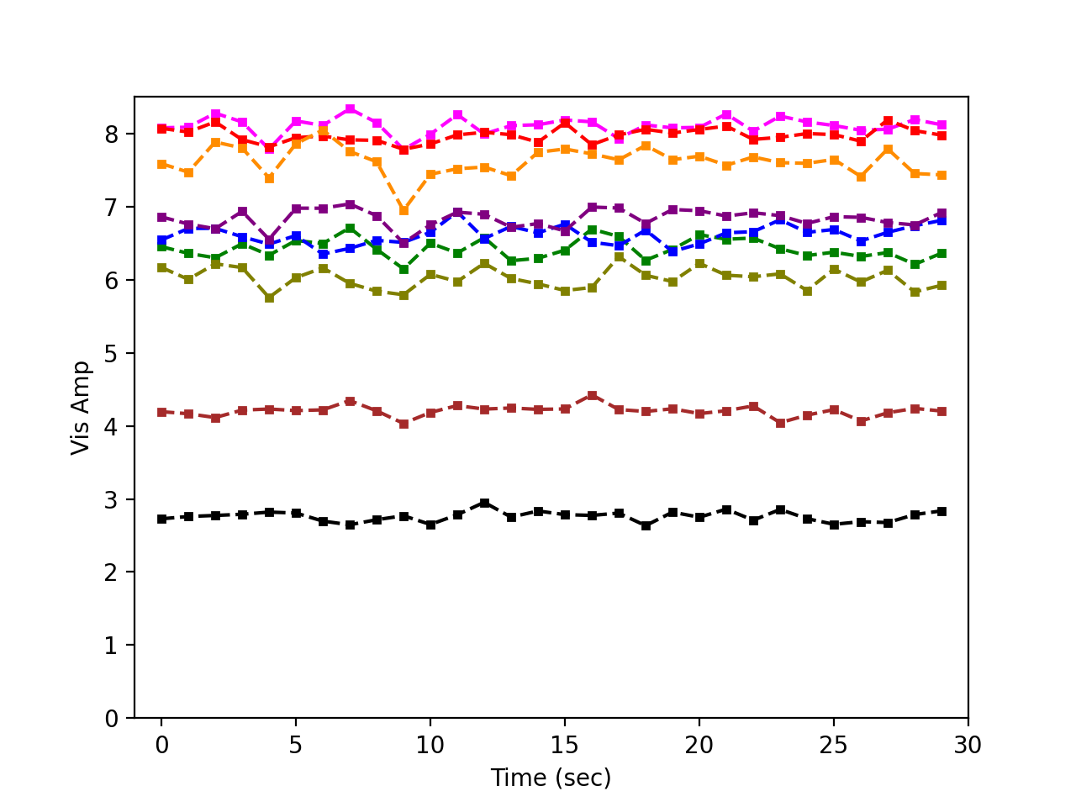
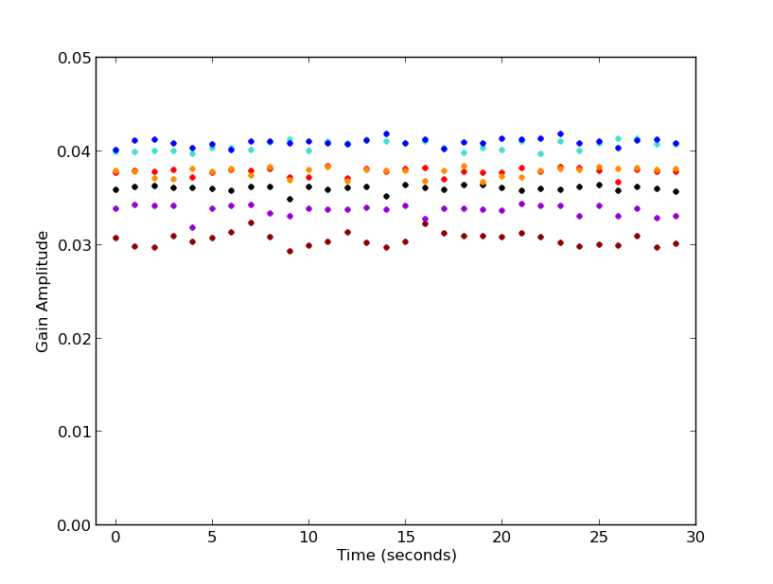
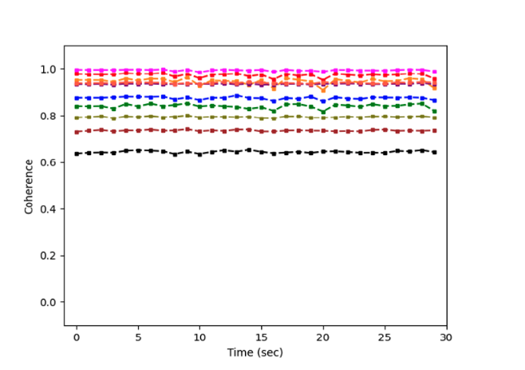
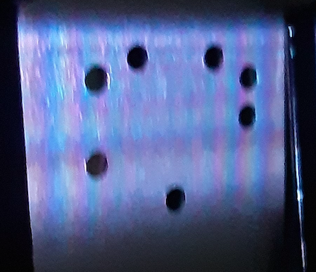
Gaussian model self-calibration in CASA
Amplitudes = illumination
Selfcal G_{amp} stable ~ 1%
Voltage gains differ by up to 30%
1.24
1.19
1.23
1.19
1.31
1.11
Coherences > 60%
Stable < 1%
1.00

Slide 9
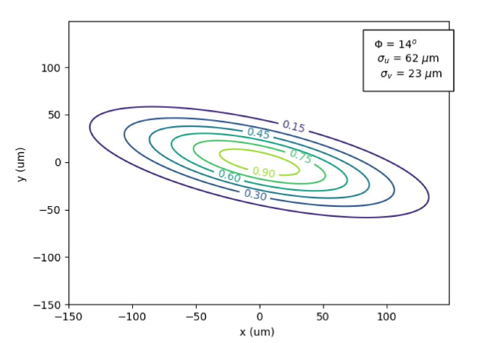
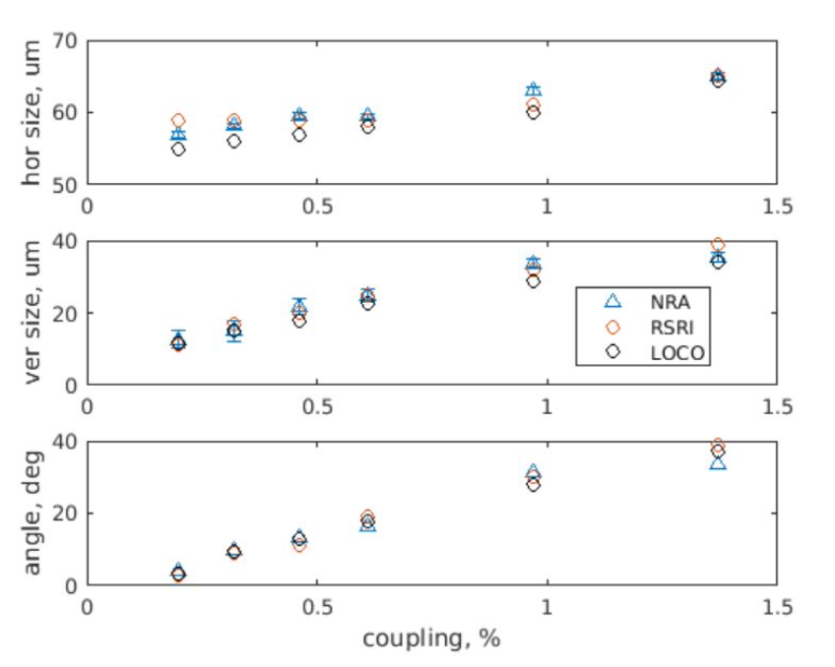
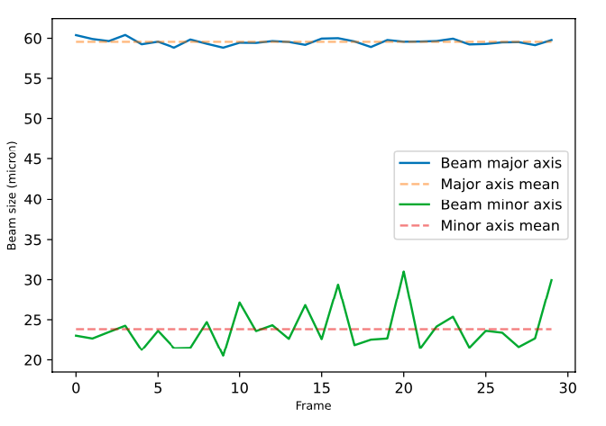
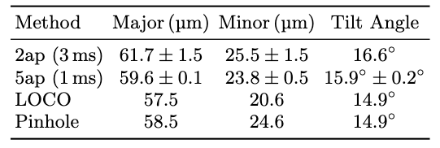
Real-time 2D Electron Beam Shape to 1% accuracy
Vary beam coupling
mín = 11um
Min size measured at ALBA = 11um
Hyper-resolution at very high S/N
11um at 15m = 0.7mrad = 0.15”
Min Fringe spacing = 3.5”
Without SC 66 40 5º

Slide 10
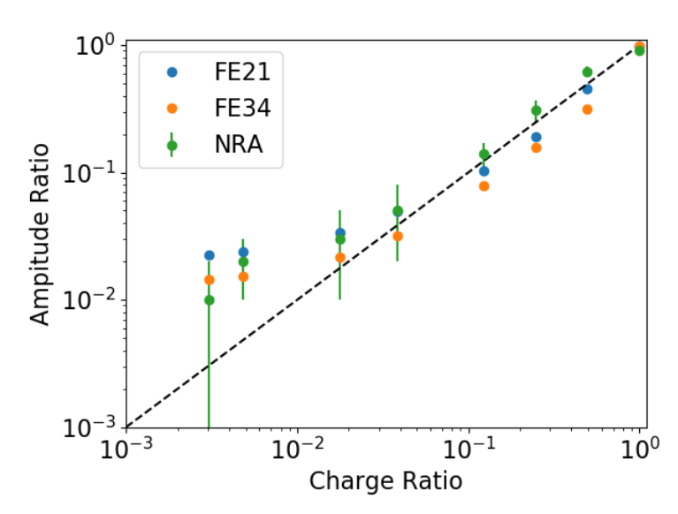
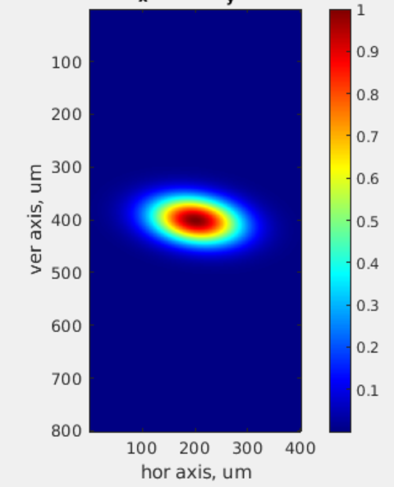
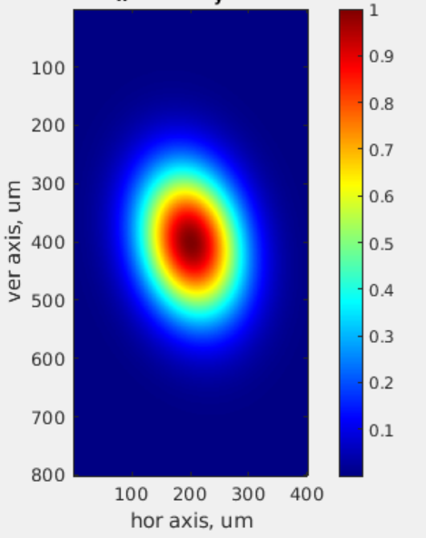
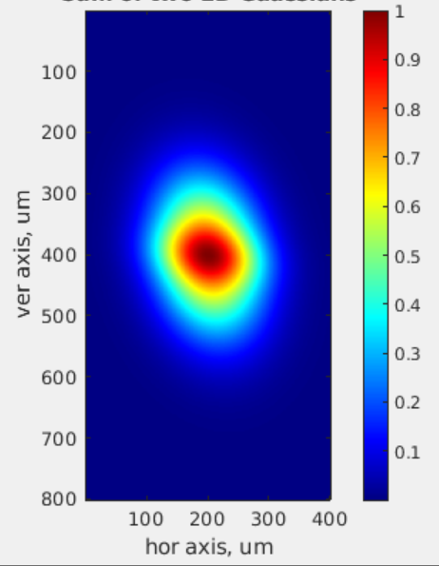
Core-Halo problem: Imaging Double-Gaussian Beams
Critical issue for LHC and future HL-LHC: power going into ‘halo’?
X-ray pinhole Images
A
B
C
Measure ’halo’ reliably down to ~1% bunch ratio
2D SRI currently being tested at LHC, and incorporated in HL-LHC design
ALBA: Create double Gaussian beams using bunch-by-bunch system
Fit double Gaussian to 7-hole interferograms

Slide 11
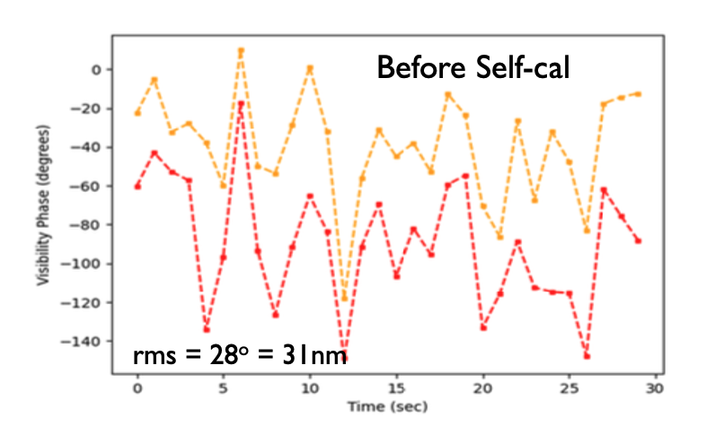
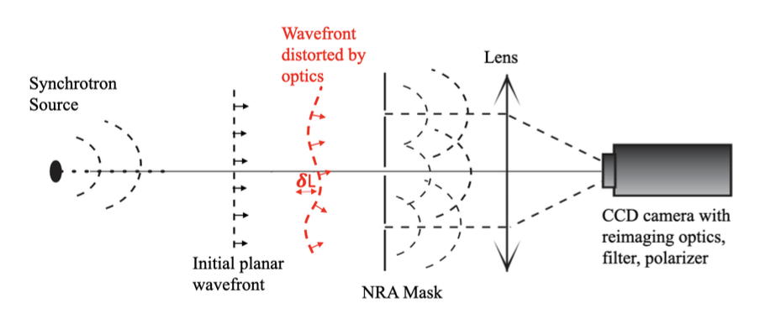
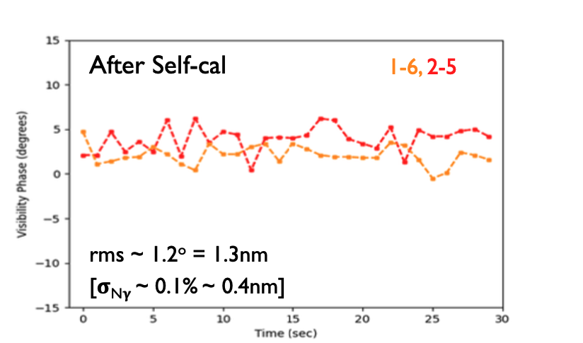
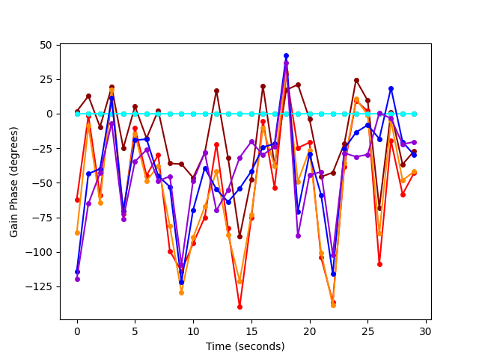
Wavefront Sensing: measure surface of constant phase of EM wave
0º
𝛉_{vis}
-140º
15º = 17nm
Selfcal Gain phase = nm-precision measure of photon pathlength
Mean = static pathlength difference (’metrology’)
Variations (millisec) = vibrations and turbulence (‘adaptive optics’)
-15º
50º = 56nm
𝛅L = 𝛌 x 𝛉_{i}/360º
𝛉_{gain}
-125º = 138nm

Slide 12
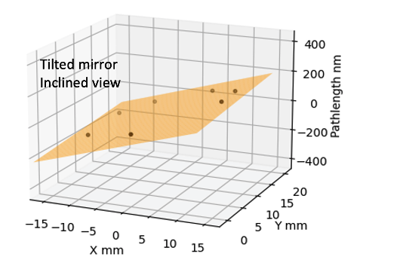
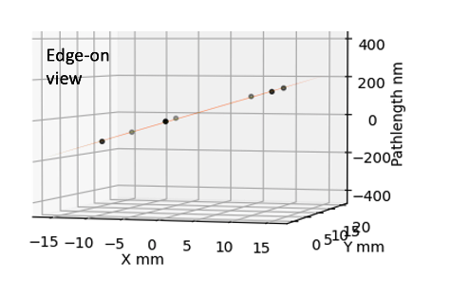
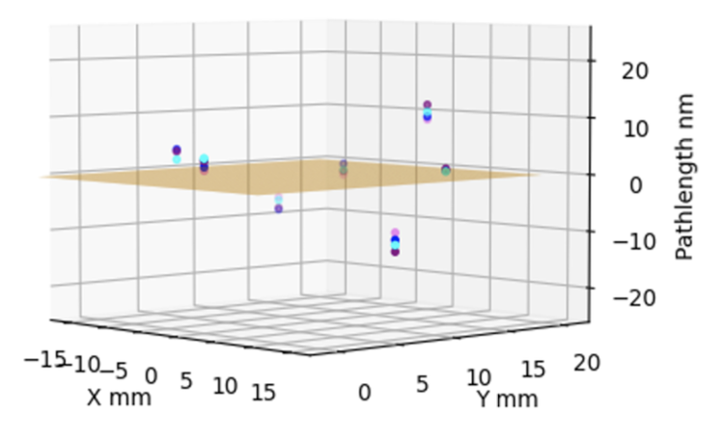
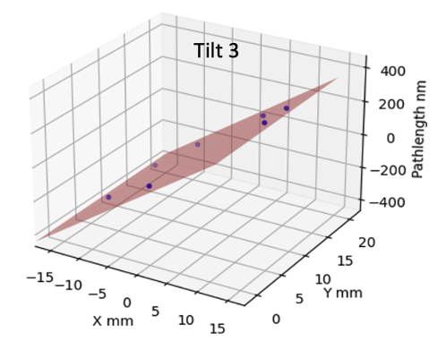
Tilting mirror tests
Tests: 0”, 2”, 4”, 6”, 8” wavefront tilts around Y axis (= X tilt)
Accuracy ~ small fraction of wavelength 𝝺 (nm precision per millisec exposure)
𝛅L
𝛅L
Reproduce WF tilts to ~ 0.1” (5e-7 rad)
Non-planar static metrology distortions seen up to 12 nm
Repeatable to rms ~ 2 nm at each hole

Slide 13
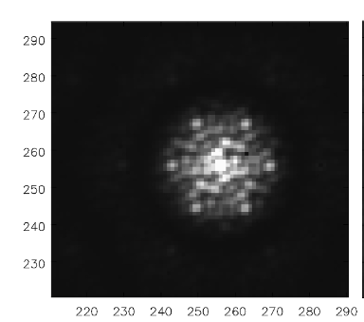
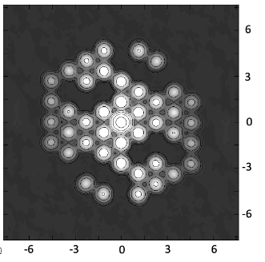




Application on JWST 7-hole AMI system
Dusty Binary Star WR137 at 4.8um and 3.8um ~ 0.1” resolution
Self-calibration + CLEAN Deconvolution
FT
3%
Visibility time series
High S/N
Very stable (rms ~ 1%, 1º)
Gain solution time series
High S/N
Very stable (rms ~ 0.1%, 0.6º)

Slide 14


Application on JWST 7-hole AMI system
Dusty Binary Star WR137 at 4.8um and 3.8um ~ 0.1” resolution
Self-calibration + CLEAN Deconvolution
Standard closure phase modeling
Self-cal + CLEAN
Lau ea 2024
4.8um
3.8um
Selfcal
Reproduce structure to 300mas
Dynamic range source ~ 240
Dynamic range calibrator star ~ 1000
Gain phase solutions => Mirror segment pistons to < 27nm
Similar to those derived with AMIGO forward-modeling (Desdoigts ea. 2025)

Slide 15
What’s new?
Why RA Self-Cal not used in Optical Interferometry?
Paucity of photons: few source photons per coherence time
Employ model fitting to Closure phases + Vis Amplitudes
Closure phase is robust to element-based gain phases => allows for averaging of many low S/N measurements w/o loss of coherence
Our Laboratory Optical Interferometry
High S/N: millions of photons/vis/msec
Employ Vis phases and amplitudes + Selfcal per coherence time + deconvolution/model fitting
Advantages:
More constraints: [N(N-1)/2] vs [N(N-1)/2 – (N-1)]
Closure phase = measure source symmetry; Vis phase more general
Employ myriad Vis-based deconvolution techniques
Correct illumination and path-length = nm-precision wavefront sensing
JWST AMI: selfcal + deconvolution in optical astronomical interferometry
High Strehl ratio
Long Coherence time
Large collecting area
=> High S/N per coherence time allows for use of visibilities + selfcal
Possible in future ground based optical astronomical interferometry?

Slide 16


Source characterization using optical masking interferometry with radio astronomical techniques
Real-time, non-invasive measurement of micron scale sources to < 1% accuracy
Wavefront sensing: nm precision on msec timescales
JWST AMI = first astronomical application
arXiv:2510.13502
arXiv:2503.10820
arXiv:2405.12090
arXiv:2409.11135
arXiv:2406.02114
JOSA-A 2025, 42, 1261
JOSA-A 2024, 41, 1513
2022PASA...39...14T
JOSA-A 2022, 39, 2214

Slide 17


Closure Phase in Image Domain
Shape-Orientation-Size conservation
3 Hole Mask
5 Hole Mask

Slide 18


Problems with JWST AMI
Under-sampling PSF by large pixels
Charge migration =? PSF smearing
Near-field optics of mask in reimaged aperture plane
=> large baseline-based errors that DO NOT obey closure and ARE NOT fixed by self-cal
Visibilities amplitudes should all = 1
Closure phases should all = 0
Closure amplitudes should all = 1

Slide 19






Fitting higher order distortions: SRI modeling with Zernike Polynomials and 7 hole mask
No distortion
1nm
Focus
Astigmatism
30nm
Input
-3nm
-30nm
Fit

Slide 20


Why non-redundant mask?
Decoherence on redundant baselines due to phase fluctuations across mask
Coherence for redundant samples lower by 5%
rms for redundant samples ~ 6x non-redundant

Slide 21


Radio measurements are visibilities = aperture plane
V_{i,j} = E_{i} x E_{j}* = A_{i,j} e^{-i𝝓i,j}
Coherent amplification of voltages, E
Geometric delays set by electronics
Complex cross multiply and average to visibilities
Images made from Fourier transform of visibilities

