Slide 1
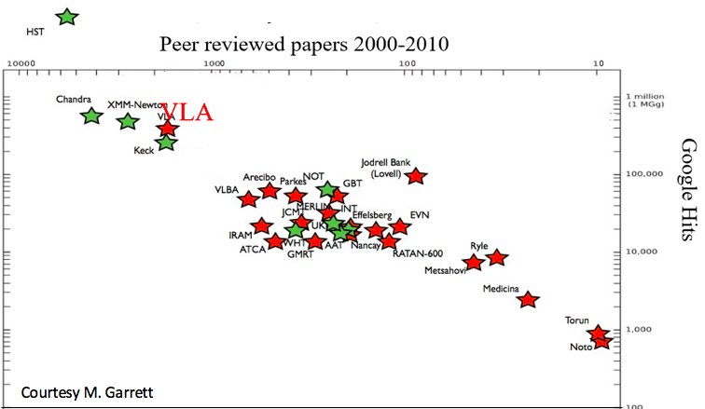
Radio Astronomy Powerhouse from 1980 to present
400 proposals per year, oversubscription ~ 3/1 for Four Decades
More than 300 PhD theses
The VLA is among the most productive telescopes ever!

Slide 2
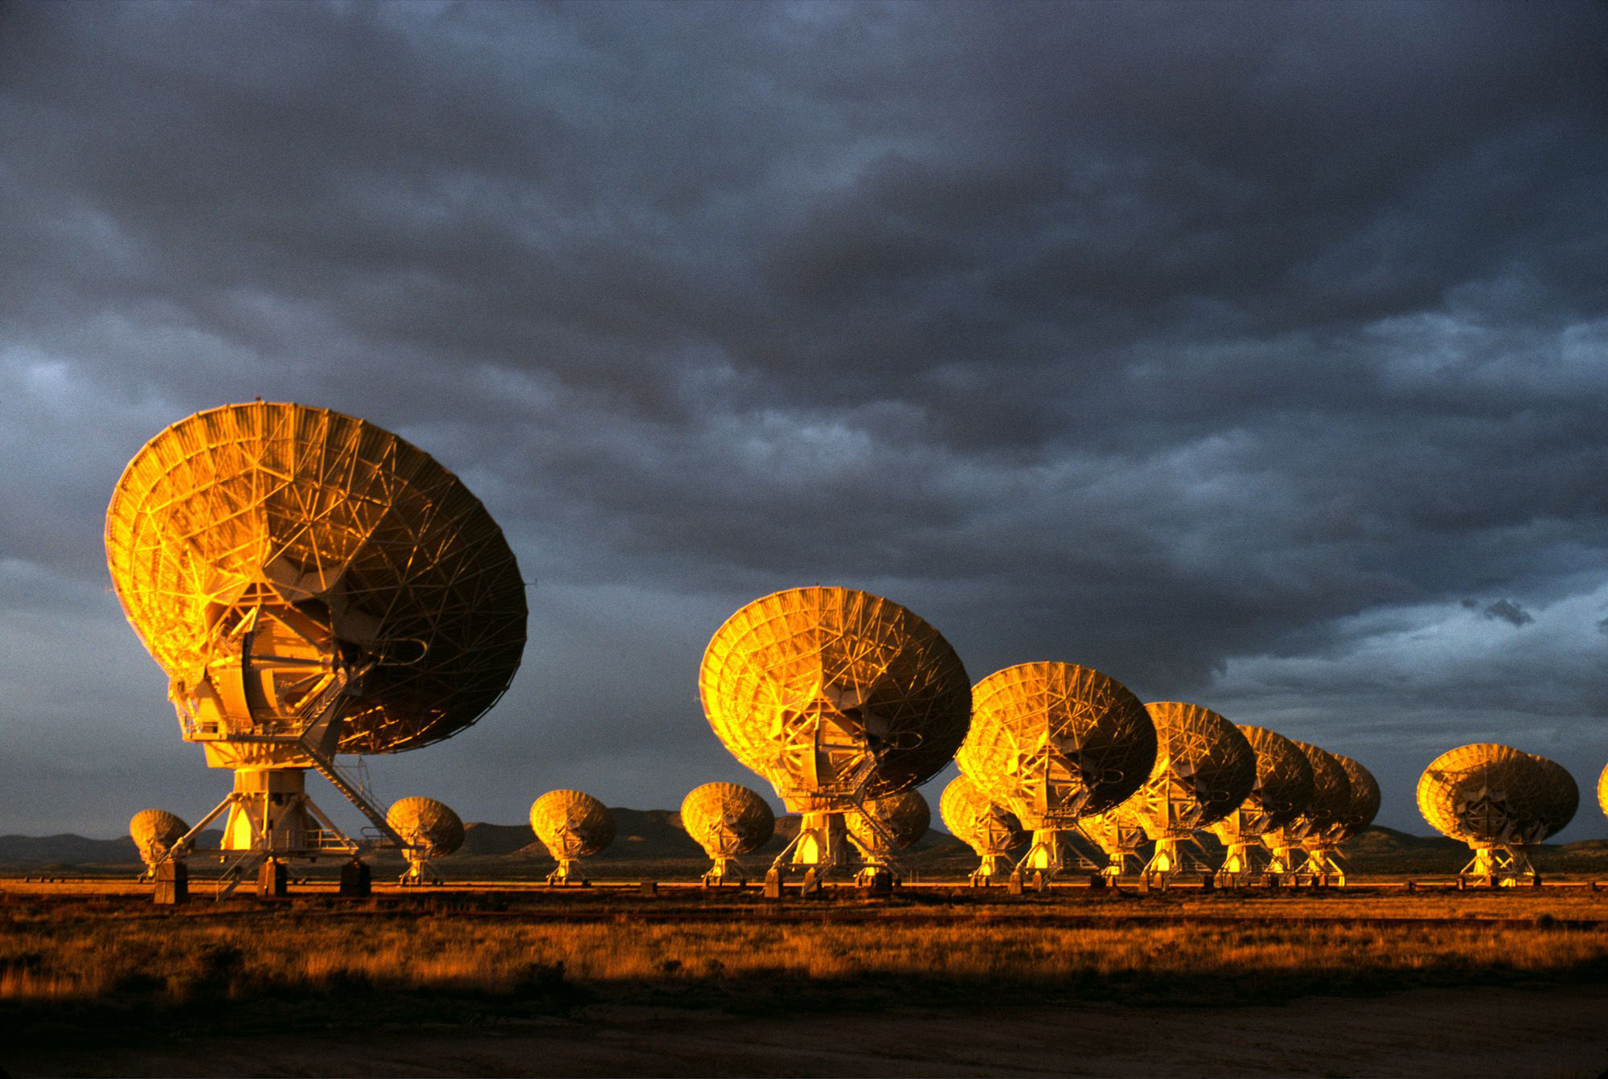
Strength through Versatility
From Mars to the Big Bang
Majority of discoveries were unforeseen in 1980

Slide 3
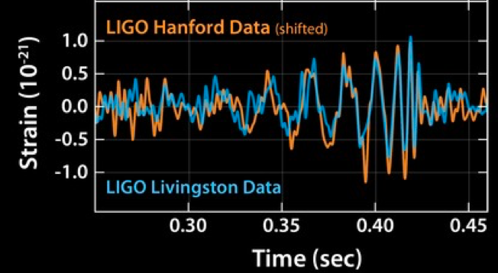
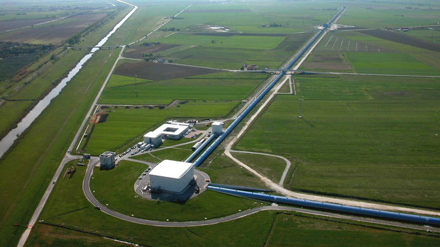
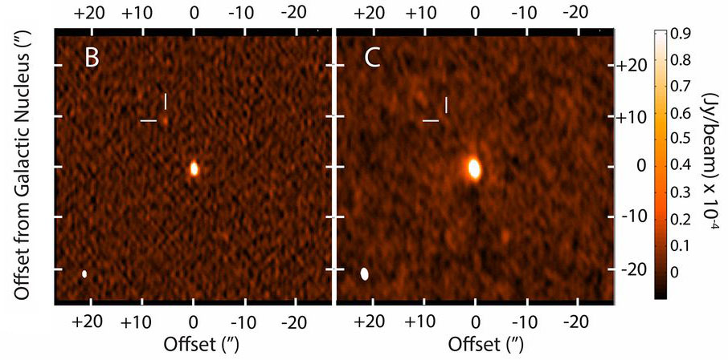
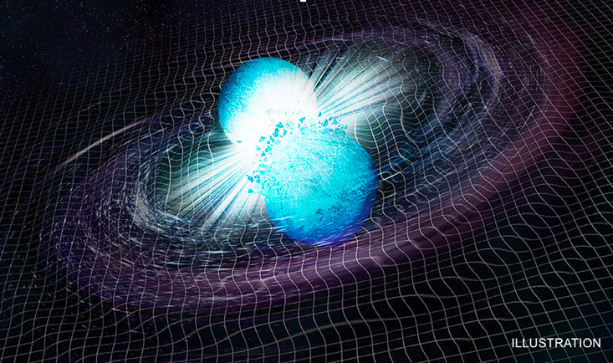
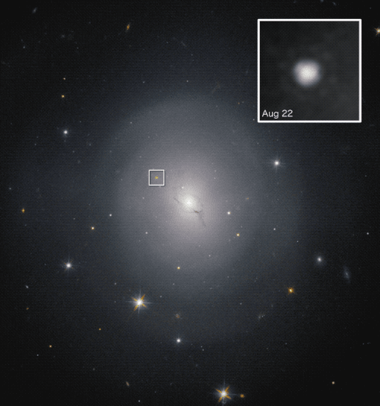

Gravitational Waves: The Explosive Universe
VLA: global leader in study of the most extreme explosions in the Universe
Gravitational waves – a new window on the Cosmos. VLA was key to localization in galaxy 130 Mlyr away.
Theory: Emitted by merging neutron stars or black holes. How to verify?
130 Mlyr
Notes:
http://adsabs.harvard.edu/abs/2018arXiv180306853
A turnover in the radio light curve of GW170817, Dobie et al. in press

Slide 4
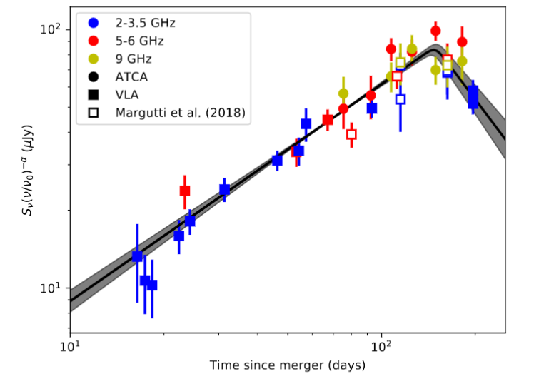
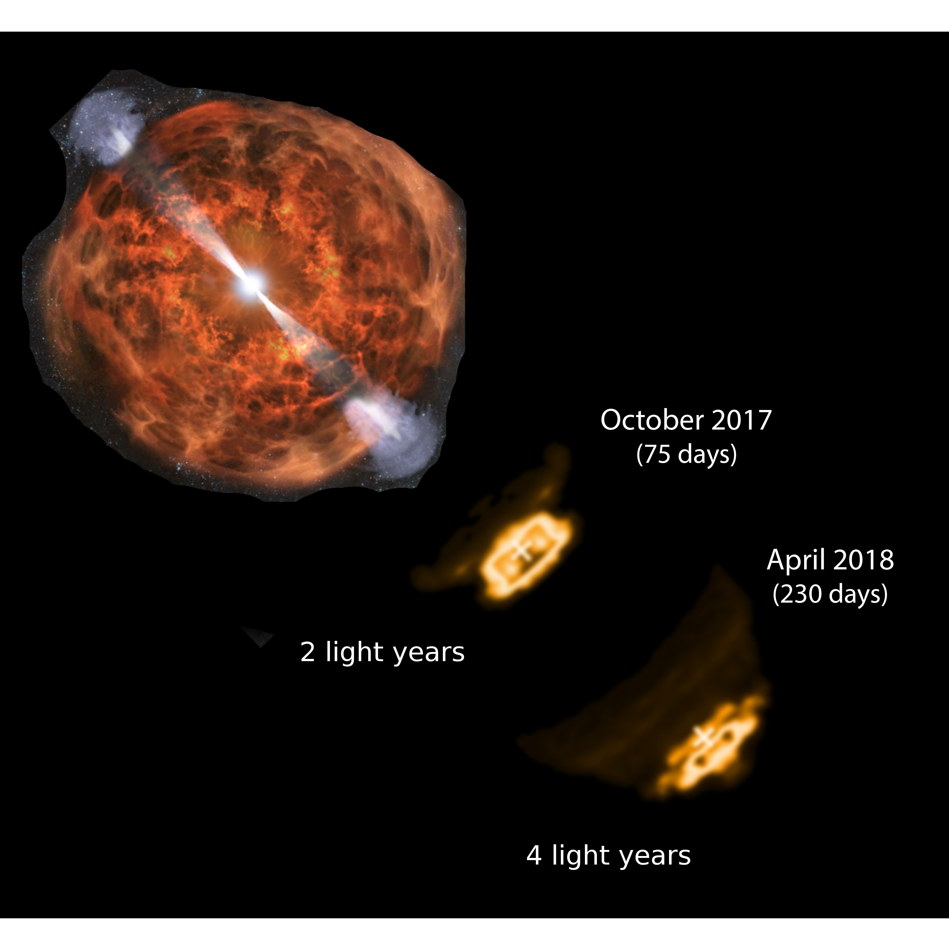
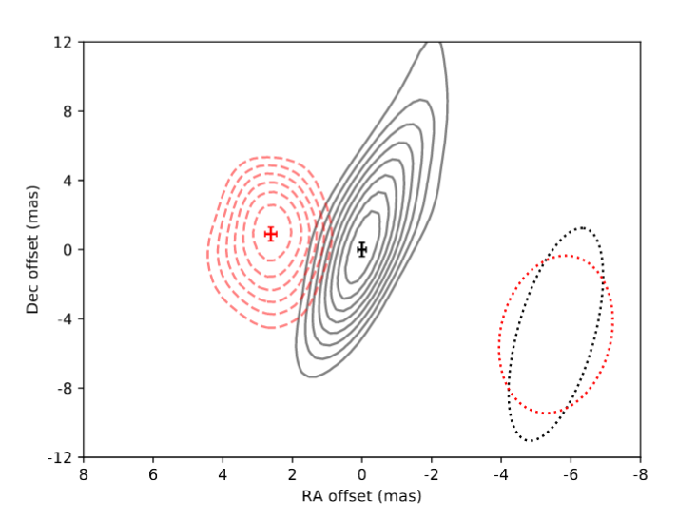
VLA determines the physics of Gravitational Wave Sources
Theory: Emitted by merging neutron stars or black holes. How to verify? VLA!
VLA monitoring: initially rising, then falling light curve = relativistic jet trapped in stellar debris, then breaks-out to interstellar space.
Confirmed by VLBA, velocity ~ c !
The total energy in the synchrotron-emitting component is few×10⁵⁰erg (= 10²⁸ megatons)
V = 0.97 x c
The radio light curve of GW170817 and VLBI imaging at mas resolution.
2 Lyr
Notes:
http://adsabs.harvard.edu/abs/2018arXiv180306853
A turnover in the radio light curve of GW170817, Dobie et al. in press

Slide 5
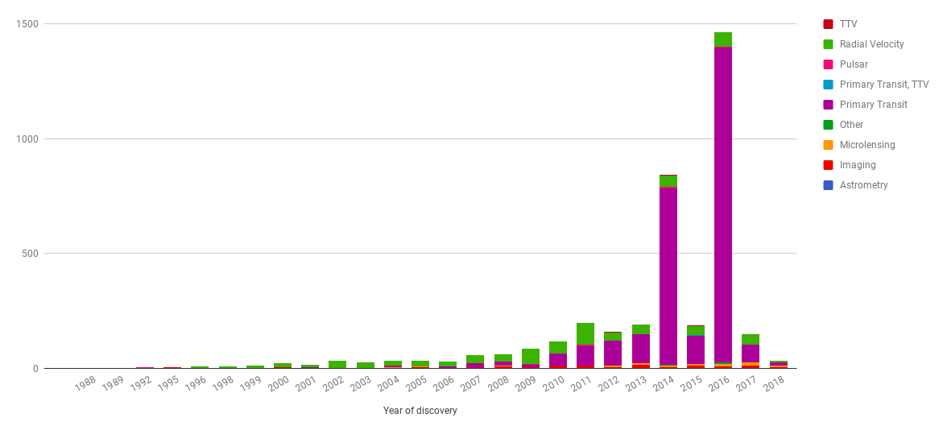
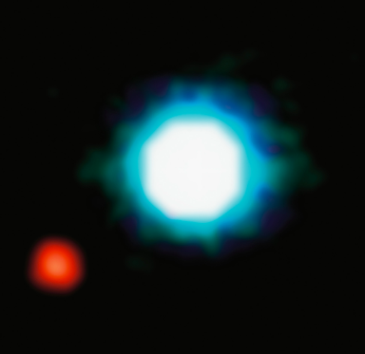
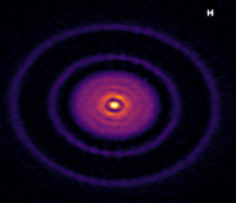
Exoplanets & Protoplanetary Disks: Fastest growing branch of Astronomy
Kepler: finding 1000’s exoplanets
ALMA and VLA: imaging 100’s of dusty proto-planetary disks
NUMBER OF DETECTED EXOPLANETS
HST
ALMA
Planet
Planet Formation
Notes:
One of the fastest growing fields in Astronomy is the study of exoplanets and protoplanetary disks. First exoplanets were discovered in the first half of the 90s; last decade has witnessed some key milestones such as the first spectrum and the first image of an exoplanet, and then the more recent exponential growth of detections lead by Kepler

Slide 6
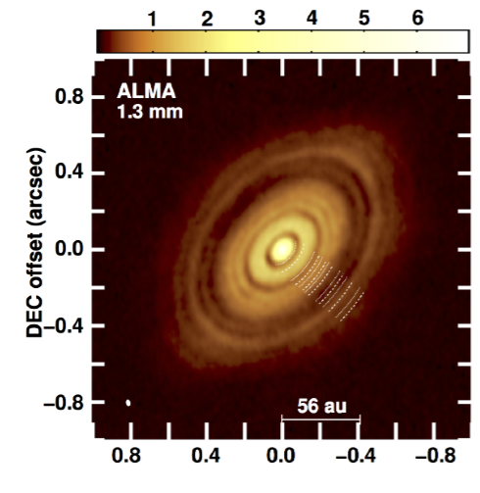
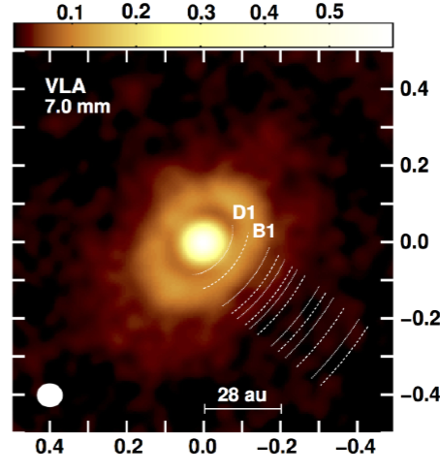
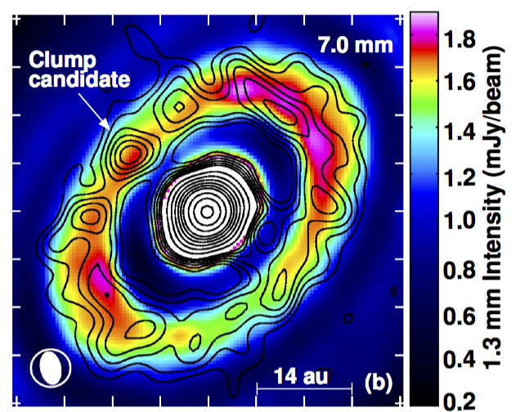
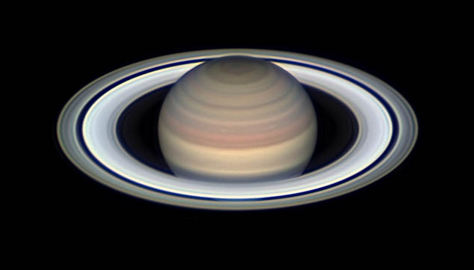
Star and Planet Formation: seeing through the dust
VLA premier tool to study the earliest (~ 1 Myr), dust-obscured stages of star and planet formation, down to ~ few AU resolution
Reveals proto-stellar dusty disks with forming planets on Solar-system scales, stellar atmospheres, and molecular outflows in forming stars
HL Tau: archetype for a dusty disk surrounding a Solar mass proto-star with an age ~ 1 Myr. The combined JVLA and ALMA imaging at 40mas resolution have revolutionized our understanding of early planet formation, tracing the growth of dust grains into planetesimals, and the gaps and clumps that result from the influence of early planets on the disks themselves.

Slide 7
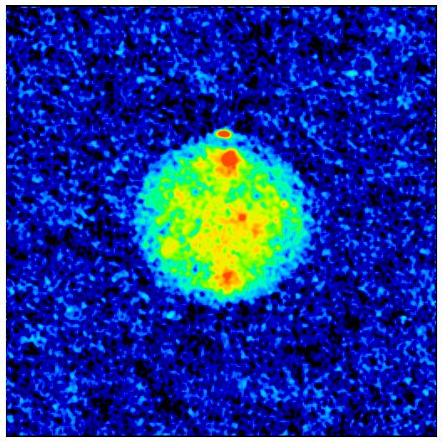
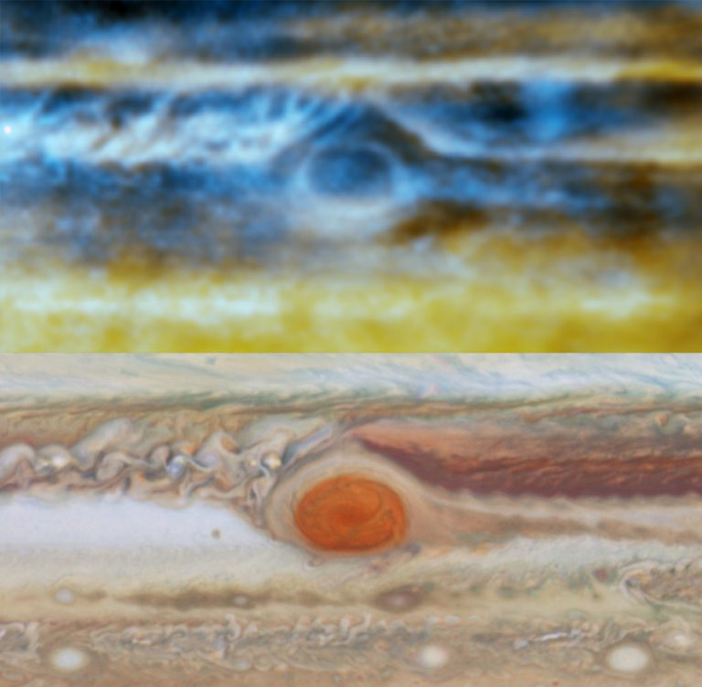
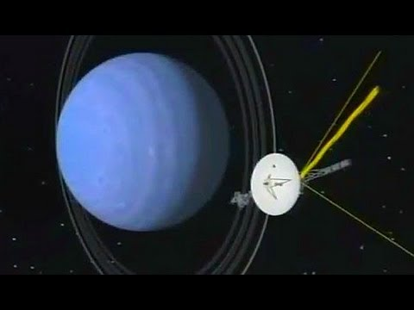
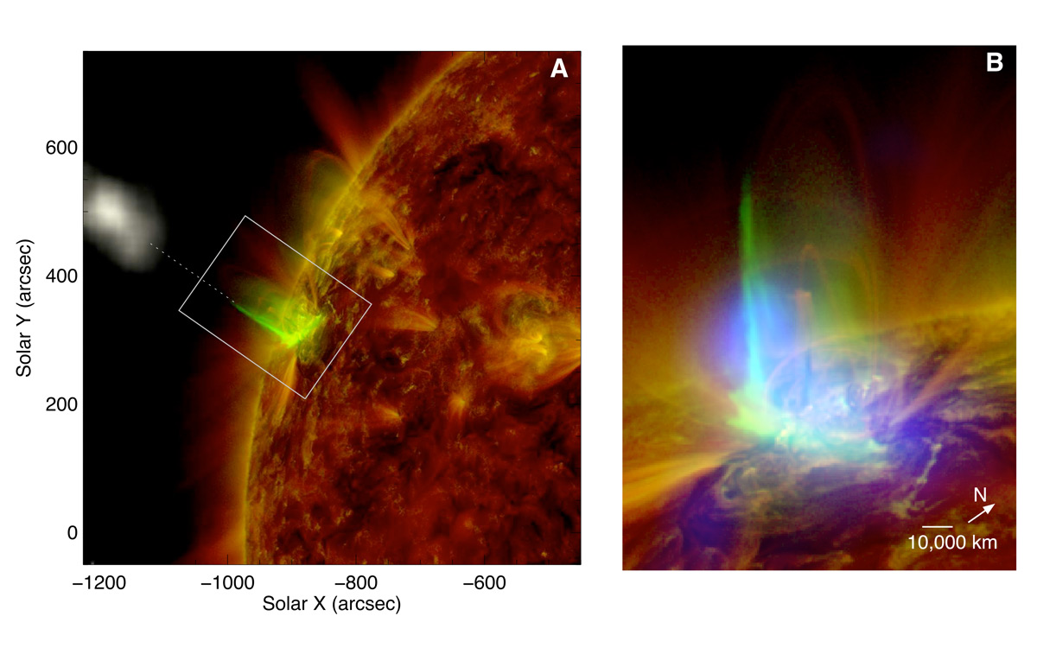
Planetary Science: versatile usage
VLA Ammonia
Water Ice Poles Mercury -180 C!
Ice on Mercury: 8GHz radar
Ammonia on Jupiter: seeing deep into the Jovian atmosphere deep imaging
Voyager Neptune Fly-by: high through-put telemetry
Imaging solar flares: explosive particle acceleration and origin of space weather 50millisecond imaging
HST

Slide 8
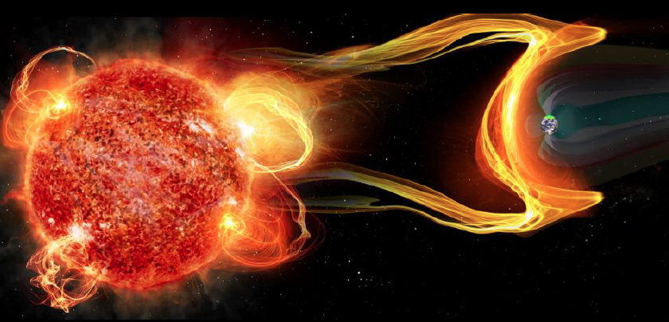
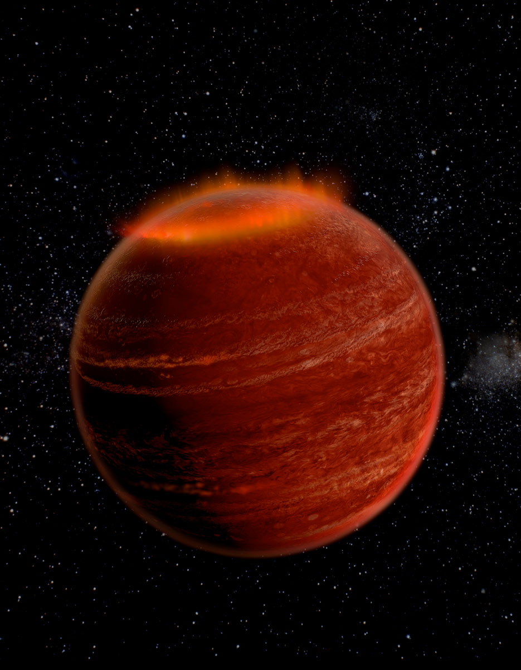
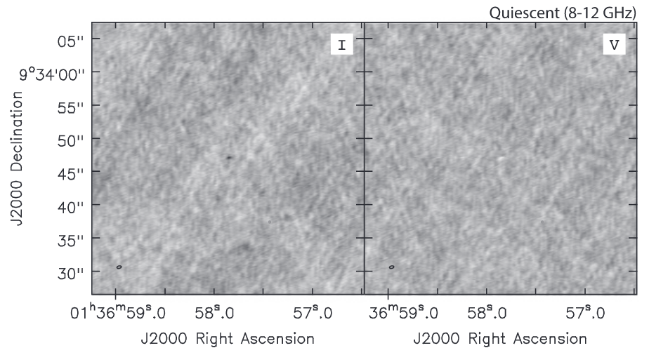
Exo-planet space weather: impact on the development of life
M-Dwarfs: most likely to host habitable planets, but very active (strong winds and flares)
VLA discovered cyclotron maser emission from M-dwarf = exo-aurora!
Wind – planet interaction => evaporation of atmospheres
Non-thermal flares and aurorae: Star-planet magnetospheric interactions
M-dwarf flares ~ 10⁴ x Sun!
M-dwarf cyclotron emission, w. B ~ 2000G!
Hallinan)

Slide 9
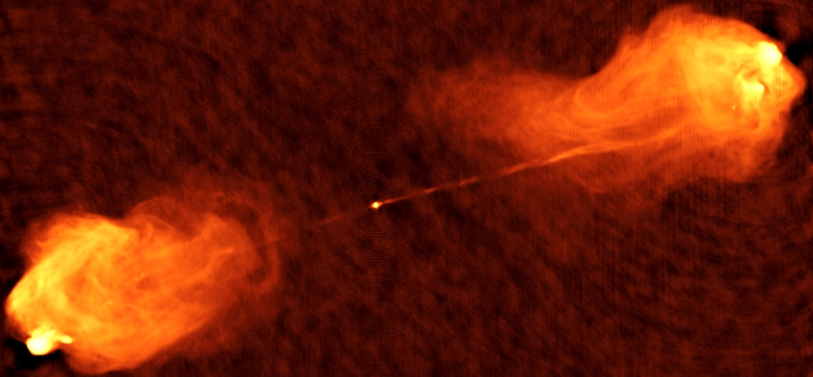
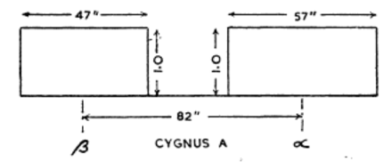
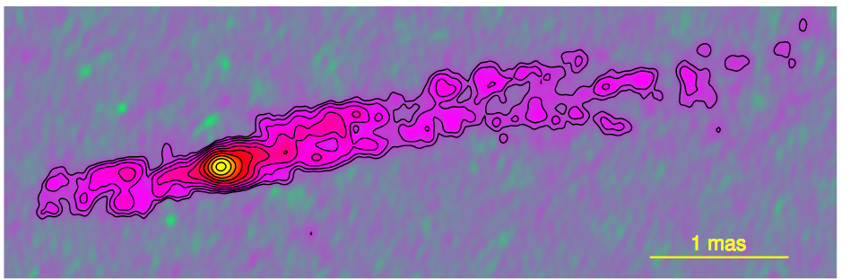
The Physics of Powerful Relativistic Jets
Radio astronomy first identified ‘Extreme Active Galaxies’: energized not by stars, but by mass accretion onto supermassive black holes, with masses 10¹⁰ M_{sun}, and luminosities 10¹⁴ L_{sun}
Emit powerful jets moving at close to the speed of light, creating giant cavities in intergalactic space on scales ~ 10x Milky Way. Radio emission = synchrotron from relativistic electrons.
Extraordinary laboratories to study magnetized plasma and relativistic particle acceleration, under the most extreme conditions
120” ~ 360 Mlyr, M_{BH} ~ 10¹⁰ M_{o}
1956
200x R_{BH}
Notes:
Radio interferometric observation of an asteroid occultation
Harju et al 2018 http://adsabs.harvard.edu/abs/2018arXiv180405640H

Slide 10
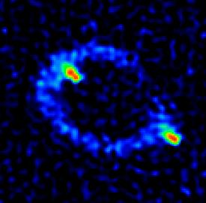
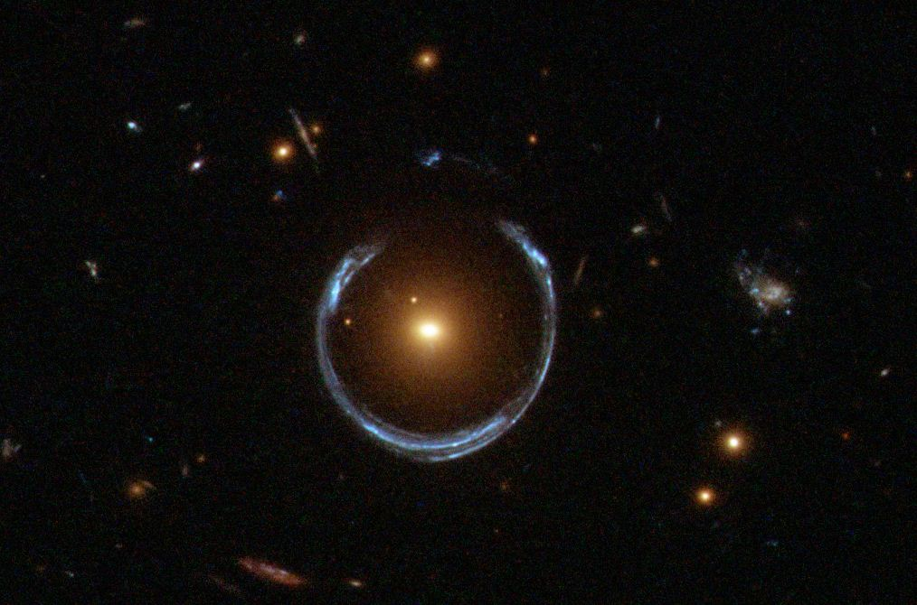
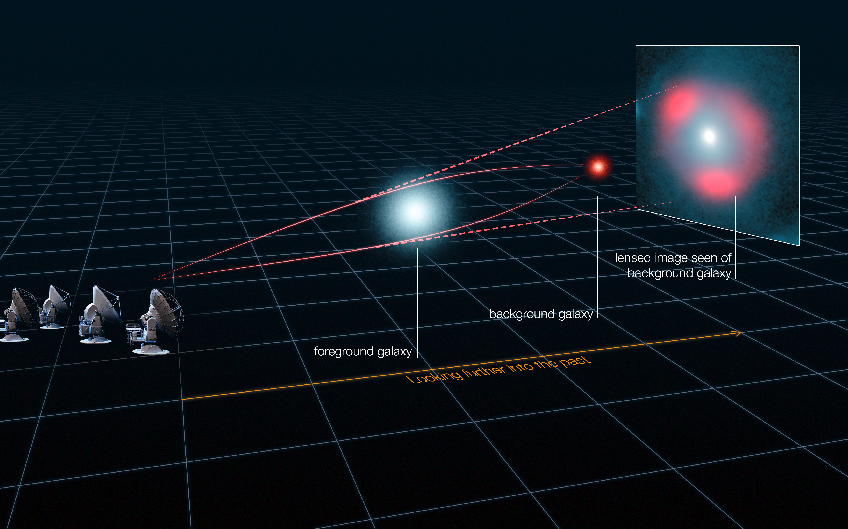
First Einstein Ring
MIT connection: first Einstein Ring
Optical example
First Einstein ring discovered by Hewitt, Burke and MIT radio group in 1984 using VLA.
Proof of strong gravitational lensing on cosmological scales by intervening galaxies = giant cosmic telescope
Weighing galaxies: Dark Matter!
Hewitt ea.

Slide 11
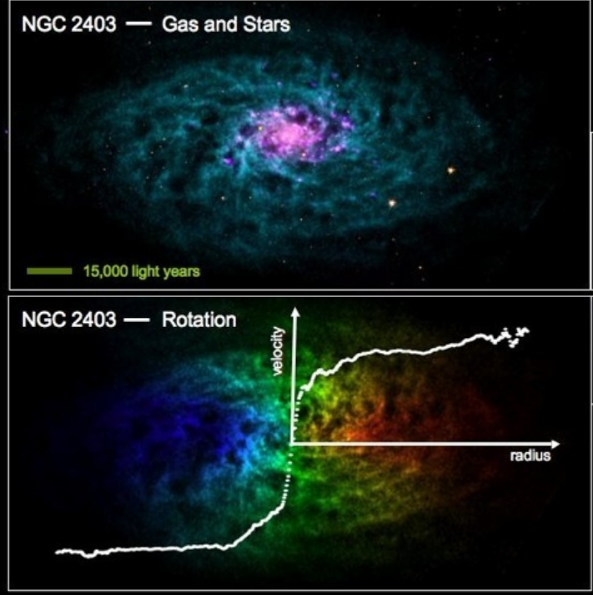
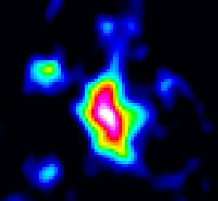
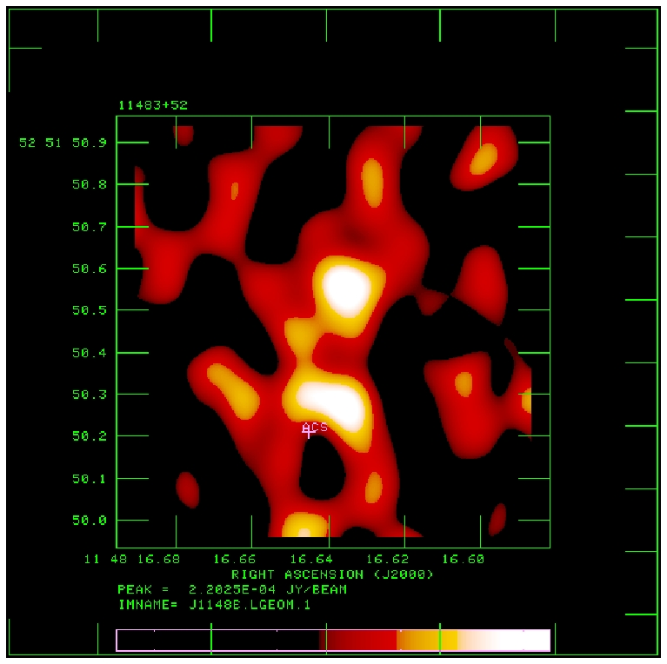
Baryon Cycle: from Cold Gas to Stars across Cosmic Time
Paramount quest in galaxy formation: tracing evolution of gas into stars across cosmic time.
VLA at 1.4 GHz is primary tool to image the extended neutral Hydrogen in nearby galaxies. Cold gas fueling star formation. Also key in the study of galaxy dynamics and Dark Matter.
VLA at 30 to 50 GHz has opened a new field: imaging molecular gas (CO) in galaxies in the early Universe
z=6.42
res= 0.15” ~ 2 klyr
VLA CO3-2
1” ~ 15 klyr
+
The discovery by the VLA of molecular gas in a galaxy 0.8 Gyr from the Big Bang., proving massive gas reservoirs very early in the Universe, fueling star formation in the 1st galaxies.
VLA images nearby galaxies: Huge HI envelopes, key Baryonic component, and probe of galaxy dynamics

Slide 12
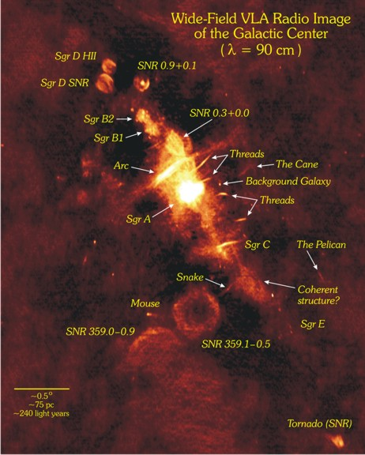
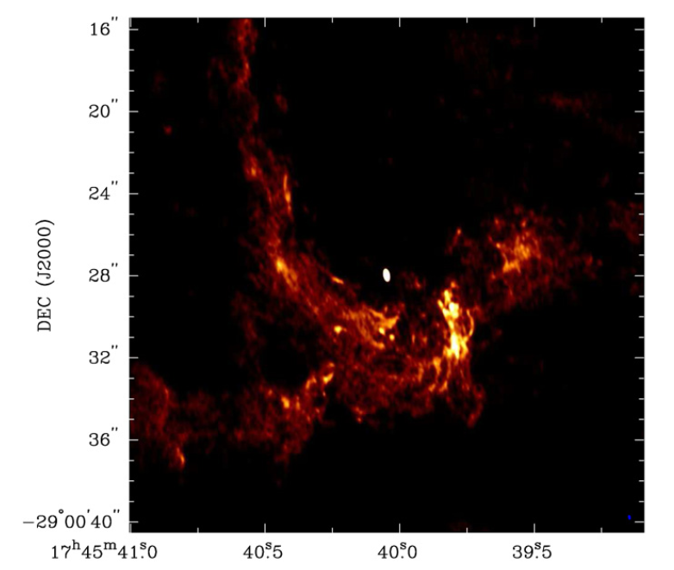
The Monster at the Galactic Center, and its Lair
VLA has led radio studies of the Galactic Center region for four decades. unveiling details of star formation and the physics of the strongly magnetized gas in the extreme environment surrounding the super-massive black hole (10⁶ M_{sun}), unhindered by dust obscuration.
The GC region may be the best analog to the extreme conditions that exist during the formation of the earliest galaxies.
1lyr
VLA images of the Galactic Center at 90cm and 1.3cm, showing the magnetic filaments, supernova remnants, and the inner spiral of ionized gas, surrounding the SMBH itself
Sgr A*

Slide 13
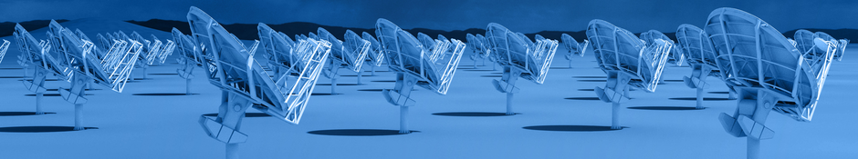
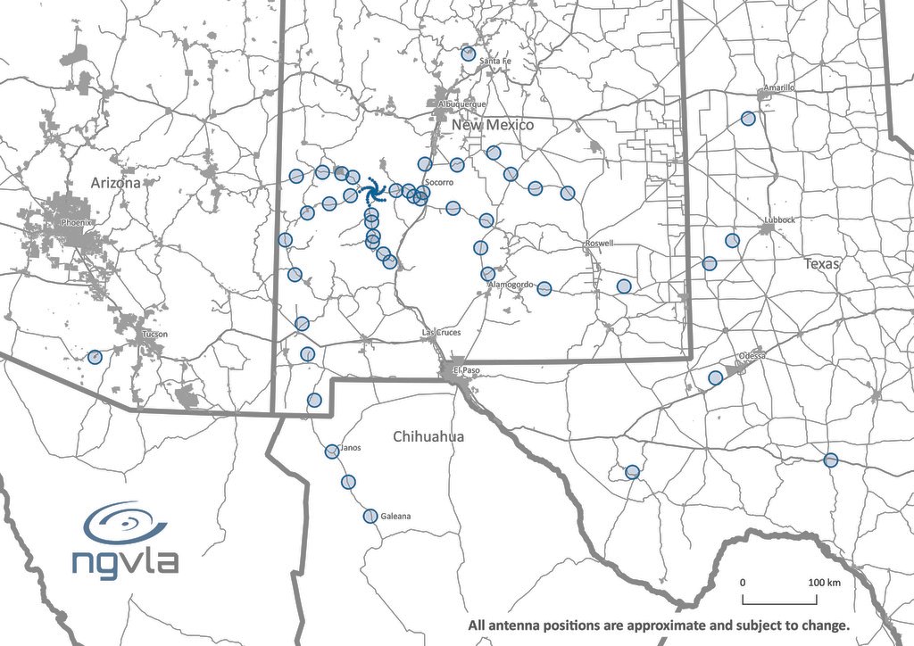
Next Generation Very Large Array
10x resolution and sensitivity of JVLA and ALMA
240 18m offset Gregorian antennas
Centered in Southwest USA, extending 8000 km across USA and Mexico
1.2 – 50.5 GHz and 70 – 116 GHz

Slide 14
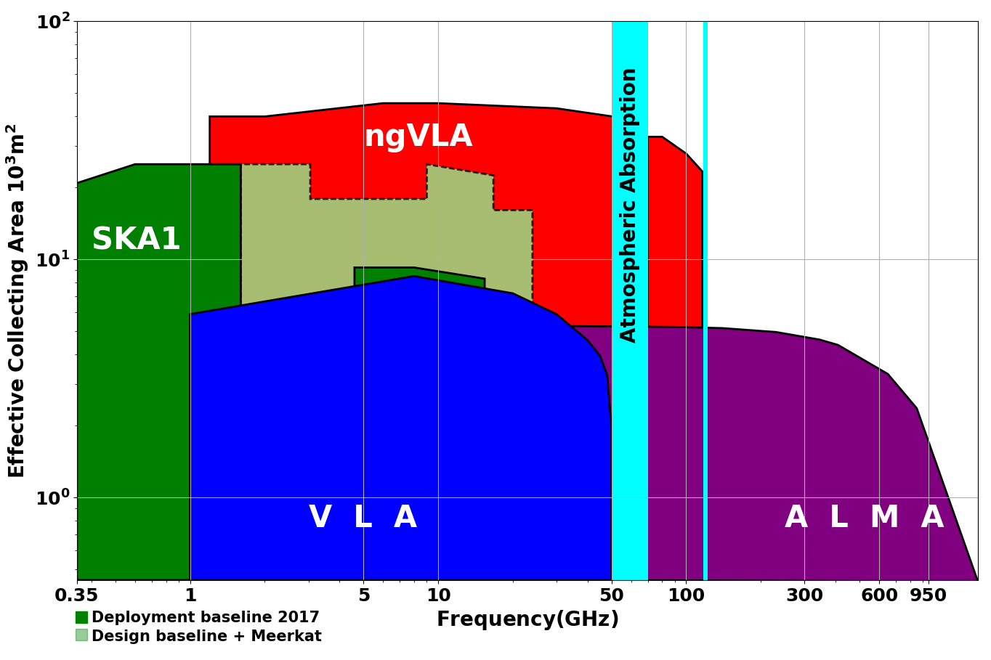
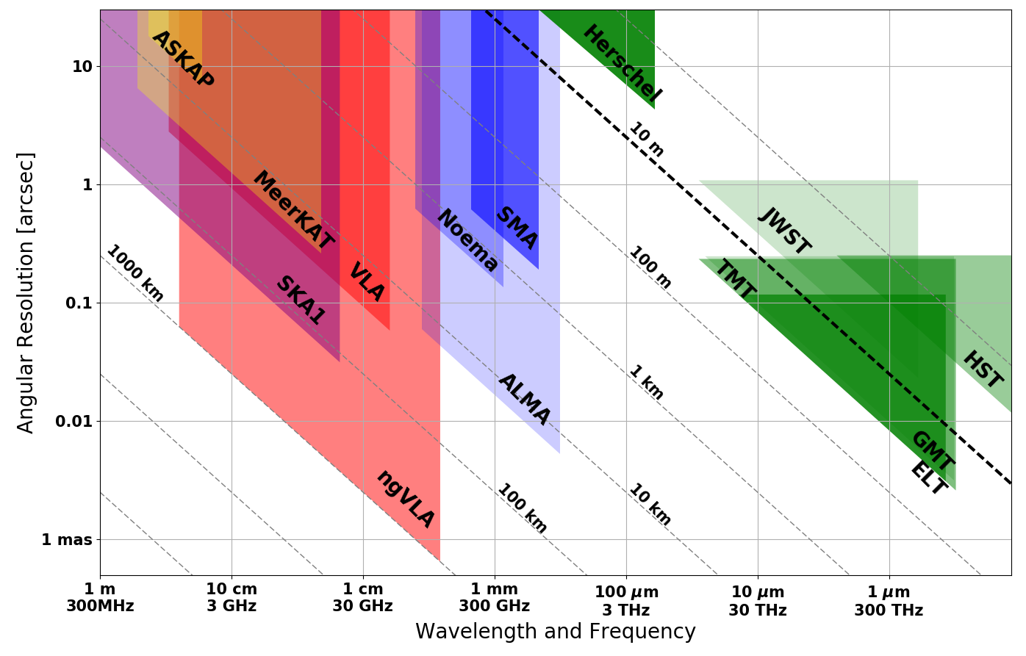
Next Generation Very Large Array
A radio facility for the mid-century
Terrestrial zone planet formation: 1AU @ 140pc
Imaging Terrestrial Planet Formation!
Notes:
Snapshot comparison of effective collecting area for dish-arrays expected in the 2030’s.
Assumes SKA deployment baseline (July 2017)
SKA 1
- 130 antennas, SKA bands 1, 2
- 67 antennas, SKA Band 5 a/b
MeerKAT:
- 64 antennas, bands 1, 2, 3
MeerKAT has receiver indexer with 4 slots

Slide 15
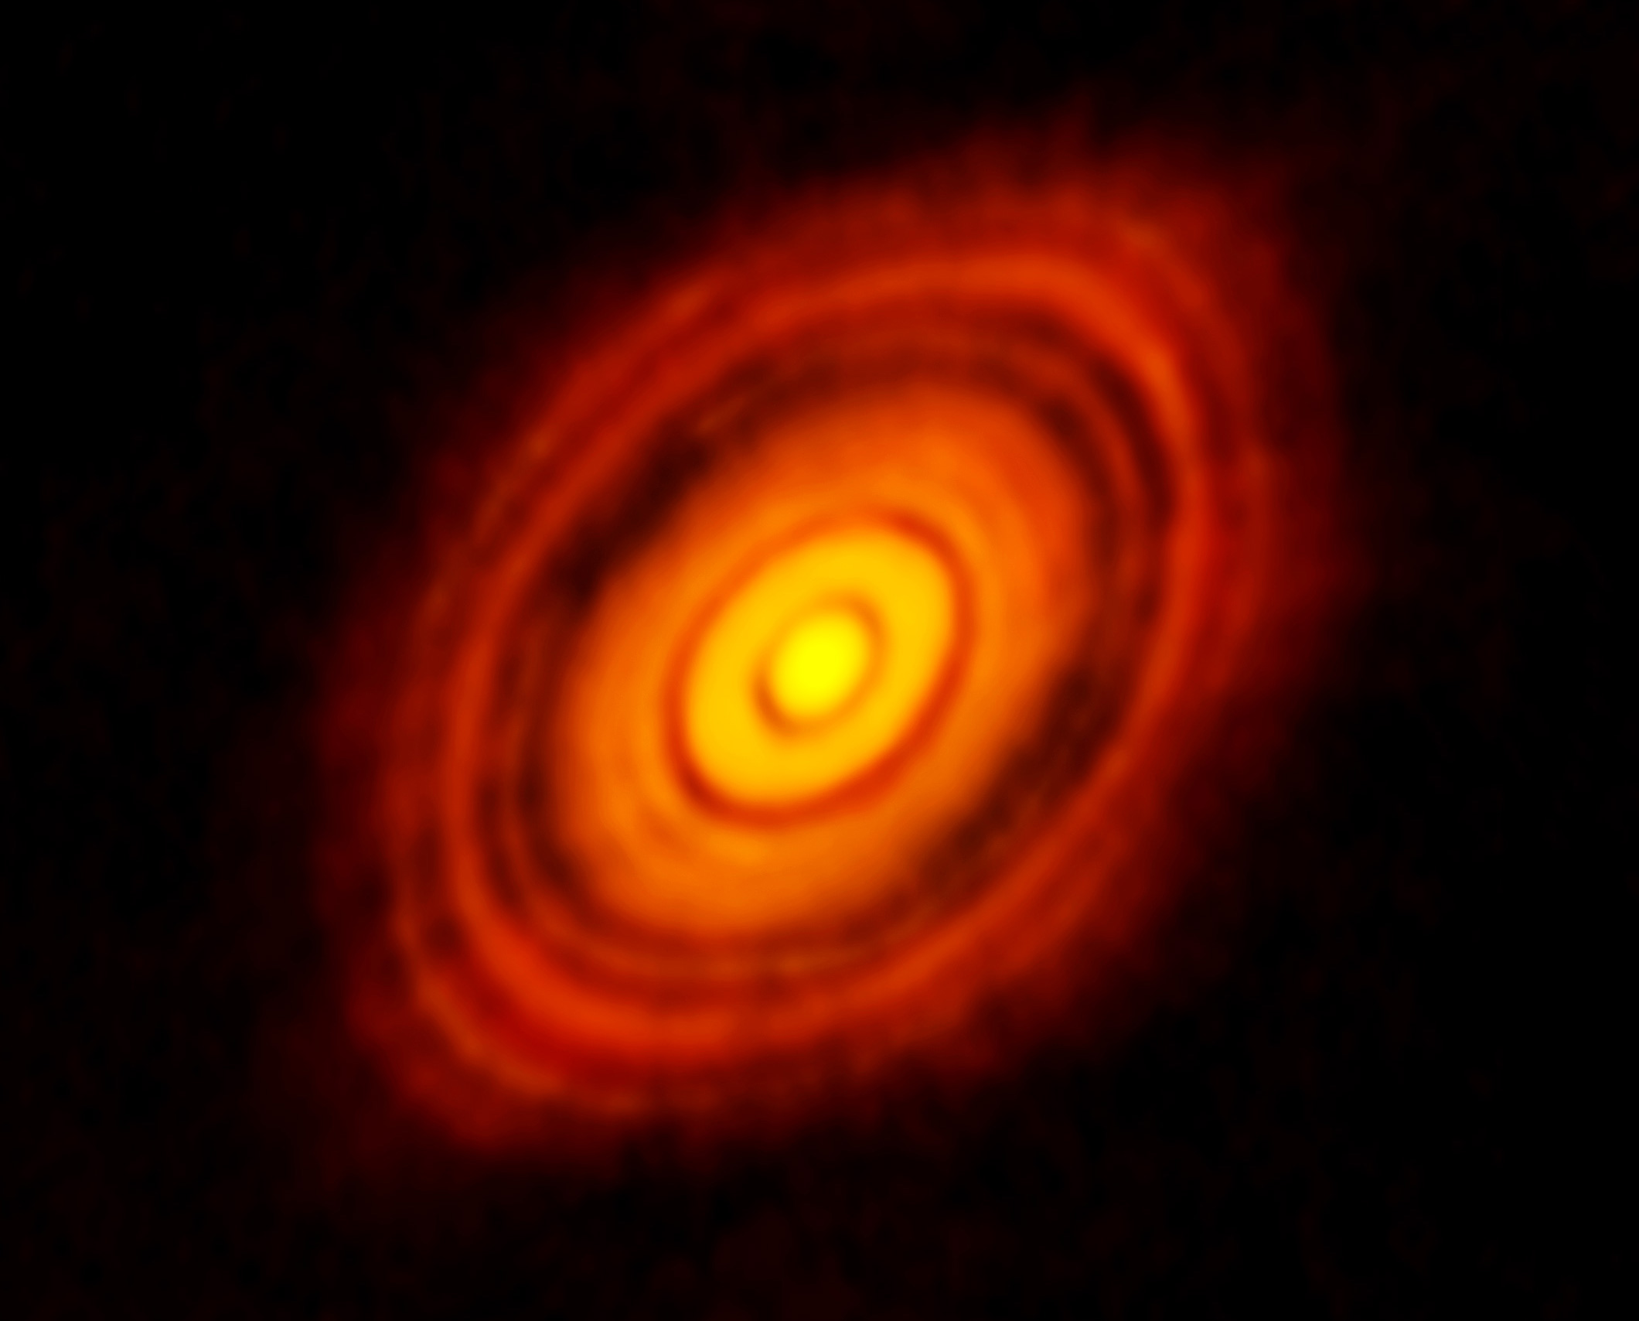
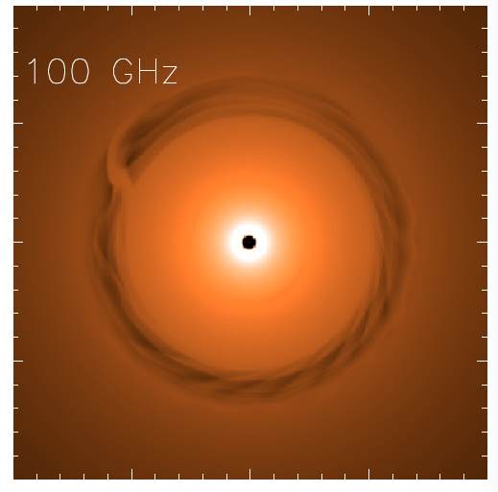
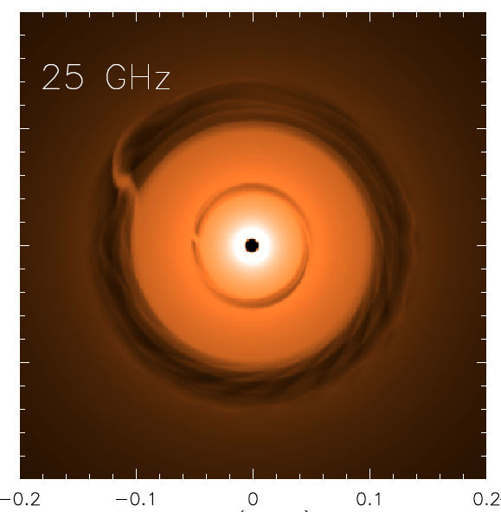
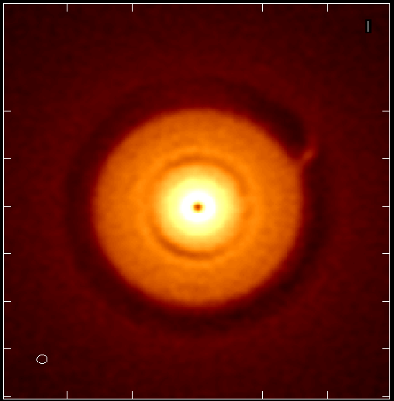
Zooming-in on terrestrial-zone planet formation
HL Tau ALMA
Saturn at 13AU
Jupiter at 6AU
ngVLA 100hr 25GHz
res = 10mas ~ 1AU
0.1” = 13AU
Isella Dust Model
Model
rms = 90nJy/bm = 1K
Image both gaps + annual motions on scales ~ inner Solar system
Circumplanetary disks: imaging accretion on to planets
Grain size stratification: Image poorly understood transition from dust to planetesimal to planets at 1AU resolution

Slide 16
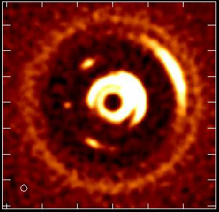
Movies of Planet Formation
Unveiling the Formation of Solar System Analogues
ngVLA images of the orbital motion of planets and related features on monthly timescales.
Simulated 100 GHz ngVLA observations of a newborn planetary system comprising a Jupiter analogue orbiting at 5 AU from a Solar type star, over 12 years.
16

Slide 17
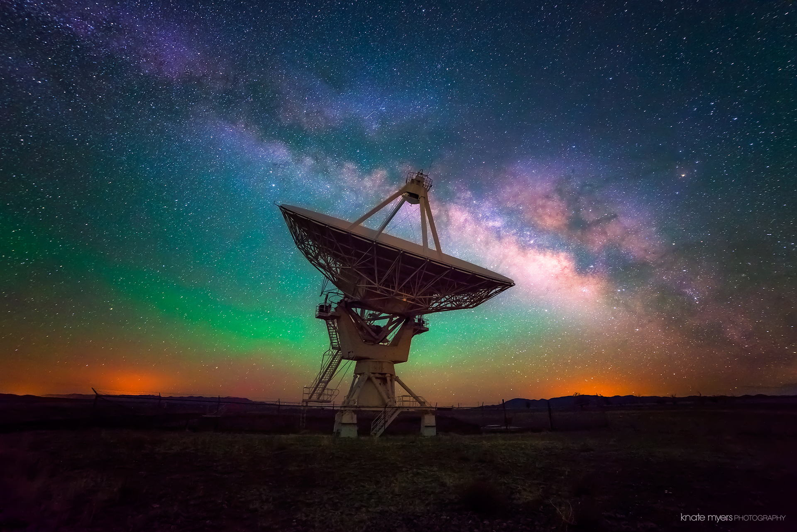
Questions?

Slide 18
Technical Specifications
27 x 25m antennas = collecting area ??
Surface accuracy = L/20 at 1cm = 0.5mm (efficiency ~ 50%)
f/D ~ 2 (w. subreflector
Frequency range (off-axis cassegrain focus) = 1.0 to 50 GHz
Max bandwidth = 8 GHz
Single-mode corregated horn feeds (1 pixel = diffraction limited FoV)
Prime focus receivers 50 MHz to 300 MHz
Receivers: HEMT GM cryocoolers ~ 10 to 20 K
Time standard = Hydrogen maser 1e-14 over 10min

