Slide 1
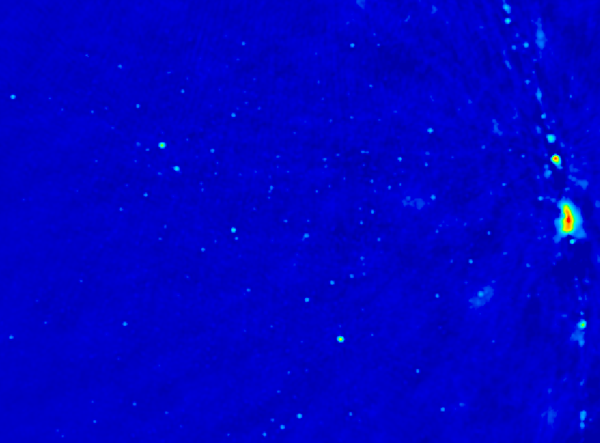
Imaging on PAPER (and HERA)
Unique imaging parameter space
  Extremely wide fields: Continuous ‘all-sky’ monitor
  Sensitive to LSS (15’ to 15º)
  Broad freq range (120 to 180MHz)
Important tests of high dynamic range calibration and imaging techniques: AIPS and CASA
First results
  Cen A
  Galactic Center
  Fermi Bubbles
HERA imaging: reionization
  Imaging simulations
  PS simulation

Slide 2
Imaging on PAPER
Violates all assumptions in synthesis imaging (eg. SIRA)
  Transit array => image in snapshots in time (10min)
  Very wide field (‘full sky’) => require 3D FT (facets)
  Very wide band (octave) => require multifreq synthesis (currently image snapshots in freq ~ 10MHz)
  Very high dynamic range > 10⁵: requires extensive iteration in selfcal/deconvolution
  Structure on all scales => require ‘multiscale clean’
  Strong and weak RFI: multiple layers of flagging

Slide 3
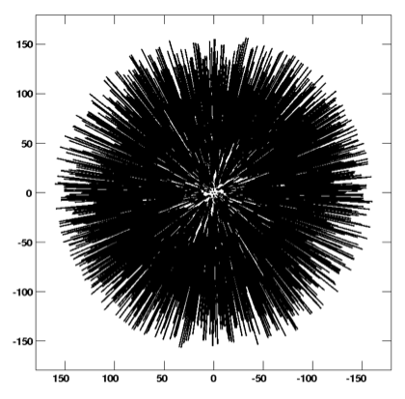
PAPER snap shot UV coverage – 64 antennas

Slide 4
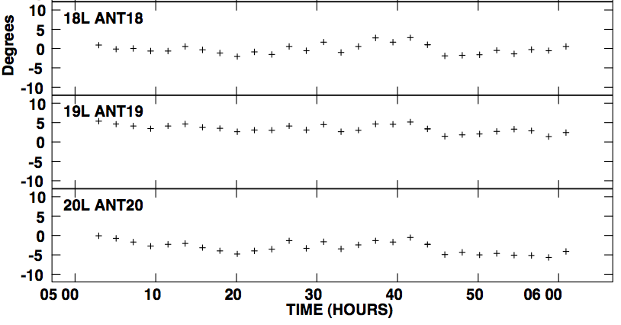
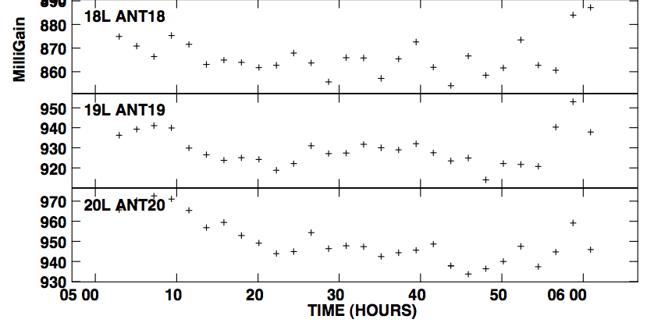
Stable system: selfcal gain solutions
Few deg over 1hr
Few % over 1hr
10º
2%

Slide 5
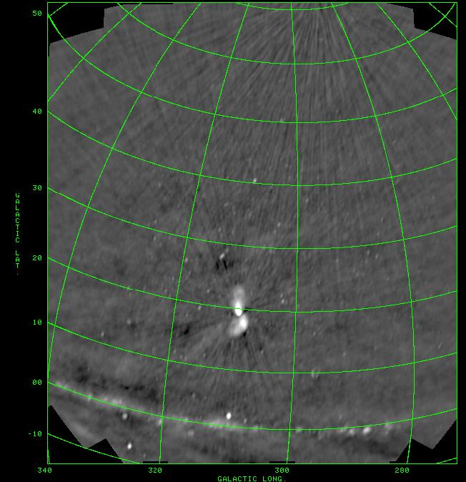
PSA64, July 2011
10min snapshots
BW = 60MHz
DNR ~ 1000
Weakest src ~ 1Jy
10º

Slide 6
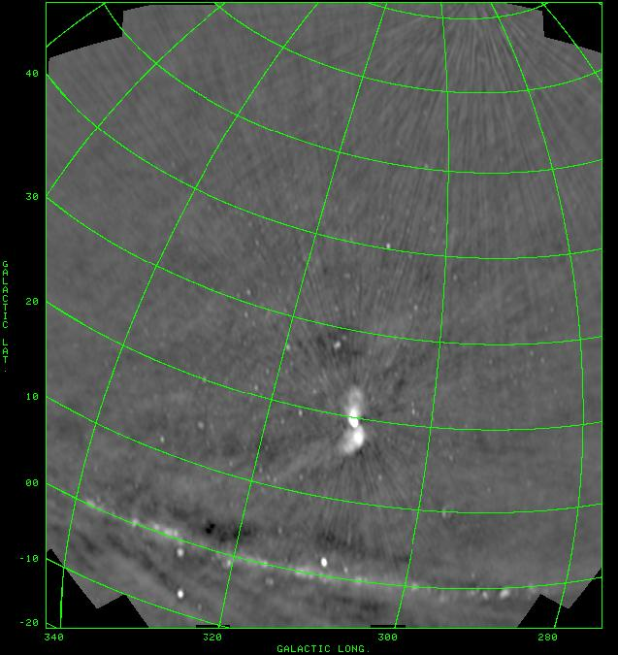

Slide 7
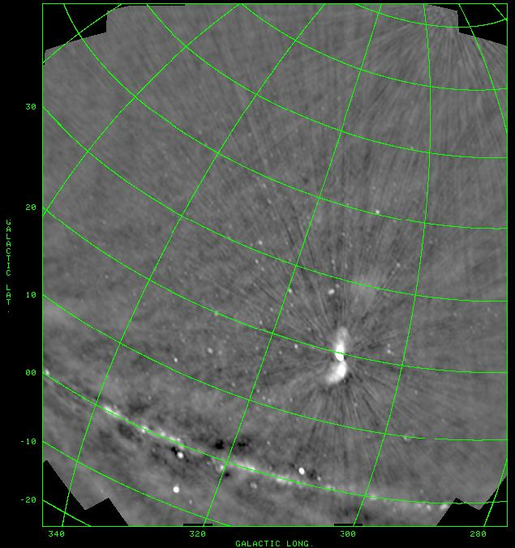

Slide 8
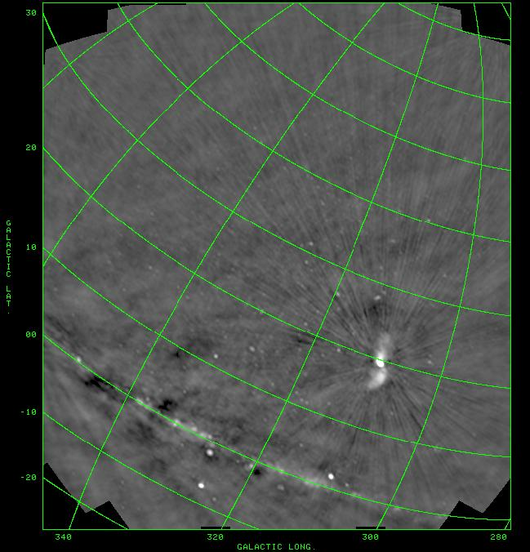

Slide 9
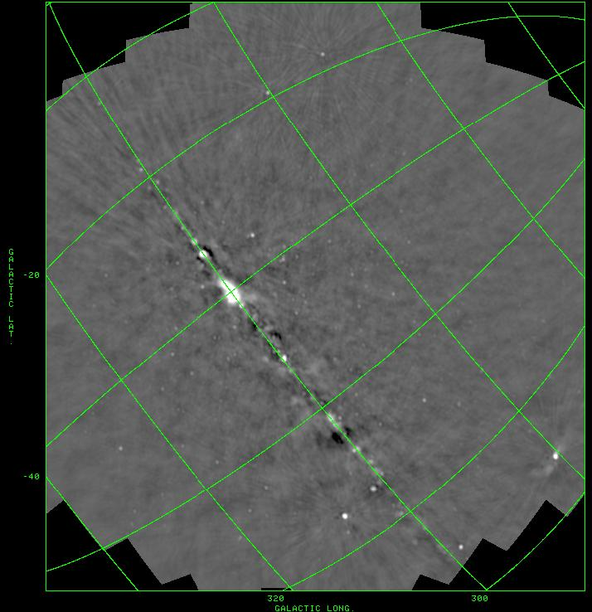

Slide 10
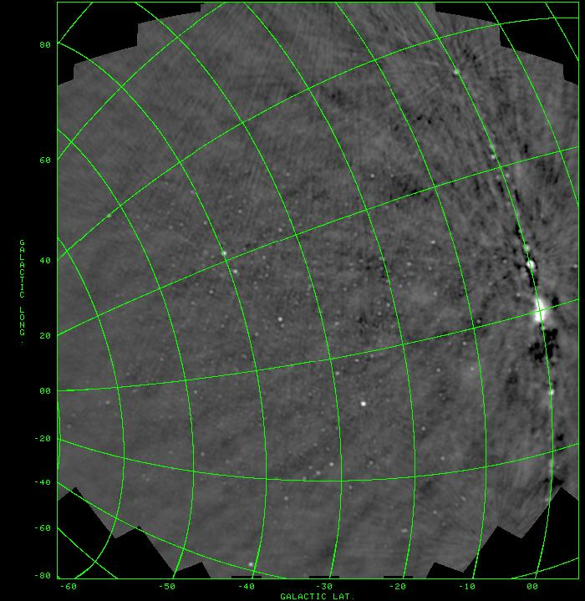

Slide 11
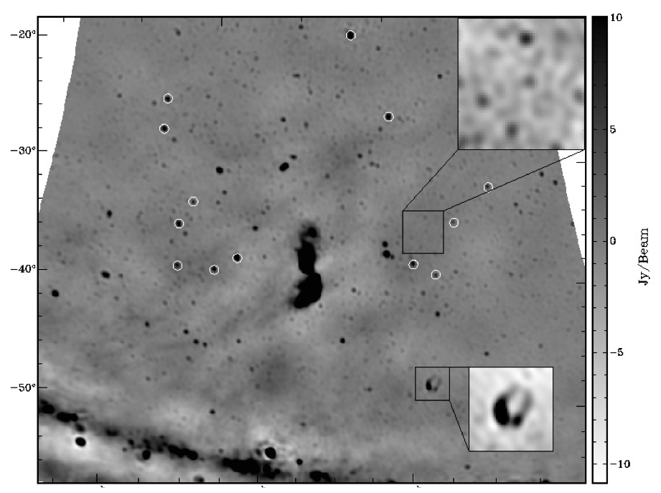
Centaurus A (Stefan ea)
Closest giant radio galaxy
4days x 3hrs/day
rms=0.5Jy
10º ~ 600 kpc

Slide 12
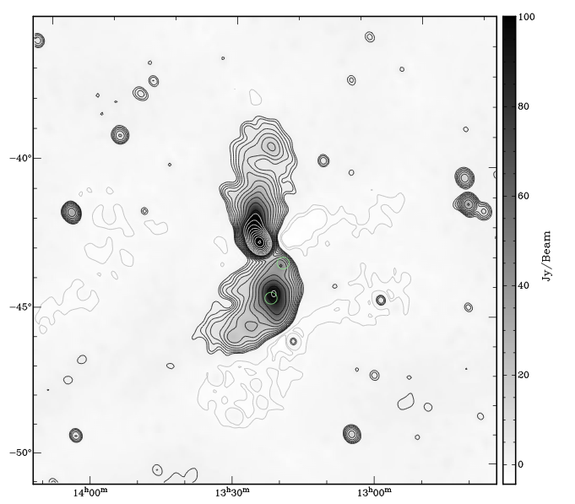
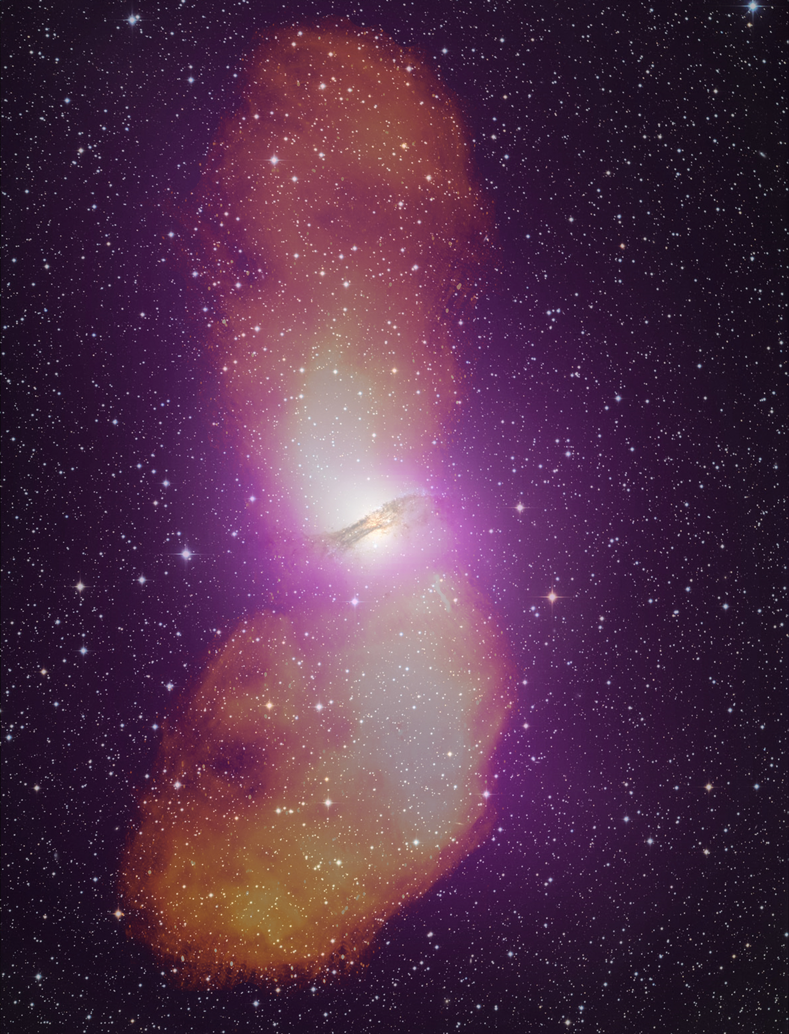
Cen A: imaging and spectra
Parkes: 1.4 GHz
(Feain ea)
PAPER: 120 to 180MHz
Stefan ea 2012

Slide 13
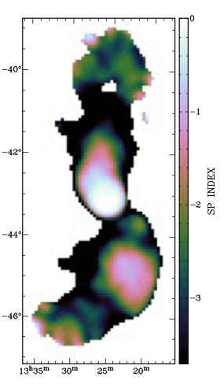
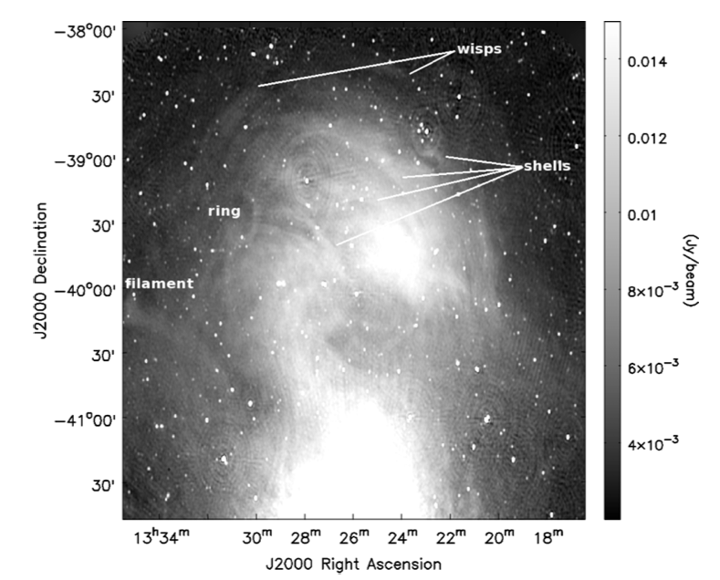
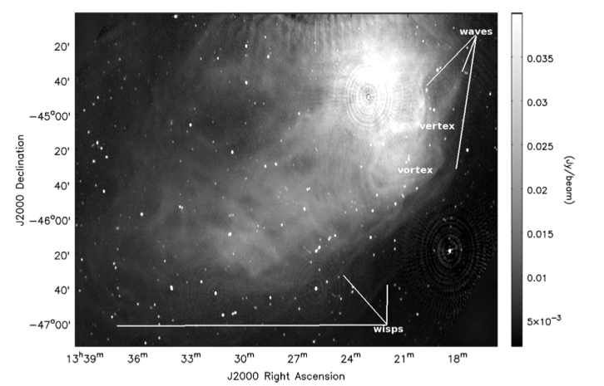
SI
Spectral flattening in regions of ‘heavy weather’: Vortices shells, rings, waves (Feain ea) => local particle acceleration

Slide 14
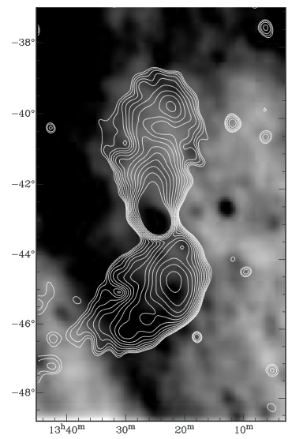
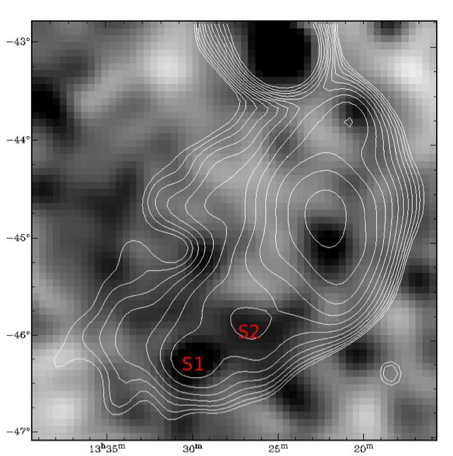
Rosat All Sky Survey
Xray: correlations (and anti-correlations)
‘Cavity in North’?
Knots in South = IC: B ~ 1 uG ~ B_{MP}
Lobe pressure ~ IGM ~ 10⁻¹³ dyn cm⁻²
Bifurcation in S lobe at Xray knot?

Slide 15
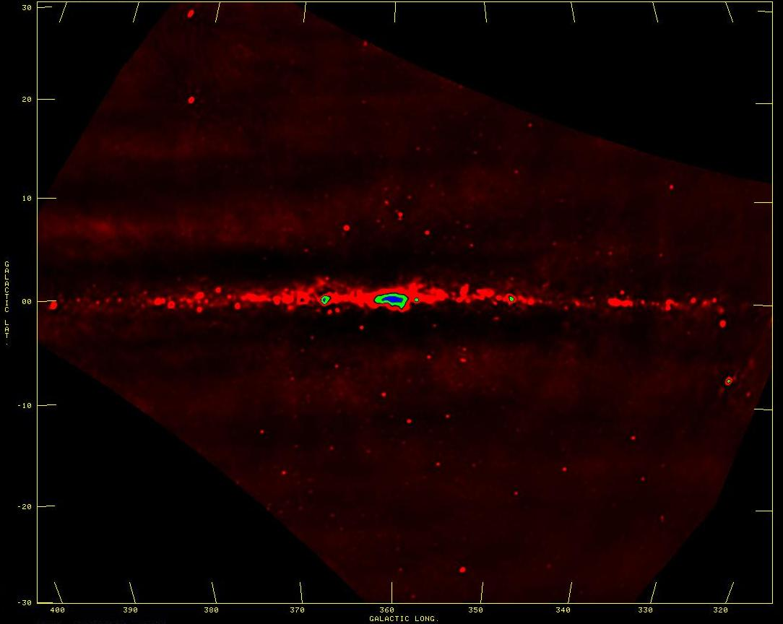
Galactic studies
SNR searches, spectra, imaging: find the missing large SNR?
Galactic HII regions: free-free abs => 3D study of thermal/nonthermal ISM
W28-SNR + M8-HII
SgrA*
10º
CTB37-SNR

Slide 16
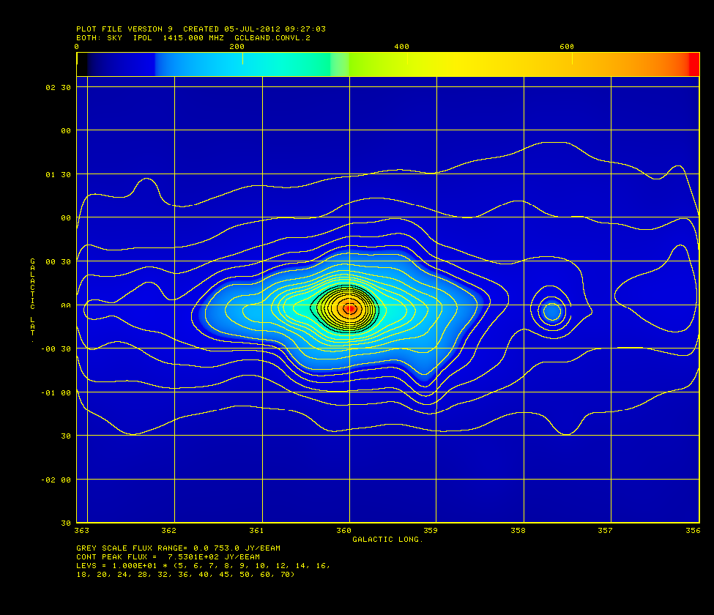
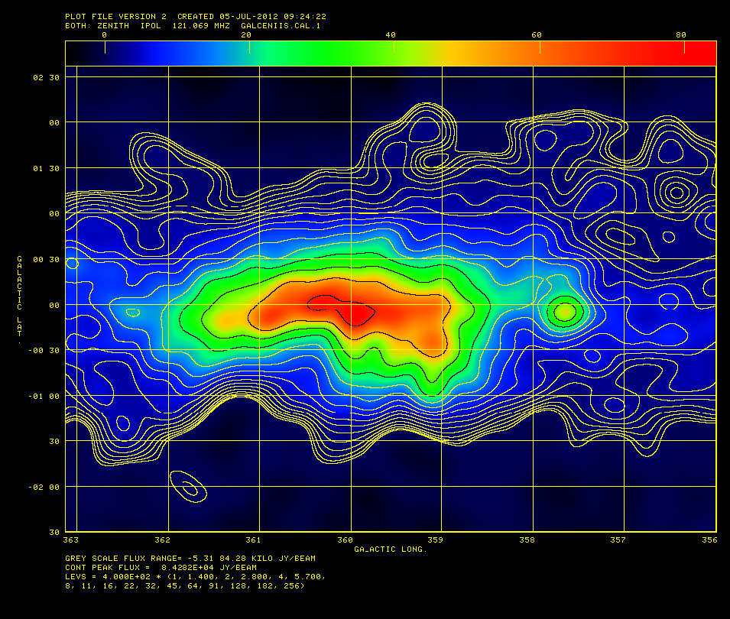
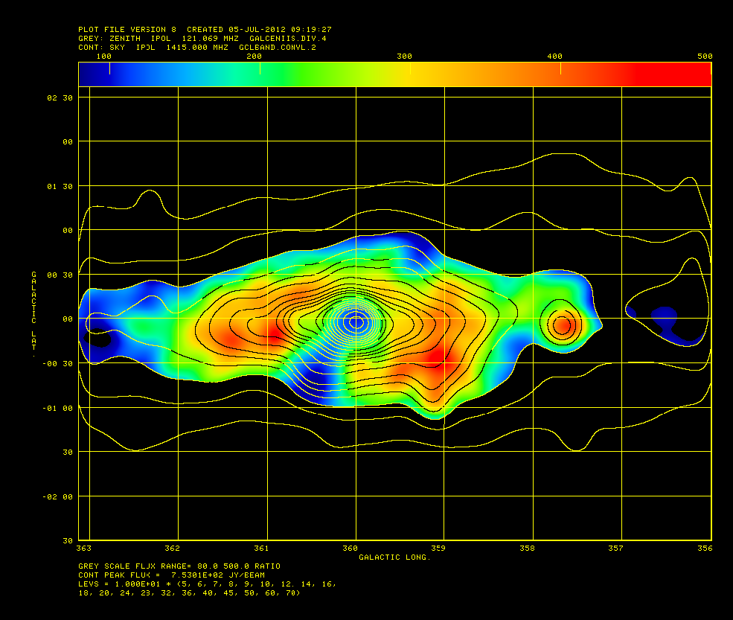
GBT 1.4 GHz (Zadeh ea)
PAPER 0.15GHz
1º
Galactic center: free-free abs
GBT 1.4GHz: clear GC peak
PAPER 150MHz: ‘flat’
GC: inverted spectrum = FF abs: EM > 10⁴ pc cm⁻⁶
‘Funnel’ to SE = thermal outflow: n_{e} > 10 cm⁻³ (or foreground HII)?
SI: 1.4 – 0.15GHz

Slide 17
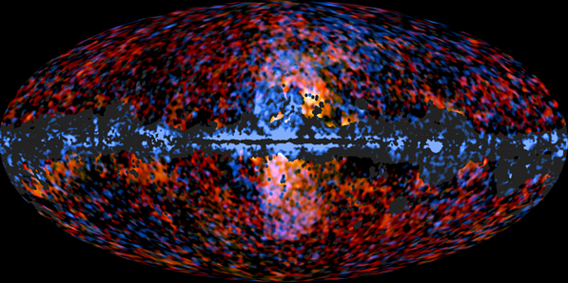
Fermi bubbles: WMAP/Fermi/Planck
Planck, 30+44 GHz
Fermi, 10-100 GeV
ESA/Planck Collaboration, NASA/DOE/Fermi LAT/D
Outflow driven by previous starburst or AGN at Gal center 10⁷ yrs ago?
WMAP = Synchrotron (polarized; Jones ea 2012)
Fermi = IC of CMB off relativistic electrons => B=6uG (Dobler 2013)
Low freq: synchrotron from relic e- = previous outflows?
Notes:
Point sources, galaxy taken out
See dobler2012: one last look at WMAPhaze
Explanations: Fermi haze is inverse Compton emission generated by the same electrons that make the synchrotron emission in Planck.
Inverse thompson scattering: electron interact with photons, and Thompson-scatter them to high energies. Bremstrallung: electron emitting as it’s accelerated by a proton (thermal).
You can get the hard spectrum and the morphology if you assume an aspherical halo. Problem is sharp edge found in Fermi data.
Alternatives: galactic wind producing e+-. Starburst/SN: significant outflow generated by SF in GC. Both have trouble explaining sharpness of features. Past accretion event (1My ago) of SMBH: results in a jet. In this one, reproducing the spectrum is difficult.

Slide 18
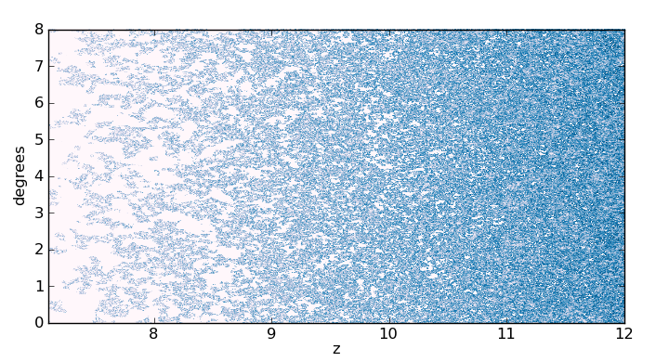
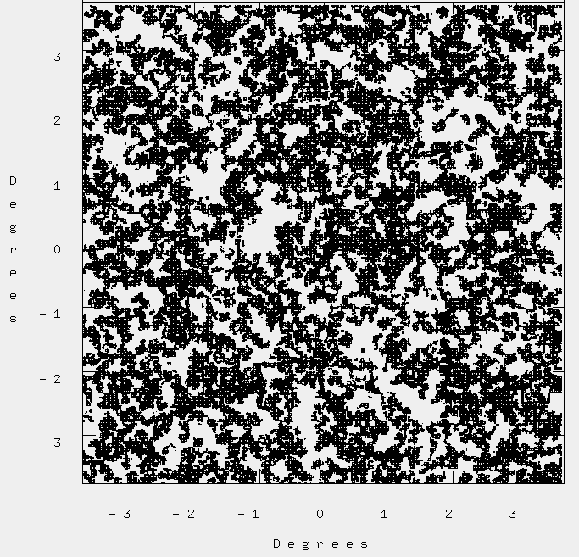
HERA imaging of reionization (w. D. Jacobs)
Model = McQuinn 21cm Fast
  Linearly evolved matter distribution
  Excursion set ionization field
Angular size ~ 8deg
26”pix, 67kHz chan
Obvious ~ degree scale structures ~ 200 cMpc (general LSS, biased galaxy formation, 1st quasars…)
Note: no ‘real simulations’ on this scale
Light-cone
0 to 30 mK
2deg
Sky

Slide 19
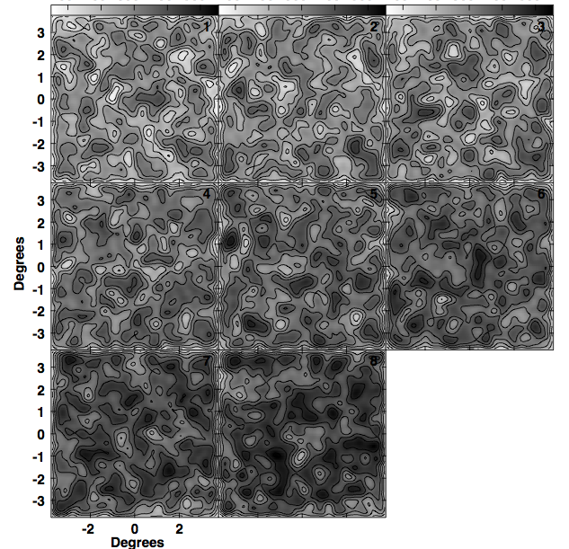
Model at HERA resolution in Jy/beam
Cube: 158-150 MHz w. 1MHz channel
HERA FoV FWHM ~ 10deg
HERA synth beam FWHM ~ 25’
Greyscale range: 0 to 0.5mJy/beam (T_{B} ~ 0 to 12mK)

Slide 20
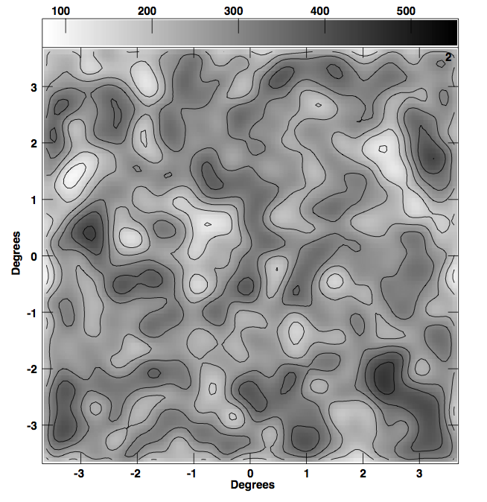
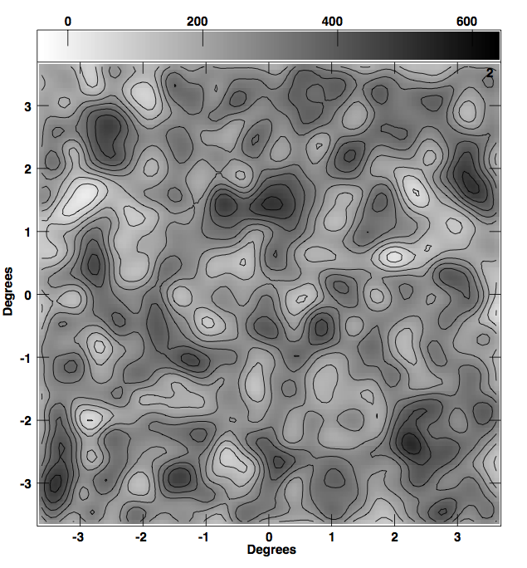
Model at 25’ res, 1MHz channel
Model plus noise: 60uJy/beam in 100hr, 1MHz chan
Signal: structure on all scales
Noise: PSF-like

Slide 21
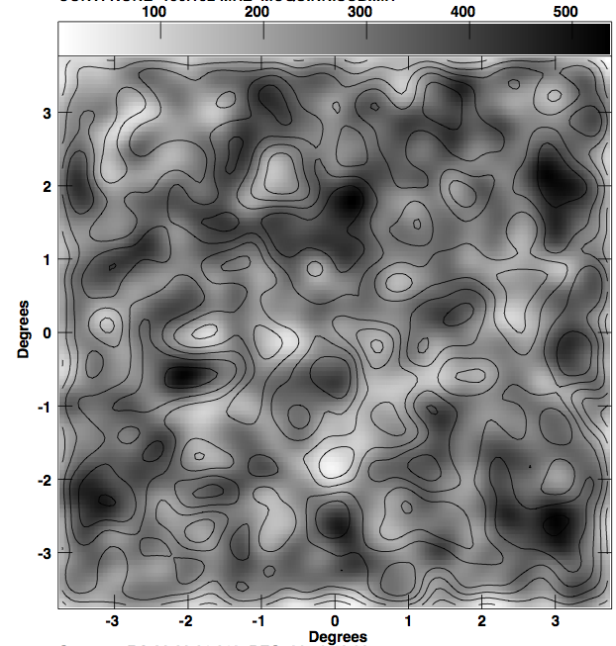
Greyscale = Model + noise
Contours = model

Slide 22
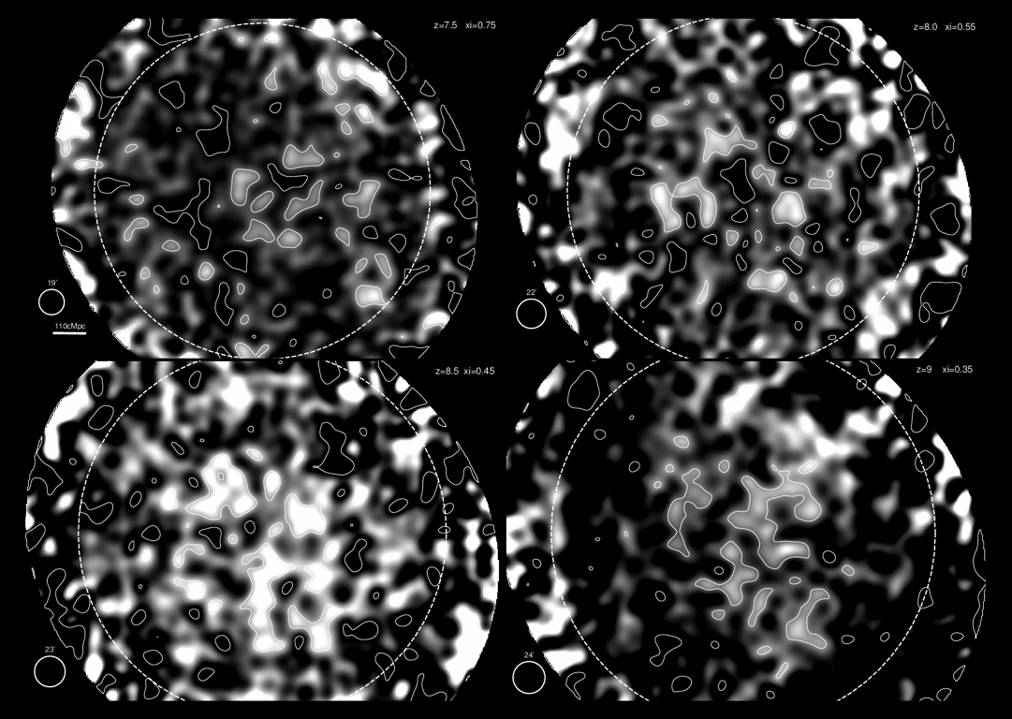
Sensitivity to Reionization structures
Contours at SNR>6
100 cMPc scale structures
Less SNR at high z.
D. Jacobs

Slide 23
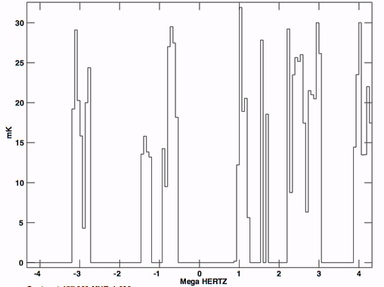
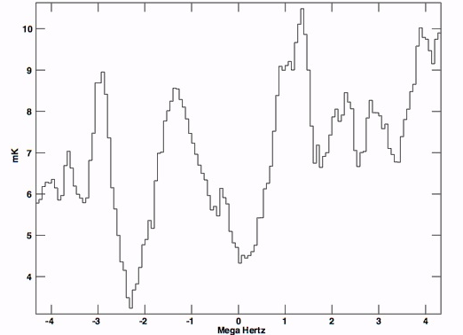
30 mK
27”, 67kHz
Spectra through model
0 mK
10 mK
25’, 67kHz
4 mK

Slide 24
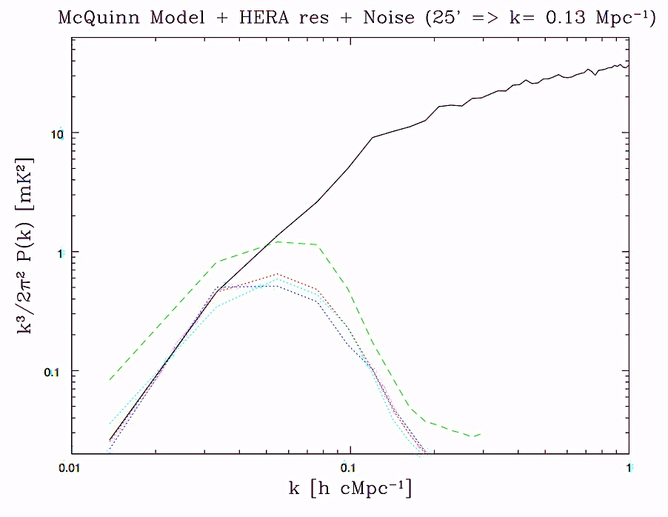
Angular power spectra
Black=Mcquinn native res (26”, 67kHz)
Red=Mcquinn 25’ res, 1MHz chan
Green=Red + noise w bias
Blue = Red + noise w. debias
Cyan = Red, 0.25MHz chan
1MHz = 17 cMpc => k=0.36 Mpc⁻¹
25’ = 47 cMpc => k=0.13Mpc⁻¹

Slide 25
Conclusions
HERA not one dimensional in approach: while optimized for DS/PS studies, but design is also excellent to explore multiple paths toward reionization, including imaging.
Sensitivity is not issue.
Investigating: foreground removal limits, calibration errors
  testing standard spectral line techniques in CASA and AIPS (uvsub,uvlin,imlin, etc)
  comparing with power spectrum techniques

