Slide 1
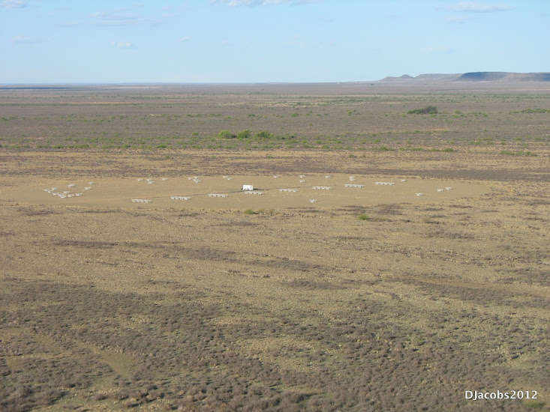
Precision Array to Probe Epoch of Reionization
LUNAR Science Forum, July 2013
C. Carilli* (NRAO) + PAPER Team**
*Member of Lunar University Network for Astrophysics Research consortium, which is funded by the NASA Lunar Science Institute (via Cooperative Agreement NNA09DB30A) to investigate concepts for astrophysical observatories on the Moon, PI J. Burns.
**http://astro.berkeley.edu/~dbacker/eor/

Slide 2
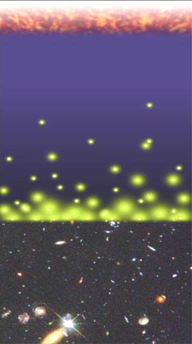
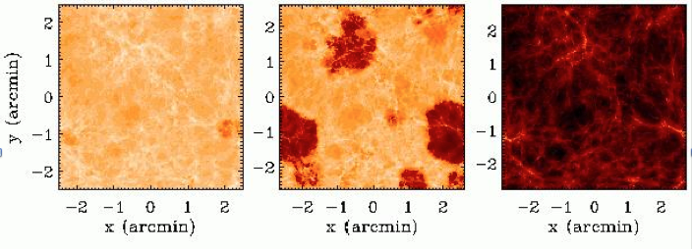
Big Bang
Dark ages and Cosmic Reionization
Period following recombination, when baryonic Universe was almost entirely neutral Hydrogen
  Dark ages: gravitational collapse of structure in linear regime: z~1000 to 20
  Reionization: first luminous objects reionize the IGM: z~ 20 to 6
Last phase of structure evolution to be explored: ‘extraordinary discovery potential’ (NWNH)
HI 21cm emission from neutral IGM: ‘most important tool to study reionization’ (NWNH) ‘Richest of all cosmological data sets’ (Barkana & Loeb)
Recombination
Dark ages
Cosmic Reionization
z~10, 140MHz
z~8, 1600MHz
Z~6, 180MHz
‘Realm of Galaxies’
HI T_{B} ~20 mK

Slide 3
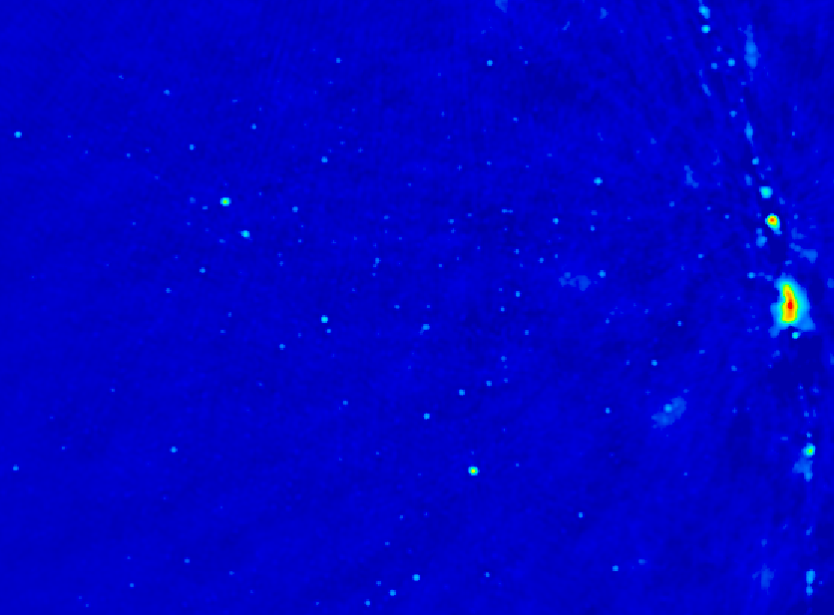
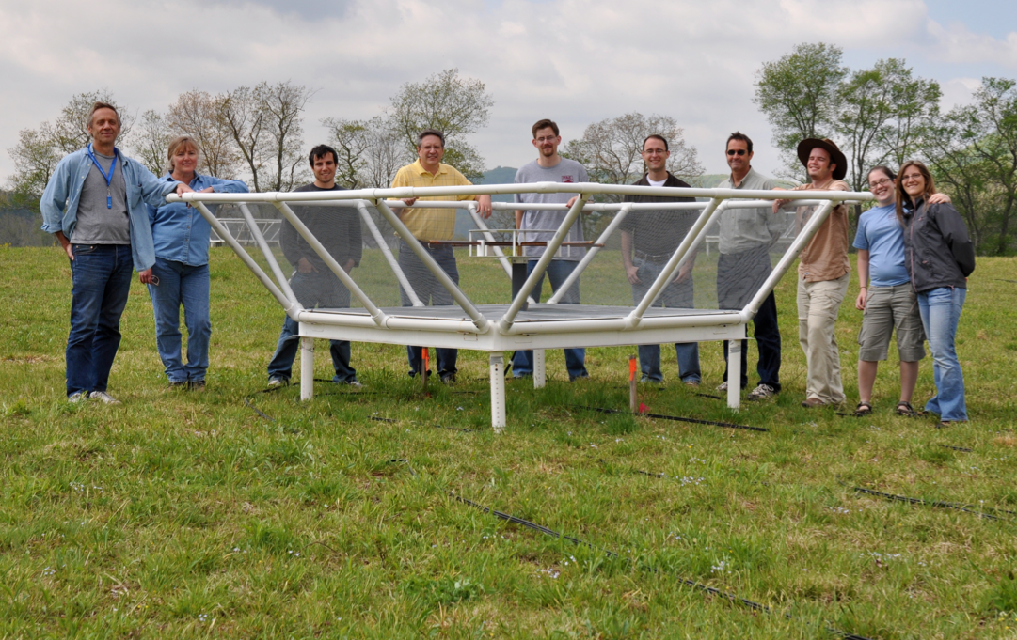
Precision Array to Probe Epoch of Reionization
Don C. Backer Array
Berkeley, NRAO, Penn, SKA/South Africa
Focus: low-ν array to study HI 21cm signal from reionization
Precision: emphasize engineering solutions first
Staged: work through problems before increasing investment

Slide 4
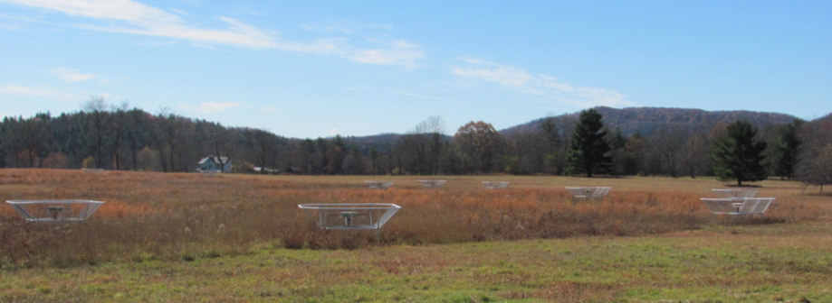
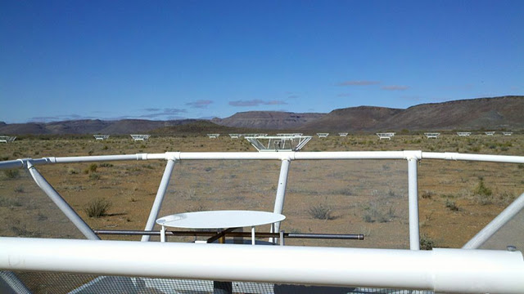
32 station engineering array in Greenbank, WV
PAPER basics
Freq = 115 to 190 MHz (z= 6.5 to 11)
Single dipole elements + ‘flaps’ => FoV_{FWHM} ~ 40º
Max baseline = 300m => res ~ 15’
Build-out to 128 antennae science array in Karoo, South Africa in 2013 (currently 64)

Slide 5
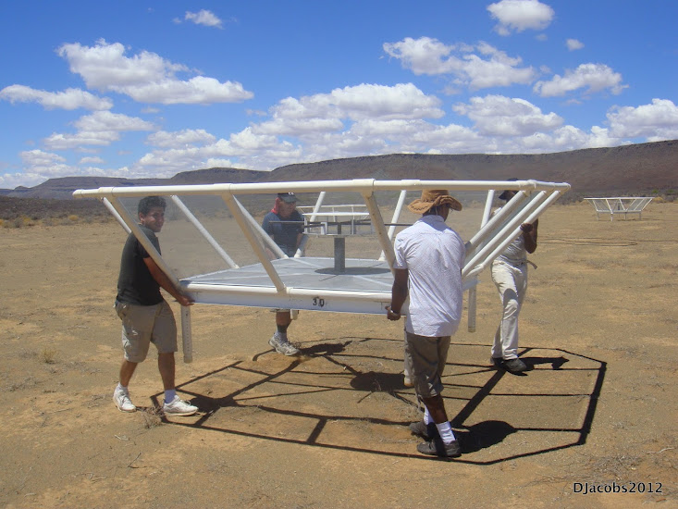
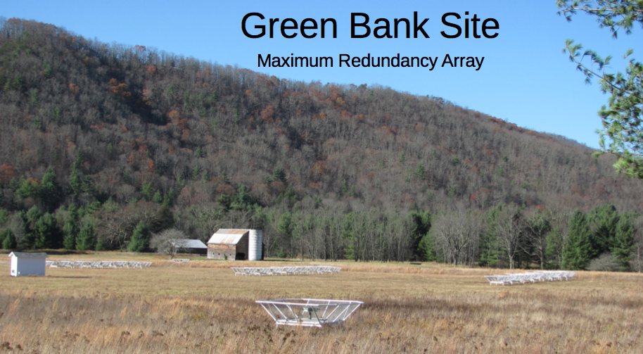
Reconfigurable => optimize for science goal
Minimum redundancy array
maximize u,v coverage => imaging
Maximum redundancy: delay spectrum analysis

Slide 6
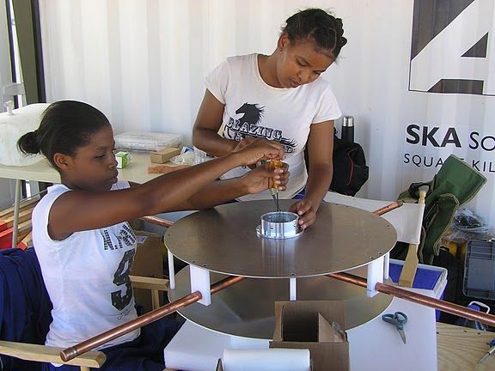
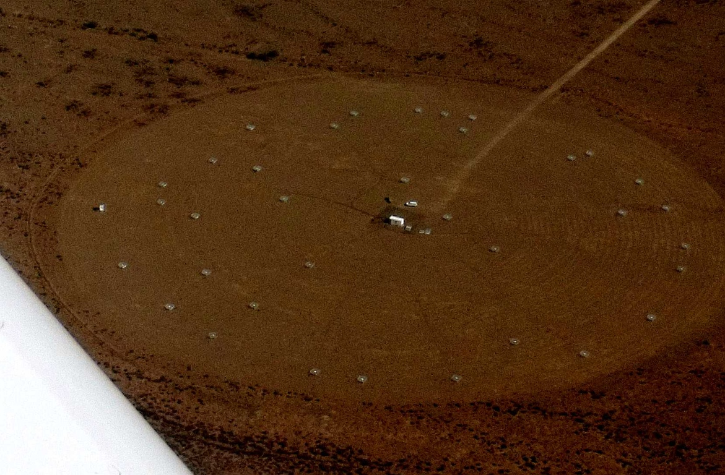
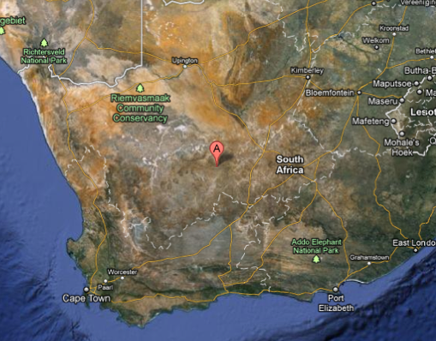
Established working array from scratch in ~ 6months, with help from ZA (SKA, Durban)
Durban University of Technology
PAPER
575 km
Cape Town

Slide 7
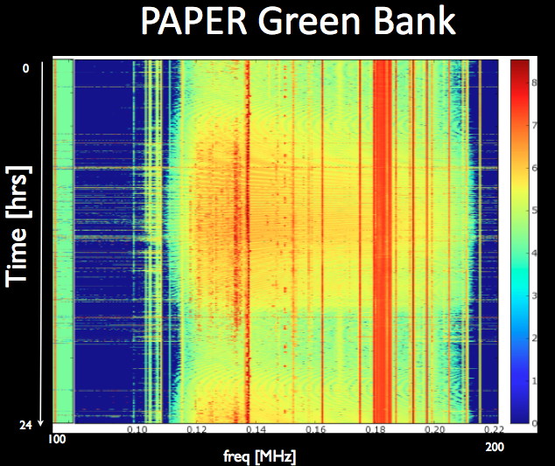
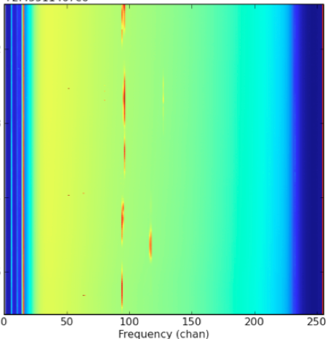
Interference – ZA Radio Quiet Zone
PAPER South Africa
TV
OrbComm
FM
ISS
OrbComm
100MHz
200MHz
100MHz
200MHz
US ‘radio quiet zone’
ZA ‘radio quiet zone’

Slide 8
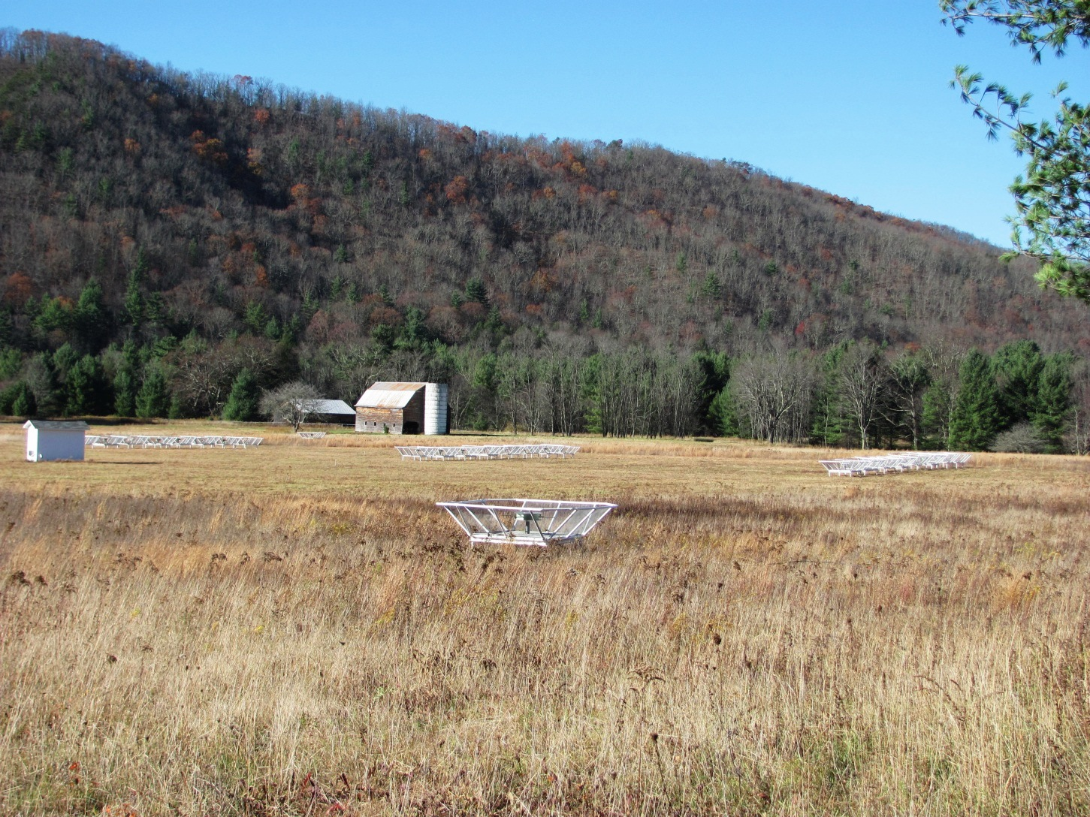
Power spectrum approach: ‘delay spectrum’ (Parsons ea)
Redundant spacings: identical measurements => add spectra coherently => ‘signal to noise’ of PS measurement improves linearly with number of measurements, N, vs. N^{1/2} with incoherent averaging (add and square vs. square and add)
Delay spectrum: PS strictly in frequency domain
Work ‘outside wedge’: reduce continuum contribution
Parsons et al. 2013, ApJ, submitted (arXiv:1304.4991)
Pober et al. 2013, ApJ, 768, L36
Moore et al. 2013, ApJ, 769, 154
Parsons et al. 2012, ApJ, 756, 165
Parsons et al. 2012, ApJ, 753, 81

Slide 9
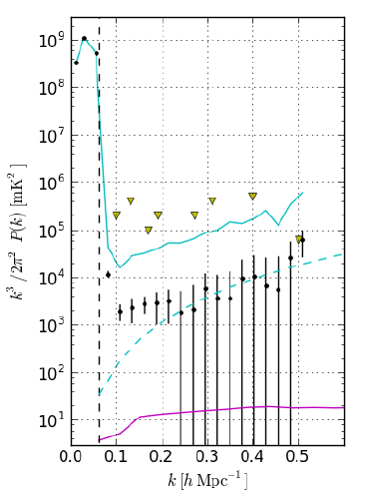
PAPER 32 Power spectrum
300hrs, 32ant, 70 redundant baselines of 30m length
Best limits to date, for k ~ 0.1 to 0.2 h⁻¹ Mpc⁻¹: < (52 mK)²
5 order of magnitude continuum suppression (in mK²)
Still inconsistent with thermal noise => residual pol. continuum?
Still factor 100 above predictions of fiducial reionization models (eg. Lidz ea)
Rule-out extreme model: neutral IGM remains cold (no large-scale Xray warming), but Lya to couples T_{s} and T_{K} and reionization occurs locally => <T_{B}> ~ 400mK
2013 build-out to 128 elements
‘horizon limit’ = ‘wedge’
Paciga ea GMRT
No warming
T_{sys}=560K
Fiducial

Slide 10
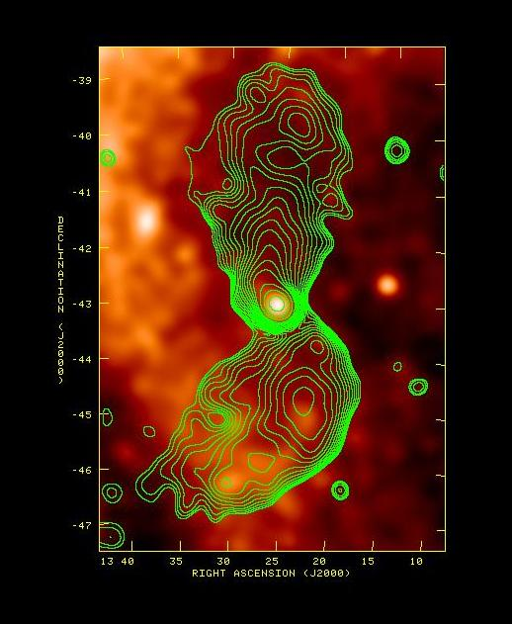
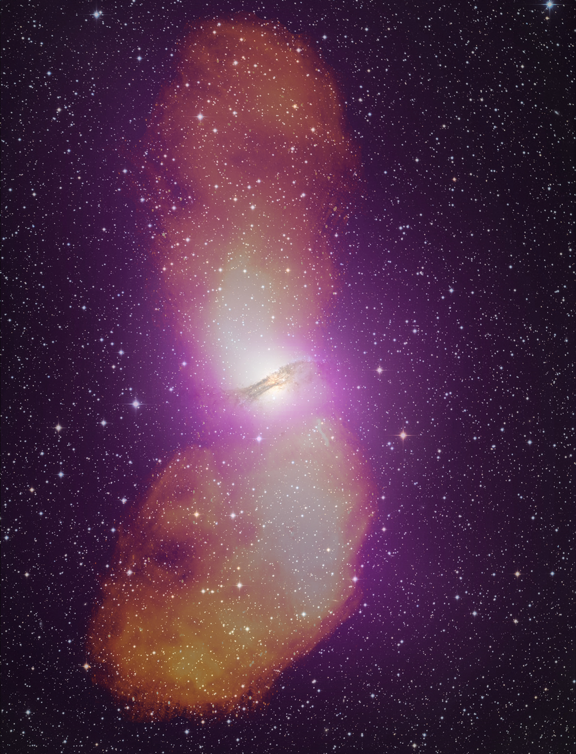
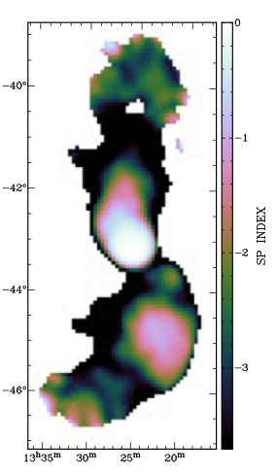
Anscillary science: imaging of large scale radio continuum sources Centaurus A: physics of radio galaxies (Stefan ea. 2013)
150MHz
+ RASS
1.4GHz
8º ~ 600kpc
Xray correlations
  Knots in South = IC? B ~ 1 uG ~ B_{MP}
  Lobe pressure ~ IGM ~ 10⁻¹³ dyn cm⁻²
Spectral flattening in regions of ‘heavy weather’: Vortices shells, rings, waves (Feain ea) => local particle acceleration

Slide 11
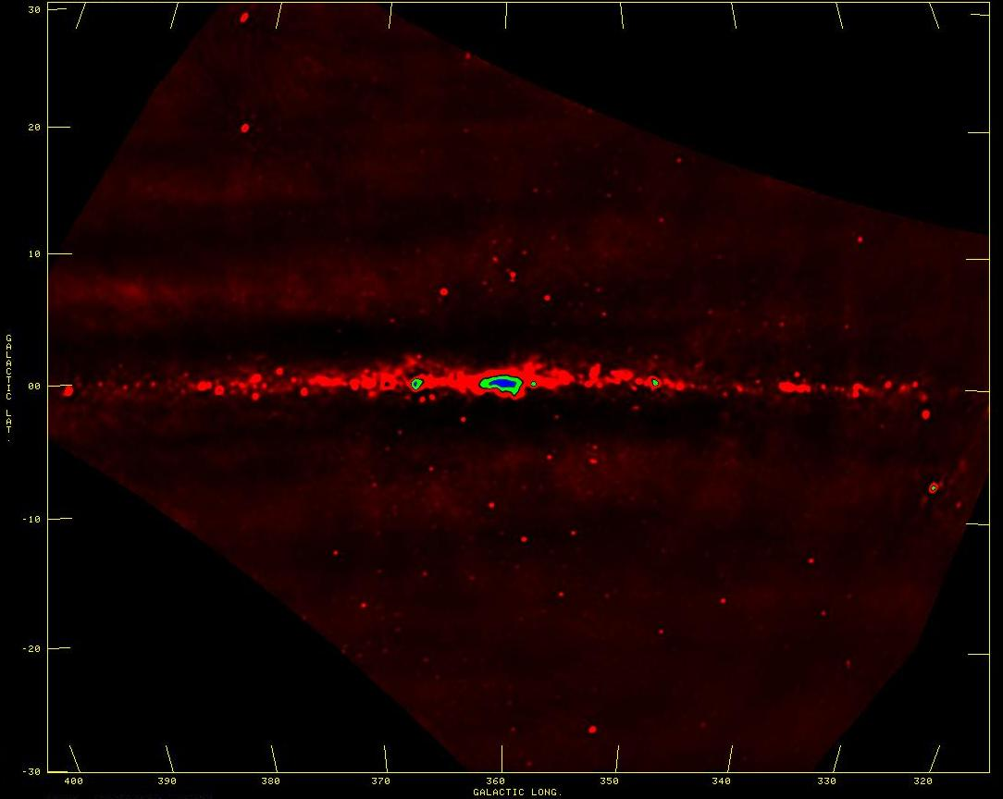
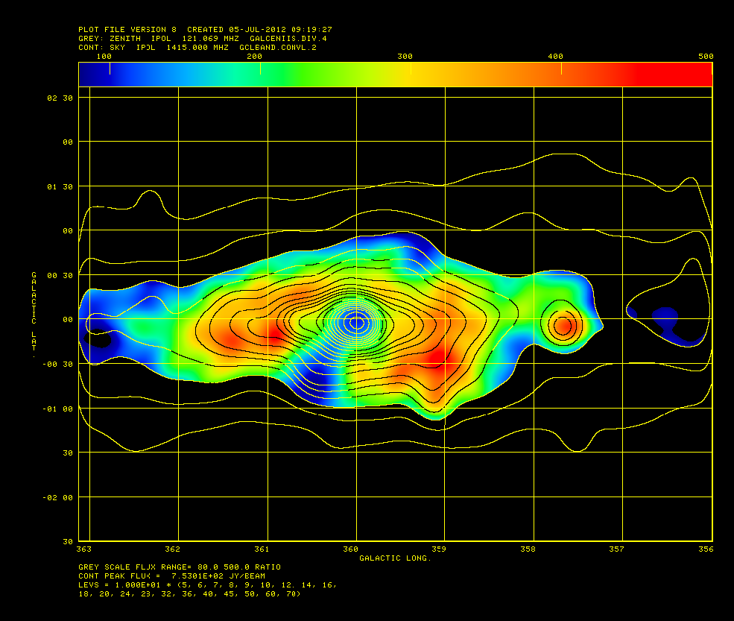
Galactic studies
SNR searches, spectra, imaging: find the missing large SNR?
Galactic HII regions: free-free abs => 3D study of thermal/nonthermal ISM
10º
W28-SNR + M8-HII
SgrA*
CTB37-SNR
SI: 1.4 – 0.15GHz
Galactic center: free-free abs
inverted spectrum = FF abs: EM > 10⁴ pc cm⁻⁶
‘Funnel’ to SE = thermal outflow: n_{e} > 10 cm⁻³ (or foreground HII)?

Slide 12
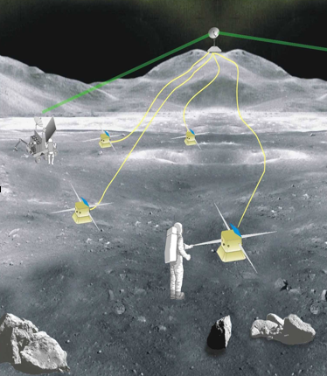
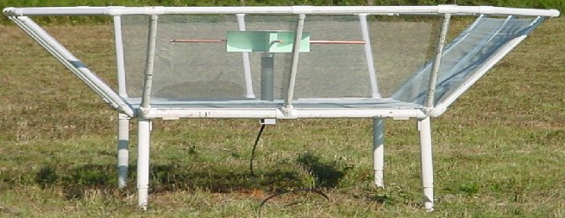
Say, its only a PAPER moon
Sailing over a cardboard sea
But it wouldn't be make-believe
If you believed in me
Destination Moon!
Technical path-finder for low frequency array on far side Moon: Required to obs linear structure formation in ‘Dark ages’
z>30, ν < 50MHz
No interference
No ionosphere
See talks by: Burns, Datta, Furlanetto, Harker, Mirocha, Lazio

Slide 13
Following are extra slides for reference

Slide 14
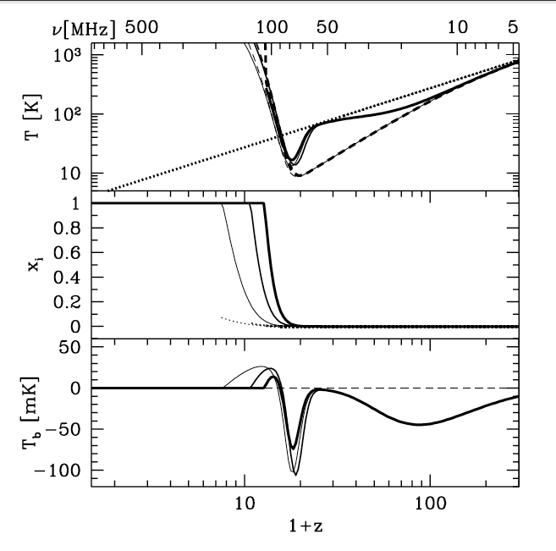
‘Richest of cosmological data sets’
z>200: T_{CMB} = T_{K}= T_{S} by residual e-, photon, and gas collisions. No signal.
z∼30 to 200: gas cools as T_{k} ≈ (1+z)² vs. T_{CMB} ≈ (1 + z), but T_{S} = T_{K} via collisions => absorption, until density drops and T_{s} → T_{CMB}
z∼20 to 30: first stars => Lyα photons couples T_{K} and T_{S} => 21-cm absorption
z∼6 to 20: IGM warmed by hard X rays => T_{K} > T_{CMB}. T_{S} coupled to T_{K} by Lya. Reionization is proceeding => bubble dominated
IGM reionized
T_{cmb}
T_{S}
T_{K}
No warming
E
D
C
B
A

Slide 15
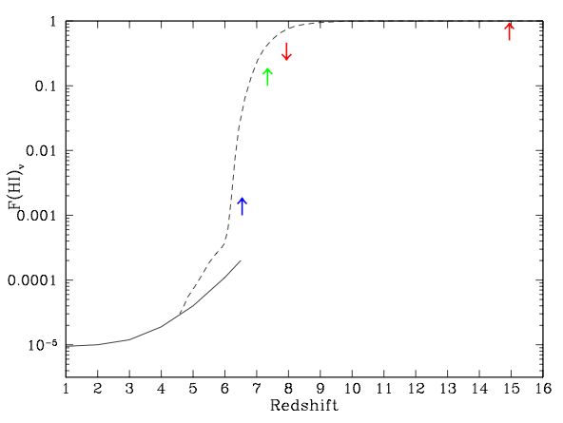
3.34
0.95
0.65
0.48
0.38Gyr
integral measure τ_{e}
CMB_{pol}
Q-DLA: only one source
Gnedin & Fan model
Quasar near-zones: relative measure
GP: saturates
Gunn-Peterson effect: resonanting scattering of Lya => increasing neutral fraction at z ~ 6 to 7
CMB large scale polarization => finite ionization fraction persisting to z ~ 10 to 12
All current diagnostics have limitations

Slide 16
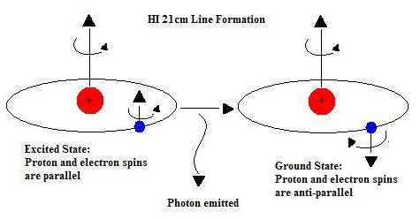
HI 21cm line: Most direct probe of the neutral IGM
Low frequencies:
ν_{obs} = 1420MHz/(1+z) ≤ 200 MHz
Advantages of the 21cm line
Direct probe of neutral IGM
Spectral line signal => full three dimensional image of structure formation (freq = z = depth)
Low freq => very (very) large volume surveys (1sr, z=7 to 11)
Hyperfine transition = weak => avoid saturation (translucent)

Slide 17
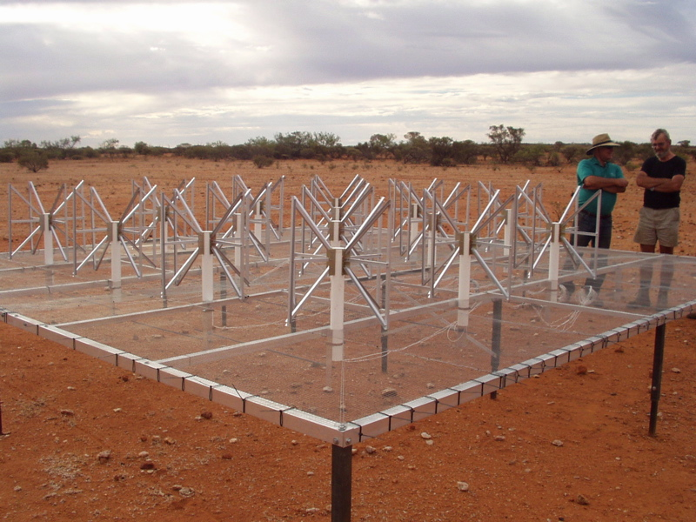
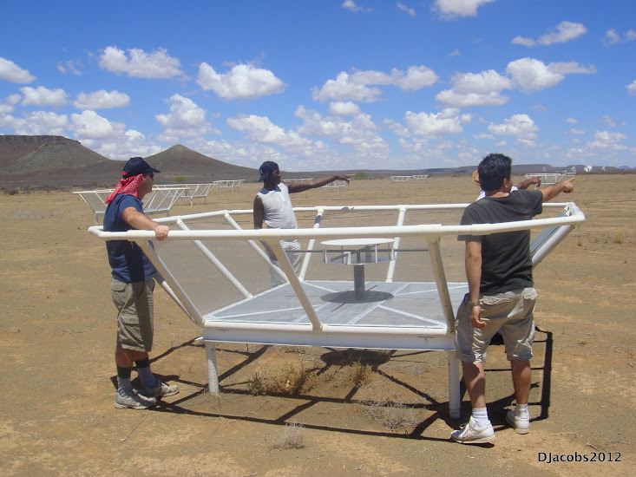
MWA - Oz
PAPER - SA
Pathfinders: 1% to 10% of a square kilometer array
 | FoV deg² | Area m² | Type | Bmax km | 1st light
SKA | 30 | 1e6 | Tile | 5 | ??
LOFAR | 25 | 1e5 | Tile | 2 | 2010
MWA | 300 | 1e4 | Tile | 1.5 | 2011
PAPER | 1600 | 3e3 | Dipole | 0.3 | 2011
GMRT | 9 | 1e4 | Dish | 2 | 2010

Slide 18
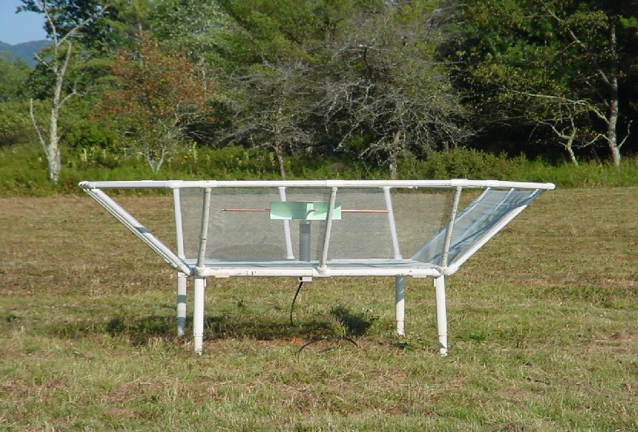
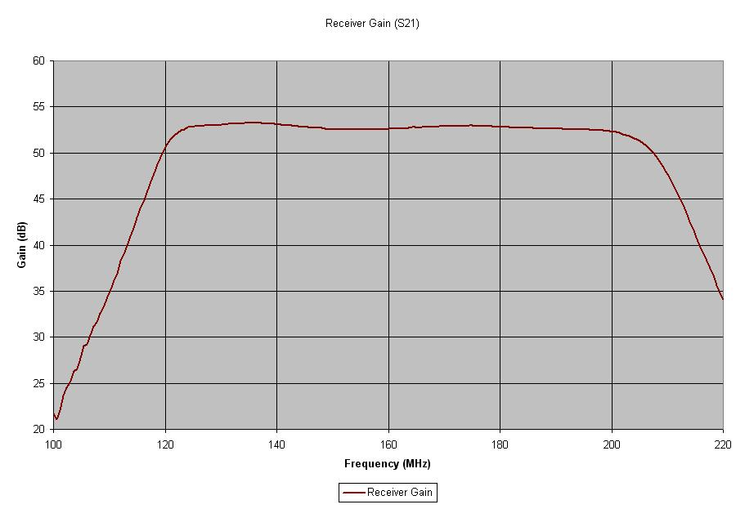
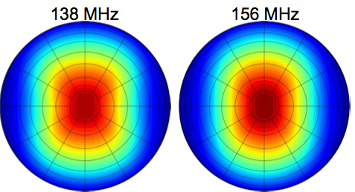
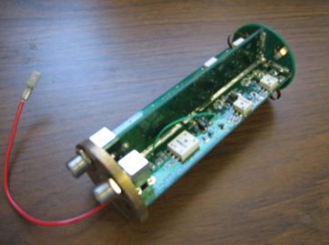
PAPER Antenna: ‘clean machine’
Sleeve dipole + flaps
Smooth, broad response in frequency and angle
Gain
10dB
120MHz
200MHz
LNA: T_{rx} = 110K, 30dB gain 120-180MHz

Slide 19
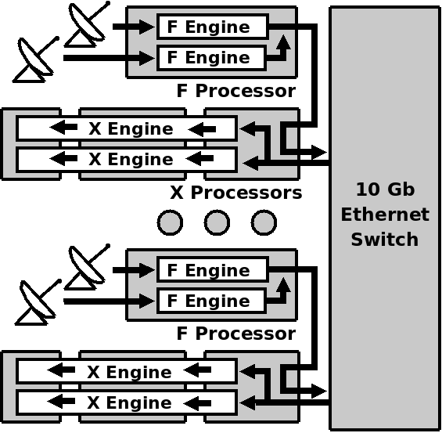
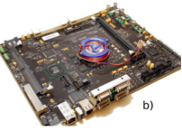
PAPER: (Xilinx) FPGA + GPU correlator from Berkeley wireless lab (CASPER)
ROACH2 F engine: sample/digitize, transform (τ → ν), using polyphase filter (‘preconvolution’)
GPU X engine: cross multiply V (B, ν)
Cross-connections: ‘packetized correlator’ using 10Gb Ethernet protocol + commercial data routers
Computing, processing, storage (Penn)
Cluster computing: 32 octal core servers
Store raw visibilities: RAIDS 120 TB
AIPY (Berkeley), CASA, AIPS (NRAO)

Slide 20
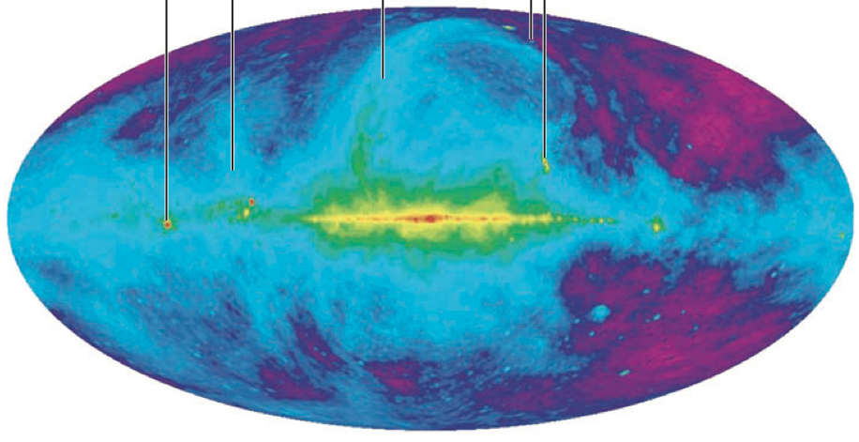
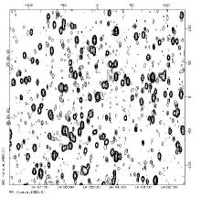
Challenge: hot, confused sky at low freq
Haslam, Eberg 408MHz
Coldest regions: T ~ 100 (ν/200 ΜΗz)^{-2.6} K = 10⁴ x 21cm signal
Highly ‘confused’: 1 source/deg² with S140 > 1 Jy

Slide 21
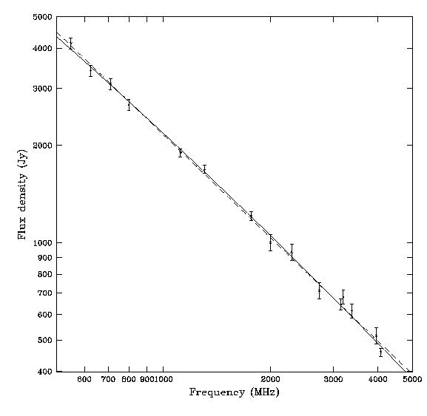
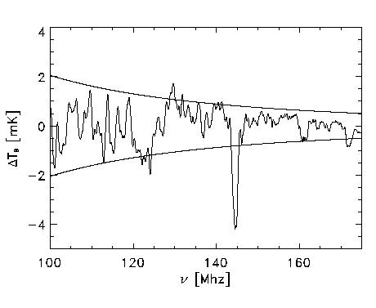
Solution: spectral decomposition
Foreground= non-thermal= featureless over ~ 100’s MHz
Signal = fine scale structure on scales ~ MHz
Cygnus A
Signal/Sky ~ 10⁻⁵
z=13
z=7
500MHz
5000MHz
Critical to mitigate freq dependent telescope response!

Slide 22
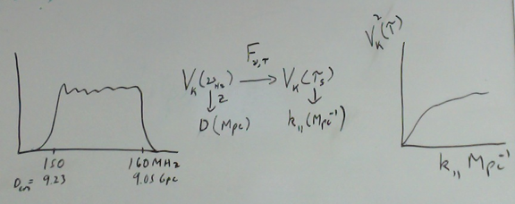
‘delay spectrum’
Freq maps to distance => Fourier conjugate (delay) maps to wavenumber
Analyze PS per N_{red} baselines, time in k_{par}: PS = square of F_{t}(V_{K}(ν)) = V²_{K}(τ)
Advantages:
  Allows study of smaller k scales
  Mitigates continuum dynamic range problems

Slide 23
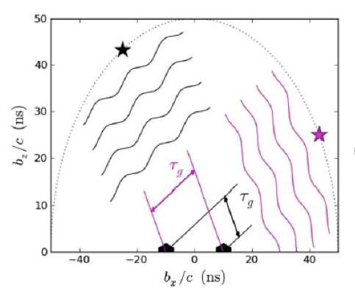
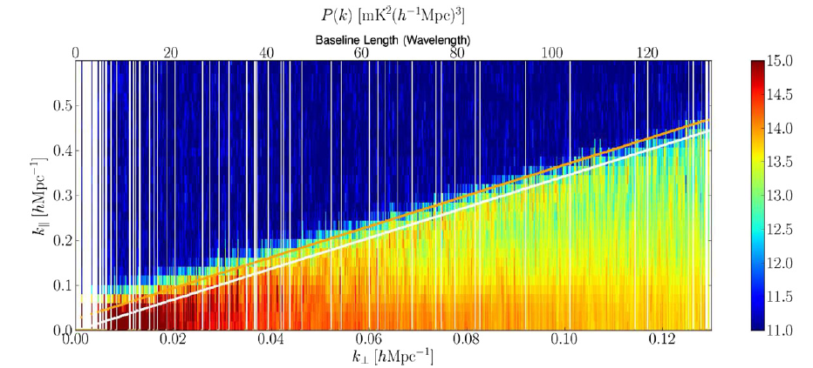
‘The Wedge’
Max. geometric delay for celestial sources
Consider k_{perp} (angle) vs. k_{par}(freq) => smooth spectrum sources naturally limited in delay (k_{par}) space to delays < geom. max.
Line sources extend beyond wedge in DS
Delay or Freq⁻¹
‘horizon limit’ for continuum sources
Baseline or Angle⁻¹

