Slide 1
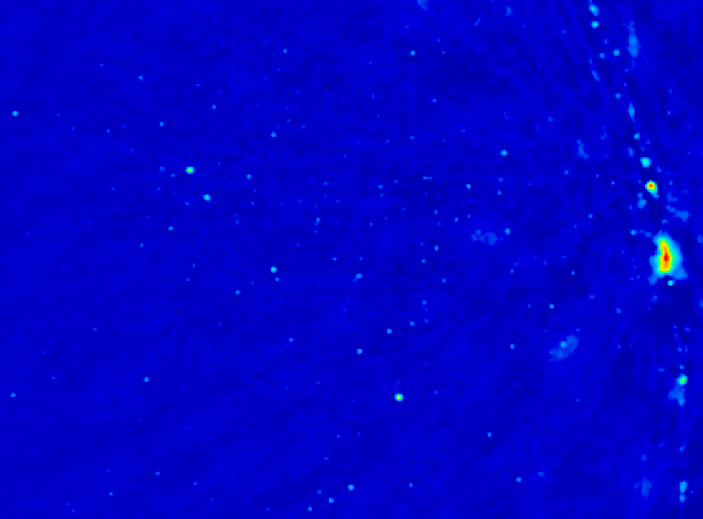
Cosmic Reionization on PAPER
Chris Carilli
Cosmology Summer School, Santa Fe, July 2013
I. Introduction: Cosmic Reionization
Concept
Constraints on evolution of neutral IGM
II. HI 21cm line
Potential for direct detection of the neutral IGM
Precision Array to Probe Epoch of Reionization: design and first results
Fan, Carilli, Keating 2006, ‘Observational constrains on cosmic reionization,’ ARAA, 44, 415
Furlanetto et al. 2006, ‘Cosmology at low frequencies: The 21 cm transition and the high-redshift Universe,’ Phys. Reports, 433, 181
Wyithe & Morales 2010, ARAA, 48, 127

Slide 2
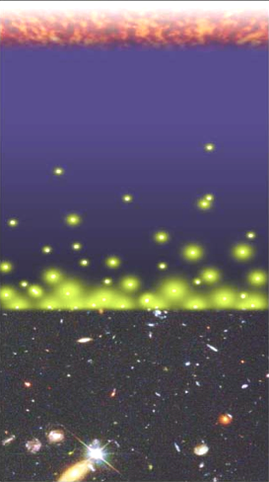
Big Bang f(HI) ~ 0
History of the IGM (Hydrogen)
Recombination
0.4 Myr
z = 1000
f(HI) ~ 1
Reionization
0.3 - 0.8 Gyr
z ~ 7 to 15
f(HI) ~ 10⁻⁵
13.6Gyr
z = 0

Slide 3
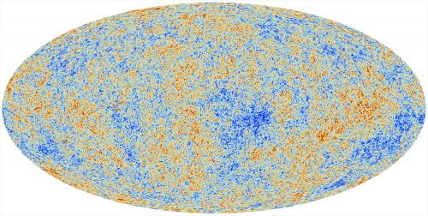
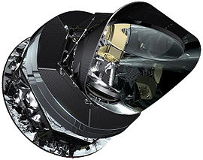
Cosmic microwave background radiation
Recombination
Early structure formation
PLANCK – imprint of primordial structure from the Big Bang

Slide 4
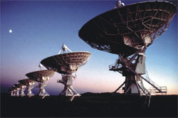
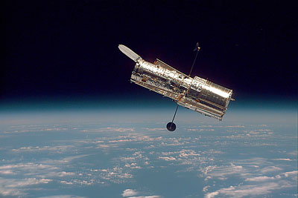
Big glass: HST, VLT, VLA
Late structure formation Realm of the Galaxies

Slide 5
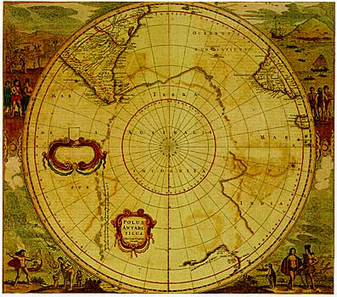
Universum incognitus
Dark ages
Last phase of cosmic evolution to be tested and explored
Cosmological benchmark: formation of first galaxies and quasars
Today’s focus: Evolution of the neutral IGM and reionization
When?
How fast?
HI 21cm signal
Cosmic Reionization

Slide 6
Numerical Simulations of the evolution of the IGM (Gnedin & Fan 2006, 648, 1)
F(HI) from z=20 to 5
Three phases
Dark Ages
Isolated bubbles (slow)
Percolation (bubble overlap, fast)
10cMpc
Matches UV lum. func. at z=5 to 8
Consistent with GP constraints on the IGM opacity at z ~ 6

Slide 7
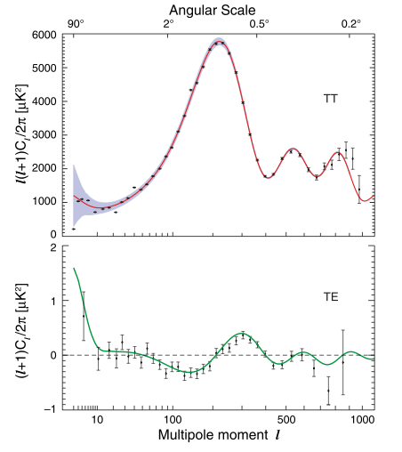
Constraint I: Large scale polarization of the CMB (WMAP)
Thomson scattering CMB (local quadrupole) during reionization => polarized
Integral measure of _{e} back to recombination
Large scale ~ horizon at z_{reion} l < 10 or angles > 10º
Weak: uK rms ~ 1% total inten.
Sachs-Wolfe
Baryon Acoustic Oscillations: Sound horizon at recombination
_{e} = 0.087 +/- 0.015
Jarosik et al 2011, ApJS 192, 14

Slide 8
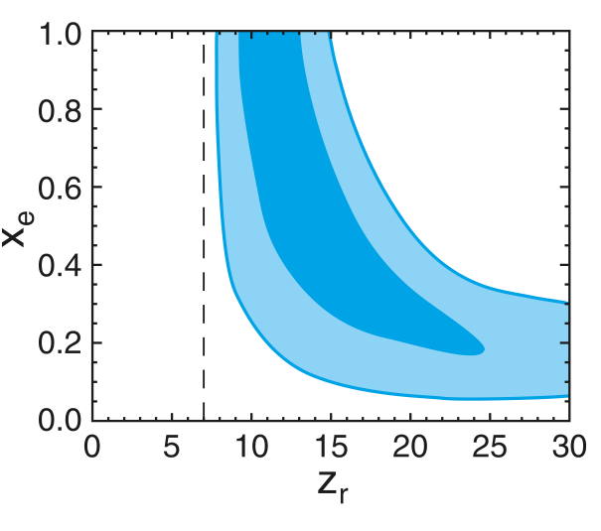
CMB large scale polarization: constraints on F(HI)
Rules-out high ionization fraction at z > 15
Allows for small (≤ 0.2) ionization to high z
Most ‘action’ at z ~ 8 – 13
Challenges:
Systematics in extracting large scale signal
Integral measure of _{e}
1-F(HI)
Two-step reionization: 7 + z_{r}
Dunkley ea 2009, ApJ 180, 306

Slide 9
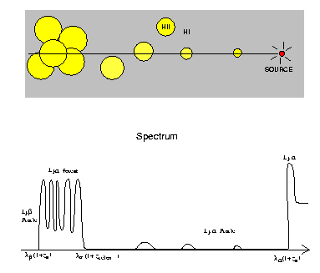
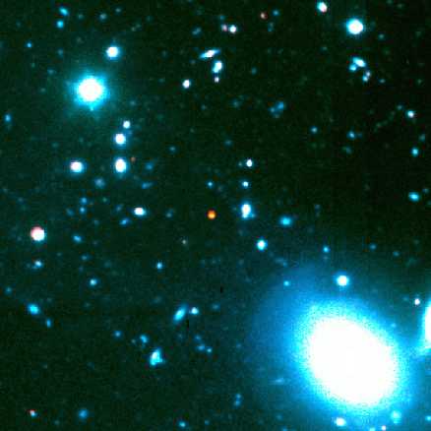
Constraint II: Gunn-Peterson Effect (Gunn + Peterson 1963)
ionized
neutral
z=6.4
quasar
z
SDSS high z quasars
Lya resonant scattering by neutral IGM
Barkana and Loeb 2001

Slide 10
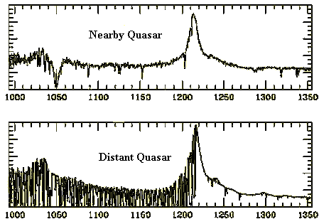
Neutral IGM after reionization = Lya forest
Lya resonant scattering by neutral gas in IGM clouds
Linear density inhomogeneities, δ~ 10
N(HI) = 10¹³ – 10¹⁵ cm⁻²
F(HI) ~ 10⁻⁵
z=0
z=3

Slide 11
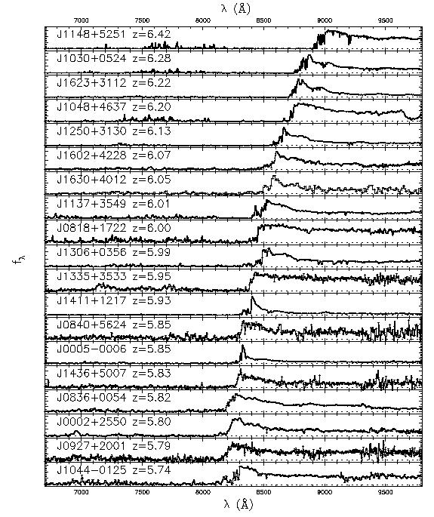
Gunn-Peterson effect
6.4
SDSS z~6 quasars
Opaque (τ > 5) at z>6
=> pushing into reionization?
5.7
SDSS quasars
Fan et al 2006

Slide 12
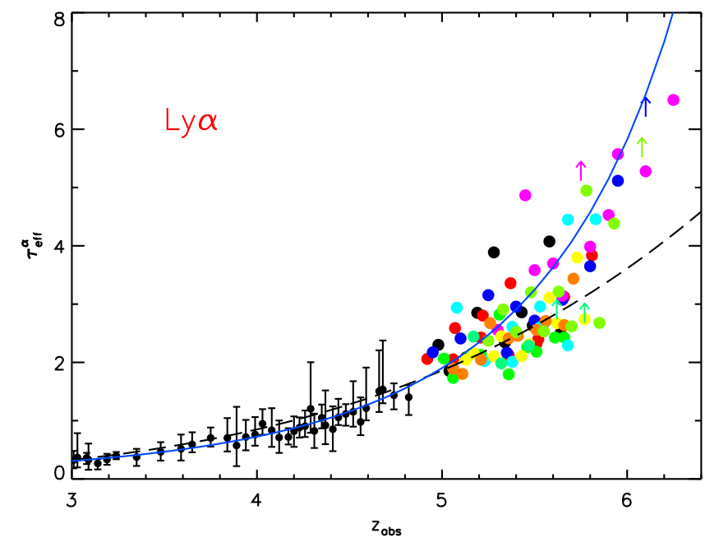
Gunn-Peterson constraints
on F(HI)
τ_{eff}
Becker et al. 2011
Diffuse IGM:
τ_{GP} = 2.6e4 F(HI) (1+z)^{3/2}
Clumping: τ_{GP} dominated by higher density regions => need models of ρ, T, UV_{BG} to derive F(HI)
Challenge: Saturates at low F(HI) => late-time probe
F(HI)_{v} ~ 10⁻⁵ at z < 4
F(HI)_{v} ≥ 10⁻⁴ at z ~ 6

Slide 13
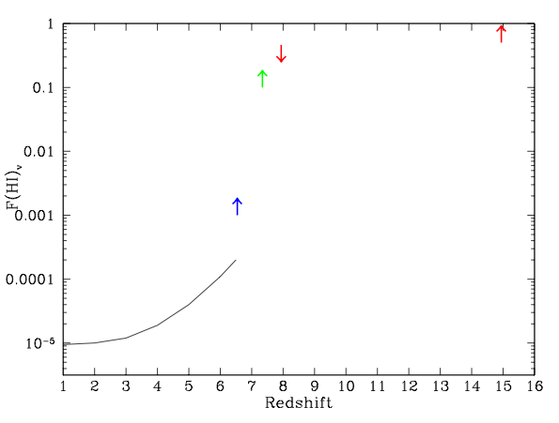
CMB_{pol}
F(HI)_{v}
Lya Forest/GP
GP => systematic rise of F(HI) to z ~ 6.5
CMB_{pol} => mostly neutral at z>15, mostly ionized at z < 8

Slide 14
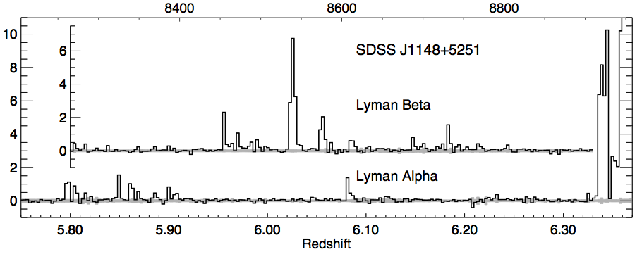
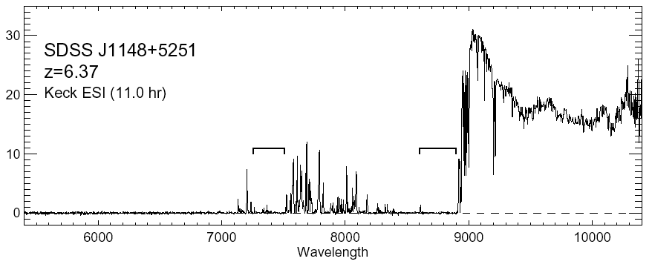
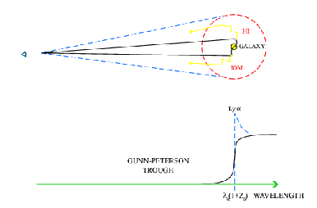
Quasar Near Zones: J1148+5251
Host galaxy redshift: z=6.419
Quasar spectrum => photons leaking down to z=6.32
White et al. 2003
Time bounded Stromgren sphere ionized by quasar
Difference in z_{host} and z_{GP} =>
R_{NZ} =4.7Mpc ~ [L_{γ} t_{Q}/F_{HI}]^{1/3} (1+z)⁻¹
cf. ‘proximity zone’ interpretation, Bolton & Haehnelt 2007
HI
HII

Slide 15
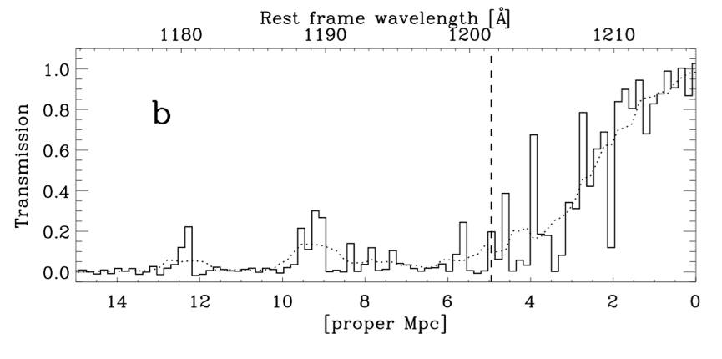
QNZ: analyze size evolution of 28 quasars at z=5.7 to 6.5 with measured z_{host} and z_{GP}
Deriving z_{GP}: clumpy structure => depends on spectral resolution.
Prescription: 1st point when transmission < 10% at 20A res (well above GP level) => reproducible, but relative, measure of size of QNZ
Accuracy: δz~ 0.01
z = 6.1
Wyithe et al. 2010

Slide 16
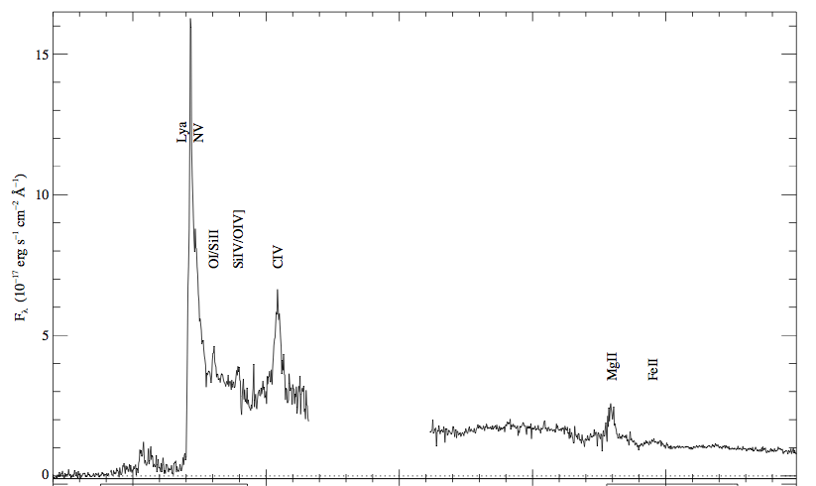
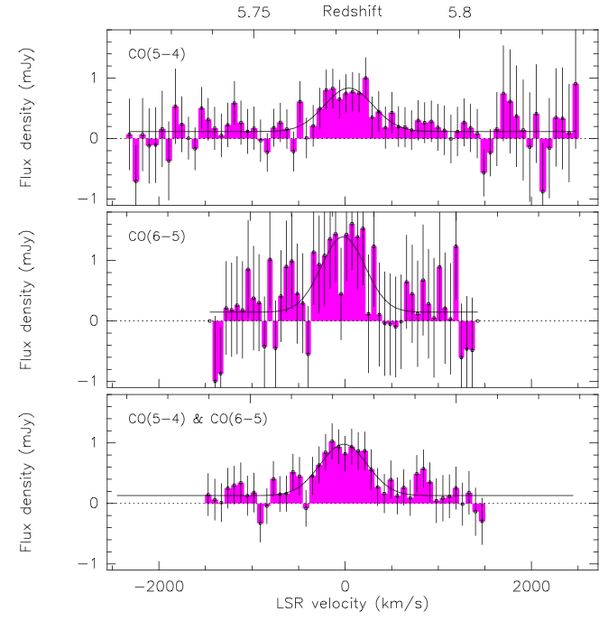
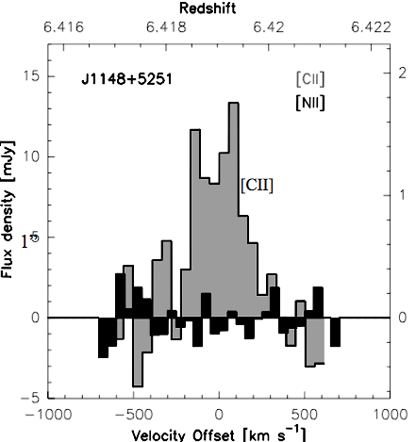
II. Deriving z_{host}: CO (8), [CII] (5), MgII (14), UV (8)
δz = 0.03 for UV lines
δz = 0.01 for MgII
δz = 0.003 for CO, [CII]
Broad ~ few 1000 km/s
Systematic offsets ~ 1000 km/s
CO/CII
Widths ~ few hundred km/s
Centered on galaxy

Slide 17
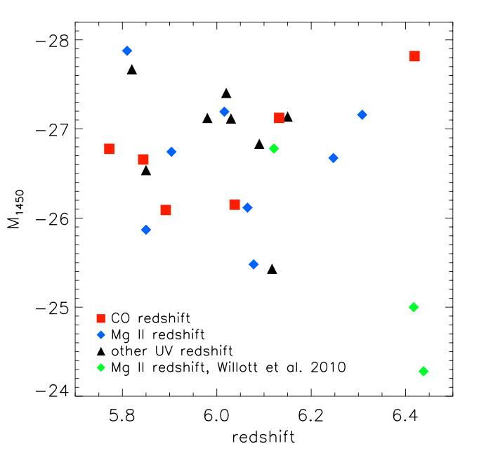
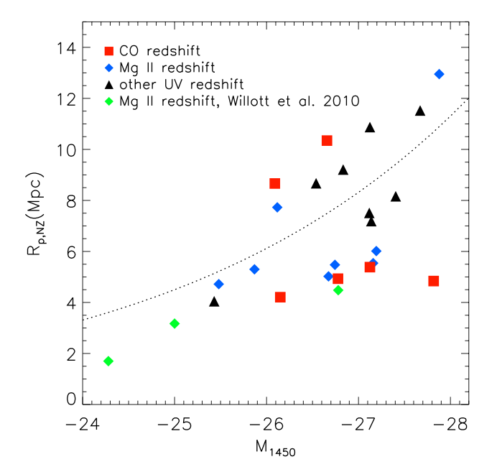
Quasar Near-Zones: 28 GP quasars at z=5.7 to 6.5
L_{UV}
R L_{γ}^{1/3}
L_{UV}
No correlation of UV luminosity with redshift
Correlation of R_{NZ} with UV luminosity
Note: significant intrinsic scatter due to local environ., t_{q}

Slide 18
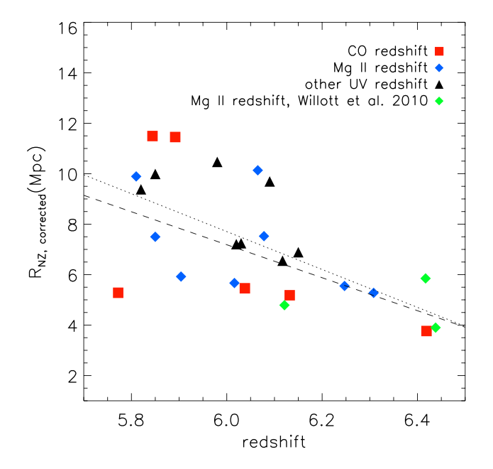
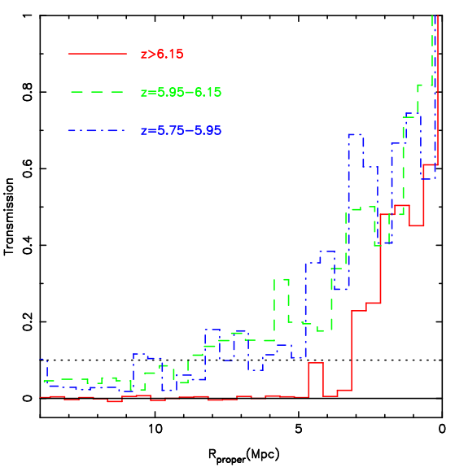
Quasar Near-Zones: R_{NZ} vs redshift
[normalized to M₁₄₅₀ = -27]
R_{NZ} = 7.3 – 6.5(z-6)
z>6.15
<R_{NZ}> decreases by factor 2.3 from z=5.7 to 6.5
If CSS => F(HI) increases by factor ~ 10 (10⁻⁴ to 10⁻³)

Slide 19
CMB_{pol}
QNZ
GP
QNZ => fairly rapid rise in F(HI) at z ~ 6 to 7?
Challenges: relative measure of size, pre-ionization, internal clumping

Slide 20
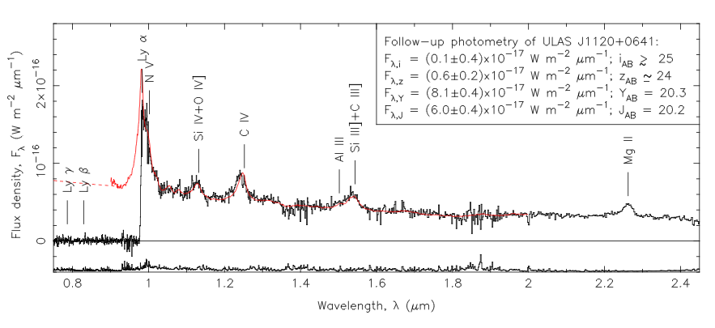
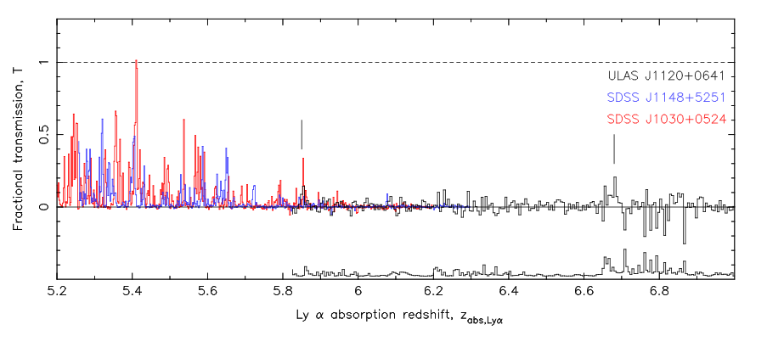
Highest redshift quasar, z=7.1: revolutionary result?
Clear GP absorption trough: τ > 5 => IGM opaque to Lya at z ≥ 6
6.2, 6.4, 7.1
Mortlock ea. Nat 474,616
Bolton ea. MNRAS, 466, L270
5.2
6.0
7.0

Slide 21
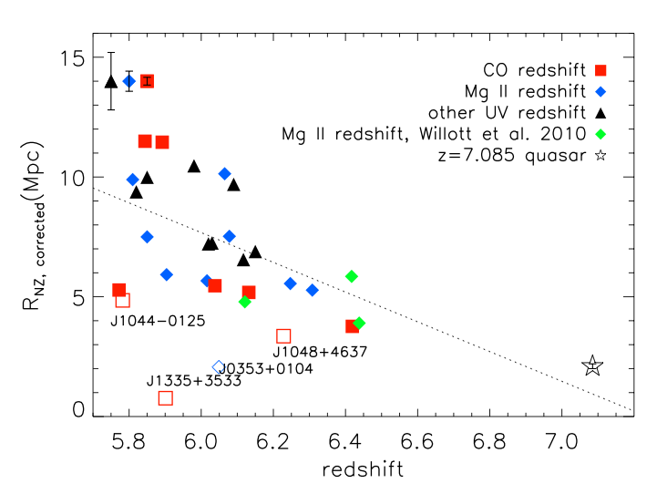
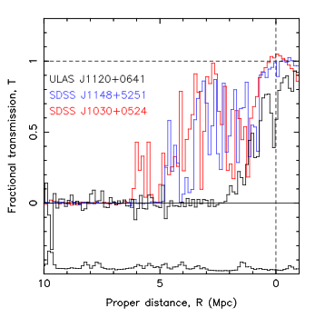
z=7.1 quasar near zone small ~ 2Mpc
z ≤ 6.4
z=7.1
Continues trend for decreasing NZ size with z

Slide 22
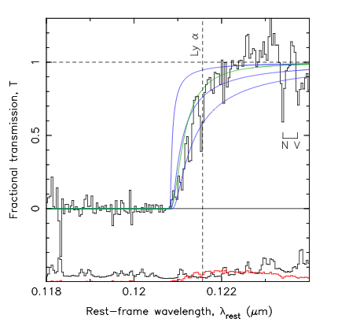
z=7.1 quasar: Damped Lya profile
N(HI) > 10^{20.5} cm⁻²
Substantially neutral IGM: f(HI) > 0.1 at 2Mpc distance, or
Damped Lya galaxy at 2.6Mpc (probability ~ 5%)
0.5
f(HI)=0.1
1.0
N(HI)=4e20 cm⁻² at 2.6Mpc
Bolton ea., Mortlock ea

Slide 23
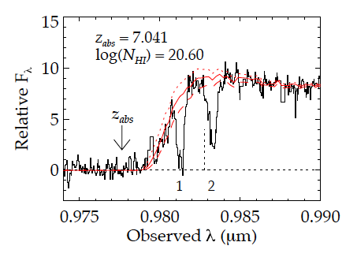
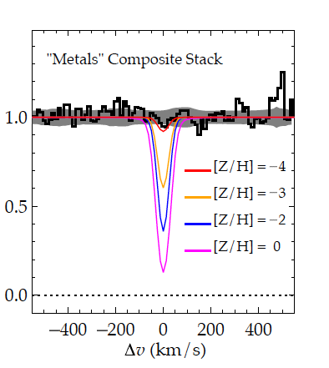
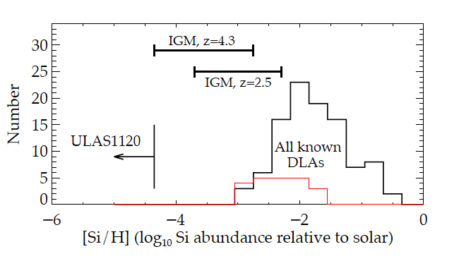
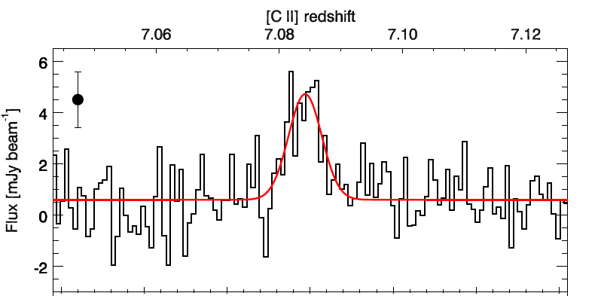
Highly Heterogeneous metalicities: galaxy vs. IGM
Simcoe ea.
Z/H < -4
[CII] + Dust detection of host galaxy => enriched ISM, but,
Very low metalicity of IGM just 2 Mpc away
Venemans ea.
[CII] 158um
Large metalicity variations expected during epoch of first galaxy formation.

Slide 24
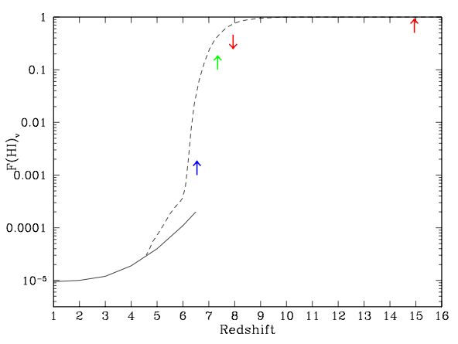
3.34
0.95
0.65
0.48
0.38Gyr
CMB_{pol}
Q-DLA
Gnedin & Fan model
QNZ
GP
z=7.1 quasar => rapid change in IGM (‘cosmic phase transition’)?
Challenge: only one example

Slide 25
3.34
0.95
0.65
0.48
0.38Gyr
CMB_{pol}
Q-DLA
integral measure τ_{e}
one source
Gnedin & Fan model
QNZ
relative measure
GP
saturates
Amazing progress, suggesting rapid change in IGM at z~7
All values have systematic/modeling uncertainties
=> Need new means to probe reionization

Slide 26
BREAK

Slide 27
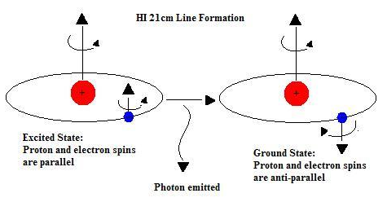
HI 21cm line: Most direct probe of the neutral IGM
Low frequencies:
ν_{obs} = 1420MHz/(1+z) ≤ 200 MHz
Advantages of the 21cm line
Direct probe of neutral IGM
Spectral line signal => full three dimensional image of structure formation (freq = z = depth)
Low freq => very (very) large volume surveys (1sr, z=7 to 11)
Hyperfine transition = weak => avoid saturation (translucent)

Slide 28
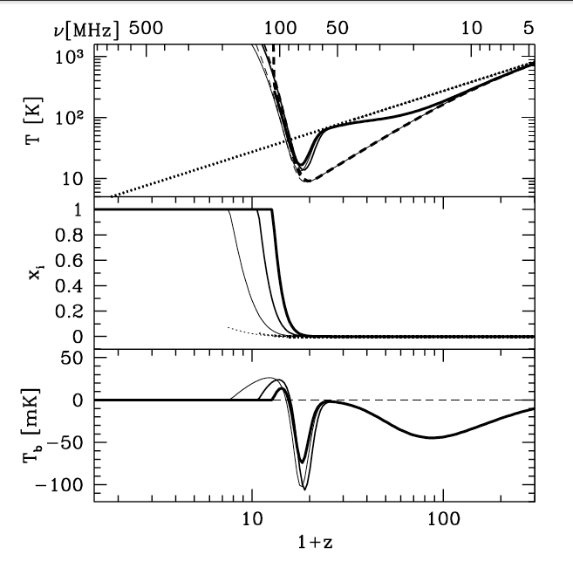
HI 21cm obs of neutral IGM
‘Richest of cosmological data sets’
z>200: T_{CMB} = T_{K}= T_{S} by residual e-, photon, and gas collisions. No signal.
z∼30 to 200: gas cools as T_{k} ≈ (1+z)² vs. T_{CMB} ≈ (1 + z), but T_{S} = T_{K} via collisions => absorption, until density drops and T_{s} → T_{CMB}
z∼20 to 30: first stars => Lyα photons couples T_{K} and T_{S} => 21-cm absorption
z∼6 to 20: IGM warmed by hard X rays => T_{K} > T_{CMB}. T_{S} coupled to T_{K} by Lya. Reionization is proceeding => bubble dominated
IGM reionized
T_{cmb}
T_{S}
T_{K}
E
D
C
B
A
First stars
Pritchard & Loeb

Slide 29
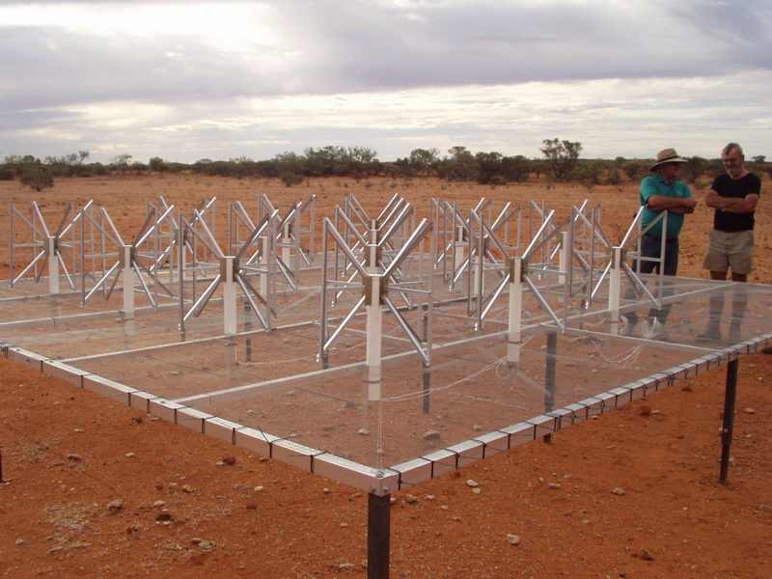
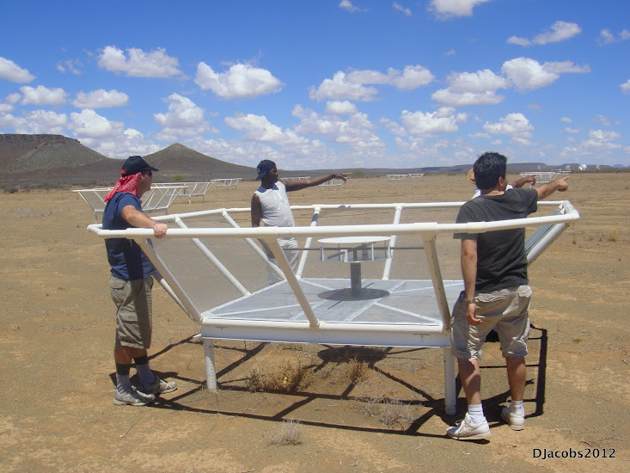
MWA - Oz
PAPER - SA
Rennaisance at low freq: 1% to 10% of a square kilometer array
Array | FoV deg² | Area m² | Type | Bmax km | Start Science obs
SKA-I Low | 30 | Few e5? | Tile | 5? | 2020?
LOFAR | 25 | 3e4 | Tile | 2 | 2013
MWA-128 | 300 | 2e3 | Tile | 1.5 | 2013
PAPER-128 | 1600 | 1e3 | Dipole | 0.3/0.6 | 2013
HERA-576 | 64 | 8e4 | Dish | 0.3/2 | 2017?

Slide 30
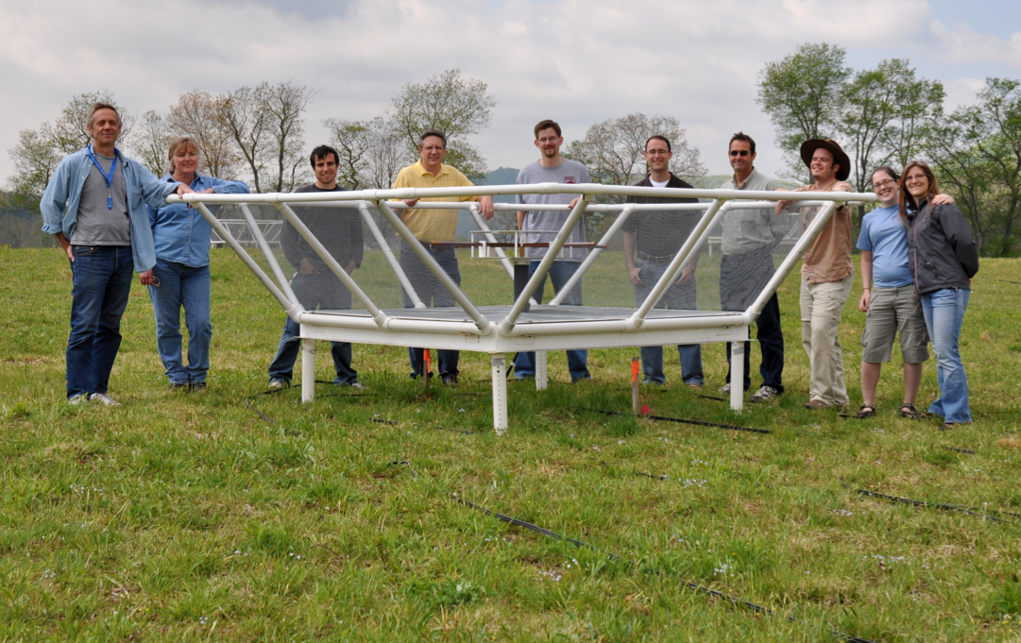
Precision Array to Probe Epoch of Reionization
Don C. Backer Array
Berkeley, NRAO, Penn, SKA/South Africa
Focus: low-ν array to study HI 21cm signal from reionization
Precision: emphasize engineering solutions first
Staged: work through problems before increasing investment

Slide 31
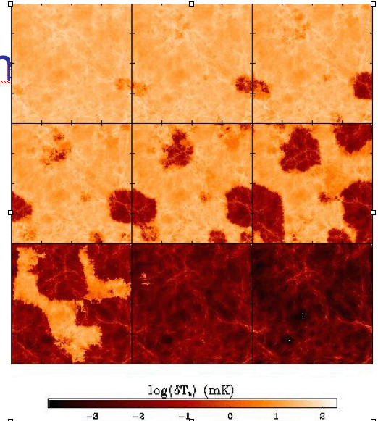
Signal end-game: HI 21cm ‘tomography’ of IGM
Challenge: Sensitivity
z= 12
ν₂₁= 109 MHz
9
Imaging of typical structures requires full Square Kilometer Array
ΔTB(2’) ~ 20 mK ~ 8uJy
SKA rms ~ 4mK
z=7.6
ν₂₁= 165 MHz
10cMpc = 4’
Furlanetto ea 2004

Slide 32
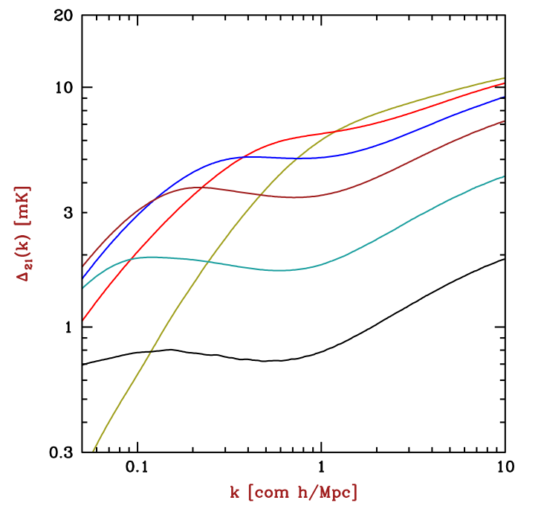
Near-term Reionization: Pathfinder science goals
3D power spectrum in 21cm line
characteristic bubble scale
z==12, f(HI) = 0.9
z=10
z=7, f(HI) = 0.02
Barkana 2009

Slide 33
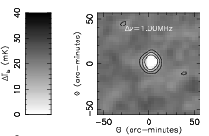
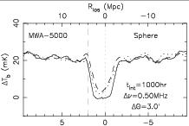
Pathfinder science goals: largest structures (QNZ)
Quasar or clustered galaxy formation: largest ionized structures ~ 15’
Signal: 20mK => 0.5 mJy
rms(HERA576,100hr,1MHz) ~ 0.07mJy
Rare but we observe huge volume: 64deg²; z=6 to 11
50cMpc
0.5 mJy
Wyithe et al. 2006

Slide 34
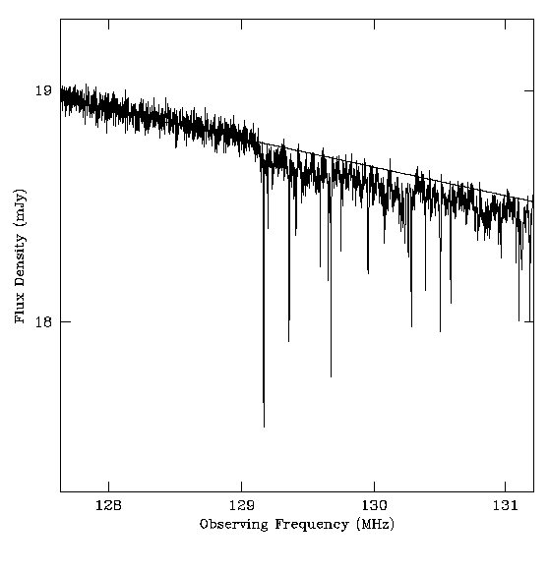
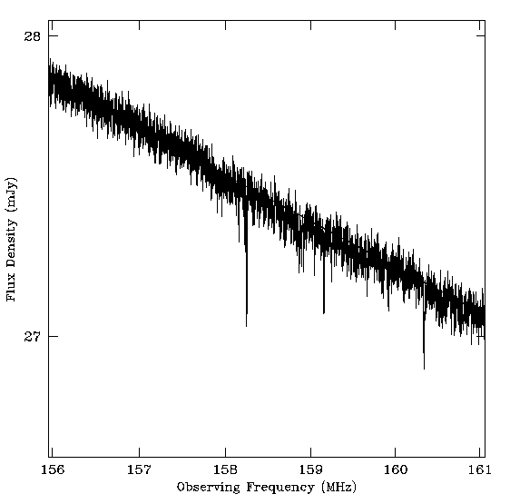
Pathfinder science goals: HI 21cm Forest
0.3 Jy
z=12
z=8
130MHz
159MHz
Perhaps easiest to detect, if there are sources!
Only way to study small scale structure during reionization
Problem: finding RL quasars z>6?
radio G-P (τ=1%)
21 Forest (10%)
mini-halos, primordial disks (10% to 100%)

Slide 35
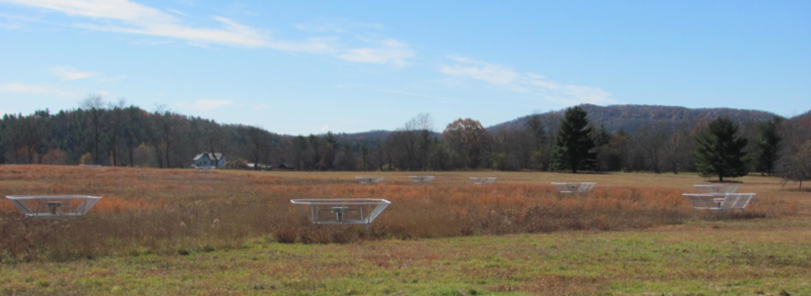
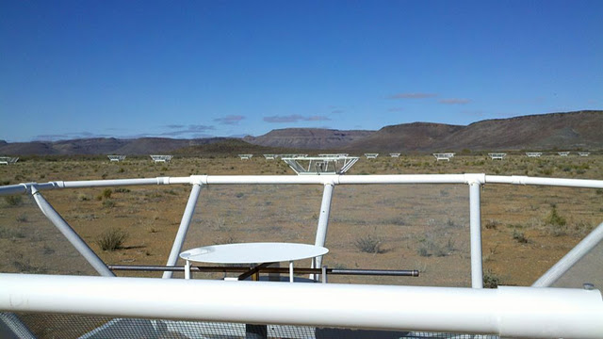
32 station engineering array in Greenbank, WV
PAPER basics
Freq = 115 to 190 MHz (z= 6.5 to 11)
Single dipole elements + ‘flaps’ => FoV_{FWHM} ~ 40º
Max baseline = 300m => res ~ 15’
Build-out to 128 antennae science array in Karoo, South Africa in 2013 (currently 64)

Slide 36
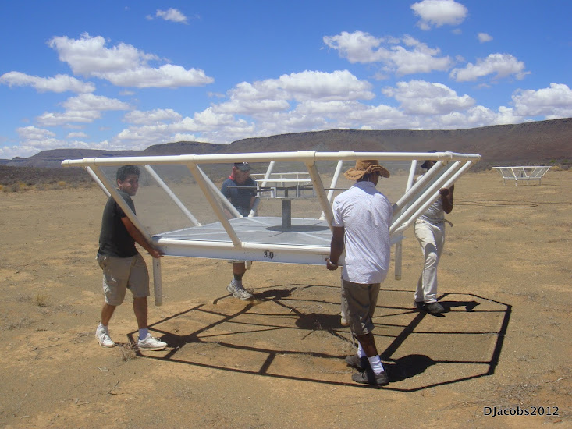
Reconfigurable => optimize for science goal
Minimum redundancy array
maximize u,v coverage => imaging
Maximum redundancy: delay spectrum analysis

Slide 37
Established working array from scratch in ~ 6months, with help from ZA (SKA, Durban)
Durban University of Technology
PAPER
575 km
Cape Town

Slide 38
Challenge: Interference
100 MHz z=13
200 MHz z=6
Aircraft
Orbcomm
TV

Slide 39
Radio quiet zones
PAPER South Africa
TV
OrbComm
FM
ISS
OrbComm
100MHz
200MHz
100MHz
200MHz
US ‘radio quiet zone’
ZA ‘radio quiet zone’

Slide 40
Challenge: hot, confused sky at low freq
Haslam, Eberg 408MHz
Coldest regions: T ~ 100 (ν/200 ΜΗz)^{-2.6} K = 10⁴ x 21cm signal
Highly ‘confused’: 1 source/deg² with S140 > 1 Jy

Slide 41
Solution: spectral decomposition
Foreground= non-thermal= featureless over ~ 100’s MHz
Signal = fine scale structure on scales ~ MHz
Cygnus A
Signal/Sky ~ 10⁻⁵
z=13
z=7
500MHz
5000MHz
Critical to mitigate freq dependent telescope response!

Slide 42
PAPER Antenna: ‘clean machine’
Sleeve dipole + flaps
Smooth, broad response in frequency and angle
Gain
10dB
120MHz
200MHz
LNA: T_{rx} = 110K, 30dB gain 120-180MHz

Slide 43
PAPER Primary beam
FW10% ~ 90º
Measure power pattern using Orbcom at 136MHz

Slide 44
PAPER: (Xilinx) FPGA + GPU correlator from Berkeley wireless lab (CASPER)
ROACH2 F engine: sample/digitize, transform (τ → ν), using polyphase filter (‘preconvolution’)
GPU X engine: cross multiply V (B, ν)
Cross-connections: ‘packetized correlator’ using 10Gb Ethernet protocol + commercial data routers
Computing, processing, storage (Penn)
Cluster computing: 32 octal core servers
Store raw visibilities: RAIDS 120 TB
AIPY (Berkeley), CASA, AIPS (NRAO)

Slide 45
Power spectrum approach: ‘delay spectrum’ (Parsons ea)
Redundant spacings: identical measurements => add spectra coherently => ‘signal to noise’ of PS in (mK²) improves linearly with number of measurements, N, vs. as N^{1/2} with incoherent averaging (add coherently and square vs. square and add)
Delay spectrum: PS strictly in frequency domain
Work ‘outside wedge’: reduce continuum contribution
Parsons et al. 2013, ApJ, submitted (arXiv:1304.4991)
Pober et al. 2013, ApJ, 768, L36
Moore et al. 2013, ApJ, 769, 154
Parsons et al. 2012, ApJ, 756, 165
Parsons et al. 2012, ApJ, 753, 81

Slide 46
‘delay spectrum’
Freq maps to distance => Fourier conjugate (delay) maps to wavenumber
Analyze PS per N_{red} baselines, time in k_{par}: PS = square of F_{t}(V_{K}(ν)) = V²_{K}(τ)
Advantages:
Allows study of smaller k scales
Mitigates continuum dynamic range problems

Slide 47
‘The Wedge’
Max. geometric delay for celestial sources
Consider k_{perp} (angle) vs. k_{par}(freq) => smooth spectrum sources naturally limited in delay (k_{par}) space to delays < geom. max.
Line sources extend beyond wedge in DS
Delay or Freq⁻¹
‘horizon limit’ for continuum sources
Baseline or Angle⁻¹

Slide 48
PAPER 32 Power spectrum
300hrs, 32ant, 70 redundant baselines of 30m length
k ~ 0.1 to 0.2 h⁻¹ Mpc⁻¹:
k³/2π² P(k) < (52 mK)²
5 order of magnitude continuum suppression
Best limits to date by 100x
Still inconsistent with thermal noise => residual (pol.) continuum?
Still 100x above predictions of fiducial reionization models (eg. McQuinn ea)
‘horizon limit’ = ‘wedge’
Paciga ea GMRT
T_{sys}=560K
Fiducial

Slide 49
Ruling out pathological (but not impossible?) models
‘horizon limit’ = ‘wedge’
Model: neutral IGM remains cold (no large-scale Xray warming), but enough Lya to couple T_{s} and T_{K} and reionization proceeds locally => <T_{B}> ~ 400mK
Build-out 2013 to 2015
128 elements
2 years observing
Full polarization (get to thermal noise)
~10x improvement (in mK) => constrain fiducial models
No warming
Fiducial

Slide 50
‘Richest of cosmological data sets’
z>200: T_{CMB} = T_{K}= T_{S} by residual e-, photon, and gas collisions. No signal.
z∼30 to 200: gas cools as T_{k} ≈ (1+z)² vs. T_{CMB} ≈ (1 + z), but T_{S} = T_{K} via collisions => absorption, until density drops and T_{s} → T_{CMB}
z∼20 to 30: first stars => Lyα photons couples T_{K} and T_{S} => 21-cm absorption
z∼6 to 20: IGM warmed by hard X rays => T_{K} > T_{CMB}. T_{S} coupled to T_{K} by Lya. Reionization is proceeding => bubble dominated
IGM reionized
T_{cmb}
T_{S}
T_{K}
No warming
E
D
C
B
A

Slide 51
Anscillary science: Unique parameter space
Continuous ‘all-sky’ monitor (GRBs, XRBs...)
Sensitive to LSS (15deg at 15’ res)
Sensitivity(10min) ~ 5mJy
Broad freq range
Violates all assumptions in synthesis imaging (eg. SIRA)
Transit array => image in snapshots in time (10min)
Very wide field (‘full sky’) => require 3D FT (facets)
Very wide band (octave) => require multifreq synthesis (currently image snapshots in freq ~ 10MHz)
Very high dynamic range > 10⁵: requires extensive iteration in selfcal/deconvolution
Structure on all scales => require ‘multiscale clean’
Strong and weak RFI: multiple layers of flagging

Slide 52
10min snapshots
DNR ~1000
All sky, All the time
10º

Slide 58
Centaurus A: physics of radio galaxies (Stefan ea. 2013)
150MHz
+ RASS
1.4GHz
8º ~ 600kpc
Xray correlations
Knots in South = IC? B ~ 1 uG ~ B_{MP}
Lobe pressure ~ IGM ~ 10⁻¹³ dyn cm⁻²
Spectral flattening in regions of ‘heavy weather’: Vortices shells, rings, waves (Feain ea) => local particle acceleration

Slide 59
Galactic studies
SNR searches, spectra, imaging: find the missing large SNR?
Galactic HII regions: free-free abs => 3D study of thermal/nonthermal ISM
W28-SNR + M8-HII
SgrA*
10º
CTB37-SNR

Slide 60
GBT 1.4 GHz (Zadeh ea)
PAPER 0.15GHz
1º
Galactic center: free-free abs
GBT 1.4GHz: clear GC peak
PAPER 150MHz: ‘flat’
GC: inverted spectrum = FF abs: EM > 10⁴ pc cm⁻⁶
‘Funnel’ to SE = thermal outflow: n_{e} > 10 cm⁻³ (or foreground HII)?
SI: 1.4 – 0.15GHz

Slide 61
Cosmic Reionization: last frontier in studies of large scale structure formation
1st insights: qso spectra + CMB_{pol} => rapidly increasing neutral fraction at z ~7, but finite ionization to z ~ 10
HI 21cm: direct observation of neutral IGM
PAPER:
First all-sky, low freq, broad band images
First PS limits from PAPER 32: rule out pathological (but not impossible) models
Build out to 128 in 2013, observe 2 years: constrain plausible models or first detection!
Hydrogen Array for EoR (HERA): MWA+PAPER++ consortium to design next gen. instrument for PS characterization: 576 x 14m => 0.1 SKA
SKA required for full tomography
Dark Ages Radio Explorer (Burns ea.): probe linear regime z > 30, <50MHz

Slide 62
Hydrogen Epoch of Reionization Array HERA-576 x 14m
What were the first luminous objects, and how did they reionized the neutral IGM?
Over what redshift range did this occur?
How did the process proceed (wrt heating, feedback, scale)
Location: Karoo, South Africa
PI institute: Berkeley; CoI: Penn, NRAO, MIT, ASU, Washington, SKA-ZA, U.KwaZulu-Natal ZA
http://reionization.org
Notes:
PSA-64, 32 antennas in a maximum-redundancy configuration, 30m between rows, 4m spacing within rows

Slide 63
HERA-576 Parameters
Notes:
PSA-64, 32 antennas in a maximum-redundancy configuration, 30m between rows, 4m spacing within rows

Slide 64
The HERA Dish
Why dish vs. tile?
Simpler electronics (no beam former)
Simpler primary beam (no tile-grating lobes) => critical for foreground removal
Electronically stable
14m diam,
4.5m focal height
zenith-pointing
Notes:
PSA-64, 32 antennas in a maximum-redundancy configuration, 30m between rows, 4m spacing within rows

Slide 65
HERA Configuration
Close-pack grid 24x24 antennas, 0.3km: optimal PS sensitivity using ‘delay spectrum’ analysis
34 outrigger antennas to +/- 1km => 3’ imaging (cal/bright src removal)
Complete uv coverage to +/- 500λ (150 MHz)
Imaging unique parameter space: sens., FoV, scale, freqs
Gal. synch. sources
Thermal absorption
Giant radio galaxies
-40 dB to 0 dB
Notes:
PSA-64, 32 antennas in a maximum-redundancy configuration, 30m between rows, 4m spacing within rows

Slide 66
HERA Signal Flow
Short analog signal chain minimizes reflection timescales
New CASPER board digitizes 0-250 MHz, hosts correlator F-engine, transmits selected 100-MHz via 10GbE optical links
42 GPU-accelerated servers act as correlator X-engines (night) and data compression engines (daytime)
Notes:
PSA-64, 32 antennas in a maximum-redundancy configuration, 30m between rows, 4m spacing within rows

Slide 67
HERA-576 Sensitivity/Goals
Overall: 11.7σ detection of the 21cm EoR HI 21cm power spectrum
Characterize PS shape: bubble scale, inside-out vs. outside—in…
Characterize evolution of PS from z=6 to 12
Image largest structures during reionization: 15’, 2MHz, 0.5mJy = highly biased regions (clusters/QSOs)?
21cm absorption toward first powerful radio galaxies?
Fiducial mode (Lidz et al. 2008): 50% ionization at z=8.5

Slide 68
Location: Karoo, South Africa
PI institute: Berkeley
CoI: Penn, NRAO, MIT, ASU, Washington, SKA-ZA, U.KwaZulu-Natal ZA
PAPER
575 km
Cape Town
PAPER South Africa
OrbCom
FM
ISS
100MHz
200MHz

Slide 69
HERA Cost & Timeline
Total Cost ~ $15M to $20M
Year 1 (Sept. 2014 – Aug. 2015): Augment PAPER-128 with 128 MWA tiles and 16 prototype dishes. Begin development of new site for hosting 576-element dish array.
Year 2 (Sept. 2015 – Aug. 2016): Conduct observations with hybrid array. Develop production dish array components. Continue infrastructure development.
Year 3 (Sept. 2016 – Aug. 2017). Install first half (288 elements) of dish array. Conduct commissioning observations July, 2017. Conduct second season of observations with hybrid array.
Year 4 (Sept. 2017 – Aug. 2018). Conduct science observations with the first half of the dish array. Install second half of the dish array afterward.
Year 5 (Sept. 2018 – Aug. 2019). Conduct science observations with full 576-element dish array.
Notes:
PSA-64, 32 antennas in a maximum-redundancy configuration, 30m between rows, 4m spacing within rows

Slide 70
HERA 24x24x10m x 1000hr sensitivity (Pober)

