Slide 1
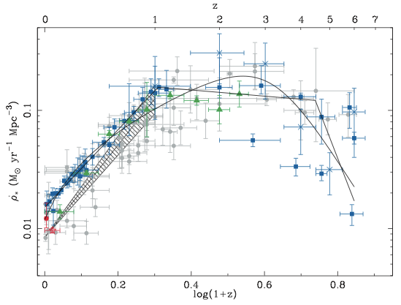
Cosmic star formation history (V. Smolcic ea)
redshift
Compilation based on different star formation estimators (UV, IR, radio, Hα..)
Large scatter: Dust obscuration is major problem
Star formation rate density [M/yr/Mpc³]
Hopkins & Beacom (2006) compilation
Notes:
Much work gone into this: z<1 rather well constrained, z>3 unconstrained
One of major difficulty: dust obscuration
Haarsma: At redshifts less than 1, our calculated star formation rates are signiÐ- cantly larger than even the dust-corrected optically selected star formation rates; however, we conÐrm the rapid rise from z \ 0 to z \ 1 seen in those surveys.
Make point here that high-z is uncertain

Slide 2
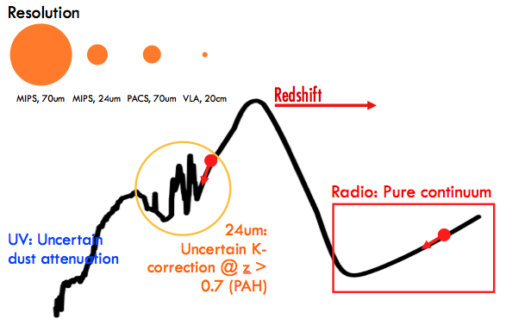
Why radio?
Advantage Dust-unbiased star formation tracer at high angular resolution
Challenge Star forming & AGN galaxy populations
For evolutionary studies needed
deep radio observations of a large sky area
multi-λ coverage &
an efficient SF/AGN identifier

Slide 3
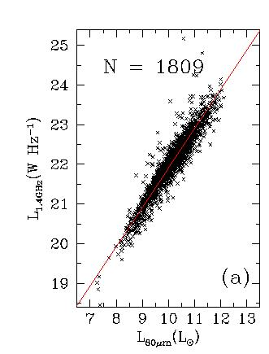
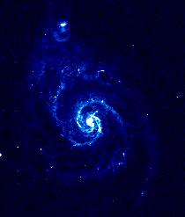
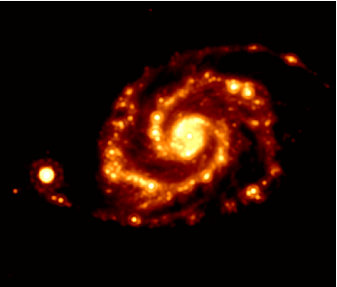
Radio as star formation tracer
IR-radio correlation:
S[(F)IR]
q = log ----------- = const.
S[20cm]
‘tightest correlation in Egal astronomy’: radio continuum traces (high-mass) star formation
radio
infra-red
Yun, Reddy, Condon (2001)

Slide 4
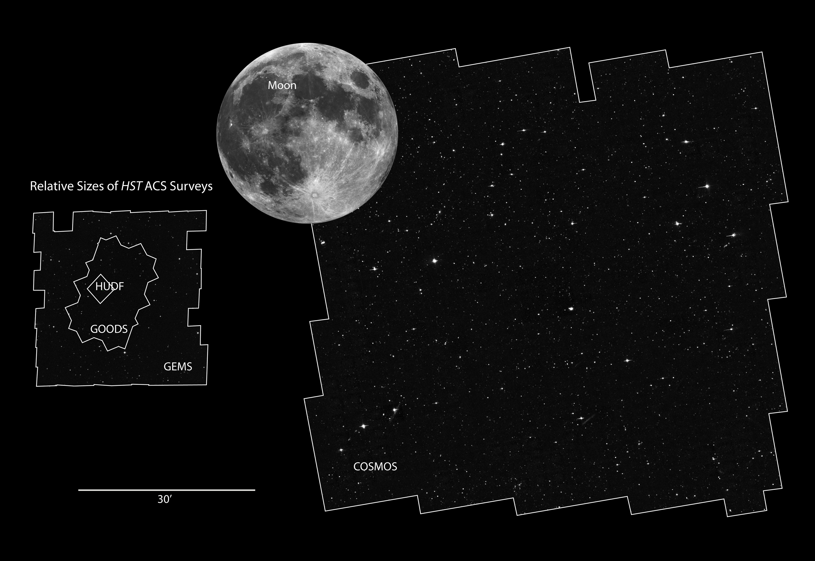
COSMOS survey
PI: Scoville
2 sq.deg.
X-ray➔radio imaging (>30 bands)
>25,000 spectra

Slide 5
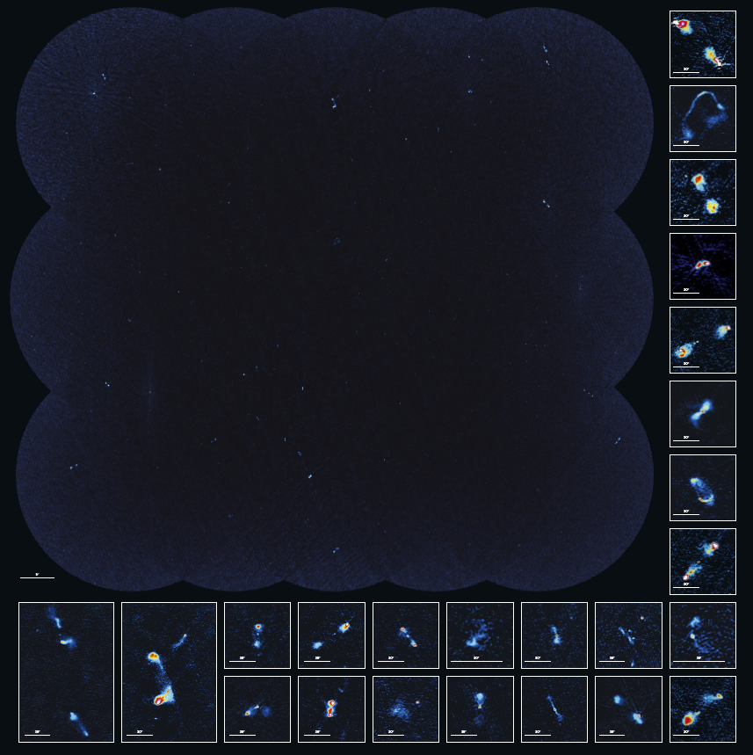
J-VLA-COSMOS Smolcic, Schinnerer++
Core team: Schinnerer, Smolčić, Carilli, Sargent, Karim, Bondi, Ciliegi, Scoville, Bertoldi, Blain, Impey, Jahnke, Koekemoer,, Le Fevre, Urry, Martínez Sansigre, Wang, Datta, Riechers
1.4 GHz Large (275hr) + Deep (62hr): Schinnerer et al. (2004, 2007,2010), Smolčić (PhD thesis)
~ 2,900 sources (S/N≥5)
~ 2 □^{O}; rms ~ 10 Jy/beam, 1.5” res.
324 MHz project (24hr): Smolčić et al. (in prep)
~ 2 □^{O}; rms ~ 0.5 mJy/beam
3 GHz Large project (384hr): PI: Smolčić; awarded
~ 2 □^{O}; rms ~ 2 Jy/beam

Slide 6
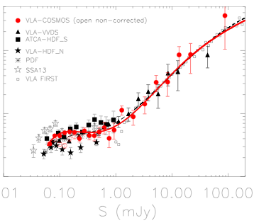
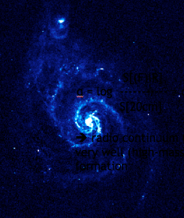
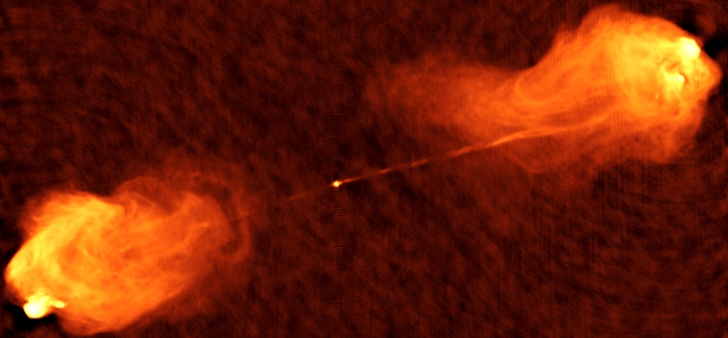
Sub-mJy source counts: SF galaxies?
n S^{2.5} (sr⁻¹ Jy^{1.5})
Star forming gals.
Radio AGN
Cambridge
FIRST/NVSS
0.01 0.1 1.0 10 100
Flux (mJy)
Bondi et al. 2008
Notes:
Counts & my pop plot

Slide 7
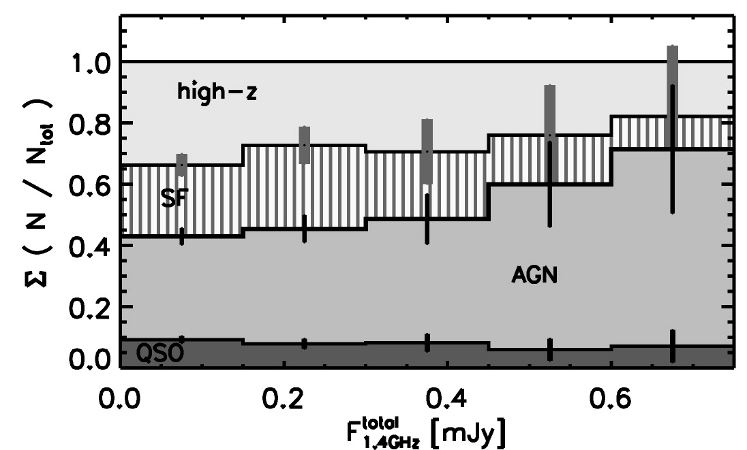
Selecting star formers vs. radio AGN
Spectral index > -0.5 => likely AGN
Multi-wavelength data (IR, Opt, Xray)
VLBI: T_{B} > 10⁵ K => likely AGN
Polarization: high pol => likely AGN?
Sub-mJy population mix:
~50-60% driven by AGN
~30-40% driven by SF
(z>1.3)
Cumulative contribution
Smolčić et al. 2008
Total radio flux [mJy]
Notes:
Counts & my pop plot

Slide 8
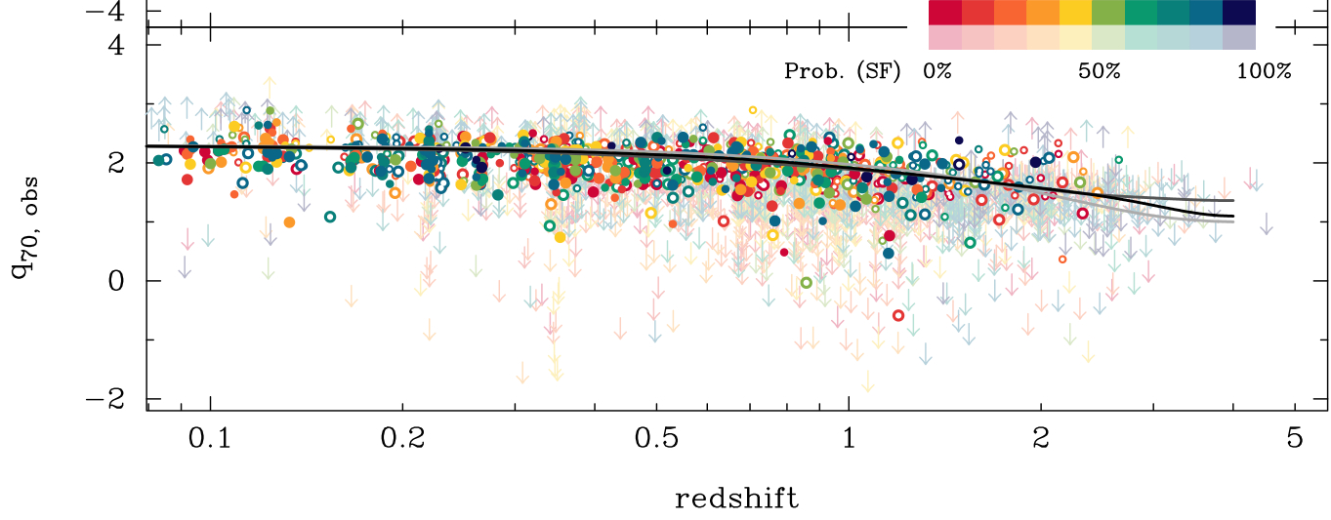
IR-radio correlation: No time evolution?
~ 5000 jointly radio and IR selected sources (no selection bias)
All sources detected
100%
AGN
100%
SF
Slope due to IR SED
(no k-correction)
Slope due to IR SED
(no k-correction)
No evolution of q as function of redshift, SFR and stellar mass out to z ~ 3 ➔ 20cm is a good star formation tracer
Sargent et al. (2010a,b)

Slide 9
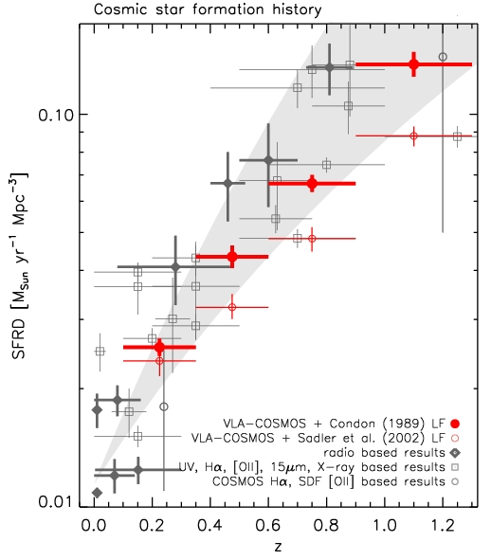
Direct detection: Dust-unbiased cosmic star formation history (z<1.3)
Good agreement between VLA-COSMOS CSFH and
  previous radio results (1 order of magnitude smaller sample; Haarsma et al. 2000)
  other estimates from Hα, OII, UV, IR with dust correction applied where needed
Smolčić et al. 2009
previous
radio data
Other
λ data
VLA-COSMOS

Slide 10
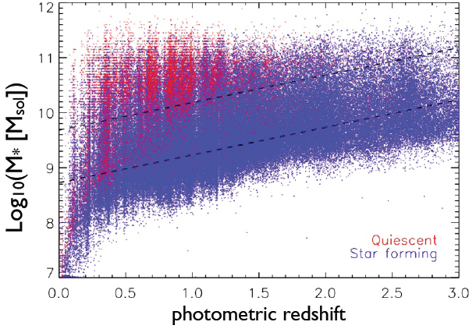
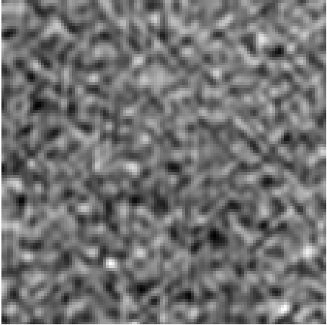
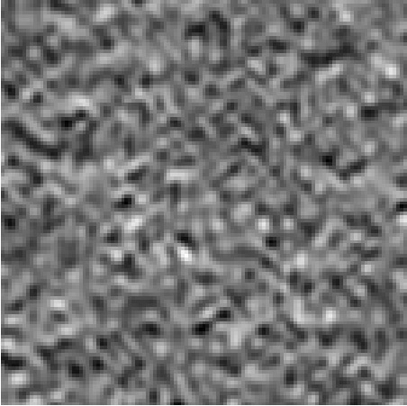
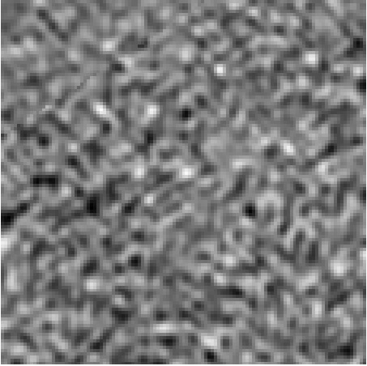
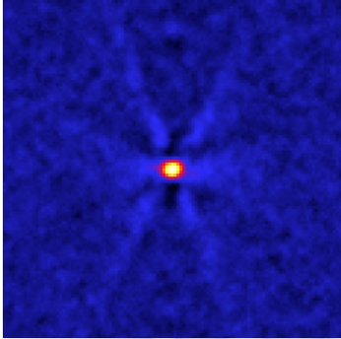
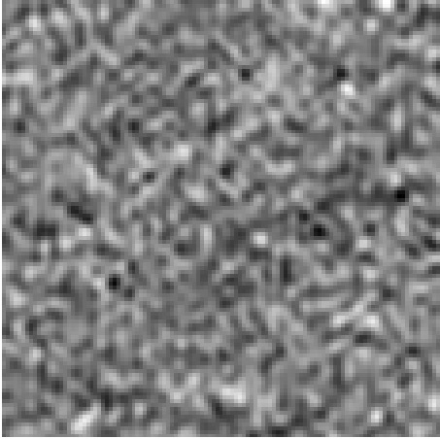
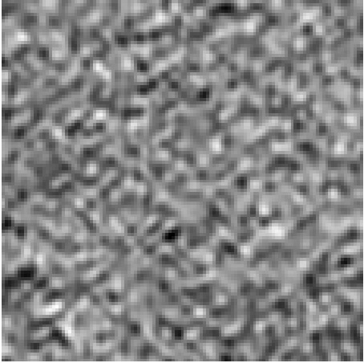
Pushing the limits via stacking
Stacking @ 20cm: Input 3.6μm catalog (Ilbert et al. 2009) → mass selected
rms ~ 12 μJy/beam
➔ < 1 μJy/beam
Karim et al. (2011)

Slide 11
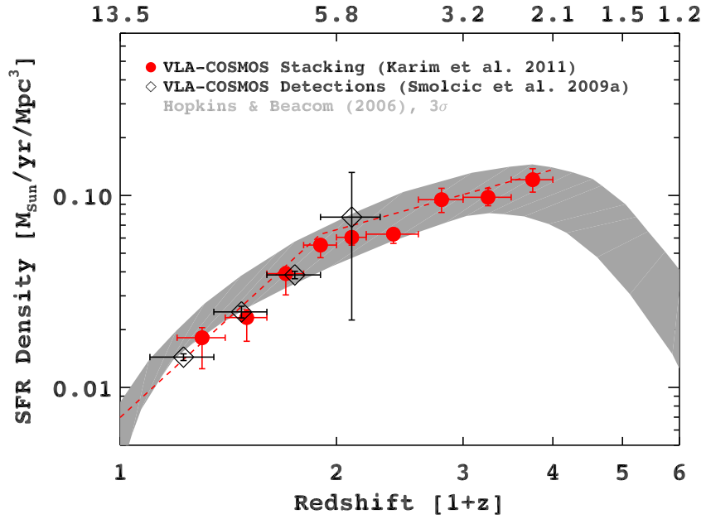
Stacking: Dust-unbiased cosmic star formation history (z<4)
Good agreement with other studies
No evolution of characteristic stellar mass (6×10¹⁰M) where most stars are formed
Integrated
> 10⁵ M_{sun}
Karim et al. (2011)

Slide 12
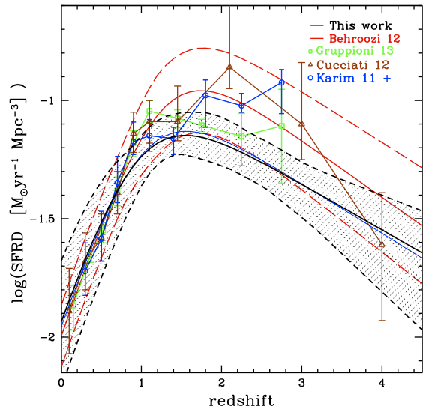
Cosmic star formation history at high-z
Ilbert et al. 2013
Good agreement between various tracers at z<1.5, large spread at z>2
SFRD derived from stellar mass density evolution

Slide 13
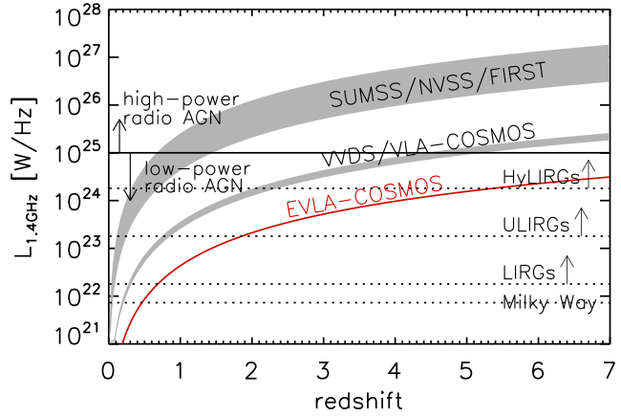
Outlook
JVLA-COSMOS Large Project:
  PI: Smolčić
  384 hours with JVLA (100 taken)
  3 GHz (10cm); 2sq.deg.
  resolution ~0.7”
  depth ~2 μJy (~ 5× deeper than VLA-COSMOS)
  Expected: 6,000-25,000 sources (up to 9× >VLA-COSMOS)
  Multi-λ:>30 bands; >25,000 optical spectra
Dust-unbiased cosmic star formation history out to z~6 & impact of dust at high redshift
VLA

Slide 14
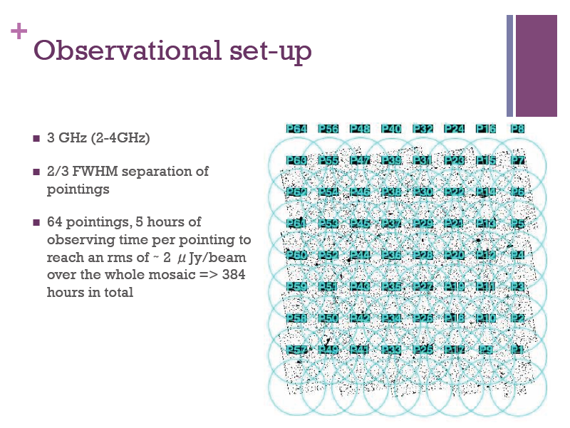

Slide 15
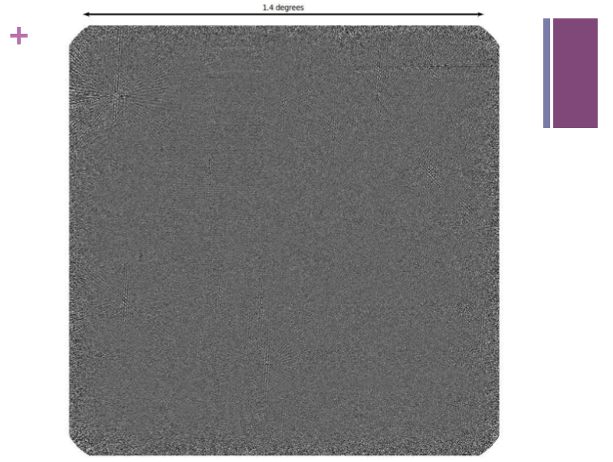
20k x 20k pixels => no longer possible to ‘look at map’

Slide 16
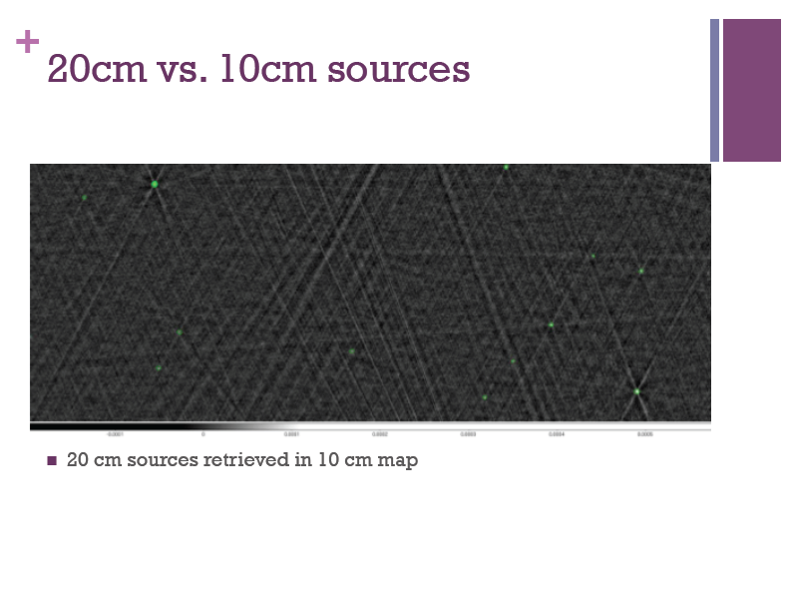

Slide 17
Imaging and calibration Issues
Octave bandwidth
  Varying Synth. Beam
  Varying Primary Beam
Imaging
  Joint deconvolution or separate pointings?
  Full-band parametric analysis or spectral cubes?
Mosaic: PB correction vs. freq
Polarization: all of the above (PB ‘pol lobes’)!
Self-calibration vs. freq/time
Big Data: tens of Tb
Big Images: 20k x 20k pixels (~ Gpixel)

Slide 18
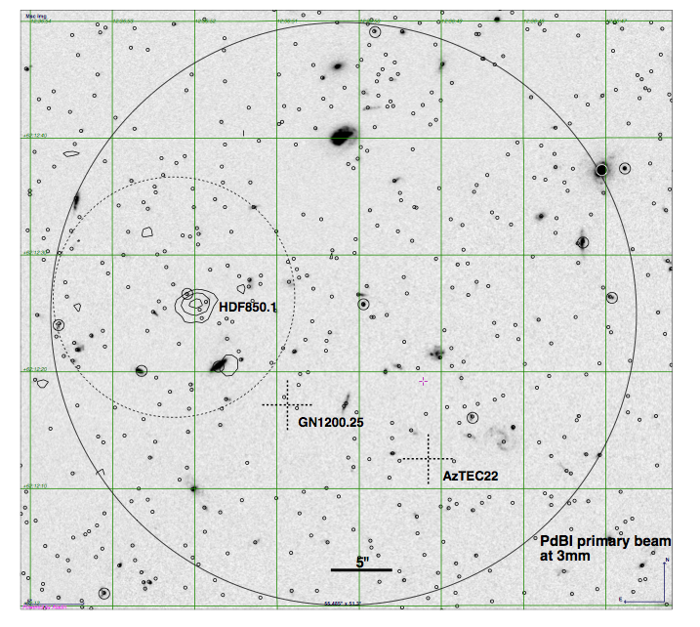
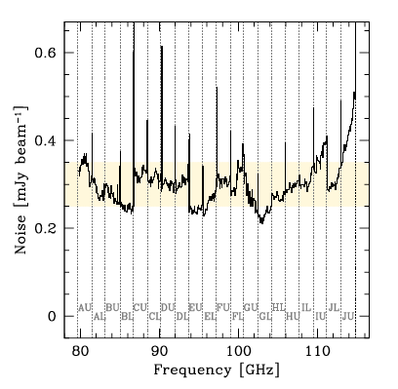
A molecular deep field: Dense gas history of Universe PdBI HDF pilot blind search
Spectral scan
80 to 115GHz
  10 Freq settings,
  56 hrs total
Spatial res ~ 3”
rms ~ 0.3 to 0.5mJy (200 km/s channel)
HDF850.1
1’
+

Slide 19
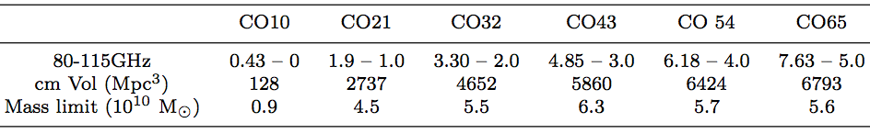
A molecular deep field: what do we expect?
z
*
*Assumes constant α, T_{B}
M_{gas} ~ 5 10¹⁰ (α/3.8) M_{o} [~ independent of z ~ submm inverse-K correction]
Predicted number detections (sBzK, BX/BM)
  N ~ 2 z=1 to 1.9 (2-1)
  N ~ 4 z=2 to 4 (3-2,4-3)
  N ~ 3 z=4 to 6 (4-3,5-4,6-5)

Slide 20
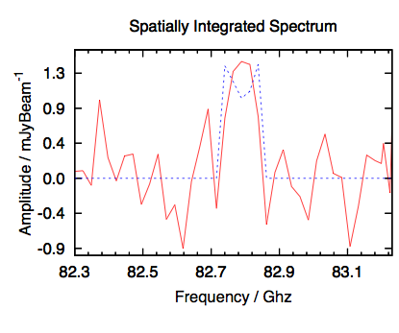
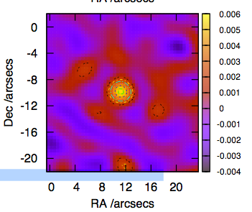
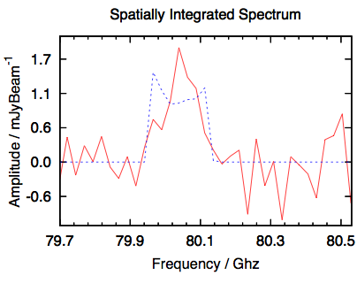
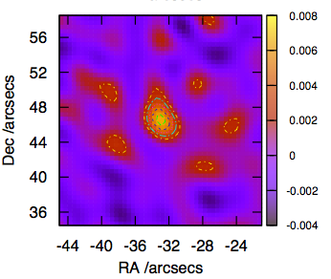
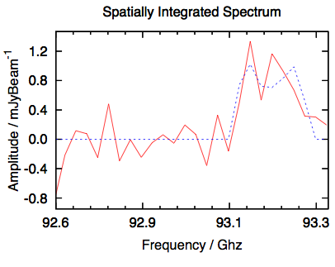
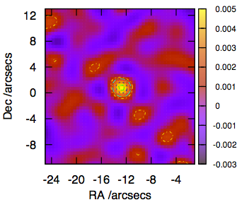
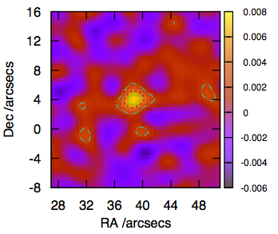
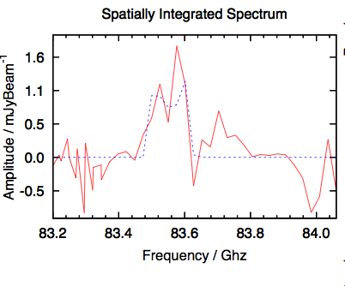
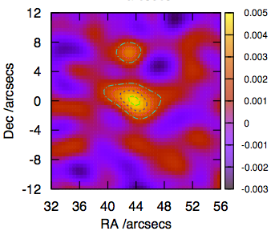
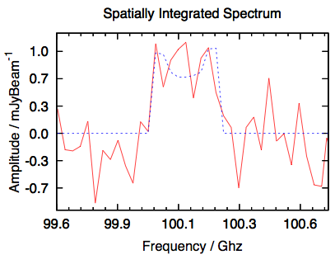
Blind CO searches
  MultiNEST: Baysian UV and image plane with multiple spatial/spectral models (Lentati)
  Standard sigma-clip search (SERCH AIPS)
sBzK
z=1.78
HDF850.1

Slide 21
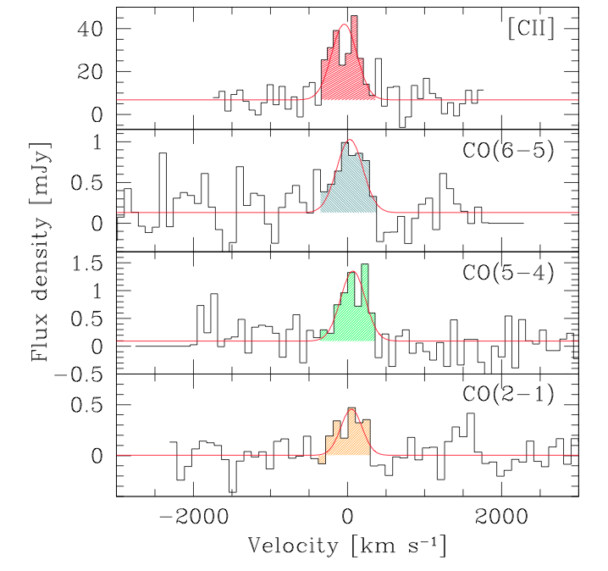
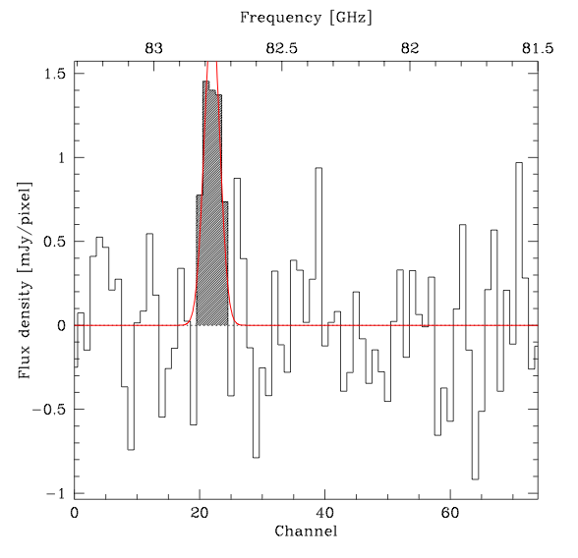
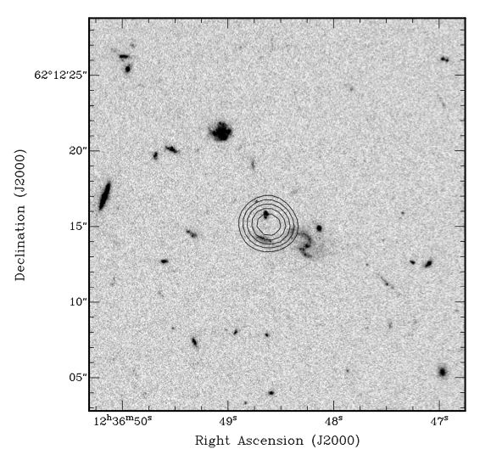
A molecular deep field: PdBI HDF pilot blind search
17 candidate CO galaxies
  HDF 850.1: z = 5.2 (finally!)
  ‘Mark Dickinson’s favorite galaxy’: CSG z = 1.78
Mostly: gas dominated disk galaxies at z ~ 1 to 3
1’
850.1 z=5.1
z_{ph} = 1.78

Slide 22
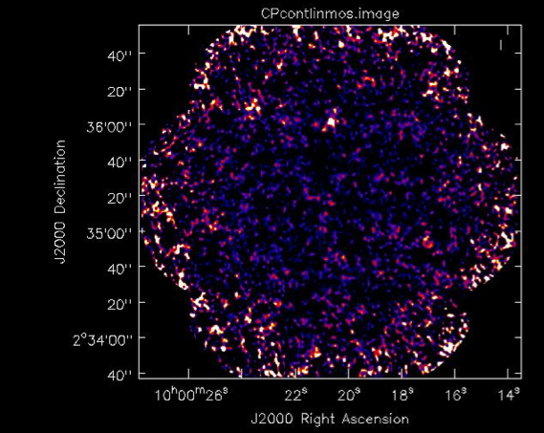
JVLA survey
300hrs, 1.5” res
30-38 GHz
7 pointings in Cosmos
49 pointings in GN
Get to M* (M(H₂) ~ few e9 M_{o})
Continuum ~ 1uJy rms = thermal emission?

Slide 23
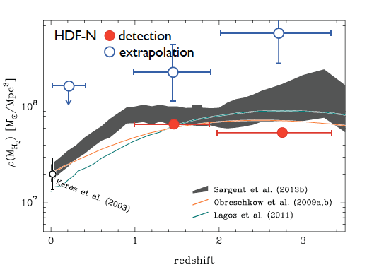
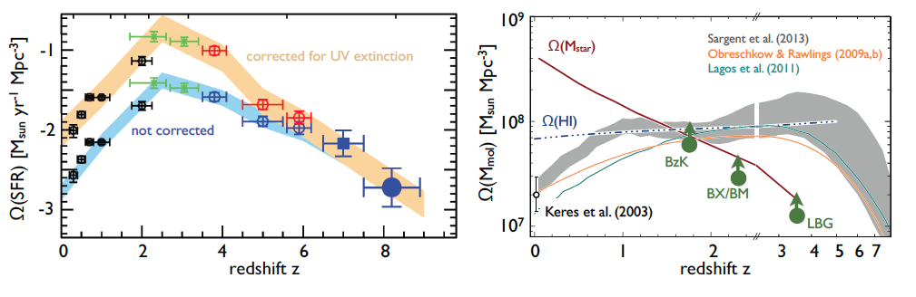
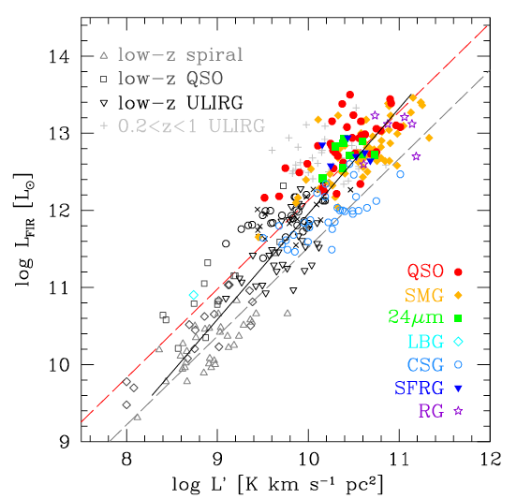
Cool Gas History of the Universe
SF Law
FIR ~ SFR
L_{CO} ~ M_{gas}
SFHU[environment, luminosity, stellar mass] has been delineated in remarkable detail back to reionization
SF laws => SFHU is reflection of CGHU: study of galaxy evolution is shifting to CGHU (source vs sink)
Epoch of galaxy assembly = epoch of gas dominated disks

