Slide 1

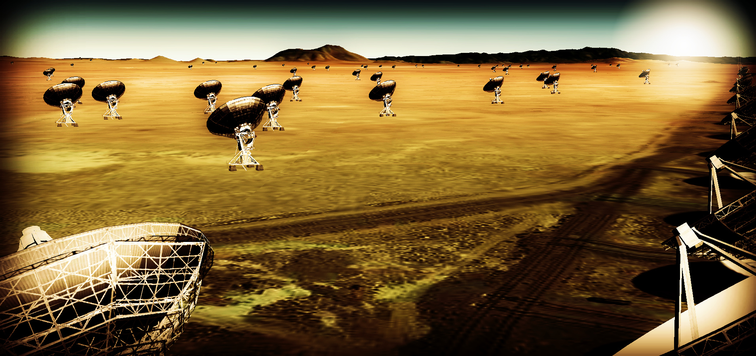
Thermal imaging on milliarcsecond scales at ~ 1cm
Effective area at 40GHz ~ 10x JVLA, ALMA
Resolution ~ 10x JVLA, ALMA
Frequency range: 1 – 50, 70 – 115 GHz
Science requirements to telescope specifications

Slide 2
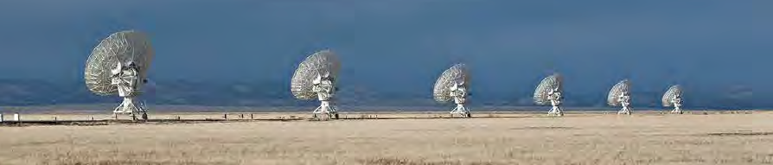
Science requirements: Community process to date (24 months!)
Jan 2015, Jan 2016: AAS community science meetings
April 2015, Dec 2015: Technology meetings (Pasadena, Socorro)
Dec 2015, Aug 2016: Kavli-sponsored RMS meetings (Chicago, Baltimore)
Nov 2015: Science working group science program reports (125 authors, 200 pages) http://library.nrao.edu/ngvla.shtml + arXiv
Circle of Life (Isella, Moullet, Hull)
Galaxy ecosystems (Murphy, Leroy)
Galaxy assembly (Lacy, Casey, Hodge)
Time domain, Cosmology, Physics (Bower, Demorest)
Reports conclude with itemized/prioritized list of key science programs
Distill science reqs to telescope specs in ‘engineering-friendly’ format
Iterate with SWGs (Feb-May)
Early times: Design and Science are ‘under construction’ – need your help!

Slide 3
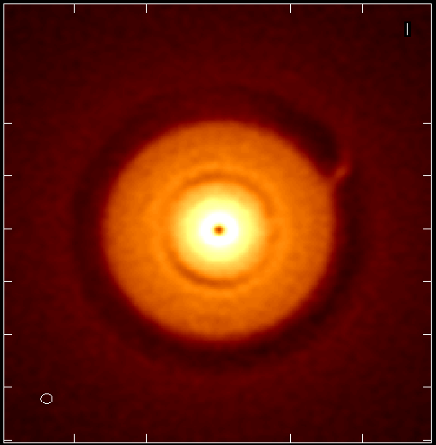
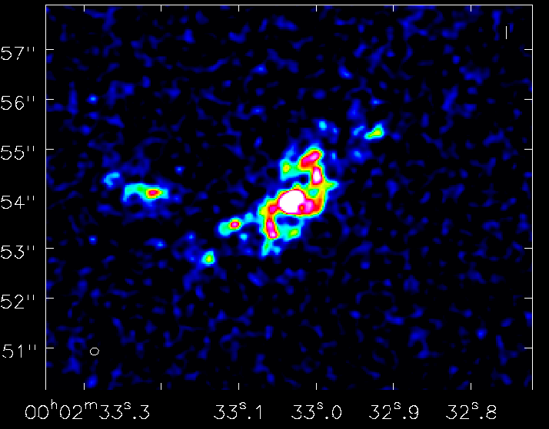
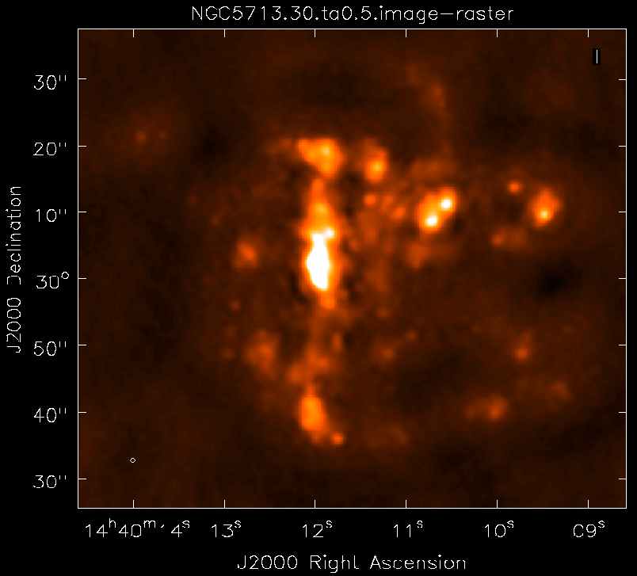
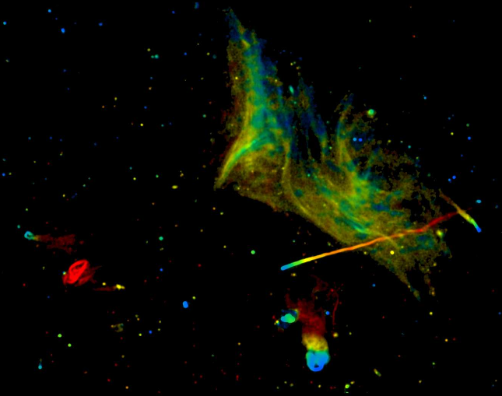
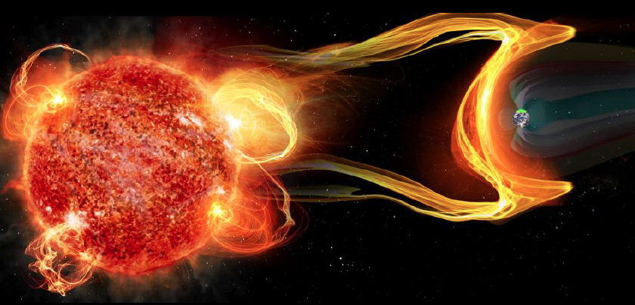
Next step: Sci. Requirements to Tel. Specifications
Goal | Science Requirement | Array Specification
Terrestrial zone | Optically thin | Freq ~ 15 to 50GHz
planet formation | 1AU at 130pc @ 30GHz | B ~ 300km
 | 1K in 10hrs @ 10mas, 30GHz | A_{full} ~ 300 x 18m; BW ~ 20GHz
Dense gas history | CO 1-0 to z=8 | Freq = 15 to 115GHz
of the Universe | M_{gas} = 10⁹ M_{o} at z = 3 in 1hr | A_{mid} ~ 70% to B ~ 30km
 | 500pc resolution at z = 3 (60mas) | 30km
 | Large volume surveys | Octave Band Ratio
Baryon cycle | T_{B} < 0.2K (1hr, 10 km/s, 80GHz, 1”) | A_{core} ~ 30% to B ~ 2km
 | Continuum science | Octave BR; Linear pol to 0.1%
Time domain | Explosive follow-up (GRBs, GW/EM…) | Minute trigger response time
 | Blind discoveries (eg. FRBs) | millisec searches
 | Exo-space weather: 1uJy in 1min | Freq ~ 1 to 20GHz A_{full} ~ 300 x 18m Circular pol to few %

Slide 4
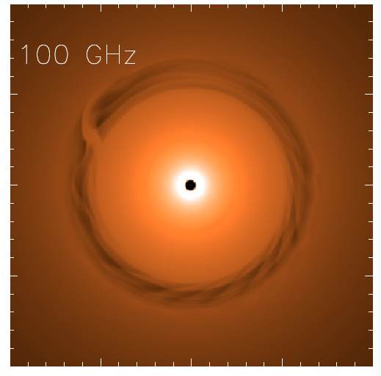
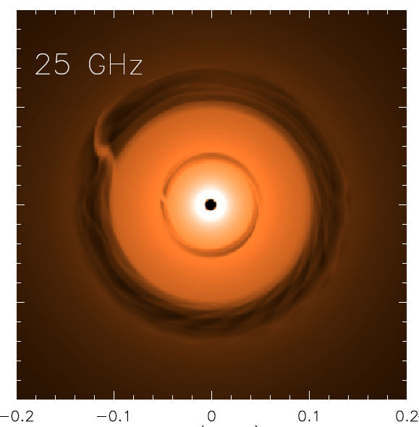
Image terrestrial zone planet formation
AU-scale imaging 1Myr protoplanetary disk at 140pc distance
Jupiter at 13AU Saturn at 6AU
ngVLA 100hr 25GHz 10mas
0.1” = 13AU
Isella Dust Model
model
rms = 90nJy/bm = 1K
Frequency: need low optical depth on AU-scales => 30GHz
Resolution: need 1AU resolution at 130pc = distance to nearest star forming regions (eg. Taurus, Ophiucus) => 10mas
Sensitivity: need 1K brightness at full resolution => 10x VLA, ALMA

Slide 5
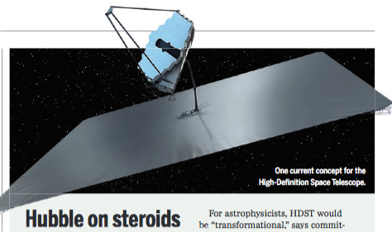
ng-Synergy: Terrestrial zone exoplanets
Full Evolutionary sequence, from birth to maturity
High Definition Space Telescope Terrestrial planets = top science goal
Direct detection of earth-like planets
Search for atmospheric bio-signatures
ngVLA
Imaging formation of terrestrial planets
Pre-biotic chemistry

Slide 6
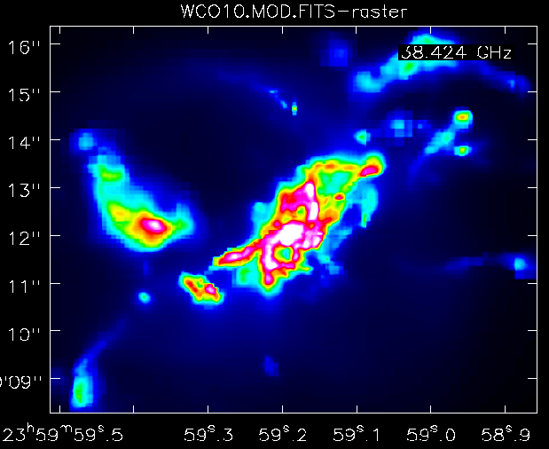
Dense gas history of Universe
Imaging ’fuel for star formation’ during epoch of galaxy assembly
1” = 7kpc
z=2, CO1-0
Narayanan Model
ngVLA
Frequency: need low order CO at z ~ 1 to 5 => 20 to 50GHz
Resolution: need ~ 1kpc => 0.15”
Sensitivity: need to reach few 10⁸ M_{o} at z ~ 2 => 12uJy @ 100 km/s
FoV, BW: 100x JVLA, ALMA spectral deep field survey speed (1000’s vs 10’s of galaxies) => 18m antenna, 20GHz BW

Slide 7
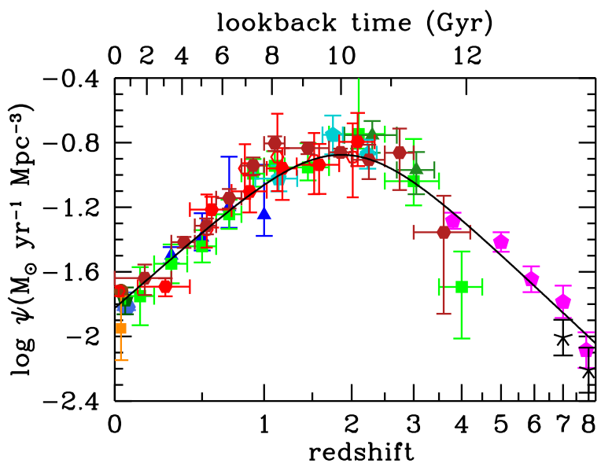
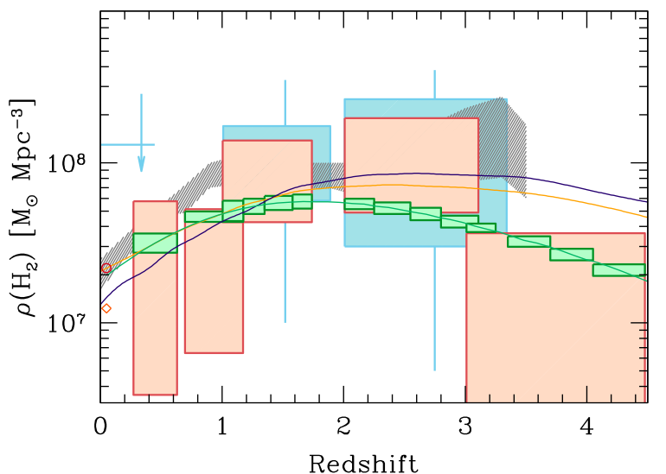
ng-Synergies: Dense Gas History of the Universe
‘Missing half of galaxy formation’
Gas
SFR
NGVLA
ALMA
Decarli
JWST, TMT

Slide 8
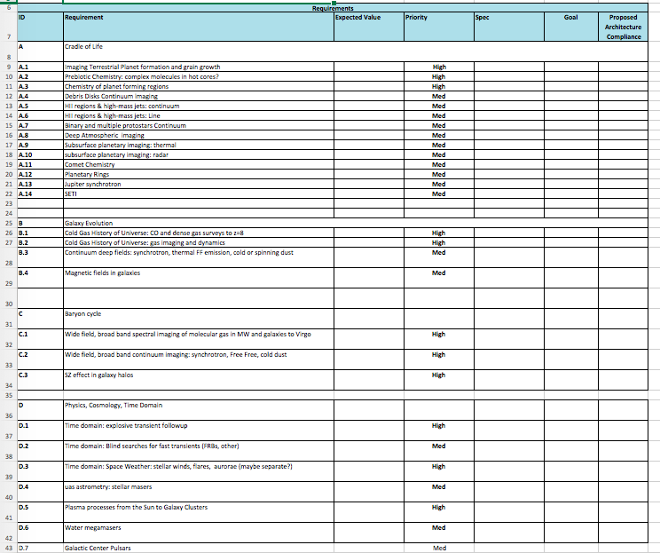
Science requirements spreadsheets
Built from SWG report summaries
Currently ~ 30 programs, med, high priority

Slide 9
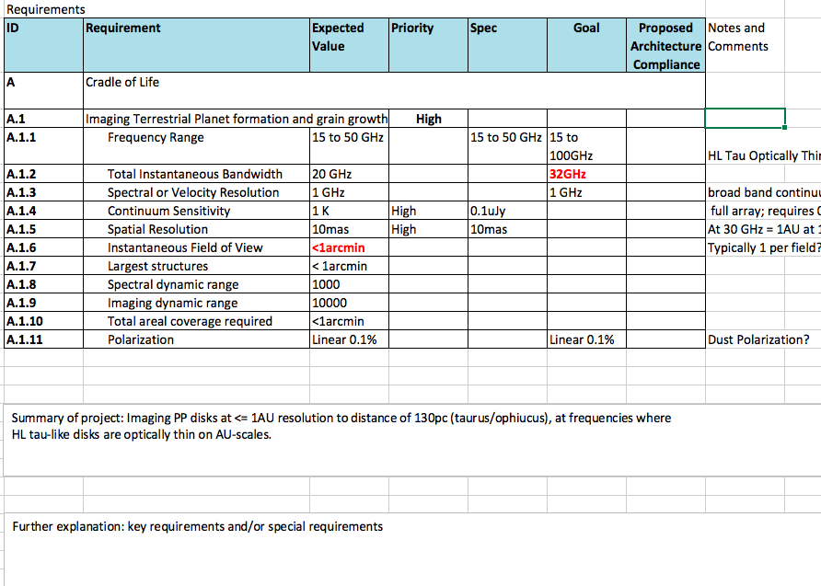
Science requirements to Telescope Specifications Spread Sheets
Engineering Friendly Format: spec, goal, design compliance

Slide 10
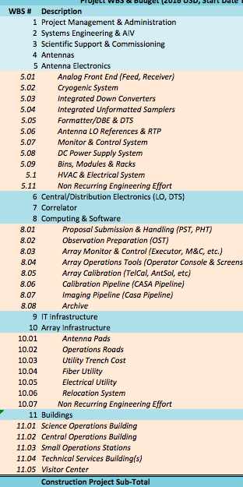
Closed loop for tradeoffs: science to telescope to cost
Science Requirements
Telescope Specs
Cost Model
Goal: PDR-level ‘proposal’ to 2020 Decade Survey for major D+D program
Compelling science program
Defensibly costed design of all major elements

Slide 11
‘Living Document’: need your help!
Broaden science program: what are we missing?
Areas to explore with testing and simulation
Configuration and antenna
Balance: Core (3km) vs. mid (30km) vs. long (300km) [some fraction reconfigurable?]
FoV: 12m to 25m
Need for total power (large single dish + camera)
Full req range
Phase Calibration: WVR, Cal. Array, Fast Switching
VLBI implementation
Deep Dives
Simulation tools are all tested and available (CASA and AIPS) to explore configuration and imaging sensitivity
Goal: stimulate research publications by the community!

Slide 12
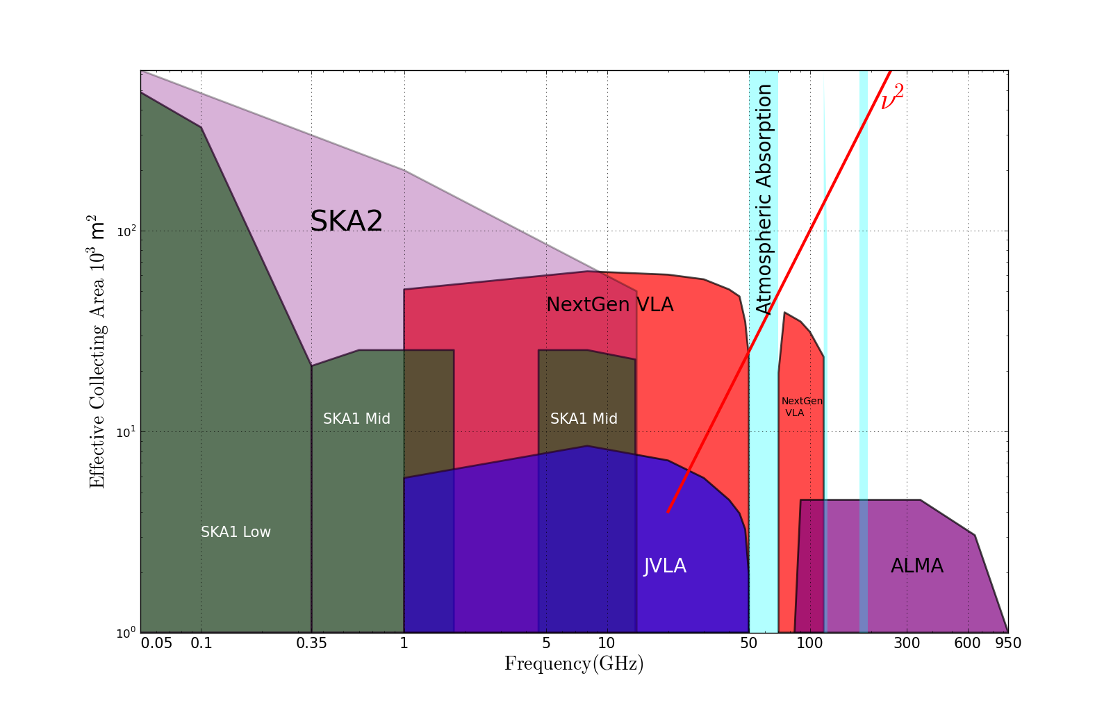
Radio facilities @ 2030
2030
Complementary suite from meter to submm, appropriate for the mid-21st century
< 3mm: ALMA 2030 superb for chemistry, dust, fine structure lines
3cm to 3mm: ngVLA superb for terrestrial planet formation, dense gas history of Universe, baryon cycle
> 3cm: SKA superb for pulsars, reionization, HI surveys

Slide 13
Thermal imaging on milliarcsecond scales at ~ 1cm
Effective area at 40GHz ~ 10x JVLA, ALMA
Resolution ~ 10x JVLA, ALMA
Frequency range: 1 – 50, 70 – 115 GHz
https://science.nrao.edu/futures/ngvla

