Slide 1
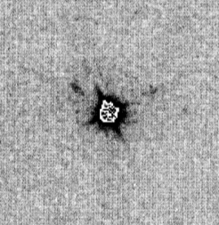
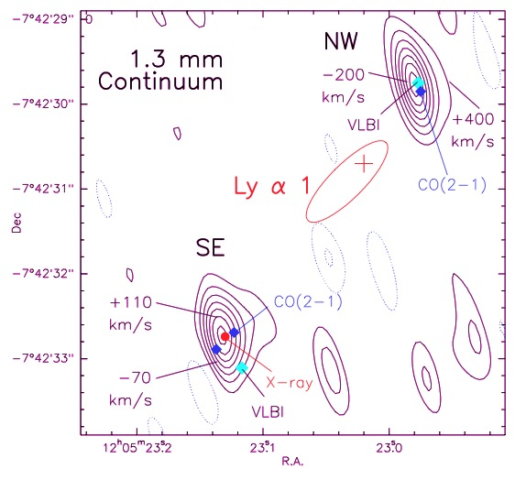
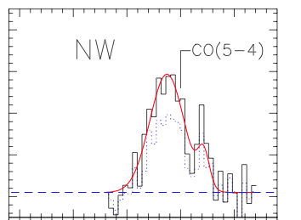
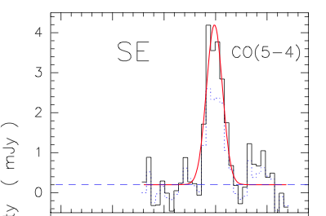
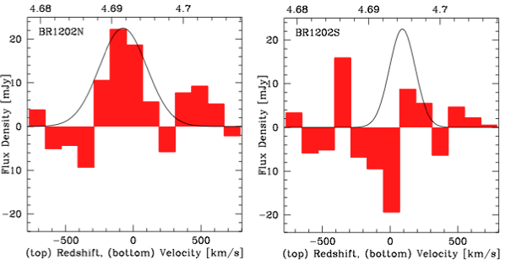
Salome ea.
CO 5-4
+
BRI1202-0725 z=4.7
HyLIRG (10¹³ L_{o}) pair
SFR ~ few 10³ M_{o} yr⁻¹
M_{H2} ~ 10¹¹ M_{o}
+
SMG
4”
+
QSO
+
HST 814 Hu ea 96
SMA
[CII] 158um
334GHz, 20hrs
Iono ea 2007

Slide 2
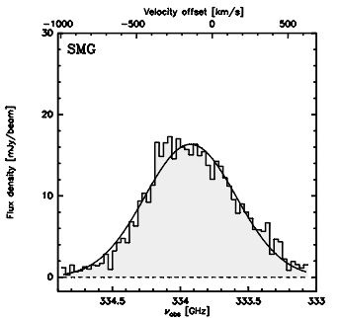
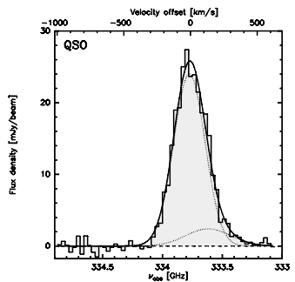
[CII] in 1202-0725
Wagg ea
ALMA SV
20min, 16 ants
334GHz
SMA 20hrs

Slide 3
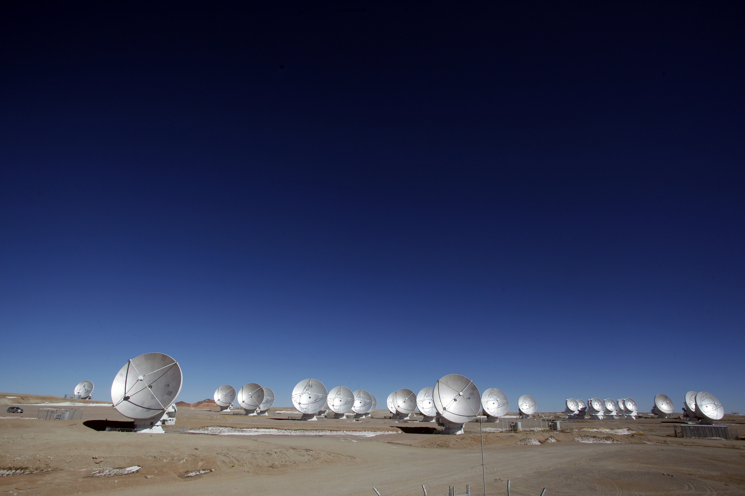
[CII] 158um line and ALMA: a new window on the 1st Galaxies
C. Carilli
Dynamics first galaxies
Anatomy of early galaxy formation
Rotation curves: in search of dark matter
Build up of dusty ISM in z ~ 6 LBGs
Redshift frontier: into reionization
Early SMBH formation
Verify + spec z for z=6 to 8 dropouts

Slide 4
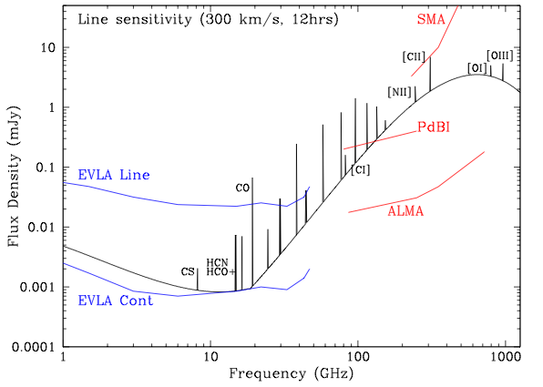
cm → submm diagnostics of cool gas in galaxy formation
100 M_{o} yr⁻¹ at z=5
Low J CO emission: total gas mass, dynamics
High density gas tracers (HCN, HCO+)
Synch. + Free-Free = star formation
EVLA/GBT Line
High J molecular lines: gas excitation, physical conditions
Dust continuum = star formation
Atomic FIR fine structure lines: ISM gas coolant

Slide 5
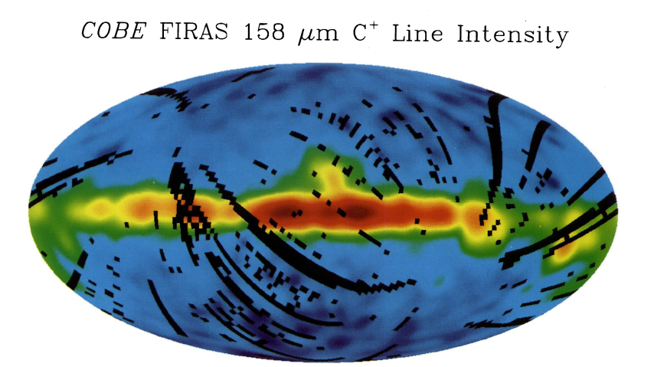
Good news: [CII] is everywhere!
[CII] 158um line: dominant cooling mechanism for cool gas, and most luminous line from star forming galaxies from DC to FIR:
0.3% of FIR luminosity of MW
[CII]/CO₁₋₀ ~ 1000
E_{ion} = 11.2eV => traces ionized and neutral gas => Good dynamical tracer
Low z requires space Obs, but z > 1 => [CII] redshifts to ALMA bands
Galactic census (Pineda ea)
PDRs (30%)
Cold HI (25%)
CO–dark H₂ (25%)
Ionized gas (20%)
Various with galaxy

Slide 6
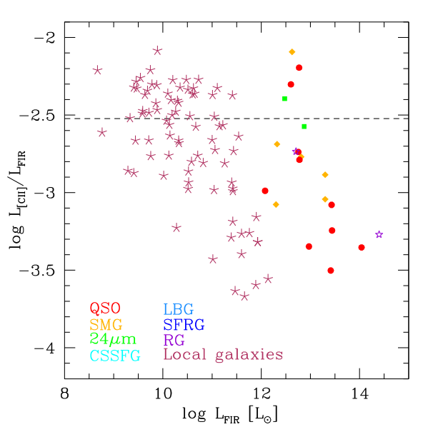
Bad news: CII is everywhere!
Low metalicity SMC/LMC
[CII]/FIR: up to factor ~ 100 scatter!
Quantitative measure of ??
Can be suppressed in SB nuclei: dust opacity or charged grains?
Low metallicity: enhanced [CII]/FIR (lower dust attenuation => large UV heating zone)
Might lose CNM contribution at z > 6 due to CMB contrast (Vallini ea)?
MW
SB nuclei
11

Slide 7
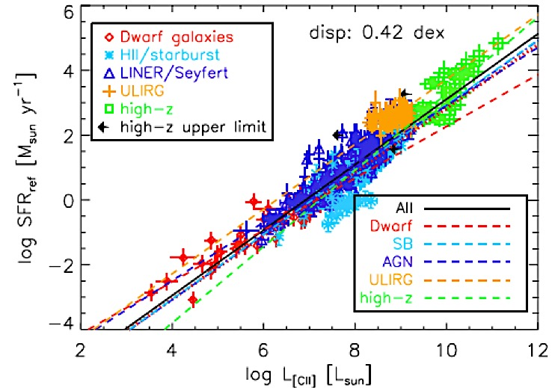
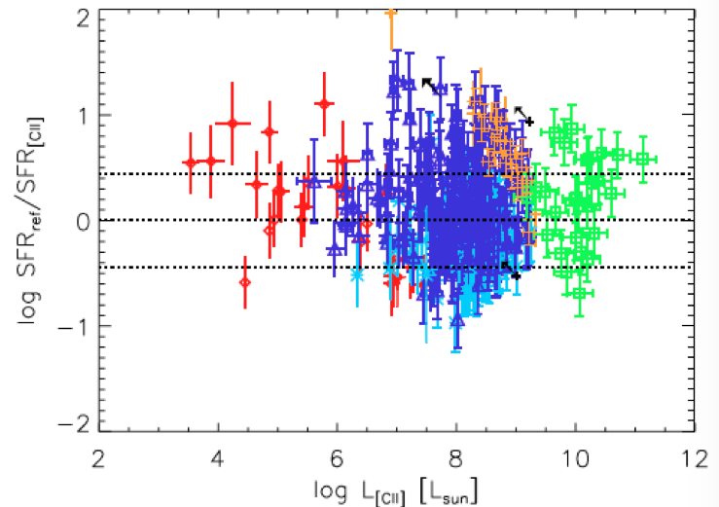
[CII]: the great elixir (or koolaid)?
Claimed to be a tracer of
Star formation rate
H₂, HI, and HII mass
Radiation field
Abundances…
Usually requires other info (T_{dust}, FSL…)
Focus: Bright [CII] tool for
Gas dynamics
ISM evolution
Spectroscopic redshifts for z>6 candidates
de Looze ea
‘This ubiquity of C+ with the varying contributions of these different components of the interstellar medium to the total energy radiated by C+ in different galaxies makes calibration of the [CII] versus star–formation rate a difficult task.’ Goldsmith ea

Slide 8
The new age of [CII]: number of detections at z>1
Results within last year: ‘show and tell’

Slide 9
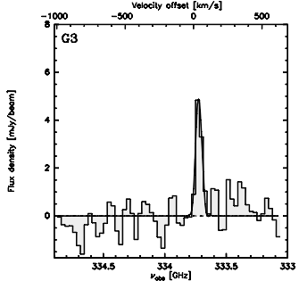
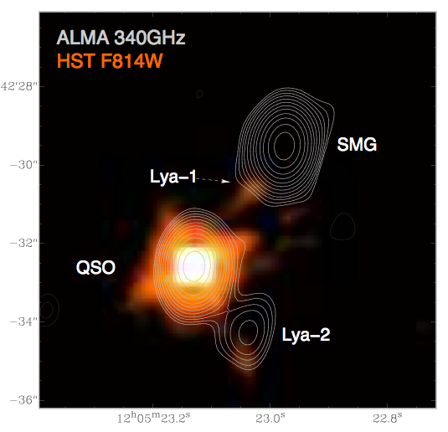
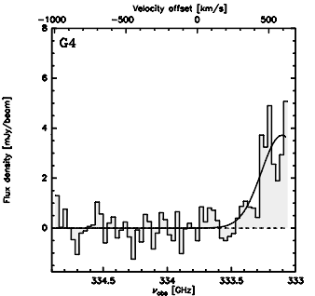
Imaging + Dynamics
Anatomy of a hyper-starburst at z=4.7
LAE1
SMG
BR1202-0725 z=4.7
G3
12kpc
700km/s
G4
QSO
LAE2
rms=100uJy
Two hyper-starbursts (SMG and BAL quasar host): FIR ~ 3x10¹³ L_{o} ; SFR ~ 3x10³ M_{o}/yr; M_{BH} ~ 10⁹ M_{o}
Two ‘normal’ LAE: SFR ~ 10² M_{o}/yr

Slide 10
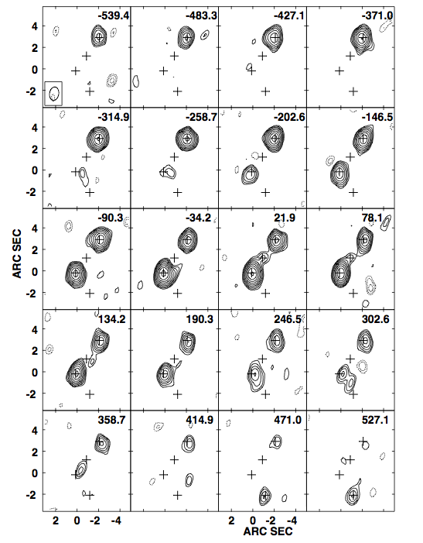
[CII] in 1202: Imaging cool gas dynamics at z=4.7
Quasar, SMG: Broad, strong lines
Tidal bridge across LAE1, as expected in gas-rich merger
Possible quasar outflow, or further tidal feature, toward LAE2
SMG
LAE1
Q
LAE2

Slide 11
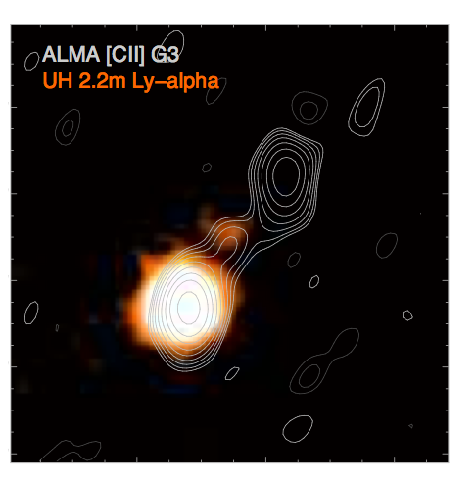
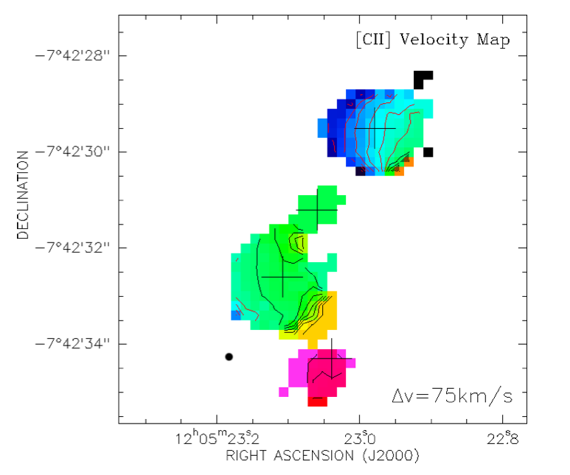
Dynamics => major merger of gas rich galaxies driving massive galaxy/BH formation at t_{univ} ~ 1Gyr
Hu & Cowie
-500km/s
SMG
7kpc
LAE1
Q
LAE2
+500km/s
Tidal stream connecting hyper-starbursts, narrow ΔV
SMG: warped gas disk
HyLIRG QSO host, with outflow in [CII] and CO, high ΔV
LAE1: Ly-alpha + [CII] in tidal gas stream?
LAE2: dust and [CII] in outflow?

Slide 12
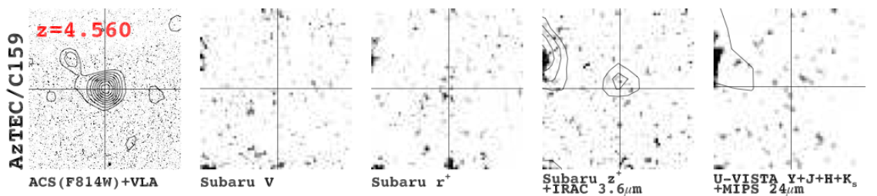
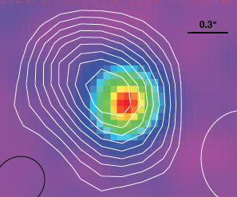
Cosmos SMG: disk dynamics at z=4.5 (Karim ea.)
ALMA 340 GHz: 20min, 30 ant, 0.35” res
Isolated SMG in Cosmos
No ACS/I detection
FIR = 0.7e13 L_{o}
SFR = 700 M_{o} yr⁻¹
Dust size < 0.2”
3GHz 340GHz
JVLA: 50uJy at 3Ghz
ALMA: 3mJy at 340 GHz

Slide 13
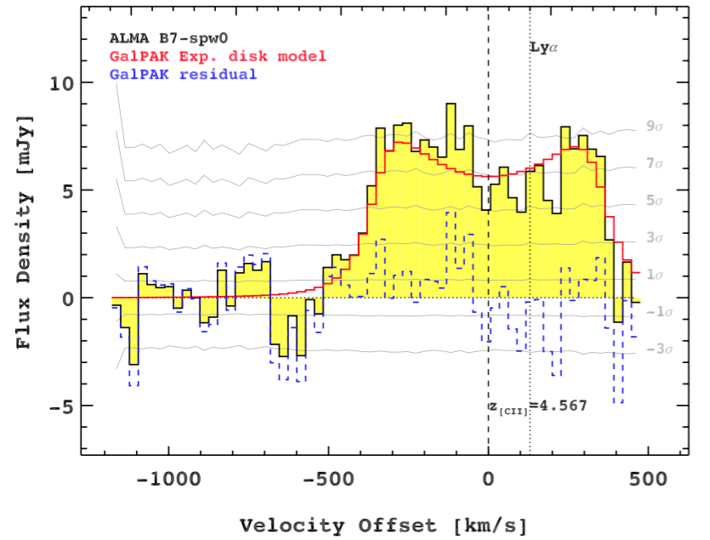
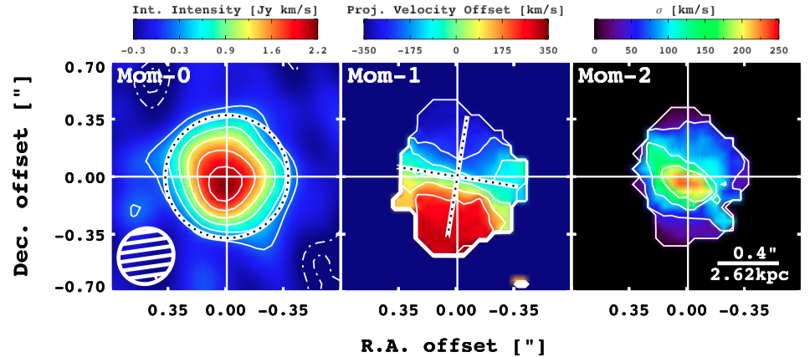
ALMA [CII] (Karim ea)
‘double horn’: width ~ 700 km/s
[CII] = 5e9 L_{o} ~ 100x MW
[CII]/FIR ~ 0.0008 ~ 0.25 x MW
Clear velocity gradient ~ 1”

Slide 14
+350 km/s
+
-350 km/s
+
Karim ea
GALPAK (Bouchet): exponential disk
Disk galaxy rotation: butterfly pattern!

Slide 15
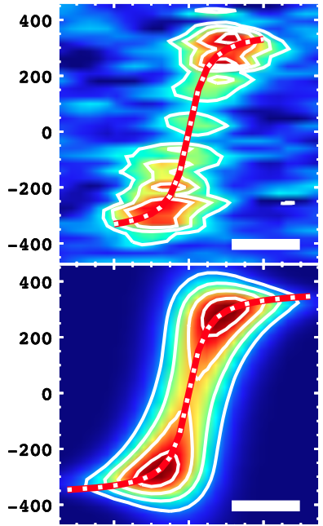
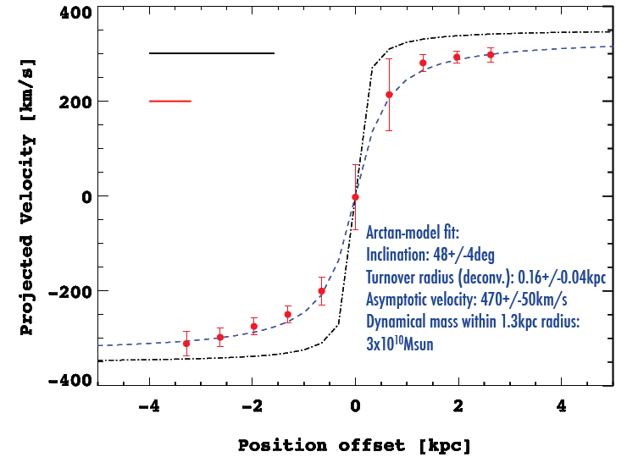
Flat rotation curve: Search for dark matter in 1st galaxies
V_{rot} = 470 km/s
i = 48º
R_{turn} = 0.16 kpc
M_{dyn} = 1.3e11 M_{o}
Intrinsic
Smoothed
Karim ea
Search for dark matter
Flat rotation curve: 1st step
Need distribution stars + cool gas
Generally: [CII] + ALMA => dynamical imaging at z > 4 comparable to HI in nearby galaxies

Slide 16
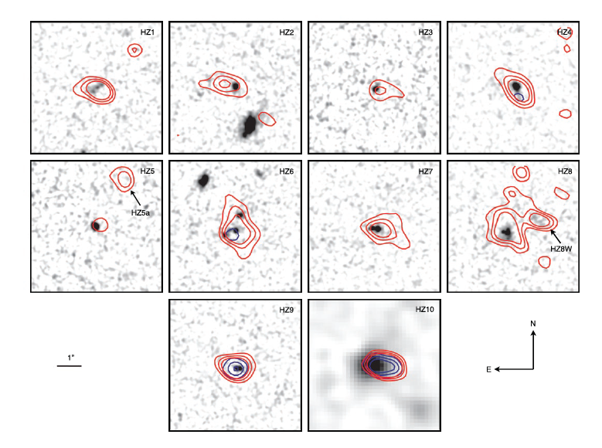
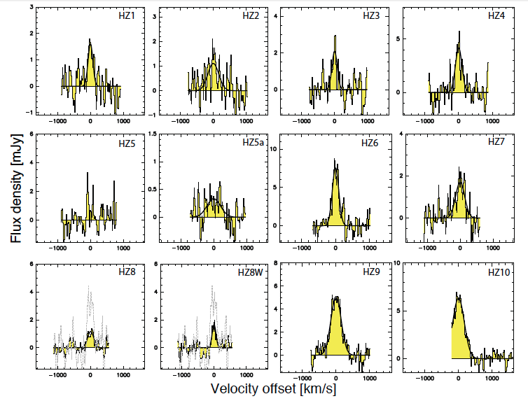
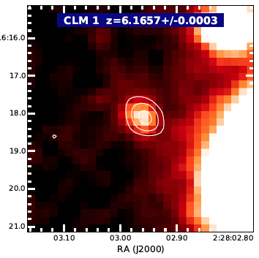
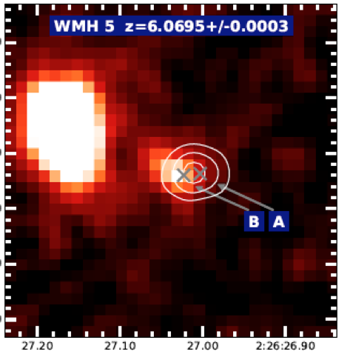
ISM evolution in first ‘normal’ galaxies
ALMA observations of z ~ 6 LBGs
1hr per source, 30 ants, 0.5” res
Capak ea.: 10 LBGs at z ~ 5.5
Willott ea.: 2 LBGs at z ~ 6.1
SFR ~ few to 100 M_{o} yr⁻¹
11 of 12 detected in [CII] (non-detection = AGN)
4 or 5 in dust continuum
Most are extended ~ 1”

Slide 17
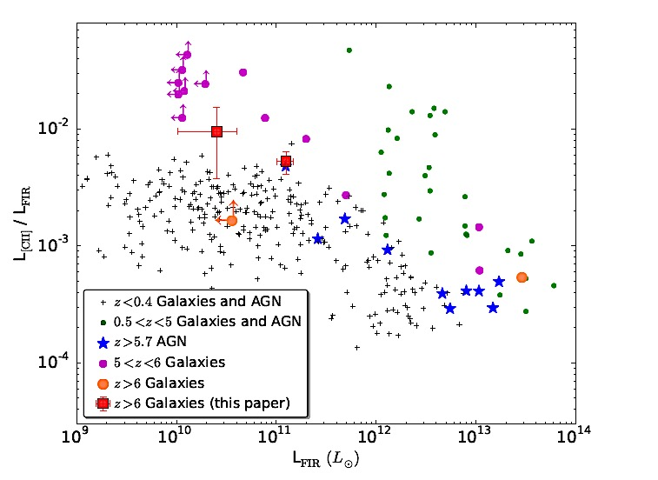
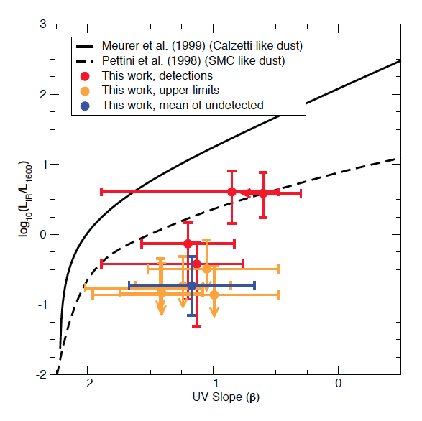
Build-up of dusty ISM at z ~ 6
z~6 LBGs =>
Low metalicity
L_{IR}/L₁₆₀₀
SMC Dust
Capak ea
Willott ea; Capak ea
[CII]/FIR ~ SMC/LMC => low metalicity (ie. Dust/Gas)
IR/1600 => SMC-type dust (silicates, amorphous carbon?) => changes SFHU?
Generally: [CII] can be strong w/o dust => don’t select on dust!

Slide 18
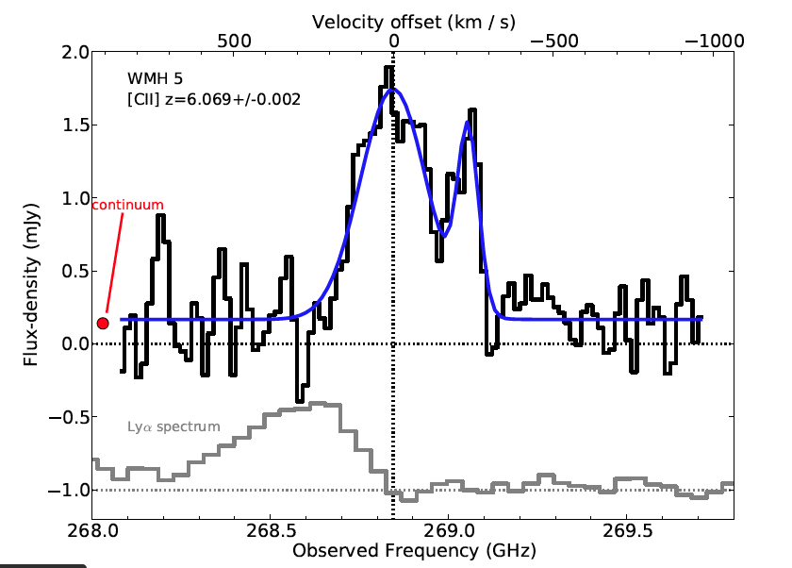
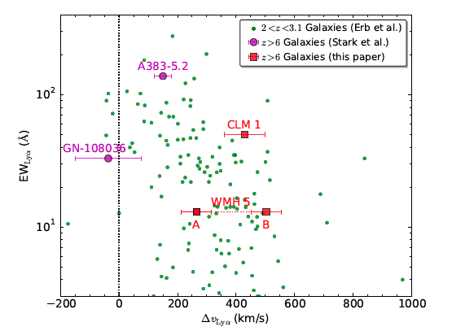
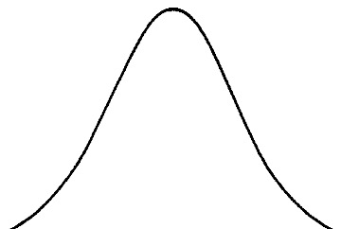
Qualitative Evidence for increasingly neutral IGM z>6?
[CII] z=6.1
expected
obs
Lya
Willott ea
Weak, asymmetric Lya w. large velocity offset => resonant scattering by neutral IGM (Gunn-Petterson)?

Slide 19
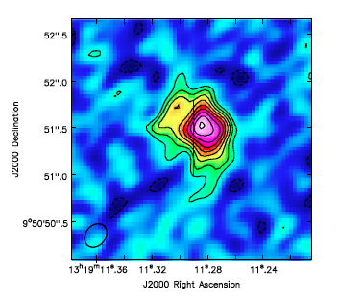
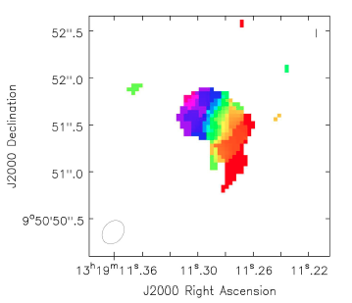
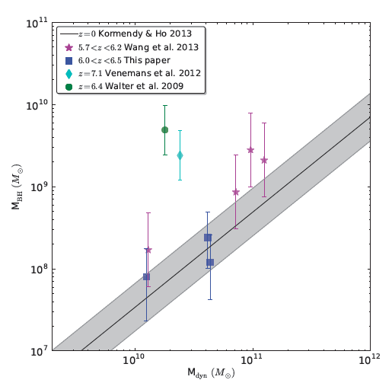
Weighing z > 6 quasar host galaxies
[CII] 300GHz, 0.5” res, 1hr, 17ant
Wang ea
z=6.13
Willott ea
-300km/s
M_{BH}
3kpc
+300km/s
Low z
M_{dyn}
7/7 detected [CII] + dust
Sizes ~ 2 – 5 kpc, clear velocity gradients
Maximal SB disk ~ 1000 M_{o} yr⁻¹ kpc⁻²
M_{dyn} ~ few e10 to 1e11 M_{o}
M_{BH} ~ 1e8 to 1e10 M_{o}
Larger BHs than expected in some cases?
Generally: [CII], CO only way to get M_{gal}

Slide 20
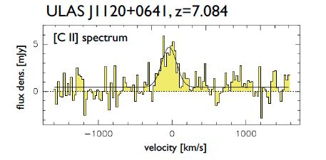
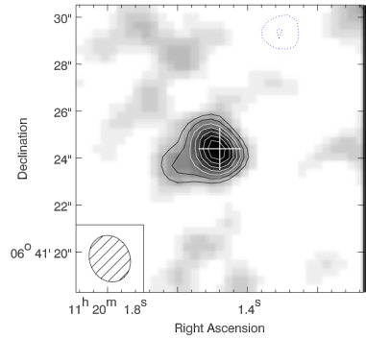
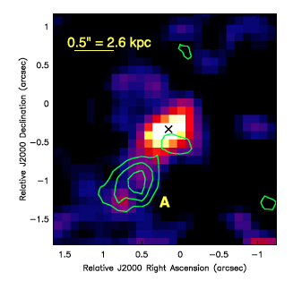
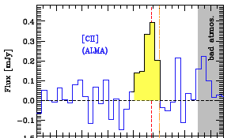
Redshift frontier: z > 7
Quasar host z=7.0 (Bure)
Weak dust continuum
Early, inhomogeneous enrichment IGM
Host redshift + DLA profile => neutral IGM
Venemans ea
Maiolino ea
Lyman Break galaxy z=7.1
Offset => satellite accretion?
[CII]

Slide 21
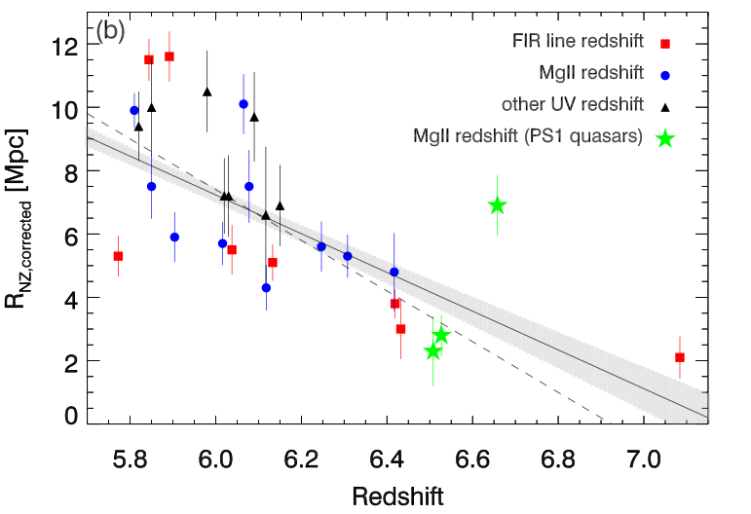
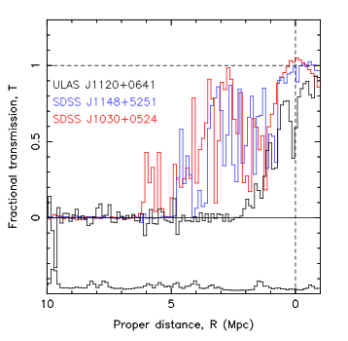
Quasar Near-Zones: R_{NZ} vs redshift
[normalized to M₁₄₅₀ = -27]
z ≤ 6.4
z=7.1
Venemans ea.
<R_{NZ}> decreases by factor ~ 9 from z=5.7 to 7.1
If CSS => F(HI) ≥ 0.04 by z ~ 7.1 (Venemans ea)

Slide 22
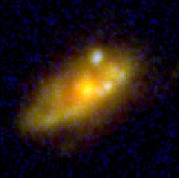
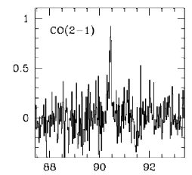
ALMA 1.2mm spectroscopy of the Hubble Ultra Deep Field (Aravena ea)
ALMA 212 – 272GHz, 1 arcmin² => [CII] z=6 to 8
rms_{cont} = 12uJy/beam => 10 M_{o} yr⁻¹
[CII] limits ~ few M_{o} yr⁻¹
bure
Flux density [mJy]
Frequency [GHz]
z=2.5 main sequence galaxy
Notes:
The bright continuum sources happens to be a massive MS galaxy at z=2.5, as reported by our detections of CO(7-6), (8-7) and CI 2-1, as well as CO(2-1) in the 3mm scan. The galaxy seems to have high excitation, and this implies the first detection of CI in this kind of galaxies. Indeed H2O is also detected.

Slide 23
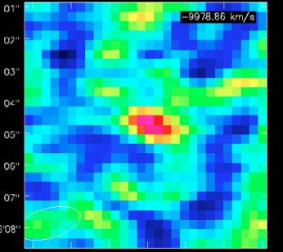
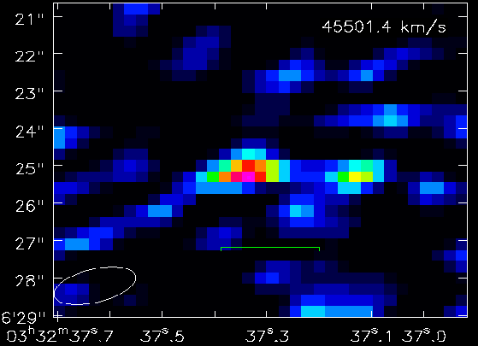
ALMA 1.2mm spectroscopy of the Hubble Ultra Deep Field (Aravena ea)
20 candidate dropouts z ~ 6 to 8: Verify + Spec. z
6 [CII] lines at z=5.6 – 7.4 at > 4σ
Line widths ~ 200 to 400 km/s
L_{CII} => SFR ~ few to 10 M_{o} year⁻¹
z=6.6, 5.0σ
z=7.4, 5.5σ
Notes:
Finally, and perhaps more interestingly, there are several z>6 dropout galaxies in the field that show strong line features, which are identified as CII line emission. These might be the highest redshift normal galaxies blindly discovered and confirmed with ALMA.

Slide 24
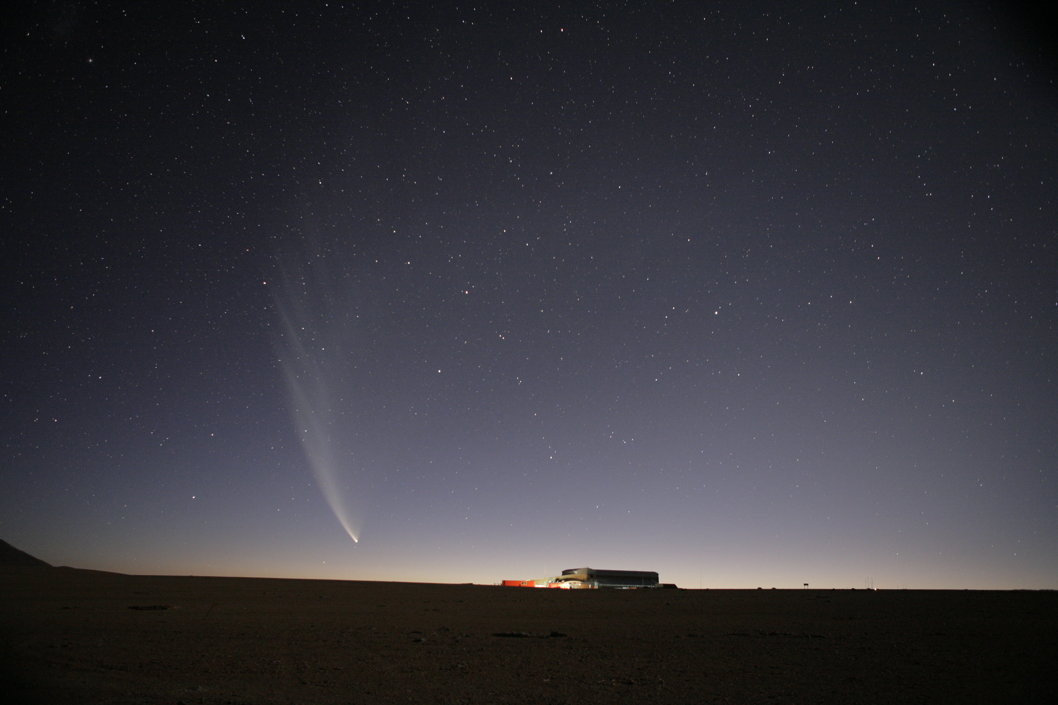
[CII] 158um line and ALMA: a new window on 1st galaxies
Dynamics first galaxies
Anatomy of early galaxy formation
Rotation curves: in search of dark matter
Build up of ISM at z ~ 5 to 6
Redshift frontier: into reionization
Verify z=6 to 8 dropouts
SMBH formation
Constraints on reionization

Slide 25
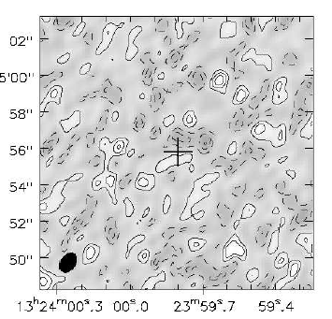
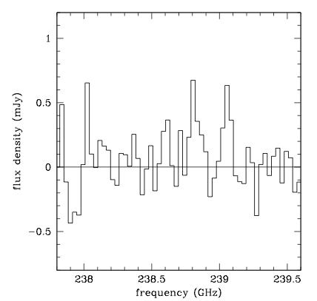

Notable non-detections: LAEs z ~ 6.5 – 7
Himiko (Ouchi ea.) IOK-1 (Ota ea.)
rms=20uJy
rms=0.2mJy
Below SFR – [CII] relation: support idea immature ISM (metalicity, dust) at z>6
“LAEs in the reionization epoch have significantly lower gas and dust enrichment than AGN-powered systems and starbursts at similar/lower redshifts, as well as local star-forming galaxies”

