Slide 2
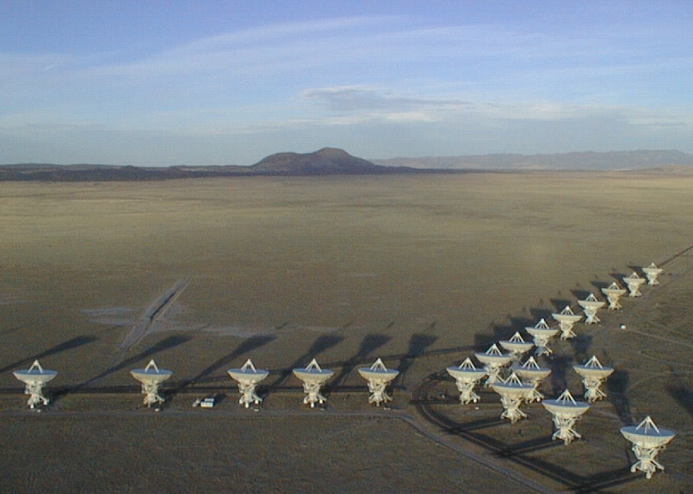
Cool side of Galaxy Formation concepts, nearby galaxies, telescopes
Chris Carilli Vatican Summer School 2014
Introductory material and general concepts
General concepts and relations
Molecules
Atomic fine structure lines
Dust
Interesting questions in galaxy formation
Centimeter and millimeter telescopes
II. High redshift galaxies and AGN/SMBH
III. First light and Cosmic Reionization

Slide 3
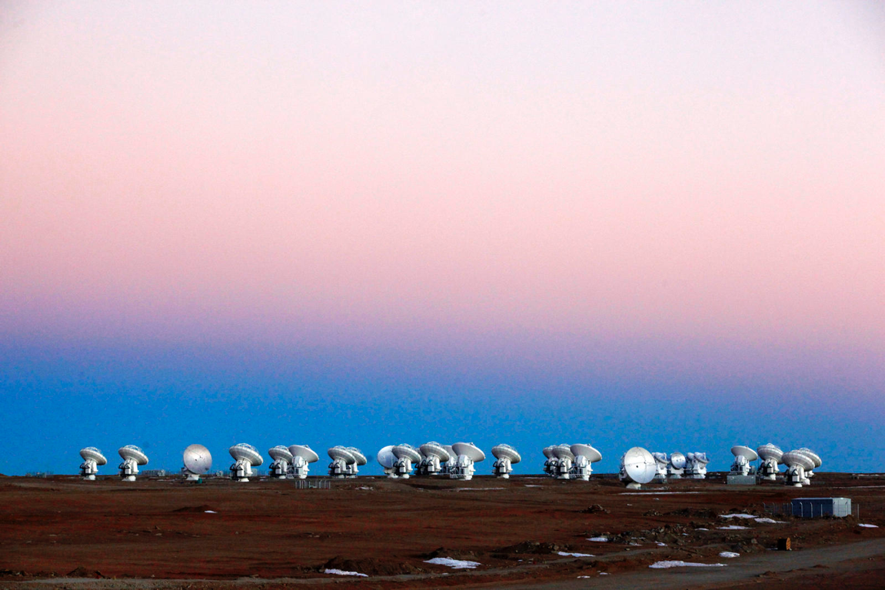
References
Molecular gas, FSL: Carilli & Walter 2013, ARAA, 51, 105
Conversion factors: Bollato et al. 2013, ARAA, 51, 207
Star Formation laws: Kennicutt & Evans, 2012, ARAA, 50, 531
Dust: Draine 2003 ARAA 41, 231
Dusty star forming galaxies at high z: Caitlin, Narayanan, Cooray, 2014, Phys Rep http://adsabs.harvard.edu/abs/2014arXiv1402.1456C

Slide 4
‘You can see a lot just by looking,’ Yogi Berra
‘Astronomy is looking up,’ anonymous
Dust and molecular gas
Lower scale height than stars
Preferentially in inner Galaxy
Scale heights
Dust/mol. gas/new stars (< 1Gyr) = 50pc
HI ~ 100 – 500 pc
Pop I stars (~ few Gyr) stars disk = 300pc
Pop II (> 10Gyr) stars = 1000pc (bulge)
Disk radial scales
Old stars ~ 5 kpc
Molecular ring < 3 kpc

Slide 5
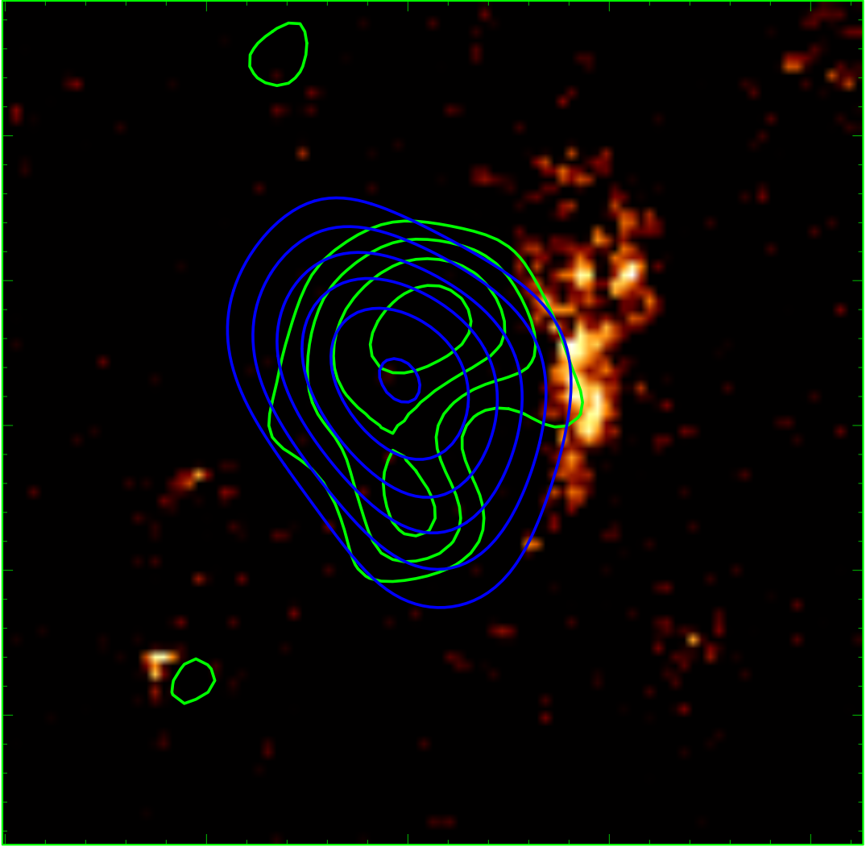
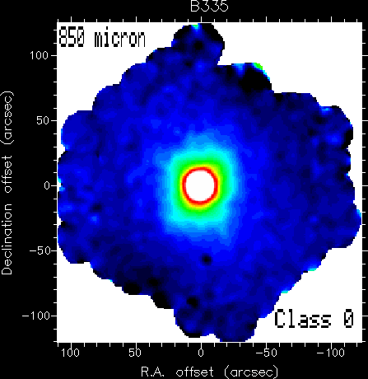
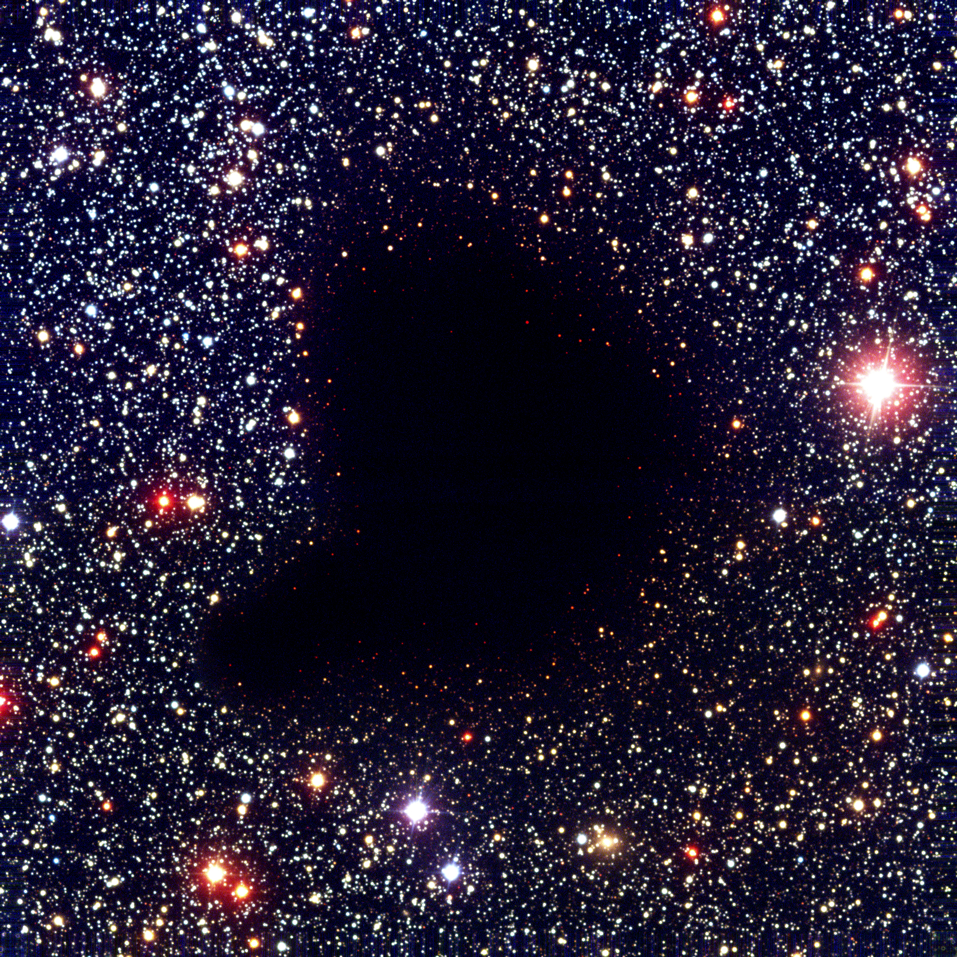
Millimeter through centimeter astronomy: unveiling the cold, obscured universe
GN20 z=4 submm galaxy
Class 0 protostar
10kpc
Dust-obscured, earliest, most active phases of star formation in galaxies
Cool gas that fuels star formation
0.3pc

Slide 6
Understanding Galaxy formation: star formation follows molecular gas and dust
Molecular Gas
(CO2-1, HERACLES)
Star Formation Rate
(UV/Halpha/mid-IR)

Slide 7
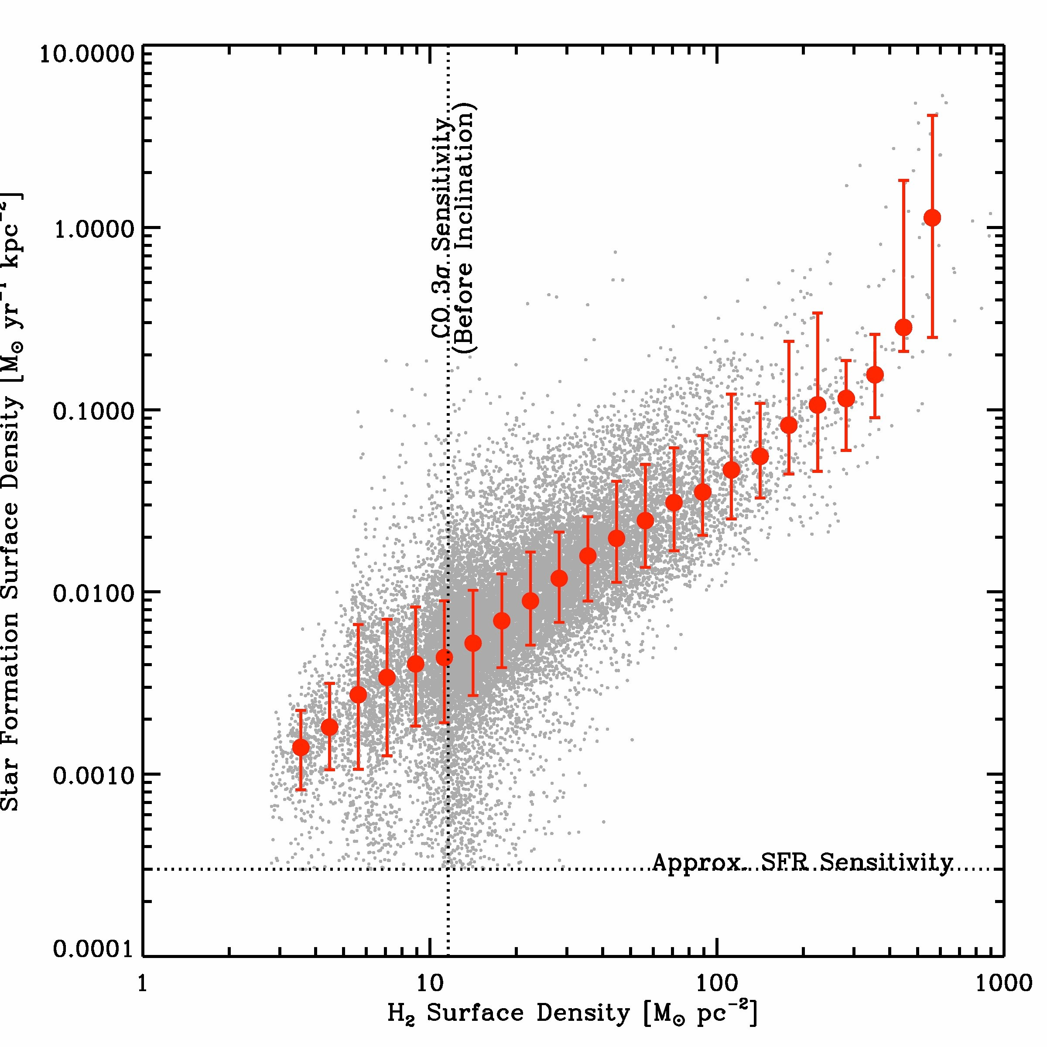
Star formation Law: relationship between H₂ surface density and star formation rate
L_{FIR} or related
L_{CO}
Caution: never trust ‘derivative’ relations (physical parameters). Go back to empirical/measured quantities
Notes:
So that’s your broad picture of the relationship between gas and star formation
… a mess at low gas surface densities
… nice at intermediate surface densities
… and maybe something going on at high surface densities
… and the data agree nicley with previous measurements
A few minutes ago I asked whether all hydrogen
… was equally good at forming stars
A quick way to try to answer that is to break our “total gas”
… measurement apart into separate atomic and molecular relations
That’s what you see here and what I’ll show in the next few slides
… still star formation rate per area on the y axis
… but now separately H2 and HI on these two X axes
You can already see just from this zoomed out plot that there’s a striking difference
… with H2 showing a strong correlation
… and HI not so much

Slide 8
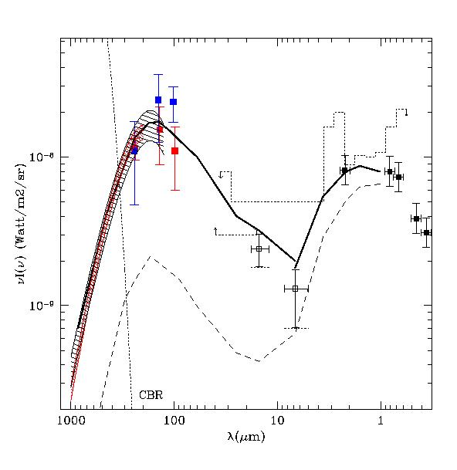
Dust obscuration: Cosmic ‘Background’ Radiation
30 nW m⁻² sr⁻¹
17 nW m⁻² sr⁻¹
Over half the light in the Universe is absorbed by dust and reemitted in the FIR
CMB
Franceschini 2000

Slide 9
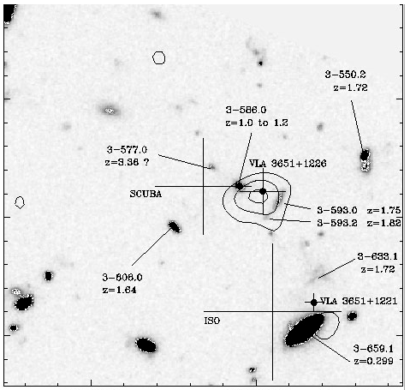
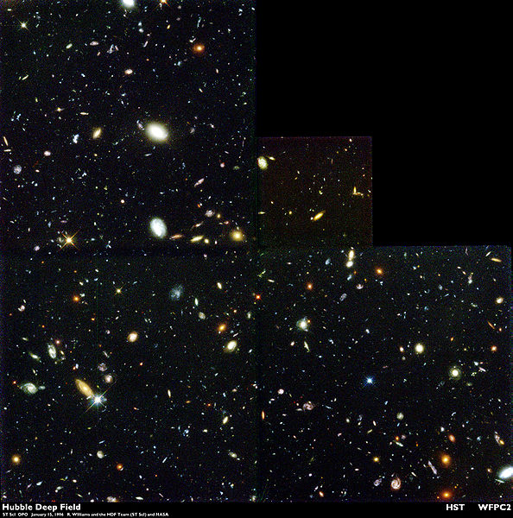
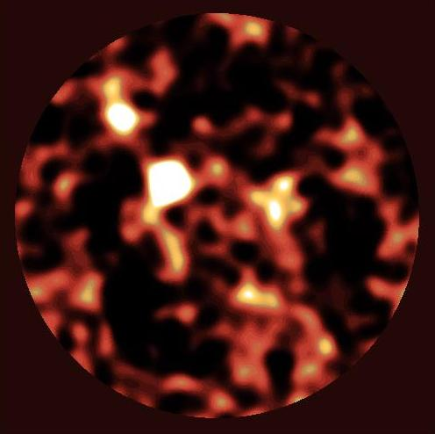
HDF850.1
Dust obscured galaxy formation: HDF
HST
SCUBA Hughes ea 98
2.5’
10³ galaxies: disks + ellipticals z=0 to 8
5 sources w. S₃₅₀ > 2mJy
submm galaxies: high z, extreme starbursts (FIR ~ 10¹³ L_{o}, SFR ~ 10³ M_{o}/yr)
Total SFR SCUBA ~ HST

Slide 10
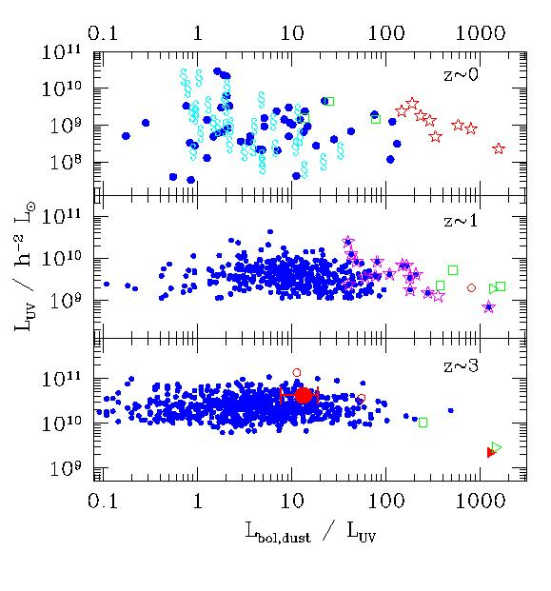
UV selected galaxies – large range in bolometric luminosity, but little correlation of Luv and Lbol
Adelberger 2000

Slide 11
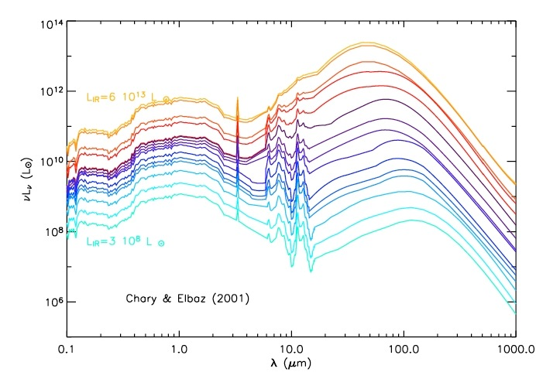
Thermal emission warm dust
Dust obscured SF
Unobscured SF
PAH
‘Main sequence’ (MW; FIR ~ 10¹⁰ L_{o}): SFR_{FIR} ~ SFR_{UV}
‘starburst’ (FIR > 10¹¹L_{o}): SFR_{FIR} >> SFR_{UV}

Slide 12
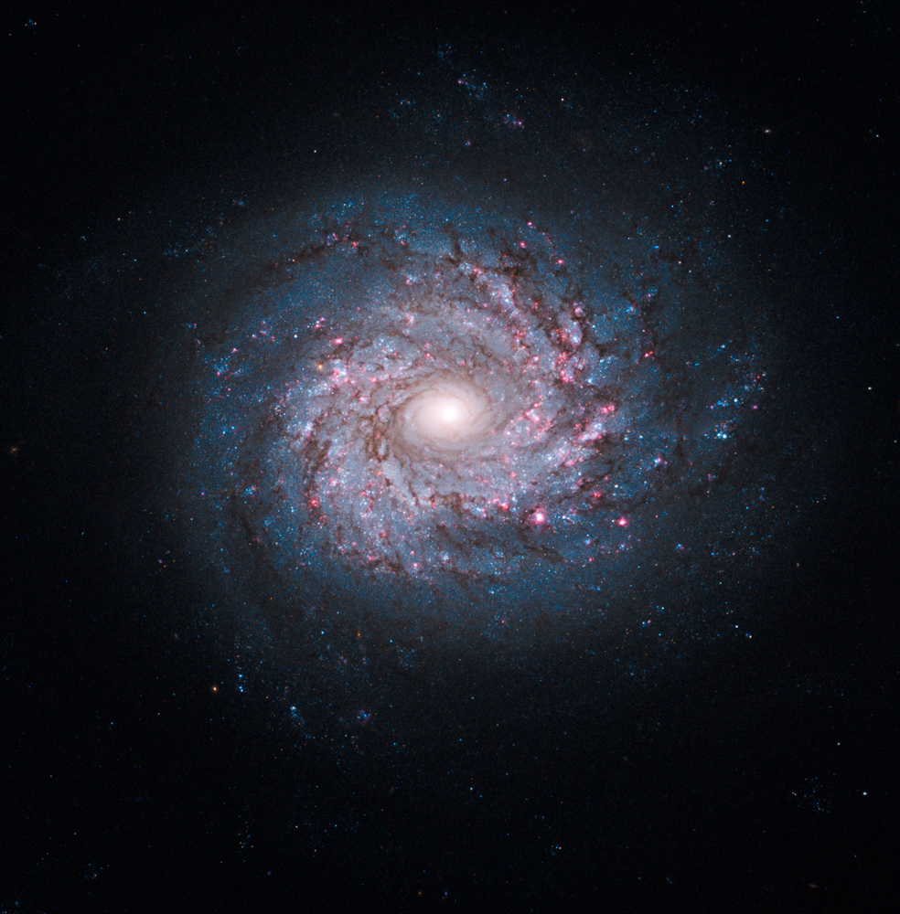
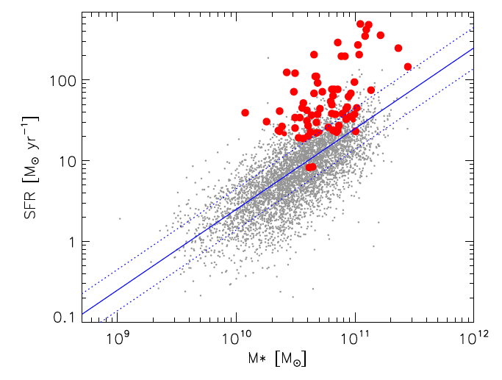
Main Sequence vs. starburst galaxies
Main sequence
Starburst (compact)
Main sequence (disk)
Elbaz
Main sequence: Secular formation ~ disk galaxies (MW)
t_{form}(z=0) ~ M*/SFR ~ O(t_{univ})
Starburst: epoch of extreme SF activity
t_{form}(z=0) ~ M*/SFR < 0.1 x t_{univ}

Slide 13
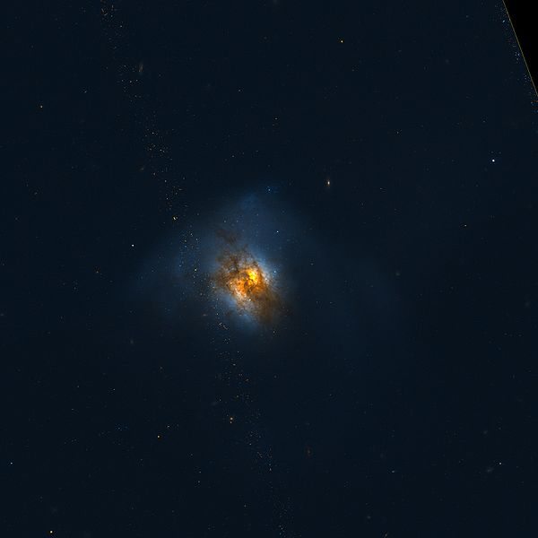
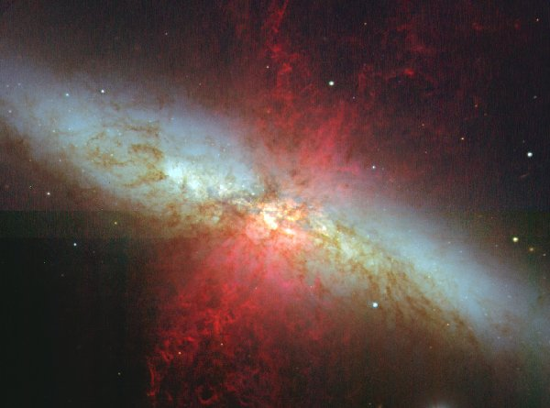
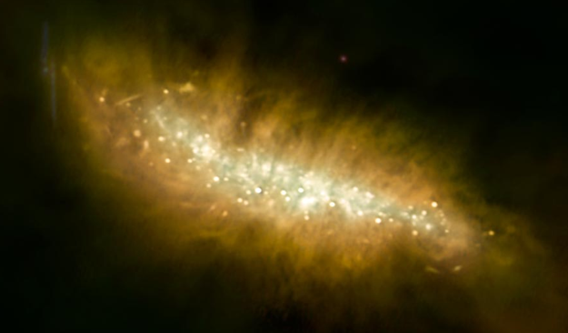
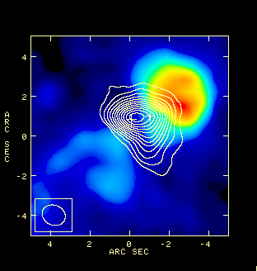
Starburst galaxies
Arp 220: FIR ~ 1e12 L_{o}
Major mergers => tidal torques drive gas to center to fuel SF
Dust obscured, nuclear starbursts scales < 1kpc
SF can drive outflows
0.5kpc
0.5kpc
M82: FIR ~ 1e11 L_{o}

Slide 14
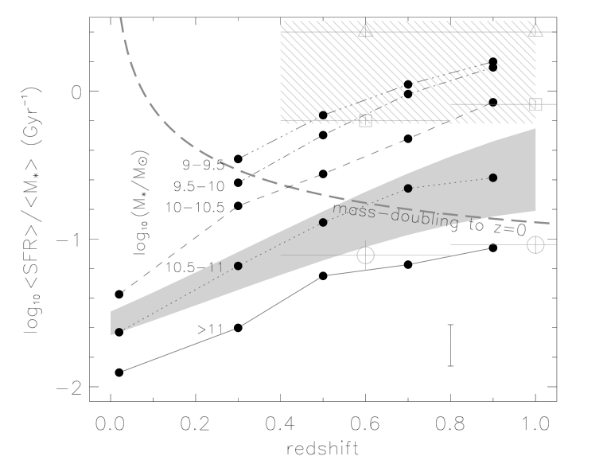
‘Downsizing’: Massive galaxies form most of stars quickly, at high z
‘active star formation’
specific SFR = SFR/M* ~ t_{form}⁻¹
t_{H}⁻¹
‘red and dead’
Zheng ea
Red and dead: massive galaxies need active SF in past
Stellar pop. synthesis at low z
Evolved galaxies at z ~1 to 2

Slide 15
Units

Slide 16
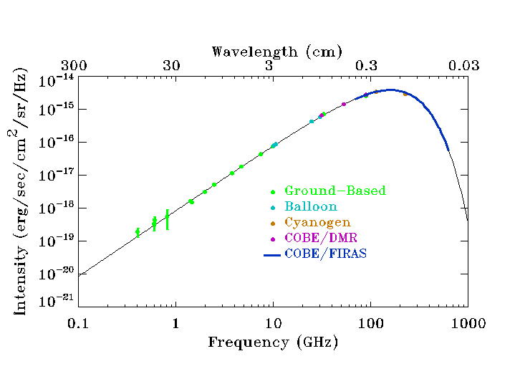
Equations
Brightness temperature: RJ approximation hν << kT
Planck black body brightness
B_{ν} = 2hν³/c² [exp(hν/kT) – 1]⁻¹ ~ 2kTν²/c² erg/s/cm²/Hz/sr
Optically thick, resolved sources = physical temp
Wien’s law: ν_{peak} = 58.8 T_{K} GHz
CMB 2.73K
Rayleigh-Jeans ~ ν²
Wien ~ exponential

Slide 17
Equations
Line width (thermal, H₂)
Non-relativistic Doppler: Δν/ν_{obs} ~ v/c
Gaussian line width: S_{ν} = S_{o} exp(-v²/2σ²)
mσ² ~ kT => σ ~ 0.7 km/s for H₂ at 100K
FWHM ~ 2.35 σ
Note: line widths are usually >> thermal => turbulence dominated
Line luminosity: S (Jy = erg/s/cm²/Hz), dV km/s
L’ = 3.25e7 S dV D_{L}² (1+z)⁻³ ν_{obs}⁻² K km/s pc²
Historical usage: resolved GMCs => surface brightness x area
L =1.04e-3 S dV D_{L}² ν_{obs} L_{o}
Home work: do algebra! (‘make it your own’)

Slide 18
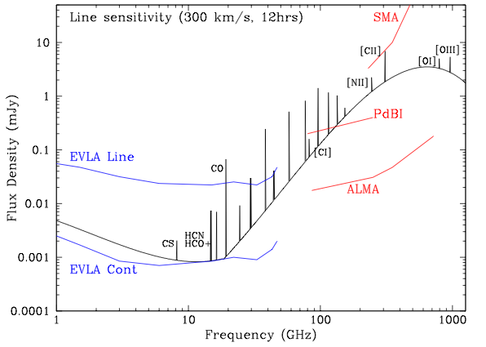
cm → submm diagnostics of galaxy formation
Rest wavelength
0.5mm
5mm
50um
z = 5
Low J CO emission: total gas mass, dynamics
High density gas tracers (HCN, HCO+)
Synch. + Free-Free = star formation
High J molecular lines: gas excitation, physical conditions
Dust continuum = star formation
Atomic FIR fine structure lines: ISM gas coolant
Observed

Slide 19
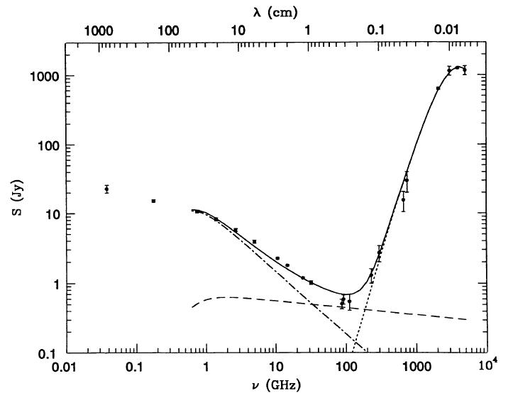
Star formation rates: Radio to FIR continuum of M82
All mechanisms ∝ massive star formation rate
Thermal dust
20 -- 70K
Synchrotron
Free-Free

Slide 20
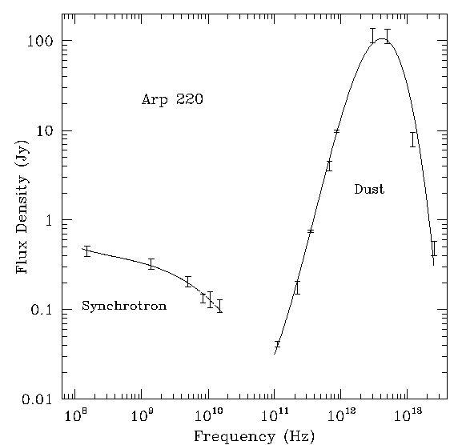
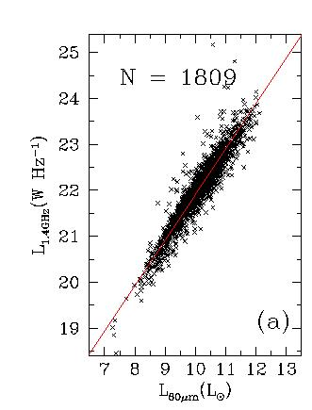
Radio – FIR: ‘tightest correlation in extragalactic astronomy’
Total SFR in Mo/yr (0.1 to 100 Mo)
Dust: direct re-radiation star light => straight-forward conversion
SFR = 3e-10 LFIR (Lo) (42 -- 122um)
Radio continuum: indirect relation, depends on B, calibrated using R-FIR
SFR = 1e-21 L1.4 (W/Hz)
Only massive stars (>5Mo) => factor ~ 5 correction to total, depending on IMF
Homework: read Condon 1992 ARAA 30, 575, and derive SFR relationships

Slide 21
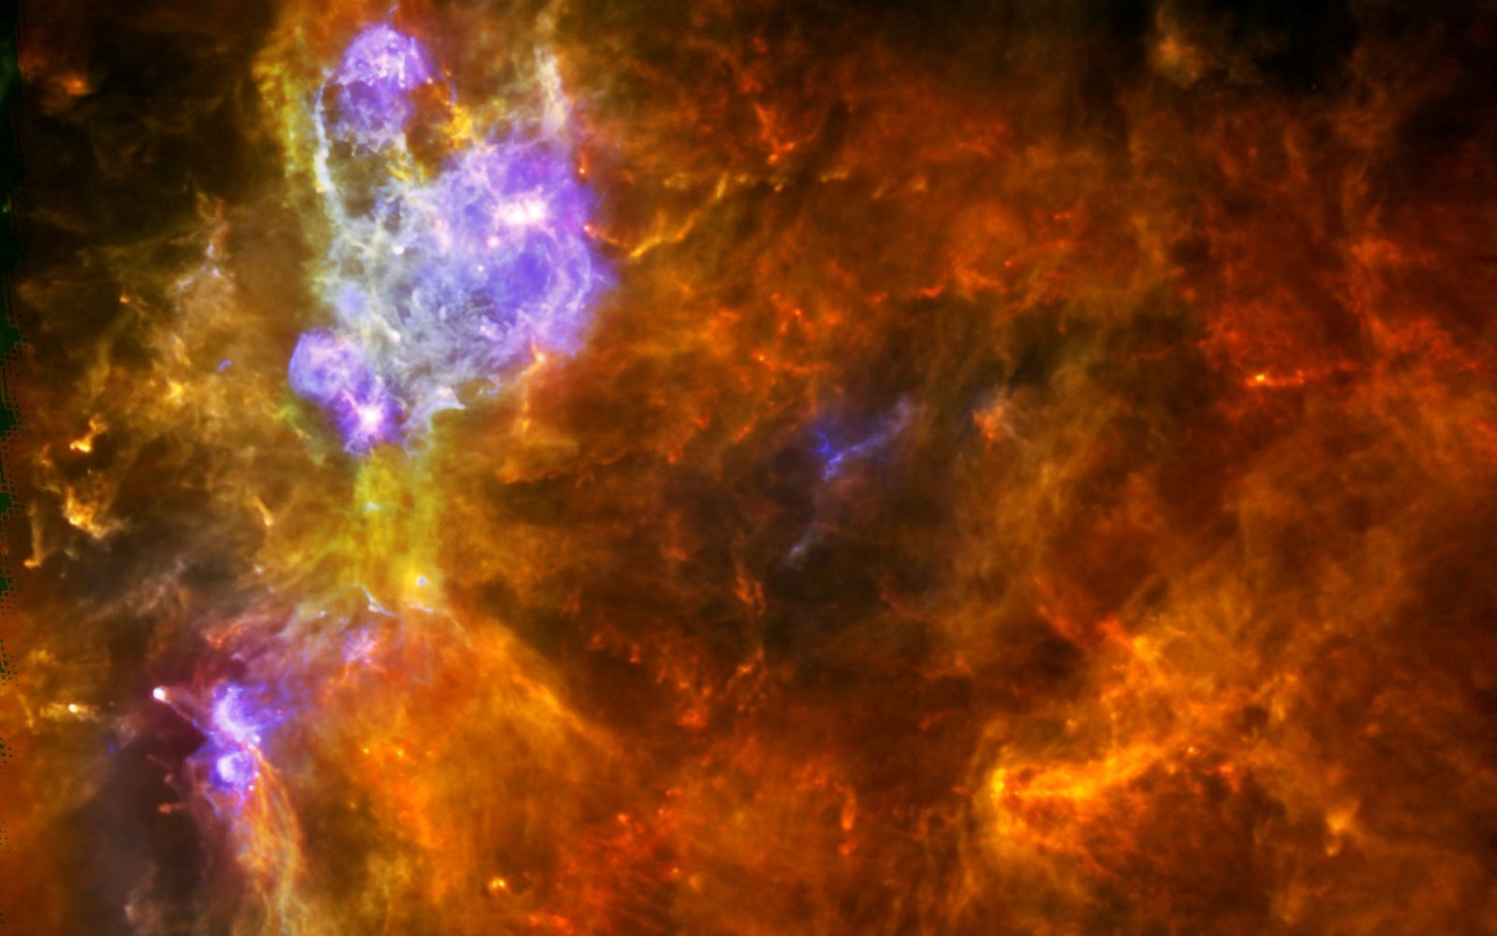
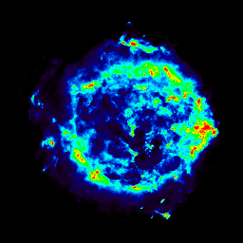
Conventional Model
Molecular clouds
Hot
stars
Heating
UV
UV
Stars
form
Warm
Dust
SN
FIR
High Correlation!
SNR
Radio
ISM
Shocks
Synchro-
tron
CR
Part.
Accl.
CR
Trans-
port
Magnetic
Field
Notes:
Dynamic:
Star form → Massive stars → UV → Hot dust → FIR
Star form → SN → SNR → cosmic ray electrons → radio continuum
If its starting to look like Ptolomy’s rings – that’s intended

Slide 22
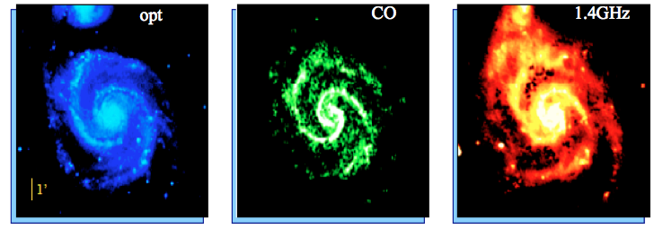
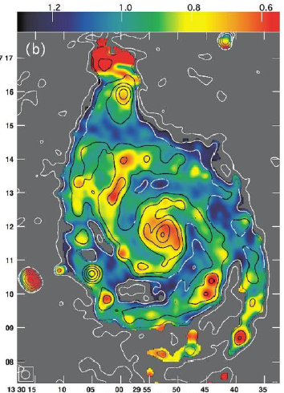
Radio spectral ‘dating’
Paladino
SI(1.4-5GHz)
Radio continuum: ‘smoothed version’ of CO/Dust = propagation of relativistic electrons on kpc-scales
Synchrotron aging: dE/dt ~ E²B²
t_{syn} ~ E/(dE/dT) ~ E⁻¹B⁻² => lose high E electrons first
ν_{syn} ~ E² B => characteristic steepening at high freq
t_{syn} ~ 1610 (B/1uG)^{-3/2} (ν_{break}/1 GHz) ^{-1/2} Myr
Homework: read Carilli ea 1991 ApJ 383, 554 and do the algebra

Slide 23
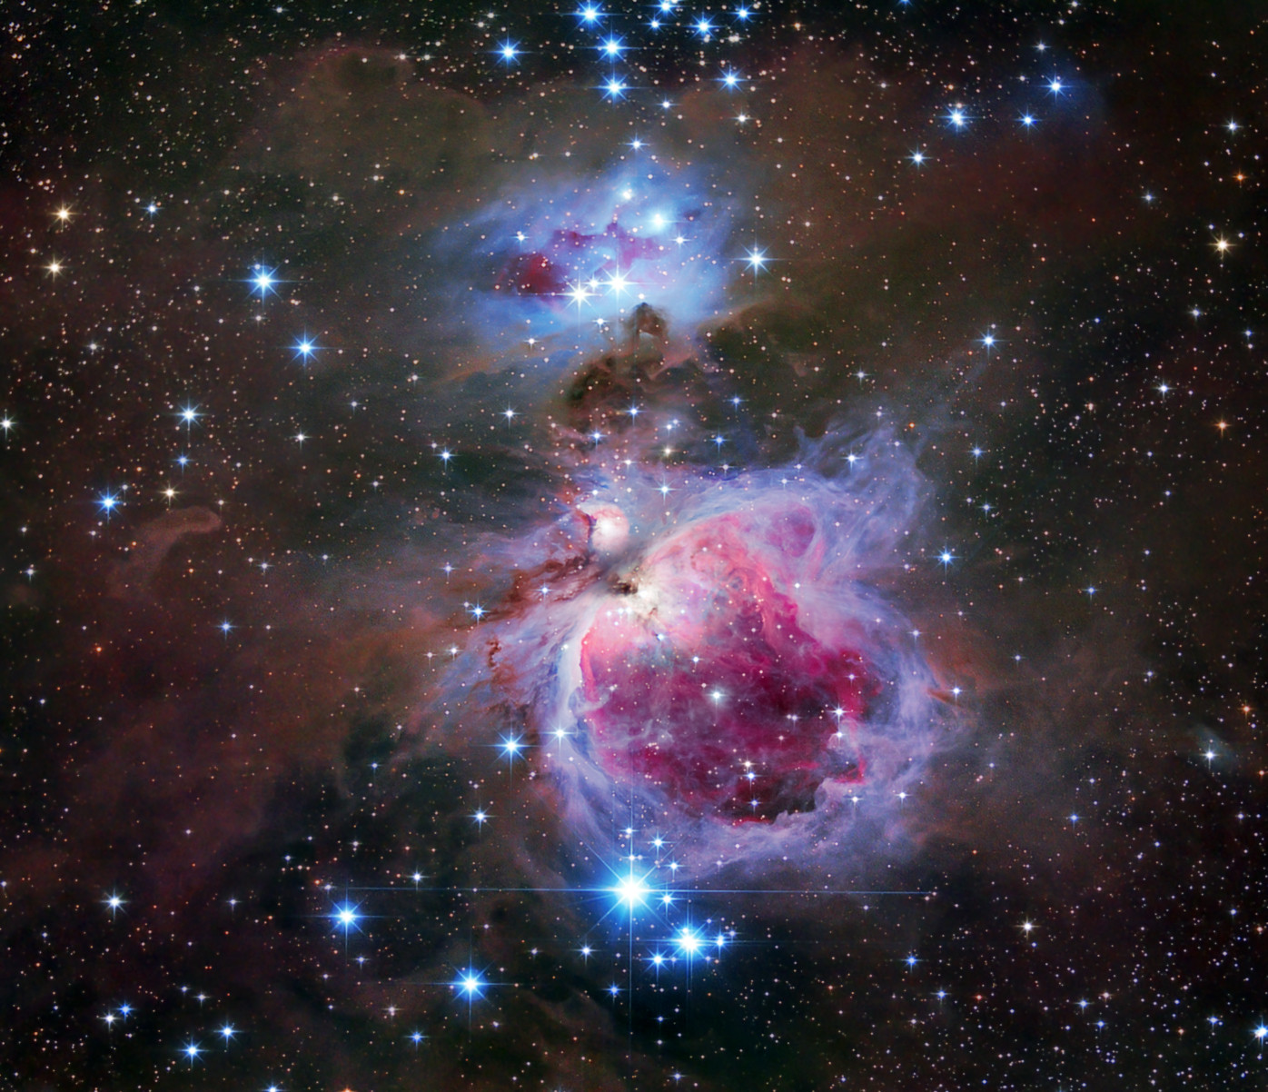
Ib. Molecules (mostly) in giant molecular clouds
Star formation occurs in GMCs
10^{4–6} M_{o}
10 – 100 pc
Ages < 20Myr (OB stars)
~ 4000 in MW
M_{H2}(MW) ~ 10⁹ M_{o}
<n> ~ 100 cm⁻³
SF cores < 1pc, n > 10⁴ cm⁻³
Observer’s view
[CII]
HII
HI
CO, dust

Slide 24
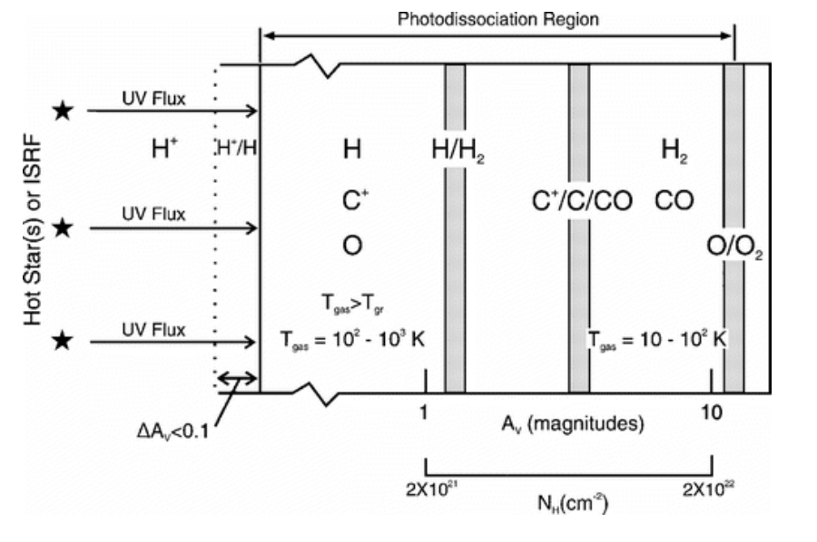
Theorist’s view molecular cloud
HII region/WIM
Photon-dominated region
Dark Mol. cloud
WNM
CNM
H₂ self-shielded
CO dust-shielded
T ~ 10⁴ K n < 10 cm⁻³
>100 cm⁻³
>1000 cm⁻³
Gas heating:
photo e^{- f}from H
photo e⁻ dust
Cosmic rays
Gas cooling:
H recomb lines
[CII] 158um
CO+

Slide 25
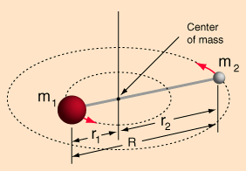
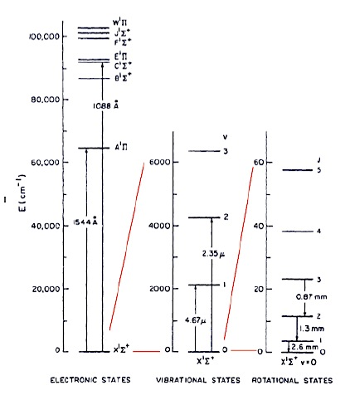
Simple molecule
Herzberg ‘Spectra Diatomic molecules’
Transitions: electronic, vibrational or rotational quantum number
Rotational transitions (mm)
KE_{rot} = ½ I ω² = ½ L²/I
L= ang. mom.= ħ[J(J+1)]^{1/2}
I = mom. inertia = μR²
μ = reduced mass = (m₁m₂)/(m₁ + m₂)
E_{J} = [ħ²/2I] J(J+1)
Selection rules: allowed (Elec) transitions
Conservation ang. mom.: ΔJ = +/- 1
Permanent dipole moment (net E field change): no homo-nuclear diatoms (H₂)
hν = (E_{j+1} – E_{j}) => ν = h/(4π²I) (J+1) = ‘CO ladder’
Homework: work through algebra. Look up difference with classical treatment.
IR
mm
UV

Slide 26
Simple molecule
Spitzer, ‘Physical Processes in ISM’
Oscillator strength (f): measure of strength of coupling of transition to EM field => line strength
f abs. cross section B_{jk} (Einstein abs coef) μ²
where μ = dipole moment molecule (charge separation, er, strength E field)
Critical density for excitation
Radiative de-excitation: A_{kj} = 2hν³/c² B_{kj} => A ν³ μ² s⁻¹
Collision excitation rate = σ_{coll} n v sec⁻¹
n_{cr} ~ A_{kj}/vσ_{coll} ν³ μ² /σ_{coll}T^{1/2}
Excitation temperature: kT_{ex} = hν

Slide 27
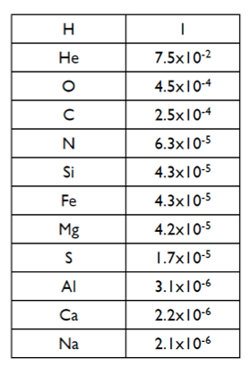
 | CO 1-0 | CO2-1 | HCN 1-0 | CS 1-0
ν GHz | 115.3 | 231.5 | 88.6 | 49.0
μ debye; er | 0.112 |  | 1.96 | 2.98
A_{kj} s⁻¹ | 7.2e-8 | 6.9e-7 | 2.4e-5
T_{ex} K | 5.5 | 16.6 | 4.25 | 2.35
n_{cr} cm⁻³ | 2.3e3 | 1.1e4 | 2.6e6
A_{kj} for HI 21cm = 2.8e-15 s⁻¹ (10⁷yrs)
A_{kj} for Lya = 6.3e8 s⁻¹ (1nanosec)
CO best overall tracer of H₂
Weak transition but
High cosmic abundance
low excitation temp/density
HCN: dense gas tracer (SF cores)
High dipole moment

Slide 28
CO excitation
Thermal excitation
CO J | N_{i}/N_{tot} T = 10K | T=20K
0 | 0.27 | 0.14
1 | 0.43 | 0.31
2 | 0.20 | 0.29
3 | 0.042 | 0.17
4 | 0.0043 | 0.067
Boltzmann distribution: Thermal distribution in
collisional equilibrium at T
N_{i}/N_{tot} = g_{i} exp(-hν_{i}/kT)/Q
Q = ‘partition function’ = Σ_{j} g_{j}exp(-hν_{j}/kT)
g_{i} = 2J_{i} + 1 (degeneracy of ang mom states states = space quantization)
Sub–thermal: population of the level is less than expected if collisional excitation rate << spontaneous emission rate. n_{cr} is strong function of frequency => at low densities, high order states are preferentially depopulated relative to thermal due to spontaneous radiation.
Often optically thick:
σ_{abs,CO0-1} ~ 10⁻¹⁶ cm⁻²
CO/H₂ ~ 10⁻⁵ => τ_{CO} ~ Nσ > 1 for N_{H2} > 10²¹ cm⁻²

Slide 29
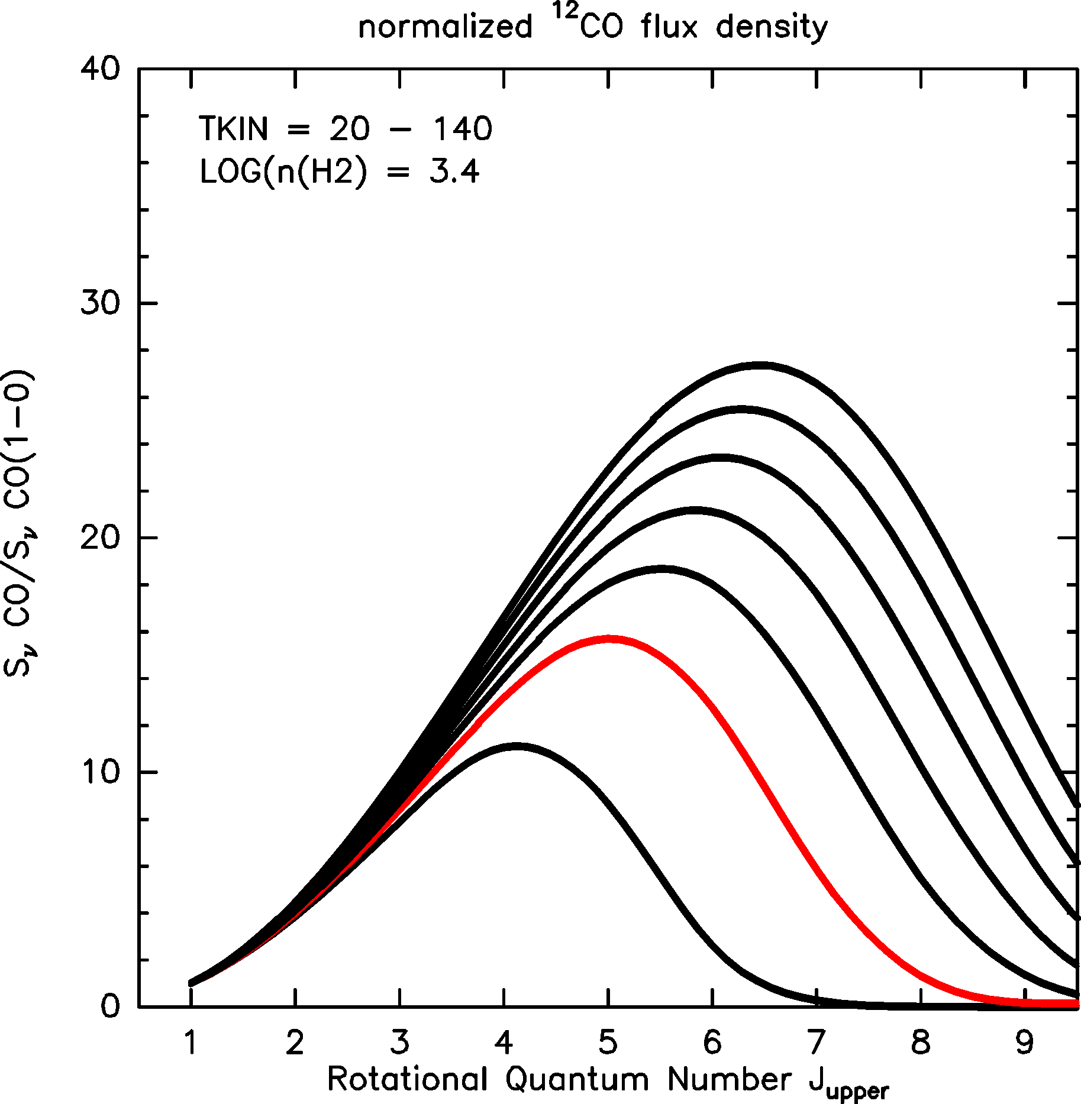
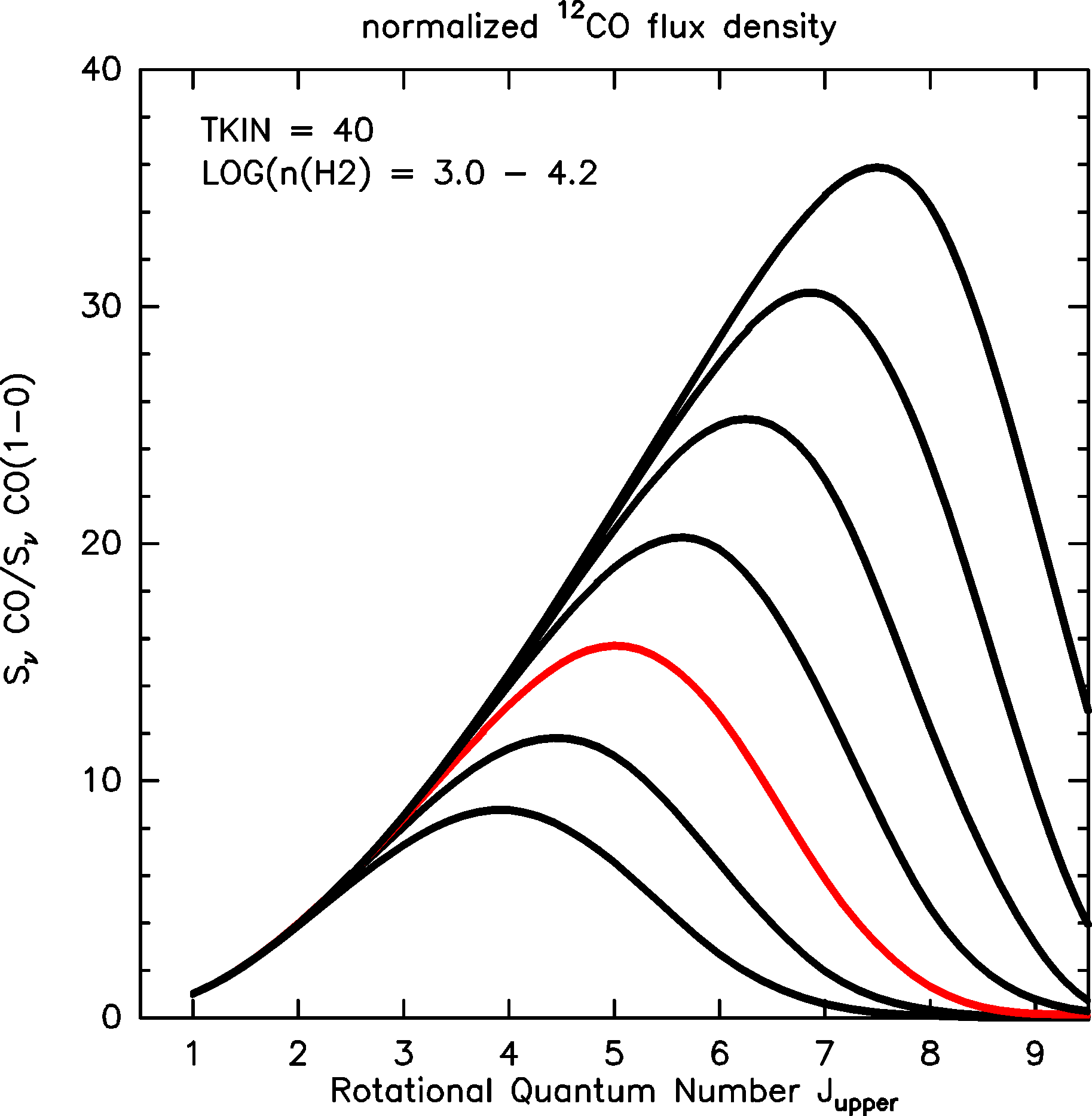
CO excitation ladder: Large Velocity Gradient models and physical diagnostics
S_{j}/S₁₋₀
140 K
Radiative transfer calculation with T, n, dv/dr
Boltzmann distribution, corrected for:
Excitation/deexcitation equilibrium
Self-opacity
Line escape fraction dictated by velocity gradient over cloud, dv/dr
Multiple transitions => derive n or T (~ degenerate)
T=140 K, n= 2500 cm⁻³ ~ T=40K, n=10,000 cm⁻³
40 K
20 K
4.2
3.4
3.0

Slide 30
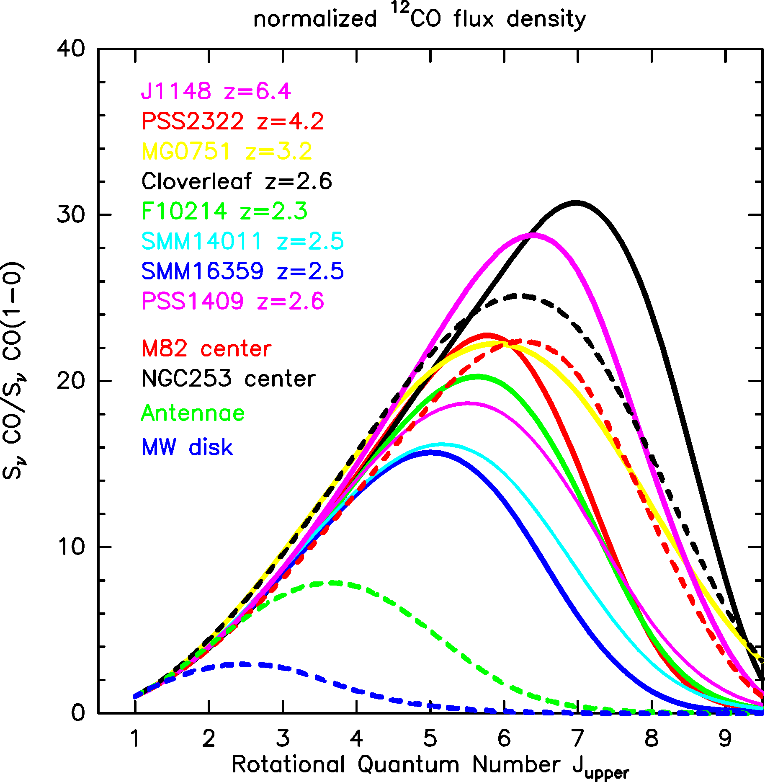
CO excitation ladder: observations
Dash = low z
Milky Way:
Peaks at CO 2-1 to 3-2
T_{kin} ~ 20 K, n(H₂) < 10³ cm⁻³
Star forming cores (< 1pc) and starburst nuclei (~100pc)
Peaks ~ CO 5-4
T_{kin} ~ 50 K, n(H₂) > 10⁴ cm⁻³
Entire ISM ~ SF core in nuclear starbursts!
Starburst nuclei
Antenae
MW
Notes:
Dashed curves: local galaxies
!!! SED lines seen in QSOs similar to local starbuts environments!!!
Perhaps entirely density driven?? -> evolutionary sequence?

Slide 31
Molecular gas mass
Difficulty
Mass dominated by H₂ : lowest (forbidden) transition at 28um (500K) => not excited in cold gas
CO best tracer but ~ 10⁻⁵ by number wrt H₂: How to go from CO luminosity to molecular gas mass?
‘Conversion factors’: α_{co} = M_{H2}/L’_{CO1-0}
Empirical/calibrated approaches
Estimate H₂ mass/column from A_{v} using a standard dust–to–gas ratio, calibrate using ¹³CO (optically thin) + isotope ratio (Dickman 1978; Dame et al. 2001)
Estimate H₂ mass using γ–ray emission, where the γ–rays result from the interaction between cosmic rays with H₂ molecules, compare to CO surface brightness (Strong & Mattox 1996, Bloemen 1989, Hunter et al 1997),
Model GMCs as self–gravitating clouds: Key discovery was the correlations between line width – cloud size, and L’_{CO} – M_{vir} (the ‘Larson relations’; Larson 1981; Solomon et al. 1987).

Slide 32
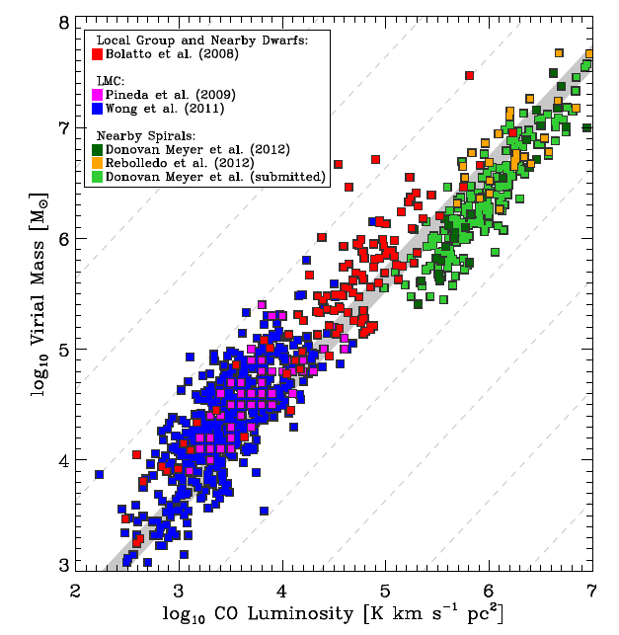
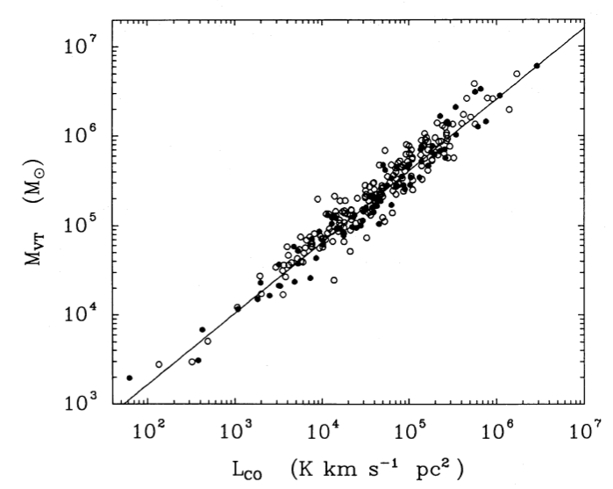
Virial theorem
Clumps optically thick but individually unobscured => velocity width reflects overall GMC dynamics.
GMCs are self gravitating, dyn mass ~ M(H₂)
KE ~ mv² ~ PE ~ GMm/R => M_{dyn} ~ Rv²/G ~ M(H₂)
α_{co} = M_{H2}/L’_{CO1-0} = 4.3 M_{o} (K km/s pc²)⁻¹
Bollato ea 2013
Nearby Galaxies
Solomon ea 1987
Galactic GMC
α_{gal}

Slide 33
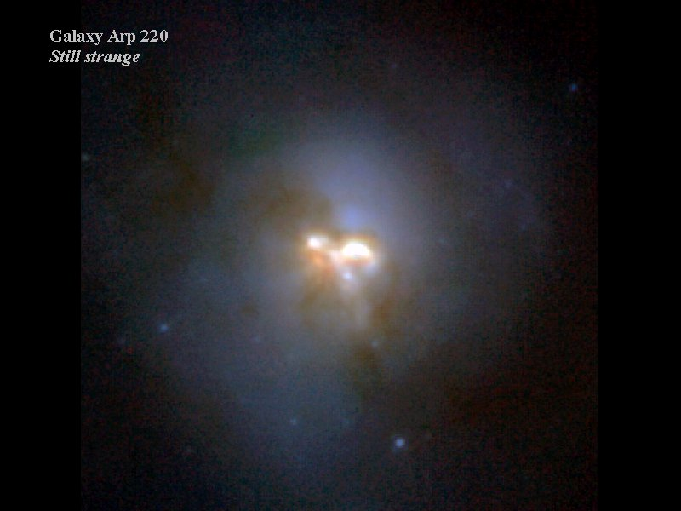
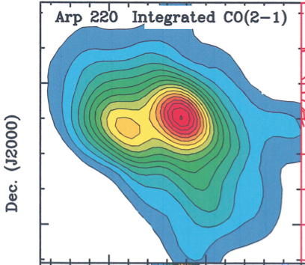
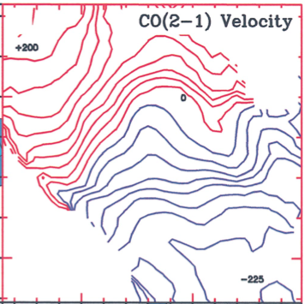
Molecular gas mass: nuclear starbursts
Arp220
300pc
Problem: M(H₂) > M_{dyn} for MW conversion
Radiative transfer modeling + gas dynamical imaging + D/G vs metalicity ratio
=> Less total gas mass required to produce given CO luminosity
α_{CO} = 0.8 M_{O}/(K km/s pc²)
Downes + Solomon

Slide 34
Conversion factors factors (Bolatto ea. 2013)
Starbursts: high density, opacity, temperature, merger dynamics
Increasing T => increasing CO brightness temp
Higher density => larger fraction of ISM is molecular vs. atomic
High N => remains optically thick, but
broader line width reflecting global merger dynamics: mass of stars/DM/gas, not just self-gravitating H₂
L’_{CO} ~ T_{B} dV => higher CO luminosity per unit gas mass.
Low metalicity galaxies: decreasing metalicity => increasing α_{co} due decreased dust shielding (CO dissociates but H₂ self-shields)
Optically thin limit: ‘count CO atoms’, and adopt abundance
L_{CO1-0} = hν N_{J=1} A_{kj} (erg/s)
α_{min} = 0.34 M_{o} (K km/s pc²)⁻¹ at T = 30K

Slide 35
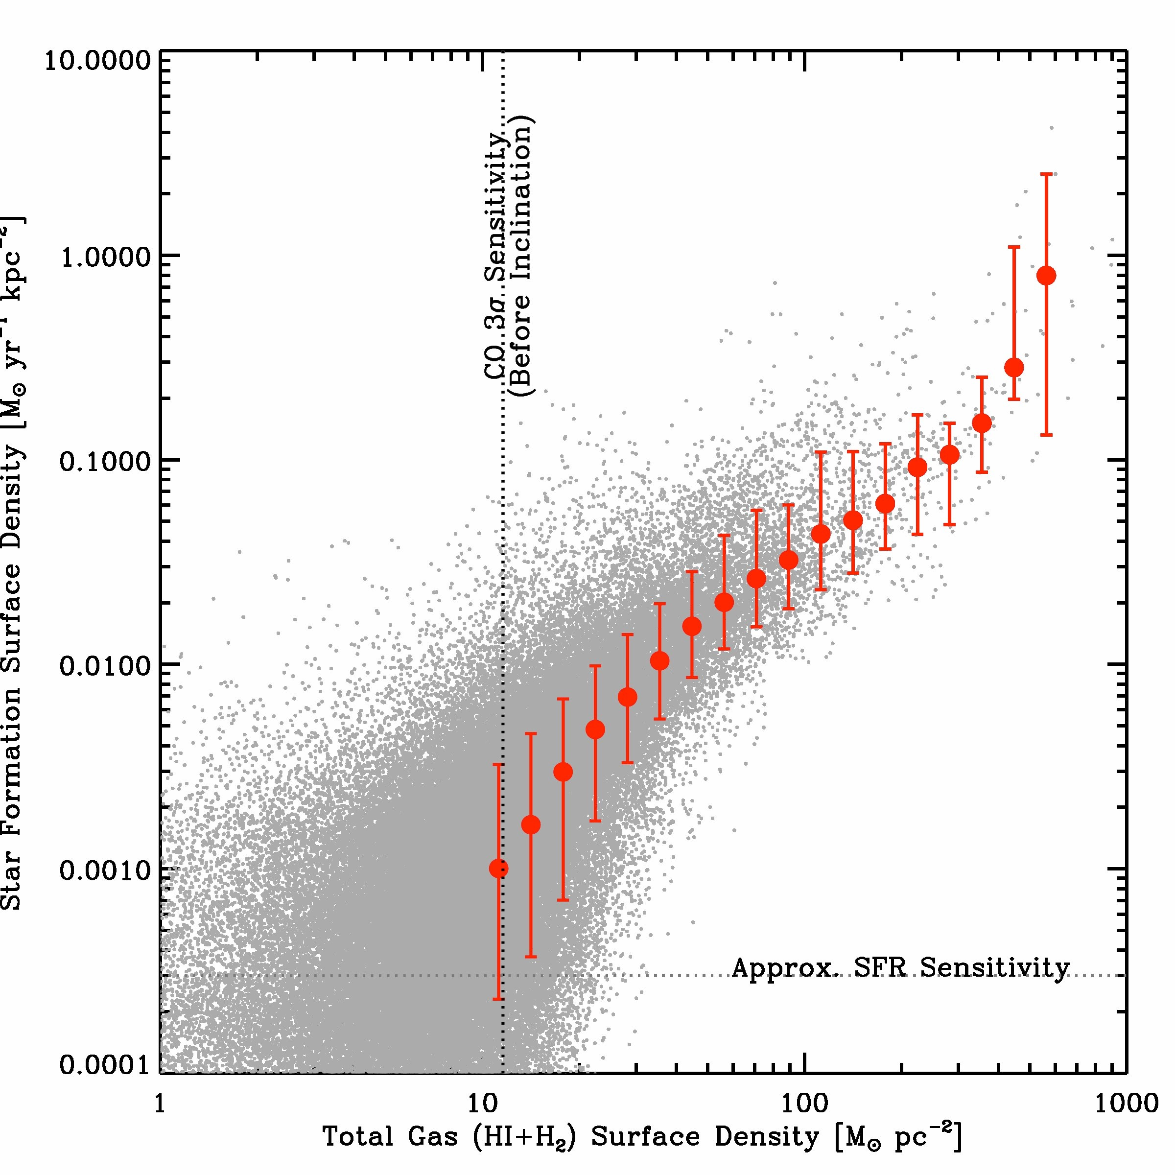
Star formation Laws: SFR vs. gas mass
Kennicutt & Evans 2012
HI+H₂
Notes:
So that’s your broad picture of the relationship between gas and star formation
… a mess at low gas surface densities
… nice at intermediate surface densities
… and maybe something going on at high surface densities
… and the data agree nicley with previous measurements
A few minutes ago I asked whether all hydrogen
… was equally good at forming stars
A quick way to try to answer that is to break our “total gas”
… measurement apart into separate atomic and molecular relations
That’s what you see here and what I’ll show in the next few slides
… still star formation rate per area on the y axis
… but now separately H2 and HI on these two X axes
You can already see just from this zoomed out plot that there’s a striking difference
… with H2 showing a strong correlation
… and HI not so much

Slide 36
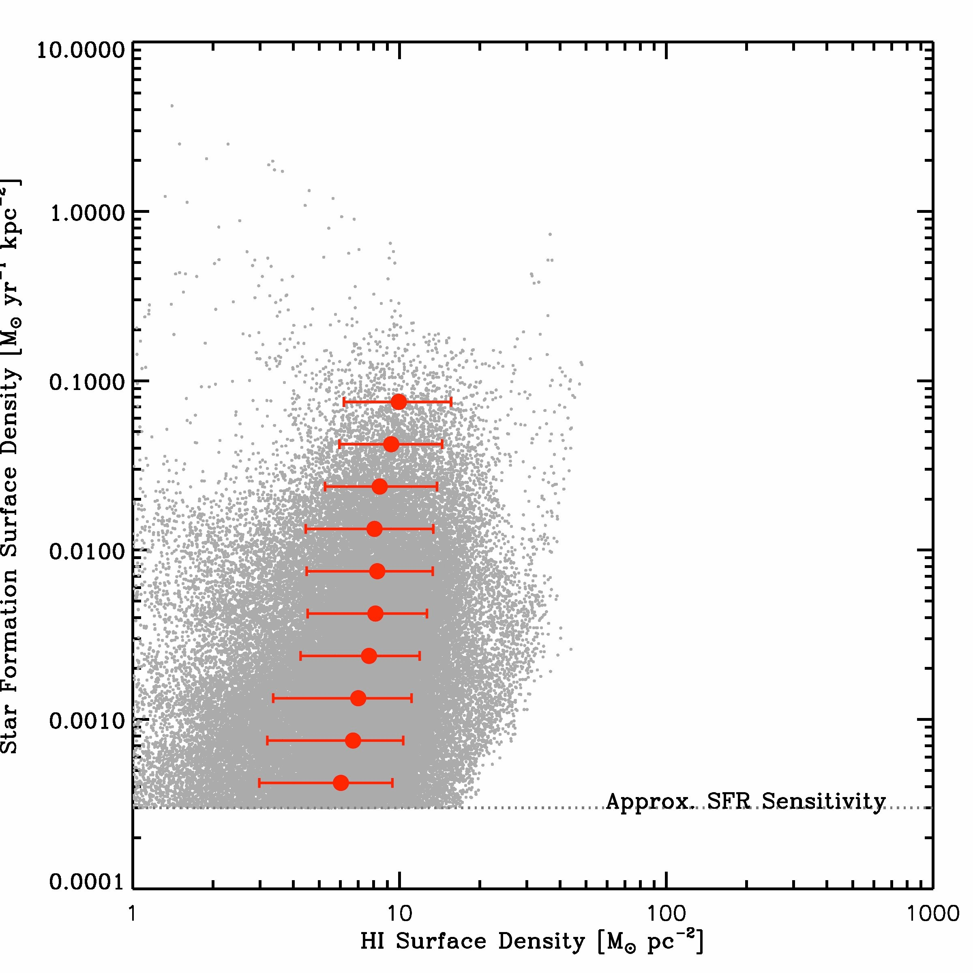
Star formation Laws: HI vs. H₂
Strong correlation SFR –H₂
No correlation SFR – HI
H₂ – HI ‘threshold’ at N_{tot} ~ 10 M_{o} pc⁻² (10²² cm⁻³)
Only H₂
Leroy ea
Only HI
Notes:
So that’s your broad picture of the relationship between gas and star formation
… a mess at low gas surface densities
… nice at intermediate surface densities
… and maybe something going on at high surface densities
… and the data agree nicley with previous measurements
A few minutes ago I asked whether all hydrogen
… was equally good at forming stars
A quick way to try to answer that is to break our “total gas”
… measurement apart into separate atomic and molecular relations
That’s what you see here and what I’ll show in the next few slides
… still star formation rate per area on the y axis
… but now separately H2 and HI on these two X axes
You can already see just from this zoomed out plot that there’s a striking difference
… with H2 showing a strong correlation
… and HI not so much

Slide 37
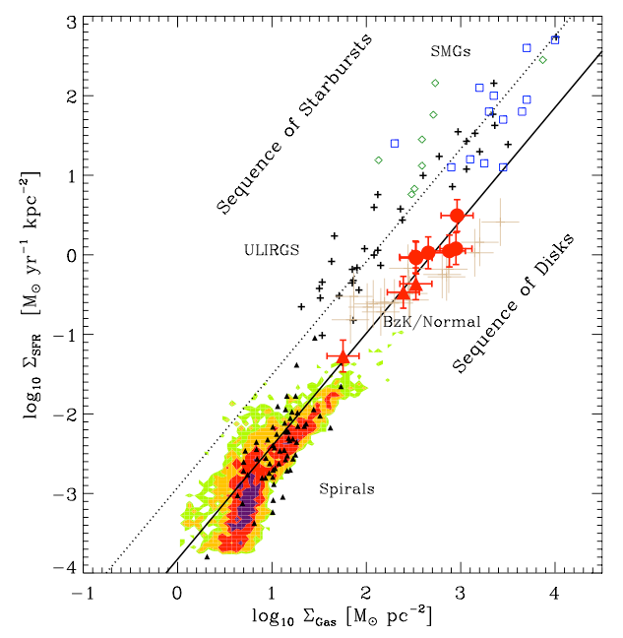
Star Formation Law: two sequences (disk – starburst)?
PL index = 1.4
Gas depletion time, t_{d} = M_{gas}/SFR
disk: t_{d} ~ few (α/4) x 10⁸ yrs
starburst: t_{d} ~ few (α/0.8) x 10⁷ yrs
SF efficiency = 1/t_{d}
Why? SB regions are dense => free fall time on small scales is short
t_{ff} ~ R/v_{rot} ~ ρ^{-1/2}
Note: In all cases, t_{d} << t_{H} => require gas resupply from IGM, even for MW
N=1.42

Slide 38
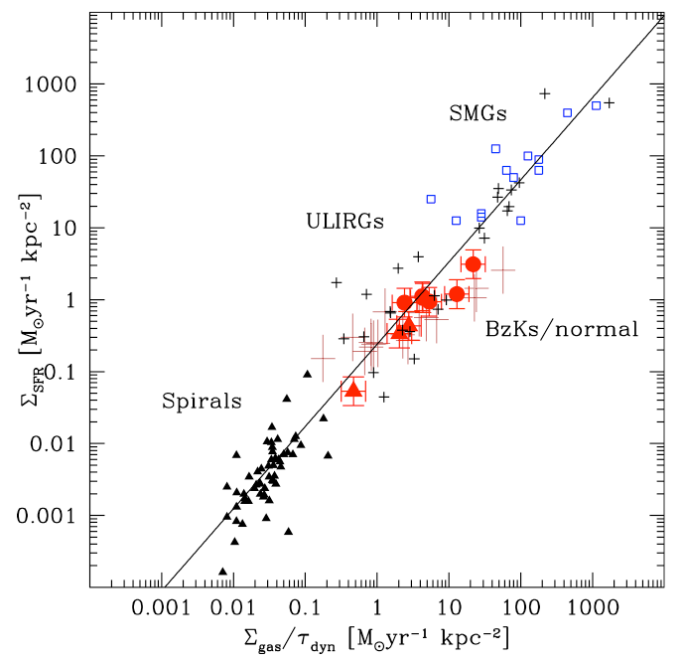
Why: gas processed on dynamical time?
Normalize by dynamical time (~ rotation period)
Linear slope fits all => Depletion time/dynamical time ~ constant
N=1.14+-0.03
Genzel ea.

Slide 39
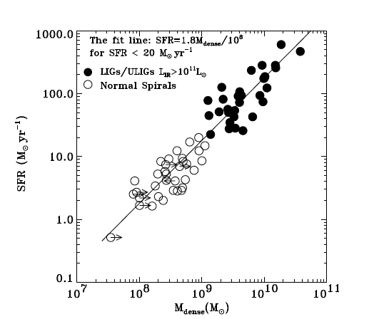
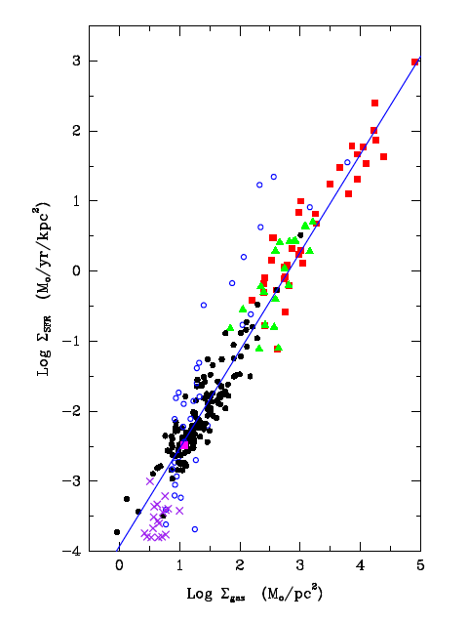
Dense gas tracers (HCN, HCO+): counting SF cores
n=1.0
n=1.4
HCN
CO
Densities > 10⁵ cm⁻³ => SF cores
HCN, HCO+ linear tracers of SFR
Problem: L_{HCN}/L_{CO} < 0.1

Slide 40
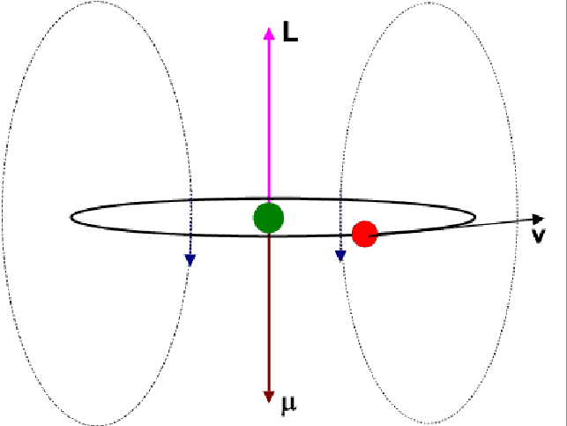
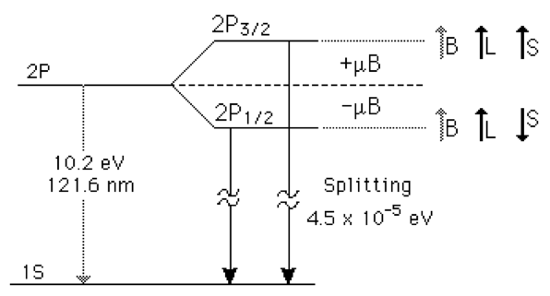
Atomic Fine Structure Lines
Spin orbit coupling: E = u_{e} • B_{orb} = L•S
Forbidden (non-Elec) transitions (no change in principle quant. num.)
Homework: Calculate energies for [CII] permitted splitting vs. FSL
[CII] 158um
FS doublet
133.4532, 133.5708nm
E=9.2 keV
7.7eV

Slide 41
Atomic Fine Structure Lines
 | [CII] | [OIII] | [NII]
Transition | ²P_{3/2} – ²P_{1/2} | ³P₁ – ³P₀ | ³P_{2/1} – ³P_{1/0}
λ um | 157.74 | 88.36 | 121.90/205.18
T_{ex} K | 91 | 163 | 115/72
A s⁻¹ | 2.1e-6 | 2.6e-5 | 7.5e-6/2.1e-6
n_{cr} cm⁻³ | 50 | 510 | 310/48
E_{ion} eV | 11.3 | 35 | 14.5
E_{ion}(H) = 13.6eV => CII exists in WNM and WIM, NII in WIM.
Assuming C/N abundance, CII 158/NII 205 => fraction CII from WIM.
NII 122/OIII 88: similar n_{cr} but different E_{ion} => radiation field hardness

Slide 42
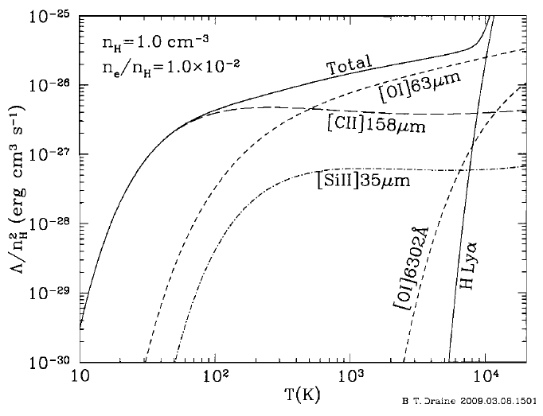
[CII] cooling neutral gas
Gas cools via C-H collisions => excite [CII] FSL
Forbidden transition => optically thin (not trapped)
C is 2nd most abundant heavy element
ISM gas Cooling:
T < 10³ K: [CII]
T > 10⁴ K: H

Slide 43
Good news: CII is everywhere!
[CII] 158um line (1900GHz) is most luminous line from star forming galaxies from meter to FIR wavelengths:
0.3% of FIR luminosity of MW
[CII]/CO3-2 ~ 50
traces WNM, WIM, SF regions => Good dynamical tracer
z > 1 => redshifts to ALMA bands (< 900 GHz)

Slide 44
Bad news: CII is everywhere!
Mag. Clouds
CII luminosity is not quantitative tracer of anything: FIR > 10¹¹ => factor ~ 100 scatter!
[CII] powerful tool for:
Gas dynamics (CNM – PDR)
Redshift determinations z>6
Low metallicity: enhanced [CII]/FIR (lower dust attenuation => large UV heating zone)
Can be suppressed in SB nuclei: dust opacity?
MW
11

Slide 45
Thermal emission warm dust
60K
3 + β
20K
PAH
at 125um

Slide 46
Dust primer (Draine 2003 ARAA 41, 231)
Carbon/crystalline (graphite): form in cool winds from evolved (AGB) stars (<1um)
Silicates/amorphous carbon: form in supernovae/SNR?
Destruction vs. creation: sputtering/shattering in ISM shocks => most dust mass reforms/accretes in ISM
Grains provide surface for complex astrochemistry and H2 formation
Dust mass insignificant (~1% of total HI gas mass)

Slide 47
ISM heating and polycyclic-aromatic hydrocarbons
Dust is the main heating mechanism of cool ISM.
FUV photons with hν>6eV free photoelectrons from dust, which heat the gas, with efficiency ~ 0.1-1%. Mostly effective with PAHs and small dust grains.
PAH: small, hot dust (0.001um), transient heating (~ very big molecules)

Slide 48
Dust and the Magic of (sub)mm ‘cosmology’: distance independent method of studying objects in universe from z=0.8 to 10
Similar, but less pronounced, for mol. lines: lines α_{RJ} ≤ 2, but dust α_{RJ} ≥ 3
Homework: make this plot and change your life!
α_{RJ}

Slide 49
Star formation history of the Universe: fundamental result from cosmological deep fields
First light + cosmic reionization
‘epoch of galaxy assembly’
~50% of present day stellar mass produced between z~1 to 3
Cosmic demise
Bowens +
Bouwens +

Slide 50
Limitation: Dust
Dust correction in UV
Factor 5 at z < 4
No correction at z > 6 ?
Bouwens +

Slide 51
Limitation: cool gas = fuel for star formation = ‘missing half of galaxy formation’
SF Law

Slide 52
Atacama Large Millimeter Array, Chile
66 antennas, 7m, 12m
90 to 900 GHz
Very Large Array Socorro, NM, USA
27 antennas
74MHz to 50 GHz

Slide 53
Interferometry: SIRA II
Van Cittert-Zernike: cross correlation of electric fields measured at 2 points = fourier transform of sky brightness
l,m ~ cos(θ_{x}, θ_{y}) (rad)
u, v = (x₁ – x₂)/λ, (y₁ – y₂)/λ (rad⁻¹)

Slide 54
Interferometry: SIRA II
‘fringe on sky’ modulated by PB
Primary beam = 2λ/D rad
Synthesized beam = λ/B rad
Amp V = strength source
Phase V = position source
SB
PB
B
D
E_{i}
E_{j}

Slide 55
Radio zoom lens
D configuration (1km)
Res = 1’ at 1.4 GHz
Max. size = 20’
res~1”
A configuration (30km)
Res = 1” at 1.4 GHz
Max. size = 20”
0.001”

Slide 56
Karl G. Jansky Very Large Array

Slide 57
Atacama Large Milllimeter Array
High sensitivity array = 54x12m
Wide field imaging array = 12x7m
Frequencies = 80 GHz to 900 GHz
Resolution = 20mas at 800 GHz
Sensitivity = 13uJy in 1hr at 230GHz
> 10² times more sensitive than existing submm arrays!
ALMA + JVLA represent an order of magnitude, or more, improvement in observational capabilities from 1 GHz to 1 THz!

Slide 59
Giant steps cm → mm: sensitivity
Rest wavelength
0.5mm
5mm
50um
z = 5
VLA cont
Observed

Slide 60
BRI1202-0725 z=4.7
HyLIRG (10¹³L_{o}) pair:
Quasar host
Obscured SMG
SFR ~ 10³; M_{H2} ~ 10¹¹
+
4”
+
HST 814 Hu ea 96
Salome ea. 2012
SMA
[CII] 158um
334GHz, 20hrs
Iono ea 2007

Slide 61
[CII] in 1202-0725
Wagg ea
ALMA SV
20min, 16 ants
334GHz
SMA 20hrs

Slide 62
Giant Steps: Frequency and resolution

Slide 63
Giant Steps: Site quality
0.3 mm
7 mm

Slide 64
Giant Steps: Site quality
Atmostpheric opacity: O₂, H₂O, CO…
H₂0
H₂0
τ = 0.5 at 0.9 THz
O₂
O₂
CO
Mauna Kea

Slide 65
Giant Steps III: Image quality
HST quality and resolution

Slide 66
Giant steps: broad band spectroscopy
JVLA: 25% FBW [eg. 31 to 39 GHz => CO1-0 at z=1.9 to 2.7) => large cosmic volume searches for molecular gas
CO 1-0 z=2.5

Slide 67
Antenna transporters
VLA: rails, 200,000kg
ALMA: roads, 100,000kg

Slide 68
VLA site 2000m

Slide 69
Chajnantor Plateau (5000m) – looking north

Slide 71
Operations Support Facility (3000m)

Slide 72
The Sun never sets on ALMA
North American ALMA Science Center, C’ville
ESO Headquarters
ALMA
NAOJ Japan
Joint ALMA Observatory, Santiago

Slide 73
Proposals: ‘open skies’ (~ 5– 10% to non-partner)
VLA: Aug 1 / Feb 1
ALMA: 2015 (annual)
Aperture Synthesis Summer School Bi-annually

Slide 74
Next Decade: Square Kilometer Array
SKA-mid
0.35 to 3 (14?) GHz
SKA-low
50 to 350 MHz

Slide 76
SKA Phase I science
Killer apps
Pulsars and gravity
Imaging reionization, first light
Foundational applications of radio astronomy
Magnetism
Milky way and nearby galaxies: star formation, cool gas, cosmic web…
Galaxy formation (SFHU, cool gas, DM, B…)
AGN, high energy sources, synoptic surveys…
Possible game changers (high risk/high return)
FRBs: as profound as pulsars!?
BAO/IM and other cosmology apps: beat Boss?
Dark ages and linear cosmology
Exoplanets/biology: band 5+
SETI

