Slide 1
Geometry of Closure Phase and
Image-plane Self-Calibration
Nithyanandan Thyagarajan (CSIRO)
Chris Carilli (NRAO)
Bojan Nikolic (U. Cambridge)
I acknowledge the Traditional Owners of the land, sea and waters, of the area that we live and work on across Australia. I acknowledge their continuing connection to their culture and pay my respects to their Elders past and present.

Slide 2
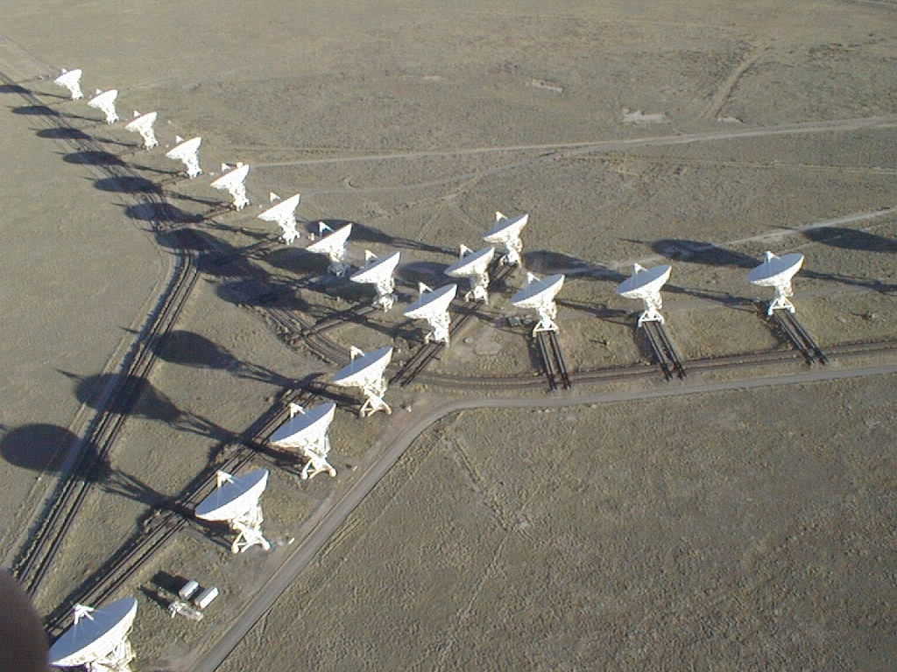
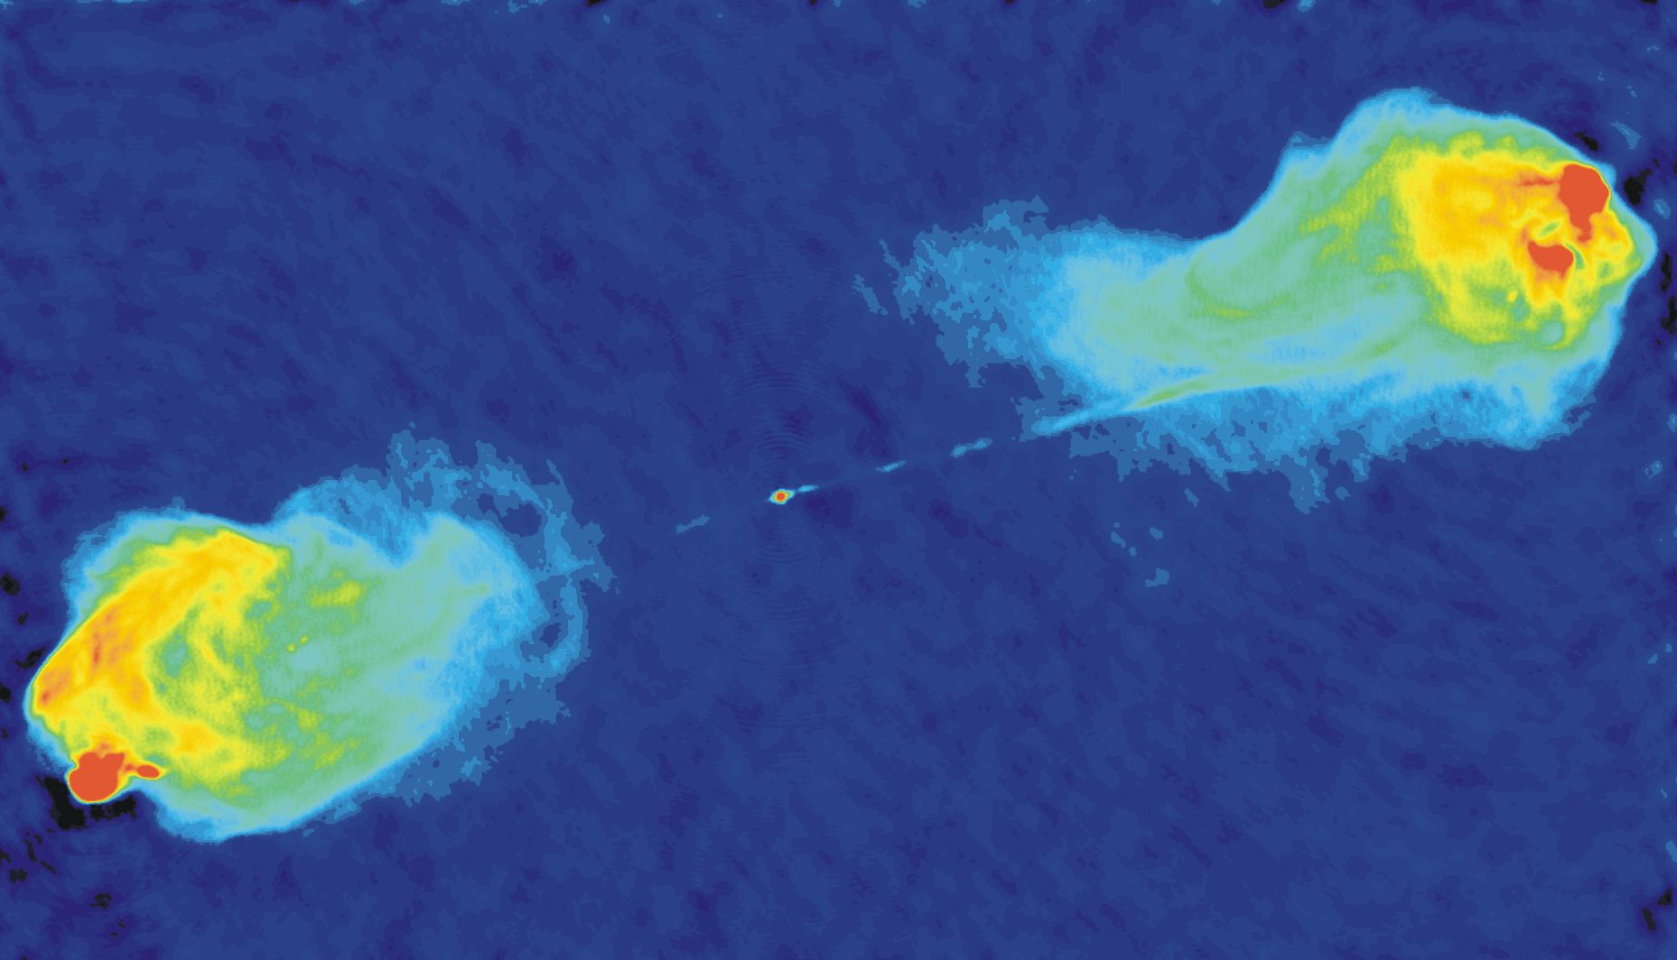


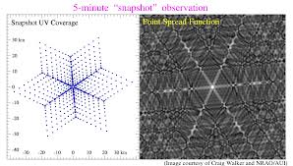



Interferometric Fringes & Image Synthesis
Measurement
(Van Citterte-Zernike relation)
Correlation in Radio
Inverse FT in Optical
Synthesized in Radio
Intrinsic in Optical
Measured in Radio
Not measured in Optical
Image Credit: NRAO
Image Credit: C. Carilli
Image Synthesis
Inverse Fourier
Series Summation
Fringe

Slide 3
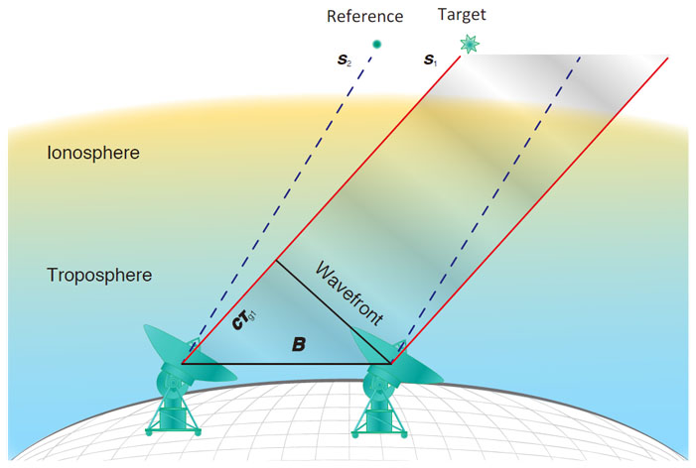
Calibration: Standard approach
Frequent observations of reference radio sources of “known” structure, strength, and position
Determine element gains
Spatial and temporal interpolation
Apply to target visibilities

Slide 4
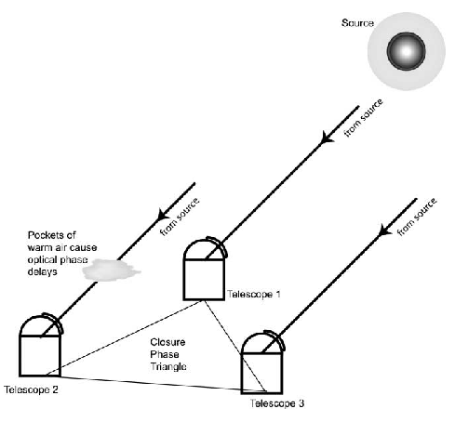
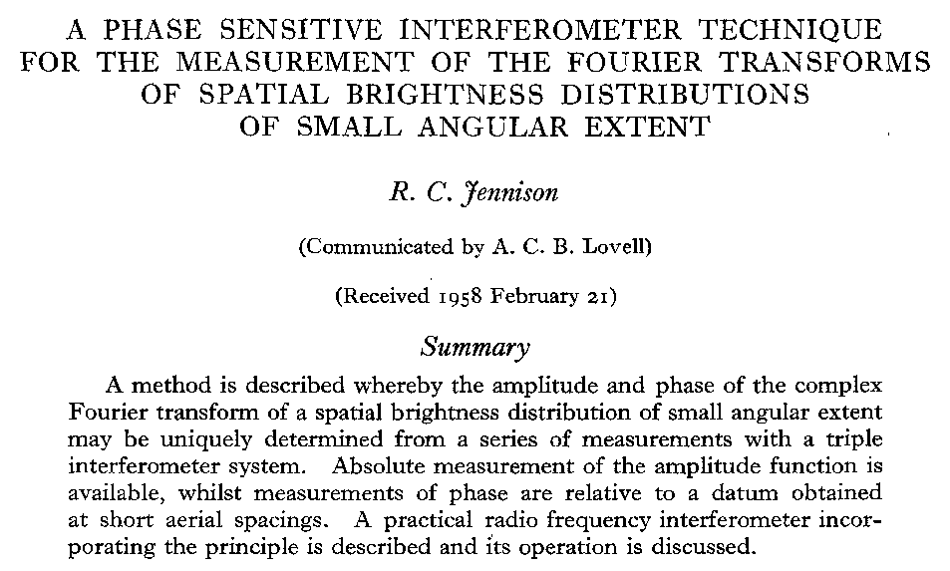
Closure Phase
Provenance
Monnier+(2006)
Bispectrum: V^{m}_{abc} = V^{m}_{ab}V^{m}_{bc}V^{m}_{ca}

Slide 5
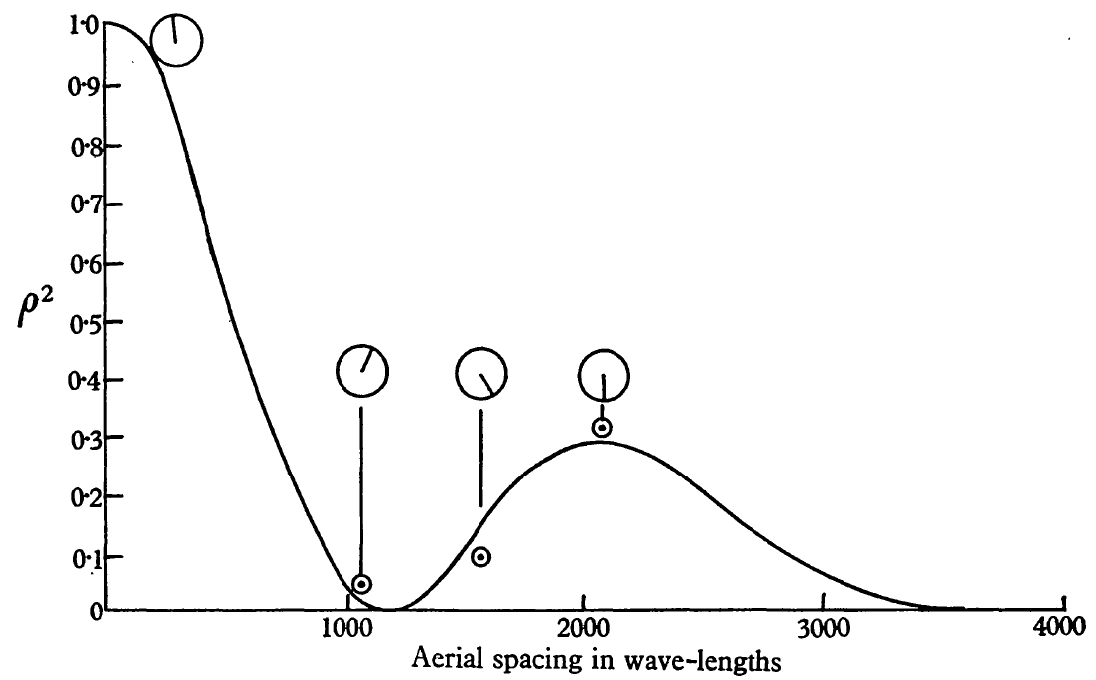
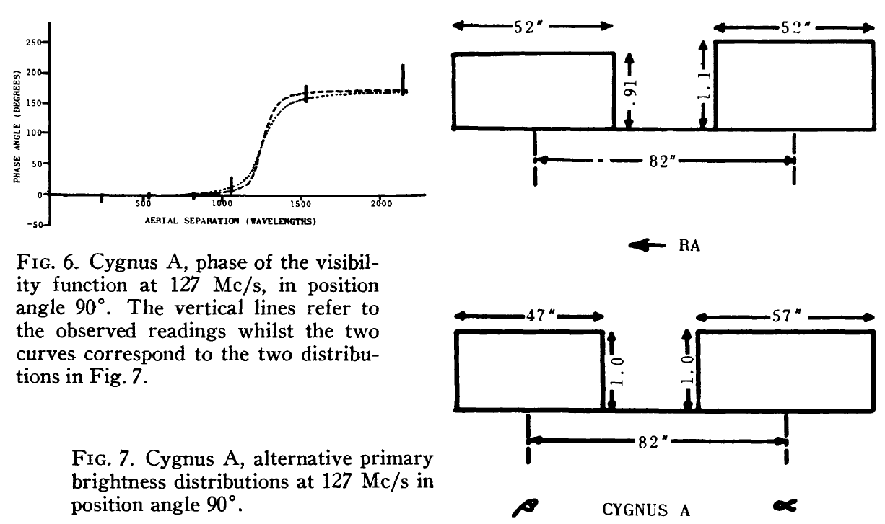
Discovery of Detailed Structures of Radio Galaxies: Double-lobed structure of Cygnus A
Image Credit: C. Carilli
Jennison (1957)
Jennison (1959)
Jennison & Latham (1959)
First determination of core-jet morphology of quasar 3C147
First direct evidence of superluminal expansion (~10c) of relativistic jet in quasar 3C273
…
M87, Sgr A* black hole morphologies by EHT

Slide 6
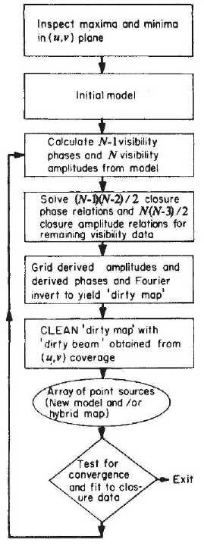
Hybrid Mapping (Before self-calibration)
N-1 unknown antenna phases
=> (N-1)(N-2)/2 closure phases
Pearson+(1981)
Wilkinson+(1977)
N unknown antenna amplitudes
=> N(N-3)/2 closure amplitudes
Iteratively estimate visibility phases
Not antenna phases
First determination of core-jet morphology of quasar 3C147
First direct evidence of superluminal expansion (~10c) of relativistic jet in quasar 3C273
Readhead+(1980)

Slide 7
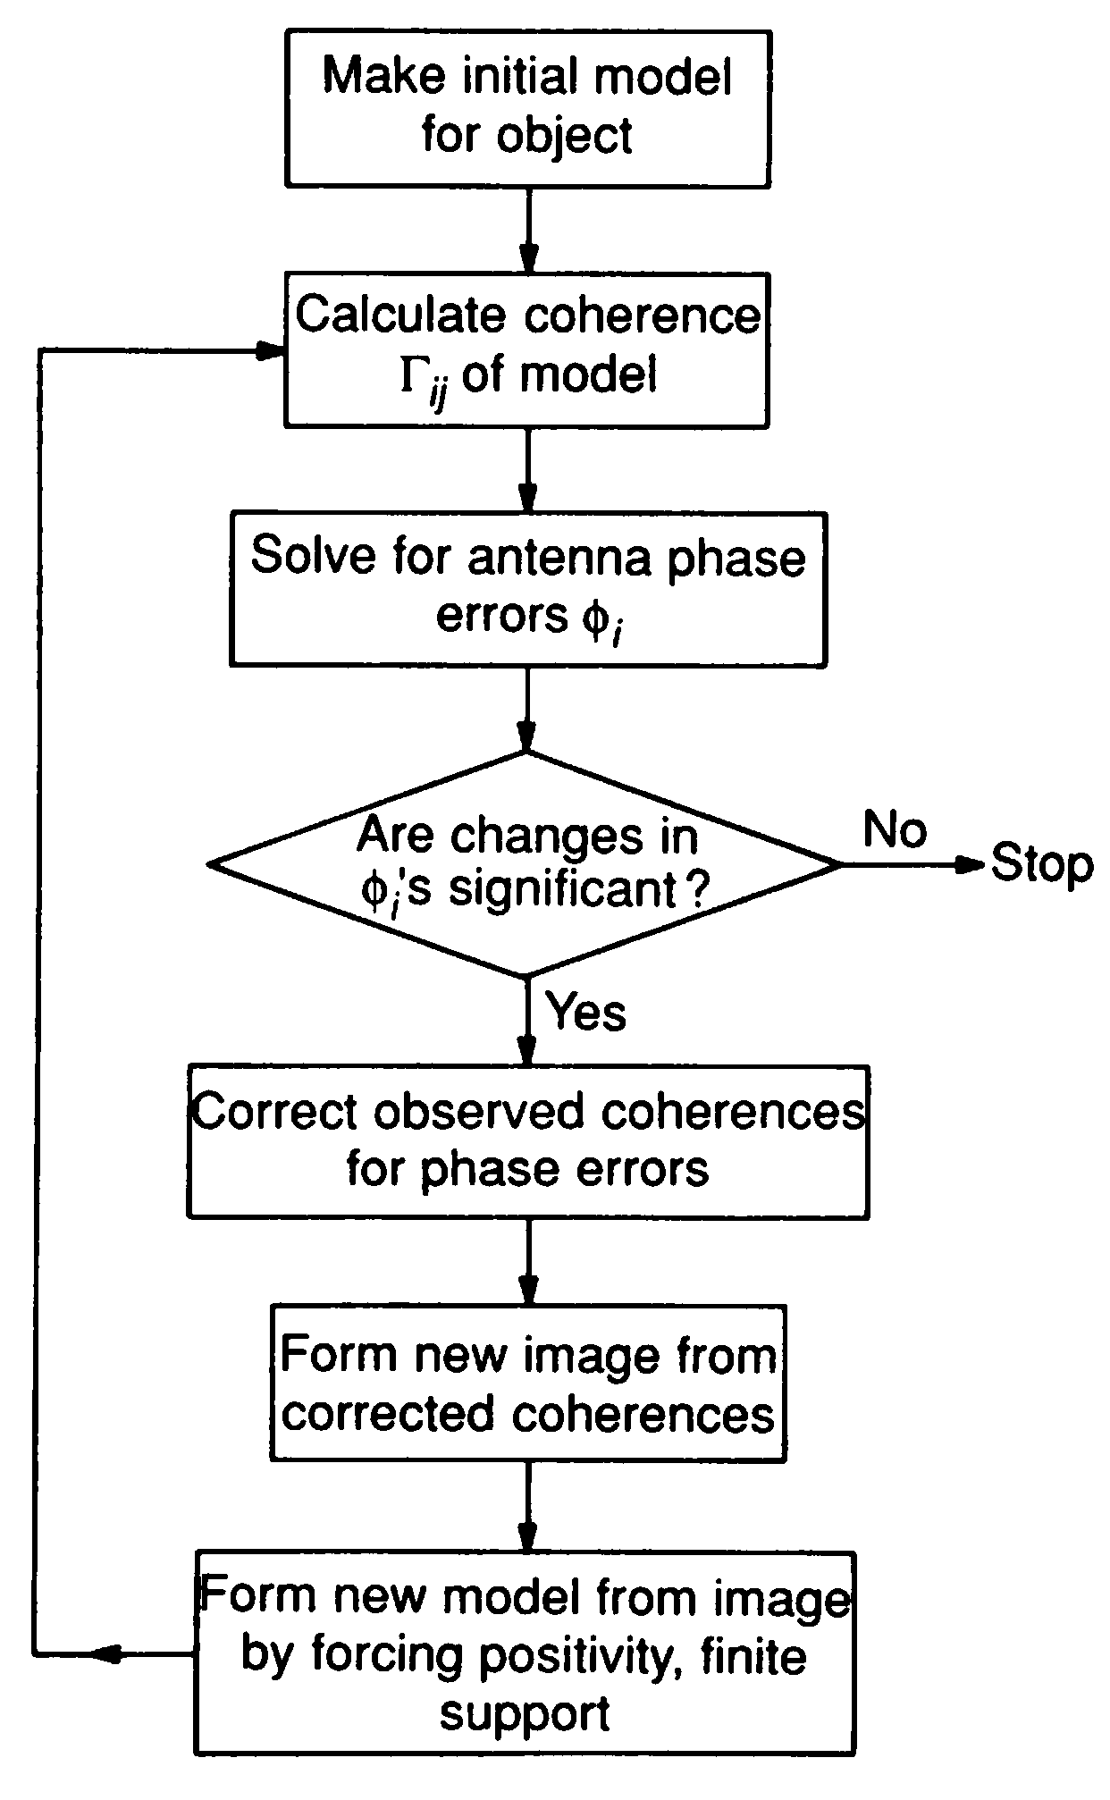
Self-calibration
N antenna complex gains from N(N-1)/2 complex visibilities => powerful constraints
Works very well for large N
Antenna-based => inherently preserves closure quantities (not explicitly estimated)
Cornwell (1989)

Slide 8
Image plane view of Closure Phase
Closure phase is independent of antenna-based gain corruptions*
Aperture-plane view straightforward
Image-plane view??
*Caveats apply: Baseline-dependent, direction-dependent and polarization leakage terms
can violate this relationship

Slide 9

Geometry of Interferometric Fringes
Null Phase Curve (NPC):
Phase-position relation:
Thyagarajan & Carilli, 2022, PASA, 39, 14
𝜹s₂₃
𝜹s₁₂
𝜹s₃₁
Fringe Slope = -u/v
Fringe Spacing
Δ Phase = 2π
Fringe NPC (straight line): Fringe Phase = 0
NPC slope = -u/v (Fixed for a given baseline vector)
NPC offset encodes visibility phase and corruptions
Any phase corruption results in parallel displacement of fringe NPC
Visibility phase = (2π / fringe spacing) x perpendicular offset of NPC from phase center

Slide 10
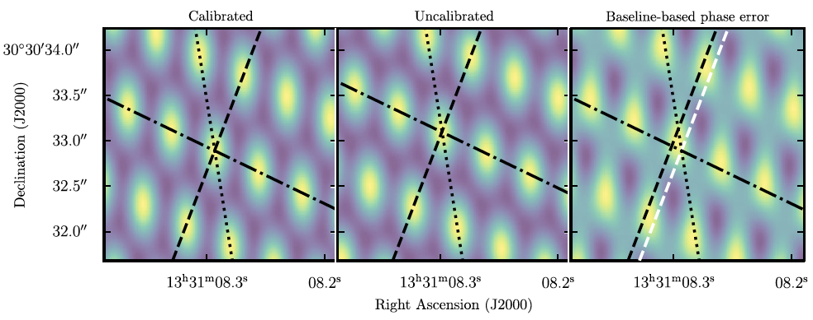
3-element Interference Pattern: Antenna vs. Baseline errors
3C 286
JVLA 9 GHz, A-array
Point source => 𝝍₃∼ 0 => three fringes intersect in grid of points
Shift of pattern but no change in the grid structure
Measured closure phase consistent with 0 using both image-plane methods as well as the well-known aperture-plane method
Thyagarajan & Carilli, 2022, PASA, 39, 14

Slide 11
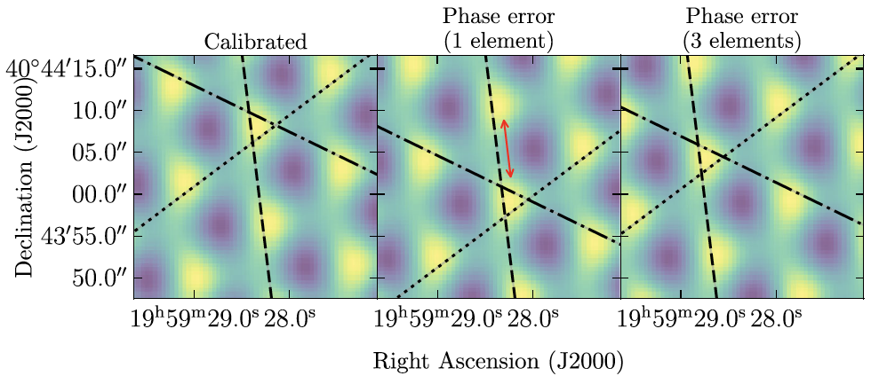
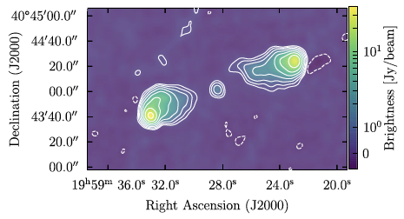
3-element Interference Pattern: Effect of Antenna Gain Errors
Cygnus A
Shift along uncorrupted fringe
JVLA 8 GHz D-array
Extended structure
𝝍₃ = 113º ± 1.5º from both image-plane methods and consistent with the aperture-plane method
Translation occurs along uncorrupted baseline fringe
SOS conservation verified
Thyagarajan & Carilli, 2022, PASA, 39, 14

Slide 12


Closure Phase in 3-element Interference
Closure phase = Sum of three perpediculars from phase centre
Closure phase = triangle height normalized by fringe spacing
Thyagarajan & Carilli, 2022, PASA, 39, 14
=
x

Slide 13
Closure Phase Conservation
Ideal
Mis-calibrated
Translated
Thyagarajan & Carilli, 2022, PASA, 39, 14
Triangle Shape-Orientation-Size (SOS) Conservation
Shape, size, orientation (SOS) of fringe triangle preserved
Closure phase invariant to (mis-)calibration/translation

Slide 14
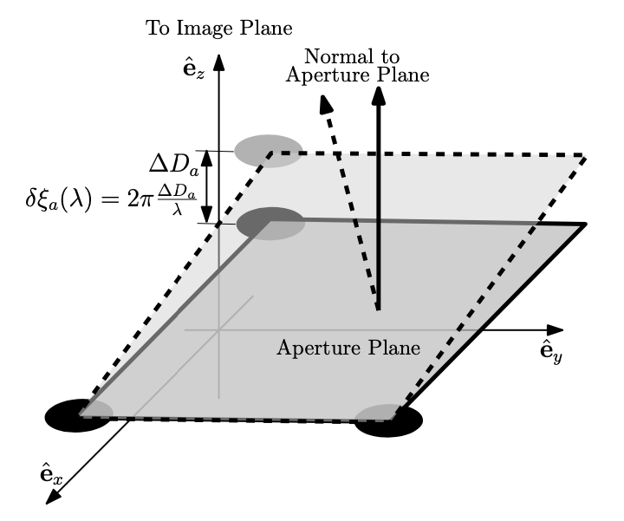
A Basis for Image-Plane Self-Calibration
Phase corruption of one element => change optical path-length to focus
Three points define a plane
Corresponds to a ‘tilt’ of the triad in aperture plane, leading so a shift of the fringe pattern in the image plane
Every 3-element interference pattern (triangle) is a “good” observable (except for an arbitrary shift)
The shifts are different for each antenna triad
Thyagarajan & Carilli, 2022, PASA, 39, 14

Slide 15
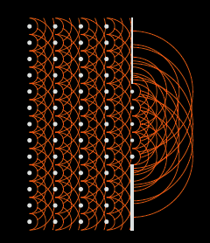
Closure Phase in the Image Plane
Shape-Orientation-Size Conservation
Image Plane Self Calibration
Chris Carilli, Nithya Thyagarajan, Bojan Nikolic
'A geometric view of closure phase in interferometry’, NT, CC 2022, PASA, 39, 14 [Shape-Orientation-Size Conservation]
’Image Plane Self-Calibration,’ CC, BN, NT 2022, JOSA-A, 39, 2214
Copyright © 2020 AUI/NRAO. All Rights Reserved.

Slide 16
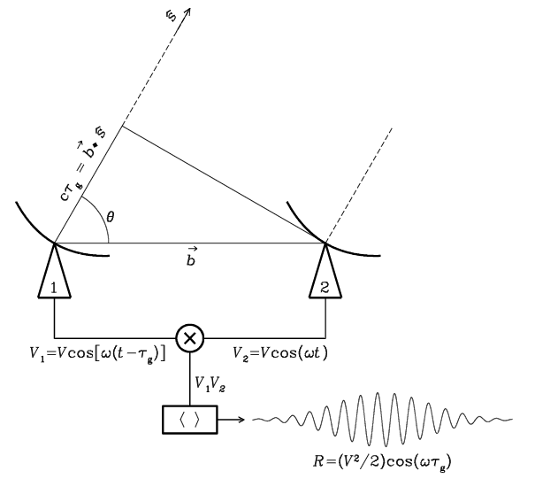
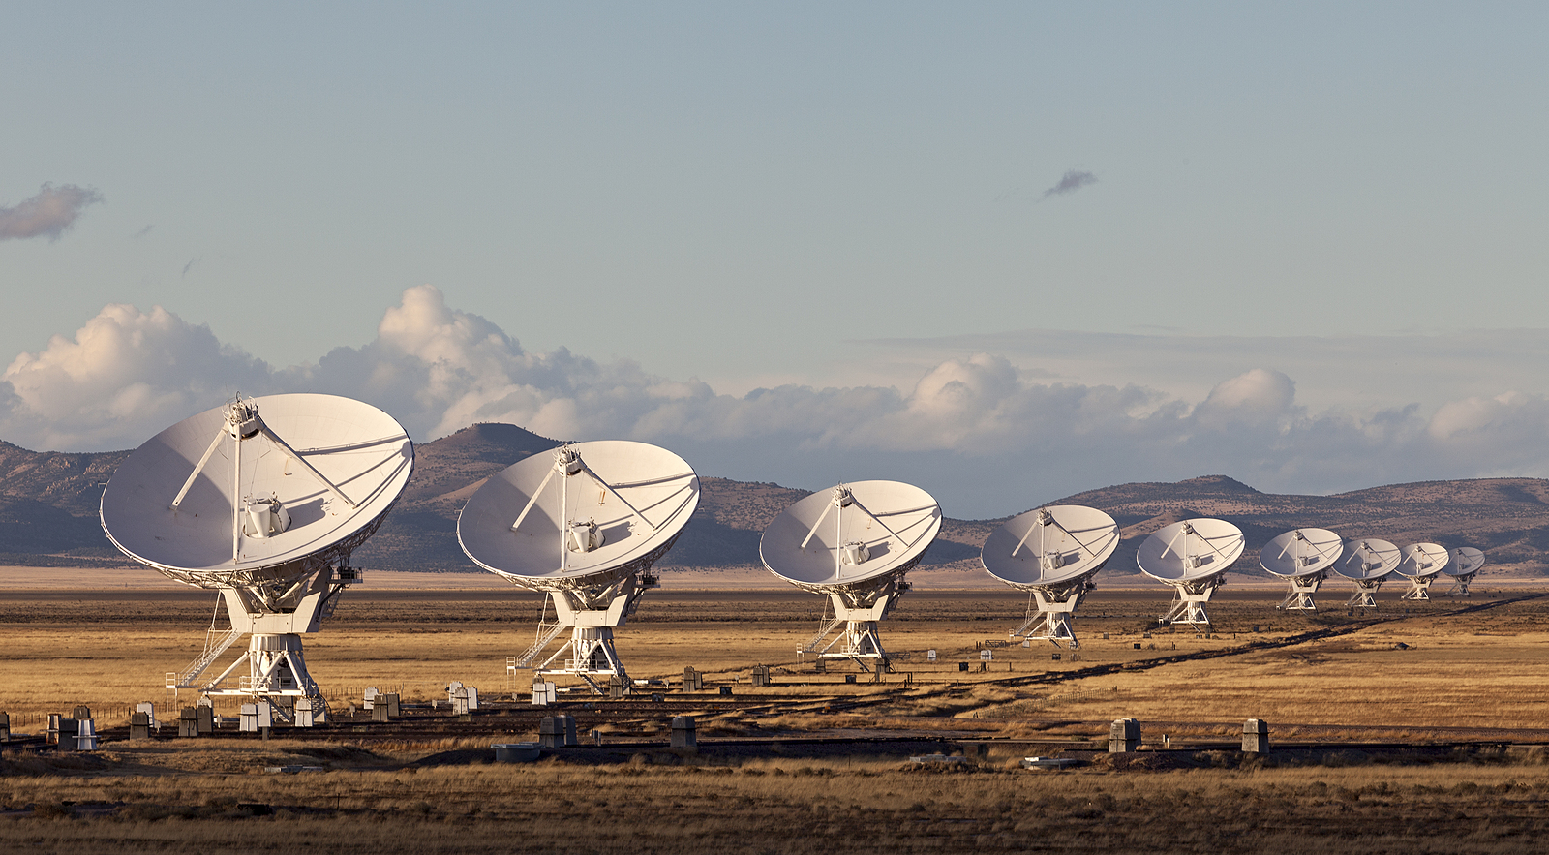

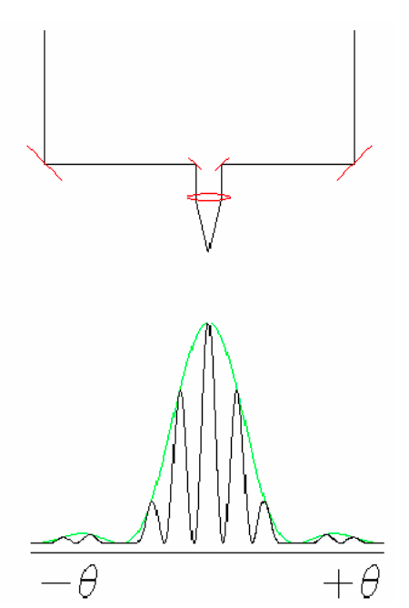
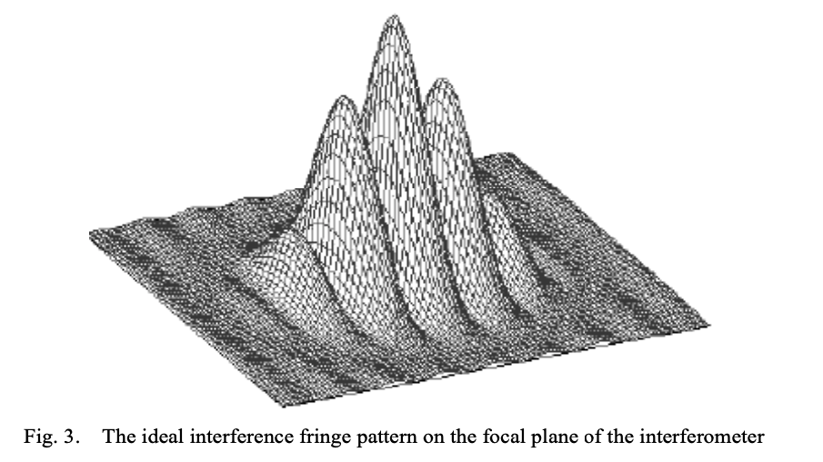
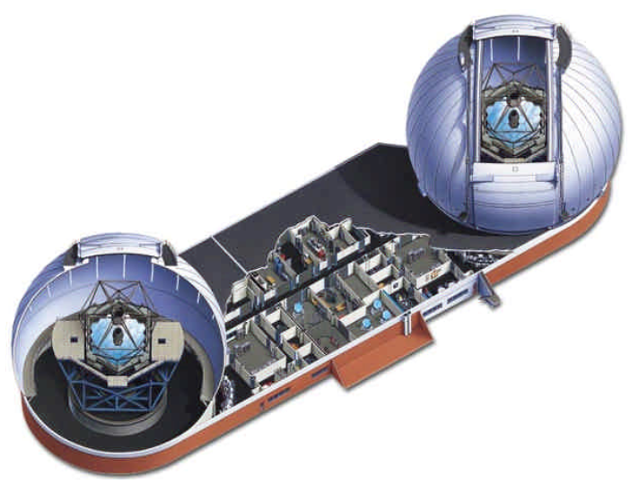
Coherent amplification of voltages, E_{1,2}
Geometric delays set by electronics
Complex cross multiply and average (correlate) voltages to aperture plane visibilities
Images made from Fourier transform of visibilities (w/o ’total power’)
Radio: direct product is visibility (aperture plane)
E₁ x E₂*
Optical: direct product is an image
Coherent reflection by mirrors
Geometric delays set by physical delay lines or primary mirror mask
Correlation via optics and interfere on focal plane (w. ‘total power’)
Visibilities generated from FT(image) (but why bother?)
‘airy disk’ = ‘primary beam’
(E₁ + E₂ )² = E₁² + E₂² + (E₁ x E₂*)
Copyright © 2020 AUI/NRAO. All Rights Reserved.

Slide 17
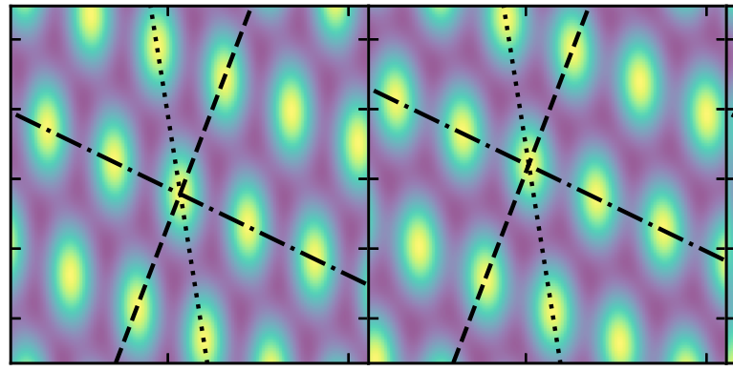
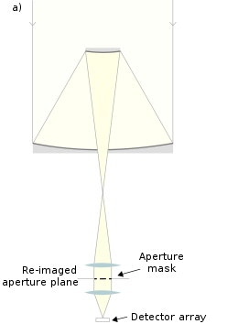
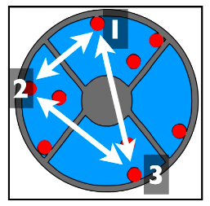
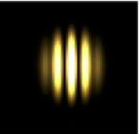
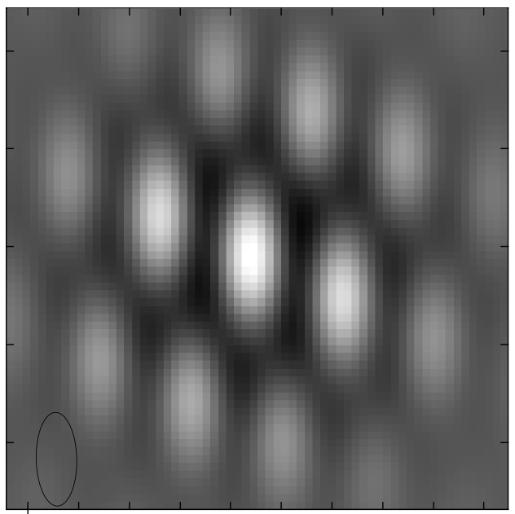
SOS and Aperture Masking
Three points define a plane
‘piston delay’
Delay corruption of one element => change optical path-length to focus
Leads to ‘tilt’ of triad in aperture plane => shift of image plane: for 3 elements, no other corruption/decoherence is possible
Image plane basis for closure phase, eg. closure phase is shift invariant
If phase errors are element-based => all images made with 3 element interferometer are true images of the sky, modulo unknown shifts
2 apertures
3 apertures
Copyright © 2020 AUI/NRAO. All Rights Reserved.

Slide 18
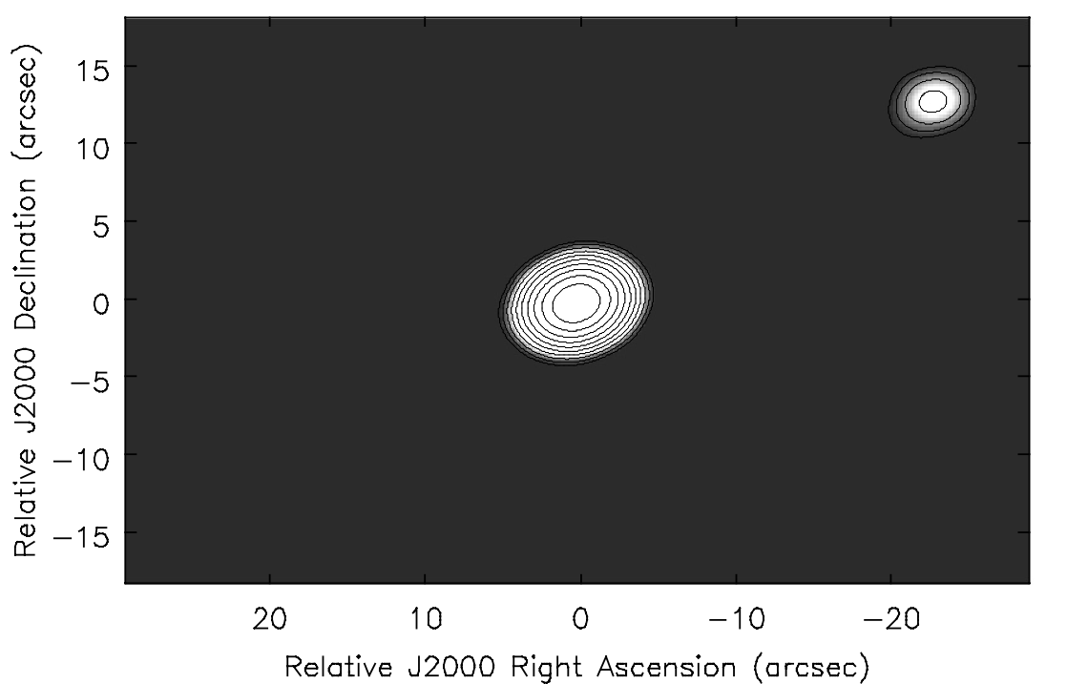
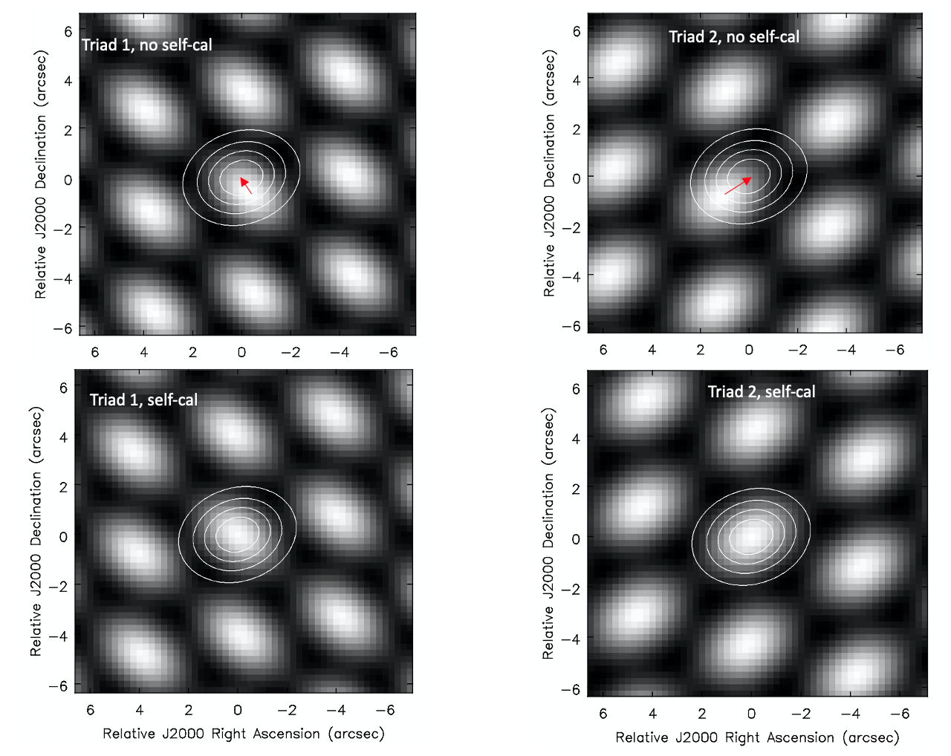
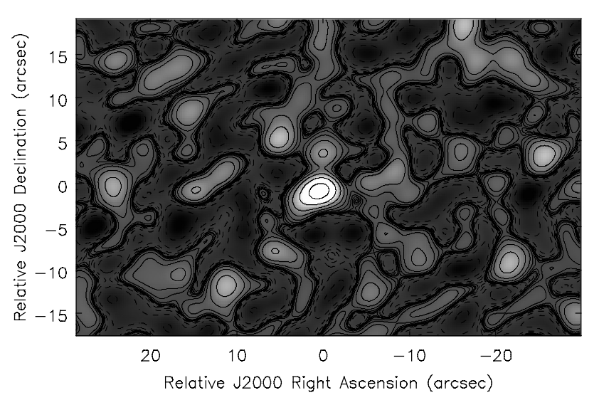
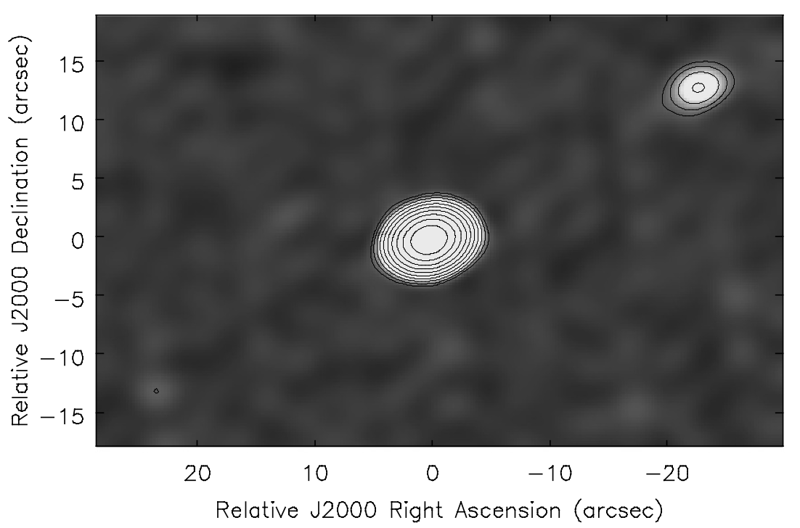
SOS Conservation => Image Plane Self-Calibration
Model: star/planet = 100/1
Interferometer generates 3-element images = true images, but unknown relative shifts due to element-based delay errors
Cross correlate each triad image with model image to derive shifts
Sum shifted images => coherent image of source with full array
80º errors, no self-calibration
80º phase errors, no self-calibration
+
+
=
Triads 3, 4, … N_{triads}
80º errors plus self-calibration
80º phase errors, after IPSC shifts.
+
+
=
Triads 3, 4, … N_{triads}

Slide 19
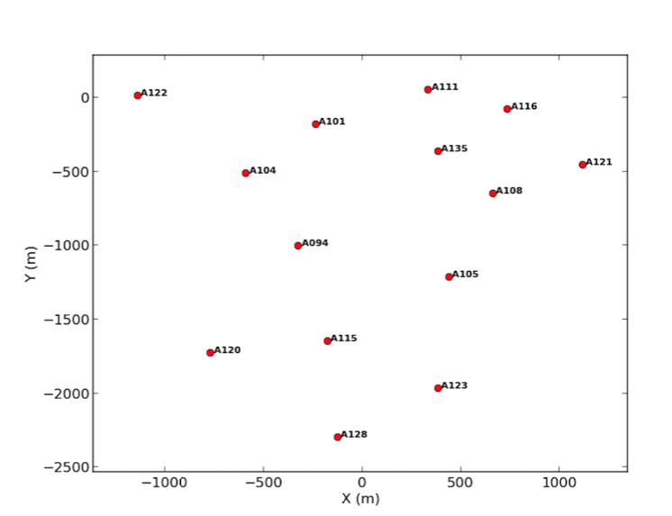
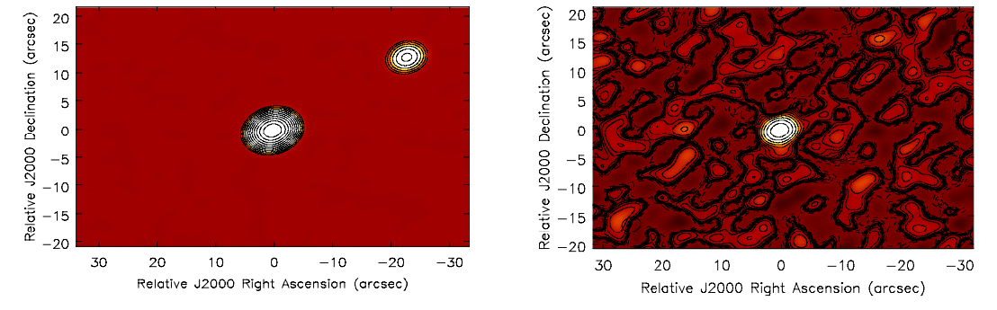
Tests of IPSC
ALMA configuration, removing closest antennas (14 antennas)
Model: Bright point plus faint companion (100/1)
SIMOBSERVE and add antenna phase errors random over +/-10º
Make all 364 triad images (= ‘starting point’)
Spatial cross correlation w. model image, starting with point source
Iterate
Star = 1 Jy, planet = 10 mJy, no errors
10º errors, no Selfcal

Slide 20
Aperture plane self-cal w. point-source model
Planet = 9.9 mJy
Rms = 0.09 mJy
Ghost = 0.20 mJy
Image plane self-cal w. point-source model
Planet = 6.3 mJy
Rms = 0.25 mJy
Ghost = 2.6 mJy
Image plane self-cal w. iteration
Planet = 9.0 mJy
Rms = 0.20 mJy
Ghost = 0.6 mJy

Slide 21
1000/1, 10º, IPSC w. point source
Planet = 0.71 mJy
Rms = 0.15 mJy
Ghost = 0.025 mJy
10/1, 10º, IPSC w. point source
Planet = 65 mJy
Rms = 2 mJy
Ghost = 21 mJy
100/1 and 80º
Planet = 65 mJy
Rms = 2 mJy
Ghost = 21 mJy

Slide 22
Image Plane Self-Calibration: an application of SOS conservation
IPSC converges, but APSC converges better (for large N)
Lower rms
Weaker ghost natural consequence of symmetrization in marginally constrained self-cal
Over-constraints = N_{vis}/(N_{ant} - 1) = (N_{ant}(N_{ant} - 1)/2) / (N_{ant} - 1) = N_{ant} / 2
APSC (14 ant) = 7
IPSC (triad-based = 3 ant) = 3/2
IPSC will not work for
1 fringe images: ‘baseline based calibration’ => turn source into model (under constrained)
4+ apertures: no longer obey SOS
Non-closing (Baseline-based) errors

Slide 23
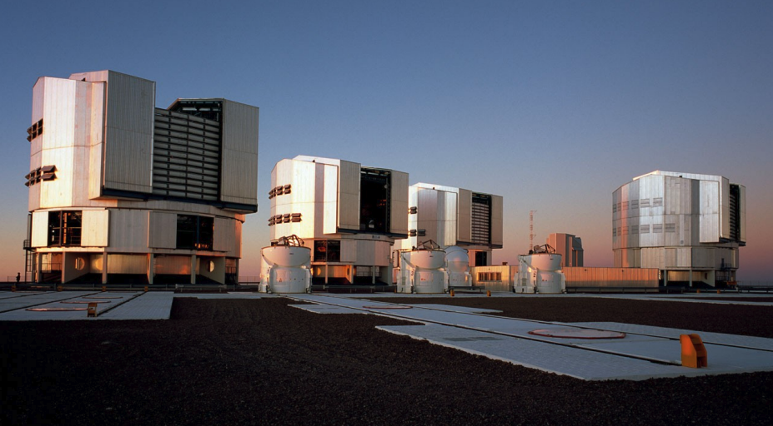
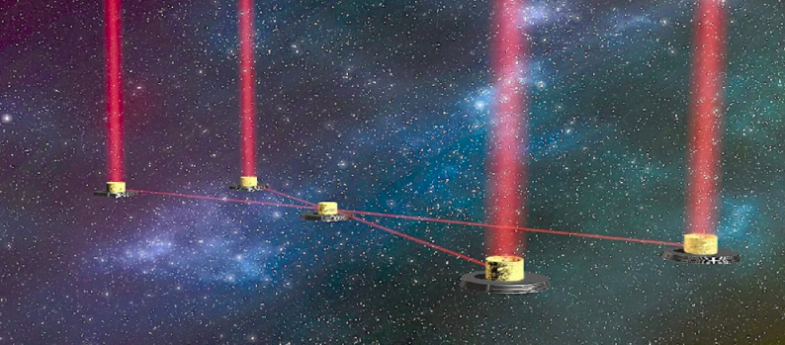
When might SOS and/or IPSC be useful?
Basic measurements in image plane
Small N
Amplitude and baseline-based errors small
All typical in laboratory and optical astronomical interferometry
Astro Examples: small N arrays w. image plane detection
VLTI: 4x8.2m + 4 x 1.8m (only 4 at time)
LIFE: space near-IR 4 x 3m elements
VLTI
Large Interferometer for Exoplanets

Slide 24
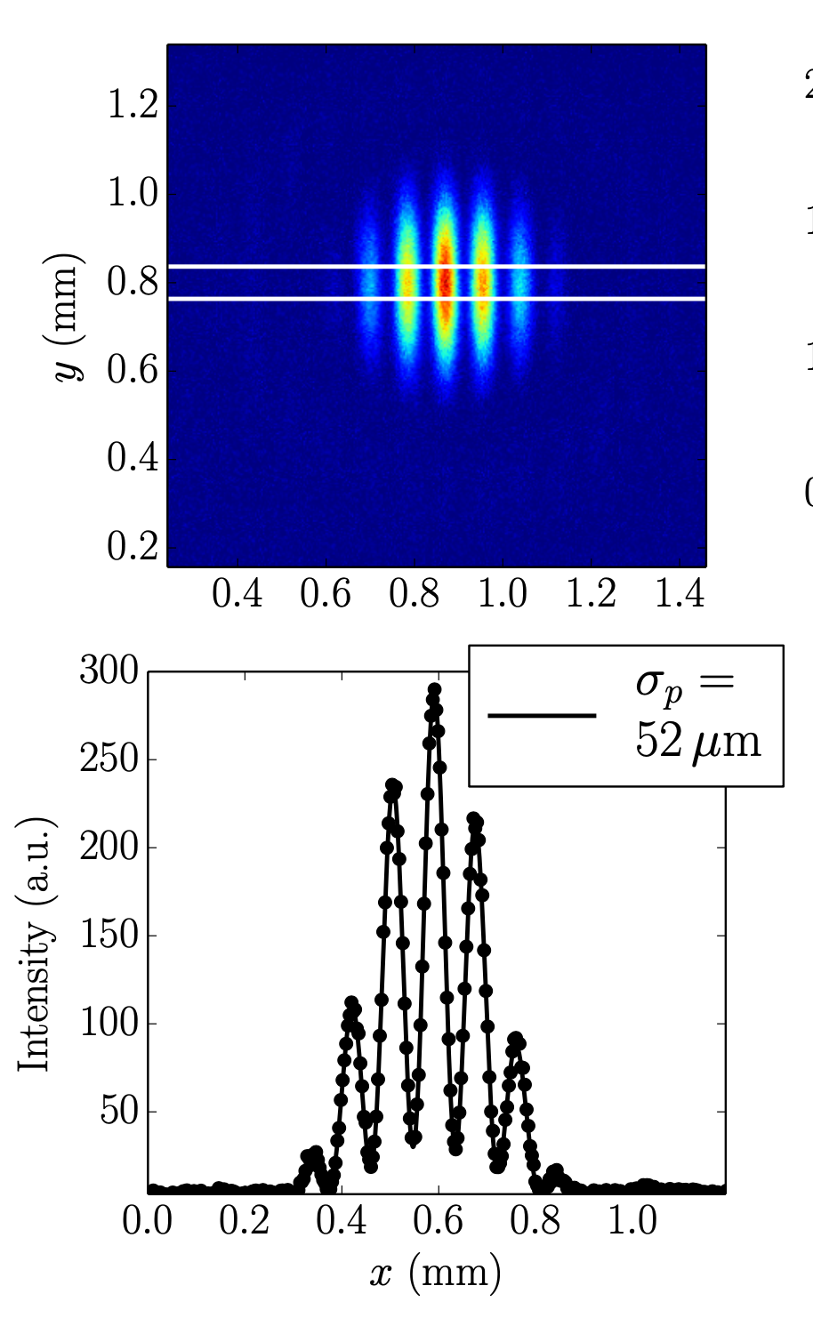
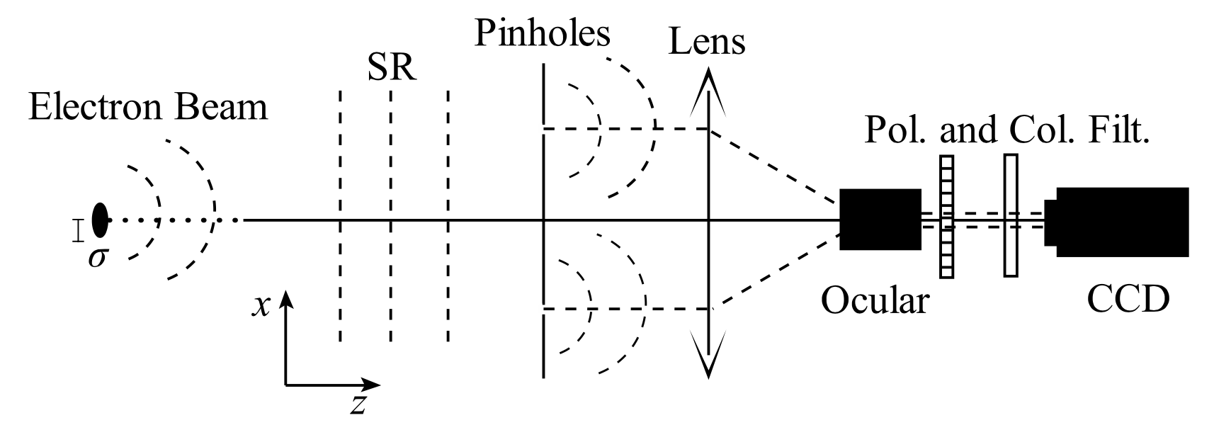
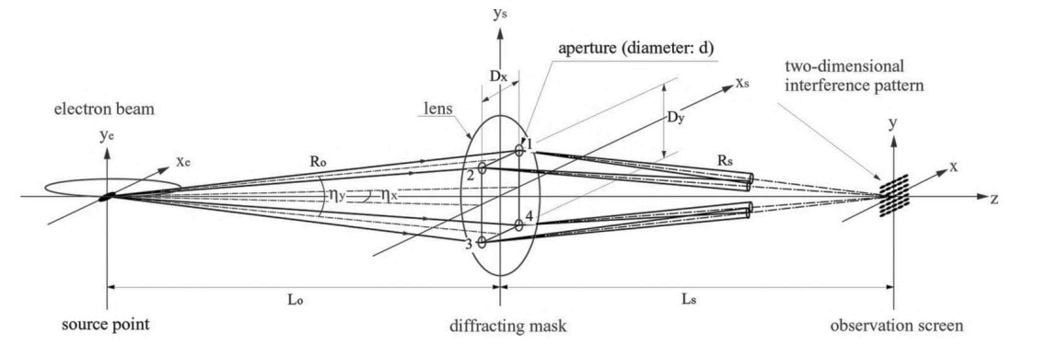
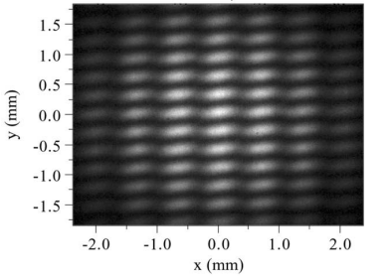
Non-Astro examples
Synchrotron light source e– beam shape characterization: 3-slit mask gives 2D beam shape robust to ‘piston errors’ due to atmosphere and device jitter
Inertial fusion reactor laser profiling, Seismology, Ultrasonic imaging, Radar, X-ray crystallography…
VLTI
ALBA synchrotron light source: fit Gaussian models to 2-slit fringe; rotate (Torino & Iriso 2018)
Spring-8 synchrotron light source (Masaki & Takano 2003)

Slide 25
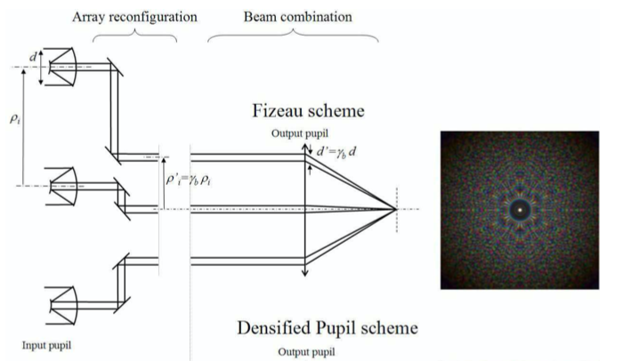
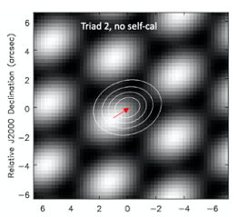
Typical optical (and laboratory) imaging interferometers
2-element beam combination (pair-wise, or non-redundant beam combination) => fringe images on CCD
FT(fringe images) => visibilities: reconstruct images from amplitudes and closure phases
Direct imaging interferometers (Fizeau, homothetic)
All-to-one beam combination where pattern of apertures is preserved in scaled pupil => direct image creation on CCD
Requires active phasing system (adaptive optics for piston delays)
IPSC: hypothetical device
Generate 3-element images w. directing imaging beam combination
Self-calibrate using image cross correlation and sum
No need for adaptive optics
N=4 array requires 3 beam splits per element and 4 CCDS
Lardiere ea 2007

Slide 26
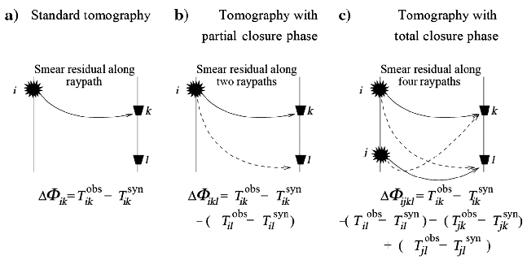
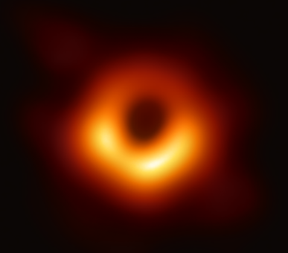
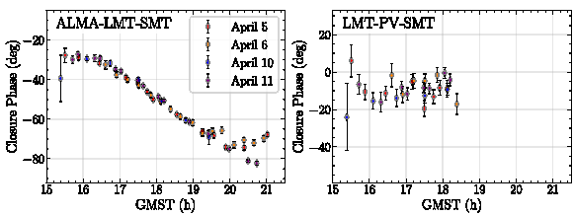
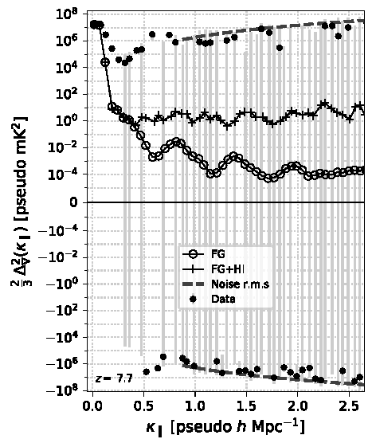
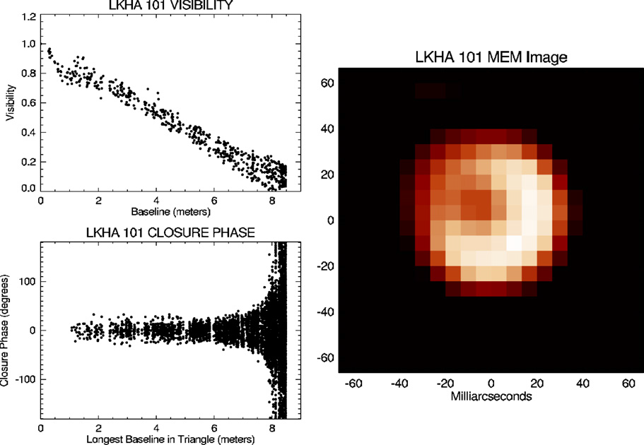
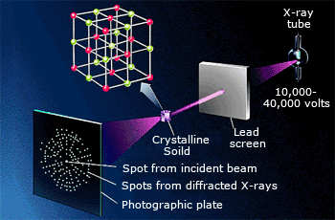
Growing list of applications
Seismic imaging/ Geophysics,
Schuster+2014
EHT image of M87 SMBH, VLBI, EHT+2019
Invariance to element-based gain corruptions => very valuable in applications where calibration/phase determination is challenging
Dust shells around stars
Optical Interferometry
Monnier+2007
21cm cosmology, Thyagarajan+2020
X-ray crystallography

Slide 27
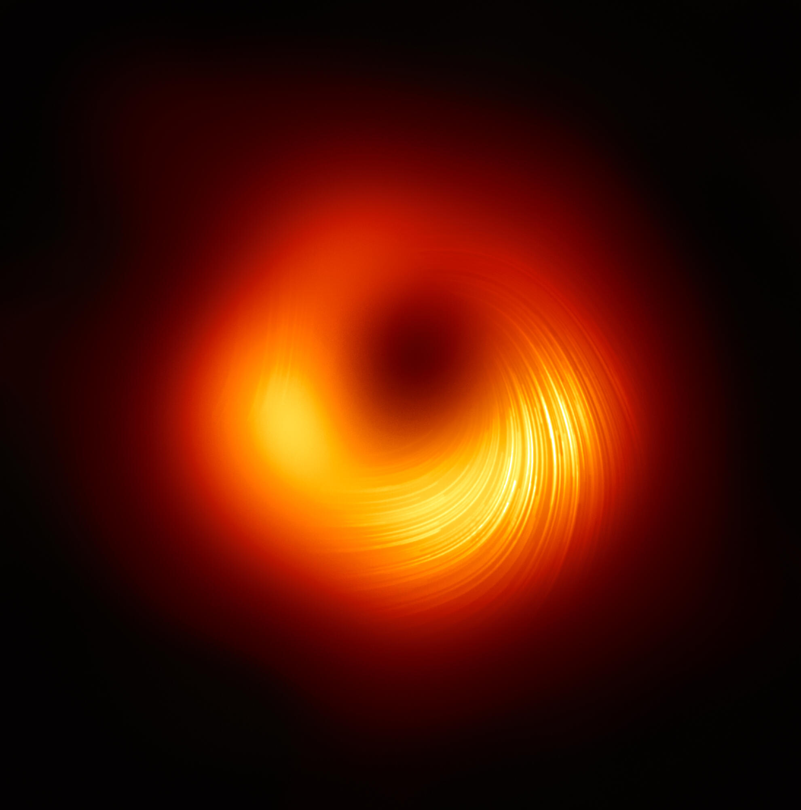
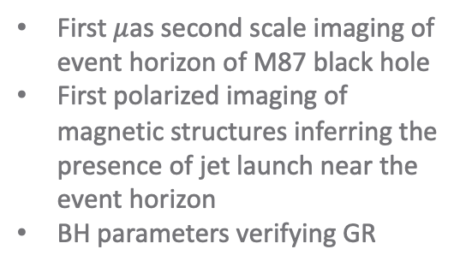
Scientific Motivation: VLBI Calibration Challenges
Pearson+(1981)
Image credit:
EHT collaboration
Wilkinson+(1977)
First $μ$as second scale imaging of event horizon of M87 black hole
First polarized imaging of magnetic structures inferring the presence of jet launch near the event horizon
BH parameters verifying GR
First determination of core-jet morphology of quasar 3C147
First direct evidence of superluminal expansion (~10c) of relativistic jet in quasar 3C273

Slide 28
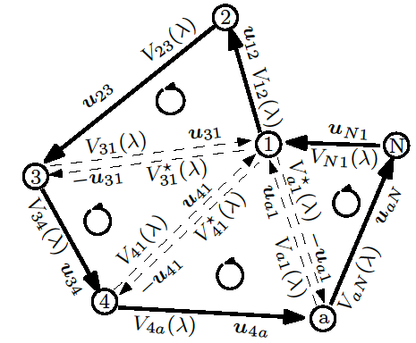

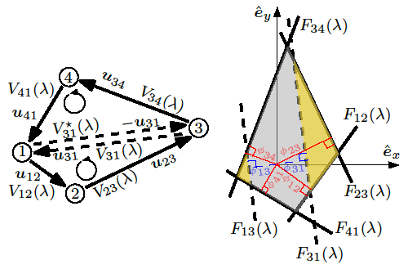

Closure Phase generalized to N-polygons
“Phase-position” and “product of areas” relations extended to closed N-polygons
Thyagarajan & Carilli, 2022, PASA, 39, 14

Slide 29
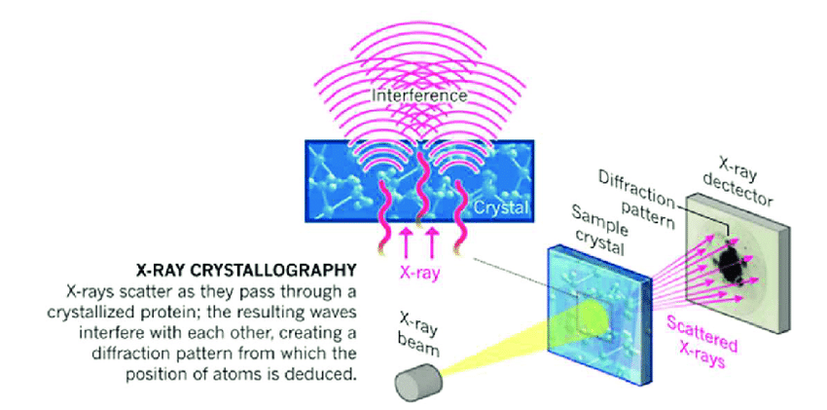


Connection to Crystallography
X-ray/electron/neutron Crystallography
Radiation scatters as it passes through crystal
Diffraction pattern (reciprocal space) is FT of electron density distribution (real space)
Need Fourier inversion to determine electron density distribution and atomic/molecular structure
But usually, only intensities of diffraction pattern available → |F_{H}|², and phases of F_{H} are lost (called the “phase problem”)
Direct Fourier inversion not possible
Use structure invariants -- triplet and quartet phases (or closure phases)* -- to determine phases with a priori knowledge of symmetries and structures using forward-modeling
The geometric picture of closure phase is easily extended to 3D crystal structure analysis
Diffraction
pattern
Electron
Density
* Nobel prize in chemistry awarded to Herbert Hauptman & Jerome Karle in 1985 "for their outstanding achievements in the development of direct methods for the determination of crystal structures” which relied heavily on the use of structure invariants

Slide 30


Connection to Seismic Imaging
Source statics
Receiver statics
Local velocity anomalies due to surface topography called “statics”
Statics affect time-delay measurements
Statics (seismic imaging) ⬄ Phase errors (radio interferometry)
Combining delays (phases) around a closed network of sources and receivers eliminate these statics
Thyagarajan & Carilli, 2020, arXiv 2012.05254
See Schuster+ 2014 for review

Slide 31



Connection to Interferometric Synthetic Aperture Radar (InSAR) and Medical Imaging
time
Coregistered phase-coherent images
(holographic images with phase information)
Closure phase image from three times
Repeat-track interferometry (Same orbit)
t₁-t₂
InSAR great for studying topography and surface changes
Repeat-track interferometry provides stack of co-registered phase coherent E-field images
Phase difference interferogram could be phase-corrupted
Closure phase images between three different times (if non-zero) robustly measures structural changes
t₂-t₃
t₃-t₁
Mt. Etna (above)
but could be medical images!

Slide 32



Connection to TDI in GW detection using LISA
Vallisneri (2005)
Laser phase noise is overwhelming source of noise (by >7 orders of magnitude)
Unequal and changing arm lengths need to be accounted for
Solution: Time Delay Interferometry (TDI)
TDI = linear combinations of time-delayed phases of laser beams on closed loops between spacecrafts
They cancel spacecraft motion effects and intrinsic phase noise
Critical for successful GW detection
LISA will detect GW from Galactic WD binaries at mHz frequencies
Three spacecrafts with arm lengths ~5 million km
Short wavelengths => Time dependence of spacecraft motion and Laser phases important
Time Delay Interferometry (TDI) in GW ⬄ Time-dependent closure phase

Slide 33


Connection: Quantum Mechanics & Polarized Light
Phase of N-vertex Bargmann invariants
Bargmann invariants are gauge-invariant to any local phase factors affecting the quantum states
Closely resemble closure phase definition and properties
Phases of Bargmann invariants = Geometric phase = Berry phase = Pancharatnam Phase
On a cyclical path through multiple polarized states on the Poincare sphere, the geometric phase = (1/2) solid angle subtended by the path = change in vector angle during parallel transport
Related to the intrinsic curvature

