Slide 1
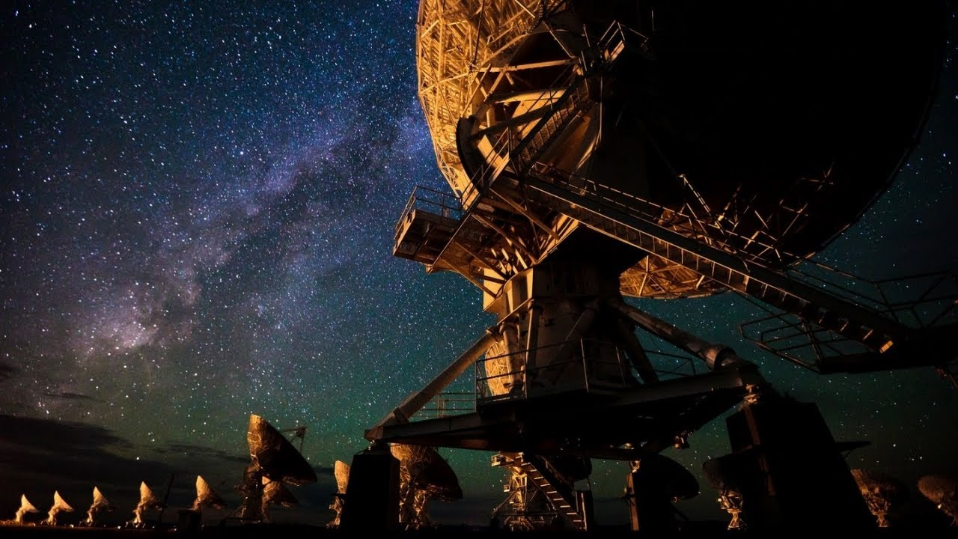
Science with the Jansky Very Large Array
Chris Carilli

Slide 2
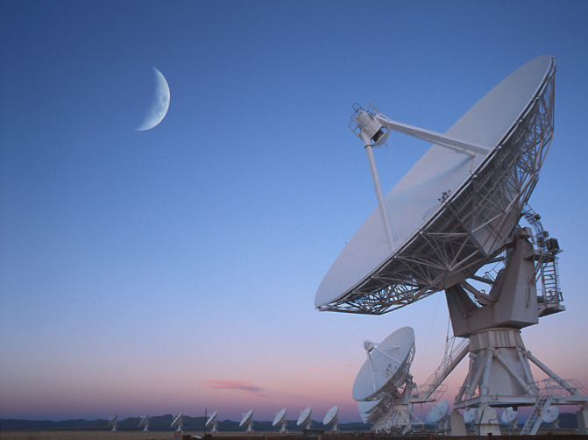
Karl Jansky Very Large Array: science from technology
Completed on time and budget 2013
Leverage existing antennas, track, transporter… replace 1970’s electronics with state-of-art
  Receivers: continuous 1 to 50 GHz, low(est?) noise (factor 5 improvement)
  Digital opt. fiber data transmission: 8 GHz BW, full pol. (factor 80)
  Correlator: 4000+ channels, 5msec ave (orders of mag.)
    10x continuum sensitivity (<1uJy)
    100x line search capability
    New time domain/fast response modes
    Spatial resolution ~ 40mas at 43 GHz

Slide 3
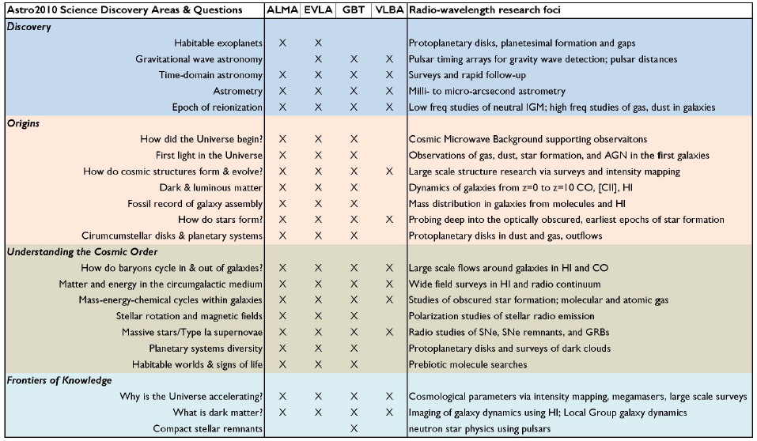
NRAO and NWNH
Emphasize new capabilities => new science
Notes:
http://arxiv.org/abs/1405.1456
The Intrinsic Two-Dimensional Size of Sagittarius A*
Bower et al. 2014 ApJ in press

Slide 4
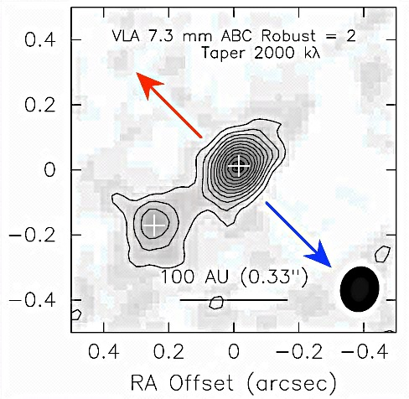
Formation of stars and planets
VLA @ 1cm provides three unique capabilities
Imaging to 40mas resolution
Interiors of dense SF cores/PP disks: optically-thick in mm
Sensitive to cm-sized dust grains: dust to pebbles to planets
Tobin ea.
Origin of stellar multiplicity
L1165: dust-embedded class 0/1 binary protostar
Binary aligned in disk, perpendicular to outflow
Protostars fragmenting out of disk
7mm, rms ~ 20uJy, 60mas

Slide 5
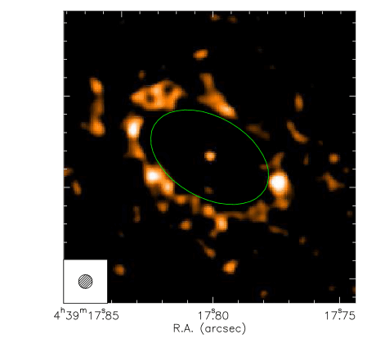
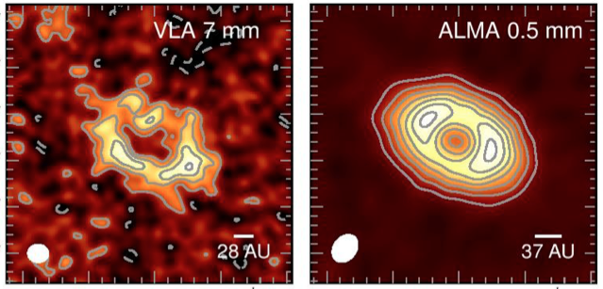

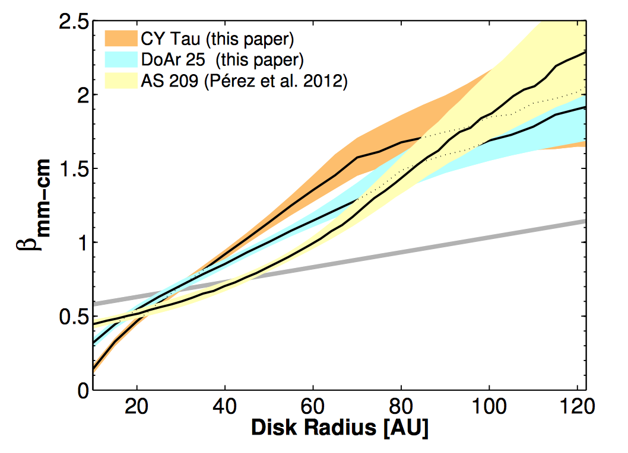
Planet formation
LkCa15 @ 7mm, 70mas, 3.6uJy
200mas
300mas
15b +
40AU
Perez, Isella, Chandler ea
LkCa15: Solar-type star + disk ~ 4Myr (‘transition disk’)
Dust ring r~45AU + compact ‘core’ (FF?)
Dust stratification: Spectral gradient => mm-sized grains concentrated in inner disk, um-sized grains in outer disk = seeds of planet formation?
Circumplanetary disk: No 7mm emission from protoplanet => planet accretion disk < 0.1M_{J}

Slide 6
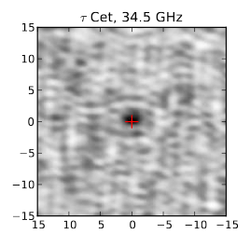
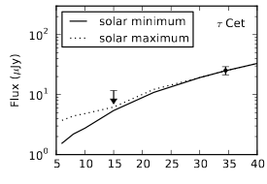
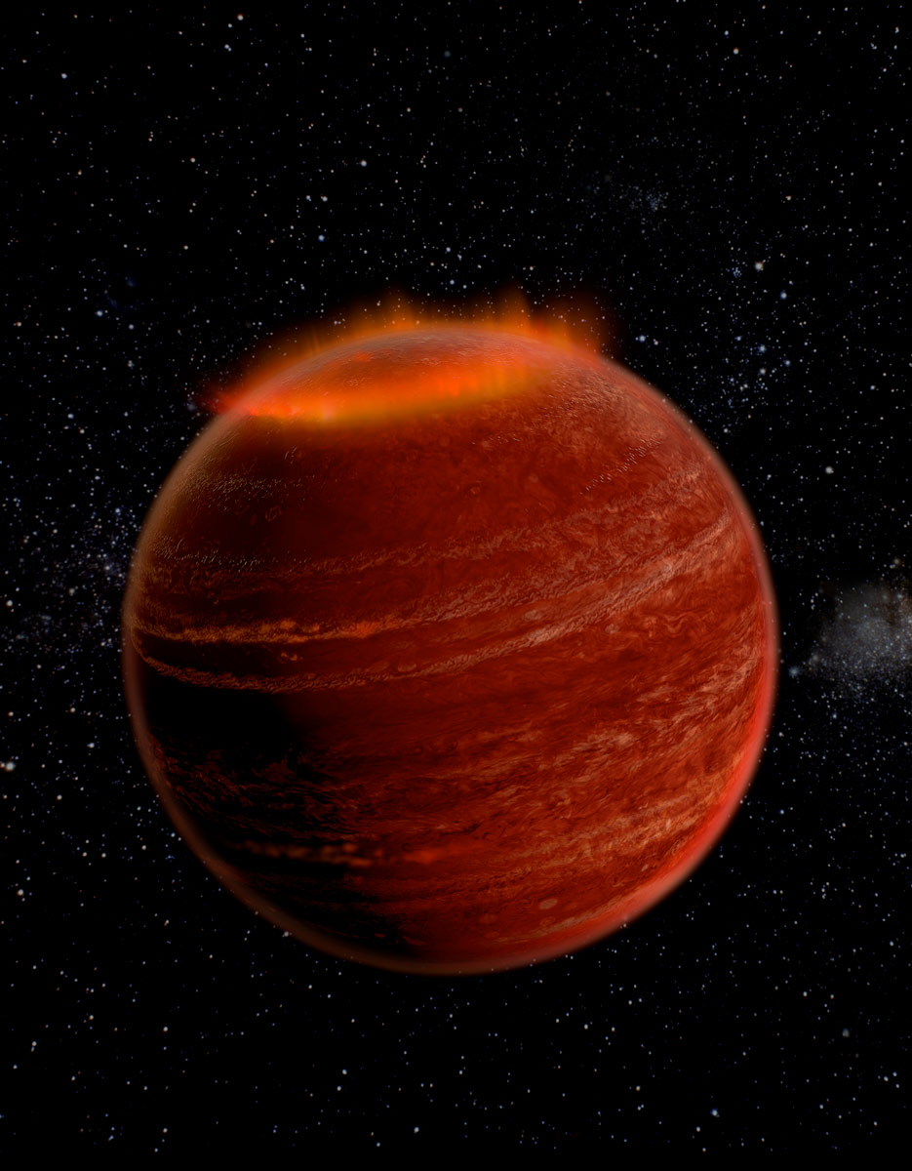
Stars and stellar phenomena
rms ~ 5uJy
Radio photospheres: uJy sensitivity
  1st detection thermal radio emission from solar-type atmospheres
  Rising spectra => optically thick free-free emission from the inner chromosphere ~ 10,000 K
Brown Dwarf magnetospheres: exo-aurora 10⁶ x Earth Aurora!
  Cyclotron emission w. B ~ 2000G
  Star-planet magnetospheric interaction driving exo-space weather, dictating exoplanet environments
Hallinan
Notes:
First Detection of Thermal Radio Emission from Solar-type Stars with the Karl G. Jansky Very Large Array
Villadsen et al. http://adsabs.harvard.edu/abs/2014ApJ...788..112V
Wu, et al. 2014 http://adsabs.harvard.edu/abs/2014A%26A...566A..17W

Slide 7
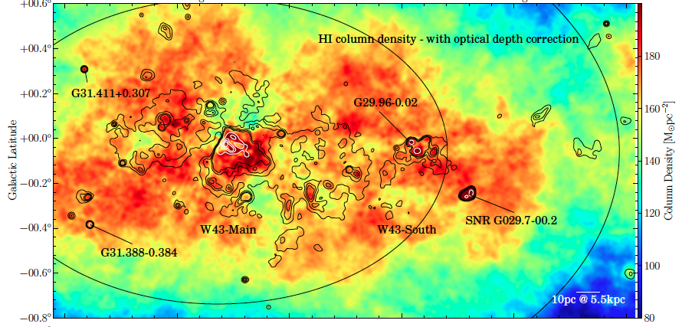
THOR: new insights into the ISM
The HI, OH, Recombination (THOR) large program: study the atomic, molecular and ionized FF emission of Giant Molecular Clouds (GMCs)
Optical depth effects: new HI mass = 6.6x10⁶M_{o} = 2.4 x larger than previously derived without self-opacity.
Challenge theoretical models for HI to H₂ threshold at N_{HI} = 10 M_{o} pc⁻²: no clear transition seen
HI (color) and radio continuum (contours) in W43
Bihr ea
Notes:
THOR - The Hi, OH, Recombination Line Survey of the Milky Way
Birh ea 2015 http://adsabs.harvard.edu/abs/2015arXiv150505176B

Slide 8
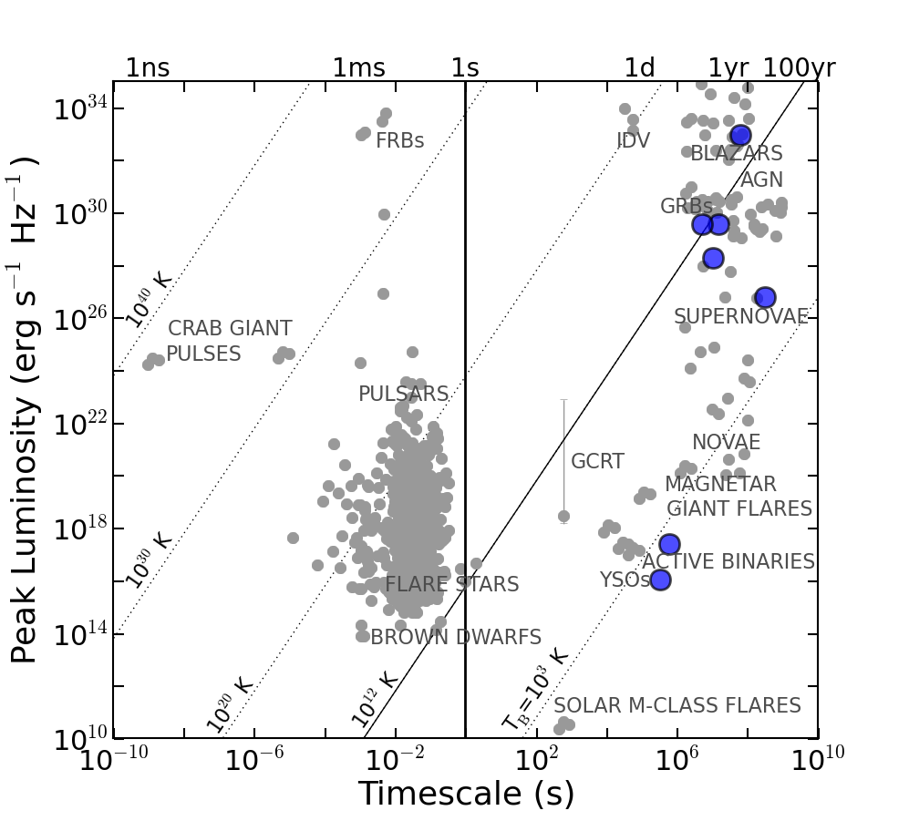

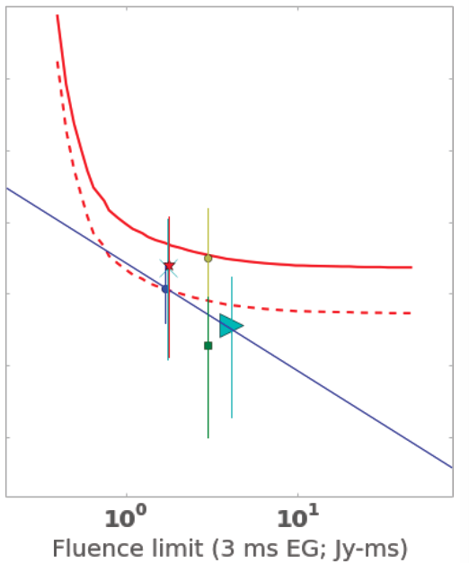
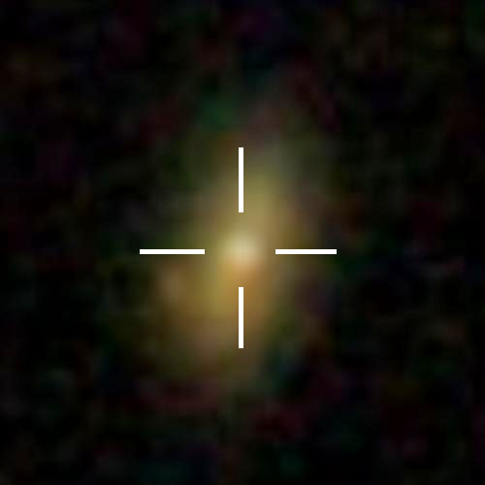
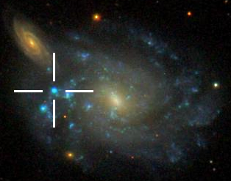
Discovery: new tools to study time domain years to milliseconds
Fast Radio Burst: game changer?
Caltech-NRAO Stripe 82 Transient Survey
Milliseconds
Law ea.
TDE
Days to years
Mooley ea
95% limit
SNe
verification and localization crucial!
1.4GHz, rms ~ 15mJy
5ms imaging over 166hrs
256x1MHz channels
2-4GHz, 270 deg², rms = 80uJy
Old Friends: SNe, XRBs, Blazars
New phenomena: TDEs, M-dwarfs…

Slide 9
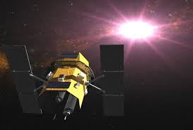
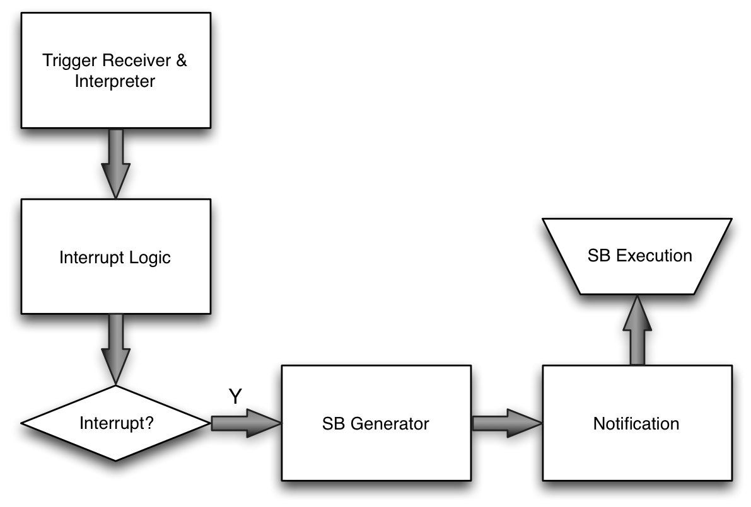
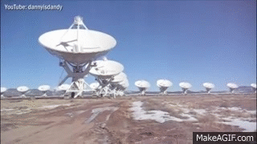

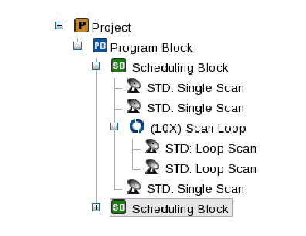

Auto-Fast Trigger Response (15min!) at JVLA: gearing up for LSST
RSRO PI: K. Bannister
Coding by B. Butler
First attempt (July 2015): GRB150724A success!
Auto-trigger: SWIFT-BAT via GCN to VLA
On source within 15 minutes
P-band, 0.5s dump time: prompt radio emission?

Slide 10
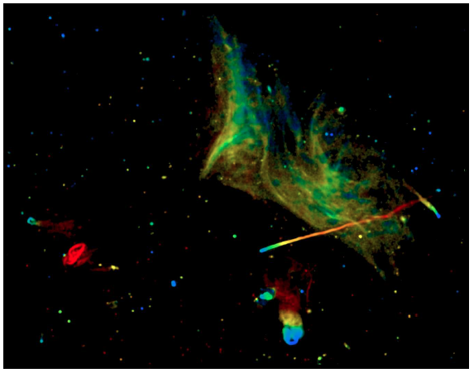
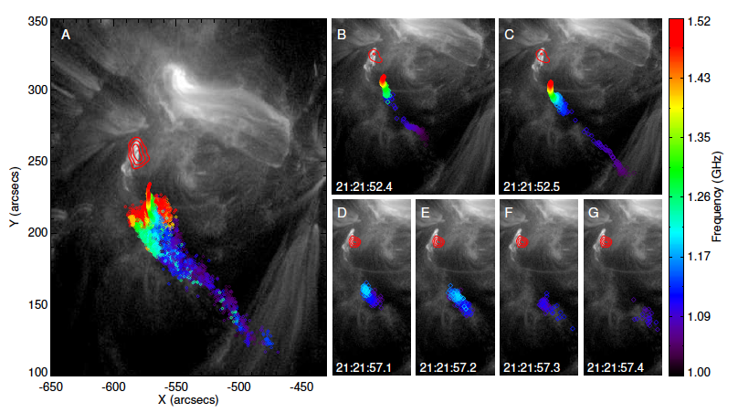
Plasma and Magnetic Universe
Owen & Rudnick A2256 z=0.058
rms = 2.5uJy
Chen, Bastian, Gary
Galaxy clusters
Ideal Lab for plasma physics on Mpc scales: halos/relics, jets, lobes, Xray cavities…
Broad band spectra + Pol.: particle acceleration, B fields, gas dyn…
Foot-points of Solar flares
Scales ~ 1000km
Evolution ~ 100msec scales
Magnetic flux ropes driving CME = origin of space weather
Kanekar ea

Slide 11
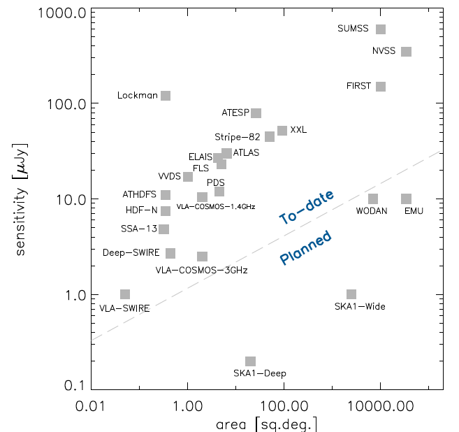
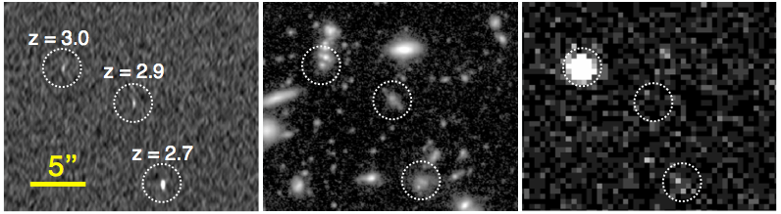
Radio continuum deep fields
Exploring the 1uJy Universe: SKA pathfinder
Res ~ 0.3” – 1”; ν = 1 – 8GHz,
rms ~ 0.5 to few uJy, FoV up to 2 deg²
Star formation, AGN, transients…
Data processing frontier: Big Data (many TB), wide field mosaics, direction dependent gains, non-coplanar arrays…
1uJy
VLA-FF
VLA-GS
Rujopakarn6GHz
HST
Xray

Slide 12
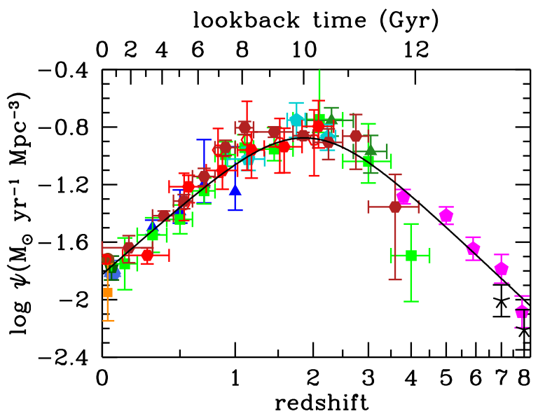
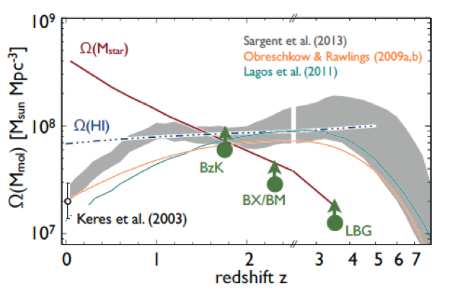
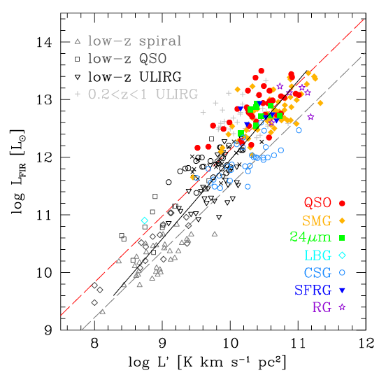
Cool Gas History of the Universe
SF Law
SFR
M_{gas}
SFHU has been delineated in remarkable detail back to reionization
SF laws => SFHU is reflection of CGHU
New capabilities => study of galaxy evolution is shifting to CGHU (source vs sink) = JVLA territory!

Slide 13
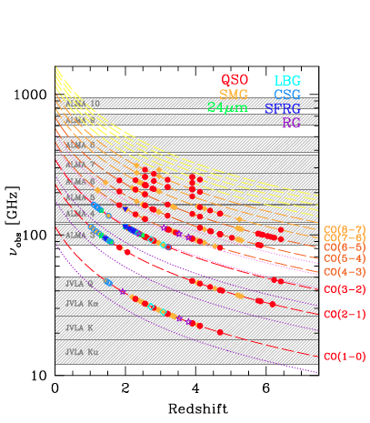
Complimentarity: centimeter – millimeter
Low order => total molecular gas mass:
  M_{H2} = α x L_{CO1-0}
High order => gas excitation
ALMA/Bure
VLA/GBT

Slide 14
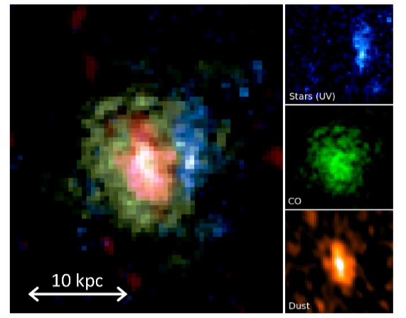
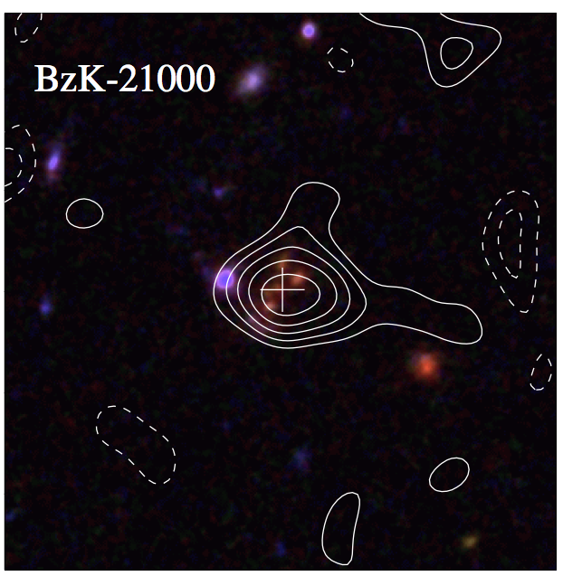
Two types detected in CO
Extreme starbursts: AGN/SMG
Main Sequence
Hodge ea .
CO2-1 z=4.0
HST
CO1-0 z=1.5
VLA
Bure
Aravena ea .
HyLIRG: FIR > 10¹³ L_{o}; SFR > 1000 M_{o} yr⁻¹
Highly obscured HST/I
M_{H2} ~ 10¹¹ M_{o}
Rare ~ 0.05 arcmin⁻²
Color-selected (sBzK, BX/BM, LBG…)
SFR ~ 10 to 100 M_{o}/yr
M_{H2} ~ few 10¹⁰ M_{o}
Common ~ 5 arcmin⁻²

Slide 15
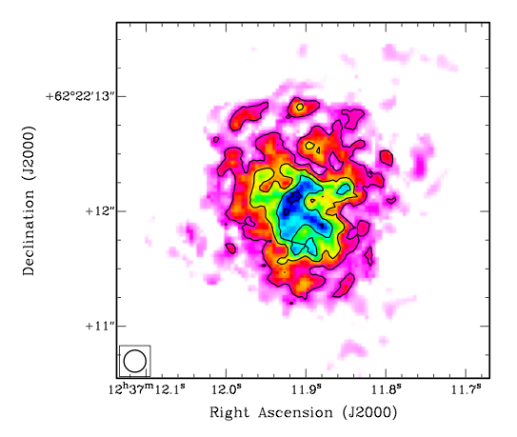
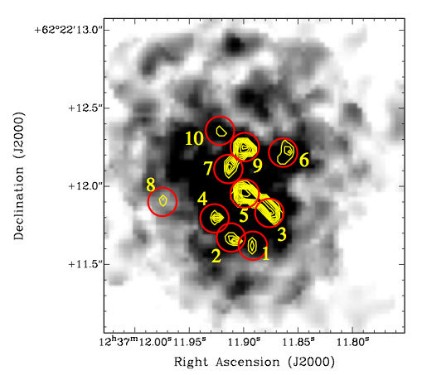
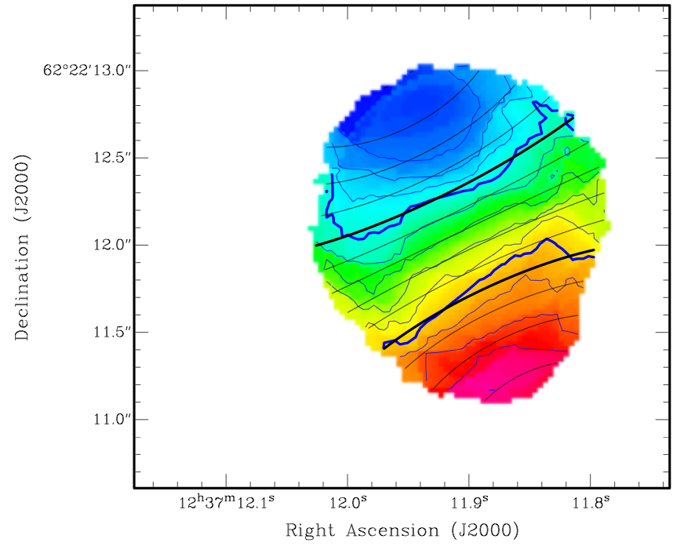
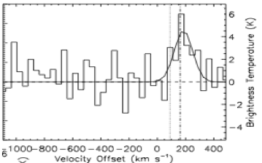
Beyond Blob-ology: dynamical imaging 1st galaxies at HST res
z=4.0 CO 2-1 Mom 0
Mom 1
-300 km/s
0.15”
7kpc
1”
+300 km/s
0.25”
Hodge ea .
14kpc rotating disk
M_{dyn} = 5.4 10¹¹ M_{o}
M_{gas} = 1.3 10¹¹ (α/0.8)
Dyn. Modeling => α ~ 1
+
Self-gravitating super-GMCs?
  T_{b} ~ 20K, σ_{v} ~ 100 km/s
  M_{dyn} ~ M_{gas} ~ 10⁹ (α/0.8) M_{o}

Slide 16
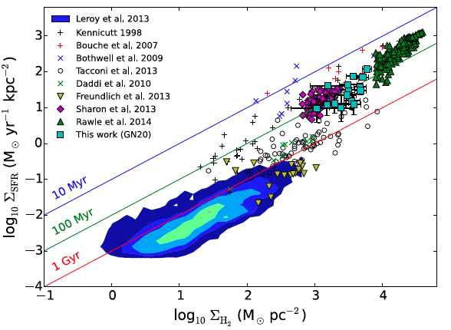
Beyond blob-ology: ISM physics in early Universe
quasars
ν²
GN20
MSG
SMG
MSG
Hodge ea .
Spatially resolved star formation law: dual sequence in gas depletion time
starburst (< 10⁸ yr)
‘main sequence’ (~ 10⁹ yr)
AGN high excitation ~ SF core (1pc), n > 10⁴ cm⁻³ , T > 50K
SMG intermediate AGN – MSG => Often large, cooler gas component
MSG intermediate SMG – MW: T ~ 20K, n_{GMC} ~ 10³ cm⁻³
+

Slide 17
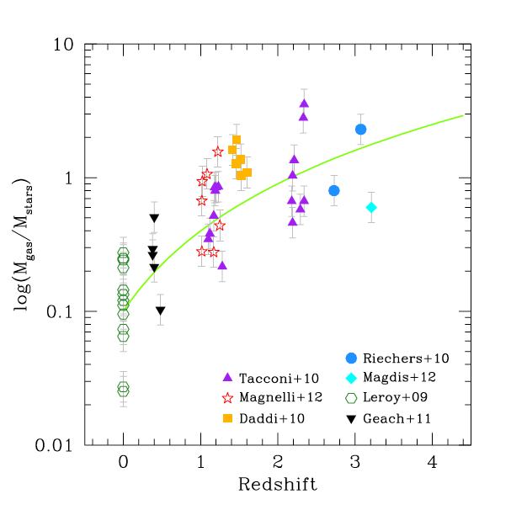
Evolution of gas fraction: epoch of peak cosmic SF rate density (z~2) = epoch of gas-dominated disks
~ L’_{CO}/R
(1+z)²
All star forming disk galaxies w. M* ≥ 10¹⁰ M_{o}
All points assume α~ 4 => empirical ratio ~ L’_{CO}/R_{rest}

Slide 18
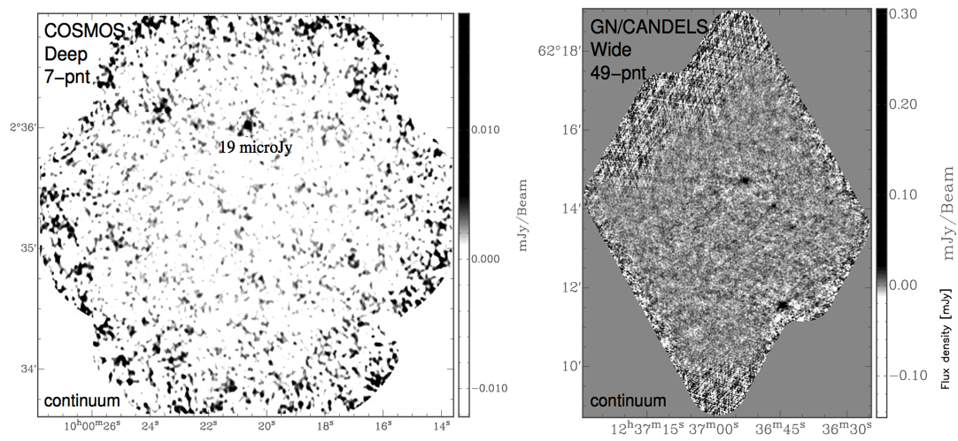
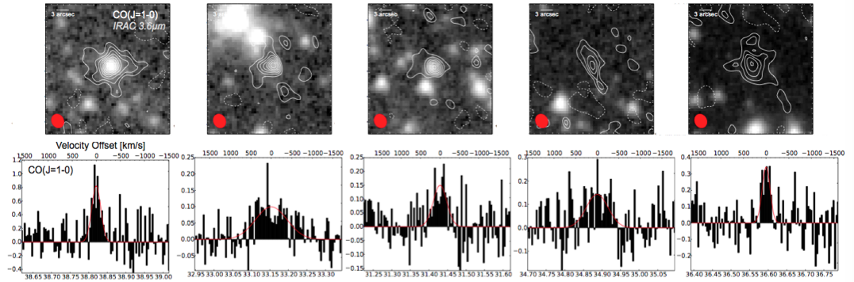
Molecular Deep Field: Blind survey CGHU (Riechers ea)
JVLA 350hrs
30 – 38 GHz
CO1-0 z = 2.0 – 2.8
CO 2-1 z= 5.0 – 6.7
σ_{100km/s} ~ 0.1mJy => M_{H2} = few e9 M_{o}
Candidate z>2 CO sources: mixed bag MSG, CO-selected…
Some are big, up to 25kpc!
rms ~ 3uJy, res ~ 1”
7arcmin²
50arcmin²

Slide 19
Karl Jansky Very Large Array: science from technology
Completed on time and budget 2013
State-of-Art electronics: JVLA remains world’s most powerful radio telescope
New capabilities (sensitivity, spectral line, freq coverage, time domain) => unprecedented science from the Sun to planet formation to the first Galaxies

Slide 20
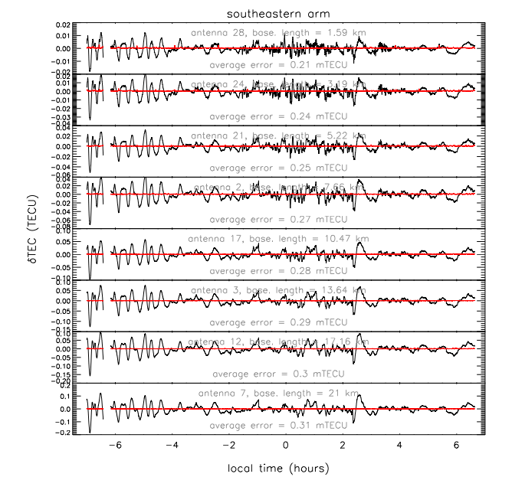
VLA: unprecedented view of the ionosphere
The 74MHz system of the VLA has been used to measure the ionospheric total electron content (TEC) fluctuations on a much wider range of scales than is possible with many other instruments.
We have shown that with a bright source, the VLA can measure differential TEC values between pairs of antennas with a precision of 0.0003 TECU, yielding more than an order of magnitude better sensitivity to TEC fluctuations than can be achieved with GPS-based relative TEC measurements
Large amplitude, long period waves representing traveling ionospheric disturbances are visible within the δTEC data near dusk and dawn as well as other times intermittently throughout the night.
Helmboldt, J ea. 2012 arXiv:1201.3872
For each antenna in the southeastern arm of the VLA, the difference between the TEC fluctuation along its line of sight and that measured along the reference antenna’s line of sight, δTEC.

Slide 21
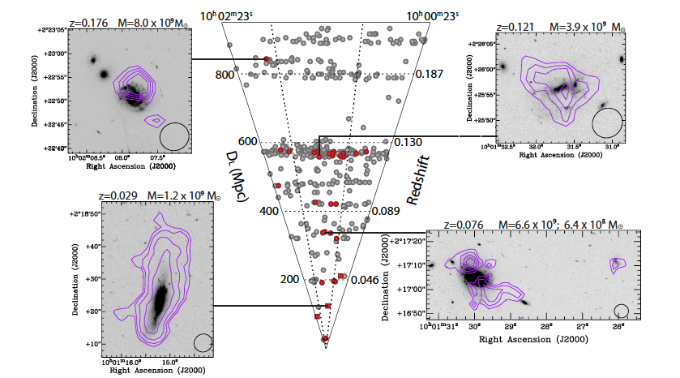
CHILES: HI Deep Fields – SKA pathfinder
Cosmos field pilot search (50hrs) 1.1 to 1.4GHz => z_{HI} ~ 0 to 0.2
33 galaxies detected, including three without a previously known redshifts.
Diverse sample : Range of HI and stellar masses, redshift
Demonstrate JVLA B-array is the ideal configuration for H I deep fields
Example HI detections in the JVLA pilot HI deep field
Fernandez ea.
Notes:
A Pilot for a Very Large Array H I Deep Field
Fernandez ea. ApJ, 770, L29
http://adsabs.harvard.edu/abs/2013ApJ...770L..29F

