Slide 1
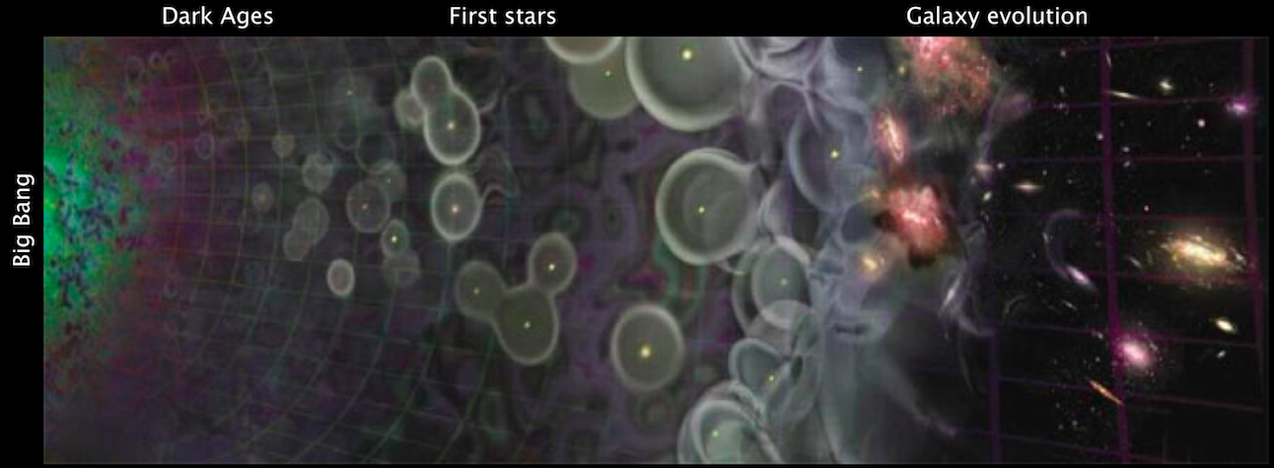
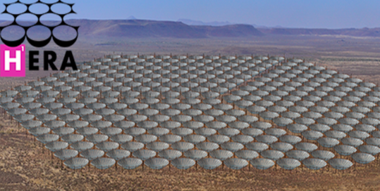
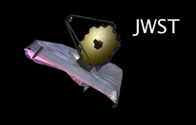
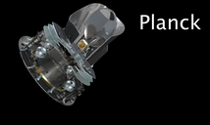
Cosmic Reionization
Last phase of cosmic evolution to be verified and explore
Cosmological benchmark: formation of first galaxies and quasars
Focus on key diagnostic: Evolution of neutral intergalactic medium
Reionization
Fig: A.Loeb
Universum incognitus
F(HI) ~ 0
F(HI) ~ 1
F(HI) ~ 10⁻⁵
z=1100
400 kyr
z ~ 6 to 30
0.3 to 1 Gyr
z < 6
1Gyr to 13.7Gyr

Slide 2
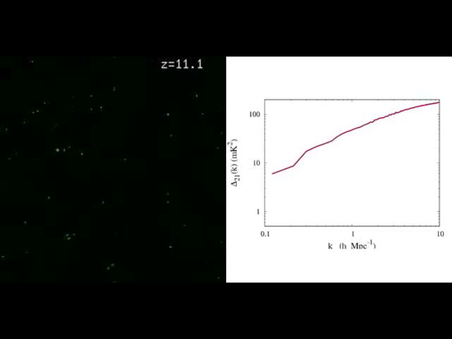
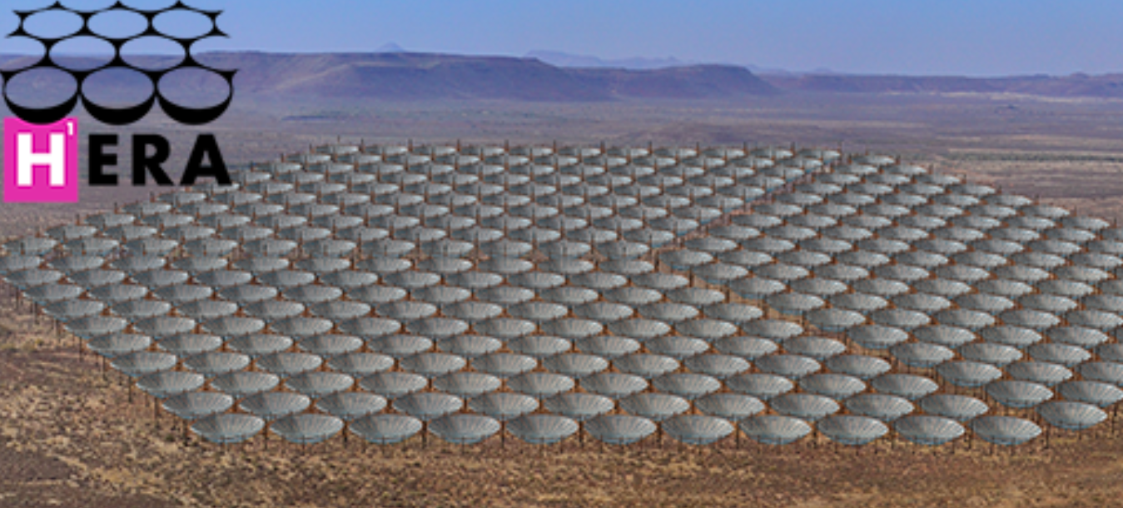
Use HI 21cm line to image LSS when Universe was filled with neutral Hydrogen
Frequencies ~ 100 to 200MHz
Line => 3D imaging
Direct probe of neutral IGM
Low freq => very large volume
McQuinn: 10cMpc, z=11 to 6
351 x 14m parabolic transit antennas, 50 to 250MHz, in Karoo, SA
Collecting area of Arecibo w. 450x FoV

Slide 3
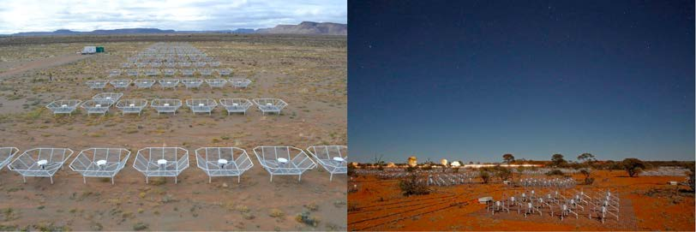
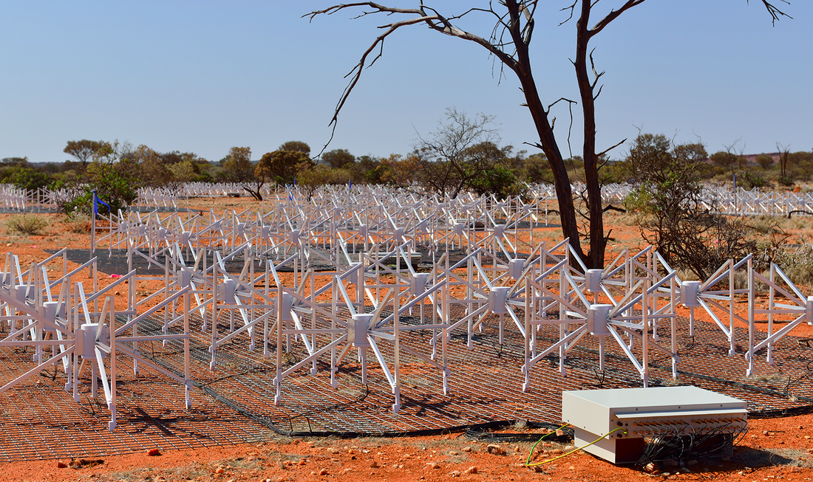
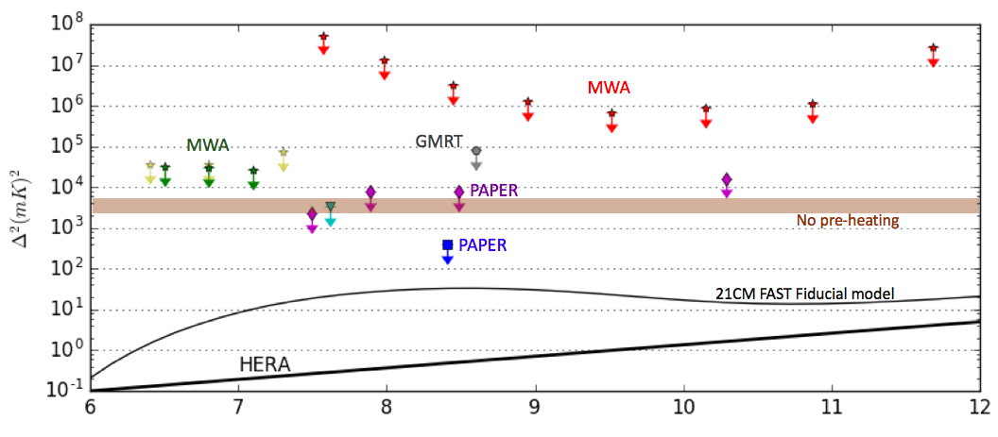
PAPER - SA
MWA - Aus
Progress in HI 21cm cosmology
k ~ 0.1 to 0.5 h/Mpc
LOFAR
First astrophysically interesting limits => early pre-heating of neutral IGM before reionizing [by XRBs or AGN in first galaxies?]
PAPER limit z ~ 8 => T_{s} > 10K > T_{smin}~ 1.5K
Challenge remains: continuum foregrounds ~ 10⁵ x brighter than HI line

Slide 4
Evolution of the IGM neutral fraction
Greig & Mesinger (2016) analysis F(HI)
HERA: Precison HI 21cm cosmology
Lya related
CMB related
QNZ

Slide 5
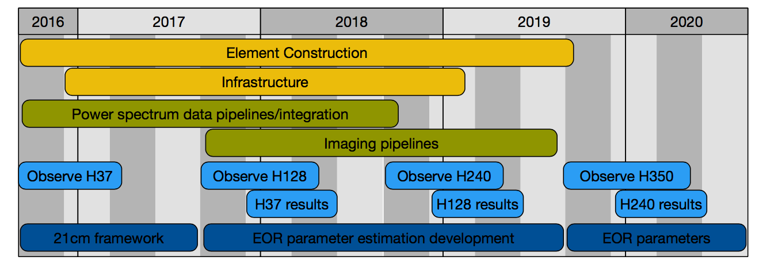
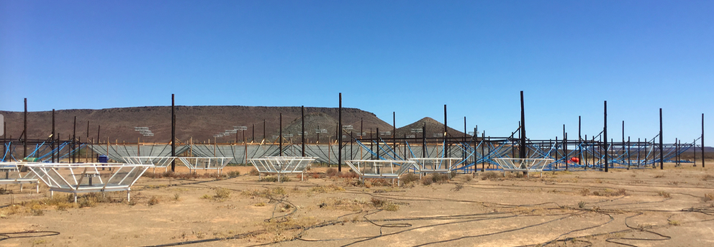
$11.8M NSF + $6M Moore Foundation to 351 antennas
Numerous contributions from partner institutions
Site work led by SKA SA: on track for 128 Antennas end 2017: most powerful reionization experiment in the world

Slide 6
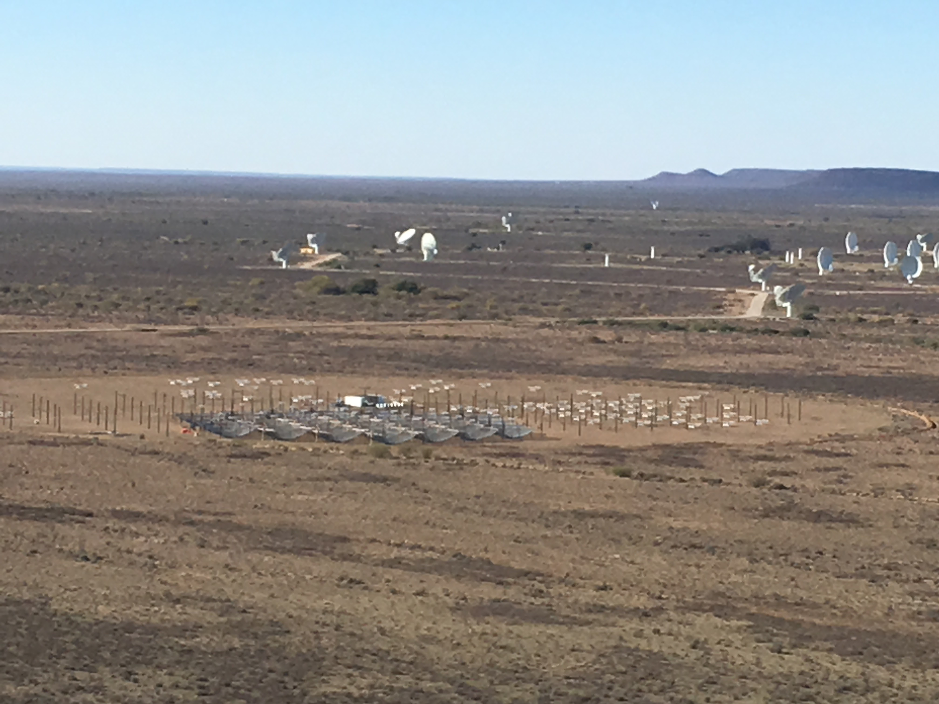

Slide 7
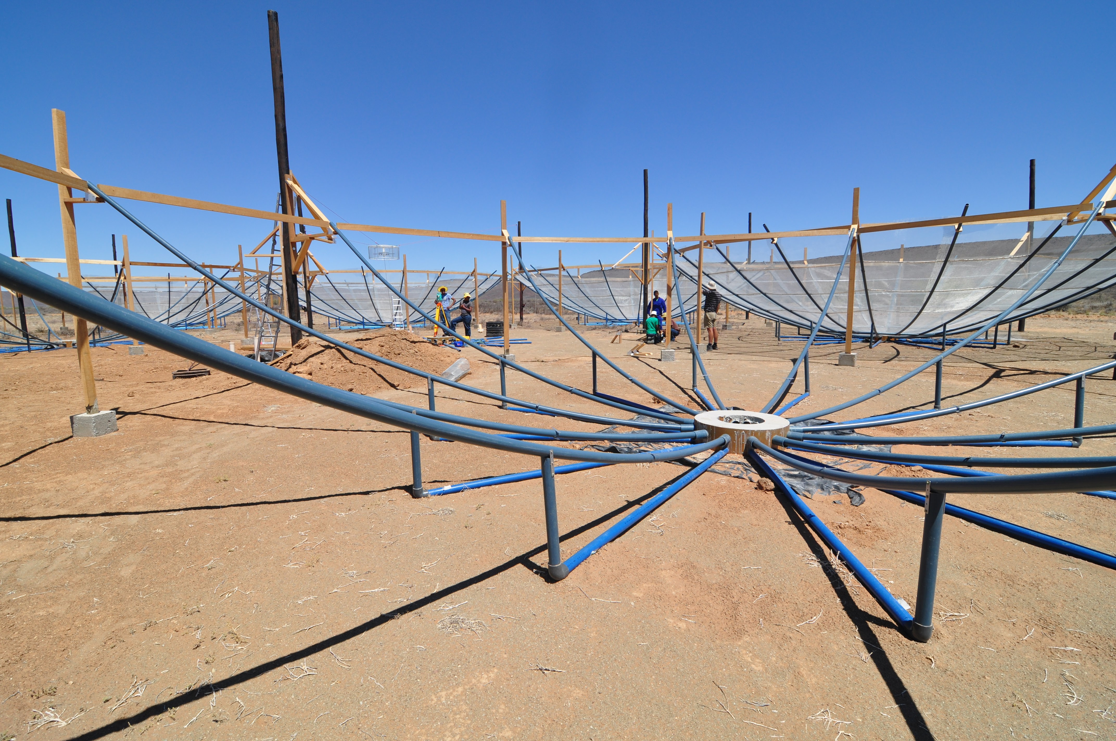
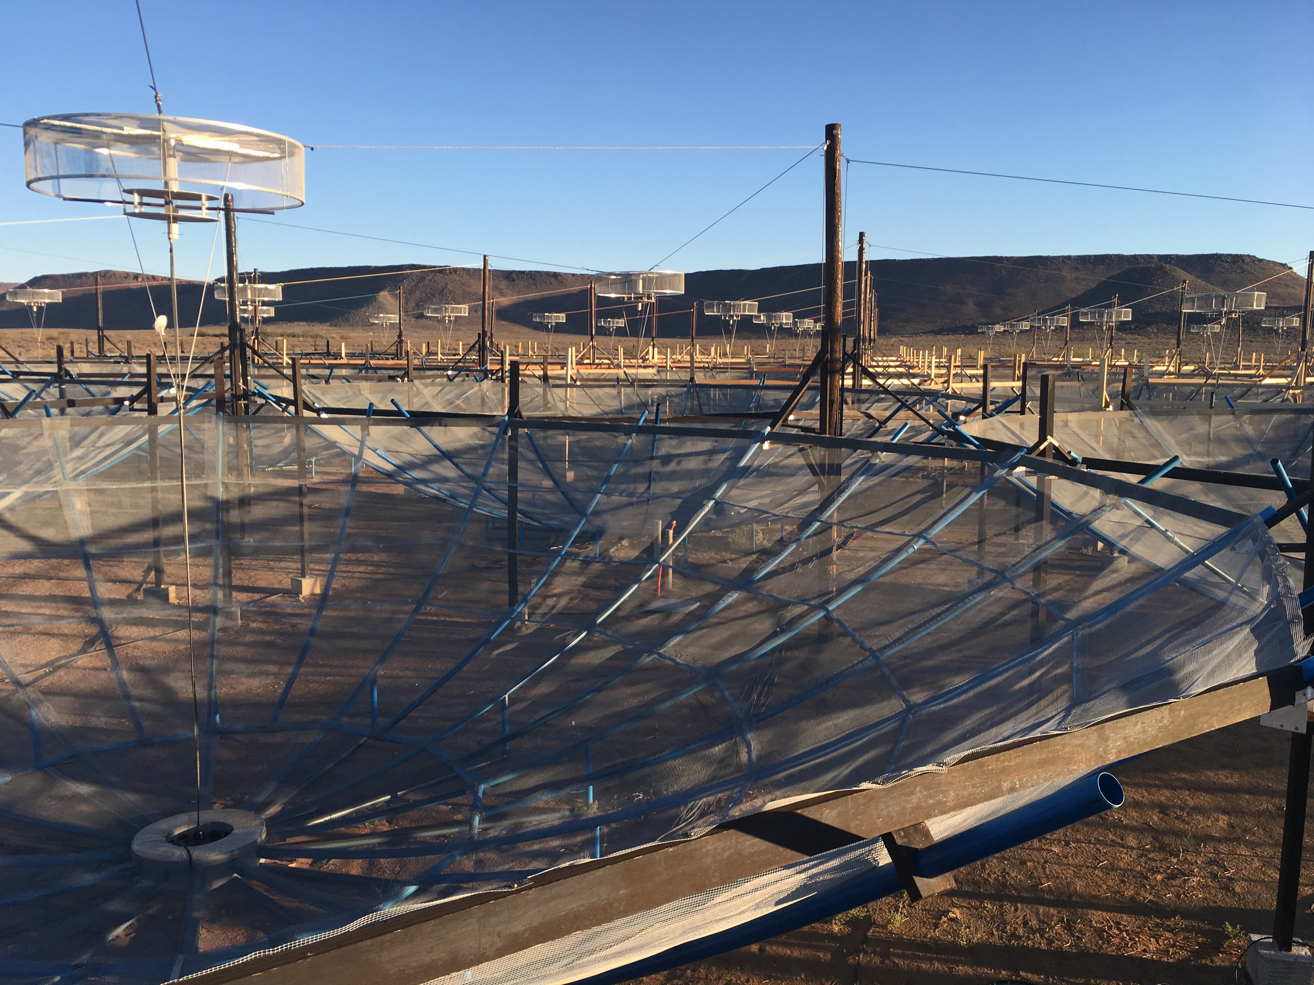
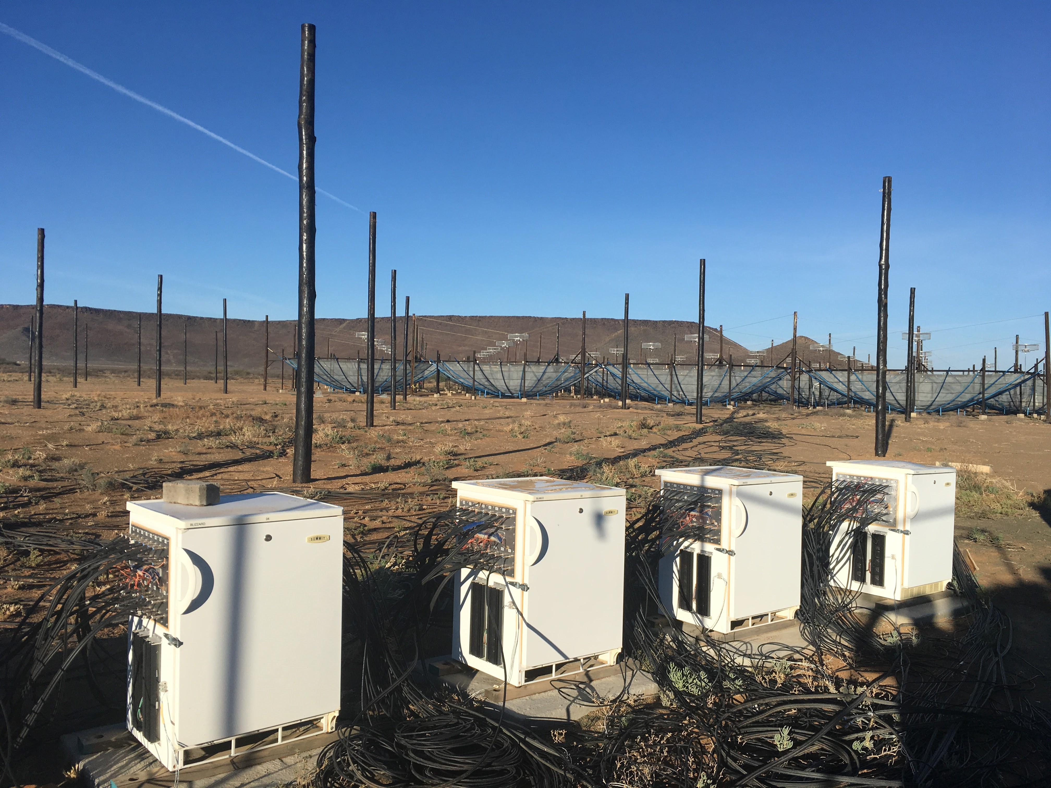
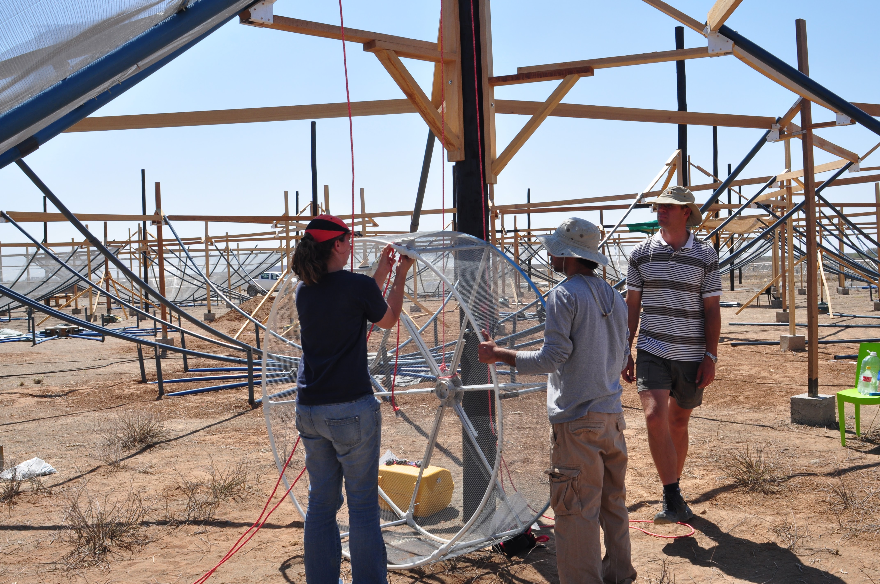

Slide 8
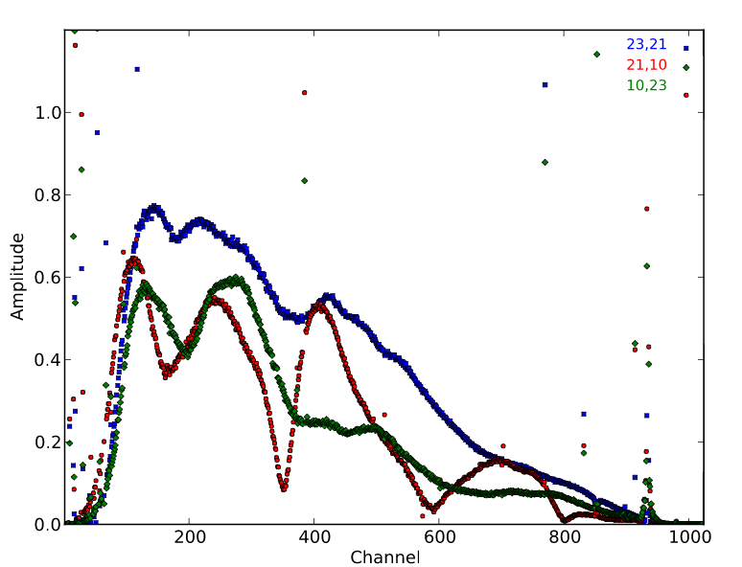
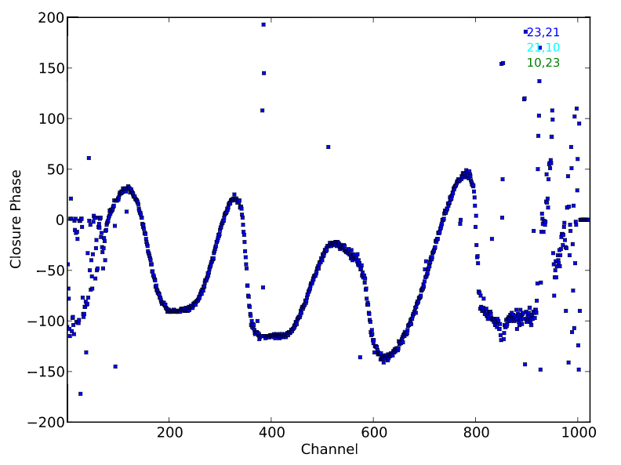


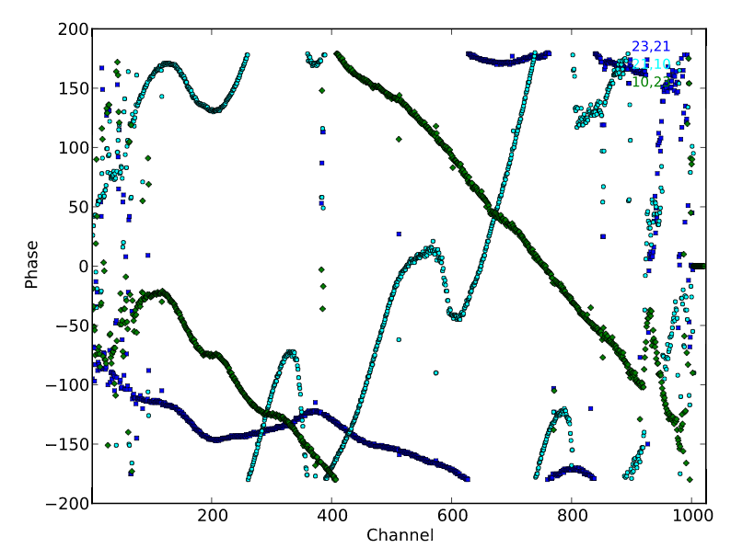
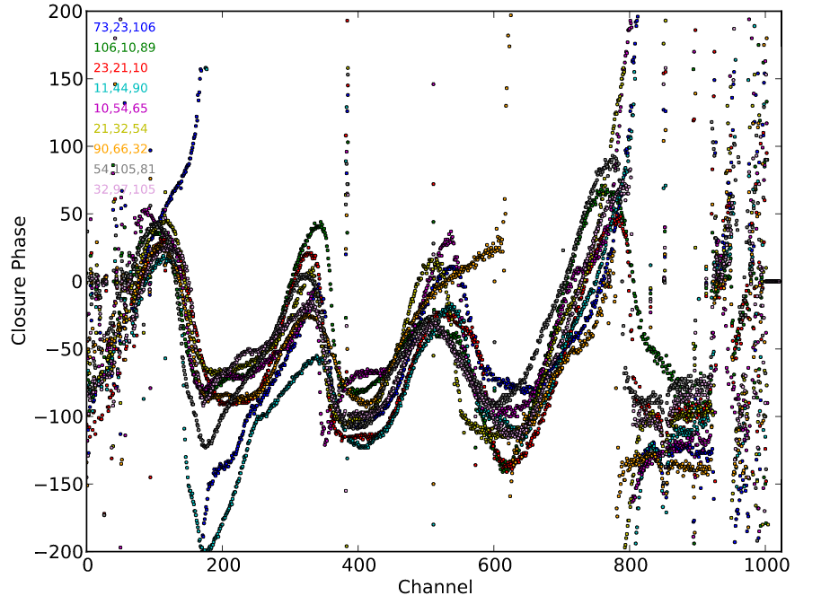
Commissioning HERA19: Violates precepts of aperture synthesis interferometry
Octave bandwidth (not monochromatic)
Very wide field (not flat-sky)
Field is COMPLETELY filled with emission (not isolated source/sources = confusion++)
Finding ‘calibrators’: 19 close-packed antennas => 19 syn. beams over FoV area
23
14m
21
10
redundant triads
Closure: non-redundacy 𝚽_{rms} ~ 12º ~ 5% consistent with 10cm spec for antenna positions, but could be other non-redundant effects

Slide 9
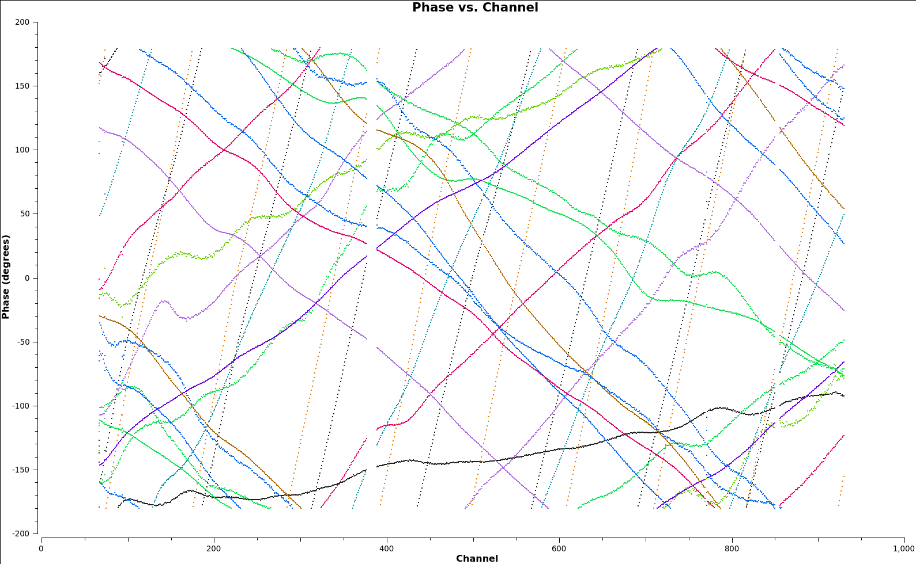
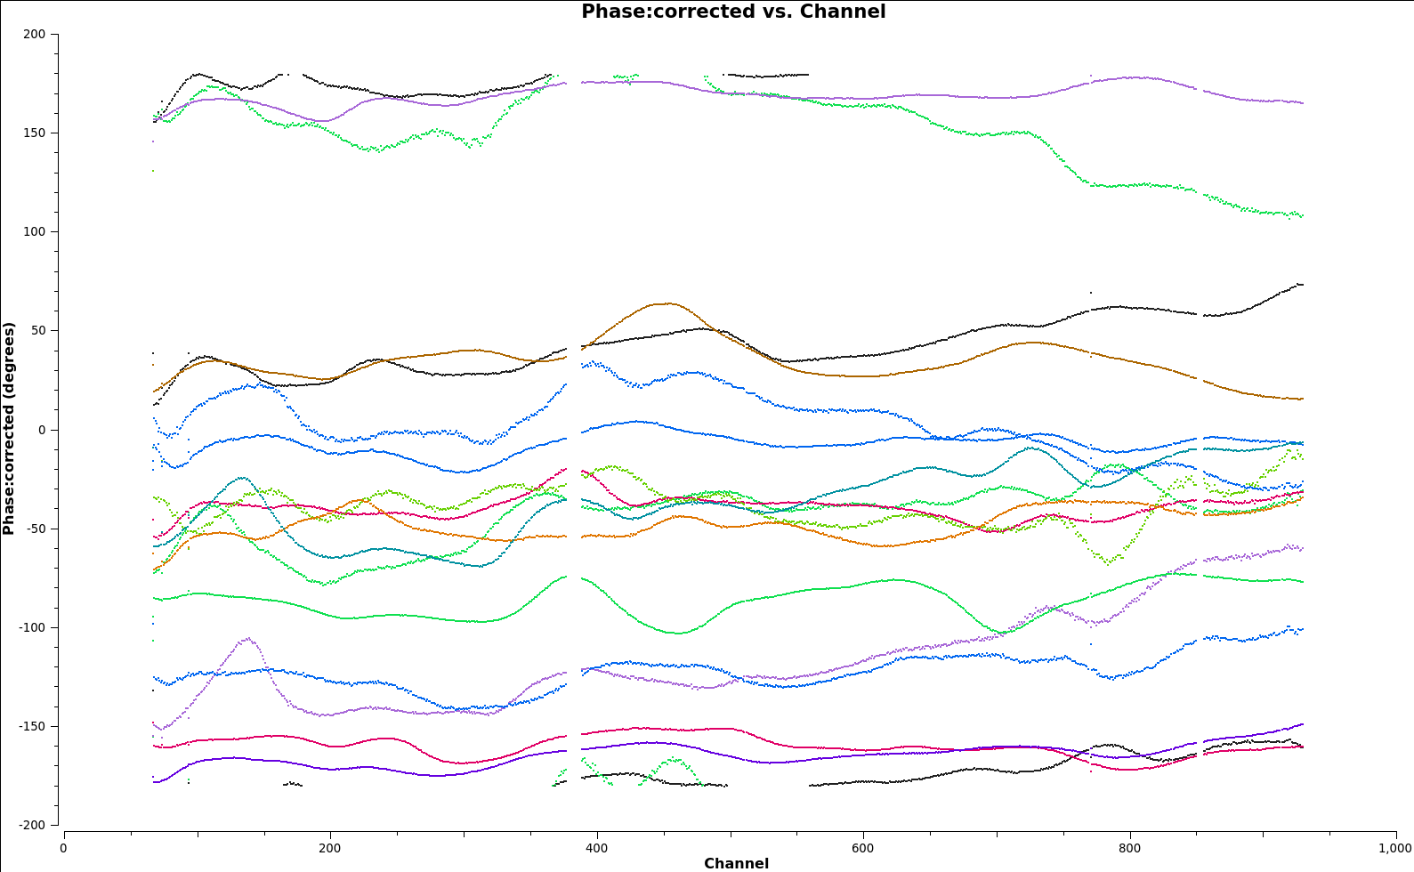
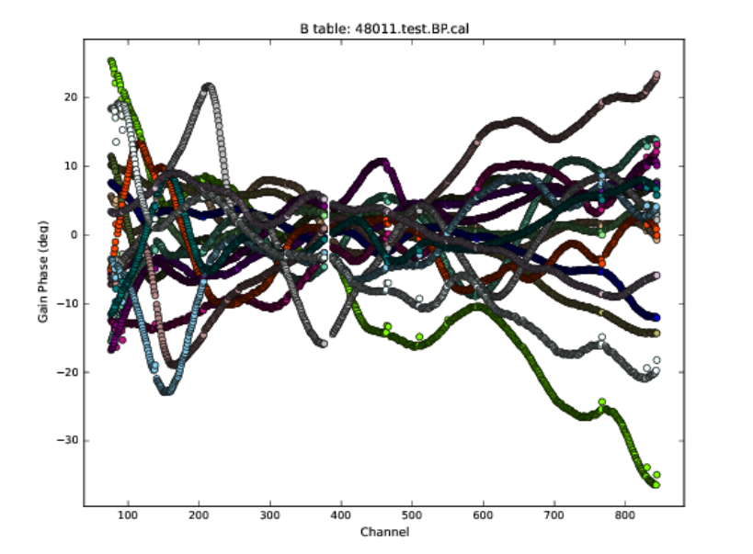
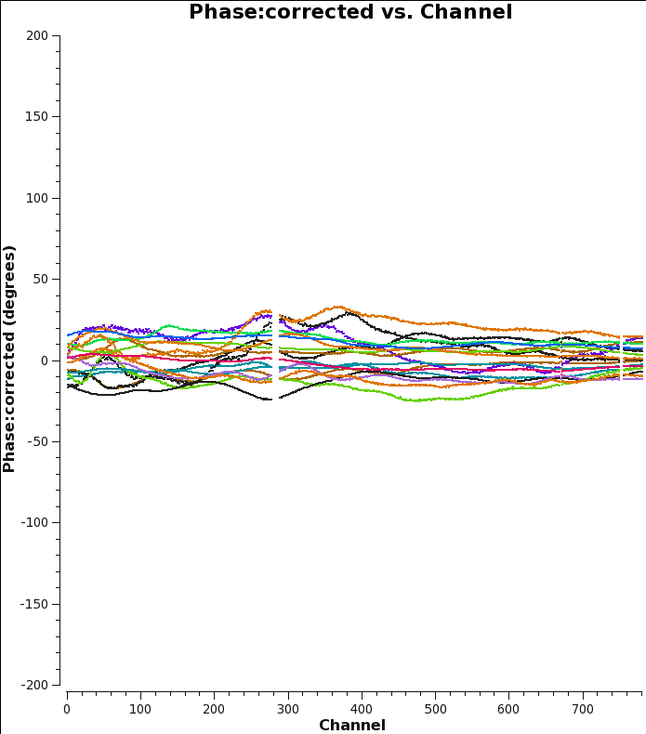
Galactic Center Sky Calibration
Uncalibrated
Delay Cal
200º
-200º
120MHz
180MHz
Gain + BP cal. spectra
25º
Bandpass solns
-30º

Slide 10
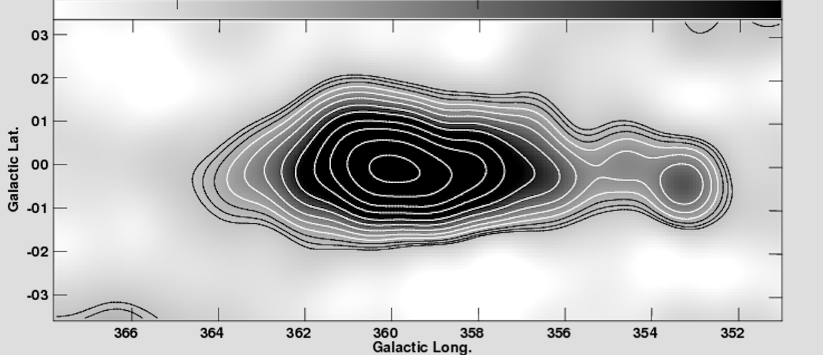
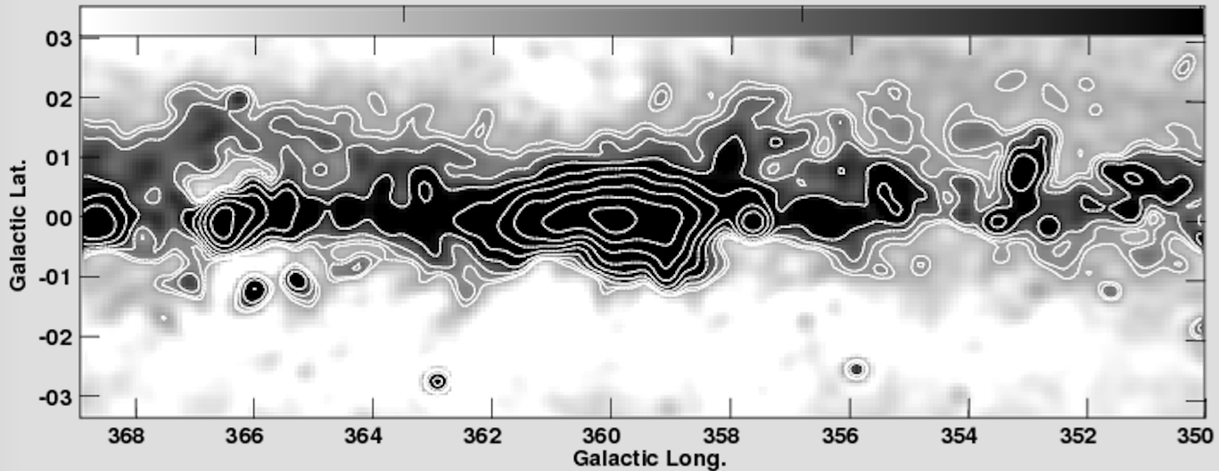
HERA first image: Galactic Center (Nikolic/Carilli)
18ants
1.2º res
DNR ~ 200
PB
PAPER 64 imaging, 20’ res (Stefan)

Slide 11
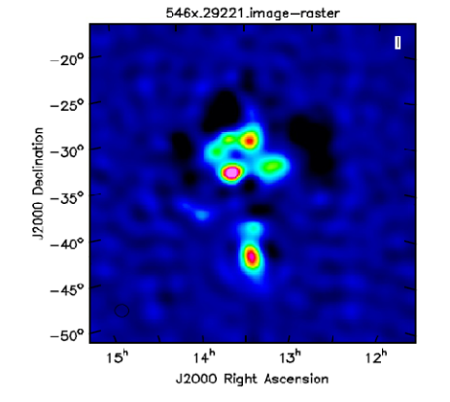
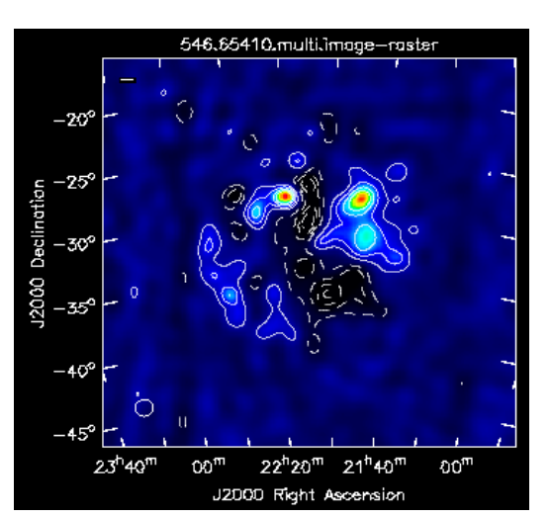
Applying GC cal to other fields: 1.2º res
PMNJ2107-2526, 34Jy
PMNJ2101-2802, 20Jy
rms ~ 0.2Jy
High Latitude
Centaurus A

Slide 12
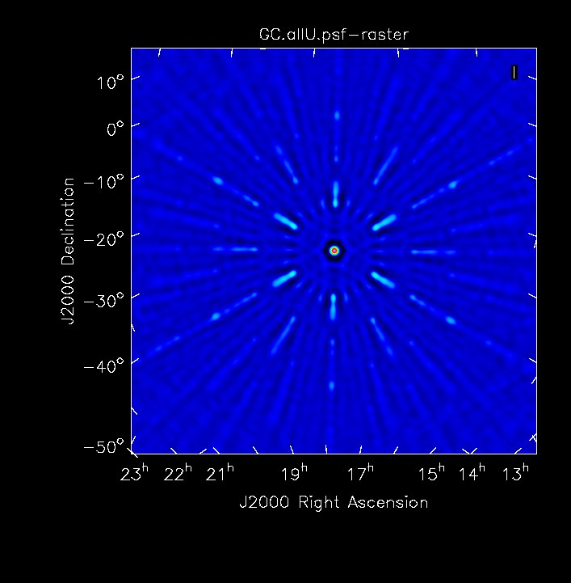
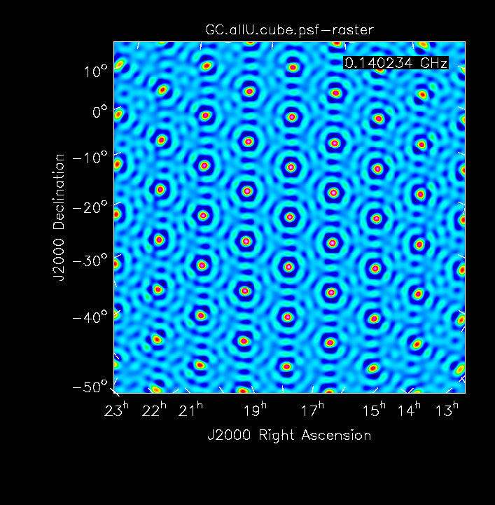
Synthesized beams
FT(UV sampling w. Unif Weighting), w/o Primary beam multiplication
PB FWHM 120, 180MHz
PSF: MFS inner 75%
PSF: Single Channel
Challenge: need MFS to perform imaging, but… resolution changes by factor 2 over band => single self-cal model for BPcal cannot represent highest frequencies vis?

Slide 13
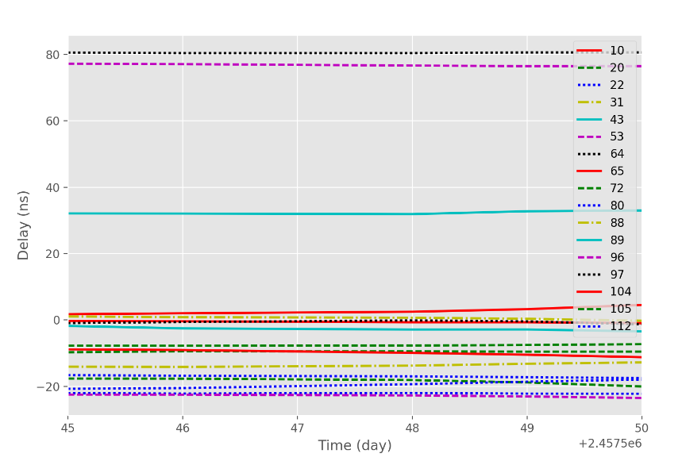
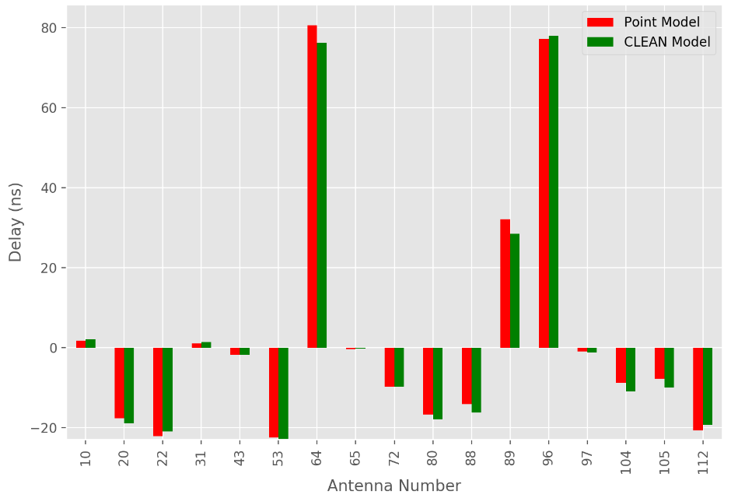
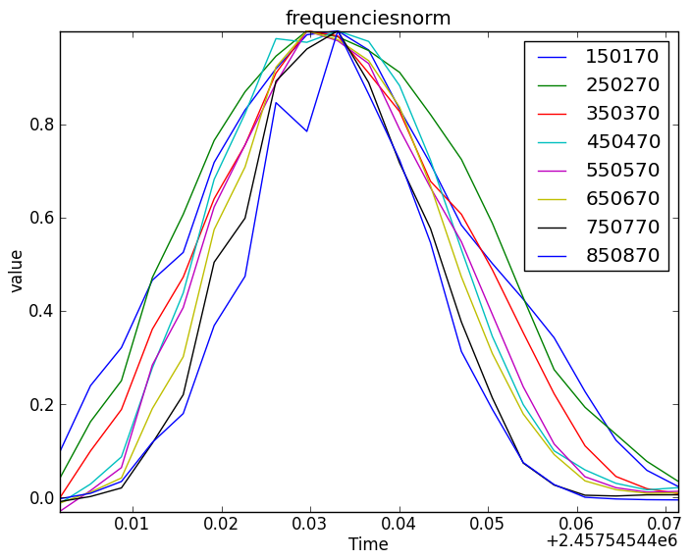
120MHz FWMH = 13º
180MHz FWHM = 7º

Slide 14
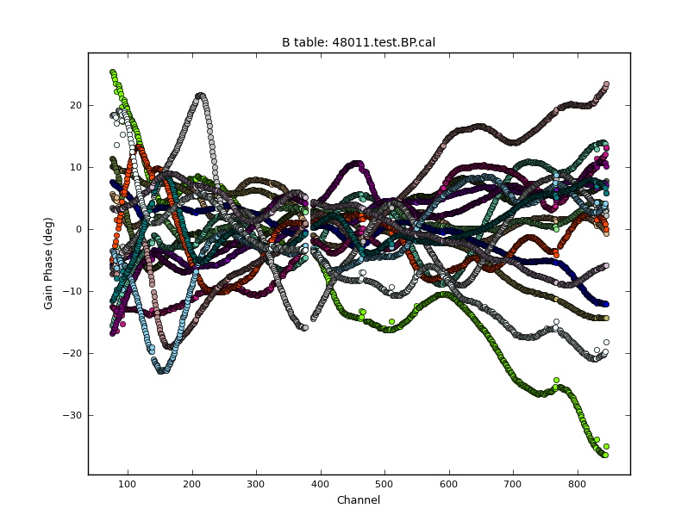
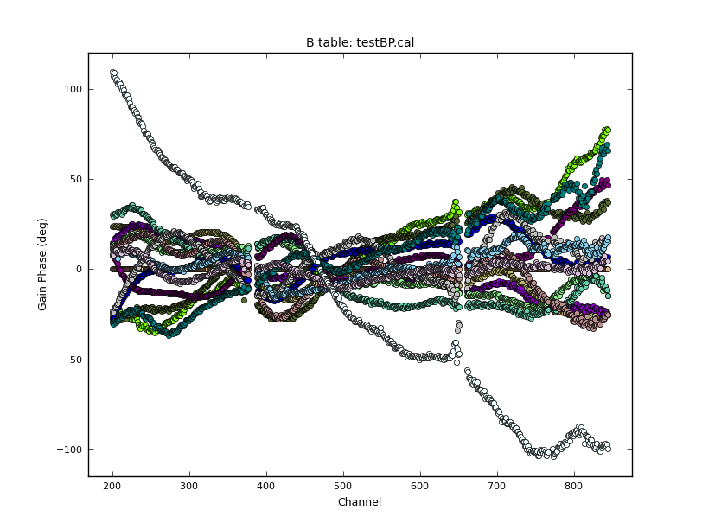
GC BPp
Bernardi BPp
Cal solutions are dominated by limitations in calibration sky model

Slide 15
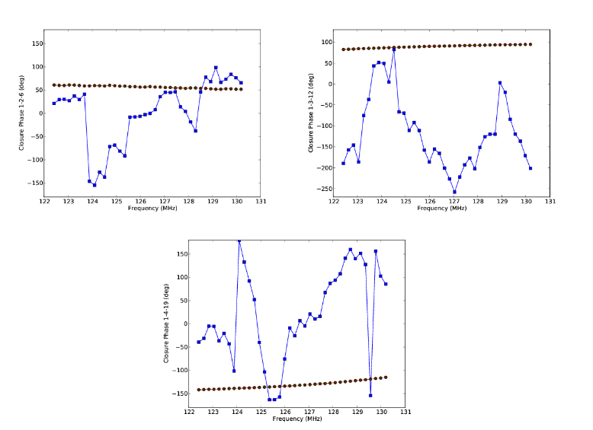
Searching for reionization signal in closure spectra: no need to calibrate!
Continuum
HI Line

Slide 16
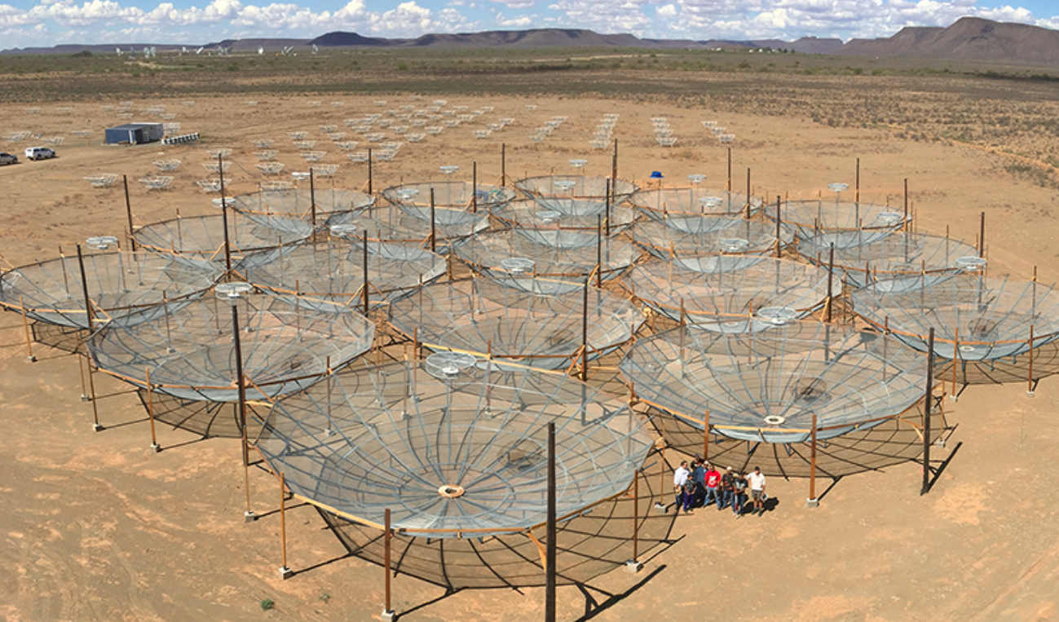

Slide 17
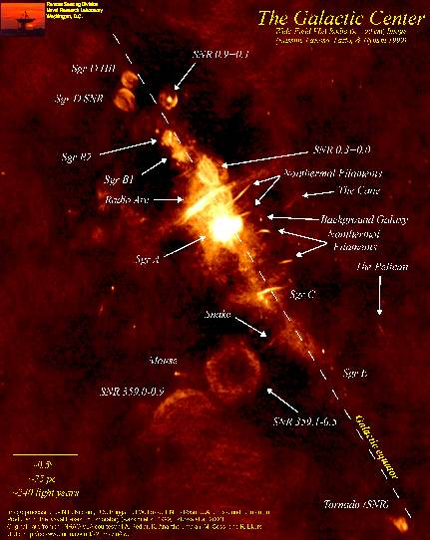
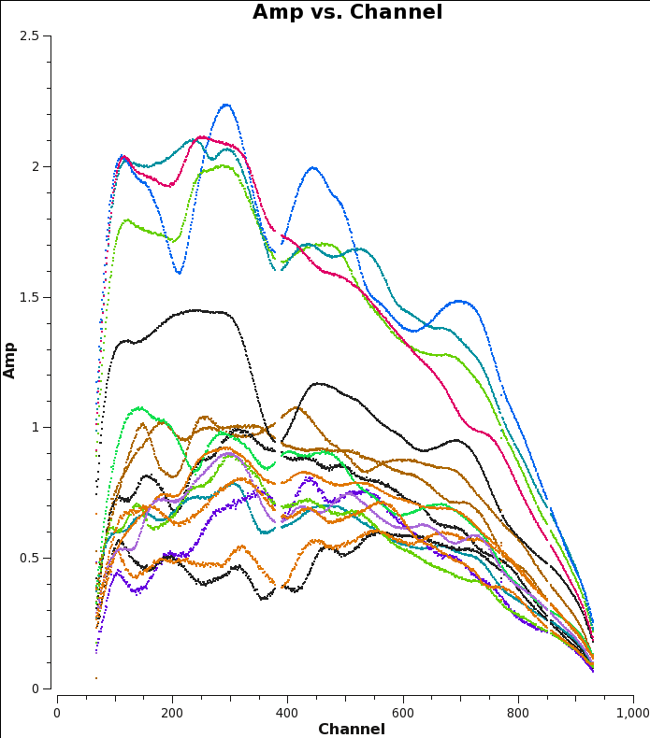
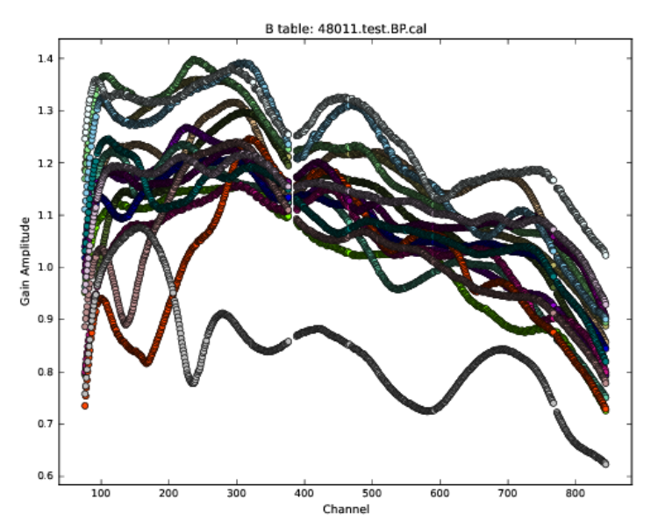
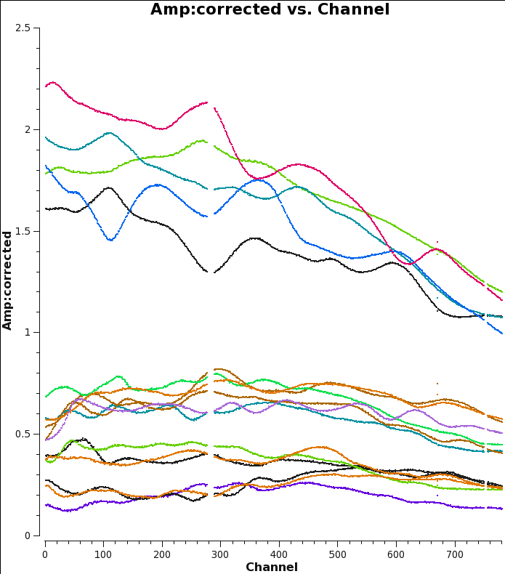
Galactic Center Sky Calibration
Uncalibrated
120MHz
180MHz
2.5
Bandpass Cal
Bandpass solns

Slide 18
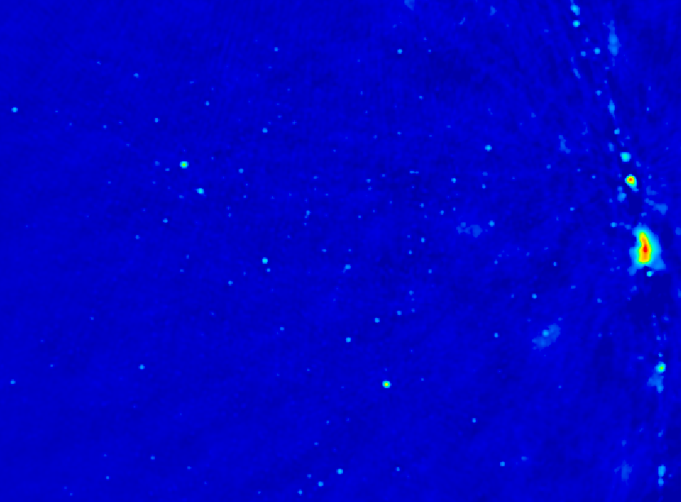
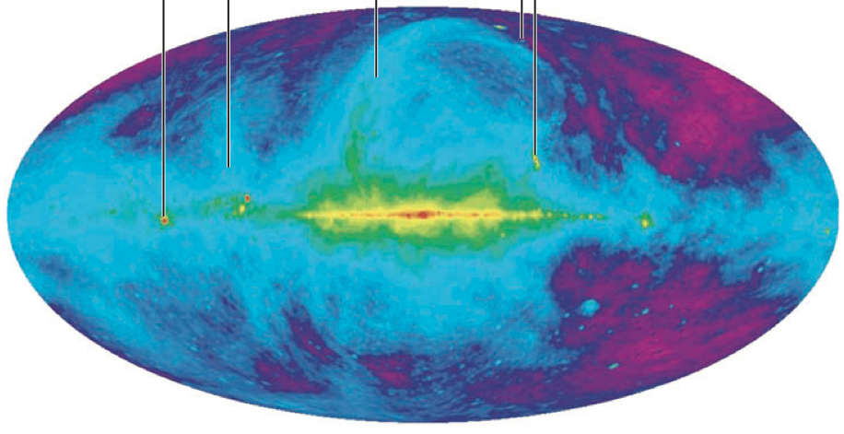
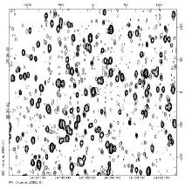
Challenge: sky is hot, confused at low freq
Haslam, Eberg 408MHz
Coldest regions: T ~ 100 (ν/200 ΜΗz)^{-2.6} K = 10⁴ x 21cm signal
Highly ‘confused’: 1 source/deg² with S140 > 1 Jy

Slide 19
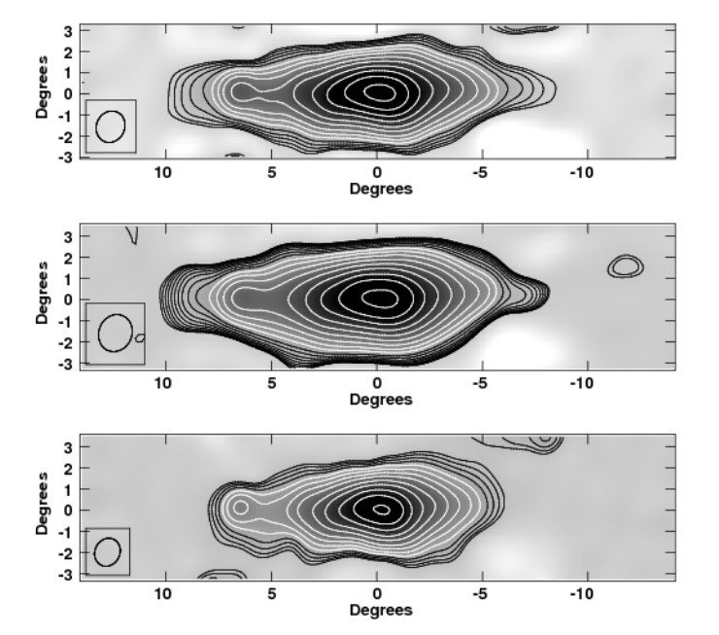
130MHz
170MHz

Slide 20
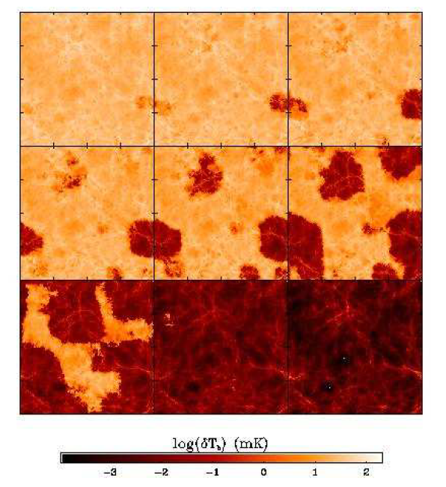
Signal end-game: HI 21cm ‘tomography’ of IGM
Challenge: Sensitivity
z=12, 110MHz
Imaging of typical structures requires full Square Kilometer Array
  S_{150MHz} (2’) ~ 8uJy
  SKA rms ~ 1.6uJy
Primary science driver for SKA-low
<T_{B}> ~ 20mK
z=6.5, 180 MHz
10cMpc = 4’
Furlanetto ea 2004

Slide 21
Near-term Goal
Evolution of 3D power spectrum in 21cm line
Early: density field
Warming: signal drop
Reionization
  z~7: Flat ~ bubble scale (0.1 – 1 Mpc⁻¹)
  PS Amp ~ 20mK²
30’, 3MHz
3’, 0.3MHz
mK²
cMpc⁻¹
Mcquinn; 10cMpc

Slide 22
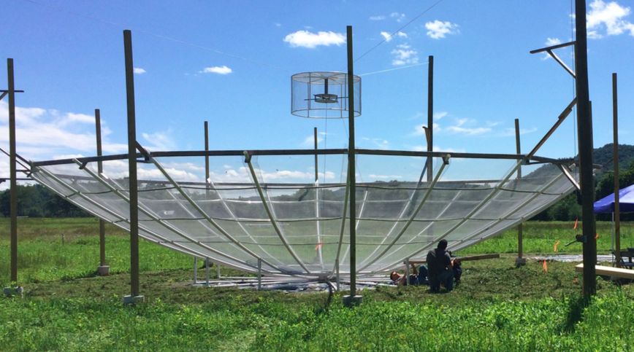
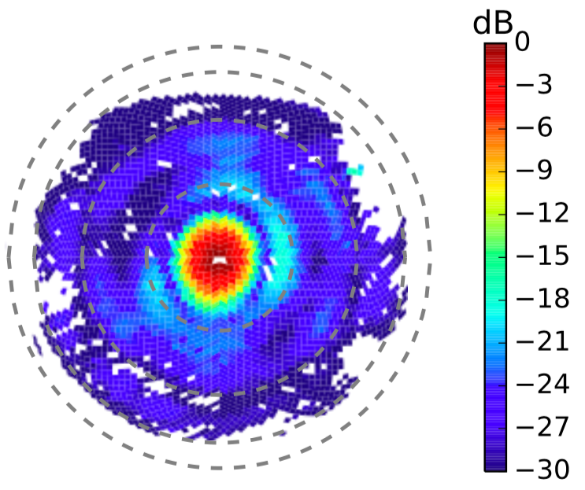
14m antenna
Optimized for: Gain, FoV, ‘standing wave delay response’
Beam map with Orbcom (Neben)
  8º FWHM (150MHz), 70% main beam efficiency, few% 1st sidelobe
  50x forward gain of PAPER element
  Chromatic response: avoid bandpass spectral structure < 20MHz

Slide 23
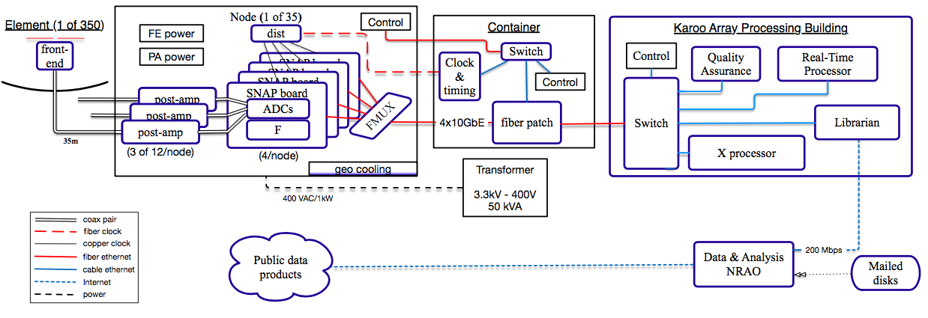
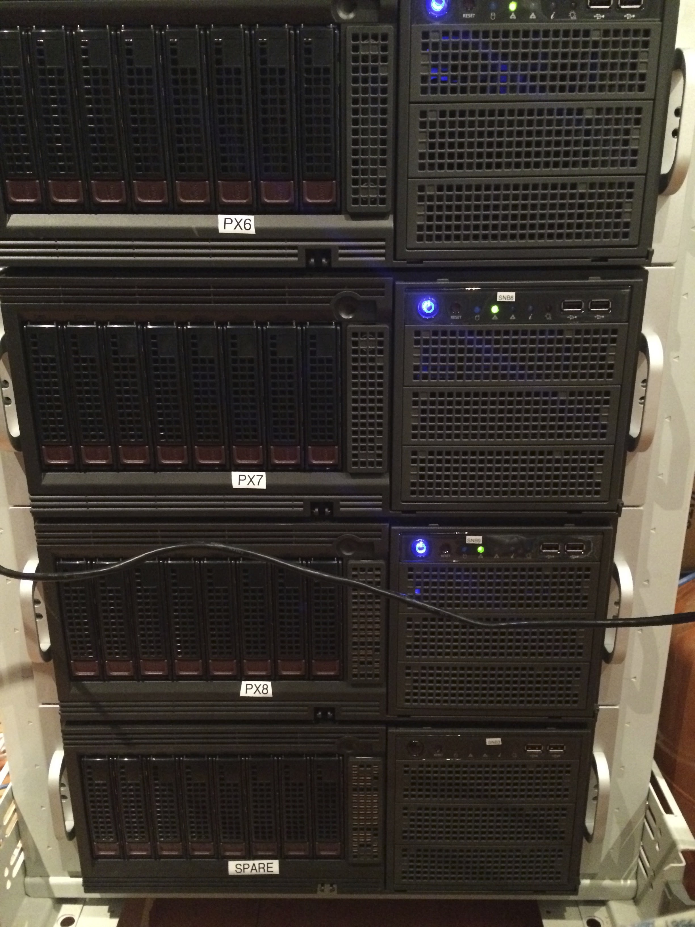




KAPB
10GbE Ethernet
Few km
Coax
35m
Internet 10000km
DSOC
Active FE: 25dB gain
SNAP/FPGA: F-engine
ADC/Sample, FT(t) → nu
GPU X-engine: cross multiple voltages
4TB/day: RTP redundant cal + average → 1.5PB on-site storage
Internet transfer (averaged) → NRAO/Soc 1PB Lustre
Analysis: N node cluster and/or XSEDE or Amazon Cloud
Notes:
PSA-64, 32 antennas in a maximum-redundancy configuration, 30m between rows, 4m spacing within rows

Slide 24




Cavendish and HERA
EM/RF delay modeling, antenna design and test system: flatten the bandpass! (de Lera Acedo, Rezavi, Fagnoni, Hills)
  Broad band feeds
  FE analog electronics: impedance matching
  ’RF over fiber’ transmission
‘Gold standard’ antennas in Lord’s Bridge (Shaw, Northrop)
Commissioning and field work (Carilli, Nikolic, Rezavi)
Bayesian power spectral analysis (Sims, Lentati, Alexander)
Funding antennas 20 to 37
Newton Advanced Fellowship: funding for collaborative work w. South Africa on imaging and calibration (Bernardi/Carilli)
Bayes PS recovery

Slide 25
Renaissance at low freq: reionization experiments
PAPER - SA
MWA - Aus
Array | FoV deg² | Area km² | Type | PS S/N* FG Avoidance | PS S/N* FG Removal | FWHM₁₅₀ arcmin | Start date
PAPER-128 | 1600 | 1200 | Dipole | 1.2 | 4.8 | 23 | 2013
MWA-128 | 300 | 3600 | Tile | 0.6 | 6.4 | 10 | 2013
LOFAR | 25 | 36000 | Tile | 1.4 | 17 | 5 | 2013
HERA-331 | 64 | 54000 | Dish | 23 | 91 | 20 | 2018
SKA-I Low | 30 | 420000 | Tile | 13 | 140 | 5 | 2021+
*Power spectrum sensitivity to ‘vanilla’ model: Pober 2014, ‘21cmSense’ cosmology calculator

Slide 26



HERA-331: Imaging Large Scale Structure (20’)
z = 10
Sims 2016
0.4mJy/bm
Provide large scale environmental ‘context’ for galaxy formation
Notes:
PSA-64, 32 antennas in a maximum-redundancy configuration, 30m between rows, 4m spacing within rows

Slide 27

Use HI 21cm line to image LSS when Universe was filled with neutral Hydrogen
Frequencies ~ 100 to 200MHz
Line => 3D imaging
Direct probe of neutral IGM
Low freq => very large volume
351 x 14m parabolic transit antennas, 50 to 250MHz, in Karoo, SA
Collecting area of Arecibo w. 450x FoV (only below 200MHz)

