Slide 1
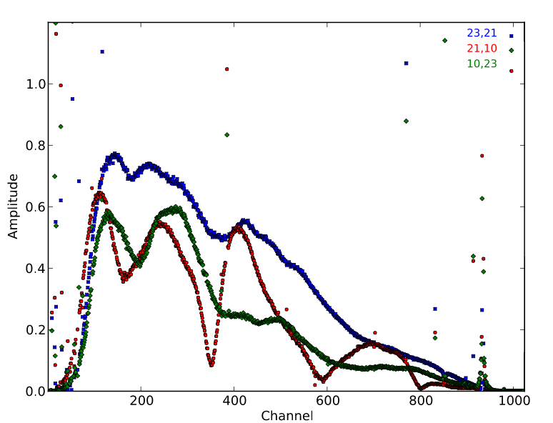
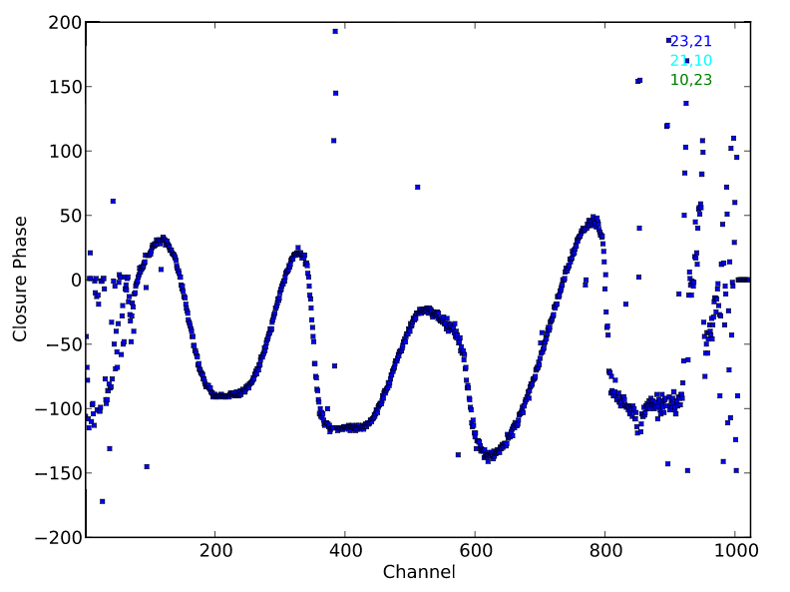


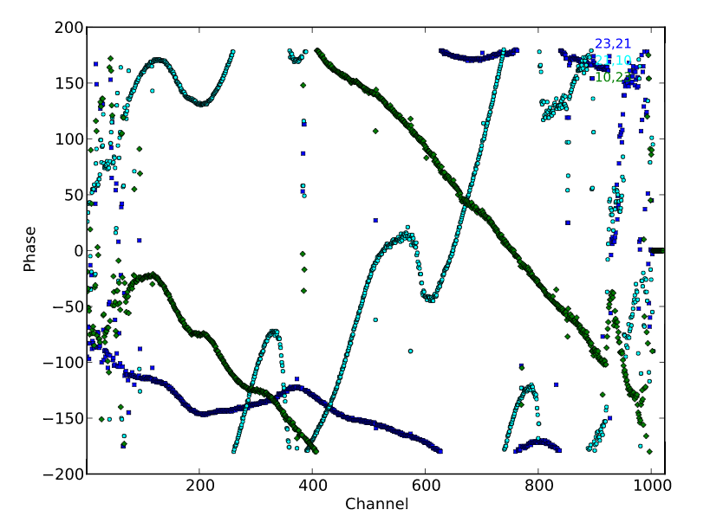
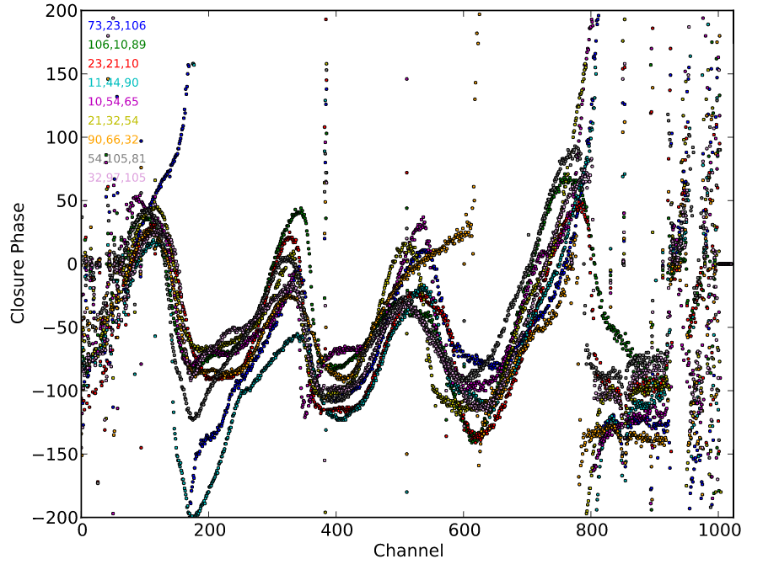
HERA19 Commissioning: closure analysis
Raw Amp on shortest triade
Closure phase on shortest triades
Raw phase on shortest triade
Redundancy on shortest triades: 𝚽_{rms} ~ 12º ~ 5%
Consistent w. 10cm spec for antenna positions, but could be other non-redundant effects
Casa tasks written (Nikolic) to easily generate phase, amp closure quantities

Slide 2
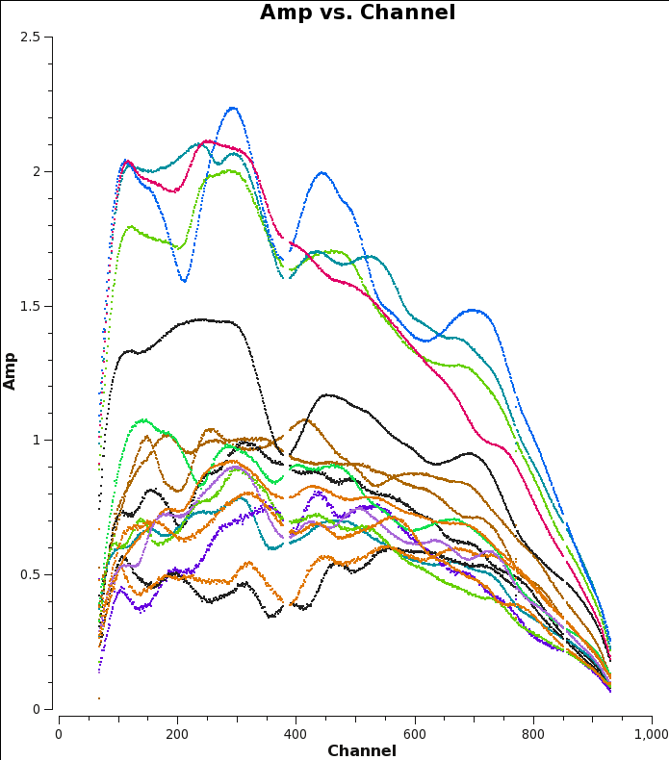
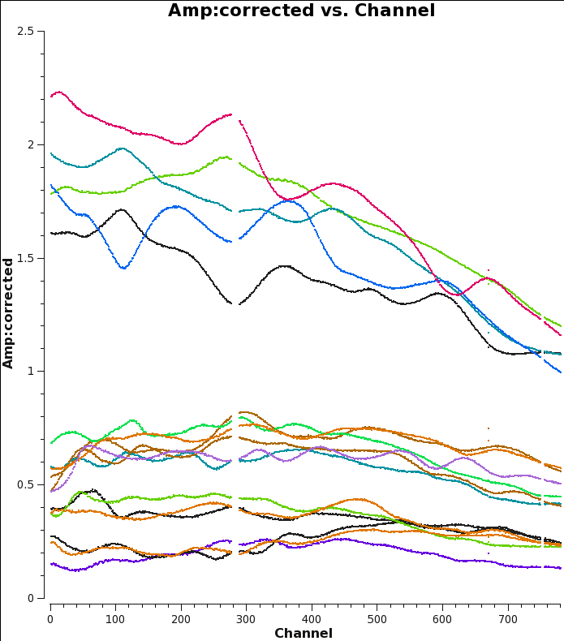
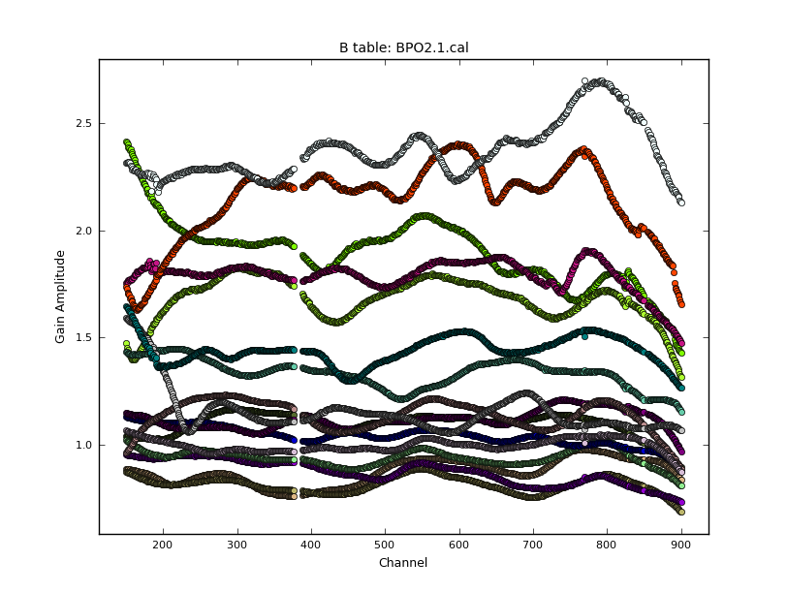
HERA19 – March data on Galactic Center
2.5
Vis spectra to Ant. 10
Amplitudes Uncalibrated
Amplitudes
Bandpass Calibrated
120MHz
180MHz
Galactic Center as calibrator
Read pyuvdata/FITS into CASA.ms, correct ant. ordering
Rotate GC to phase center
Point source model: delays, gaincal (amp, phase) mean offsets
Image with MFS, nterms=1 (flat spectrum)
Use CLEAN model to derive residual bandpass
Iterate BP once -- converges
2.5
Bandpass solns
0.5

Slide 3
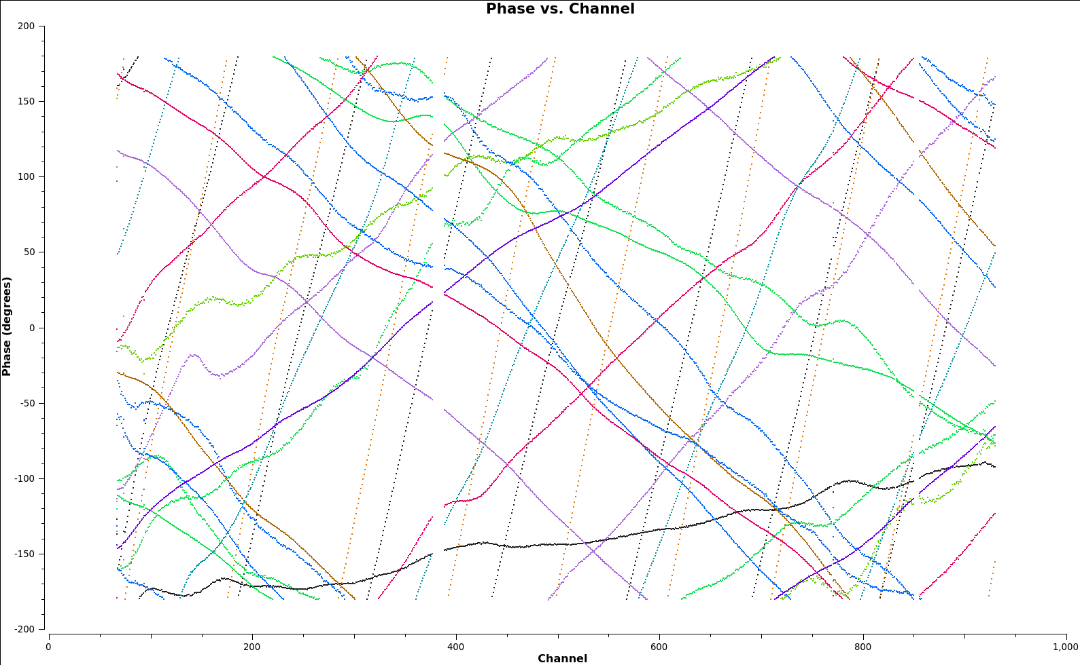
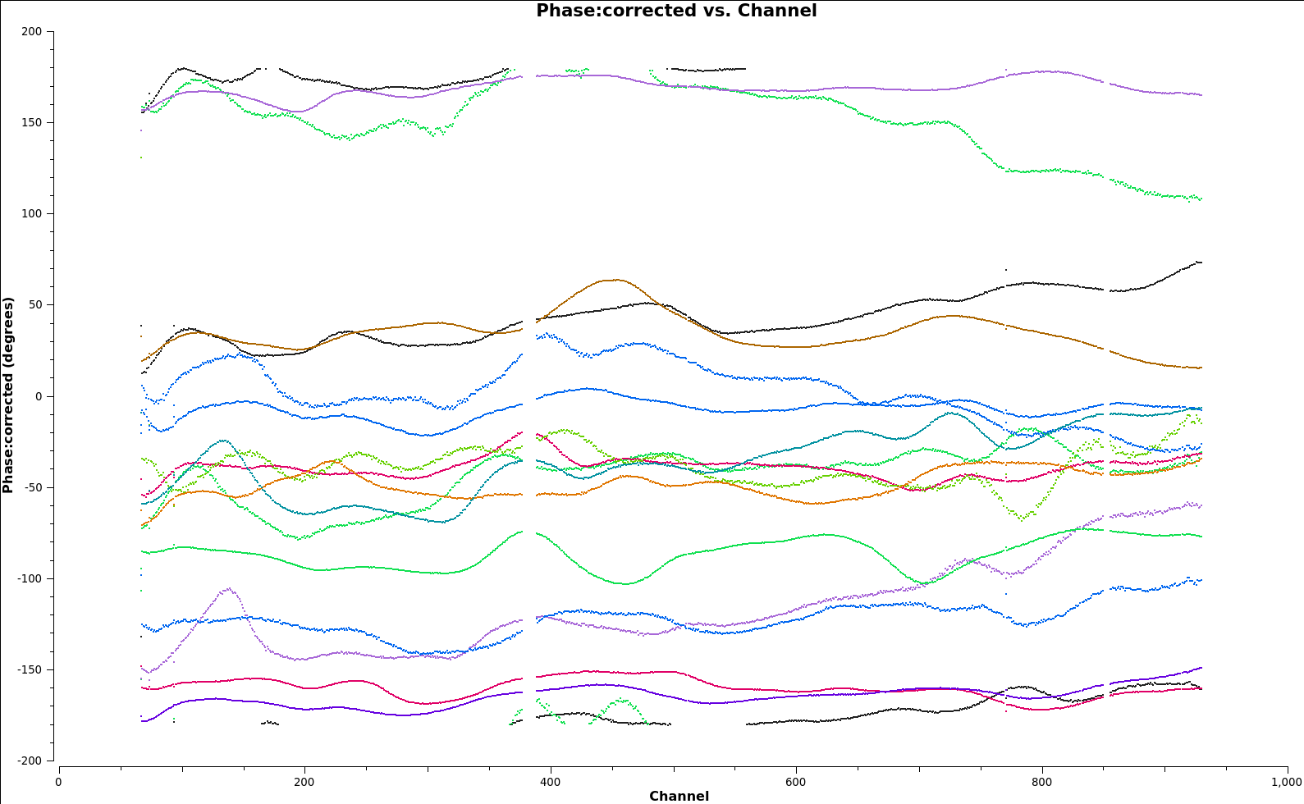
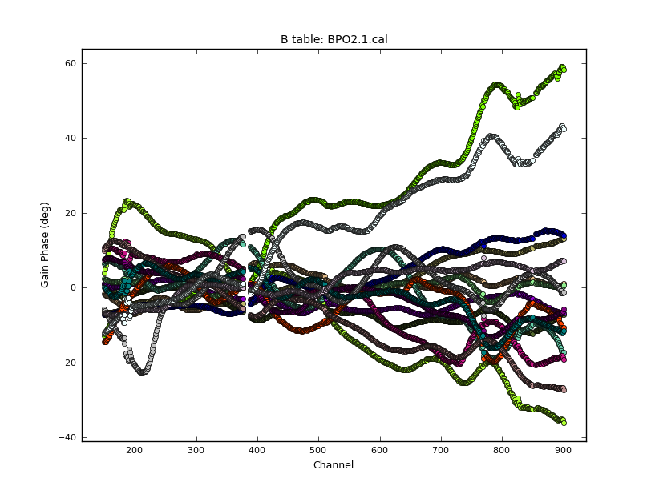
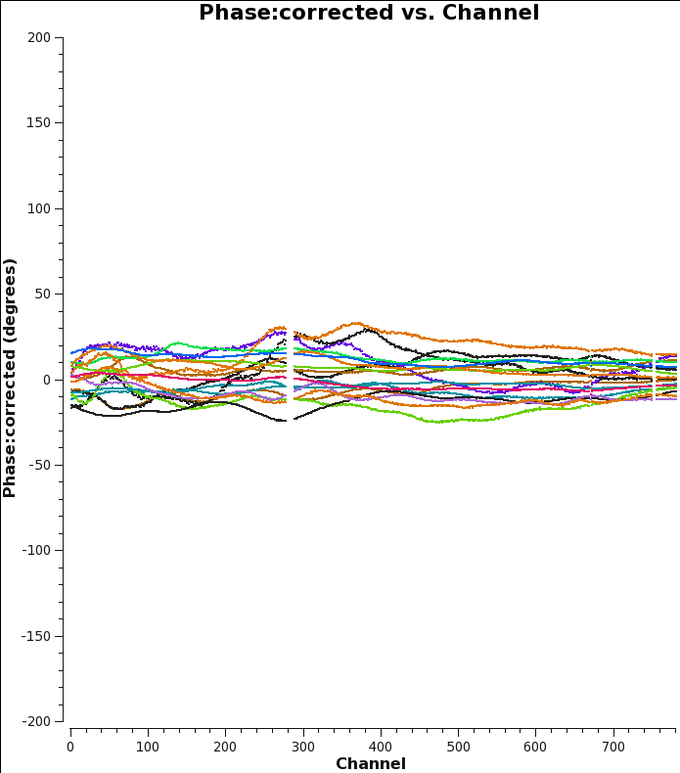
Vis Phases to Ant. 10
Point source delay cal model is incorrect on long N-S baselines => corrected in BP cal with more complete CLEAN model (ie. slope in BP for some baselines is artificial due to delay cal)
Galactic Center Sky Calibration
Uncalibrated
Delay Calibrated
200º
-200º
120MHz
180MHz
Gain + BP calibrated spectra
60º
Bandpass solns
-60º

Slide 4
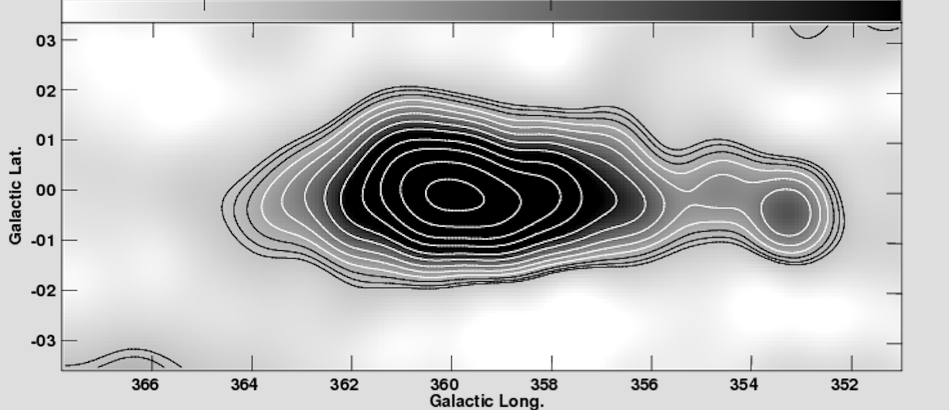
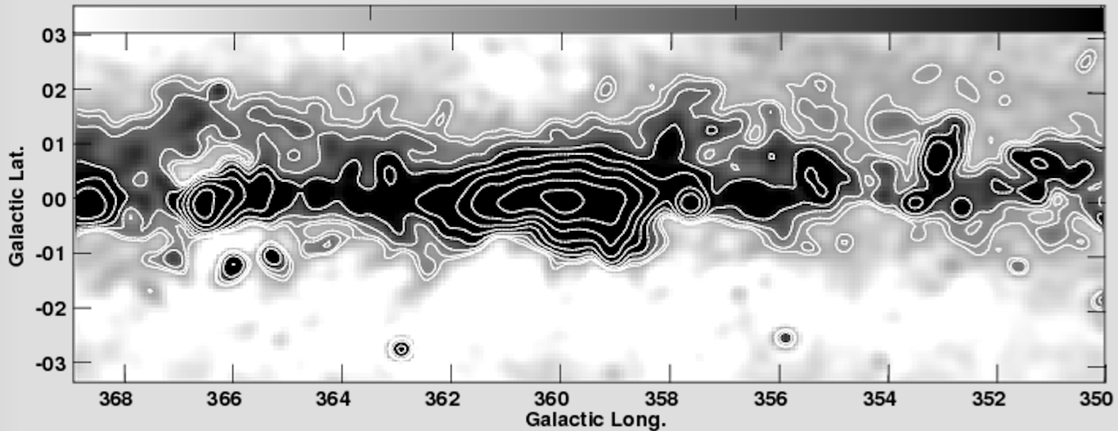
HERA first image: Galactic Center (Nikolic/Carilli)
18ants
1.2º res
DNR ~ 200
PB
PAPER 64 imaging, 20’ res (Stefan)

Slide 5
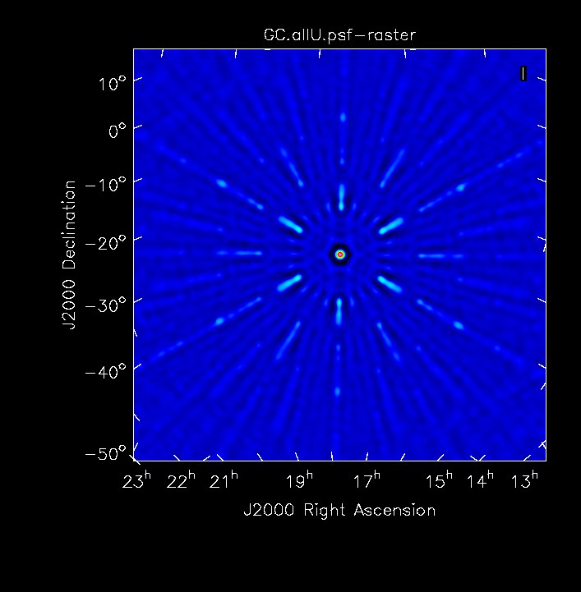
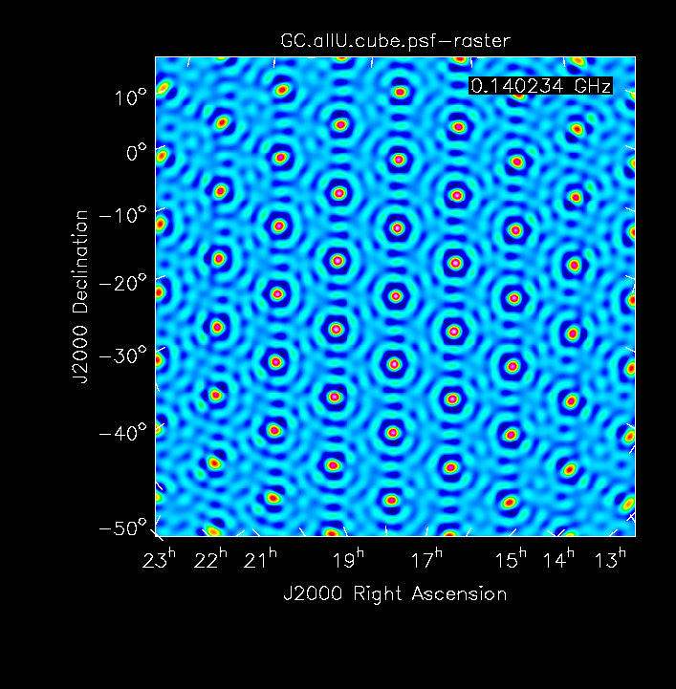
Synthesized beams
FT(UV sampling w. Unif Weighting), w/o Primary beam multiplication
PB FWHM 120, 180MHz
PSF: MFS inner 75%
PSF: Single Channel
Challenge: need MFS to perform imaging, but… resolution changes by factor 2 over band => single self-cal model for BPcal cannot represent highest frequencies vis?

Slide 6
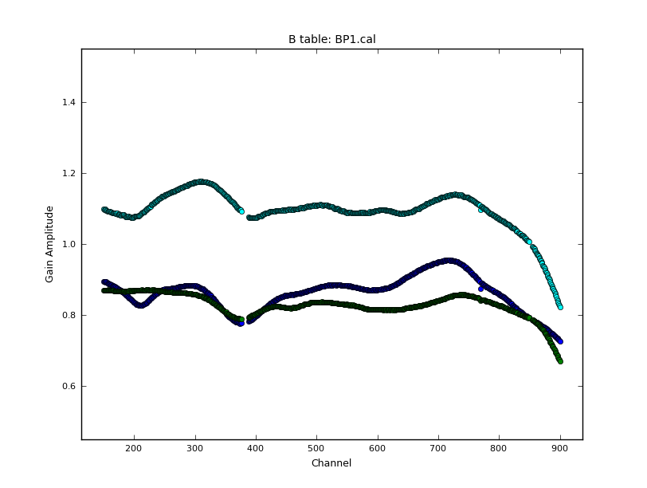
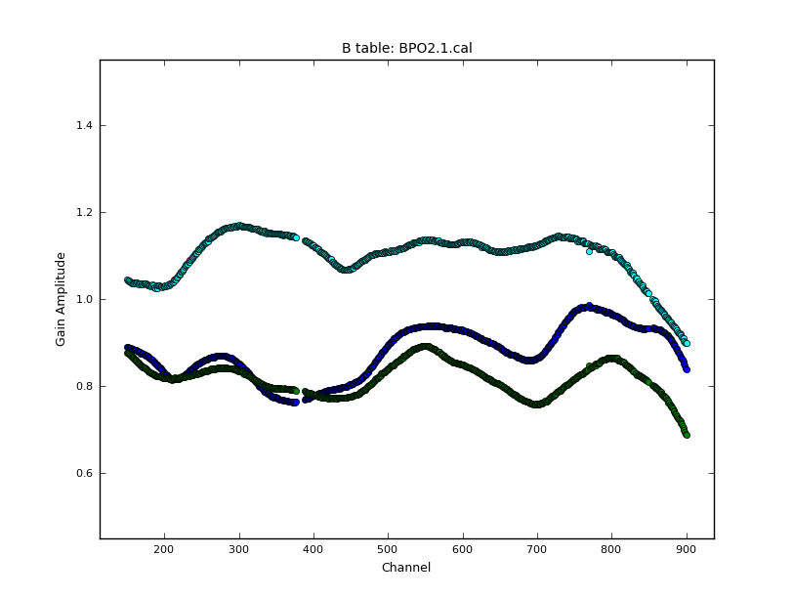
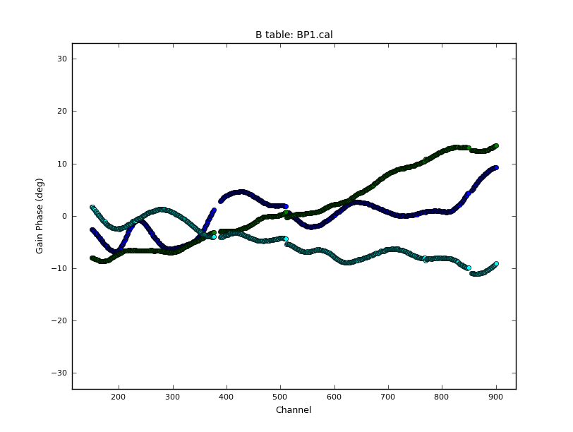
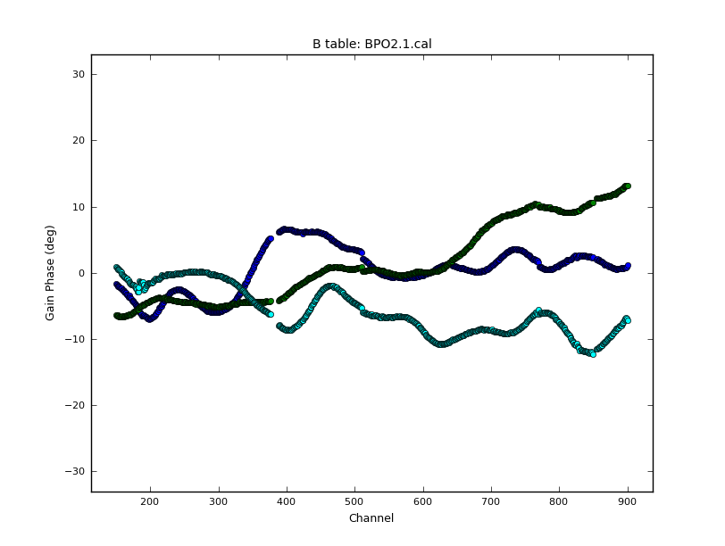
Diagnostics: Bandpass solutions vs. time (10min) -- Ant 10,21,23
Note: part of difference could be due to model inadequacy
30º
-30º

Slide 7
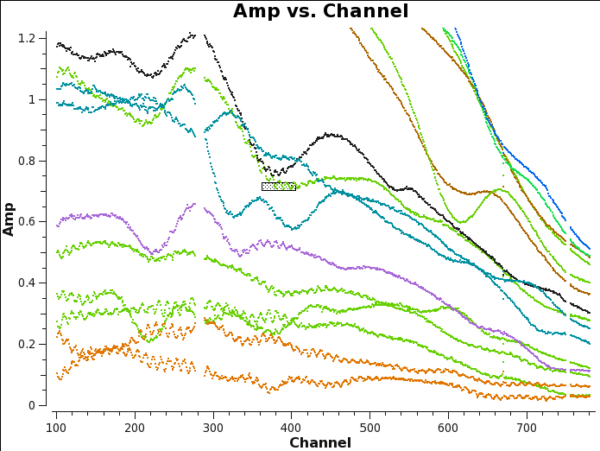
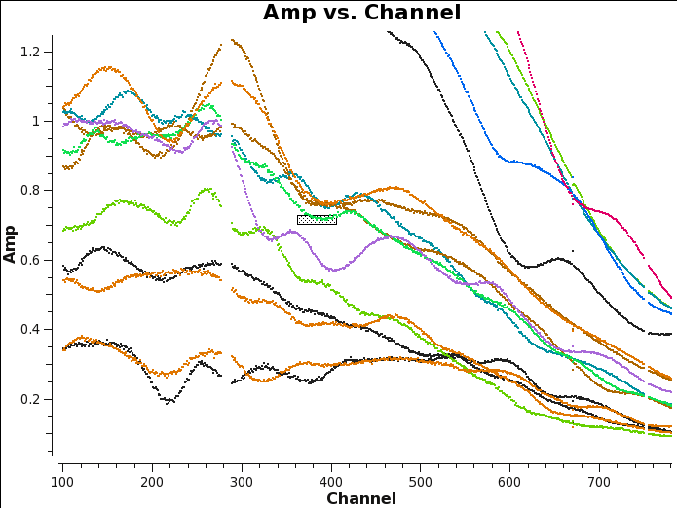
Diagnostics: calibrated vis spectra. Ant 54 high freq ripple
Ant 54
Ant 10

Slide 8
Thoughts
1. Can get from measured voltages through calibration and sky maps via pyuvdata to CASA
2. Currently clunky and idiosyncratic (conversion software = constantly moving target). Need to codify and establish robust path
3. Important to ensure RTP does not preclude GC sky cal, please
4. MFS is lifesaver wrt grating lobes. Problem: changing resolution with freq
5. Working S/W => can now turn to array diagnosis
6. Speculate: two stage Cal process
Initial sky cal on GC for delays, absolute gains, bandpasses => remove gross offsets and shapes, tie to celestial frame and flux scale
Subsequent redundant cal per chan over day: remove time-dependence and model freq dependence (see 4)
Or vice versa (but GC is special field?)

