Slide 1
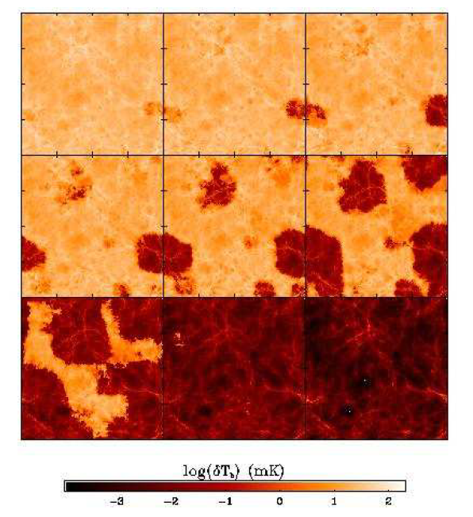
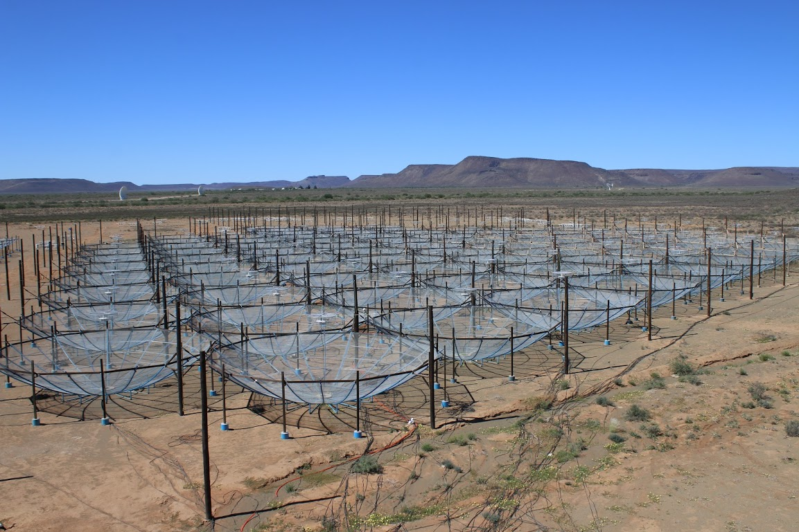
Closure phase delay spectrum
A new approach to the first detection of the HI 21cm signal from Cosmic Reionization
C. Carilli, N. Thyagarajan, B. Nikolic, J. Kent, K. Gale-Sides, S. Matika, G. Bernardi, N. Kern and the HERA TEAM
150 MHz
z=8.5
Hydrogen Epoch of Reionization Array
Low frequency: need DNR ~ 10⁵

Slide 2
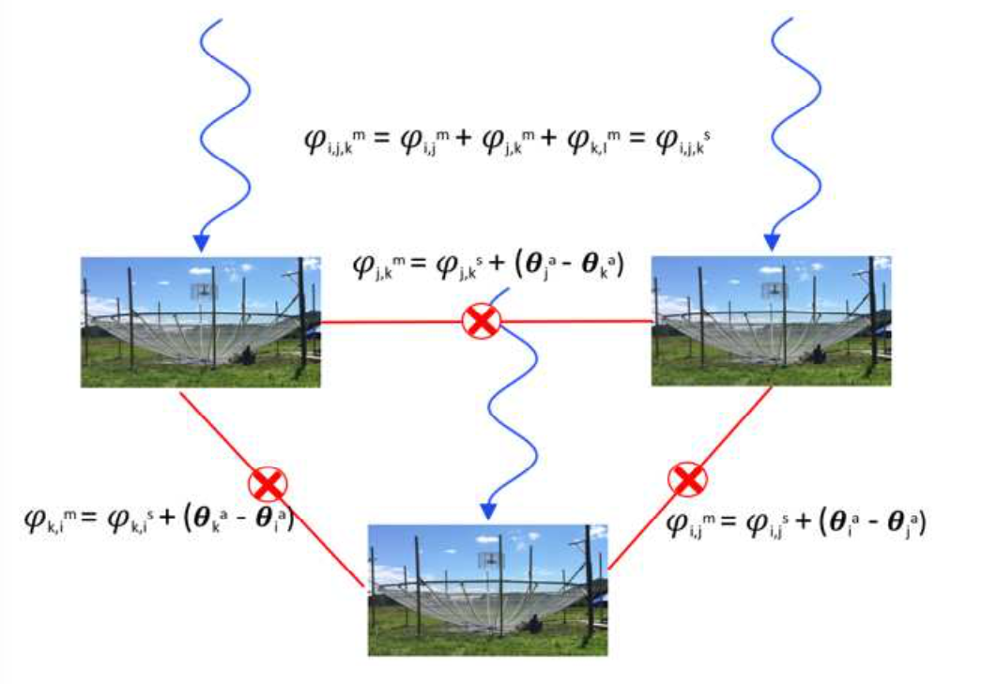
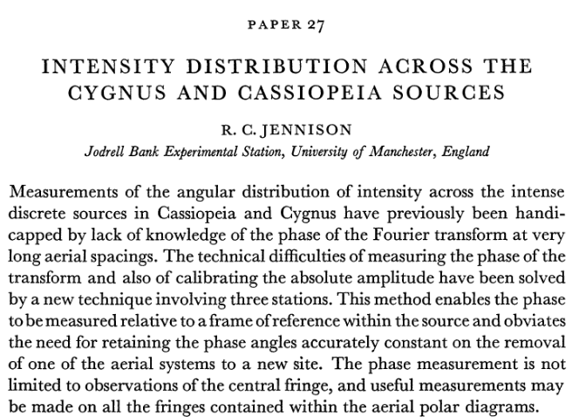
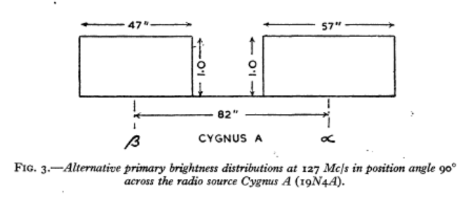
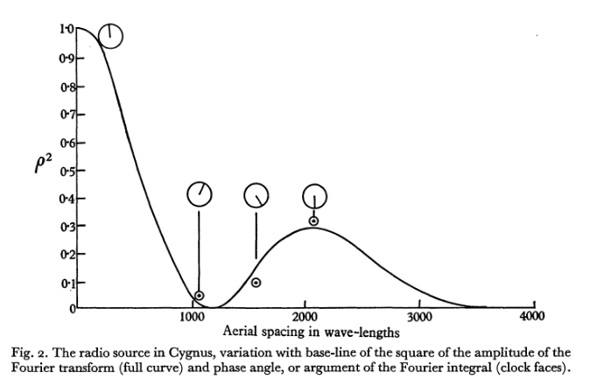



Closure phase: true sky-observable independent of antenna-based gains
1956
Triple Product or Bispectrum

Slide 3
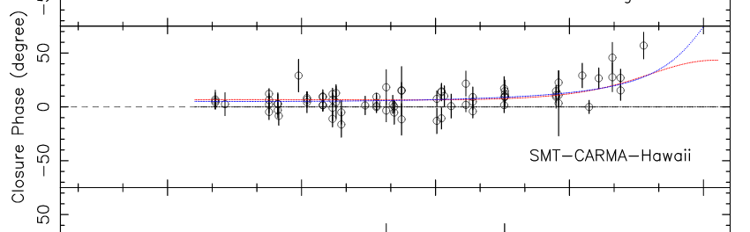
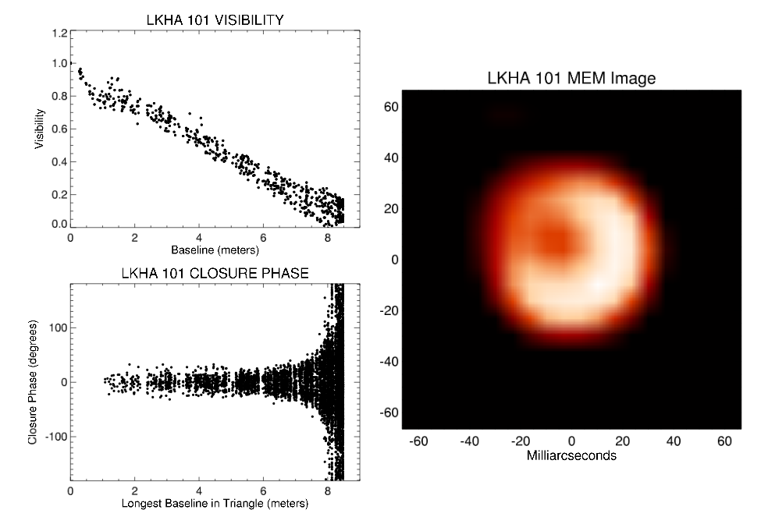
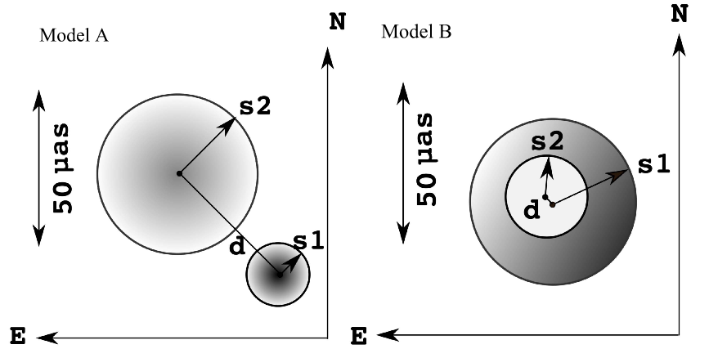
Closure Phase: determine source structure with an interferometer in conditions when phase calibration is difficult
Optical Interferometry and aperture masking: stellar surfaces (Baldwin 1976; Monnier 2006)
Submm VLBI: EHT and size of the Galactic SMBH (Lu 2018)
Can we exploit Closure phase in the context HI 21cm cosmology?

Slide 4
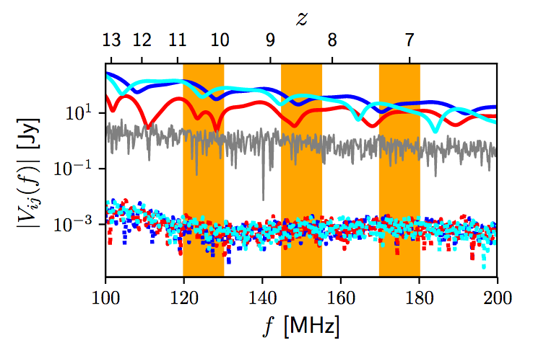
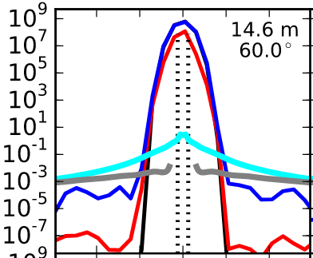


Delay spectrum: review
Parsons et al. 2014
Foregrounds ~ 10⁵ x HI
Freq = LoS distance = k⁻¹
F(V_{f})² → P(k)
Spectral structure is smooth for foregrounds; noise-like for HI => separate in PS domain at large k
Foregrounds
Noise 1 min
HI 21cm
Continuum
HI line

Slide 5
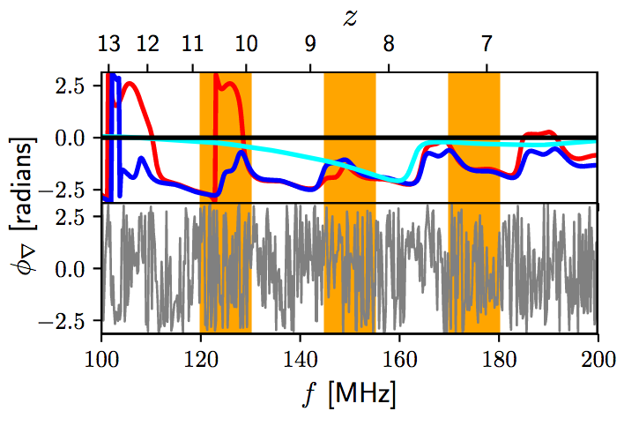
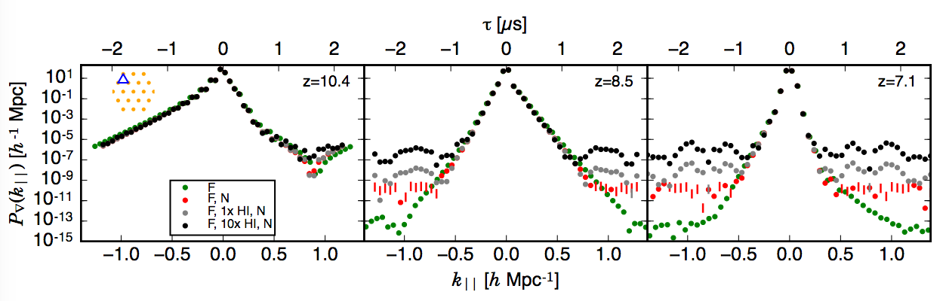
Closure Phase Delay Power Spectrum Method (PRISim simulations)
Thyagarajan et al. PRL, 2018
Foregrounds EQ14 triad
Goal: determine statistics of HI signal in frequency, not specific spatial structure
Required PS DNR ~ 10¹⁰
‘Core’ of PS due to foreground broadens with more structure FG spec.
Units? Closure PS ~ measure of S_{FG}/S_{HI}, and hence can be related back to Jy using S_{FG}
HI
10x HI
HI Fiducial
Noise 10⁶ records
Foreground

Slide 6
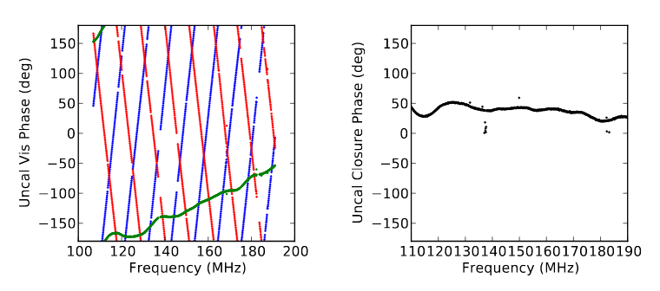
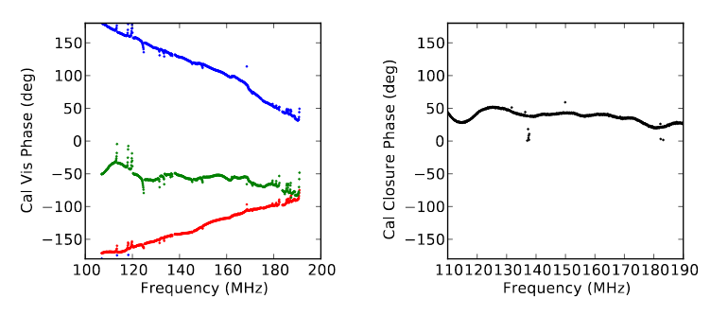
Galactic Center: uncalibrated
HERA Data of Closure phase: independent of antenna-based gain calibration
Carilli et al. Radio Science, 2017
Galactic Center: calibrated

Slide 7
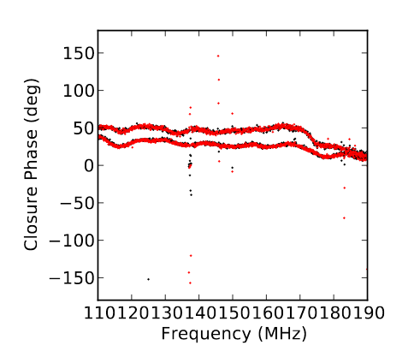
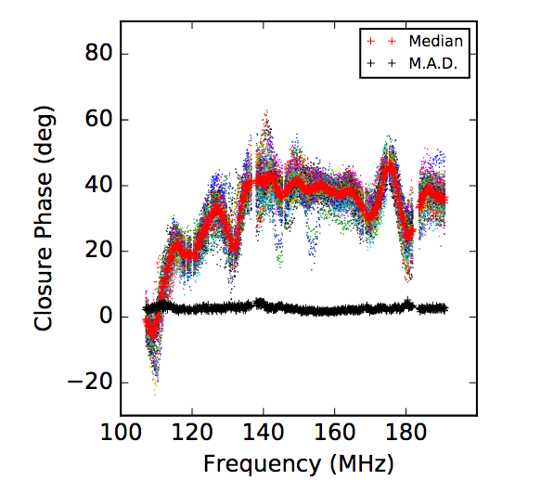
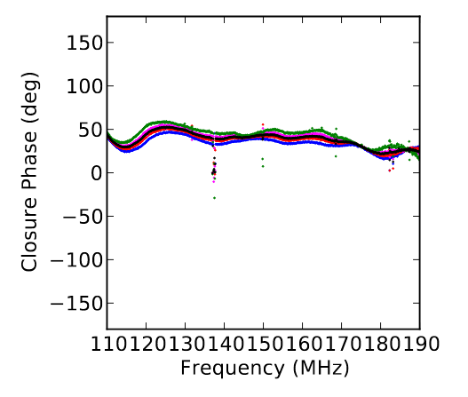
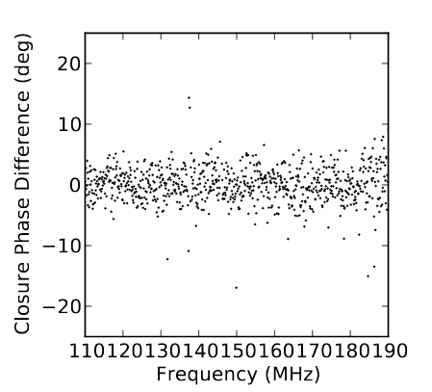
HERA Closure array diagnostics: redundancy and time variations
Time Variation: Day to Day
Redundancy EQ28 rms ~ 3deg ~ 1%
Time Variation: 2.5min records
=> bin in LST day to day

Slide 8
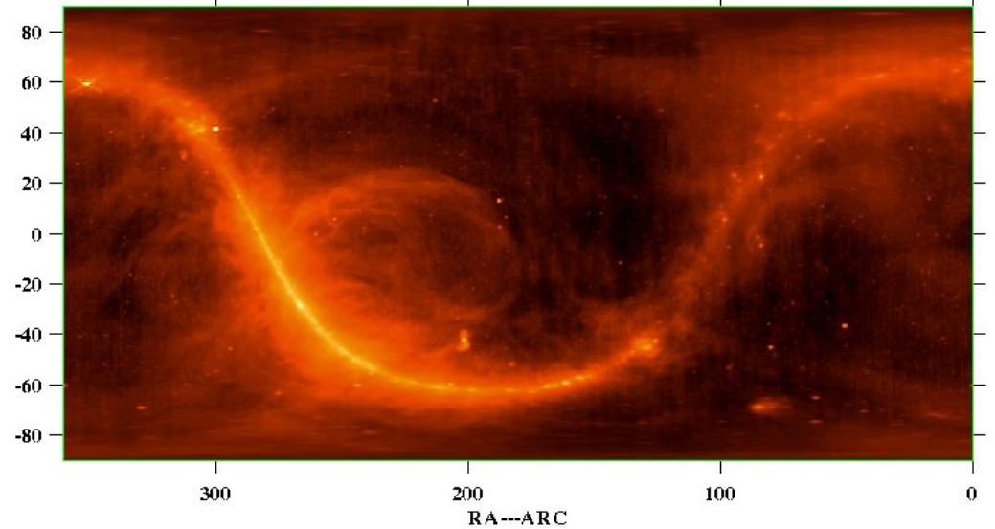
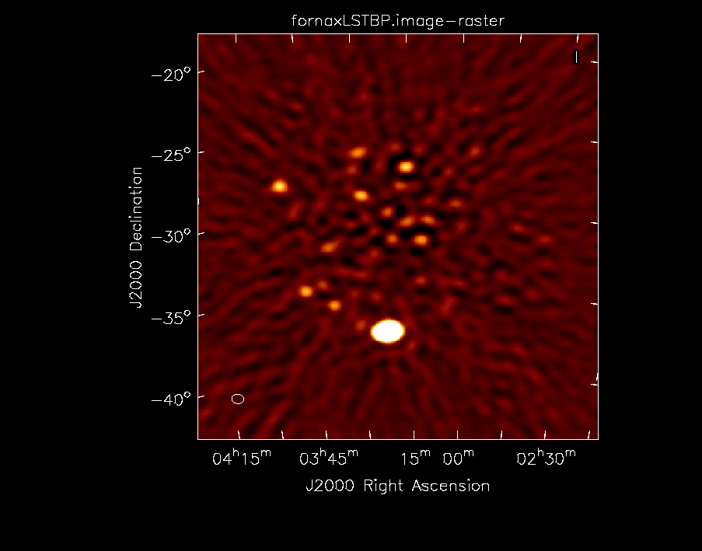
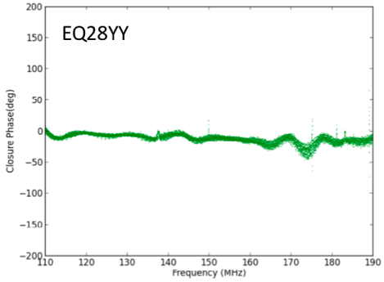
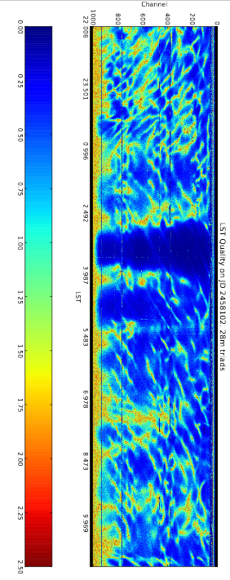
Fornax A: a Gift
15 Jy
160 Jy
Dominant point source: 𝜃_{cl} → 0º
Middle of Cold patch: dec = -37º => 20% PB => 160 Jy (not 700 Jy)
Improves redundancy
Easier modeling for PS analysis
Narrow ‘continuum core’ of PS
𝜎 ~ fewº

Slide 9
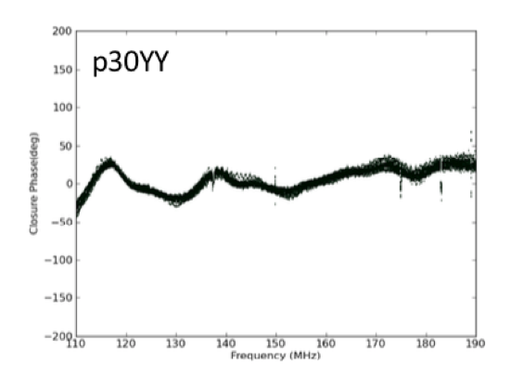
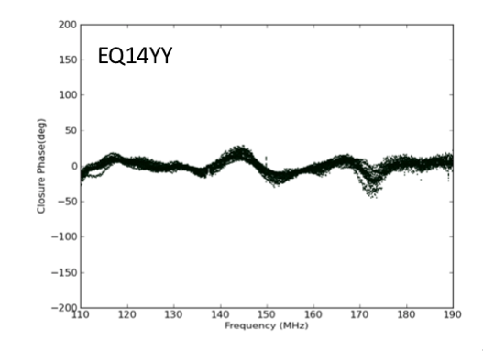
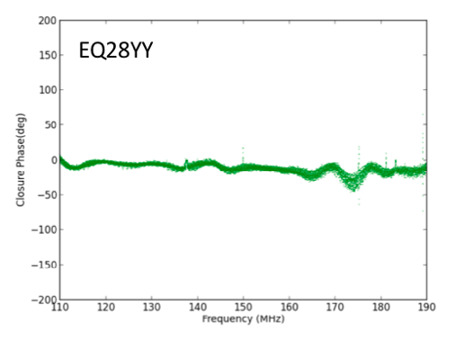
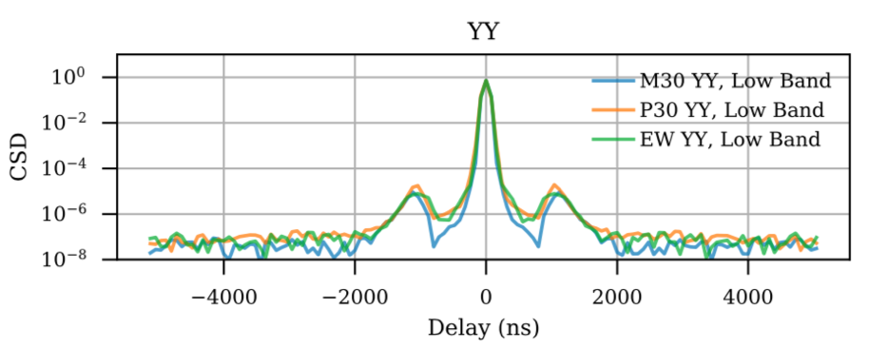
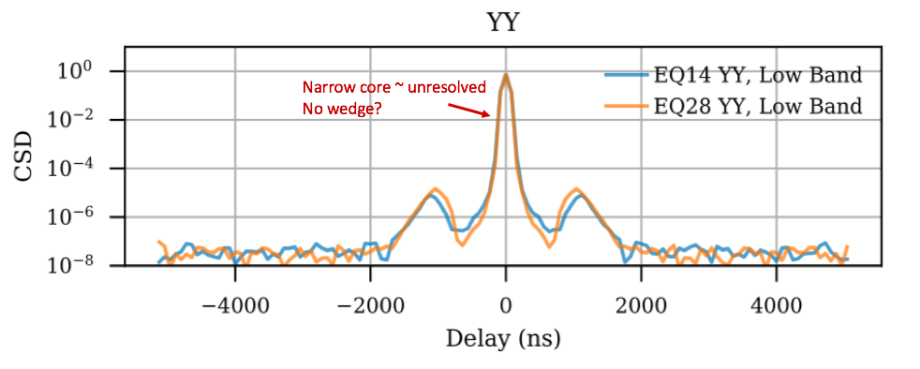
HERA-51 Closure spectra and Power Spectra (uncalibrated data)
2 RFI free ranges with ~ zero CL spectra
115 – 135 MHz,
151 – 170 MHz
1usec resonance in system (1MHz ripple)
IDR2 data (18days): 60sec ave of 𝜽_{cl} bin in LST 1st and 2nd halves, then Xcorr
Average PS incoherently over +/-10min around Fornax transit, and 34 triads

Slide 10
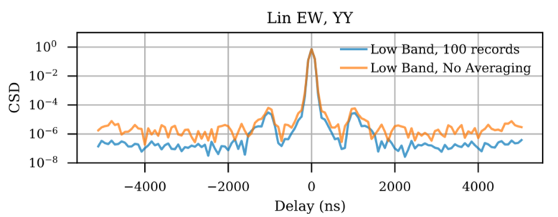
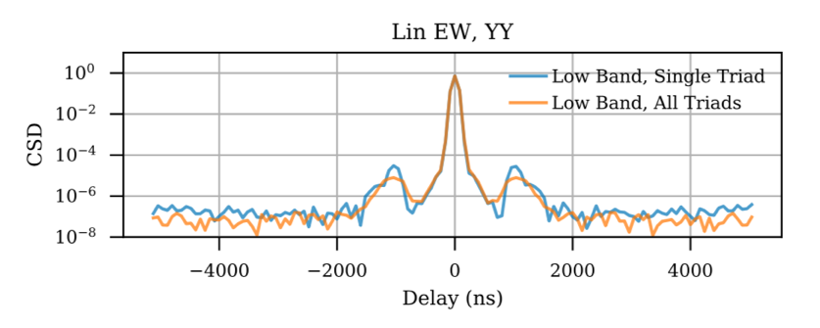
Incoherent averaging of PS
Time
37 Triads

Slide 11
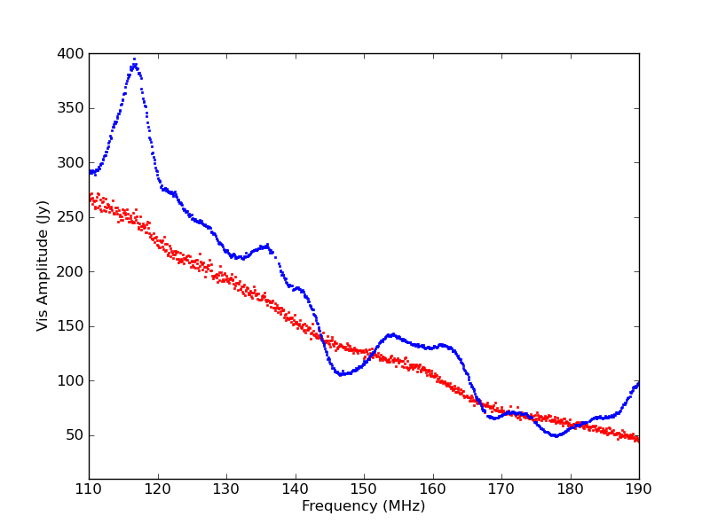
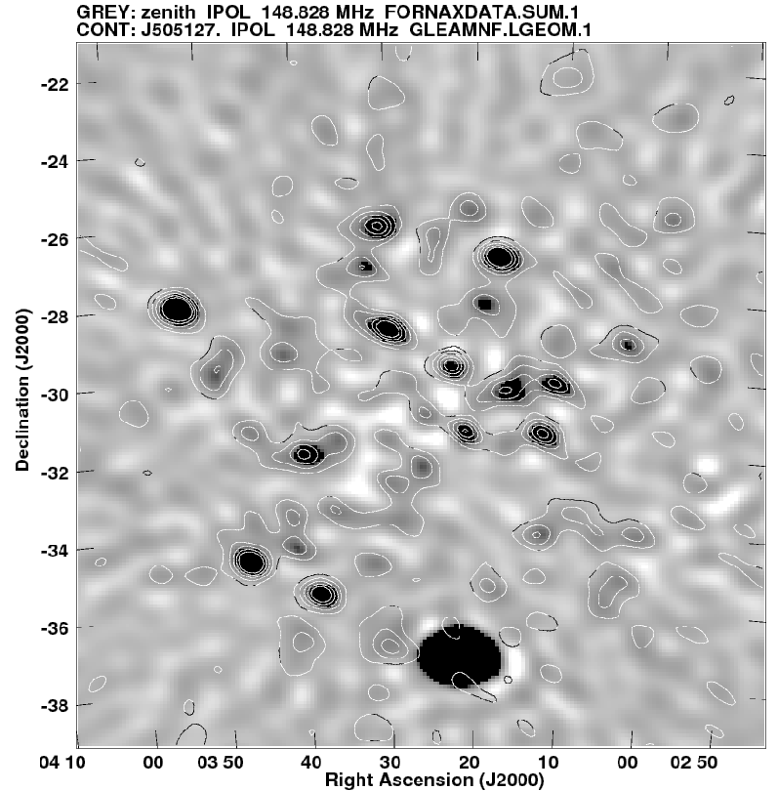
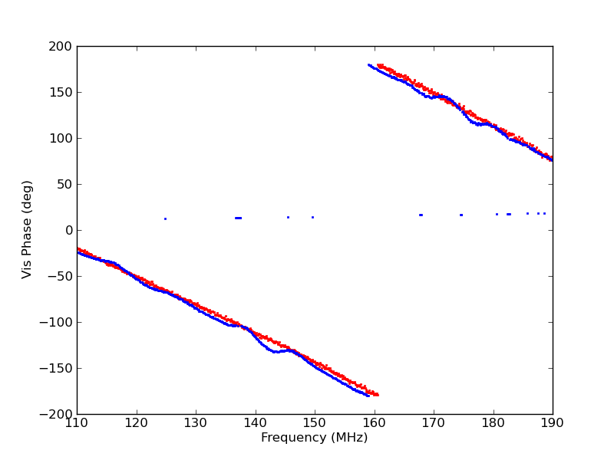
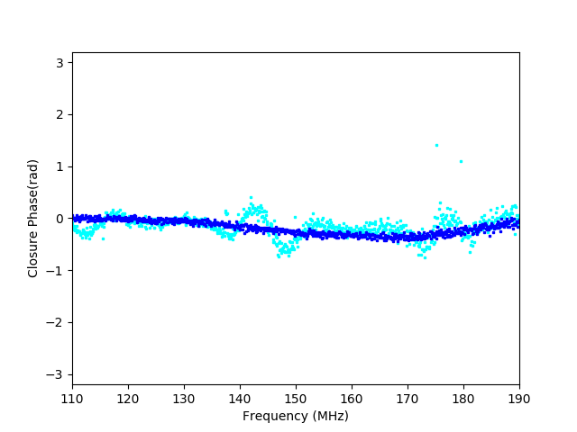
Modeling for quantitative comparison and analysis: confusion limited imaging
Vis Amp 28m
1st cntr = 0.4 Jy/beam
HERA 51 IDR2 LST Binned data w. ‘Kern’ Sky Calibration
GLEAM sources at 150 MHz: 1300 sources in Primary Beam (100 deg²) down to 50mJy + CASA
Syn Beam FWHM ~ 0.55º
=> 4 sources per syn. beam, or >200 mJy/beam
Thermal noise ~ 3.3 mJy/beam
Good agreement model and data =>
Model (sources + telescope) provides a good representation of sky seen by HERA
Data is finding sources down to confusion limit
Vis Phase
Closure Phase EQ28

Slide 12
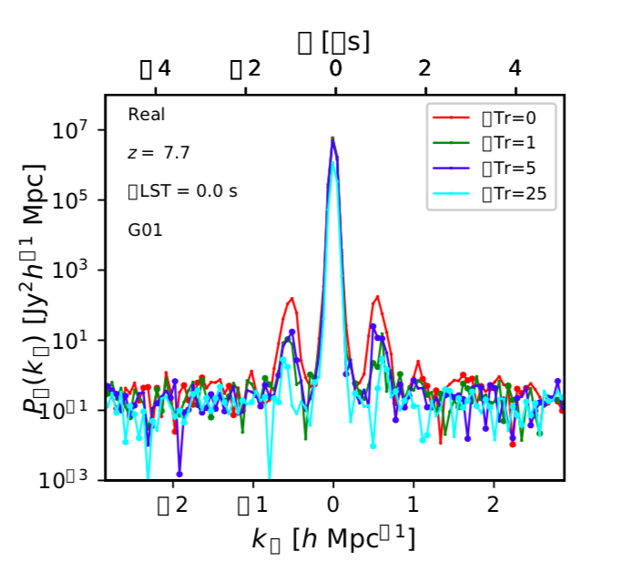
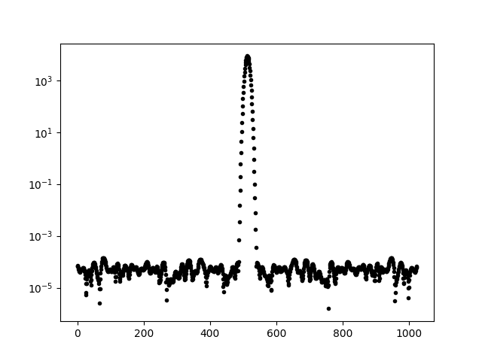

Preliminary ‘calibrated’ power spectrum
HERA-51, 18 days, 34 EQ28 triads, +/-10min around Fornax
Appears noise limited; unresolved ‘core’
PS Dynamic range ~ 10⁸ (need to get to 10¹⁰)
More data: 10x more time, 2pol, different triads
Next winter: 351 antennas!
1usec bump: mitigated with xcorr of selected triads, and/or possibly time averaging. Should not be seen w. new Receivers (?)
Fornax Model
DNR ~ 10⁸
DNR ~ 10⁸

Slide 13
Why Closure delay power spectrum?
Advantages
Independent of antenna-based gains, including direction dependent terms common to antennas (=ionosphere)
Independent and competitive approach (vital check!)
Extraordinarily simple, fast analysis
Narrow continuum PS core in Fornax, no wedge
Disadvantage
Non-closing effects? (if due to PB => broad in frequency?)
Signal loss in triad xcorr?
Not substitute for long-term goal of direct imaging of HI, but a near-term method to obtain/verify the first statistical detection of HI PS

