Slide 1
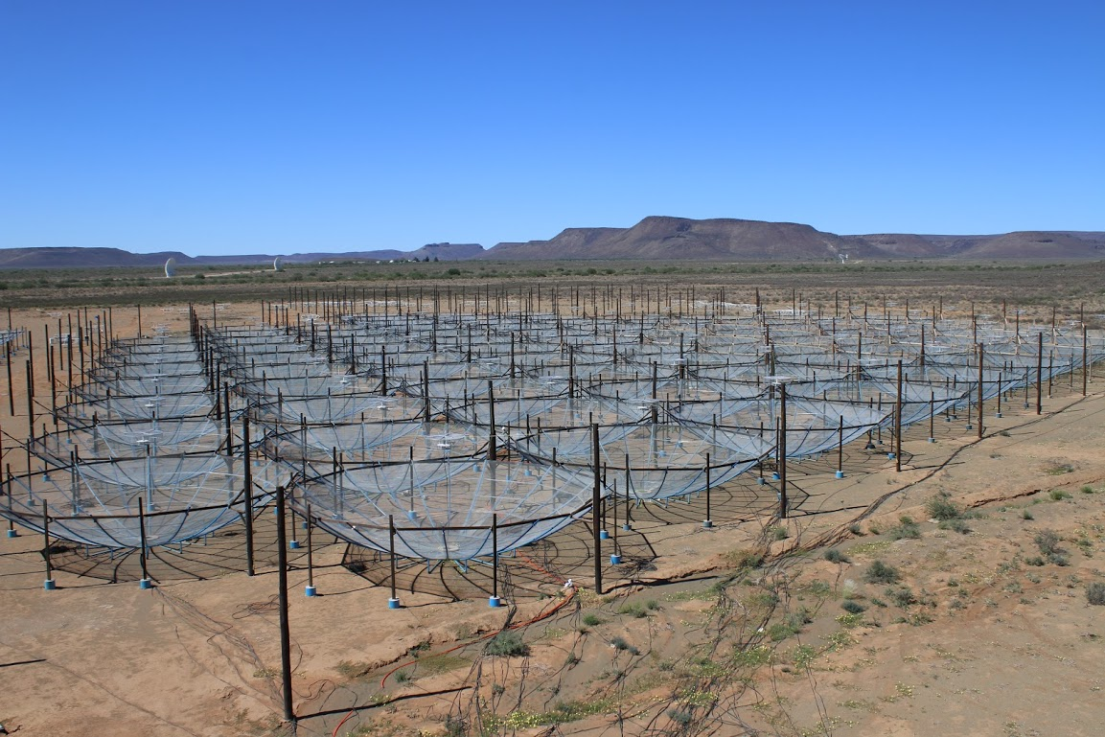
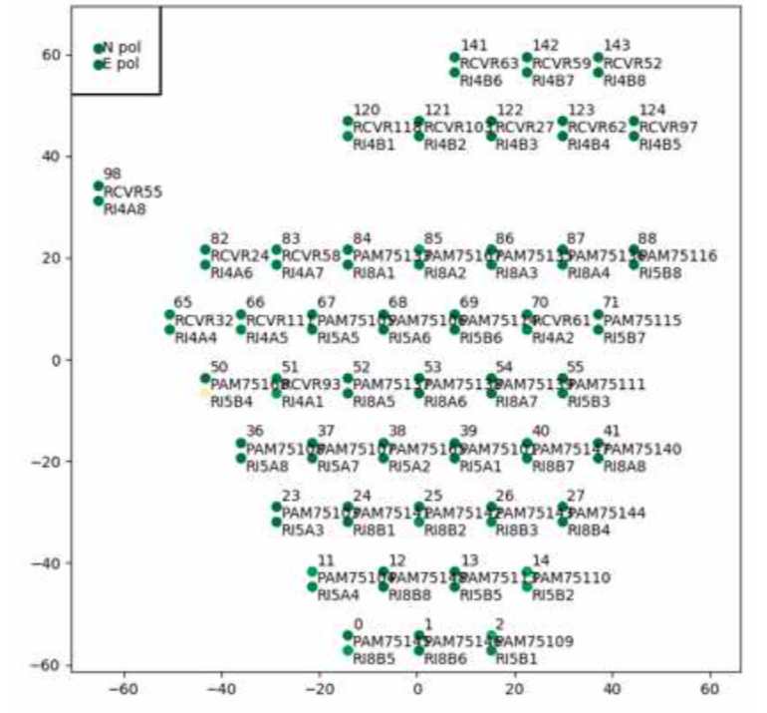
Hydrogen Epoch of Reionization Array
HERA Imaging and Visibility Modeling
C. Carilli, N. Thyagarajan, B. Nikolic, J. Kent, K. Gale-Sides, S. Matika, G. Bernardi, N. Kern and the HERA TEAM
Present data and models used in Closure Phase Delay Spectrum approach to HI 21cm cosmology (Thyagarajan – next talk)
Close investigation of visibilities and images is critical for subsequent diagnosis of power spectral results
Models are needed for physical interpretation of CPDS results
Data-Model comparison leads to interesting implications
Karoo Radio Preserve, South Africa
51 x 14m ‘zenith’ antennas in close-packed hexagon
100 MHz to 200 MHz, 1024 channels
FoV ~ 8deg => 20min per field

Slide 2
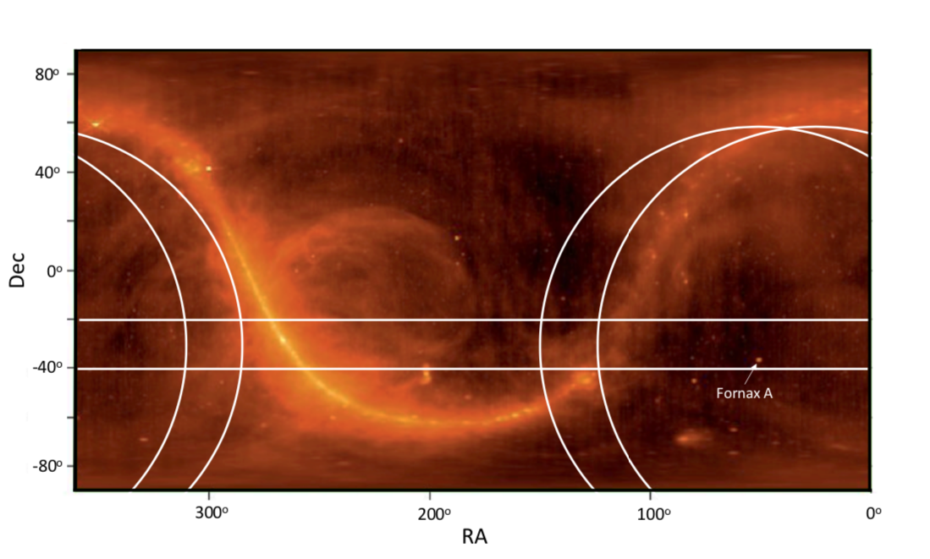
Two Fields: Fornax A and J0137-307
Data
Cold patch: T_{sky} ~ 180 K at 150MHz
20min/day x 18 days; LST bin
IDR2 (Dillon, Kern…): Calibrated via (i) delay, (ii) redundant, (iii) sky-BP
CASA MFS CLEAN 120-180 MHz
FWHM = 45’x35’
Models
GLEAM point sources to 50 mJy => 8000 sources per 30º field
PRISm uv-simulator + HERA telescope model

Slide 3
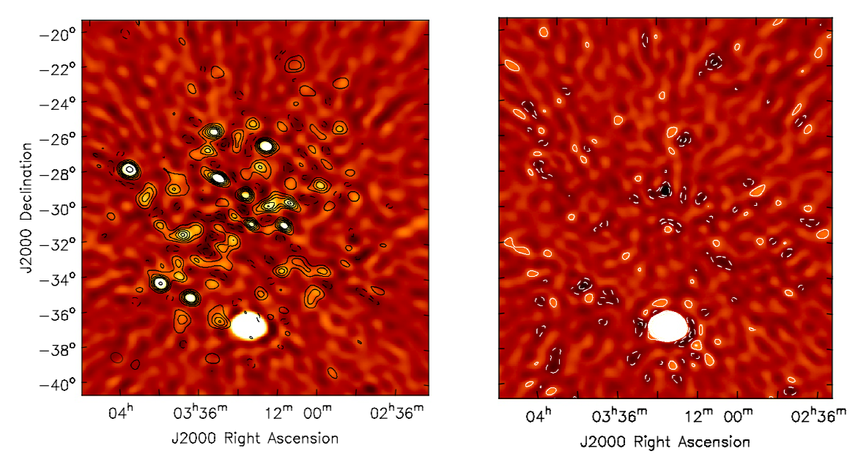
Images: Fornax A
Color = Data
Contours = Model
Data – Model
Lowest contour = 0.6 Jy/bm
Excellent match => Data OK; Model OK
Highly in-beam confusion limited: rms_{image} = 0.4 Jy/bm; rms_{theory} < 1mJy/bm !
GLEAM counts => at least 0.3 Jy/bm
Fornax = 173 Jy => 23% point of PB; slightly extended (40’)
Next brightest source = 8 Jy

Slide 4
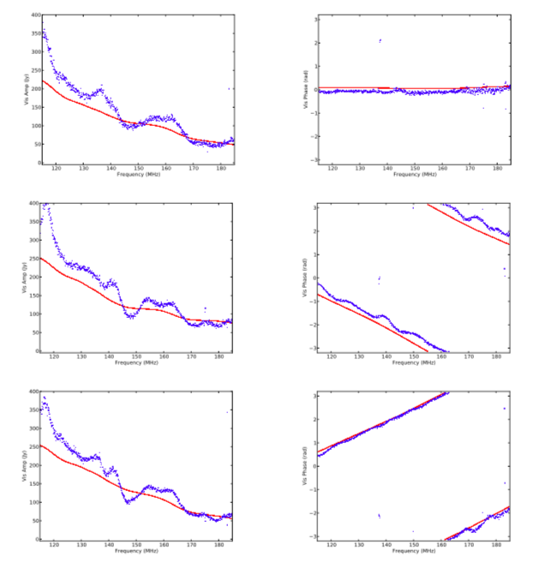
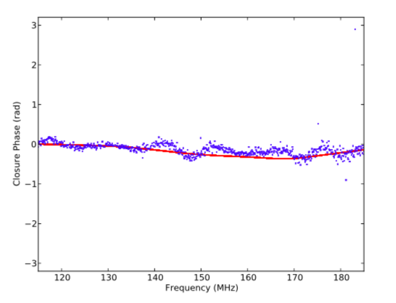
Amp 29m
39-41
Phase
Fornax Visibilities: Model vs. Data for 29m equilateral triad
Amp
Broad agreement model-data on broad frequency scales
Data show structure on ~ 10 MHz scales at tens of percent amplitude not seen in models
Dominant point source => Closure phase ~ 0
41-70
300 Jy
Closure phase
70-39

Slide 5
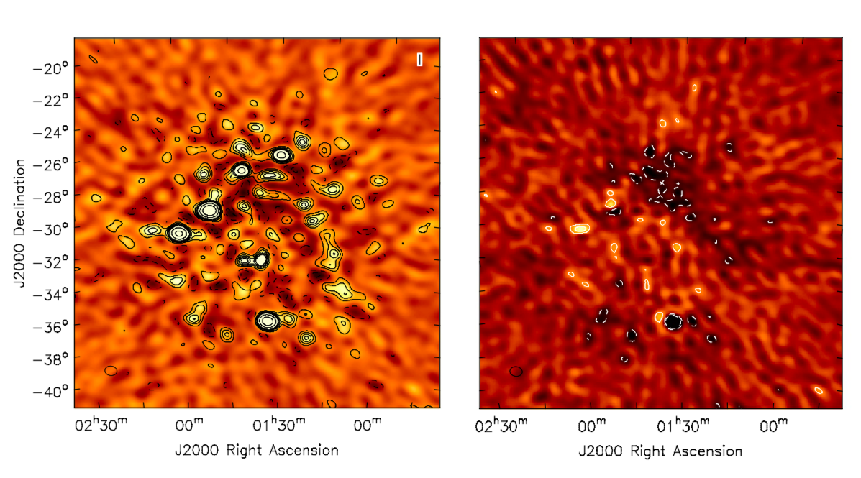
Images J0137-307
Good agreement model and data to in-beam confusion limit
Difference large scale residuals => Diffuse Galactic Emission (not in model)?
Strongest source ~ 10 Jy

Slide 6
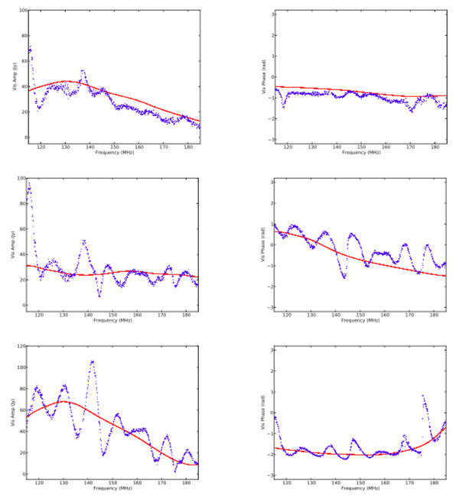
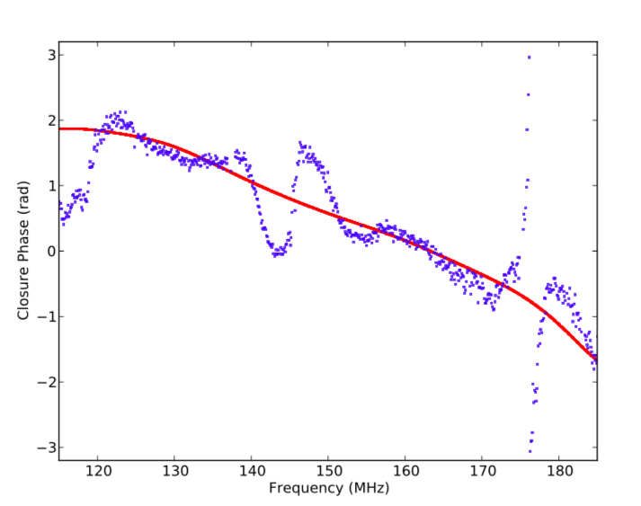
J0137 Visibilities: Model vs. Data for 29m equilateral triad
Agreement on broad frequency scales
Differences on ~ 10 MHz scales: ‘sinusoidal’ fluctuations up to 100%
=> Significant missing flux in the models
80 Jy

Slide 7
Galactic Plane is ALWAYS above Horizon
Way down in Primary Beam, but very large scale => fills far sidelobes
Hypothesis: Missing visibility structure = Galactic diffuse emission, in particularly, bright plane filling far sidelobes, beating against main beam emission on short baselines?

Slide 8
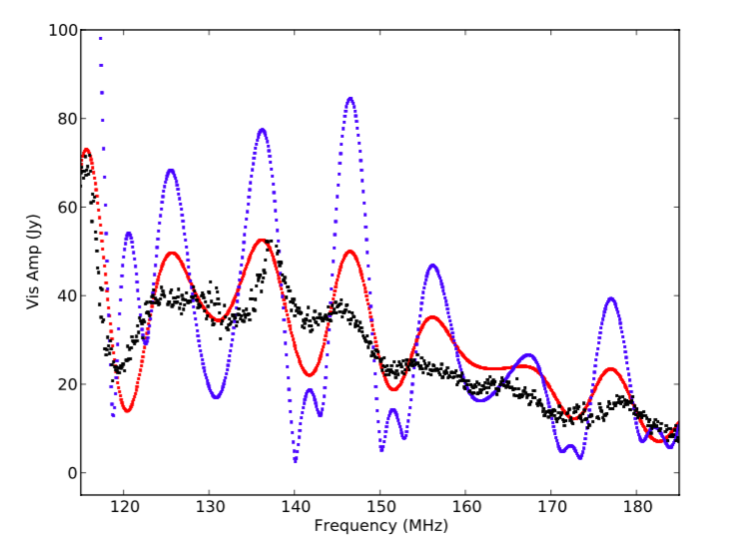
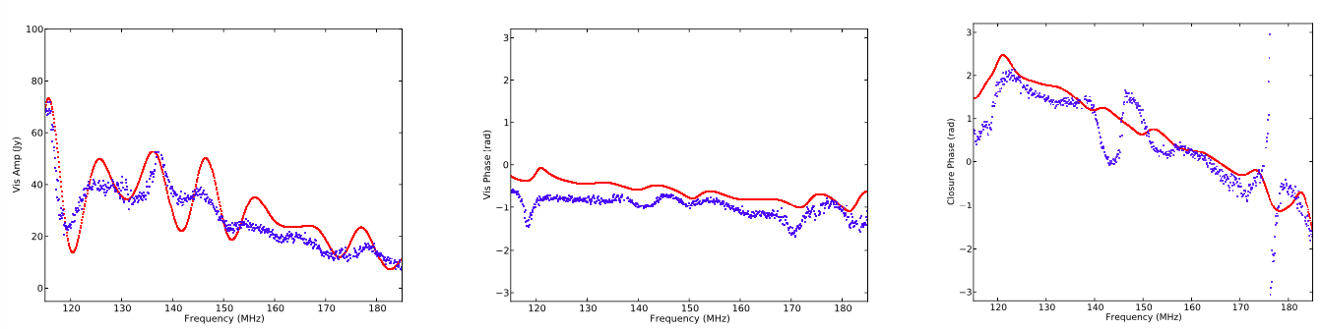
Model: GLEAM + Full Sky GSM at J0137
B = 29m
Add full-sky GSM and use Fagnoni wide field beam EM model
Reproduces qualitatively similar structure as seen in the real data: 10 MHz sinusoidal in frequency
Problem: amplitude scaling is problematic. Beam is highly uncertain at very large zenith angles
Deeper problem: double counting of point sources
[Diffuse – Points] + Points = Diffuse!
GLEAM + GSM
GLEAM + GSM/3
Amp
Phase
Closure phase

Slide 9
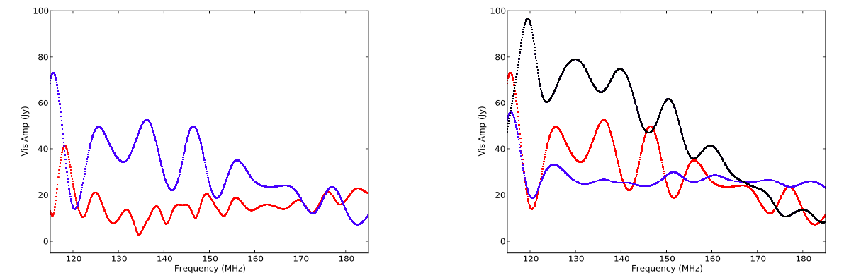
Tests vs. Baseline length and Orientation
Gets weaker and shorter 𝝺 with increasing B
Depends strongly on orientation [but difficult to predict since GP skirts horizon over large angle]
29m
+30º
29m
EW
-30º
44m

Slide 10
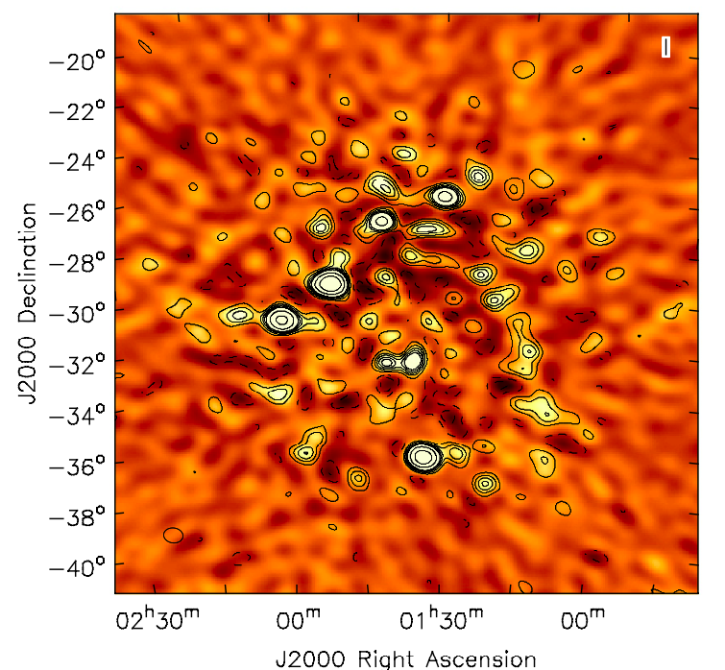
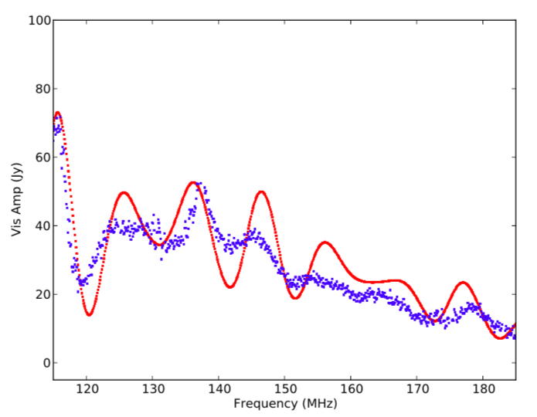
Summary
HERA imaging: point sources
Highly in-beam confusion limited by > two orders of magnitude!
Model and data images agree to this confusion limit
HERA Visibilities
Model – data agreement on broad frequency scales
Model missing ~ 10 MHz sinusoid of significant amplitude: likely diffuse Galactic emission filling far sidelobes
Modeling is difficult: beam unknown at zenith large angles, and impossible to measure with zenith telescope
  Solution: steerable antenna. Perhaps one is enough for holography?
Deeper problem: double counting
  Solution: wide field self-cal, but to get diffuse emission right is hard
Bad news: affects sky-based calibration on short B (BP; Kern)
Good news: 10 MHz => k ~ 0.1 Mpc⁻¹ < Delay spectrum analysis range

